Slide 1
Beyond the Guidelines: Clinical Investigator Perspectives on the Management of Bladder Cancer (Part 2 of a 2-Part Series) Friday, February 18, 2022 6:30 PM – 8:00 PM PT
Faculty
Shilpa Gupta, MD
Daniel P Petrylak, MD
Guru Sonpavde, MD
Moderator
Sumanta Kumar Pal, MD

Slide 2
Faculty
Shilpa Gupta, MD Associate Professor Director, Genitourinary Oncology Program Taussig Cancer Institute, Cleveland Clinic Cleveland, Ohio
Guru Sonpavde, MD Bladder Cancer Director Dana-Farber Cancer Institute Associate Professor of Medicine Harvard Medical School Boston, Massachusetts
Daniel P Petrylak, MD Professor of Internal Medicine (Medical Oncology) and Urology Yale School of Medicine New Haven, Connecticut
Moderator Sumanta Kumar Pal, MD Professor, Department of Medical Oncology and Therapeutics Research City of Hope Duarte, California

Slide 3
Commercial Support
This activity is supported by educational grants from Astellas and Seagen Inc, AstraZeneca Pharmaceuticals LP, Bristol-Myers Squibb Company, and Gilead Sciences Inc.

Slide 4
Research To Practice CME Planning Committee Members, Staff and Reviewers
Planners, scientific staff and independent reviewers for Research To Practice have no relevant conflicts of interest to disclose.

Slide 5
Beyond the Guidelines: Clinical Investigator Perspectives on the Management of Bladder Cancer (Part 2 of a 2-Part Series) Friday, February 18, 2022 6:30 PM – 8:00 PM PT
Faculty
Shilpa Gupta, MD
Daniel P Petrylak, MD
Guru Sonpavde, MD
Moderator
Sumanta Kumar Pal, MD

Slide 6
Agenda
Module 1 – Integrating Novel Agents into the Treatment Paradigm for Nonmetastatic Urothelial Bladder Cancer (UBC) — Dr Pal
Module 2 – Current and Future Front-Line Management of Metastatic UBC (mUBC) — Dr Gupta
Module 3 – Selection and Sequencing of Therapy for Relapsed/Refractory mUBC — Dr Petrylak
Module 4 – Tolerability/Toxicity of Novel Treatment Strategies and Practical Considerations in the Management of UBC — Dr Sonpavde

Slide 7
Bladder Cancer Survey Respondents
Neeraj Agarwal, MD
Andrea B Apolo, MD
Joaquim Bellmunt, MD, PhD
Robert Dreicer, MD, MS
Terence Friedlander, MD
Petros Grivas, MD, PhD
Shilpa Gupta, MD
Elisabeth Heath, MD
Richard M Joseph, MD
Sumanta Kumar Pal, MD
Lakshminarayanan Nandagopal, MD
Peter H O'Donnell, MD
Daniel P Petrylak, MD
Thomas Powles, MBBS, MRCP, MD
Jonathan E Rosenberg, MD
A Oliver Sartor, MD
Susan F Slovin, MD, PhD
Matthew R Smith, MD, PhD
Guru Sonpavde, MD
Evan Y Yu, MD

Slide 8
MODULE 1: Integrating Novel Agents into the Treatment Paradigm for Nonmetastatic Urothelial Bladder Cancer (UBC) — Dr Pal

Slide 9
Integrating Novel Agents into the Treatment Paradigm for Nonmetastatic Urothelial Bladder Cancer (UBC)
Sumanta Kumar Pal, MD

Slide 10
Dr Pal (Moderator) — Disclosures
No relevant conflicts of interest to disclose

Slide 11
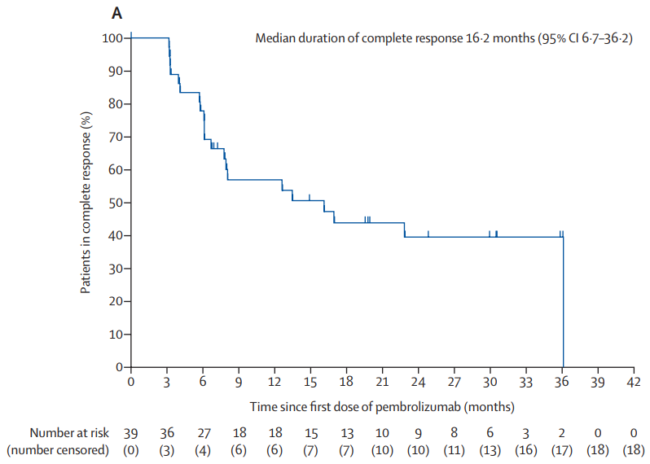
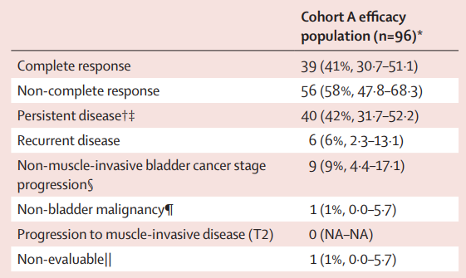
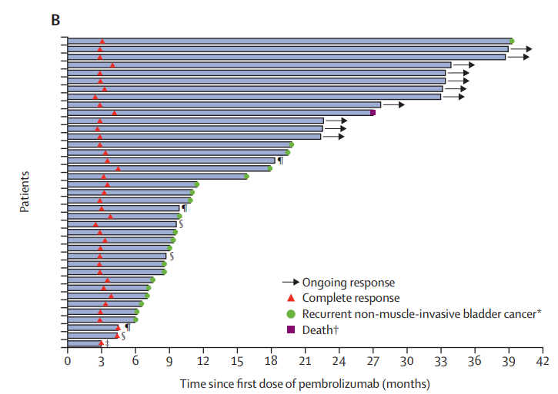
Multicenter, phase II study across 54 sites in 14 countries
Patients had to have BCG-unresponsive bladder cancer, ECOG 0-2 and decline radical cystectomy
Patients received pembrolizumab every 3 weeks for 24 mos or until centrally confirmed disease persistence, recurrence or progression
Primary endpoint was complete response rate (absence of high-risk NMIBC)
334 patients were screened → 101 eligible patients enrolled with a median follow-up of 36.4 months
39 of 96 patients (41%) had a complete response at 3 months
Grade 3 or 4 treatment-related Aes occurred in 13% of pts
Balar, Arjun V., Ashish M. Kamat, Girish S. Kulkarni, Edward M. Uchio, Joost L. Boormans, Mathieu Roumiguié, Laurence E. M. Krieger, et al. “Pembrolizumab Monotherapy for the Treatment of High-Risk Non-Muscle-Invasive Bladder Cancer Unresponsive to BCG (KEYNOTE-057): An Open-Label, Single-Arm, Multicentre, Phase 2 Study.” The Lancet Oncology 22, no. 7 (July 1, 2021): 919–30. https://doi.org/10.1016/S1470-2045(21)00147-9.

Slide 12
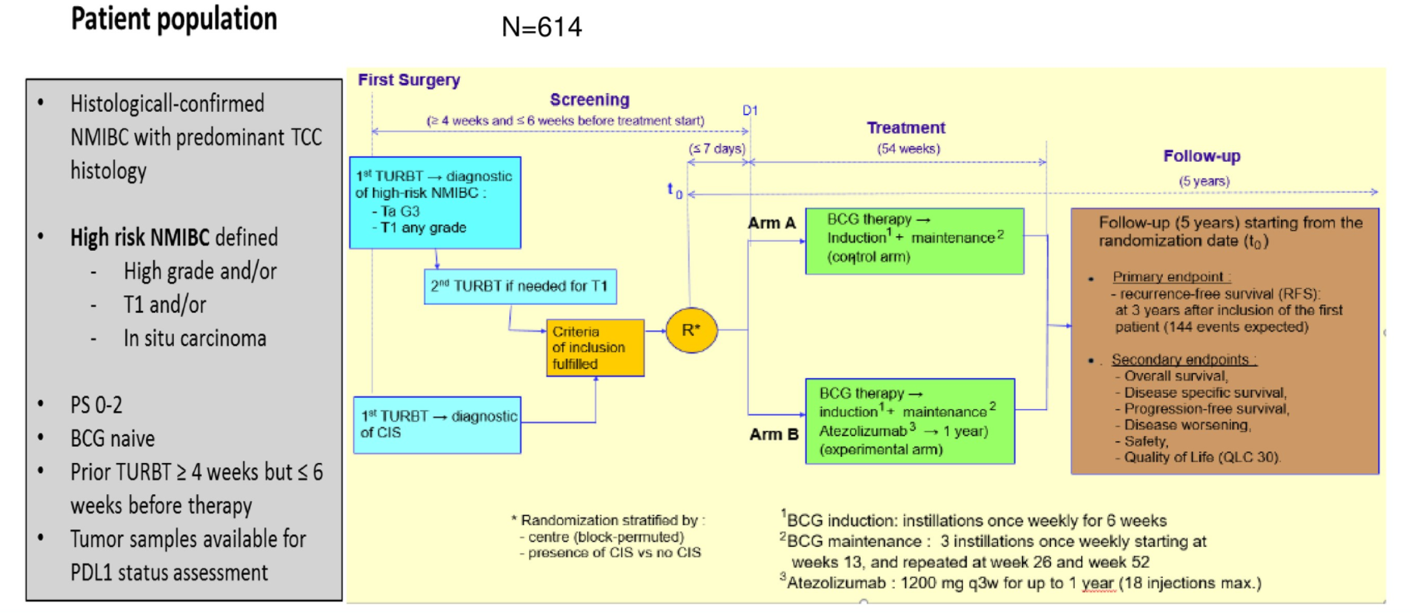
Roupret, M et al. “ALBAN: An Open Label, Randomized, Phase III Trial, Evaluating Efficacy of Atezolizumab in Addition to One Year BCG (Bacillus Calmette-Guerin) Bladder Instillation in BCG-Naive Patients with High-Risk Nonmuscle Invasive Bladder Cancer (AFU-GETUG 37).” Journal of Clinical Oncology 37, no. 15_suppl (May 20, 2019): TPS4589–TPS4589. https://doi.org/10.1200/JCO.2019.37.15_suppl.TPS4589.

Slide 13
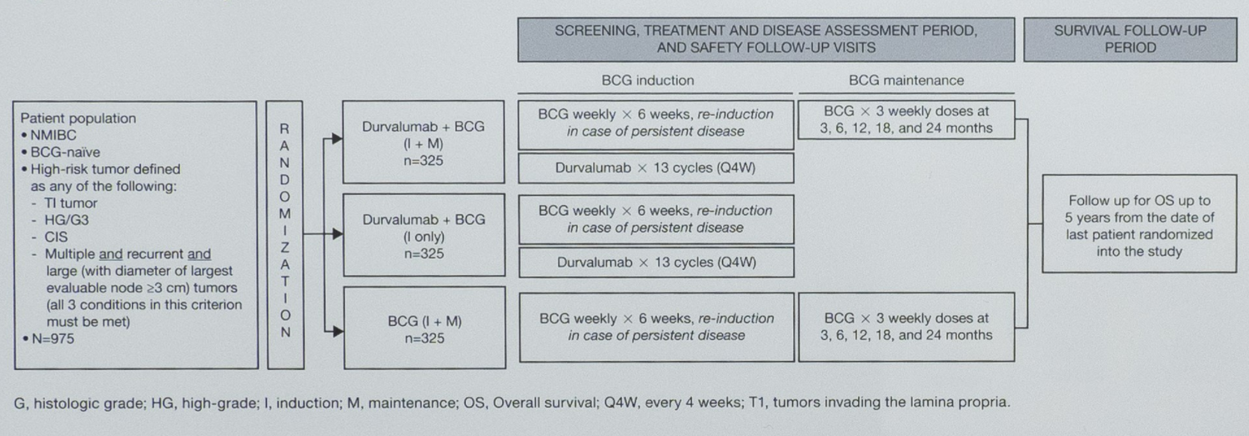
De Santis, Maria, Ramil Abdrashitov, Axel Hegele, Margaret Kolb, Suzanne Parker, Juan Palou Redorta, Hiroyuki Nishiyama, Feng Xiao, Ashok Kumar Gupta, and Neal D. Shore. “A Phase III, Randomized, Open-Label, Multicenter, Global Study of Durvalumab and Bacillus Calmette-Guérin (BCG) versus BCG Alone in High-Risk, BCG-Naïve Non-Muscle-Invasive Bladder Cancer (NMIBC) Patients (POTOMAC).” Journal of Clinical Oncology 37, no. 7_suppl (March 1, 2019): TPS500–TPS500. https://doi.org/10.1200/JCO.2019.37.7_suppl.TPS500.

Slide 14
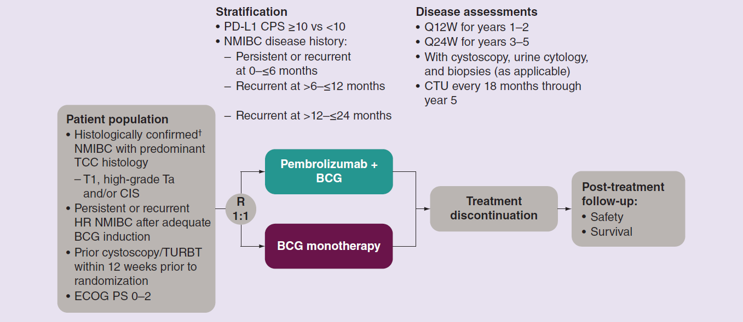
Kamat, Ashish M., Neal Shore, Noah Hahn, Shaheen Alanee, Hiroyuki Nishiyama, Shahrokh Shariat, Kijoeng Nam, Ekta Kapadia, Tara Frenkl, and Gary Steinberg. “KEYNOTE-676: Phase III Study of BCG and Pembrolizumab for Persistent/Recurrent High-Risk NMIBC.” Future Oncology (London, England) 16, no. 10 (April 2020): 507–16. https://doi.org/10.2217/fon-2019-0817.

Slide 15
CheckMate 274: Adjuvant Nivolumab
Bajorin, Dean F., J. Alfred Witjes, Jürgen E. Gschwend, Michael Schenker, Begoña P. Valderrama, Yoshihiko Tomita, Aristotelis Bamias, et al. “Adjuvant Nivolumab versus Placebo in Muscle-Invasive Urothelial Carcinoma.” New England Journal of Medicine 384, no. 22 (June 3, 2021): 2102–14. https://doi.org/10.1056/NEJMoa2034442.

Slide 16
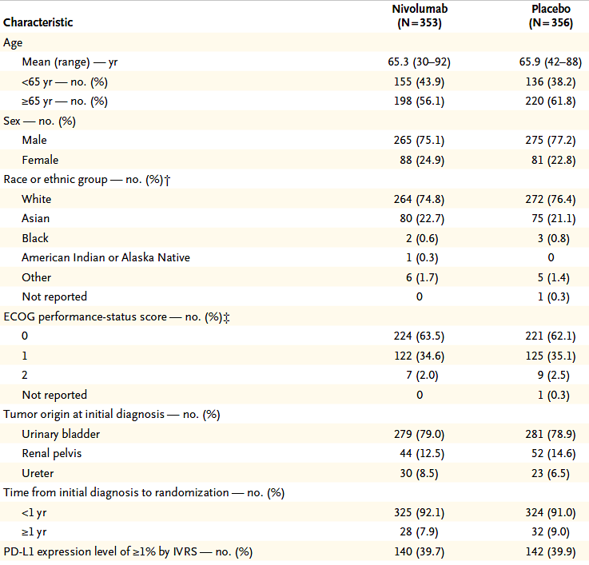
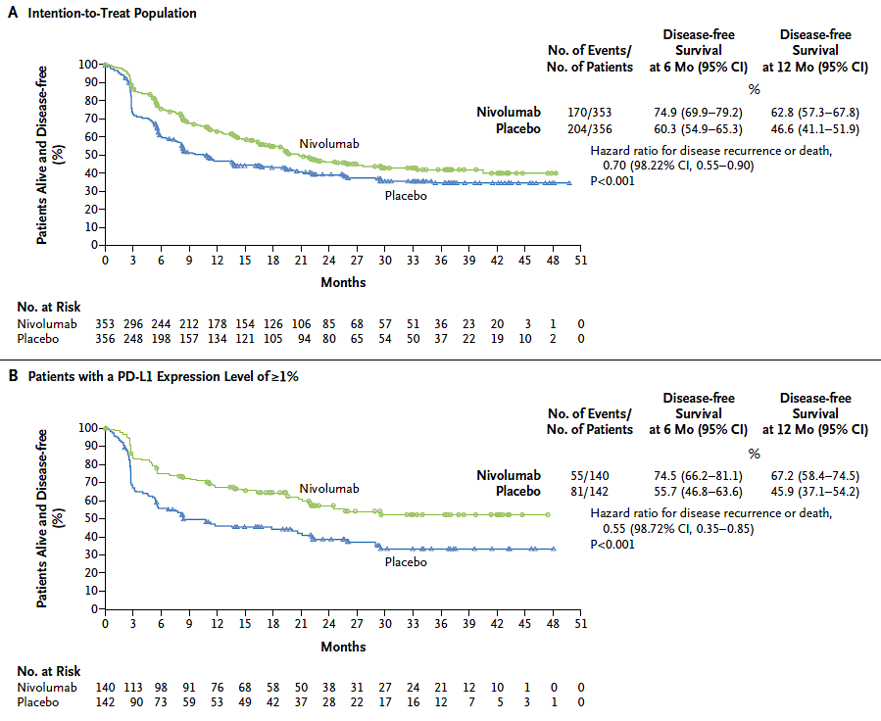
CheckMate 274: Adjuvant Nivolumab
Bajorin, Dean F., J. Alfred Witjes, Jürgen E. Gschwend, Michael Schenker, Begoña P. Valderrama, Yoshihiko Tomita, Aristotelis Bamias, et al. “Adjuvant Nivolumab versus Placebo in Muscle-Invasive Urothelial Carcinoma.” New England Journal of Medicine 384, no. 22 (June 3, 2021): 2102–14. https://doi.org/10.1056/NEJMoa2034442.

Slide 17
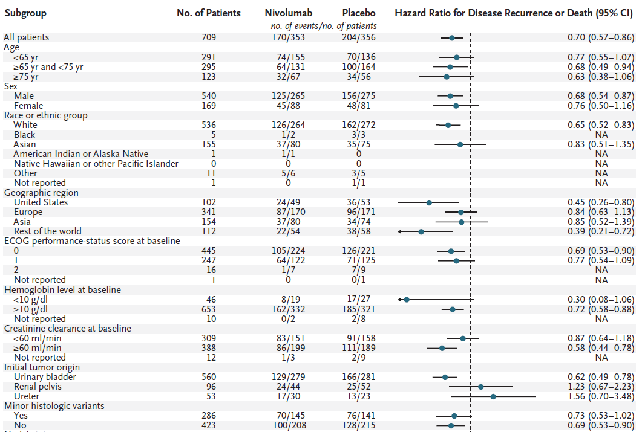
CheckMate 274: Adjuvant Nivolumab
Bajorin, Dean F., J. Alfred Witjes, Jürgen E. Gschwend, Michael Schenker, Begoña P. Valderrama, Yoshihiko Tomita, Aristotelis Bamias, et al. “Adjuvant Nivolumab versus Placebo in Muscle-Invasive Urothelial Carcinoma.” New England Journal of Medicine 384, no. 22 (June 3, 2021): 2102–14. https://doi.org/10.1056/NEJMoa2034442.

Slide 18
Pal, Sumanta K., Jonathan E. Rosenberg, Jean H. Hoffman-Censits, Raanan Berger, David I. Quinn, Matthew D. Galsky, Juergen Wolf, et al. “Efficacy of BGJ398, a Fibroblast Growth Factor Receptor 1-3 Inhibitor, in Patients with Previously Treated Advanced Urothelial Carcinoma with FGFR3 Alterations.” Cancer Discovery 8, no. 7 (July 2018): 812–21. https://doi.org/10.1158/2159-8290.CD-18-0229.

Slide 19
Pal, Sumanta K., Siamak Daneshmand, Surena F. Matin, Yohann Loriot, Srikala S. Sridhar, Petros Grivas, Shilpa Gupta, et al. “PROOF 302: A Randomized, Double-Blind, Placebo-Controlled, Phase III Trial of Infigratinib as Adjuvant Therapy in Patients with Invasive Urothelial Carcinoma Harboring FGFR3 Alterations.” Journal of Clinical Oncology 38, no. 6_suppl (February 20, 2020): TPS600–TPS600. https://doi.org/10.1200/JCO.2020.38.6_suppl.TPS600.

Slide 20
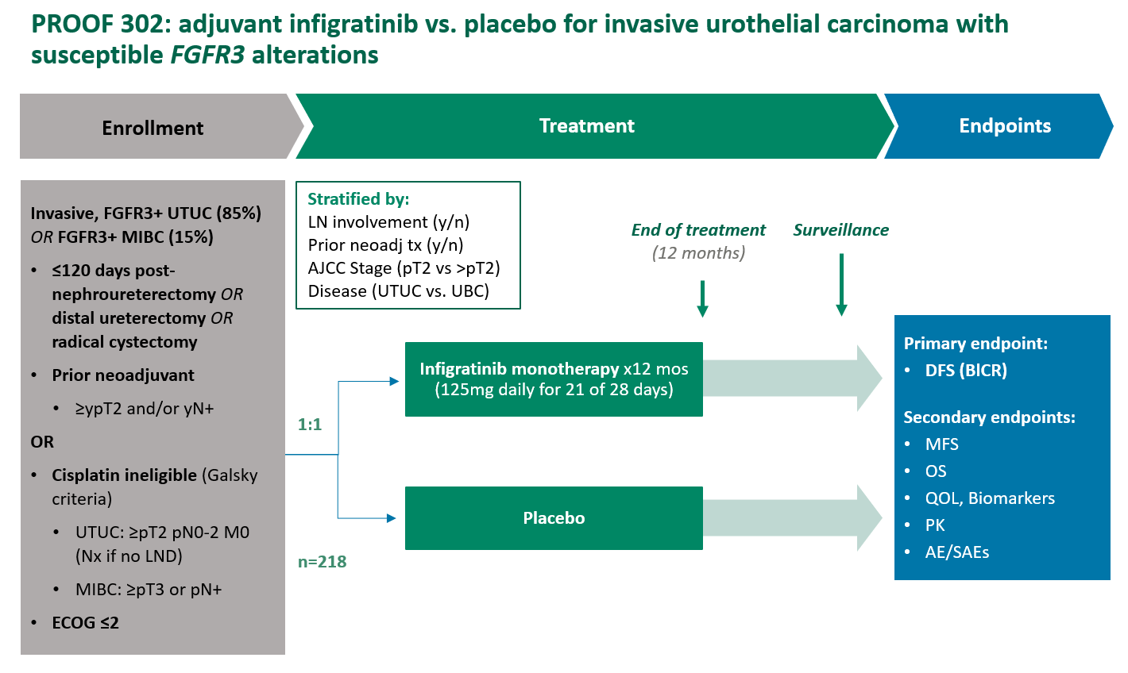
Pal, Sumanta K., Siamak Daneshmand, Surena F. Matin, Yohann Loriot, Srikala S. Sridhar, Petros Grivas, Shilpa Gupta, et al. “PROOF 302: A Randomized, Double-Blind, Placebo-Controlled, Phase III Trial of Infigratinib as Adjuvant Therapy in Patients with Invasive Urothelial Carcinoma Harboring FGFR3 Alterations.” Journal of Clinical Oncology 38, no. 6_suppl (February 20, 2020): TPS600–TPS600. https://doi.org/10.1200/JCO.2020.38.6_suppl.TPS600.

Slide 21
Bellmunt, Joaquim, Maha Hussain, Jürgen E. Gschwend, Peter Albers, Stephane Oudard, Daniel Castellano, Siamak Daneshmand, et al. “Adjuvant Atezolizumab versus Observation in Muscle-Invasive Urothelial Carcinoma (IMvigor010): A Multicentre, Open-Label, Randomised, Phase 3 Trial.” The Lancet Oncology 22, no. 4 (April 1, 2021): 525–37. https://doi.org/10.1016/S1470-2045(21)00004-8.

Slide 22
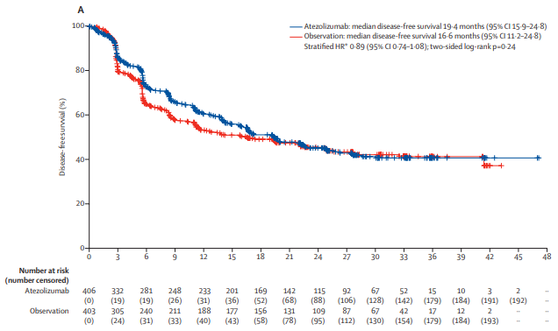
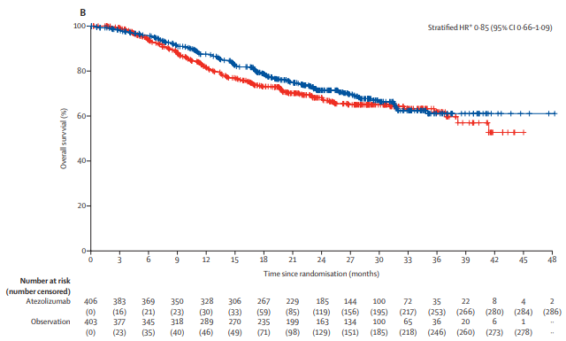
Disease-Free Survival
Overall Survival
Key Difference: Observation on Control Arm
Bellmunt, Joaquim, Maha Hussain, Jürgen E. Gschwend, Peter Albers, Stephane Oudard, Daniel Castellano, Siamak Daneshmand, et al. “Adjuvant Atezolizumab versus Observation in Muscle-Invasive Urothelial Carcinoma (IMvigor010): A Multicentre, Open-Label, Randomised, Phase 3 Trial.” The Lancet Oncology 22, no. 4 (April 1, 2021): 525–37. https://doi.org/10.1016/S1470-2045(21)00004-8.

Slide 23
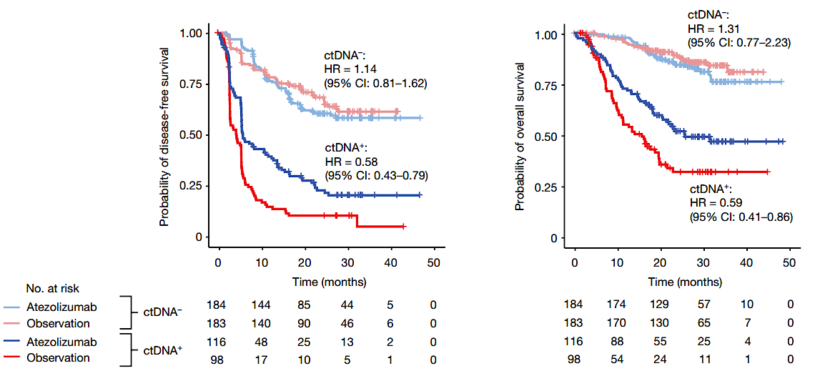
Powles, Thomas, Zoe June Assaf, Nicole Davarpanah, Romain Banchereau, Bernadett E. Szabados, Kobe C. Yuen, Petros Grivas, et al. “CtDNA Guiding Adjuvant Immunotherapy in Urothelial Carcinoma.” Nature 595, no. 7867 (July 2021): 432–37. https://doi.org/10.1038/s41586-021-03642-9.

Slide 24
Powles, Thomas, Zoe June Assaf, Nicole Davarpanah, Romain Banchereau, Bernadett E. Szabados, Kobe C. Yuen, Petros Grivas, et al. “CtDNA Guiding Adjuvant Immunotherapy in Urothelial Carcinoma.” Nature 595, no. 7867 (July 2021): 432–37. https://doi.org/10.1038/s41586-021-03642-9.

Slide 25
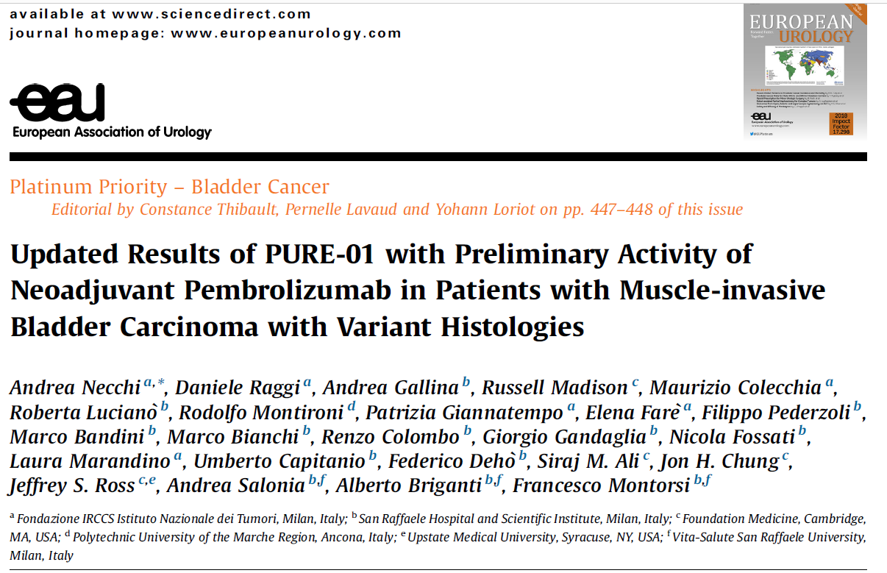
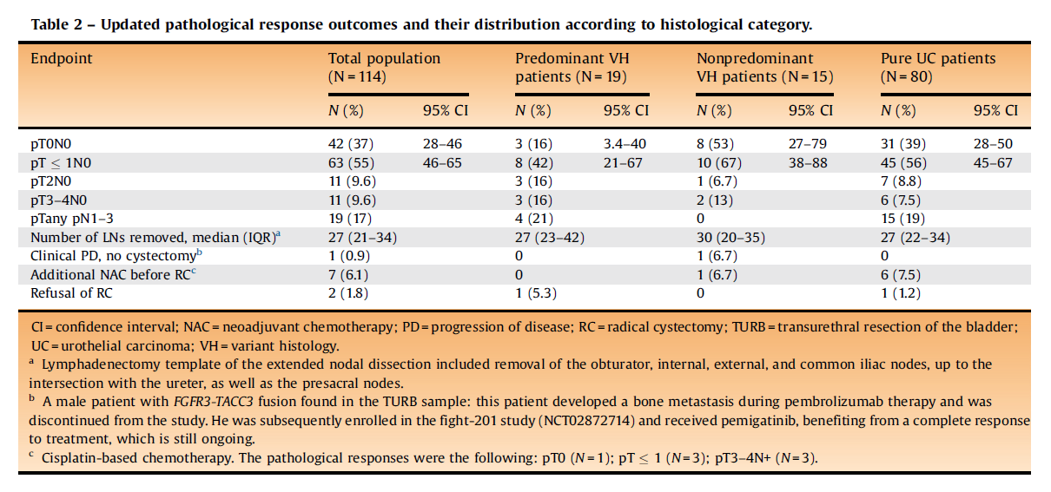
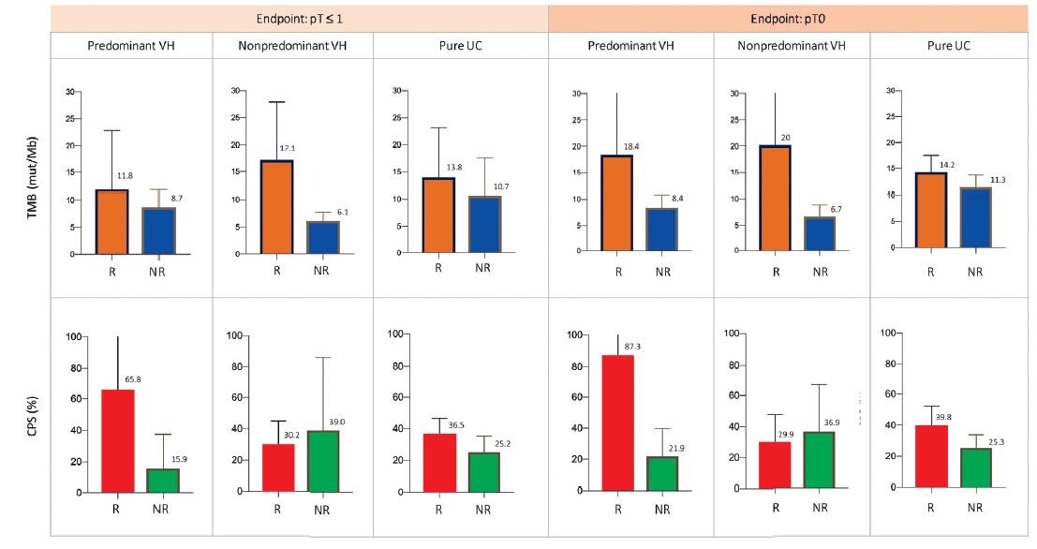
Necchi, Andrea, Daniele Raggi, Andrea Gallina, Russell Madison, Maurizio Colecchia, Roberta Lucianò, Rodolfo Montironi, et al. “Updated Results of PURE-01 with Preliminary Activity of Neoadjuvant Pembrolizumab in Patients with Muscle-Invasive Bladder Carcinoma with Variant Histologies.” European Urology 77, no. 4 (April 2020): 439–46. https://doi.org/10.1016/j.eururo.2019.10.026.

Slide 26
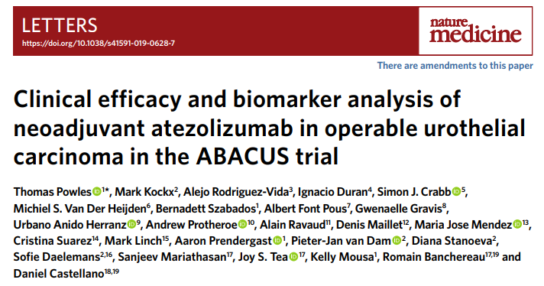
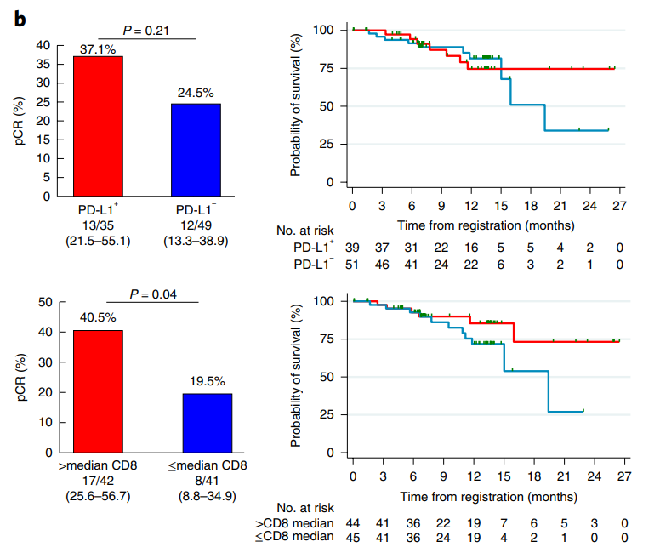
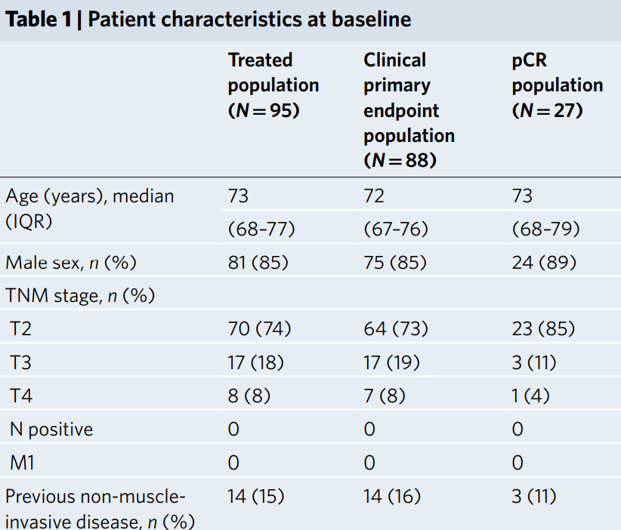
Powles, Thomas, Mark Kockx, Alejo Rodriguez-Vida, Ignacio Duran, Simon J. Crabb, Michiel S. Van Der Heijden, Bernadett Szabados, et al. “Clinical Efficacy and Biomarker Analysis of Neoadjuvant Atezolizumab in Operable Urothelial Carcinoma in the ABACUS Trial.” Nature Medicine 25, no. 11 (November 2019): 1706–14. https://doi.org/10.1038/s41591-019-0628-7.

Slide 27
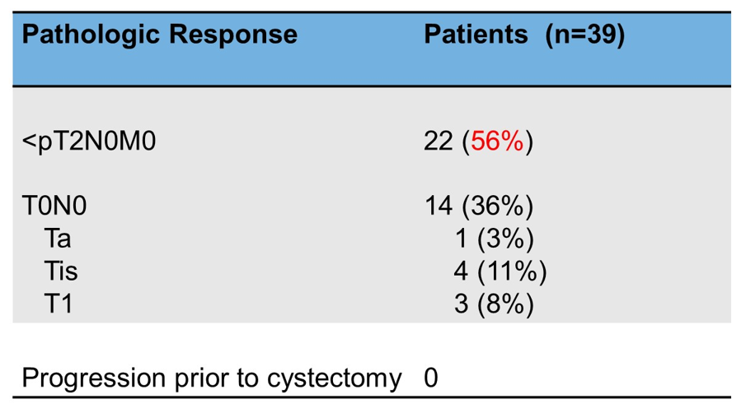
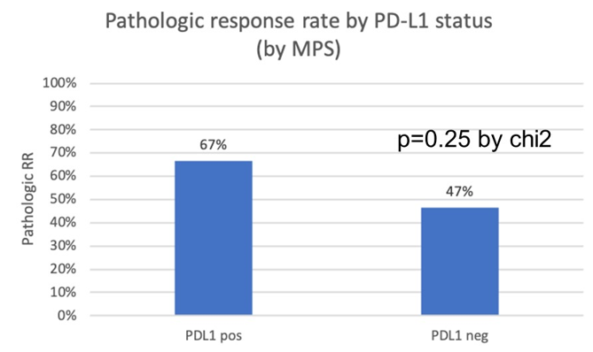
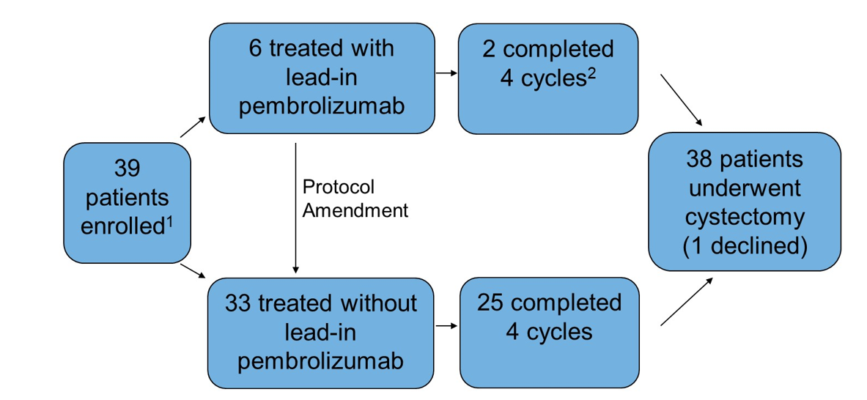
Rose, Tracy L., Michael R. Harrison, Allison M. Deal, Sundhar Ramalingam, Young E. Whang, Blaine Brower, Mary Dunn, et al. “Phase II Study of Gemcitabine and Split-Dose Cisplatin Plus Pembrolizumab as Neoadjuvant Therapy Before Radical Cystectomy in Patients With Muscle-Invasive Bladder Cancer.” Journal of Clinical Oncology 39, no. 28 (October 1, 2021): 3140–48. https://doi.org/10.1200/JCO.21.01003.

Slide 28
Galsky, Matt D., Siamak Daneshmand, Kevin G. Chan, Tanya B. Dorff, Jeremy Paul Cetnar, Brock O Neil, Anishka D’souza, et al. “Phase 2 Trial of Gemcitabine, Cisplatin, plus Nivolumab with Selective Bladder Sparing in Patients with Muscle- Invasive Bladder Cancer (MIBC): HCRN GU 16-257.” Journal of Clinical Oncology 39, no. 15_suppl (May 20, 2021): 4503–4503. https://doi.org/10.1200/JCO.2021.39.15_suppl.4503.

Slide 32
Clinical Investigator Survey Results

Slide 33
In general, would you recommend pembrolizumab to a patient with BCG-unresponsive non-muscle-invasive bladder cancer (NMIBC) who is…
65 years old, otherwise healthy and prefers not to undergo cystectomy
Yes
16
No
4
70 years old, with minor comorbidities
Yes
13
No
7
80 years old, with significant comorbidities and not a candidate for cystectomy
Yes
16
No
4
Survey of genitourinary cancer clinical investigators

Slide 34
A 65-year-old man receives neoadjuvant dose-dense MVAC for PD-L1-positive MIBC and undergoes cystectomy, which reveals significant residual disease and a positive pelvic lymph node. Regulatory and reimbursement issues aside, what adjuvant systemic therapy, if any, would you recommend?
19
Nivolumab
None
1
Survey of genitourinary cancer clinical investigators

Slide 35
A 65-year-old man receives neoadjuvant dose-dense MVAC for PD-L1-positive MIBC and undergoes cystectomy, which reveals small amounts of residual disease and negative pelvic lymph nodes. Regulatory and reimbursement issues aside, what adjuvant systemic therapy, if any, would you recommend?
None
11
Nivolumab
9
Survey of genitourinary cancer clinical investigators

Slide 36
A 65-year-old man receives neoadjuvant dose-dense MVAC for PD-L1-negative MIBC and undergoes cystectomy, which reveals significant residual disease and a positive pelvic lymph node. Regulatory and reimbursement issues aside, what adjuvant systemic therapy, if any, would you recommend?
19
Nivolumab
None
1
Survey of genitourinary cancer clinical investigators

Slide 37
A 65-year-old man is diagnosed with MIBC and undergoes cystectomy, which reveals pT3N1 PD-L1-positive disease. Regulatory and reimbursement issues aside, what adjuvant systemic therapy, if any, would you recommend?
Nivolumab
9
Cisplatin-based chemotherapy
8
Cisplatin-based chemotherapy → nivolumab
2
None
1
Survey of genitourinary cancer clinical investigators

Slide 38
A 65-year-old man is diagnosed with MIBC and undergoes cystectomy, which reveals pT3N1 PD-L1-negative disease. Regulatory and reimbursement issues aside, what adjuvant systemic therapy, if any, would you recommend?
Cisplatin-based chemotherapy
10
Nivolumab
6
Cisplatin-based chemotherapy → nivolumab
3
None
1
Survey of genitourinary cancer clinical investigators

Slide 39
MODULE 2: Current and Future Front-Line Management of Metastatic UBC (mUBC) — Dr Gupta

Slide 40
Current and Future Front-Line Management of Metastatic UBC (mUBC)
Shilpa Gupta, M.D.
Associate Professor
Director, Genitourinary Oncology Program
Cleveland Clinic Taussig Cancer Institute
Cleveland,OH

Slide 41
Dr Gupta — Disclosures
Advisory Committee | Aveo Pharmaceuticals, EMD Serono Inc, Gilead Sciences Inc, Lilly, Pfizer Inc
Consulting Agreements | Aveo Pharmaceuticals, Bristol-Myers Squibb Company, EMD Serono Inc, Gilead Sciences Inc, Janssen Biotech Inc, Lilly, Pfizer Inc
Ownership Interest | Nektar
Speakers Bureau | Bristol-Myers Squibb Company, Gilead Sciences Inc, Janssen Biotech Inc, Seagen Inc

Slide 42
Platinums are the backbone of first-line therapy in mUBC
Gemcitabine-Cisplatin (GC): Median OS ~ 14 months, ORR 49%
ddMVAC: Median OS ~ 15 months, ORR 70%
Gemcitabine-Carboplatin: Recent trials show median OS~ 13 months ORR 43%
Only a minority of patients receive 2nd-line therapy for mUC
An unmet need to improve survival with 1st-line treatment
Von der Maase H et al. JCO 2005 Sternberg CN Eur J Cancer 2006, Galsky MD Lancet 2020, Flannery K et al. Future Oncol 2019, Powles T ASC) GU 2021

Slide 43
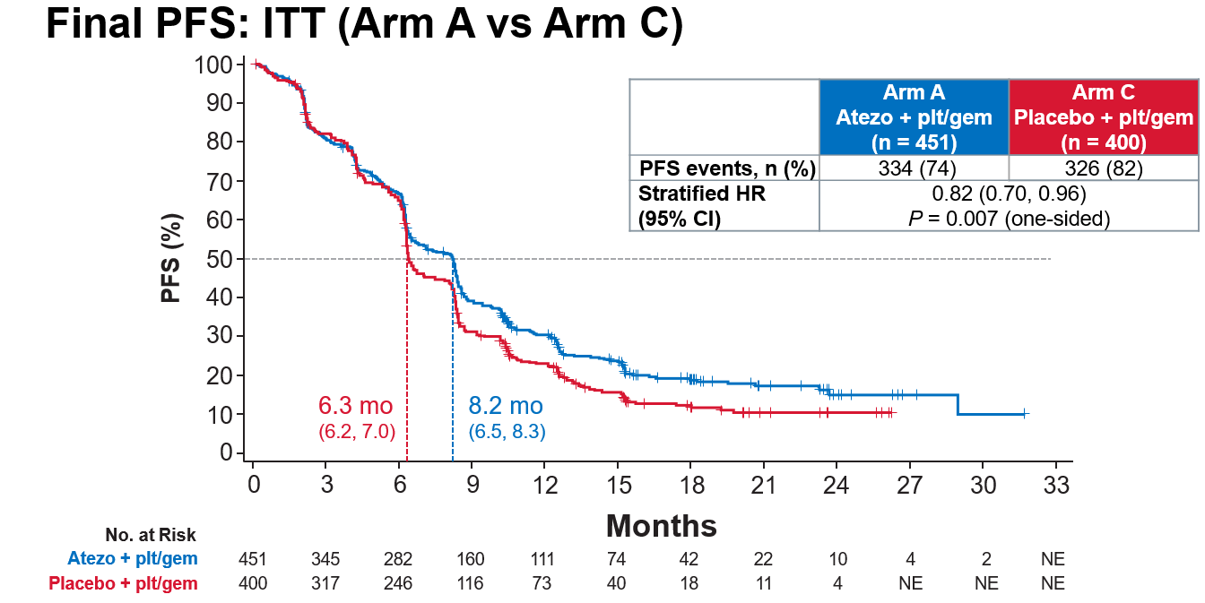
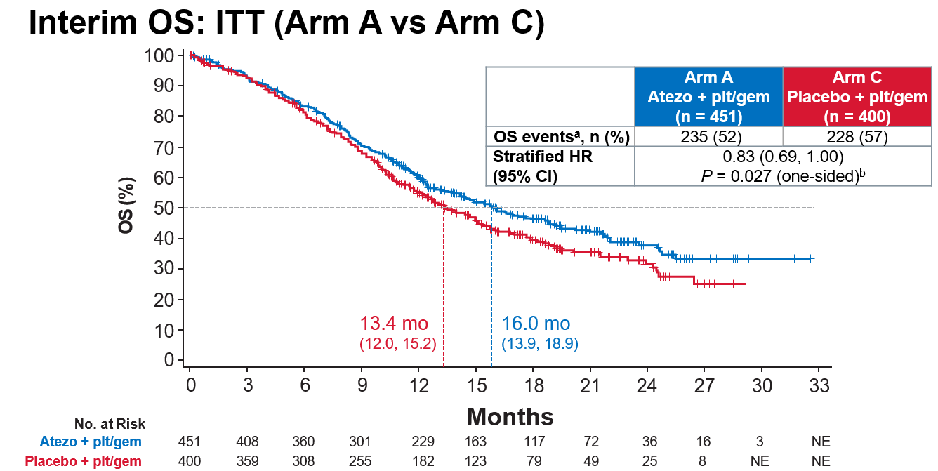
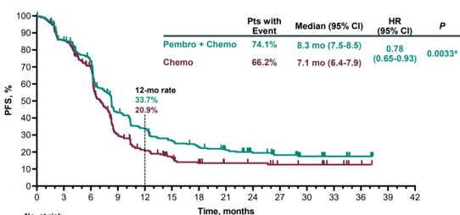
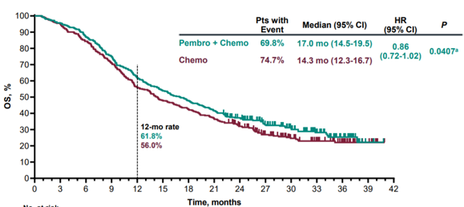
First-line Chemo-IO did not improve OS compared to Chemo
IMvigor130
PFS improvement not clinically meaningful
No significant OS benefit so far
Atezolizumab
+ Chemo
Atezolizumab
Placebo + Chemo
KEYNOTE-361
Pembrolizumab
+ Chemo
No PFS or OS improvement
Pembrolizumab
Chemo

Slide 44
DANUBE: First-line durvalumab +/- tremelimumab versus SOC chemotherapy in la/mUC
Thomas Powles ESMO 2020

Slide 45
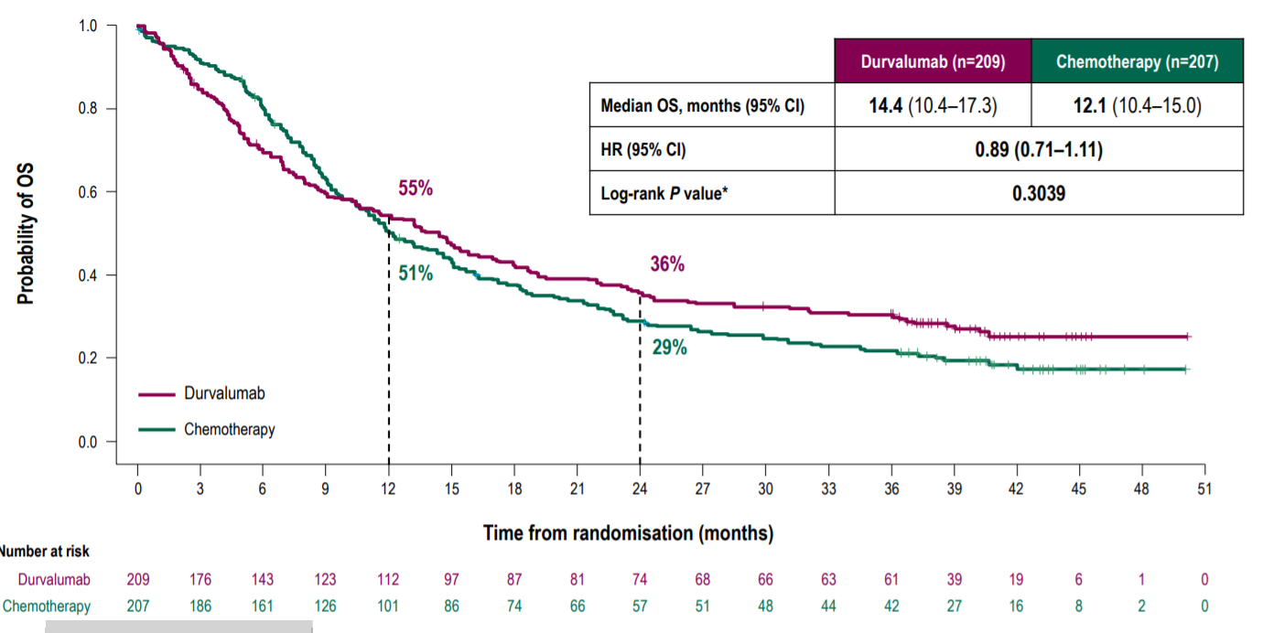
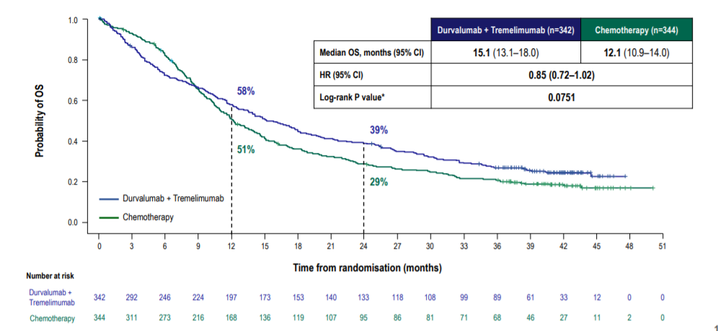
Durva and Durva/Tremi did not improve OS compared to chemo in ITT population
February 22, 2021: Voluntary Withdrawal Announced of Durvalumab Indication for Previously Treated Locally Advanced or Metastatic Bladder Cancer
Thomas Powles ESMO 2020

Slide 46
Evolution of First-Line Therapy in Cisplatin-Ineligible mUC
Atezolizumab accelerated FDA approval
IMvigor 210 (Cohort 1) ORR 23%, Median OS 15.9 mo
Median DoR NR
Prior to April, 2017
Gemcitabine-Carboplatin
ORR 36%
Median OS ~ 9 months
April, 2017
Pembrolizumab accelerated FDA approval
KEYNOTE-052
ORR 24%, Median DoR, NR
May, 2017
Gemcitabine-Carboplatin followed by avelumab maintenance (preferred)
JAVELIN Bladder 100
Pembrolizumab label restricted to ”platinum-ineligible” mUC ONLY
June, 2018
NOW
FDA restricted atezo and pembro
to cisplatin-ineligible with high PD-L1 expressing tumors OR those who are “platinum-ineligible”
De Santis M et al. JCO 2021
.Balar AV Lancet 2017
Balar AV et al. Lancet 2017
Powles T et al. NEJM 2020

Slide 47
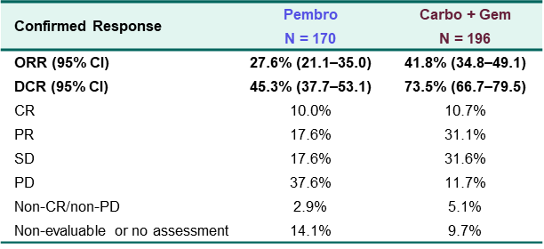
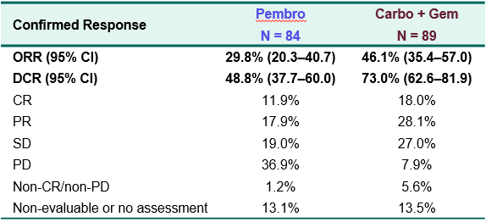
KEYNOTE-361: Pembro Alone or Combined with Chemo vs Chemo
Response Rates and Disease Control Rates Lower with Pembro Compared to Carbo-Gem
Total Patients
CPS >10

Slide 48
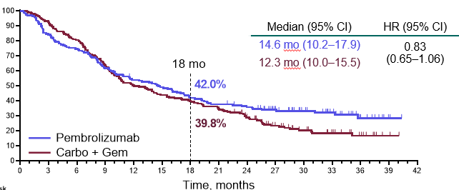
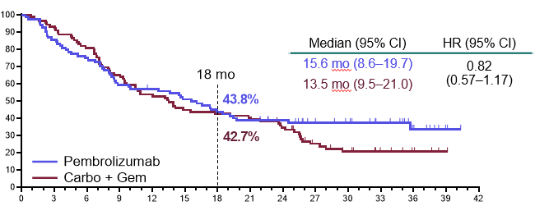
KEYNOTE-361: Pembro Alone or Combined with Chemo vs Chemo
OS for Pembro catches up but DOES NOT cross significantly enough for a positive trial
Total Patients
CPS >10

Slide 49
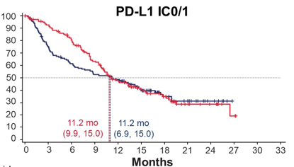
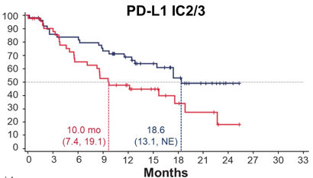
IMvigor130 Exploratory Analysis: Atezo vs Chemo in Cis-Ineligible Patients (OS)
PD-L1 seems to predict responses to atezo in this exploratory analysis

Slide 50
Thomas Powles ASCO 2020

Slide 51
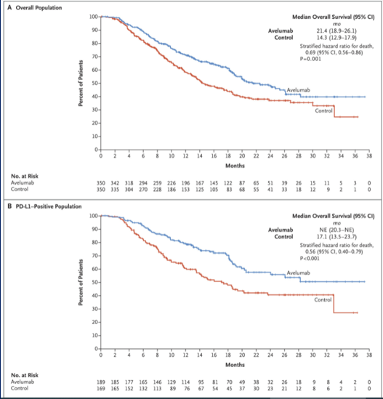
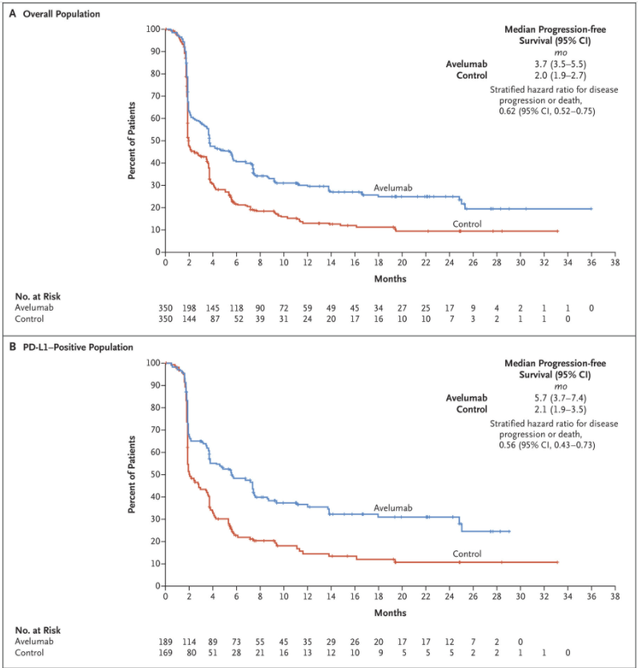
Maintenance Avelumab improves OS and PFS
38 months median follow-up data shows median OS of 23.8 months with Avelumab + BSC vs 15 months with BSC alone
(Powles et al. ASCO GU 2022)

Slide 52
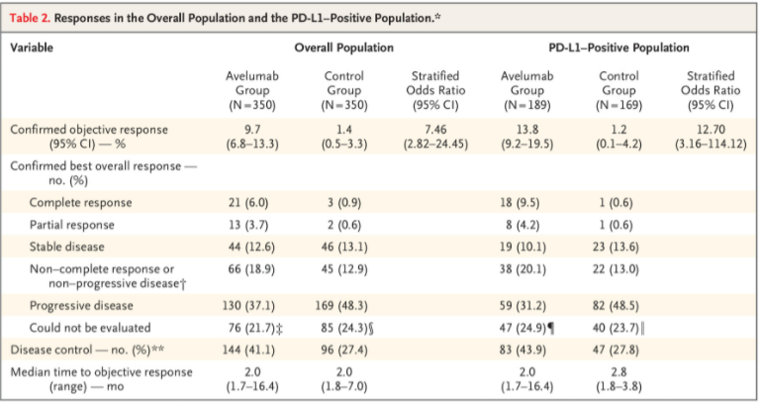
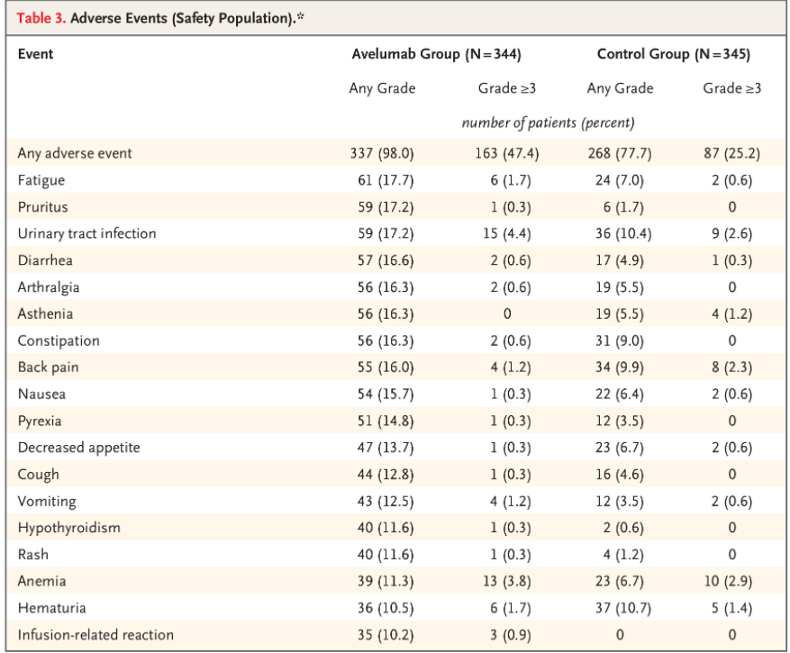

Slide 53
Powles T et al. NEJM 2020

Slide 54
Maintenance PARP inhibitors in mUC
Abstract 436
Crabb SJ et al
A randomized, double blind, biomarker selected, phase II clinical trial of maintenance PARP inhibition following chemotherapy for metastatic urothelial carcinoma (mUC): Final analysis of the ATLANTIS rucaparib arm
Abstract 442
Vignani F et al
Randomized phase II study of niraparib plus BSC vs BSC alone as maintenance treatment in patients with advanced UC whose disease did not progress after first-line platinum-based chemotherapy: The Meet-URO12 trial

Slide 55
Patient Selection for first-line treatment in mUBC
PD-L1 is not a reliable biomarker (KEYNOTE-361) and FDA has restricted pembrolizumab label only to platinum-ineligible mUBC pts
Our group proposed a consensus definition for “platinum-ineligibility” for standardization using 1 of the 5 parameters:
ECOG PS ≥ 3
Cr Cl < 30 ml/min
Peripheral neuropathy ≥ 3
NYHA Heart Failure Class > 3
ECOG PS 2 and Cr Cl < 30 ml/min
Gupta, S et al. ASCO GU 2019

Slide 56
Treatment Paradigm for mUBC in 2022
Vedotin
Govitecan
PD-L1 is not a reliable biomarker
Vedotin
Govitecan

Slide 57
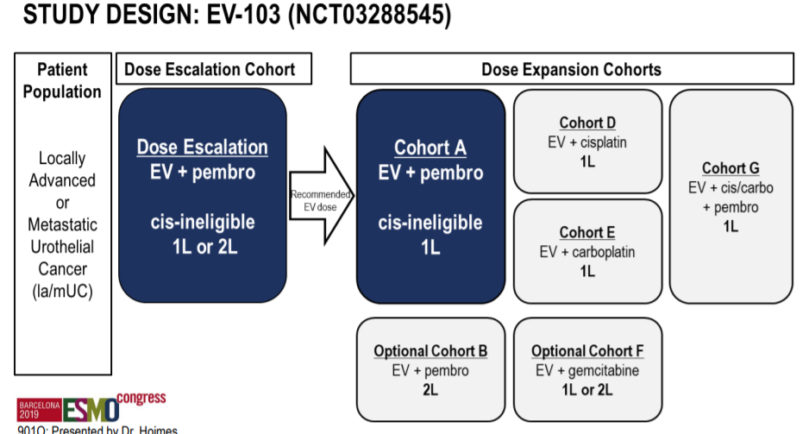
Enfortumab vedotin and pembrolizumab in first-line cisplatin-ineligible mUC
Hoimes et al. ESMO 2019

Slide 58
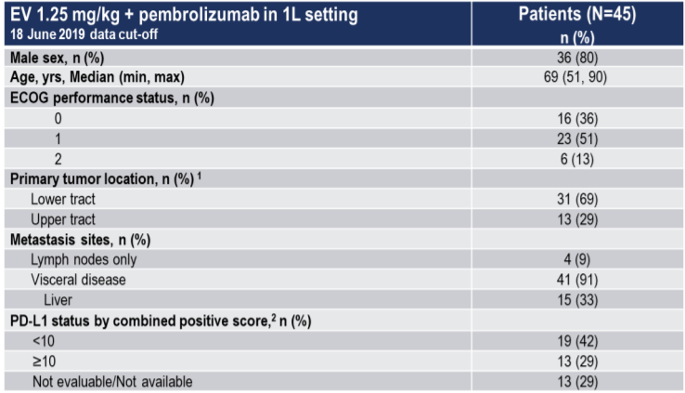
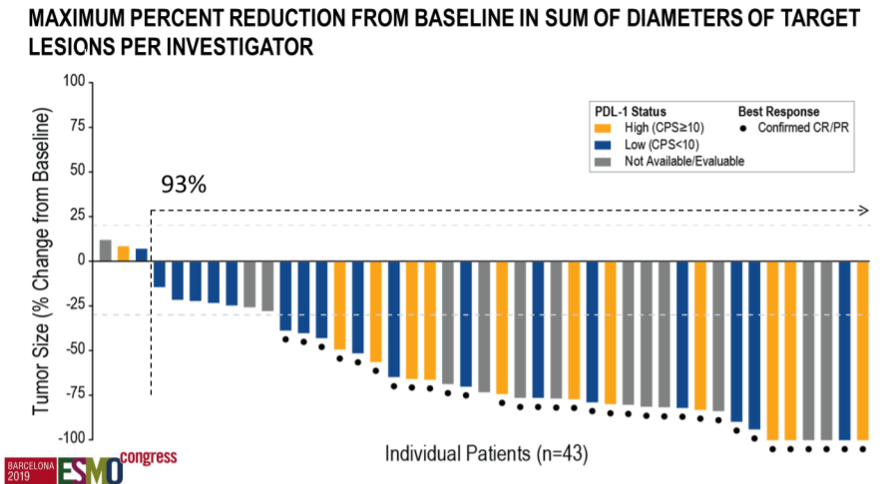
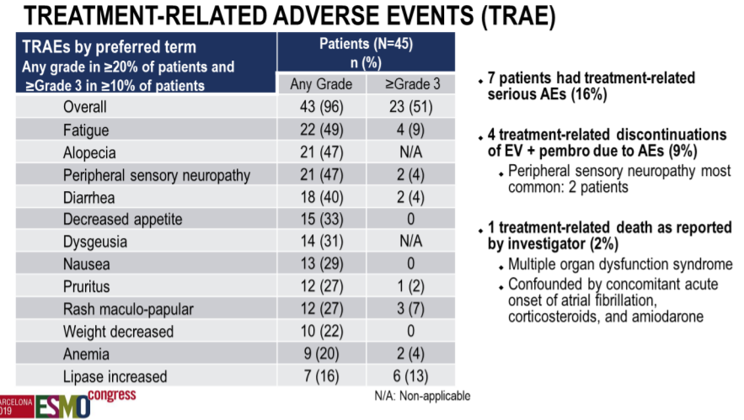
ASCO GU 2021: Updated median follow-up of 24.9 mo
Median PFS 12.3 mos. and median OS is not reached
The most TRAEs were peripheral sensory neuropathy (56%, 4% ≥G3), fatigue (51%, 11% ≥G3), and alopecia (49%)
1 treatment-related death
ORR 73.3%; CR 17.8%, ORR 57% in liver metastases
Fridlander TW et al. ASCO GU 2021
Hoimes et al. ESMO 2019

Slide 59
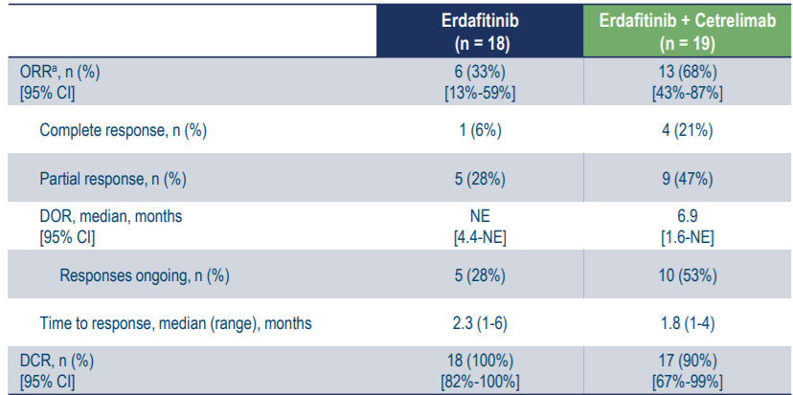
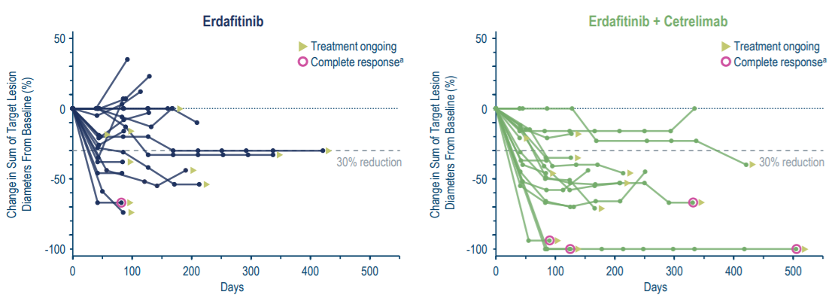
Erdafitinib (FGFRi) + Cetrelimab (anti-PD-L1) in 1L mUC: NORSE Study
Powles T ESMO 2021

Slide 60
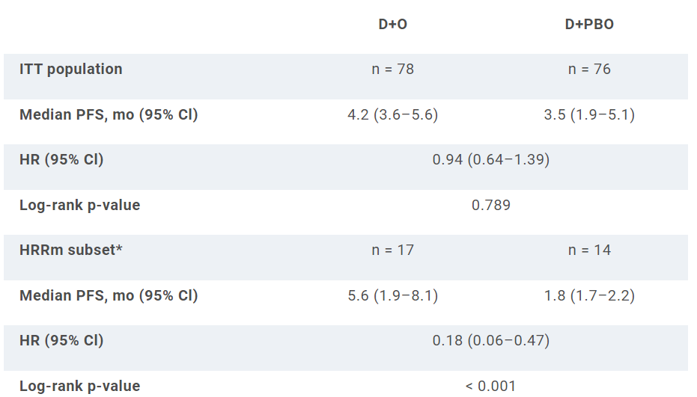
Reinvigorating the role of PARP inhibitors in mUBC Durvalumab + olaparib for first-line treatment of platinum-ineligible patients with mUC (BAYOU)
Platinum-ineligible mUC population, N=154
Randomized to receive durva+olaparib vs durva+placebo
20% had an HRRm
Rosenberg JE ASCO GU 2022

Slide 61
How will 1st-line therapy in mUC evolve in future?
Key Ongoing Phase 3 Trials
CheckMate 901
NILE
EV-302
Gem + Cis/Carbo
Gem + Cis/Carbo
Durvalumab
EV + Pembrolizumab
Gem + Cis/Carbo
Nivolumab
Gem + Cis/Carbo
Durva/Tremi
Gem + Cis/Carbo
Ipi/Nivo
Gem + Cis/Carbo

Slide 62
A032001: MAINCAV- Phase III randomized trial of maintenance cabozantinib and avelumab vs maintenance avelumab after 1L platinum-based chemotherapy in patients with mUC (including N3 only disease) (NCT05092958)
Patients with locally advanced/mUC, N3 only disease allowed
CR/PR/SD with standard
1st-line platinum-based chemotherapy (4-6 cycles)
Stratification:
Best response to 1st-line chemo (CR vs PR vs SD)
Sites of metastases: visceral vs non-visceral
Avelumab 800 mg IV q2 wk x 2 yrs
Primary endpoint: OS
Secondary endpoints:
PFS, Safety, Tumor response, HRQOL
1:1
Cabozantinib 40 mg PO daily +
Avelumab 800 mg IV q2 wk
x 2 yrs
N = 654
C1 D1
C2 D1
Progression/end of Tx
RNAseq
ctDNA
WES
PBMC - Flow MDSC, etc
TCRseq
IHC multicolor
TCRseq
Study Chair: Shilpa Gupta
PBMC - Flow MDSC, etc
Cytokine/Chemokine assay

Slide 63
Conclusions
Platinum-based chemotherapy is the kingpin in 1L mUC and addition of more agents is NOT better
Maintenance immunotherapy improves outcomes
Ongoing first-line trials will establish the role of novel chemo-sparing combinations
PD-L1 does not appear to be predictive for IO benefit

Slide 64
Clinical Investigator Survey Results

Slide 65
What would be your preferred first-line treatment regimen for a 65-year-old patient with de novo metastatic urothelial bladder cancer (UBC)?
Cisplatin/gemcitabine → maintenance avelumab
16
Cisplatin/gemcitabine
4
Survey of genitourinary cancer clinical investigators

Slide 66
What would you generally recommend for a 65-year-old patient who experiences disease recurrence in the liver 9 months after cystectomy and adjuvant gemcitabine/cisplatin for muscle-invasive FGFR wild-type UBC?
Pembrolizumab
15
Enfortumab vedotin
5
Survey of genitourinary cancer clinical investigators

Slide 67
What would you generally recommend for a 65-year-old patient who experiences disease recurrence in the liver 9 months after cystectomy and adjuvant nivolumab for muscle-invasive FGFR wild-type UBC?
Enfortumab vedotin
11
Cisplatin/gemcitabine
6
Cisplatin/gemcitabine → maintenance avelumab
3
Survey of genitourinary cancer clinical investigators

Slide 68
What would you generally recommend for a 65-year-old patient who experiences disease recurrence in the liver 9 months after cystectomy and adjuvant nivolumab for muscle-invasive UBC and is found to have an FGFR3 mutation?
Erdafitinib
6
Enfortumab vedotin
5
Cisplatin/gemcitabine
5
Cisplatin/gemcitabine → maintenance avelumab
3
Pembrolizumab
1
Survey of genitourinary cancer clinical investigators

Slide 69
Based on current clinical trial data and your personal experience, do you believe pembrolizumab in combination with enfortumab vedotin will result in superior outcomes compared to currently available up-front regimens for metastatic UBC?
19
Yes
No
1
Survey of genitourinary cancer clinical investigators

Slide 70
MODULE 3: Selection and Sequencing of Therapy for Relapsed/Refractory mUBC — Dr Petrylak

Slide 71
Selection and Sequencing of Therapy for Relapsed/Refractory mUBC
Daniel P. Petrylak, MD
Professor of Medicine and Urology
Director, GU Translational Working Group
Co Director, Cell Signaling Program
Smilow Cancer Center, Yale University

Slide 72
Dr Petrylak — Disclosures
Consulting Agreements | Gilead Sciences Inc, Ipsen Biopharmaceuticals Inc
Contracted Research | Gilead Sciences Inc

Slide 73
Enfortumab Vedotin: Proposed Mechanism of Action
Notes:
Enfortumab vedotin is a fully human monoclonal antibody against Nectin-4 that is conjugated with the microtubule-disrupting agent monomethyl auristatin E (MMAE) by a protease cleavable linker

Slide 74
EV-201: Single-Arm, Pivotal Phase 2 Trial
Cohort 1
Prior PD-1/L1 inhibitor and platinum-based therapy
Enrollment completed July 2018
N=128¹
Enfortumab vedotin
1.25 mg/kg IV on days 1, 8, and 15
of each 28-day cycle
Primary endpoint:
ORR per RECIST v1.1
as determined by BICR
Select secondary endpoints:
DOR
PFS
OS
Safety
Screening and enrollment
51 global sites
Previously treated locally advanced or metastatic urothelial cancer
Cohort 2
Prior PD-1/L1 inhibitor, platinum naive,
cisplatin ineligible
Completed Accrual
¹ 3 patients did not receive enfortumab vedotin treatment:
one each due to clinical deterioration, patient decision, and low hemoglobin after enrollment
BICR=blinded independent central review;
DOR=duration of response; ORR=objective response rate; OS=overall survival; PFS=progression-free survival
Daniel P. Petrylak
Balar AV et al. ASCO GU 2021;Abstract 394.

Slide 75
EV-201 Cohort 2: Best Overall Response per BICR
ORR per RECIST v 1.1 assessed by BICR | Patients (N=89) %
Confirmed ORR, 95% CI¹ | 52 (40.8, 62.4)
Best overall response²
Confirmed complete response | 20
Confirmed partial response | 31
Stable disease | 30
Progressive disease | 9
Not evaluable³ | 9
ORR = Objective Response Rate; RECIST = Response Evaluation Criteria in Solid Tumors; BICR = Blinded Independent Central Review
¹CI = Confidence Interval, Computed using the Clopper-Pearson method
²Best overall response according to RECIST v1.1. Complete response and partial response were confirmed with repeat scans ≥28 days after initial response.
³Includes five subjects who did not have response assessment post-baseline, two subjects whose post-baseline assessment did not meet the minimum interval requirement for stable disease, and one subject whose response cannot be assessed due to incomplete anatomy.
Balar AV et al. ASCO GU 2021;Abstract 394.

Slide 76
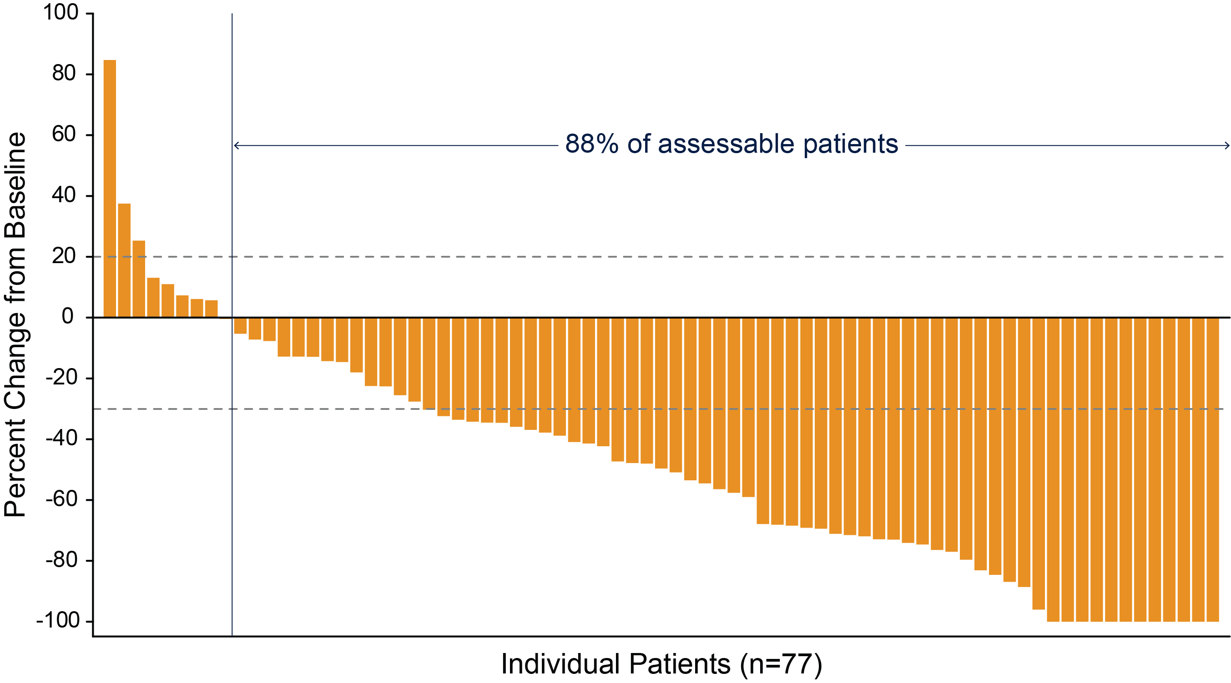
EV-201 Cohort 2: Change in Tumor Measurements per BICR
Data are not available for 12 subjects due to no response assessment post-baseline (n=5), incomplete assessment of target lesions post-baseline (n=1),
or no measurable disease at baseline per BICR (n=6).
Balar AV et al. ASCO GU 2021;Abstract 394.

Slide 77
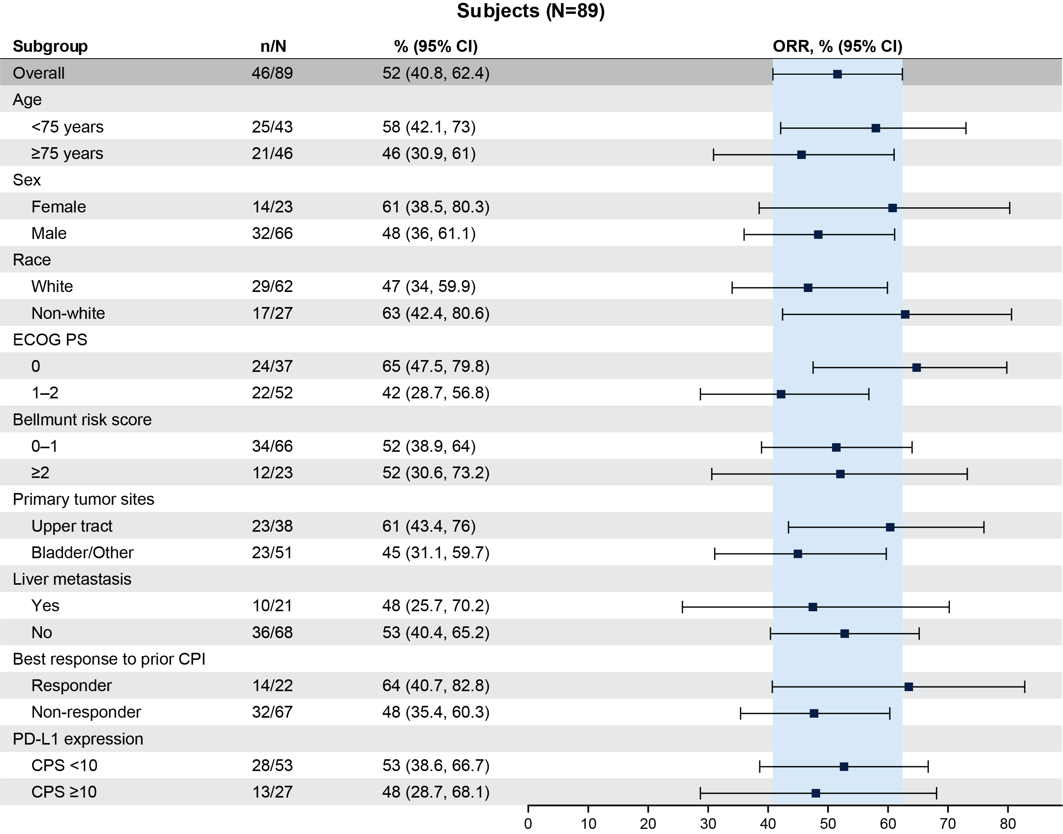
EV-201 Cohort 2: Responses by Subgroup per BICR
Responses were observed across all subgroups, including patients:
with primary tumor sites in the upper tract (ORR=61%)
with liver metastasis (ORR=48%)
who did not respond to prior PD-1/PD-L1 inhibitors (ORR=48%)
BICR = Blinded Independent Central Review; ORR = Objective Response Rate; ECOG PS= Eastern Cooperative Oncology Group Performance Score; CPI = Checkpoint Inhibitor; PD-1 = programmed cell death protein 1 inhibitor; PD-L1 = programmed death-ligand 1; CPS = combined positive score
Balar AV et al. ASCO GU 2021;Abstract 394.

Slide 78
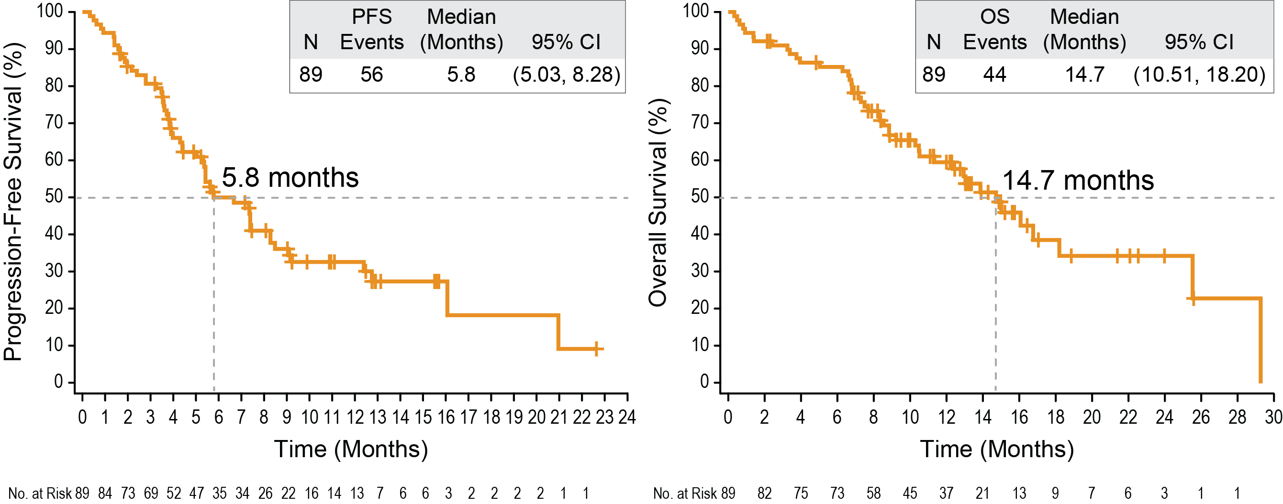
EV-201 Cohort 2: Progression-Free Survival and Overall Survival
Median follow-up: 13.4 months
Balar AV et al. ASCO GU 2021;Abstract 394.

Slide 80
Methods – EV-301 Phase 3 Trial Design
Subjects screenedª
(N=745)
Enfortumab vedotin
(N=301)
EV 1.25 mg/kg
on Days 1, 8, and 15
of each 28-day cycle
Key eligibility criteria:
Aged ≥18 years
Histologically/cytologically confirmed UC with radiologically documented la/m UC
Radiographic progression or relapse during or after a PD-1/L1 treatment for la/m UC
Use of platinum-containing regimen for la/m UC; progression within 12 months of completion if used in the adjuvant/neoadjuvant setting
ECOG PS 0 or 1
1:1 randomization
with stratification^{b}
(N=608)
Open-label
Chemotherapy
(N=307)^{c}
Docetaxel 75 mg/m² or
vinflunine^{d} 320 mg/m² or
paclitaxel 175 mg/m²
on Day 1
of each 21-day cycle
Radiologic progression
Discontinuation criteria met
Study completion
Prespecified interim analysis conducted at ≥285 events (deaths)
ªScreening at 185 study centers in North America, Europe, Asia Pacific, and Latin America.
^{b}Stratification variables were ECOG performance status (0 or 1), regions of the world (US, western Europe, or rest of world), liver metastasis (yes or no).
^{c}Investigator selected prior to randomization.
^{d}In countries where approved; overall proportion of patients receiving vinflunine will be capped at 35%.
Abbreviations: ECOG PS, Eastern Cooperative Oncology Group performance status; EV, enfortumab vedotin; la/m, locally advanced or metastatic; PD-1/L1, programmed cell death protein-1/programmed death-ligand 1; UC, urothelial carcinoma.
Powles T et al. N Engl J Med 2021

Slide 81
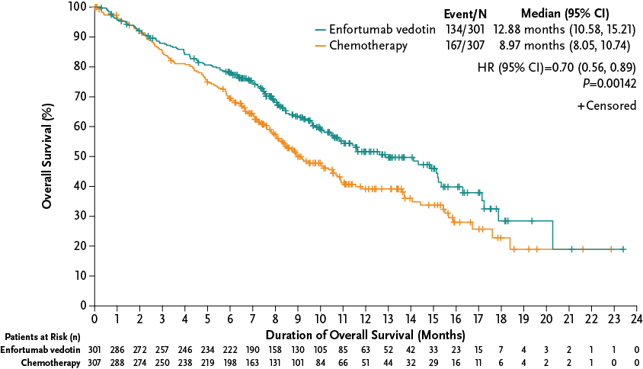
Overall Survival (Intention-to-Treat Population)
OS Rate, % (95% CI) | Enfortumab vedotin N=301 | Chemotherapy N=307
6-month | 77.9 (72.74, 82.25) | 69.5 (63.85, 74.38)
12-month | 51.5 (44.63, 58.03) | 39.2 (32.60, 45.64)
Median OS (95% CI)
12.88 months (10.58, 15.21)
8.97 months (8.05, 10.74)
Abbreviations: CI, confidence interval; HR, hazard ratio; OS, overall survival.
Data cut-off: July 15, 2020
Powles T et al. N Engl J Med 2021

Slide 82
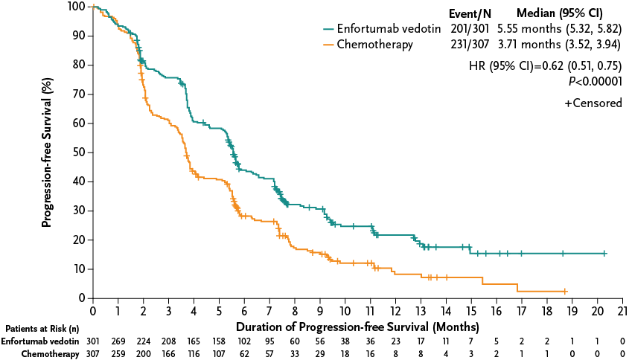
Progression-Free Survival (Intention-to-Treat Population)
Median PFS (95% CI)
5.55 months (5.32, 5.82)
3.71 months (3.52, 3.94)
Abbreviations: CI, confidence interval; HR, hazard ratio; PFS, progression-free survival.
Data cut-off: July 15, 2020
Powles T et al. N Engl J Med 2021

Slide 83
Best Overall Response (Response-Evaluable Population)
ORR=40.6%
95% CI: 34.90, 46.54
P<0.001
ORR=17.9%
95% CI: 13.71, 22.76
SD=31.3%
SD=35.5%
PR=35.8%
PR=15.2%
CR=4.9%
CR=2.7%
Disease control rate, % (95% CI) |  | 71.9 (66.30, 76.99) |  | 53.4 (47.52, 59.17) |  | P<0.001
*Disease control rate is defined as the proportion of patients who had a best overall response of confirmed CR, PR, or SD (at least 7 weeks).
Abbreviations: CR, complete response; ORR, objective response rate; PR, partial response; SD, stable disease.
Data cut-off: July 15, 2020
Powles T et al. N Engl J Med 2021

Slide 84
Phase II BLC2001 Study of Erdafitinib: Design
Siefker-Radtke AO, et al. ASCO 2018. Abstract 4503. Siefker-Radtke AO, et al. ASCO 2016. Abstract TPS4575. ClinicalTrials.gov. NCT02365597.

Slide 85
Phase II BLC2001 Study of Erdafitinib: Antitumor Activity
Prior IO ORR, 59%
ORR to Prior IO, 5%
Siefker-Radtke AO, et al. ASCO 2018. Abstract 4503.
Notes:
CT, chemotherapy; DoR, duration of response; IO, immunotherapy; Mets, metastases; PD, progressive disease; SD, stable disease; TTR, time to response.

Slide 86
Phase II BLC2001 Study of Erdafitinib: Survival
At follow-up of 11 mos, 21.2% of patients remained on erdafitinib
mPFS, 5.5 mo
mOS, 13.8 mo
Siefker-Radtke AO, et al. ASCO 2018. Abstract 4503.
Notes:
NE, not estimable.

Slide 87
Response Rates with FGFR Inhibitors in Urothelial Cancer
ORR, %
Notes:
https://ascopubs.org/doi/10.1200/JCO.2019.37.7_suppl.409
https://ascopubs.org/doi/abs/10.1200/JCO.2020.38.6_suppl.489
https://ascopubs.org/doi/abs/10.1200/JCO.2020.38.6_suppl.527

Slide 88
TROPHY-U-01 (IMMU-132-06) Study A Phase II Open Label Study of IMMU-132 in Metastatic Urothelial Cancer After Failure of Platinum-based Regimen or Anti-PD-1/ PD-L1 Based Immunotherapy
Results from the Study-01 basket trial warranted further investigation in a dedicated phase 2 trial.
TROPHY-U-01 (NCT03547973) is an international, single-arm, open-label, phase 2 trial evaluating the antitumor activity and safety of sacituzumab govitecan in 140 pts with advanced UC.
Cohort 1 (100 patients): pts who progressed after prior platinum-based and anti PD-1/anti PD-L1 based therapies.
Objectives:
Overall response rate (ORR) will be centrally reviewed
Duration of response (DOR)
Progression-free survival (PFS)
Overall survival (OS)
Sacituzumab Govitecan 10 mg/kg
Days 1 and 8, every 21 days
Continue treatment in the absence of unacceptable toxicity or PD
Cohort 2 (40 patients): pts ineligible for platinum-based therapy and who progressed after prior anti PD-1/anti PD-L1 based therapies.

Slide 89
TROPHY-U-01 Cohort 1: Response Assessmentsª
ORR and mDOR values were consistent with investigator assessments
 | Sacituzumab Govitecan (n=113)
Overall Response Rate
ORR, n (%) [95% CI] | 31 (27.4) [19.5, 36.6]
CR, n (%) PR, n (%) | 6 (5.3) 25 (22.1)
Response duration
mDOR, months 95% CI Range | 7.2 4.7-8.6 1.4-13.7
Subjects with visceral metastasis involving the liver had an ORR of 31.6%
compared with 25.3% in those without liver involvement
ª Assessments were per blinded independent review assessment, RECIST v1.1.
CR, complete response; mDOR, median duration of response; ORR, objective response rate; PR, partial response; RECIST v1.1, Response Evaluation Criteria in Solid Tumors version 1.1.
Tagawa ST, et al. TROPHY-U-01: A Phase 2 Open-label Study of Sacituzumab Govitecan in Patients With Metastatic Urothelial Carcinoma Progressing After Platinum-based Chemotherapy and Checkpoint Inhibitors. J Clin Oncol. 2021. In press.

Slide 90
TROPHY-U-01 Cohort 1: Survival Outcomesª
PFS
OS
OS, overall survival; PFS, progression-free survival.
ª Median follow-up time was 6.3 months, defined as time from informed consent date to death date, end of study date or data cutoff date, whichever occurs first.
Orange hash marks indicate data censoring.
Tagawa ST, et al. TROPHY-U-01: A Phase 2 Open-label Study of Sacituzumab Govitecan in Patients With Metastatic Urothelial Carcinoma Progressing After Platinum-based Chemotherapy and Checkpoint Inhibitors. J Clin Oncol. 2021. In press.

Slide 91
Case: Retroperitoneal Lymph Node Metastasis
61 year-old male with past medical history of G1 neuropathy and RLE edema, with target lesions consisting of periportal, retroperitoneal, and mesenteric adenopathy
Refractory to adjuvant tx: Cisplatin/gemcitabine
Prior metastatic regimens:
Atezolizumab (24 mon)
Enfortumab vedotin (8 mon)
Pemetrexed (3 mon)
Confirmation of PR after cycle 4 with SG treatmentª
No worsening of neuropathy reported
Significant reduction in lower extremity edema
On treatment for 7 mon and ongoing at time of data cut-off
Images provided by Daniel P. Petrylak from the Yale School of Medicine, New Haven, CT
27.2 mm (2D)
27.7 mm (2D)
Baseline CT
Follow-up CT
(after 10 cycles of SG)
70% reduction of target lesions
Presented by: Scott T. Tagawa
ªAssessed by investigator using RECISTv1.1.
CT, computed tomography; G1, grade 1; PR, partial response; RECIST, Response Evaluation Criteria In Solid Tumors; RLE, right leg extremity; SG, sacituzumab govitecan.

Slide 92
Figure 3. TROPHY-U-01: Phase II trial of SG in stage IV urothelial cancer after failure of a platinum-based regimen and/or anti-PD-1/PD‑L1-based therapies
Cohort 1 (100 patients): patients with mUC who progressed after prior platinum-based and CPI-based therapies
Continue treatment in the absence of unacceptable toxicity or disease progression
Primary objective:
ORR
Secondary objectives:
Safety/tolerability
DOR
PFS
Overall survival (OS)
SG 10 mg/kg
Cohort 2 (40 patients): patients with mUC ineligible for platinum-based therapy and who progressed after prior CPI-based therapies
Days 1 and 8, every 21 days
Pembrolizumab 200 mg
day 1 every 21 days
Cohort 3 (up to 61 patients): mUC CPI naïve patients who progressed after prior platinum-based therapies
SG Days 1 and 8, every 21 days
Petrylak DP et al. ASCO 2020;Abstract 5027

Slide 93
Exposure and Response Outcomes
Response Outcomes
Median treatment cycles (range): 5 (1-15)
Median duration of treatment (range): 4.5 months (0.3 – 15.6)
Median dose intensity: 92%
At a median follow-up of 6.8 months, ORR was 29% (6/21) with 6 confirmed PRs
Endpoint | N=21
Median (range) follow-up, mon | 6.8 (1.6–18.9)
Patients continuing treatment, n (%) | 9 (43)
ORR, n (%) [95% CI] | 6 (29) [12–54]
CR, n (%) | 0 (0)
PR, n (%) | 6 (29)
SD, n (%) | 10 (48)
Median TTR, (range), mon | 1.3 (1.1–1.5)
CBR, n (%) [95% CI] | 7 (33) [15–59]
Median DOR (95% CI), mon | NR (4.3–NR)
CBR, clinical benefit rate defined as CR + uCR + PR + uPR or (SD >= 6 months); CI, confidence interval; DOR, duration of response; mon, month; NR, not reached; ORR, objective response; PR, partial response; SD, stable disease; TTR, time to response
Petrylak DP et al. ASCO 2020;Abstract 5027
Notes:
Table_14_2_1_1_2 (ORR [95% CI], CR, PR, CBR)
Table_14_3_1_1_1_1 (median follow-up)
Table_14_1_1_1 (patients continuing treatment = 22 treated – 12 permanently discontinued treatment = 10 patients; 10/22 = 45%)
Table 14.2.1.3 (DOR; TTR)

Slide 94
62% (13/21) of Patients Demonstrated a Reduction in Tumor Size
90
62%
70
Change From Baseline
50
30
10
*
*
*
-10
-30
-50
-70
-90
-110
*Denotes patients who had a 0% change from baseline in tumor size.
One patient had only screening data and thus is not represented.
Petrylak DP et al. ASCO 2020;Abstract 5027
Notes:
Figure_14_2_1_1_2_1

Slide 95
Duration of Response (Local Assessment)
Median DOR not reached
The DOR of responders ranged from 1.4+ to 10.4+ months, with 3 of 6 responders having a duration of ≥4 months
Five of 6 responders have an ongoing response
DOR, duration of response.
Petrylak DP et al. ASCO 2020;Abstract 5027
Notes:
Table 14.2.1.3 (range of DOR of responders)
l-16-2-7-4-dor-other
f-14-1-7-1-7-dp_emc

Slide 96
Survival Outcomes
At this early follow-up, the median PFS and OS compare favorably to current standards of care for platinum-ineligible patients with mUC who have progressed after CPI therapy
The OS rate (95% CI) at 6 months and 12 months was: 76.4% (48.4–90.5) and 43.0% (13.1–70.4), respectively
Petrylak DP et al. ASCO 2020;Abstract 5027

Slide 97
TROPHY-U-01 Is a Registrational, Open-Label, Multicohort Phase 2 Trial in Patients With mUC
Cohort 1* (~100 patients): patients with mUC who progressed after prior platinum-based and CPI-based therapies
SG 10 mg/kg
Days 1 and 8, every 21 days
Continue treatment in the absence of unacceptable toxicity or disease progression
Primary Endpoint: Objective response rate by central review
Key Secondary Endpoints: Safety/tolerability, DOR, PFS, OS
Cohort 2 (~40 patients): patients with mUC ineligible for platinum-based therapy and who progressed after prior CPI-based therapies
SG 10 mg/kg
Days 1 and 8, every 21 days
Cohort 3ª (up to 61 patients): mUC CPI naïve patients who progressed after prior platinum-based therapies
SG 10 mg/kg
Days 1 and 8, every 21 days
Pembrolizumab 200 mg
day 1 every 21 days
Cohort 4 (up to 60 patients): mUC platinum-naïve patients
SG
Days 1 and 8, every 21 days
Continue until a maximum of 6 cycles has been completed,^{d} disease progression, lack of clinical benefit, toxicity, or withdrawal of consent
Maintenance avelumab (800 mg every 2 weeks) with SG (Days 1 and 8 every 21 days) for those without disease progression
Cisplatin^{b}
Cohort 5 (up to 60 patients): mUC platinum-naïve patients
SG
Days 1 and 8, every 21 days
Cisplatin^{c} Avelumab 800 mg every 2 weeks
Key Inclusion Criteria: Age ≥18 years, ECOG of 0/1, creatinine clearance (CrCl) ≥30 mL/min,^{b,c} adequate hepatic function
Key Exclusion Criteria: Immunodeficiency, active Hepatitis B or C, active secondary malignancy, or active brain metastases
*Accelerated FDA approval for treatment of patients with locally advanced or mUC who previously received platinum-containing chemotherapy and PD-1/L1 inhibitor¹
ªExclusions for Cohort 3 only: active autoimmune disease or history of interstitial lung disease. ^{b}In patients with CrCl ≥60 mL/min; ^{c}In patients with creatinine clearance 50–60 mL/min. ^{d}For patients who have not progressed, maintenance therapy will begin with infusions of avelumab (800 mg every 2 weeks beginning cycle 1, day 1 and every 2 weeks thereafter) followed by SG on days 1 and 8 every 21 days.
CBR, clinical benefit rate; CPI, checkpoint inhibitor; CrCl, creatinine clearance; DOR, duration of response; ECOG PS, Eastern Cooperative Oncology Group performance status; mUC, metastatic urothelial cancer; NR, not reached; ORR, objective response rate; OS, overall survival; PFS, progression-free survival; RECIST, Response Evaluation Criteria in Solid Tumors; SG, sacituzumab govitecan.
1. TRODELVYTM (sacituzumab govitecan-hziy). Prescribing Information. Immunomedics, Inc.; April 2021; EudraCT Number: 2018-001167-23; ClinicalTrials.gov Number: NCT03547973. IMMU-132-06 study.
Grivas P et al. ASCO GU 2022;Abstract 434.

Slide 98
Overall Response and Best % Change From Baseline in Tumor Size
Median follow-up: 5.8 months (data cutoff date: 2021-09-24)
Median time to response: 2 months (1.3–2.8; n=14)
Median DOR not yet reached: N/A (2.80-N/A)
Median PFS (95% CI), 5.5 months (1.7–NR); median OS, not reached
 | Cohort 3ª (N=41)
Objective response rate (CR + PR), n (%) [95%CI] | 14 (34) [20.1-50.6]
Objective response rate (CR + PR), evaluable patients, n (%) | 14 (38)
Best overall response, n (%)
CR | 1 (2)
PR | 13 (32)
SD | 11 (27)
SD ≥ 6 months | 4 (10)
PD | 12 (29)
Not assessed | 4 (10)
Clinical Benefit Rate (CR + PR + SD), n (%) [95%CI] | 25 (61) [44.5-75.8]
63% of patients with tumor shrinking^{a,b}
ªResponses assessed by investigator in the intent-to-treat population. ^{b}Patients without post-baseline assessments are not shown here.
CR, complete response; DOR, duration of response; ORR, objective response rate; PD, progressive disease; PR, partial response; SD, stable disease
Grivas P et al. ASCO GU 2022;Abstract 434.

Slide 99
Disitamab Vedotin for Patients with HER2-Overexpressing mUBC
43 HER2⁺ (IHC status 3+ or 2+) locally advanced or mUC who previously failed at least one line of systemic chemotherapy
ORR=51.2%
The median PFS and OS were 6.9 months (95% CI, 5.6–8.9) and 13.9 months (95% CI, 9.1–NE)
The most common treatment-related adverse events (TRAE) were hypoesthesia (60.5%), alopecia (55.8%), and leukopenia (55.8%)
Wang J et al. ASCO 2021;Abstract 1022. Xinan Sheng et al. Clin Cancer Res 2021;27:43-51

Slide 100
Primary Analysis From DS8201-A-U105: A Phase 1b, <br />2-Part, Open-Label Study of Trastuzumab Deruxtecan <br />(T-DXd) With Nivolumab in Patients With HER2-Expressing Urothelial Carcinoma (UC)

Slide 101
Summary of Efficacy Results in UC Cohorts

Slide 102
Cabozantinib in Platinum Refractory Metastatic Urothelial Cancer
ORR=19%
Lancet Oncol 2020;21: 1099–109

Slide 103
Conclusions: Treatment of Metastatic Urothelial Cancer
Enfortumab Vedotin is FDA approved as third line therapy in patients who have progressed on chemotherapy and checkpoint inhibition therapy
Enfortumab Vedotin has accelerated approval in patients who are cisplatin ineligible and have progressed on 1 prior treatment
Sacituzumab Govetecan (phase 2) is FDA approved and has promising activity in patients who have failed 2 or more prior therapies
Studies are evaluating the combination of checkpoint inhibition with targeted therapies
All metastatic urothelial cancer patients should be checked for FGF-R3 mutations; erdafitinib had a 40% response rate in this patient population

Slide 104
Clinical Investigator Survey Results

Slide 105
What would you generally recommend as second-line therapy for a 65-year-old patient with FGFR wild-type UBC metastatic to the liver whose disease progresses on first-line cisplatin/gemcitabine followed by avelumab maintenance?
20
Enfortumab vedotin
Survey of genitourinary cancer clinical investigators

Slide 106
What would you generally recommend as second-line therapy for a 65-year-old patient with FGFR3 mutation-positive UBC metastatic to the liver whose disease progresses on first-line cisplatin/gemcitabine followed by avelumab maintenance?
Erdafitinib
12
Enfortumab vedotin
8
Survey of genitourinary cancer clinical investigators

Slide 107
What would you generally recommend as second-line therapy for an 80-year-old patient with FGFR3 mutation-positive UBC metastatic to the liver whose disease progresses on first-line pembrolizumab?
Erdafitinib
9
Enfortumab vedotin
7
Chemotherapy
4
Survey of genitourinary cancer clinical investigators

Slide 108
What would you generally recommend as third-line therapy for an 80-year-old patient with FGFR wild-type metastatic UBC whose disease has progressed on first-line pembrolizumab and second-line enfortumab vedotin?
Sacituzumab govitecan
10
Chemotherapy
9
Supportive care
1
Survey of genitourinary cancer clinical investigators

Slide 109
Which of the following would you generally recommend first for a patient with metastatic UBC who is eligible to receive all 3 agents?
Enfortumab vedotin
15
Erdafitinib
5
Sacituzumab govitecan
0
Survey of genitourinary cancer clinical investigators

Slide 110
If disitamab vedotin were available for patients with HER2-positive metastatic UBC, would you use it?
Yes, second line or beyond
4
Yes, third line or beyond
16
Survey of genitourinary cancer clinical investigators

Slide 111
MODULE 4: Tolerability/Toxicity of Novel Treatment Strategies and Practical Considerations in the Management of UBC — Dr Sonpavde

Slide 112
Presentation Title
Toxicities of Novel Treatment Strategies and Practical Considerations in the Management of Urothelial Carcinoma
Guru Sonpavde, MD
Dana-Farber Cancer Institute
Associate Professor of Medicine
Harvard Medical School
Boston, MA

Slide 113
Dr Sonpavde — Disclosures
Advisory Committee | Astellas, AstraZeneca Pharmaceuticals LP, Bicycle Therapeutics, Bristol-Myers Squibb Company, EMD Serono Inc, Exelixis Inc, G1 Therapeutics Inc, Genentech, a member of the Roche Group, Gilead Sciences Inc, Immunomedics Inc, Infinity Pharmaceuticals Inc, Janssen Biotech Inc, Lilly, Loxo Oncology Inc, a wholly owned subsidiary of Eli Lilly & Company, Merck, Pfizer Inc, Sanofi Genzyme, Scholar Rock, Seagen Inc
Consulting Agreements (Paid) | AstraZeneca Pharmaceuticals LP, Debiopharm, EMD Serono Inc
Consulting Agreements (Unpaid) | Bavarian Nordic, Bristol-Myers Squibb Company, G1 Therapeutics Inc, QED Therapeutics, Seagen Inc
Travel Cost | AstraZeneca Pharmaceuticals LP, Bristol-Myers Squibb Company
Writing/Editor Fees | Elsevier Practice Update Bladder Cancer Center of Excellence

Slide 114
Urothelial Carcinoma Therapy: metastatic disease Dramatic advances in therapeutic landscape
Treatment | First-line | Second-line | Post-platinum & PD1/L1 | Late salvage
Cisplatin-eligible | GC/(dd)-MVAC→ Avelumab | Post-platinum Pembrolizumab (or nivolumab or avelumab) Erdafitinib (FGFR2/3) EV (cis-ineligible) Post-PD1/L1 inhibitor Gem-Carbo* EV (cis-ineligible) | EV SG Erdafitinib (FGFR2/3) | Taxane Vinflunine
Cisplatin-ineligible | Gem-Carbo* →Avelumab Atezolizumab if PD-L1+
Platinum-ineligible | Pembrolizumab Atezolizumab
*Split dose weekly cisplatin + gemcitabine reasonable alternative to gem-carbo in selected patients with CrCl ≥40 ml/min (no Phase III data)
EV: Enfortumab Vedotin, SG: Sacituzumab Govitecan

Slide 115
Urothelial Carcinoma Therapy: Peri-operative disease Adjuvant nivolumab added to therapeutic armamentarium
Setting | Cisplatin-eligibility | Therapy
Neoadjuvant | Cisplatin-eligible | GC x 4 ddMVAC x 4 MVAC x 3
 | Cisplatin-ineligible | Surgery
Adjuvant | Cisplatin-eligible, no prior NAC (if ≥ypT3 or N+) | GC x 4 ddMVAC x 4 MVAC x 3
 | Cisplatin-eligible, prior NAC | Nivolumab x 1 year (if ≥ypT2 or N+)
 | Cisplatin-ineligible (no NAC) | Nivolumab x 1 year (if ≥ypT3 or N+) Gem-Carbo x 4 (Only if upper tract ≥ypT2/N+)

Slide 116
Immune related adverse events from ICIs
Any organ (patient education, vigilance, high index of suspicion, collaboration with specialties)-common (fatigue) or rare unpredictable symptoms (visual)-prevent pregnancy
Severe irAEs in 10-15% with PD1/L1 inhibitor monotherapy (PD1 > PD-L1), and 30-60% of combination PD1/L1 + CTLA4 inhibitors
Life-threatening if not promptly and appropriately managed.
irAEs can affect >1 organ system (pneumonitis-NSCLC ; dermatitis- melanoma )
Median time to onset 2-3 months, can occur early and even years after discontinuing the ICI
Infusion reactions with avelumab ~20% (needs premedication with diphenhydramine, acetaminophen for first 4 infusions)
Champiat S, et al. Ann Oncol 27: 559–574, 2016

Slide 117
Laboratory monitoring of patients on ICI
Laboratory | Baseline | Every cycle | Every 6-12 weeks
CBC | X | X
CMP | X | X
TSH, FT4 | X |  | X
UA | X |  | X
EKG | X |  | X
Troponins | X |  | X
Lipase, Amylase | X |  | X
Brahmer JR, et al. SITC guidelines. J Immunother Cancer 2021;9:e002435.

Slide 118
Fatal irAEs from ICIs
Number of cases (light blue) and fatality rate (dark blue).
Toxic fatal event onset occurred early.
Retrospective review of 3545 patients: 0.6% fatality rates; cardiac and neurologic events were prominent (43%).
Meta-analysis of 112 trials (19 217 patients) showed toxic fatality rates of 0.36% (anti–PD-1), 0.38% (anti–PD-L1), 1.08% (anti–CTLA-4), and 1.23% (PD-1/PD-L1 plus CTLA-4).
613 fatal ICI toxic events in Vigilyze database:
CTLA4i deaths from colitis (70%)
anti–PD1/L1 fatalities from pneumonitis (35%), hepatitis (22%), and neurotoxicities (15%)
Combination PD-1/CTLA-4 deaths from colitis (37%) and myocarditis (25%).
Wang DY, et al. JAMA Oncol 2018 Dec 1;4(12):1721-1728.

Slide 119
Principles of managing irAEs from immune checkpoint inhibitors ASCO / ESMO guidelines
Grade 1: continue ICI with close monitoring, except for some neurologic, hematologic and cardiac toxicities.
Grade 2: ICI therapy may be suspended, consider resuming when symptoms revert to grade 1. Corticosteroids (Prednisone 0.5-1 mg/kg/d) may be administered (arthritis may respond to very low doses 0.25 mg/kg/d; Antibiotic prophylaxis if >20 mg/d >4 wk).
Grade 3: suspension of ICIs and initiate high-dose corticosteroids (Prednisone 1.0-2.0 mg/kg/d) tapered over at least 4-6 weeks.
Grade 4: permanent discontinuation of ICI, except for endocrinopathies that have been controlled by hormone replacement; High-dose corticosteroids
Evaluate after 72 hours of corticosteroids to adapt therapy
Schneider B, et al. JCO 2021 Dec 20;39(36):4073-4126.
Haanen J, et al. ESMO IO Dec 2021

Slide 120
Steroid-Refractory irAEs
Strategy aims to inhibit key
inflammatory components in the pathophysiology of irAEs, while limiting potential adverse effects of immuno-suppression on tumor response.
Colitis: Infliximab, vedolizumab
Pneumonitis: Infliximab
Nephritis: Infliximab, mycophenolate, azathioprine
Hepatitis: Mycophenolate, tocilizumab (NO infliximab)
Neurotoxicity: IVIG, rituximab, plasmapheresis
Psoriasis: Ustekinumab
Dermatitis: Dupilumab (IL-4, IL-13 inh), rituximab, CSA
Myocarditis: Infliximab, mycophenolate, IVIG, ATG
Arthritis: Adalimumab, etanercept, tocilizumab
Martins F, et al. Lancet Oncol 2019 Jan;20(1):e54-e64.

Slide 121
Underlying autoimmune disease and ICIs
In 123 patients with autoimmune diseases, 92 (75%) had exacerbation of preexisting autoimmune disease, irAEs, or both.
No differences in patients with active versus inactive disease.
Patients receiving immunosuppressive therapy at initiation of CPI therapy had fewer adverse events.
Most flares and irAEs were managed with corticosteroids; 16% required other immunosuppressive therapies.
In 112 patients, autoimmune disease flare and/or other irAE(s) occurred in 79 patients (71%).
Immunosuppressive therapy in 48 patients (43%) and permanent discontinuation of ICI in 24 patients (21%).
Median PFS was shorter in patients receiving immunosuppression at ICI initiation (Prednisone ≥10 mg/d at baseline may compromise efficacy-study confounded by comorbidity requiring steroids).
Median PFS shorter in patients who experienced flare of autoimmune disease/irAE.
Abdel-Wahab N, et al. Ann Intern Med. 2018 Jan 16;168(2):121-130.
Tison A, et al. Athritis Rheumatol 2019 Dec;71(12):2100-2111.
Ricciuti B, et al. JCO 2019;37(22):1927-1934.

Slide 122
Enfortumab Vedotin Adverse Events
Adverse Event, % | Enfortumab Vedotin N=296 |  | Chemotherapy N=291
 | All Grade | Grade ≥3 | All Grade | Grade ≥3
Any adverse event | 94 | 51 | 92 | 50
Alopecia | 45 | 0 | 36 | 0
Peripheral sensory neuropathy | 34 | 3 | 21 | 2
Pruritus | 32 | 1 | 5 | 0
Fatigue | 31 | 6 | 23 | 5
Decreased appetite | 31 | 3 | 23 | 2
Diarrhea | 24 | 3 | 17 | 2
Dysgeusia | 24 | 0 | 7 | 0
Nausea | 23 | 1 | 22 | 1
Rash maculopapular | 16 | 7 | 2 | 0
Anemia | 12 | 3 | 20 | 8
Neutrophil count decreased | 10 | 6 | 17 | 13
Neutropenia | 7 | 5 | 8 | 6
White blood cell decreased | 5 | 1 | 11 | 7
Febrile neutropenia | 1 | 1 | 6 | 6
Serious adverse events | 23 | - | 23 | -
Leading to treatment withdrawal | 14 | - | 11 | -
Data cut-off: July 15, 2020

Slide 123
Skin toxicities with EV
Skin reactions occurred in 55% of 680 patients treated with EV in trials: 23% maculopapular rash and 33% pruritus.
Grade 3-4 skin reactions in 13%: maculopapular rash (erythematous), dermatitis bullous/exfoliative, palmar-plantar erythrodysesthesia.
Median time to severe skin reactions 0.6 mo (0.1 to 6.4 mo).
After interruption, those who restarted EV (n=59), 24% at same dose and 16% of patients at reduced dose experienced recurrent severe rash.
Skin reactions led to discontinuation of EV in 2.6%.
Severe/fatal reactions: Stevens-Johnson syndrome (SJS), Toxic Epidermal Necrolysis (TEN).
Discontinue EV for SJS/TEN or Grade 4 or recurrent Grade 3 events.
Refer to dermatology for suspected SJS/TEN or Grade 3-4 skin events.

Slide 124
EV associated neuropathy
Incidence
Management
Peripheral neuropathy in 52% of 680 patients treated with EV in trials including 39% sensory neuropathy, 7% muscular weakness and 6% motor neuropathy.
4% experienced Grade 3-4 reactions.
Occurred in patients treated with EV with or without preexisting peripheral neuropathy.
The median time to onset of Grade ≥2 peripheral neuropathy was 4.6 months (0.1 to 15.8 mo).
Neuropathy led to treatment discontinuation in 5% of patients.
Permanently discontinue EV if Grade ≥3 peripheral neuropathy
Prevent: dose reductions/interruptions, exercise, cryotherapy
Non-pharmacologic therapy: Acupuncture, Scrambler therapy (electro-cutaneous stimulation), Neurofeedback
Topical therapy: Menthol, Capsaicin
Pharmacologic therapy (pain+):
- Duloxetine
- Gabapentin
- Venlafaxine
- Pregabalin

Slide 125
Hyperglycemia with EV
Patients with baseline hemoglobin A1C ≥8% were excluded from clinical trials.
Hyperglycemia and diabetic ketoacidosis (DKA), including fatal events, occurred in patients with and without pre-existing diabetes mellitus.
The median time to onset of hyperglycemia was 0.6 months (range: 0.1 to 20.3 months).
14% of the 680 trial patients treated with EV developed hyperglycemia.
7% of patients developed Grade 3-4 hyperglycemia.
Grade 3-4 hyperglycemia increased in patients with higher BMI and higher baseline A1C.
5% of patients required insulin therapy.
Hyperglycemia led to discontinuation of EV in 0.6% of patients.
Closely monitor blood glucose levels in patients with, or at risk for, DM or hyperglycemia.
If blood glucose is elevated (>250 mg/dL), withhold EV.

Slide 126
Eye toxicities with EV
Ocular events were reported in 40% of 384 patients treated with EV in trials in which ophthalmologic exams were scheduled.
Events involved the cornea: dry eye, keratitis, blurred vision, lacrimation, conjunctivitis, limbal stem cell deficiency, and keratopathy.
Dry eye in 34%, and blurred vision in 13% of patients.
The median time to onset of symptomatic ocular disorder was 1.6 months (0 to 19.1 months).
Consider artificial tears for prophylaxis of dry eyes and ophthalmologic evaluation if ocular symptoms occur.
Consider dose interruption, reduction of EV and topical steroids for severe symptoms.

Slide 128
x
TROPHY-U-01: Toxicities with Sacituzumab Govitecan post-platinum and PD1/L1 inhibitors
Category | Event | All Grades (%) | Grade 3 (%) | Grade 4 (%)
Hematologicª | Neutropenia | 46 | 22 | 12
 | Leukopenia | 26 | 12 | 5
 | Anemia | 34 | 14 | 0
 | Lymphopenia | 12 | 5 | 2
 | Febrile neutropenia | 10 | 7 | 3
Gastrointestinal | Diarrhea^{b} | 65 | 9 | 1
 | Nausea | 58 | 4 | 0
 | Vomiting | 28 | 1 | 0
General disorders & administrative site conditions | Fatigue | 50 | 4 | 0
Skin & subcutaneous tissue | Alopecia | 47 | 0 | 0
Metabolism & nutrition | Decreased appetite | 36 | 3 | 0
Infections & infestations | Urinary tract infection | 8 | 6 | 0
• 7 (6%) pts discontinued due to TRAEs
– 4 discontinued due to neutropenia or its complications
30% GCSF usage
One treatment-related death (sepsis due to febrile neutropenia)
2-drug antiemetic regimen recommended (3-drug regimen for persistent nausea and vomiting)
Loriot Y, et al. ESMO September 2020; Tagawa S, JCO 2021

Slide 129
Pre-medications for Sacituzumab Govitecan
Pooled safety population (ASCENT, IMMU-132-01, and TROPHY U-01) at dose of 10 mg/kg:
Hypersensitivity reactions within 24 hrs in 37%.
Grade 3-4 hypersensitivity in 2%.
Permanent discontinuation 0.3%.
Anaphylactic reactions 0.3%.
Closely monitor for hypersensitivity and infusion-related reactions during each SG infusion and for at least 30 minutes after completion of each infusion.
Premedication using antipyretics and H1 (histamine 1) and H2 (histamine 2) blockers; corticosteroids (e.g. hydrocortisone 50 mg) for patients who had prior infusion reactions.
First infusion: Administer infusion over 3 hours. Observe patients during the infusion and for at least 30 minutes following the initial dose.
Subsequent infusions: Administer infusion over 1 to 2 hours if prior infusions were tolerated. Observe during the infusion and for at least 30 minutes after infusion.

Slide 130
Erdafitinib Treatment-Related AEs
Low Phosphate diet at baseline
Avoid nuts, fish, processed meats, baked food, hard cheese, cola drinks
Metabolic
GI
Skin / Nail
Eye
Arlene O. Siefker-Radtke, ASCO 2018
Loriot Y, NEJM 2019

Slide 131
Monitoring and management of ocular toxicities of Erdafitinib
Incidence
Monitoring & management
Baseline and monthly ophthalmology exams during the first 4 months- then every 3 months (self-exam with Amsler’s grid).
Urgent eye exam any time for visual symptoms.
Ophthalmological exam includes:
- visual acuity
- slit lamp examination
- fundoscopy
- optical coherence tomography.
Hold erdafitinib for CSR and discontinue if no resolution within 4 weeks or Grade 4.
Central serous retinopathy/retinal pigment epithelial detachment (CSR/RPED) in 25% - median time to onset 50 days.
Grade 3 CSR/RPED, involving central field of vision in 3% of patients.
CSR/RPED resolved in 13% and was ongoing in 13% at the study cutoff.
CSR/RPED led to dose interruptions and reductions in 9% and 14% of patients, respectively and 3% discontinuations.

Slide 132
Clinical Investigator Survey Results

Slide 133
Is there a baseline Hgb A1C level beyond which you would not consider treating a patient with metastatic UBC with enfortumab vedotin?
Yes
10
No
10
Survey of genitourinary cancer clinical investigators

Slide 134
What would you generally recommend as second-line therapy for a 65-year-old patient with a history of poorly controlled diabetes and FGFR wild-type UBC metastatic to the liver whose disease progresses on first-line cisplatin/gemcitabine followed by avelumab maintenance?
Sacituzumab govitecan
12
Enfortumab vedotin
7
Other chemotherapy
1
Survey of genitourinary cancer clinical investigators

Slide 135
Approximately what proportion of your patients with metastatic UBC receiving erdafitinib develop clinically significant ocular toxicity?
Percent of patients
Median: 10%
Respondent
Do you recommend regular ophthalmologic examinations to your patients with metastatic UBC receiving erdafitinib?
Yes
15
No
5
Survey of genitourinary cancer clinical investigators

Slide 136
In general, when you administer sacituzumab govitecan for metastatic UBC, do you preemptively prescribe growth factors for the prevention of treatment-related neutropenia?
No
11
Yes
9
Survey of genitourinary cancer clinical investigators

Slide 137
A patient who is experiencing a good response to sacituzumab govitecan for metastatic UBC is found to have an absolute neutrophil count of 900/mm³ without fever. What would you recommend?
Hold sacituzumab govitecan until counts return to normal and restart at a reduced dose
11
Hold sacituzumab govitecan until counts return to normal and restart at the same dose
6
Hold sacituzumab govitecan until counts return to normal and restart with G-CSF support
2
Permanently discontinue sacituzumab govitecan
1
Survey of genitourinary cancer clinical investigators

