Slide 1
Saturday, June 4, 2022
6:45 AM – 7:45 AM CT (7:45 AM – 8:45 AM ET)
Breakfast with the Investigators:
Prostate Cancer
A CME Hybrid Symposium Held in Conjunction
with the 2022 ASCO Annual Meeting
Faculty
Andrew J Armstrong, MD, ScM
Alan H Bryce, MD
Alicia K Morgans, MD, MPH
Moderator
Neil Love, MD

Slide 2




Faculty
Andrew J Armstrong, MD, ScM
Professor of Medicine, Surgery, Pharmacology and Cancer Biology
Director of Research
Duke Cancer Institute Center for Prostate and Urologic Cancers
Divisions of Medical Oncology and Urology
Duke University
Durham, North Carolina
Alicia K Morgans, MD, MPH
Genitourinary Medical Oncologist
Medical Director, Survivorship Program
Dana-Farber Cancer Institute
Boston, Massachusetts
Alan H Bryce, MD
Chair, Division of Hematology and Medical Oncology
Chair, Genitourinary Disease Group
Mayo Clinic
Phoenix, Arizona
Moderator
Neil Love, MD
Research To Practice
Miami, Florida

Slide 3
Commercial Support
This activity is supported by educational grants from AstraZeneca Pharmaceuticals LP, Bayer HealthCare Pharmaceuticals, Exelixis Inc, Janssen Biotech Inc, administered by Janssen Scientific Affairs LLC, Merck, Novartis Pharmaceuticals Corporation on behalf of Advanced Accelerator Applications, and Sanofi Genzyme.
Research To Practice CME Planning Committee Members,
Staff and Reviewers
Planners, scientific staff and independent reviewers for Research To Practice have no relevant conflicts of interest to disclose.

Slide 4
Dr Love — Disclosures
Dr Love is president and CEO of Research To Practice. Research To Practice receives funds in the form of educational grants to develop CME activities from the following companies: AbbVie Inc, Adaptive Biotechnologies Corporation, ADC Therapeutics, Agios Pharmaceuticals Inc, Alexion Pharmaceuticals, Amgen Inc, Array BioPharma Inc, a subsidiary of Pfizer Inc, Astellas, AstraZeneca Pharmaceuticals LP, Aveo Pharmaceuticals, Bayer HealthCare Pharmaceuticals, BeiGene Ltd, BeyondSpring Pharmaceuticals Inc, Blueprint Medicines, Boehringer Ingelheim Pharmaceuticals Inc, Bristol-Myers Squibb Company, Celgene Corporation, Clovis Oncology, Coherus BioSciences, CTI BioPharma Corp, Daiichi Sankyo Inc, Eisai Inc, Elevation Oncology Inc, EMD Serono Inc, Epizyme Inc, Exact Sciences, Exelixis Inc, Five Prime Therapeutics Inc, Foundation Medicine, G1 Therapeutics Inc, Genentech, a member of the Roche Group, Genmab, Gilead Sciences Inc, GlaxoSmithKline, Grail Inc, Halozyme Inc, Helsinn Healthcare SA, ImmunoGen Inc, Incyte Corporation, Ipsen Biopharmaceuticals Inc, Janssen Biotech Inc, administered by Janssen Scientific Affairs LLC, Jazz Pharmaceuticals Inc, Karyopharm Therapeutics, Kite, A Gilead Company, Lilly, Loxo Oncology Inc, a wholly owned subsidiary of Eli Lilly & Company, Merck, Mersana Therapeutics Inc, Natera Inc, Novartis, Novartis Pharmaceuticals Corporation on behalf of Advanced Accelerator Applications, Novocure Inc, Oncopeptides, Pfizer Inc, Pharmacyclics LLC, an AbbVie Company, Puma Biotechnology Inc, Regeneron Pharmaceuticals Inc, Sanofi Genzyme, Seagen Inc, Servier Pharmaceuticals LLC, Sumitomo Dainippon Pharma Oncology Inc, Taiho Oncology Inc, Takeda Pharmaceuticals USA Inc, Tesaro, A GSK Company, TG Therapeutics Inc, Turning Point Therapeutics Inc, Verastem Inc and Zymeworks Inc.

Slide 5
Dr Armstrong — Disclosures
Advisory Committee | Advanced Accelerator Applications, Exelixis Inc, Merck, Myovant Sciences, Novartis, Pfizer Inc
Consulting Agreements | Advanced Accelerator Applications, Astellas, AstraZeneca Pharmaceuticals LP, Bayer HealthCare Pharmaceuticals, Bristol-Myers Squibb Company, Dendreon Pharmaceuticals Inc, FORMA Therapeutics, Janssen Biotech Inc, Merck, Myovant Sciences, Novartis, Pfizer Inc
Contracted Research (to Institution) | Advanced Accelerator Applications, Amgen Inc, Astellas, AstraZeneca Pharmaceuticals LP, Bayer HealthCare Pharmaceuticals, BeiGene Ltd, Bristol-Myers Squibb Company, Constellation Pharmaceuticals, Dendreon Pharmaceuticals Inc, Endocyte Inc, FORMA Therapeutics, Janssen Biotech Inc, Merck, Novartis, Pfizer Inc

Slide 6
Dr Bryce — Disclosures
No relevant conflicts of interest to disclose

Slide 7
Dr Morgans — Disclosures
Advisory Committee | Bayer HealthCare Pharmaceuticals, Gilead Sciences Inc, Myovant Sciences
Consulting Agreements | Astellas, AstraZeneca Pharmaceuticals LP, Bayer HealthCare Pharmaceuticals, Exelixis Inc, Janssen Biotech Inc, Lantheus, Merck, Myovant Sciences, Novartis, Pfizer Inc, Sanofi Genzyme, Telix Pharmaceuticals
Contracted Research | Astellas, Bayer HealthCare Pharmaceuticals, Dendreon Pharmaceuticals Inc, Myovant Sciences, Pfizer Inc, Seagen Inc
Data and Safety Monitoring Board/Committee | Gilead Sciences Inc

Slide 8
Agenda
Module 1 – Optimal Application of Hormonal Therapy in Prostate Cancer Management
Module 2 – Selection and Sequencing of Therapy for Patients with Metastatic Castration-Resistant Prostate Cancer (mCRPC); Novel Investigational Strategies
Module 3 – Current and Potential Role of PARP Inhibitors in the Management of Prostate Cancer

Slide 9
Agenda
Module 1 – Optimal Application of Hormonal Therapy in Prostate Cancer Management
Module 2 – Selection and Sequencing of Therapy for Patients with Metastatic Castration-Resistant Prostate Cancer (mCRPC); Novel Investigational Strategies
Module 3 – Current and Potential Role of PARP Inhibitors in the Management of Prostate Cancer

Slide 10
Case 1 — Andrew J Armstrong, MD, ScM
67-year-old AAM presented as a referral from his PCP for an elevated PSA of 6.7, and TRUS biopsy reveals GG4 adenocarcinoma, normal CT/bone scan c/w high risk localized prostate cancer
Despite IMRT and 2 years of ADT, PSA starts to rise 2 years later in the face of castrate levels of testosterone (20), and imaging is normal
Despite bicalutamide, PSA continues to rise and PSMA-PET CT shows only pelvic uptake in lymph nodes, which are not pathologically enlarged. PSA is now 10.2 and has doubled from 5 over 4 months
Apalutamide is started with ongoing ADT for his rapid PSA rise (PSADT 4 mo), nmCRPC

Slide 11
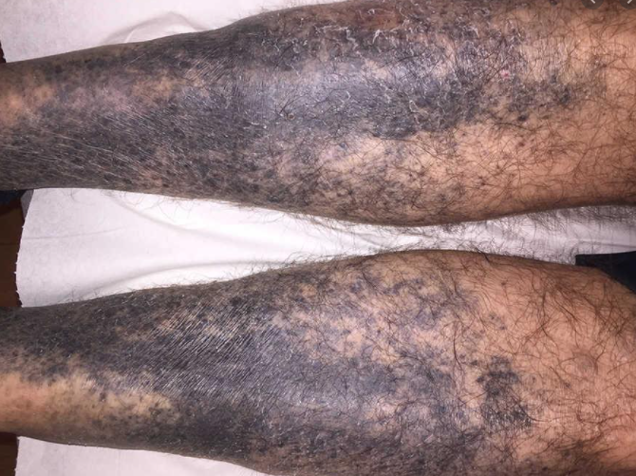
Case — Andrew J Armstrong, MD, ScM
About 2-3 months into therapy, a hyperpigmented rash develops in his lower extremities, sparing palms/soles and rest of his body
Rash is a little bit itchy, painless, somewhat
nodular/bumpy and is largely covered by
his socks
He continues to be active, otherwise
tolerating ADT/apalutamide well with
only mild fatigue, hot flushes, and is
active working
PSA has dropped to undetectable

Slide 12
Discussion
Case — Andrew J Armstrong, MD, ScM
Rash is observed occasionally with novel AR inhibitor use in the nmCRPC setting ranging from 2-30%, particularly with apalutamide (24% risk, grade 3-4 in 5%),
2-3% of whom had to stop therapy due to rash, 6-7% required dose holds or reductions due to rash
Similar results recently
reported in TITAN (mHSPC
setting) with apalutamide
Chi K et al JCO 2021

Slide 13
Skin Rash with Apalutamide
Case — Andrew J Armstrong, MD, ScM
Most commonly macular or maculo-papular
Grade 3 rash by definition covers >30% of body surface area and is reported in 5.5% of men treated with apalutamide, vs 0.3% with placebo
Therapies used in the trial with success included topical steroids, oral anti-histamines, oral steroids, drug holds, and dose reductions
Median time to onset is 82 days, and 80% of patients with rash saw resolution within 2 months
This patient was having a great response, and thus we dose reduced the apalutamide after a 3-week hold. Rash stabilized, regressed, and did not further progress with resumption of apalutamide at 180 mg daily
Hyperpigmentation remained under his socks but did not cause any symptoms

Slide 14
Case — Alan H Bryce, MD
February Year 1: 71 yo otherwise healthy male with a rising PSA to 5.0. Biopsy shows G 4 + 3 prostate cancer
April Year 1: RARP. G 4 + 3, T3 N0 M0. Nadir PSA <0.1
February Year 2: PSA 0.6, begin ADT x 12 months
July Year 2: Complete salvage radiation therapy

Slide 15
Case — Alan H Bryce, MD
January Year 3: PSA 0.5. Testosterone <7.0.
April Year 3: PSA 1.2. Choline PET-CT with uptake in a left iliac node, 1.7cm. Begin Apalutamide
June Year 3: PSA 0.8. Patient intolerant of Apalutamide due to fatigue
July Year 3: Begin Darolutamide
May Year 5: PSA <0.1, ECOG 0. Continue on Darolutamide

Slide 16
Overall Survival: Darolutamide, Enzalutamide, Apalutamide
 | ARAMIS¹ | PROSPER² | SPARTAN³
Antiandrogen | Darolutamide | Enzalutamide | Apalutamide
Median follow-up | 49 mo | 47 mo | 52 mo
Median OS | Not estimated | 57 vs 56 mo | 74 vs 60 mo
OS hazard ratio | 0.69 (p = 0.003) | 0.73 (p = 0.001) | 0.78 (p = 0.0161)
¹ Fizazi K et al; ARAMIS Investigators. N Engl J Med 2020;383:1040-9.
² Sternberg CN et al; PROSPER Investigators. N Engl J Med 2020;382(23):2197-206.
³ Smith MR et al; SPARTAN Investigators. Eur Urol 2021;79(1):150-158.

Slide 17
Comparison of Toxicities: Darolutamide, Enzalutamide or
Apalutamide for Nonmetastatic CRPC
Toxicity | ARAMIS |  | PROSPER |  | SPARTAN
 | Darolutamide | Placebo | Enzalutamide | Placebo | Apalutamide | Placebo
Fatigue/asthenia | 16% | 11% | 33% | 14% | 30% | 21%
Falling | 4% | 5% | 11% | 4% | 16% | 9%
Dizziness | 5% | 4% | 10% | 4% | 9% | 6%
Mental impairment | 1% | 2% | 5% | 2% | 5% | 3%
Sternberg CN et al; PROSPER Investigators. N Engl J Med 2020;382(23):2197-206.
Fizazi K et al; ARAMIS Investigators. N Engl J Med 2020;383:1040-9.
Small EJ et al; SPARTAN Investigators. ASCO 2020;Abstract 5516.

Slide 18
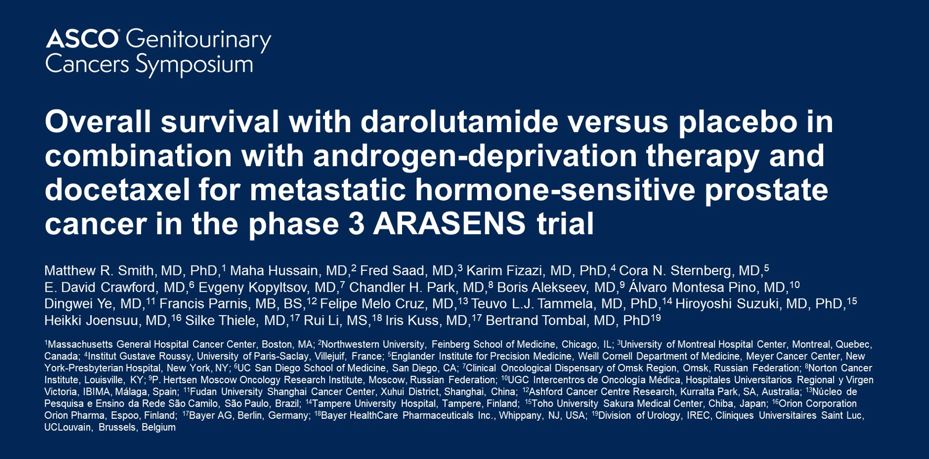
2022;Abstract 13

Slide 19
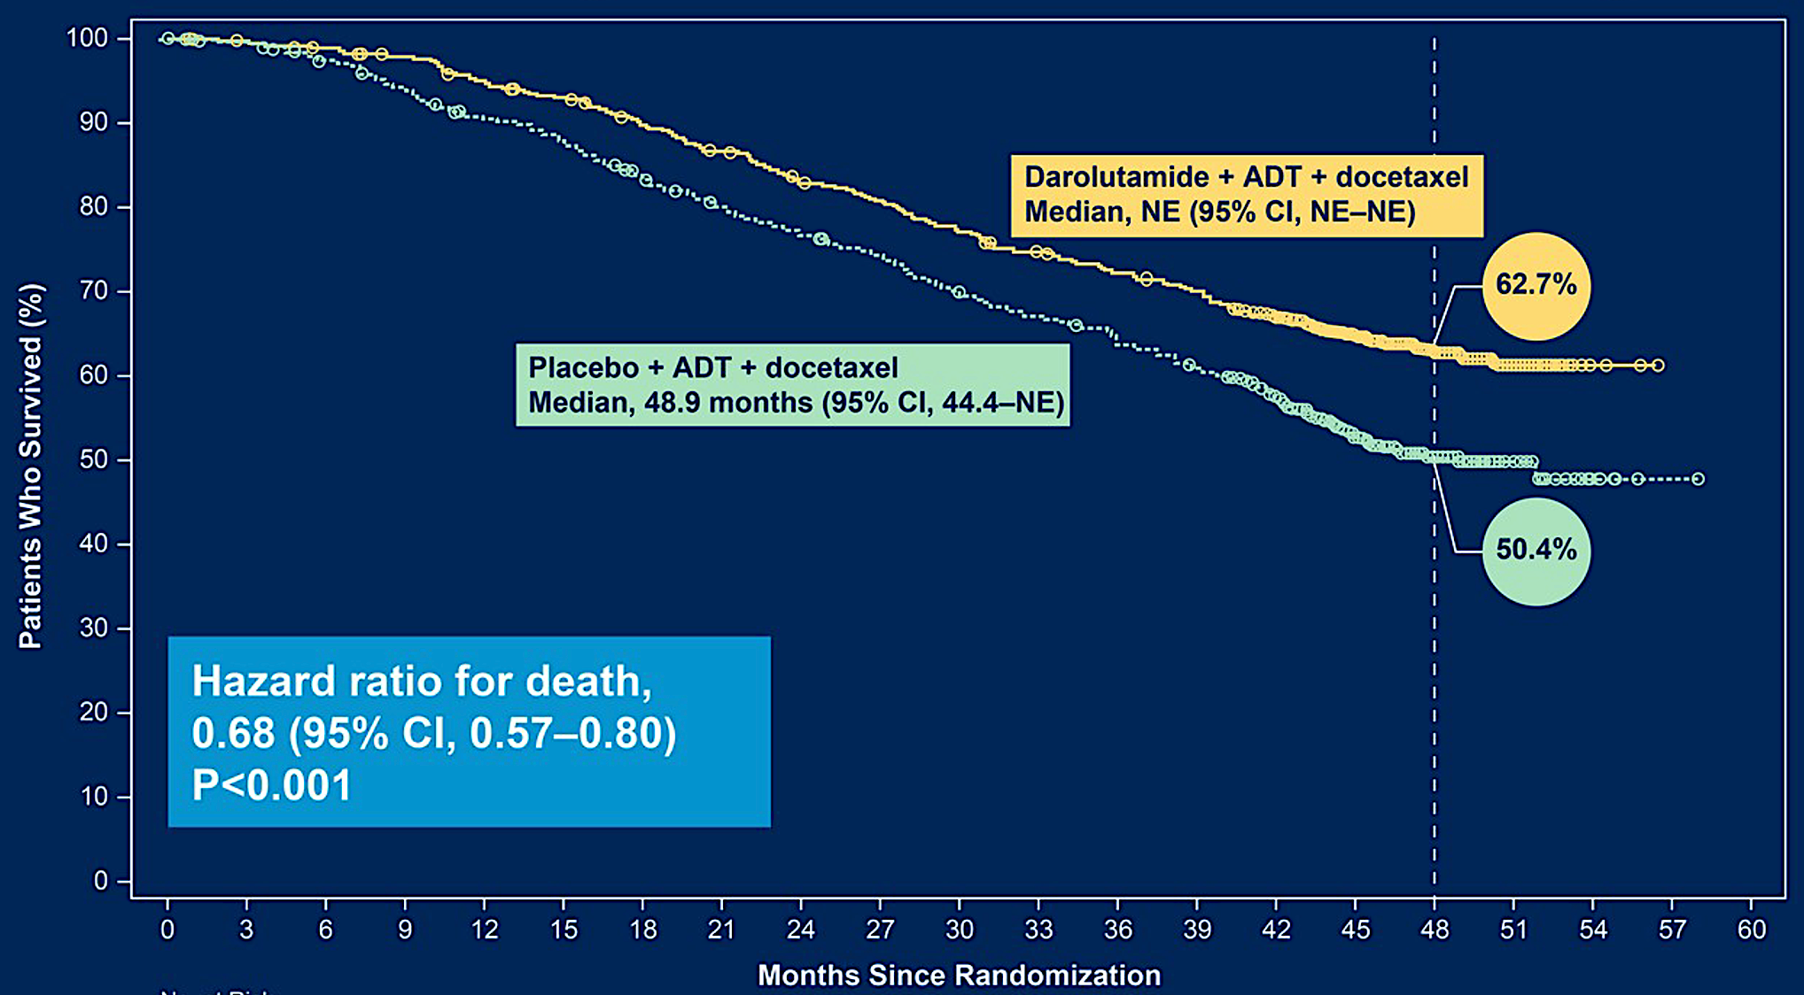
ARASENS: Primary Endpoint — Overall Survival
Smith MR et al. Genitourinary Cancers Symposium 2022;Abstract 13.

Slide 20
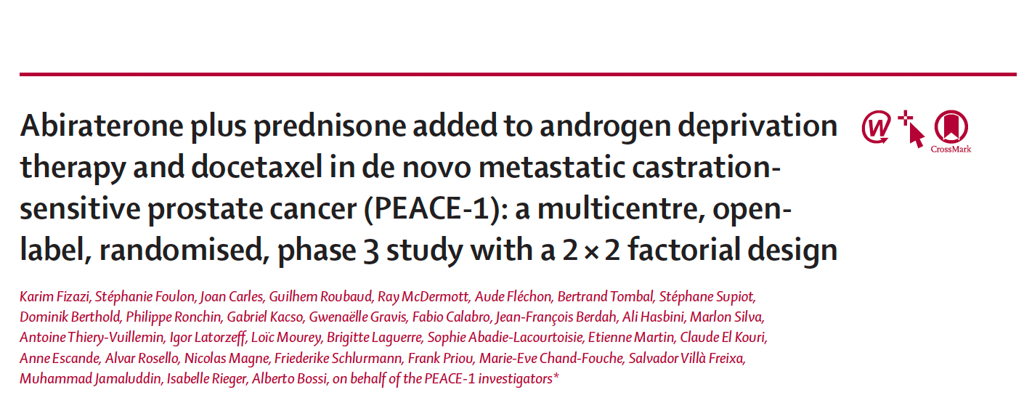
Lancet 2022;399:1695-07.

Slide 21
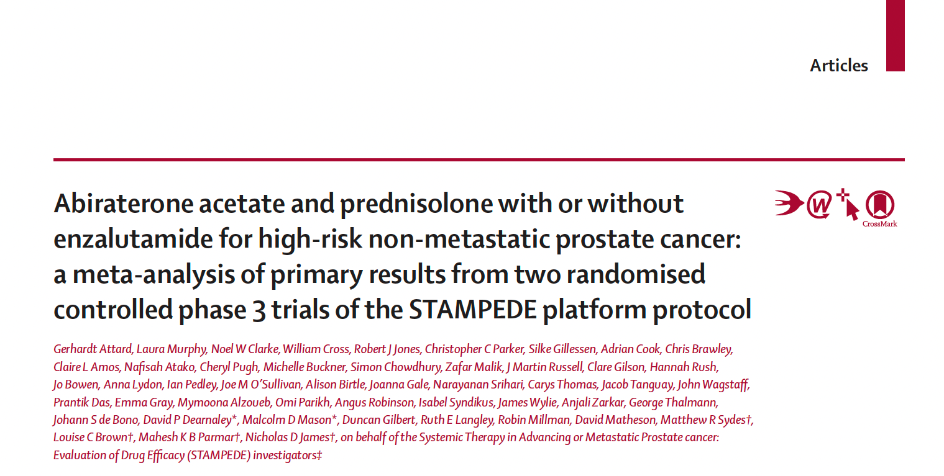
Lancet 2022;399(10323):447-60

Slide 22
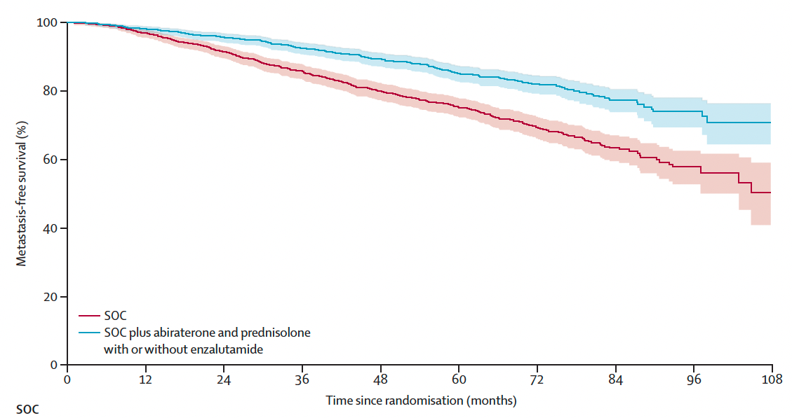
STAMPEDE Primary Endpoint: Metastasis-Free Survival
(Pooled Analysis)
Trial | N | MFS HR
Abiraterone + prednisone trial | 988 | 0.54
Abiraterone + prednisone + enzalutamide trial | 986 | 0.53
Overall | 1974 | 0.53
Attard G et al. Lancet 2022;399(10323):447-60.

Slide 23
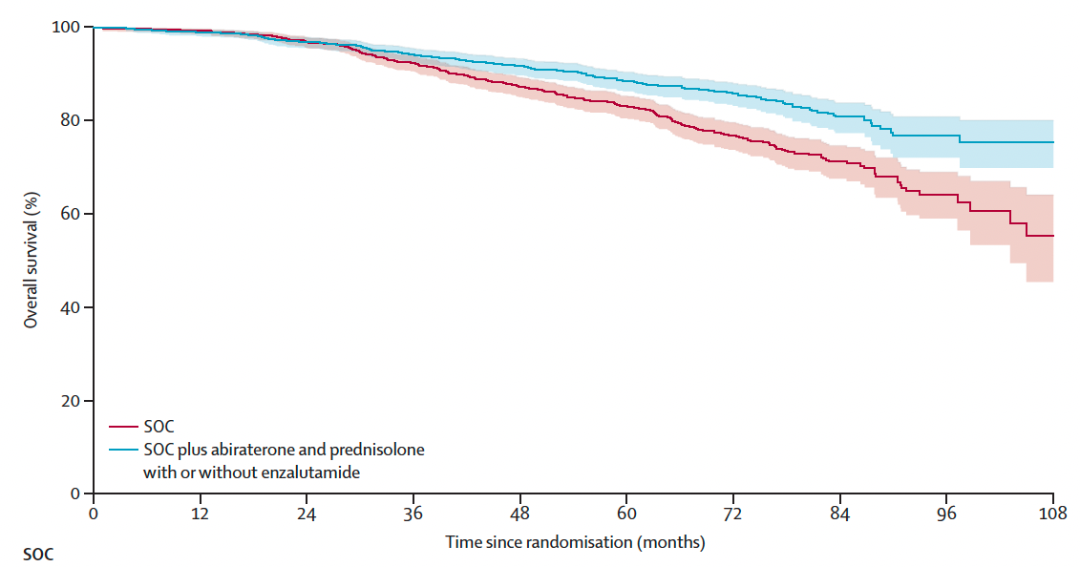
STAMPEDE: Overall Survival (Pooled Analysis)
Trial | N | OS HR
Abiraterone + prednisone trial | 988 | 0.63
Abiraterone + prednisone + enzalutamide trial | 986 | 0.54
Overall | 1974 | 0.60
Attard G et al. Lancet 2022;399(10323):447-60.

Slide 24
Agenda
Module 1 – Optimal Application of Hormonal Therapy in Prostate Cancer Management
Module 2 – Selection and Sequencing of Therapy for Patients with Metastatic Castration-Resistant Prostate Cancer (mCRPC); Novel Investigational Strategies
Module 3 – Current and Potential Role of PARP Inhibitors in the Management of Prostate Cancer

Slide 25
Case — Alicia K Morgans, MD, MPH
This patient is a 71 yo man with a history of CAD with prior MI and advanced
prostate cancer diagnosed 8 years ago.
Diagnosed after PSA 9.7 ng/mL at annual physical, and underwent prostatectomy.
  Gleason 4 + 4 (GG 4) prostate adenocarcinoma, pT3aN0, post-op PSA undetectable
In 18 months, PSA increased to 4.7 ng/mL (testosterone level WNL).
  Conventional imaging with bone metastases in multiple vertebral bodies, left 7th rib
Started ADT + abiraterone acetate for mHSPC, PSA nadir 0.05 ng/mL.
11 months later, PSA 6.8 ng/mL. Repeat imaging with bone scan and CT performed.

Slide 26
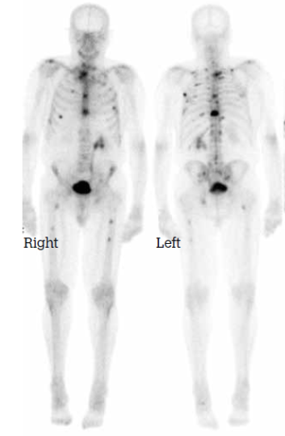
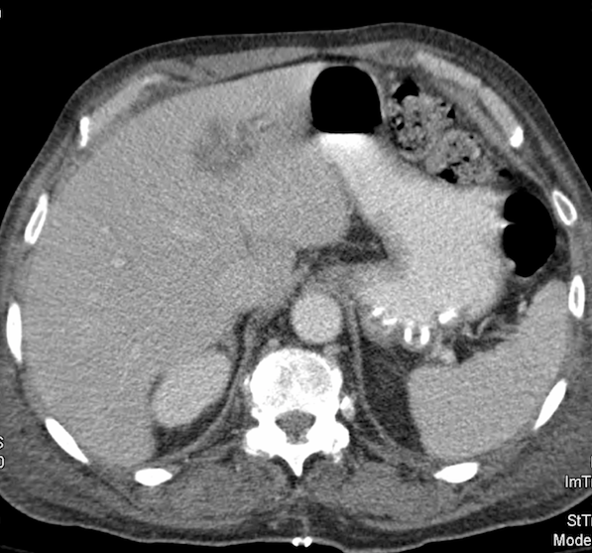
Imaging
Case — Alicia K Morgans, MD, MPH
New liver lesions and progression of bone metastases

Slide 27
Case — Alicia K Morgans, MD, MPH
This patient was treated with 10 cycles of docetaxel, and had improvement of
mid-back pain and decrease in PSA (nadir 1.8 ng/mL).
Tolerated well with mild fatigue and mild neuropathy in fingers.
CBC after completing treatment with mild anemia (Hgb 11.2), otherwise no cytopenias.
3 months after completing docetaxel, he presents with fatigue but otherwise remains active.
  Labs demonstrate PSA 37.3 ng/mL
  CT and bone scan were performed

Slide 28
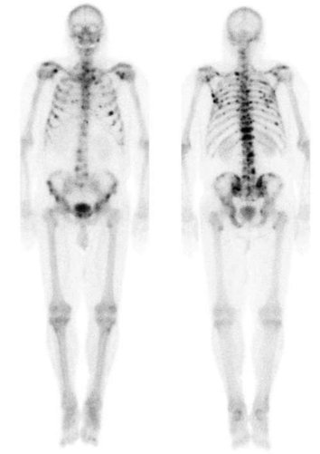
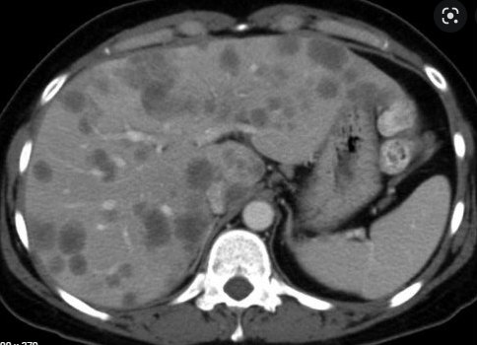
Imaging
Case — Alicia K Morgans, MD, MPH
Increased liver lesions and progression of bone metastases

Slide 29
Case — Alicia K Morgans, MD, MPH
What options for treatment could be considered at this point?

Slide 30
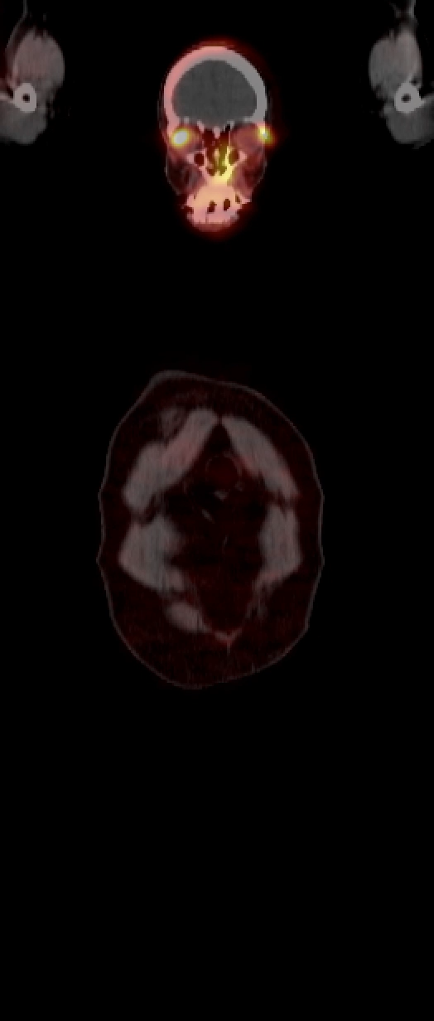
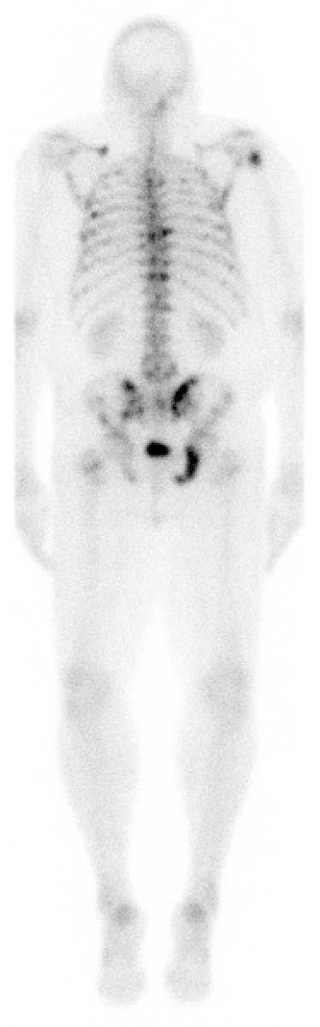
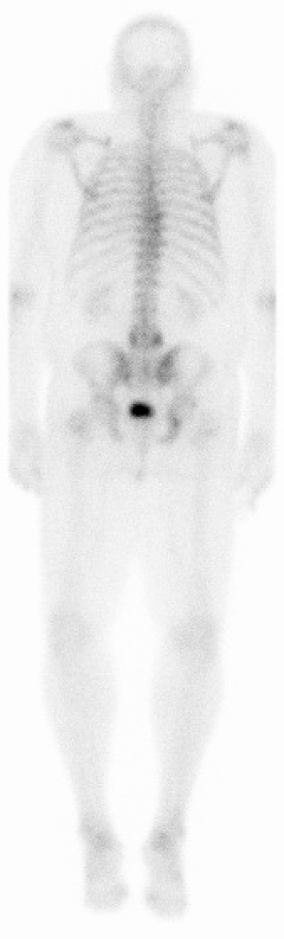
Case — Andrew J Armstrong, MD, ScM
68 yo AAM with high volume mCRPC, no soft tissue metastases.
Progressed despite prior docetaxel/ADT for mHSPC and enzalutamide for mCRPC.
PSADT is rapid, with bone only metastases.
¹⁷⁷Lu-PSMA
6 x 200mCi q6 wk
PSMA-PET/CT
Treatment included ADT and a short course of abiraterone but abi stopped due to intolerance and PSA rise prior to ¹⁷⁷Lu-PSMA-617 initiation. Anemia due to bone metastases improved after 2-3 doses.

Slide 31
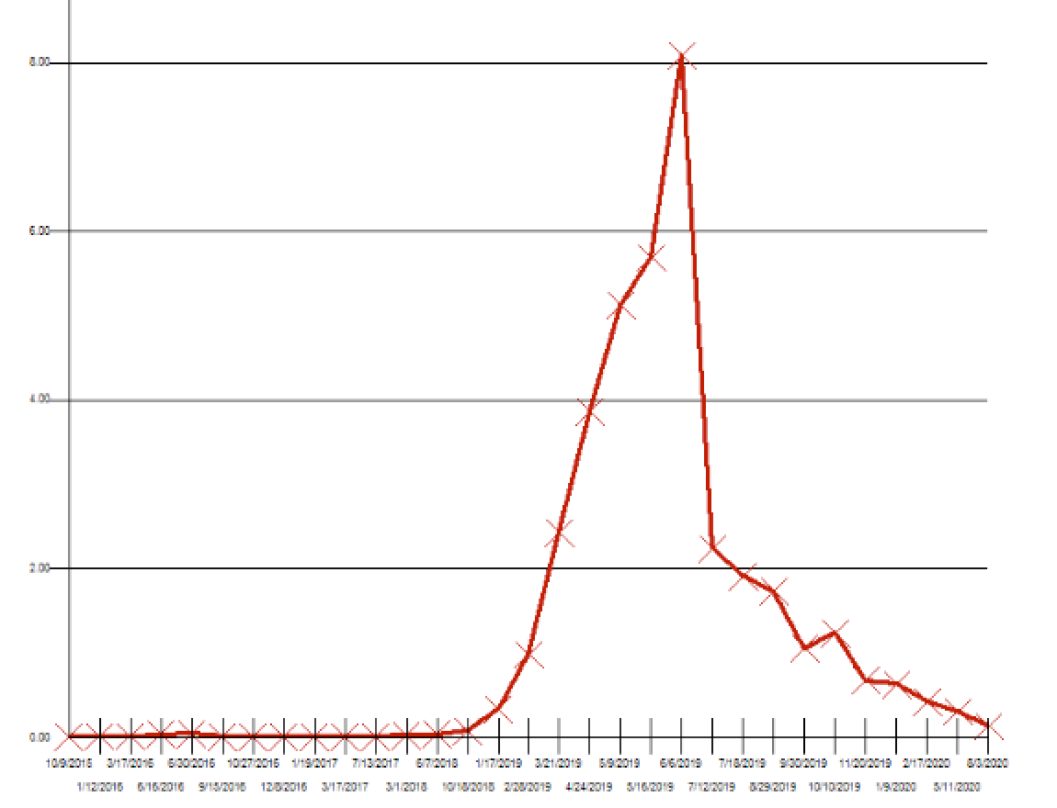
Case — Andrew J Armstrong, MD, ScM
800
809
¹⁷⁷Lu-PSMA
6 x 200mCi q6 wk
Patient remains active and working, asymptomatic from his prostate cancer, with a high QOL, now off therapy other than ADT for 8 months
CT/BS show ongoing response without progression
600
400
200
224
PSA (ng/mL)
63
13

Slide 32
Case — Andrew J Armstrong, MD, ScM
After 3 cycles of ¹⁷⁷Lu-PSMA-617, the patient’s bone pain and anemia resolved. He did experience mild fatigue but was able to return full time to work in the legal profession
Bone scan and CT revealed a complete remission by imaging that lasted for 12 months
PSA rose subsequently with reappearance of high volume bone metastases and recurrence of fatigue, weight loss, and bone pain
He was subsequently treated with cabazitaxel and responded well to therapy with an ongoing PSA decline and improvement in symptoms

Slide 33
Case — Andrew J Armstrong, MD, ScM
What predisposes to extraordinary responses to ¹⁷⁷Lu-PSMA-617?
  PSMA uptake, lack of PSMA heterogeneity
  Lack of genomic alterations associated with lineage plasticity and NEPC (TP53, RB1, PTEN)?
Patient’s PSA is now back up to 600 with new bone metastases. PSMA PET is brightly positive still about 18 months after completing 6 doses of ¹⁷⁷Lu-PSMA-617 which he tolerated well and he had returned to work full time
How would you treat him now?
  Cabazitaxel vs repeat ¹⁷⁷Lu-PSMA-617?

Slide 34
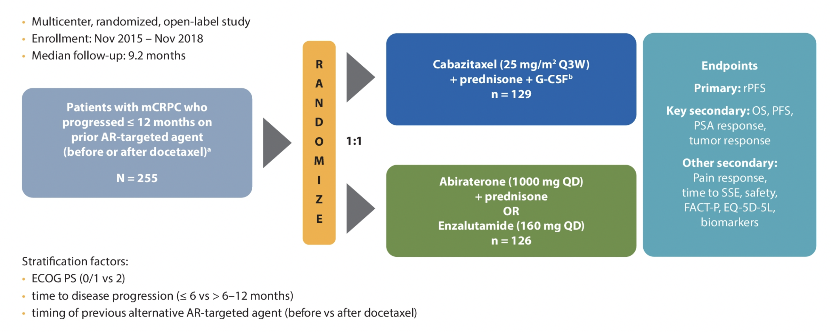
CARD Study Design
Tombal B et al. ASCO 2020;Abstract 5569.

Slide 35
FDA Approves ¹⁷⁷Lu-PSMA-617 for mCRPC
Press Release: March 23, 2022
On March 23, 2022, the Food and Drug Administration approved the radioligand therapy
¹⁷⁷Lu-PSMA-617 for the treatment of prostate-specific membrane antigen (PSMA)-positive metastatic castration-resistant prostate cancer (mCRPC) in adult patients who have received treatment with androgen receptor pathway inhibition and taxane-based chemotherapy.
On the same day, the FDA approved gallium Ga 68 gozetotide, a radioactive diagnostic agent for positron emission tomography (PET) of PSMA-positive lesions, including selection of patients with metastatic prostate cancer for whom ¹⁷⁷Lu-PSMA-617 PSMA-directed therapy is indicated. Gallium Ga 68 gozetotide is the first radioactive diagnostic agent approved for patient selection for a radioligand therapeutic agent.
Efficacy was evaluated in the Phase III VISION trial, which demonstrated a statistically significant improvement in the primary endpoints OS and radiographic progression-free survival. Hazard ratio (HR) for OS was 0.62 (95% CI: 0.52-0.74; p < 0.001) for the comparison of ¹⁷⁷Lu-PSMA-617 with best standard care (BSoC) to BSoC. Median OS was 15.3 months (95% CI: 14.2-16.9) on the ¹⁷⁷Lu-PSMA-617 with BSoC arm and 11.3 months (95% CI: 9.8, 13.5) on the BSoC arm.
https://www.fda.gov/drugs/resources-information-approved-drugs/fda-approves-pluvicto-metastatic-castration-resistant-prostate-cancer

Slide 36
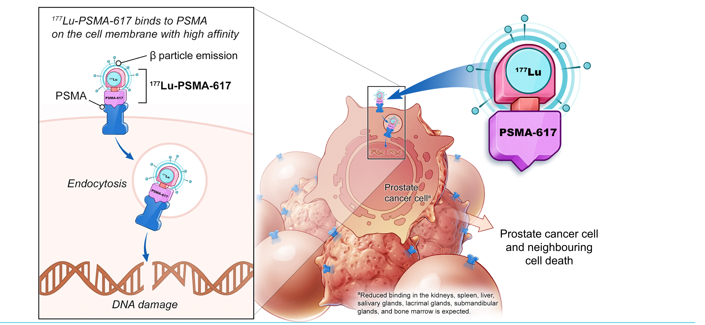
177Lu-PSMA-617 targeted radioligand therapy<br />
¹⁷⁷Lu-PSMA-617: Mechanism of Action
TARGETED TO PSMA
Morris MJ et al. ASCO 2021;Abstract LBA4.

Slide 37
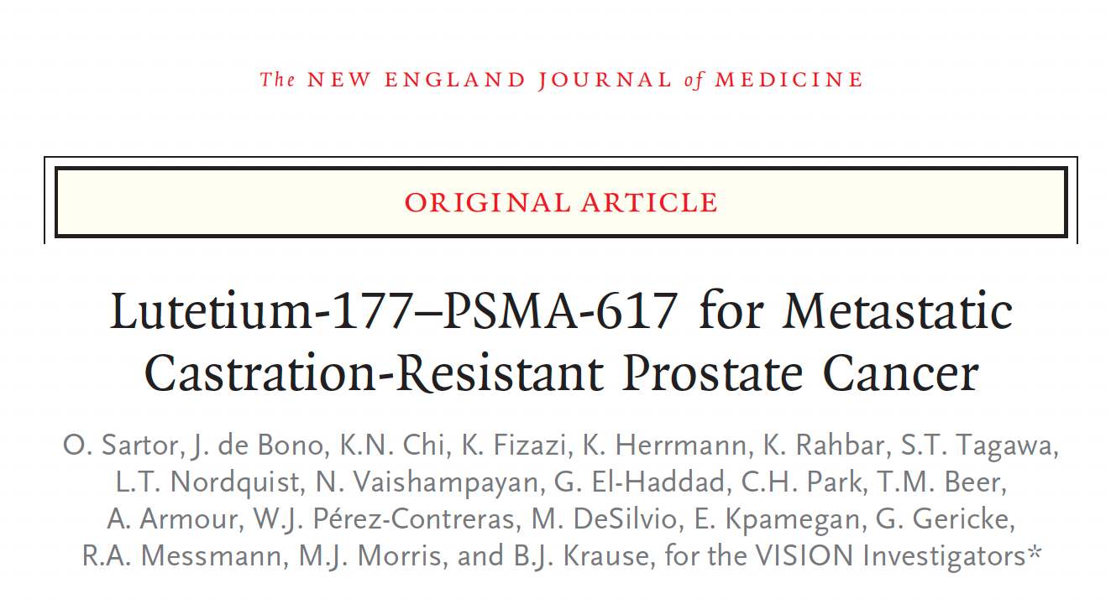
N Engl J Med 2021;385:1091-103

Slide 38
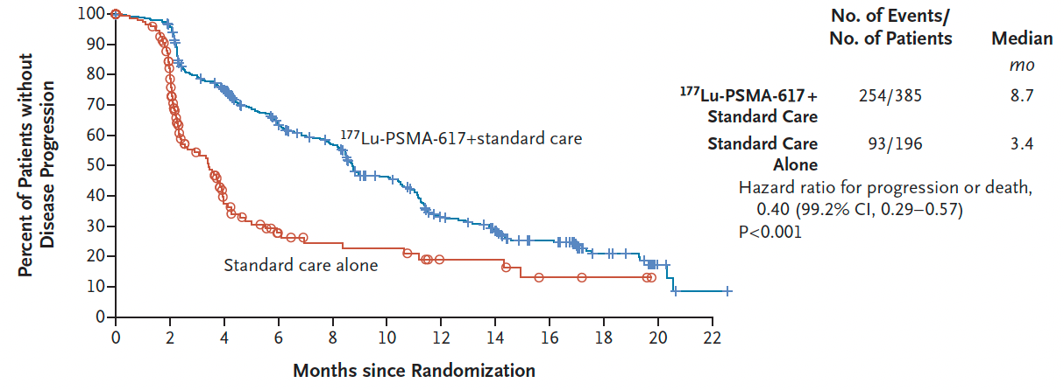
VISION: Efficacy Summary
Imaging–based progression-free survival
Median OS (¹⁷⁷Lu-PSMA-617 vs standard therapy): 15.3 mo vs 11.3 mo (HR 0.62, p < 0.001)
Time to first symptomatic skeletal event (¹⁷⁷Lu-PSMA-617 vs standard therapy): 11.5 mo vs 6.8 mo (HR 0.50, p < 0.001)
Sartor O et al. N Engl J Med 2021;385:1091-103.

Slide 39
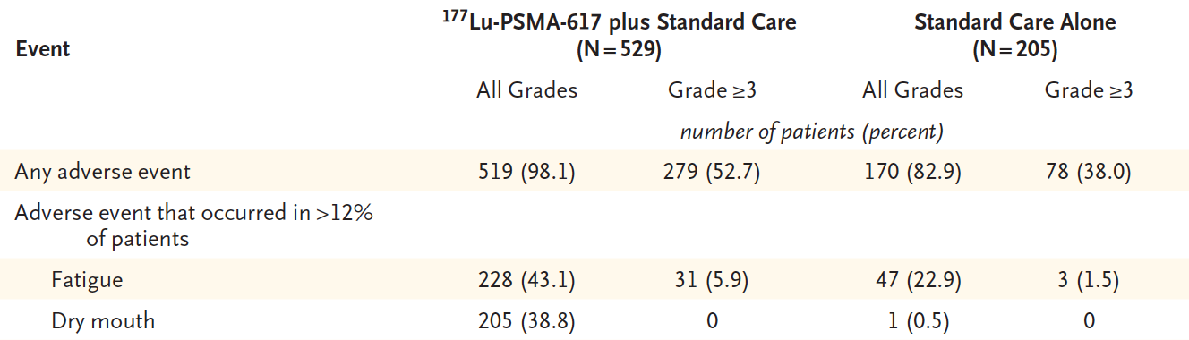
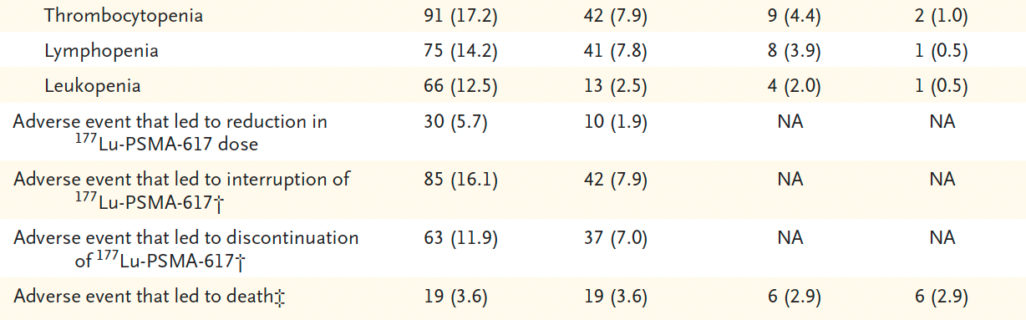
VISION: Selected Adverse Events
Sartor O et al. N Engl J Med 2021;385:1091-103.

Slide 40
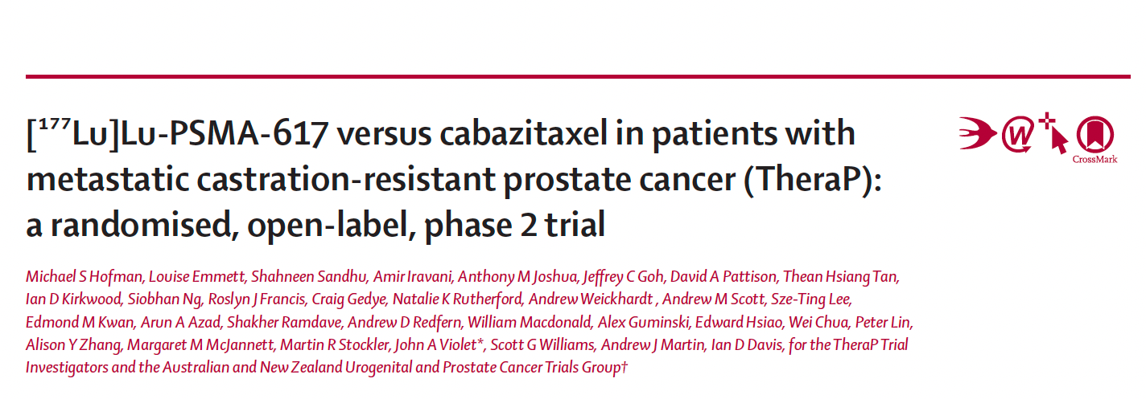
Lancet 2021;397:797-804.

Slide 41
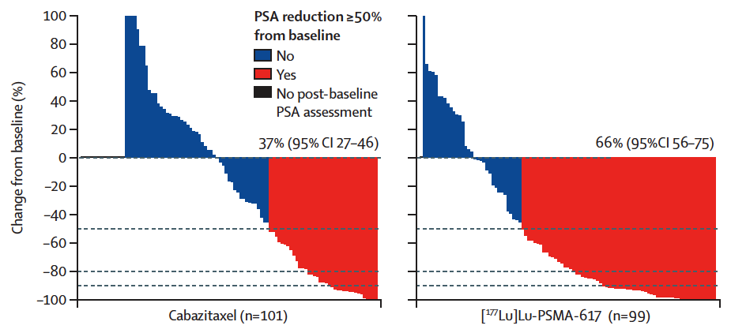
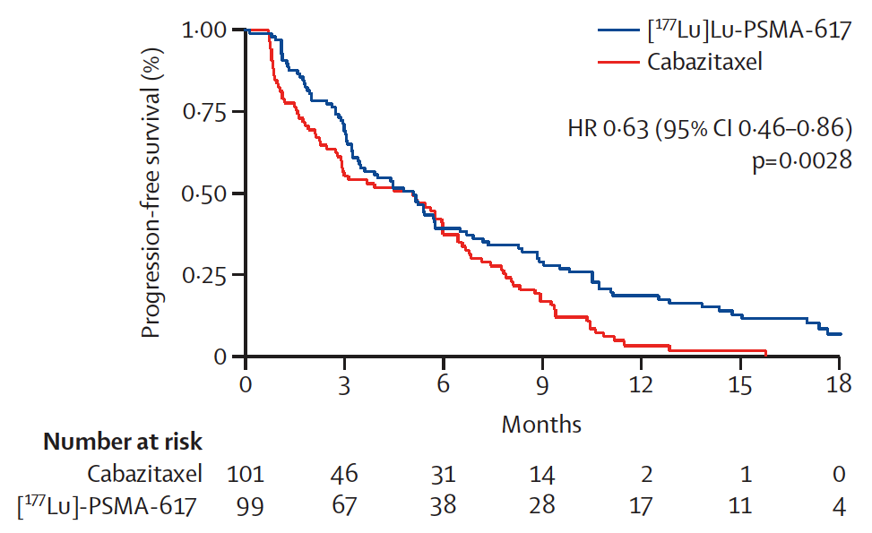
TheraP ANZUP 1603: ¹⁷⁷Lu-PSMA-617 versus Cabazitaxel for mCRPC
PSA Response and Progression-Free Survival
PSA response
Radiographic or PSA progression-free survival
Hofman MS et al. Genitourinary Cancers Symposium 2021;Abstract 6;
Hofman MS et al. Lancet 2021;397(10276):797-804.

Slide 42
TheraP: ¹⁷⁷Lu-PSMA-617 (LuPSMA) versus Cabazitaxel in Metastatic Castration-Resistant Prostate Cancer (mCRPC) Progressing After Docetaxel—Overall Survival After Median Follow-Up of 3 Years (ANZUP 1603)
Hofman MS et al.
ASCO 2022;Abstract 5000.
Track: Genitourinary Cancer – Prostate, Testicular, and Penile
June 5, 2022, 9:00 AM

Slide 43
[¹⁷⁷Lu]Lu-PSMA-617 in PSMA-Positive Metastatic Castration-Resistant Prostate Cancer: Prior and Concomitant Treatment Subgroup Analyses of the VISION Trial
Vaishampayan N et al.
ASCO 2022;Abstract 5001.
Track: Genitourinary Cancer – Prostate, Testicular, and Penile
June 5, 2022, 9:00 AM

Slide 44
[⁶⁸Ga]Ga-PSMA-11 PET Baseline Imaging as a Prognostic Tool for Clinical Outcomes to [¹⁷⁷Lu]Lu-PSMA-617 in Patients with mCRPC: A VISION Substudy
Kuo P et al.
ASCO 2022;Abstract 5002.
Track: Genitourinary Cancer – Prostate, Testicular, and Penile
June 5, 2022, 9:00 AM

Slide 45
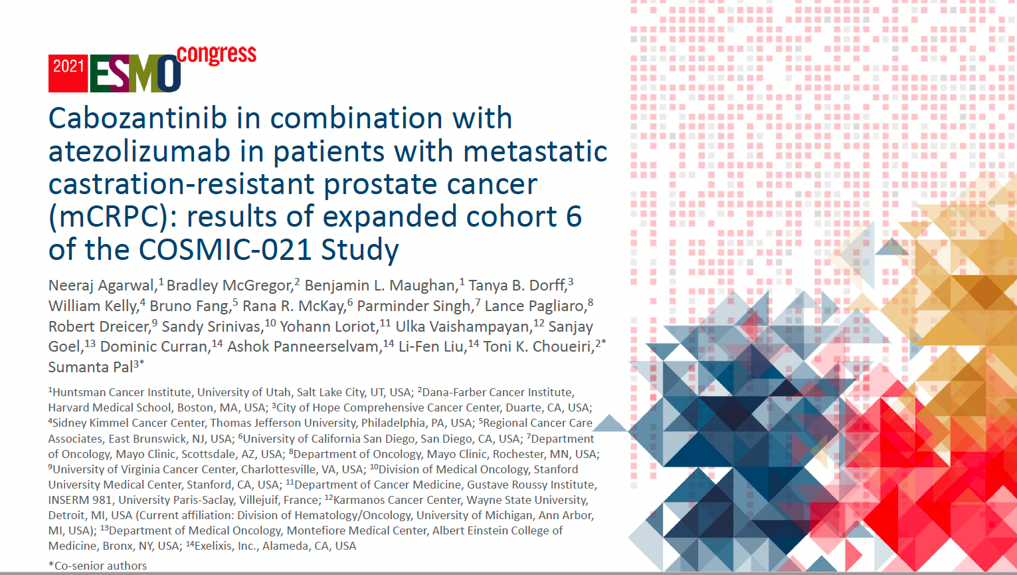
Abstract LBA24

Slide 46
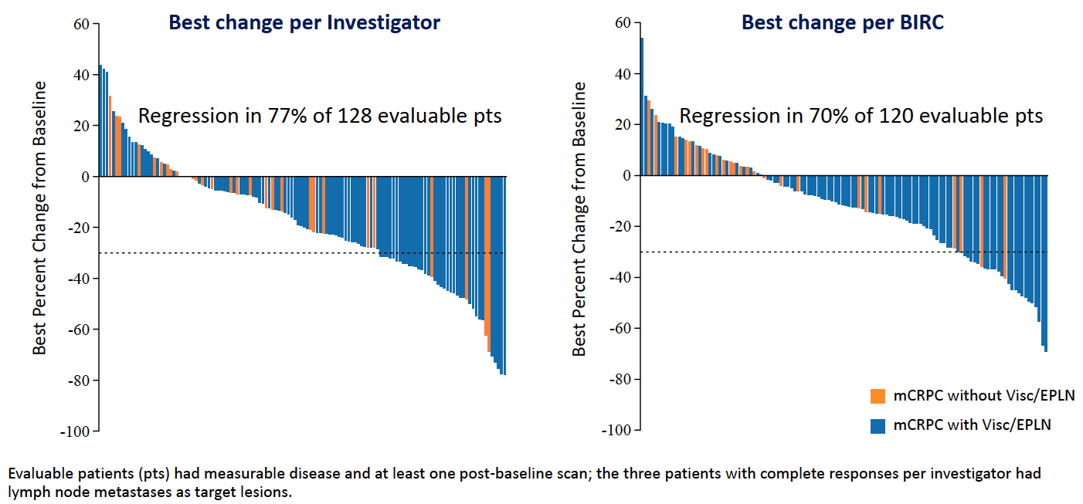
COSMIC-021: Cabozantinib/Atezolizumab for mCRPC
Best Change from Baseline in Sum of Target Lesions
BIRC = blinded independent review committee; EPLN = extrapelvic lymph nodes
Agarwal N et al. ESMO 2021;Abstract LBA24.

Slide 47
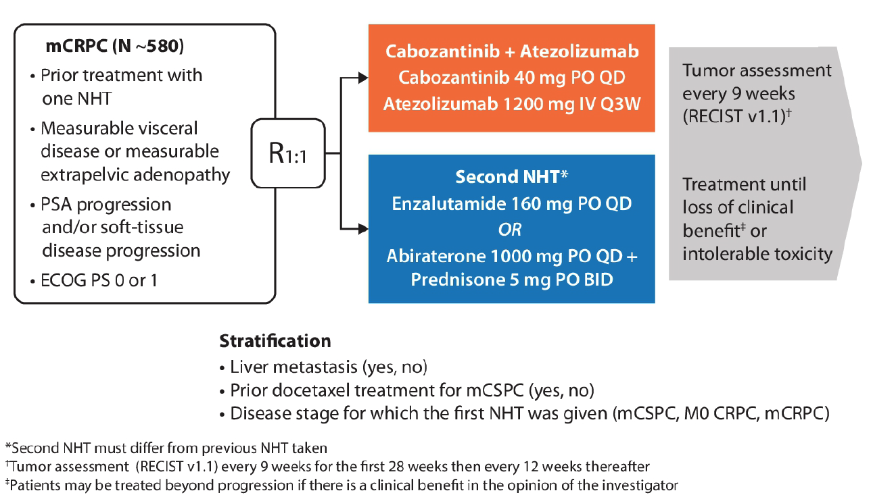
CONTACT-02: Phase III Trial Schema
Primary Endpoints
PFS per RECIST v1.1 by BIRC
OS
Secondary Endpoint
ORR per RECIST v1.1 by BIRC
NHT = novel hormone therapy
Agarwal N et al. Genitourinary Cancers Symposium 2021;Abstract TPS190.

Slide 48
Agenda
Module 1 – Optimal Application of Hormonal Therapy in Prostate Cancer Management
Module 2 – Selection and Sequencing of Therapy for Patients with Metastatic Castration-Resistant Prostate Cancer (mCRPC); Novel Investigational Strategies
Module 3 – Current and Potential Role of PARP Inhibitors in the Management of Prostate Cancer

Slide 49
Case — Alicia K Morgans, MD, MPH
This patient is a 69-year-old gentleman with a history of HTN, and localized prostate cancer diagnosed in 6/2013
  Underwent radical prostatectomy in 9/2015, with PSA 11.3 ng/mL at diagnosis
  Pathology was pT3aN0M0, Gleason 5 + 5 (Grade Group 5) prostate adenocarcinoma
8/2019 presents with 6-month history of progressive fatigue, new and worsening lower back pain, decreased appetite and a 22 lb weight loss
PSA 23.5 ng/mL. CT/bone scan obtained

Slide 50
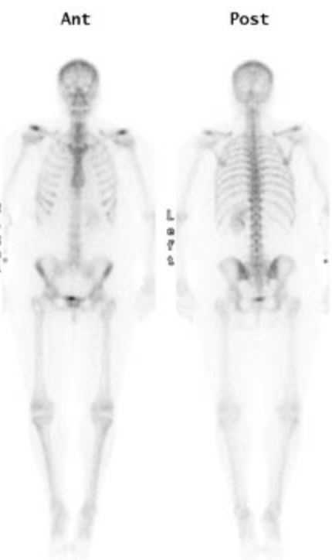
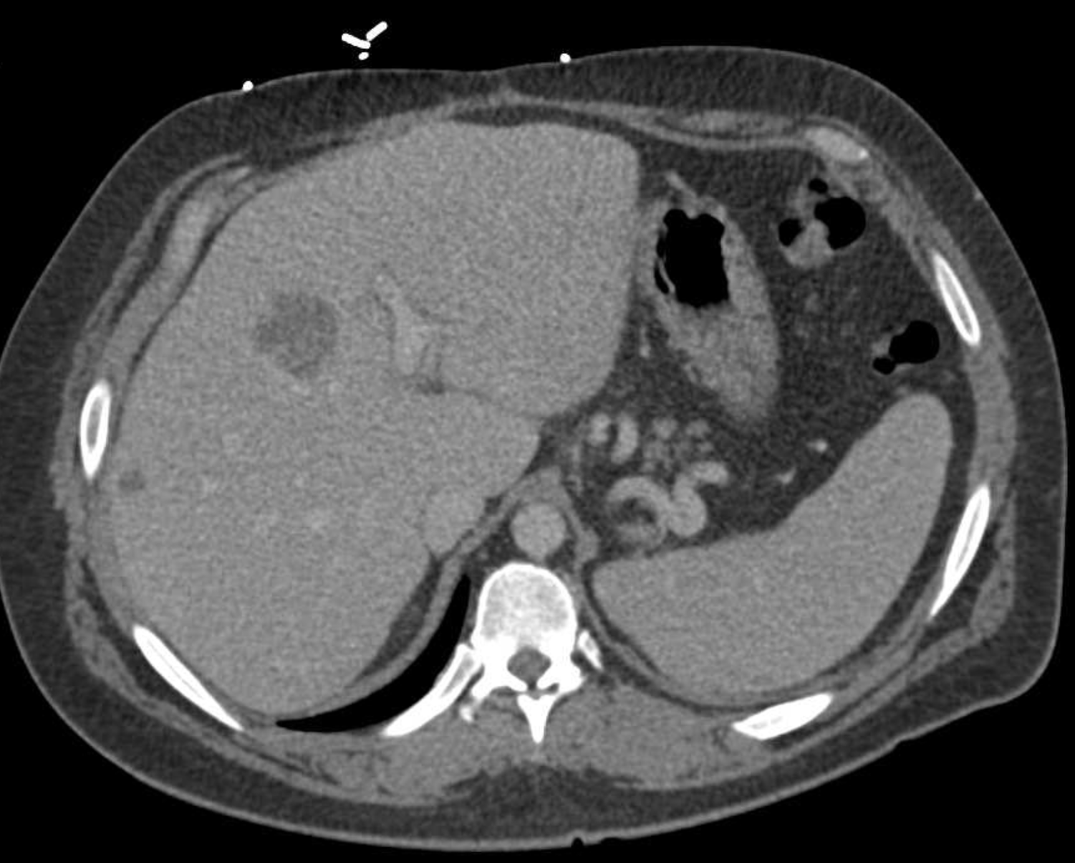
Case — Alicia K Morgans, MD, MPH

Slide 51
Case — Alicia K Morgans, MD, MPH
Diagnosed with mHSPC in liver and with retroperitoneal adenopathy.
Initiated treatment with docetaxel x 6 cycles.
Tolerated treatment well with disease response for 9 months (PSA nadir 1.7 ng/mL), then PSA increased to 4.3 ng/mL in 6/2020. Patient noted increase in lower back pain.
CT abd/pelvis and bone scan repeated.

Slide 52
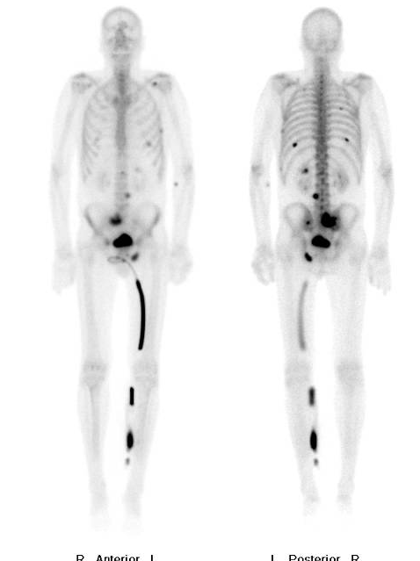
Case — Alicia K Morgans, MD, MPH

Slide 53
Case — Alicia K Morgans, MD, MPH
Liver lesions stable, progression of disease retroperitoneal lymph nodes and bone.
What do you consider next in terms of workup and potential treatment?

Slide 54
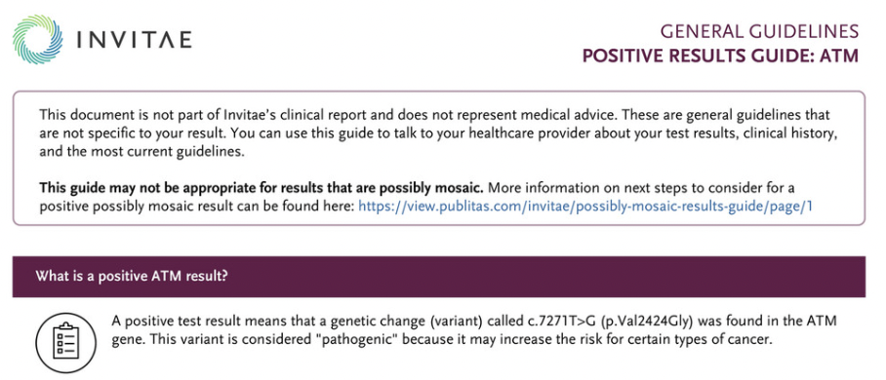
Case — Alicia K Morgans, MD, MPH
Patient undergoes germline DNA testing that identifies an ATM mutation.

Slide 55
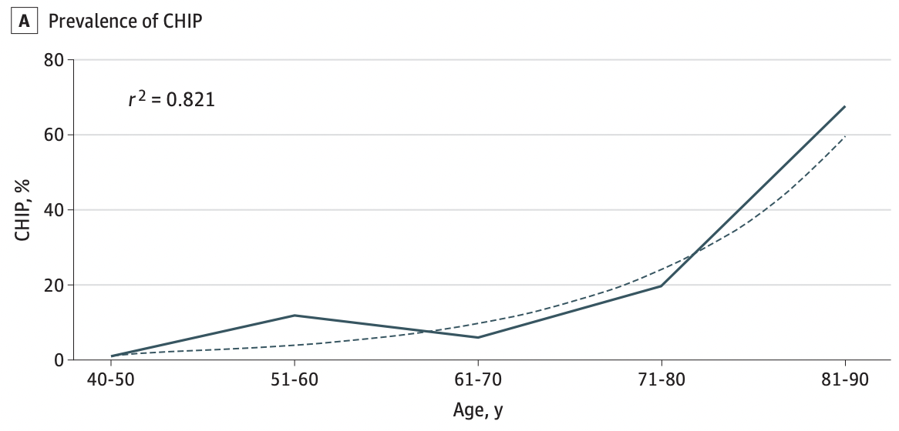
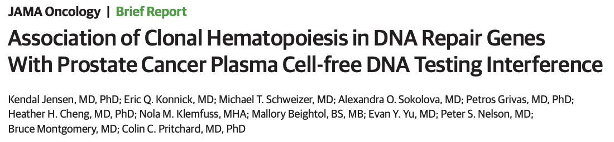
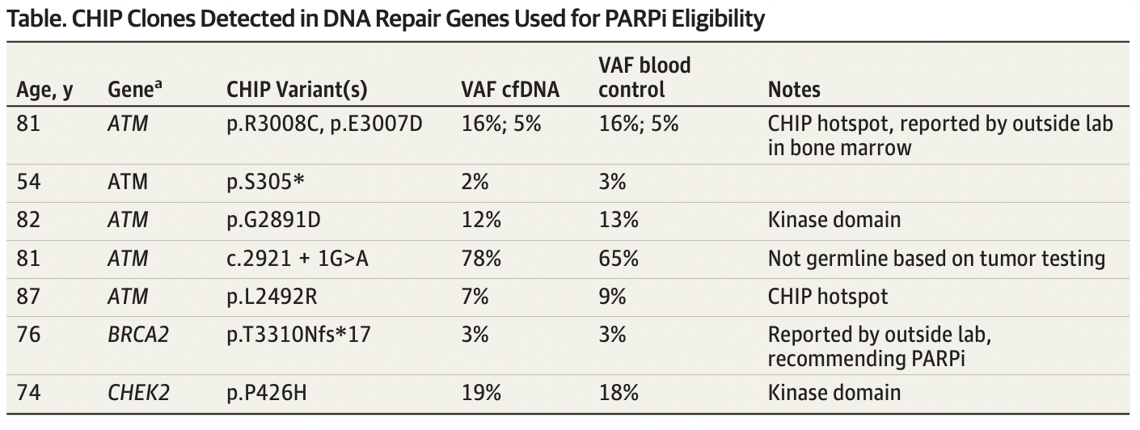
Case — Alicia K Morgans, MD, MPH
ATM and CHIP
Prostate cancer mutations are identified in plasma only.
CHIP can be detected in plasma and whole blood.
Use of a whole blood control can distinguish between these.
Jensen K, et al. JAMA Oncol, 2021.

Slide 56
Case — Alicia K Morgans, MD, MPH
Patient initiates therapy with Olaparib 300 mg PO BID + abiraterone acetate 1000 mg PO daily + prednisone 5 mg PO daily.
He tolerated treatment well after experiencing Grade 1 anorexia/nausea in the first week of treatment. He had inadequately controlled HTN prior to treatment, and his BP meds were adjusted, and his BP improved to the normal range. CBC was monitored closely, and he had a stable anemia (Hgb 10.9).

Slide 57
Managing Side Effects with PARP Inhibitor Combinations
Case — Alicia K Morgans, MD, MPH
Considerations for patient counseling
Considerations for clinical evaluation
  Counsel patients prior to treatment specifically on risk of hematologic and GI AEs, as well as fatigue
  Explain the necessity of regular blood tests for AE monitoring for cytopenias and liver function tests
  Prepare the patient for the possibility of blood transfusions
  Ensure that the patient has first recovered from hematologic toxicity caused by prior anticancer therapies before initiating treatment (if possible)
  Other causes of AEs should be identified, including androgen deprivation therapy
  Common causes of fatigue include ADT, depression, sleep disturbances
  Common causes of anemia include low iron levels in blood, stomach ulcer bleeding, CKD
  Workup should include iron studies, vitamin B12, and folic acid levels to determine whether supplementation is needed
Adverse events appear additive, not synergistic.

Slide 58
Case — Alan H Bryce, MD
1. January Year 1: 67 yo man, screening PSA 6.5. Biopsy demonstrates Gleason 3 + 4 adenocarcinoma
2. April Year 3: PSA 10.3. RARP. Gleason 4 + 3, 2/27 lymph nodes positive. T3a N1 MX. Post-op PSA <0.1. Begin ADT
3. May Year 5: PSA recurrence 0.6. Imaging study showed no evidence of metastatic disease
4. August Year 5: Complete salvage radiation therapy to the prostate bed with 7425 cGy in 30 total fractions
Germline- No pathogenic variants
Somatic- 1) Prostatectomy tissue- KMT2D p.G4603fs, TMB 0.8 m/MB, MSI-S

Slide 59
Case — Alan H Bryce, MD
5. March Year 6: PSA 23. F18 PET-CT showed enlarging retroperitoneal lymphadenopathy
6. May Year 6: Begin sipuleucel T
7. August Year 6: Begin abiraterone acetate PSA 66
8. January Year 8: PSA 24 over nadir of 2.6. Imaging shows new small volume bone metastases. Discontinue abiraterone

Slide 60
Case — Alan H Bryce, MD
9. May Year 8: Begin docetaxel
10. October Year 8: Chemotherapy discontinued after 8 cycles with stable disease. PSA 95.3. Imaging with equivocal progression of bone metastases. Obtain cfDNA
Germline- No pathogenic variants
Somatic- 1) Prostatectomy tissue- KMT2D p.G4603fs, TMB 0.8 m/MB, MSI-S
2) cfDNA testing BRCA2 T3033fs
11. December Year 8: Progression of bone and LN metastases. PSA 163. Begin rucaparib

Slide 61
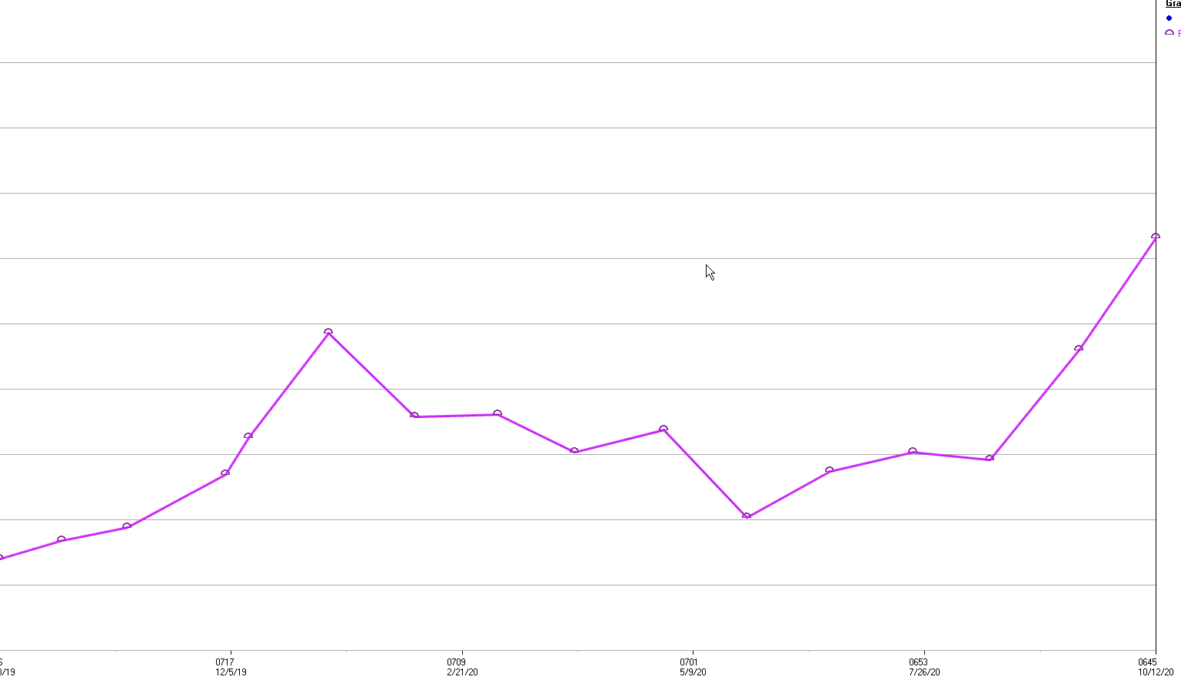
Case — Alan H Bryce, MD
Initial PSA rise 243
PSA 316
Cycle 12
Clinical Progression
PSA 163
Start Rucaparib
December
PSA 102
Cycle 7
11. December Year 8: Progression of bone and LN metastases. PSA 163, initiate rucaparib

Slide 62
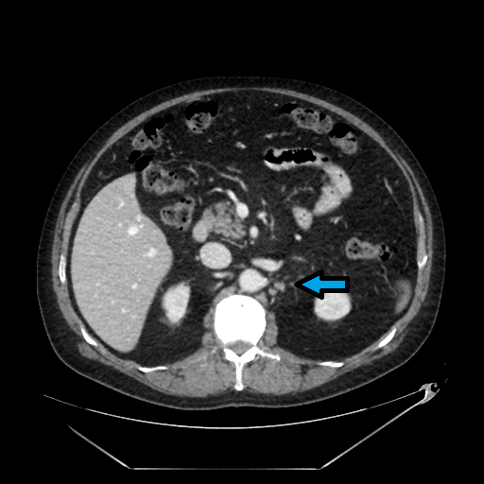
Case — Alan H Bryce, MD
December Year 8
October Year 9

Slide 63
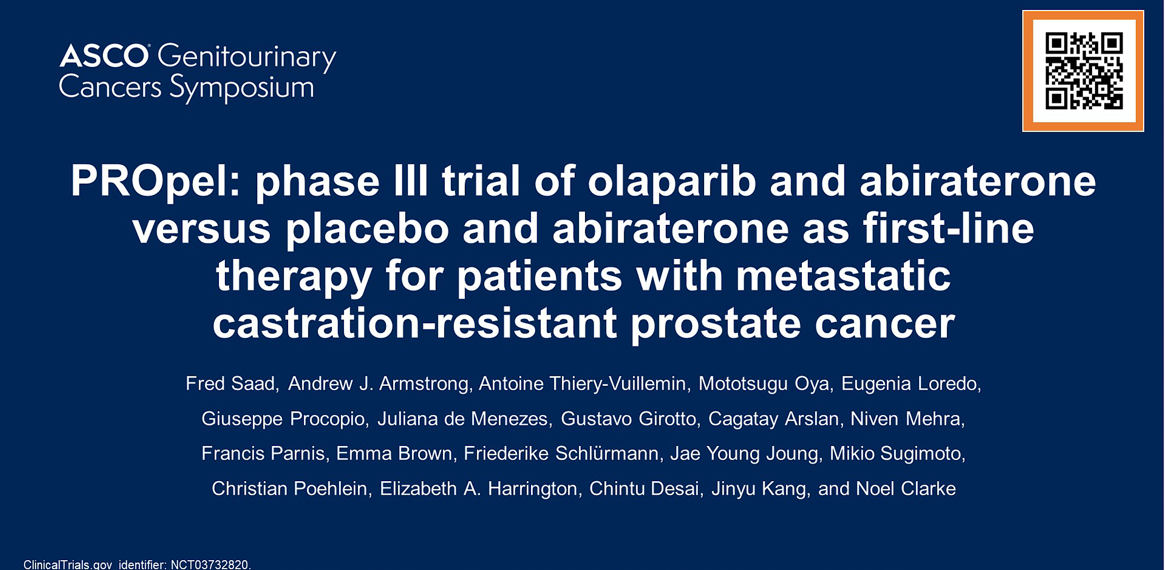
2022;Abstract 11

Slide 64
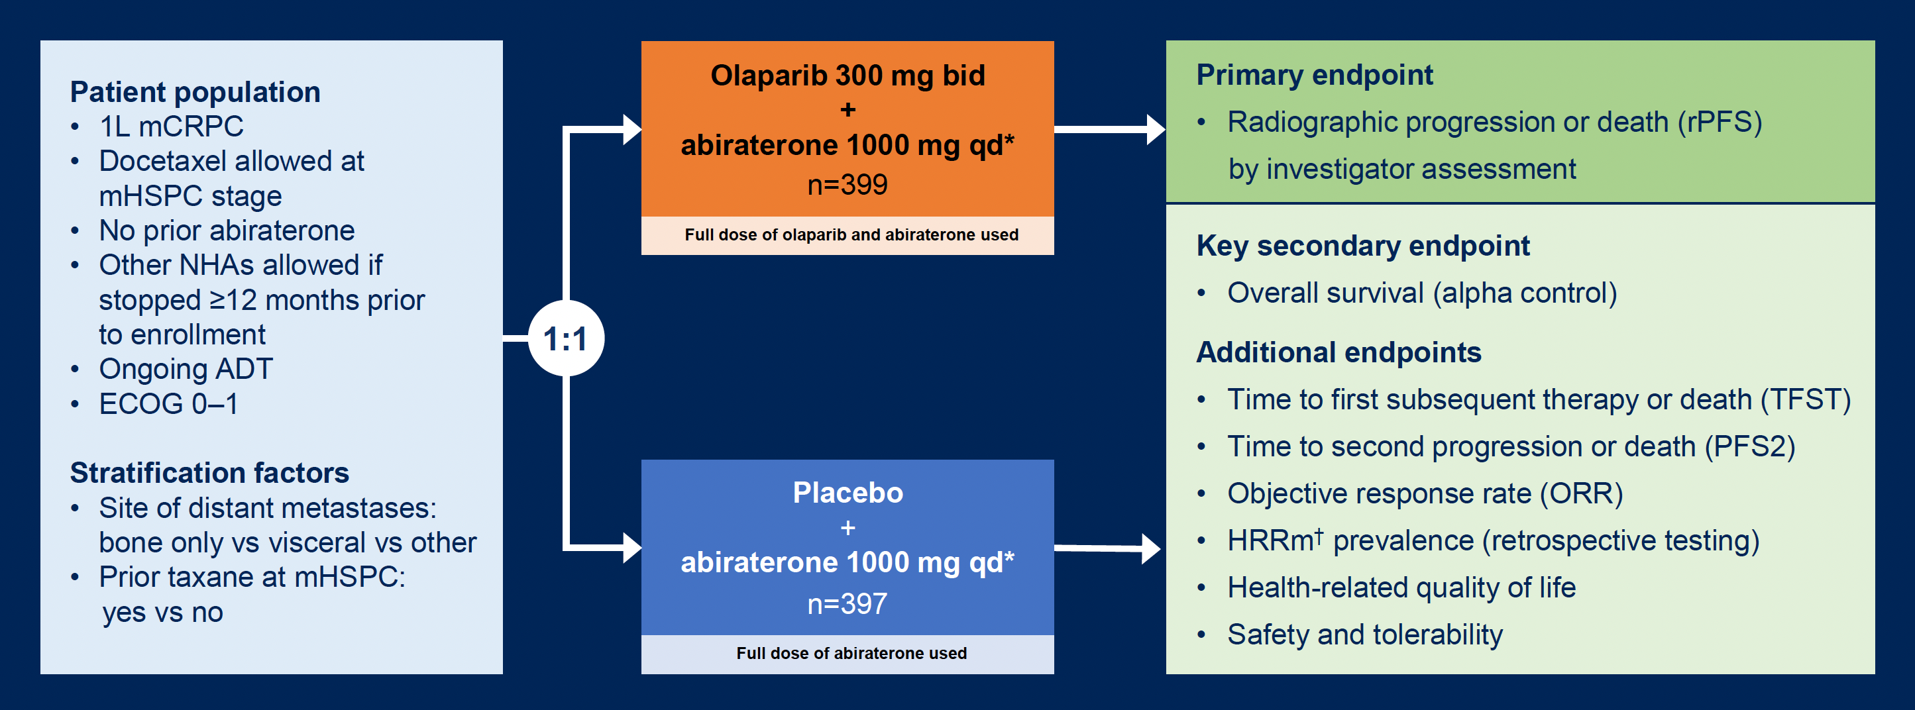
PROpel Phase III Study Design
Saad F et al. Genitourinary Cancers Symposium 2022;Abstract 11.

Slide 65
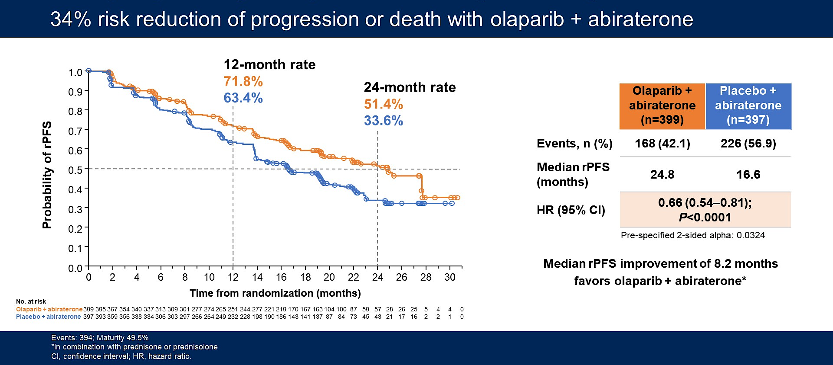
PROpel: Olaparib and Abiraterone versus Placebo and Abiraterone as First-Line Therapy for mCRPC
Primary Endpoint: Investigator-Assessed Radiographic Progression-Free
Survival (rPFS)
Saad F et al. Genitourinary Cancers Symposium 2022;Abstract 11.

Slide 66
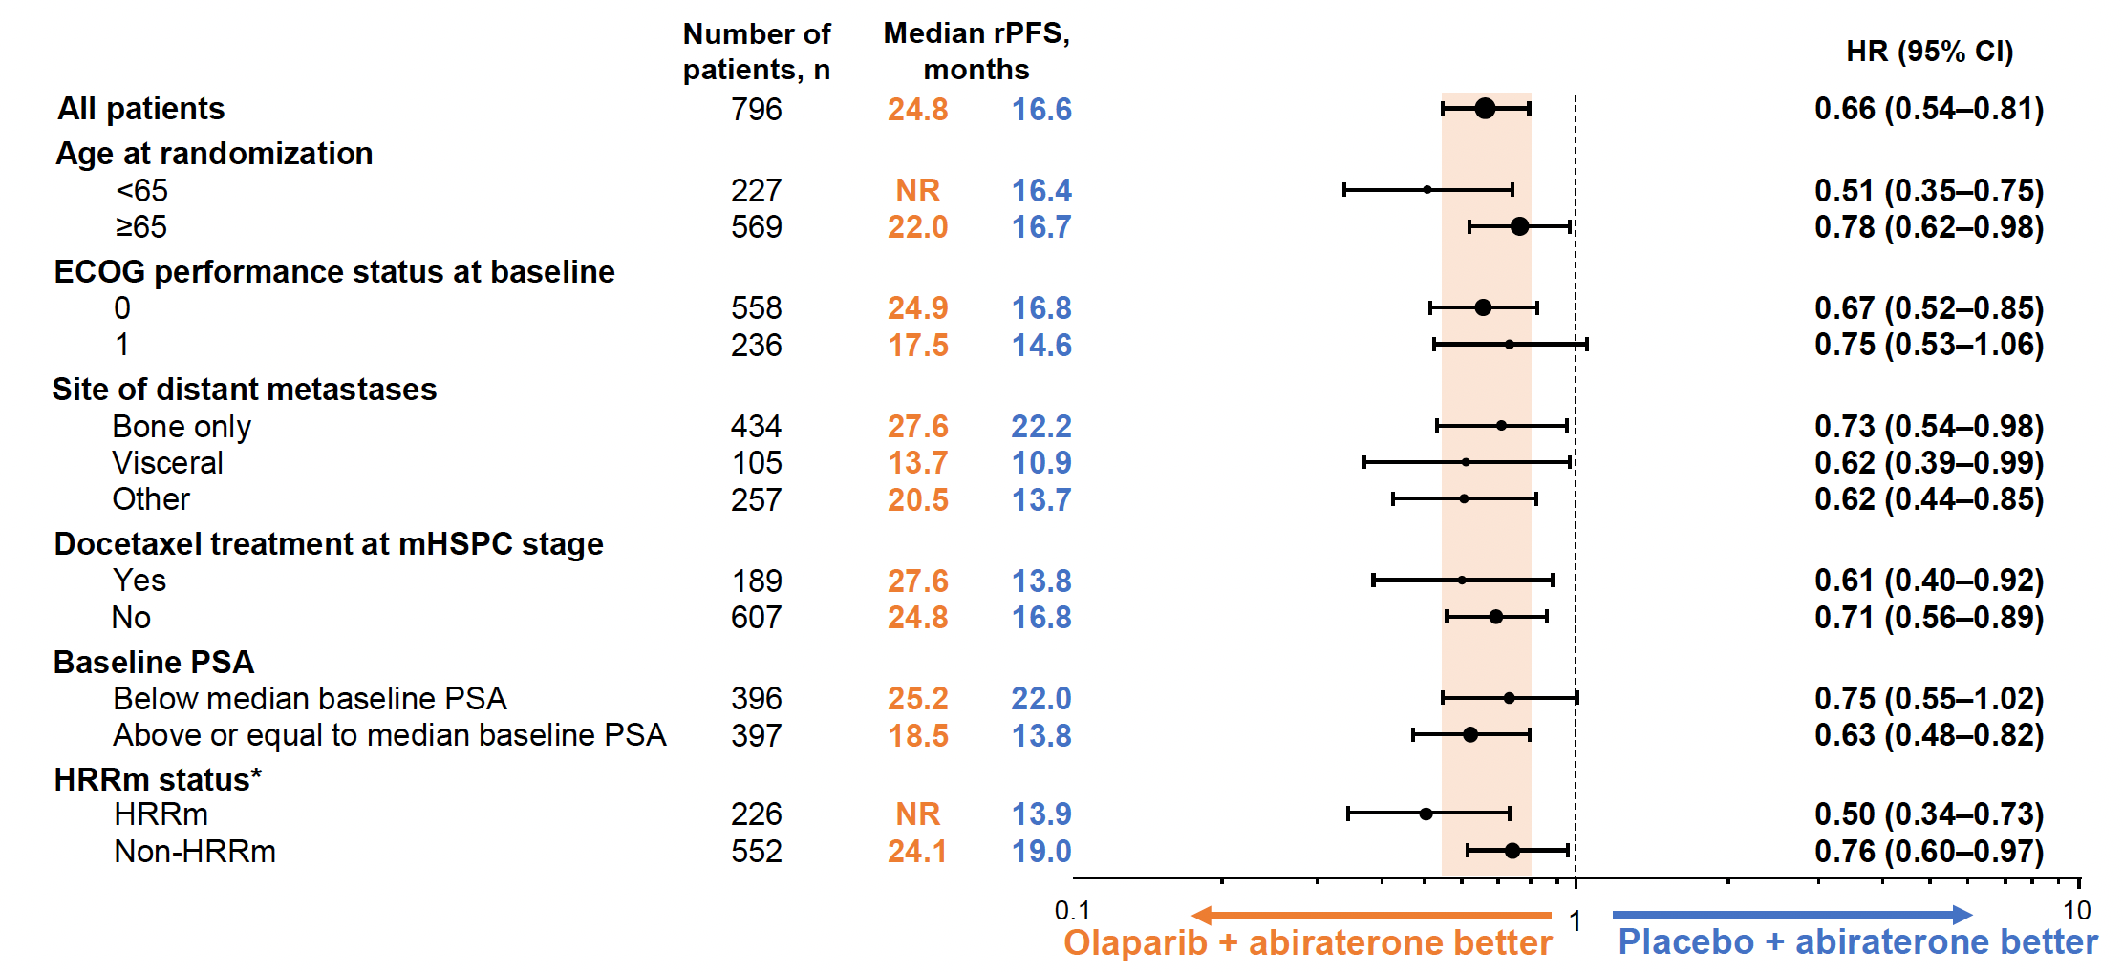
PROpel: Subgroup Analysis of rPFS
Saad F et al. Genitourinary Cancers Symposium 2022;Abstract 11.

Slide 67
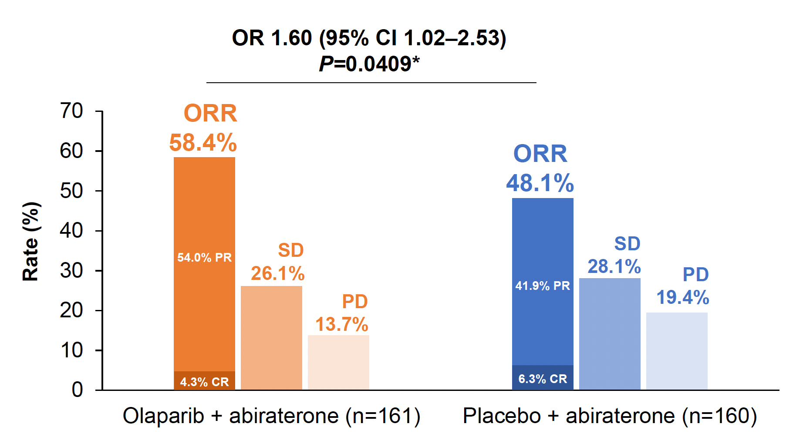
PROpel: Overall Response Rate (Patients with Measurable Disease)
Saad F et al. Genitourinary Cancers Symposium 2022;Abstract 11.

Slide 68
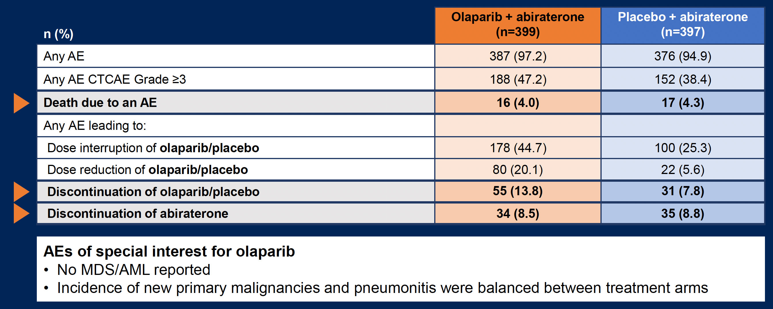
PROpel: Overall Safety Profile
CTCAE = Common Terminology Criteria for Adverse Events
Saad F et al. Genitourinary Cancers Symposium 2022;Abstract 11.

Slide 69
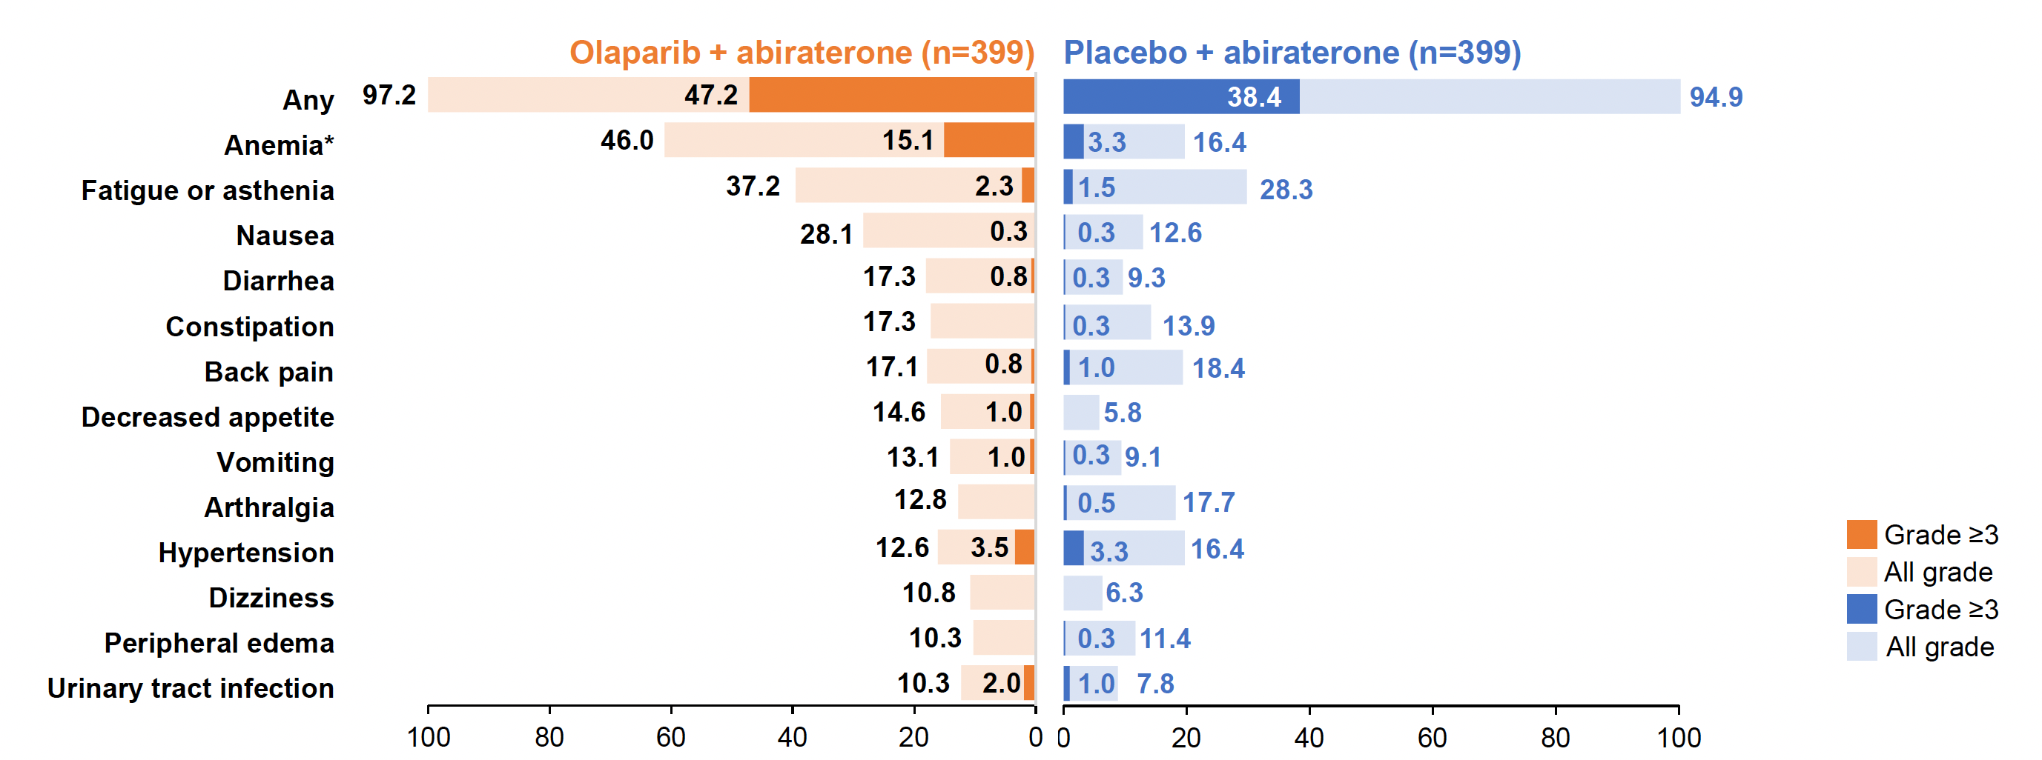
PROpel: Most Common Adverse Events
Saad F et al. Genitourinary Cancers Symposium 2022;Abstract 11.

Slide 70
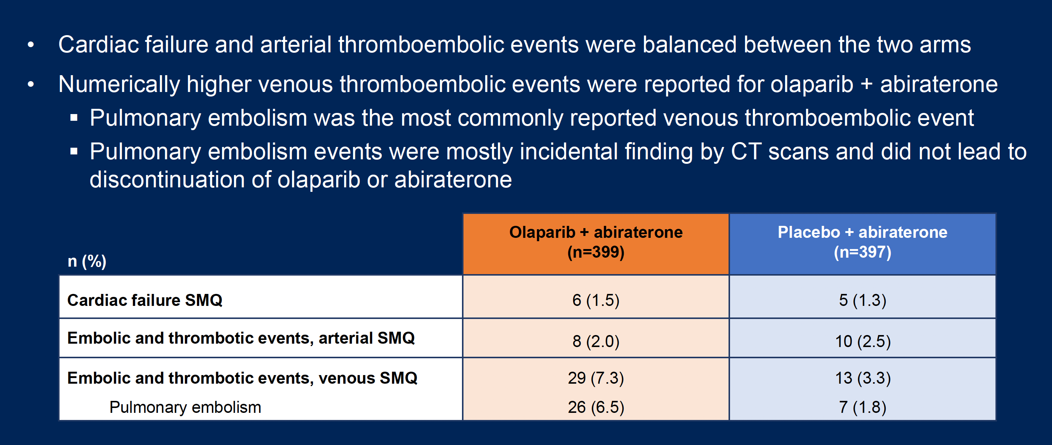
PROpel: Cardiac and Thromboembolic Adverse Events
Saad F et al. Genitourinary Cancers Symposium 2022;Abstract 11.

Slide 71
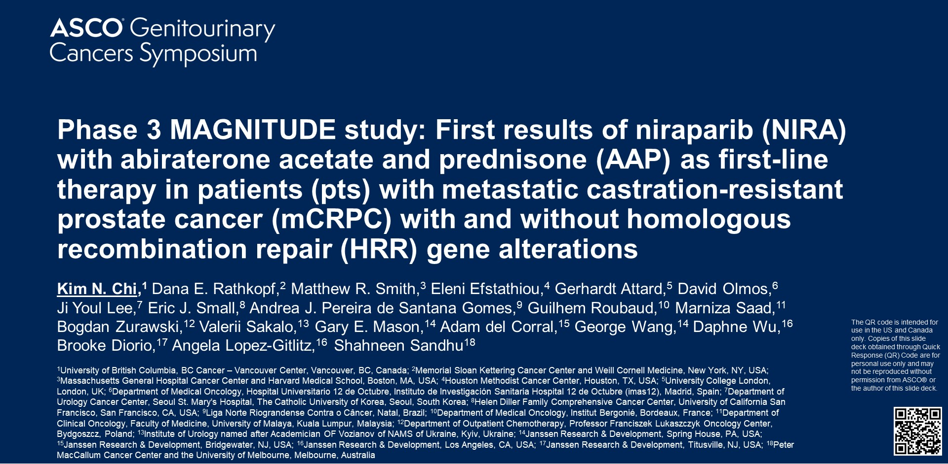
2022;Abstract 12

Slide 72
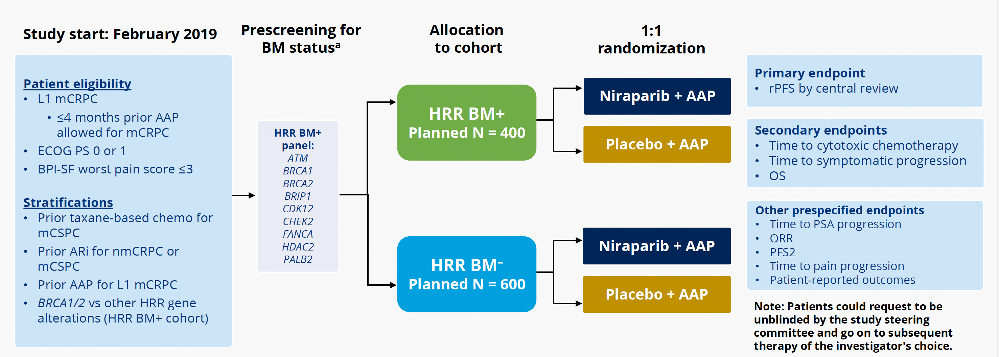
MAGNITUDE Phase III Study Design
Chi KN et al. Genitourinary Cancers Symposium 2022;Abstract 12.

Slide 73
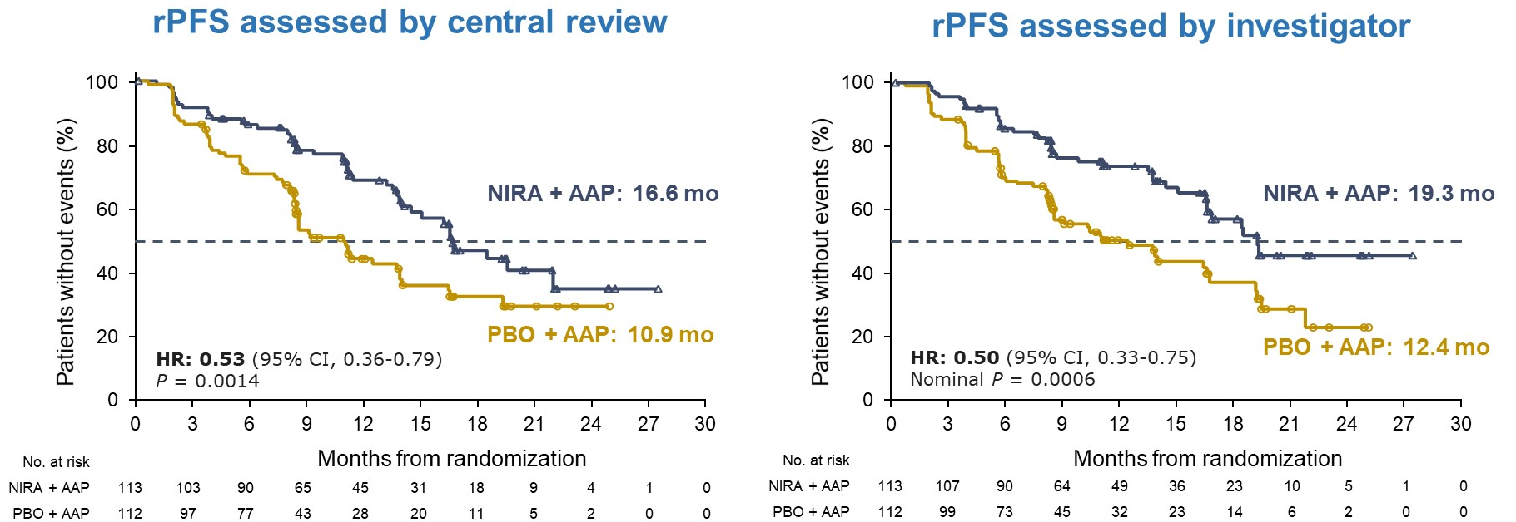
MAGNITUDE: BRCA1/2 Mutations — Primary Endpoint
Niraparib with Abiraterone Acetate Significantly Reduced the Risk of
Disease Progression or Death by 47% in mCRPC
Chi KN et al. Genitourinary Cancers Symposium 2022;Abstract 12.

Slide 74
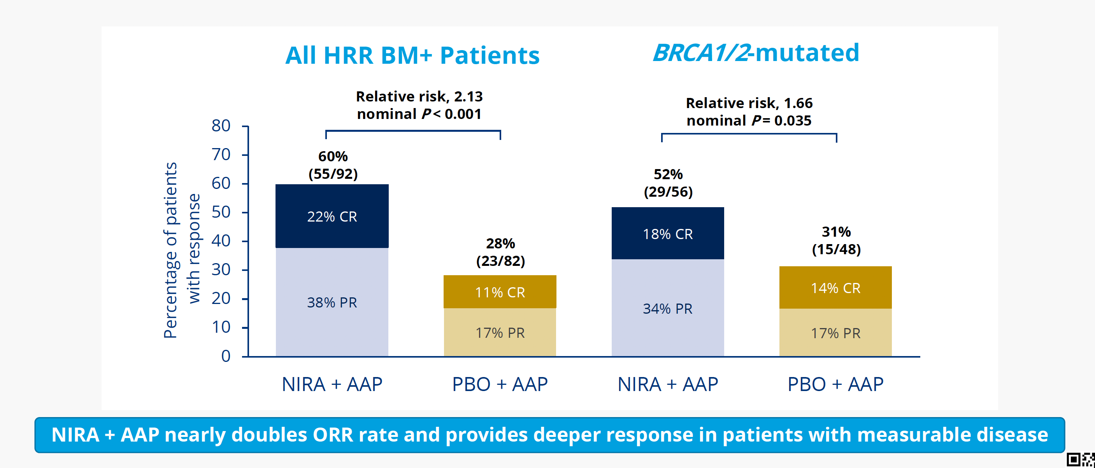
MAGNITUDE: Overall Response Rate
Chi KN et al. Genitourinary Cancers Symposium 2022;Abstract 12.

Slide 75
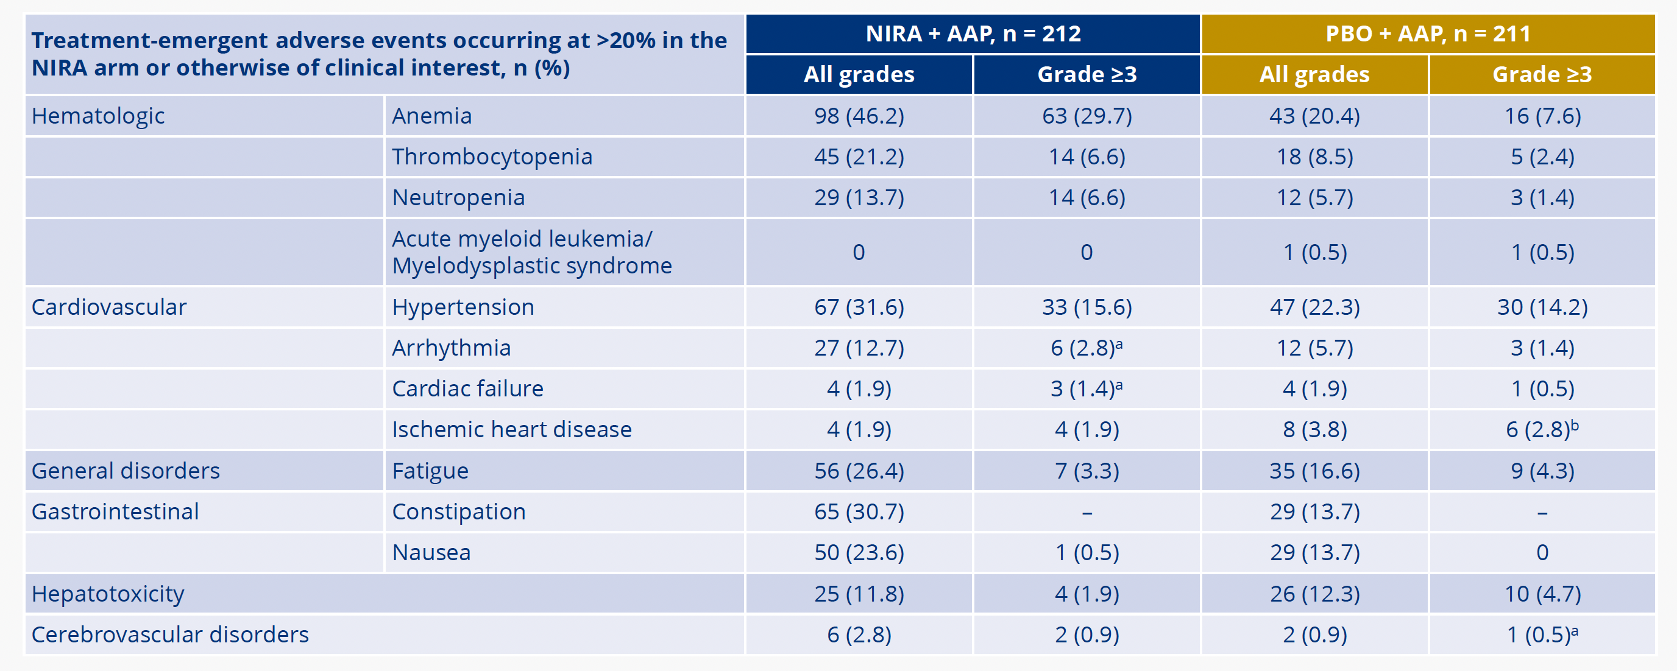
MAGNITUDE HRR Biomarker-Positive:
Treatment-Emergent Adverse Events
Chi KN et al. Genitourinary Cancers Symposium 2022;Abstract 12.

Slide 76
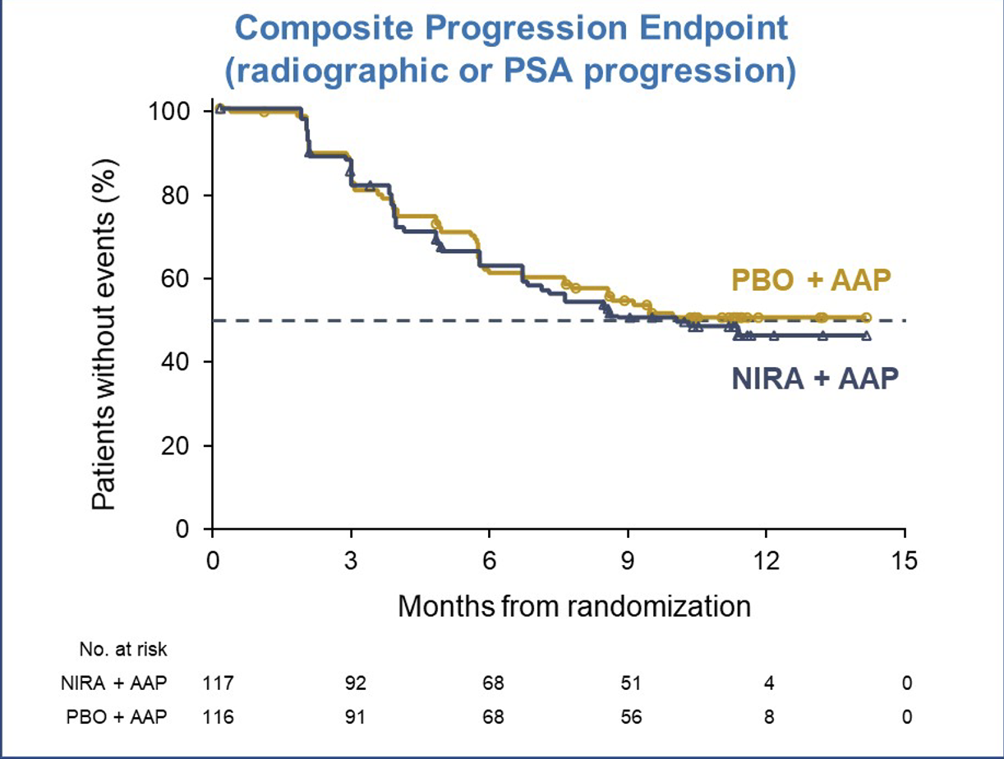
MAGNITUDE HRR BM-: Prespecified Early Futility Analysis
No Benefit of NIRA + AAP in HRR BM- Patients
Composite endpointª (N= 222)
HR = 1.09^{b} (95% CI 0.75-1.59)
[futility was defined as ≥1
Additional grade 3/4 toxicity was observed using NIRA + AAP vs PBO + AAP
With added toxicity and no added efficacy in patients with HRR BM- mCRPC, the IDMC recommend stopping enrollment in this cohort
^{b}Breakdown of composite events
83 PSA events (HR = 1.03, 95% CI 0.67-1.59)
65 rPFS events (HR = 1.03, 95% CI 0.63-1.67)
ªrPFS or PSA progression, whichever occurred first

Slide 77
Select Ongoing Phase III Trials of PARP Inhibitor Combined with Secondary Hormonal Therapy
Study | No. of patients | Randomization | Est primary completion
Metastatic castration resistant prostate cancer (mCRPC)
TALAPRO-2 | 1060 | Talazoparib + enzalutamide Placebo + enzalutamide | Nov 2024
CASPAR | 1002 | Rucaparib + enzalutamide +/- ADT Placebo + enzalutamide +/- ADT | Sep 2026
Metastatic hormone-sensitive prostate cancer (mHSPC)
TALAPRO-3 | 550 | Talazoparib + enzalutamide Placebo + enzalutamide | Dec 2024
AMPLITUDE | 788 | Niraparib + abiraterone Placebo + abiraterone | Nov 2024
www.clinicaltrials.gov. Accessed May 2022.

Slide 78
Appendix of Key Data Sets

Slide 79
STAMPEDE: Noteworthy Adverse Event Differences
Event | Control: Abiraterone trial (n = 455) |  | Control: Abiraterone and enzalutamide trial (n = 533) |  | Combination: Abiraterone trial (n = 451) |  | Combination: Abiraterone and enzalutamide trial (n = 513)
 | All grades | Grade 3-4 | All grades | Grade 3-4 | All grades | Grade 3-4 | All grades | Grade 3-4
Hypertension | 15% | 1% | 16% | 2% | 29% | 5% | 51% | 14%
ALT increased | 11% | 0 | 15% | 1% | 23% | 5% | 41% | 13%
Grade 5 AEs | 0 |  | 0 |  | 3* |  | 4**
* Three Grade 5 AEs: rectal adenocarcinoma, pulmonary hemorrhage, respiratory disorder
** Four Grade 5 AEs: 2 septic shock, 2 sudden death
Attard G et al. Lancet 2022;399(10323):447-60.

Slide 80
Select Ongoing Phase III Trials of Secondary Hormonal Therapy for High-Risk Localized or Locally Advanced Prostate Cancer
 | No. of patients | Setting | Randomization
DASL-HiCaP | 1,100 | Localized, very high risk, undergoing definitive RT | Darolutamide + LHRH analogue + EBRT Placebo + LHRH analogue + EBRT
ATLAS | 1,503 | Localized, high risk, receiving primary RT | Apalutamide + bicalutamide + GnRH agonist + RT Placebo + bicalutamide + GnRH agonist + RT
PROTEUS | 2,400 | Localized, high risk, candidates for prostatectomy | Apalutamide + ADT Placebo + ADT
EMBARK | 1,068 | High-risk M0 after definitive therapy | Enzalutamide + leuprolide Enzalutamide Placebo + leuprolide
ERADICATE | 810 | High-risk M0 after prostatectomy | ADT Darolutamide + ADT
RT = radiation therapy; EBRT = external beam RT
Clinicaltrials.gov. Accessed May 18, 2022

Slide 81
FDA Approvals of Next-Generation Antiandrogens for Nonmetastatic CRPC
Agent | Approval date | Pivotal study
Darolutamide | July 30, 2020 | ARAMIS
Enzalutamide | July 12, 2018 | PROSPER
Apalutamide | February 14, 2018 | SPARTAN
https://www.fda.gov/drugs/resources-information-approved-drugs/

Slide 82



Primary Endpoint: Metastasis-Free Survival (MFS) in Nonmetastatic CRPC
SPARTAN¹
Apalutamide
72% reduction of distant progression or death
Median MFS: APA 40.5 vs PBO 16.2 months
24-month MFS benefit
PROSPER²
Enzalutamide
71% reduction of distant progression or death
Median MFS: ENZA 36.6 vs PBO 14.7 months
22-month MFS benefit
ARAMIS³
Darolutamide
59% reduction of distant progression or death
Median MFS: DARO 40.4 vs PBO 18.4 months
22-month MFS benefit
PBO = placebo
1. Smith MR et al. NEJM 2018;378:1408-18. 2. Hussain M et al. NEJM 2018;378:2465-74. 3. Fizazi K et al. NEJM 2019;380:1235-46.

Slide 83
Secondary Endpoint: Overall Survival (OS) in Nonmetastatic CRPC
SPARTAN¹
Apalutamide
APA
median, 73.9 mo
22% reduction in risk of death
Median OS
  73.9 mo vs 59.9 mo
  HR = 0.78; p = 0.016
PBO
median, 59.9 mo
HR, 0.78 (95% CI, 0.64-0.96)
P = .0161
PROSPER²
Enzalutamide
Enzalutamine
Placebo
27% reduction in risk of death
Median OS
  67.0 mo vs 56.3 mo
  HR = 0.73; p = 0.001
 | Enzalutamide (N = 933) | Placebo (N = 478)
Median, mo (95% CI) | 67.0 (64.0-NR) | 56.3 (54.5-63.0)
HR (95% CI) | 0.73 (0.61-0.89)
P | .001
ARAMIS³
Darolutamide
31% reduction in risk of death
Median OS
  HR = 0.69; p = 0.003
Darolutamide
Placebo
1. Smith MR et al. Eur Urol 2020;79:150-8. 2. Sternberg CN et al. NEJM 2020;382:2197-206. 3. Fizazi K et al. NEJM 2020;383:1040-9.

Slide 84



Final OS Analyses: Enzalutamide, Abiraterone and Apalutamide for mHSPC
ARCHES¹
Enzalutamide + ADT
34% reduction in risk of death
Median OS
  Not reached vs not reached
  HR = 0.66; p < 0.001
LATITUDE²
Abiraterone + ADT
34% reduction in risk of death
Median OS
  53.3 mo vs 36.5 mo
  HR = 0.66; p < 0.0001
TITAN³
Apalutamide + ADT
35% reduction in risk of death
Median OS
  Not reached vs 52.2 mo
  HR = 0.65; p < 0.0001
1. Armstrong AJ et al. J Clin Oncol 2022;40(15):1616-22. 2. Fizazi K et al. GU Cancers Symposium 2019;Abstract 141. 3. Chi KN et al. GU Cancers Symposium 2021;Abstract 11.

Slide 85

ARASENS: Grade 3-4 Adverse Events
Smith MR et al. Genitourinary Cancers Symposium 2022;Abstract 13.

Slide 86

ARASENS: Adverse Events of Special Interest with
Androgen Receptor (AR) Pathway Inhibitors
Smith MR et al. Genitourinary Cancers Symposium 2022;Abstract 13.

Slide 87

PEACE-1: Study Design
Fizazi K et al. ASCO 2021;Abstract 5000.

Slide 88

PEACE-1 Coprimary Endpoint: Radiographic Progression-Free Survival
Fizazi K et al. Lancet 2022;399:1695-07.

Slide 89

PEACE-1 Coprimary Endpoint: Overall Survival
Fizazi K et al. Lancet 2022;399:1695-07.

Slide 90

PEACE-1: Efficacy Outcomes in the ITT Population
Fizazi K et al. Lancet 2022;399:1695-07.

Slide 91

PEACE-1: Adverse Events in the Safety Population
Fizazi K et al. Lancet 2022;399:1695-07.

Slide 92
Summary of Key Clinical Trials in mHSPC
Trial name | Experimental arm | Comparator arm | rPFS | OS
CHAARTED¹ | Docetaxel | ADT | 32 vs 19 mo | HR: 0.72; 57.6 vs 47.2 mo
STAMPEDE-C² | Docetaxel | ADT | 44 vs 34.8 mo, HR: 0.61 | HR: 0.81; 81 vs 71 mo
LATITUDE³ | Abiraterone | ADT | NR | HR: 0.66; 53.3 vs 36.5 mo
STAMPEDE-G⁴ | Abiraterone | ADT | NR | HR: 0.6; 6.6 vs 3.8 y
ARCHES⁵ | Enzalutamide | ADT | HR: 0.39 NR vs 19 | HR: 0.66; NR vs NR
ENZAMET⁶ | Enzalutamide | ADT + NSAA with docetaxel | HR: 0.34 HR: 0.48 | HR: 0.53 HR: 90
TITAN⁷ | Apalutamide | ADT | HR: 0.48 | HR: 0.67; NR vs 52.2
PEACE-1⁸ | Abiraterone | ADT + docetaxel | 4.5 vs 2 y HR: 0.50 | HR: 0.75
ARASENS⁹ | Darolutamide | ADT + docetaxel | NR | HR: 0.68; NR vs 48.9 mo
ADT = androgen deprivation therapy; NSAA = nonsteroidal anti-antigen
1. Sweeney CJ et al. NEJM 2015; 2. James ND et al. Eur Urol 2015; 3. Fizazi K et al. Lancet Oncol 2019; 4. Clarke NW et al. Ann Oncol 2019; 5. Armstrong AJ et al. J Clin Oncol 2019; 6. Davis ID et al. NEJM 2019; 7. Chi KN et al. NEJM 2019; 8. Fizazi K et al. Lancet 2022; 9. Smith MR et al. NEJM 2022.

Slide 93
Updated Overall Survival Outcomes in ENZAMET (ANZUP 1304), an International, Cooperative Group Trial of Enzalutamide in Metastatic Hormone-Sensitive Prostate Cancer (mHSPC)
Davis ID et al.
ASCO 2022;Abstract LBA5004.
Track: Genitourinary Cancer – Prostate, Testicular, and Penile
June 5, 2022, 9:00 AM

Slide 94


N Engl J Med 2019 Dec 26;381(26):2506-2518

Slide 95


Range of an α-Emitting Radiopharmaceutical Compared to a β-Emitter
Short range of α-particles could reduce bone marrow exposure¹
Bone
Marrow
Tumor
Bone Mineral
(Hydroxyapatite)
Radionuclide
Range of α-particle
(short range – ~2 to 10
cell diameters²)
Range of β-particle
(long range
– 10 to 1000 cell diameters²)
1. Henriksen G, et al. Cancer Res 2002;62:3120–5. 2. Brechbiel MW. Dalton Trans 2007;43:4918-28.

Slide 96



Lancet Oncol 2014;15:738-46
Lancet Oncol 2019;20:408-19

Slide 97
ALSYMPCA AND ERA 223: Summary of Key Outcomes with Radium-223 in mCRPC
 | ALSYMPCA |  |  | ERA 223
 | R-223 + BSC (n = 614) | BSC (n = 307) | HR (p-value) | AAP + R-223 (n = 401) | AAP + placebo (n = 405) | HR (p-value)
Skeletal EFS, median | 15.6 mo | 9.8 mo | 0.66 (0.0004) | 22.3 mo | 26.0 mo | 1.12 (0.26)
OS, median | 14.9 mo | 11.3 mo | 0.70 (<0.001) | 30.7 mo | 33.3 mo | 1.2 (0.13)
BSC = best supportive care; AAP = abiraterone acetate with prednisone or prednisolone; EFS = event-free survival; OS = overall survival
Parker C et al. N Engl J Med 2013;369(3):213-23; Sartor O et al. Lancet Oncol 2014;15(7):738-46;
Smith M et al. Lancet Oncol 2019;20(3):408-19.

Slide 98

Abstract 5002
Gillessen S et al. ASCO 2021;Abstract 5002.

Slide 99

PEACE-3 Original Study Schema
Gillessen S et al. ASCO 2021;Abstract 5002.

Slide 100


PEACE-3: Cumulative Incidence of Fractures by Treatment Arm and Use of Bone Protecting Agents
Gillessen S et al. ASCO 2021;Abstract 5002.

Slide 101

PEACE-3: Bone Fractures and Cumulative Incidence — Safety Population
Gillessen S et al. ASCO 2021;Abstract 5002.

Slide 102

Abstract 577O

Slide 103

PRINCE: ¹⁷⁷Lu-PSMA-617 Combined with Pembrolizumab for mCRPC
PSA Response Rate (Primary Endpoint)
Sandhu S et al. ESMO 2021;Abstract 577O.

Slide 104

PRINCE: Treatment-Related Adverse Events (TRAEs)
Pruritus
Sandhu S et al. ESMO 2021;Abstract 577O.

Slide 105
Immune Checkpoint Inhibitors in mCRPC
Therapy | Disease state | Disease response
Pembrolizumab monotherapyª | Postchemotherapy | ORR 9% PSA RR 14%
Pembrolizumab + enzalutamide^{b} | Prechemotherapy, progressing on enzalutamide | ORR 12% PSA RR 14%
Atezolizumab + enzalutamide^{c} | Pre- and postchemotherapy, s/p abiraterone | ORR 14% PSA RR 26%
Atezolizumab + cabozantinib^{d} | Prechemotherapy, s/p enzalutamide or abiraterone | ORR 34% PSA RR 29%
ª Antonarakis ES et al. JCO 2020:38(5):395-405. ^{b} Presented at the 2021 ASCO Annual Meeting – Virtual. ^{c} Sweeney C. AACR 2020; IMbassador250. ^{d} Agarwal ASCO 2020; COSMIC-021.

Slide 106

Inherited DNA Repair Gene Mutations in Men with Metastatic Prostate Cancer
Multicenter study of 692 men
Deleterious mutations were found in 82 men (11.8%) in 16 genes
Observed rate exceeded that associated with localized prostate cancer (4.6%) and general population without cancer (2.7%)
Courtesy of Matthew Smith, MD, PhD

Slide 107

N Engl J Med 2020;383:2345-57.

Slide 108

PROfound Primary Endpoint: Imaging-Based PFS with Olaparib for Patients with mCRPC and at Least 1 Alteration in BRCA1, BRCA2 or ATM (Cohort A)
 | Olaparib (n = 162) | Control (n = 83) | HR | p-value
Median iPFS | 7.4 mo | 3.6 mo | 0.34 | <0.001
de Bono J et al; PROfound investigators. N Engl J Med 2020;382(22):2091-102.

Slide 109


PROfound: OS with Olaparib for Patients with mCRPC and at Least 1 Alteration in BRCA1, BRCA2 or ATM (Cohort A)
Overall survival
Crossover-adjusted overall survival
Hussain M et al; PROfound investigators. N Engl J Med 2020;383(24):2345-57.

Slide 110

J Clin Oncol 2020;38:3763-72.

Slide 111


TRITON2: Response to Rucaparib in Patients with mCRPC Harboring a BRCA1 or BRCA2 Gene Alteration
ORR per independent radiology review: 43.5%
Confirmed PSA response rate: 54.8%
ORR = objective response rate
Abida W et al; TRITON2 Investigators. J Clin Oncol 2020;38(32):3763-72.

Slide 112


PARP Inhibitor Monotherapy with Investigational Agents
Lancet Oncol 2021;22(9):1250-64
Lancet Oncol 2022;23:362-73

Slide 113
TALAPRO-1 and GALAHAD: PARP Inhibitor Monotherapy Studies with Talazoparib and Niraparib for mCRPC
 | TALAPRO-1 (talazoparib) (N = 104) | GALAHAD (niraparib) (N = 289)
Eligibility, gene alterations | DDR-HHR gene alterations* | Germline or somatic BRCA1 or BRCA2 (BRCA cohort) Other prespecified DNA repair gene defects (non-BRCA cohort)**
Overall response rate BRCA1/2 Non-BRCA1/2 | 46% 7% | 34% 11%
rPFS, median (BRCA1/2) | 11.2 mo | 5.5 mo
*DDR-HHR gene alterations: ATM, ATR, BRCA1, BRCA2, CHEK2, FANCA, MLH1, MRE11A, NBN, PALB2, RAD51C
** DDR (non-BRCA cohort): ATM, BRCA1, BRCA2, BRIP1, CHEK2, FANCA, HDAC2, and PALB2
de Bono JS et al. Lancet Oncol 2021;22(9):1250-64. Smith MR et al. Lancet Oncol 2022;23:362-73.

Slide 114



Next-Generation Androgen Receptor Inhibitors
Apalutamide
Enzalutamide
Darolutamide
Apalutamide and enzalutamide have similar structures
Darolutamide is structurally distinct from apalutamide and enzalutamide, characterized by low blood-brain barrier penetration, and may have improved tolerability
Zurth C et al. Genitourinary Cancers Symposium 2018;Abstract 345; Sandmann S et al. Genitourinary Cancers Symposium 2019;Abstract 156.

Slide 115



N Engl J Med 2020;383:1040-9.
N Engl J Med 2020;382(23):2197-206.
Eur J Cancer 2020;[Online ahead of print].

Slide 116

PROpel: TFST and PFS2
Saad F et al. Genitourinary Cancers Symposium 2022;Abstract 11.

Slide 117

MAGNITUDE: All HRR Biomarker-Positive — Primary Endpoint
Niraparib with Abiraterone Acetate Significantly Reduced the Risk of
Disease Progression or Death by 27% in mCRPC
Chi KN et al. Genitourinary Cancers Symposium 2022;Abstract 12.

Slide 118

MAGNITUDE HRR Biomarker-Positive: Summary of TEAEs
Chi KN et al. Genitourinary Cancers Symposium 2022;Abstract 12.

