Slide 1
Monday, June 6, 2022 6:45 AM – 7:45 AM CT (7:45 AM – 8:45 AM ET)
Breakfast with the Investigators:
Urothelial Bladder Cancer
A CME Hybrid Symposium Held in Conjunction with the 2022 ASCO Annual Meeting
Faculty
Yohann Loriot, MD, PhD
Elizabeth R Plimack, MD, MS
Jonathan E Rosenberg, MD
Moderator
Neil Love, MD

Slide 2
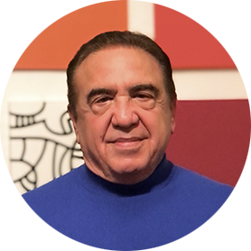
Faculty
Yohann Loriot, MD, PhD Deputy Chair, Early Drug Development (DITEP) Chair, GU Oncology Group Leader, Resistance to Innovative Drugs Program Molecular Predictors and New Targets in Oncology, INSERM U981 Gustave Roussy Villejuif, France
Jonathan E Rosenberg, MD Chief, Genitourinary Medical Oncology Service Division of Solid Tumor Oncology Enno W Ercklentz Chair Memorial Sloan Kettering Cancer Center New York, New York
Elizabeth R Plimack, MD, MS Chief, Division of Genitourinary Medical Oncology Director, Genitourinary Clinical Research Professor, Medical Oncology Deputy Director, Fox Chase Cancer Center Temple Health Philadelphia, Pennsylvania
Moderator Neil Love, MD Research To Practice Miami, Florida

Slide 3
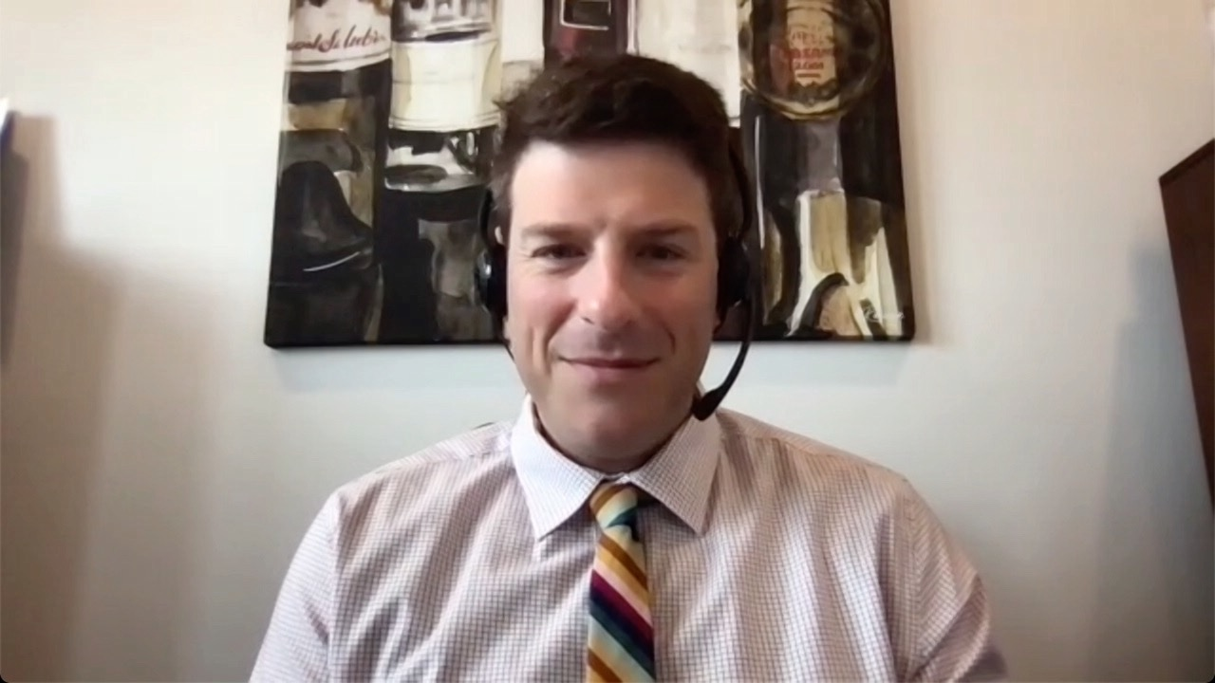
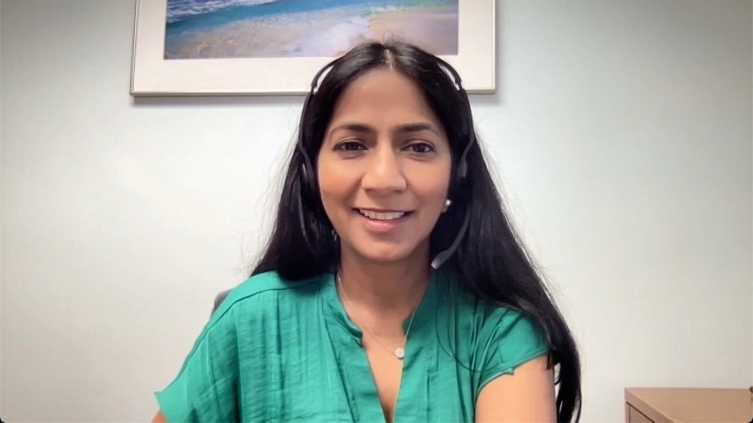
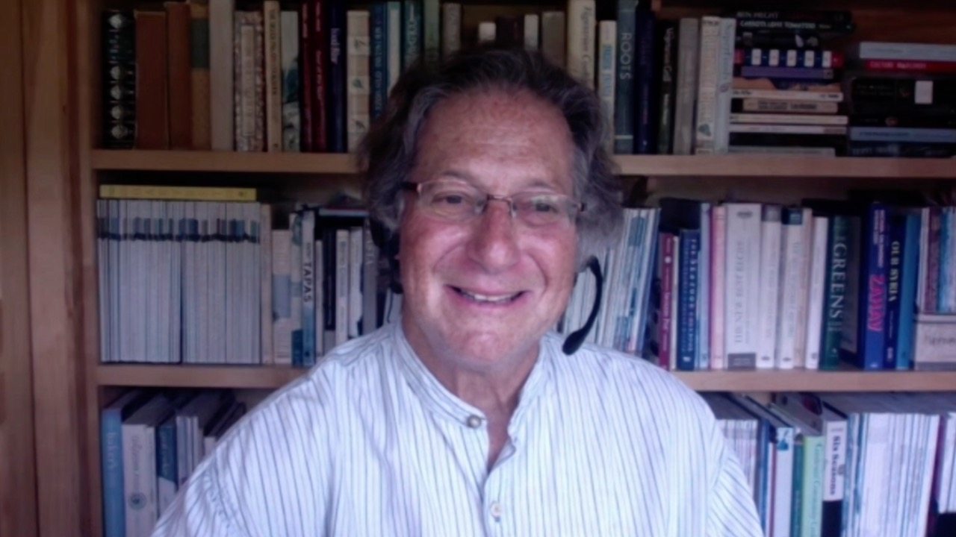
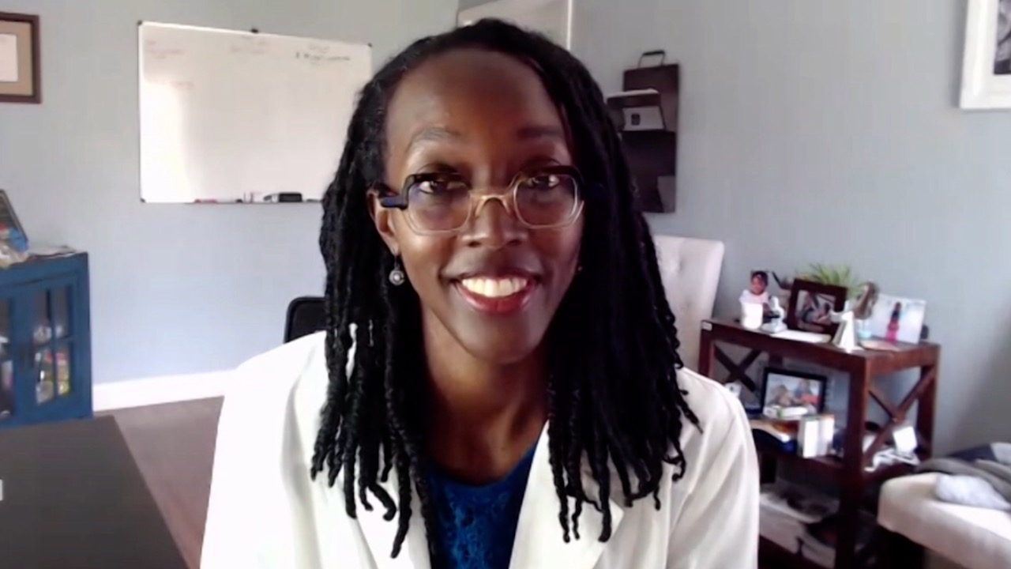
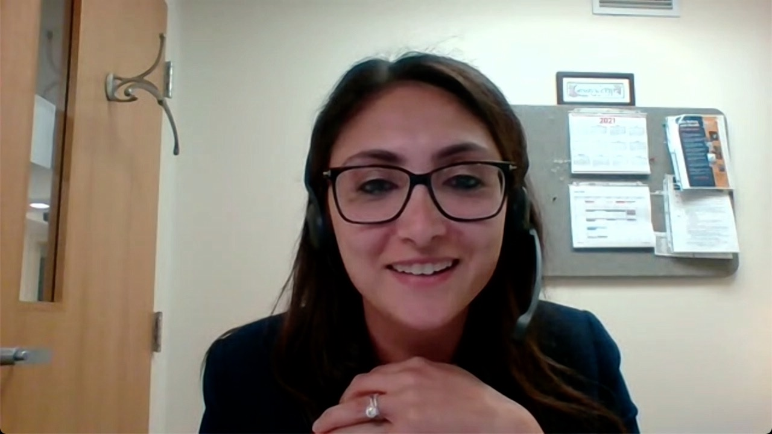
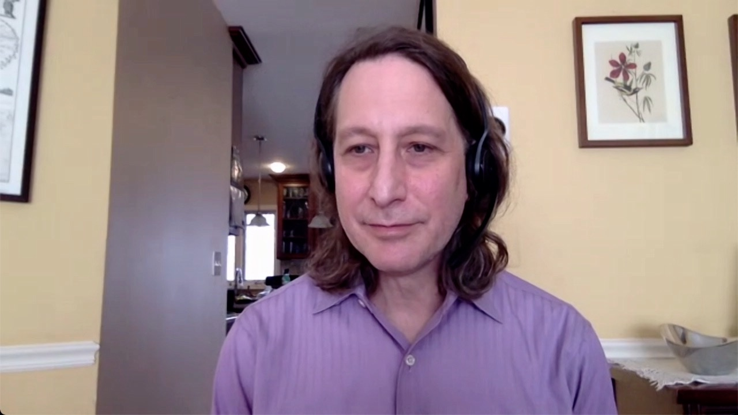
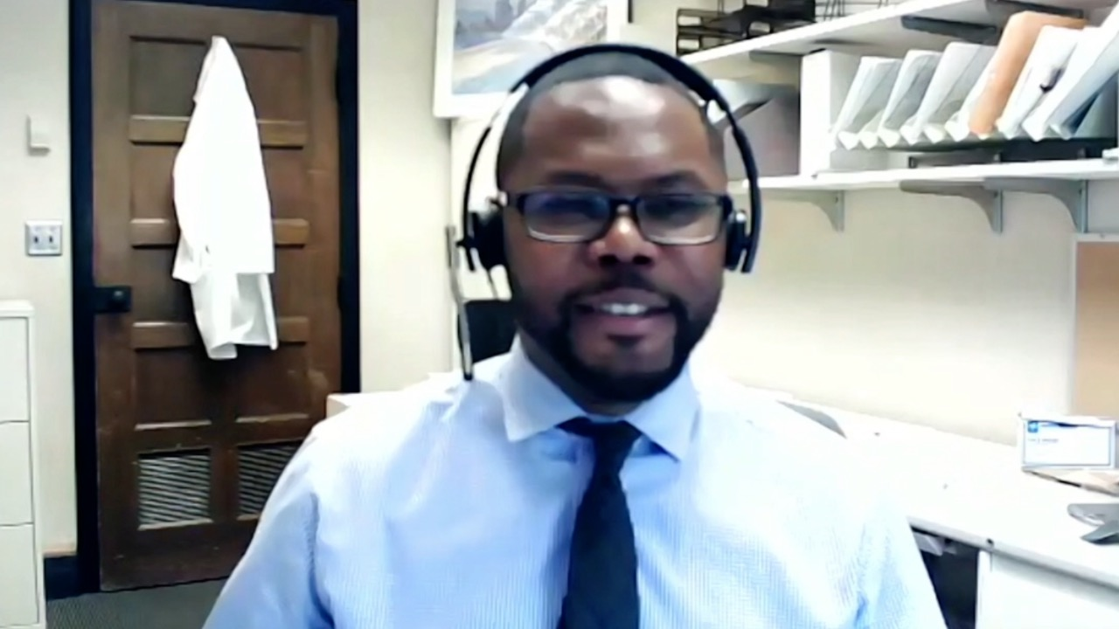
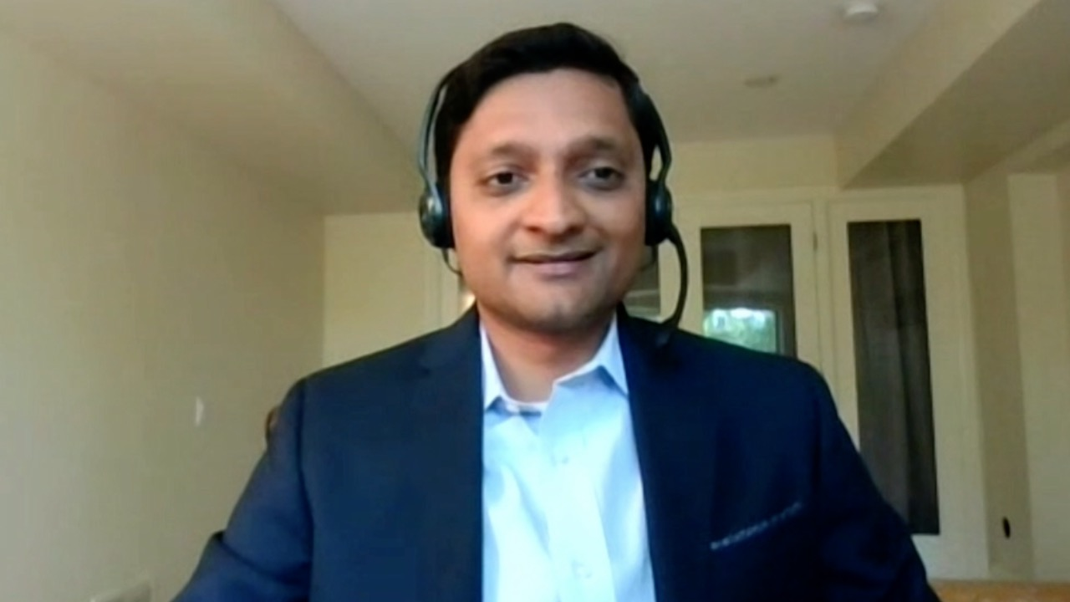
Spencer H Bachow, MD
Lynn Cancer Institute
Boca Raton, Florida
Shaachi Gupta, MD, MPH
Florida Cancer Specialists
Lake Worth, Florida
Philip L Brooks, MD
Northern Light Eastern Maine Medical Center and Lafayette Family Cancer Institute
Brewer, Maine
Zanetta S Lamar, MD
Florida Cancer Specialists
Naples, Florida
Shams Bufalino, MD
Advocate Aurora Health Park Ridge, Illinois
Neil Morganstein, MD
Atlantic Health System
Summit, New Jersey
Lionel A Kankeu Fonkoua, MD
Mayo Clinic Rochester, Minnesota
Vignesh Narayanan, MD
Colorado Permanente Medical Group (CPMG)
Lone Tree, Colorado

Slide 4
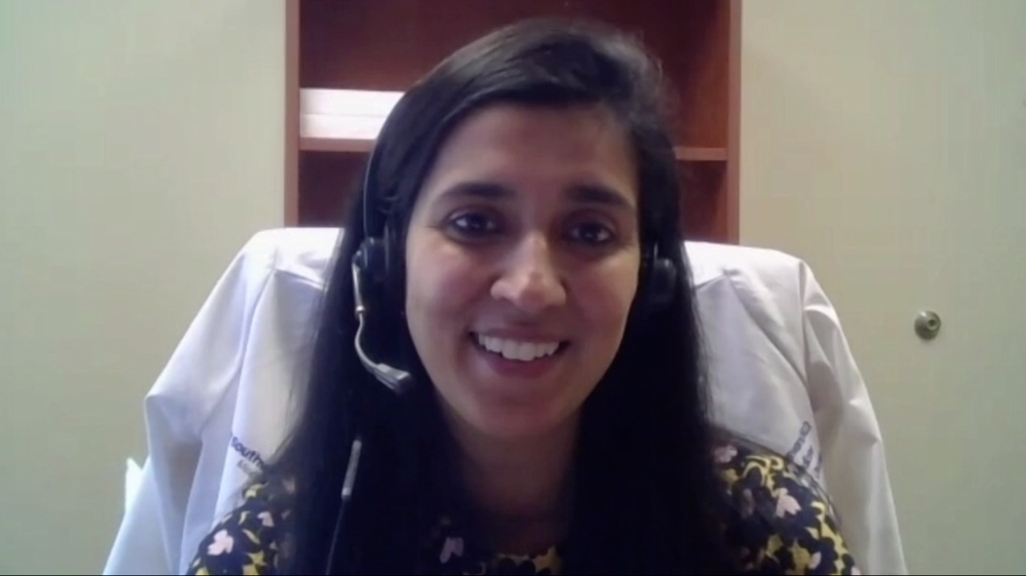
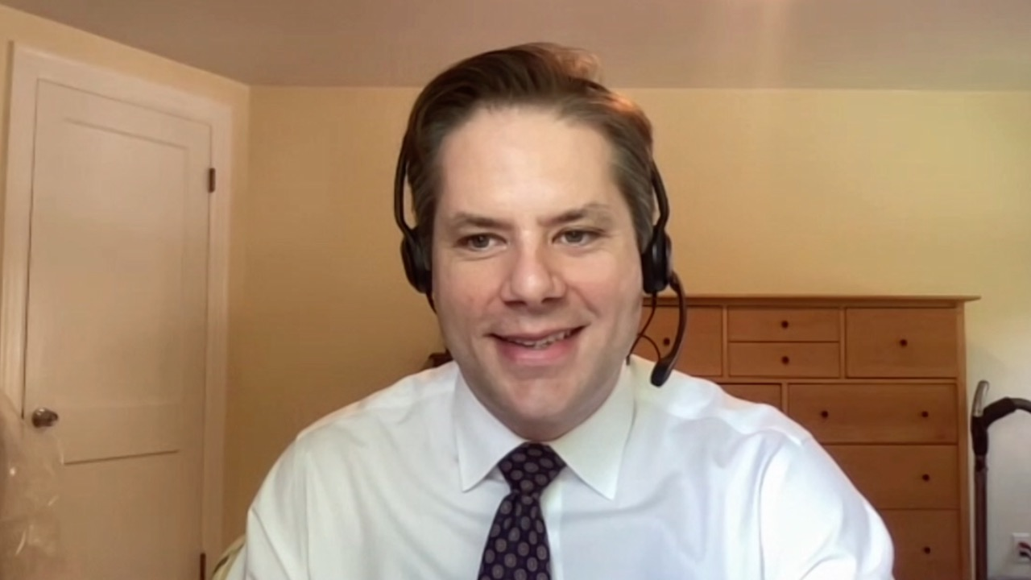
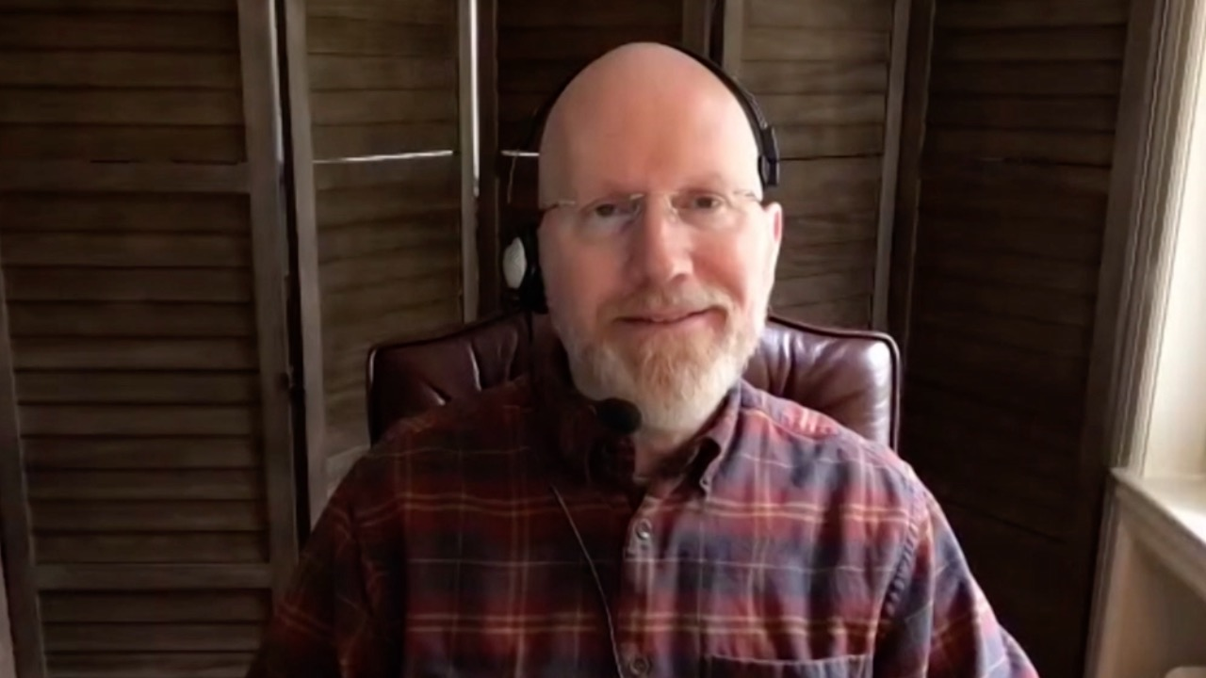
Namrata I Peswani, MD
Harold C Simmons Comprehensive Cancer Center
Richardson, Texas
Matthew R Strickland, MD Massachusetts General Hospital Cancer Center
Boston, Massachusetts
Erik Rupard, MD
The Reading Hospital West Reading, Pennsylvania

Slide 5
Commercial Support
This activity is supported by educational grants from Astellas and Seagen Inc, AstraZeneca Pharmaceuticals LP, Bristol-Myers Squibb Company, Gilead Sciences Inc, and Janssen Biotech Inc, administered by Janssen Scientific Affairs LLC.
Research To Practice CME Planning Committee Members, Staff and Reviewers
Planners, scientific staff and independent reviewers for Research To Practice have no relevant conflicts of interest to disclose.

Slide 6
Dr Love — Disclosures
Dr Love is president and CEO of Research To Practice. Research To Practice receives funds in the form of educational grants to develop CME activities from the following companies: AbbVie Inc, Adaptive Biotechnologies Corporation, ADC Therapeutics, Agios Pharmaceuticals Inc, Alexion Pharmaceuticals, Amgen Inc, Array BioPharma Inc, a subsidiary of Pfizer Inc, Astellas, AstraZeneca Pharmaceuticals LP, Aveo Pharmaceuticals, Bayer HealthCare Pharmaceuticals, BeiGene Ltd, BeyondSpring Pharmaceuticals Inc, Blueprint Medicines, Boehringer Ingelheim Pharmaceuticals Inc, Bristol-Myers Squibb Company, Celgene Corporation, Clovis Oncology, Coherus BioSciences, CTI BioPharma Corp, Daiichi Sankyo Inc, Eisai Inc, Elevation Oncology Inc, EMD Serono Inc, Epizyme Inc, Exact Sciences, Exelixis Inc, Five Prime Therapeutics Inc, Foundation Medicine, G1 Therapeutics Inc, Genentech, a member of the Roche Group, Genmab, Gilead Sciences Inc, GlaxoSmithKline, Grail Inc, Halozyme Inc, Helsinn Healthcare SA, ImmunoGen Inc, Incyte Corporation, Ipsen Biopharmaceuticals Inc, Janssen Biotech Inc, administered by Janssen Scientific Affairs LLC, Jazz Pharmaceuticals Inc, Karyopharm Therapeutics, Kite, A Gilead Company, Lilly, Loxo Oncology Inc, a wholly owned subsidiary of Eli Lilly & Company, Merck, Mersana Therapeutics Inc, Natera Inc, Novartis, Novartis Pharmaceuticals Corporation on behalf of Advanced Accelerator Applications, Novocure Inc, Oncopeptides, Pfizer Inc, Pharmacyclics LLC, an AbbVie Company, Puma Biotechnology Inc, Regeneron Pharmaceuticals Inc, Sanofi Genzyme, Seagen Inc, Servier Pharmaceuticals LLC, Sumitomo Dainippon Pharma Oncology Inc, Taiho Oncology Inc, Takeda Pharmaceuticals USA Inc, Tesaro, A GSK Company, TG Therapeutics Inc, Turning Point Therapeutics Inc, Verastem Inc and Zymeworks Inc.

Slide 7
Dr Loriot — Disclosures
Advisory Committee | AstraZeneca Pharmaceuticals LP, Astellas, Basilea Pharmaceutica Ltd, Bristol-Myers Squibb Company, Gilead Sciences Inc, Janssen Biotech Inc, Loxo Oncology Inc, a wholly owned subsidiary of Eli Lilly & Company, Merck KgaA, Merck Sharp & Dohme LLC, Pfizer Inc, Roche Laboratories Inc, Seagen Inc
Contracted Research | Celsius Therapeutics, Janssen Biotech Inc, Merck Sharp & Dohme LLC, Roche Laboratories Inc, Sanofi Genzyme

Slide 8
Dr Plimack — Disclosures
Advisory Committee | Astellas, Aveo Pharmaceuticals, Bristol-Myers Squibb Company, Calithera Biosciences, Genentech, a member of the Roche Group, Janssen Biotech Inc, MEI Pharma Inc, Merck, Pfizer Inc, Regeneron Pharmaceuticals Inc, Seagen Inc
Contracted Research | Astellas, Bristol-Myers Squibb Company, Genentech, a member of the Roche Group, Merck
Data and Safety Monitoring Board/Committee | AstraZeneca Pharmaceuticals LP, Infinity Pharmaceuticals Inc

Slide 9
Dr Rosenberg — Disclosures
Advisory Committee | Astellas, Seagen Inc
Consulting Agreements | Alligator Bioscience, Astellas, AstraZeneca Pharmaceuticals LP, Boehringer Ingelheim Pharmaceuticals Inc, Bristol-Myers Squibb Company, EMD Serono Inc, Genentech, a member of the Roche Group, Gilead Sciences Inc, Infinity Pharmaceuticals Inc, Lilly, Merck, Mirati Therapeutics, Pfizer Inc, QED Therapeutics, Seagen Inc, Tyra Biosciences
Contracted Research | Astellas, AstraZeneca Pharmaceuticals LP, Bayer HealthCare Pharmaceuticals, Seagen Inc
Data and Safety Monitoring Board/Committee | Gilead Sciences Inc
Honorarium | EMD Serono Inc

Slide 10
Monday, June 6, 2022 6:45 AM – 7:45 AM CT (7:45 AM – 8:45 AM ET)
Breakfast with the Investigators:
Urothelial Bladder Cancer
A CME Hybrid Symposium Held in Conjunction with the 2022 ASCO Annual Meeting
Faculty
Yohann Loriot, MD, PhD
Elizabeth R Plimack, MD, MS
Jonathan E Rosenberg, MD
Moderator
Neil Love, MD

Slide 11
Agenda
Module 1 – Current and Future Management of Localized Urothelial Bladder Cancer (UBC)
Module 2 – First-Line Treatment for Patients with Metastatic UBC (mUBC)
Module 3 – Later-Line Therapeutic Options for Patients with mUBC; Novel Investigational Strategies

Slide 12
Agenda
Module 1 – Current and Future Management of Localized Urothelial Bladder Cancer (UBC)
Module 2 – First-Line Treatment for Patients with Metastatic UBC (mUBC)
Module 3 – Later-Line Therapeutic Options for Patients with mUBC; Novel Investigational Strategies

Slide 13
Case — Yohann Loriot, MD, PhD
A 67 yo gentleman referred to the GU oncology clinics for NMIBC
Comorbidities:
History of psoriasis
Hypertension
Disease history
Haematuria in July 2020 -> US and CT-scan revealed mass of the left wall of the bladder
TURBT performed in late August 2020 (summer vacation..)
Pathological report: urothelial carcinoma, no variant, high grade tumor, T1 and CIS
Second TURBT in early October: no tumor cells

Slide 14
Clinical case: what would you recommend?
Case — Yohann Loriot, MD, PhD
1- BCG 1 year
2- BCG 3 years
3- Up-front cystectomy
4- Other

Slide 15
Clinical case
Case — Yohann Loriot, MD, PhD
The patient started BCG, 6 weekly instillations
TURBT at 8 weeks: no relapse
The patient received 3 additional instillations at month 3 and month 6
Endoscopy performed at month 9: flat lesion in the left part of the bladder
Pathological report: CIS, no papillary tumor

Slide 16
Clinical case: what would you recommend?
Case — Yohann Loriot, MD, PhD
1- Intravesical chemotherapy
2- Cystectomy
3- Pembrolizumab
4- Other

Slide 17
Clinical case
Case — Yohann Loriot, MD, PhD
The patient started pembrolizumab IV 200 mg q3wk
Endoscopy performed at 3 months showed no lesion
Systemic biopsies were performed and no lesion was found
At 6 months, patient complained of psoriasis-like rash
Psoriasis patches cover 10% of his body
Creams and other topical meds probably were not enough

Slide 18
Clinical case: what would you recommend?
Case — Yohann Loriot, MD, PhD
1- Start phototherapy and continue pembrolizumab
2- Stop pembrolizumab until Grade 1 rash resolves and then resume
3- Stop pembrolizumab and proceed with surgery
4- Other

Slide 19
Clinical case
Case 2 — Yohann Loriot, MD, PhD
Pembrolizumab was stopped and the patient recovered within 3 months
No lesion was found during 9 months
New lesion was observed 1.5 years after the first infusion
Finally, the patient proceeded with surgery

Slide 20
Case — Elizabeth R Plimack, MD, MS
70 yo woman, in 2015 presented with hematuria. Workup revealed 4 cm UC of left renal pelvis. Nephroureterectomy revealed pT1N0M0 with extensive non-invasive spread throughout the collecting duct
2016 TURBT high grade UC, T1
2017 BCG induction #1
2018 BCG maintenance
2018 HG T1, persistent
2019 BCG induction #2
2019 HG T1, persistent
2019-2020: Clinical trial with low dose radiation x 3 fractions with durvalumab x 8 cycles
Complicated by rash covering 90% of body surface area requiring prolonged steroid taper

Slide 21
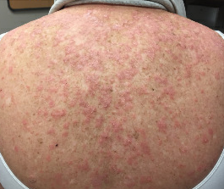
Case — Elizabeth R Plimack, MD, MS
Rash ultimately resolved. Q4 month cystoscopies – so far no recurrence of UC
Rash – upper back:

Slide 22
Case — Jonathan E Rosenberg, MD
55-year-old man presented with gross hematuria in 2018
Cystoscopy and TUR with CIS around L ureteral orifice
Received induction BCG x 6, negative cytology at 3 months
Received BCG maintenance x 3 doses
3 months later, pt had suspicious cytology, negative cystoscopy
3 months after, lateral wall erythema, TURBT showed CIS from left lateral wall

Slide 23
Case — Jonathan E Rosenberg, MD
Repeat induction BCG x 6
3 months later, TURBT, ureteroscopy: atypia from bladder; left renal pelvis bx with atypia; bladder cytology positive
3 months later, TURBT: CIS right anterior and left lateral wall; prostatic urethra with HG UCC with superficial lamina propria invasion
Then received intravesical gemcitabine/docetaxel x 6

Slide 24
Case — Jonathan E Rosenberg, MD
3 months after intravesical chemotherapy, TURBT: left lateral wall with CIS
Recommended for RC/diversion
CT urogram + chest – no upper tract or metastatic disease
Transferred care to tertiary center, TURBT showed CIS of posterior bladder wall

Slide 25
Case — Jonathan E Rosenberg, MD
Referred to medical oncology to discuss pembrolizumab
RC recommended, but pt refused
Started pembrolizumab
After 3 months of pembrolizumab, cystoscopy was negative, but cytology positive
CT urogram obtained, showed new urothelial thickening of proximal to mid right ureter concerning for tumor. No definite metastatic disease
Right ureteroscopy with HG upper tract UC. Recommended for radical nephroureterectomy and is currently receiving preoperative chemotherapy

Slide 26
Case — Elizabeth R Plimack, MD, MS
74-year-old man, presented with gross hematuria, found to have muscle-invasive bladder cancer (MIBC) (cT2N0M0)
Received 4 cycles of DDMVAC with a clinical complete response. He declined cystectomy
Cystoscopic and CT surveillance every 3 months was NED x 2

Slide 27
Case — Elizabeth R Plimack, MD, MS
At 9 months biopsy proven recurrent disease was noted in the bladder and one iliac LN.
His recurrent tumor was sequenced and compared to his primary. Mutations identified at diagnosis remained, additional mutations present.
Given LN, he had NAC again – DDMVAC x 3. Developed peripheral neuropathy.
Post-NAC imaging showed resolution of LAD, no distant disease.
He went for cystoprostatectomy with LND

Slide 28
Case — Elizabeth R Plimack, MD, MS
Recovered well from surgery.
Pathology showed no residual UC in the bladder, but occult nodal disease in the previously enlarged LN.
Adjuvant therapy was discussed, and patient elected to pursue adjuvant immunotherapy with a checkpoint inhibitor.

Slide 29
Case — Elizabeth R Plimack, MD, MS
Adjuvant immunotherapy was well tolerated, only mild dry mouth noted.
After completing 8 months of a 12 month planned course his imaging unfortunately showed a nodal recurrence.
He discontinued adjuvant therapy and was presented options for treatment of metastatic disease.

Slide 30
Case — Elizabeth R Plimack, MD, MS
Patient elected enfortumab vedotin.
He developed a pruritic rash:
Started after C1D8. C1D15 held. Resolved with 5d oral steroids.
Steroid premedication: Dex 4 mg day before, day of and day after each subsequent treatment helped but did not mitigate altogether.
Persistent and new skin toxicity required dose reduction and missed doses.
Additional toxicities included dysguesia and poor appetite resulting in weight loss.

Slide 31
Case — Elizabeth R Plimack, MD, MS
Post-EV imaging showed radiographic complete response
Complete resolution of previously seen pelvic LAD
No evidence of metastatic disease
Patient now enjoying a treatment break

Slide 32
Lancet Oncol 2021;22(7):919-30.

Slide 33
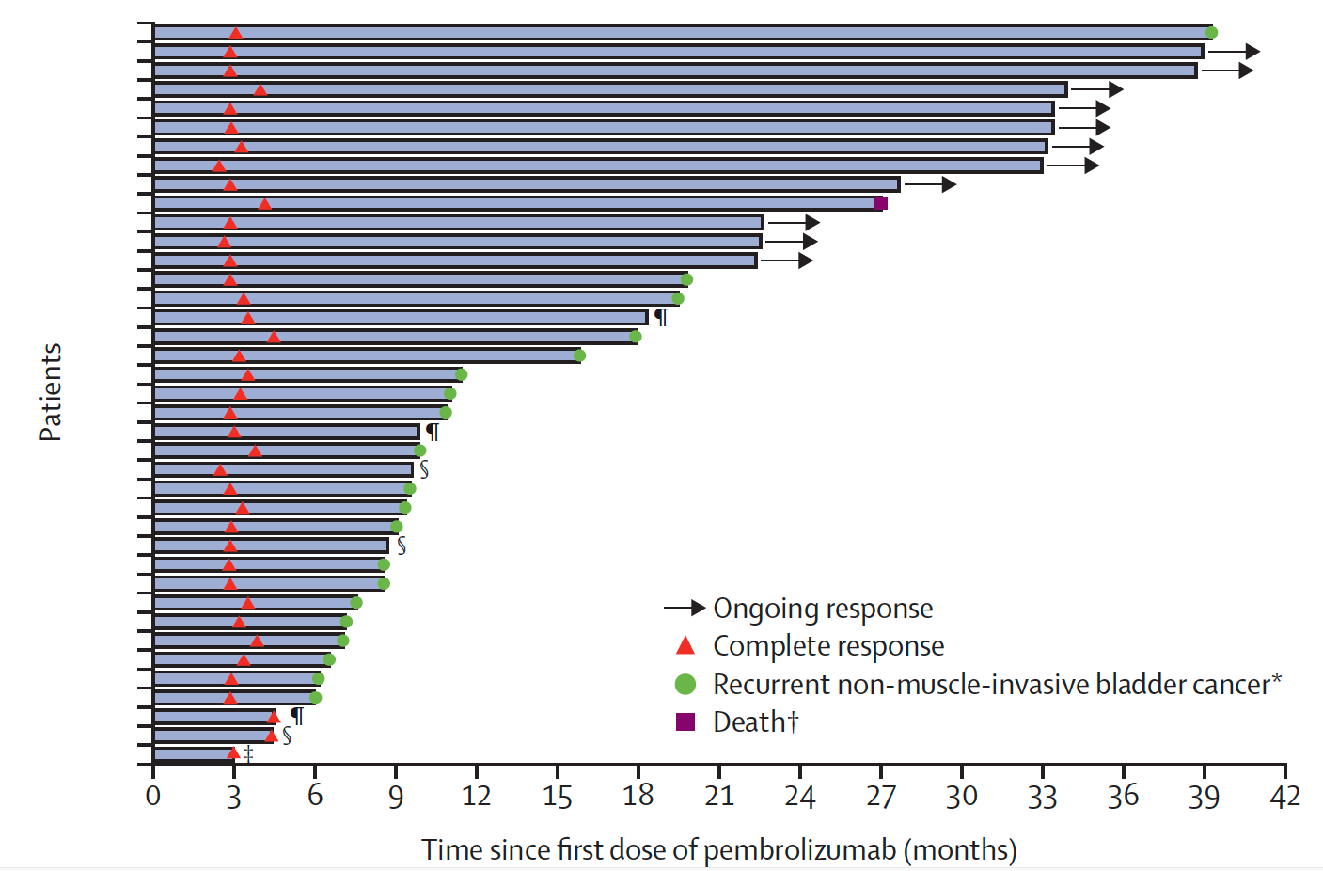
KEYNOTE-057: Pembrolizumab for High-Risk Non-Muscle-Invasive Bladder Cancer (NMIBC) Response, Duration of Response and Summary of Adverse Events (AEs)
Serious AEs: 8%
AEs leading to treatment interruption: 13%
Immune-related (IR) AEs: 22%
Grade 3/4 IRAEs: 3%
Complete response (CR) at 3 months: 41%
Median duration of CR: 16.2 mo
Balar AV et al. Lancet Oncol 2021;22(7):919-30.

Slide 34
Key Ongoing Phase III Trials of Anti-PD-1/PD-L1 Antibodies for NMIBC
Protocol | n | Randomization
ALBAN (NCT03799835) | 516 | Atezolizumab + BCG BCG
POTOMAC (NCT03528694) | 1,018 | Durvalumab + BCG BCG
KEYNOTE-676 (NCT03711032) | 1,405 | Pembrolizumab + BCG BCG
CheckMate 7G8 (NCT04149574) | 13 | Nivolumab + BCG BCG
BCG = Bacillus Calmette-Guérin
www.clinicaltrials.gov; Accessed May 2022.

Slide 35
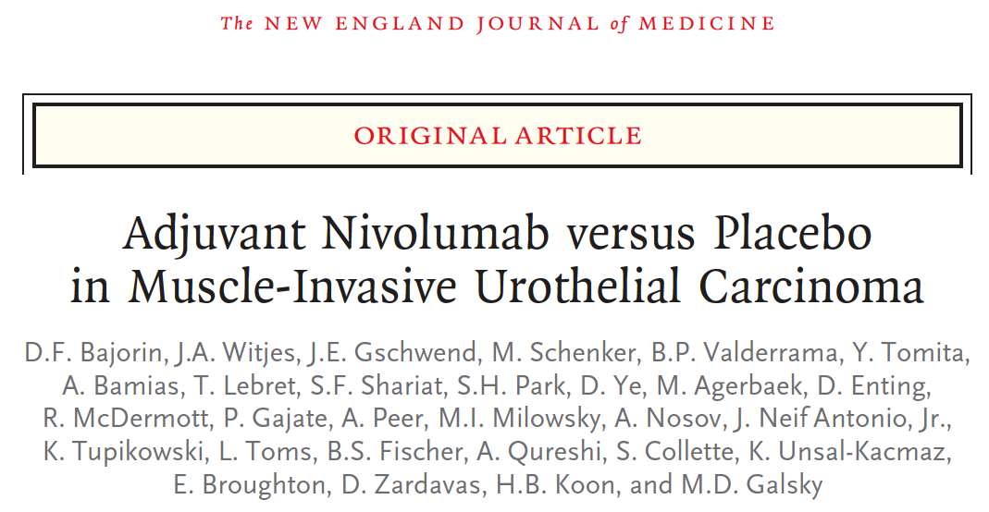
N Engl J Med 2021;384(22):2102-14.

Slide 36
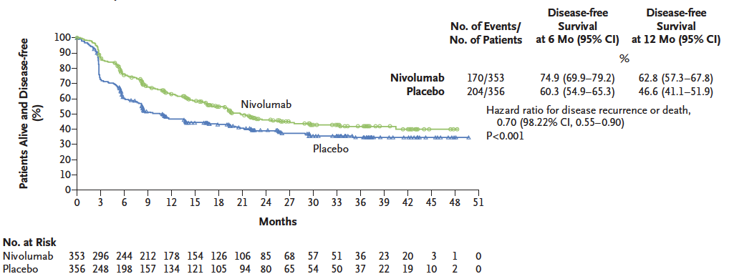
CheckMate 274: Adjuvant Nivolumab for High-Risk MIBC Disease-Free Survival in the Intent-to-Treat Population
Bajorin DF et al. N Engl J Med 2021;384(22):2102-14.

Slide 37
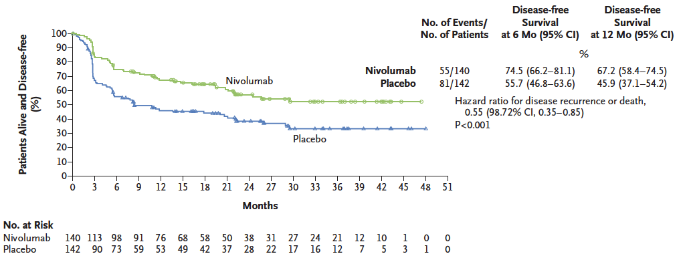
CheckMate 274: Adjuvant Nivolumab for High-Risk MIBC Disease-Free Survival for Patients with PD-L1 Expression of 1% or More
Bajorin DF et al. N Engl J Med 2021;384(22):2102-14.

Slide 38
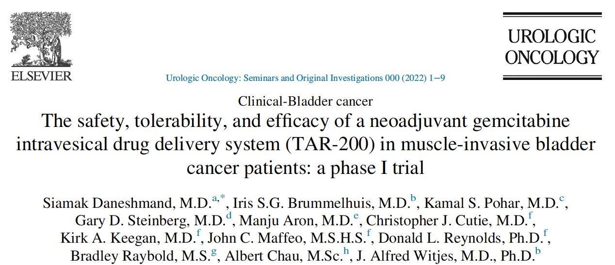
Urol Oncol 2022;[Online ahead of print].

Slide 39
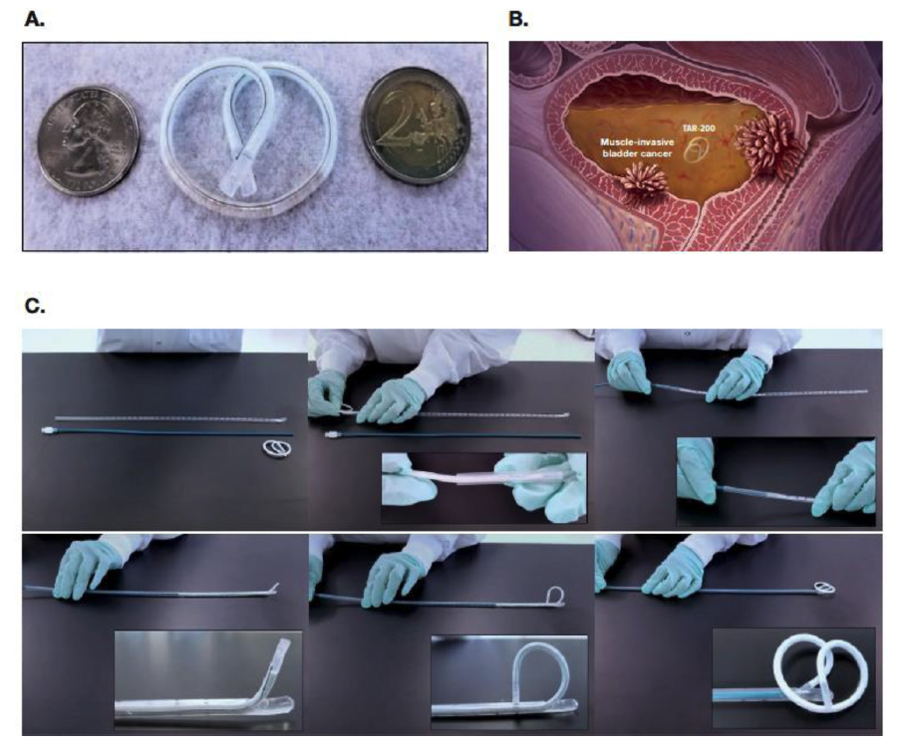
Components of TAR-200
TAR-200, a gemcitabine-releasing intravesical system, is formed into a “pretzel”-like configuration within the bladder.
TAR-200:
A. Consists of a small, flexible silicone tube filled with gemcitabine
B. Is designed to release drug directly inside the bladder over the indwelling period
C. Is inserted using a TARIS urinary placement catheter
Daneshmand S et al. Urol Oncol 2022;[Online ahead of print].

Slide 40
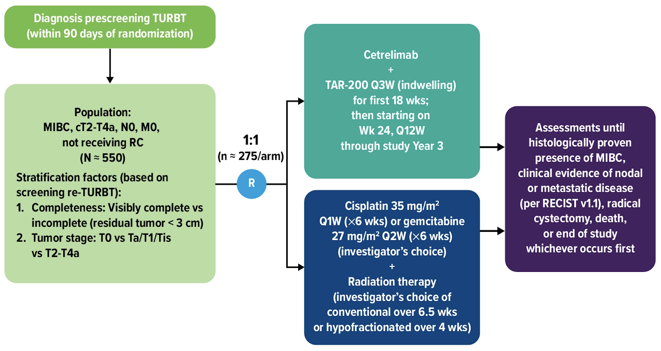
SunRISe-2: TAR-200 in Combination with Cetrelimab versus Concurrent Chemoradiation Therapy for Patients with MIBC
Williams SB et al. ASCO 2021;Abstract TPS4586.

Slide 41
2022 Abstract 435
Petrylak DP et al. Genitourinary Cancers Symposium 2022;Abstract 435.

Slide 42
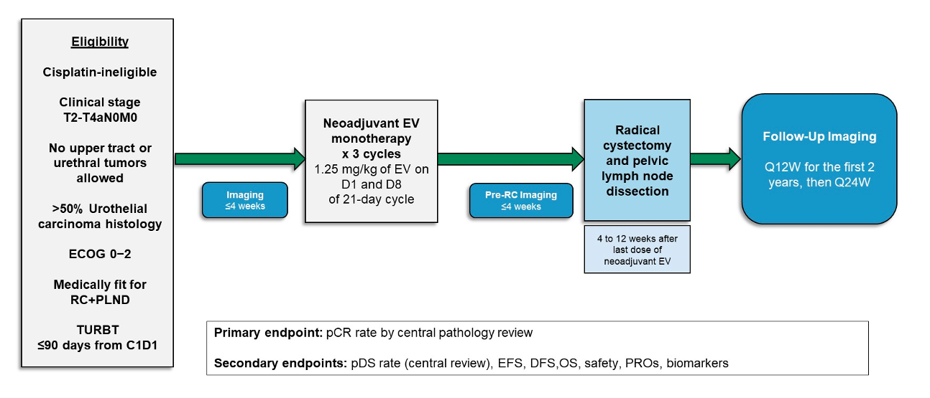
EV-103 Cohort H Study Schema
Petrylak DP et al. Genitourinary Cancers Symposium 2022;Abstract 435.

Slide 43
EV-103 Cohort H: Efficacy by Central Pathology Review
Petrylak DP et al. Genitourinary Cancers Symposium 2022;Abstract 435.

Slide 44
Phase II Study of Erdafitinib versus Investigator’s Choice of Intravesical Chemotherapy for Patients with Recurrence of High-Risk NMIBC After BCG
Eligibility (N = 280)
High-risk non-muscle-invasive bladder cancer FGFR mutations or fusions and recurrence after BCG therapy ECOG PS 0-1
Erdafitinib
PO on day 1 of 28-day cycle
Until 2 years treatment, disease progression, intolerable toxicity, consent withdrawal or investigator decision
R
Investigator’s choice
Intravesical gemcitabine or intravesical mitomycin C (MMC)/hyperthermic MMC
Primary endpoint: Relapse-free survival (RFS)
Secondary endpoints: Time to progression/disease worsening, disease-specific survival, overall survival, RFS2, safety
www.clinicaltrials.gov. NCT04172675. Accessed May 2022.

Slide 45
Agenda
Module 1 – Current and Future Management of Localized Urothelial Bladder Cancer (UBC)
Module 2 – First-Line Treatment for Patients with Metastatic UBC (mUBC)
Module 3 – Later-Line Therapeutic Options for Patients with mUBC; Novel Investigational Strategies

Slide 46
Case — Yohann Loriot, MD, PhD
An 81 yo gentleman referred to the GU oncology clinic for metastatic urothelial carcinoma
Comorbidities:
Renal failure (creatinine clearance = 40 mL/min)
Coronary heart disease
Pacemaker insertion (atrial fibrillation)
Disease history:
Haematuria in February 2020 → pathological mass in the right ureter
Radical nephroureterectomy in June 2018 → urothelial carcinoma pT3pN0
No perioperative systemic therapy
October 2020: He’s doing well (PS1) and he’s asymptomatic but CT scan revealed retroperitoneum lymph nodes

Slide 47
Any additional work-up?
Case — Yohann Loriot, MD, PhD
1- PD-L1 expression (CPS or IC)
2- FGFR2/3 mutation/fusion
3- TMB
4- Other
5- None

Slide 48
Case — Yohann Loriot, MD, PhD
CPS = 20%, FGFR3 S249C
Clinical strategies discussed:
1- Carbo/gemcitabine first and switch maintenance with avelumab if no progression
2- Atezolizumab/pembrolizumab
3- Chemotherapy + atezolizumab
4- Erdafitinib
5- Other

Slide 49
Case — Yohann Loriot, MD, PhD
The patient declined the chemotherapy and received 6 cycles of atezolizumab
Complete response of all LN except one in the mediastinum
Which option would you select?
1- Continue atezolizumab
2- Stop and wait
3- Radiotherapy on residual lesion
Baseline
After 6 cycles

Slide 50
Case — Yohann Loriot, MD, PhD
Additional cycles of atezolizumab were given with excellent tolerance
However, the new CT scan showed lung mets

Slide 51
Case — Yohann Loriot, MD, PhD
Again the patient declined the chemotherapy
EV was not available in this setting
Patient enrolled in a clinical trial with an FGFR inhibitor
After three months, the patient achieved a complete response

Slide 52
Case — Jonathan E Rosenberg, MD
71 yo woman presented with hematuria, cystoscopy showed sessile tumor
TURBT showed invasive urothelial carcinoma, NOS, involving the muscularis propria
Imaging showed no extravesical disease or metastases
Started gemcitabine and cisplatin neoadjuvant chemotherapy
Chemotherapy was poorly tolerated
Required switch to split dosing for renal insufficiency
Required growth factor support and dose reduction for cytopenias
Stopped after 3.5 cycles of gemcitabine and cisplatin
Post-chemo CT without metastases
Radical cystectomy and TAH-BSO
3.5 cm poorly differentiated UC with micropapillary and plasmacytoid features, pT3b, 7/20 LN involved, negative margins
Refused enrollment to AMBASSADOR (A031501) trial (pembro vs observation)

Slide 53
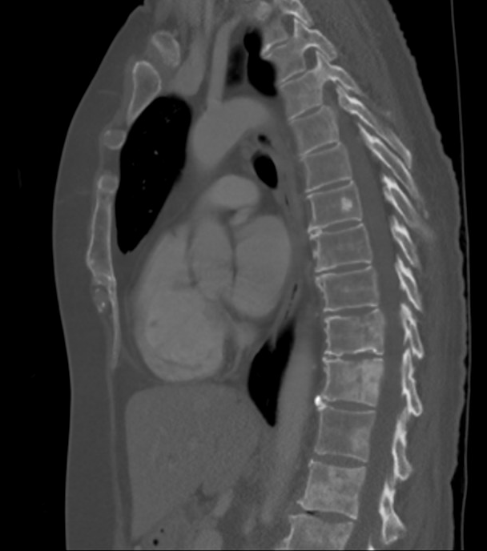
Case — Jonathan E Rosenberg, MD
CT just over 1 year following end of chemotherapy showed multiple mixed sclerotic and lytic lesions in the spine but no extraosseous tumors
Biopsy showed metastatic poorly differentiated carcinoma positive for p63, CK20, GATA-3, and CK5/6, negative for TTF1, immunoprofile similar to prior specimens
KPS 70% with fatigue and mild generalized back pain
NGS sequencing showed no actionable alterations
TP53, ATM, KDM6A, RPTOR, TERT promoter

Slide 54
Case — Jonathan E Rosenberg, MD
No measurable disease and therefore not a trial candidate
Poor tolerance to prior chemotherapy
Bone-only disease has poor track record for IO therapy
Relatively asymptomatic – mild pain, fatigue, MR without need for RT
Reviewed data from EV-103 cohort A with 73% ORR, data from EV with bone pain palliation, and pt elected compassionate use for combination therapy enfortumab and pembrolizumab

Slide 55
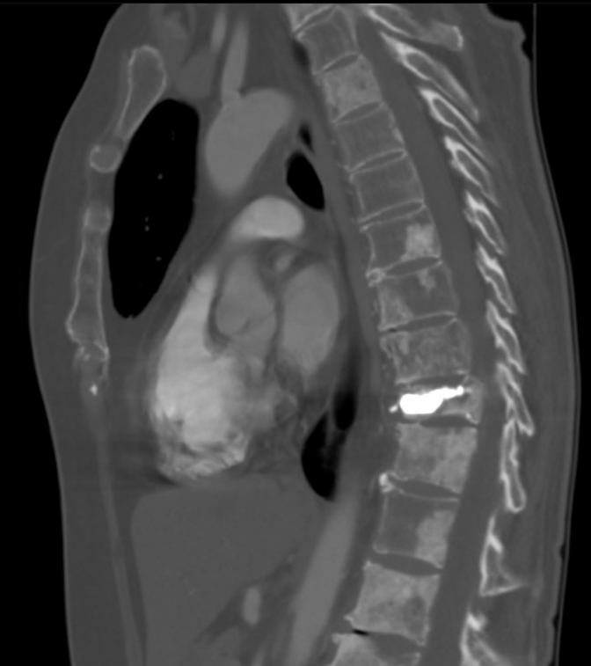
Case — Jonathan E Rosenberg, MD
Received enfortumab 1.25 mg/kg IV days 1 and 8 and pembrolizumab 200 mg IV day 1 every 21 days
Developed acute back pain during cycle 1, found to have compression fracture and underwent kyphoplasty with relief
Scans after cycle 2 showed sclerosis of bone lesions consistent with treatment effect, alkaline phosphatase went from 350 to 150, pain improved and KPS improved to 80%
After cycle 2

Slide 56
Case — Jonathan E Rosenberg, MD
Went on to receive 5 additional cycles of EV and pembrolizumab without significant complication except grade 1 neuropathy
At cycle 6, presented with increasing back and pelvic bone pain
Spinal MRI showed new epidural disease, and bone scan showed new pelvic metastases
Palliative RT administered to spine and pelvis
Performance status rapidly deteriorated, and pt decided for best supportive care and no further anticancer therapy
Passed away 4 weeks after radiation completed

Slide 57
2022
Abstract 487

Slide 58
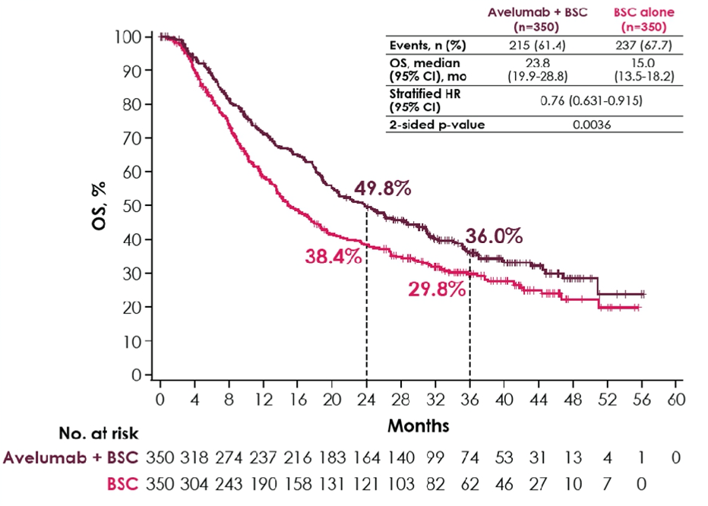
JAVELIN-100: Long-Term Overall Survival (OS)
Powles T et al. Genitourinary Cancers Symposium 2022;Abstract 487.

Slide 59
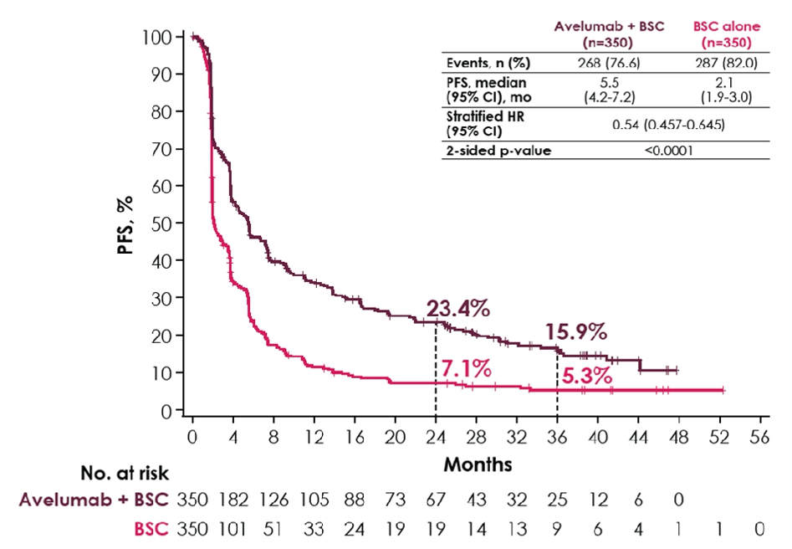
JAVELIN-100: Investigator-Assessed Progression-Free Survival (PFS)
Powles T et al. Genitourinary Cancers Symposium 2022;Abstract 487.

Slide 60
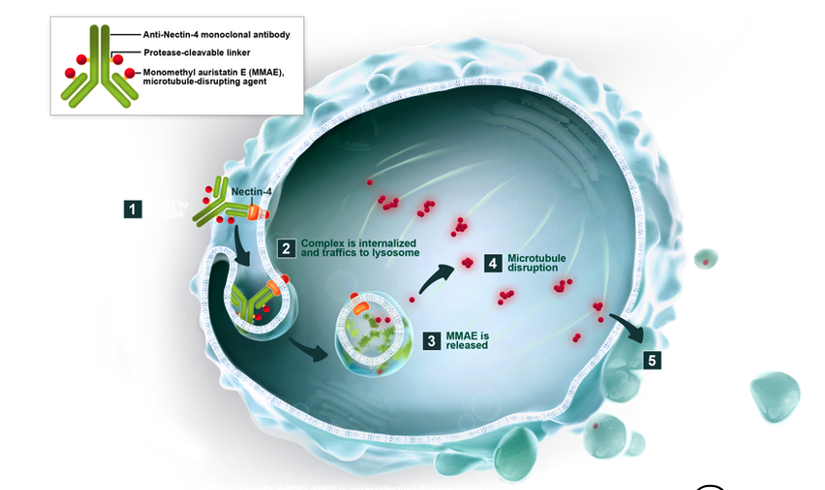
Enfortumab Vedotin: Nectin-4 Targeted Therapy
Anti-Nectin-4 monoclonal antibody
Protease-cleavable linker
Monomethyl auristatin E (MMAE), microtubule-disrupting agent
Courtesy of Jonathan E Rosenberg, MD

Slide 61
Study EV-103: Update on Durability Results and Long Term Outcome of Enfortumab Vedotin + Pembrolizumab in First Line Locally Advanced or Metastatic Urothelial Carcinoma (la/mUC)
Friedlander TW et al. ASCO 2021;Abstract 4528.

Slide 62
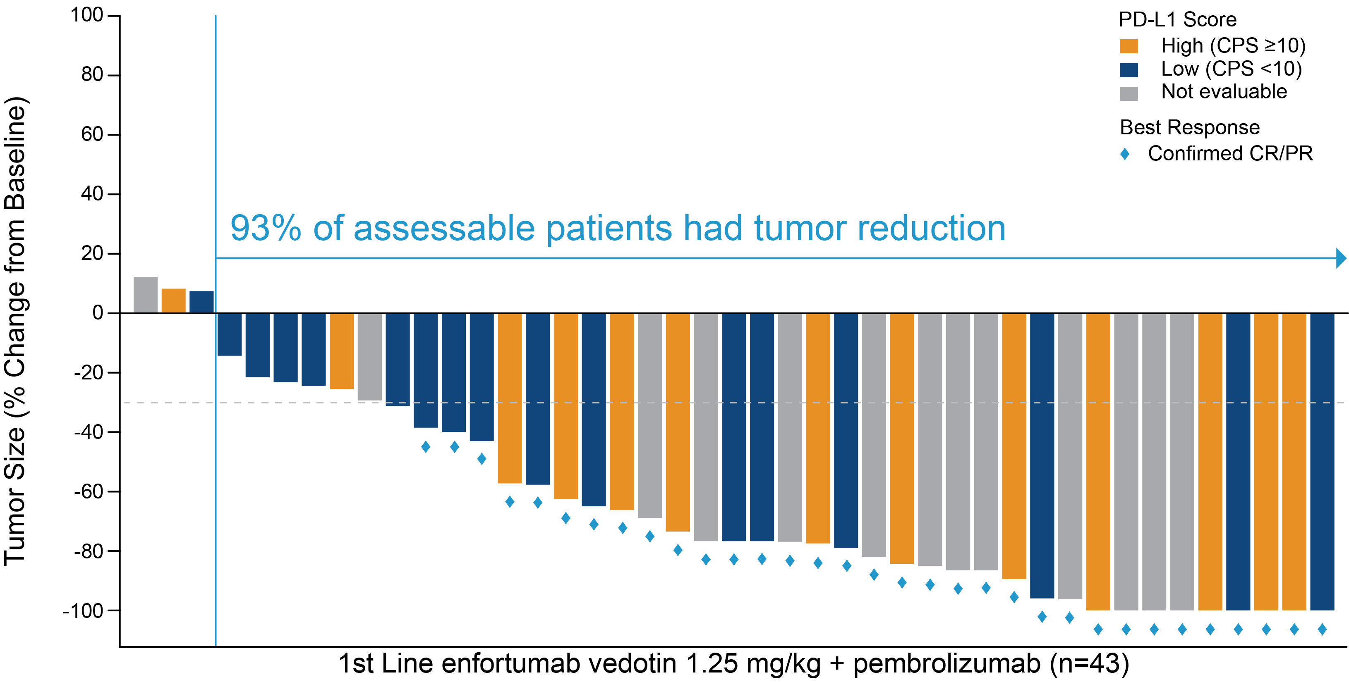
EV-103: Enfortumab Vedotin with Pembrolizumab as First-Line Therapy for Locally Advanced or Metastatic Urothelial Carcinoma
Friedlander TW et al. ASCO 2021;Abstract 4528.

Slide 63
Abstract LBA27

Slide 64
Rationale for Combining Erdafitinib and Cetrelimab
Powles T et al. ESMO 2021;Abstract LBA27.

Slide 65
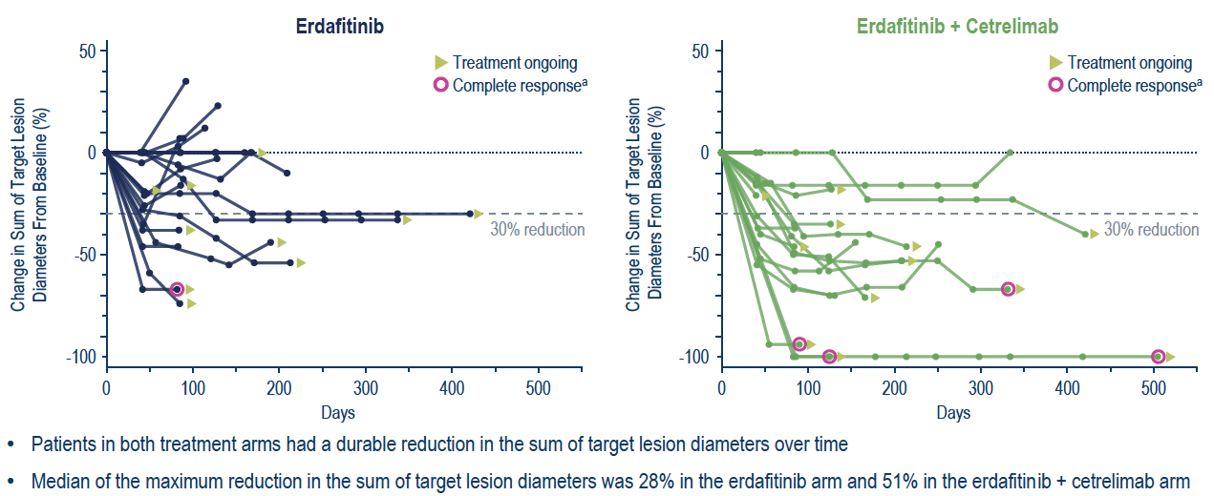
NORSE: Response and Antitumor Activity
ORR = 33%
ORR = 68%
Powles T et al. ESMO 2021;Abstract LBA27.

Slide 66
Agenda
Module 1 – Current and Future Management of Localized Urothelial Bladder Cancer (UBC)
Module 2 – First-Line Treatment for Patients with Metastatic UBC (mUBC)
Module 3 – Later-Line Therapeutic Options for Patients with mUBC; Novel Investigational Strategies

Slide 67
Case — Elizabeth R Plimack, MD, MS
79 yo former smoker, retired volunteer firefighter, motorcycle enthusiast
Presented with hematuria
Treated with BCG for T1 urothelial carcinoma
6 months later – lung metastases
Pt had donated one of his kidneys 30 years ago. His current creatinine 0.96, EGFR >60
PD-L1 testing was not performed

Slide 68
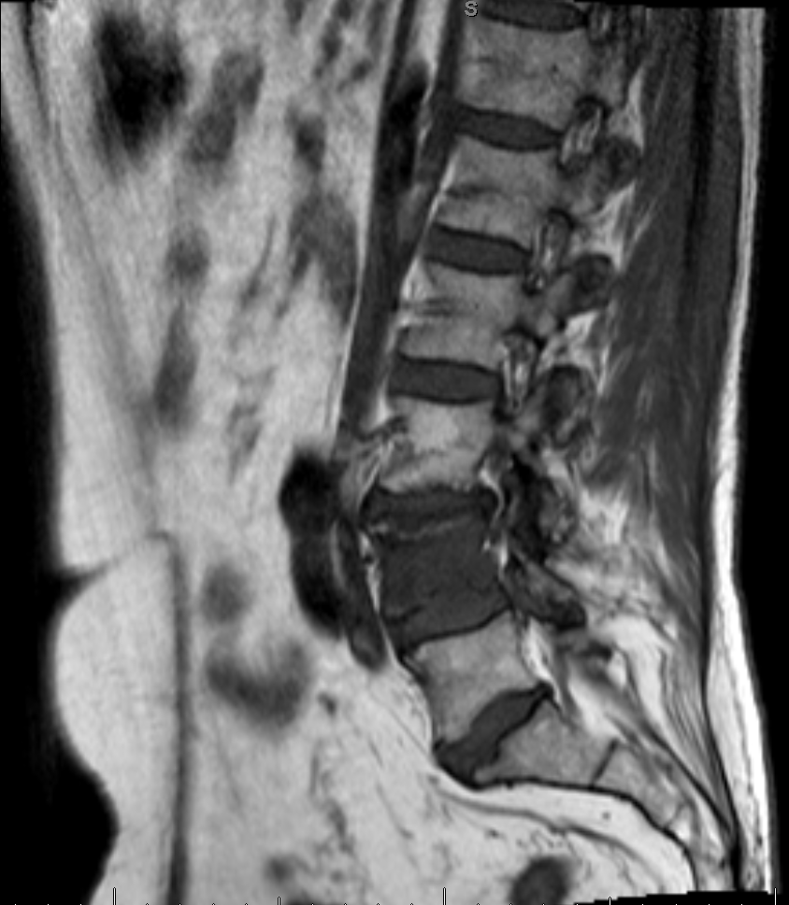
Case — Elizabeth R Plimack, MD, MS
Atezolizumab initiated
Response in the lung
At 9 months, PD with new lesion in the spine
Radiation to spine
Atezolizumab continued beyond PD
Ultimately discontinued after 2 years for PD in the lungs
Genomic testing not available

Slide 69
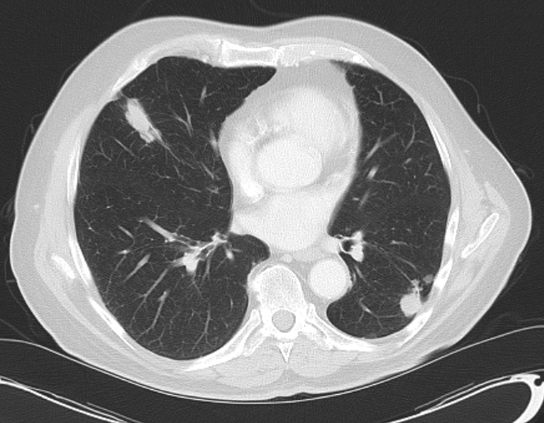
Case — Elizabeth R Plimack, MD, MS
Next-line therapy options
Pembrolizumab
Gemcitabine
Gemcitabine + carboplatin
Paclitaxel
Docetaxel
Enfortumab vedotin
Erdafitinib

Slide 70
Case — Elizabeth R Plimack, MD, MS
Started with gemcitabine
PD in lung lesions after 9 months → carboplatin added
At 18 months treatment stopped for chemo break in setting of response and cumulative toxicity
Molecular testing sent

Slide 71
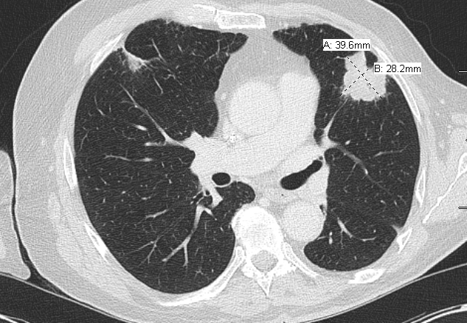
Case — Elizabeth R Plimack, MD, MS
Erdafitinib initiated at standard starting dose: 8 mg daily

Slide 72
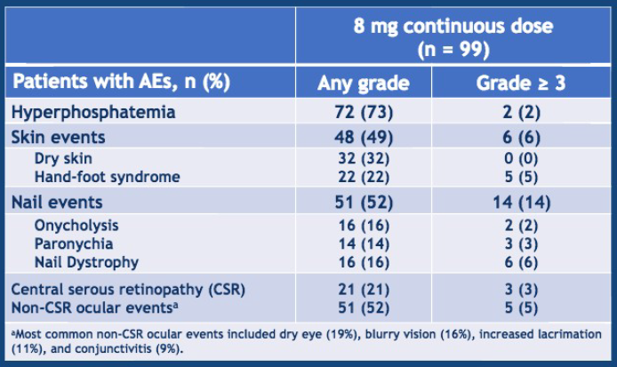
Phase II erdafitinib: Oral pan-FGFR (1-4) inhibitor
Case — Elizabeth R Plimack, MD, MS
Notable AEs: Hyperphosphatemia, skin/nail changes, central retinopathy
Siefker Radtke ASCO 2018
Loriot et al NEJM 2019

Slide 73
 Phosphorous
Erdafitinib
initiated
8 mg Daily
Erdafitinib
Held
Erdafitinib
Restarted 6 mg daily
Hold per
package
insert
Normal
Range
2.4 - 4.4

Slide 74
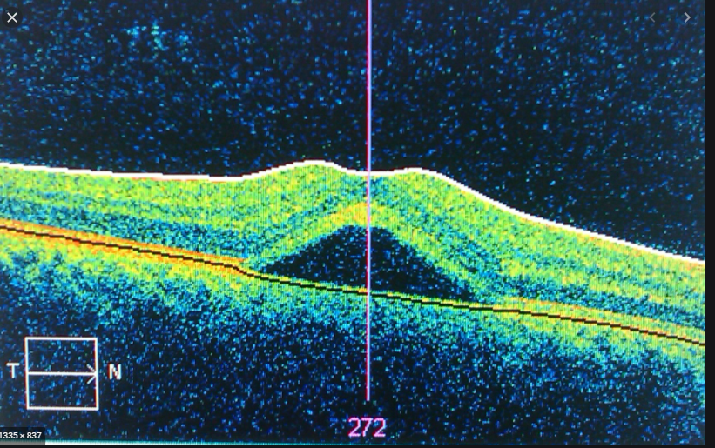
Case — Elizabeth R Plimack, MD, MS
Central serous retinopathy (CSR)
Routine monthly eye exams
At month 2, retinal imaging showed CSR
No changes in visual acuity

Slide 75
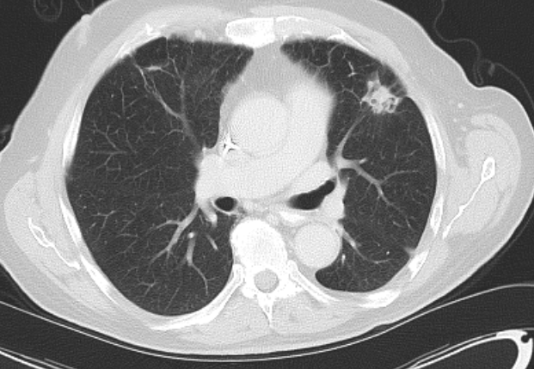
Erdafitinib: Response at 6 mg daily
Case — Elizabeth R Plimack, MD, MS

Slide 76
Case — Jonathan E Rosenberg, MD
59-year-old man presented 10 years ago with NMIBC treated with BCG
8 years ago, had a high grade upper tract UC treated with cisplatin and gemcitabine followed by nephroureterectomy → pT0N0
Subsequently developed bladder recurrence 1 year later with focus of high grade UC in background of low grade UC, cTa. Treated with BCG
CT 1 year later with lung metastases, s/p wedge resection confirming metastatic UC
Received atezolizumab with SD as best response, stopped after 1.5 years for progression, no autoimmune AEs
Underwent RFA of selected growing lung metastases and was off systemic therapy for 1 year
Subsequently was treated with enfortumab on EV-201 with partial response, continued therapy until progression at 1 year
Went on clinical trial of PRMT5 inhibitor with prolonged stable disease, stopped for fatigue and hematologic toxicity

Slide 77
Case — Jonathan E Rosenberg, MD
At progression, received gemcitabine/paclitaxel chemotherapy with partial response in lungs that lasted 1 year before having increasing size of lung tumors
Molecular testing without any druggable alterations
After sacituzumab govitecan was FDA approved, pt started on treatment

Slide 78
Case — Jonathan E Rosenberg, MD
In cycle 1, pt experienced neutropenic fever and was subsequently dose reduced to 7.5 mg/kg
CT after cycle 3 showed decreased soft tissue component of cavitary metastasis, other pulmonary lesions stable
Baseline
After cycle 3

Slide 79
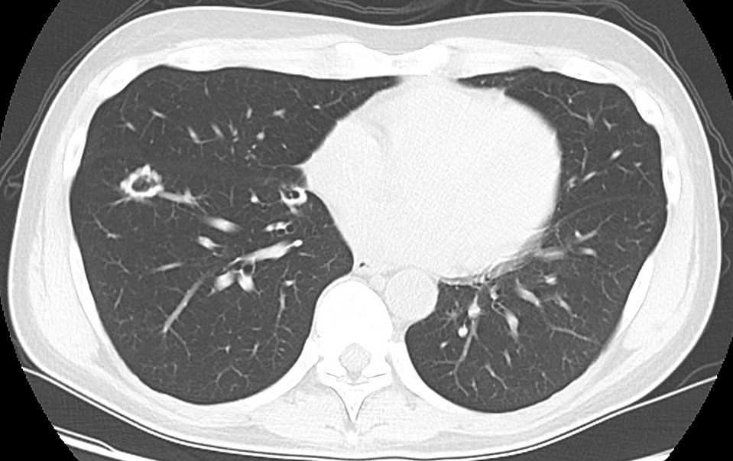
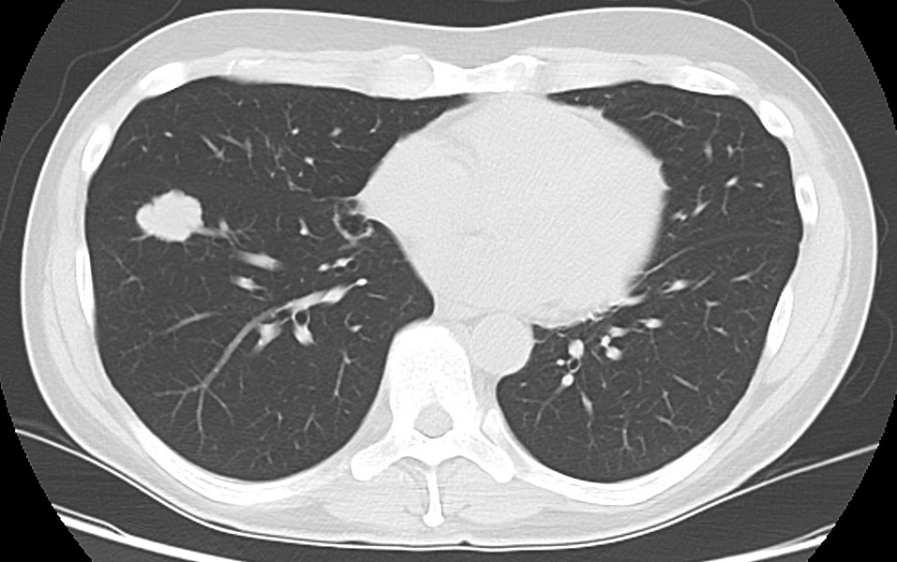
Case — Jonathan E Rosenberg, MD
Tolerated treatment well
Restaging scan after cycle 6 showed unchanged response/stable disease
After cycle 9, multiple pulmonary metastases increased in size and treatment was stopped
Baseline
After cycle 9

Slide 80
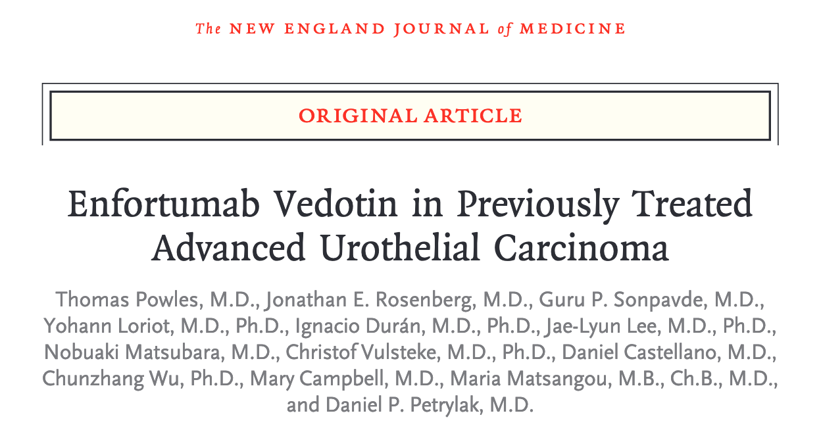
N Engl J Med 2021;384(12):1125-35.

Slide 81
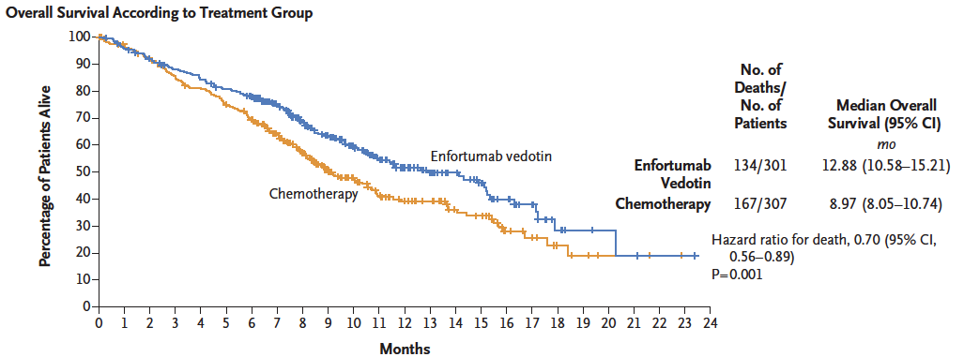
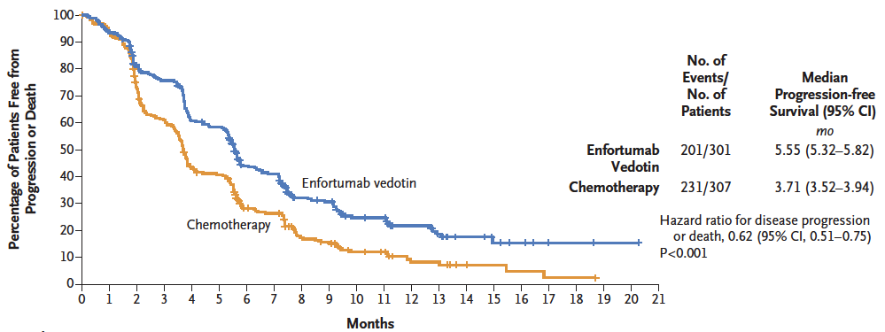
EV-301: Survival and Response Analyses
Overall Survival
 | EV (n = 301) | Chemo (n = 307)
ORR | 40.6% | 17.9%
DCR | 71.9% | 53.4%
HR: 0.70
p = 0.001
ORR = overall response rate; DCR = disease control rate
Progression-Free Survival
Incidence of treatment-related adverse events was similar in the 2 groups:
93.9% versus 91.8%
Incidence of events of Grade 3 or higher was also similar in the 2 groups:
51.4% versus 49.8%
HR: 0.62
p = 0.001
Powles T et al. N Engl J Med 2021;384(12):1125-35.

Slide 82
EV-301: Antitumor Response
 | EV (n = 288) | Chemotherapy (n = 296) | p-value
Overall response | 40.6% | 17.9% | <0.001
Complete response (CR) | 49% | 2.7%
Partial response (PR) | 35.8% | 15.2%
Stable disease (SD) | 31.3% | 35.5%
Disease control rate* | 71.9% | 53.4% | <0.001
Duration of response at 12 months | 27.7% | 19.8%
Time to response, median | 1.87 mo | 1.91 mo
*Disease control rate: CR + PR + SD at least 7 weeks
Powles T et al. N Engl J Med 2021;384(12):1125-35.

Slide 83
EV-301: Treatment-Related Adverse Events (TRAEs) of Special Interest
TRAE | Enfortumab vedotin (n = 296) |  | Chemotherapy (n = 291)
 | Any grade | Grade ≥3 | Any grade | Grade ≥3
Skin reactions | 47% | 33% | 16% | <1%
Peripheral neuropathy | 46% | 5% | 31% | <1%
Ocular disorders | 19% | <1% | 5% | <1%
Infusion-related reactions | 9% | 1% | 5% | 0
Hyperglycemia | 6% | 4% | <1% | 0
TRAE summary | Any grade |  | Any grade
Leading to dose reduction | 32% |  | 28%
Leading to dose interruption | 51% |  | 19%
Leading to dose withdrawal | 14% |  | 11%
Powles T et al. N Engl J Med 2021;384(12):1125-35.

Slide 84
Lancet Oncol 2021;22:872-82.

Slide 85
FGFR3 Genomic Alterations in Muscle-Invasive Bladder Cancer
Genomics of MIBC: TCGA
In muscle-invasive disease, FGFR3 mutations occur in ~20% of tumors, but protein and/or gene overexpression in ~50%.
Activating mutations of FGFR3 in ~75% of low-grade papillary bladder tumors.
FGFR3-TACC3 fusions are enriched in young, Asian, nonsmokers, upper tract tumors (invasive, high grade).
Preclinical evidence exists for activity of FGFR inhibitors in selected cells with FGFR alterations.
Robertson AG et al. Cell 2017;171(3):540-56; Cappellen D et al. Nat Genet 1999;23:18-20; Nassar A et al. JCO Precis Oncol 2018; Gust KM et al. Mol Cancer Ther 2013;12:1245-54; Grünewald S et al. Int J Cancer 2019; Sfakianos JP et al. Eur Urol 2015;68(6):970-7.

Slide 86
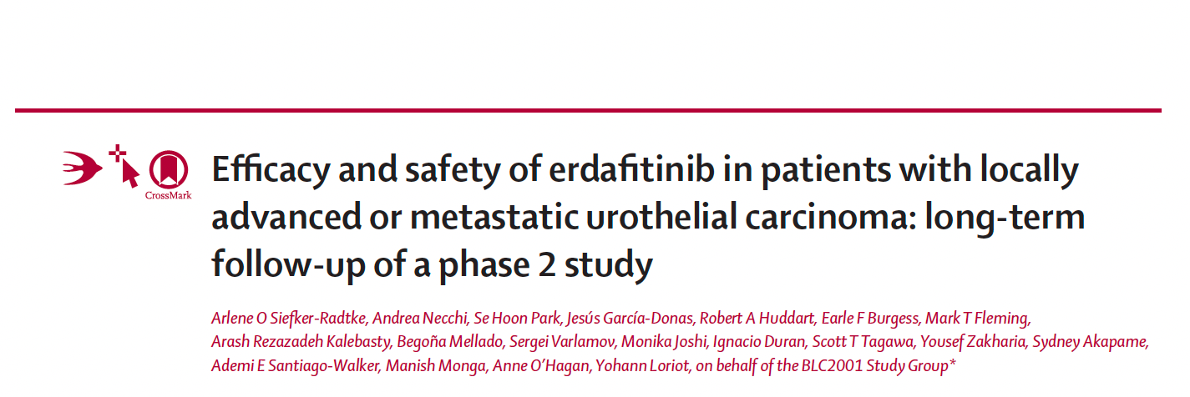
Lancet Oncol 2022;23:248-58.

Slide 87
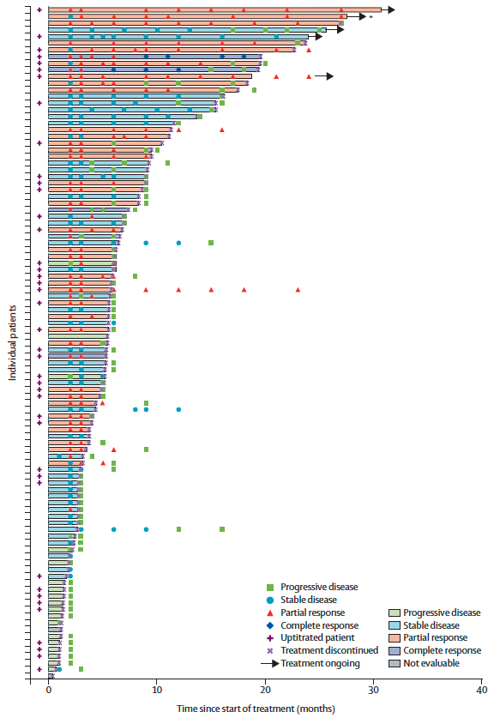
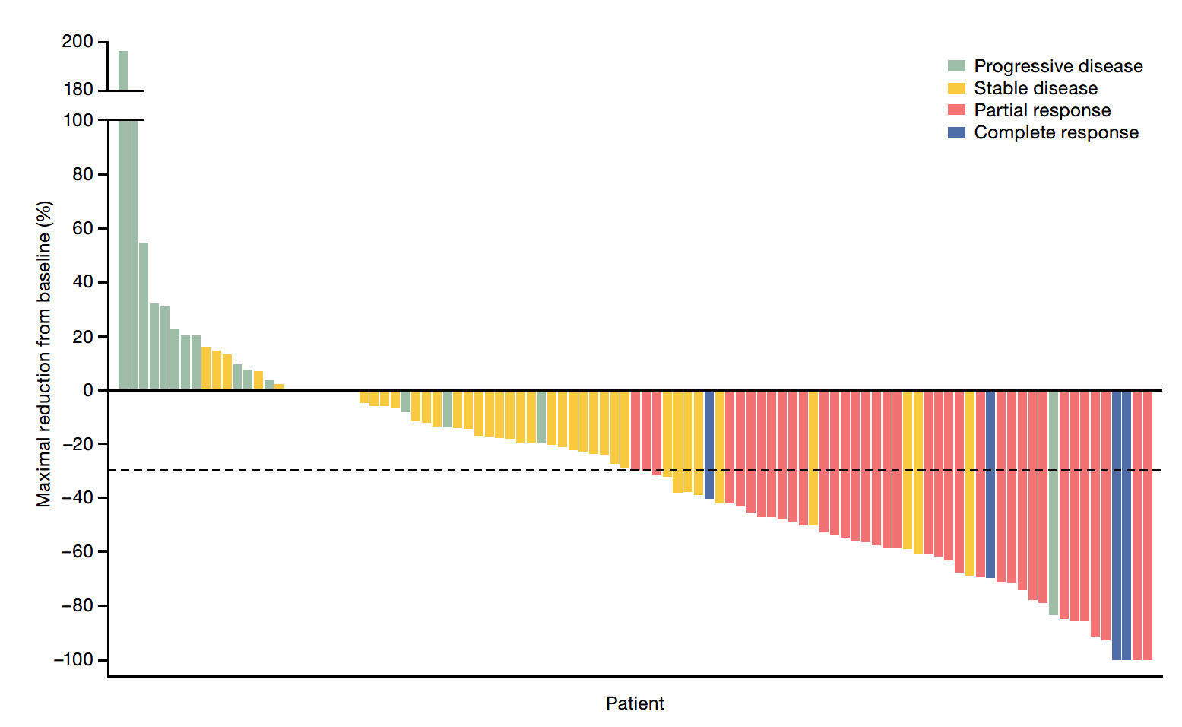
BLC2001: Responses in Patients Who Received the Selected 8 mg/Day Erdafitinib UpT Regimen
Objective response rate: 40%
Siefker-Radtke AO et al. Lancet Oncol 2022;23:248-58.

Slide 88
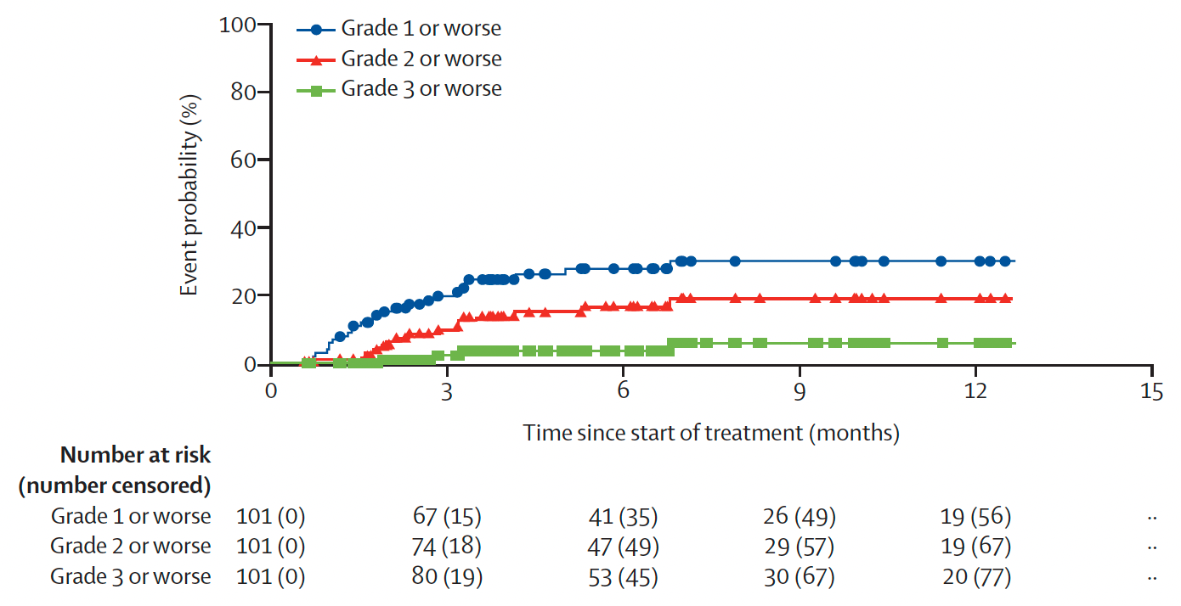
BLC2001: Post-Hoc Analysis of the Cumulative Incidence of First-Onset Central Serous Retinopathy Events by Grade
Siefker-Radtke AO et al. Lancet Oncol 2022;23:248-58.

Slide 89
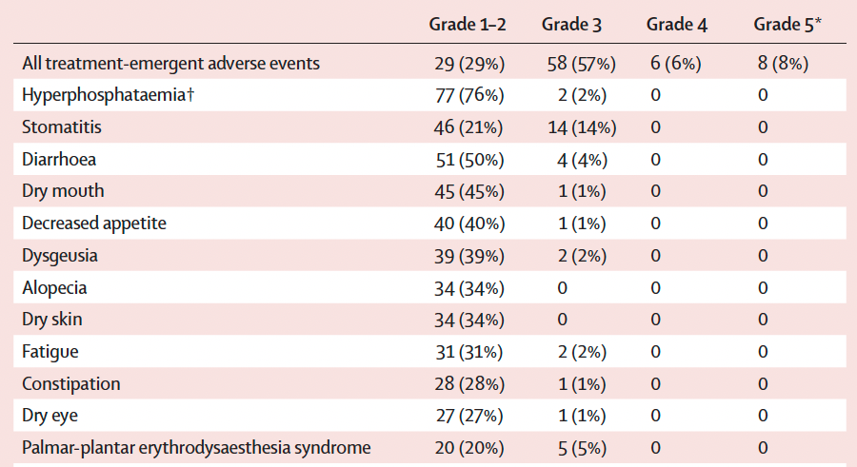
BLC2001: Select Treatment-Emergent Adverse Events
Siefker-Radtke AO et al. Lancet Oncol 2022;23:248-58.

Slide 90
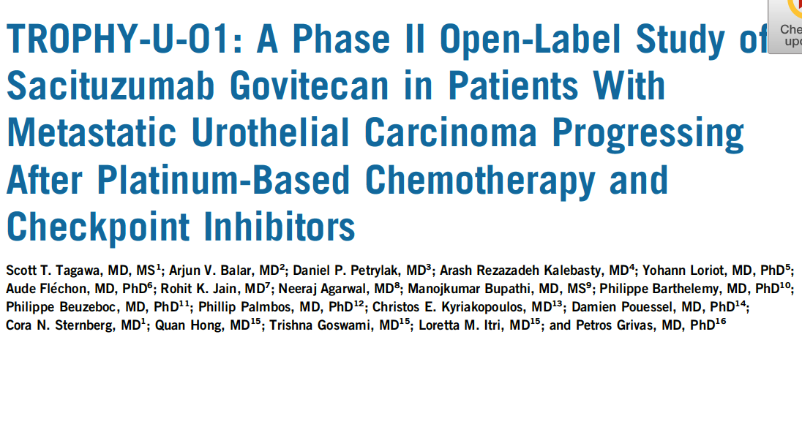
of
J Clin Oncol 2021;39(22):2474-85.

Slide 91
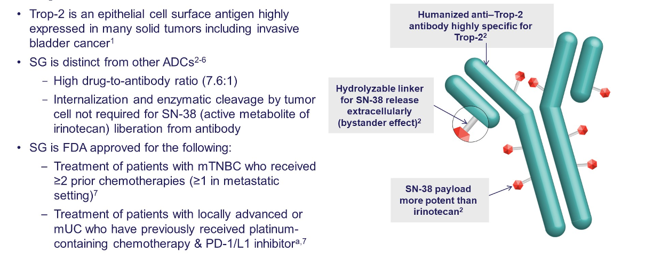
Sacituzumab Govitecan: A First-in-Class TROP2-Directed Antibody-Drug Conjugate
Grivas P et al. Genitourinary Cancers Symposium 2022;Abstract 434.

Slide 92
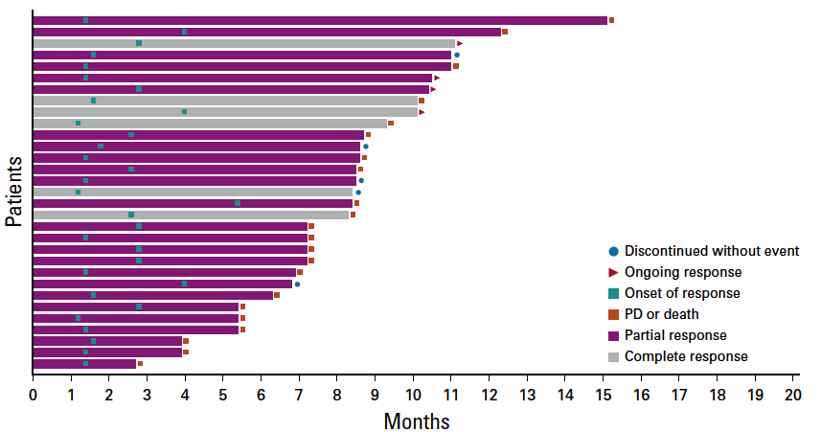
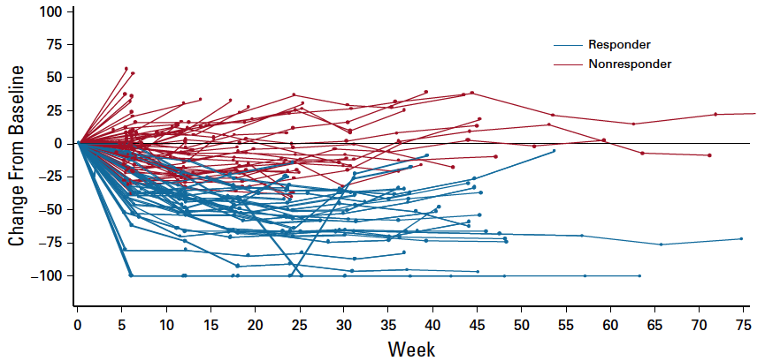
TROPHY U-01 (Cohort 1): Objective Response Rate, Duration of Response and Survival
Median DOR: 7.2 mo
Median time to onset of response: 1.6 mo
ORR: 27% (31/113)
Median PFS: 5.4 mo Median OS: 10.9 mo
Tagawa ST et al. J Clin Oncol 2021;39(22):2474-85; Loriot Y et al. ESMO 2020;Abstract LBA24.

Slide 93
2022 Abstract 434

Slide 94
TROPHY U-01: Overall Response and Best Change from Baseline in Tumor Size
Grivas P et al. Genitourinary Cancers Symposium 2022;Abstract 434.

Slide 95
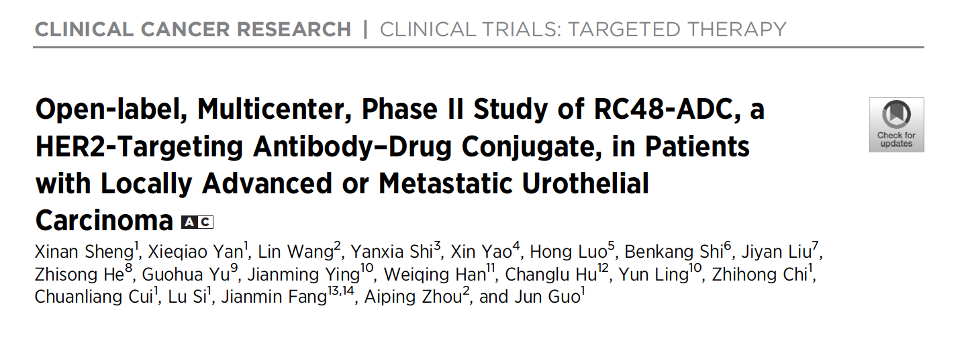
Clin Cancer Res 2021;27:43-51.

Slide 96
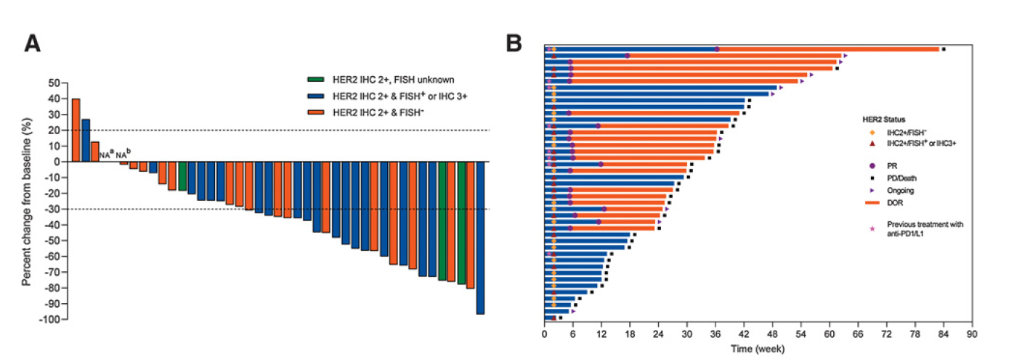
Phase II Study of Disitamab Vedotin (RC48) for HER2-Positive Locally Advanced or Metastatic Urothelial Carcinoma
Sheng X et al. Clin Cancer Res 2021;27:43-51.

Slide 97
Appendix of Key Data Sets

Slide 98
With permission from Terese Winslow LLC

Slide 99
TAR-200-101: Study Design and Outcomes
Response
Daneshmand S et al. Urol Oncol 2022;[Online ahead of print].

Slide 100
SunRISe-1: Ongoing Phase IIb Trial of TAR-200, Cetrelimab, or the Combination for BCG-Unresponsive, High-Risk NMIBC
Clinical trial identifier: NCT04640623
Primary endpoint: Overall clinical response rate
Van der Heijden SB et al. ESMO 2021;Abstract 719TiP.

Slide 101
Lancet 2020;395:1547-57.

Slide 102
IMvigor130: Overall Survival (OS) with Monotherapy (Arm B vs Arm C)
13.1 mo
(11.7, 15.1)
15.7 mo
(13.1, 17.8)
Galsky MD et al. Lancet 2020;395(10236):1547-57.

Slide 103
IMvigor130: OS by PD-L1 Status
Galsky MD et al. Lancet 2020;395(10236):1547-57.

Slide 104
Lancet Oncol 2021;22:931-45.

Slide 105
KEYNOTE-361: Progression-Free and Overall Survival with Pembrolizumab and Chemotherapy
PFS
OS
Powles T et al. Lancet Oncol 2021;22:931-45.

Slide 106
KEYNOTE-361: OS with Pembrolizumab Alone
PD-L1 CPS ≥10
ITT
CPS = combined positive score
Powles T et al. Lancet Oncol 2021;22:931-45.

Slide 107
CheckMate 901 Evaluating Nivolumab with Ipilimumab as First-Line Treatment for Unresectable or Metastatic Urothelial Carcinoma Fails to Meet Primary Endpoint Press Release: May 16, 2022
“The Phase 3 CheckMate-901 trial, comparing nivolumab plus ipilimumab to standard-of-care chemotherapy as a first-line treatment for patients with untreated unresectable or metastatic urothelial carcinoma, did not meet the primary endpoint of overall survival (OS) in patients whose tumor cells express PD-L1 ≥1% at final analysis. The company remains blinded to the data, and an independent Data Monitoring Committee recommended that the trial continue to assess other primary and secondary endpoints. No new safety signals were observed at the time of the analysis.
The CheckMate -901 trial is also assessing nivolumab plus ipilimumab in patients with unresectable or metastatic urothelial carcinoma who are ineligible for cisplatin-based chemotherapy. Additionally, a sub-study of CheckMate-901 with pivotal intent is evaluating nivolumab in combination with chemotherapy versus chemotherapy alone in patients who are eligible for cisplatin-based chemotherapy.”
https://news.bms.com/news/corporate-financial/2022/Bristol-Myers-Squibb-Provides-Update-on-CheckMate--901-Trial-Evaluating-Opdivo-nivolumab-Plus-Yervoy-ipilimumab-as-First-Line-Treatment-for-Patients-with-Unresectable-or-Metastatic-Urothelial-Carcinoma/default.aspx

Slide 108
Genitourinary Cancers Symposium 2022;Abstract 432

Slide 109
LEAP-011 Study Design
Loriot Y et al. Genitourinary Cancers Symposium 2022;Abstract 432.

Slide 110
LEAP-011: Progression-Free Survival by BICR
BICR = blinded independent central review
Loriot Y et al. Genitourinary Cancers Symposium 2022;Abstract 432.

Slide 111
LEAP-011: Overall Survival
Loriot Y et al. Genitourinary Cancers Symposium 2022;Abstract 432.

Slide 112
LEAP-011: Confirmed ORR by BICR
Loriot Y et al. Genitourinary Cancers Symposium 2022;Abstract 432.

Slide 113
LEAP-011: Summary of Treatment-Related Adverse Events
Loriot Y et al. Genitourinary Cancers Symposium 2022;Abstract 432.

Slide 114
JAVELIN-100 Study Design
Powles T et al. Genitourinary Cancers Symposium 2022;Abstract 487.

Slide 115
2022 Abstract 439

Slide 116
The ARIES Study Design
Iacovelli R et al. Genitourinary Cancers Symposium 2022;Abstract 439.

Slide 117
ARIES Primary Endpoint: 1-Year and Median Overall Survival
Iacovelli R et al. Genitourinary Cancers Symposium 2022;Abstract 439.

Slide 118
ARIES Secondary Endpoint: Overall Survival by PD-L1 Expression
Iacovelli R et al. Genitourinary Cancers Symposium 2022;Abstract 439.

Slide 119
ARIES Secondary Endpoint: Response Rate
Iacovelli R et al. Genitourinary Cancers Symposium 2022;Abstract 439.

Slide 120
Lancet Oncol 2021;22:872-82.

Slide 121
EV-201: Efficacy in Cisplatin-Ineligible Patients with Advanced Urothelial Carcinoma Previously Treated with PD-1 or PD-L1 Inhibitor Therapy
Objective response rate per BICR: 52%
Median duration of response: 10.9 months
Median PFS: 5.8 months
Cohort 2 included adults (aged ≥18 years) with an ECOG PS score of 2 or less who were considered ineligible for cisplatin at enrolment and who had not received platinum-containing chemotherapy in the locally advanced or metastatic setting.
Yu EY et al. Lancet Oncol 2021;22:872-82.

Slide 122
NORSE: Phase II Trial Design
ORR = overall response rate; DCR = disease control rate; DOR = duration of response
Powles T et al. ESMO 2021;Abstract LBA27.

Slide 123
NORSE: Safety
ORR = 33%
ORR = 68%
TEAE = treatment-emergent adverse event
Powles T et al. ESMO 2021;Abstract LBA27.

Slide 124
NORSE: Treatment-Emergent Adverse Events
ORR = 33%
ORR = 68%
Powles T et al. ESMO 2021;Abstract LBA27.

Slide 125
Rationale for Targeting FGFR in Urothelial Carcinoma (UC)^{1,2}
FGFR Signaling Pathway³
FGFR is altered in 15%-20% of advanced UC⁴
Mutated FGFR3 is present in 37% of upper-tract UC⁵
FGFR alterations: Amplification (receptor overexpression) or mutation/translocation (ligand-independent signaling)
FGF ligand: Amplification (autocrine), or ECM/stromal cell release (paracrine)
Cancer Type | Frequency of FGFR Alterations¹
Metastatic UC | 15%-20%
NMIBC | 40%-70%
Cholangiocarcinoma | 14%-22%
NSCLC | 4%
HCC (FGF19 amp by FISH) | 21%
Glioblastoma | 23%
Breast cancer | 3%-5%
Ovarian cancer | 7%
Head and neck cancer | 9%-17%
1. The Cancer Genome Atlas (TCGA) genomic alteration database: https://tcga-data.nci.nih.gov/docs/publications/tcga/. Accessed February 6, 2020. 2. Genomics Evidence Neoplasia Information Exchange (GENIE) genomic alteration database: https://www.aacr.org/Research/Research/pages/aacr-project-genie.aspx. Accessed February 6, 2020. 3. Touat M et al. Clin Cancer Res. 2015;21:2684-2694. 4. Rodriguez-Vida A et al. J Hematol Oncol. 2015;8:119. 5. Li Q et al. Curr Urol Rep. 2016;17:12.

Slide 126
Antibody-Drug Conjugates in UBC
Courtesy of Matthew D Galsky, MD

Slide 127
2022 Abstract 434

Slide 128
TROPHY U-01 Multicohort-Phase Trial in Metastatic Urothelial Carcinoma
Grivas P et al. Genitourinary Cancers Symposium 2022;Abstract 434.

Slide 129
TROPHY U-01: Objective Response Rate by Subgroup and Individual Response Assessment
Grivas P et al. Genitourinary Cancers Symposium 2022;Abstract 434.

Slide 130
TROPHY U-01: Most Common Treatment-Related Adverse Events for All Patients
Grivas P et al. Genitourinary Cancers Symposium 2022;Abstract 434.

Slide 131
Cabozantinib in Combination with Atezolizumab in Urothelial Carcinoma Previously Treated with Platinum-Containing Chemotherapy: Results from Cohort 2 of the COSMIC-021 Study
Pal SK et al. ASCO 2020;Abstract 5013.

Slide 132
COSMIC-021: Study Design for UC Expansion Cohort 2
Pal SK et al. ASCO 2020;Abstract 5013.

Slide 133
COSMIC-021: Immune-Related Adverse Events (AEs)
Pal SK et al. ASCO 2020;Abstract 5013.

Slide 134
COSMIC-021: Tumor Response by RECIST v1.1, Investigator Report
Pal SK et al. ASCO 2020;Abstract 5013.

Slide 135
Cabozantinib (C) in Combination with Atezolizumab (A) in Urothelial Carcinoma (UC): Results from Cohorts 3, 4, 5 of the COSMIC-021 Study
Pal SK et al. ASCO 2022;Abstract 4504.
June 3, 2022 – 5:09 PM EDT

Slide 136
A Randomised, Double Blind, Phase II Clinical Trial of Maintenance Cabozantinib Following Chemotherapy for Metastatic Urothelial Carcinoma (mUC): Final Analysis of the ATLANTIS Cabozantinib Comparison
Jones RJ et al. ASCO 2022;Abstract LBA4505.
June 3, 2022 – 5:21 PM EDT

