Slide 1
Cholangiocarcinoma and other biliary tract cancers
Juan W Valle
Professor of Medical Oncology
University of Manchester / The Christie
01 July 2022

Slide 2
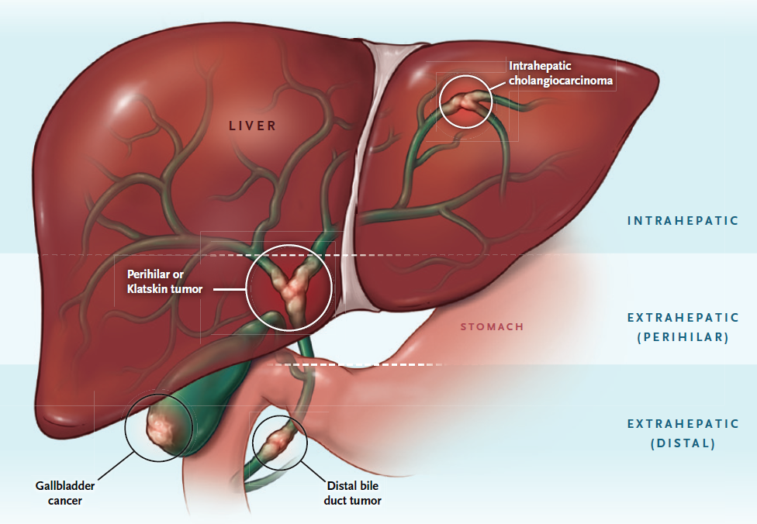
Biliary tract cancer | context
Heterogeneous group of malignancies
Mostly adenocarcinomas
Low-incidence in West (0.35-2/100,000)
Global “hot spots”
CCA: NW Thailand, Lao PDR, China
GBC: India, Chile
Aggressive behaviour - most patients present with unresectable (locally advanced or metastatic disease)
Valle et al Lancet 2021 Jan 30;397(10272):428-444; Figure from Goyal et al. N Engl J Med 2021;384(11):1054-1064

Slide 3
Systemic chemotherapy | modest progress
Chemotherapy for advanced disease
ABC-02: CisGem improves OS in 1L (UK)
BT22: CisGem improves OS in 1L (Japan)
CisGem-S1 improves OS vs CisGem in 1L (Japan)
FUGA-BT: gem-S1 non-inferior to CisGem in 1L (Japan)
Advanced disease
Chemotherapy
ABC-06: FOLFOX improves OS in 2L (UK)
NIFTY: nal-iri /5-FU improves PFS/OS in 2L (S Korea)
2010 | 2011 | 2012 | 2013 | 2014 | 2015 | 2016 | 2017 | 2018 | 2019 | 2020
2021
Adapted from Valle et al Lancet 2021; 397(10272):428-444

Slide 4
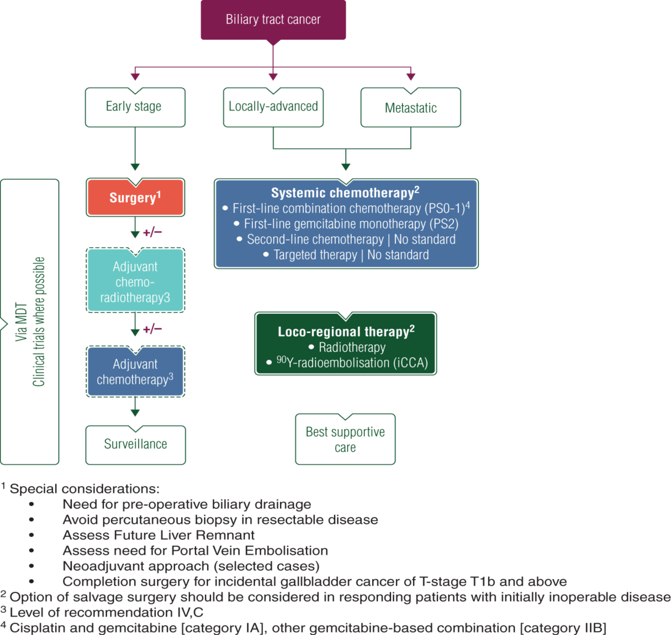
ESMO guidelines*
* update in progress
Chemotherapy
First-line: CisGem
Second-line: FOLFOX
Rapidly evolving
BILCAP: Stronger level of recommendation
CCA, cholangiocarcinoma; iCCA, intrahepatic CCA; MDT, multidisciplinary team; PS, performance status.
Valle JW, et al. Ann Oncol. 2016;27(suppl5):v28–v37.

Slide 5
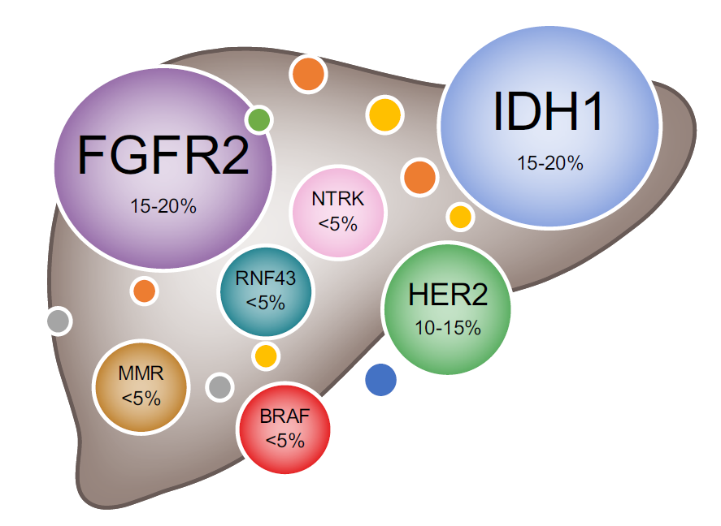
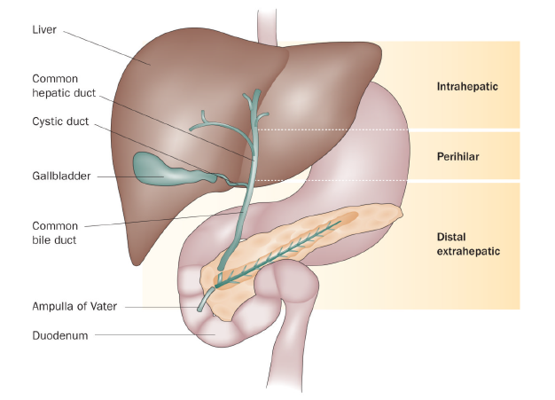
Advanced biliary tract cancer | from
anatomical to molecular subgroups
Anatomical¹
Molecular²
BRAF, B-Raf proto-oncogene; FGFR2, fibroblast growth factor receptor 2; HER2, human epidermal growth factor receptor 2; IDH1, isocitrate dehydrogenase 1; MMR, mismatch repair deficiency; NTRK, neurotrophic receptor tyrosine kinase; RNF43, ring finger protein 43.
1. Blechacz B, et al. Nat Rev Gastroenterol Hepatol. 2011;8:512–22; 2. Lamarca A, et al. J Hepatol. 2020;73:170–85

Slide 6
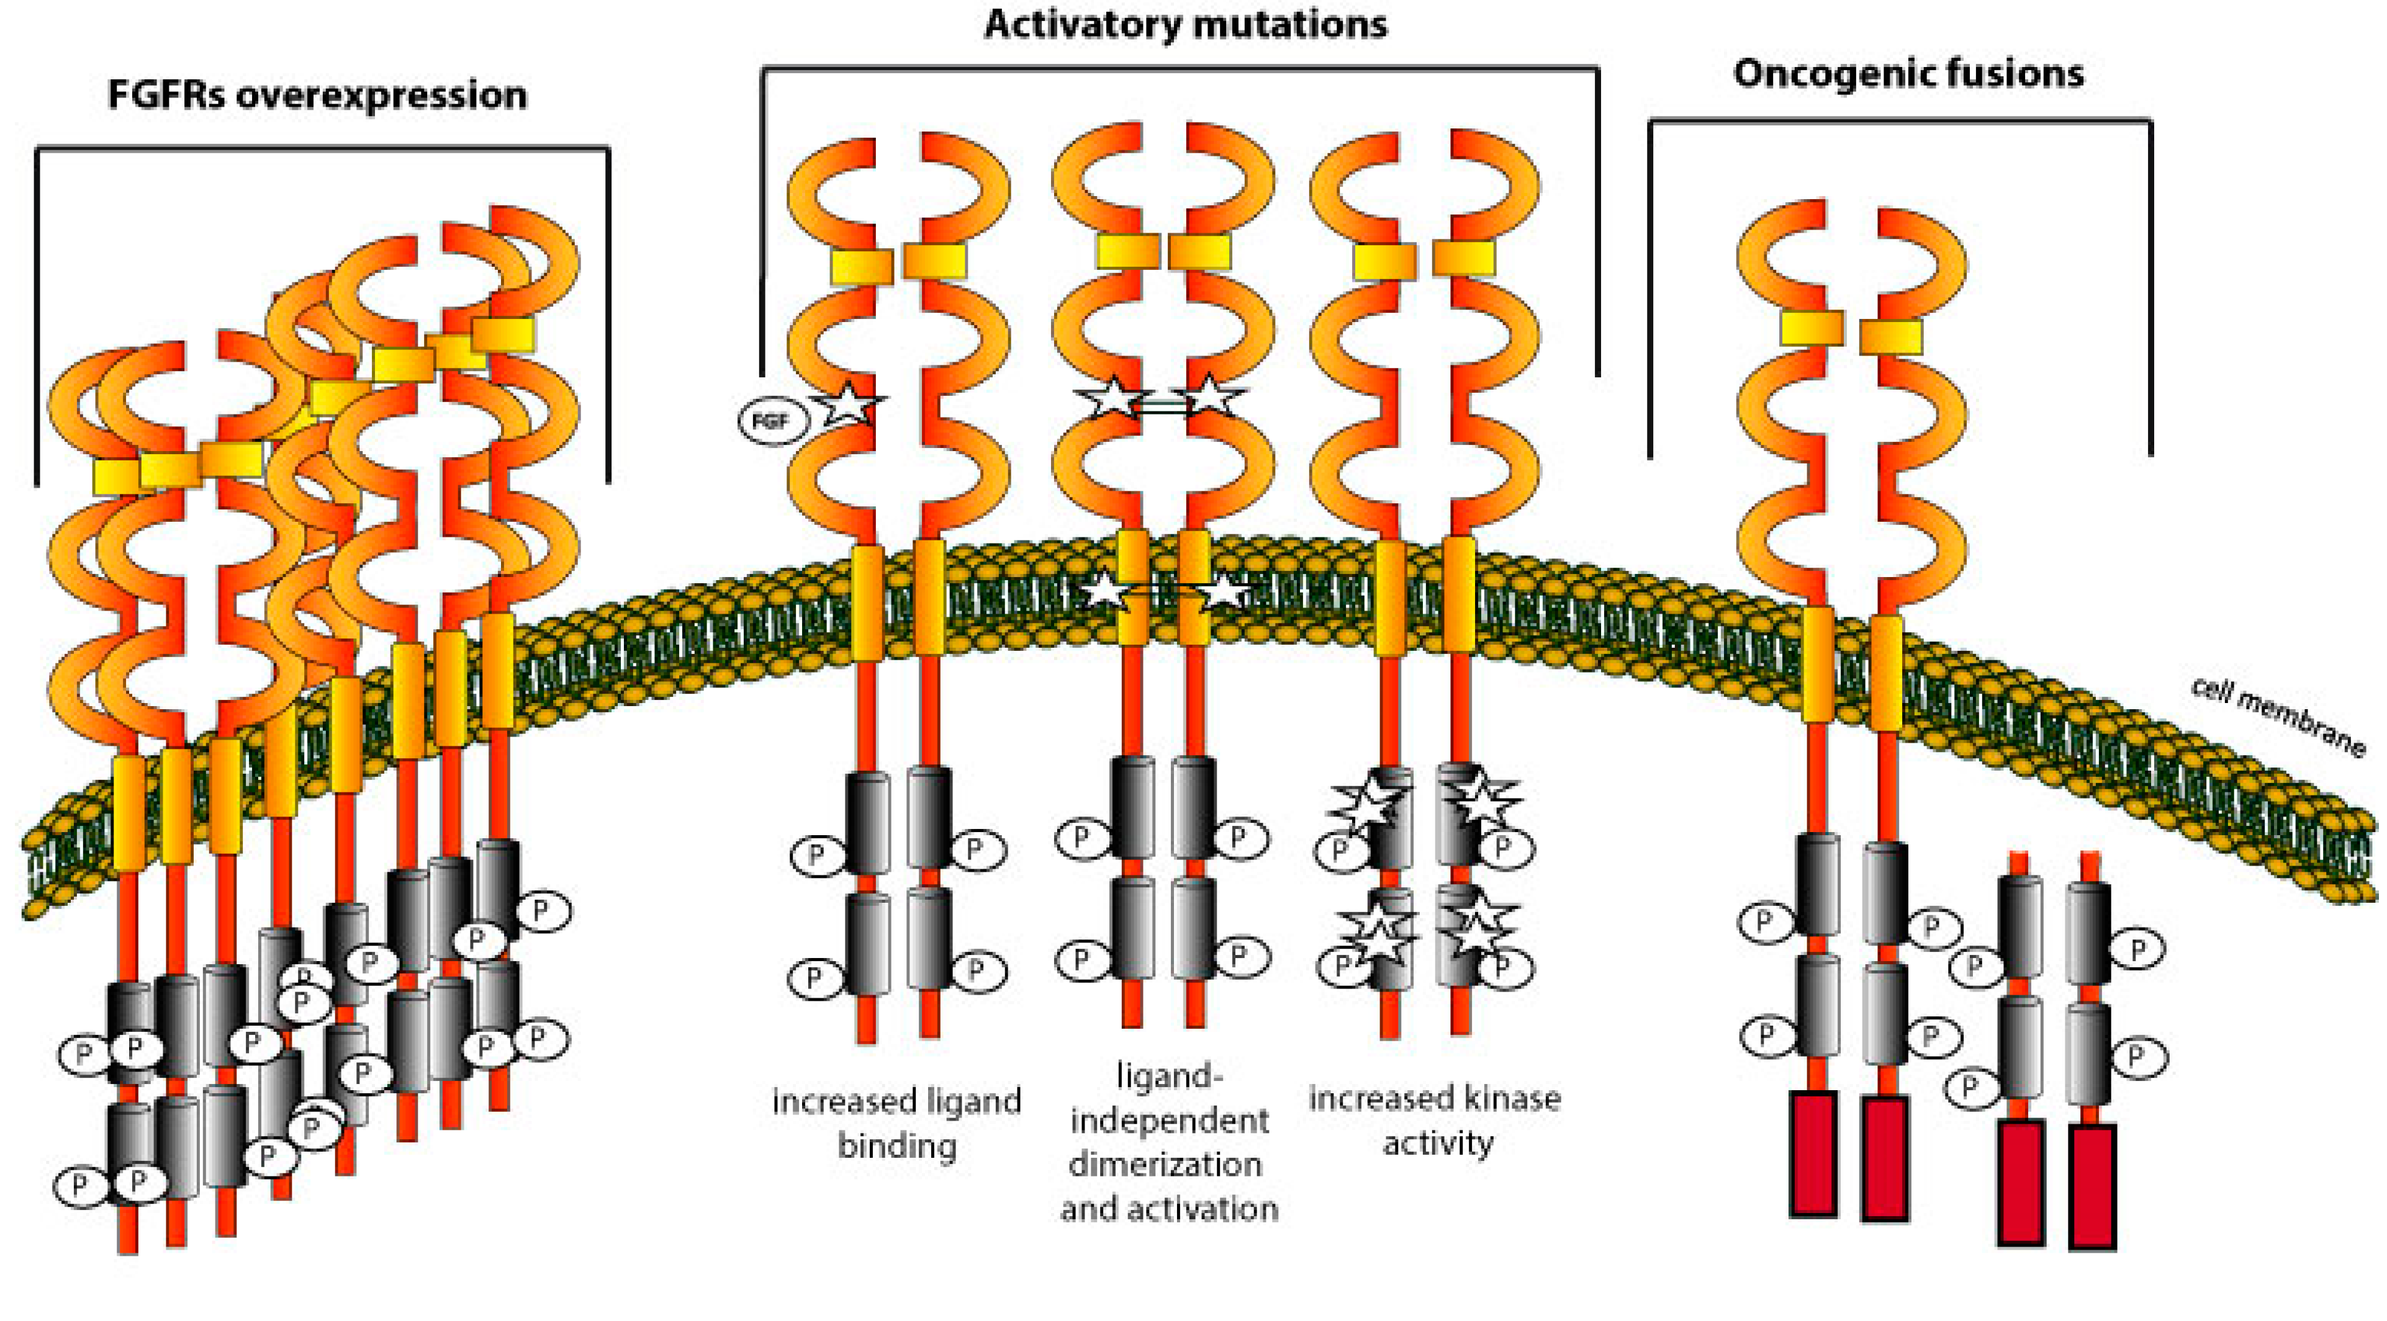
FGFR as a target in intrahepatic CCA
Fibroblast Growth Factor Receptor
Porębska et al J. Clin. Med. 2019;8(1), 7

Slide 7
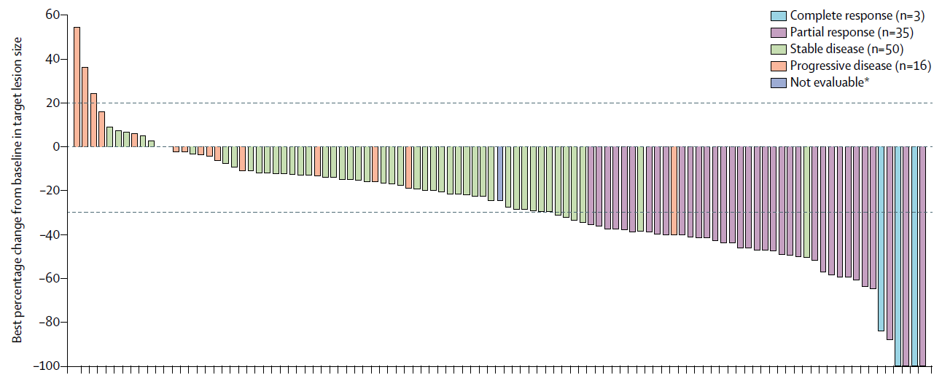
Targeting FGFR2 fusions
FIGHT-202 study
Each bar represents 1 patient
Figure from Lamarca A, et al. J Hepatol. 2020
Applies to about approx. 10% of patients with iCCA
Patients treated with pemigatinib
Overall response rate 35.5%
Disease control rate 82.2%
Median Duration of Response 7.5 months
Abou Alfa et al. Lancet Oncol 2020;21(5):671-684

Slide 8
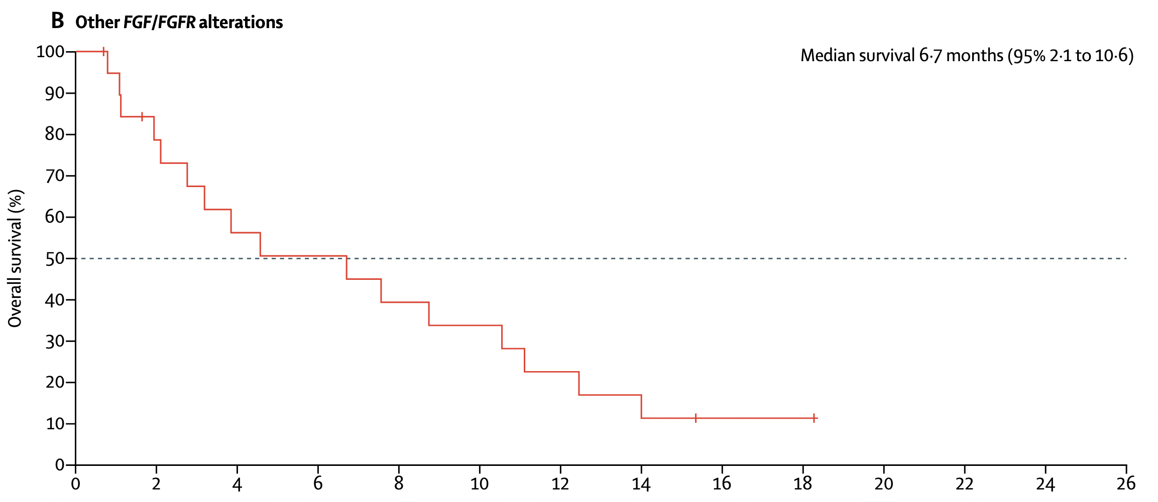
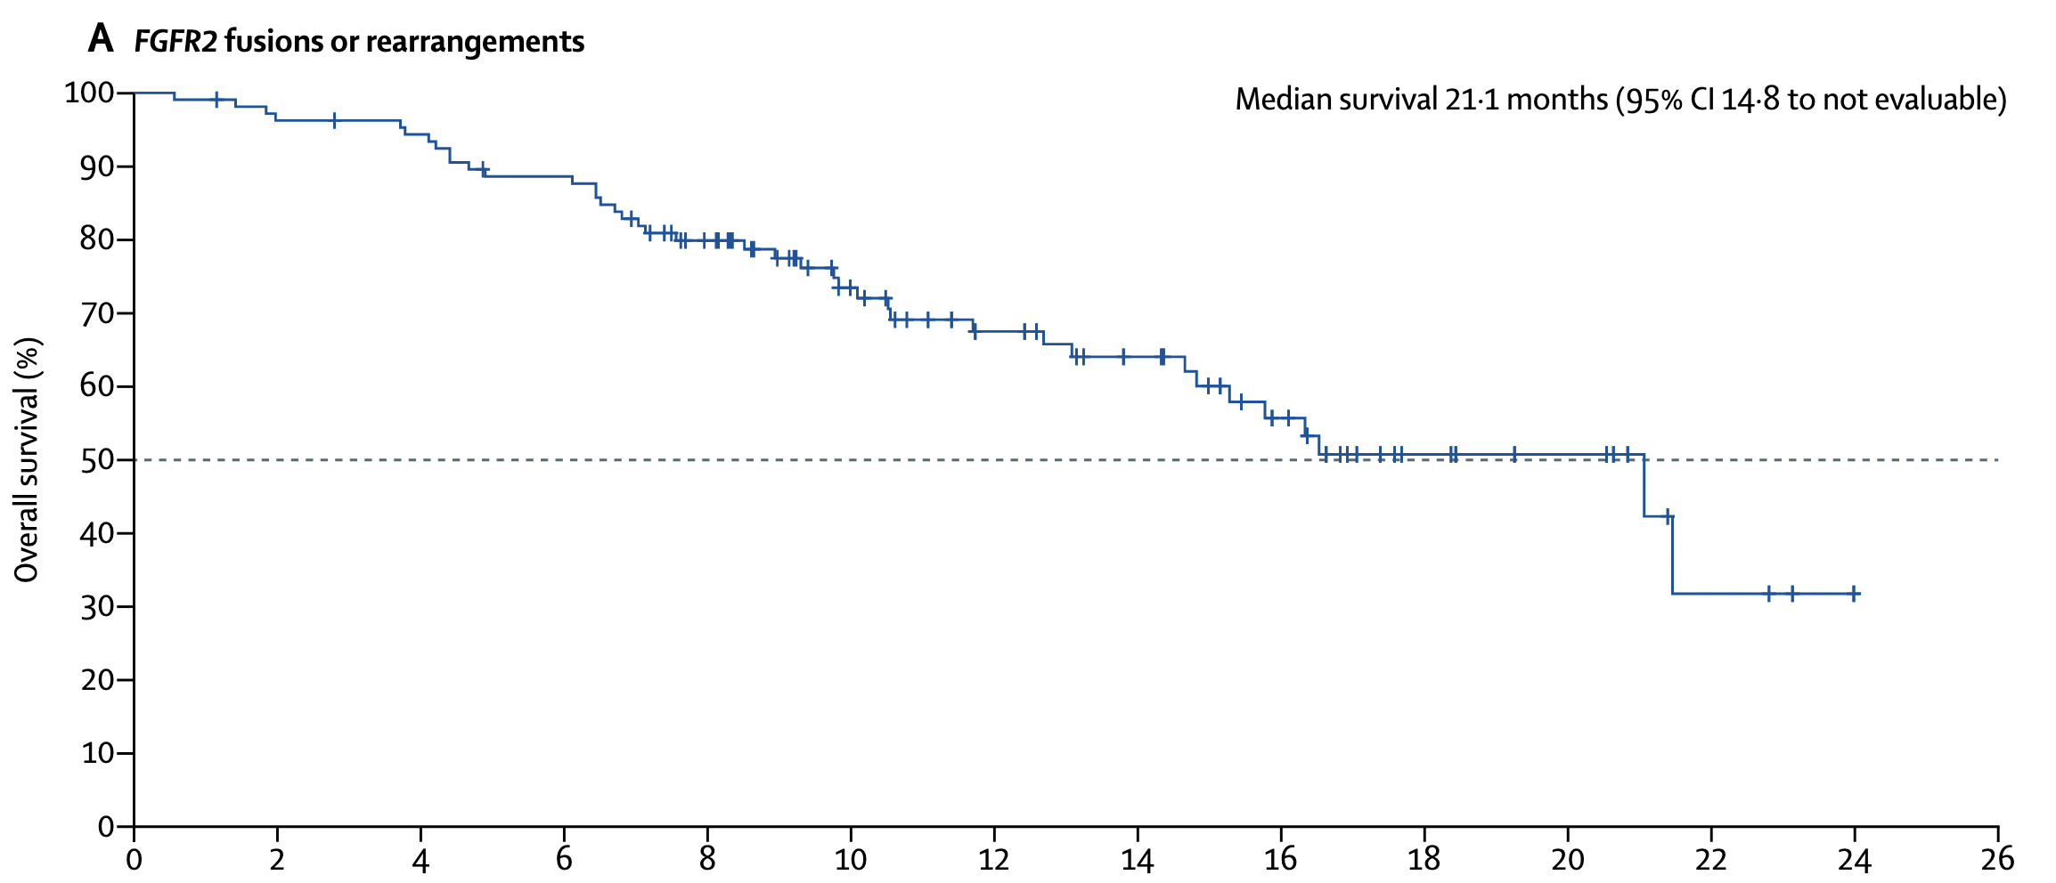
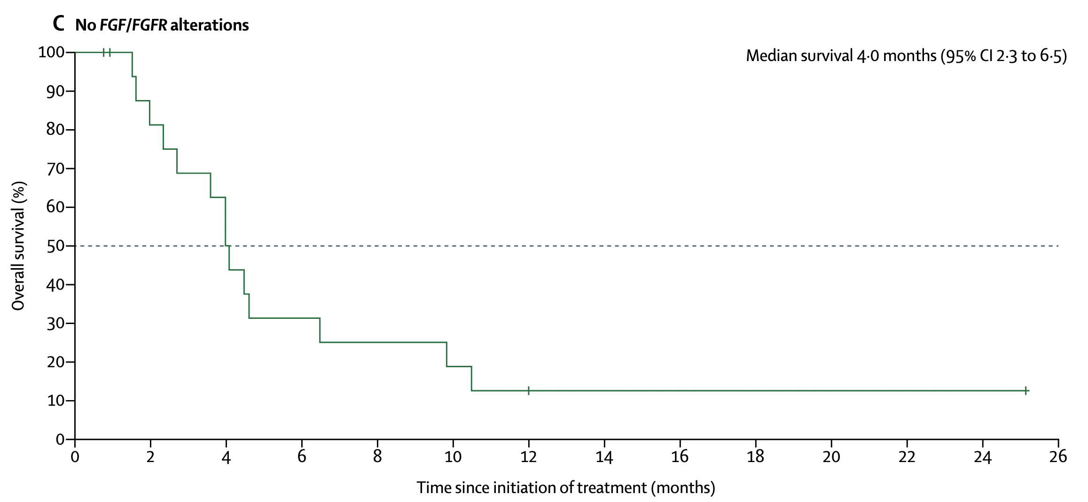
Targeting FGFR2 fusions
FIGHT-202: Overall Survival
Other FGF/FGFR alterations
Median survival 6.7 months (95% 2·1 to 10·6)
FGFR2 fusions or rearrangements
Median survival 21.1 months (95% 14·8 to not evaluable)
No FGF/FGFR alterations
Median survival 4.0 months (95% 2·3 to 6·5)
Median OS: Not mature at data cutoff
Abou Alfa et al. Lancet Oncol 2020;21(5):671-684

Slide 9
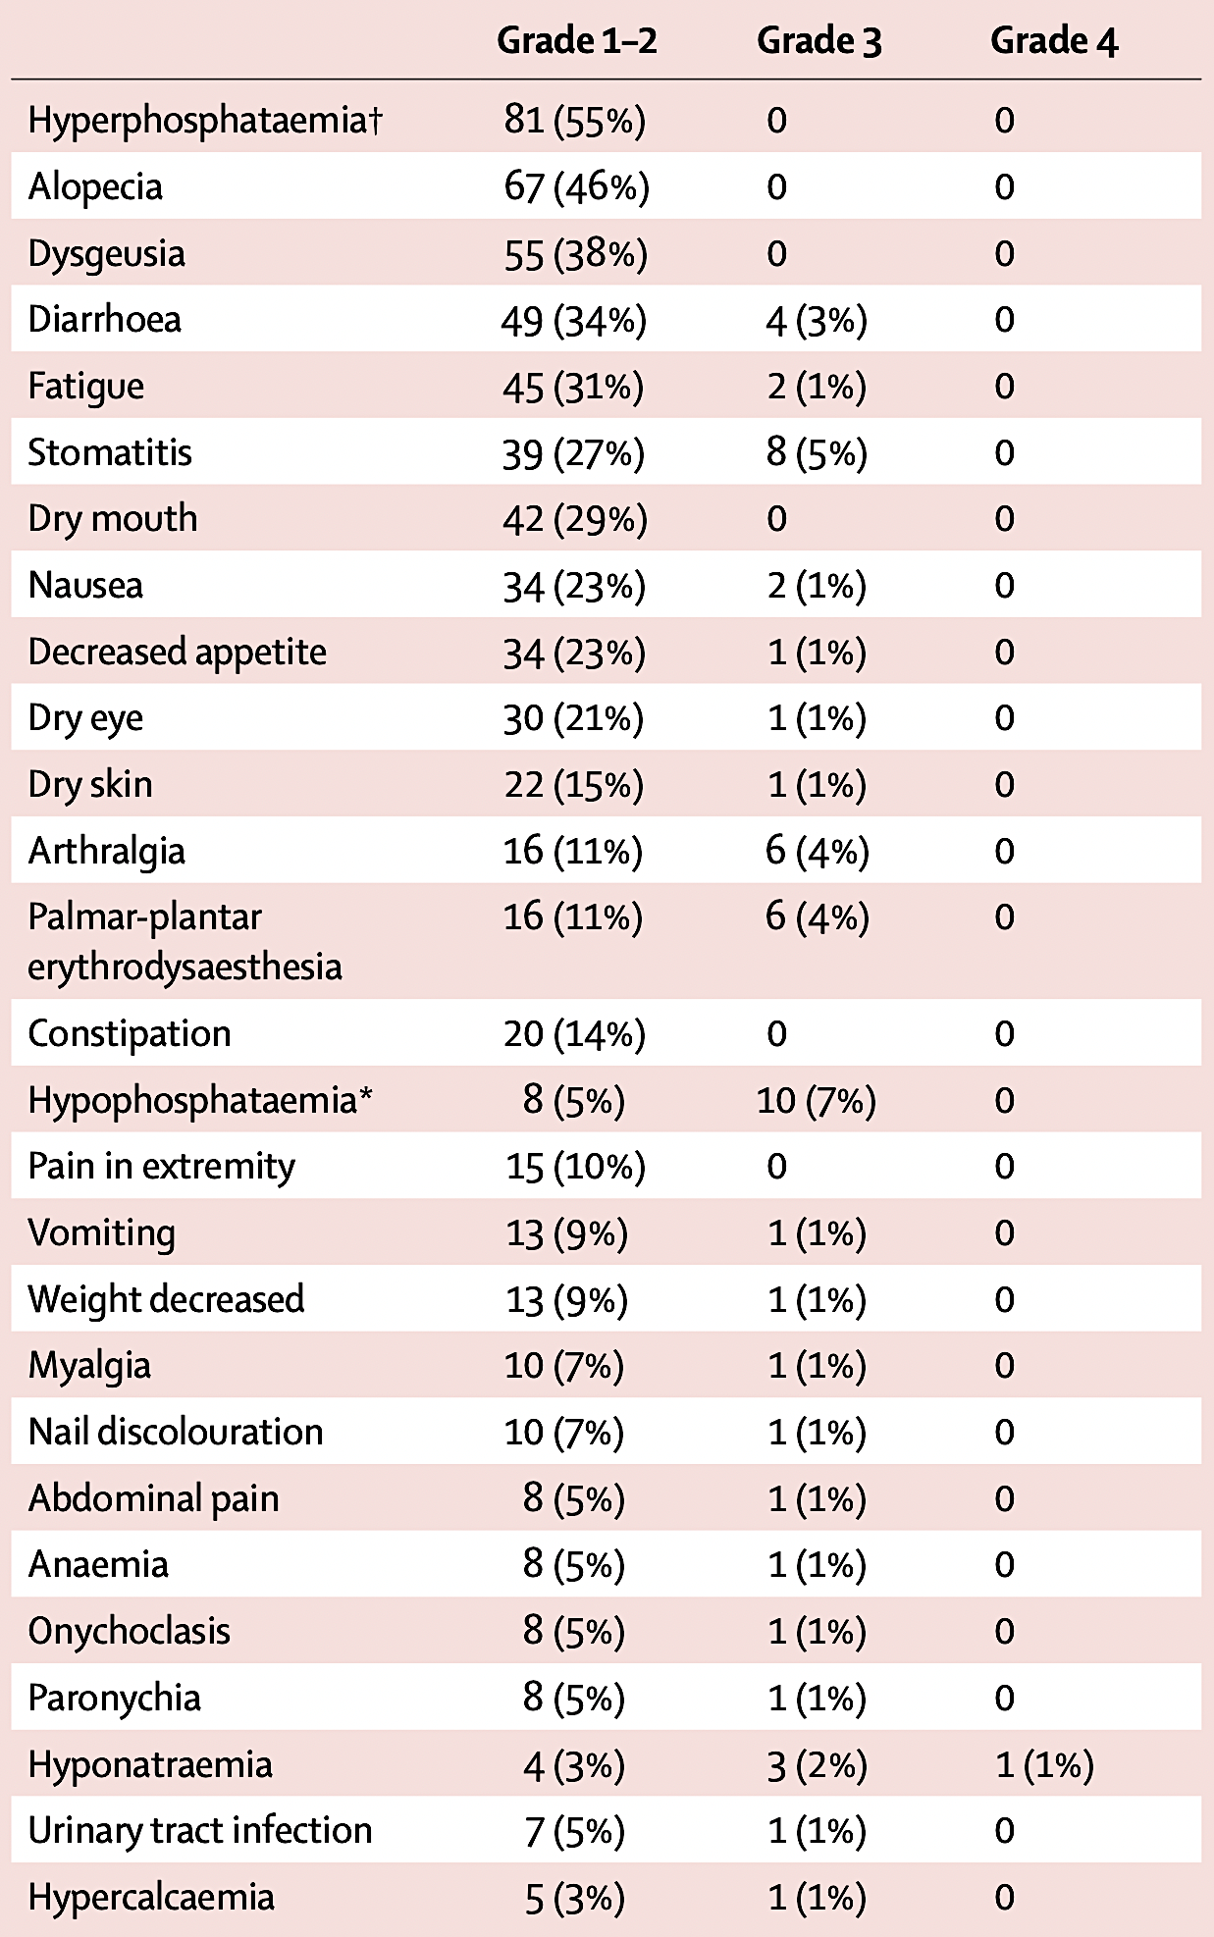
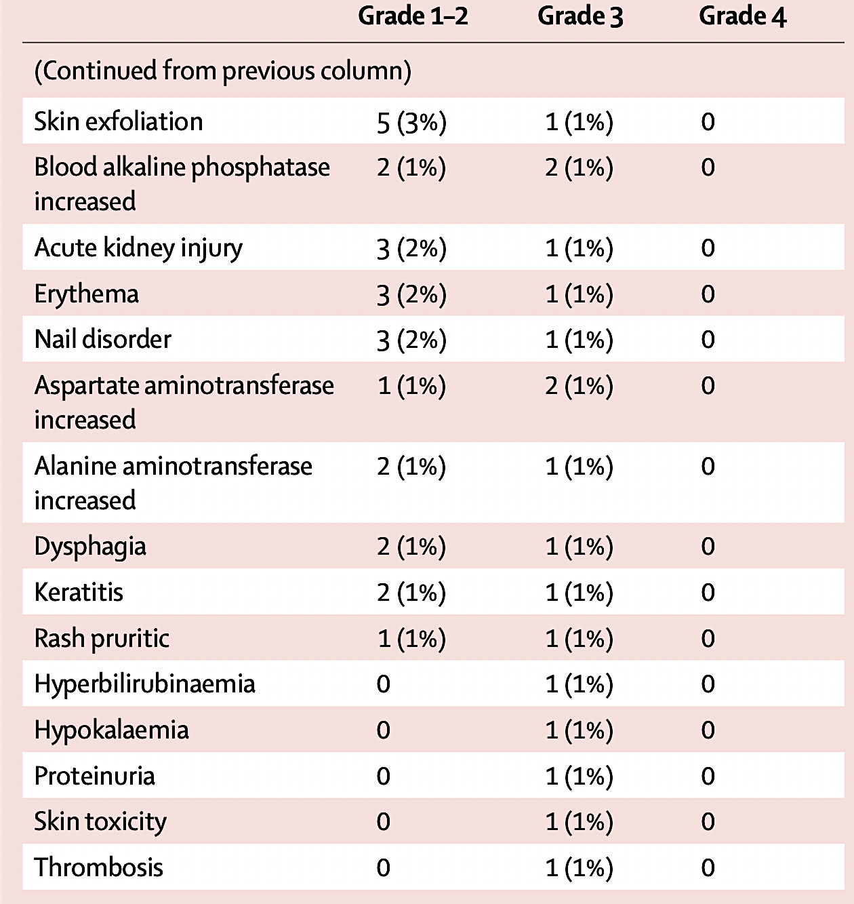
Targeting FGFR2 fusions
FIGHT-202 Treatment Related Adverse Events
Abou Alfa et al. Lancet Oncol 2020;21(5):671-684

Slide 10
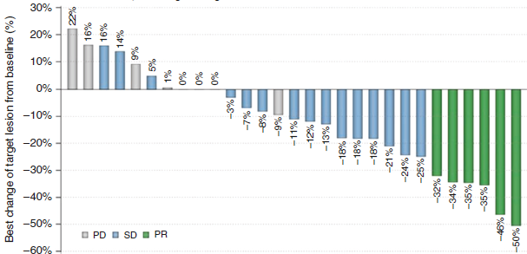
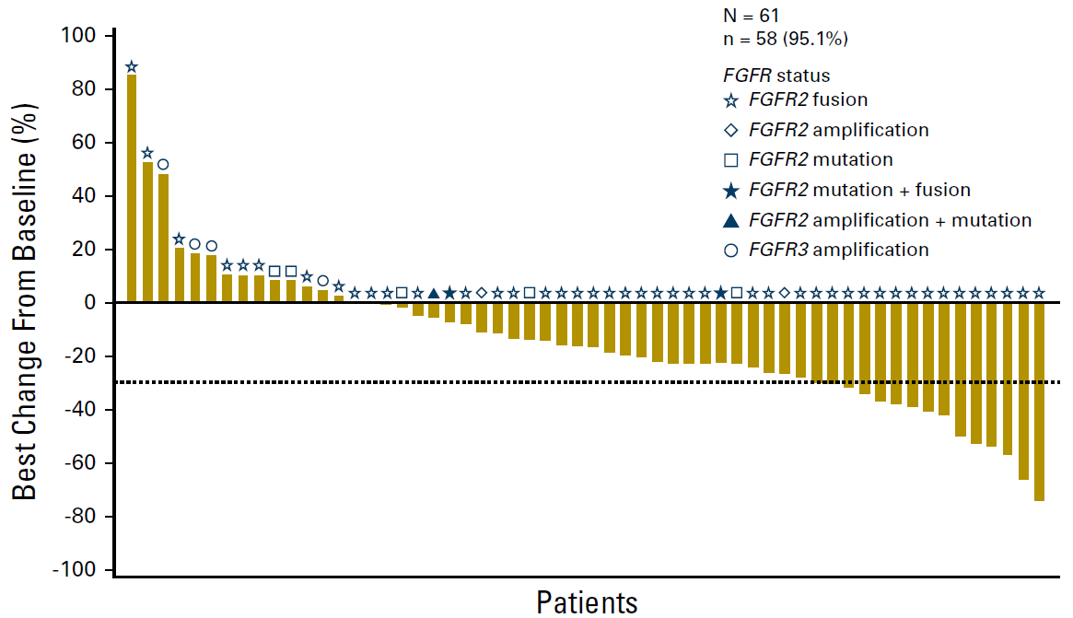
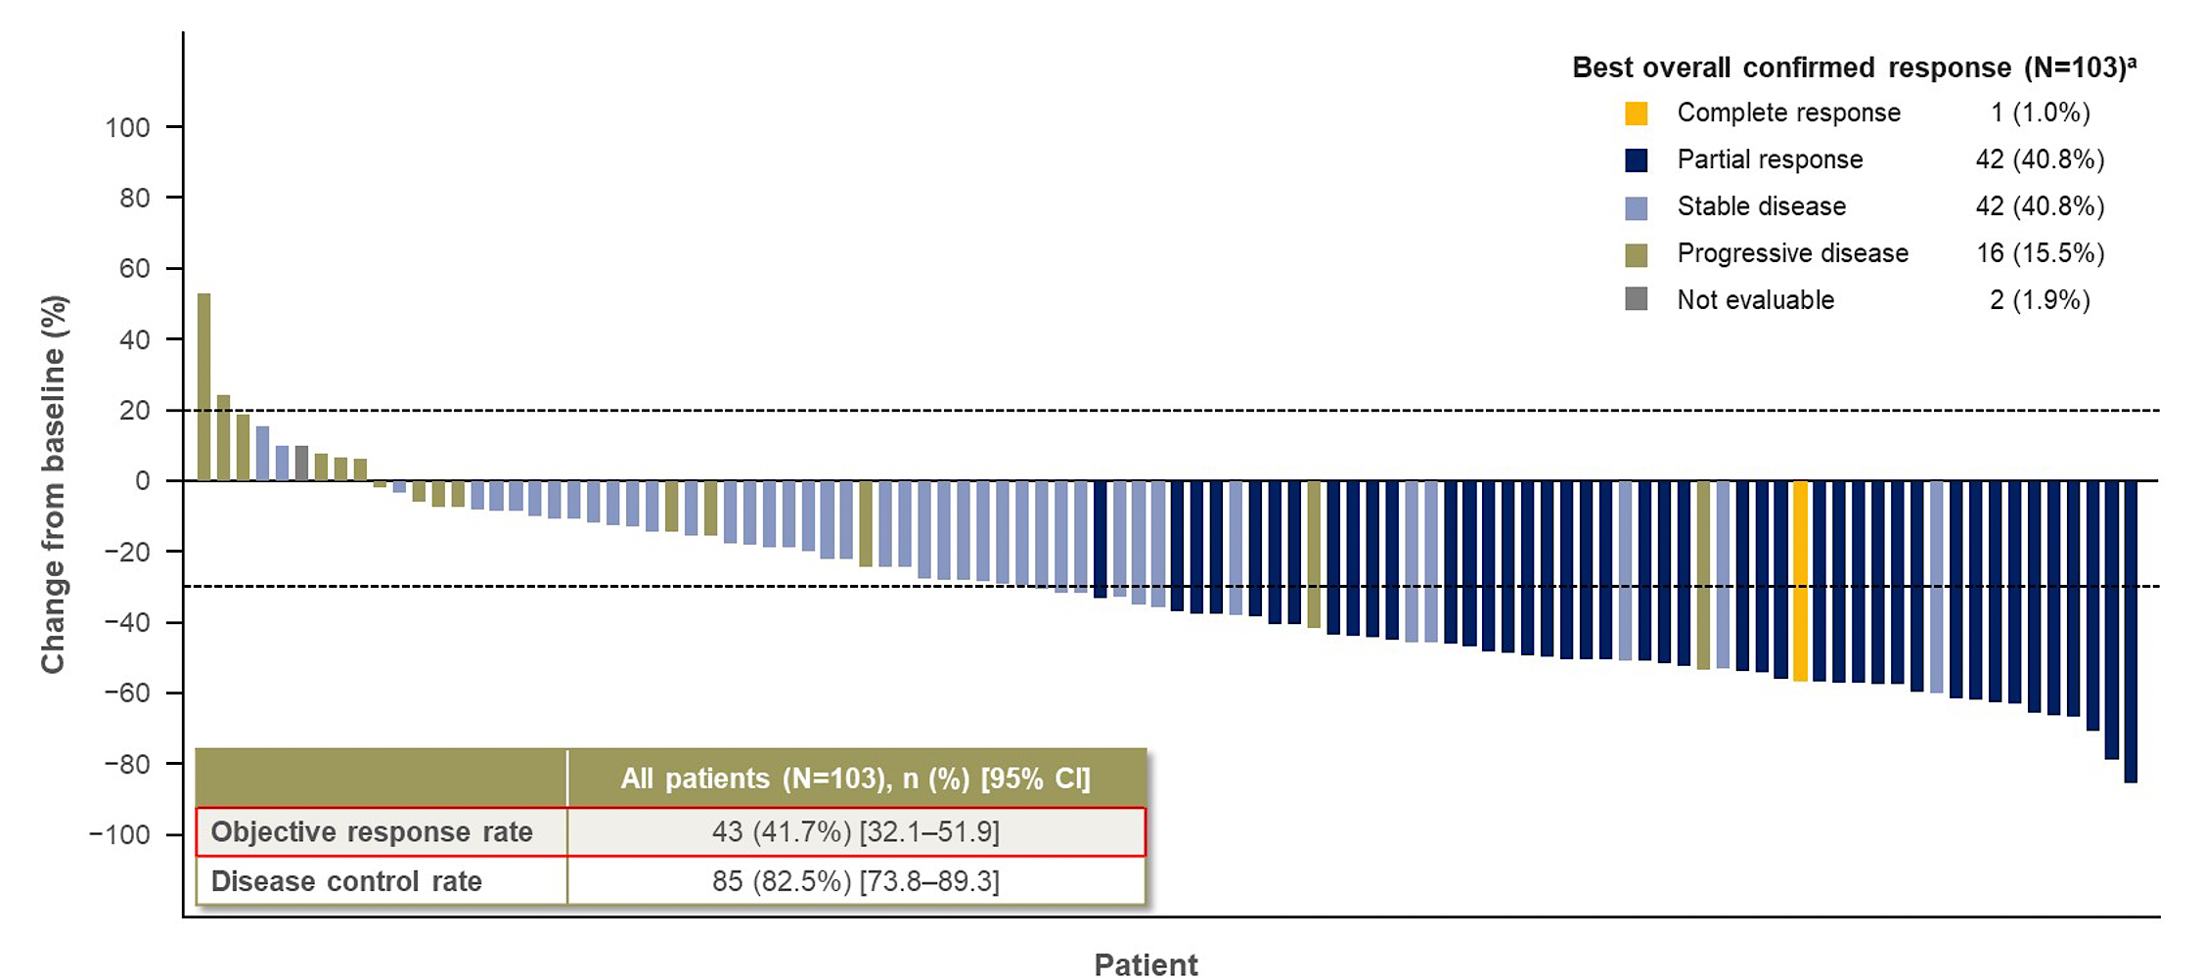
Multiple FGFR2-targeted agents
Pemigatinib (INCB054828)¹
Derazantinib (ARQ 087)³
Infigratinib (BJG398)²
Futibatinib (TAS-120)⁴
1. Abou Alfa et al. Lancet Oncol 2020;21(5):671-684; 2. Javle et al J Clin Oncol 2018;36(3):276-282; 3. Mazzaferro et al Br J Cancer 2019;120(2):165-171; 4. Goyal et al ASCO 2022 abstr 4009

Slide 11
Targeting FGFR2 fusions
FOENIX CCA2: Most Common (≥15%) Treatment-Related AEs with Futibatinib
Goyal et al ASCO 2022 abstr 4009

Slide 12
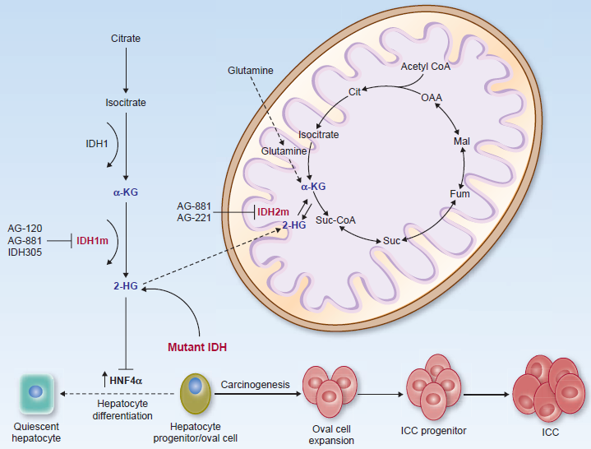
IDH-1 mutations
Isocitrate dehydrogenase
IDH exists as 3 isoforms¹
IDH-1 & -2 have cancer-associated mutations which happen early in tumour development
These mutations result in novel gain-of-function enzyme activity that
blocks normal cell differentiation
promotes tumourigenesis
2-HG; 2-hydroxyglutarate, αKG; α-ketoglutarate; ICC, intrahepatic cholangiocarcinoma; IDH, isocitrate dehydrogenase.
1. Cairns RA, et al. Nat Rev Cancer. 2011;11:85–95; Figure from Valle JW, et al. Cancer Discov. 2017;7:943–62.

Slide 13
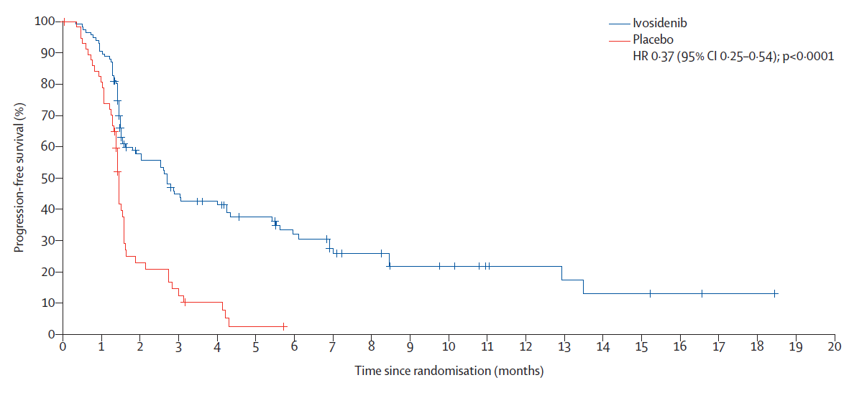
Targeting IDH1 mutations
ClarIDHy study – randomised study¹
Ivosidenib
Placebo
HR 0.37 (95% CI 0.25–0.54); p<0.0001
Figure from Lamarca A, et al. J Hepatol. 2020
Applies to about 10-15% of patients with iCCA
Ivosidenib reduced risk of disease progression-free by 63%
Patients were allowed to cross over
Patients receiving ivosidenib lived longer (especially when correcting for patients who crossed over)
1. Abou-Alfa GK, et al. Lancet Oncol. 2020;21:796–8075

Slide 14
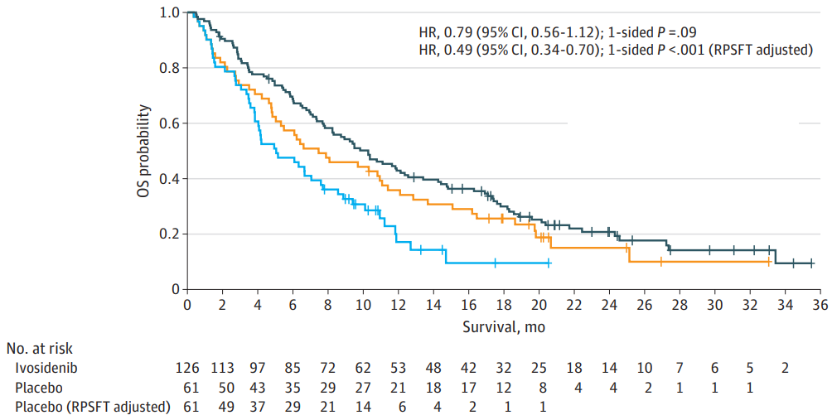
Targeting IDH1 mutations
Median OS
10.3 (7.8-12.4)
7.5 (4.8-11.1)
5.1 (3.8-7.6)
Figure from Lamarca A, et al. J Hepatol. 2020
Applies to about 10-15% of patients with iCCA
Ivosidenib reduced risk of disease progression-free by 63%
Patients were allowed to cross over
Patients receiving ivosidenib lived longer (especially when correcting for patients who crossed over)
Zhu AX et al JAMA Oncol 2021:7(11):1669-1677

Slide 15
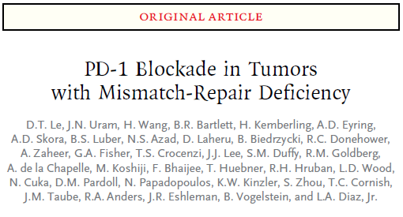
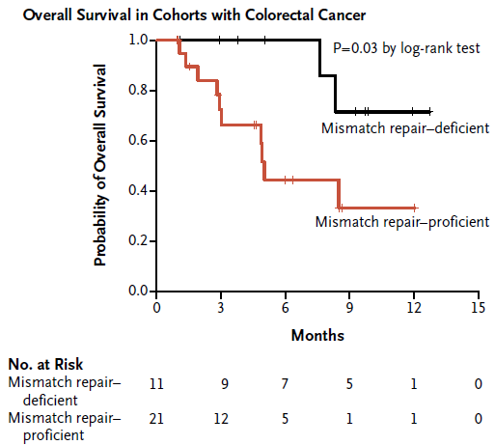
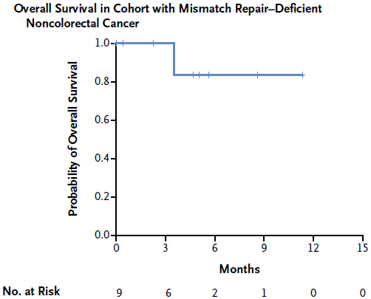
Targeting mismatch repair deficiency
Phase 2 study
Pembrolizumab (anti PD-1)
Le et al N Engl J Med. 2015;372:2509–20

Slide 16
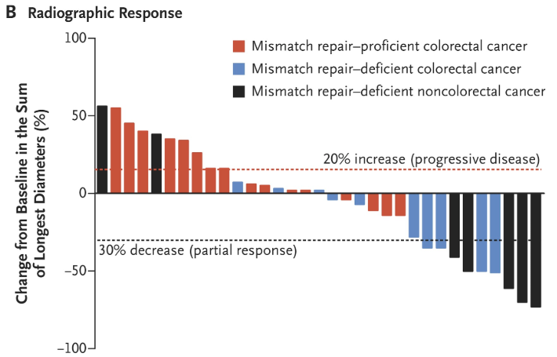
Targeting mismatch repair deficiency
Figure from Lamarca A, et al. J Hepatol. 2020
Applies to about 2.5% of patients with CCA²
CCA
May 2017 | FDA grants accelerated approval to pembrolizumab for first tissue/site agnostic indication
1. Le DT, et al. N Engl J Med. 2015;372:2509–20; 2. Weinberg BA, et al. J Gastrointest Oncol. 2019;10:652–62.

Slide 17
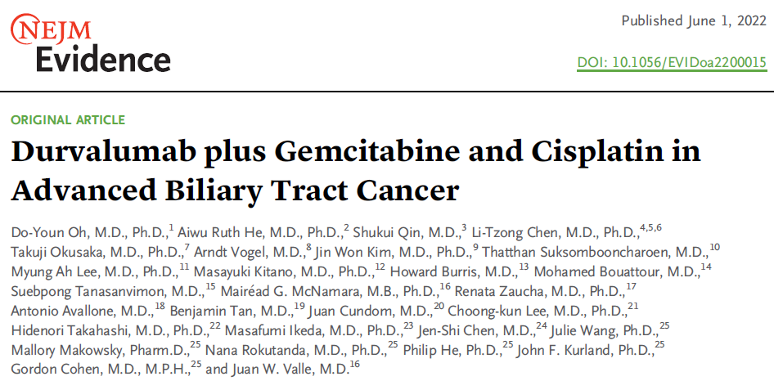
TOPAZ-1 study | design
Oh et al N Engl J Med Evidence 2002;Jun1

Slide 18
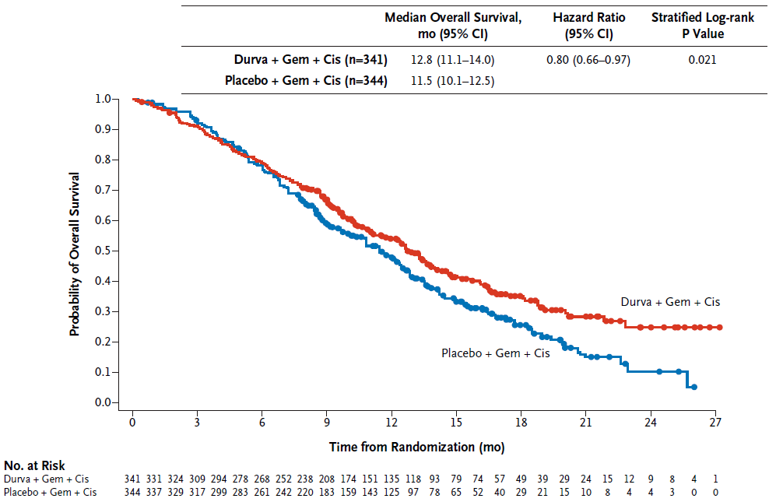
TOPAZ-1 study | primary end-point (OS)
12-mo OS
54.1%
48.0%
18-mo OS
35.1%
25.6%
24-mo OS
24.9%
10.40%
Oh et al N Engl J Med Evidence 2002;Jun1

Slide 19
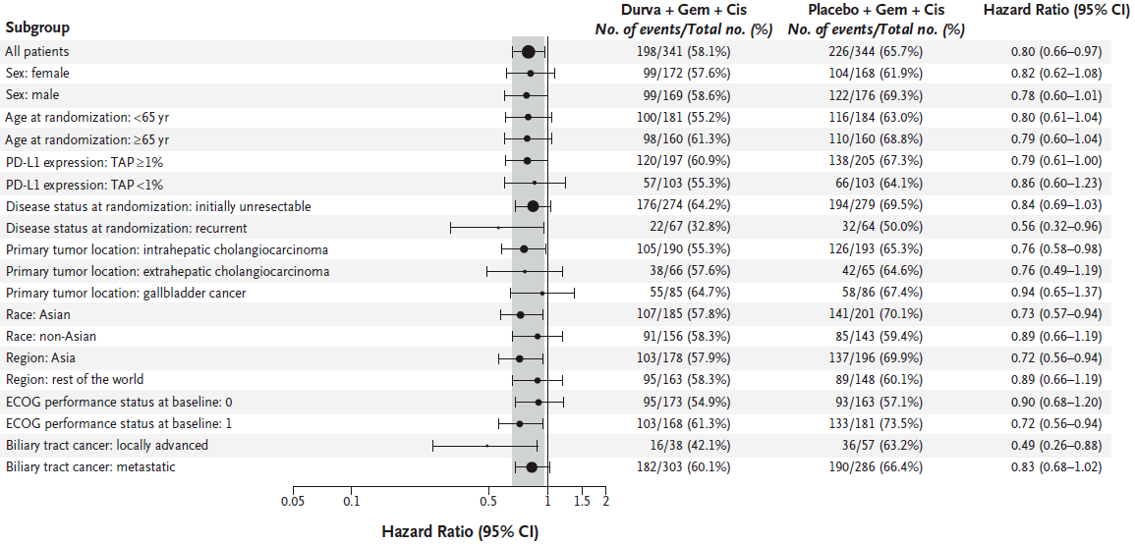
TOPAZ-1 study | exploratory subgroup (OS)
Oh et al N Engl J Med Evidence 2002;Jun1

Slide 20
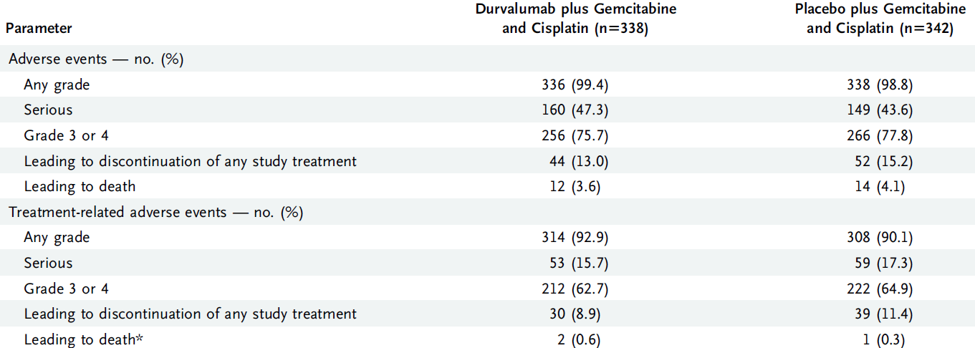
TOPAZ-1 study | safety
Oh et al N Engl J Med Evidence 2002;Jun1

Slide 21
PHASE 1
PHASE 2
PHASE 3
Immunotherapy trials in biliary tract cancer
Monotherapy
Pembrolizumab (KEYNOTE-158)(NCT02628067)
Pembrolizumab (S Korea)(NCT03110328)
Pembrolizumab (Spain)(NCT03260712)
Pembrolizumab or nivolumab (NCT03695952)
Nivolumab (NCT02829918)
Bintrafusp (M7824)(NCT03833661)
Combination
Nivolumab + ipilimumab (NCT02834013)
Pembrolizumab + GM-CSF (NCT02703714)
Pembrolizumab + Peg-interferon α2b (NCT02982720)
Pembrolizumab + Allogeneic NK Cell (NCT03937895)
Pembrolizumab + CisGem (EORTC-1607 ABC-09)(NCT03260712)
Pembrolizumab + capecitabine + oxaliplatin (NCT03111732)
Pembrolizumab + ramucirumab (NCT03260712)
Pembrolizumab + lenvatinib (LEAP-005)(NCT03695952)
Durvalumab + tremelimumab + TACE/RFA/ablation (NCT02821754)
Durvalumab + tremelimumab + SIRT (NCT04238637)
Durvalumab + tremelimumab + radiotherapy (NCT03482102)
Durvalumab + tremelimumab + CisGem (NCT03046862)
Durvalumab + tremelimumab +/- paclitaxel (NCT03704480)
Durvalumab + AZD6738 (NCT04298008)
Camrelizumab + GemOx (NCT03486678)
Nivolumab + etinostat (NCT03250273)
Atezolizumab + /- cobimetinib (NCT03201458)
Neoadjuvant CisGem +/- durvalumab (DEBATE)(NCT04308174)
First-line
- CisGem + durvalumab/placebo (TOPAZ-1)(NCT03875235)
- CisGem + pembrolizumab/placebo (KEYNOTE966)NCT04003636)
- CisGem + bintrafusp/placebo (M7824)(NCT04066491)
Monotherapy
- KEYNOTE 028 (pembrolizumab)
- Nivolumab
- Bintrafusp (M7824)
Combination
- Nivolumab + CisGem
- Pembrolizumab + ramucirumab (NCT02443324)
Adapted from Valle et al Lancet 2021; 397(10272):428-444

Slide 22
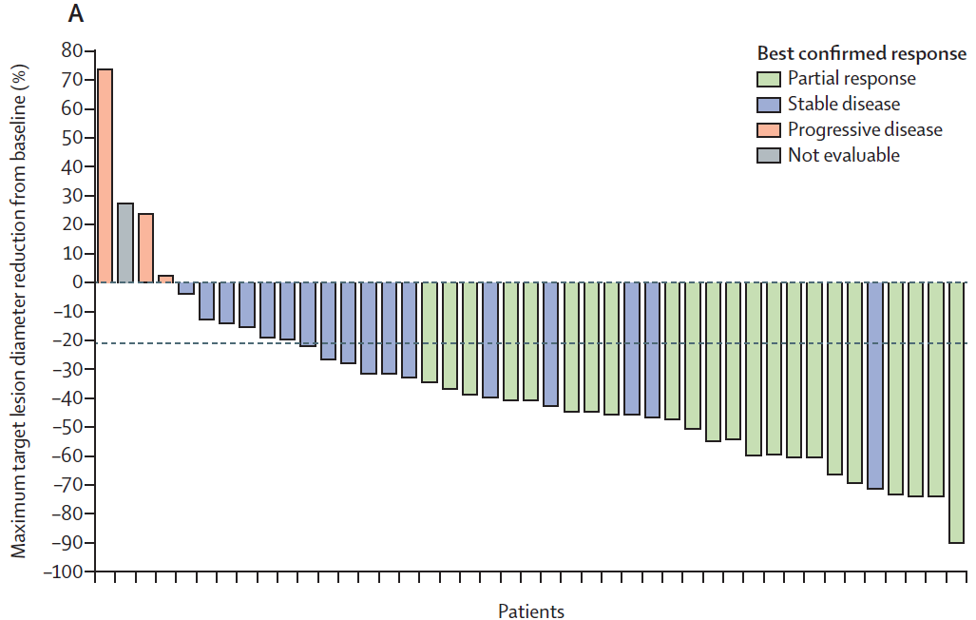
Targeting the BRAF^{V600E} mutation
Figure from Lamarca A, et al. J Hepatol. 2020
ROAR study (Rare Oncology Agnostic Research)
57/626 (9.1%) of patients screened had mBRAF^{V600E}
Response rate:
Investigator assessed: 22/43 (51%, 95%CI 36–67)
Independent review: 20/43 (47%, 95%CI 31–62)
Median PFS 9 months
Median OS 14 months
Subbiah et al Lancet Oncol 2020; 21: 1234–43

Slide 23
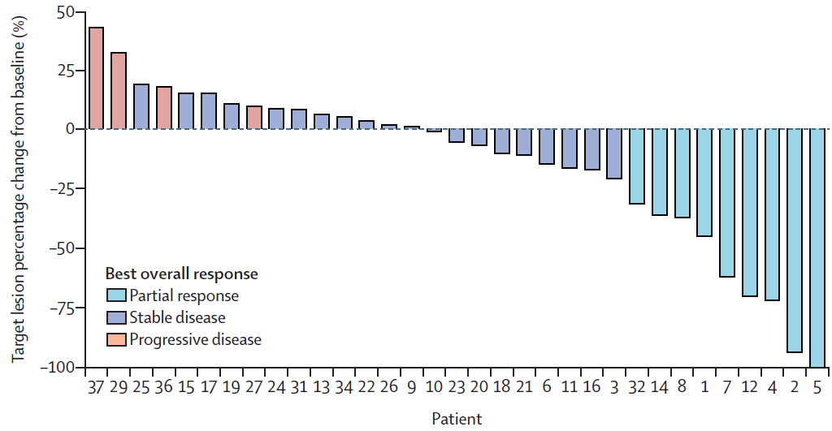
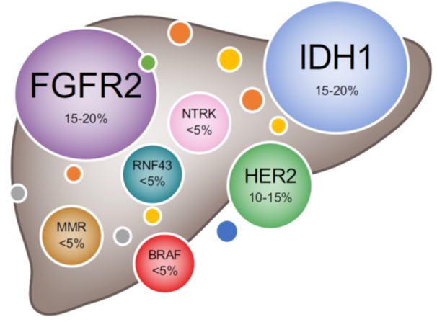
Targeting HER-2
Tumour location (n=39)
Gallbladder 16 (41%)
Extrahepatic 7 (18%)
Intrahepatic 7 (18%)
Ampulla 5 (13%)
Undesignated† 4 (10%)
Overall RR 23%
mPFS 4.0 months
mOS 10.9 months
HER2 status
Amplification, overexpression status unknown 31 (80%)
Amplification, no overexpression 4 (10%)
Amplification and overexpression 2 (5%)
Overexpression, amplification status unknown 2 (5%)
Javle et al Lancet Oncol 2021 Sep;22(9):1290-1300

Slide 24
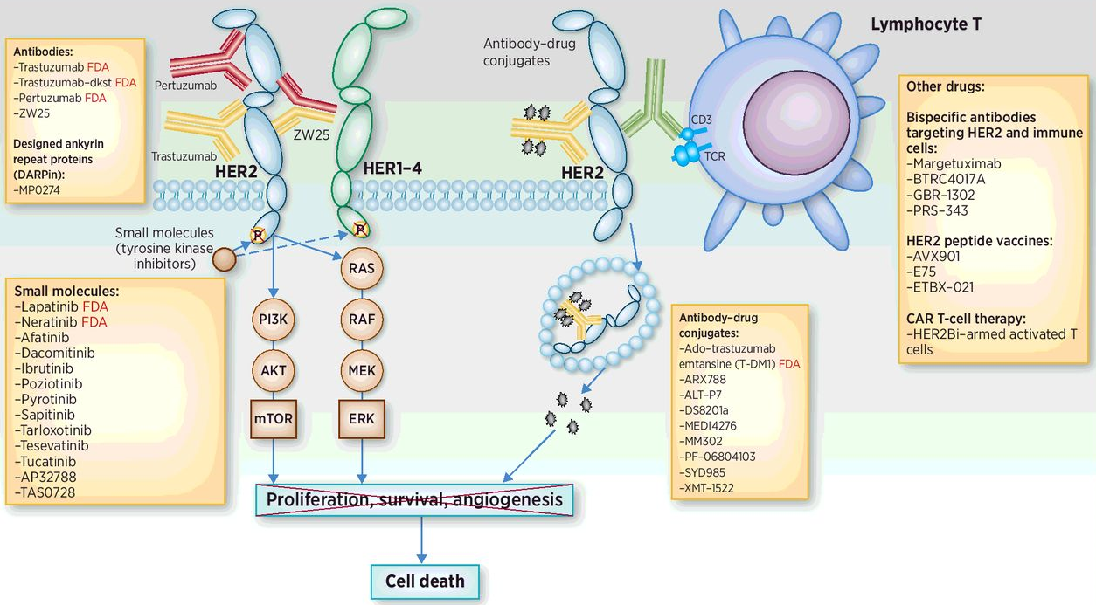
Targeting HER-2
Meric-Bernstam et al Clin Cancer Res 2019;25(7):2033-2041

Slide 25
Targeting HER-2
n=22
RR 36.4%
DCR 81.8%
PFS: 5.1 mo
OS: 7.1 mo
Lung toxicity
Meric-Bernstam et al Clin Cancer Res 2019;25(7):2033-2041; Ohba et al ASCO 2022 (suppl 16; abstr 4006)

Slide 26
Targeting HER-2 | studies in BTC
NCT Number | Setting | Primary Site | Therapeutic Regimen | Phase | Compound Descriptions
NCT03613168 | First-line | HER2-positive BTCs | CisGem + trastuzumab | 2 | Trastuzumab: anti-HER2 monoclonal antibody
NCT02992340 | First-line | HER2-positive BTCs | CisGem + varlitinib | 1/2 | Varlitinib: pan-HER inhibitor targeting HER1, HER2 and HER4
NCT02836847 | First-line | HER2-positive eCCAs and GBCs | GEMOX + trastuzumab/other targeted agents | 2 | Trastuzumab: anti-HER2 monoclonal antibody
NCT04482309 | First- and later-line | HER2-positive solid tumors, including eCCA | Trastuzumab deruxtecan | 2 | Trastuzumab deruxtecan (DS-8201): antibody-drug conjugate composed of an anti-HER2 antibody and a cytotoxic topoisomerase I inhibitor
NCT03602079 | First- and later-line | HER2-positive solid tumors, including eCCA | A166 | 1/2 | A166: antibody-drug conjugate targeting HER
NCT04430738 | First- and later-line | HER2-positive solid tumors, including eCCA | Oxaliplatin-based regimen + trastuzumab + tucatinib | 1 | Tucatinib: highly selective HER2 inhibitor
NCT03821233 | First- and later-line | HER2-positive solid tumors, including eCCA | ZW49 | 1 | ZW49: antibody-drug conjugate that combines a novel auristatin payload with ZW25
NCT04466891 | First- and later-line | HER2-positive BTCs | ZW25 (Zanidatamab) | 2 | ZW25: Biparatopic antibody which binds to the same domains as trastuzumab and pertuzumab
NCT04329429 | Second-line | HER2-positive BTCs | RC48-ADC | 2 | RC48-ACD: novel HER2-targeting antibody-drug conjugate that delivers the anticancer agent MMAE into HER2-positive cells
NCT03185988 | Second-line | HER2-positive solid tumors, including eCCA | Chemotherapy + varlitinib | 2 | Trastuzumab: anti-HER2 monoclonal antibody
NCT03093870 | Second-line | HER2-positive BTCs | Capecitabine + varlitinib | 2/3 | Varlitinib: pan-HER inhibitor targeting HER1, HER2 and HER4
NCT03231176 | Second-line | HER2-positive BTCs | Capecitabine + varlitinib | 2 | Varlitinib: pan-HER inhibitor targeting HER1, HER2 and HER4
NCT02892123 | Second-and later-line | HER2-positive solid tumors, including eCCA | ZW25 (Zanidatamab) + paclitaxel or capecitabine or vinorelbine | 1 | ZW25: biparatopic antibody which binds to the same domains as trastuzumab and pertuzumab

Slide 27
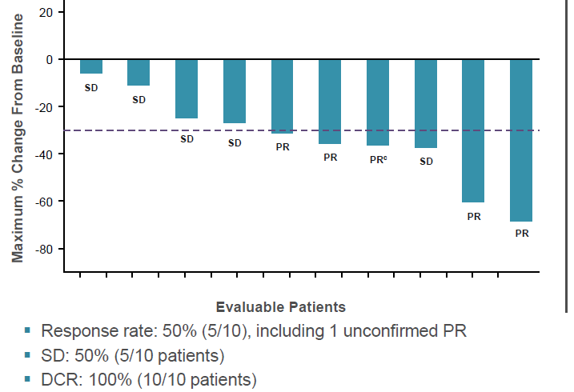
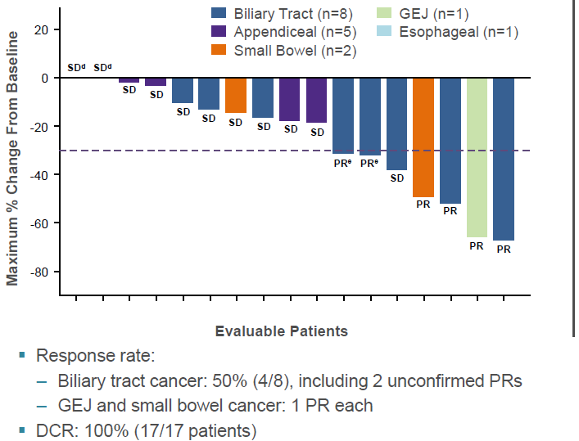
KRAS| targeting the KRAS^{G12C} mutation
Preliminary data - phase 2 study of adagrasib
Other GI cancers (inc n=8 biliary)
Pancreatic cancer (n=12)
Bekaii-Saab et al J Clinical Oncol 2022; 40, no. 4_suppl:abstr 519

Slide 28
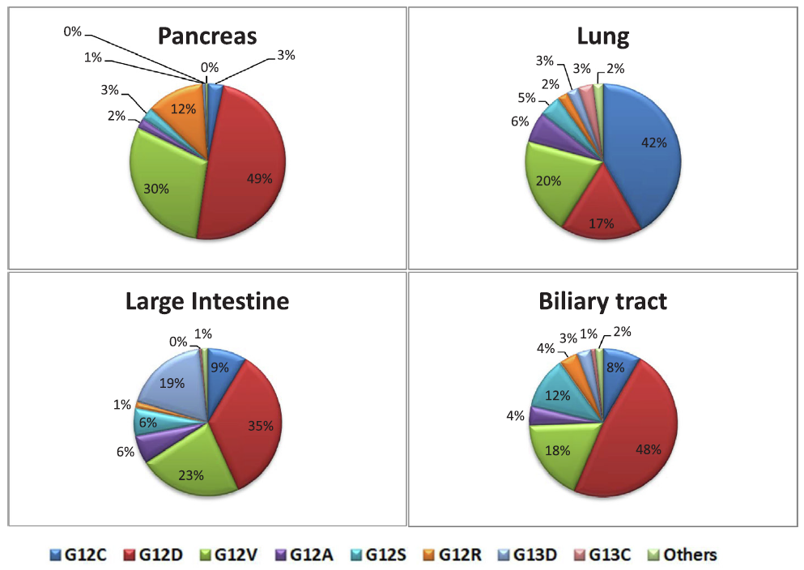
KRAS| targeting the KRAS^{G12C} mutation
Upreti and Adeji Cancer Treat Rev 2020;89:102070

Slide 29
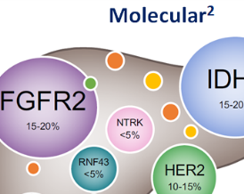
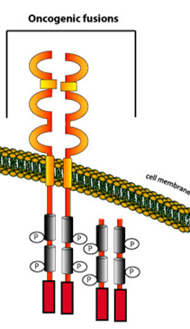
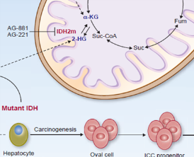
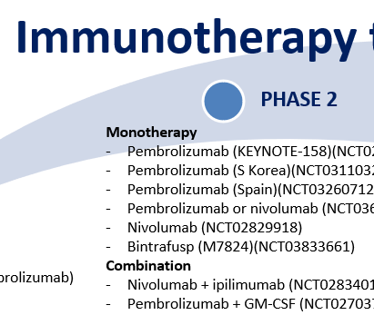
Take-home messages
Anatomical subgroups of BTC remain relevant for surgery and loco-regional therapies
Immunotherapy - addition of durvalumab provides an incremental benefit over cisplatin and gemcitabine in unselected patient population
The identification of molecular subgroups is expanding treatment options in selected sub-populations
FGFR2, IDH1, HER2, BRAF^{V600E} , MSI-high, NTRK, etc.
Future efforts are needed to explore:
Prognostic significance
Impact of prior or post-study therapy
Primary and secondary resistance
Rational combinations

Slide 30
Case #1

Slide 31
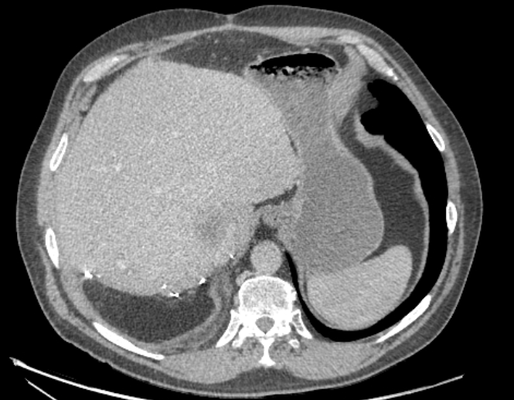
Case #1 60 year-old male, no significant co-morbidities PS 1
First seen 31-Oct-2017
Aug 2017 –right hemi-hepatectomy: moderately differentiated adenocarcinoma, CK7 positive, pT2a N0. Macroscopically tumour present at resection margin (R2 resection)
Nov 2017 – Apr 2018: received 8 cycles of cisplatin and gemcitabine (due to R2 resection)
May 2018 - CT scan (end of treatment): no visible disease
Jan 2019 - CT scan (for investigation of urosepsis): new liver lesions
Feb 2019 – Aug 2019: received 8 cycles of cisplatin and gemcitabine re-challenge
Molecular profiling during chemotherapy: FGFR2 fusion and IDH1 R132C mutation
CT scan Jan 2019
Central hepatic disease recurrence + distant LNs
CA19-9 non-secretor

Slide 32
Case #1 60 year-old male, no significant co-morbidities PS 1
First seen 31-Oct-2017
Aug 2017 –right hemi-hepatectomy: moderately differentiated adenocarcinoma, CK7 positive, pT2a N0. Macroscopically tumour present at resection margin (R2 resection)
Nov 2017 – Apr 2018: received 8 cycles of cisplatin and gemcitabine (due to R2 resection)
May 2018 - CT scan (end of treatment): no visible disease
Jan 2019 - CT scan (for investigation of urosepsis): new liver lesions
Feb 2019 – Aug 2019: received 8 cycles of cisplatin and gemcitabine re-challenge
Molecular profiling during chemotherapy: FGFR2 fusion and IDH1 R132C mutation
Oct 2019 – CT scan: disease progression
CT scan Jan 2019
Central hepatic disease recurrence + distant LNs
CA19-9 non-secretor

Slide 33
Case #1 60 year-old male, no significant co-morbidities PS 1
SECOND-LINE THERAPY
Nov 2019 – Jan 2022; TAS-120 (futibatinib) clinical trial (targeting FGFR2 fusion)
Best response (Dec 2020): partial response (-33% by RECIST)
Toxicities (all reported as part of clinical trial): hyper-phosphataemia, oral mucositis, dry skin, nail changes, cataracts
futibatinib

Slide 34
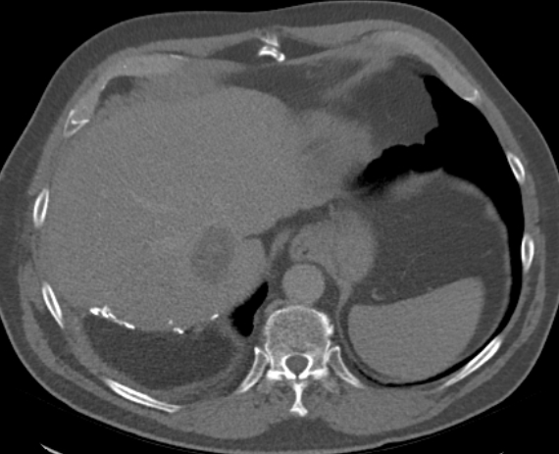
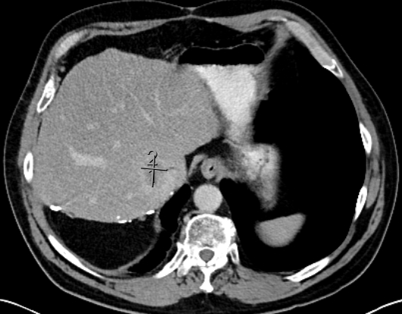
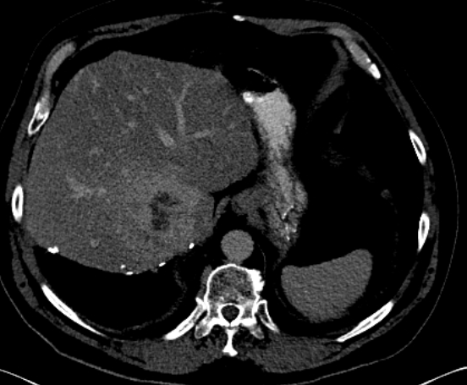
Case #1 60 year-old male, no significant co-morbidities PS
SECOND-LINE THERAPY
Nov 2019 – Jan 2022; TAS-120 (futibatinib) clinical trial (targeting FGFR2 fusion)
Best response (Dec 2020): partial response (-33% by RECIST)
Toxicities (all reported as part of clinical trial): hyper-phosphataemia, oral mucositis, dry skin, nail changes, cataracts
CT scan Oct 2019
Progression of hepatic disease recurrence + distant LNs
CT scan Dec 2020
Best response (nadir)
CT scan Dec 2021
Disease progression
Progression-free: 26 months

Slide 35
Case #1 60 year-old male, no significant co-morbidities PS 1
THIRD-LINE THERAPY
Jan 2022 - CT scan: disease progression; PS 1
Feb 2022 – commenced FOLFOX (delayed due to urinary tract infection)
Mucositis
Acute right visual defect
CT brain: normal
MR brain: left occipital acute infarct. Started on aspirin with future switch to clopidogrel.
Mar 2022 - CT scan (new baseline): increase liver lesion 7.8 x 6.8 cm, previously 7.2cm + stable LN disease
Mar 2022 – commenced FOLFIRI (>30 days post infarct)
June 2022 – on cycle 4, CT scan planned after cycle 6
FOURTH-LINE THERAPY?
- ivosidenib? Not yet available in Europe

Slide 36
Case #2

Slide 37
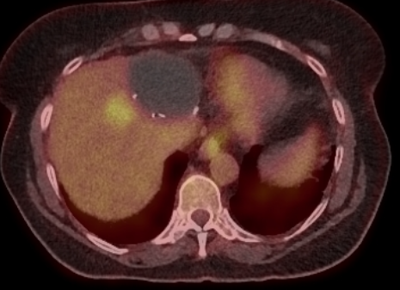
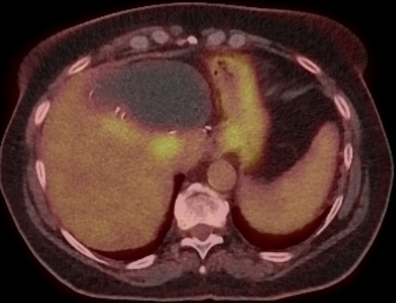
Case #2 62 year-old female, depression, recurrent UTIs, PS 0
Seen Dec 2017 for consideration of radioembolization
Jul 2015: left hepatectomy for pT2a poorly-differentiated intra hepatic cholangiocarcinoma.
May 2016: relapse along the surgical margin of the liver - resectable - for neoadjuvant chemotherapy
May-Oct 2016: received cisplatin / gemcitabine (4 cycles)
Nov 2016: laparotomy - open and shut procedure - inoperable disease.
Second line of treatment, ABC-06 trial offered, patient keen to explore other treatment options

Slide 38
Case #2 62 year-old female, depression, recurrent UTIs, PS 0
Feb 2017: Underwent radioembolisation
May 2017 – CT scan: stable disease (minor response)
Aug 2017 – CT scan: stable disease (minor response)
Nov 2017 – CT scan: new multiple pulmonary lesions; liver disease controlled
Nov 2017: consented for molecular profiling within ClarIDHy study: insufficient tumour tissue. Patient declined re-biopsy.
SECOND-LINE THERAPY
Jan - 2018: commenced FOLFOX chemotherapy – GCSF added at cycle 8
Feb 2018: patient consented to re-biopsy (liver): IDH1 mutation
Jul 2018 – CT scan: disease progression
Jul 2018: stopped FOLFOX (after cycle 10)

Slide 39
Case #2 62 year-old female, depression, recurrent UTIs, PS 0
THIRD-LINE THERAPY
Aug 2018: commenced AG120 (ivosidenib) or placebo in ClarIDHy study
Sep 2018 - CT scan (6 weeks): +19% by RECIST 1.1 (stable disease)
Oct 2018 - CT scan: +34% by RECIST 1.1 (disease progression)
Unblinded: was receiving ivosidenib

Slide 40
Case #2 62 year-old female, depression, recurrent UTIs, PS 0
FOURTH-LINE THERAPY
Nov 2018: cisplatin / gemcitabine re-challenge
Jan 2019: radiotherapy to sternal metastasis
Feb 2019 – CT scan: mixed response. Some responding lesions, but new liver lesions.

Slide 41
Case #2 62 year-old female, depression, recurrent UTIs, PS 0
FOURTH-LINE THERAPY
Nov 2018: cisplatin / gemcitabine re-challenge
Jan 2019: radiotherapy to sternal metastasis
Feb 2019 – CT scan: mixed response. Some responding lesions, but new liver lesions.
Treatment break (falling performance status)
May 2019 – CT scan: further disease progression
Patient opted for Best Supportive care
June 2019: patient died

Slide 42
Case #3

Slide 43
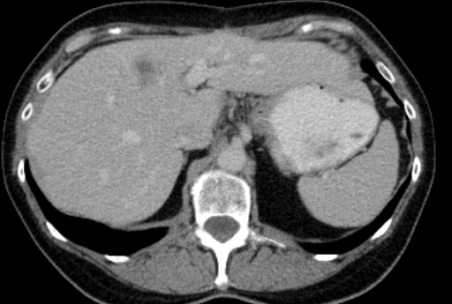
Case #3 63 year-old female, hypothyroid, Gilbert’s PS 0
Oct 2018: elective cholecystectomy: incidental finding of moderately differentiated adenocarcinoma of the gallbladder (stage pT2). Adverse features: invasion of the media of the vessel, perineural invasion, involved cystic duct margin and tumour was present in lymphoid tissue
Mar 2019: Underwent GB bed resection and hepaticojejunostomy under the HPB Surgical Team at Newcastle. No residual tumour in the gallbladder bed, although 1/5 lymph nodes were involved by adenocarcinoma
May 2019 to Oct 2019: Received adjuvant capecitabine chemotherapy
July 2020 - surveillance CT scan: suspicious focal lesion in the left lobe of the liver measuring 2cm.
Aug 2020 - FDG PET scan: disease relapse confirmed the presence of a 1.9 cm lesion within Seg. 4 of the liver with avid tracer uptake and metastatic LNs at porta hepatis and para-aortic region

Slide 44
Case #3 63 year-old female, hypothyroid, Gilbert’s PS 0
FIRST-LINE THERAPY
Oct 2020 – commenced cisplatin, gemcitabine and pembrolizumab within clinical trial
Dec 2020 - CT scan (after 4 cycles): partial response (41% reduction in marker lesions per RECIST)
Mar 2021 - CT scan (after 8 cycles): partial response (58% reduction)
Jun 2021 - CT scan (after 12 cycles): partial response (58% reduction)
Sep 2021 - CT scan (after 16 cycles): partial response (69% reduction) – cisplatin omitted from cycle 17 (sensory and motor neuropathy)
CA19-9 response
1800

Slide 45
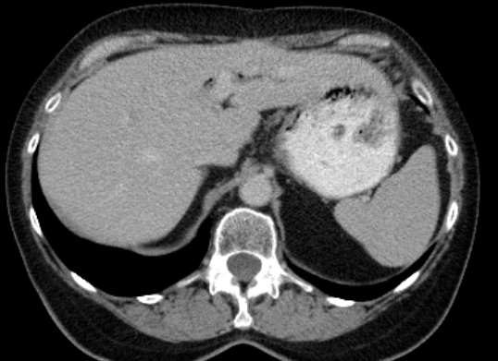
Case #3 63 year-old female, hypothyroid, Gilbert’s PS 0
FIRST-LINE THERAPY
Oct 2020 – commenced cisplatin, gemcitabine and pembrolizumab within clinical trial
Dec 2020 - CT scan (after 4 cycles): partial response (41% reduction in marker lesions per RECIST)
Mar 2021 - CT scan (after 8 cycles): partial response (58% reduction)
Jun 2021 - CT scan (after 12 cycles): partial response (58% reduction)
Sep 2021 - CT scan (after 16 cycles): partial response (69% reduction) – cisplatin omitted from cycle 17 (sensory and motor neuropathy)
“segment 4a hypodense lesion difficult to appreciate”
CT scan Sep 2020
CT scan Sep 2021

Slide 46
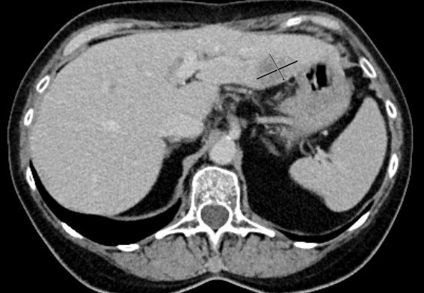
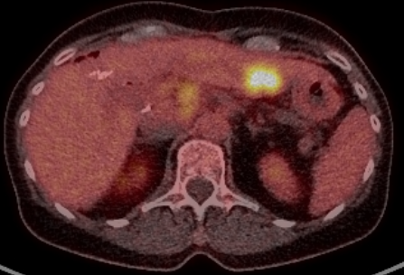
Case #3 63 year-old female, hypothyroid, Gilbert’s PS 0
FIRST-LINE THERAPY
Oct 2020 – commenced cisplatin, gemcitabine and pembrolizumab within clinical trial
Dec 2020 - CT scan (after 4 cycles): partial response (41% reduction in marker lesions per RECIST)
Mar 2021 - CT scan (after 8 cycles): partial response (58% reduction)
Jun 2021 - CT scan (after 12 cycles): partial response (58% reduction)
Sep 2021 - CT scan (after 16 cycles): partial response (69% reduction) – cisplatin omitted from cycle 17 (sensory and motor neuropathy)
Nov 2021 - CT TAP: new low density focus within hepatic segments 2/3 is suspicious for a new liver metastasis.
Jan 2022 - Proceed with Cycle 21 gemcitabine / pembrolizumab
Jan 2022 - CT and MR scans confirm disease progression
SECOND-LINE THERAPY?
FOLFIRI?
Phase 1
Other trial?

Slide 47
Case #3 63 year-old female, hypothyroid, Gilbert’s PS 0
SECOND-LINE THERAPY
18/01/2022 - consent and screen for phase II clinical trial of an oral compound
Good biomarker response (CA19-9)
Radiological response
WHAT DO WE DO FOR THIRD-LINE THERAPY? Options on further disease progression
FOLFIRI?
Phase 1?

