Slide 1
Meet The Professor
Optimizing the Management of
Hepatobiliary Cancers
Robin K (Katie) Kelley, MD
Professor of Clinical Medicine
Division of Hematology/Oncology
Helen Diller Family Comprehensive Cancer Center
University of California, San Francisco (UCSF)
San Francisco, California

Slide 2
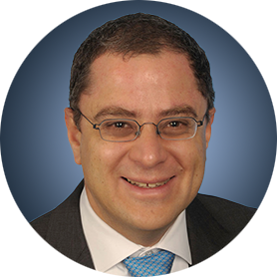
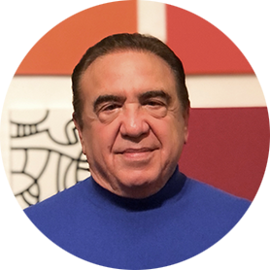
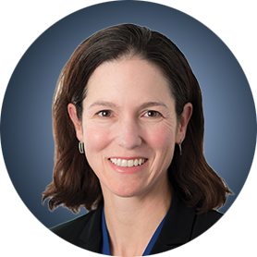
Meet The Professor Program Participating Faculty
Ghassan Abou-Alfa, MD, MBA
Attending
Memorial Sloan Kettering Cancer Center
Professor
Weill Cornell College at Cornell University
New York, New York
MODERATOR
Neil Love, MD
Research To Practice
Robin K Kelley, MD
Professor of Clinical Medicine, Division of Hematology/Oncology
Helen Diller Family Comprehensive Cancer Center
University of California, San Francisco (UCSF)
San Francisco, California

Slide 3
Commercial Support
This activity is supported by an educational grant from AstraZeneca Pharmaceuticals LP.
Research To Practice CME Planning Committee Members,
Staff and Reviewers
Planners, scientific staff and independent reviewers for Research To Practice have no relevant conflicts of interest to disclose.

Slide 4
Dr Kelley — Disclosures
Advisory Committee | Agios Pharmaceuticals Inc, AstraZeneca Pharmaceuticals LP, Exelixis Inc, Ipsen Biopharmaceuticals Inc, Kinnate Biopharma, Merck
Advisory Board | Kinnate Biopharma
Advisory Board or Steering Committee (to Institution) | Agios Pharmaceuticals Inc, AstraZeneca Pharmaceuticals LP, Exelixis Inc, Ipsen Biopharmaceuticals Inc, Merck
Research Funding (to Institution) | Agios Pharmaceuticals Inc, AstraZeneca Pharmaceuticals LP, Bayer HealthCare Pharmaceuticals, Bristol-Myers Squibb Company, EMD Serono Inc, Exelixis Inc, Genentech, a member of the Roche Group, Lilly, Loxo Oncology Inc, a wholly owned subsidiary of Eli Lilly & Company, Merck, Novartis, Partner Therapeutics, QED Therapeutics, Relay Therapeutics, Surface Oncology, Taiho Oncology Inc
Uncompensated Service on IDMC | Genentech, a member of the Roche Group, Merck

Slide 5
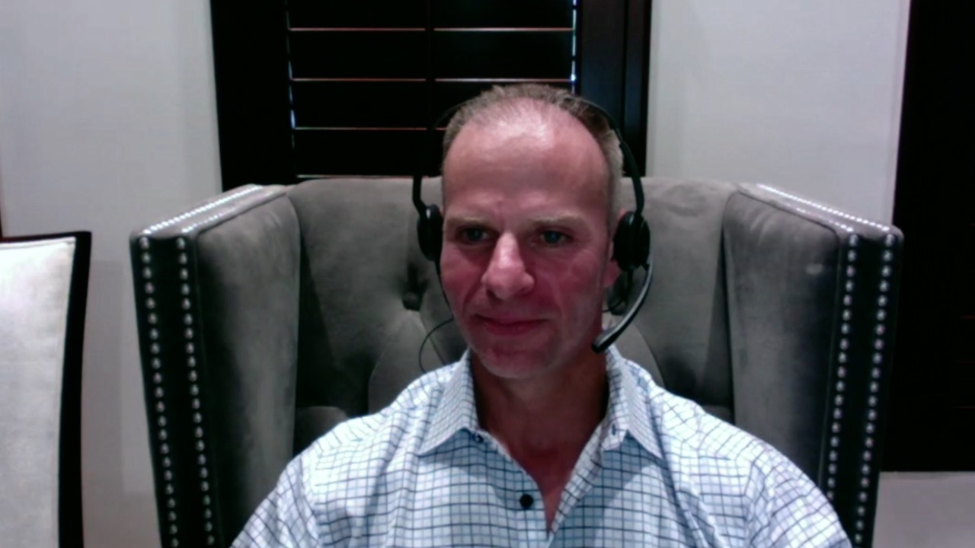
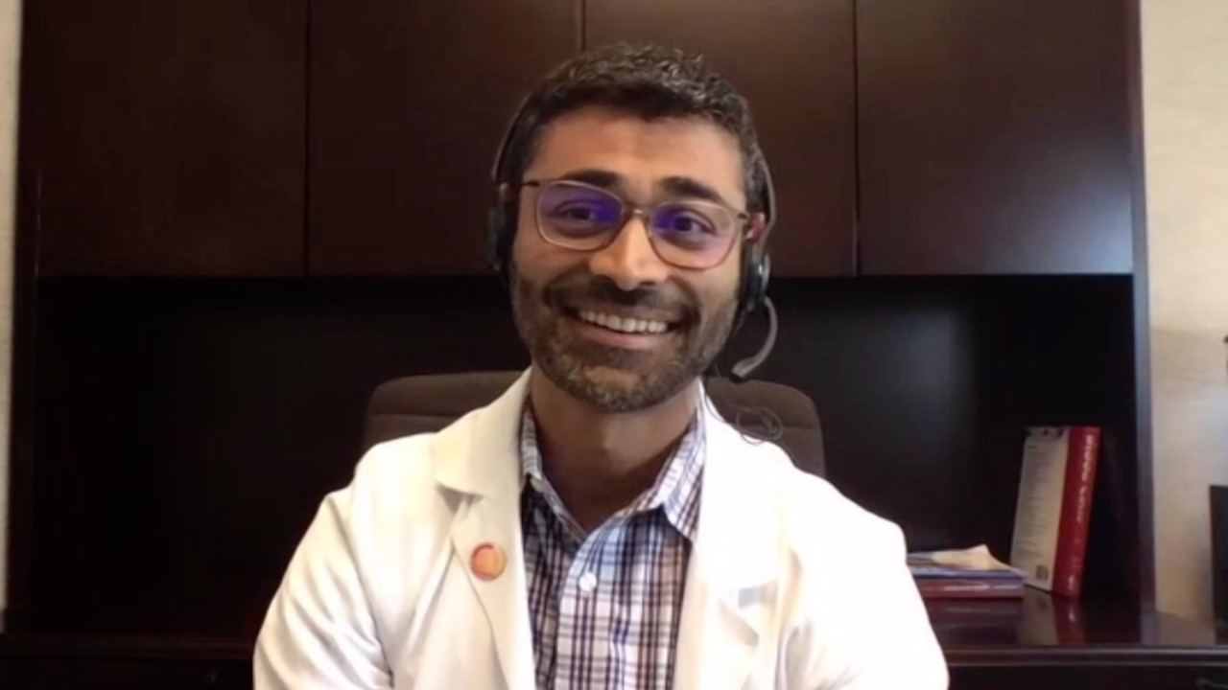
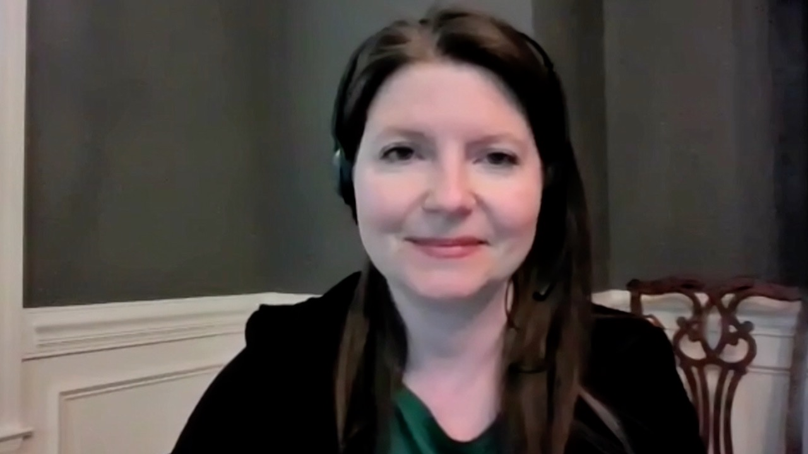
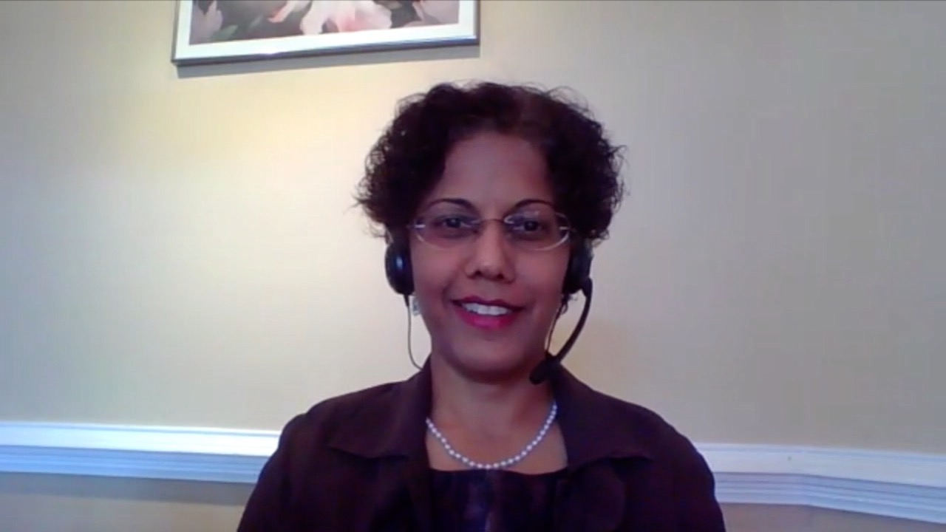
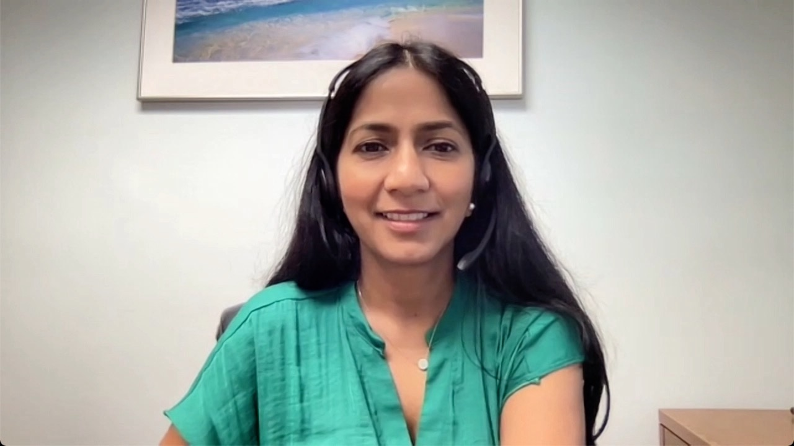

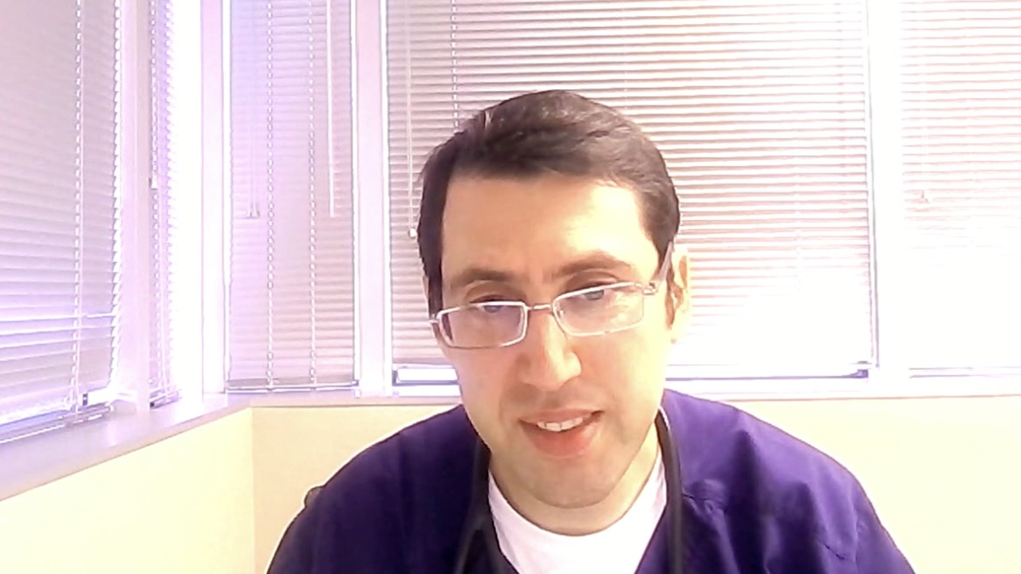

Warren S Brenner, MD
Lynn Cancer Institute
Boca Raton, Florida
Minesh Dinubhai Patel, MD
Piedmont Cancer Institute
Peachtree City, Georgia
Jennifer L Dallas, MD
Novant Health Cancer Institute
Charlotte, North Carolina
Priya Rudolph, MD, PhD
Georgia Cancer Specialists
Northside Hospital Cancer Institute
Athens, Georgia
Shaachi Gupta, MD, MPH Florida Cancer Specialists
Lake Worth, Florida
Liudmila N Schafer, MD
Saint Luke’s Cancer Institute Kansas City, Missouri
Pavel A Levin, MD, PhD
Texas Oncology-Pearland
Houston, Texas
John Yang, MD
Oncologist
Fall River, Massachusetts

Slide 6
Meet The Professor with Dr Kelley
Introduction
MODULE 1: Hepatocellular Carcinoma
Case Presentations
Journal Club with Dr Kelley
MODULE 2: Biliary Tract Cancers
Case Presentations
Key Recent Data Sets; Journal Club with Dr Kelley
MODULE 3: Appendix of Key Publications

Slide 7
Meet The Professor with Dr Kelley
Introduction
MODULE 1: Hepatocellular Carcinoma
Case Presentations
Journal Club with Dr Kelley
MODULE 2: Biliary Tract Cancers
Case Presentations
Key Recent Data Sets; Journal Club with Dr Kelley
MODULE 3: Appendix of Key Publications

Slide 8
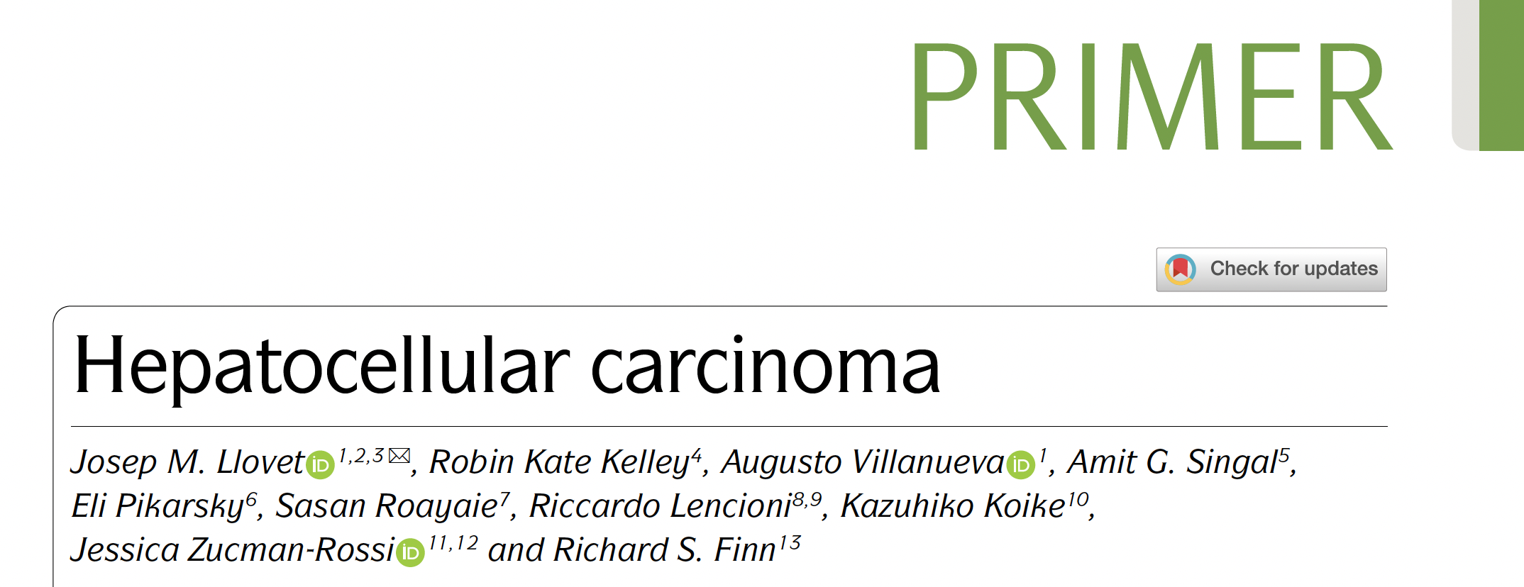

Nat Rev Dis Primers 2021;7(1):6.

Slide 9
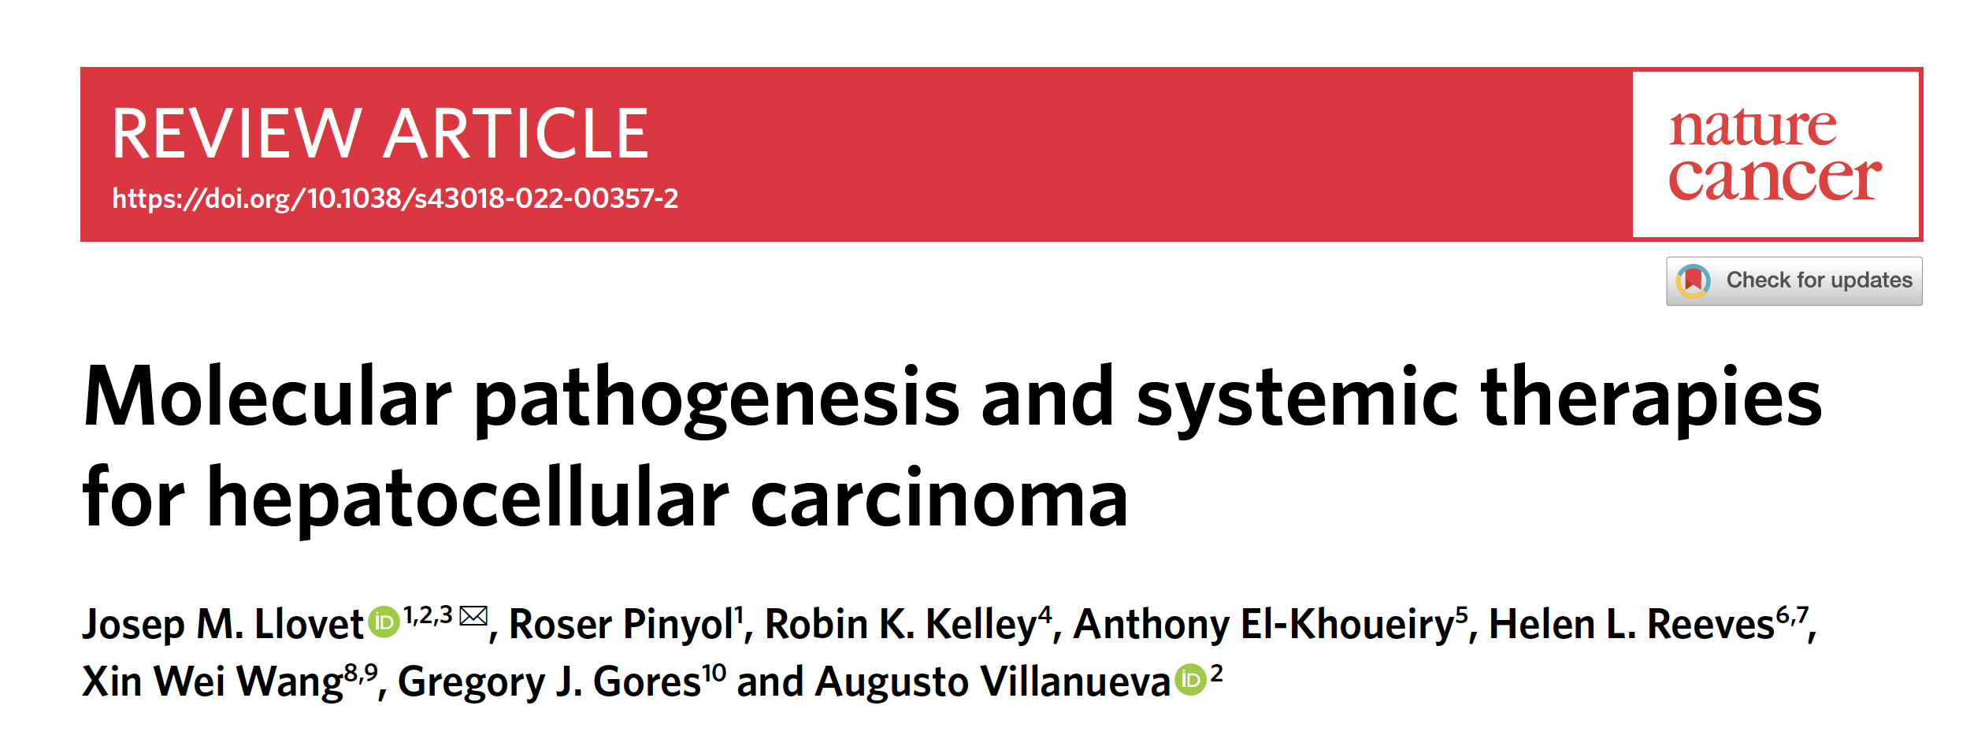
Nat Cancer 2022;3(4):386-401.

Slide 10
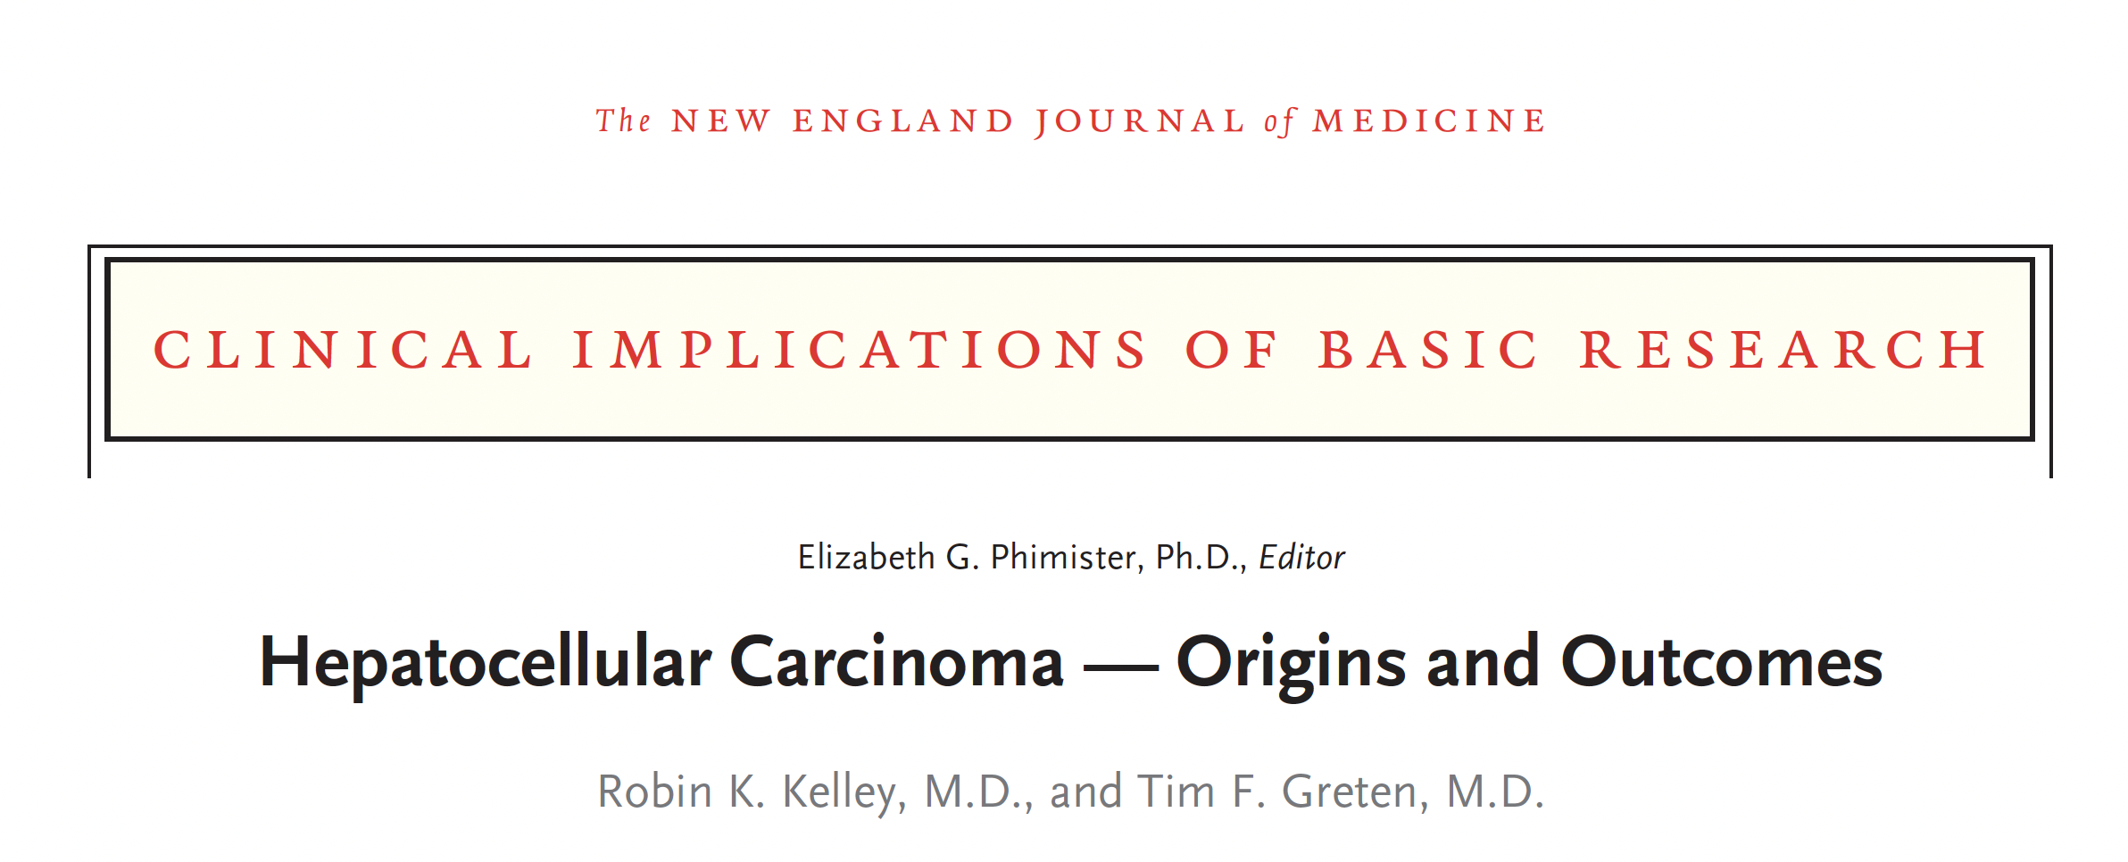
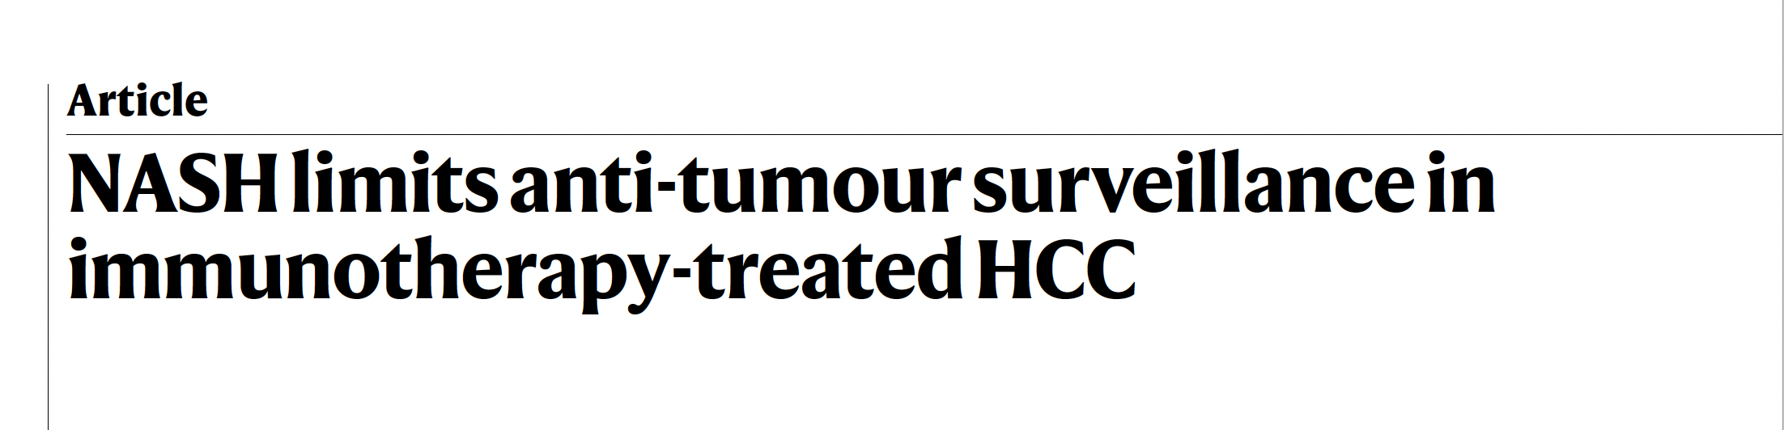
N Engl J Med 2021;385(3):280-2.
Pfister D et al. Nature 2021;592:450-6.

Slide 11
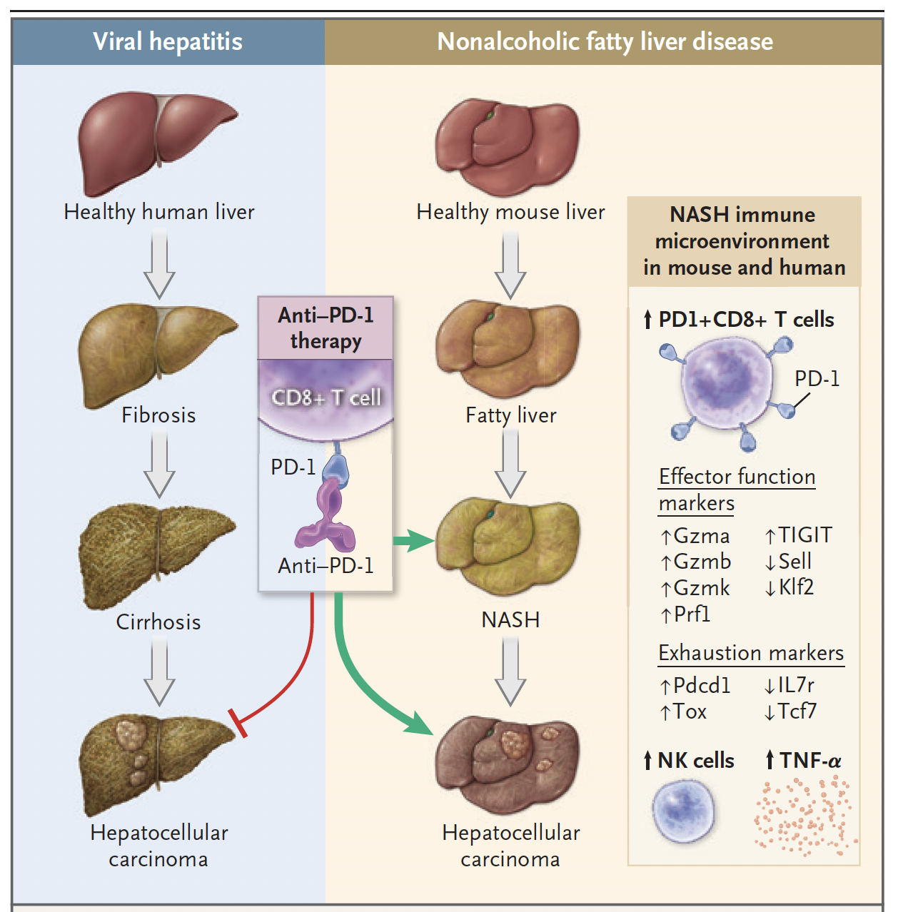
PD-1 Inhibition for Hepatocellular Carcinoma in the Context of NASH
Kelley RK, Greten TF. N Engl J Med 2021;385(3):280-2.

Slide 12
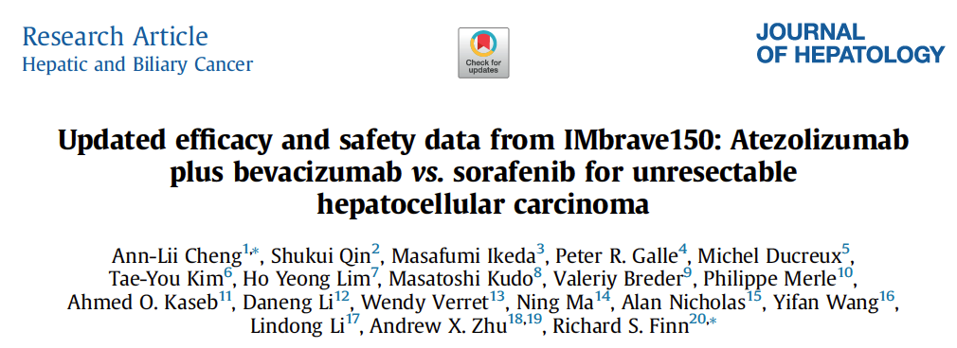
J Hepatol 2022;76(4):862-73.

Slide 13
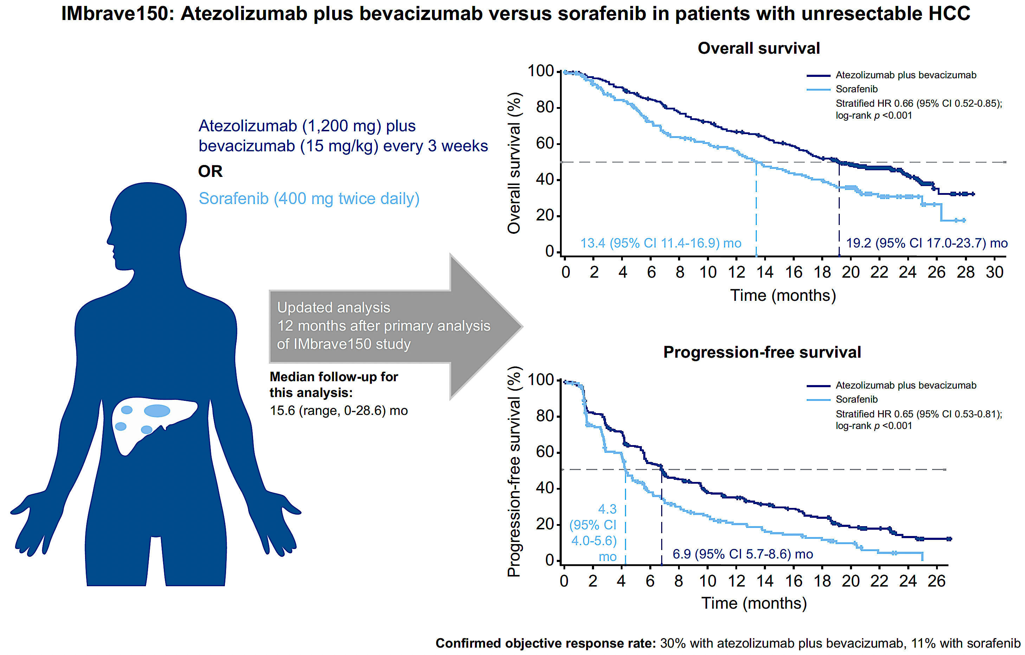
IMbrave150: Updated OS and PFS with Atezolizumab and Bevacizumab (Median Follow-Up = 15.6 Months)
Cheng A-L et al. J Hepatol 2022;76(4):862-73.

Slide 14
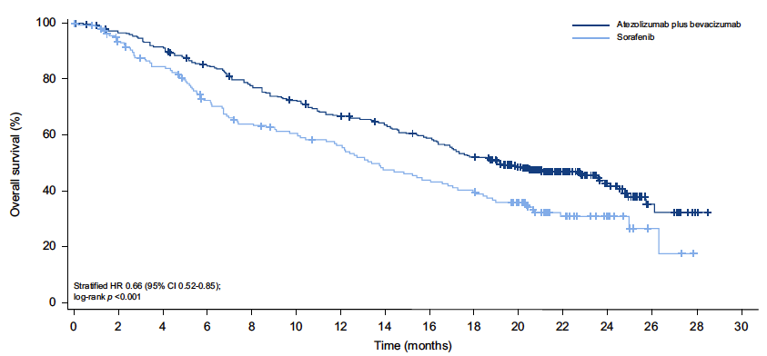
IMbrave150: Updated OS with Atezolizumab and Bevacizumab (Median Follow-Up = 15.6 Months)
Median 19.2 mo
Median 13.4 mo
Cheng A-L et al. J Hepatol 2022;76(4):862-73.

Slide 15
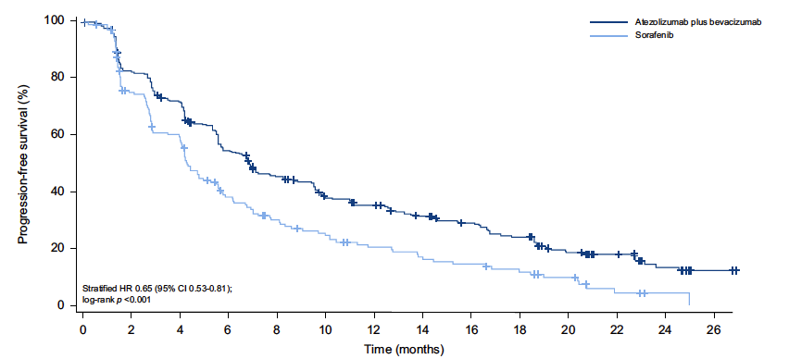
IMbrave150: Updated PFS with Atezolizumab and Bevacizumab (Median Follow-Up = 15.6 Months)
Median 6.9 mo
Median 4.3 mo
Cheng A-L et al. J Hepatol 2022;76(4):862-73.

Slide 16
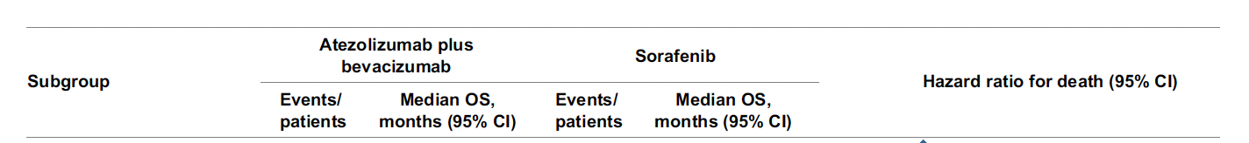
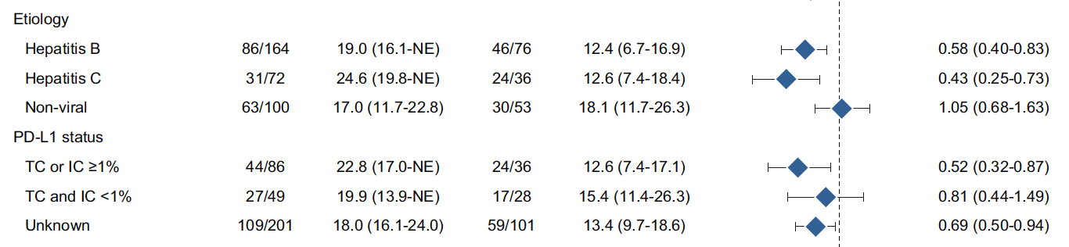
IMbrave150 Update: Subgroup Analysis of OS with Atezolizumab and Bevacizumab (Median Follow-Up = 15.6 Months)
Cheng A-L et al. J Hepatol 2022;76(4):862-73.

Slide 17
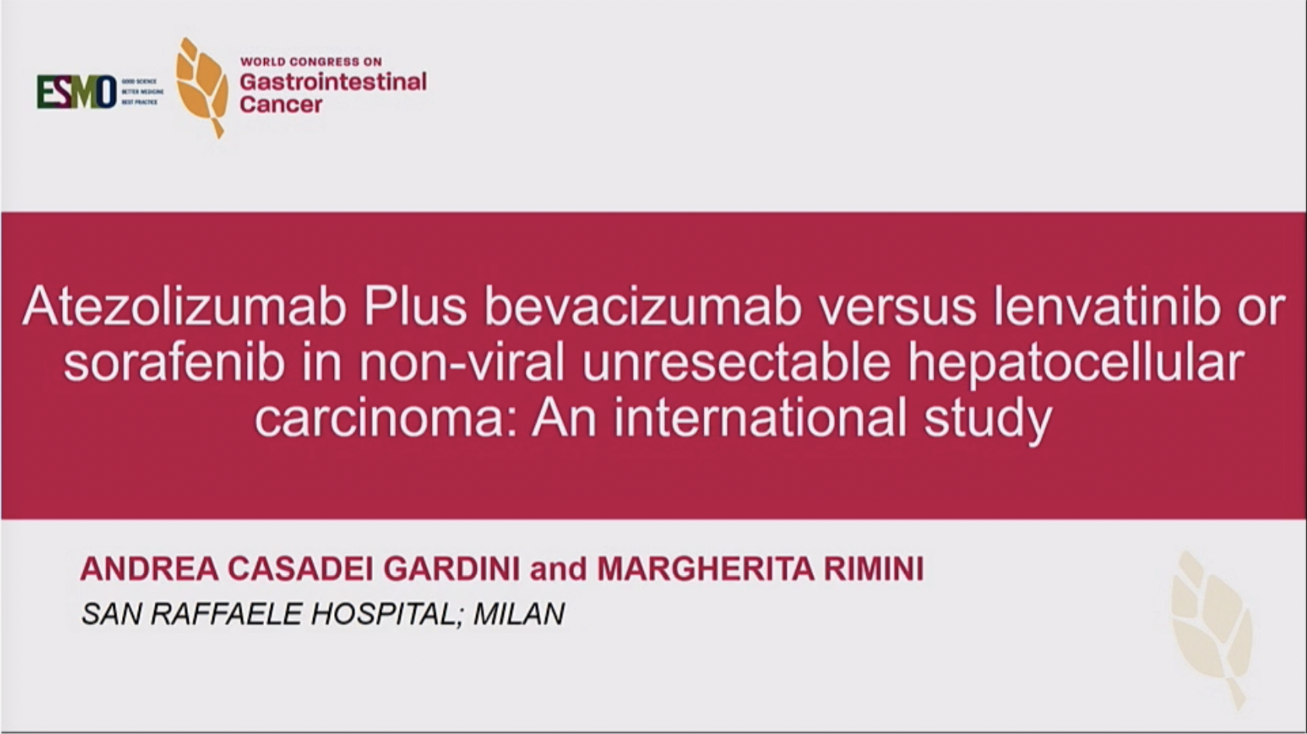
2022 | Abstract SO-14

Slide 18
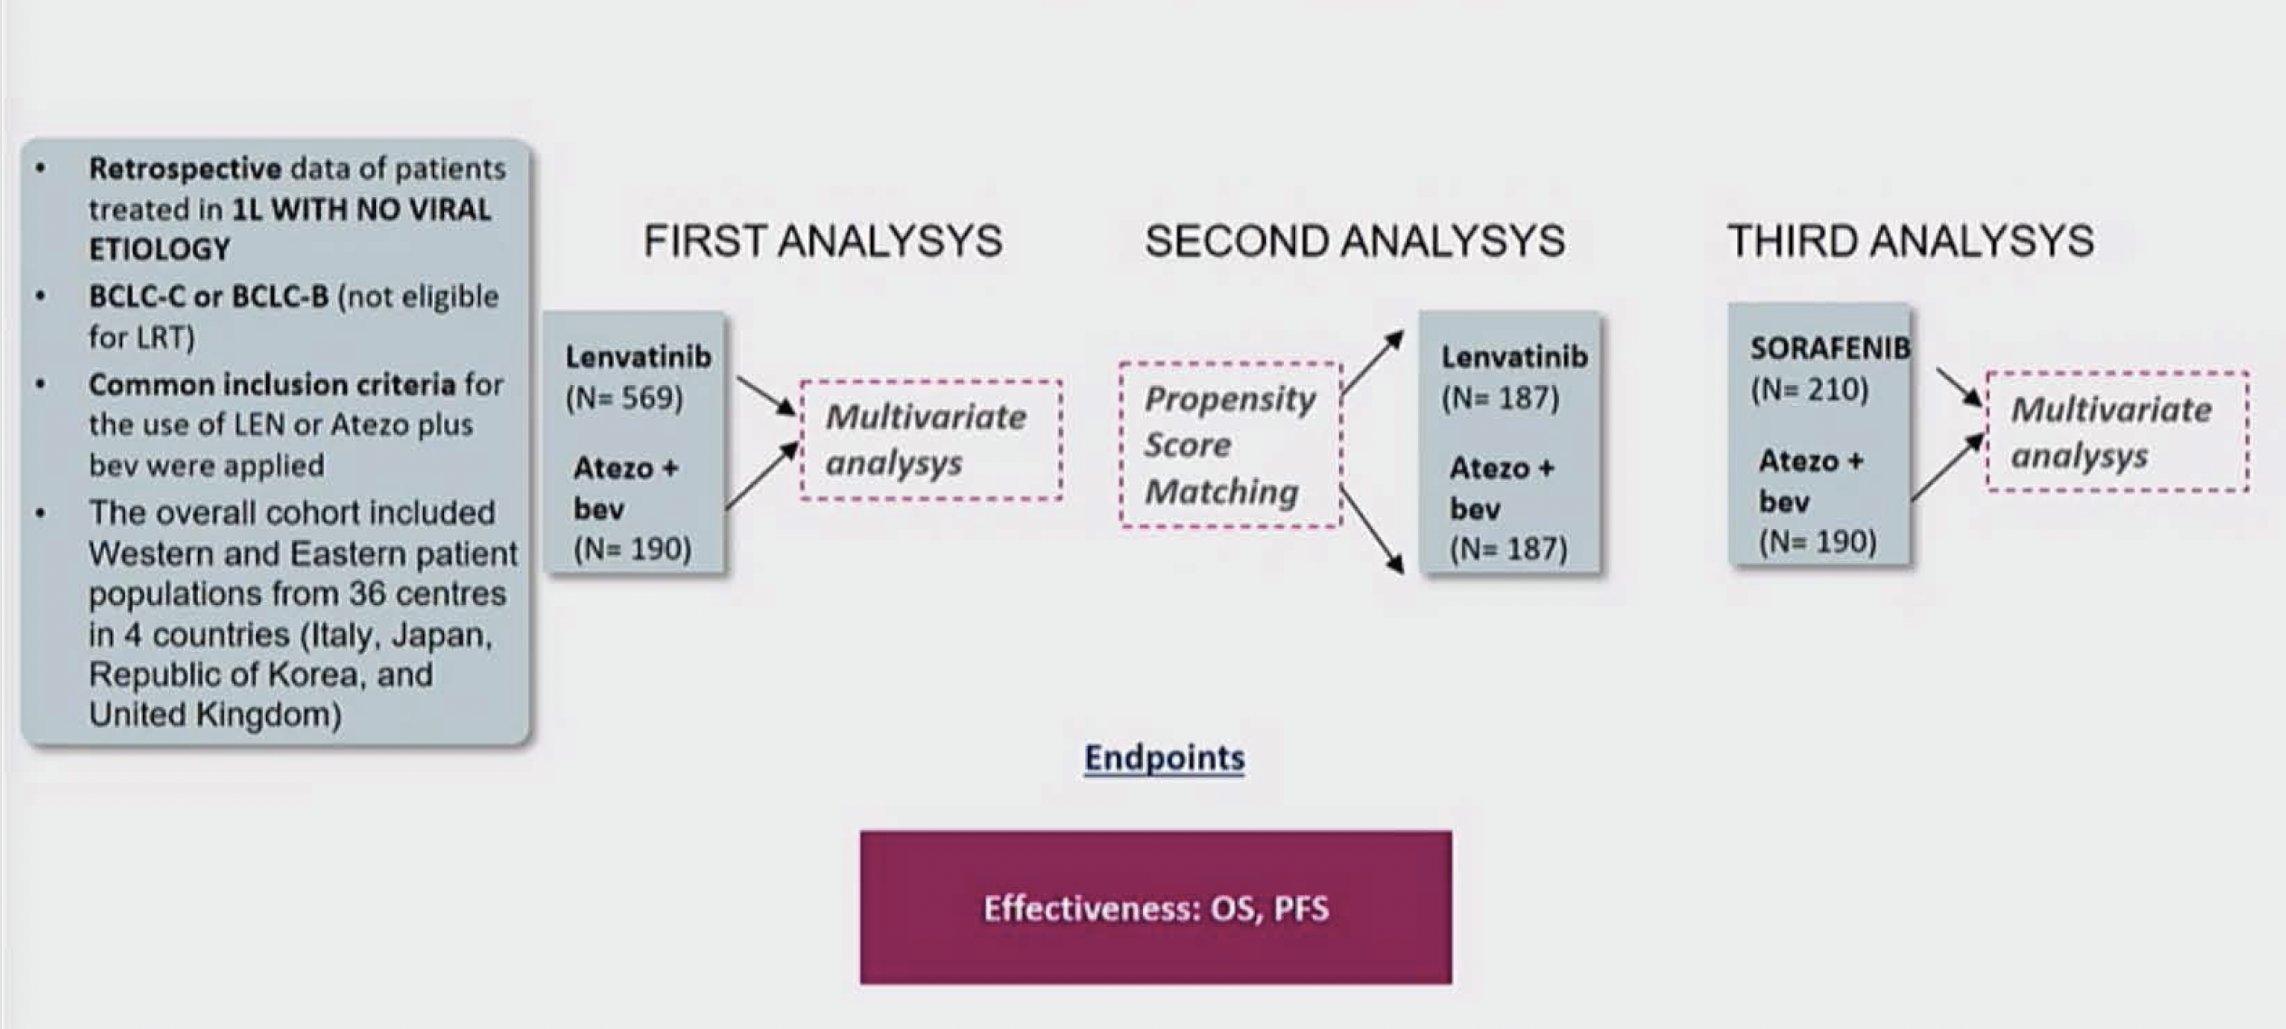
Study Design
FIRST ANALYSIS
SECOND ANALYSIS
THIRD ANALYSIS
Multivariate
analysis
Multivariate
analysis
Gardini AC, Rimini M. ESMO World Congress on Gastrointestinal Cancer 2022;Abstract SO-14.

Slide 19
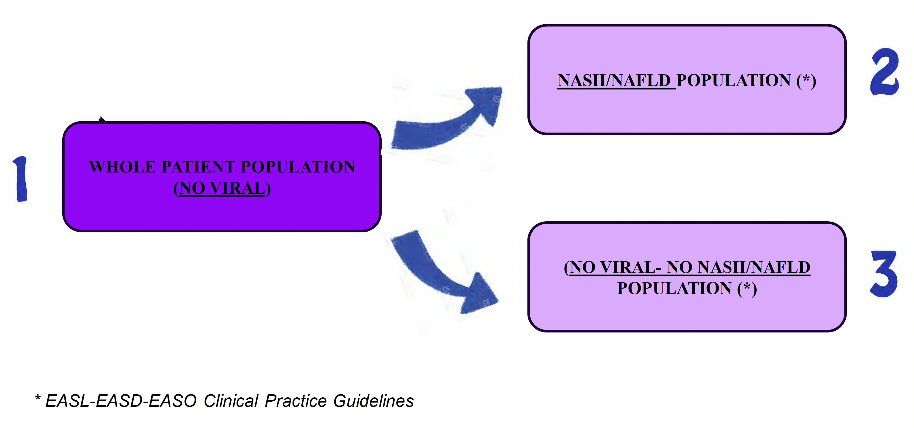
Study Design and Population
NASH = nonalcoholic steatohepatitis; NAFLD = nonalcoholic fatty liver disease
Gardini AC, Rimini M. ESMO World Congress on Gastrointestinal Cancer 2022;Abstract SO-14.

Slide 20
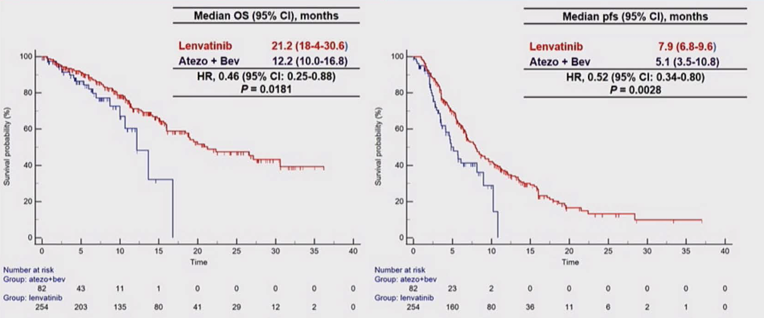
Efficacy Results (First Study): NASH/NAFLD
Gardini AC, Rimini M. ESMO World Congress on Gastrointestinal Cancer 2022;Abstract SO-14.

Slide 21
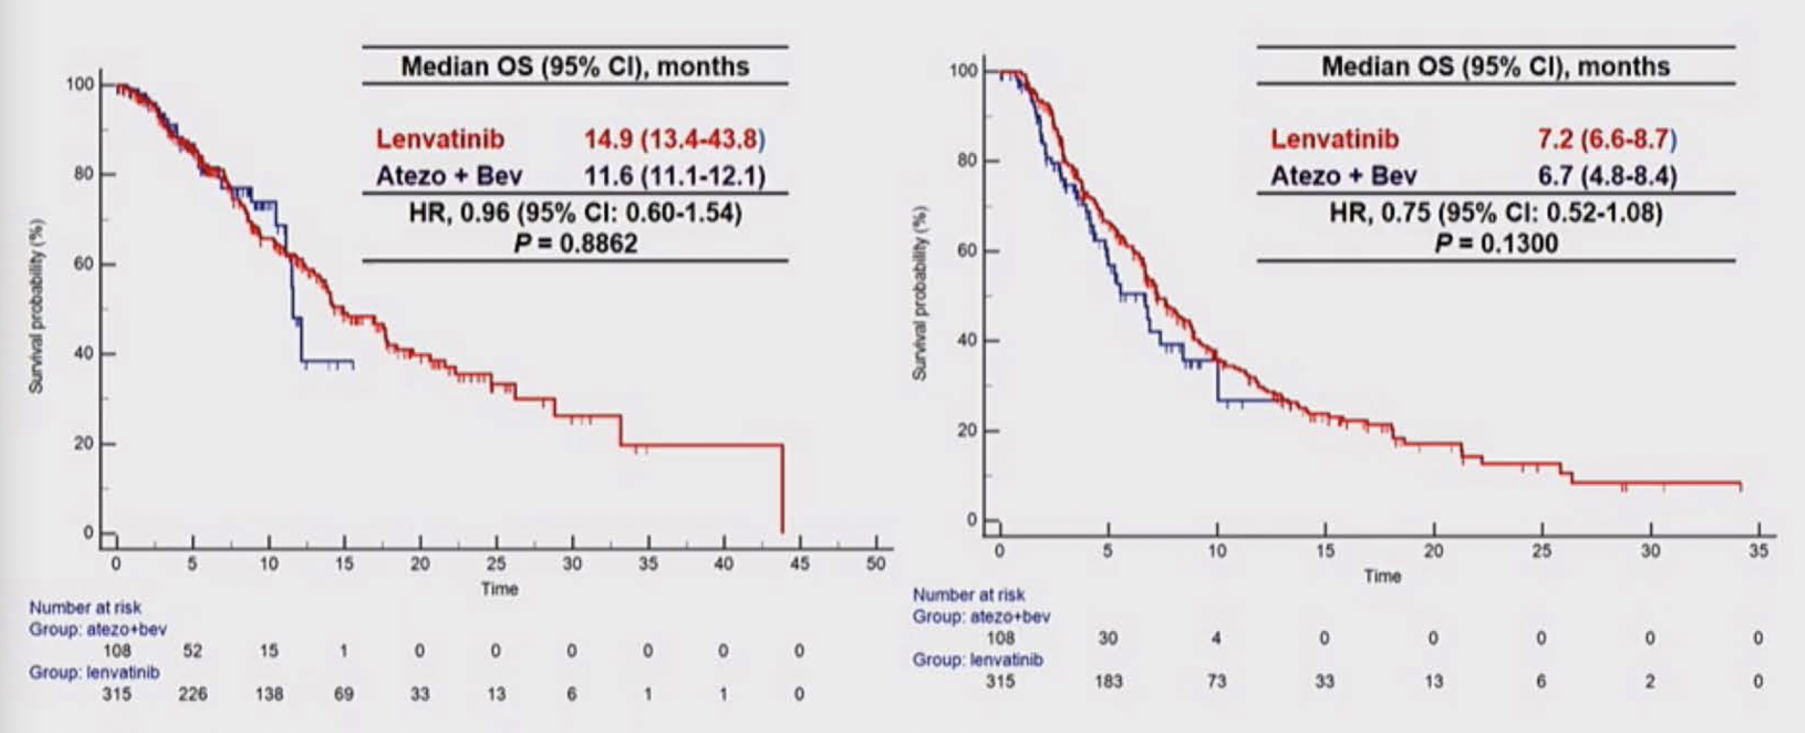
Clinical Outcomes in Nonviral, Non-NASH/NAFLD Population
Gardini AC, Rimini M. ESMO World Congress on Gastrointestinal Cancer 2022;Abstract SO-14.

Slide 22
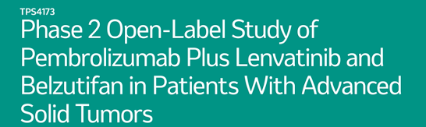

ASCO 2022

Slide 23
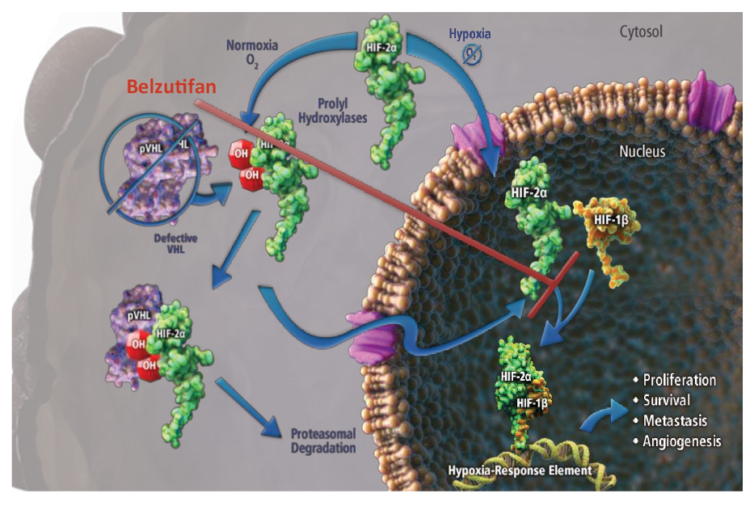
Belzutifan Inhibition of HIF-2α Affects Downstream Pathways
Kelley RK et al. ASCO 2022;Abstract TPS4173.

Slide 24
Meet The Professor with Dr Kelley
Introduction
MODULE 1: Hepatocellular Carcinoma (HCC)
Case Presentations
  Dr Patel: An 84-year-old man with newly diagnosed HCC who has a PR with atezolizumab/bevacizumab
  Dr Brenner: A 66-year-old man with HCC and lung metastases (AFP: 30,000) who receives front-line atezolizumab/bevacizumab
  Dr Gupta: A 66-year-old man with metastatic HCC and rapid disease progression on first-line atezolizumab/bevacizumab
  Dr Yang: A 78-year-old man with PMH of alcoholic cirrhosis and newly diagnosed multifocal HCC
  Dr Schafer: An 82-year-old man with NASH liver cirrhosis and advanced HCC who develops proteinuria on atezolizumab/bevacizumab
Journal Club with Dr Kelley
MODULE 2: Biliary Tract Cancers
Case Presentations
Key Recent Data Sets; Journal Club with Dr Kelley
MODULE 3: Appendix of Key Publications

Slide 25
Case Presentation: An 84-year-old man with newly diagnosed HCC who has a PR with atezolizumab/bevacizumab
Dr Minesh Patel (Peachtree City, Georgia)

Slide 26
Case Presentation: An 84-year-old man with newly diagnosed HCC who has a PR with atezolizumab/bevacizumab (continued)
Dr Minesh Patel (Peachtree City, Georgia)

Slide 27
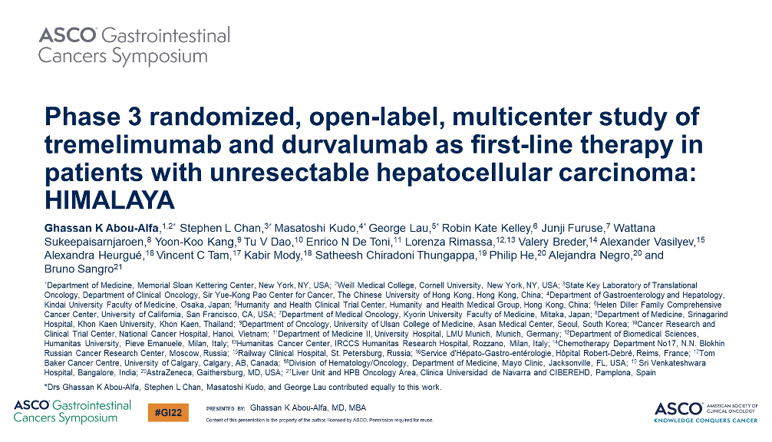
2022 | Abstract 379

Slide 28
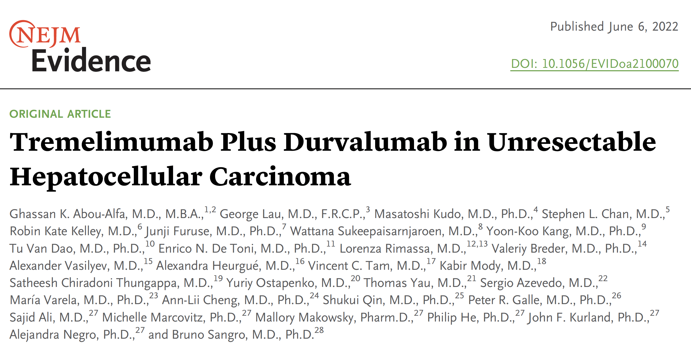

Slide 29
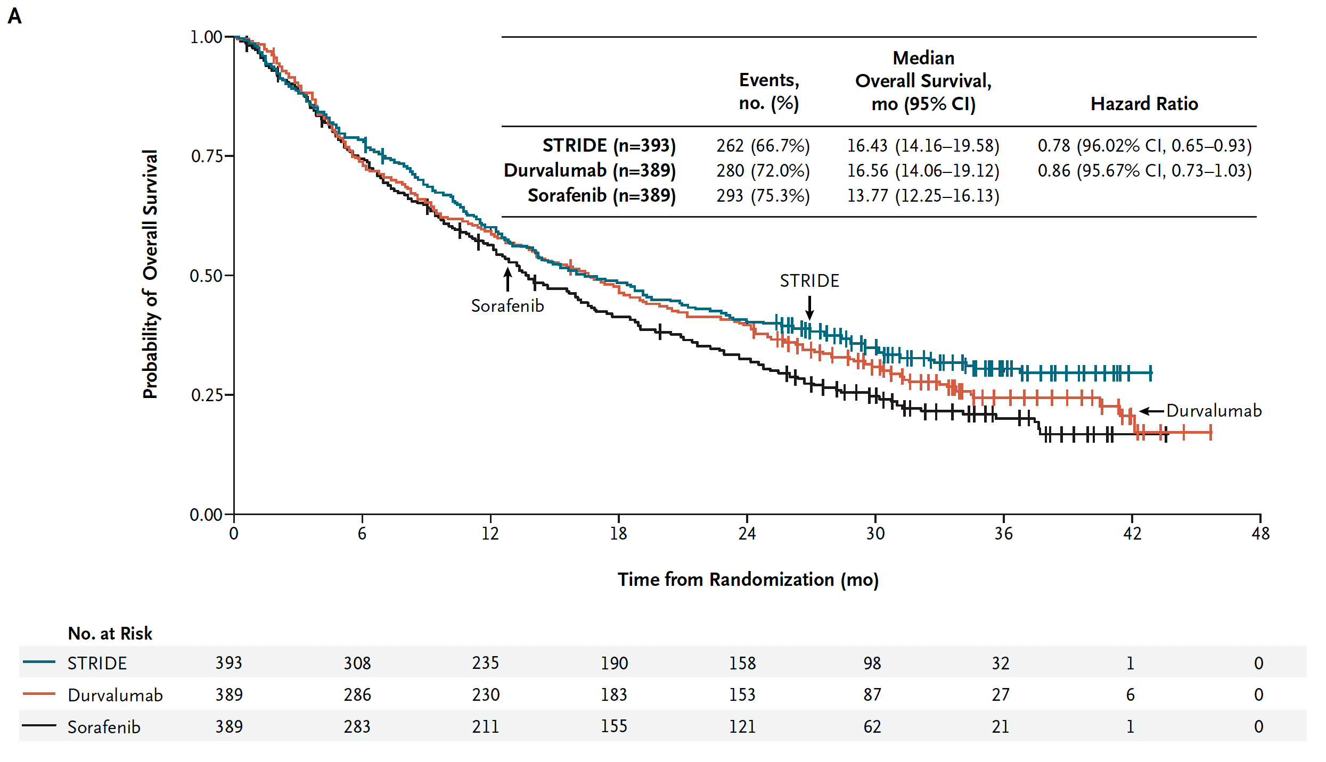
HIMALAYA: Overall Survival
Abou-Alfa G et al. NEJM Evidence, June 6, 2022.

Slide 30
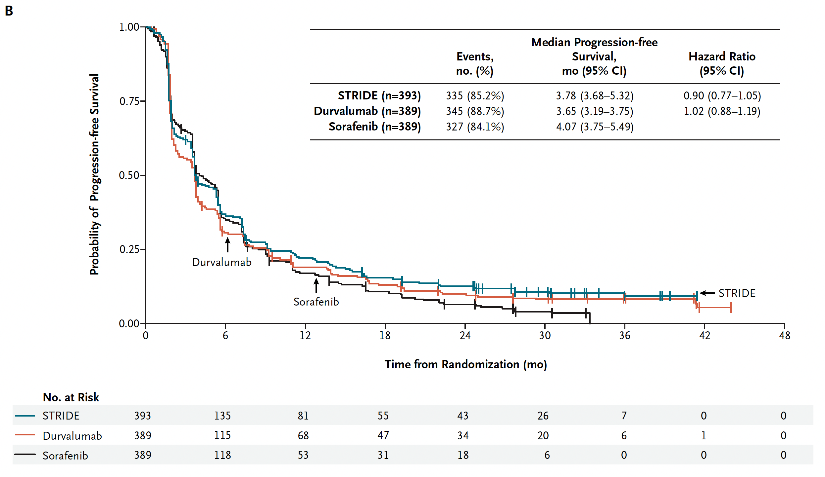
HIMALAYA: Progression-Free Survival
Abou-Alfa G et al. NEJM Evidence, June 6, 2022.

Slide 31
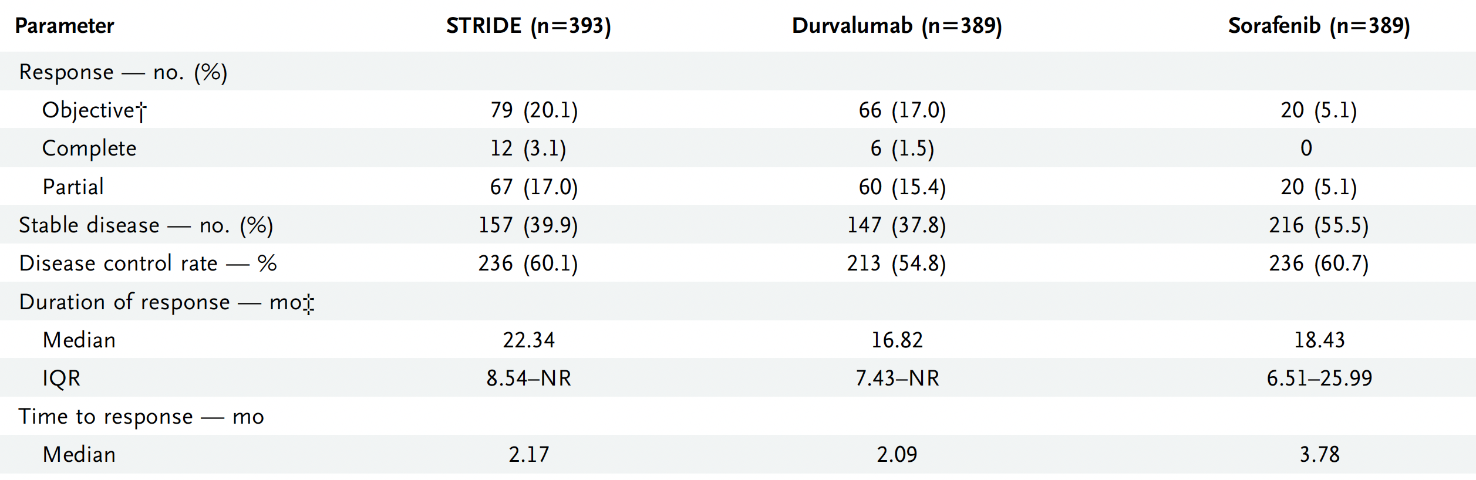
HIMALAYA: Response Outcomes (Intent-to-Treat Population)
Abou-Alfa G et al. NEJM Evidence, June 6, 2022.

Slide 32
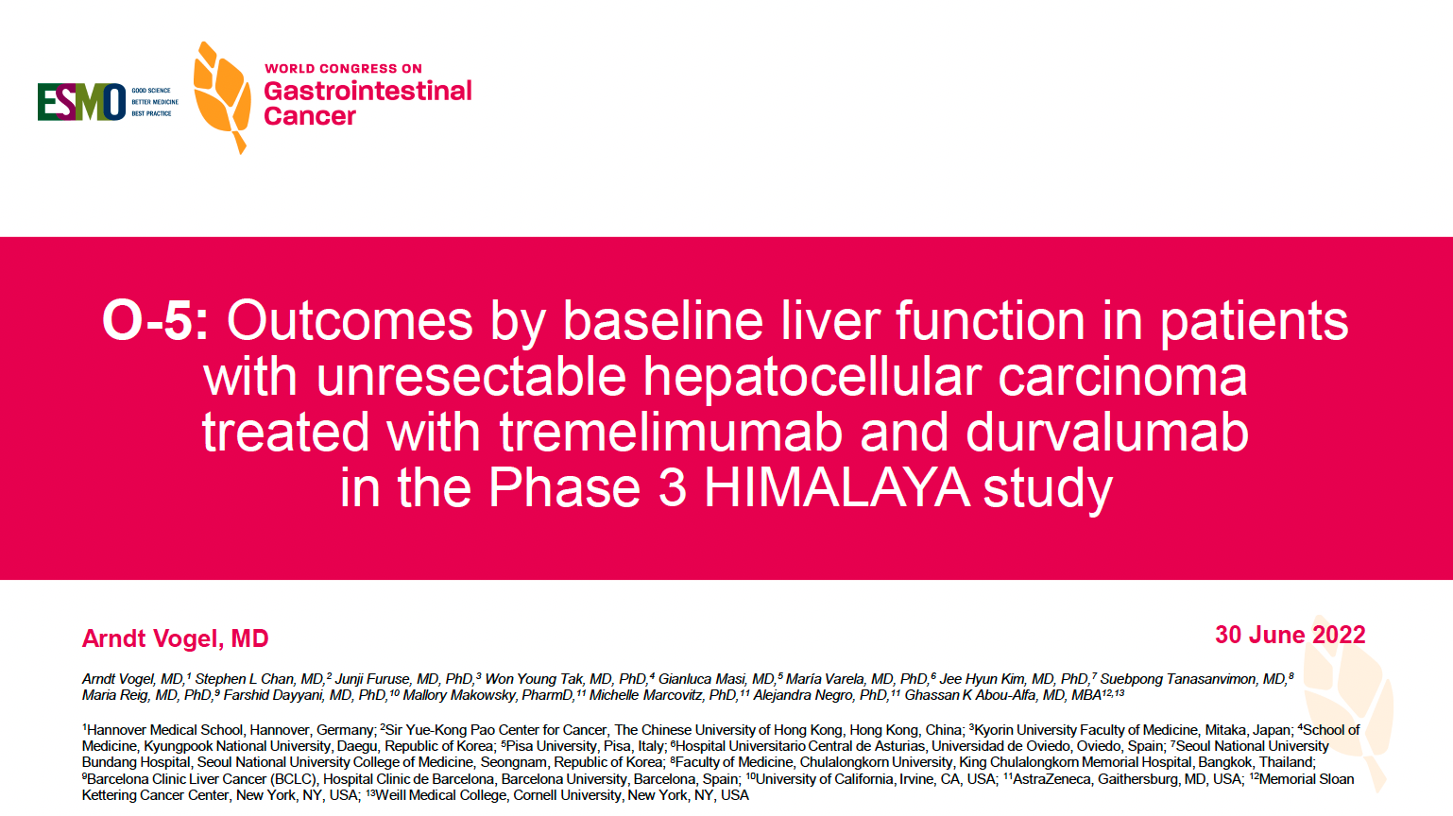
2022 | Abstract O-5

Slide 33
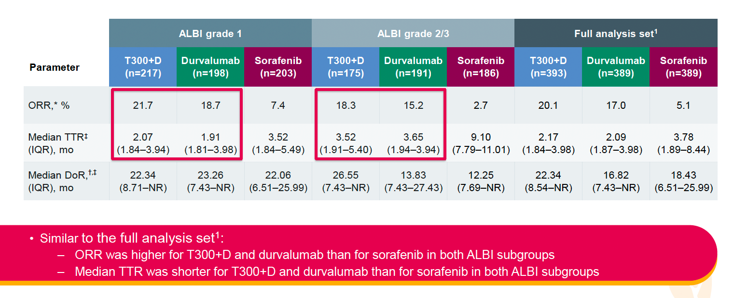
HIMALAYA: Response Outcomes in ALBI Grade Subgroups
ORR = overall response rate; TTR = time to response; DoR = duration of response
Vogel A et al. ESMO World Congress on Gastrointestinal Cancer 2022;Abstract O-5.

Slide 34
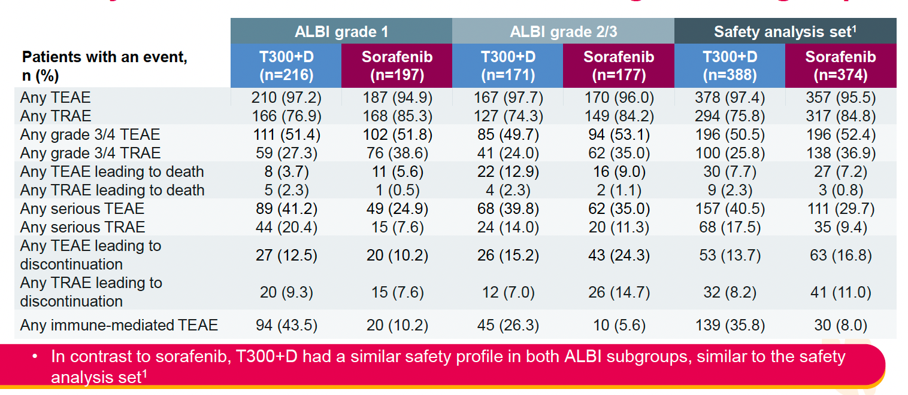
HIMALAYA: Safety for T300 + D versus Sorafenib in ALBI Grade Subgroups
TEAE = treatment-emergent adverse event; TRAE = treatment-related adverse event
Vogel A et al. ESMO World Congress on Gastrointestinal Cancer 2022;Abstract O-5.

Slide 35
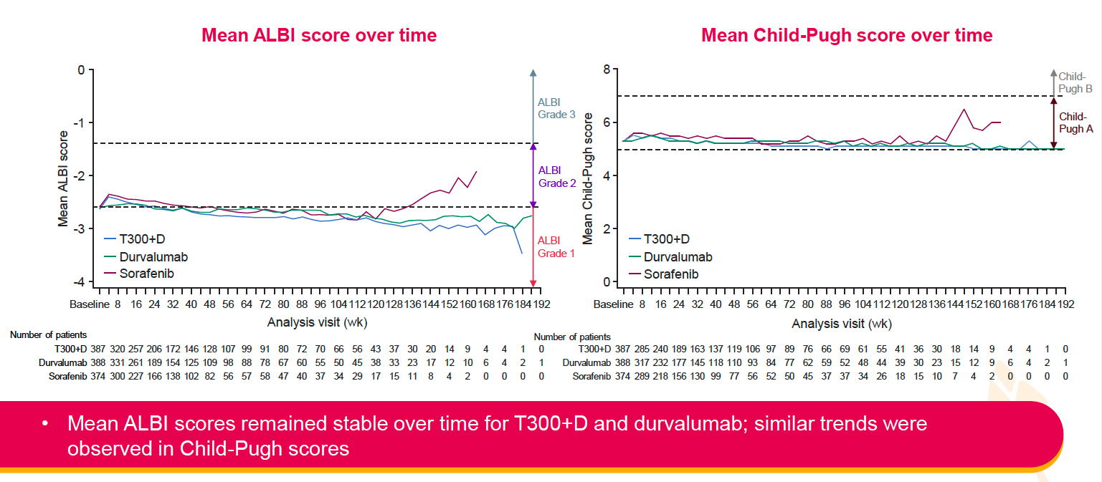
HIMALAYA: Liver Function Over Time in the Study Population
Vogel A et al. ESMO World Congress on Gastrointestinal Cancer 2022;Abstract O-5.

Slide 36
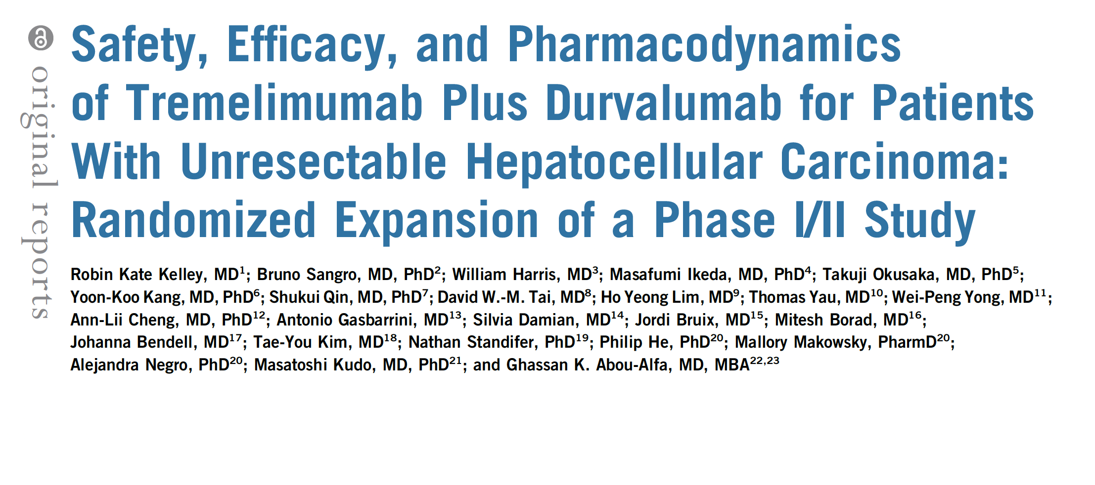
J Clin Oncol 2021;39(27):2991-3001.

Slide 37
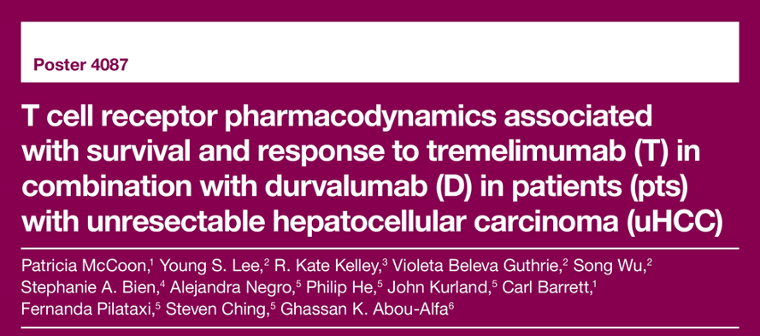
ASCO 2021

Slide 38
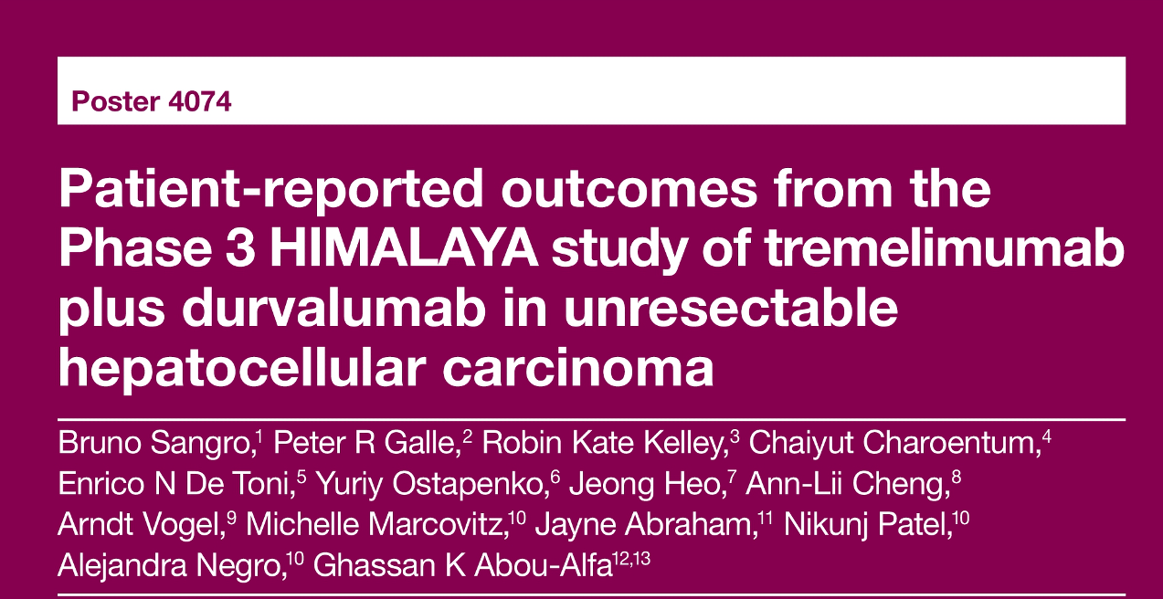
ASCO 2022

Slide 39
Case Presentation: A 66-year-old man with HCC and lung metastases (AFP: 30,000) who receives front-line atezolizumab/bevacizumab
Dr Warren Brenner (Boca Raton, Florida)

Slide 40
Case Presentation: A 66-year-old man with metastatic HCC and rapid disease progression on first-line atezolizumab/bevacizumab
Dr Shaachi Gupta (Lake Worth, Florida)

Slide 41
Case Presentation: A 78-year-old man with PMH of alcoholic cirrhosis and newly diagnosed multifocal HCC
Dr John Yang (Fall River, Massachusetts)

Slide 42
Case Presentation: An 82-year-old man with NASH liver cirrhosis and advanced HCC who develops proteinuria on atezolizumab/bevacizumab
Dr Liudmila Schafer (Kansas City, Missouri)

Slide 43
Meet The Professor with Dr Kelley
Introduction
MODULE 1: Hepatocellular Carcinoma
Case Presentations
Journal Club with Dr Kelley
MODULE 2: Biliary Tract Cancers
Case Presentations
Key Recent Data Sets; Journal Club with Dr Kelley
MODULE 3: Appendix of Key Publications

Slide 44

Gastrointestinal Cancers Symposium 2022.

Slide 45
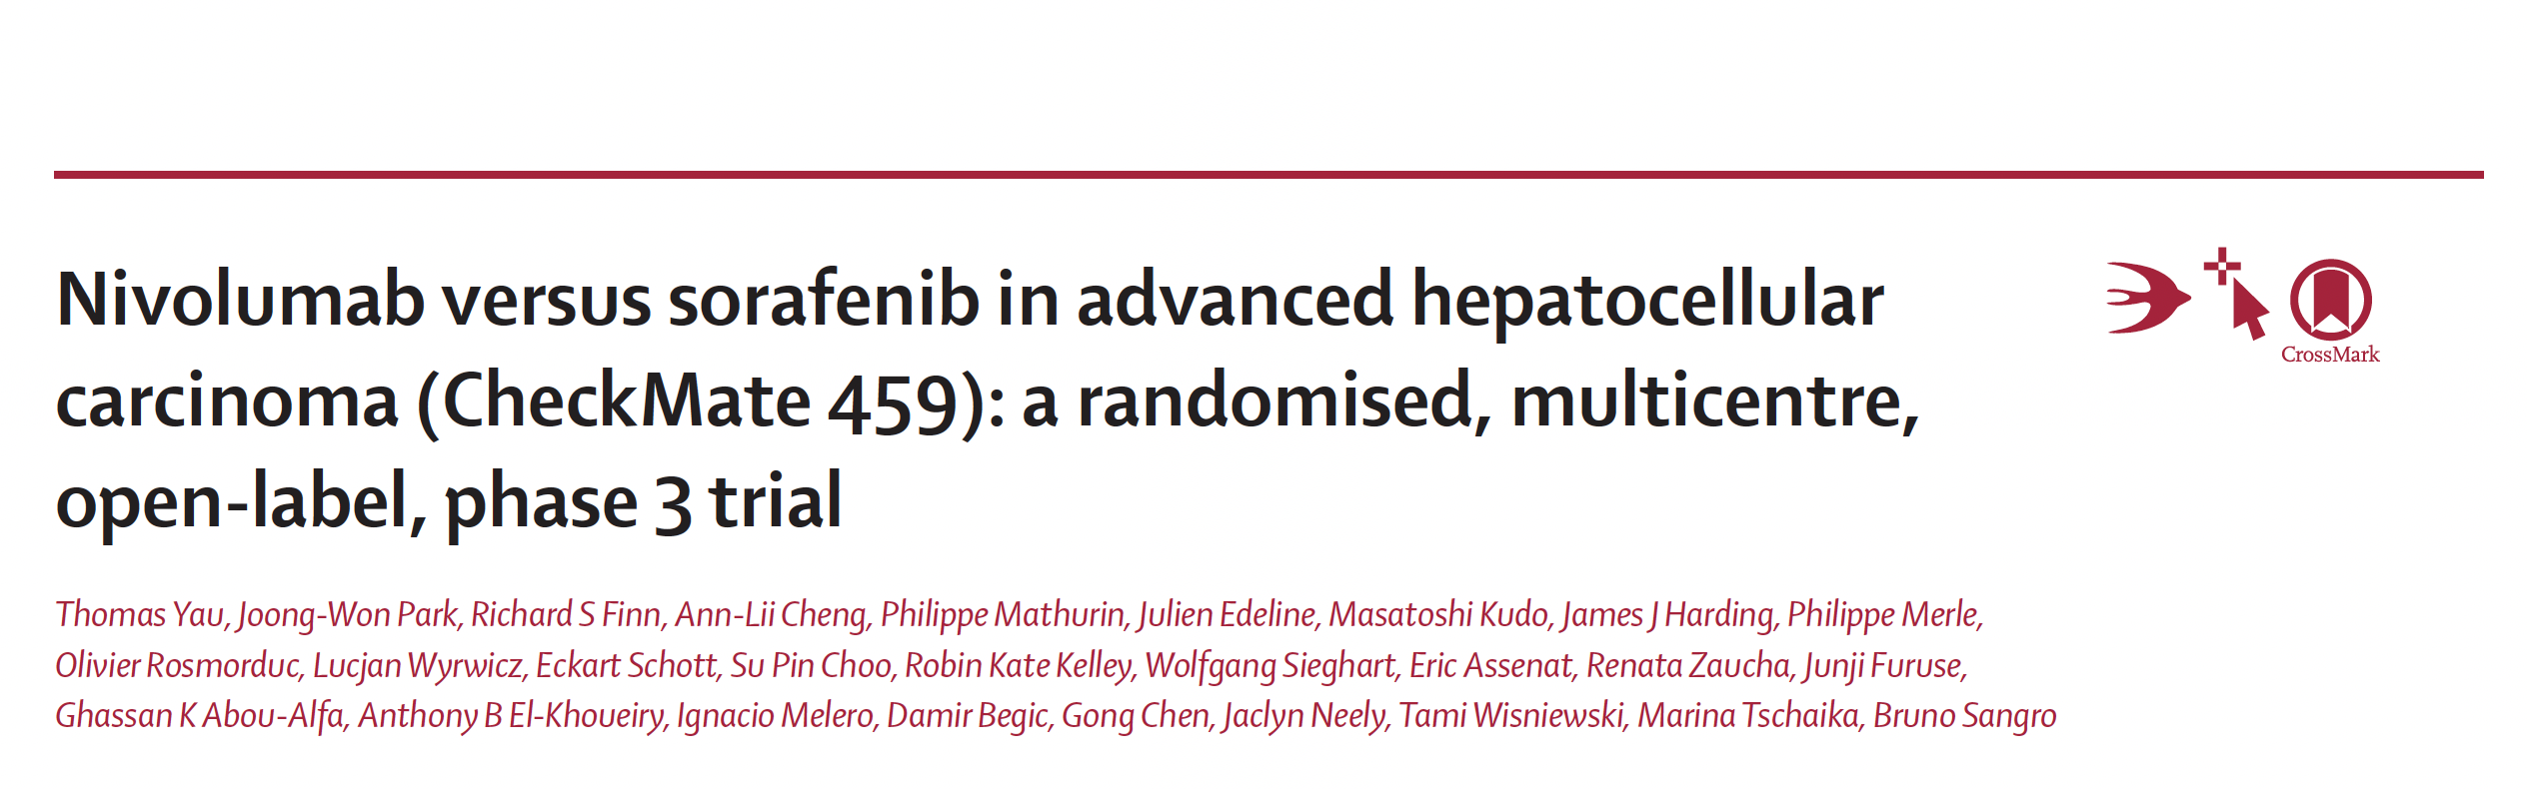
Lancet Oncol 2022;23:77-90.

Slide 46
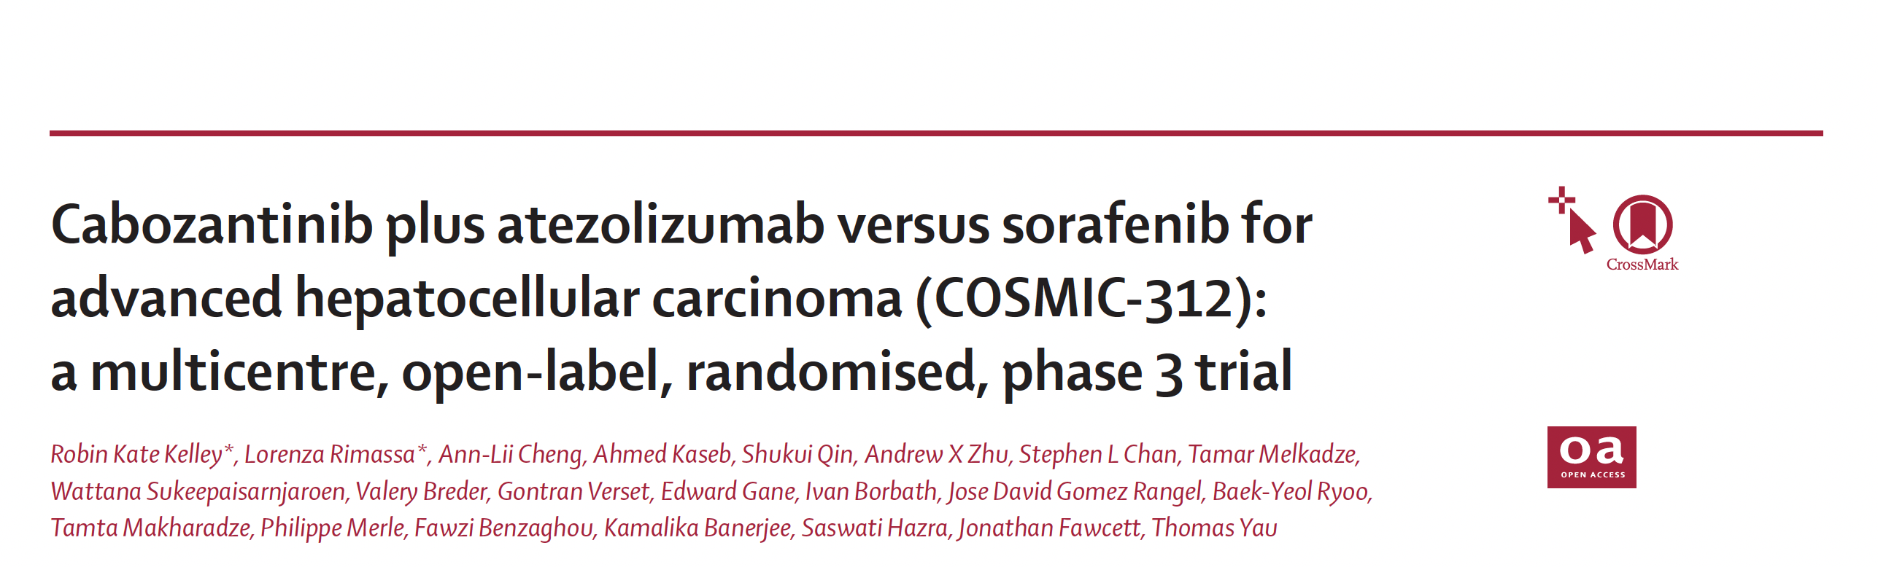
Lancet Oncology 2022;[Online ahead of print].

Slide 47
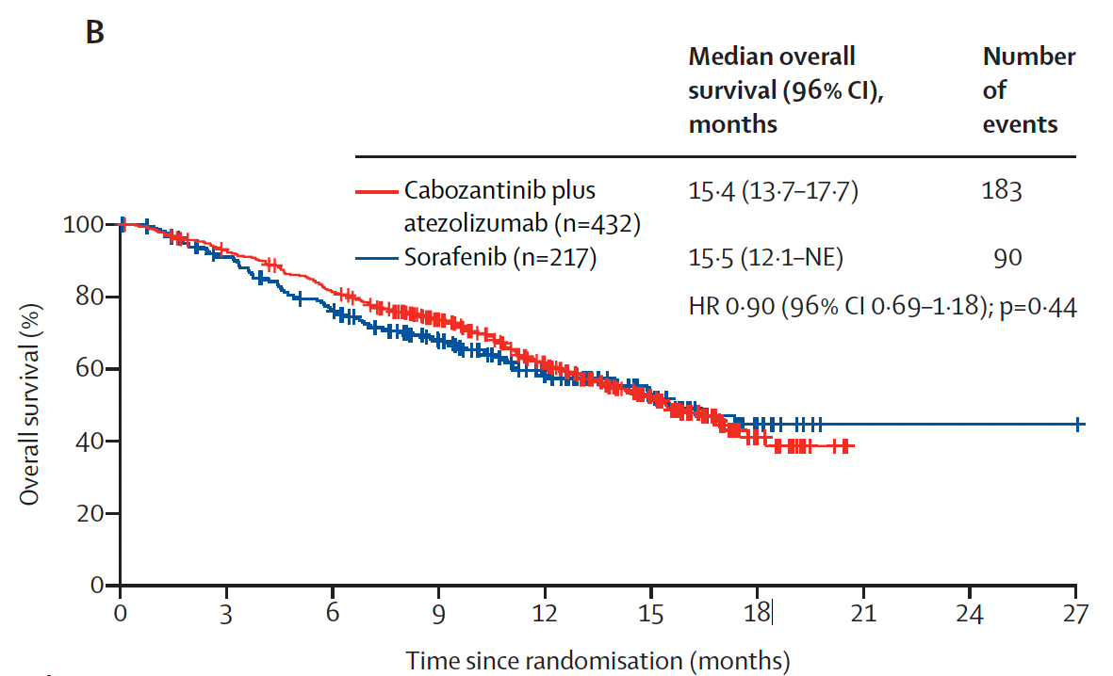
COSMIC-312: Overall Survival in the ITT Population
(Interim Analysis)
Kelley RK et al. Lancet Oncol 2022;[Online ahead of print].

Slide 48
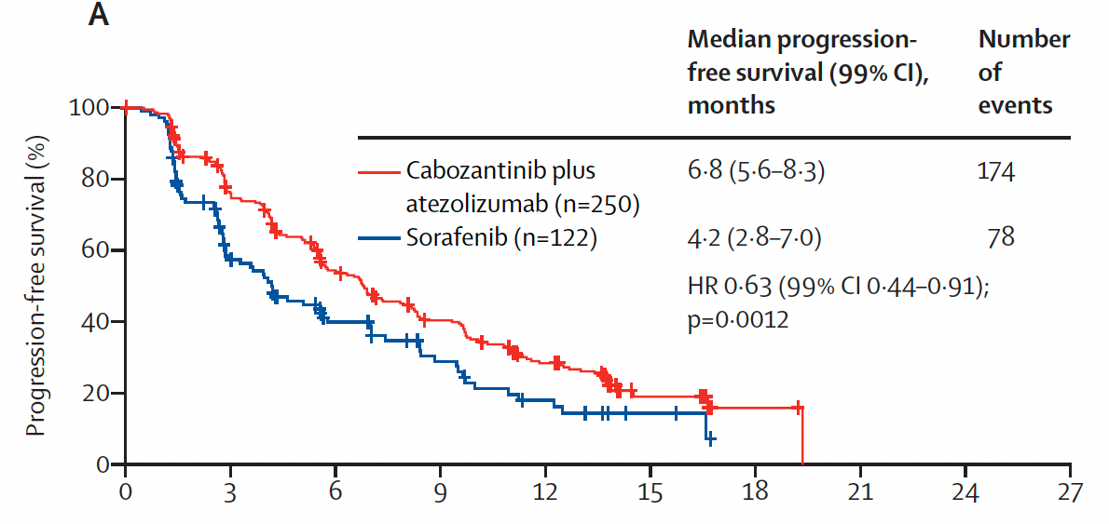
COSMIC-312: Progression-Free Survival in the ITT Population (Final Analysis)
Time since randomization (months)
Kelley RK et al. Lancet Oncol 2022;[Online ahead of print].

Slide 49
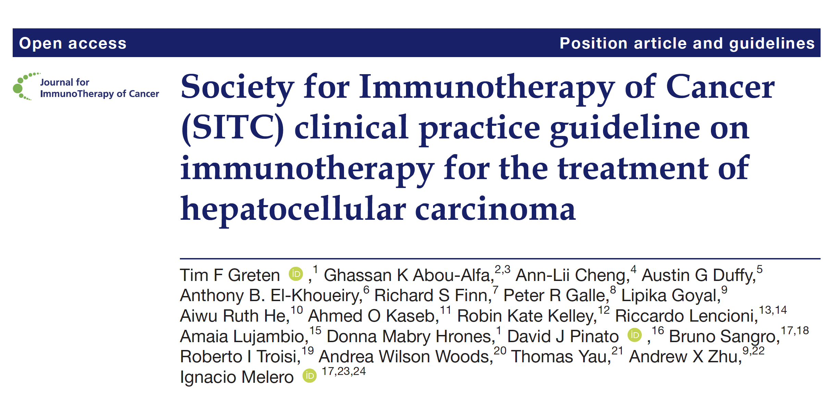
J Immunother Cancer 2021;9(9):e002794.

Slide 50
Meet The Professor with Dr Kelley
Introduction
MODULE 1: Hepatocellular Carcinoma
Case Presentations
Journal Club with Dr Kelley
MODULE 2: Biliary Tract Cancers
Case Presentations
Key Recent Data Sets; Journal Club with Dr Kelley
MODULE 3: Appendix of Key Publications

Slide 51
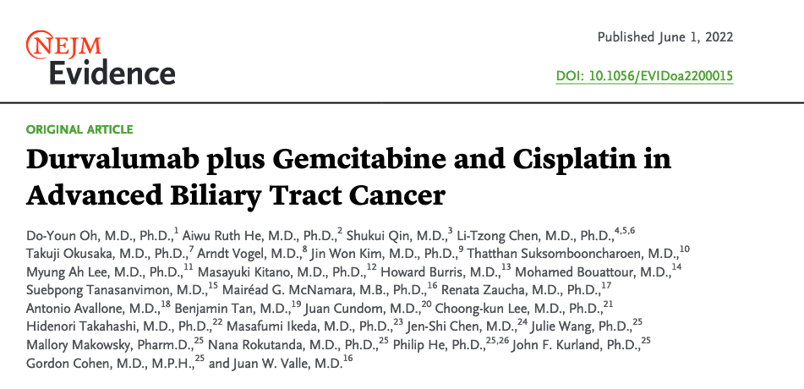

Slide 52
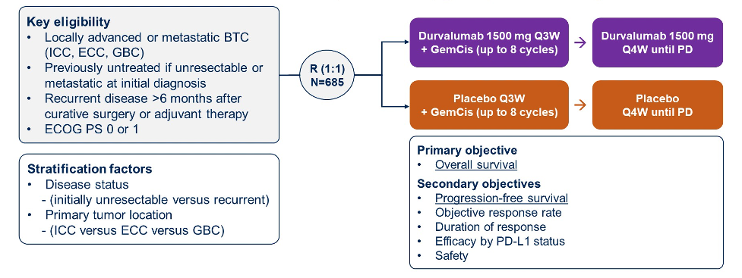
TOPAZ-1 Phase III Trial Schema
BTC = biliary tract cancer
Oh D-Y et al. Gastrointestinal Cancers Symposium 2022;Abstract 378.

Slide 53
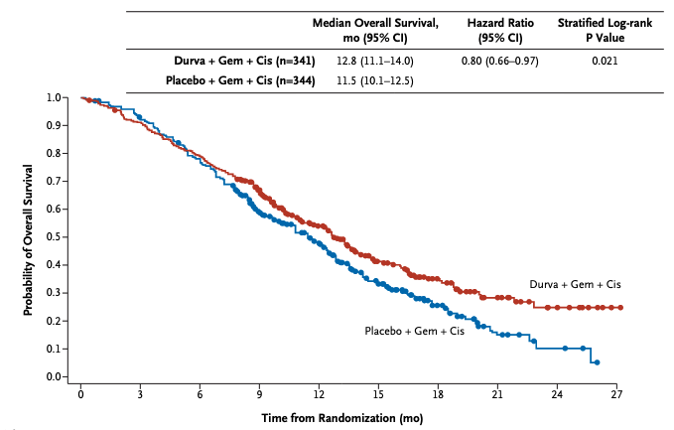
TOPAZ-1: Primary Overall Survival Endpoint with Durvalumab and Gemcitabine/Cisplatin for Advanced Biliary Tract Cancer
Oh D-Y et al. NEJM Evidence, June 1, 2022.

Slide 54
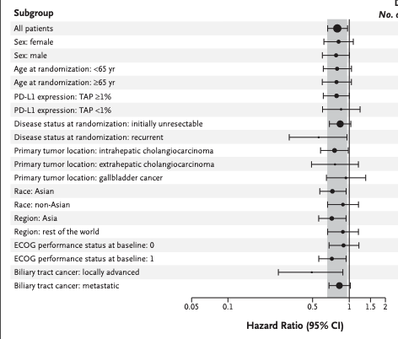
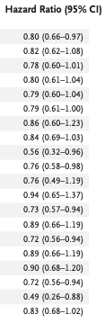
TOPAZ-1: Overall Survival Subgroup Analysis
Oh D-Y et al. NEJM Evidence, June 1, 2022.

Slide 55
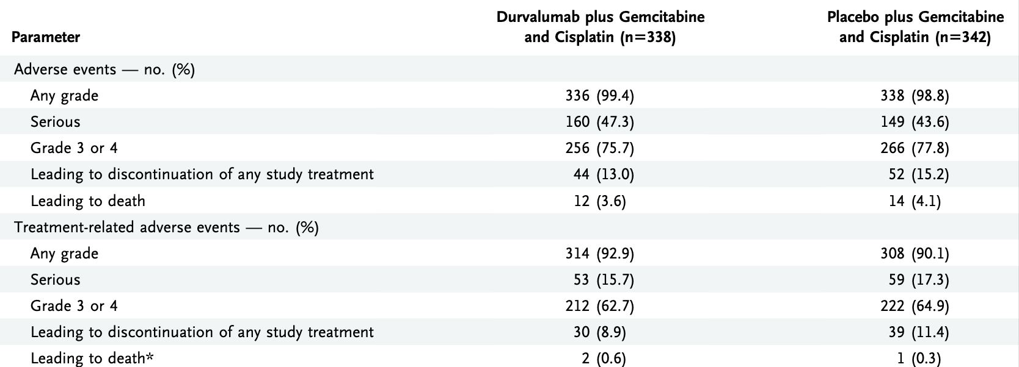
TOPAZ-1: Adverse Event Summary
Oh D-Y et al. NEJM Evidence, June 1, 2022.

Slide 56

2022 | Abstract O-1

Slide 57

TOPAZ-1: OS by Primary Tumor Location and Region
He AR et al. ESMO World Congress on Gastrointestinal Cancer;Abstract O-1.

Slide 58

TOPAZ-1: PFS by Primary Tumor Location
He AR et al. ESMO World Congress on Gastrointestinal Cancer;Abstract O-1.

Slide 59

TOPAZ-1: ORR and DoR by Primary Tumor Location
ORR = objective response rate; DoR = duration of response; OR = odds ratio; TTR = time to response
He AR et al. ESMO World Congress on Gastrointestinal Cancer;Abstract O-1.

Slide 60
Meet The Professor with Dr Kelley
Introduction
MODULE 1: Hepatocellular Carcinoma
Case Presentations
Journal Club with Dr Kelley
MODULE 2: Biliary Tract Cancers
Case Presentations
  Dr Rudolph: A 71-year-old woman with metastatic pancreaticobiliary cancer thought to be intrahepatic cholangiocarcinoma
  Dr Levin: A 49-year-old woman with intrahepatic cholangiocarcinoma and micrometastases in portal lymph nodes
  Dr Dallas: A 66-year-old man with metastatic cholangiocarcinoma who has stable disease on gemcitabine
  (NGS: MSS, PIK3CA, KRAS G12A)
  Dr Patel: A 72-year-old man with metastatic cholangiocarcinoma with PD on chemoimmunotherapy and Y-90 (NGS: PD-L1 10%, PTEN mutation, MYC alteration)
Key Recent Data Sets; Journal Club with Dr Kelley
MODULE 3: Appendix of Key Publications

Slide 61
Case Presentation: A 71-year-old woman with metastatic pancreaticobiliary cancer thought to be intrahepatic cholangiocarcinoma
Dr Priya Rudolph (Athens, Georgia)

Slide 62
Do you generally offer anti-PD-1/PD-L1 monotherapy to a patient with biliary tract cancer who experiences disease progression on first-line gemcitabine/cisplatin, and would your decision be dependent on PD-L1 status?
Yes, for a patient with high PD-L1
Yes, independent of PD-L1 status
No, I would not offer anti-PD-1/PD-L1 monotherapy in this setting
I’m not sure

Slide 63




Multiple FGFR2-targeted agents
Pemigatinib (INCB054828)¹
Derazantinib (ARQ 087)³
Infigratinib (BJG398)²
Futibatinib (TAS-120)⁴
1. Abou Alfa et al. Lancet Oncol 2020;21(5):671-684; 2. Javle et al J Clin Oncol 2018;36(3):276-282; 3. Mazzaferro et al Br J Cancer 2019;120(2):165-171; 4. Goyal et al ASCO 2022 abstr 4009
Courtesy of Professor Juan W Valle, MD

Slide 64
Case Presentation: A 49-year-old woman with intrahepatic cholangiocarcinoma and micrometastases in portal lymph nodes
Dr Pavel Levin (Houston, Texas)

Slide 65
Case Presentation: A 66-year-old man with metastatic cholangiocarcinoma who has stable disease on gemcitabine
(NGS: MSS, PIK3CA, KRAS G12A)
Dr Jennifer Dallas (Charlotte, North Carolina)

Slide 66
Case Presentation: A 72-year-old man with metastatic cholangiocarcinoma with PD on chemoimmunotherapy and
Y-90 (NGS: PD-L1 10%, PTEN mutation, MYC alteration)
Dr Minesh Patel (Peachtree City, Georgia)

Slide 67
Meet The Professor with Dr Kelley
Introduction
MODULE 1: Hepatocellular Carcinoma
Case Presentations
Journal Club with Dr Kelley
MODULE 2: Biliary Tract Cancers
Case Presentations
Key Recent Data Sets; Journal Club with Dr Kelley
MODULE 3: Appendix of Key Publications

Slide 68
Multimodal Profiling of Biliary Tract Cancers to Detect Potentially Actionable Biomarkers and Differences in Immune Signatures Between Subtypes
Mody K et al.
Gastrointestinal Cancers Symposium 2021;Abstract 4023.

Slide 69
Final Results from ClarIDHy, a Global, Phase 3, Randomized, Double-Blind Study of Ivosidenib (IVO) versus Placebo (PBO) in Patients (pts) with Previously Treated Cholangiocarcinoma (CCA) and an Isocitrate Dehydrogenase 1 (IDH1) Mutation
Abou-Alfa GK et al.
ASCO 2021;Abstract 4069.

Slide 70
Prevalence of Germline Mutations and Homologous Recombination Deficiency (HRD) in a Real-World Biliary Tract Cancer (BTC) Cohort
Kelley RK et al.
Gastrointestinal Cancers Symposium 2022;Abstract 476.

Slide 71


Slide 72

J Gastrointest Oncol 2022;13(2):822-32.

Slide 73
Meet The Professor with Dr Kelley
Introduction
MODULE 1: Hepatocellular Carcinoma
Case Presentations
Journal Club with Dr Kelley
MODULE 2: Biliary Tract Cancers
Case Presentations
Key Recent Data Sets; Journal Club with Dr Kelley
MODULE 3: Appendix of Key Publications

Slide 74
First-Line Treatment for Advanced Hepatocellular Carcinoma (HCC)

Slide 75
FDA-Approved Systemic Therapy for Advanced HCC
2007
2008
2009
2010
2011
2012
2013
2014
2015
2016
2017
2018
2019
2020
Sorafenib
First Line
Lenvatinib
Atezolizumab + bevacizumab
Durvalumab/tremelimumab*
Second Line and Beyond
Regorafenib
Nivolumab†
Pembrolizumab‡
Cabozantinib
Ramucirumab
Nivolumab + ipilimumab‡
* Positive Phase III trial
† Accelerated approval withdrawn
‡ Accelerated approval

Slide 76
FDA-Approved Anti-VEGF-Directed Monotherapy for HCC
Approved line of therapy | Agent | Study | Primary outcomes
First line | Sorafenib¹ | Sorafenib vs placebo (N = 602) Phase III SHARP trial | TTP 4.1 mo vs 4.9 mo mOS 10.7 mo vs 7.9 mo
 | Lenvatinib² | Lenvatinib vs sorafenib (N = 954) Phase III REFLECT trial | mPFS 7.4 mo vs 3.7 mo mOS 13.6 mo vs 12.3 mo
Second line | Regorafenib³ | Regorafenib vs placebo (N = 573) Phase III RESORCE trial | mPFS 3.1 mo vs 1.5 mo mOS 10.7 mo vs 7.9 mo
 | Cabozantinib⁴ | Cabozantinib vs placebo (N = 707) Phase III CELESTIAL trial | mPFS 5.2 mo vs 1.9 mo mOS 10.2 mo vs 8.0 mo
Second line | Ramucirumab⁵ | Ramucirumab vs placebo (N = 565) Phase III REACH-2 trial | mPFS 2.8 mo vs 1.6 mo mOS 8.5 mo vs 7.3 mo
TTP = time to progression; mPFS = median progression-free survival; mOS = median overall survival
¹ Llovet JM et al. N Engl J Med 2008;359(4):378-90; ² Kudo M et al. Lancet 2018;391(10126):1163-73; ³ Bruix J et al. Lancet 2017;389(10064):56-66; ⁴ Abou-Alfa GK et al. N Engl J Med 2018;379(1):54-63; ⁵ Zhu AX et al. Lancet Oncol 2019;20(2):282-96.

Slide 77
J Hepatol 2022;76(4):862-73.

Slide 78
IMbrave150: Updated OS and PFS with Atezolizumab and Bevacizumab (Median Follow-Up = 15.6 Months)
Cheng A-L et al. J Hepatol 2022;76(4):862-73.

Slide 79
IMbrave150: Updated OS with Atezolizumab and Bevacizumab (Median Follow-Up = 15.6 Months)
Median 19.2 mo
Median 13.4 mo
Cheng A-L et al. J Hepatol 2022;76(4):862-73.

Slide 80
IMbrave150: Updated PFS with Atezolizumab and Bevacizumab (Median Follow-Up = 15.6 Months)
Median 6.9 mo
Median 4.3 mo
Cheng A-L et al. J Hepatol 2022;76(4):862-73.

Slide 81
IMbrave150 Update: Subgroup Analysis of OS with Atezolizumab and Bevacizumab (Median Follow-Up = 15.6 Months)
Cheng A-L et al. J Hepatol 2022;76(4):862-73.

Slide 82
2022 | Abstract SO-14

Slide 83
Study Design
FIRST ANALYSIS
SECOND ANALYSIS
THIRD ANALYSIS
Multivariate
analysis
Multivariate
analysis
Gardini AC, Rimini M. ESMO World Congress on Gastrointestinal Cancer 2022;Abstract SO-14.

Slide 84
Study Design and Population
NASH = nonalcoholic steatohepatitis; NAFLD = nonalcoholic fatty liver disease
Gardini AC, Rimini M. ESMO World Congress on Gastrointestinal Cancer 2022;Abstract SO-14.

Slide 85

Efficacy Results (First Study): ALL Population No Viral
Gardini AC, Rimini M. ESMO World Congress on Gastrointestinal Cancer 2022;Abstract SO-14.

Slide 86

Clinical Outcomes in Whole Patient Population
Gardini AC, Rimini M. ESMO World Congress on Gastrointestinal Cancer 2022;Abstract SO-14.

Slide 87
Efficacy Results (First Study): NASH/NAFLD
Gardini AC, Rimini M. ESMO World Congress on Gastrointestinal Cancer 2022;Abstract SO-14.

Slide 88
Clinical Outcomes in Nonviral, Non-NASH/NAFLD Population
Gardini AC, Rimini M. ESMO World Congress on Gastrointestinal Cancer 2022;Abstract SO-14.

Slide 89

Conclusion
Gardini AC, Rimini M. ESMO World Congress on Gastrointestinal Cancer 2022;Abstract SO-14.

Slide 90

Increase in Immune Checkpoint Proteins in the Tumor Microenvironment of HCC: Rationale for Targeting PD-1/PD-L1 and CTLA-4
Due to the differences in timing, location, and nonoverlapping effects between the PD-1/PD-L1 and CTLA-4 signaling pathways, combination therapy concurrently targeting these 2 immune checkpoints may achieve synergistic effects in the treatment of HCC
Xing R et al. Front Immunol 2021;12:783236.

Slide 92

HIMALAYA Phase III Trial Schema
Abou-Alfa GK et al. Gastrointestinal Cancers Symposium 2022;Abstract 379.

Slide 93
HIMALAYA: Overall Survival
Abou-Alfa G et al. NEJM Evidence, June 6, 2022.

Slide 94
HIMALAYA: Progression-Free Survival
Abou-Alfa G et al. NEJM Evidence, June 6, 2022.

Slide 95
HIMALAYA: Response Outcomes (Intent-to-Treat Population)
Abou-Alfa G et al. NEJM Evidence, June 6, 2022.

Slide 96

HIMALAYA: Time to Deterioration of Global Health Status or Quality of Life
Abou-Alfa G et al. NEJM Evidence, June 6, 2022.

Slide 97

HIMALAYA: Summary of Treatment-Related Adverse Events
Abou-Alfa G et al. NEJM Evidence, June 6, 2022.

Slide 98

HIMALAYA: Select Treatment-Emergent Adverse Events
Abou-Alfa G et al. NEJM Evidence, June 6, 2022.

Slide 99
2022 | Abstract O-5

Slide 100

HIMALAYA: Exploratory Liver Function Analysis
Vogel A et al. ESMO World Congress on Gastrointestinal Cancer 2022;Abstract O-5.

Slide 101

HIMALAYA: OS for T300 + D versus Sorafenib by ALBI Grade
OS = overall survival; T300 + D = 300-mg priming dose of tremelimumab and regular schedule of durvalumab; HR = hazard ratio
Vogel A et al. ESMO World Congress on Gastrointestinal Cancer 2022;Abstract O-5.

Slide 102

HIMALAYA: OS for Durvalumab versus Sorafenib by ALBI Grade
Vogel A et al. ESMO World Congress on Gastrointestinal Cancer 2022;Abstract O-5.

Slide 103
HIMALAYA: Response Outcomes in ALBI Grade Subgroups
ORR = overall response rate; TTR = time to response; DoR = duration of response
Vogel A et al. ESMO World Congress on Gastrointestinal Cancer 2022;Abstract O-5.

Slide 104
HIMALAYA: Safety for T300 + D versus Sorafenib in ALBI Grade Subgroups
TEAE = treatment-emergent adverse event; TRAE = treatment-related adverse event
Vogel A et al. ESMO World Congress on Gastrointestinal Cancer 2022;Abstract O-5.

Slide 105

HIMALAYA: Safety for Durvalumab versus Sorafenib in ALBI Grade Subgroups
Vogel A et al. ESMO World Congress on Gastrointestinal Cancer 2022;Abstract O-5.

Slide 106
HIMALAYA: Liver Function Over Time in the Study Population
Vogel A et al. ESMO World Congress on Gastrointestinal Cancer 2022;Abstract O-5.

Slide 107

HIMALAYA: Conclusions
Vogel A et al. ESMO World Congress on Gastrointestinal Cancer 2022;Abstract O-5.

Slide 108
Select Ongoing Phase III Trials of Combination Therapy for Locoregional HCC
Study | N | Eligibility | Randomization arms | Est primary completion
EMERALD-1 | 724 | Child-Pugh A-B7 Not amenable to curative surgery, transplant or ablation | TACE + durvalumab TACE + durvalumab + bevacizumab TACE + placebo | September 2022
EMERALD-2 | 877 | Child-Pugh score of 5-6 High risk of recurrence after curative resection or ablation | Durvalumab + bevacizumab q3wk Durvalumab + placebo q3wk Durvalumab + placebo q2wk | June 2023
EMERALD-3 | 525 | Child-Pugh A Not amenable to curative surgery, transplant or ablation | TACE + durvalumab + tremelimumab + lenvatinib TACE + durvalumab + tremelimumab TACE | October 2025
TACE = transarterial chemoembolization
www.clinicaltrials.gov. Accessed June 2022.

Slide 109

Lancet Oncol 2022;[Online ahead of print].

Slide 110
COSMIC-312: Progression-Free Survival in the ITT Population (Final Analysis)
Time since randomization (months)
Kelley RK et al. Lancet Oncol 2022;[Online ahead of print].

Slide 111
COSMIC-312: Overall Survival in the ITT Population
(Interim Analysis)
Kelley RK et al. Lancet Oncol 2022;[Online ahead of print].

Slide 112

COSMIC-312: Interim Analysis of PFS for Cabozantinib versus Sorafenib
Kelley RK et al. Lancet Oncol 2022;[Online ahead of print].

Slide 113

COSMIC-312: Tumor Response by Blinded Independent Review Committee
Kelley RK et al. Lancet Oncol 2022;[Online ahead of print].

Slide 114

COSMIC-312: Select Adverse Events
Kelley RK et al. Lancet Oncol 2022;[Online ahead of print].

Slide 115
Selection and Sequencing of Therapies for Relapsed/Refractory HCC

Slide 116
FDA-Approved Anti-VEGF-Directed Monotherapy for HCC
Approved line of therapy | Agent | Study | Primary outcomes
First line | Sorafenib¹ | Sorafenib vs placebo (N = 602) Phase III SHARP trial | TTP 4.1 mo vs 4.9 mo mOS 10.7 mo vs 7.9 mo
 | Lenvatinib² | Lenvatinib vs sorafenib (N = 954) Phase III REFLECT trial | mPFS 7.4 mo vs 3.7 mo mOS 13.6 mo vs 12.3 mo
Second line | Regorafenib³ | Regorafenib vs placebo (N = 573) Phase III RESORCE trial | mPFS 3.1 mo vs 1.5 mo mOS 10.7 mo vs 7.9 mo
 | Cabozantinib⁴ | Cabozantinib vs placebo (N = 707) Phase III CELESTIAL trial | mPFS 5.2 mo vs 1.9 mo mOS 10.2 mo vs 8.0 mo
Second line | Ramucirumab⁵ | Ramucirumab vs placebo (N = 565) Phase III REACH-2 trial | mPFS 2.8 mo vs 1.6 mo mOS 8.5 mo vs 7.3 mo
TTP = time to progression; mPFS = median progression-free survival ; mOS = median overall survival
¹ Llovet JM et al. N Engl J Med 2008;359(4):378-90; ² Kudo M et al. Lancet 2018;391(10126):1163-73; ³ Bruix J et al. Lancet 2017;389(10064):56-66; ⁴ Abou-Alfa GK et al. N Engl J Med 2018;379(1):54-63; ⁵ Zhu AX et al. Lancet Oncol 2019;20(2):282-96.

Slide 117

2022 | Abstract SO-12

Slide 118

CheckMate 040: Phase I/II Study Design
Melero I et al. ESMO World Congress on Gastrointestinal Cancer 2022;Abstract SO-12.

Slide 119

CheckMate 040: 5-Year Efficacy Results
INV = investigator; BICR = blinded independent central review
Melero I et al. ESMO World Congress on Gastrointestinal Cancer 2022;Abstract SO-12.

Slide 120

CheckMate 040: 5-Year Overall Survival
Melero I et al. ESMO World Congress on Gastrointestinal Cancer 2022;Abstract SO-12.

Slide 121

J Clin Oncol 2021;39(27):2991-3001.

Slide 122
Durvalumab and Tremelimumab Alone or in Combination for Progressive HCC After Prior Sorafenib: Response Outcomes
Outcome | T300 + D (n = 75) | Durvalumab (n = 104) | Tremelimumab (n = 69) | T75 + D (n = 84)
ORR | 24% | 11% | 7% | 10%
CR | 1% | 0 | 0 | 2%
PR | 17% | 11% | 5% | 6%
SD | 16% | 28% | 29% | 23%
Disease control rate | 34% | 39% | 34% | 31%
Median DoR | Not reached | 11 mo | 24 mo | 13 mo
Median PFS | 2.2 mo | 2.1 mo | 2.7 mo | 1.9 mo
ORR = objective response rate; CR = complete response; PR = partial response; SD = stable disease; DoR = duration of response; PFS = progression-free survival
Kelley RK et al. J Clin Oncol 2021;39(27):2991-3001.

Slide 123

Durvalumab and Tremelimumab Alone or in Combination for Progressive HCC After Prior Sorafenib: Overall Survival
Kelley RK et al. J Clin Oncol 2021;39(27):2991-3001.

Slide 124

Gastrointestinal Cancers Symposium 2022;Abstract 383.

Slide 125

KEYNOTE-394 Study Design and Statistical Considerations
Qin S et al. Gastrointestinal Cancers Symposium 2022;Abstract 383.

Slide 126

KEYNOTE-394: Overall Survival
Qin S et al. Gastrointestinal Cancers Symposium 2022;Abstract 383.

Slide 127

KEYNOTE-394: Progression-Free Survival
Qin S et al. Gastrointestinal Cancers Symposium 2022;Abstract 383.

Slide 128

KEYNOTE-394: Objective Response
Qin S et al. Gastrointestinal Cancers Symposium 2022;Abstract 383.

Slide 129

KEYNOTE-394: Adverse Event (AE) Summary
Qin S et al. Gastrointestinal Cancers Symposium 2022;Abstract 383.

Slide 130
Current Treatment Strategies for Advanced Biliary Tract Cancers

Slide 131

Timeline of Developments in Systemic Therapy of Biliary Tract Cancer
Valle JW et al. Lancet 2021;397(10272):428-44.

Slide 132
Therapeutic Targets and Approach to Molecular
Profiling for Biliary Tract Cancers
Target | Frequency | Targeted agents | Molecular test
IDH1 | 13% of intrahepatic cholangiocarcinomas | Ivosidenib | Tumor next-generation DNA sequencing or targeted sequencing for hotspot mutations in coding region of IDH1
FGFR pathway | 20% of intrahepatic cholangiocarcinomas | Erdafitinib; futibatinib; infigratinib; pemigatinib | Tumor next-generation DNA sequencing including FGFR2 intronic region, targeted RNAseq or FISH testing for FGFR2 translocation
BRAF | 5% of intrahepatic cholangiocarcinomas | Dabrafenib with trametinib; vemurafenib | Tumor next-generation DNA sequencing or targeted sequencing for hotspot mutations in coding region of BRAF
MSI-high or MMR deficiency | 2% of biliary tract cancers | Pembrolizumab | Multiple testing modalities available: PCR, immunohistochemistry or tumor next-generation DNA sequencing
ERBB2 (HER2) | 15%-20% gallbladder cancer; extrahepatic cholangiocarcinomas |  | Multiple testing modalities available including immunohistochemistry and FISH for expression and amplification, tumor next-generation DNA sequencing for mutations
Valle JW et al. Lancet 2021;397(10272):428-44.

Slide 133

Emerging Targets in Cholangiocarcinoma: Focus on FGFR2 and IDH1
Mutation profiling of
N=1632 iCCA using
Foundation Medicine
panel
n=1048 with primary
tumor biopsy (PbX)
Israel MA et al. Oncologist 2021;26(9):787-96.

Slide 134
FGFR Inhibitor Efficacy in FGFR2 Fusion-Positive Cholangiocarcinoma
 | Pemigatinib* (N = 107) | Infigratinib* (N = 108) | Futibatinib (N = 67) | Derazantinib (N = 29)
ORR | 35.5% | 23.1% | 37.3% | 20.7%
DCR | 82.2% | 84.3% | 82.1% | 82.8%
mPFS | 6.9 mo | 7.3 mo | 7.2 mo | 5.7 mo
mOS | 21.1 mo | 12.2 mo | NR | NR
Toxicities | Hyperphosphatemia, alopecia, diarrhea | Hyperphosphatemia, stomatitis, fatigue | Hyperphosphatemia, diarrhea, dry mouth | Hyperphosphatemia, fatigue, ocular
* FDA approved
Abou-Alfa GK et al. Lancet Oncol 2020;21(5):671-84; Javle M et al. Gastrointestinal Cancers Symposium 2021; Goyal L et al. ASCO 2020; Mazzaferro V et al. Br J Cancer 2019;120(2):165-71.

Slide 135

Lancet Gasteroenterol Hepatol 2021;6(10):803-15.

Slide 136

Phase II Study of Infigratinib for Advanced or Metastatic Cholangiocarcinoma Harboring FGFR2 Fusions or Rearrangements
ORR: 23.1% in overall population
  34% in 2nd line subgroup (n = 50)
  Median duration of response 7.3 mo
Javle M et al. Lancet Gasteroenterol Hepatol 2021;6(10):803-15.

Slide 137

Infigratinib for Advanced or Metastatic Cholangiocarcinoma: Adverse Events in ≥20% of Patients
Javle M et al. Lancet Gasteroenterol Hepatol 2021;6(10):803-15.

Slide 138

2022 | Abstract O-2

Slide 139

FIGHT-202 Trial Schema
Vogel A et al. ESMO World Congress on Gastrointestinal Cancer 2022;Abstract O-2.

Slide 140

FIGHT-202 Final Results: Response to Pemigatinib
Vogel A et al. ESMO World Congress on Gastrointestinal Cancer 2022;Abstract O-2.

Slide 141

FIGHT-202 Final Results: Best Percentage Change from Baseline in Target Lesion Size in Cohort A
Vogel A et al. ESMO World Congress on Gastrointestinal Cancer 2022;Abstract O-2.

Slide 142

FIGHT-202 Final Results: PFS and OS for All Patients
Vogel A et al. ESMO World Congress on Gastrointestinal Cancer 2022;Abstract O-2.

Slide 143

FIGHT-202: TEAEs Occurring in ≥25% of Patients
Vogel A et al. ESMO World Congress on Gastrointestinal Cancer 2022;Abstract O-2.

Slide 144
FDA Accepts for Priority Review Futibanib’s New Drug Application for Cholangiocarcinoma
Press Release: March 30, 2022
“The US Food and Drug Administration (FDA) has accepted for priority review the New Drug Application (NDA) for futibatinib in the treatment of patients with previously treated locally advanced or metastatic cholangiocarcinoma (CCA) harboring FGFR2 gene rearrangements, including gene fusions. Futibatinib is an investigational, oral, potent, selective and irreversible small-molecule inhibitor of FGFR1, 2, 3 and 4. The FDA provided an anticipated Prescription Drug User Fee Act (PDUFA) action date of September 30, 2022.
The NDA is based on data from the pivotal Phase 2b FOENIX-CCA2 trial in 103 patients with locally advanced or metastatic unresectable intrahepatic (inside the liver) CCA, harboring FGFR2 gene rearrangements including fusions who had received one or more prior lines of systemic therapy. Patients in the trial received futibatinib 20 mg once daily until disease progression or unacceptable toxicity. The trial's primary endpoint was an objective response rate (ORR), which was 41.7% as assessed by independent central review. The key secondary endpoint of duration of response (DOR) demonstrated a median of 9.7 months (72% of responses ≥6 months). Common treatment-related adverse events (TRAEs) in the trial were hyperphosphatemia (85%), alopecia (33%) and dry mouth (30%). The only serious adverse reaction reported in more than one patient enrolled in the FOENIX-CCA2 trial was migraine (1.9%).”
https://www.prnewswire.com/news-releases/us-food-and-drug-administration-fda-accepts-for-priority-review-taiho-oncologys-new-drug-application-for-futibatinib-for-cholangiocarcinoma-301513278.html?tc=eml_cleartime

Slide 145

ASCO 2022;Abstract 4009.

Slide 146

FOENIX-CCA2: Phase II Study Design
Goyal L et al. ASCO 2022;Abstract 4009.

Slide 147

FOENIX-CCA2: Phase II Study of Futibatinib for Intrahepatic Cholangiocarcinoma with FGFR2 Fusions/Rearrangements
Median PFS: 8.9 mo
Median OS: 20.0 mo
Goyal L et al. ASCO 2022;Abstract 4009.

Slide 148

FOENIX-CCA2: Most Common (≥15%) Treatment-Related Adverse Events (TRAEs) with Futibatinib for Intrahepatic Cholangiocarcinoma
Goyal L et al. ASCO 2022;Abstract 4009.

Slide 149

FOENIX-CCA2: Adverse Events (AEs) of Special Interest with Futibatinib for Intrahepatic Cholangiocarcinoma
Goyal L et al. ASCO 2022;Abstract 4009.

Slide 150
Ongoing Phase III Studies of FGFR Inhibitors for Advanced Cholangiocarcinoma
Study | N | Eligibility | Randomization arms | Est primary completion
FIGHT-302 | 434 | Previously untreated Unresectable and/or metastatic FGFR2 rearrangement | Pemigatinib Gemcitabine + cisplatin | March 2027
PROOF | 300 | Previously untreated Unresectable and/or metastatic FGFR2 fusion/translocation | Infigratinib Gemcitabine + cisplatin | January 2026
FOENIX-CCA3 | 216 | Previously untreated Unresectable and/or metastatic FGFR2 rearrangement | Futibatinib Gemcitabine + cisplatin | April 2025
www.clinicaltrials.gov. Accessed June 2022.

Slide 151

JAMA Oncol 2021;7(11):1669-77.

Slide 152

ClarIDHy: Final Overall Survival (OS) with Ivosidenib for Advanced Cholangiocarcinoma with an IDH1 Mutation
Zhu AX et al. JAMA Oncol 2021;7(1):1669-77.

Slide 153

ClarIDHy: Progression-Free Survival (PFS) with Ivosidenib for Advanced Cholangiocarcinoma with an IDH1 Mutation
Median PFS: 2.7 mo vs 1.4 mo
HR: 0.37, p < 0.0001
Abou-Alfa GK et al. Lancet Oncol 2020;21(6):796-807.

Slide 154
ClarIDHy: Select Adverse Events
Adverse Event | Ivosidenib (n = 121) |  |  | Placebo (n = 59)
 | Grade 1-2 | Grade 3 | Grade 4 | Grade 1-2 | Grade 3 | Grade 4
Diarrhea | 33% | 2% | 0 | 24% | 2% | 0
Fatigue | 23% | 3% | 0 | 15% | 0 | 0
Ascites | 13% | 7% | 0 | 8% | 7% | 0
Electrocardiogram QT prolonged | 8% | 1% | 0 | 2% | 0 | 0
ALT increased | 7% | 2% | 0 | 2% | 0 | 0
AST increased | 6% | 5% | 0 | 3% | 2% | 0
Hyponatremia | 5% | 3% | 2% | 2% | 8% | 2%
Blood bilirubin increased | 4% | 6% | 0 | 5% | 2% | 0
Abou-Alfa GK et al. Lancet Oncol 2020;21(6):796-807.

Slide 155
Dabrafenib/Trametinib Combination Granted Accelerated Approval for a Tumor-Agnostic Indication for Solid Tumors with BRAF V600E Mutation
Press Release: June 23, 2022
“The US Food and Drug Administration (FDA) granted accelerated approval for dabrafenib + trametinib for the treatment of adult and pediatric patients 6 years of age and older with unresectable or metastatic solid tumors with BRAF V600E mutation who have progressed following prior treatment and have no satisfactory alternative treatment options. In accordance with the Accelerated Approval Program, continued approval for this indication may be contingent upon verification and description of clinical benefit in a confirmatory trial(s).
The FDA approval was based on clinical efficacy and safety demonstrated in three clinical trials. In the Phase II ROAR (Rare Oncology Agnostic Research) basket study and the NCI-MATCH Subprotocol H study, dabrafenib + trametinib resulted in overall response rates of up to 80% in patients with BRAF V600E solid tumors, including high- and low-grade glioma, biliary tract cancer and certain gynecological and gastrointestinal cancers. An additional study (Study X2101) demonstrated the clinical benefit and acceptable safety profile of dabrafenib + trametinib in pediatric patients.
The safety profile of dabrafenib + trametinib observed in these studies was consistent with the known safety profile in other approved indications.”
https://www.novartis.com/news/media-releases/novartis-tafinlar-mekinist-receives-fda-approval-first-tumor-agnostic-indication-braf-v600e-solid-tumors

Slide 156

Lancet Oncol 2020;21(9):1234-43.

Slide 157

ROAR Phase II Basket Trial: Dabrafenib/Trametinib Combination for Cholangiocarcinoma with a BRAF V600E Mutation
ORR: 47%
Subbiah V et al. Lancet Oncol 2020;21(9):1234-43.

Slide 158
ROAR Phase II Basket Trial: Select Adverse Events with Dabrafenib/Trametinib for Cholangiocarcinoma with a BRAF V600E Mutation
 | Grade 1-2 | Grade 3 | Grade 4
Increased gamma-glutamyltransferase | 7 (16%) | 5 (12%) | 0
Pyrexia | 26 (60%) | 3 (7%) | 0
Decreased WBC count | 7 (16%) | 3 (7%) | 0
Hypertension | 2 (5%) | 3 (7%) | 0
Hyperglycemia | 6 (14%) | 2 (5%) | 0
Subbiah V et al. Lancet Oncol 2020;21(9):1234-43.

Slide 159
Future Directions in the Management of Biliary Tract Cancers

Slide 161
TOPAZ-1 Phase III Trial Schema
BTC = biliary tract cancer
Oh D-Y et al. Gastrointestinal Cancers Symposium 2022;Abstract 378.

Slide 162
TOPAZ-1: Primary Overall Survival Endpoint with Durvalumab and Gemcitabine/Cisplatin for Advanced Biliary Tract Cancer
Oh D-Y et al. NEJM Evidence, June 1, 2022.

Slide 163
TOPAZ-1: Overall Survival Subgroup Analysis
Oh D-Y et al. NEJM Evidence, June 1, 2022.

Slide 164
TOPAZ-1: Adverse Event Summary
Oh D-Y et al. NEJM Evidence, June 1, 2022.

Slide 165

Zanidatamab: A Bispecific HER2-Targeted Antibody
Pant S et al. Gastrointestinal Cancers Symposium 2021;Abstract TPS352.

Slide 166
Zanidatamab (ZW25) in HER2-Positive Biliary Tract Cancer (BTC): Results from a Phase I Study
Meric-Bernstam F et al.
Gastrointestinal Cancers Symposium 2021;Abstract 299.

Slide 167

Antitumor Activity of Zanidatamab in a Phase I Study for
Advanced Biliary Tract Cancer
Objective response rate: 8 (40%)
Meric-Bernstam F et al. Gastrointestinal Cancers Symposium 2021;Abstract 299.

Slide 168
Adverse Events (AEs) Associated with Zanidatamab in a Phase I Study for Advanced Biliary Tract Cancer
 | N = 21
Patients with treatment-emergent AEs | 21 (100%)
Patients with zanidatamab-related AEs (≥15% of patients)
Any AE | 15 (71%)
Diarrhea | 9 (43%)
Infusion-related reaction | 7 (33%)
Meric-Bernstam F et al. Gastrointestinal Cancers Symposium 2021;Abstract 299.

Slide 169

HERIZON-BTC-01 (ZW25-203): Phase IIb Study of
Zanidatamab Monotherapy for Advanced or
Metastatic HER2-Amplified Biliary Tract Cancer
Pant S et al. Gastrointestinal Cancers Symposium 2021;Abstract TPS352.

Slide 170

Abstract 4006.

Slide 171

HERB: A Phase II Study of Trastuzumab Deruxtecan (T-DXd) for HER2-Expressing Biliary Tract Cancer
Ohba A et al. ASCO 2022;Abstract 4006.

Slide 172

HERB Primary Endpoint: Confirmed Objective Response Rate (ORR) by Blinded Independent Central Review with T-DXd for Biliary Tract Cancer
Ohba A et al. ASCO 2022;Abstract 4006.

Slide 173
HERB Secondary Endpoints: Progression-Free Survival (PFS) and Overall Survival (OS) with T-DXd for Biliary Tract Cancer
 | HER2-positive disease (n = 22) | HER2-low expressing disease (n = 8)
Median PFS | 5.1 mo | 3.5 mo
6-month PFS rate | 40.9% | 0
Median OS | 7.1 mo | 8.9 mo
6-month OS rate | 63.6% | 75.0%
Ohba A et al. ASCO 2022;Abstract 4006.

Slide 174

HERB: Treatment-Emergent Adverse Events with T-DXd for Biliary Tract Cancer
Ohba A et al. ASCO 2022;Abstract 4006.

Slide 175

HERB: Interstitial Lung Disease (ILD)/Pneumonitis with T-DXd for Biliary Tract Cancer
Ohba A et al. ASCO 2022;Abstract 4006.

Slide 176
Abstract 519.

Slide 177

KRYSTAL-1: Trial Schema
Bekaii-Saab TS et al. Gastrointestinal Cancers Symposium 2022;Abstract 519.

Slide 178

KRYSTAL-1: Best Tumor Change from Baseline and Duration of Treatment with Adagrasib for Other Gastrointestinal Tumors
Bekaii-Saab TS et al. Gastrointestinal Cancers Symposium 2022;Abstract 519.

