Slide 1
Meet The Professor Optimizing the Management of HER2-Positive Breast Cancer
Mark D Pegram, MD Susy Yuan-Huey Hung Endowed Professor of Oncology Director, Clinical and Translational Research Unit Associate Dean for Clinical Research Quality Stanford University School of Medicine Associate Director for Clinical Research Stanford Comprehensive Cancer Institute Stanford, California

Slide 2
Meet The Professor Program Participating Faculty
Adam M Brufsky, MD, PhD
Professor of Medicine
Co-Director, Comprehensive Breast Cancer Center
UPMC Hillman Cancer Center
Department of Medicine
University of Pittsburgh
Pittsburgh, Pennsylvania
Professor Giuseppe Curigliano, MD, PhD
Clinical Director
Division of Early Drug Development for Innovative Therapy
Co-Chair, Cancer Experimental Therapeutics Program
Department of Oncology and Hemato-Oncology
University of Milano
European Institute of Oncology
Milano, Italy
Lisa A Carey, MD, ScM L Richardson and Marilyn Jacobs Preyer Distinguished Professor for Breast Cancer Research Deputy Director for Clinical Sciences Lineberger Comprehensive Cancer Center University of North Carolina Chapel Hill, North Carolina
Nancy U Lin, MD
Associate Chief, Division of Breast Oncology
Dana-Farber Cancer Institute
Associate Professor of Medicine
Harvard Medical School
Boston, Massachusetts

Slide 3
Meet The Professor Program Participating Faculty
Joyce O’Shaughnessy, MD
Celebrating Women Chair in Breast Cancer Research
Baylor University Medical Center
Director, Breast Cancer Research Program
Texas Oncology
US Oncology
Dallas, Texas
MODERATOR
Neil Love, MD Research To Practice
Mark D Pegram, MD Susy Yuan-Huey Hung Endowed Professor of Oncology Director, Clinical and Translational Research Unit Associate Dean for Clinical Research Quality Stanford University School of Medicine Associate Director for Clinical Research Stanford Comprehensive Cancer Institute Stanford, California

Slide 4
Commercial Support
This activity is supported by educational grants from AstraZeneca Pharmaceuticals LP, Daiichi Sankyo Inc, and Seagen Inc.
Research To Practice CME Planning Committee Members, Staff and Reviewers
Planners, scientific staff and independent reviewers for Research To Practice have no relevant conflicts of interest to disclose.

Slide 5
Dr Pegram — Disclosures
Advisory Committee | AstraZeneca Pharmaceuticals LP, bioTheranostics Inc, Daiichi Sankyo Inc, Genentech, a member of the Roche Group, Gilead Sciences Inc, Pfizer Inc, Sanofi Genzyme, Seagen Inc
Consulting Agreements | AstraZeneca Pharmaceuticals LP, bioTheranostics Inc, Daiichi Sankyo Inc, Genentech, a member of the Roche Group, Gilead Sciences Inc, Novartis, Pfizer Inc
Data and Safety Monitoring Board/Committee | AstraZeneca Pharmaceuticals LP
Nonrelevant Financial Relationship | Spouse employed by Rain Therapeutics Inc
Dr Mark Pegram’s contribution to this activity was as a paid consultant and was not part of his Stanford University duties or responsibilities.

Slide 6
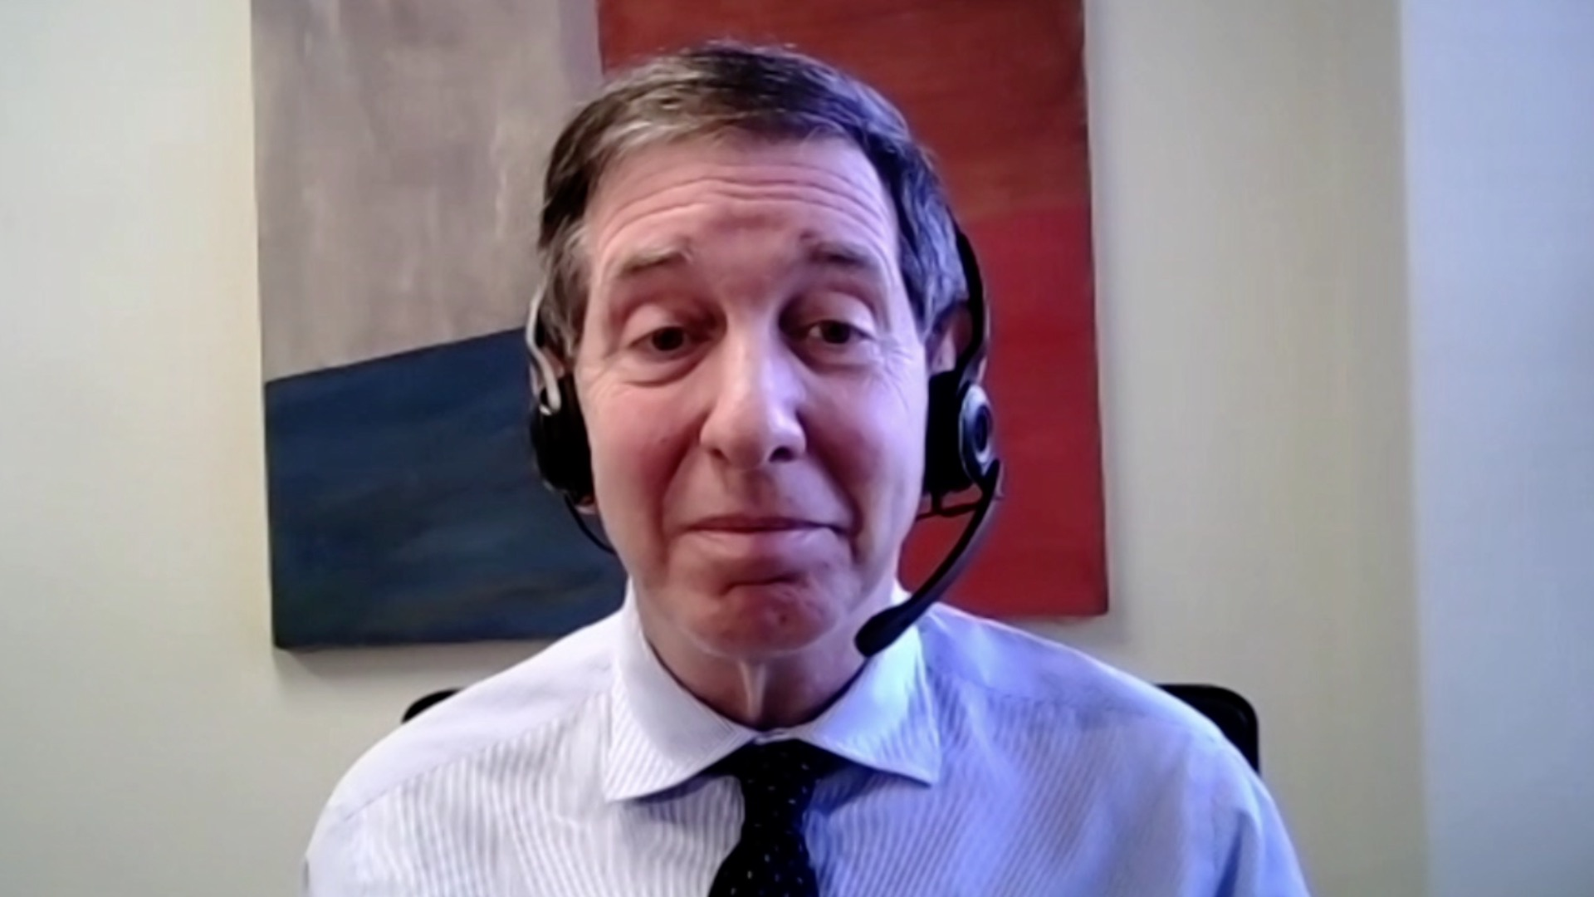
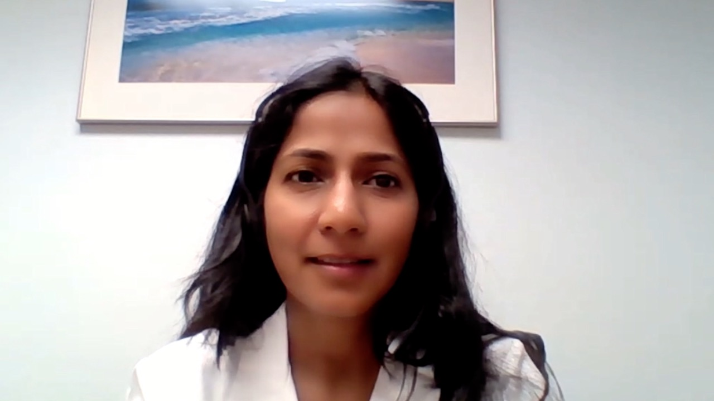
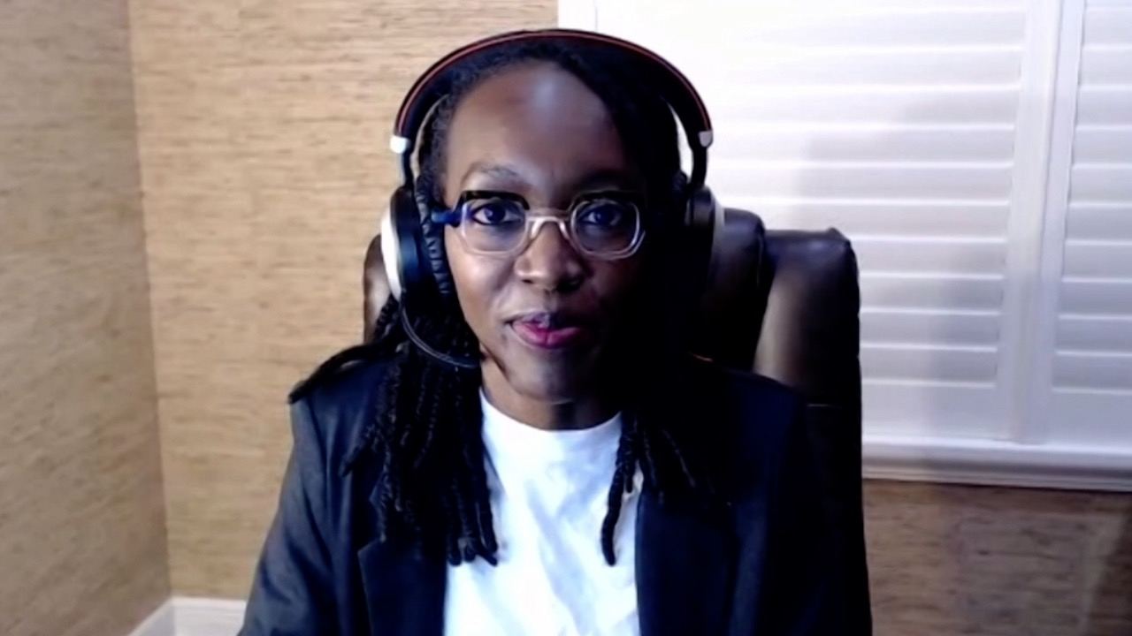
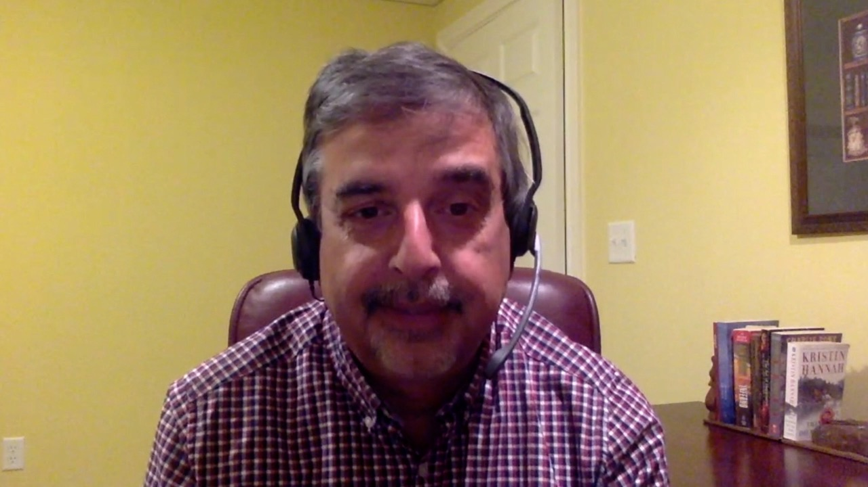
Alan B Astrow, MD
NewYork-Presbyterian Brooklyn Methodist Hospital
Brooklyn, New York
Niyati A Nathwani, MD
Carolina Blood and Cancer Care Associates
Charlotte, North Carolina
Shaachi Gupta, MD, MPH
Florida Cancer Specialists
Lake Worth, Florida
Chris Prakash, MD
US Oncology Research
Paris, Texas
Zanetta S Lamar, MD
Florida Cancer Specialists
Naples, Florida
Raman Sood, MD
Brooks Memorial Hospital
Dunkirk, New York
Joanna Metzner-Sadurski, MD
University of South Carolina
Greenwood, South Carolina

Slide 7
Meet The Professor with Dr Pegram
Introduction: Journal Club with Dr Pegram – Part 1
MODULE 1: Case Presentations
MODULE 2: Faculty Survey
MODULE 3: Journal Club with Dr Pegram – Part 2
MODULE 4: Appendix

Slide 8
Meet The Professor with Dr Pegram
Introduction: Journal Club with Dr Pegram – Part 1
MODULE 1: Case Presentations
MODULE 2: Faculty Survey
MODULE 3: Journal Club with Dr Pegram – Part 2
MODULE 4: Appendix

Slide 9
NPJ Breast Cancer 2021 October 8;7(1):134.

Slide 10
“The following statements are true: as of this writing, there has been no prospective randomized trial that has demonstrated an OS benefit from the addition of anthracyclines to taxane-based chemotherapy in the curative setting … no randomized study has shown the addition of anthracycline to a taxane/trastuzumab-based regimen improves outcomes for HER2-amplified breast cancer … Thus, rather than asking which patients can be safely be treated without an anthracycline, we should be asking, does the data clearly exist to warrant the use of an anthracycline, keeping in mind that in many cases we are potentially harming patients more than helping them.”
Hurvitz SA et al. NPJ Breast Cancer 2021 October 8;7(1):134.

Slide 11
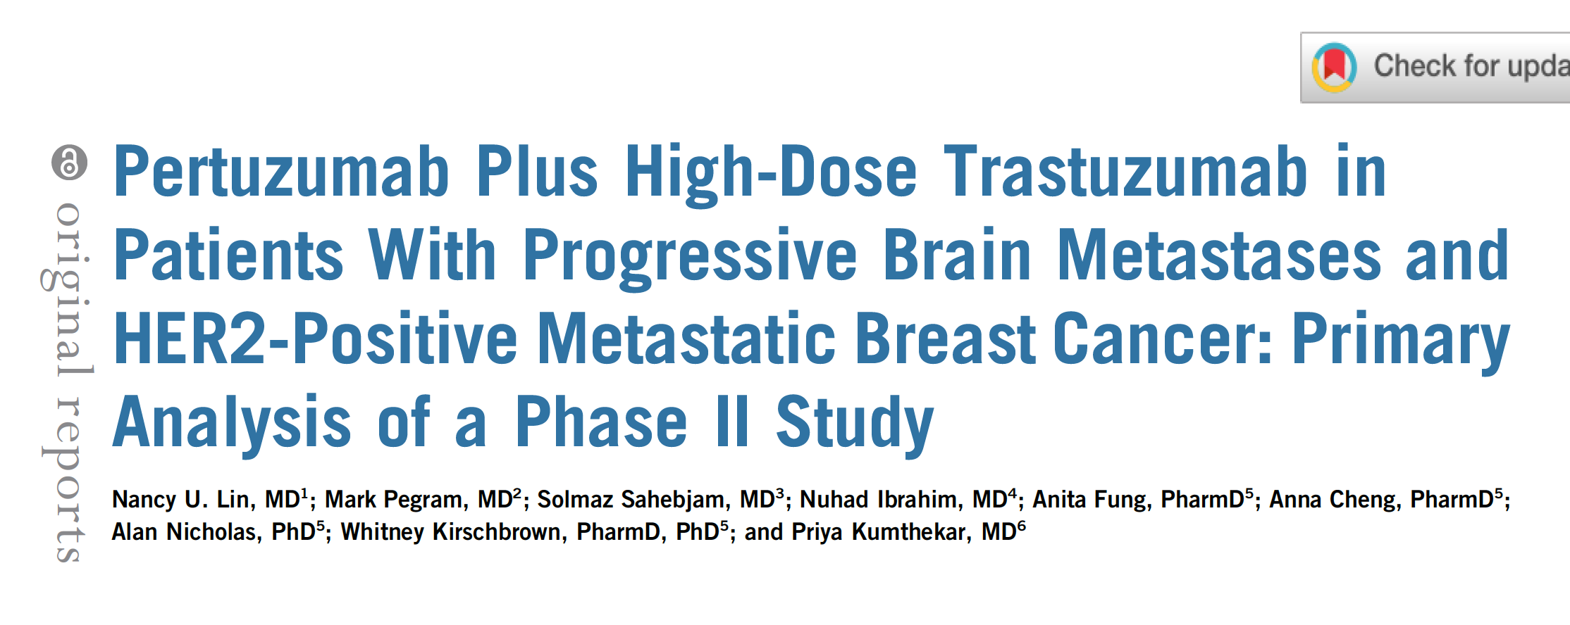
J Clin Oncol 2021 August 20;39(24):2667-75.

Slide 12
Updated Results of Tucatinib vs Placebo Added to Trastuzumab and Capecitabine for Patients with Previously Treated HER2-Positive Metastatic Breast Cancer with Brain Metastases (HER2CLIMB)
Lin NU et al.
SABCS 2021;Abstract PD4-04.

Slide 13
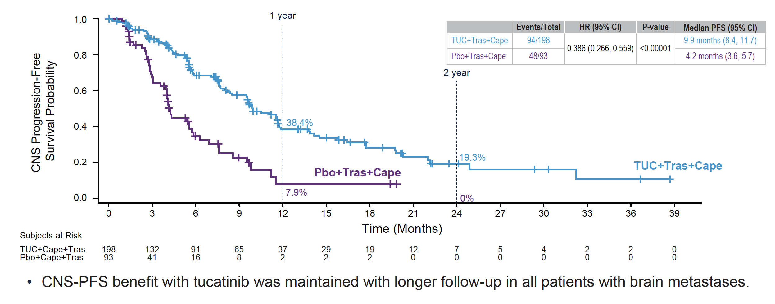
HER2CLIMB: CNS-PFS for All Patients with Brain Metastases
CNS-PFS = central nervous system progression-free survival
Lin NU et al. SABCS 2021;Abstract PD4-04.

Slide 14
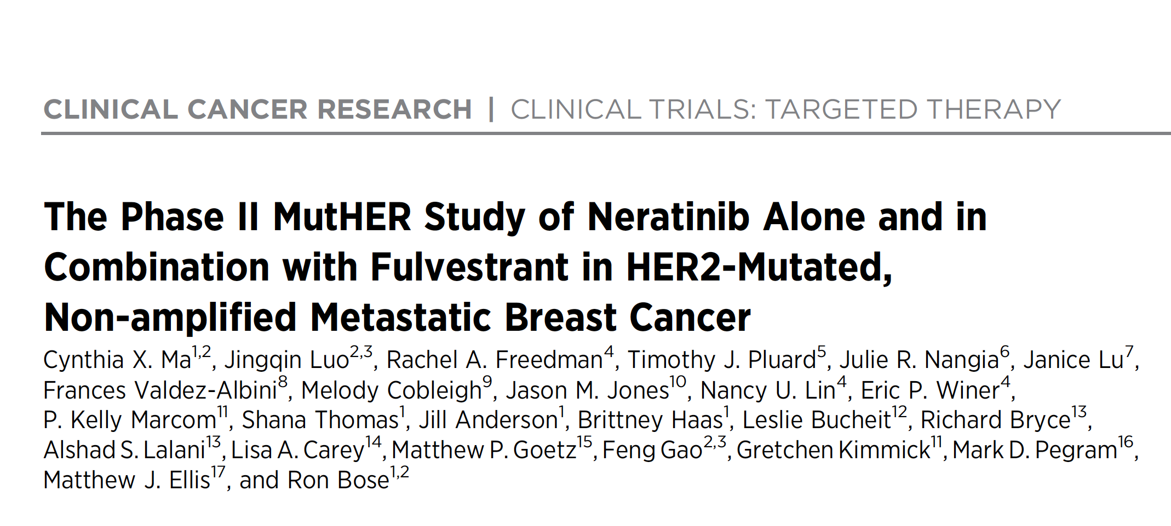
Clin Cancer Res 2022 April 1;28(7):1258-67.

Slide 15
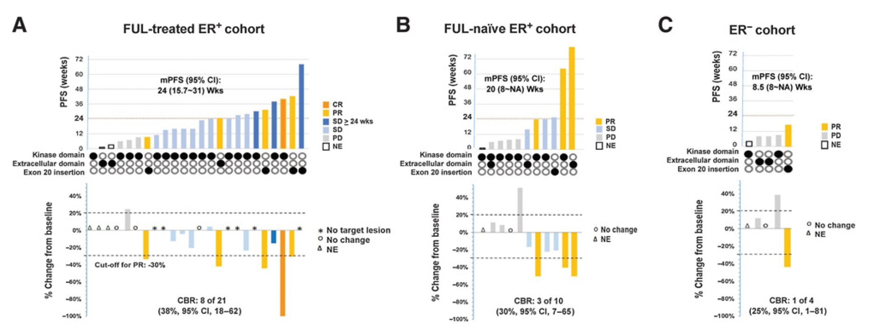
Efficacy of Neratinib with Fulvestrant for ER-Positive Cohorts and Neratinib Monotherapy for ER-Negative Cohort
Ma CX et al. Clin Cancer Res 2022 April 1;28(7):1258-67.

Slide 16
Meet The Professor with Dr Pegram
MODULE 1: Case Presentations
Dr Sood: 65-year-old woman with ER/PR-, HER2+ metastatic breast cancer, s/p multiple lines of HER2-directed therapy, now NED after 8 years of pertuzumab/trastuzumab
Dr Gupta: 63-year-old woman with a 1.8-cm triple-positive IDC s/p partial mastectomy/ALND (9 N+) receives adjuvant TCHP x 6
Dr Prakash: 70-year-old woman with de novo ER+, HER2+ breast cancer who develops asymptomatic, bilateral brain metastases on TCHP
Dr Nathwani: 44-year-old woman with metastatic ER/PR-, HER2+ breast cancer completes THP with CR but 3 months later has multiple brain metastases
Dr Lamar: 31-year-old woman with ER/PR+, HER2- breast cancer s/p neoadjuvant dd AC → paclitaxel and bilateral mastectomy, now with HER2+ disease on repeat testing
Dr Astrow: 45-year-old woman with triple-negative breast cancer at biopsy declines neoadjuvant therapy and at surgery has a 3.2-cm node-negative, HER2+ tumor
Dr Metzner-Sadurski: 62-year-old woman with ER/PR-, HER2+ breast cancer develops paralysis but recovers functioning after paclitaxel/trastuzumab, now with bone metastases responding to T-DXd

Slide 17
Case Presentation: 65-year-old woman with ER/PR-, HER2+ metastatic breast cancer, s/p multiple lines of HER2-directed therapy, now NED after 8 years of pertuzumab/trastuzumab
Dr Raman Sood (Dunkirk, New York)

Slide 18
A 63-year-old woman with a 1.8-cm ER-positive, HER2-positive IDC goes directly to surgery and is found to have 9 positive nodes. What would be your likely postoperative systemic approach?
Chemotherapy/trastuzumab/pertuzumab
Chemotherapy/trastuzumab/pertuzumab → T-DM1
Chemotherapy/trastuzumab/pertuzumab → T-DM1 → neratinib Chemotherapy/trastuzumab/pertuzumab → neratinib
Other
I’m not sure

Slide 19
Case Presentation: 63-year-old woman with a 1.8-cm triple-positive IDC s/p partial mastectomy/ALND (9 N+) receives adjuvant TCHP x 6
Dr Shaachi Gupta (Lake Worth, Florida)

Slide 20
A 70-year-old woman with de novo ER-positive, HER2-positive metastatic breast cancer responds to TCHP but then has disease progression, including asymptomatic bilateral brain metastases. Generally, would you use systemic treatment and hold off on radiation therapy?
Yes
No, I would likely use radiation therapy also
I’m not sure

Slide 21
Which systemic treatment would you likely recommend for the patient in the previous scenario?
T-DM1
Tucatinib/trastuzumab/capecitabine
Tucatinib
Trastuzumab deruxtecan (T-DXd)
Other
I’m not sure

Slide 22
Case Presentation: 70-year-old woman with de novo ER+, HER2+ breast cancer who develops asymptomatic, bilateral brain metastases on TCHP
Dr Chris Prakash (Paris, Texas)

Slide 23
Case Presentation: 44-year-old woman with metastatic ER/PR-, HER2+ breast cancer completes THP with CR but 3 months later has multiple brain metastases
Dr Niyati Nathwani (Charlotte, North Carolina)

Slide 24
A 31-year-old patient with T2N2 ER-positive, HER2-negative IDC receives neoadjuvant dose-dense AC-T with minor response at surgery, but the tumor is now HER2-positive and a BRCA2 mutation is found. Which of the following agents would likely be part of your adjuvant systemic strategy?
Trastuzumab, pertuzumab
Trastuzumab, pertuzumab, neratinib
Trastuzumab, pertuzumab, neratinib, olaparib
Trastuzumab, pertuzumab, olaparib
Paclitaxel, trastuzumab, pertuzumab
Paclitaxel, trastuzumab, pertuzumab, neratinib
Paclitaxel, trastuzumab, pertuzumab, neratinib, olaparib
Paclitaxel, trastuzumab, pertuzumab, olaparib
Other
I’m not sure

Slide 25
Case Presentation: 31-year-old woman with ER/PR+, HER2- breast cancer s/p neoadjuvant dd AC → paclitaxel and bilateral mastectomy, now with HER2+ disease on repeat testing
Dr Zanetta Lamar (Naples, Florida)

Slide 26
A 45-year-old patient with a 3.2-cm ER-positive, HER2-positive IDC goes directly to surgery and is found to be node-negative. What would be your likely postoperative systemic approach?
Chemotherapy/trastuzumab/pertuzumab
Chemotherapy/trastuzumab/pertuzumab →neratinib
Chemotherapy/trastuzumab
Chemotherapy/trastuzumab → neratinib
Other
I’m not sure

Slide 27
Case Presentation: 45-year-old woman with triple-negative breast cancer at biopsy declines neoadjuvant therapy and at surgery has a 3.2-cm node-negative, HER2+ tumor
Dr Alan Astrow (Brooklyn, New York)

Slide 28
Case Presentation: 62-year-old woman with ER/PR-, HER2+ breast cancer develops paralysis but recovers functioning after paclitaxel/trastuzumab, now with bone metastases responding to T-DXd
Dr Joanna Metzner-Sadurski (Greenwood, South Carolina)

Slide 29
Meet The Professor with Dr Pegram
Introduction: Journal Club with Dr Pegram – Part 1
MODULE 1: Case Presentations
MODULE 2: Faculty Survey
MODULE 3: Journal Club with Dr Pegram – Part 2
MODULE 4: Appendix

Slide 30
Regulatory and reimbursement issues aside, would you offer trastuzumab deruxtecan to a patient with HER2 IHC 0 metastatic breast cancer (mBC) with a HER2 mutation?
No
Yes
Yes
Yes
Yes
No

Slide 31
Regulatory and reimbursement issues aside, how are you most likely to approach the use of trastuzumab deruxtecan for HER2 IHC 1+ versus HER2 IHC 2+ mBC?
Equally likely to use for IHC 2+ and IHC 1+ disease
Equally likely to use for IHC 2+ and IHC 1+ disease
Equally likely to use for IHC 2+ and IHC 1+ disease
Equally likely to use for IHC 2+ and IHC 1+ disease
Equally likely to use for IHC 2+ and IHC 1+ disease
Equally likely to use for IHC 2+ and IHC 1+ disease

Slide 32
A woman who has completed 5 years of an adjuvant aromatase inhibitor for ER-positive, HER2 IHC 2+, FISH-negative breast cancer develops symptomatic liver metastases 3 years later. Regulatory and reimbursement issues aside, when would you most likely offer trastuzumab deruxtecan?
After 1 line of chemotherapy
After 1 line of chemotherapy
After 1 line of chemotherapy
After 1 line of endocrine therapy
After 1 line of endocrine therapy
After 1 line of chemotherapy

Slide 33
A woman undergoes neoadjuvant chemotherapy and surgery for BRCA wild-type, ER-negative, HER2 IHC 2+, FISH-negative breast cancer and develops symptomatic liver metastases while receiving adjuvant capecitabine. Regulatory and reimbursement issues aside, when would you most likely offer trastuzumab deruxtecan?
As first-line therapy
As second-line therapy
As second-line therapy
As third-line therapy
As first-line therapy
As first-line if PD-L1(-), second-line if PD-L1(+)

Slide 34
On the basis of your personal experience and available clinical trial data, how would you characterize the degree of alopecia observed with trastuzumab deruxtecan?
Less alopecia than that observed with platinum agents
Moderate alopecia as observed with platinum agents
Moderate alopecia as observed with platinum agents
Moderate alopecia as observed with platinum agents
Moderate alopecia as observed with platinum agents
Moderate alopecia as observed with platinum agents

Slide 35
On the basis of your personal experience and available clinical trial data, how would you describe the “chemotherapy-like” side-effect profile (fatigue, GI symptoms) of trastuzumab deruxtecan?
Similar to but less concerning than anthracycline/platinum agents
Similar to the profile of anthracycline/platinum agents
Similar to but less concerning than anthracycline/platinum agents
Similar to but less concerning than anthracycline/platinum agents
Similar to but less concerning than anthracycline/platinum agents
Similar to the profile of anthracycline/platinum agents

Slide 36
What grade of interstitial lung disease (ILD) would lead you to permanently discontinue treatment with trastuzumab deruxtecan?
Grade 2
Grade 2
Grade 2
Grade 2
Grade 3 or 4
Grade 2, or Grade 1 if no resolution by day 49

Slide 37
Have you re-administered trastuzumab deruxtecan to a patient who developed Grade 1 ILD and recovered from it?
Yes
Yes
Yes
Yes
Yes
Yes

Slide 38
Do you use chest imaging to monitor a patient receiving trastuzumab deruxtecan who otherwise does not require chest imaging? How often would you perform chest imaging if the patient remained asymptomatic?
No
Yes, every 3 to 4 cycles
No if asymptomatic
No
No
Yes, q6weeks
NA = not applicable

Slide 39
Do you evaluate pulmonary function, either clinically or by specific PFTs?
No
Yes
Yes
No
No
No

Slide 40
Regulatory and reimbursement issues aside, which next line of therapy would you recommend to a patient with hormone receptor-negative, HER2 IHC 1+ or 2+, BRCA wild-type breast cancer who receives neoadjuvant chemoimmunotherapy and develops metastatic disease while receiving adjuvant immunotherapy?
Sacituzumab govitecan
Sacituzumab govitecan
T-DXd
Sacituzumab govitecan
Sacituzumab govitecan
Sacituzumab govitecan or T-DXd

Slide 41
Meet The Professor with Dr Pegram
Introduction: Journal Club with Dr Pegram – Part 1
MODULE 1: Case Presentations
MODULE 2: Faculty Survey
MODULE 3: Journal Club with Dr Pegram – Part 2
MODULE 4: Appendix

Slide 42
Front Oncol 2022 April 27;12:890810.

Slide 43
Frontiers in Oncology July 2022
Table of Contents
Long Noncoding RNA MIR210HG Promotes the Warburg Effect and Tumor Growth by Enhancing HIF-1α Translation in Triple-Negative Breast Cancer – Du Y et al
The Metabolic Mechanisms of Breast Cancer Metastasis – Wang L et al
DNA N6-Methyladenine (6mA) Modification Regulates Drug Resistance in Triple Negative Breast Cancer – Sheng Xianneng et al
The Deubiquitinating Enzyme UCHL1 Induces Resistance to Doxorubicin in HER2+ Breast Cancer by Promoting Free Fatty Acid Synthesis – Lu G et al
Hyperglycemia and Chemoresistance in Breast Cancer: From Cellular Mechanisms to Treatment Response – Qiu J et al
Hypoxia in Breast Cancer—Scientific Translation to Therapeutic and Diagnostic Clinical Applications – Zhang Y et al
Potential Mechanism Underlying the Role of Mitochondria in Breast Cancer Drug Resistance and Its Related Treatment Prospects – Li Y and Li Z

Slide 44
Frontiers in Oncology July 2022
Table of Contents (Continued)
Metabolic Syndrome and Breast Cancer: Prevalence, Treatment Response, and Prognosis – Dong S et al
Comprehensive Association Analysis of 21-Gene Recurrence Score and Obesity in Chinese Breast Cancer Patients – Tong Y et al
The Synergistic Effects of Pyrotinib Combined With Adriamycin on HER2-Positive Breast Cancer – Wang C et al
Enhanced Susceptibility to Breast Cancer in Korean Women With Elevated Serum Gamma-Glutamyltransferase Levels: A Nationwide Population-Based Cohort Study – Seol A et al
The lncRNA ADAMTS9-AS2 Regulates RPL22 to Modulate TNBC Progression via Controlling the TGF-β Signaling Pathway – Ni K et al
Lactate Dehydrogenase-A (LDH-A) Preserves Cancer Stemness and Recruitment of Tumor-Associated Macrophages to Promote Breast Cancer Progression – Wang S et al

Slide 45
Frontiers in Oncology July 2022
Table of Contents (Continued)
Hormone Receptor Status May Impact the Survival Benefit Between Medullary Breast Carcinoma and Atypical Medullary Carcinoma of the Breast: A Population-Based Study – Qin W et al
Anticancer Mechanisms of Salinomycin in Breast Cancer and Its Clinical Applications – Wang H et al
Mammary Tumorigenesis and Metabolome in Male Adipose Specific Monocyte Chemotactic Protein-1 Deficient MMTV-PyMT Mice Fed a High-Fat Diet – Yan L et al
Lipid Changes During Endocrine Therapy in Breast Cancer Patients: The Results of a 5-Year Real-World Retrospective Analysis – He T et al

Slide 46
Clin Breast Cancer 2021 August;21(4):e340-61.

Slide 47
Fernandes LE et al. Clin Breast Cancer 2021 August;21(4):e340-61.

Slide 48
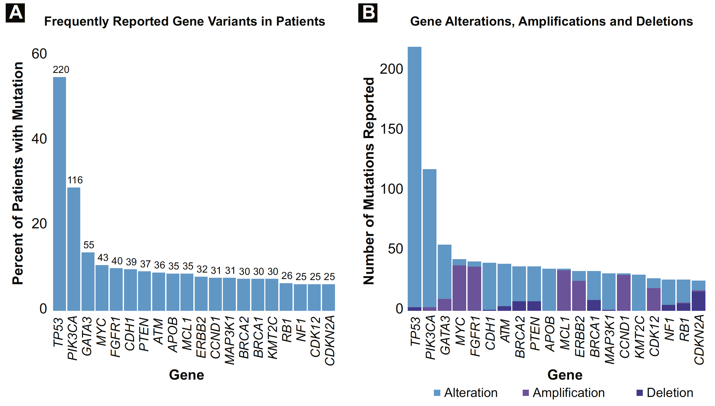
Molecular Characteristics of the Tempus Molecular Sequenced Cohort
Fernandes LE et al. Clin Breast Cancer 2021 August;21(4):e340-61.

Slide 49
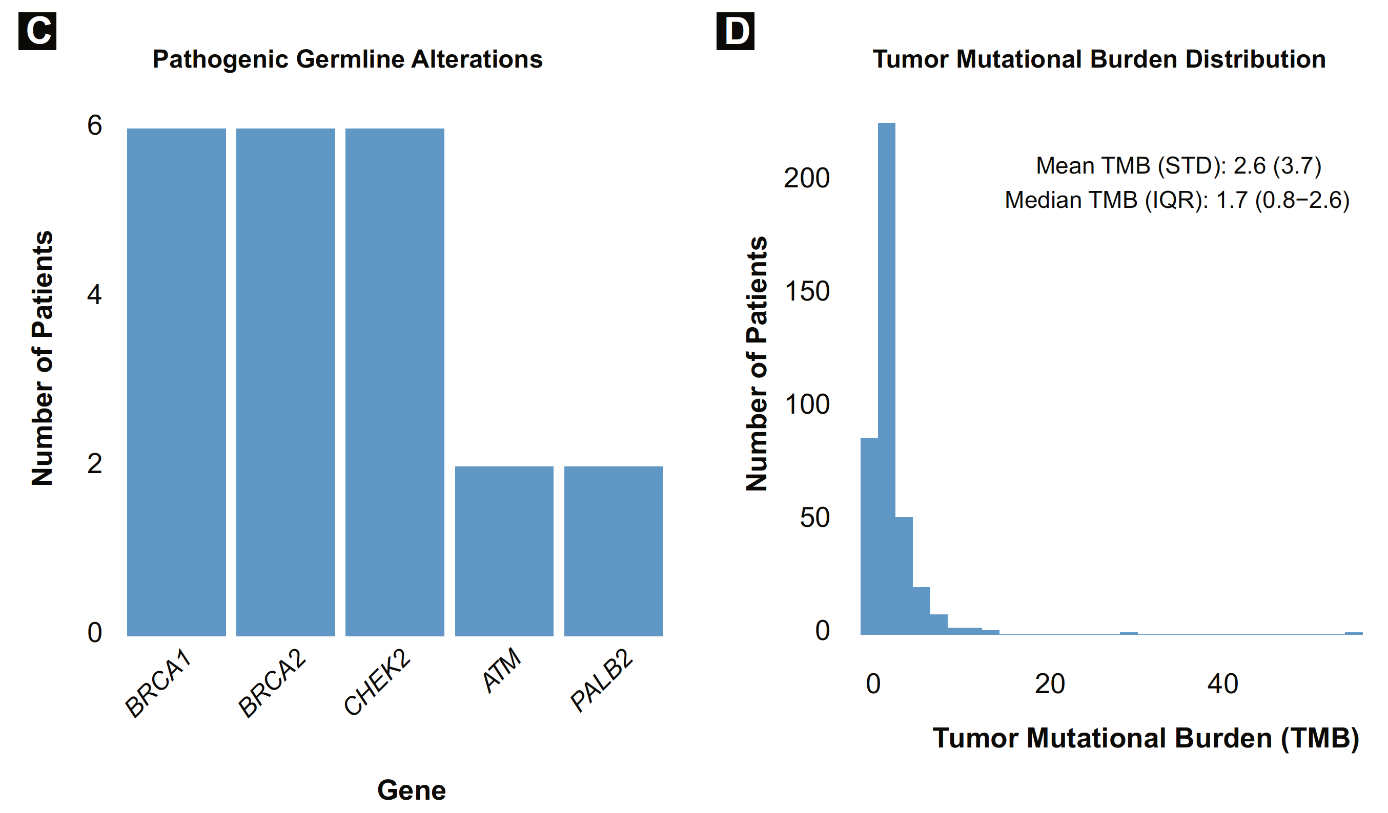
Molecular Characteristics of the Tempus Molecular Sequenced Cohort (Continued)
Fernandes LE et al. Clin Breast Cancer 2021 August;21(4):e340-61.

Slide 50
J Immunother Cancer 2022 January;10(1):e003171.

Slide 51
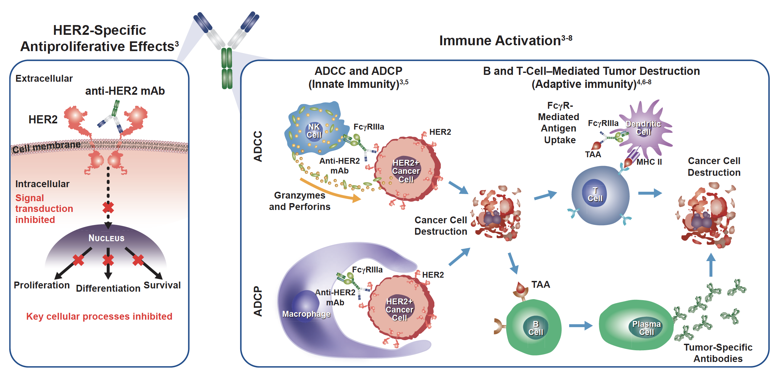
Mechanism of Action of Anti-HER2 Monoclonal Antibodies: Antiproliferative Effects and Immune Activation
Musolino A et al. J Immunother Cancer 2022 January;10(1):e003171.

Slide 52
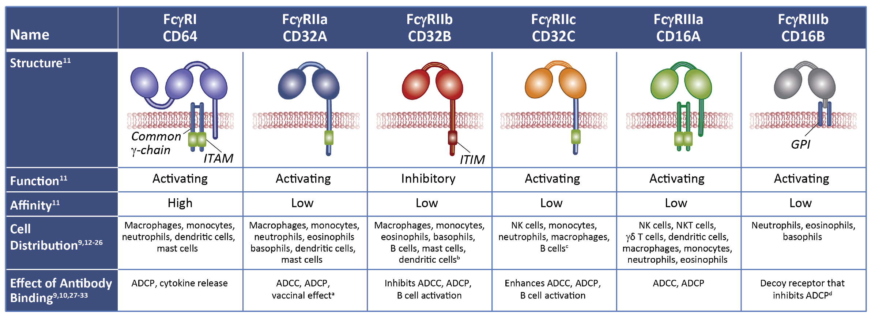
Fcγ Receptors Differ in Function, Cell Distribution, Immune Response, Signaling Motifs and Affinity for IgG Molecules
Musolino A et al. J Immunother Cancer 2022 January;10(1):e003171.

Slide 53
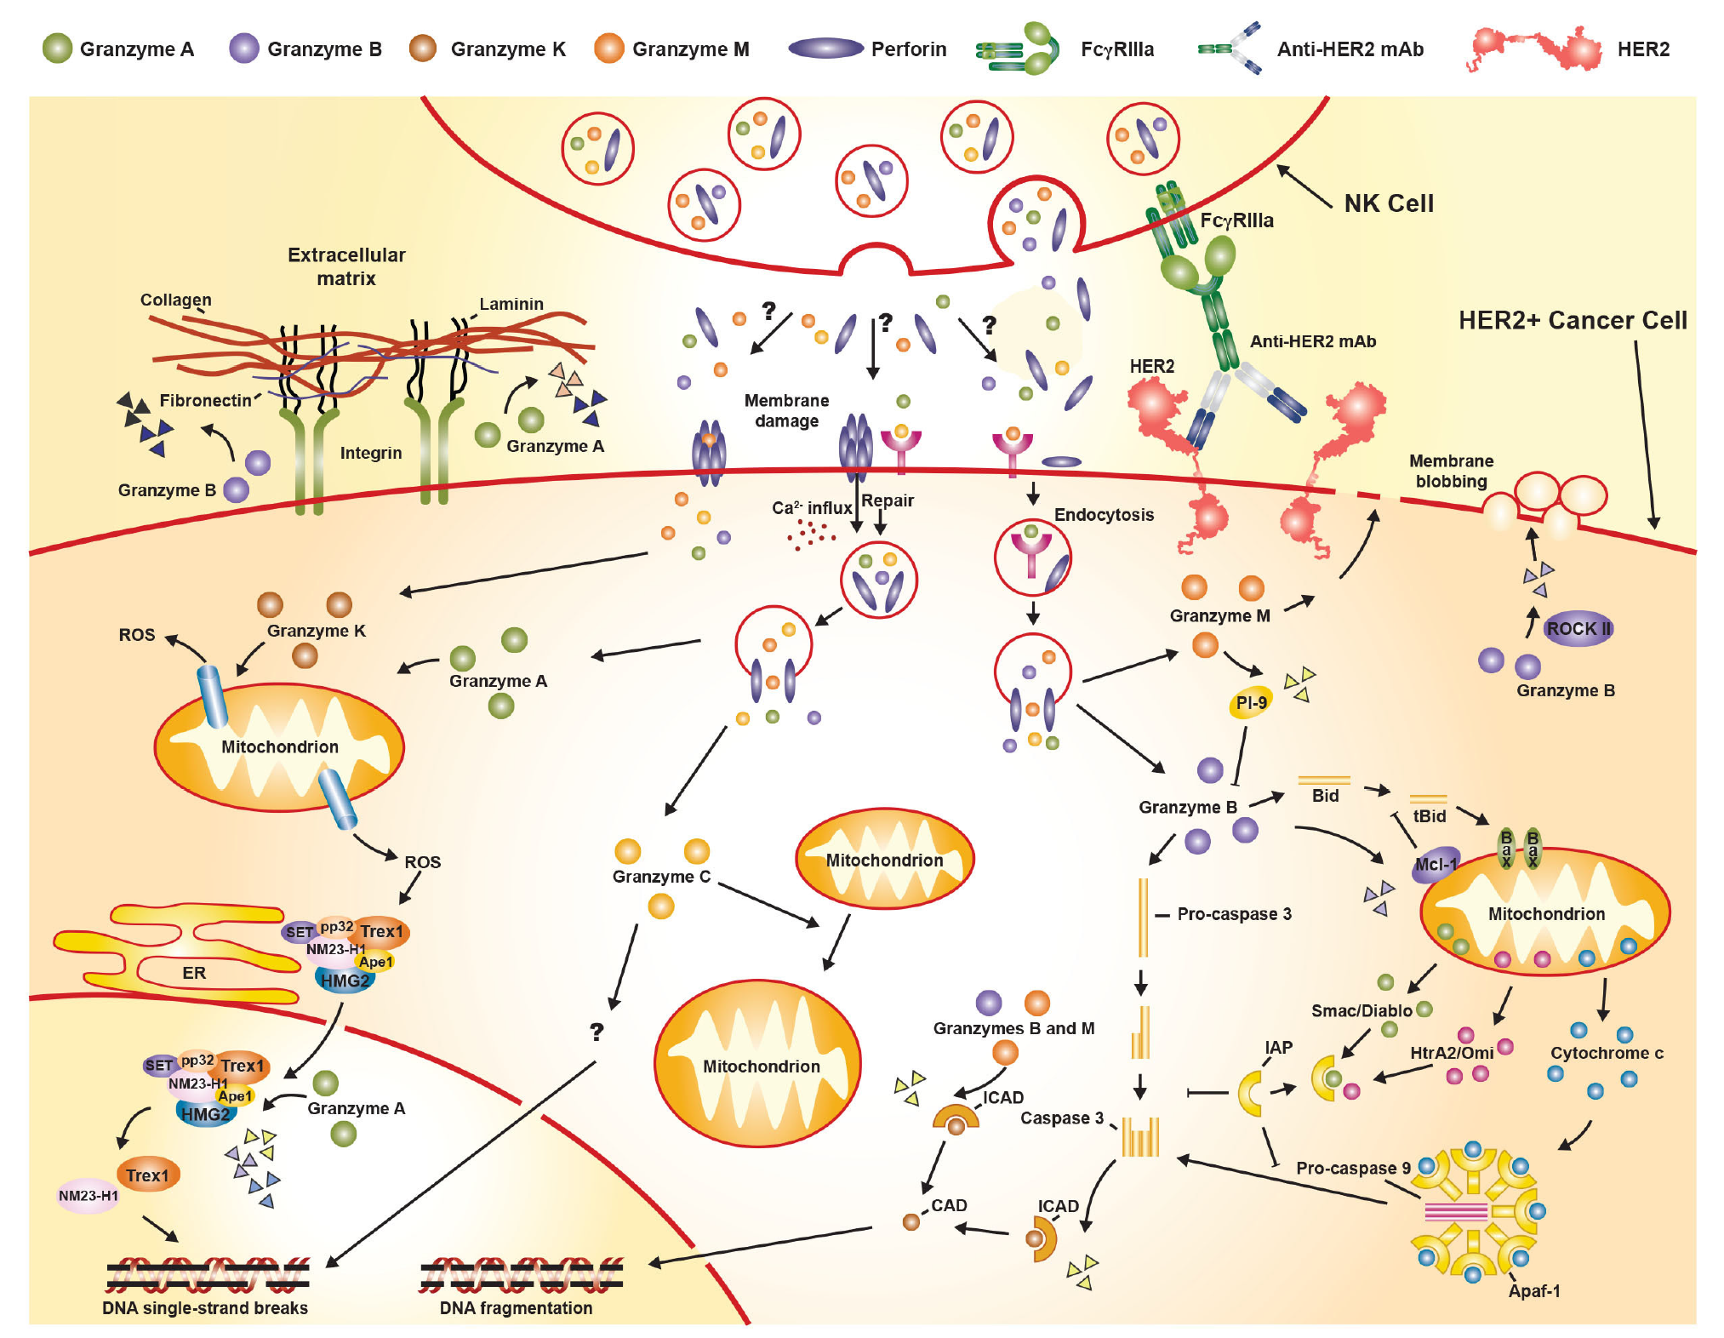
Classical Granzyme/Perforin-Mediated Apoptosis Pathway
Musolino A et al. J Immunother Cancer 2022 January;10(1):e003171.
(Adapted from Bots and Medema)

Slide 54
Proc Natl Acad Sci U S A 2021 July 20;118(29):e2026849118.

Slide 55
Meet The Professor with Dr Pegram
Introduction: Journal Club with Dr Pegram – Part 1
MODULE 1: Case Presentations
MODULE 2: Faculty Survey
MODULE 3: Journal Club with Dr Pegram – Part 2
MODULE 4: Appendix

Slide 56
Optimal Management of Patients with HER2-Positive Localized Breast Cancer (BC)

Slide 57
FDA-Approved Agents for HER2-Positive Localized Breast Cancer
Agent | Setting | Pivotal trial(s) | Regimens | Year approved
Trastuzumab | Adjuvant HER2+ LBC, first line | NSABP-31 N9831 BCIRG 006 HERA | AC-T-placebo vs AC-T-H AC-T vs AC-H vs AC-T-H AC-T vs ACT-H vs TC-H Observation vs trastuzumab | 2006
Pertuzumab | Neoadjuvant HER2+ LBC | NeoSphere | TD vs PTD vs PT vs PD | 2013
Pertuzumab | Adjuvant HER2+ LBC | APHINITY | Chemotherapy + trastuzumab + pertuzumab vs placebo | 2017
Neratinib | Extended adjuvant HER2+ LBC | ExteNET | Placebo vs neratinib | 2017
T-DM1 | Adjuvant HER2+ LBC with residual disease after neoadjuvant taxane and trastuzumab-based treatment | KATHERINE | Trastuzumab vs T-DM1 | 2019
LBC = localized breast. cancer; AC = doxorubicin and cyclophosphamide; T = paclitaxel; H = trastuzumab; TC = docetaxel and cyclophosphamide; TD = trastuzumab and docetaxel; PTD = pertuzumab, trastuzumab and docetaxel; PT = pertuzumab and trastuzumab; PD = pertuzumab and docetaxel
Choong GM et al. CA Cancer J Clin 2020;70:355-74.

Slide 58
Flow of Neoadjuvant and Adjuvant Therapy in Breast Cancer
Krawczyk N et al. Cancers 2022 Jun 18;14(12):3002.

Slide 59
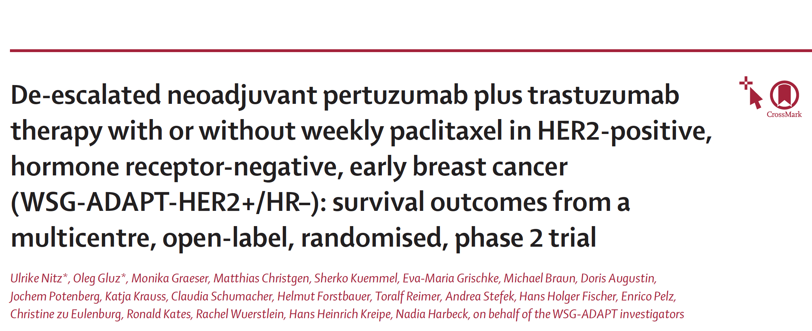
Ann Oncol 2017;28:2768-72.
Lancet Oncol 2022;23:625-35.

Slide 60
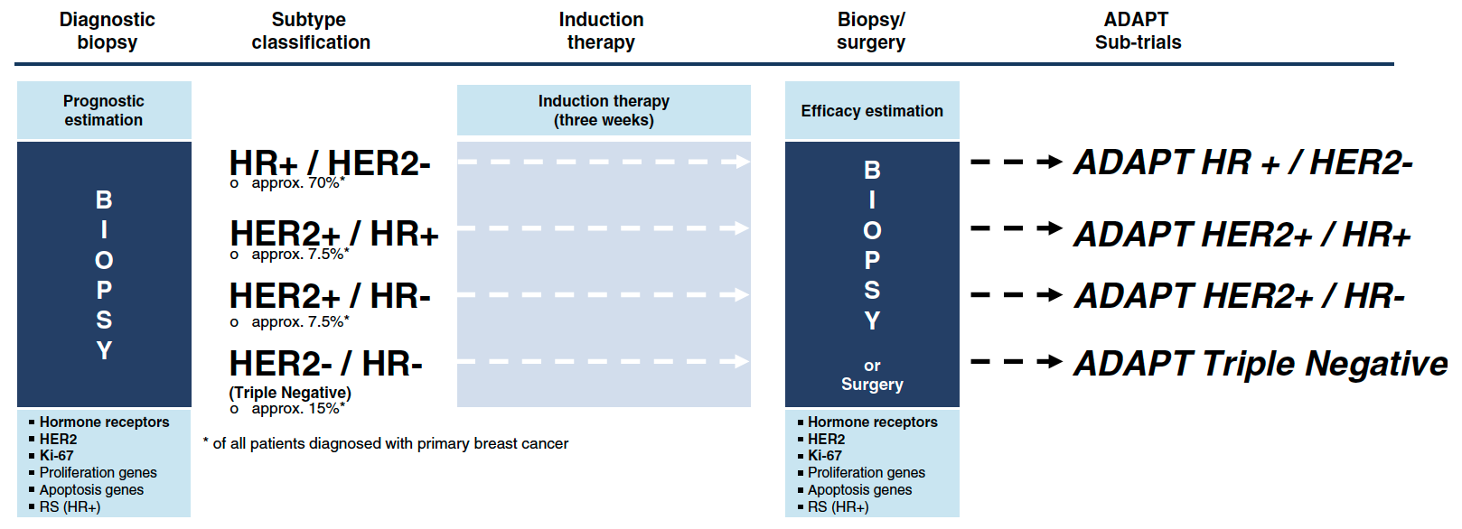
Adjuvant Dynamic Marker-Adjusted Personalized Therapy (ADAPT) Trial: Umbrella Trial Design
Hofmann D et al. Trials 2013;14:261.

Slide 61
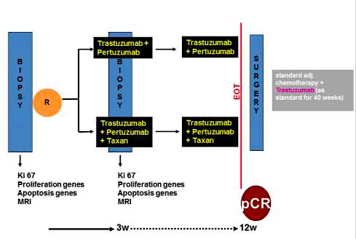
ADAPT HER2-Positive Schema
+ Taxane
+ Taxane
Nitz U et al. Lancet Oncol 2022;23:625-35.

Slide 62
WSG ADAPT Neoadjuvant Studies for HER2-Positive Disease
Study | N and setting | Treatment arms | pCR rate* | Survival
WSG-ADAPT HER2+/HR- | 134 ER/PR-negative cT1-4c | Trastuzumab + pertuzumab Trastuzumab + pertuzumab + paclitaxel | 34.4% vs 90.5% | 5-year iDFS 87% vs 98% 5-year dDFS 92% vs 98% 5-year OS 94% vs 98%
WSG-ADAPT-TP HER2+/HR+ | 375 ER and/or PR-positive cT1-4c | T-DM1 T-DM1 + ET Trastuzumab + ET | 41% vs 41.5% vs 15% | 5-year DFS 88.9% vs 85.3% vs 84.6% 5-year OS 97.2% vs 96.4% vs 96.3
pCR = pathologic complete response; iDFS = invasive disease-free survival; dDFS = distant disease-free survival; OS = overall survival; ET = endocrine therapy
*Defined as ypT0/is ypN0

Slide 63
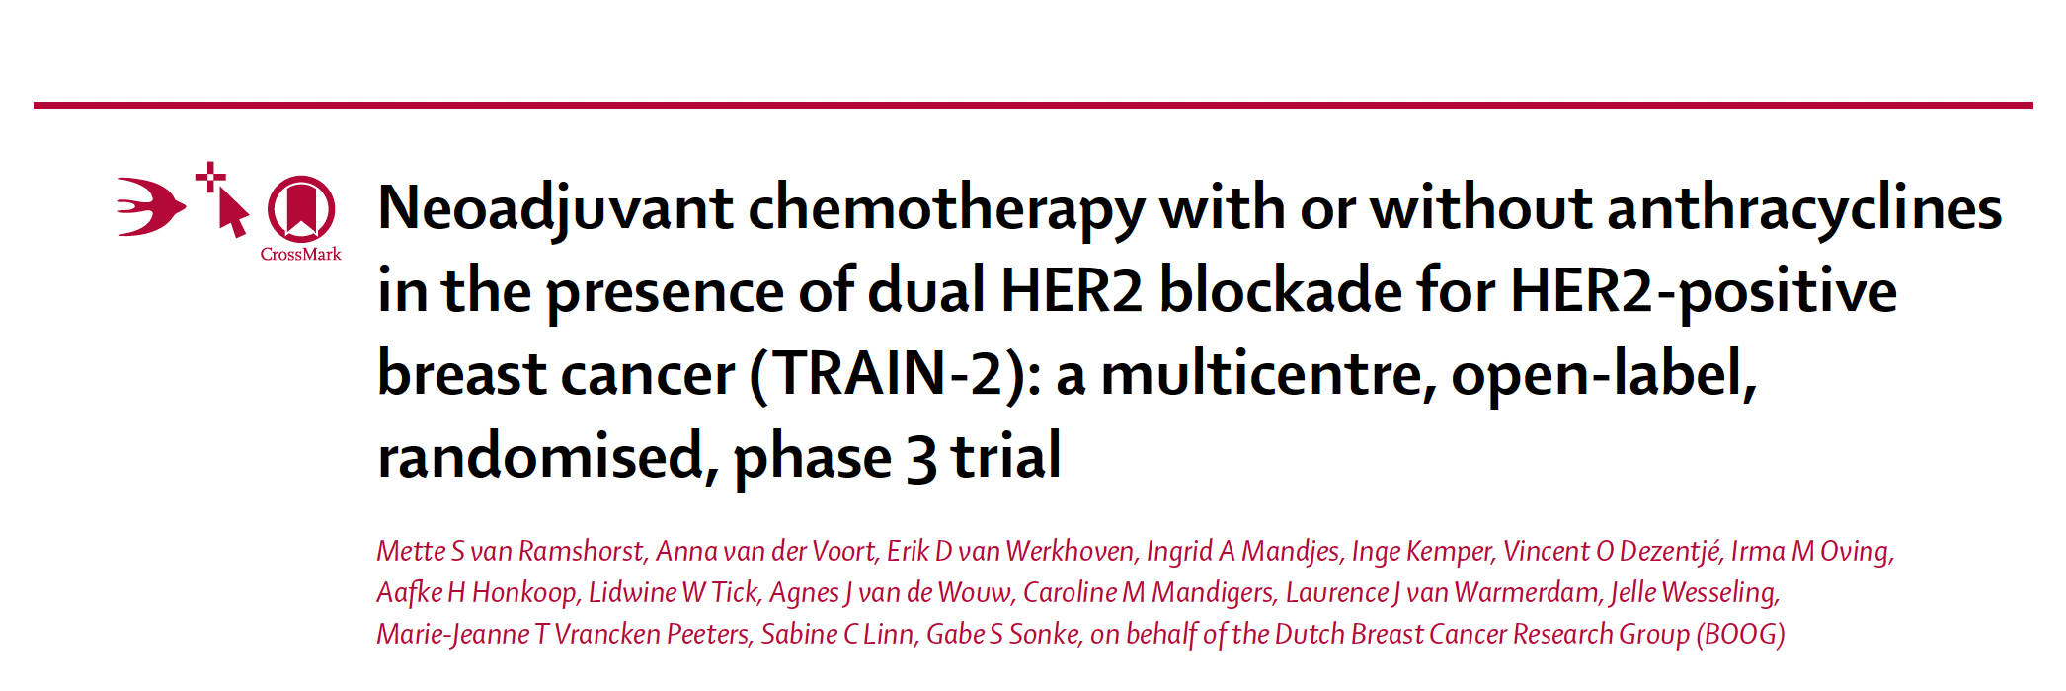
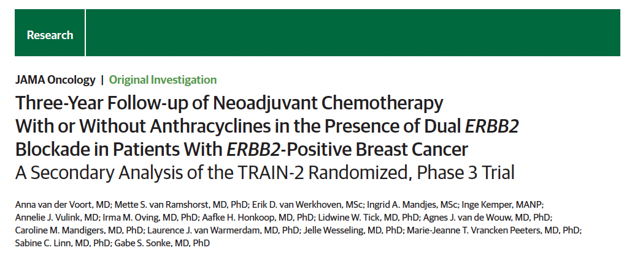
Lancet Oncol 2018;9(12):1630-40.
JAMA Oncol 2021;7(7):978-84.

Slide 64
TRAIN-2: pCR Rates and Key Toxicity Differences with Anthracycline- and Non-Anthracycline-Containing Regimens
PCR Rate
Toxicity
van Ramshorst MS et al. Lancet Oncol 2018;9(12):1630-40.

Slide 65
TRAIN-2: Three-Year Follow-Up Summary
TRAIN-2 is not powered to detect differences for event-free survival (EFS) and OS secondary endpoints, and results are for descriptive purposes
Endpoint | Anthracycline group (n = 219) | Nonanthracycline group (N = 219) | HR
3-y EFS rate | 92.7% | 93.6% | 0.90
3-y OS rate | 97.7% | 98.2% | 0.91
Results were irrespective of hormone receptor and nodal status
pCR in the breast and axillary lymph nodes was associated with DFS (HR 0.42; p = 0.006)
A decline in LVEF ≥10% from baseline to less than 50% was more common in patients who received anthracyclines than in those who did not (7.7% vs 3.2%; p = 0 .04)
van der Voort A et al. JAMA Oncol 2021;7(7):978-84.

Slide 66
J Clin Oncol 2021 July 20;39(21):2375-85.

Slide 67
ATEMPT: Invasive Disease-Free Survival (iDFS) and Recurrence-Free Interval (RFI)
Outcome | T-DM1 (n = 383) | Paclitaxel/trastuzumab (n = 114)
Three-year iDFS | 97.8% | 93.4%
Three-year RFI | 99.2% | 94.3%
Tolaney SM et al. J Clin Oncol 2021;39(21):2375-85.

Slide 68
ATEMPT: Clinically Relevant Toxicity
Clinically Relevant Toxicity | T-DM1 (n = 383) | TH (n = 114)
Grade ≥3 nonhematologic toxicity | 9% | 11%
Grade ≥2 neurotoxicity | 11% | 23%
Grade ≥4 hematologic toxicity | 1% | 0%
Febrile neutropenia | 0% | 2%
Any toxicity requiring dose delay | 28% | 26%
Any toxicity requiring early discontinuation | 17% | 6%
Total | 46% | 47%
Tolaney SM et al. J Clin Oncol 2021;39(21):2375-85.

Slide 69
Select Ongoing Trials HER2-Positive Localized Breast Cancer
Trial identifier | Phase (N) | Setting | Regimens | Estimated completion date
CompassHER2 pCR (NCT04266249) | II (N = 2,156) | Neoadjuvant and adjuvant | Preoperative chemotherapy + trastuzumab/pertuzumab If pCR → postoperative trastuzumab/pertuzumab If residual disease → postoperative T-DM1 or T-DM1 + tucatinib | 2023
DESTINY-Breast05 (NCT04622319) | III (N = 1,600) | High risk, residual disease after neoadjuvant chemotherapy | Trastuzumab deruxtecan (T-DXd) T-DM1 | 2027
DESTINY-Breast11 (NCT05113251) | III (N = 624) | Neoadjuvant, high risk | T-DXd T-DXd → THP AC → THP | 2024
THP = paclitaxel, trastuzumab and pertuzumab
www.clinicaltrials.gov. Accessed August 2022.

Slide 70
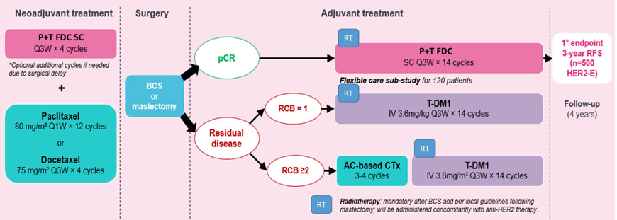
DECRESCENDO Phase II De-escalation Study Design
N = 1,065
Debien V et al. ASCO 2022;Abstract TPS621.

Slide 71
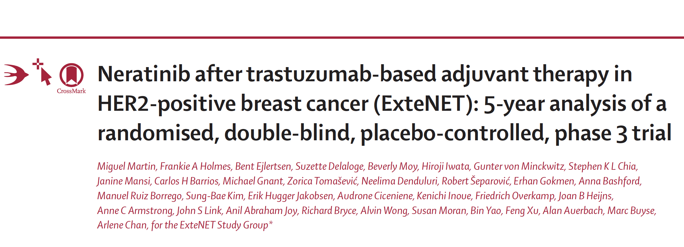
Lancet Oncol 2017;18:1688-700.

Slide 72
ExteNET: 5-Year Analysis of Invasive Disease-Free Survival
Completion of prior trastuzumab
Martin M et al. Lancet Oncol 2017;18:1688-700.

Slide 73
Continued Efficacy of Neratinib in Patients with HER2-Positive Early-Stage Breast Cancer: Final Overall Survival Analysis from the Randomized Phase 3 ExteNET Trial
Holmes FA et al.
SABCS 2020;Abstract PD3-03.

Slide 74
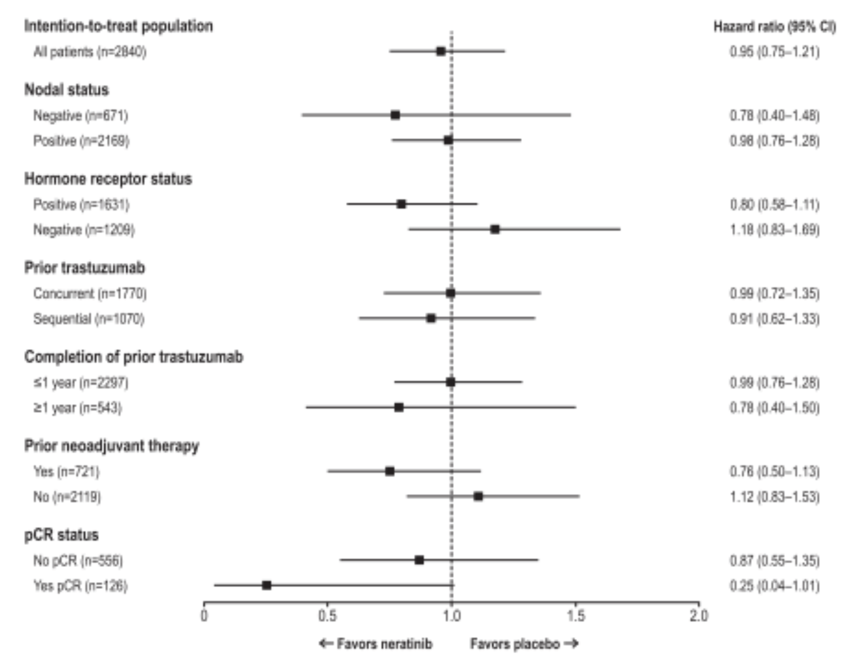
ExteNET: Final Overall Survival Analysis (8-Year Follow-Up)
Holmes FA et al. SABCS 2020;Abstract PD3-03.

Slide 75
ExteNET Final Overall Survival Analysis: Conclusions
Holmes FA et al. SABCS 2020;Abstract PD3-03.

Slide 76
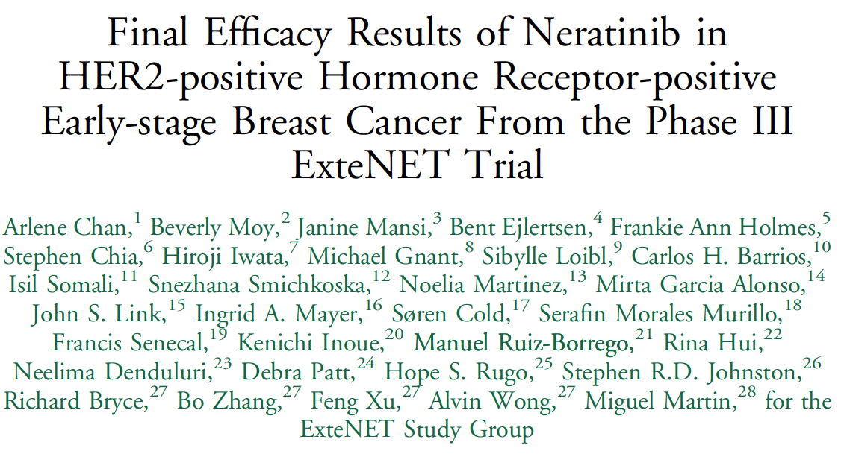
Clin Breast Cancer 2021;21(1):80-91.

Slide 77
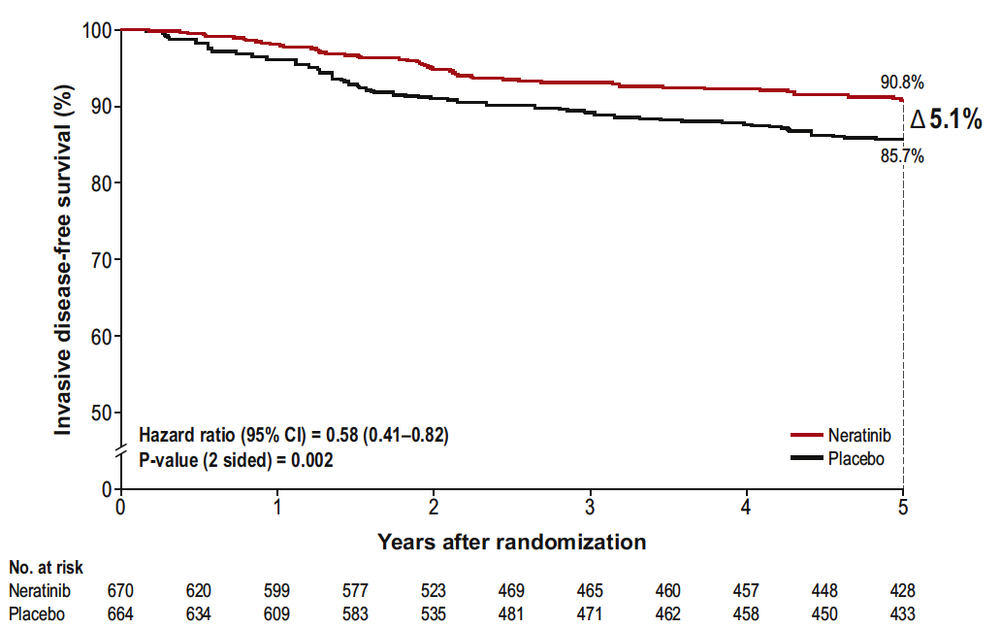
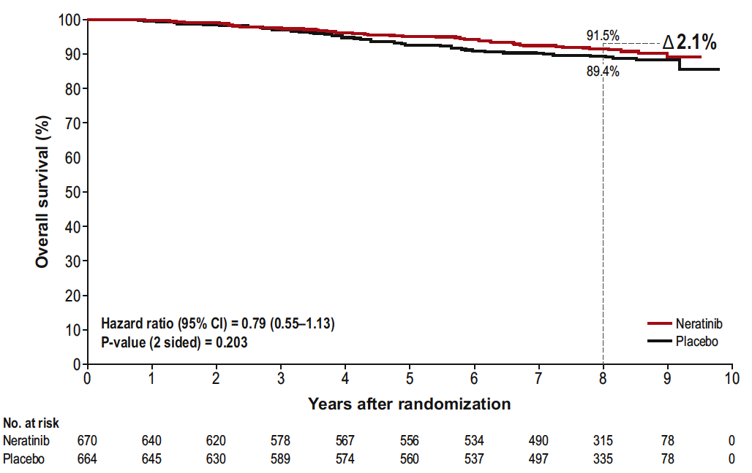
ExteNET: Final Analysis with Neratinib for HER2-Positive Localized Breast Cancer (HR+/≤ 1-Year population)
Invasive disease-free survival at 5 years
Overall survival at 8 years
Chan A et al. Clin Breast Cancer 2021;21(1):80-91.

Slide 78
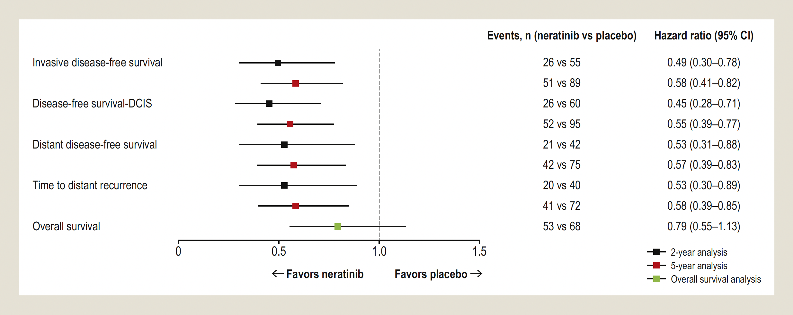
ExteNET: 2-Year, 5-Year and Overall Survival in HR+/≤1-Year Population (N = 1,334)
Chan A et al. Clin Breast Cancer 2021;21(1):80-91.

Slide 79
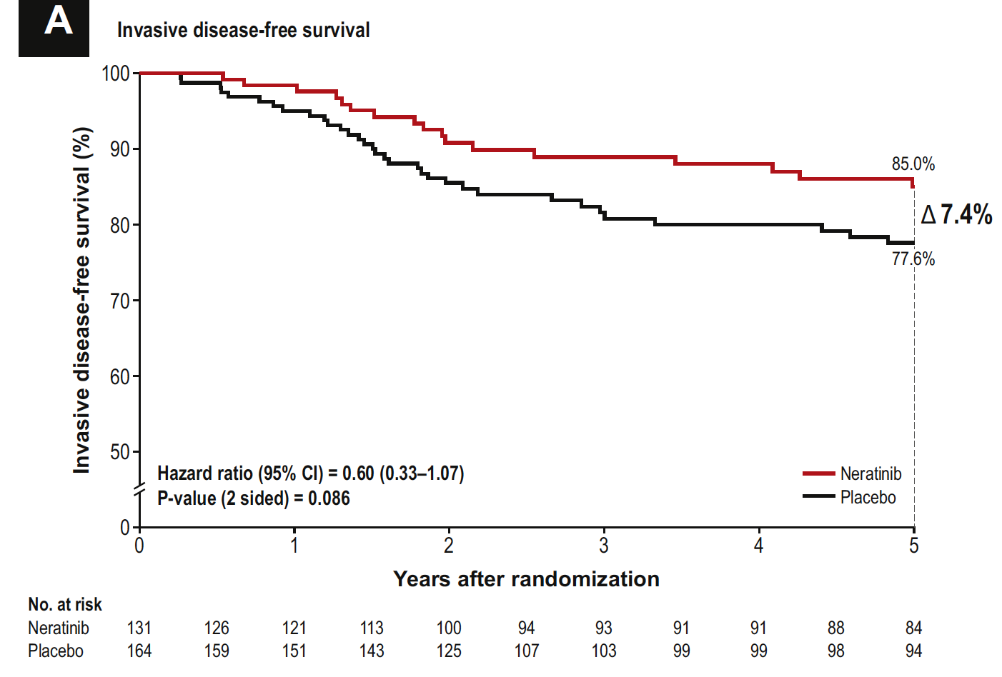
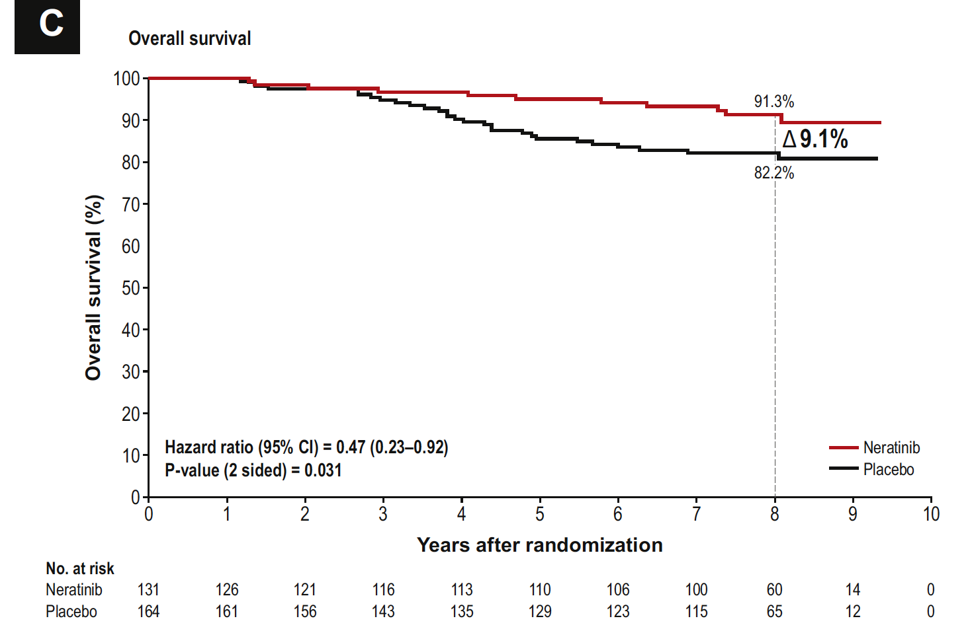
ExteNET: Invasive Disease-Free and Overall Survival at 5 Years in the HR+/≤1-Year Population with No pCR After Neoadjuvant Therapy (N = 295)
Chan A et al. Clin Breast Cancer 2021;21(1):80-91.

Slide 80
ExteNET: Cumulative Incidence of CNS Recurrence
Population or subgroup | Events, n |  | Cumulative incidence of CNS recurrence
 | Neratinib | Placebo | Neratinib | Placebo
Intention-to-treat population (n = 2,840) | 16 | 23 | 1.3% | 1.8%
HR-positive/≤1-year population (EU indication) (n = 1,334) | 4 | 12 | 0.7% | 2.1%
Adjuvant or neoadjuvant therapy (n = 1,334) Adjuvant (n = 980) Neoadjuvant (n = 354) | 3 1 | 6 6 | 0.7% 0.7% | 1.5% 3.7%
pCR status (n = 354) No (n = 295) Yes (n = 38) | 1 0 | 5 1 | 0.8% 0 | 3.6% 5.0%
Chan A et al. Clin Breast Cancer 2021;21(1):80-91; Holmes FA et al. San Antonio Breast Cancer Symposium 2020;Abstract PD3-03.

Slide 81
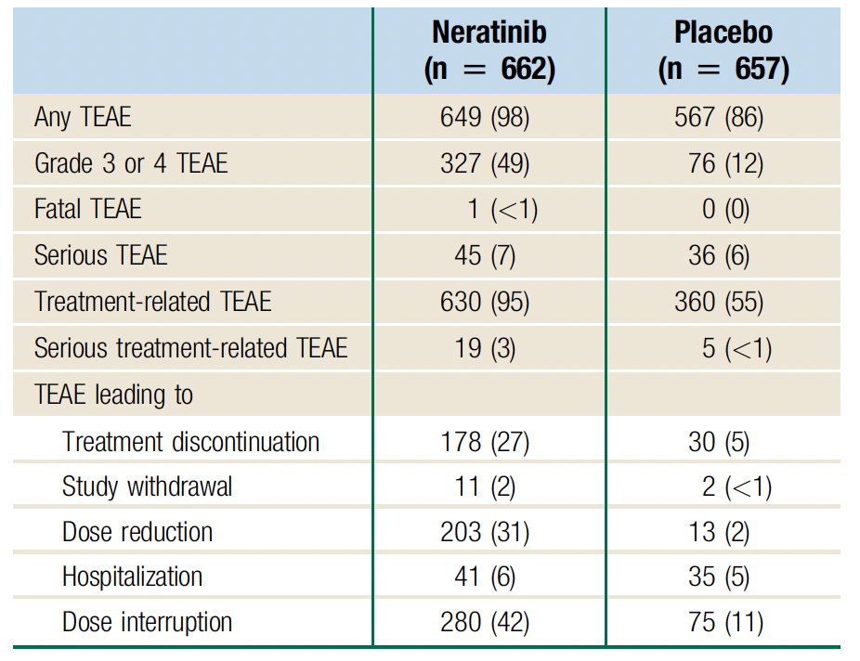
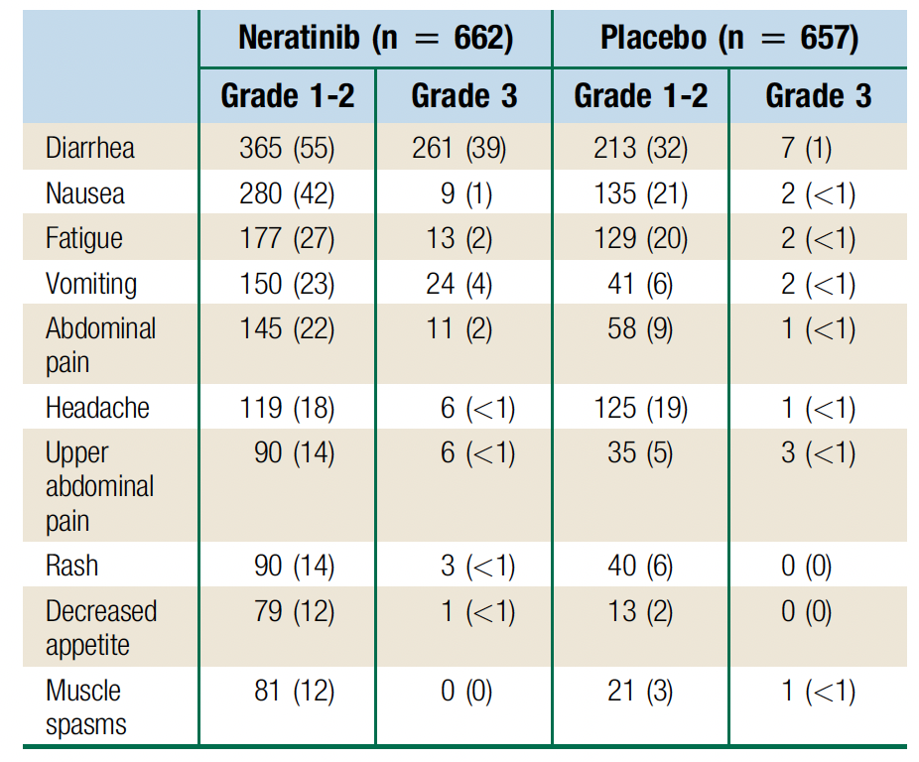
ExteNET: Adverse Events (AEs)
Summary of AEs
Frequent Treatment-Emergent AEs (TEAEs)
Chan A et al. Clin Breast Cancer 2021;21(1):80-91.

Slide 82
Association Between Treatment Duration and Overall Survival in Early-Stage HER2+ Breast Cancer Patients Receiving Extended Adjuvant Therapy with Neratinib in the ExteNET Trial
Moy B et al.
ASCO 2021;Abstract 540.

Slide 83
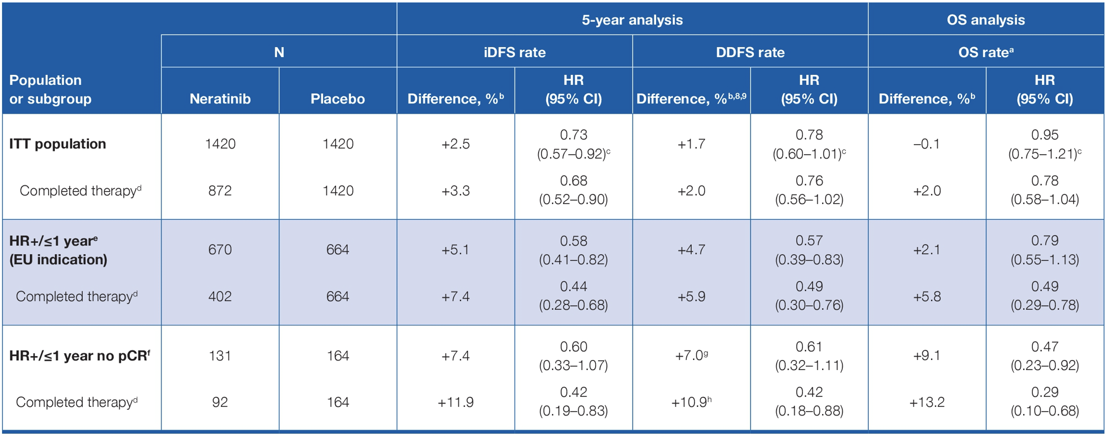
ExteNET: Survival Summary for Patients Who Completed Planned Neratinib Therapy
Moy B et al. ASCO 2021;Abstract 540.

Slide 84
Effects of Diarrheal Prophylaxis or Dose Escalation on Neratinib-Associated Diarrhea and Tolerability in Patients with HER2+ Early-Stage Breast Cancer: Final Findings from the CONTROL Trial
Chan A et al.
ESMO Breast 2022;Abstract P73.

Slide 85
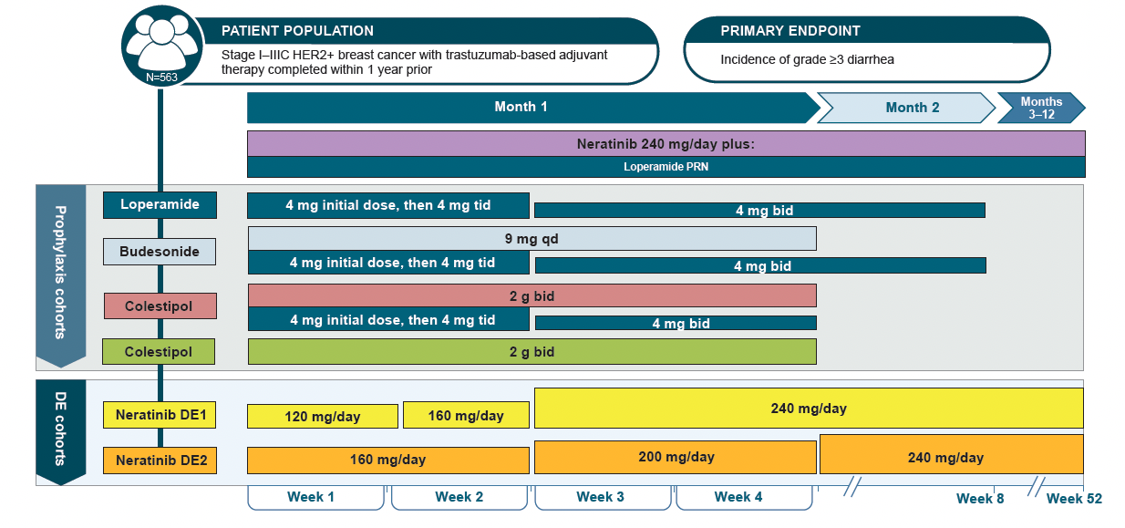
CONTROL Trial Cohorts: Study Schema
Chan A et al. ESMO Breast 2022;Abstract P73.

Slide 86
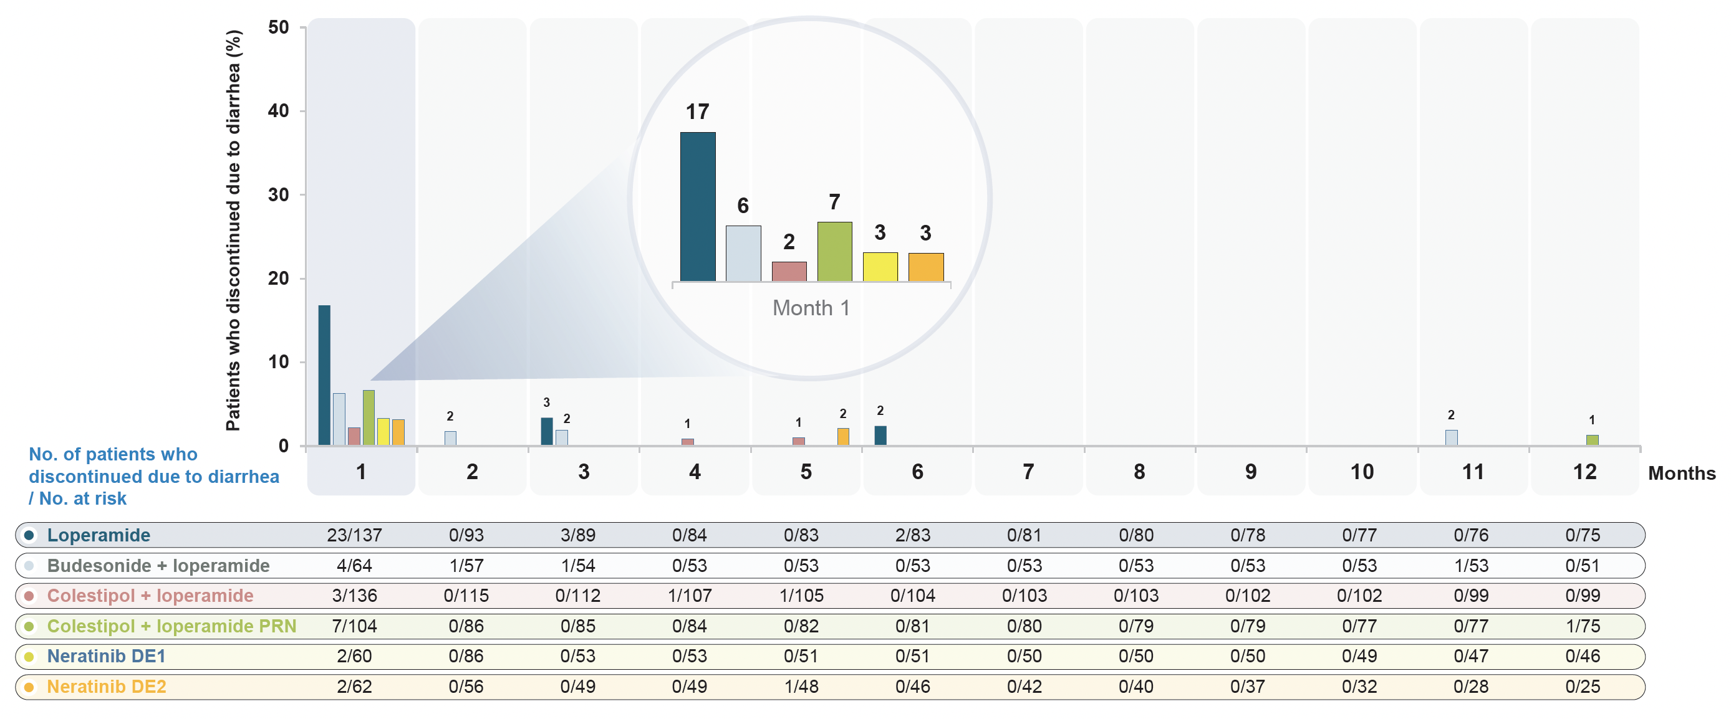
CONTROL: All Strategies Reduced the Rate of Discontinuation Due to Diarrhea
Chan A et al. ESMO Breast 2022;Abstract P73.

Slide 87
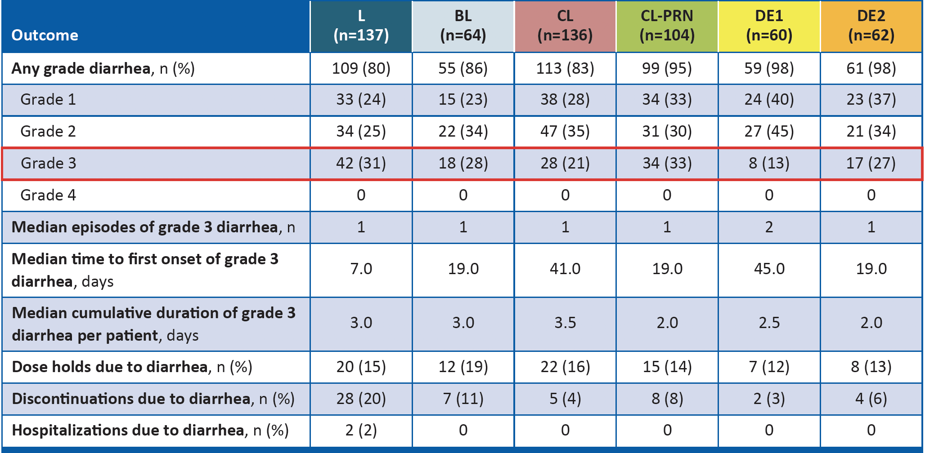
CONTROL: Diarrhea Profile
Chan A et al. ESMO Breast 2022;Abstract P73.

Slide 88
CONTROL: Conclusions
These final findings from the CONTROL study show improved tolerability of neratinib with all diarrhea prophylaxis and DE schedules. These results demonstrate that neratinib is well tolerated as extended-adjuvant treatment for patients with HER2+ breast cancer after 1 year of trastuzumab.
Adoption of neratinib DE with loperamide PRN during the first 2 weeks of treatment (DE1 cohort) was associated with a lower rate of Grade 3 diarrhea compared to the CONTROL prophylaxis strategies, the DE2 strategy and the neratinib arm in the ExteNET trial.
The DE1 cohort also had the lowest rate of diarrhea-related discontinuations (3%) and dose holds (12%) compared to the other strategies investigated in the CONTROL trial and the neratinib arm in the ExteNET trial.
These findings suggest that several modalities, most notably neratinib DE1 with loperamide PRN, allow patients to stay on treatment longer and receive the full benefit of neratinib therapy.
The US package label for neratinib now includes both the mandatory loperamide prophylaxis regimen and the DE1 strategy from CONTROL as diarrhea-mitigation strategies.
Chan A et al. ESMO Breast 2022;Abstract P73.

Slide 89
Evolving Treatment Paradigms for Patients with Metastatic HER2-Positive BC

Slide 90
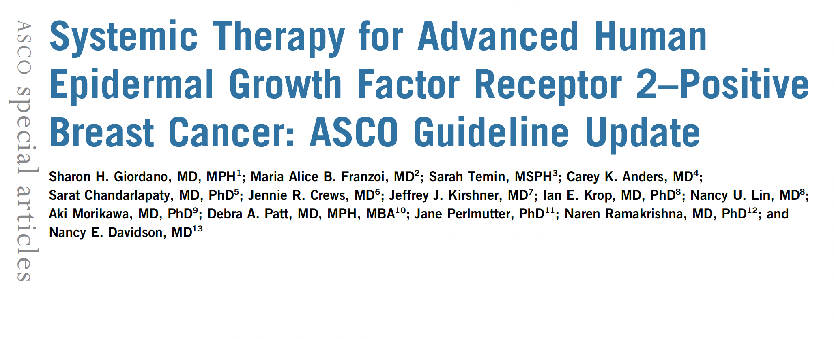
J Clin Oncol 2022 August;40:2612-35.

Slide 91
Trastuzumab Deruxtecan (T-DXd) and DESTINY-Breast Studies

Slide 92
Trastuzumab Deruxtecan Significantly Delayed Disease Progression in Comparison to Physician’s Choice of Treatment for HER2-Positive Metastatic Breast Cancer in the DESTINY-Breast02 Phase III Trial Press Release – August 15, 2022
Positive high-level results from the DESTINY-Breast02 Phase III trial of trastuzumab deruxtecan versus physician’s choice of treatment showed the trial met the primary endpoint, demonstrating a statistically significant and clinically meaningful improvement in progression-free survival in patients with HER2-positive unresectable and/or metastatic breast cancer previously treated with trastuzumab emtansine. The trial also met the key secondary endpoint of improved overall survival.
The trial evaluated a similar later-line patient population as the single-arm DESTINY-Breast01 Phase II trial, which was the basis for initial approvals in advanced HER2-positive metastatic breast cancer. The safety profile of trastuzumab deruxtecan in DESTINY-Breast02 was consistent with previous Phase III clinical trials with no new safety concerns identified. Interstitial lung disease (ILD) rates and severity were consistent with those observed in other metastatic breast cancer trials of trastuzumab deruxtecan, with a low rate of Grade 5 ILD events observed as determined by an independent adjudication committee.
https://www.astrazeneca.com/media-centre/press-releases/2022/enhertu-improved-pfs-in-mbc-in-destiny-breast02.html

Slide 93
Fam-Trastuzumab Deruxtecan-Nxki Approved in the United States for HER2-Positive Metastatic Breast Cancer Treated with a Prior Anti-HER2 Regimen Press Release – May 5, 2022
“Fam-trastuzumab deruxtecan-nxki has been approved in the US for the treatment of adult patients with unresectable or metastatic HER2-positive breast cancer who have received a prior anti-HER2-based regimen either in the metastatic setting, or in the neoadjuvant or adjuvant setting and have developed disease recurrence during or within six months of completing therapy.
The approval by the Food and Drug Administration (FDA) was based on positive results from the DESTINY-Breast03 Phase III trial that showed fam-trastuzumab deruxtecan-nxki reduced the risk of disease progression or death by 72% versus trastuzumab emtansine (T-DM1) (hazard ratio [HR] 0.28; 95% confidence interval [CI]: 0.22-0.37; p<0.0001) in patients with HER2-positive unresectable and/or metastatic breast cancer previously treated with trastuzumab and a taxane.
The approval was granted under the FDA’s Real-Time Oncology Review (RTOR) program and converts the accelerated approval of fam-trastuzumab deruxtecan-nxki in later line HER2-positive metastatic breast cancer to standard approval, broadening fam-trastuzumab deruxtecan-nxki’s breast cancer indication in the US to earlier lines of use in patients with HER2-positive metastatic breast cancer.”
https://finance.yahoo.com/news/enhertu-fam-trastuzumab-deruxtecan-nxki-110000498.html

Slide 94
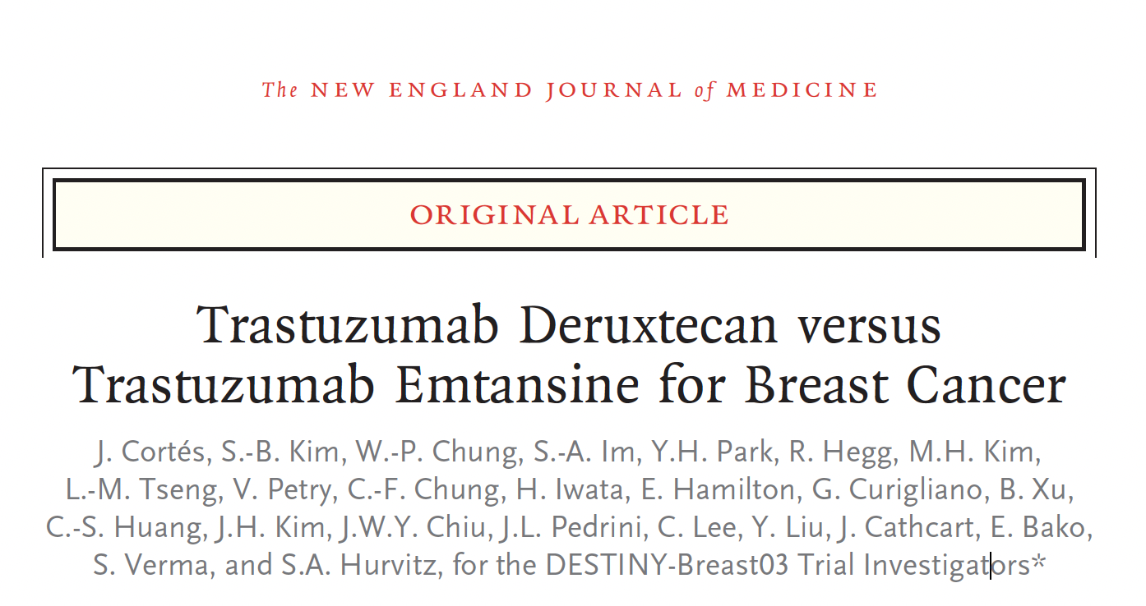
N Engl J Med 2022 March 24;386:1143-54.

Slide 95
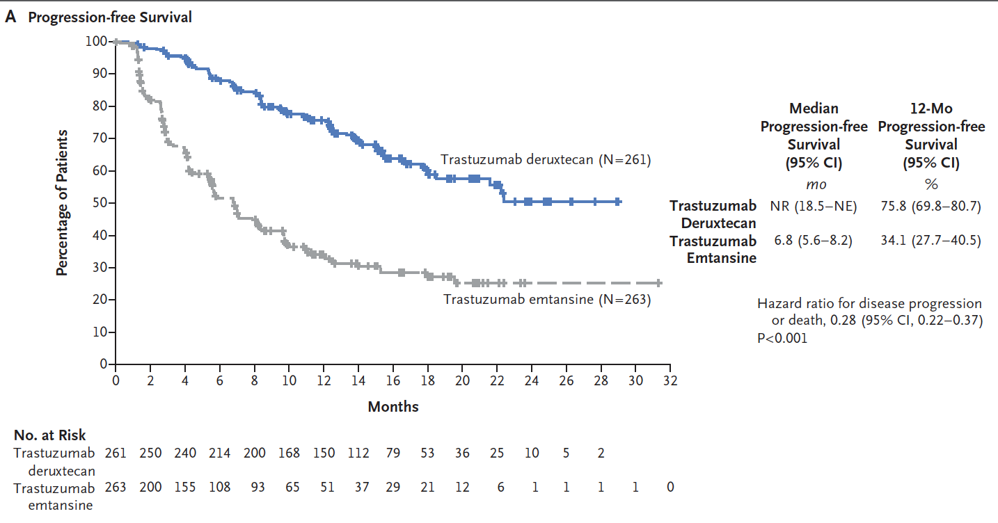
DESTINY-Breast03: Progression-Free Survival
Cortés J et al. N Engl J Med 2022;386(12):1143-54.

Slide 96
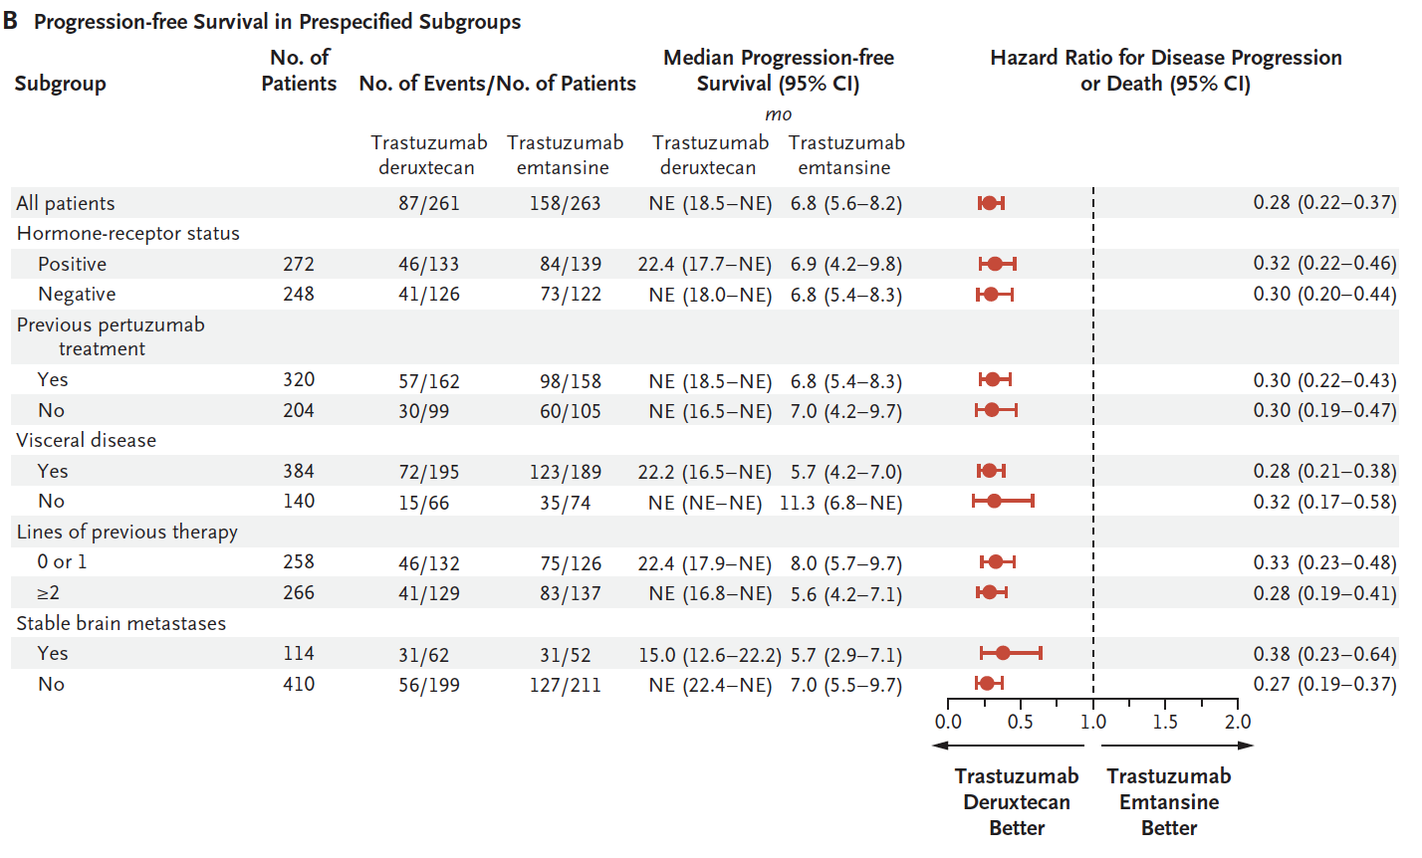
DESTINY-Breast03: Progression-Free Survival in Prespecified Subgroups
Cortés J et al. N Engl J Med 2022;386(12):1143-54.

Slide 97
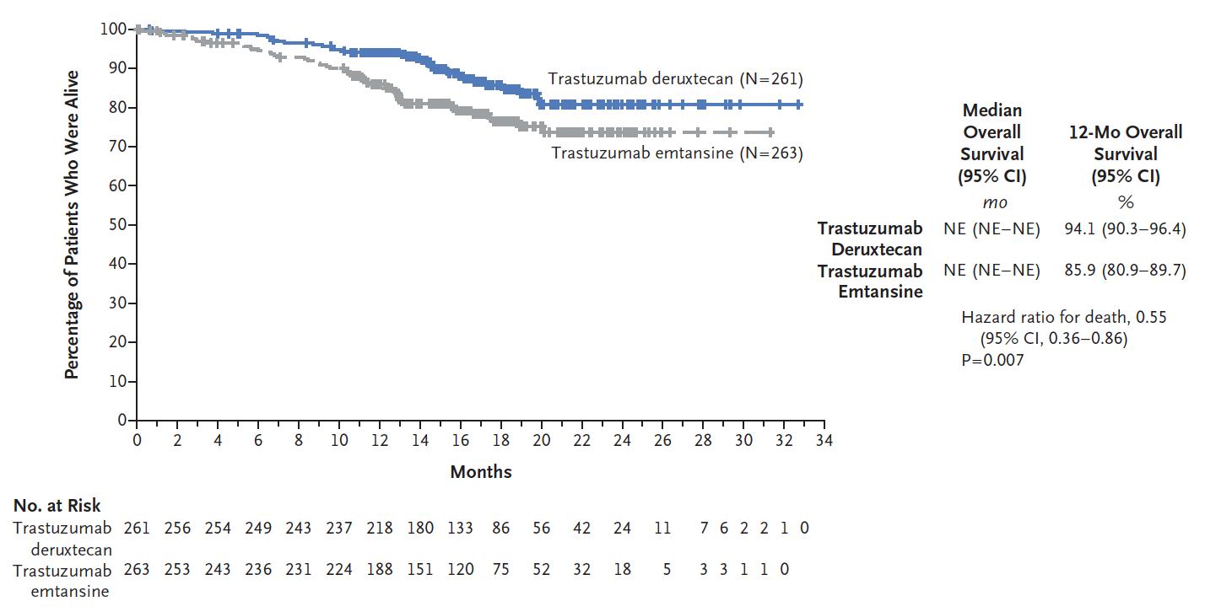
DESTINY-Breast03: First Interim Analysis of Overall Survival
Cortés J et al. N Engl J Med 2022;386(12):1143-54.

Slide 98
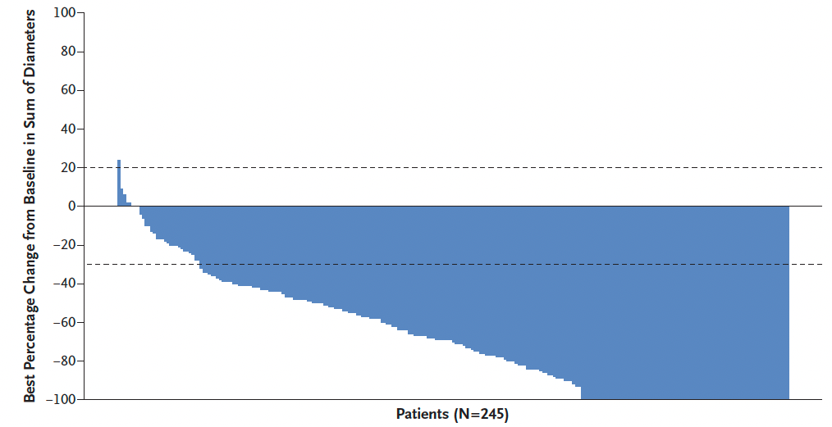
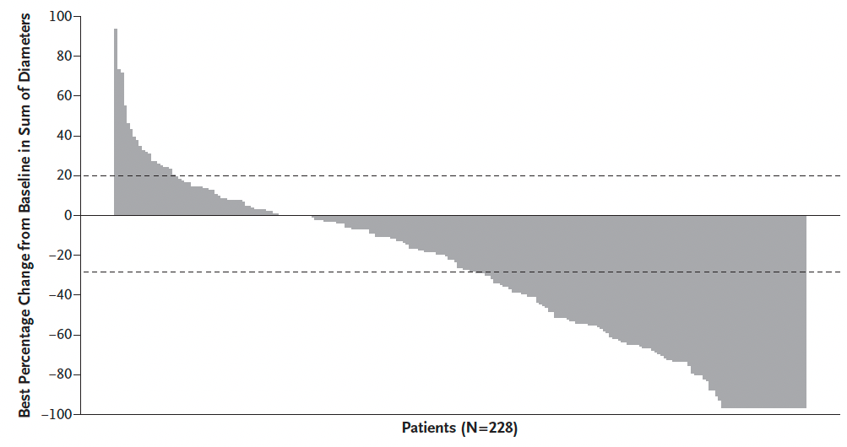
DESTINY-Breast03: Antitumor Activity
Trastuzumab deruxtecan
Trastuzumab emtansine
ORR: 79.7%
ORR: 34.2%
ORR = overall response rate
Cortés J et al. N Engl J Med 2022;386(12):1143-54.

Slide 99
Abstract 1000

Slide 100
DESTINY-Breast03: Safety Update Overview
TEAE = treatment-emergent adverse event
Hamilton E et al. ASCO 2022;Abstract 1000.

Slide 101
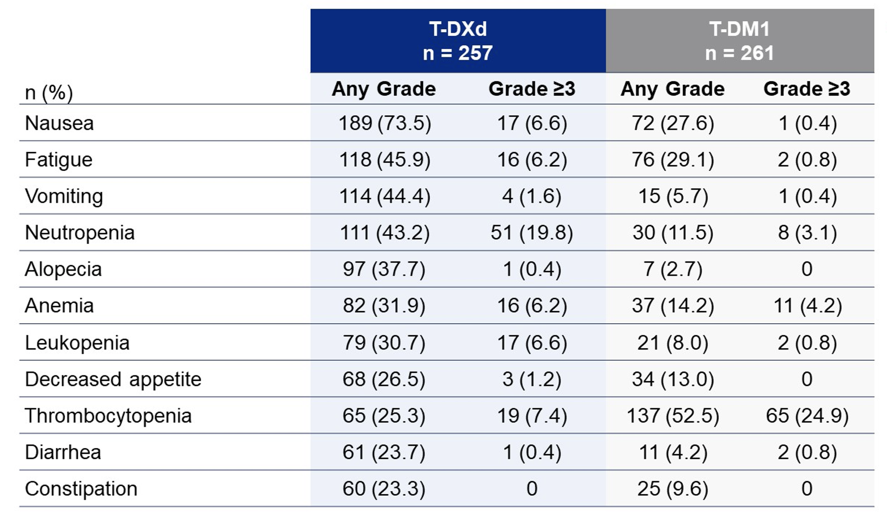
DESTINY-Breast03: Drug-Related TEAEs in ≥20% of Patients
Hamilton E et al. ASCO 2022;Abstract 1000.

Slide 102
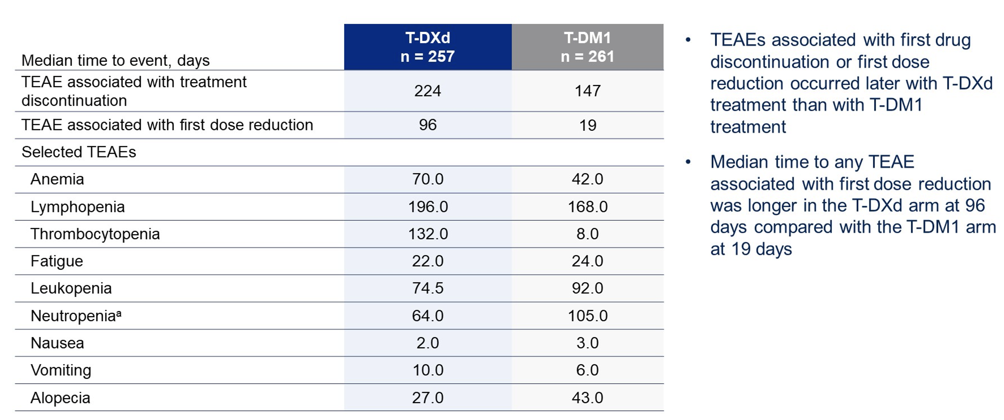
DESTINY-Breast03: Time to First Onset of TEAEs
ILD = interstitial lung disease
Hamilton E et al. ASCO 2022;Abstract 1000.

Slide 103
DESTINY-Breast03: Prevalence of Nausea and Vomiting
Hamilton E et al. ASCO 2022;Abstract 1000.

Slide 104
DESTINY-Breast03: Prevalence of Fatigue and Alopecia
Hamilton E et al. ASCO 2022;Abstract 1000.

Slide 105
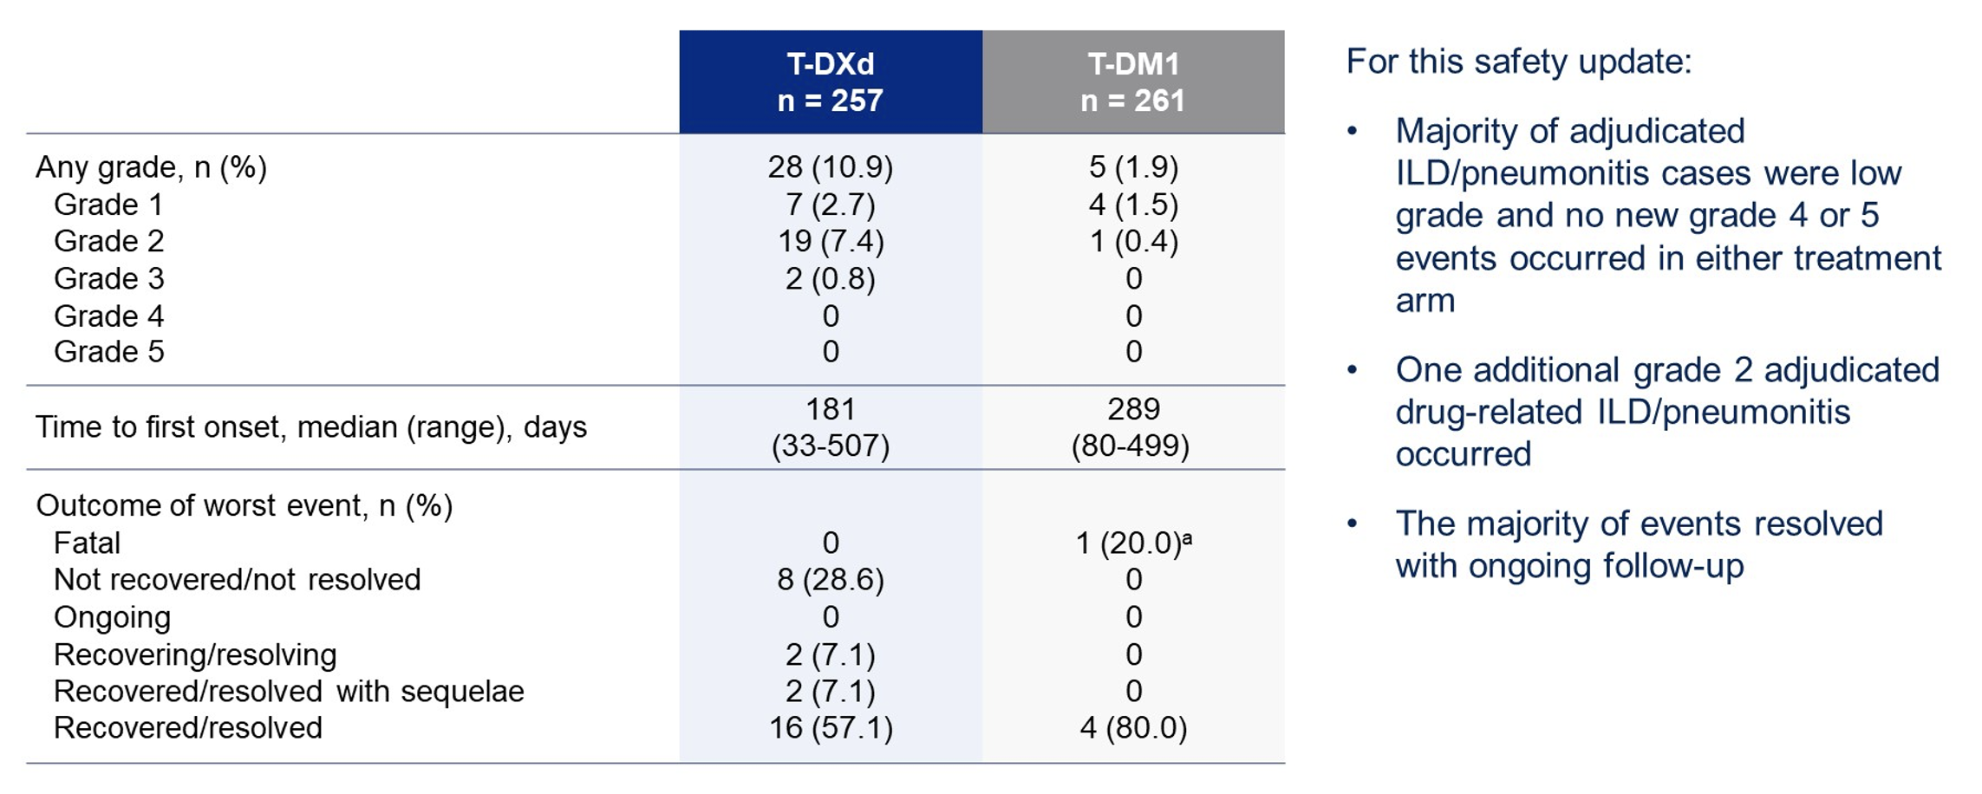
DESTINY-Breast03: Adjudicated Drug-Related ILD/Pneumonitis
Hamilton E et al. ASCO 2022;Abstract 1000.

Slide 106
DESTINY-Breast09 Phase III Trial Design
Estimated enrollment: N = 1,134
Pathologically documented breast cancer: Advanced or metastatic Locally assessed and prospectively centrally confirmed as IHC 3+ or ISH+ Documented by local testing as HR-positive or negative in the metastatic setting No prior chemotherapy or HER2-targeted therapy for advanced or metastatic disease or only 1 previous line of ET in the metastatic setting Prior (neo)adjuvant chemotherapy or HER2-targeted therapy allowed if >6 months from treatment to diagnosis of metastasis
T-DXd
+
pertuzumab-matching placebo
T-DXd + pertuzumab
R
Investigator choice of docetaxel or paclitaxel combined with pertuzumab/trastuzumab
Primary endpoint: Progression-free survival
www.clinicaltrials.gov. NCT04784715. Accessed August 2022.

Slide 107
Trastuzumab Deruxtecan Granted FDA Approval for HER2-Low Breast Cancer Press Release – August 5, 2022
“Today, the US Food and Drug Administration approved fam-trastuzumab-deruxtecan-nxki, an IV infusion for the treatment of patients with unresectable (unable to be removed) or metastatic (spread to other parts of the body) HER2-low breast cancer. This is the first approved therapy targeted to patients with the HER2-low breast cancer subtype, which is a newly defined subset of HER2-negative breast cancer.
Patients with HER2-low breast cancer are eligible for fam-trastuzumab-deruxtecan-nxki if they have received a prior chemotherapy in the metastatic setting, or their cancer returned during, or within 6 months of completing, adjuvant chemotherapy.
This approval is based on DESTINY-Breast04, a randomized, multicenter, open label clinical trial that enrolled 557 adult patients with unresectable or metastatic HER2-low breast cancer.”
https://www.fda.gov/news-events/press-announcements/fda-approves-first-targeted-therapy-her2-low-breast-cancer

Slide 108
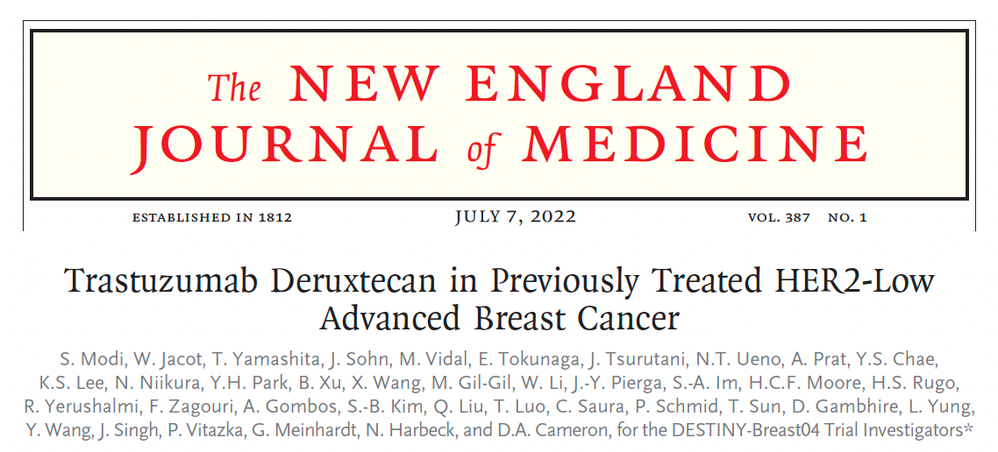
Abstract LBA3

Slide 109
T-DXd Mechanism of Action, Bystander Effect and Rationale for Targeting HER2-Low Breast Cancer
Modi S et al. ASCO 2022;Abstract LBA3. Modi S et al. N Engl J Med 2022 July 7;387(1):9-20.

Slide 110
DESTINY-Breast04 Phase III Trial Schema
TPC = treatment of physician's choice; PFS = progression-free survival; BICR = blinded independent central review; OS = overall survival
Modi S et al. ASCO 2022;Abstract LBA3. Modi S et al. N Engl J Med 2022 July 7;387(1):9-20.

Slide 111
DESTINY-Breast04: PFS for HR-Positive (Primary Endpoint) and All Patients
mPFS = median progression-free survival
Modi S et al. ASCO 2022;Abstract LBA3. Modi S et al. N Engl J Med 2022 July 7;387(1):9-20.

Slide 112
DESTINY-Breast04: OS for HR-Positive and All Patients
mOS = median overall survival
Modi S et al. ASCO 2022;Abstract LBA3. Modi S et al. N Engl J Med 2022 July 7;387(1):9-20.

Slide 113
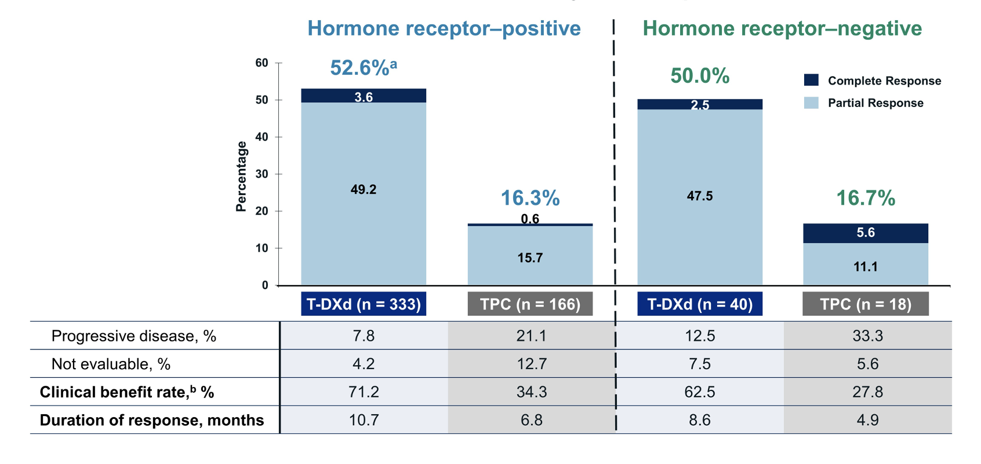
DESTINY-Breast04: Confirmed Objective Response Rate
Modi S et al. ASCO 2022;Abstract LBA3. Modi S et al. N Engl J Med 2022 July 7;387(1):9-20.

Slide 114
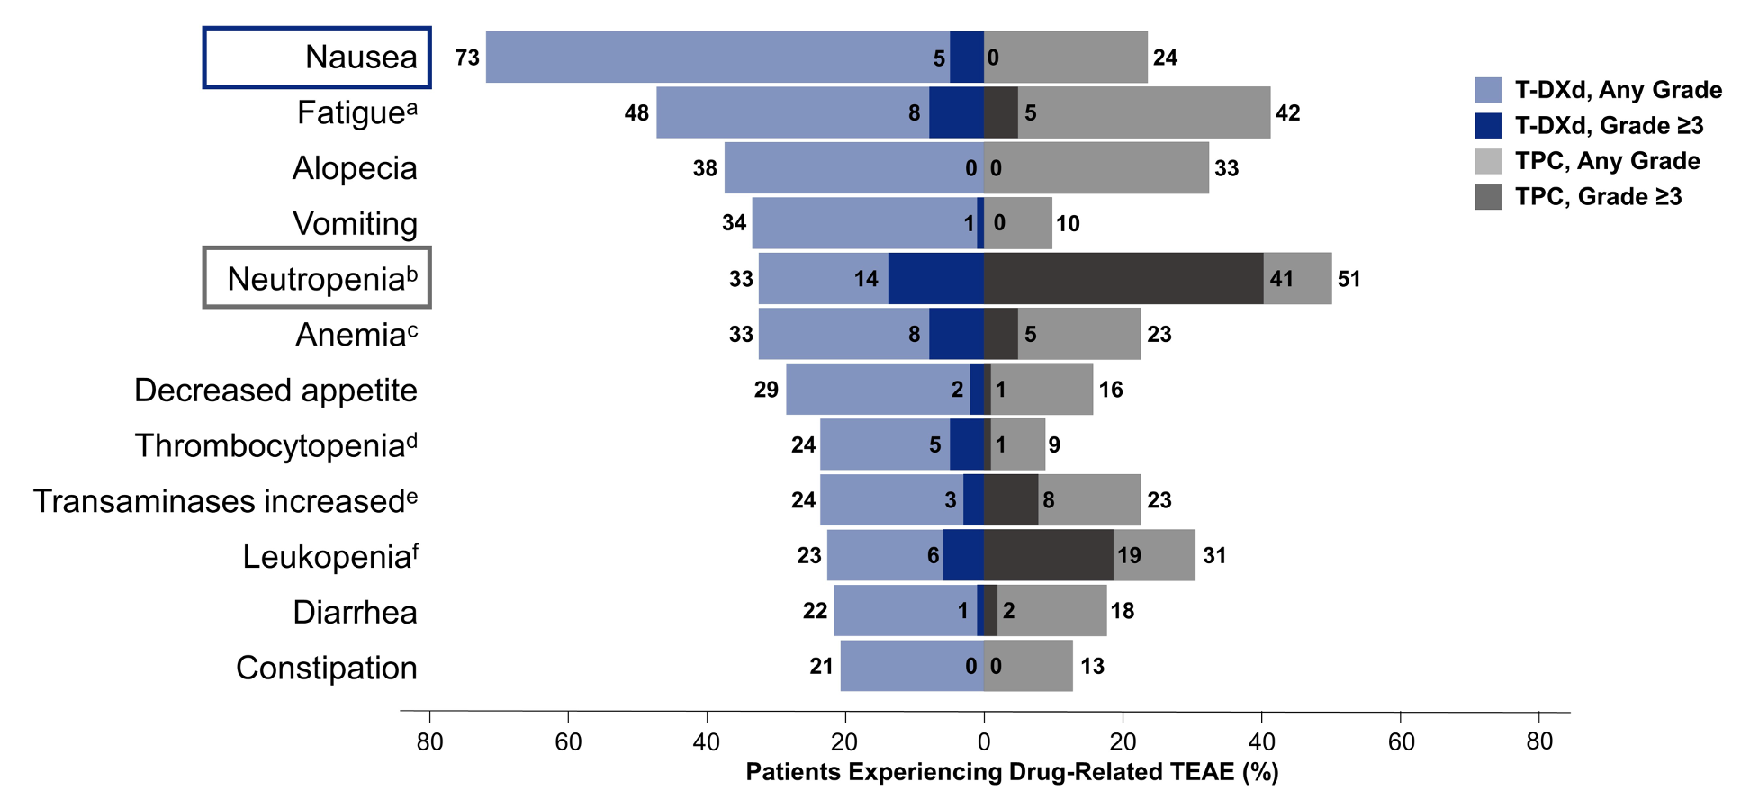
DESTINY-Breast04: Common Drug-Related TEAEs
Modi S et al. ASCO 2022;Abstract LBA3. Modi S et al. N Engl J Med 2022 July 7;387(1):9-20.

Slide 115
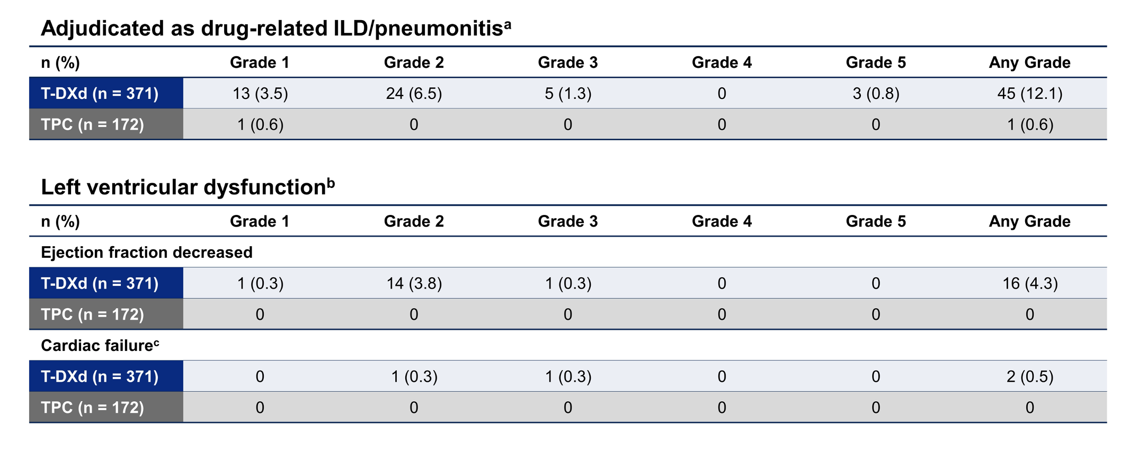
DESTINY-Breast04: Adverse Events of Special Interest
Modi S et al. ASCO 2022;Abstract LBA3. Modi S et al. N Engl J Med 2022 July 7;387(1):9-20.

Slide 116
DESTINY-Breast06 Phase III Trial Design
Estimated enrollment: N = 850
Metastatic breast cancer HER2-low or negative by local test IHC 2+/ISH- or IHC 1/ISH- or IHC 0/ISH- HER2-low or HER2 IHC >0 <1 by central lab HR-positive No prior chemotherapy for advanced or metastatic disease PD within 6 months of starting first-line therapy with ET/CDK4/6 OR PD on at least 2 prior line of ET +/- targeted therapy
Trastuzumab deruxtecan
R
Physician’s choice:
Capecitabine or paclitaxel or nab paclitaxel
Primary endpoint: PFS in HR-positive, HER2-low population
www.clinicaltrials.gov. NCT04494425. Accessed August 2022.

Slide 117
DESTINY-Breast08 Phase I Trial Design
Estimated enrollment: N = 182
Metastatic breast cancer (mBC) HER2-low (IHC 2+/ISH- or IHC 1+/ISH- or untested) HR-positive At least 1 prior line of ET +/- targeted therapy and 1 prior line of chemotherapy for mBC (Part 1) Only 1 prior line of ET +/- targeted therapy and no prior chemotherapy for mBC (Part 2)
T-DXd + capecitabine
T-DXd + durvalumab + paclitaxel
T-DXd + capivasertib
T-DXd + anastrozole
T-DXd + fulvestrant
Primary endpoints: Adverse events, serious adverse events
Secondary endpoints: Objective response rate, progression-free survival, duration of response, overall response
www.clinicaltrials.gov. NCT04538742. Accessed August 2022.

Slide 118
Tucatinib and HER2CLIMB Studies

Slide 119
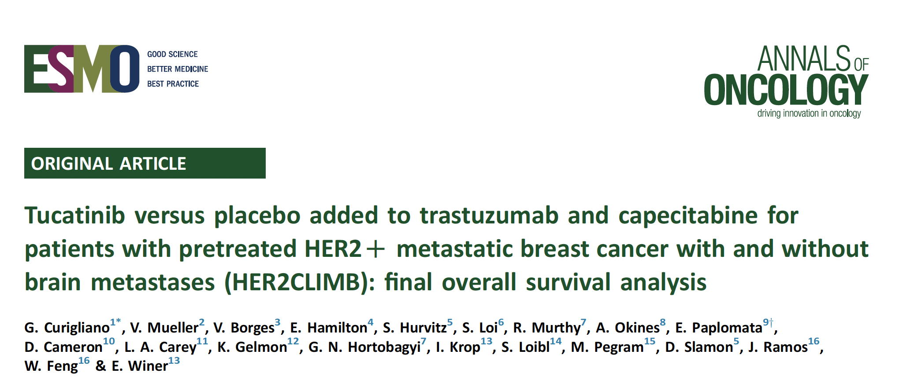
Ann Oncol 2022 March;33(3):321-9.

Slide 120
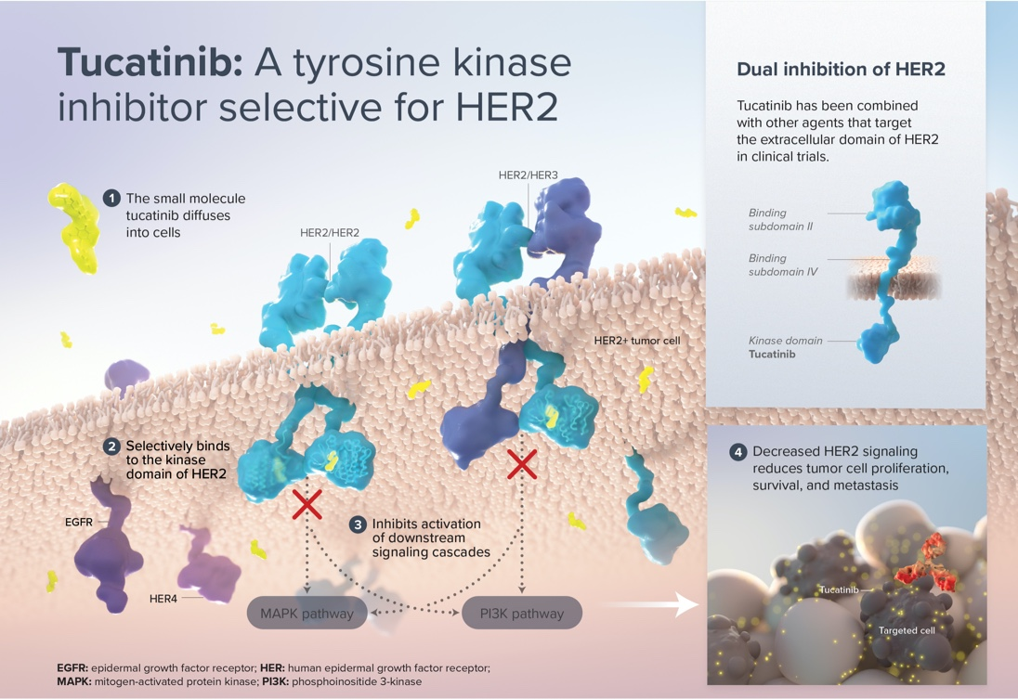
Tucatinib Mechanism of Action
www.seagen.com/science/pipeline/tucatinib

Slide 121
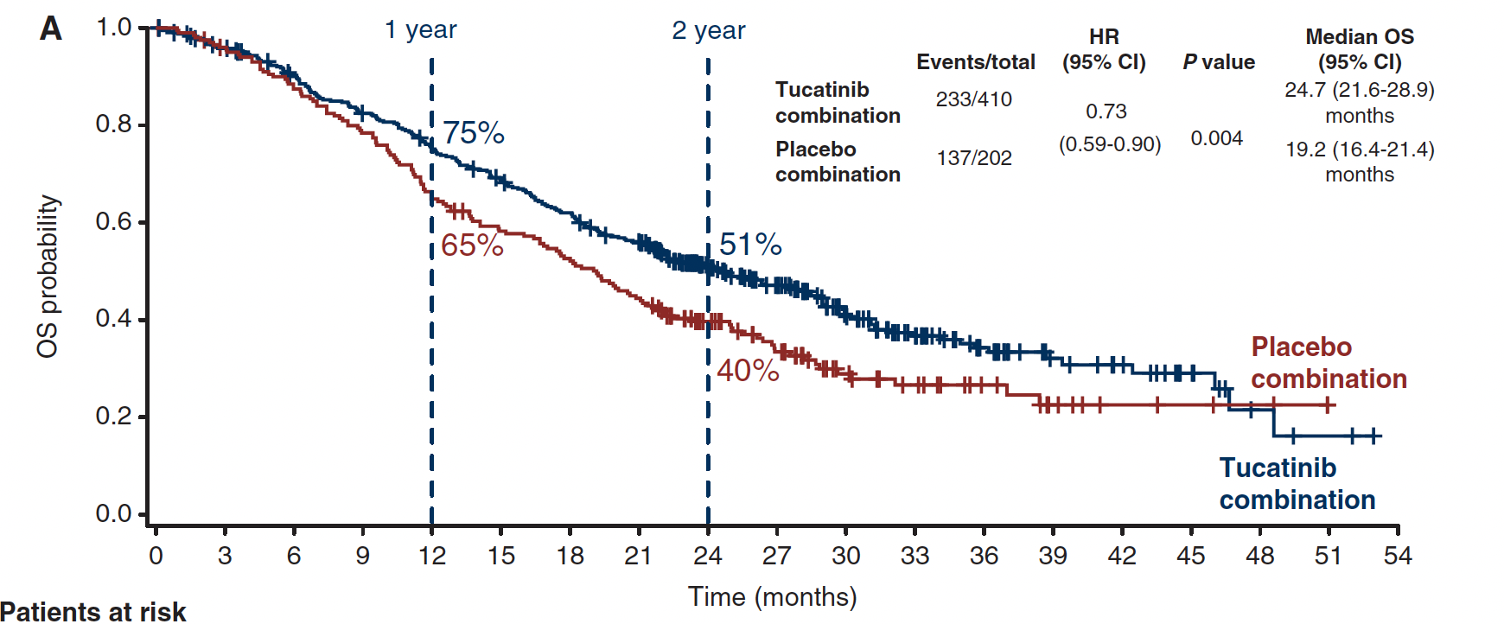
HER2CLIMB: Overall Survival
Curigliano G et al. Ann Oncol 2022 March;33(3):321-9.

Slide 122
HER2CLIMB: Progression-Free Survival
Curigliano G et al. Ann Oncol 2022 March;33(3):321-9.

Slide 123
HER2CLIMB: Forest Plot of Overall Survival
Curigliano G et al. Ann Oncol 2022 March;33(3):321-9.

Slide 124
HER2CLIMB: Summary of Adverse Events
Curigliano G et al. Ann Oncol 2022 March;33(3):321-9.

Slide 125
HER2CLIMB: Adverse Events
Curigliano G et al. Ann Oncol 2022 March;33(3):321-9.

Slide 126
HER2CLIMB-02 Phase III Trial Design
Tucatinib + T-DM1
Estimated enrollment: N = 460
Unresectable locally advanced or metastatic breast cancer HER2-positive Prior treatment with taxane and trastuzumab in any setting, separately or in combination
R
Placebo + T-DM1
Primary endpoint: PFS by investigator assessment
www.clinicaltrials.gov. NCT03975647. Accessed August 2022.

Slide 127
HER2CLIMB-04 Phase II Study Schema
Eligibility
HER2-positive locally advanced or metastatic breast cancer
Prior treatment with taxane and trastuzumab (+/- pertuzumab) in the locally advanced or metastatic setting or disease progression within 6 months of (neo)adjuvant therapy with taxane and trastuzumab (+/- pertuzumab)
cORR = confirmed objective response rate
Krop I et al. ASCO 2022;Abstract TPS1111.

Slide 128
HER2CLIMB-05 Phase III Study Schema
Hamilton E et al. ASCO 2022;Abstract TPS1108.

Slide 129
Neratinib and the NALA Study

Slide 130
J Clin Oncol 2020;38:3138-49.

Slide 131
NALA: Centrally Assessed PFS
Saura C et al. J Clin Oncol 2020;38:3138-49.

Slide 132
NALA: Overall Survival (ITT Population)
Saura C et al. J Clin Oncol 2020;38:3138-49.

Slide 133
NALA: Treatment-Emergent AEs in >15% of Patients
Saura C et al. J Clin Oncol 2020;38:3138-49.

Slide 134
NALA: Changes Over Time in Global Quality of Life and Functioning
EORTC QoL
Global Health Status Score
Saura C et al. J Clin Oncol 2020;38:3138-49.

Slide 135
Key Considerations in the Care of Patients with HER2-Positive BC with Brain Metastasis

Slide 136
Incidence and Prognosis of HER2-Positive CNS Metastases
registHER (N = 1,012) and SystHERs (N = 997) observational studies for patients with HER2-Positive breast cancer treated with trastuzumab and other anti-HER2 therapies
Incidence
Prognosis
37.3%
44.6 mo
30.6%
38 mo
Overall Survival (months)
Incidence
26.4 mo
30 mo
registHER
SystHERs
Brufsky AM et al. Clin Cancer Res 2011;17(14):4834-43. Hurvitz SA et al. Clin Cancer Res 2019;25(8): 2433-41.

Slide 137
J Clin Oncol 2022 August;40:2636-55.

Slide 138
Ann Oncol 2020 October;31(10):1350-8.

Slide 139
KAMILLA: Percent Change in Sum of Dimensions of Target Brain Lesions
Montemurro F et al. Ann Oncol 2020 October;31(10):1350-8.

Slide 140
KAMILLA: Progression-Free Survival
BM = brain metastases
Montemurro F et al. Ann Oncol 2020 October;31(10):1350-8.

Slide 141
KAMILLA: Overall Survival
Montemurro F et al. Ann Oncol 2020 October;31(10):1350-8.

Slide 142
Oncologist 2021 August;26(8):e1327-38.

Slide 143
NALA: PFS for Patients with CNS Metastases at Baseline
Hurvitz SA et al. Oncologist 2021 August;26(8):e1327-38.

Slide 144
NALA: OS for Patients with CNS Metastases at Baseline
Hurvitz SA et al. Oncologist 2021 August;26(8):e1327-38.

Slide 145
NALA: Efficacy in Patients with CNS Metastases at Baseline
Endpoint | Neratinib + capecitabine (n = 51) | Lapatinib + capecitabine (n = 50) | Hazard ratio | p-value
Median PFS | 5.6 mo | 4.3 mo | 0.66 | 0.074
Median OS | 13.9 mo | 12.4 mo | 0.90 | 0.635
Time to intervention for CNS disease (12-month cumulative incidence) | 25.5% | 36.0% | — | 0.430
Progressive CNS disease (12-month cumulative incidence) | 26.2% | 41.6% | — | 0.364
Median CNS PFS | 12.4 mo | 8.3 mo | 0.62 | 0.143
Objective response rate | 28.6% | 28.2% | — | 0.972
Median duration of response | 8.3 mo | 5.3 mo | 0.47 | 0.252
Clinical benefit rate | 40.0% | 30.8% | — | 0.410
Hurvitz SA et al. Oncologist 2021 August;26(8):e1327-38.

Slide 146
NALA: Time to Intervention for CNS Disease – Progressive CNS Disease
Hurvitz SA et al. Oncologist 2021 August;26(8):e1327-38.

Slide 147
NALA: Time to Intervention for CNS Disease – CNS PFS
Hurvitz SA et al. Oncologist 2021 August;26(8):e1327-38.

Slide 148
NALA: Time to Intervention for CNS Disease – Patients with CNS Metastases at Baseline
Hurvitz SA et al. Oncologist 2021 August;26(8):e1327-38.

Slide 149
NALA: Best Change in Intracranial Tumor Size from Baseline in Patients with Target CNS Lesions at Screening
Intracranial ORR: 26.3%
Intracranial ORR: 15.4%
Hurvitz SA et al. Oncologist 2021 August;26(8):e1327-38.

Slide 150
N Engl J Med 2022 March 24;386:1143-54.

Slide 151
DESTINY-Breast03: Progression-Free Survival for Patients with Brain Metastases
Cortés J et al. N Engl J Med 2022;386(12):1143-54.

Slide 152
Lin NU et al. J Clin Oncol 2020;38:2610-9.

Slide 153
HER2CLIMB: CNS Progression-Free Survival and Overall Survival for Patients with Brain Metastases
Lin NU et al. J Clin Oncol 2020;38:2610-9.

Slide 154
HER2CLIMB: CNS Progression-Free Survival and Overall Survival for Patients with Active Brain Metastases
Lin NU et al. J Clin Oncol 2020;38:2610-9.

Slide 155
HER2CLIMB: Intracranial Confirmed Objective Response Rate for Patients with Active Brain Metastases and Measurable Intracranial Lesions at Baseline
Response | Tucatinib, trastuzumab and capecitabine (n = 55) |  | Placebo, trastuzumab and capecitabine (n = 20)
Best overall intracranial response
Complete response | 5.5% | 5.5% | 5%
Partial response | 41.8% | 41.8% | 15.0%
Stable disease | 43.6% | 43.6% | 80.0%
Progressive disease | 3.6% | 3.6% | 0
Intracranial ORR | 47.3% | 47.3% | 20.0%
Intracranial DoR | 6.8 mo | 6.8 mo | 3.0 mo
DoR = duration of response
Lin NU et al. J Clin Oncol 2020;38:2610-9.

Slide 156
HER2CLIMB: CNS Progression-Free Survival and Overall Survival for Patients with Stable Brain Metastases
Lin NU et al. J Clin Oncol 2020;38:2610-9.

Slide 157
HER2CLIMB: Duration of Treatment for Patients with Isolated Progression in the Brain Who Continued Assigned Study Treatment
Lin NU et al. J Clin Oncol 2020;38:2610-9.

Slide 158
HER2CLIMB: Time to Second Disease Progression
Time from random assignment to
second disease progression
Time from first PD to
second disease progression
Lin NU et al. J Clin Oncol 2020;38:2610-9.

Slide 159
Trastuzumab-Deruxtecan (T-DXd) in HER2-Positive Breast Cancer Patients (Pts) with Active Brain Metastases: Primary Outcome Analysis from the TUXEDO-1 Trial
Bartsch R et al. ESMO Breast 2022;Abstract 165MO.

Slide 160
Bartsch R et al. ESMO Breast 2022;Abstract 165MO.

Slide 161
Bartsch R et al. ESMO Breast 2022;Abstract 165MO.

Slide 162
Bartsch R et al. ESMO Breast 2022;Abstract 165MO.

Slide 163
DESTINY-Breast07 Phase I/II Trial Design
T-DXd + durvalumab
Estimated enrollment: N = 450
Metastatic breast cancer HER2-positive No prior treatment for metastatic disease (0-1 prior treatment allowed for part 2)
T-DXd + pertuzumab
T-DXd + paclitaxel
T-DXd + durvalumab + paclitaxel
T-DXd
Part 2, patients with active brain metastases
T-DXd + tucatinib
Primary endpoints: AEs, serious AEs
Secondary endpoints: Objective response rate, PFS, PFS2, DoR, OS
www.clinicaltrials.gov. NCT04538742. Accessed August 2022.

Slide 164
DESTINY-Breast12 Phase IIIb/IV Trial Design
Trastuzumab deruxtecan
Cohort 1: Absence of BM at baseline
Estimated enrollment: N = 500
Metastatic breast cancer HER2-positive Absence or presence of brain metastases (BM) at baseline ≤2 prior lines of therapy in the metastatic setting
Trastuzumab deruxtecan
Cohort 2: Presence of BM at baseline
Primary endpoints: Objective response rate for patients without BM at baseline (Cohort 1), PFS for patients with BM at baseline (Cohort 2)
www.clinicaltrials.gov. NCT04739761. Accessed August 2022.

