Slide 1

Second-generation ROS1 Inhibitors
Current and Emerging Strategies for Patients with NSCLC Harboring an EGFR Exon 20 Insertion Mutation
Zosia Piotrowska, MD, MHS
Assistant Professor of Medicine
Harvard Medical School |Massachusetts General Hospital

Slide 2
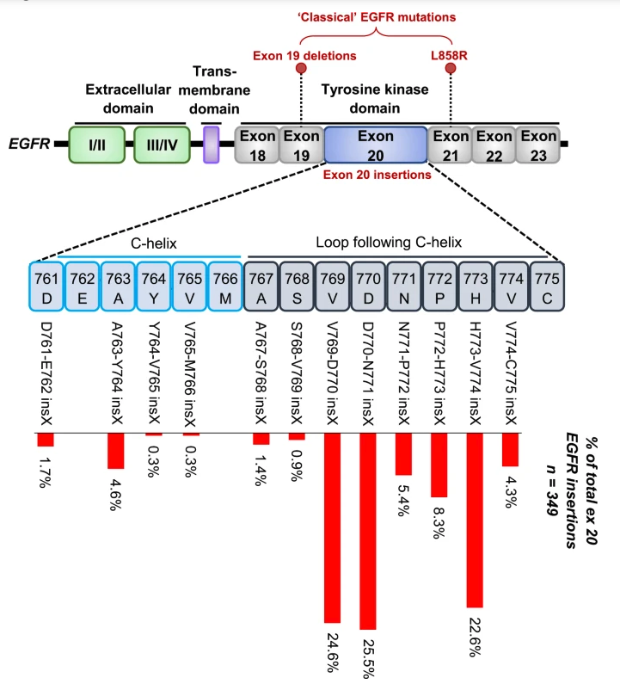
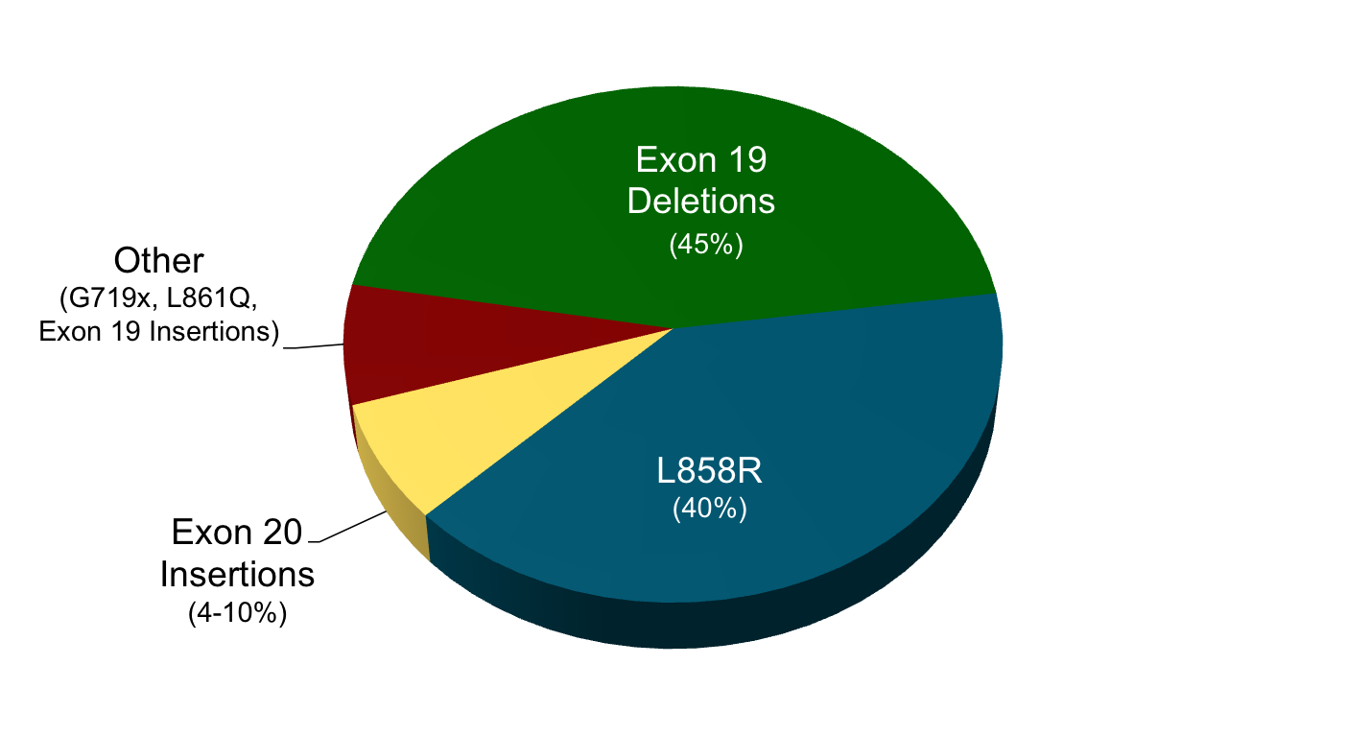
EGFR Exon 20 Insertions
Exon 20 NSCLC: US and China
 |  | Exon 20 Frequency | Total Number of NSCLC Patients/year
United States | EGFR | 2.1% | 3.6% | 7700
 | HER2 | 1.5%
China | EGFR | 2.4% | 6.3% | 41100
 | HER2 | 3.9%
Vyse et al. Signal Transduction and Targeted Therapy. 2019
Yasuda, et al. Lancet Oncol, 2011; Yasuda, et al. Science Trans Med, 2014, Heymach J, WCLC 2018

Slide 3
Distinguishing between EGFR mutations in NSCLC
SENSITIZING MUTATIONS
Exon 19 Deletion
L858R mutation
T790M (resistance mutation in exon 20)
L861Q*
G719X*
S768I*
Exon 20 Insertions (not an exhaustive list)
A763_Y764insFQEA
A767_V769dup
S768_D770dupSVD
V769_D770insASV
D770_N771ins..
D770_P772dup
N771_H773dup
N771_P772ins…
P772_H773dupPH
V774ins
*S768I, G719X, L861Q: Uncommon, but sensitizing EGFR mutations. Afatinib is FDA approved, and data for osimertinib is emerging but promising (Ahn, ASCO 2018, Abstract 9050)

Slide 4
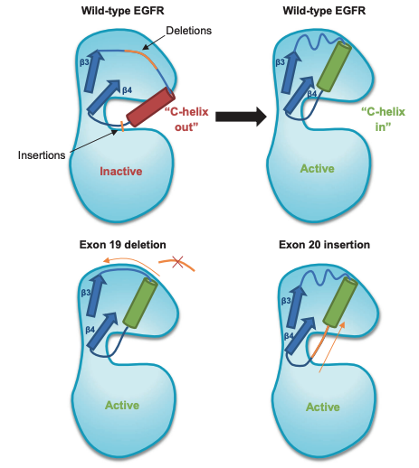
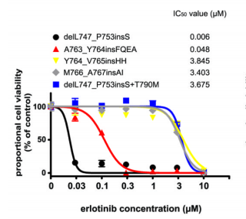
Why are EGFR exon 20 insertions challenging to target?
Vyse et al. Signal Transduction and Targeted Therapy . 2019
  Yasuda et al. Science and Translational Medicine. 2013

Slide 5
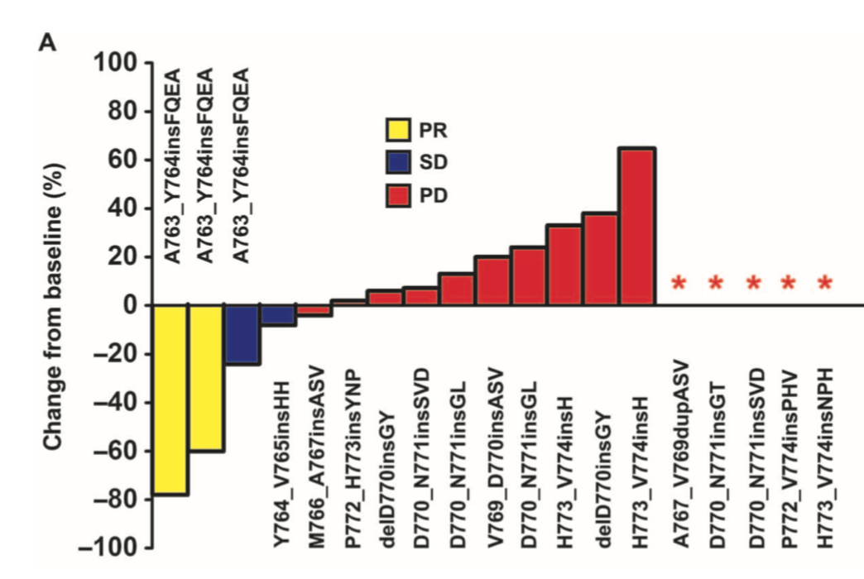
Standard Therapies for EGFR Ins20
Exon 20 insertions are generally refractory to 1st and 2nd generation EGFR TKIs
  Erlotinib/Gefitinib: mPFS 1.5-2 mos
  Afatinib: mPFS 2.9 mos
The A763_Y764insFQEA is an exception which is sensitive to 1st/2nd gen EGFR TKIs
Chemotherapy is currently the standard-of-care.
Several targeted therapy options are currently in clinical trials:
  Poziotinib
  Mobocertinib (TAK-788)
  Osimertinib
The role of immunotherapy for patients with EGFR mutations (including ins20) is unknown.
Best Response to Erlotinib and Gefitinib¹
1. Yasuda, et al. Science Trans Med, 2014

Slide 6
Emerging Targeted Therapies for EGFR Exon 20 Insertions
Drug | MOA | n | ORR | mPFS | Major Toxicities | % Dose Reduction | % DC due to Toxicity | FDA BT Therapy
Poziotinib^{1,2} | TKI | 115 | 15% | 4.2 mo | 82% Diarrhea; 26% Gr 3+ 68% Rash; 30% Gr 3+ | 78% | 12%
Mobocertinib (TAK-788) ^{3,4} | TKI | 28 | 43% | 7.3 mo | 85% Diarrhea; 28% Gr 3+ 36% Rash; 1% Gr 3+ 43% Nausea; 6% Gr 3+ | 25% | 14% | X
Amivantamab (JNJ-372) ⁵ | EGFR/MET Ab | 39 | 36% | 8.3 mo [95% CI, 3.0-14.8] | 72% Rash; 0% Gr3 60% Infusion Reaction 34% Paronychia | 10% | 6% | X
Osimertinib⁶ | TKI | 17 | 24% | 9.6 mo | 76% Diarrhea; 0% Gr 3+ 38% Rash; 0% Gr 3+ *10% Gr 3+ plts, 10% Gr 3+ QTc | NR | 1/17
CLN-081⁷ | TKI | 22 | 35% (unconf) | NR | 60% Rash; 0% Gr 3+ 13% Stomatitis, 0% Gr 3 | 9% | 0%
1. Le X, AACR 2020, 2. Socinski M, ESMO 2020; 3. Riely G, ESMO 2020; 4.Riely G, ASCO 2020; 5. Park K, ASCO 2020; 6. Piotrowska Z, ASCO 2020; 7. Piotrowska Z, ESMO 2020.

Slide 7
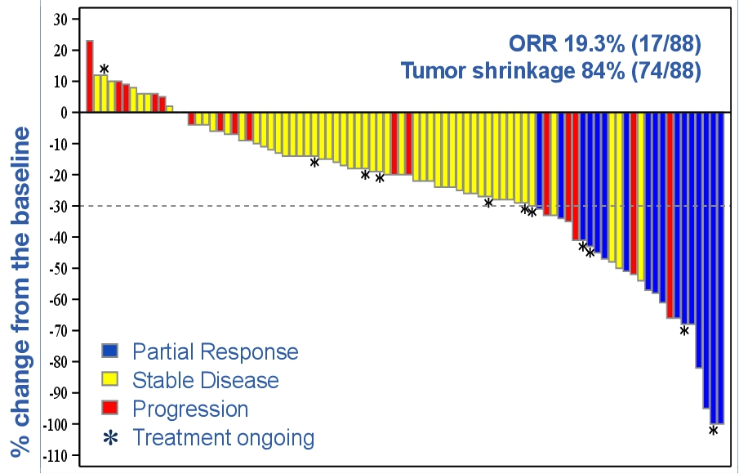
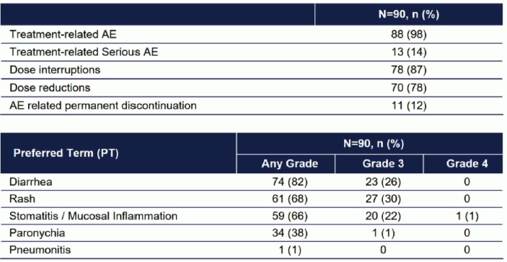
Poziotinib
Efficacy
Safety
ORR 14.8%
Le et al. ASCO 2020; Socinski ESMO 2020
Notes:
Preliminary results from a small investigator initiated trial were promising, but recent updates from the larger, phase II ZENITH20 trial were disappointing:
115 patients with EGFR exon 20 insertions
ORR 14.8%, mPFS 4.2 months
68% of patients required dose reduction, 88% dose interruption
TRAEs: Diarrhea (79%), Rash (60%), Stomatitis (52%), Paronychia (45%)

Slide 8
Mobocertinib (TAK-788) Efficacy
Notes:
Mobocertinib is an oral, EGFR TKI
Phase 1 testing established 160mg QD as the RP2D.
Among 28 pts treated at RP2D:
ORR 43%
mPFS 7.3 mos
Outcomes were best (ORR 56%, mPFS 8.1 mos) among 16 patients without baseline brain mets.

Slide 9
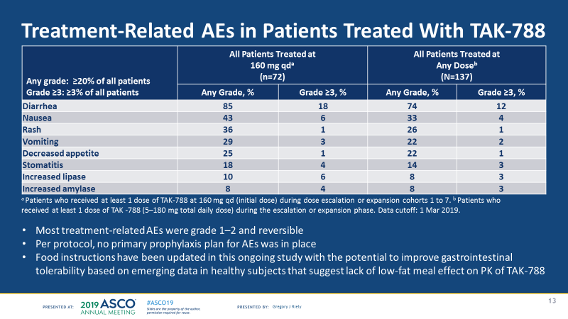
Mobocertinib (TAK-788)
Toxicities
  GI toxicities (diarrhea, nausea) and rash are most common.
  25% pts required dose reduction due to AE
  14% pts discontinued treatment due to an AE.
  Note: Several cases of cardiomyopathy have been observed on the phase I/II study and cardiac surveillance should be considered

Slide 10
Amivantamab (JNJ-372) Efficacy
Amivantamab (JNJ-372)- fully human EGFR-MET bispecific antibody
Previously shown to have activity in TKI-resistant, EGFR mutant cancers including EGFR C797S
Phase 1 CHRYSALIS study of amivantamab for pts with advanced NSCLC
  RP2D: 1050mg/1400mg IV weekly (based on weight)
  Cohort D: EGFR exon 20 insertions (n=39)
ORR 36%
mPFS 8.3 mos
Park K, ASCO 2020

Slide 11
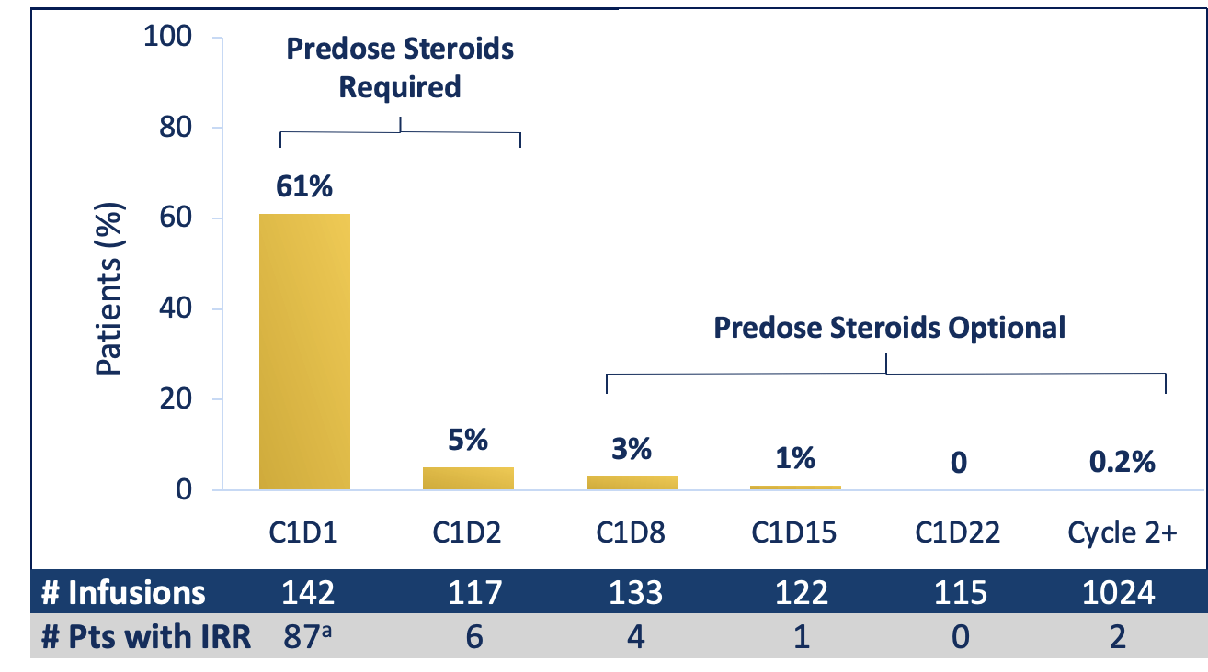
Amivantamab (JNJ-372) Toxicities
Infusion Reactions:
IRR Severity: 98% Gr 1-2; 2% Gr 3
Chills, SOB, nausea, flushing
Primarily limited to first infusion
Improves with split dosing (C1D1, C1D2)
Park K, ASCO 2020

Slide 12
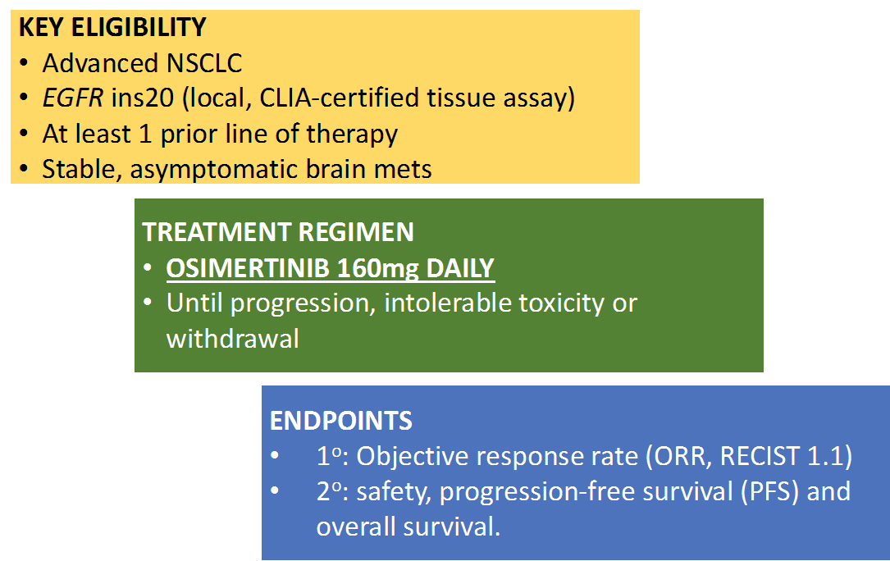
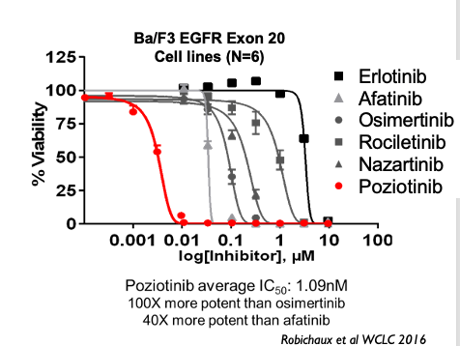
Osimertinib
EA5162: Phase II Study of Osimertinib in Advanced NSCLC Patients with Exon 20 Insertion Mutations in EGFR
Piotrowska Z, ASCO 2020

Slide 13
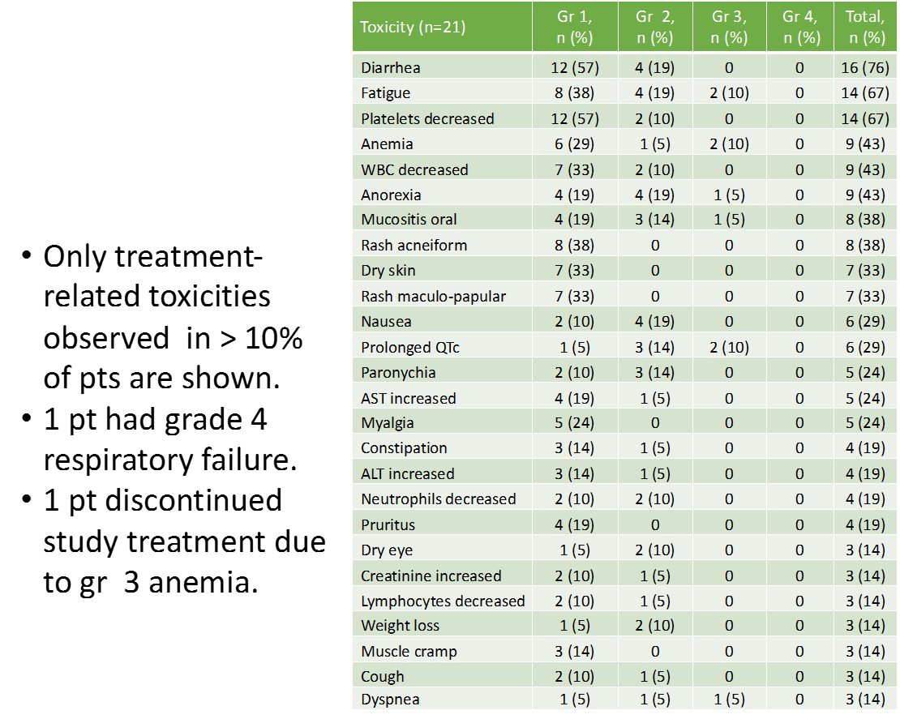
Osimertinib
Piotrowska Z, ASCO 2020

Slide 14
CLN-081 (TAS6417)
CLN-081 (TAS6417) – oral EGFR TKI
Ongoing phase 1 study (in dose escalation)
Toxicities: Rash (60% all grades, no grade 3), stomatitis (13%), dry skin (13%)
Preliminary Results from ongoing Phase 1 Study:
ORR* 6/17 (35%)
*unconfirmed
Piotrowska Z, ESMO 2020

Slide 15
Other Emerging Therapies for EGFR Exon 20
Drug | MOA | n | ORR | mPFS | Major Toxicities | % Dose Reduction | % DC due to Toxicity
Tarloxotinib¹ | Hypoxia-activated TKI | 11 | 0% |  | 61% QTc Prolonged; 35% Gr 3+ 43% Rash; 4% Gr 3+ 21% Diarrhea; 4% Gr 3+ | 5/23 (22%) | 1/23 (4%)
BDTX-189² | Oral Allosteric ErbB Inhibitor | Phase 1 study ongoing (NCT04209465)
1. Liu, ESMO 2020; 2. Hamilton E, ASCO 2020

Slide 16
Conclusions
Several new targeted therapies show signs of activity for patients with EGFR exon 20 insertions, including both TKIs (Mobocertinib, Osimertinib) and antibody-based therapy (amivantamab.) New drugs are being developed (CLN-081, BDTX-189.)
However, many of these have significant toxicities and outcomes are still inferior to those of patients with EGFR exon 19 deletion or exon 21 L858R substitution mutation. Better therapies are needed for EGFR exon 20 insertions.
Key issues for drug development going forward will be optimizing the therapeutic window of new drugs for EGFR exon 20, identifying optimal sequence of therapies and maximizing CNS benefit.

Slide 17
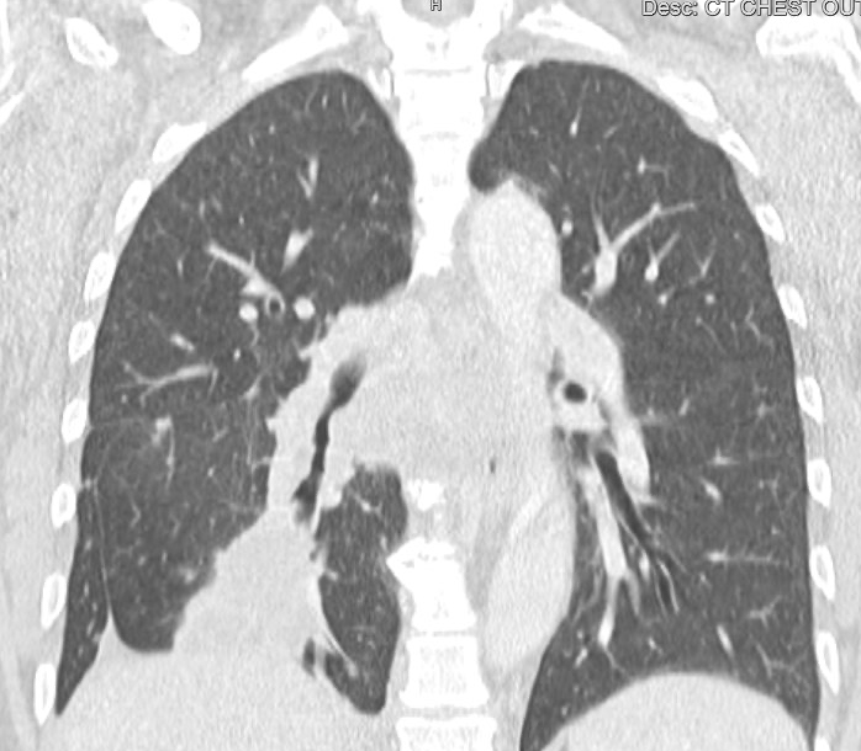
Case 1, Part One (selection of first-line therapy)
55yo F never-smoker presented with several months of cough and R sided pleuritic chest pain.
PMHx: None; Meds: None
Chest CT: RLL mass encasing RLL bronchus.
PET/CT: RLL mass with endobronchial extension, bilateral pulmonary nodules and right hilar, subcarinal, right paratracheal and paraesophageal, bilateral cervical lymphadenopathy. There was evidence of bone mets including L1 and R 12th rib.
Brain MRI: Negative

Slide 18
Case 1, Part One, continued
Bronchoscopy and EBUS with biopsy of endobronchial diease of the RLL revealed adenocarcinoma, TTF1 positive.
PD-L1 0%
Next-generation sequencing: EGFR Exon 20 insertion (V769_D770insASV)
What is the optimal first-line therapy for this patient?
Notes:
Options:
Chemo
Chemoimmunotherapy
First line chemo vs. TAK-788 Trial

Slide 19
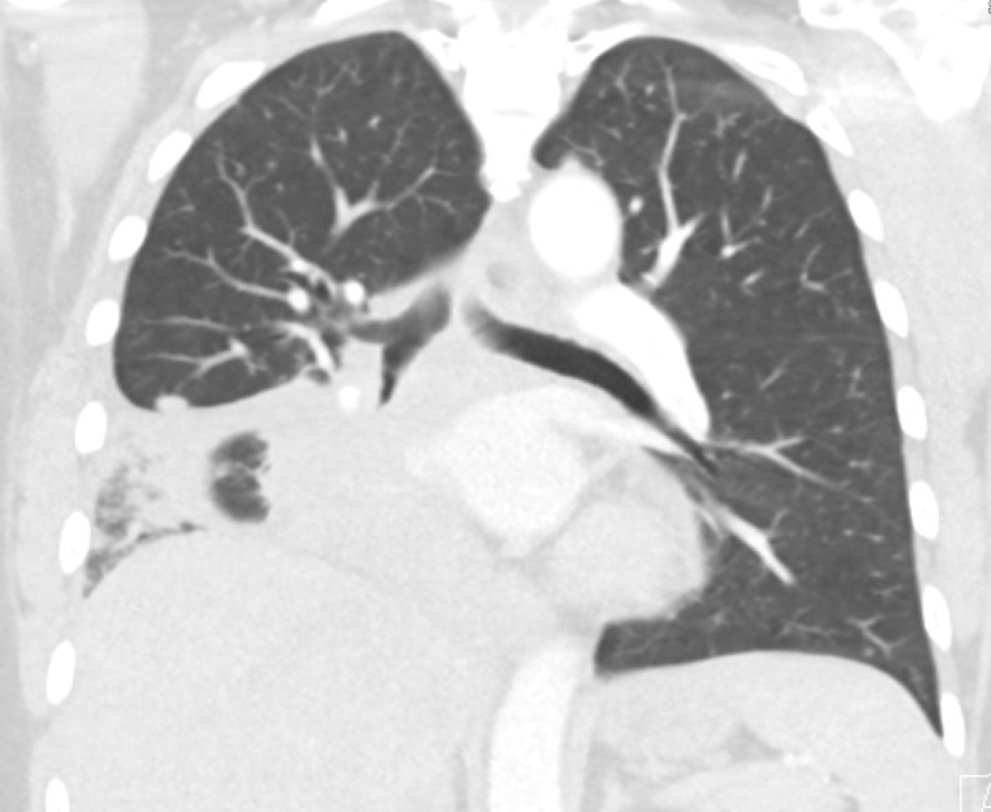
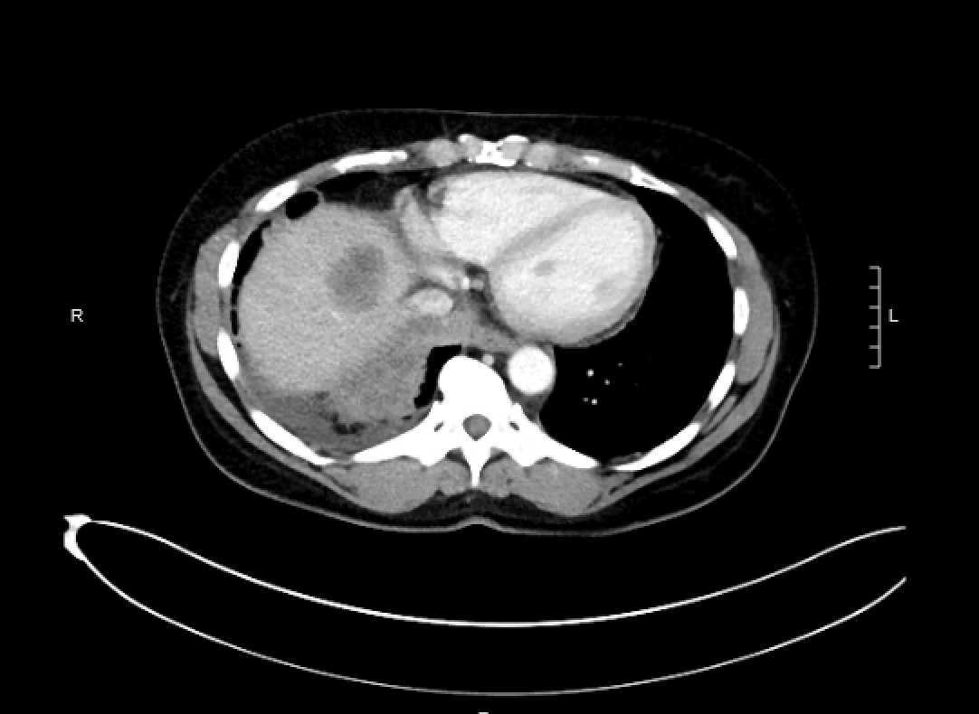
Case 1, Part Two
55yo F with EGFR exon 20 insertion mutant lung adenocarcinoma (PD-L1 0%), RLL mass with lung, lymph and bone mets at diagnosis.
Received first-line carboplatin/pemetrexed chemotherapy, with initial response to treatment.
Progressed after 9 months on Carbo/Pem (4 cycles) followed by pemetrexed maintenance.
Restaging scans show increased RLL mass, new 3cm liver lesion. Brain MRI negative.

Slide 20
Case 1, Part Two
55yo F with EGFR exon 20 insertion mutant lung adenocarcinoma (PD-L1 0%), RLL mass with lung, lymph and bone mets at diagnosis.
Received first-line carboplatin/pemetrexed chemotherapy, with initial response to treatment.
Progressed after 9 months on Carbo/Pem (4 cycles) followed by pemetrexed maintenance.
Restaging scans show increased RLL mass, new 3cm liver lesion. Brain MRI negative.
What treatment options should be considered?

Slide 21
Case 1, Part Two
55yo F with EGFR exon 20 insertion mutant lung adenocarcinoma (PD-L1 0%), RLL mass with lung, lymph and bone mets at diagnosis.
Progressed after 9 months on Carbo/Pem (4 cycles) followed by pemetrexed maintenance.
Enrolled in a second-line mobocertinib (TAK-788) clinical trial.
She had a partial response to mobocertinib and grade 2 rash and diarrhea.
Developed CNS and systemic (liver, lung) progression after 8 months on mobocertinib.

Slide 22
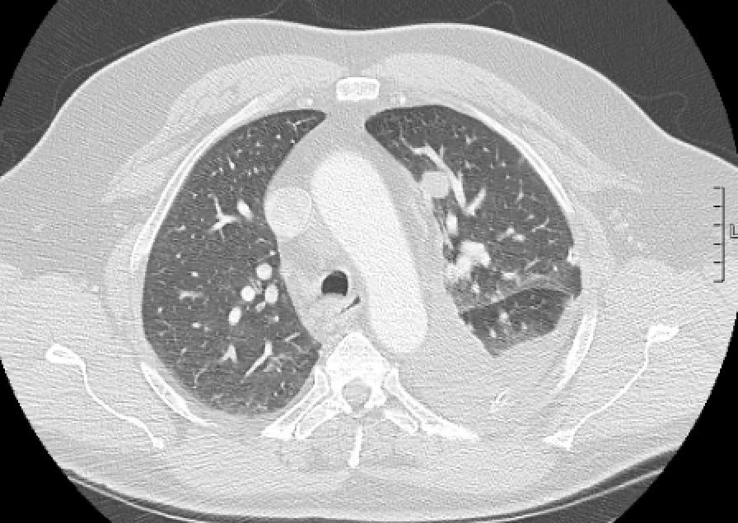
Case 2
67yo former smoker (20py, quit 10 yrs ago) with HTN, HLD presented with dyspnea.
CXR showed a large left pleural effusion.
Chest CT showed 1.8cm LUL mass with extensive pleural nodularity and left pleural effusion.
L thoracentesis cytology – adenocarcinoma
PD-L1 60%
NGS- EGFR exon 20 insertion (Pro772_His773dup)

Slide 23
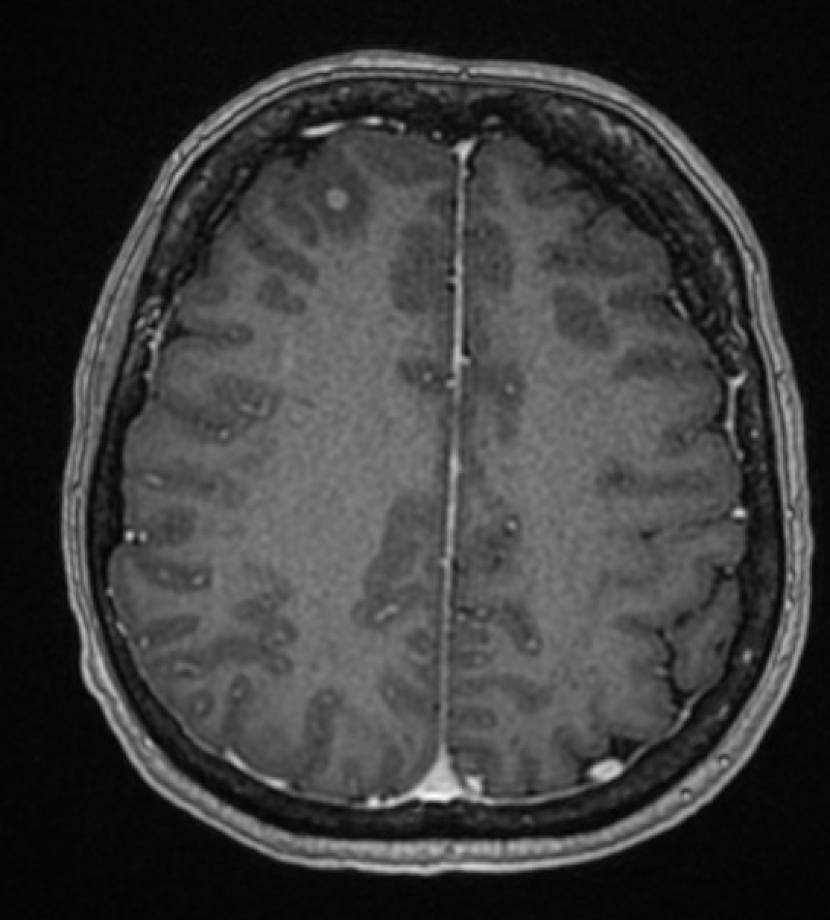
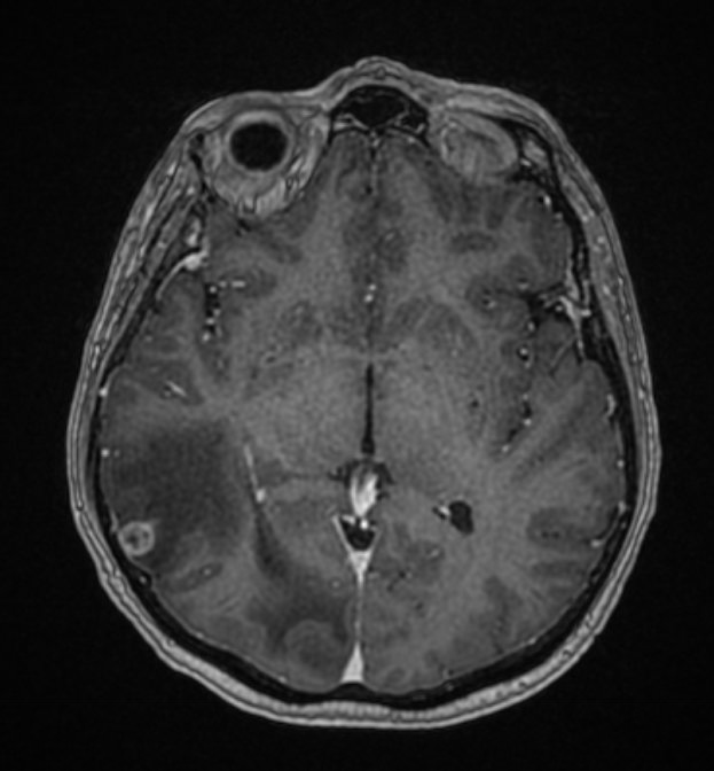
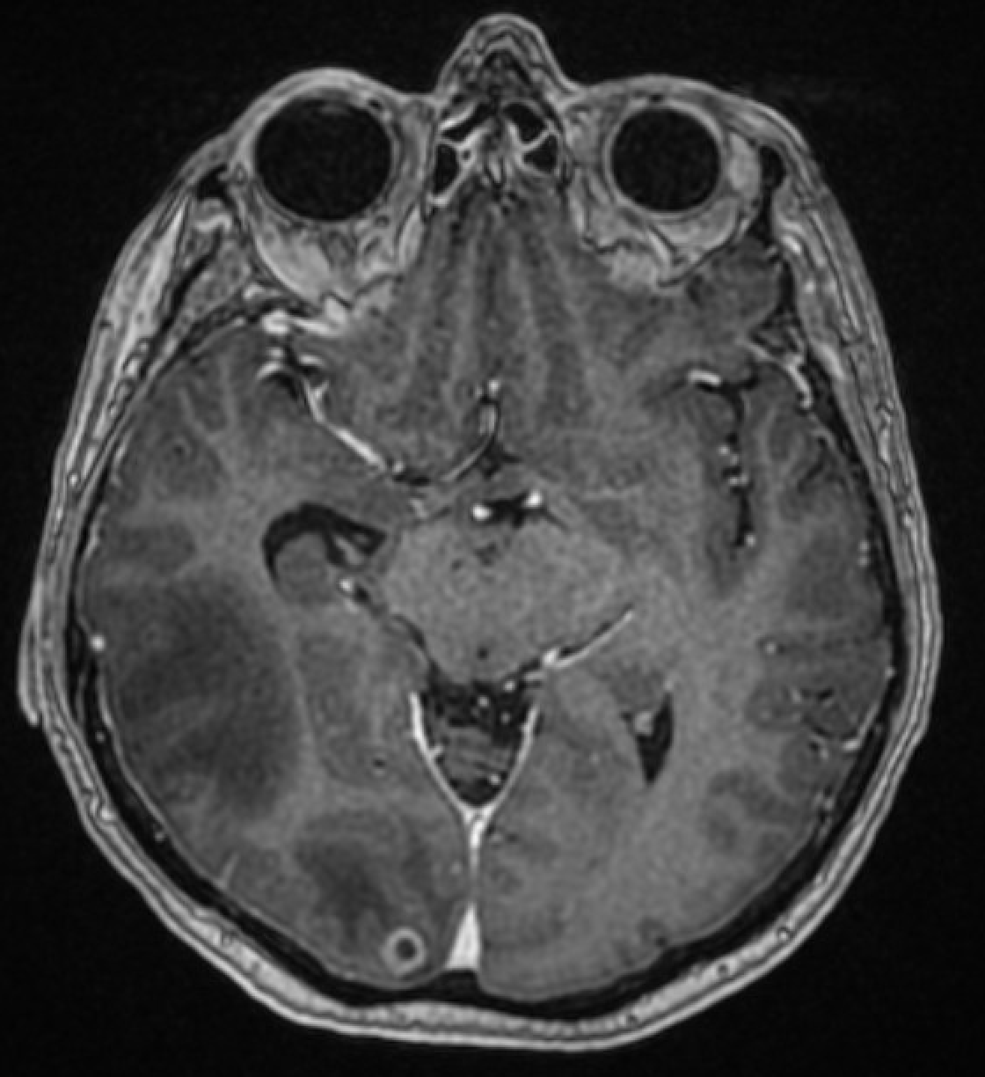
Case 2
The patient received first-line Carbo/Pemetrexed but progressed after 6 months with increased pleural effusion.
He enrolled on a clinical trial of amivantamab as second-line therapy.
He had stable disease for seven months on amivantamab.
Treatment was complicated by grade 1 infusion reaction with first treatment (no recurrence), grade 1-2 rash.
Upon progression on amivantamab, he developed new liver and brain metastases.
What treatment options should be considered?

