Slide 1
Meet The Professor Current and Future Role of Immunotherapy in the Management of Lung Cancer
Stephen V Liu, MD
Associate Professor of Medicine
Georgetown University Hospital
Washington, DC

Slide 2
Commercial Support
This activity is supported by educational grants from Eisai Inc, Genentech, a member of the Roche Group, and Regeneron Pharmaceuticals Inc and Sanofi Genzyme.

Slide 3
Dr Love — Disclosures
Dr Love is president and CEO of Research To Practice. Research To Practice receives funds in the form of educational grants to develop CME activities from the following companies: AbbVie Inc, Adaptive Biotechnologies Corporation, ADC Therapeutics, Agios Pharmaceuticals Inc, Alexion Pharmaceuticals, Amgen Inc, Array BioPharma Inc, a subsidiary of Pfizer Inc, Astellas, AstraZeneca Pharmaceuticals LP, Aveo Pharmaceuticals, Bayer HealthCare Pharmaceuticals, BeiGene Ltd, BeyondSpring Pharmaceuticals Inc, Blueprint Medicines, Boehringer Ingelheim Pharmaceuticals Inc, Bristol-Myers Squibb Company, Celgene Corporation, Clovis Oncology, Coherus BioSciences, Daiichi Sankyo Inc, Eisai Inc, Epizyme Inc, Exact Sciences Inc, Exelixis Inc, Five Prime Therapeutics Inc, Foundation Medicine, G1 Therapeutics Inc, Genentech, a member of the Roche Group, Genmab, Gilead Sciences Inc, GlaxoSmithKline, Grail Inc, Halozyme Inc, Helsinn Healthcare SA, ImmunoGen Inc, Incyte Corporation, Ipsen Biopharmaceuticals Inc, Janssen Biotech Inc, administered by Janssen Scientific Affairs LLC, Jazz Pharmaceuticals Inc, Karyopharm Therapeutics, Kite, A Gilead Company, Lilly, Loxo Oncology Inc, a wholly owned subsidiary of Eli Lilly & Company, Merck, Natera Inc, Novartis, Novocure Inc, Oncopeptides, Pfizer Inc, Pharmacyclics LLC, an AbbVie Company, Puma Biotechnology Inc, Regeneron Pharmaceuticals Inc, Sanofi Genzyme, Seagen Inc, Servier Pharmaceuticals LLC, Sumitomo Dainippon Pharma Oncology Inc, Taiho Oncology Inc, Takeda Pharmaceuticals USA Inc, Tesaro, A GSK Company, TG Therapeutics Inc, Turning Point Therapeutics Inc and Verastem Inc.

Slide 4
Research To Practice CME Planning Committee Members, Staff and Reviewers
Planners, scientific staff and independent reviewers for Research To Practice have no relevant conflicts of interest to disclose.

Slide 5
Dr Liu — Disclosures
Advisory Committee | Amgen Inc, AstraZeneca Pharmaceuticals LP, Bayer HealthCare Pharmaceuticals, BeiGene Ltd, Blueprint Medicines, Bristol-Myers Squibb Company, Daiichi Sankyo Inc, Eisai Inc, Elevation Oncology, Genentech, a member of the Roche Group, Guardant Health, Janssen Biotech Inc, Jazz Pharmaceuticals Inc, Lilly, Novartis, Regeneron Pharmaceuticals Inc, Sanofi Genzyme, Takeda Pharmaceuticals USA Inc, Turning Point Therapeutics Inc
Consulting Agreements | BeiGene Ltd, Blueprint Medicines, Daiichi Sankyo Inc, Elevation Oncology, Genentech, a member of the Roche Group, Janssen Biotech Inc, Lilly, Turning Point Therapeutics Inc
Contracted Research | Alkermes, Bayer HealthCare Pharmaceuticals, Blueprint Medicines, Bristol-Myers Squibb Company, Elevation Oncology, Genentech, a member of the Roche Group, Lilly, Merck, Merus BV, Pfizer Inc, Rain Therapeutics, RAPT Therapeutics, Turning Point Therapeutics Inc
Data and Safety Monitoring Board/Committee | Candel Therapeutics

Slide 6
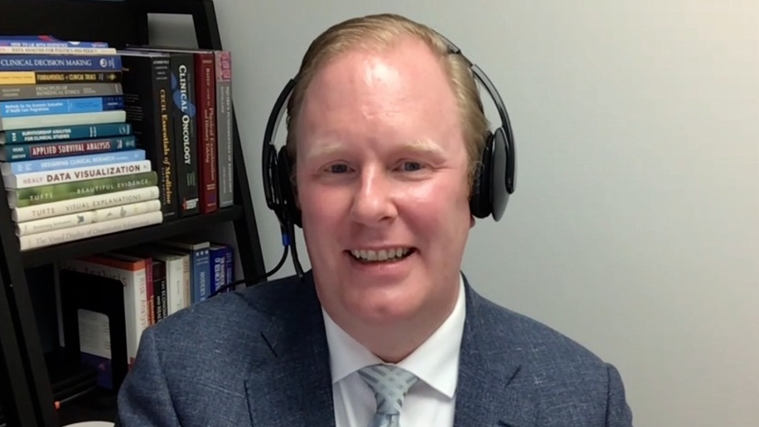
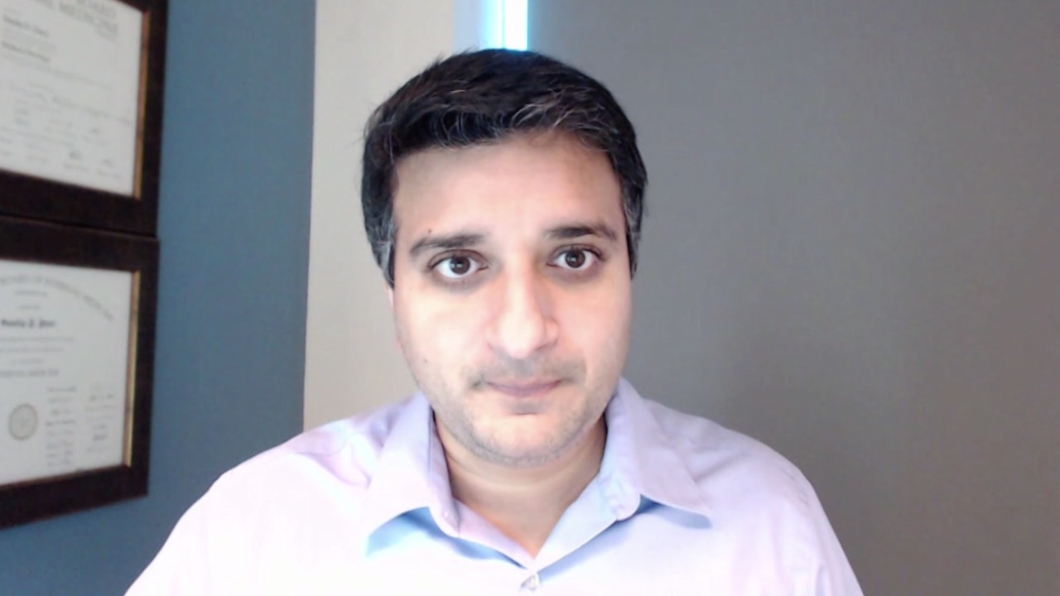
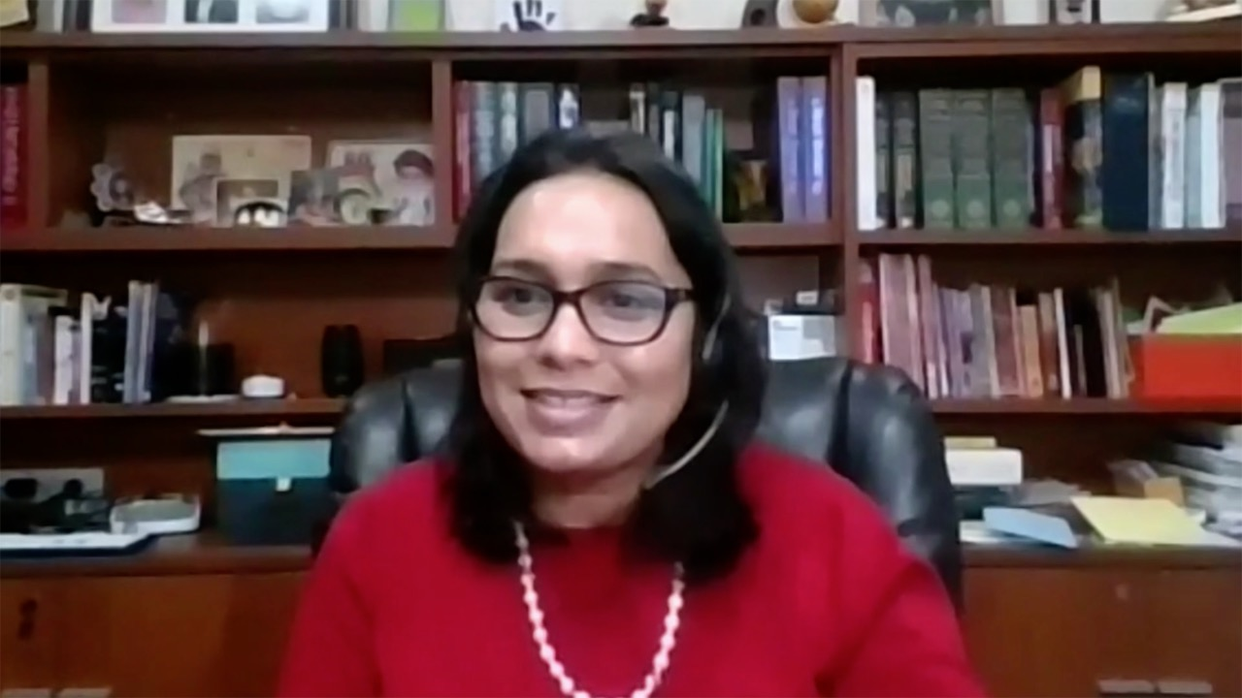
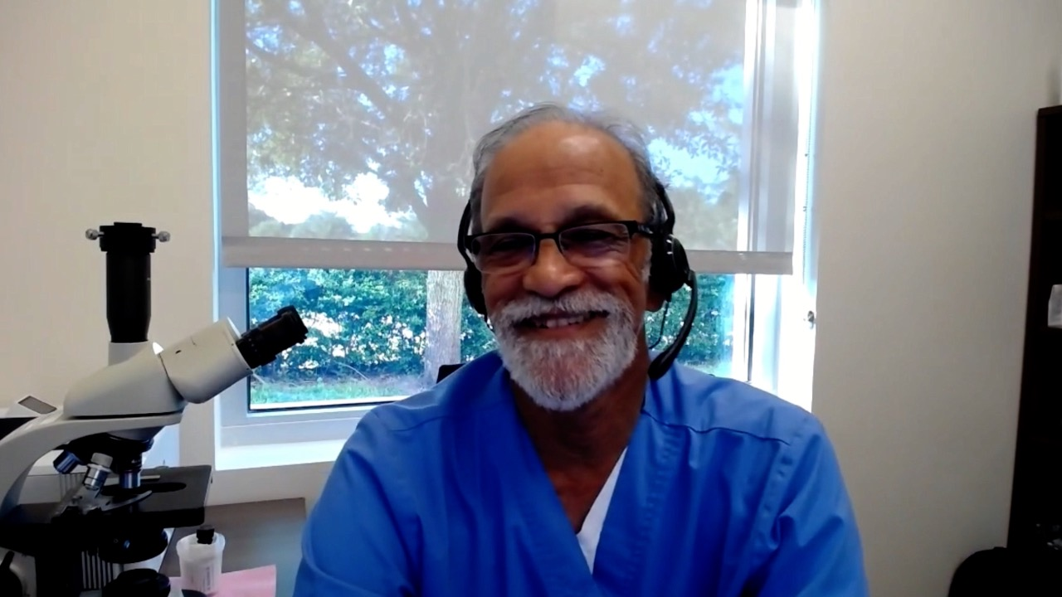
Matthew Gubens, MD, MS
University of California, San Francisco
San Francisco, California
Sandip Patel, MD
San Diego Center for Precision Immunotherapy
San Diego, California
Ranju Gupta, MD
Hematology Oncology Associates
Lehigh Valley Health Network
Bethlehem, Pennsylvania
Raji Shameem, MD
Florida Cancer Specialists and Research Institute
Deland, Florida
Kapisthalam (KS) Kumar, MD
Florida Cancer Specialists and Research Institute
New Port Richey, Florida

Slide 7
Meet The Professor with Dr Liu
MODULE 1: Adjuvant and Neoadjuvant Immunotherapy in Non-Small Cell Lung Cancer (NSCLC)
MODULE 2: Case Presentations
Dr Patel: A 57-year-old man with metastatic NSCLC and no actionable mutations
Dr Shameem: A 66-year-old woman with newly diagnosed adenocarcinoma of the lung — PD-L1 65%
Dr Kumar: A 70-year-old man with localized NSCLC and no actionable mutations — PD-L1 90%
Dr Gupta: A 60-year-old woman with extensive-stage small cell lung cancer
Dr Gubens: A 72-year-old woman with Stage IIIB adenocarcinoma of the lung and an EGFR L858R tumor mutation — PD-L1 40%
MODULE 3: Thoughts for the Future
MODULE 4: Journal Club with Dr Liu
MODULE 5: Appendix – Key Data Sets

Slide 8
Meet The Professor with Dr Liu
MODULE 1: Adjuvant and Neoadjuvant Immunotherapy in Non-Small Cell Lung Cancer (NSCLC)
MODULE 2: Case Presentations
Dr Patel: A 57-year-old man with metastatic NSCLC and no actionable mutations
Dr Shameem: A 66-year-old woman with newly diagnosed adenocarcinoma of the lung — PD-L1 65%
Dr Kumar: A 70-year-old man with localized NSCLC and no actionable mutations — PD-L1 90%
Dr Gupta: A 60-year-old woman with extensive-stage small cell lung cancer
Dr Gubens: A 72-year-old woman with Stage IIIB adenocarcinoma of the lung and an EGFR L858R tumor mutation — PD-L1 40%
MODULE 3: Thoughts for the Future
MODULE 4: Journal Club with Dr Liu
MODULE 5: Appendix – Key Data Sets

Slide 9
Recent Advances in Adjuvant Systemic Treatment of Solid Tumors
Disease | Agent or regimen
NSCLC | Atezolizumab (10-15-21) | Osimertinib (12-18-20) | Durvalumab (2-16-18) |  | Nivolumab/chemotherapy*
Breast | Abemaciclib (10-13-21) | Olaparib | Pembrolizumab (7-26-21) |  | T-DM1 (5-3-19)
Upper GI | Nivolumab (5-20-21)
RCC | Pembrolizumab (11-17-21)
Bladder | Nivolumab (8-19-21) | Pembrolizumab† (1-8-2020)
Ovarian | Olaparib/bevacizumab (5-8-20) | Niraparib (4-29-20) | Olaparib/Bevacizumab (5-8-20) | Olaparib (12-19-18)
Melanoma | Dabrafenib/trametinib (4-30-18) | Pembrolizumab (2-15-19) | Dabrafenib/Trametinib (4-30-18) | Nivolumab (12-20-17)
Prostate | Abiraterone (+ LHRH agonist)
* Neoadjuvant therapy
† Indicated for patients with non-muscle-invasive bladder cancer who are not eligible for cystectomy but who may have undergone TURBT

Slide 10
FDA Approves Atezolizumab as Adjuvant Treatment for NSCLC Press Release: October 15, 2021
“The Food and Drug Administration approved atezolizumab for adjuvant treatment following resection and platinum-based chemotherapy in patients with stage II to IIIA non-small cell lung cancer (NSCLC) whose tumors have PD-L1 expression on ≥ 1% of tumor cells, as determined by an FDA-approved test.
Today, the FDA also approved the VENTANA PD-L1 (SP263) Assay (Ventana Medical Systems, Inc.) as a companion diagnostic device to select patients with NSCLC for adjuvant treatment with atezolizumab.
The major efficacy outcome measure was disease-free survival (DFS) as assessed by the investigator in the primary efficacy analysis population (n=476) of patients with stage II-IIIA NSCLC with PD-L1 expression on ≥1% of tumor cells (PD-L1 ≥1% TC). Median DFS was not reached (95% CI: 36.1, NE) in patients on the atezolizumab arm compared with 35.3 months (95% CI: 29.0, NE) on the BSC arm (HR 0.66; 95% CI: 0.50, 0.88; p=0.004).”
https://www.fda.gov/drugs/resources-information-approved-drugs/fda-approves-atezolizumab-adjuvant-treatment-non-small-cell-lung-cancer

Slide 11
IMpower010: A Phase III Trial of Adjuvant Atezolizumab After Chemotherapy for Resected Stage IB-IIIA NSCLC
Wakelee HA et al. ASCO 2021;Abstract 8500.

Slide 12
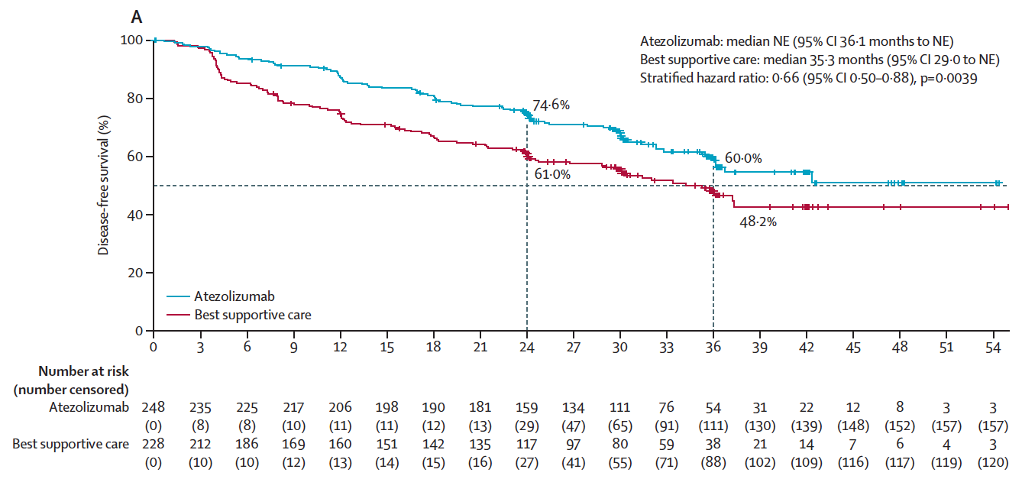
IMpower010 Primary Endpoint: Disease-Free Survival in the PD-L1 ≥1% Tumor Cells Stage II-IIIA Population
Felip E et al. Lancet 2021;398(10308):1344-57.

Slide 13
IMpower010: Efficacy Summary
 | Atezolizumab | BSC | HR (p-value)
TC PD-L1 ≥1%, Stage II-IIIA (n = 248, 228) Median disease-free survival (DFS) 2-year DFS rate 3-year DFS rate | Not estimable 75% 60% | 35.3 mo 61% 48% | 0.66 (0.0039) - -
All randomized Stage II-IIIA (n = 442, 440) Median DFS 2-year DFS rate 3-year DFS rate | 42.3 mo 70% 56% | 35.3 mo 62% 50% | 0.79 (0.020) - -
ITT population (n = 507, 598) Median DFS 2-year DFS rate 3-year DFS rate | Not estimable 71% 58% | 37 mo 64% 53% | 0.81 (0.040) - -
BSC = best supportive care; TC = tumor cells
Overall survival data in the ITT population were immature and not formally tested.
Felip E et al. Lancet 2021;398(10308):1344-57.

Slide 14
Adapted from Wakelee H et al. ASCO 2021;Abstract 8500
Chaft JE. IASLC 2021;Abstract PL05.04

Slide 15
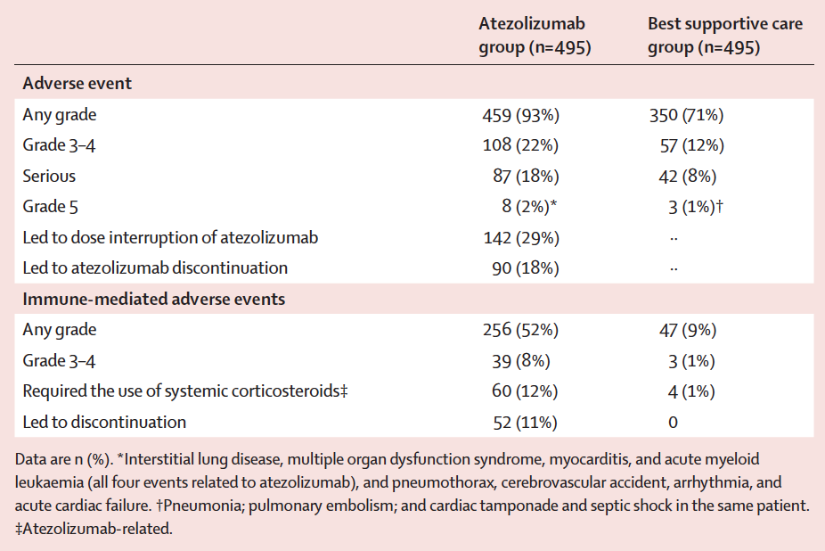
IMpower010: Safety Summary
Felip E et al. Lancet 2021;398(10308):1344-57.

Slide 16
CheckMate 816 Met a Primary Endpoint of Improved Event-Free Survival with Neoadjuvant Nivolumab in Combination with Chemotherapy Press Release: November 8, 2021
“The Phase 3 CheckMate-816 trial met the primary endpoint of improved event-free survival (EFS) in patients with resectable stage IB to IIIA non-small cell lung cancer (NSCLC). In a prespecified interim analysis, nivolumab plus chemotherapy showed a statistically significant and clinically meaningful improvement in EFS compared to chemotherapy alone when given before surgery. This combination previously showed a significant improvement of pathologic complete response (pCR), the trial’s other primary endpoint. The safety profile of nivolumab plus chemotherapy was consistent with previously reported studies in NSCLC. CheckMate-816 is the first Phase 3 trial with an immunotherapy-based combination to demonstrate a statistically significant and clinically meaningful benefit as a neoadjuvant treatment for patients with non-metastatic non-small cell lung cancer.”
https://news.bms.com/news/details/2021/Neoadjuvant-Opdivo-nivolumab-Plus-Chemotherapy-Significantly-Improves-Event-Free-Survival-in-Patients-with-Resectable-Non-Small-Cell-Lung-Cancer-in-Phase-3-CheckMate--816-Trial/default.aspx

Slide 17
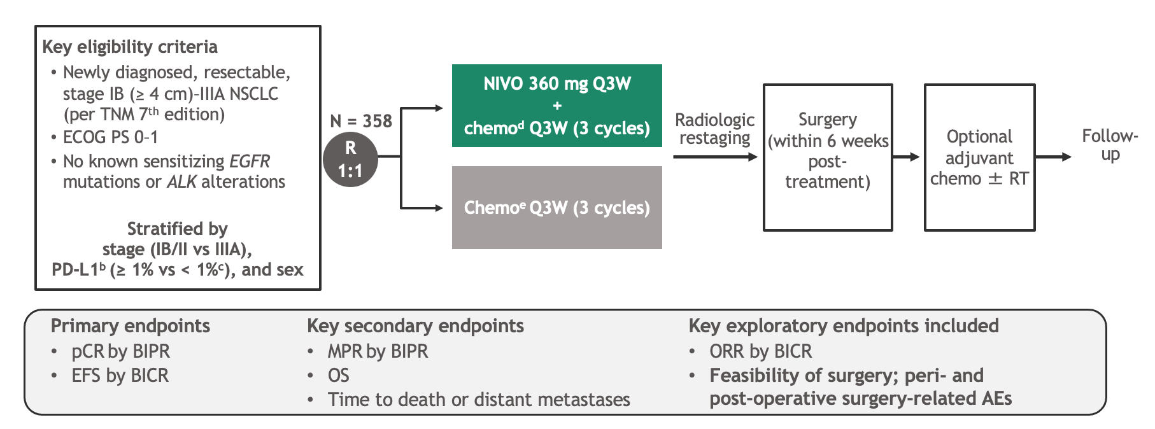
CheckMate 816: A Phase III Trial of Neoadjuvant Nivolumab with Chemotherapy for Newly Diagnosed, Resectable, Stage IB-IIIA NSCLC
Spicer J et al. ASCO 2021;Abstract 8503.

Slide 18
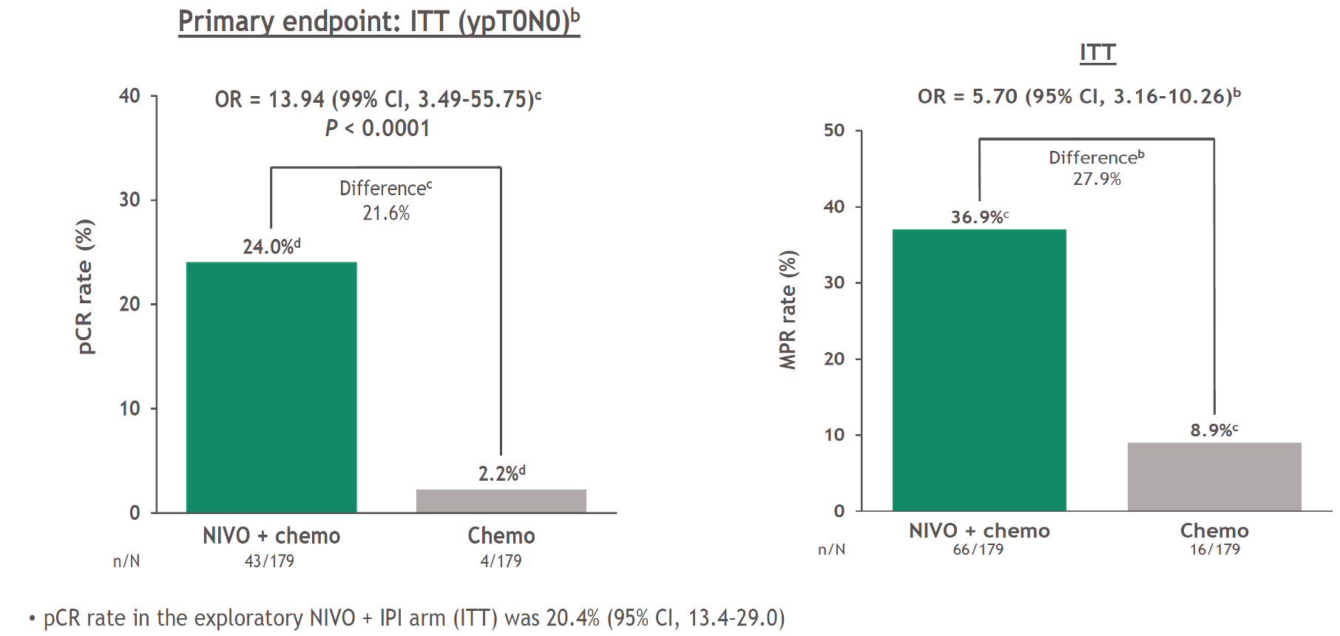
CheckMate 816 Coprimary Endpoint: Pathologic Complete Response (pCR)
Forde PM et al. AACR 2021;Abstract CT003.

Slide 19
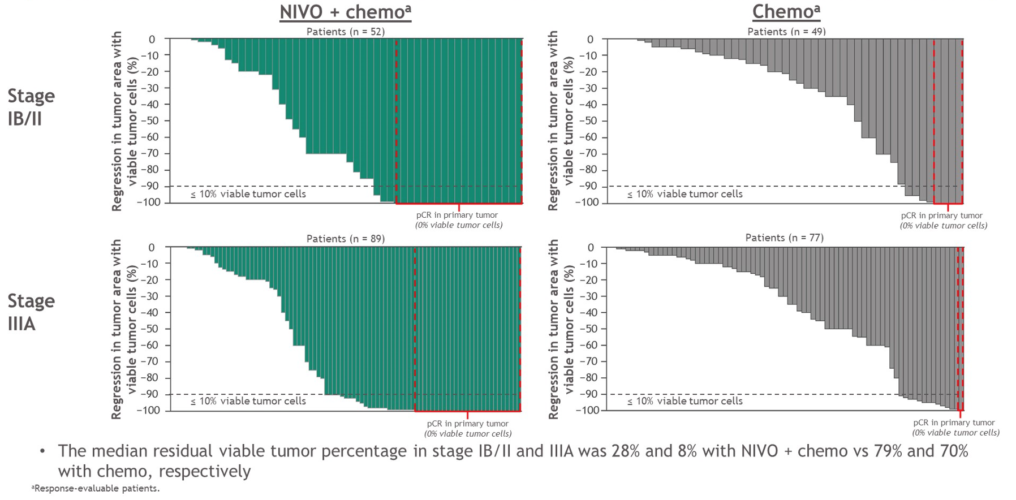
CheckMate 816: Depth of Pathologic Regression in Primary Tumor by Stage
Spicer J et al. ASCO 2021;Abstract 8503.

Slide 20
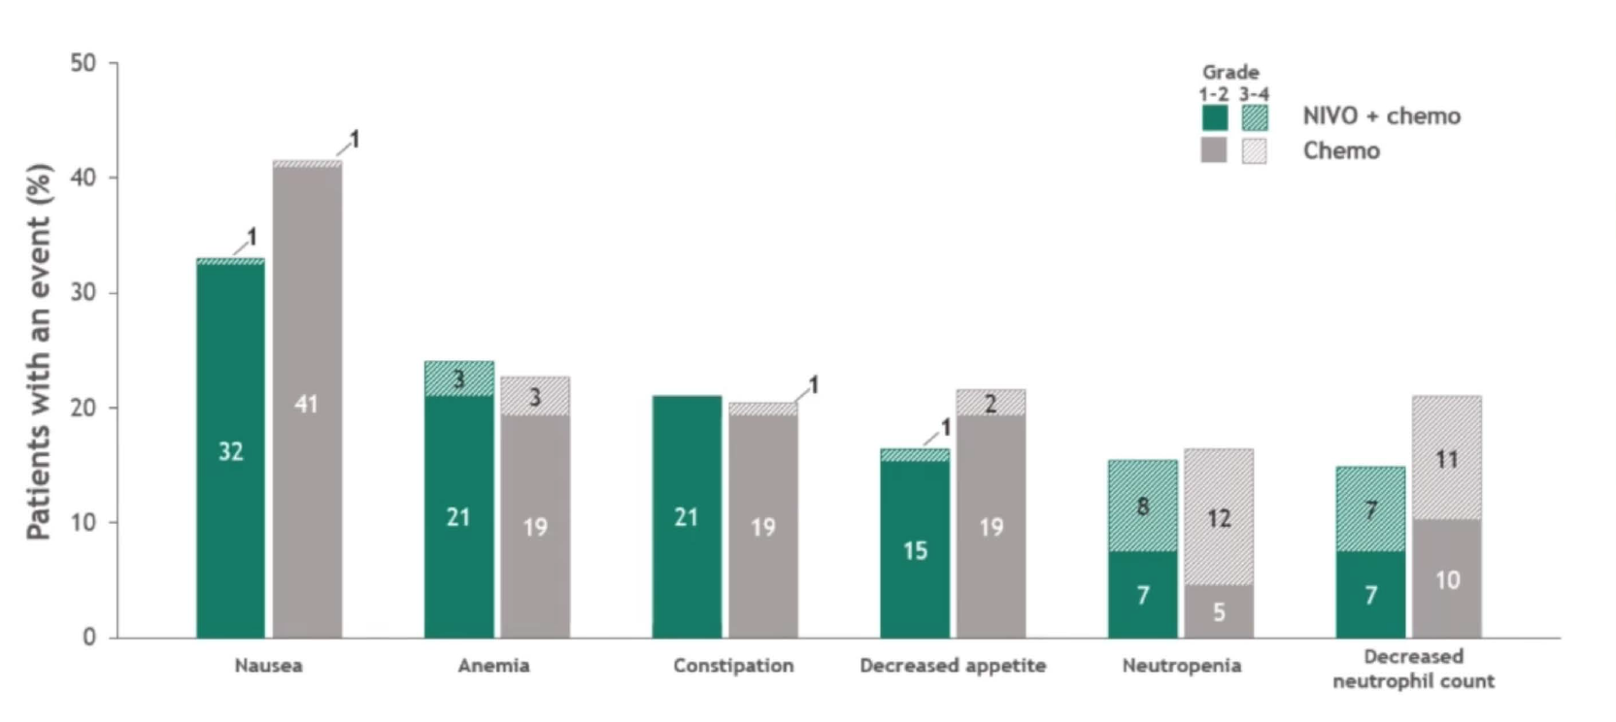
CheckMate 816: Treatment-Related Adverse Events in ≥15% of Patients
Forde PM et al. AACR 2021;Abstract CT003.

Slide 21
In general, what would you estimate to be the 5-year risk of disease recurrence for an otherwise healthy 65-year-old patient with NSCLC and PD-L1 TPS = 50% in each of the following scenarios?
Disease stage | No adjuvant treatment | Adjuvant chemotherapy | Adjuvant chemotherapy + anti-PD-1/PD-L1 antibody | Treatment
IB | 25% | 25% | 20% | None
IIA | 35% | 30% | 20% | Cisplatin/pemetrexed → atezolizumab
IIB | 50% | 45% | 20% | Cisplatin/pemetrexed → atezolizumab
IIIA | 60% | 55% | 30% | Cisplatin/pemetrexed → atezolizumab
TPS = tumor proportion score
Faculty Survey November 2021

Slide 22
How long have you been in oncology practice (after fellowship)?
Less than 5 years
5-10 years
11-20 years
21-30 years
31-40 years
41-50 years
More than 50 years
N = 36
Survey of live webinar audience

Slide 23
If you were a patient with Stage IB non-small cell lung cancer with a PD-L1 TPS of 50% and cost were not an issue, what would be your preference?
Chemotherapy
Chemotherapy → atezolizumab
Atezolizumab
No systemic treatment
Other
N = 34
Survey of live webinar audience

Slide 24
In what situations, if any, are you currently recommending neoadjuvant chemotherapy (with or without an anti-PD-1/PD-L1 antibody) for your patients with non-small cell lung cancer (NSCLC)?
“Resectable N2+ NSCLC”
Faculty Survey November 2021

Slide 25
Based on available data and your clinical experience, does neoadjuvant immunotherapy (alone or with chemotherapy) increase the risk of surgical complications in patients with NSCLC?
1. Yes
2. No
3. I’m not sure
4. It is too early to tell
Faculty Survey November 2021

Slide 26
Meet The Professor with Dr Liu
MODULE 1: Adjuvant and Neoadjuvant Immunotherapy in Non-Small Cell Lung Cancer (NSCLC)
MODULE 2: Case Presentations
Dr Patel: A 57-year-old man with metastatic NSCLC and no actionable mutations
Dr Shameem: A 66-year-old woman with newly diagnosed adenocarcinoma of the lung — PD-L1 65%
Dr Kumar: A 70-year-old man with localized NSCLC and no actionable mutations — PD-L1 90%
Dr Gupta: A 60-year-old woman with extensive-stage small cell lung cancer
Dr Gubens: A 72-year-old woman with Stage IIIB adenocarcinoma of the lung and an EGFR L858R tumor mutation — PD-L1 40%
MODULE 3: Thoughts for the Future
MODULE 4: Journal Club with Dr Liu
MODULE 5: Appendix – Key Data Sets

Slide 27
Case Presentation – Dr Patel: A 57-year-old man with metastatic NSCLC and no actionable mutations
Dr Sandip Patel
Diagnosed with metastatic NSCLC
On baseline O² due to COPD
Chemoimmunotherapy initiated with decrease in oxygen requirement and improvement in lean muscle mass within 6 weeks
CT: Nearly 50% increase in size of multiple mediastinal lymph nodes in the chest
Therapy continued with patient monitoring for 6 to 8 weeks
Follow-up CT: 50% decrease of multiple mediastinal lymph nodes

Slide 28
Which first-line treatment regimen would you recommend for a 65-year-old patient with metastatic nonsquamous lung cancer, no identified targetable mutations and a PD-L1 TPS of 0%?
1. Chemotherapy
2. Chemotherapy + bevacizumab
3. Pembrolizumab
4. Atezolizumab
5. Cemiplimab
6. Carboplatin/pemetrexed/pembrolizumab
7. Atezolizumab/carboplatin/nab paclitaxel
8. Atezolizumab/carboplatin/paclitaxel/bevacizumab
9. Ipilimumab/nivolumab
10. Ipilimumab/nivolumab + chemotherapy
11. Other
Faculty Survey November 2021

Slide 29
Which first-line treatment regimen would you recommend for a 65-year-old patient with metastatic squamous lung cancer, no identified targetable mutations and a PD-L1 TPS of 0%?
1. Chemotherapy
2. Pembrolizumab
3. Atezolizumab
4. Cemiplimab
5. Carboplatin/paclitaxel/pembrolizumab
6. Carboplatin/nab paclitaxel/pembrolizumab
7. Ipilimumab/nivolumab
8. Ipilimumab/nivolumab + chemotherapy
9. Other
Faculty Survey November 2021

Slide 30
Which first-line treatment regimen would you recommend for a 65-year-old patient with metastatic squamous lung cancer, no identified targetable mutations and a PD-L1 TPS of 10%?
1. Chemotherapy
2. Pembrolizumab
3. Atezolizumab
4. Cemiplimab
5. Carboplatin/paclitaxel/pembrolizumab
6. Carboplatin/nab paclitaxel/pembrolizumab
7. Ipilimumab/nivolumab
8. Ipilimumab/nivolumab + chemotherapy
9. Other
Faculty Survey November 2021

Slide 31
Case Presentation – Dr Shameem: A 66-year-old woman with newly diagnosed adenocarcinoma of the lung – PD-L1 65%
Dr Raji Shameem
Never smoker presents with progressive shortness of breath
Chest CT: Right hilar lung mass extending into the mediastinal subcarinal space, large right pleural effusion
CT guided biopsy: Adenocarcinoma, PD-L1 65%
Carboplatin/pemetrexed/pembrolizumab with pembrolizumab held after cycle 1
Liquid and tumor tissue NGS testing ordered
Liquid NGS: NTRK mutation
Tumor tissue: Notable for PD-L1 65%, NTRK fusion reported to be negative
Chemotherapy plus pembrolizumab continued, patient faring well
Questions
Which NTRK inhibitor would the faculty typically use, entrectinib or larotrectinib? Do any data indicate that one would have better CNS activity?

Slide 32
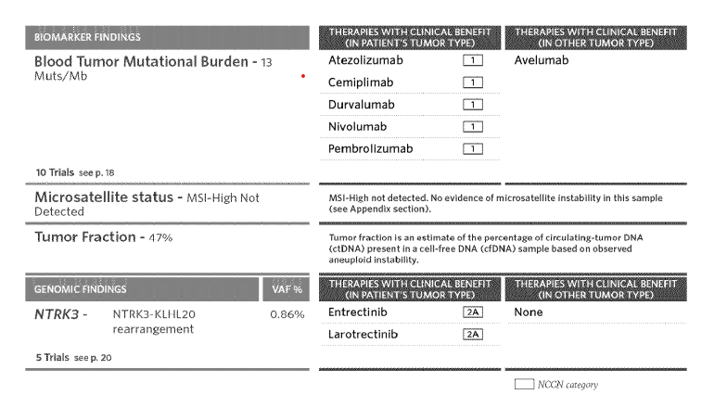
Case Presentation – Dr Shameem: A 66-year-old woman with newly diagnosed adenocarcinoma of the lung – PD-L1 65% (continued)
Dr Raji Shameem
Liquid NGS results

Slide 33
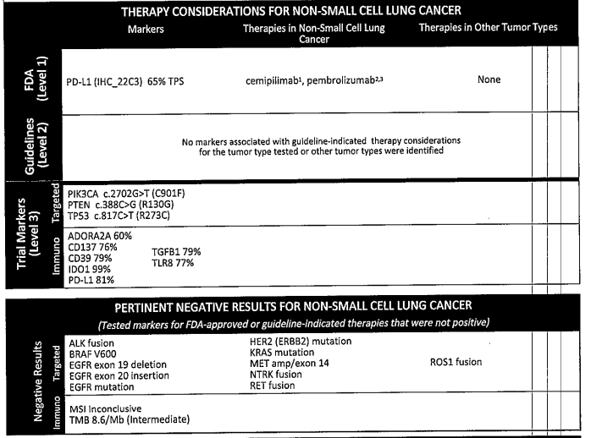
Case Presentation – Dr Shameem: A 66-year-old woman with newly diagnosed adenocarcinoma of the lung – PD-L1 65% (continued)
Tumor tissue NGS results
Dr Raji Shameem

Slide 34
Case Presentation – Dr Kumar: A 70-year-old man with localized NSCLC and no actionable mutations – PD-L1 90%
Dr KS Kumar
Clinically unresectable, received neoadjuvant cisplatin/pemetrexed with good response
Underwent surgical resection
All nodes negative, residual tumor was 0.6 cm
NGS: No actionable mutations, PD-L1 = 90%
Questions
Would the faculty consider this patient to be a candidate for anti-PD-L1 therapy?
If you had seen the patient initially, would you have considered neoadjuvant anti-PD-1/PD-L1 therapy?

Slide 35
Case Presentation – Dr Gupta: A 60-year-old woman with extensive-stage small cell lung cancer
Dr Ranju Gupta
August 2020: Diagnosed with extensive stage small cell lung cancer, symptomatic with mediastinal adenopathy
Cisplatin/etoposide/atezolizumab x 4 → atezolizumab maintenance
Questions
What second-line treatment options are available for this patient when her disease progresses?
Would there still be a role for prophylactic cranial radiation if the patient had stable disease for 6 months or more?

Slide 36
In general, what would be your preferred first-line treatment regimen for a 65-year-old patient with extensive-stage small cell lung cancer (SCLC)?
1. Carboplatin/etoposide
2. Carboplatin/etoposide + trilaciclib
3. Cisplatin/etoposide
4. Cisplatin/etoposide + trilaciclib
5. Carboplatin/etoposide + atezolizumab
6. Carboplatin/etoposide + atezolizumab + trilaciclib
7. Carboplatin/etoposide + durvalumab
8. Carboplatin/etoposide + durvalumab + trilaciclib
9. Cisplatin/etoposide + durvalumab
10. Cisplatin/etoposide + durvalumab + trilaciclib
11. Carboplatin/irinotecan
12. Cisplatin/irinotecan
13. Other
Faculty Survey November 2021

Slide 37
In what situations if any, do you administer trilaciclib to patients with extensive-stage SCLC who are receiving platinum/etoposide- or topotecan-containing regimens to reduce the incidence of chemotherapy-induced myelosuppression?
“I have not used trilaciclib but might consider it if multi-lineage myelosuppression was noted with topotecan.”
Faculty Survey November 2021

Slide 38
The benefits and risks of adding durvalumab to platinum/etoposide and of adding atezolizumab to carboplatin/etoposide are very similar, and from a clinical point of view selecting between the 2 regimens as first-line treatment for a patient with extensive-stage SCLC can be considered a “coin flip.”
1. Agree
2. Disagree
3. I’m not sure
Faculty Survey November 2021

Slide 39
In general, what is your preferred second-line treatment for a patient with extensive-stage SCLC with metastases and disease progression on chemotherapy/atezolizumab?
1. Topotecan or irinotecan
2. Lurbinectedin
3. Nivolumab/ipilimumab
4. Pembrolizumab
5. Nivolumab
6. Other
Faculty Survey November 2021

Slide 40
Case Presentation – Dr Gubens: A 72-year-old woman with Stage IIIB adenocarcinoma of the lung and an EGFR L858R tumor mutation – PD-L1 40%
Dr Matt Gubens
Never smoker presents with progressive cough
RUL mass, 2.4-cm, with R hilar and mediastinal LAD
CT guided biopsy: Adenocarcinoma, PD-L1 40%
NGS: EGFR L858R mutation
Definitive chemoradiation therapy, with good radiographic response
Question
Would you consider consolidation durvalumab in this patient with an EGFR activating mutation?

Slide 41
Case Presentation – Dr Gubens: A 72-year-old woman with Stage IIIB adenocarcinoma of the lung and an EGFR L858R tumor mutation – PD-L1 40% (continued)
Dr Matt Gubens
Never smoker presents with progressive cough
RUL mass, 2.4-cm, with R hilar and mediastinal LAD
CT guided biopsy: Adenocarcinoma, PD-L1 40%
NGS: EGFR L858R mutation
Definitive chemoradiation therapy, with good radiographic response
Discussed PACIFIC data with consolidation durvalumab with patient’s 2 physician daughters
Consolidation durvalumab x 6 months → Abnormal thyroid function tests (TSH: 20, T4: 11)
Initiated levothyroxine 88 mcg and continued durvalumab
One month later: Fasting glucose 317, A1C 7.3 → Immune-related insuline-dependent diabetes
Durvalumab discontinued, but 24 months later no evidence of recurrence

Slide 42
What would you most likely recommend as consolidation treatment for a patient with locally advanced NSCLC who has completed chemoradiation therapy and is found to have an EGFR activating mutation?
1. Durvalumab
2. Osimertinib
3. Durvalumab + osimertinib
4. Durvalumab followed by osimertinib
5. Other
Faculty Survey November 2021

Slide 43
Meet The Professor with Dr Liu
MODULE 1: Adjuvant and Neoadjuvant Immunotherapy in Non-Small Cell Lung Cancer (NSCLC)
MODULE 2: Case Presentations
Dr Patel: A 57-year-old man with metastatic NSCLC and no actionable mutations
Dr Shameem: A 66-year-old woman with newly diagnosed adenocarcinoma of the lung — PD-L1 65%
Dr Kumar: A 70-year-old man with localized NSCLC and no actionable mutations — PD-L1 90%
Dr Gupta: A 60-year-old woman with extensive-stage small cell lung cancer
Dr Gubens: A 72-year-old woman with Stage IIIB adenocarcinoma of the lung and an EGFR L858R tumor mutation — PD-L1 40%
MODULE 3: Thoughts for the Future
MODULE 4: Journal Club with Dr Liu
MODULE 5: Appendix – Key Data Sets

Slide 44
Thoughts for the Future
Choice of immunotherapy regimen
Interval between dosing
Immunotherapy combinations
Anti-PD-1/PD-L1 antibody/tyrosine kinase inhibitor
Immunotherapy/immunotherapy
Other investigational approaches

Slide 45
FDA-Approved Single-Agent Immunotherapy Options for First-Line Therapy
Monotherapy | FDA approval | Pivotal study | Histologic type | HR (OS)
Pembrolizumab^{1,2} (q3wk or q6wk) | 4/11/19 10/24/16 | KEYNOTE-042 KEYNOTE-024 | PD-L1 TPS ≥1% | 0.63
Atezolizumab³ (q2wk, q3wk or q4wk) | 5/18/20 | IMpower110 | PD-L1 TPS ≥50, EGFR and/or ALK wt | 0.59
Cemiplimab⁴ (q3wk) | 2/22/21 | EMPOWER-Lung 1 (Study 1624) | PD-L1 TPS ≥50, EGFR and/or ALK and/or ROS1 wt | 0.57
¹ Mok. Lancet 2019. ² Reck. J Clin Oncol 2019. ³ Herbst. N Engl J Med 2020. ⁴ Sezer. Lancet 2021.

Slide 46
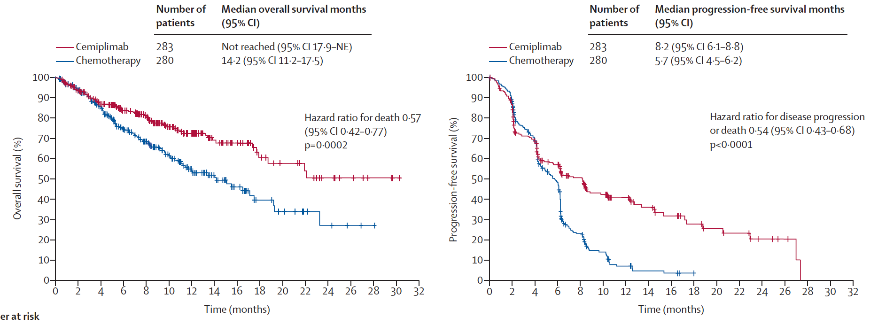
EMPOWER-Lung 1: A Phase III Trial of Cemiplimab Monotherapy for First-Line Treatment of NSCLC with PD-L1 ≥50%
Overall Survival
Progression-Free Survival
Sezer A et al. Lancet 2021;397:592-604.

Slide 47
FDA-Approved Immunotherapy Combination Options for First-Line Therapy
Combination regimen | FDA approval | Pivotal study | Histologic type | HR (OS)
Pembrolizumab (q3wk or q6wk) + Platinum and pemetrexed¹ | 8/20/18 | KEYNOTE-189 | Nonsquamous | 0.56
Pembrolizumab (q3wk or q6wk) + Carboplatin, paclitaxel or nab paclitaxel² | 10/30/18 | KEYNOTE-407 | Squamous | 0.71
Atezolizumab (q3wk) + Carboplatin and paclitaxel and bevacizumab³ | 12/6/18 | IMpower150 | Nonsquamous | 0.80
Atezolizumab (q3wk) + Carboplatin and nab paclitaxel⁴ | 12/3/19 | IMpower130 | Nonsquamous | 0.79
Nivolumab (q2wk) + Ipilimumab⁵ | 5/15/20 | CheckMate 227 | PD-L1 TPS ≥1, EGFR and/or ALK wt | 0.76
Nivolumab (q3wk) + Ipilimumab and chemotherapy⁶ | 5/26/20 | CheckMate 9LA | EGFR and/or ALK wt | 0.72
¹ Rodriguez-Abreu. Ann Oncol 2021. ² Paz-Ares. J Thorac Oncol 2020. ³ Socinski J Thorac Oncol 2021. ⁴ West. Lancet Oncol 2019. ⁵ Paz-Ares. ASCO 2021;Abstract 9016. ⁶ Reck. ASCO 2021;Abstract 9000.

Slide 48
EMPOWER-Lung 3: First-Line Cemiplimab with Platinum-Doublet Chemotherapy for Advanced NSCLC
Gogishvili M et al. ESMO 2021;Abstract LBA51.

Slide 49
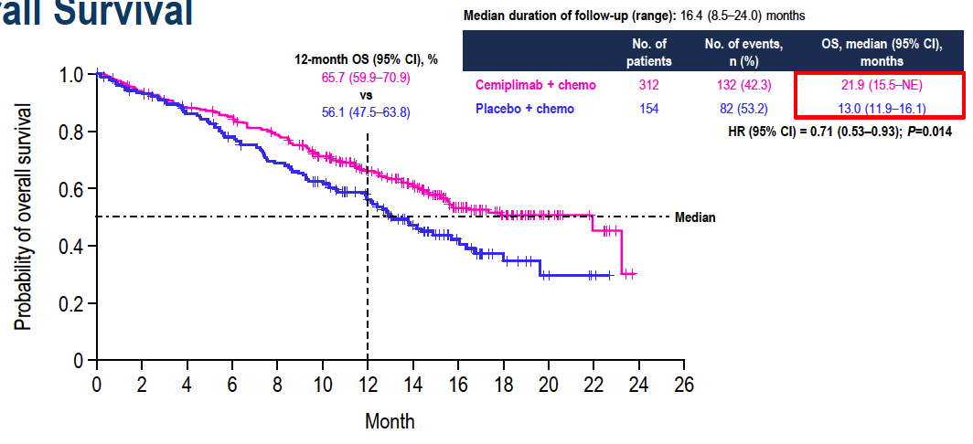
EMPOWER-Lung 3: First-Line Cemiplimab with Platinum-Doublet Chemotherapy for Advanced NSCLC
Gogishvili M et al. ESMO 2021;Abstract LBA51.

Slide 50
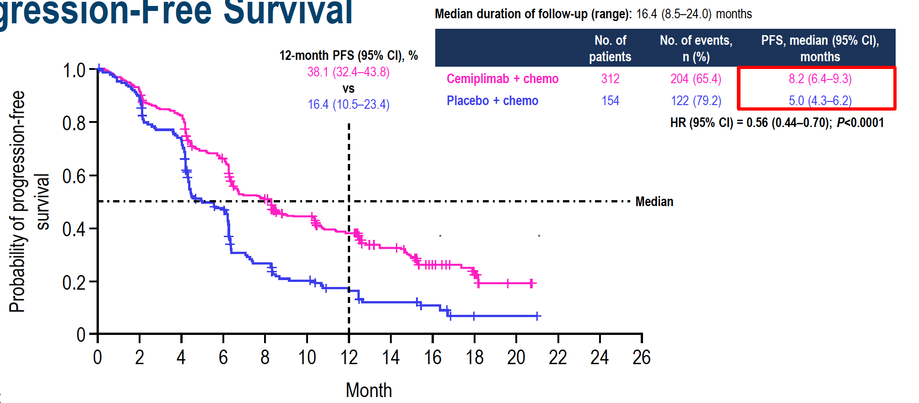
EMPOWER-Lung 3: Progression-Free Survival
Gogishvili M et al. ESMO 2021;Abstract LBA51.

Slide 51
Thoughts for the Future
Choice of immunotherapy regimen
Interval between dosing
Immunotherapy combinations
Anti-PD-1/PD-L1 antibody/tyrosine kinase inhibitor
Immunotherapy/immunotherapy
Other investigational approaches

Slide 52
KEYNOTE-146: Phase IB/II Trial of Lenvatinib/Pembrolizumab in Advanced Solid Cancers
Efficacy in the Metastatic NSCLC Population
N | Line of therapy | ORR | Median DOR | Median PFS
21 | Any | 33% | 10.9 mo | 5.9 mo
DOR = duration of response
Summary of Treatment-Related Adverse Events (TREAs): All Patients
Parameter | (N = 137)
Serious AEs | 26%
TREAs leading to pembrolizumab dose interruption | 45%
TREAs leading to pembrolizumab discontinuation | 15%
TREAs leading to lenvatinib dose reduction and/or interruption | 85%
TREAs leading to lenvatinib discontinuation | 13%
Taylor MH et al. J Clin Oncol 2020;38:154-63.

Slide 53
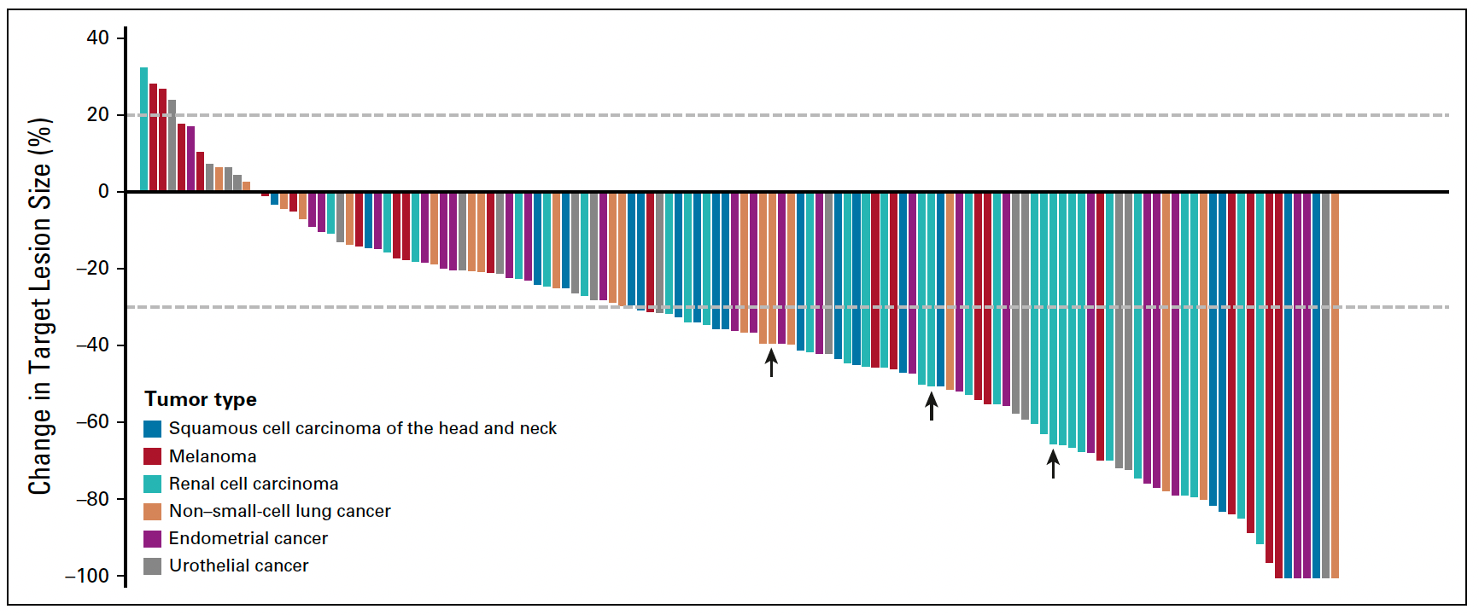
KEYNOTE-146: Maximum Change in Target Lesion Size (All Patients)
Taylor MH et al. J Clin Oncol 2020;38:154-63.

Slide 54
Ongoing LEAP Phase III Trials in NSCLC
Trial ID | N | Patient population | Line of therapy | Treatment
LEAP-006 | 726 | Previously untreated metastatic nonsquamous NSCLC | 1L | Pemetrexed + platinum chemo + Pembrolizumab + lenvatinib Pemetrexed + platinum chemo + pembrolizumab + placebo
LEAP-007 | 620 | Previously untreated, advanced (Stage IV), PD-L1 positive (TPS ≥1%) NSCLC | 1L | Lenvatinib + pembrolizumab Placebo + pembrolizumab
LEAP-008 | 405 | Metastatic NSCLC that progressed during/after platinum doublet chemotherapy or on treatment with anti-PD-1/PD-L1 monoclonal antibody as monotherapy or combination therapy | ≥2L | Lenvatinib + pembrolizumab Standard chemotherapy Lenvatinib
Taylor MH et al. Futur Oncol 2021;17(6):637-47. www.clinicaltrials.gov. NCT03829319, NCT03829332, NCT03976375. Accessed November 2021.

Slide 55
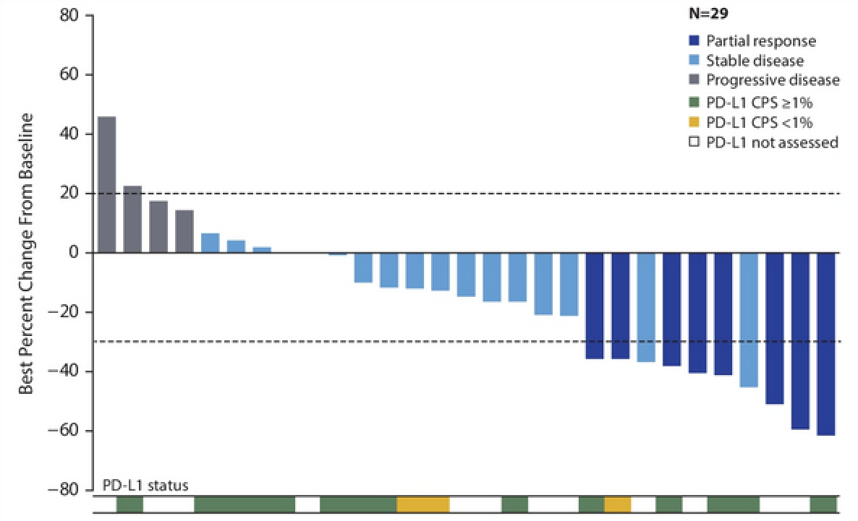
COSMIC-021 (Cohort 7): Best Change from Baseline with Cabozantinib/Atezolizumab for Metastatic NSCLC
Patient population
Radiographic progression on or after 1 prior ICI treatment
≤2 lines of prior systemic anticancer therapy for metastatic NSCLC
No EGFR mutations, ALK or ROS1 rearrangements or BRAF V600E mutation
ORR: 27%
Disease Control Rate: 83%
DOR: 5.7 months
No apparent correlation between responses and PD-L1 status
Neal JW et al. ASCO 2020;Abstract 9610.

Slide 56
COSMIC-021 (Cohort 7): Immune-Related Adverse Events with Cabozantinib/Atezolizumab for Metastatic NSCLC
Neal JW et al. ASCO 2020;Abstract 9610.

Slide 57
Enrollment Complete in Phase III CONTACT-01 Pivotal Trial of Cabozantinib in Combination with an Immune Checkpoint Inhibitor for Previously Treated Metastatic NSCLC Press Release: November 9, 2021
“Enrollment is now completed for CONTACT-01, the global, phase 3 pivotal trial evaluating cabozantinib in combination with atezolizumab in patients with metastatic non-small cell lung cancer (NSCLC) who have been previously treated with an immune checkpoint inhibitor and platinum-containing chemotherapy.
CONTACT-01 is a global, multicenter, randomized, phase 3, open-label study that enrolled 366 patients who were randomized 1:1 to the experimental arm of cabozantinib in combination with atezolizumab and the control arm of docetaxel. The primary endpoint of the trial is overall survival. Secondary endpoints include progression-free survival, objective response rate and duration of response. Results from cohort 7 of the phase 1b COSMIC-021 trial informed the CONTACT-01 trial design.”
https://ir.exelixis.com/news-releases/news-release-details/exelixis-announces-enrollment-completion-phase-3-contact-01

Slide 58
CONTACT-01 Phase III Study Design
Key eligibility
Metastatic NSCLC
PD during or after treatment with platinum-containing chemotherapy and anti-PD-L1/PD-1 antibody (concurrent or sequential)
Atezolizumab + cabozantinib
R
Docetaxel
Primary endpoint: Overall survival
Secondary endpoints: PFS, ORR, DOR, others
www.clinicaltrials.gov. NCT04471428. Accessed November 2021.

Slide 59
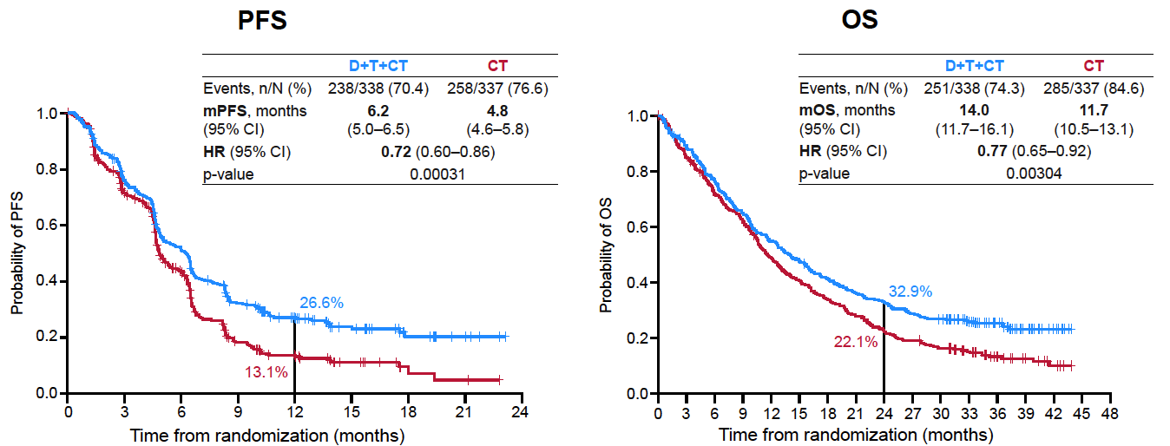
POSEIDON: First-Line Durvalumab with Tremelimumab and Chemotherapy for Advanced NSCLC
Johnson ML et al. WCLC 2021;Abstract PL02.01

Slide 60
Rodriguez-Abreu D et al. ASCO 2020;Abstract 9503.

Slide 61
Rodriguez-Abreu D et al. ASCO 2020;Abstract 9503.

Slide 62
Rodriguez-Abreu D et al. ASCO 2020;Abstract 9503.

Slide 63
CITYSCAPE
Rodriguez-Abreu D et al. ASCO 2020;Abstract 9503.

Slide 64
CITYSCAPE
Rodriguez-Abreu D et al. ASCO 2020;Abstract 9503.

Slide 65
CITYSCAPE
Rodriguez-Abreu D et al. ASCO 2020;Abstract 9503.

Slide 66
CITYSCAPE
Rodriguez-Abreu D et al. ASCO 2020;Abstract 9503.

Slide 67
CITYSCAPE
Rodriguez-Abreu D et al. ASCO 2020;Abstract 9503.

Slide 68
SKYSCRAPER-02: A Phase III, Randomized, Double-Blind, Placebo-Controlled Study of Atezolizumab plus Carboplatin and Etoposide with or without Tiragolumab in Patients with Untreated Extensive-Stage SCLC

Slide 69
Meet The Professor with Dr Liu
MODULE 1: Adjuvant and Neoadjuvant Immunotherapy in Non-Small Cell Lung Cancer (NSCLC)
MODULE 2: Case Presentations
Dr Patel: A 57-year-old man with metastatic NSCLC and no actionable mutations
Dr Shameem: A 66-year-old woman with newly diagnosed adenocarcinoma of the lung — PD-L1 65%
Dr Kumar: A 70-year-old man with localized NSCLC and no actionable mutations — PD-L1 90%
Dr Gupta: A 60-year-old woman with extensive-stage small cell lung cancer
Dr Gubens: A 72-year-old woman with Stage IIIB adenocarcinoma of the lung and an EGFR L858R tumor mutation — PD-L1 40%
MODULE 3: Thoughts for the Future
MODULE 4: Journal Club with Dr Liu
MODULE 5: Appendix – Key Data Sets

Slide 70
Journal Club with Dr Liu
Reuss JE et al. Antibody drug conjugates in lung cancer: State of the current therapeutic landscape and future developments. Clin Lung Cancer 2021;[Online ahead of print].
Jonna S et al. Effect of prior therapy on tumor mutational burden in NSCLC. Transl Lung Cancer Res 2021;10(3):1231-8.
Farid S, Liu SV. Chemo-immunotherapy as first-line treatment for small-cell lung cancer. Ther Adv Med Oncol 2020;12:1758835920980365.
Montenegro GB et al. Immunotherapy in lung cancer. J Surg Oncol 2021;123(3):718-29.

Slide 71
Meet The Professor with Dr Liu
MODULE 1: Adjuvant and Neoadjuvant Immunotherapy in Non-Small Cell Lung Cancer (NSCLC)
MODULE 2: Case Presentations
Dr Patel: A 57-year-old man with metastatic NSCLC and no actionable mutations
Dr Shameem: A 66-year-old woman with newly diagnosed adenocarcinoma of the lung — PD-L1 65%
Dr Kumar: A 70-year-old man with localized NSCLC and no actionable mutations — PD-L1 90%
Dr Gupta: A 60-year-old woman with extensive-stage small cell lung cancer
Dr Gubens: A 72-year-old woman with Stage IIIB adenocarcinoma of the lung and an EGFR L858R tumor mutation — PD-L1 40%
MODULE 3: Thoughts for the Future
MODULE 4: Journal Club with Dr Liu
MODULE 5: Appendix – Key Data Sets

Slide 72
Practical Considerations with the Use of Anti-PD-1/PD-L1 Antibodies for the Management of Localized and Locally Advanced NSCLC

Slide 73
Select Ongoing Phase III Trials of Immunotherapy in the Neoadjuvant Setting
Trial identifier | N | Patient population | Study arms
IMpower030 (NCT03456063) | 453 | Resectable Stage II, IIIA or select IIIB (T3N2 only) NSCLC Squamous or nonsquamous histology | Atezolizumab + platinum-based chemotherapy Placebo + platinum-based chemotherapy
KEYNOTE-671 (NCT03425643) | 786 | Resectable Stage II, IIIA or resectable IIIB (T3-4N2) NSCLC | Pembrolizumab + platinum-based chemotherapy Placebo + platinum-based chemotherapy
AEGEAN (NCT03800134) | 800 | Resectable Stage IIA to select (ie, N2) Stage IIIB NSCLC | Durvalumab + platinum-based chemotherapy Placebo + platinum-based chemotherapy
www.clinicaltrials.gov; Accessed November 2021.

Slide 74
Select Ongoing Phase III Trials of Immunotherapy in the Adjuvant Setting
Trial identifier | N | Patient population | Study arms
BR31 (NCT02273375) | 1,360 | Stage IB (≥4 cm in the longest diameter), II or IIIA after complete resection | Durvalumab Placebo
KEYNOTE-091/ PEARLS (NCT02504372) | 1,177 | Stage IB with T ≥4 cm, II-IIIA NSCLC after complete surgical resection with or without adjuvant chemotherapy | Pembrolizumab Placebo
ANVIL (NCT02595944) | 903 | Complete surgical resection of Stage IB (≥4 cm), II or IIIA NSCLC with adjuvant chemotherapy Negative for ALK translocation and EGFR exon 19 deletion or exon 21 L858R mutation | Nivolumab Placebo
www.clinicaltrials.gov; Accessed November 2021.

Slide 75
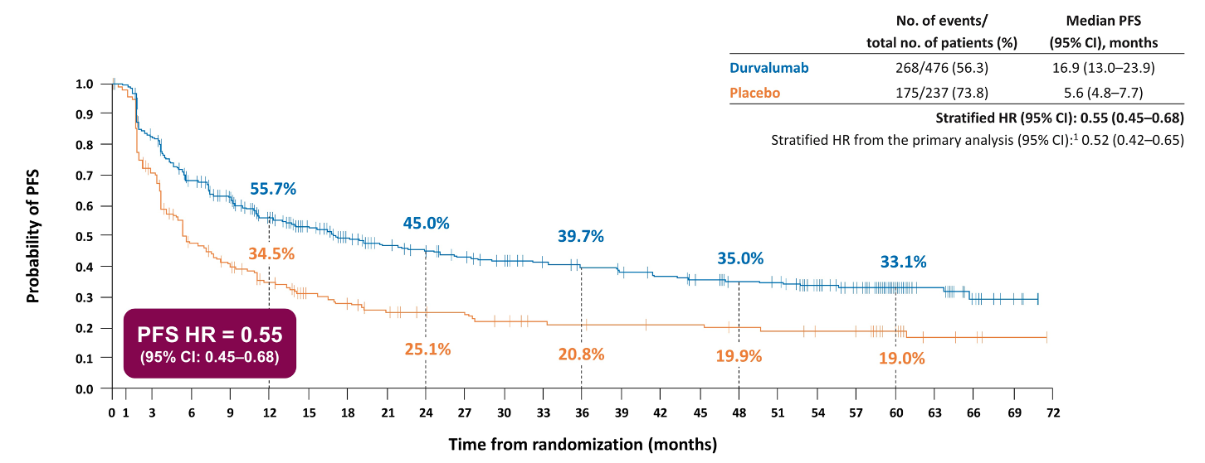
PACIFIC: Five-Year Progression-Free Survival (PFS) with Durvalumab After Chemoradiation Therapy for Stage III NSCLC
Spigel DR et al. ASCO 2021;Abstract 8511.

Slide 76
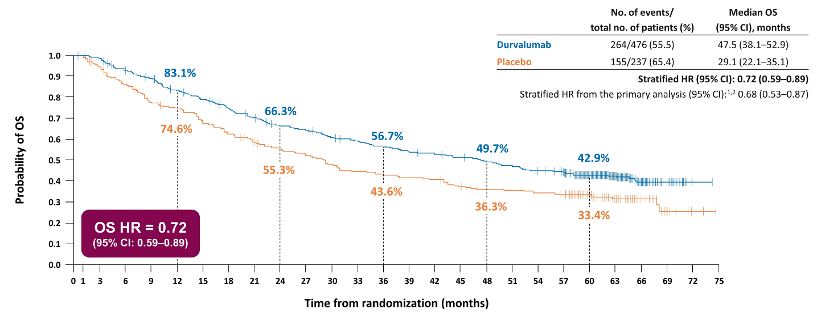
PACIFIC: Five-Year Overall Survival (OS) with Durvalumab After Chemoradiation Therapy for Stage III NSCLC
Spigel DR et al. ASCO 2021;Abstract 8511.

Slide 77
PACIFIC-R: Real-World Study of Durvalumab After Chemoradiation Therapy for Patients with Unresectable Stage III NSCLC
International observational study (N = 1,155)
Median PFS: 22.5 months
Median duration of durvalumab treatment: 11 months
Summary of safety and pneumonitis | N = 1,155
Discontinuation of durvalumab due to AE | 17.5%
Discontinuation of durvalumab due to pneumonitis Temporary Permanent | 13.8% 5.1% 8.7%
Any-grade pneumonitis and/or interstitial lung disease Moderate severity Life-threatening Fatal | 18.5% 8.8% 0.2% 0.1%
Girard N et al. ESMO 2021;Abstract 1171MO.

Slide 78
FDA Approves Durvalumab for Fixed-Dose Use in NSCLC, Bladder Cancer Indications Press Release: November 20, 2020
“The FDA has approved durvalumab for an additional dosing option, a fixed dose of 1500 mg every 4 weeks, in the approved indications of unresectable stage III non-small cell lung cancer after chemoradiation and previously treated advanced bladder cancer.
This new dosing option is consistent with the dosing for the agent that has been approved in extensive-stage small cell lung cancer (ES-SCLC); this will serve as an alternative option for patients who weigh more than 30 kg rather than the weight-based dosing of 10 mg/kg that is administered every 2 weeks.
The regulatory decision was based on data from several clinical trials examining the agent, including the phase 3 PACIFIC trial (NCT02125461), which supported the 2-week, weight-based dosing in patients with unresectable stage III NSCLC, and the phase 3 CASPIAN trial (NCT03043872), which examined a 4-week, fixed-dose during maintenance treatment in patients with ES-SCLC.”
https://www.onclive.com/view/fda-approves-durvalumab-for-fixed-dose-use-in-nsclc-bladder-cancer-indications

Slide 79
Phase II KEYNOTE-799 Trial of Pembrolizumab with Concurrent Chemoradiation Therapy for Unresectable Stage III NSCLC Coprimary Endpoints: Overall Response Rate (ORR) and Grade 3 or Higher Pneumonitis
 | Cohort A (squamous and nonsquamous) (n = 112) | Cohort B (nonsquamous only) (n = 102)
ORR | 70.5% | 70.6%
Response ≥12 mo | 79.7% | 75.6%
Grade ≥3 pneumonitis | 8.0% | 6.9%
Jabbour SK et al. JAMA Oncol 2021;7(9):1351-9.

Slide 80
Role of Immunotherapy for Small Cell Lung Cancer (SCLC)

Slide 81
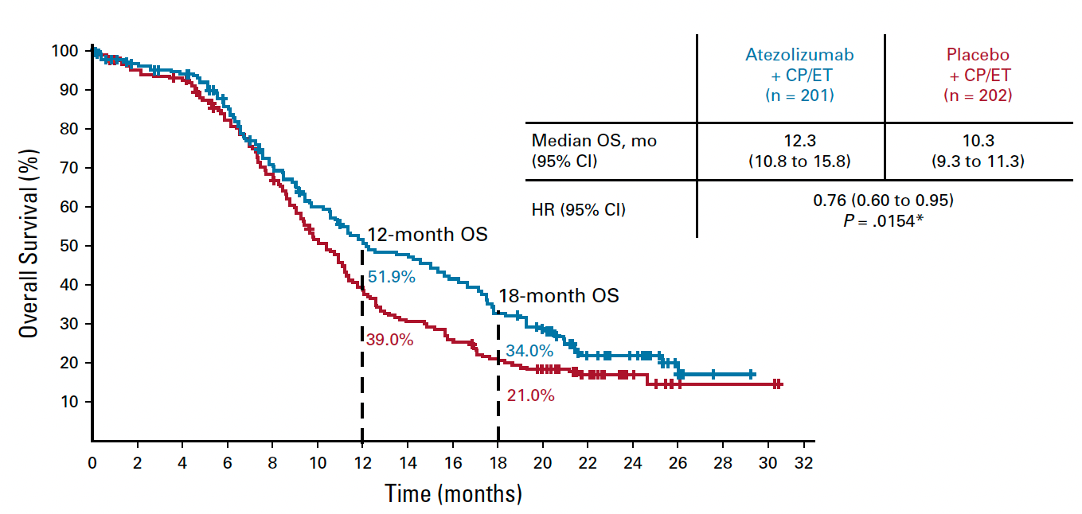
IMpower133: Updated OS in Extensive-Stage SCLC (ES-SCLC) Treated with First-Line Atezolizumab, Carboplatin and Etoposide
Median follow up: 22.9 mo
Benefit independent of PD-L1 status
Liu SV et al. J Clin Oncol 2021;39(6):619-30.

Slide 82
CASPIAN: Three-Year Updated OS with First-Line Durvalumab, Platinum and Etoposide for ES-SCLC
1.0
Median follow up: 39.4 mo
D + EP
EP
Events, n/N (%)
mOS, months (95% CI)
HR (95% CI)
221/268 (82.5)
12.9 (11.3-14.7)
248/269 (92.2)
10.5 (9.3-11.2)
0.8
Probability of OS
0.71 (0.60-0.86)
0.0003
0.6
52.8%
Nominal P value
0.4
32.0%
39.3%
22.9%
17.6%
0.2
24.8%
5.8%
13.9%
9 12 15 18 21 24 27 30 33 36 39 42 45 48 51
Time from randomization (months)
0
0
3
6
No. at risk
D + EP | 268 | 244 | 214 | 177 | 140 | 109 | 85 | 70 | 60 | 54 | 50 | 46 | 39 | 25 | 13 | 3 | 0 | 0
EP | 269 | 243 | 212 | 156 | 104 | 82 | 64 | 51 | 36 | 24 | 19 | 17 | 13 | 10 | 3 | 0 | 0 | 0
Paz-Ares LG et al. Ann Oncol. 2021;32(suppl 5):S1283-46.

