Slide 1

Novel and Emerging Strategies for Diffuse Large B-Cell Lymphoma
Dr. Gilles SALLES
Chief of the Lymphoma Service
Memorial Sloan Kettering Cancer Center, New York

Slide 2
New agents in DLBCL
Recently FDA approved agents:
  Polatuzumab vedotin
  Selinexor
  Tafasitamab
  (Axicabtagene ciloleucel and Tisagenlecleucel)
Agents in development
  CD3 x CD20 Bispecific antibodies (mosunetuzumab and others)
  Loncastuximab
  Magrolimab

Slide 3
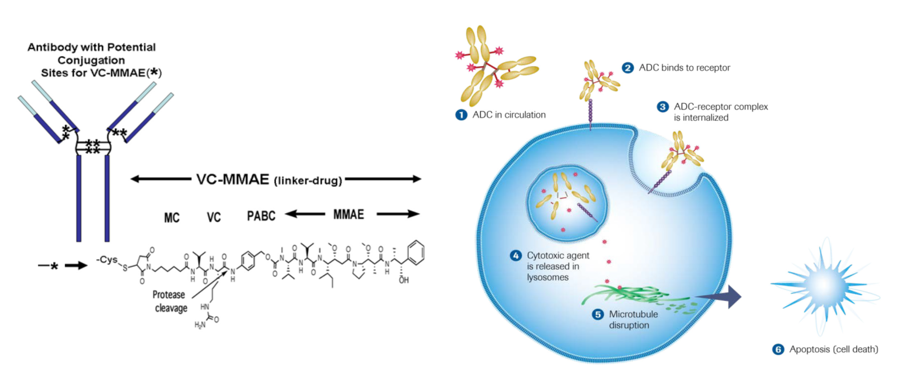

Polatuzumab vedotin
Polatuzumab vedotin (pola) is an antibody drug conjugate (ADC) consisting of a potent microtubule inhibitor monomethyl auristatin E (MMAE) conjugated to CD79b monoclonal antibody via a protease-cleavable peptide linker
Pola has demonstrated efficacy in R/R DLBCL in combination with rituximab^{1,2}
Treatment | Best overall response
Pola +/- rituximab | 51−56%^{1,2}
1. Palanca-Wessels A, et al. Lancet Oncol, 2015;16:704−15
2. Morschhauser F, et al. Lancet Hematology, 2019;6:e254 −65
Notes:
Anti-CD79b - Targets to malignant B cells
Not expressed on
vital tissue
Highly internalized
VC linker - Cleaved by lysosomal proteases
Stable in circulation
MOA:
Pola binds to cell-surface antigen CD79b, a component of the B-cell receptor, which is expressed only on B cells and in most non-Hodgkin lymphomas.
Binding to CD79b triggers internalization. The stable VC linker within pola is cleaved, releasing MMAE. MMAE binds to microtubules.
MMAE inhibits microtubule polymerization, disrupts cell division, and triggers apoptosis.

Slide 4
Randomised Phase II study of pola-BR versus BR (GO29365): study design
Pola 1.8mg/kg + BR
(n=6/histology)
Pola 1.8mg/kg + BG
(n=6/histology)
Safety run-in phase
OR
Phase II expansion
Pola 1.8mg/kg + BG
(n=20/histology)
Patients
R/R DLBCL
R/R FL
Pola 1.8mg/kg + BR
(n=40/histology)
Phase II randomisation
R
1:1
BR
(n=40/histology)
Primary endpoint (Phase II): PET-CR rate
according to modified Lugano criteria
Sehn L, et al. Abstract #1683, ASH 2018
BG, bendamustine and obinutuzumab; BR, bendamustine and rituximab; FL, follicular lymphoma; PET-CR, positron electron tomography–complete response; pola, polatuzumab vedotin; R, randomisation; R/R, relapsed/refractory

Slide 5
Polatuzumab vedotin added to bendamustine/ rituximab
Response at EOT (IRC)^{1*}
BR
Pola + BR
Seven patients have ongoing response durations of ≥20 months at data cut-off
Data cut-off: 1. 30 April 2018, 2. May 2017
*Primary endpoint; PET-CR is assessed by modified Lugano criteria
BOR, best overall response; BR, bendamustine and rituximab; CR, complete response; EOT, end of treatment;
INV, investigator; IRC, independent review committee; OR, objective response; pola, polatuzumab vedotin
1. Sehn L, et al. Abstract #1683, ASH 2018 | 2. Sehn L, et al. Abstract #7507. ASCO 2018

Slide 6
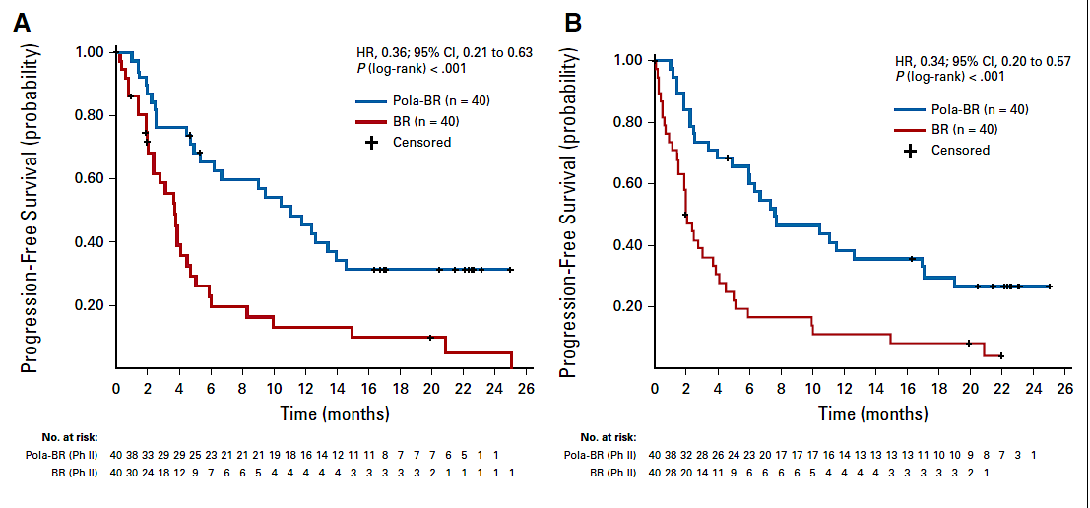
Polatuzumab vedotin added to bendamustine/rituximab
Progression Free Survival (IRC)
Few patients with durable responses
Toxicity: hematological, infectious, neurological
Sehn, JCO 2019

Slide 7
OS was significantly longer with pola + BR versus BR
Pola + BR vs BR:
median OS 12.4 vs 4.7 months
HR 0.42, 95% CI: 0.27–0.75; p=0.0023
1.0
Pola + BR (n=40)
BR (n=40)
0.8
0.6
Probability of OS
0.4
0.2
0.0
0
2
4
6
8
10
12
14
16
18
20
22
24
26
No. at risk
Time (months)
BR
40
33
27
25
17
15
11
10
10
7
7
7
7
7
7
6
6
6
6
5
5
4
4
3
3
1
1
Pola + BR
40
38
36
34
33
30
30
27
25
24
22
21
19
17
16
16
16
15
15
13
12
9
9
5
3
2
1
Median follow-up: 22.3 months
Data cut-off: 30 April 2018
BR, bendamustine and rituximab; pola, polatuzumab vedotin
Sehn L, et al. Abstract #1683, ASH 2018

Slide 8
In frontline: Pola-R-CHP in a phase 1b/2 trial
1
The safety and tolerability of pola-R-CHP is similar to that of R-CHOP
2
3
PFS in patients with 1L DLBCL receiving pola + R/G-CHP
100
80
Pola + R/G-CHP (n=66)
60
PFS (%)
40
20
PFS at 2 years: 83% (95%CI: 73−93%)
0
0
3
6
9
12
15
18
21
24
27
30
33
Months
G, obinutuzumab; R-CHP, rituximab, cyclophosphamide, doxorubicin, and prednisone;
R-CHOP, rituximab, cyclophosphamide, doxorubicin, vincristine, and prednisone
Tilly H, et al. Lancet Oncol 2019; [Epub ahead of print]
Notes:
In the GO29044 phase Ib/2 study, patients with previously untreated higher-risk DLBCL, gained promising benefits from pola + R-CHP,
This was greater than the benefit obtained from Pola + R in the ROMULUS study (Overall response rate: 89% vs 56%; complete response: 77% vs 15%, respectively)
The safety profile of Pola + R-CHP was similar to that observed in the R-CHOP arm of the GOYA study (previously untreated DLBCL); this was manageable and as expected

Slide 9

POLARIX: Study design
A double-blinded, phase 3, placebo-controlled trial
ARM A
Pola
1.8mg/kg
R-CHP + vincristine placebo
Q21D x 6 cycles
Rituximab
375 mg/m²
Cycles 7 and 8
Patients
Previously untreated DLBCL
Age 18–80 years
IPI 2–5
ECOG PS 0–2
N=875
R
1:1
ARM B
R-CHOP + pola placebo
Q21D x 6 cycles
Rituximab
375 mg/m²
Cycles 7 and 8
Stratification factors
IPI score (2 vs 3–5)
Bulky disease (≥7.5cm)
Geographical region
Collaboration with LYSA and LYSARC
LYSA, the lymphoma study association; IPI, international prognostic index; ECOG PS, Eastern Cooperative Oncology Group Performance Status; R-CHP, rituximab, cyclophosphamide, doxorubicin, and prednisone; Q21D, every 21 days; R-CHOP, rituximab, cyclophosphamide, doxorubicin, vincristine, and prednisone
Notes:
Patients were stratified using: IPI score (2 vs 3–5), Bulky disease (≥7.5cm), Geographical region
An interim analysis of the results is planned for after four treatment cycles
Follow-up period: 5 years from the end of treatment

Slide 10
POLARIX: Study objective and endpoints
OBJECTIVE: To evaluate the efficacy and safety of pola + R-CHP compared with R-CHOP in previously untreated patients with DLBCL
Primary endpoint | PFS*
Secondary endpoints‡ | PET/CT-CR rate at end of treatment (IRC) Event-free survival Overall survival Patient reported outcomes
Safety endpoints‡ | Incidence, nature, and severity of adverse events
*Investigator assessed; ‡These lists are not exhaustive

Slide 11
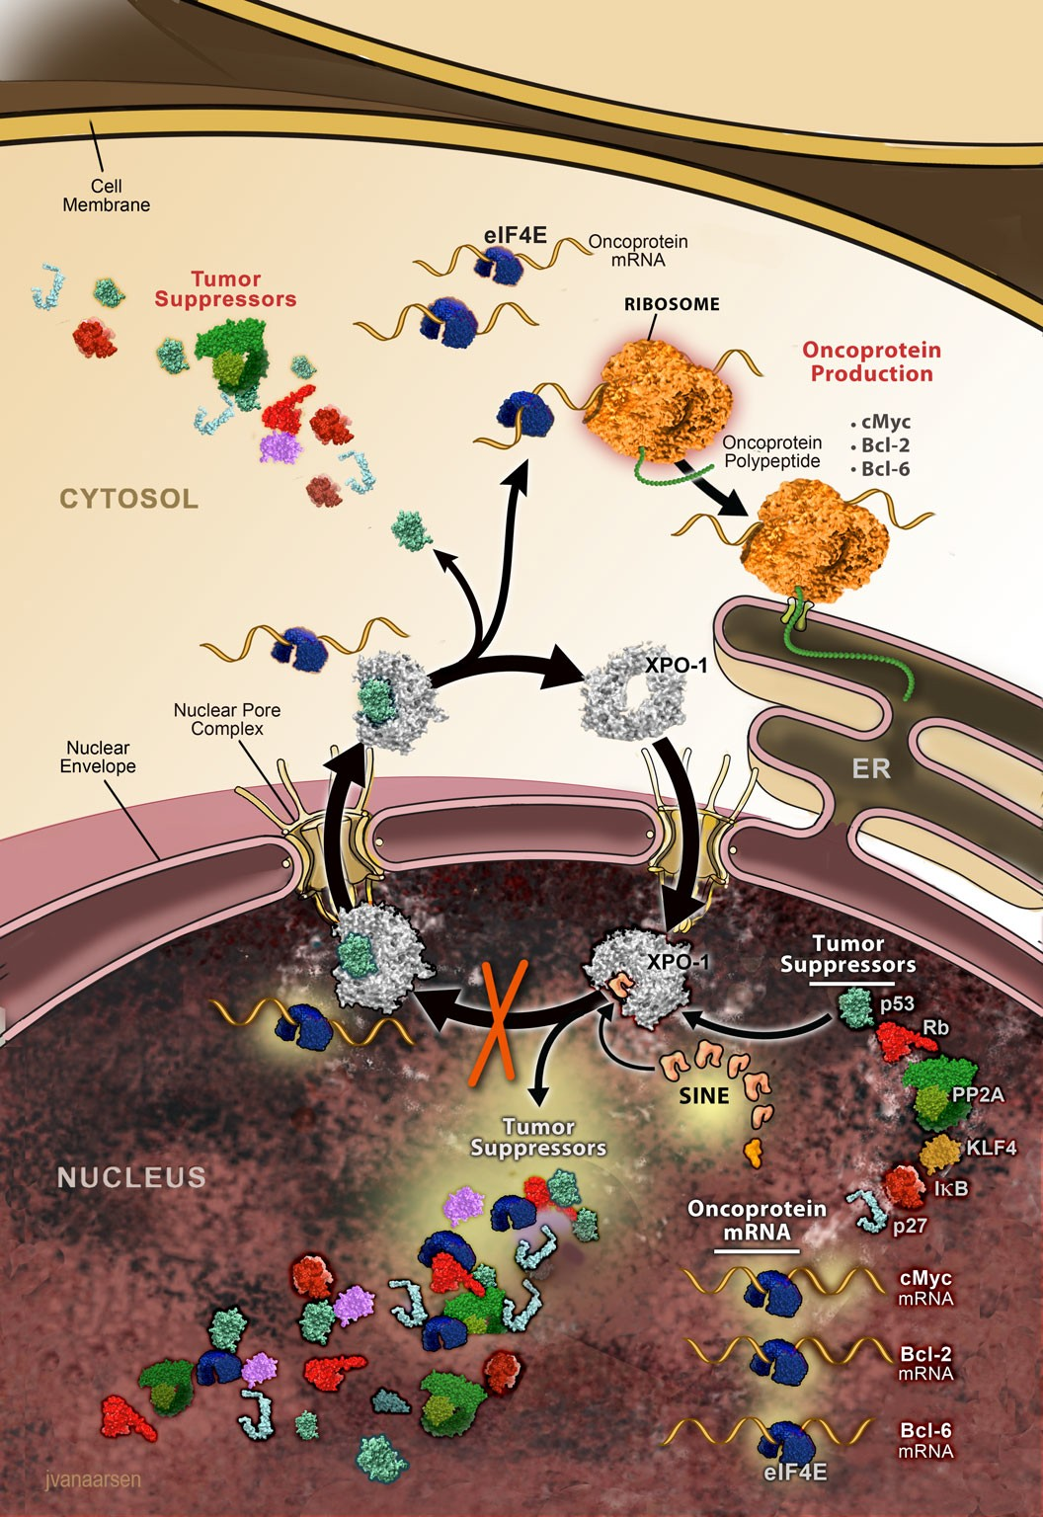
Selinexor – Mechanism of Action
The nuclear export protein Exportin 1 (XPO1) is overexpressed in all types of malignant lymphoma, including DLBCL
Selinexor (KPT-­‐330) is a Selective Inhibitor of Nuclear Export (SINE) compound that inhibits XPO1 to force nuclear retention of tumor suppressors and other proteins integral to tumorigenesis
Selinexor interferes with proteins known to play critical roles in DLBCL
  Reduces Myc, Bcl2 and Bcl6 proteins through forced nuclear retention of eIF4E
  Blocks NF-­‐kB activation through nuclear retention of IkB

Slide 12
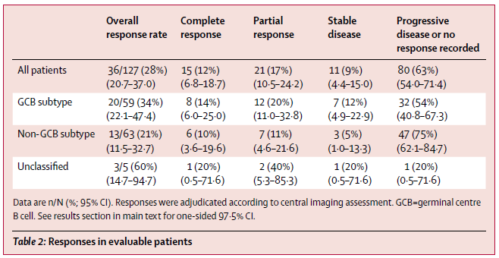
Phase II SADAL trial of selinexor: first inhibitor of nuclear export
Median progression-free survival: 2.6 months (95% CI, 1.9 - 4.0)
Median overall survival: 9.1 months (95% CI, 6.6 - 15.1)
Kalakonda N et al. Lancet Haematol. 2020;7(7):e511-e522.

Slide 13
Phase II SADAL trial of selinexor: first inhibitor of nuclear export
In patients with ≥ partial response,
median overall survival was not reached,
In patients with stable disease,
- median overall survival was 18·3 months (95% CI 11·1–28·0).
Median progression-free survival: 2.6 months (95% CI, 1.9 - 4.0)
Median overall survival: 9.1 months (95% CI, 6.6 - 15.1)
Kalakonda N et al. Lancet Haematol. 2020;7(7):e511-e522.

Slide 14
Selinexor: first inhibitor of nuclear export
Management of side effects
Most common grade 3-4 AEs
Thrombocytopenia (46%); neutropenia (24%) and anemia (22%)
Fatigue (11%), hyponatraemia (8%), and nausea (6%)
Supportive measures:
Cytopenia:
  . growth factors, transfusions
    . dose reduce from 60mg 2/week to 40mg 2/week then 60mg 1/week
Anorexia, weight loss
. olanzapine (2.5 to 5 mg QHS)
Nausea, vomiting
. 5HT3 antagonists, NK1R receptors antagonists.
Steroids… ,sodium intake…
Kalakonda N et al. Lancet Haematol. 2020;7(7):e511-e522.

Slide 15
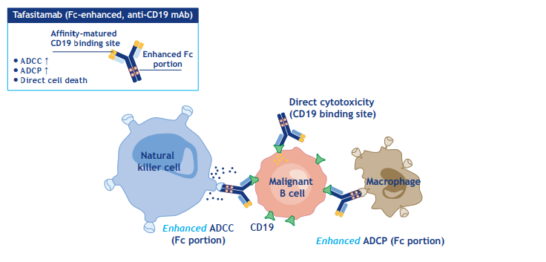
Tafasitamab: a humanized and engineered anti-CD19 Ab
Previously known as XmAb5574, then MOR208

Slide 16
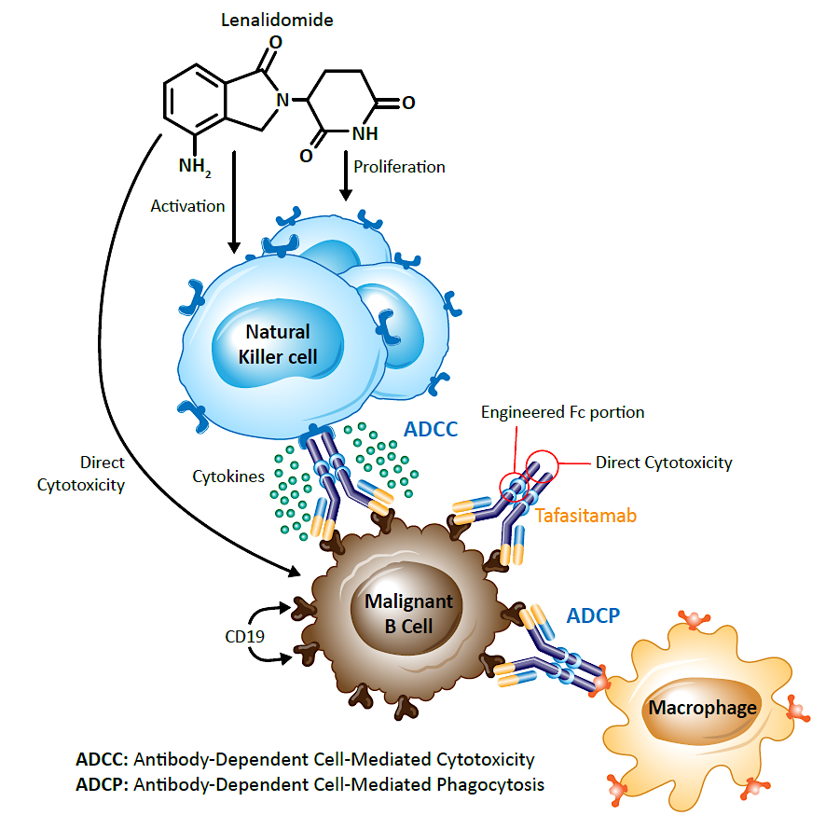
Modes of action provide the rationale for tafasitamab + lenalidomide combination
Tafasitamab MoA
Antibody Dependent Cellular Cytotoxicity via NK cells (ADCC)
Antibody Dependent Cellular Phagocytosis (ADCP)
Direct cytotoxicity
Lenalidomide MoA
Direct cytotoxicity
Increase NK cell numbers (ADCC)
Activate NK cells
Increased anti-tumor effects

Slide 17
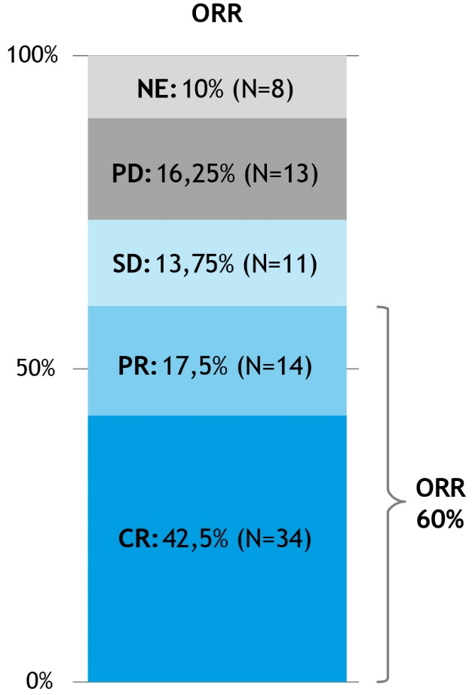
Tafa-Len: L-MIND study
Primary endpoint: Overall Response Rate (ORR) by IRC
  ORR 60.0% (95% CI: 48.4%–70.8%)
  CR-rate 42.5%
        82% of CRs PET-confirmed
        18% of CRs based on CT only
N=80: full analysis set → patients receiving at least one dose of tafasitamab and LEN
NE due to missing post-baseline tumor assessment
CI, confidence interval; CR, complete response; CT, computed tomography; IRC, independent review committee; LEN, Lenalidomide; NE, not evaluable; ORR, overall response rate; PET, positron emission tomography; PR, partial response; PD, progressive disease; SD, stable disease.
Salles et al, Lancet Oncol. 2020

Slide 18
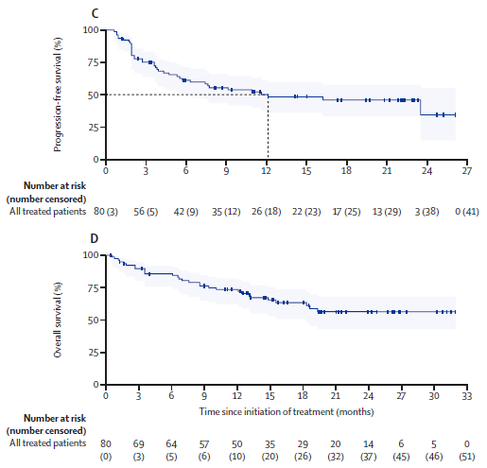
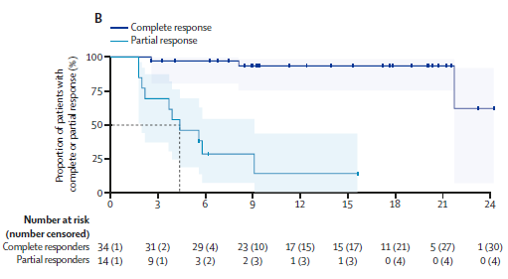
R/R DLBCL Patients: Tafasitamab-Lenalidomide
PFS
DOR
OS
Salles GA et al. Lancet Oncol. 2020;21(7):978-988.

Slide 19
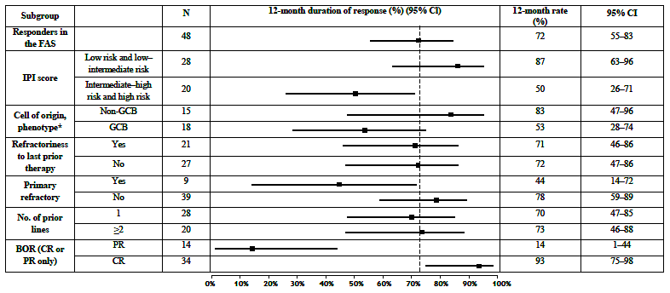
L-MIND: 12-months DOR by baseline characteristics
Two patients had DHL/THL after central FISH review: one with DHL achieved PR only; another patient with THL (was also primary refractory subgroup) achieved CR and remains in remission after >30 months.
Salles et al, Lancet Oncol. 2020 (supplemental data)

Slide 20
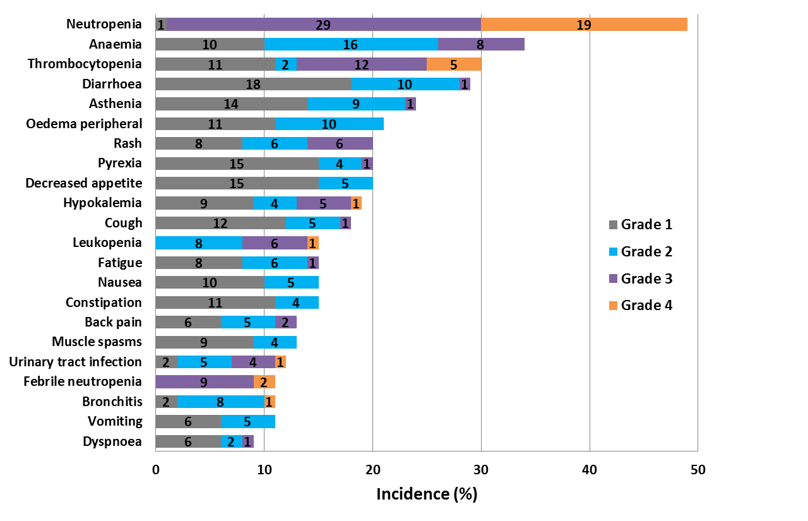
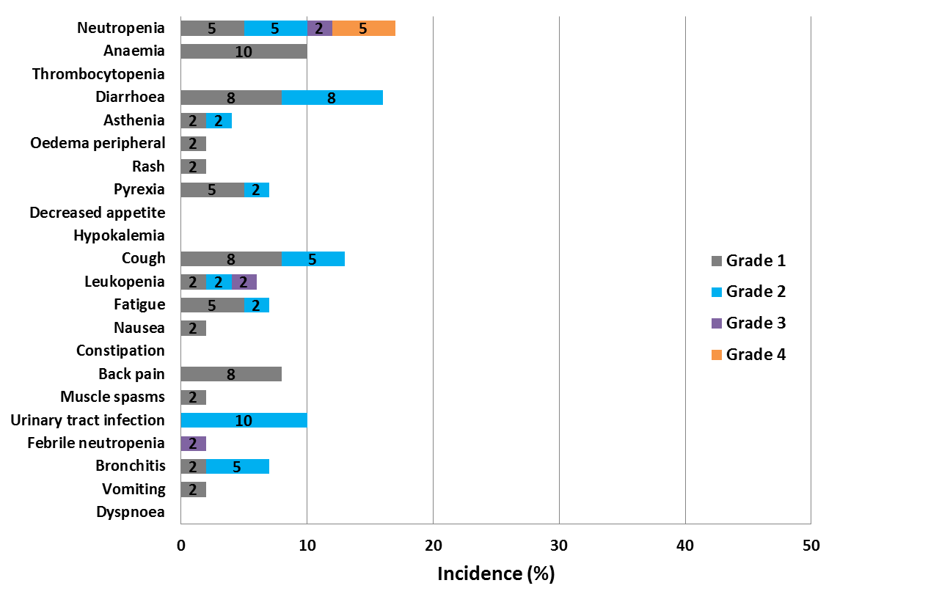
Tafa-len (L-MIND): safety by treatment phase
Tafasitamab + LEN combination (up to 12 cycles)
n=80, median exposure 6.5 months
Tafasitamab monotherapy (cycle 13 onwards or after LEN discontinuation) n=37, median exposure 8.7 months
  Incidence and severity of TEAEs is lower during the tafasitamab monotherapy phase
  10 patients (12%) discontinued tafasitamab + LEN due to AE
AE collection period included 30 days after end of treatment. | LEN, Lenalidomide.
Salles et al, Lancet Oncol 2020

Slide 21
Anti-CD19 CAR-T Cell Therapies in R/R aggressive NHL
 | KTE-C19 ^{1, 2} Axi-cel | CTL019 ^{3,4} Tisagenlecleucel | JCAR017 ⁵ Liso-cel
Vector | Gammaretroviral | Lentiviral | Lentiviral
Costimulatory domain | CD28 | 4-1BB | 4-1BB
Disease state | DLBCL, TFL, PMBCL | DLBCL, TFL | DLBCL, t-iNHL, FL3B
ORR | 84% | 54% | 73%
CR Rate | 58% | 40% | 53%
Median follow-up (months) | 27 | 32 | 12
Median PFS (months) | 5.9 | 2.9 | 6.8
Median DOR (months) | NR | NR | NR
Median OS (months) | NR | 11.1 | 21
Grade 3-4 CRS | 11% | 23%* | 2%
Grade 3-4 Neurotox | 32% | 11% | 10%
CRS grading using UPenn scale

Slide 22
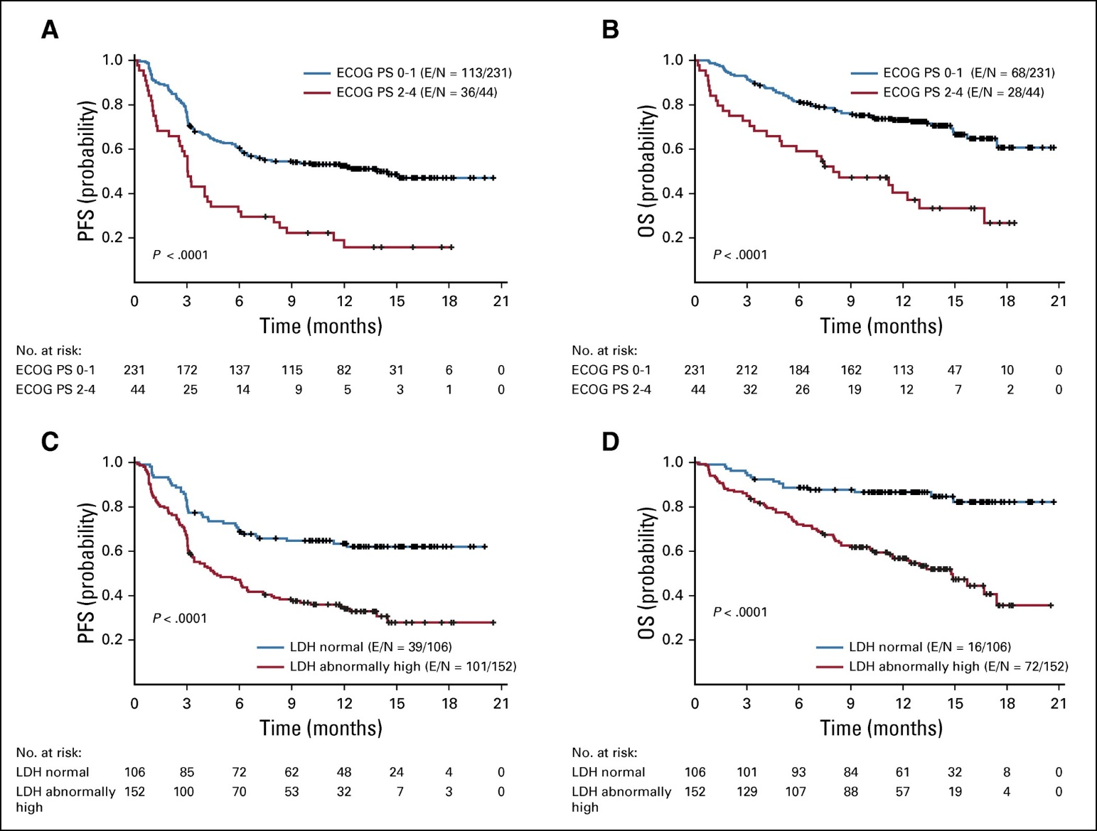
Axicabtagene Ciloleucel in “real world“
PFS and OS by Baseline ECOG and LDH
Loretta J. Nastoupil et al, JCO 2020

Slide 23
Relapsed and refractory DLBCL
Patients treated
in 1L
~60% of all 1L patients cured by R-CHOP
~10-15% refractory
~20-30% relapsed
R/R DLBCL
~50%
~50%
~30% of all DLBCL patients
Chemo-immunotherapy
ASCT eligible
ASCT ineligible
2nd line
Investigational agents
Do not respond to salvage
Tafasitamab-lenalidomide
~50%
~50%
Transplant
No transplant
3rd line
and +
CAR-T cells
40% - 50%
Relapse post
transplant
Cure
50% - 60%
Pola – BR
Relapse
Selinexor
20 - 25% of all ASCT eligible patients are cured by transplant
Best supportive care

Slide 24
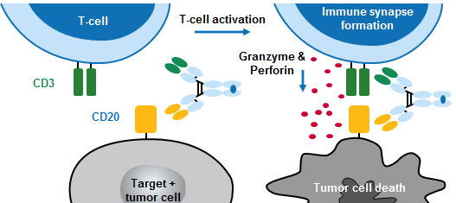
Background
Mosunetuzumab (RG7828; BTCT4465A)
  Full-length, fully humanized IgG1 bispecific antibody¹
  Redirects T cells to engage and eliminate B cells; T-cell activation, cytokine elevation and increase in
TILs observed (Hernandez et al. ASH 2019 P-1585)
  No ex-vivo T cell manipulation required (‘off-the-shelf’ and no delay in treatment)
• GO29781
  Phase I/Ib dose-escalation and expansion study in heavily pre-treated R/R B-cell NHL
  Cycle 1 step-up dosing: mitigates CRS, allowing dose escalation to maximize therapeutic potential^{2,3}
Data for 270 R/R B-cell NHL pts, including 30 pts with prior CAR-T
Registry number: NCT02500407
CRS, cytokine release syndrome; NHL, non-Hodgkin lymphoma; pts, patients; R/R, relapsed or refractory; TILs, tumor-infiltrating lymphocytes
Sun et al. Sci Transl Med 2015
Budde et al. ASH 2018; 3 Bartlett et al. ASCO 2019
Schuster S et al, ASH 2019

Slide 25
Mosunetuzumab: objective response rate in aggressive NHL
Best change (%) in SPD from baseline in aggressive NHL (2.8mg to 40.5mg cohorts)
0.4/1.0/2.8mg
0.8/2.0/4.2mg
100
1.0/1.0/3.0mg
1.0/2.0/6.0mg
80
0.8/2.0/6.0mg
1.0/2.0/9.0mg
60
1.0/2.0/13.5mg
Best change (%) in SPD
40
1.0/2.0/20.0mg
1.0/2.0/27.0mg
20
1.0/2.0/40.5mg
0
–20
–40
ORR: 46/124 (37.1%)
CR: 24/124 (19.4%)
–60
–80
–100
Aggressive NHL: DLBCL, trFL, MCL, Richter’s transformation, transformed marginal zone lymphoma and FL (Grade 3B) SPD: sum of the product of the diameters; CCOD: Aug 9, 2019
Schuster S et al, ASH 2019

Slide 26
Response rates and duration in aggressive NHL
Time on treatment and duration of response among aggressive NHL complete responders
Investigator-assessed best objective response (pooled data from 2.8mg to 40.5mg cohorts)
 | N* | ORR, n (%) | CR, n (%)
Aggressive NHL | 124 | 46 (37.1%) | 24 (19.4%)
DLBCL/trFL after ≥ 2 lines | 98 | 37 (37.8%) | 20 (20.4%)
Refractory to anti-CD20 | 88/98 | 32 (36.4%) | 18 (20.5%)
With prior auto SCT | 32/98 | 17 (53.1%) | 11 (34.3%)
DLBCL
trFL
Complete response Partial response Death
Progressive disease
Dose optimization is ongoing
Increased efficacy in pts with higher exposure to mosunetuzumab, as measured by CD20 receptor occupancy (RO%)
MCL
Richter’s
0 2 4 6 8
10 12 14 16 18 20 22 24 26 28 30 32 34
Time from first treatment (Month)
17 CR pts (70.8%) remain in remission (up to 16 months off treatment)
Mosunetuzumab tolerability profile appeared favorable
Li et al. ASH 2019;Abstract 1285
*efficacy-evaluable pts: pts who were enrolled for at least 3 months, or had response data available at any time, or discontinued treatment for any cause; CCOD: Aug 9, 2019
Schuster S et al, ASH 2019

Slide 27
Bi-Specifics CD3 x CD20 in patients with DLBCL: update at ASH 2020
 | Mosunetuzumab¹ (RG7828) | Odronextamab¹ (REGN1979) | Glofitamab¹ * (RG6026) | Epcoritamab¹ (GEN3013)
Patients | 98 | 35 | 28 | 33
ORR | 38% | 40% | 61% | 76%
CR | 20% | 31% | 54% | 48%
Schuster SJ et al, ASH 2019, Abstract 6 (doses >=2.5 mg); 2. Bannerji R, et al. ASH 2020, Abstract 400 (doses 80-320); 3. Hutchings M, et al. ASH 2020, Abstract 403 (step up dosing from 2.5 to 16/30 mg); 4. Hutchings M, et al. ASH 2020, Abstract 402 (all doses).
* “aggressive lymphoma”

Slide 28
Novel agents in development for DLBCL
Class | Target | Agent | Overall response rate (%) | Complete response rate (%) | Reference
Monoclonal antibody | CD19 | tafasitamab + lenalidomide | 60 | 43 | Salles et al
Antibody drug conjugates | CD19 | loncastuximab tesirine | 59 | 41 | Kahl et al
 | CD79b | polatuzumab vedotin | 52 | 13 | Palanca-Wessels et al
 |  | polatuzumab vedotin + BR versus BR | 45 17.5 | 40 17.5 | Sehn et al
Bispecific antibodies | CD19/CD3 | blinatumomab | 43 | 19 | Viardot et al
 | CD20/CD3 | mosunetuzumab | 35 | 19 | Schuster et al
 |  | glofitamab | 38 | 31 | Dickinson et al
Other target inhibitors | BCL2 | venetoclax | 18 | 12 | Davids et al
 | XPO1 | selinexor | 28 | 12 | Kalakonda et al
Checkpoint inhibitors | PD-1 | nivolumab | ≤ 10 | ≤ 3 | Ansell et al
 | CD47 | magrolimab | 40 | 33 | Advani et al
Salles et al., Lancet Oncol. 2020; Kahl et al., Clin Cancer Res. 2019; Palanca-Wessels et al., Lancet Oncol. 2015; Sehn et al., JCO 2020; Viardot et al., Blood 2016; Schuster el al., ASH 2019; Dickinson et al., EHA 2020; Davids et al., JCO 2017; Kalakonda et al., Lancet Haematol. 2020; Ansell et al., JCO 2019; Advani et al., N Engl J Med., 2018

Slide 29
Loncastuximab Tesirine (ADCT-402):
Patients with DLBCL: Response Rates (Efficacy Analysis Set)
Response, n (%) | Total (All Doses) (n=137) | Non-bulky disease (n=119) |  | Bulky disease (n=18) | Dose ≥120 µg/kg (n=127)
Complete response (CR) | 31 (22.6) | 29 (24.4) |  | 2 (11.1) | 30 (23.6)
Partial response (PR) | 26 (19.0) | 24 (20.2) |  | 2 (11.1) | 25 (19.7)
Stable disease | 24 (17.5) | 21 (17.6) |  | 3 (16.7) | 22 (17.3)
Progressive disease | 54 (39.4) | 43 (36.1) |  | 11 (61.1) | 48 (37.8)
Not evaluable | 2 (1.5) | 2 (1.7) |  | 0 | 2 (1.6)
Overall response rate (CR + PR) | 57 (41.6) | 53 (44.5) |  | 4 (22.2) | 55 (43.3)
Dose ≥120
µg/kg (n=127)
Data shown as of 16 Oct 2018

Slide 30
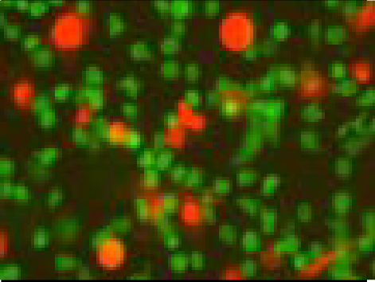
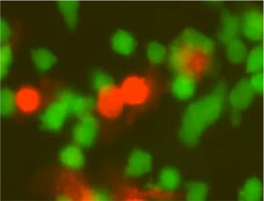

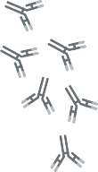
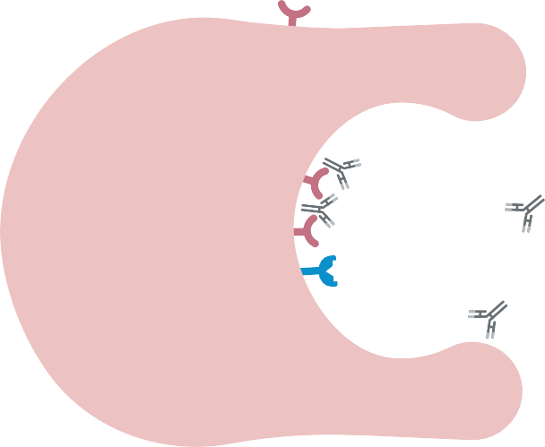
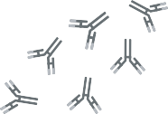


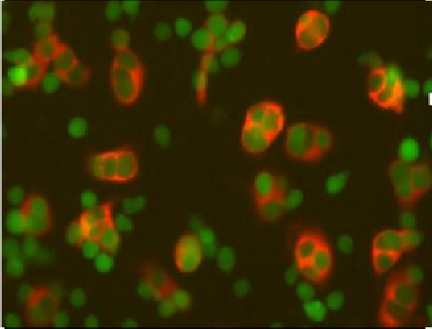
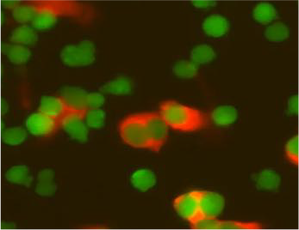










5F9 is a First-in-class Macrophage Immune Checkpoint Inhibitor Targeting CD47
Control mAb: No Phagocytosis
5F9
C
ll
l
e
c
y
h
t
l
a
H
e
CD47“don’t eat me” signal
Anti-CD47 mAb: Phagocytosis
l
l
e
c
r
e
c
n
a
C
M
a
c
r
o
p
h
a
g
e
Macrophages Cancer cells
5F9 is a humanized IgG4 antibody against CD47, a don’t eat me signal, that induces tumor cell phagocytosis
5F9 can eliminate cancer cells through blockade of CD47 to its binding partner SIRP-alpha on macrophages
Cancer cells express pro-phagocytic (eat me) signals while most normal cells do not; this allows 5F9 to selectively eliminate cancer cells
5F9/CD47 blockade induces anti-tumor activity in over 25 tumor models

Slide 31
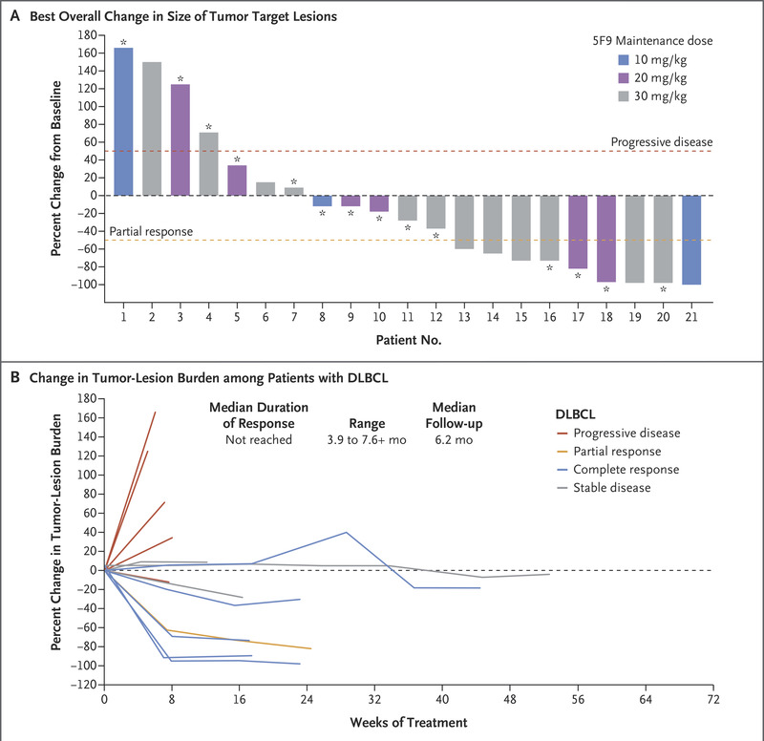
MTD not reached up to 30 mg/kg of 5F9 dosing
Recommended Phase 2 dose (RP2D) selected:
. > 5F9 1 mg/kg priming dose followed by:
> 5F9 30 mg/kg maintenance dose
weekly for Cycle 1,
Q2 weeks Cycle 2 and beyond
DLBCL : ORR 40 %
CR 33%
91% of responders had persisting response at 6 months

Slide 32
In conclusion: multiple options in a moving field
1) Different agents with different modes of action and different toxicity profiles
  Outpatient management feasible
  Sequencing these agents and other available therapies (CAR T)
    Avoiding bendamustine before leukapheresis for CAR T
    How to sequence CD19 directed CAR and Tafa ??
    Len is a non-cytotoxic immunotherapy combination for 2nd line
2) Lack of predictive markers for activity
3) Some combinations feasible
4) Pursue clinical trials

Slide 33
Clinical cases

Slide 34
Patient Case 1
67 year old male, no previous medical history
Diagnosed with DLBCL in August 2016
  Stage III disease, high LDH, performance status of 0, age-adjusted IPI = 2
  CD10+ BCL6+ (GCB origin), no translocation of MYC or BCL2, Ki67 80%
Received 6 cycles of R-CHOP – achieved a CR
Recurrence of disease in July 2018, treated with R-ICE and ASCT, new CR in Dec 2018
Recurrence in June 2019, received axicabtagene ciloleucel , partial response at M1 and progressive disease at M3
What are the options ?

Slide 35
Patient Case 1 continued
The patient is now 70 years old, had received 3 lines of therapy including ASCT and CAR-T
Bendamustine rituximab :
  Feasible, potential risks of cytopenia/infections post CAR T-cell therapy?
  Tafasitamab/lenalidomide:
Need to confirm CD19 persistence
Other options such as clinical trials or selinexor…

Slide 36
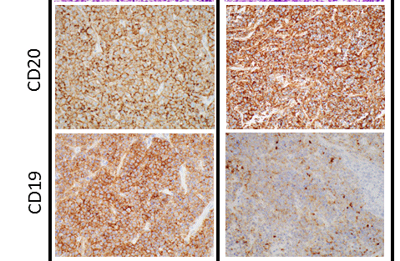
Patient Case 1 continued
The patient is now 70 years old, had received 3 lines of therapy including ASCT and CAR-T
Bendamustine rituximab :
- Feasible, potential risks of cytopenia/infections post CAR T-cell therapy?
Tafasitamab lenalidomide:
- Need to confirm CD19 persistence
other options such as clinical trials or selinexor…
A new biopsy showed lack of CD19 staining (30% or post CAR relapse)
The patient received 6 cycles of R-Benda Pola
Benda was dose reduced from cycle 3, and withdrawn at cycle 6
Achieved a CR
- but experienced relapse after 11 months….

Slide 37
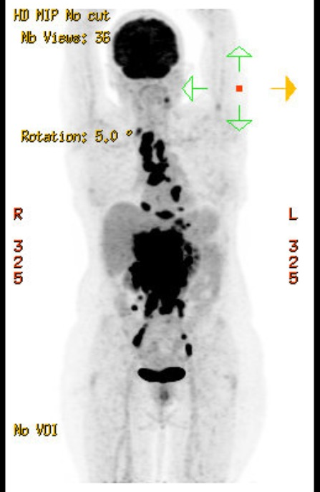
Patient Case 2
75 year old female, medical history of elevated blood pressure and type 2 diabetes
Diagnosed with DLBCL in October 2019
- Stage IV disease (GI tract, bone marrow)
- Classified as non-GCB based on IHC findings (CD10neg+ MUM1 positive)
Received 6 cycles of R-CHOP
- Rather well tolerated
- Achieved a CR in Feb 2020
Recurrence of disease in October 2020, with disseminated disease

Slide 38
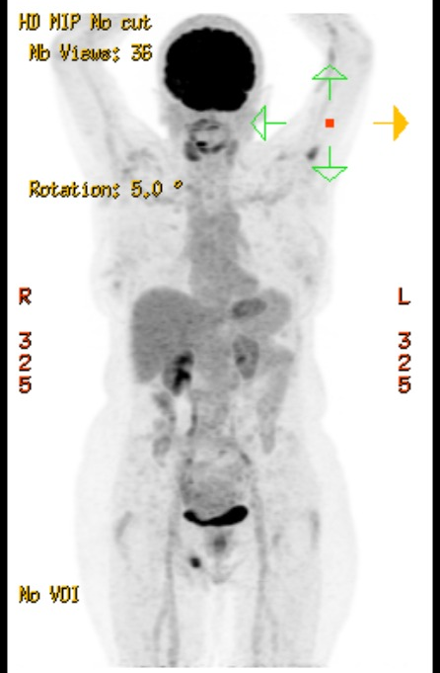
Patient Case 2 continued
75 year old female, medical history of elevated blood pressure and type 2 diabetes
Diagnosed with DLBCL in October 2019
- Stage IV disease (GI tract, bone marrow)
- Classified as non-GCB based on IHC findings (CD10neg+ MUM1-positive)
Received 6 cycles of R-CHOP
- Rather well tolerated
- Achieved a CR in Feb 2020
Recurrence of disease in October 2020, with disseminated disease
Had a good performance status,
But refused new chemotherapy options (R-benda, R-GemOx)
Started on Tafa-Len (L-MIND regimen) - currently responding
(Len was dose reduced at 20 mg)

Slide 39
Patient Case 3
73 year old male,
- Past medical history of smoking, COPD, high blood pressure
- MI 3 years ago, stented, on antiplatelet agents
Diagnosed with follicular lymphoma in October 2017
- High tumor burden and received R-Benda x 6
- Progressed 3 months later
- A new biopsy showed transformation to large cell lymphoma,
DLBCL with MYC and BCL2 translocation = high grade B-cell lymphoma

Slide 40
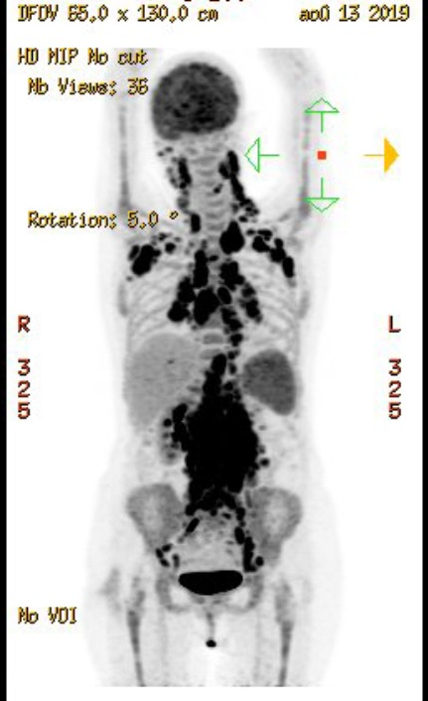
Patient Case 3 continued
73 year old male,
- Past medical history of smoking, COPD, high blood pressure
- MI 3 years ago, stented, on antiplatelet agents
Diagnosed with follicular lymphoma in October 2017
- High tumor burden and received R-Benda x 6
- Progressed 3 months later
- A new biopsy showed transformation to large cell lymphoma,
DLBCL with MYC and BCL2 translocation = high grade
B-cell lymphoma
Received 6 cycles of DA-R-EPOCH
- Stable disease
Treated with 2 cycles of R-GemOx
- Progressive disease

Slide 41
Patient Case 3 continued
Transformed FL to HG B-cell lymphoma now 75 y old
Refractory to 2 chemo regimens
Treatment options:
- Discussion of CAR-T eligibility?
- Benda already administered
- Tafa-Len?
- Selinexor was proposed

Slide 42
Patient Case 3 continued
Transformed FL to HG B-cell lymphoma now 75 y old
Refractory to 2 chemo regimens
Treatment with selinexor
  Received the drug at standard dosing of 60 mg twice a week, with
  anti-emetic agents
  Was dose reduced for gr 3 thrombocytopenia after one cycle to 60 mg once a week
  Loss of 8 pounds, put on steroids and olanzapine
  Stayed on drug for 8 months…

