Slide 1
Newly Approved Agents in the Care of Patients with Metastatic Urothelial Bladder Carcinoma
Who Experience Disease Progression on Immune Checkpoint Inhibitor Therapy
Faculty
Elizabeth R Plimack, MD, MS
Jonathan E Rosenberg, MD
Andrew Ruplin, PharmD
Cristina Salabao, MSN, FNP-C
Moderator
Neil Love, MD

Slide 2
Module 1: First-Line Systemic Therapy for Metastatic Urothelial Bladder Cancer (mUBC)

Slide 3
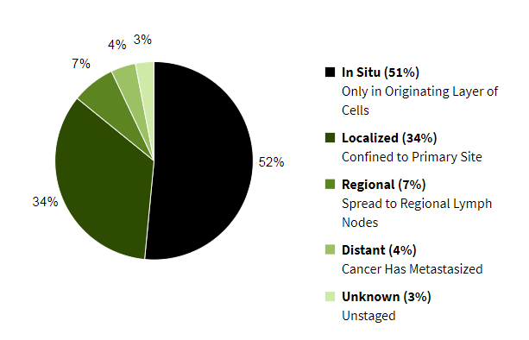
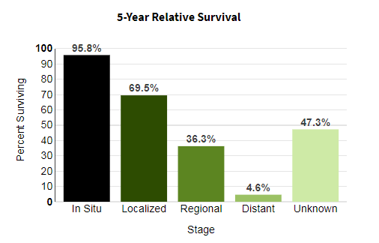
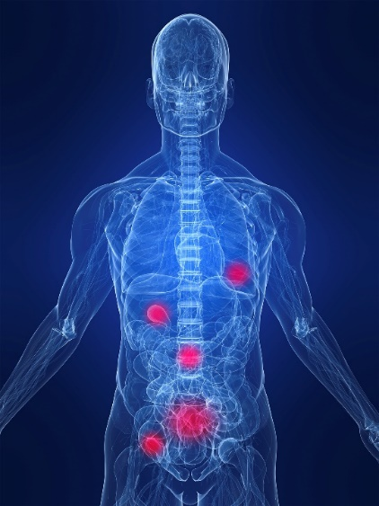
Metastatic Urothelial Cancer
Generally not curable.
Goal: Control the cancer/symptoms, maintaining quality of life
Median overall survival is less than 2 years
Common sites
of metastases:
Pelvis
Lung
Liver
Lymph nodes
Bone (spine)
Courtesy of Elizabeth R Plimack, MD, MS
http://seer.cancer.gov/statfacts/html/urinb.html. Accessed 1/2020

Slide 4
After a long drought, novel therapies for metastatic urothelial cancer emerge
Atezolizumab
2016
Nivolumab
2017
Durvalumab
2017
Avelumab
2017
Pembrolizumab
2017
Erdafitinib
Gemcitabine (EMA)
2019
2008
Cisplatin
Vinflunine (EMA)
Enfortumab Vedotin
1978
2009
2019
1978
1982
1986
1990
1994
1998
2002
2006
2010
2014
2018
2020
Today
May 31
ASCO 2020
https://www.accessdata.fda.gov/scripts/cder/daf/
Accessed 5/2020
Courtesy of Elizabeth R Plimack, MD, MS

Slide 5
Major changes to locally advanced/metastatic UC treatment paradigm since 2016
First-line therapy remains platinum-based combination chemotherapy for most patients
Immunotherapy in first-line setting for cisplatin-ineligible patients with PDL1 high tumors
Maintenance immunotherapy to become standard following chemotherapy
Two novel agents approved in 2019
  Erdafitinib targeting FGFR pathway alterations
  Enfortumab vedotin antibody-drug conjugate targeting Nectin-4
Courtesy of Jonathan E Rosenberg, MD

Slide 6
Checkpoint inhibitors
US FDA approved for UC
Agent | Ab Inhibits: | Schedule | Post Platinum | Frontline Cis-ineligible
Atezolizumab | PD-L1 | Q3 Weeks | accelerated | accelerated
Nivolumab | PD-1 | Q4 Weeks | accelerated | -
Durvalumab | PD-L1 | Q2 Weeks | accelerated | -
Avelumab | PD-L1 | Q2 Weeks | accelerated | -
Pembrolizumab | PD-1 | Q3 Weeks | Level 1 | accelerated
June 2018: Use of Atezo and Pembro was restricted to PDL1 positive patients
only
Courtesy of Elizabeth R Plimack, MD, MS

Slide 7
3,253 pts later, what have we learned?
No OS benefit to gem/platinum + checkpoint
Non-additive ORR benefit with gem/platinum + checkpoint
No benefit with treme (CTLA4)
Early deaths in PDL1 low treated with single agent checkpoint → label restricted to PDL1 high in 2018
No information on ddMVAC backbone
1L = chemo
Courtesy of Elizabeth R Plimack, MD, MS

Slide 8
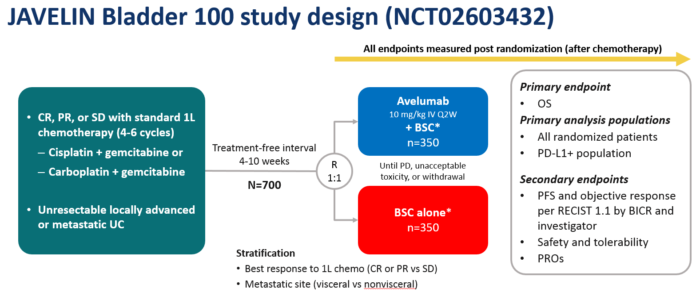

JAVELIN Bladder 100 study design / patient selection
JAVELIN 100
All patients received prior gem platinum outside the study
  Patients with PD as best response were excluded
  Patients unable to complete 4 cycles were excluded
Endpoints measured after randomization
No placebo
No crossover within the study
Courtesy of Elizabeth R Plimack, MD, MS
Elizabeth R. Plimack MD MS
Powles, et al. ASCO 2020

Slide 9
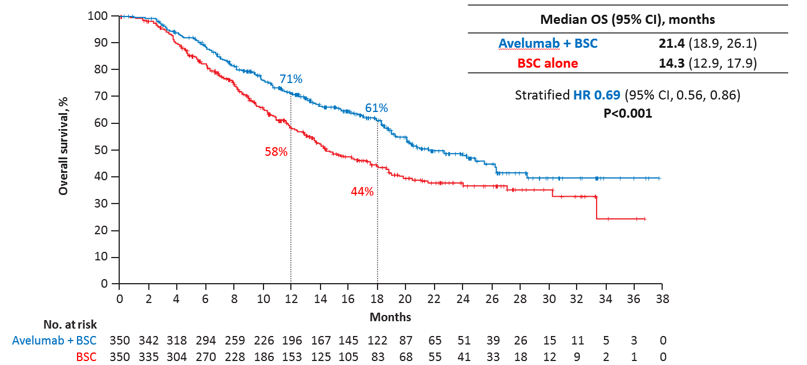
JAVELIN Bladder 100: Overall survival
JAVELIN 100
Median OS for avelumab
21.4 months
This is the longest OS ever documented in a Phase III metastatic urothelial cancer trial in any line of therapy
Superior to BSC alone
Courtesy of Elizabeth R Plimack, MD, MS
Elizabeth R. Plimack MD MS
Powles, et al. ASCO 2020

Slide 10
These data change paradigm in two ways
They provide a new framework around which to consider a treatment break vs maintenance therapy post platinum
They mark a shift in selection of first line systemic therapy
Courtesy of Elizabeth R Plimack, MD, MS

Slide 11
Post platinum, is switch maintenance checkpoint inhibition preferred over a treatment break followed by second line?
For most patients, yes
Longer OS with switch maintenance
Delay in PFS is meaningful – particularly if progression is symptomatic
Not all patients will be caught by the second line safety net
However:
If you can guarantee a patient access to second line checkpoint after a treatment break (crossover) their survival may not be impacted
Some patients will have durable response to platinum and not require checkpoint for months if at all. These patients will be overtreated.
Courtesy of Elizabeth R Plimack, MD, MS

Slide 12
These data change paradigm in two ways
They provide a new framework around which to consider a treatment break vs maintenance therapy post platinum
They mark a shift in selection of first line systemic therapy
Courtesy of Elizabeth R Plimack, MD, MS

Slide 13
JAVELIN 100 ushers in two paradigm shifts in the treatment of metastatic urothelial cancer
FIRST LINE: Platinum based chemotherapy is best initial therapy
  Highest ORR
  “Tail on the curve” with durable treatment free survival for some
  Sets patient up for best OS to subsequent checkpoint inhibitor
  Does not require PDL1 testing for treatment selection
  Unlikely that a non-responder to platinum would have benefited from first line checkpoint inhibition
POST PLATINUM: Switch maintenance is preferred over treatment break as timing for next line checkpoint inhibitor in patients with SD or response
  Delays progression of disease and potentially symptoms
  Overall survival can be similar, only if access to second line checkpoint is guaranteed
Courtesy of Elizabeth R Plimack, MD, MS
Elizabeth R. Plimack MD MS

Slide 14
Current Standard of Care at FCCC:
Front Line in 2020
First line metastatic | Preferred | Alternate
Cisplatin eligible | DDMVAC x 4-6 cycles → avelumab or pembrolizumab maintenance | Gemcitabine + cisplatin x 4-6 cycles → avelumab or pembrolizumab maintenance
Cisplatin ineligible | Carboplatin + gemcitabine x 4-6 cycles → avelumab or pembrolizumab maintenance | Gemcitabine single agent (PDL1 -) Atezolizumab (chemo unfit and PDL1+)
Courtesy of Elizabeth R Plimack, MD, MS
See NCCN guidelines for more options

Slide 15
What would be your preferred first-line treatment regimen for a
65-year-old patient with metastatic urothelial bladder cancer (mUBC)?
Cisplatin/gemcitabine
Cisplatin/gemcitabine → avelumab
Cisplatin/gemcitabine → avelumab
Cisplatin/gemcitabine
DDMVAC
Platinum/gemcitabine → avelumab
Cisplatin/gemcitabine → avelumab
Cisplatin/gemcitabine → avelumab
DDMVAC = dose-dense methotrexate, vinblastine, doxorubicin and cisplatin

Slide 16
What would be your preferred first-line treatment regimen for an 80-year-old patient with metastatic UBC who is not a candidate for cisplatin-based chemotherapy?
Pembrolizumab
Carboplatin/gemcitabine → avelumab
Cisplatin/gemcitabine → avelumab
Carboplatin/gemcitabine → avelumab
Carboplatin/gemcitabine → pembrolizumab
Carboplatin/gemcitabine → avelumab
Gemcitabine/taxane/doxorubicin → immunotherapy
Carboplatin/gemcitabine → avelumab

Slide 17
What would be your preferred first-line treatment regimen for an 80-year-old patient with metastatic UBC who is not a candidate for platinum-based chemotherapy?
Pembrolizumab
Pembrolizumab
Pembrolizumab
Pembrolizumab
Gemcitabine alone
Pembrolizumab
Pembrolizumab
Pembrolizumab

Slide 18
Module 2: Enfortumab Vedotin for Advanced Urothelial Bladder Cancer

Slide 19

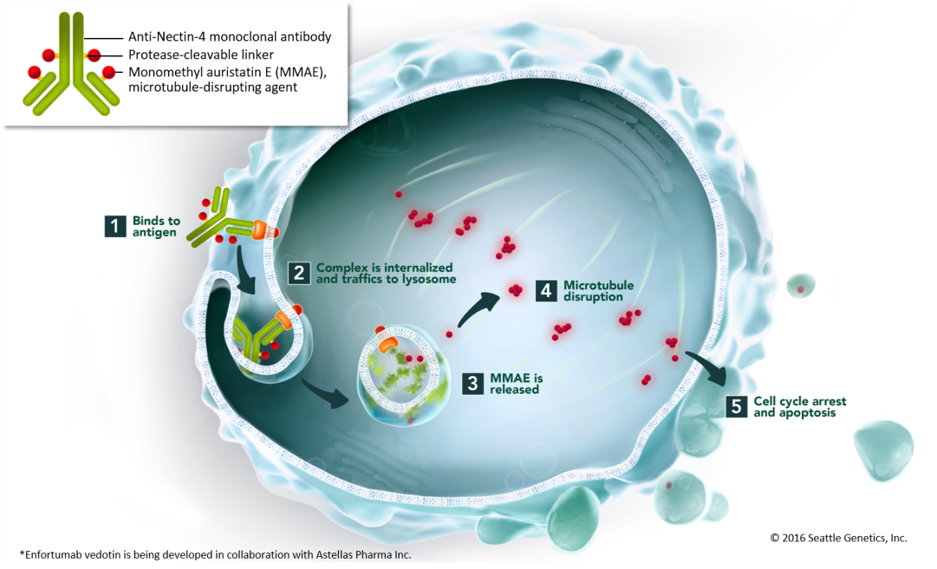
Enfortumab Vedotin is an Antibody-Drug Conjugate Targeting Nectin-4
Enfortumab vedotin (EV) is a fully humanized monoclonal antibody against Nectin-4 conjugated with the microtubule-disrupting agent monomethyl auristatin E by a protease‑cleavable linker
Nectin-4, a transmembrane cell adhesion molecule¹, was found to be highly expressed in 97% of mUC patient samples³
Courtesy of Elizabeth R Plimack, MD, MS
Rosenberg ASCO 2018

Slide 20
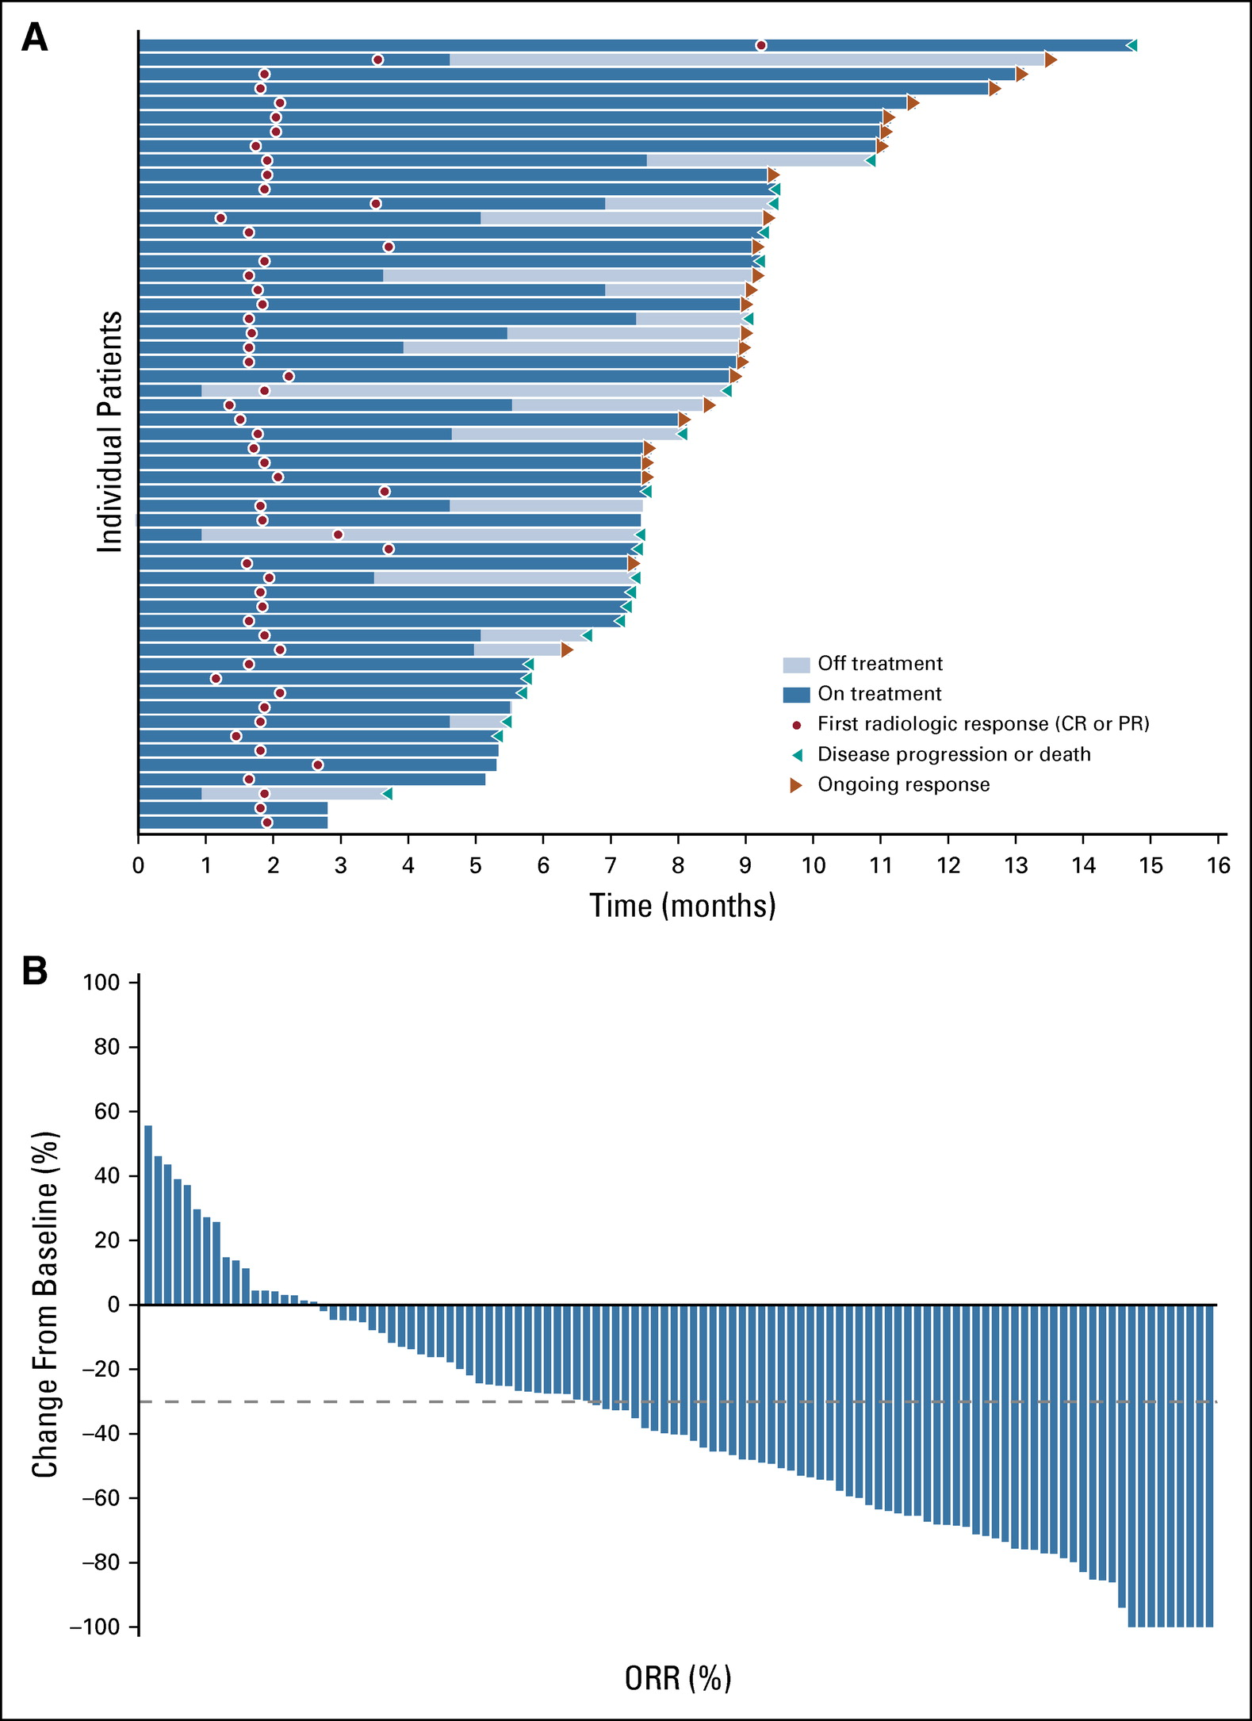
EV-201 Majority of patients have tumor reduction, many responses ongoing
Rosenberg et al. J Clin Oncol. 2019; 29; 2592-2600
Courtesy of Jonathan E Rosenberg, MD

Slide 21
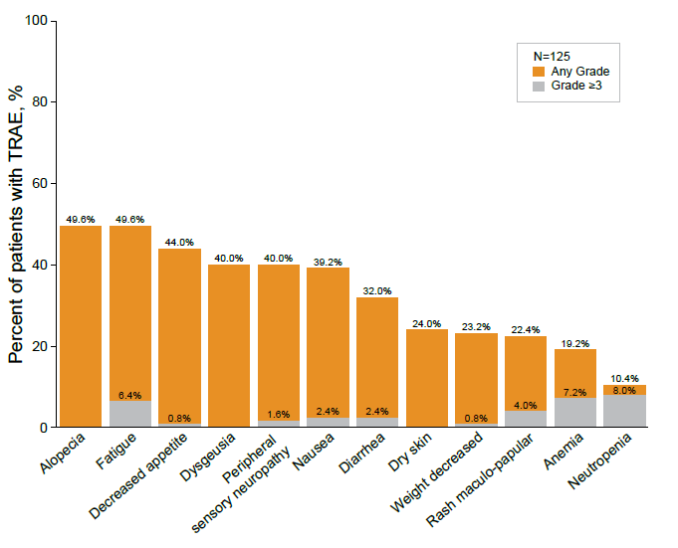
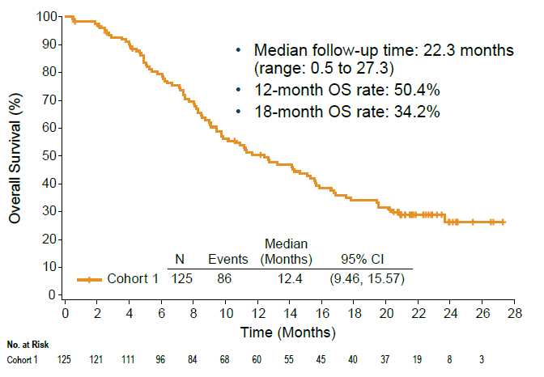
EV-201: Enfortumab Vedotin Monotherapy in Met UC
Courtesy of Elizabeth R Plimack, MD, MS
O Donnell et al ESMO 2020

Slide 22
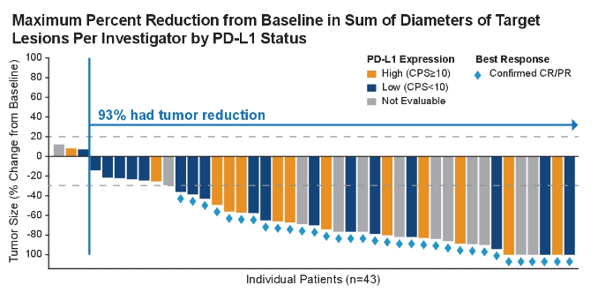
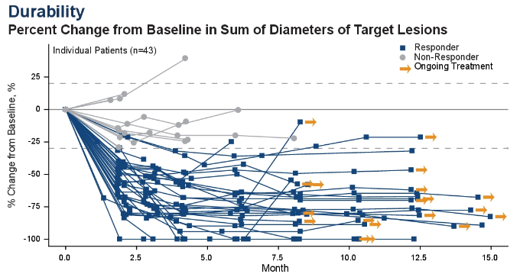
Enfortumab Vedotin + Pembro 1L
Courtesy of Elizabeth R Plimack, MD, MS
Rosenberg et al ASCO 2020

Slide 23
What would you generally recommend for a patient who experiences disease recurrence in the liver 9 months after cystectomy and adjuvant chemotherapy for muscle-invasive UBC (FGFR wild type)?
Nivolumab/ipilimumab
Pembrolizumab
Pembrolizumab
Pembrolizumab
Pembrolizumab
Pembrolizumab
Pembrolizumab
Pembrolizumab

Slide 24
What would you generally recommend for a patient who experiences disease recurrence in the liver 18 months after cystectomy and adjuvant chemotherapy for muscle-invasive UBC (FGFR wild type)?
Enfortumab vedotin
Platinum-based chemotherapy → avelumab
Re-treatment with platinum-based therapy
Pembrolizumab
Platinum-based chemotherapy (DDMVAC or carboplatin/gemcitabine)
Other chemotherapy
Other chemotherapy
Repeat cisplatin-based chemotherapy

Slide 25
What would you generally recommend as second-line therapy for a patient with metastatic FGFR wild-type UBC to the liver whose disease progresses on first-line cisplatin/gemcitabine?
Pembrolizumab
Pembrolizumab
Pembrolizumab
Pembrolizumab
Pembrolizumab
Pembrolizumab
Enfortumab vedotin
Pembrolizumab

Slide 26
Approximately what proportion of patients with mUBC receiving anti-PD-1/PD-L1 antibody therapy in your practice achieve a response to therapy lasting 12 months or more?
15%
10%
15%
10%
10% to 15%
25%
10%
20%

Slide 27
What would you generally recommend as second-line therapy for a 60-year-old patient with metastatic FGFR wild-type UBC to the liver whose disease progresses on first-line cisplatin/gemcitabine followed by maintenance avelumab?
Enfortumab vedotin
Enfortumab vedotin
Enfortumab vedotin
Enfortumab vedotin
Enfortumab vedotin
Enfortumab vedotin
Enfortumab vedotin
Enfortumab vedotin

Slide 28
What would you generally recommend as second-line therapy for an 80-year-old patient with metastatic FGFR wild-type UBC to the liver whose disease progresses on first-line pembrolizumab?
Enfortumab vedotin
Chemotherapy if fit, enfortumab vedotin if not
Chemotherapy
Chemotherapy
Enfortumab vedotin
Chemotherapy
Chemotherapy
Chemotherapy

Slide 29
Regulatory and reimbursement issues aside, would you administer pembrolizumab in combination with enfortumab vedotin to a patient with mUBC outside of a protocol setting?
Yes, in the second line or beyond
No
Yes, in the first line. Yes, in the second line or beyond
Yes, in the first line
No
No
No
No

Slide 30
What is your usual starting dose and schedule of enfortumab vedotin in younger, otherwise healthy patients with mUBC?
1.25 mg/m²
1.25 mg on days 1, 8 and 15 of 28-day cycle
1.25 mg on days 1, 8 and 15 of 28-day cycle
1.25 mg/kg q3 out of 4 weeks
1.25 mg/kg
1.25 mg on days 1, 8 and 15 of 28-day cycle
1.25 mg on days 1, 8 and 15 of 28-day cycle
1.25 mg/kg IV days 1, 8, 18 q4wk

Slide 31
What precautions, if any, do you take to prevent and monitor for infusion site extravasation in your patients receiving enfortumab vedotin?
Cautious IV placement, frequent monitoring of IV access site during infusion
Thorough evaluation of IV access; central line when indicated
No precautions beyond those already employed for other chemotherapies
Port placement when appropriate
Standard precautions
Work with nursing to ensure comfort with IV access, consider an implanted port
Use of central lines, fresh peripheral IV with good flow
Routine

Slide 32
In your current practice, how do you typically approach the management of neuropathy experienced with enfortumab vedotin?
Dose interruption
Early dose reduction and/or interruption
Early dose reduction and initiation of duloxetine
Hold dose for Grade 2, restart if Grade 1 or less, dose reduce as appropriate
Dose holds, treatment breaks and dose reductions
Dose delays and reduction
Dose reduce or stop therapy
Dose reduce or interrupt therapy

Slide 33
In your current practice, how do you typically approach the management of hyperglycemia experienced with enfortumab vedotin?
Hold and then resume at same dose with DM management
Hold off (interrupt) dose as per guidelines
Hold EV; insulin and potentially also metformin
Insulin, work with the patient’s primary care doctor
Standard management
Skip dose, start metformin, resume when under better control
Hold the dose, manage hyperglycemia
Manage hyperglycemia with drugs and continue enfortumab

Slide 34
Is there a baseline Hgb A1C level beyond which you would not consider treating a patient with mUBC with enfortumab vedotin?
No
No
No
No
Yes: 8
Yes: >7
Yes: 8
No

Slide 35
In your current practice, how do you typically approach the management of skin-related adverse events experienced with enfortumab vedotin?
Topical moisturizers and steroid creams, antihistamines, oral steroids if needed
Consider dermatology evaluation; use steroid creams
Brief EV holds, use of barrier/moisturizer treatments like Aquaphor®
Topical steroids
Hold, sometimes it is dose limiting
Topical steroids, moisturizers, dermatology referral, skip doses if severe
Hold the dose if blistering or extensive erythema
Grade 1-2, manage symptoms and continue enfortumab, Grade ≥3, stop

Slide 36
In your current practice, how do you typically approach the management of ocular toxicity experienced with enfortumab vedotin?
Refer to ophthalmology for management, steroid eye drops
Consider artificial tears for prophylaxis; refer to ophthalmology
Hold EV, refer to ophthalmology
Use topical steroids for keratitis
Supportive management, ophthalmologic follow-up
Natural tears, ophthalmologic referral if not improving
Would hold the dose
Artificial tears, steroid drops if significant and ophthalmology consult

Slide 37
How would you generally sequence enfortumab vedotin and erdafitinib for a patient with mUBC who is eligible to receive both agents?
Enfortumab vedotin → erdafitinib
Erdafitinib → enfortumab vedotin
Enfortumab vedotin → erdafitinib
Enfortumab vedotin → erdafitinib
Enfortumab vedotin → erdafitinib
Enfortumab vedotin → erdafitinib
Erdafitinib → enfortumab vedotin
Erdafitinib → enfortumab vedotin

Slide 38
Based on current clinical trial data and your personal experience, how would you compare the global tolerability/toxicity of enfortumab vedotin to that of erdafitinib in patients with mUBC?
Enfortumab vedotin has less toxicity
About the same
Enfortumab vedotin has less toxicity
Enfortumab vedotin has less toxicity
About the same
Enfortumab vedotin has less toxicity
About the same
About the same

Slide 39
Case – Ms Salabao: 70-year-old woman
70 year-old woman with a history of multiple sclerosis & biopsy-proven high grade urothelial carcinoma.
Staging PET-CT: FDG-avid RP lymph nodes and indeterminate FDG uptake in an 8mm lung nodules and ribs.
Her treatment course has been as follows:

Slide 40
Case – Ms Salabao: 70-year-old woman (cont):
Oncology History
October 2018
September 2019
December 2019
April 2019
August 2019
April 2020
Neoadjuvant gemcitabine + cisplatin.
Left radical nephroureterectomy, ypT3, negative margins.
New liver lesions– biopsy-proven metastatic urothelial cancer (ERBB2 mutation, TMB 17.5, no FGFR2/3 variant).
3 cycles pembro followed by progression– liver and bone.
Trial– neratinib + paclitaxel– again progression in liver.
04/07/20: C1D1 enfortumab vedotin.
.

Slide 41
Pretreatment Considerations
Clinical Reasoning
Peripheral neuropathy
Prior exposure cisplatin and paclitaxel.
Grade 1 peripheral neuropathy prior to initiating EV.
We considered dose-reduction or eliminating D15 EV but fortunately neuropathy did not worsen.
Taking into account her treatment history, what side effect should we monitor particularly closely when initiating EV?
¹Rosenberg JE, O'Donnell PH, Balar AV, et al. Pivotal Trial of Enfortumab Vedotin in Urothelial Carcinoma After Platinum and Anti-Programmed Death 1/Programmed Death Ligand 1 Therapy. J Clin Oncol. 2019;37(29):2592-2600. doi:10.1200/JCO.19.01140
Notes:
Dose reduction is the recommendation though we may only do D1, D8

Slide 42
Symptom Management
Symptom Management
A tolerated EV therapy with PR after 2 cycles of EV.
Prior to C4, she complains of alopecia, and “itchy red eyes” accompanied by mild blurry vision. Labs unremarkable.
What was our next intervention?
Referred ophthalmologist for evaluation.
Diagnosed with mild keratitis and completed a course of tobramycin/dexamethasone eyedrops. She continued rewetting and steroid drops with stable symptoms for duration of EV.
Notes:
Alopecia is also a somewhat commonly reported sfx of EV-- consider rx for wig etc etc

Slide 43
Case – Dr Ruplin: 69-year-old woman
Advanced Urothelial Carcinoma History
November 20, 2017: Cycle 1, day 1 dose-dense MVAC, with a planned 4 cycles in the neoadjuvant setting.
January 31, 2018: Radical cystectomy with bilateral pelvic lymph node dissection. Pathology demonstrates high-grade urothelial carcinoma, with 10% clear cell histology and 20% plasmacytoid/signet ring cell, stage pT3a, negative margins, 3 of 28 lymph nodes positive. Also noted squamous metaplasia.
June 04, 2018: Embarks on adjuvant Palbociclib as well as Trastuzumab plus Pertuzumab due to high HER2 expression. Plan is for the patient to complete 6 months of therapy followed by weekly Trastuzumab with everolimus 5 mg PO.
March 13, 2019: Patient develops post-menopausal vaginal bleeding. Patient undergoes a vaginal biopsy as well as a hysteroscopy with biopsies of the cervix and uterus. Biopsies reveal poorly differentiated carcinoma with focal plasmacytoid features and focally beneath uninvolved squamous mucosa consistent with involvement by patient's known urothelial carcinoma. MRI of pelvis also completed revealing a suspicious sacral lesion.

Slide 44
Case – Dr Ruplin: 69-year-old woman (cont)
March 19, 2019: PET/CT scan reveals metabolic activity at the cervix and vagina consistent with known tumor involvement and recent biopsy, max SUV of 6.5. There is a left obturator lymph node measuring approximately 1.3 cm on recent diagnostic CT with focal uptake with a max SUV of 4.8, which is more questionable in etiology. There is a focal FDG uptake in the left sacral sclerotic lesion measuring approximately 1.5 cm with a max SUV of 7.0.
April 01, 2019: Patient begins pelvic radiation therapy + concurrent weekly Cisplatin x 6 weeks.
April 06-April 07, 2019: Patient admitted to hospital with AKI and bilateral LE edema. Therefore, missed week 2 of Cisplatin.
April 24, 2019: Patient stops Cisplatin after 2 doses secondary to poor tolerance. Initiates Pembrolizumab IV q3 weeks.
June 24, 2019: PET/CT following 3 cycles of Pembrolizumab reveals the previously described FDG avid solitary left supraclavicular lymph nodes not well visualized on this exam. The degree of FDG avidity within the uterus is similar to previous with a maximum SUV of 7.1, previously 7.5. There is interval decrease in FDG avidity of several pelvic lymph nodes that are normal in size. For example, left pelvic wall lymph node measuring 1.1 x 0.7 cm, now with an SUV max of 3.3, previously 4.3 and previously 4.8.

Slide 45
Case – Dr Ruplin: 69-year-old woman (cont)
June 24, 2019 (cont): Therefore, there is interval decrease in FDG uptake in multiple nonenlarged pelvic and periaortic lymph nodes, as well as in the left sacral sclerotic lesion that is likely an osseous metastasis that was previously 7.0 SUV, now 5.1. There are no new lesions.
10/09/2019: Initiates C1D1 IMMU-132 trial (sacituzumab govitecan). Has progression not long after.
01/08/2020: Initiates enfortumab vedotin at 1.25 mg/kg days 1,8,15 every 28 days
09/02/2020: Dose reduction to 1 mg/kg given every 28 days due to neuropathies, rash, and reported taste changes that the patient attributes to enfortumab vedotin. Radiographic scans are currently stable.
Questions:
For how long have you successfully treated a patient with EV thus far?
Have you eliminated days of treatment from EV cycles before? (e.g., day 1 only every 28 days)

Slide 46
Case – Dr Rosenberg: 88-year-old man
Age: 88 Sex: Male
How long ago did you first see the patient? 6 months ago
Please briefly describe the patient’s clinical course prior to receiving enfortumab vedotin.
PD on pembrolizumab, gemcitabine/carboplatin
What was the outcome with enfortumab vedotin? Stable disease
Did the patient experience any tolerability issues with enfortumab vedotin?
Yes: Fatigue and rash
Questions
1. Would a study in octogenarians be useful to define extreme geriatric dosing?
2. Prospective trials of dermatologic management?

Slide 47
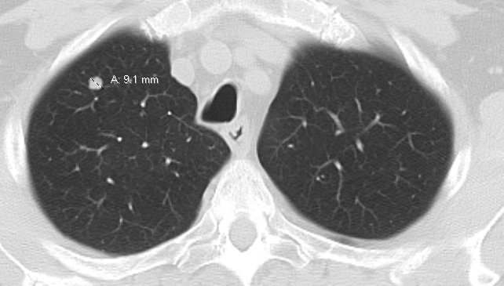
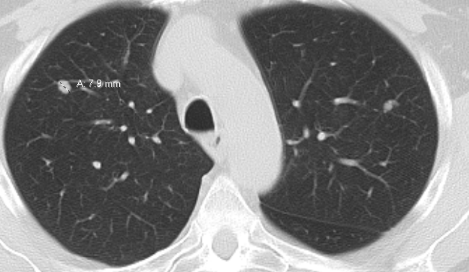
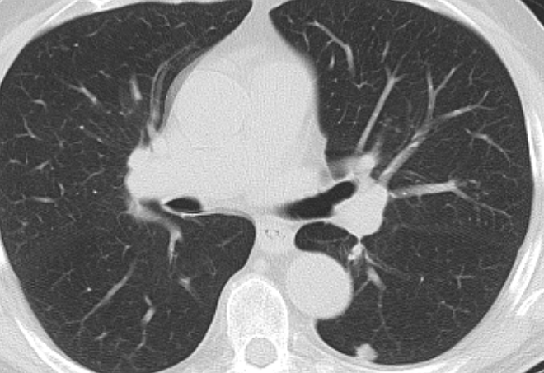
Case – Dr Plimack: 83 yo man with chronic renal insufficiency
Ta urothelial cancer→ BCG
1 year later, new UTUC → nephroureterectomy
  High grade urothelial carcinoma, no LVI (T3N0M0 = stage III)
1 year after surgery, surveillance imaging shows multiple lung metastases
Creatinine 2.9

Slide 48

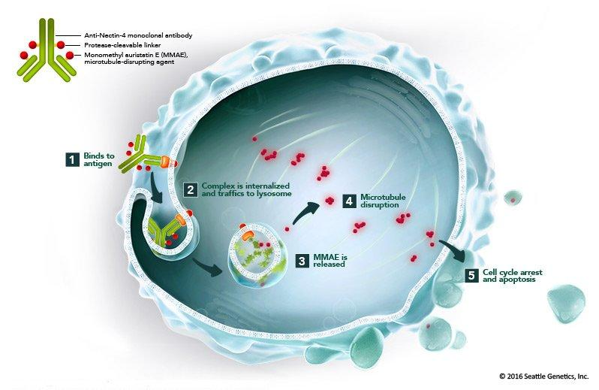
Case – Dr Plimack: 83 yo man with chronic renal insufficiency (cont)
Pembrolizumab → sustained PR
At 2 years on pembro, imaging met criteria for PD and pt developed grade 2 colitis
Started on Enfortumab Vedotin

Slide 49
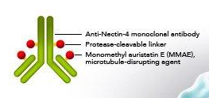
Case – Dr Plimack: 83 yo man with chronic renal insufficiency (cont)
Pembrolizumab → sustained PR
At 2 years on pembro, imaging met criteria for PD and pt developed grade 2 colitis
Started on Enfortumab Vedotin

Slide 50
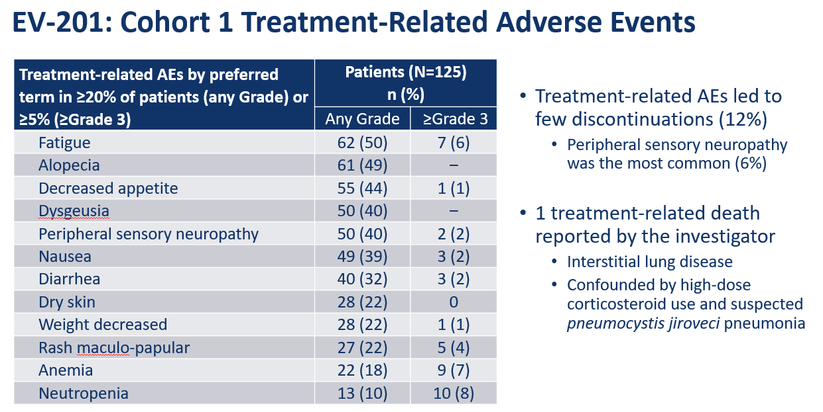
Enfortumab Vedotin
Petrylak ASCO 2019

Slide 51
Case – Dr Plimack: 83 yo man with chronic renal insufficiency (cont) – Enfortumab vedotin
Patient received treatment at standard dose
  1.25 mg/kg weekly x3 weeks, off 1 week (q 28 day cycle).
Achieved a partial response, but eventually developed neuropathy
Initially grade 2 (per patient)→ progressed to grade 3
Treatment held at 14 months in setting of response
Neuropathy did not resolve, EV could not be restarted
CTCAE V 5.0

Slide 52
Case – Ms Salabao: 67-year-old man
67-year-old male with a history of HLD and HTN, diagnosed in 02/2016 with high grade (2/3) papillary urothelial carcinoma with focal squamous differentiation that invaded the lamina propria.
Genomic testing showed a genetic alteration in the genes BRIP1, PI3KCA and FGFR3.
Treatment history is as follows:

Slide 53
Case – Ms Salabao: 67-year-old man (cont): Oncology History
February 2016
December 2016
December 2017
June 2016
May 2018
July 2016
September 2016
Initial diagnosis and resection; repeat TURBT with residual disease. BCG x 6.
TURBT with persistent disease, PET CT with metastases to the retrocrural and left periaortic lymph nodes.
Started gemcitabine + cisplatin.
Progression through gem/cis x6 cycles. Started trial with B-701 + docetaxel.
Progression and switch to trial with IMMU-132.
Imaging w/ progressive disease x 14 cycles IMMU-132. Started pembrolizumab.
Progression after 6 cycles pembro and started EV-201, enfortumab vedotin.

Slide 54
Lab Abnormalities
Sodium | 140
Potassium | 4.1
Chloride | 101
Carbon Dioxide | 21
BUN | 12
Creatinine | 0.96
GFR (estimated) | 90
Glucose | 138 (H)
Phosphorus | 3.0
ALT (SGPT) (U/L) | 31
AST (SGOT) | 3
Alk Phos | 100
WBC | 1.70 (L)
RBC | 5.33
Hgb | 11.9 (L)
HCT | 34.6 (L)
PLT | 299
Neutrophil # (manual) | 0.21 (L)
Band # (manual) | 0.03
Lymph# (manual) | 0.90
Mono# (manual) | 0.71
Eos# (manual) | 0.00
Baso# (manual) | 0.02
He presents prior to C15D8 today feeling overall well.
His labs today are displayed to the right:
What lab abnormalities should be monitored closely on EV and what is concerning specific to this patient?

Slide 55
Lab Abnormalities
For this patient, neutropenia is grade 4. Hematological toxicities of grade 3 (or grade 2 decreased platelets) would require a hold until grade 1 or less and restart at the same dose
  If grade 4, hold and resume at grade 1 or less with at least 1 dose reduction or consider discontinuation of treatment.
Specifically, hyperglycemia requires a dose hold. When FBS is <250, EV may be restarted at the same dose.
For nonhematological toxicities, hold until grade 1 or less and restart at the same dose OR with 1 dose reduction.
  EV-201 specifically found grade 2-4 hypophosphatemia, hyponatremia, hypokalemia, hyperlipasemia, elevated creatinine and hyperuricemia.
¹Rosenberg JE, O'Donnell PH, Balar AV, et al. Pivotal Trial of Enfortumab Vedotin in Urothelial Carcinoma After Platinum and Anti-Programmed Death 1/Programmed Death Ligand 1 Therapy. J Clin Oncol. 2019;37(29):2592-2600. doi:10.1200/JCO.19.01140
¹Erdafitinib [package insert], 2019.

Slide 56
Symptom Management
Symptom Management
He presents prior to C20D1 EV with the following complaints:
  Has been unable to button his shirts
  Difficulty holding onto a screwdriver when working around the home.
Grade 2 neuropathy (limitation of instrumental ADLs):
Hold EV
  Option 1: Resume when less than or equal to Gr 1 at same dose level
  Option 2: Resume when less than or equal to Gr 1 at 1 dose level reduction
What are the next steps?
We had already reduced from 1.25mg/kg to 1mg/kg and further reduced to 0.75mg/kg after this event.
¹Erdafitinib [package insert], 2019.

Slide 57
Enfortumab vedotin: Take Home Points
For use after platinum-based therapies.
Major adverse effects: hyperglycemia, dermatological toxicities and peripheral neuropathy (for comprehensive list see prescribing information).
May hold treatment and/or dose reduce.
Courtesy of Cristina Salabao, MSN, FNP-C

Slide 58
Case – Ms Salabao: 67-year-old man (cont):
Disease Progression
After 22 cycles of EV, his disease unfortunately progressed.
We discussed other treatment options including clinical trial and compassionate use therapies.
Why was erdafitinib selected as the next line of therapy?

Slide 59
Treatment Planning
Genomic testing revealed FGFR3 mutation.
Erdafitinib (an FGFR kinase inhibitor) has effect in those with an FGFR 2 or 3 mutation with a confirmed response rate of 40% and mean OS of 11.3 months.
BLC2001 found a favorable response in metastatic or unresectable urothelial carcinoma previously pre-treated with platinum-based therapy.
¹Zhu J. ASCO 2020: ERDAFITINIB in Locally Advanced or Metastatic Urothelial Carcinoma: Long-Term Outcomes in BLC2001. Retrieved from https://www.urotoday.com/conference-highlights/asco-2020/asco-2020-bladder-cancer/121875-asco-2020-erdafitinib-in-locally-advanced-or-metastatic-urothelial-carcinoma-long-term-outcomes-in-blc2001.html
²Loriot Y et al.. Erdafitinib in Locally Advanced or Metastatic Urothelial Carcinoma. N Engl J Med. 2019 Jul 25;381(4):338-348.

Slide 60
Pretreatment Evaluation
Pretreatment Evaluation
Phosphorus
He has some questions about diet while on erdafitinib.
What electrolyte monitoring in particular is required prior to and for the duration of erdafitinib?
Hyperphosphatemia was reported in 76% of patients treated with erdafitinib.
  Limit intake of phos to 600-800mg/day.
  Dose adjustment per Erdafitinib prescribing information.
  Consider phosphorus binder for phos >7 until <5.5.
5.6-6.9 mg/dL | Continue without any modification
7.0-9.0 mg/dL | Hold until <5.5 at same dose level (reduce 1 level if prolonged)
>9 mg/dL | Hold until <5.5 at 1 dose level reduction
>10* | Hold until <5.5 at 2 dose level reductions
* (or if Gr 3 or higher hypercalcemia or significant change in renal function)
²Loriot Y et al.. Erdafitinib in Locally Advanced or Metastatic Urothelial Carcinoma. N Engl J Med. 2019 Jul 25;381(4):338-348.
²Erdafitinib [package insert], 2019.
Notes:
Hyperphos– most common cause of dose hold
Consider phos binder >5.5
M continues on erda with response and no significant DLTs

Slide 61
Module 3: Role of Erdafitinib in the Treatment of Advanced UBC

Slide 62
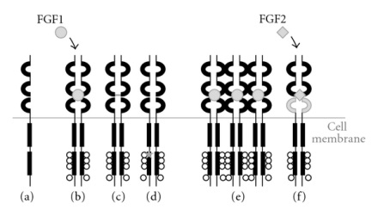

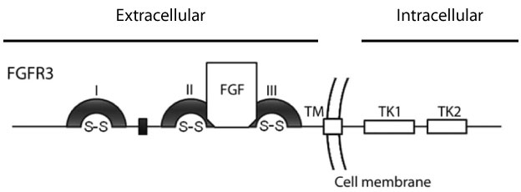
Fibroblast Growth Factor Receptor 3 is a therapeutic target in mUC
Mutation frequency in non-invasive disease is >50% in Ta tumors
Mutations and fusions are less common in advanced UC
  Mutation 5-15%
  Fusion 3-5% using NGS
FGFR3 activation can occur by mutation, overexpression or gene fusion
FGFR3 signals via PI3K, PKC, RAS/MAP kinase pathways
Mutation leads to ligand independent dimerization
Fusion/translocation
TACC3
FGFR3
Overexpression
Courtesy of Jonathan E Rosenberg, MD

Slide 63
Erdafitinib is the first targeted therapy approved for advanced bladder cancer
Accelerated approval April 12, 2019
Indicated in tumors with FGFR3 or FGFR2 alterations
  Progression during or following prior platinum-containing chemotherapy
Dosing:
  8 mg daily
  Increase to 9mg daily if serum phosphorus level is <5.5 mg/dL (and no ocular disorders or ≥ grade 2 toxicity) at days 14-21 of therapy
  Continue until disease progression or unacceptable toxicity occurs
  Monthly ophthalmologic exams x 4 then q3 months
Courtesy of Jonathan E Rosenberg, MD

Slide 64

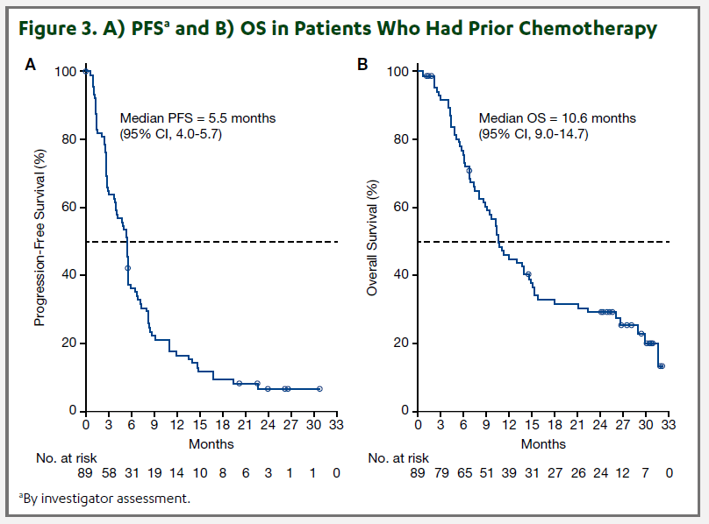
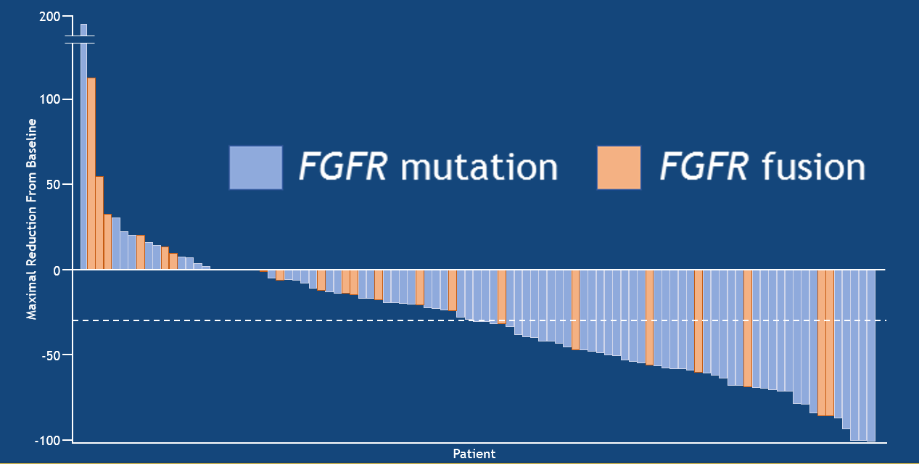
Phase II Erdafitinib: oral pan-FGFR (1-4) inhibitor
FGFR mutation or fusion required for enrollment (prevalence in met UC: 15-20%)
At least 1 prior systemic therapy. Prior checkpoint allowed.
ORR 40%, mOS 13.8 months
Siefker Radtke ASCO 2018, Loriot NEJM 2019
Courtesy of Elizabeth R Plimack, MD, MS
Necchi ESMO 2020

Slide 65

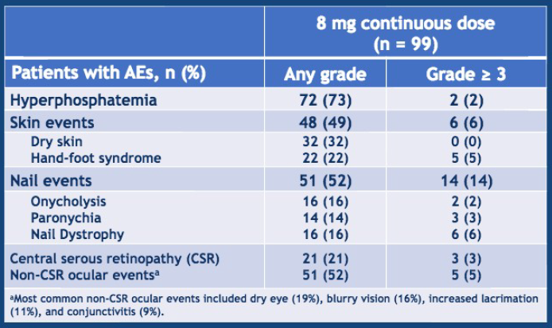
Phase II Erdafitinib: oral pan-FGFR (1-4) inhibitor
Notable AEs: Hyperphosphatemia, skin/nail changes, central retinopathy.
Courtesy of Elizabeth R Plimack, MD, MS
Siefker Radtke ASCO 2018

Slide 66
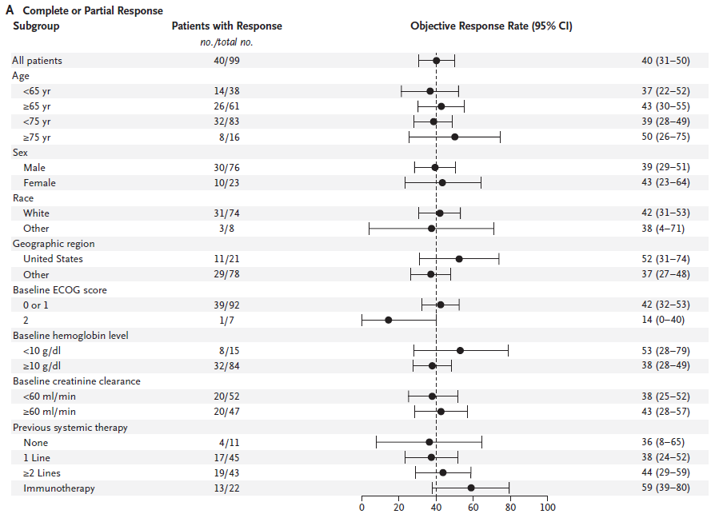
Phase II Erdafitinib: oral pan-FGFR (1-4) inhibitor
Courtesy of Elizabeth R Plimack, MD, MS
Siefker Radtke ASCO 2018, Loriot NEJM 2019

Slide 67
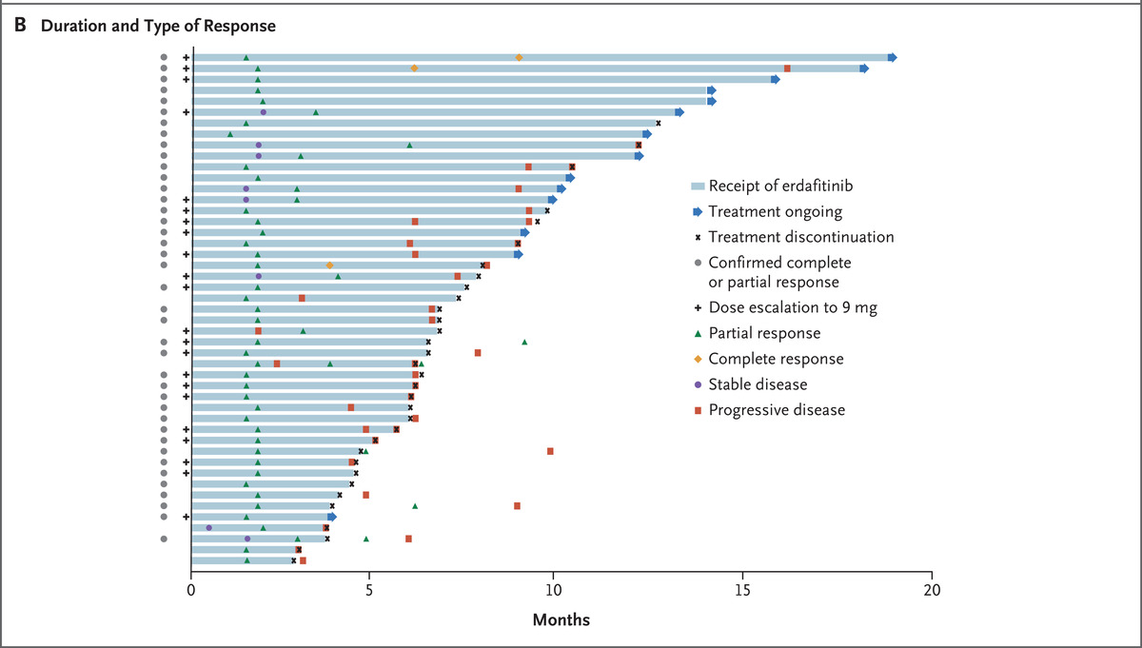

Y Loriot et al. N Engl J Med 2019;381:338-348.
Response to Treatment, According to Subgroup.
BLC2001: Some patients treated with erdafitinib have responses >1 year
Courtesy of Jonathan E Rosenberg, MD
Notes:
Figure 1. Response to Treatment, According to Subgroup. Panel A shows the rate of complete or partial response to continuous daily treatment with erdafitinib among patients in the selected-regimen group, according to subgroup. The safety profile allowed for a dose escalation from 8 mg to 9 mg of erdafitinib per day in 41 of the 99 patients who met target levels for serum phosphate. Panel B shows the duration and type of response in 47 patients, of whom 40 had a confirmed response (the primary end point) and 7 had an unconfirmed response. All objective responses required confirmation by an additional scan within 6 weeks after the first assessment. Race was reported by the patients. Scores on the Eastern Cooperative Oncology Group (ECOG) scale range from 0 (no disability) to 5 (death).

Slide 68
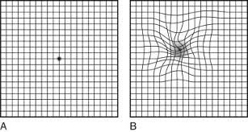
Y Loriot et al. N Engl J Med 2019;381:338-348.
BLC2001: Toxicity of erdafitinib
55% of patients required dose reductions
41% of patients were able to escalate to 9mg daily
59% required subsequent dose reductions
46% of patients had grade 3 or higher AE attributable to treatment
Most common toxicities are hyperphosphatemia (on-target effect), stomatitis, and diarrhea
Central serious retinopathy in 21% of patients, 3% grade 3
  Generally reversible
  Amsler grid testing
Courtesy of Jonathan E Rosenberg, MD

Slide 69
mUC patients with progression after immunotherapy have limited options
Response rates to second-line PD-1/L1 inhibitors are 13%-21% ^{1,2}
Single agent chemotherapy post-platinum and post-PD-1/L1 inhibitors shows limited activity (ORR ~11%)³
Enfortumab Vedotin, an antibody-drug conjugate, showed an ORR of 45% in patients with prior PD-1/L1 inhibitors in a phase 1 study⁴
Enfortumab Vedotin was FDA approved December 2019 for patients with progression after cytotoxic chemotherapy and immune checkpoint blockade
¹ Bellmunt J, et al. N Engl J Med. 2017;376:1015-26; ² Powles T, et al. Lancet. 2018;391:748-57; ³ Petrylak DP et al. Lancet. 2017;390:2266-77; ⁴ Rosenberg JE, et al. J Clin Oncol. 2020; 38: 1041-1049.
Courtesy of Jonathan E Rosenberg, MD

Slide 70
Current Standard of Care at FCCC: Subsequent Therapy
Prior therapy | Subsequent Preferred | Alternatives
Post 1st line platinum | Pembrolizumab (maintenance or at PD) | Erdafitinib* other PD1/PDL1 inhibitor
Post 1st line PD1/PDL1 inhibitor | DDMVAC (cis eligible) Gemcitabine carboplatin (cis ineligible) | Gemcitabine single agent
Post platinum and PD1/PDL1 inhibitor | Enfortumab Vedotin Erdafitinib (FGFR altered*) | Gemcitabine single agent Taxane single agent
* Erdafitinib restricted to patients with FGFR 3 mutations or FGFR 2/3 fusions
Always consider
CLINICAL TRIAL
See NCCN guidelines for more options
Courtesy of Elizabeth R Plimack, MD, MS

Slide 71
SUMMARY: Advanced Disease
Front line
  Platinum based chemotherapy still provides the highest response rate to date, and for cisplatin these responses can be durable.
  Start with 4-6 cycles, then follow with maintenance pembro or avelumab in patients with response or SD
  Checkpoint inhibition should be reserved for second line. First line = no benefit, risk of early death
Second line and beyond
  Checkpoint inhibition (does not require PDL1 testing for 2nd line use)
  After platinum and a checkpoint inhibitor
    Enfortumab Vedotin
    Erdafitinib for those with FGFR mutations
Always consider
CLINICAL TRIAL
Courtesy of Elizabeth R Plimack, MD, MS

Slide 72
What would you generally recommend for a patient who experiences disease recurrence in the liver 9 months after cystectomy and adjuvant chemotherapy for muscle-invasive UBC and is found to have an FGFR3 mutation?
Enfortumab vedotin
Erdafitinib
Erdafitinib
Erdafitinib
Pembrolizumab
Erdafitinib
Erdafitinib
Erdafitinib

Slide 73
What would you generally recommend for a patient who experiences disease recurrence in the liver 18 months after cystectomy and adjuvant chemotherapy for muscle-invasive UBC and is found to have an FGFR3 mutation?
Nivolumab/ipilimumab
Platinum-based chemotherapy → avelumab
Erdafitinib
Erdafitinib
Platinum-based chemotherapy (DDMVAC or carboplatin/gemcitabine)
Other chemotherapy
Erdafitinib
Repeat cisplatin-based chemotherapy

Slide 74
What would you generally recommend as second-line therapy for a patient with metastatic UBC (mUBC) to the liver whose disease progresses on first-line cisplatin/gemcitabine and who is found to have an FGFR3 mutation?
Pembrolizumab
Erdafitinib
Erdafitinib
Erdafitinib
Pembrolizumab
Pembrolizumab
Erdafitinib
Erdafitinib

Slide 75
What would you generally recommend as second-line therapy for a 60-year-old patient with metastatic UBC to the liver whose disease progresses on first-line cisplatin/gemcitabine followed by maintenance avelumab and who is found to have an FGFR3 mutation?
Enfortumab vedotin
Erdafitinib
Erdafitinib
Enfortumab vedotin
Enfortumab vedotin
Enfortumab vedotin
Erdafitinib
Erdafitinib

Slide 76
What would you generally recommend as second-line therapy for an 80-year-old patient with metastatic UBC to the liver whose disease progresses on first-line pembrolizumab and who is found to have an FGFR3 mutation?
Enfortumab vedotin
Chemotherapy if fit, enfortumab vedotin or erdafitinib if not
Chemotherapy
Erdafitinib
Enfortumab vedotin
Chemotherapy
Erdafitinib
Chemotherapy

Slide 77
What is your usual starting dose and schedule of erdafitinib for younger, otherwise healthy patients with mUBC?
8 mg once daily
8 mg once daily
8 mg per day
4 mg BID
8 mg per day
8 mg per day
8 mg and up-titrate to 9 mg
8 mg per day

Slide 78
Do you counsel all of your patients with mUBC receiving erdafitinib to limit their phosphate intake?
Yes: Provide a list of foods high in phosphate to avoid/limit
Yes: Provide a list of foods high in phosphate to avoid/limit
No
Yes
No
Yes: As low as reasonably achievable
Yes
Yes: Modest

Slide 79
In your current practice, how do you typically approach the management of gastrointestinal toxicity experienced with erdafitinib?
Antidiarrheal medication and diet modifications
Antidiarrheals, antiemetics, optimize nutrition
Loperamide and hold the drug if Grade 2 or worse
Hold drug and start at lower dose
Supportive management, treatment breaks
With difficulty
Usually not dose limiting, unless mucositis, then hold therapy
Grade 1-2, manage symptoms and continue erdafitinib, Grade ≥3, stop

Slide 80
In general, when you administer erdafitinib, do you preemptively prescribe steroid mouthwash for the prevention of treatment-related stomatitis?
No
No
No
No
No
No
No
No

Slide 81
In your current practice, how do you typically approach the management of stomatitis experienced with erdafitinib?
Magic mouthwash, bicarbonate rinse, Gelclair®. Then dose reduction if significant impact on QoL
Steroid mouthwash; interrupt drug if needed
Hold the drug and give magic mouthwash for Grade 2; magic mouthwash for Grade 1 and greater
Magic mouthwash, hold drug
Supportive care, steroid mouthwash, treatment breaks, dose reductions
Steroid mouthwash, dose interruption, reduction
Good mouth care. Sugar-free candies to promote saliva, salt and soda mouth rinses
Miracle mouthwash, dose reductions

Slide 82
In your current practice, how do you typically approach the management of skin-related adverse events experienced with erdafitinib?
Steroid creams, and moisturizers, followed by dose reduction
Consider dermatology evaluation; use steroid creams
Hold the drug if Grade 3 or worse
Hold the drug
Supportive care, topical treatments, dermatology consult, treatment breaks
Topical steroid and dose interruption
Protective gloves, emollient creams from a tube
Moisturizers, dose reductions

Slide 83
What type of prophylactic measures do you generally recommend to potentially reduce the incidence of nail events (eg, onycholysis, nail dystrophy, paronychia) in your patients receiving erdafitinib?
Moisturize hands aggressively and then wear gloves at night
Optimal nail hygiene, avoid injury, consider podiatrist for diabetics
Avoidance of manual tasks as much as possible
None
Generally good nail and skin care
Dermatology referral
Creams, gloves if washing/using water, avoid hot water, good nail care
Avoid prolonged contact with water, trauma, friction, pressure on nails and nail beds

Slide 84
Do you recommend regular ophthalmologic examinations to your patients with mUBC receiving erdafitinib?
Yes — Monthly for the first 4 to 5 months
Yes — Monthly x 4 then every 3 months
Yes — At baseline
Yes — q6m
Yes — Monthly
Yes — Monthly
Yes — Monthly on protocol, otherwise symptom based and using
Amsler grid due to COVID-19 limitations
Yes — Monthly x 3, then every 2 to 3 months

Slide 85
In your current practice, how do you typically approach the management of ocular toxicity experienced with erdafitinib?
Dose hold and repeat ocular exam
Dry-eye prophylaxis with ocular demulcents, ophthalmalogic exams
Follow guidance from ophthalmologist
Hold dose, restart if returns to Grade 1
Continue treatment unless visual acuity is impaired
Dose interruption/reduction
Hold therapy, resume with dose reduction when resolves
Interrupt therapy and then resume with dose reduction

Slide 86
Case – Ms Salabao: 75-year-old woman
75-year-old woman initially diagnosed urothelial carcinoma (OSH 05/2011).
S/p nephroureterectomy 07/2011; pathology showed urothelial carcinoma in the right renal pelvis invading but not beyond muscularis; + CIS, negative margins.
Her treatment course has been as follows:

Slide 87
Case – Ms Salabao: 75-year-old woman (cont):
Oncology History
2011
June 2017
May 2019
July 2016
August 2016
April 2020
Initial diagnosis and resection.
Imaging showed pulmonary met. Path + poorly diff carcinoma c/w urothelial primary.
Gemcitabine + cisplatin x6 cycles.
Atezolizumab x30 cycles.
PET CT w/ progression in LNs and lungs. Started protocol 17-492
cabozantinib + atezolizumab.
Progression after 12 cycles. Oncopanel with activating FGFR3 mutation. Started erdafitinib 8mg/day.

Slide 88
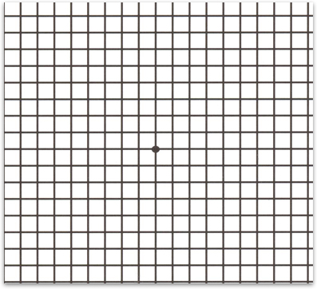
Symptom Management
Symptom management
She is presented with the following during drug teaching and is also set up with a related specialist.
Ophthalmology
Central serous retinopathy/retinal pigment epithelial detachment (CSR/RPED) in 25% of patients.
~50 days after starting.
Most common cause of dose reduction.
Monthly ophthalmological eval x4, then every 3 months thereafter.
Consider Amsler grid for self-monitoring.
Consider prophylactic lubricating drops.
Who is the specialist and why?
²Loriot Y et al.. Erdafitinib in Locally Advanced or Metastatic Urothelial Carcinoma. N Engl J Med. 2019 Jul 25;381(4):338-348.
²Erdafitinib [package insert], 2019.
Notes:
Ocular disorder most frequent cause of dose reduction (not just CSR and RPED).
DC if high grade.

Slide 89
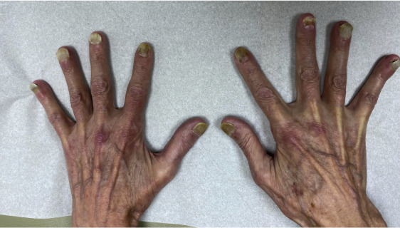
Symptom Management
Symptom management
She presents today after 2 months of erdafitinib with the following findings on exam:
Nail disorders
Nail effects such as onycholysis, paronychia and nail infections
Hold medication until grade 1
Antiseptic soaks can be helpful
Consider course of antifungals or antibiotics or referral to dermatology
** Not actual patient image¹
¹Deutsch A, McLellan BN. Severe onycholysis and eyelash trichomegaly in a patient treated with erdafitinib. JAAD Case Rep. 2020;6(6):569-571. Published 2020 Apr 25. doi:10.1016/j.jdcr.2020.04.013
²Loriot Y et al.. Erdafitinib in Locally Advanced or Metastatic Urothelial Carcinoma. N Engl J Med. 2019 Jul 25;381(4):338-348.

Slide 90
Erdafitinib: Take Home Points
For use in those with advanced urothelial cancer with FGFR 2/3 alterations.
Major adverse effects include: Hyperphosphatemia, central serous retinopathy/retinal pigment epithelial detachment/ocular disorders and dermatological changes.
Can hold medication and dose adjust.
Courtesy of Cristina Salabao, MSN, FNP-C

Slide 91
Case – Dr Ruplin: 60-year-old man
Oncologic History
Gross hematuria. Ultrasound showing large vascular bladder mass.
02/15/2019 TURBT. Pathology showed high-grade T1 urothelial carcinoma. Resection was incomplete secondary to bleeding. There was high suspicion of clinical T3 disease.
CT with a question of metastasis to the pelvic lymph nodes and peritoneum.
04/08/2019, cycle 1, day 1, dose-dense MVAC. He completed 6 cycles on 06/17/2019.
On 06/28/2019, CT showed decreased size of the bladder mass and peritoneal nodules, stable right pelvic sidewall lymph node and nonocclusive pericatheter thrombus.
08/23/2019, CT showed increase in the bladder mass with stable peritoneal nodules, stable and necrotic right external iliac nodes.
09/15/2019, cycle 1, day 1, IL-7 plus atezolizumab. Final dose of IL-7 was delivered on 09/26/2019 and final dose of atezolizumab was delivered on 10/24/2019.
CT imaging done on 10/30/2019 showed worsening disease characterized by enlarging lobulated bladder wall mass. There was a question of minimal extension outside of the bladder wall.

Slide 92
Case – Dr Ruplin: 60-year-old man (cont)
11/21/2019, he underwent a TURBT. Pathology specimen showed high-grade urothelial carcinoma pT1. There was no muscularis propria in the specimen. Interestingly, most of the tumor was low-grade.
12/13/2019, CT of the chest, abdomen and pelvis showed the bladder mass slightly decreased, now measuring 7 x 3.1 cm. No evidence of bony disease. There were prominent right inguinal and iliac chain lymph nodes. The subcentimeter peritoneal nodule in the right lower quadrant was stable. There were also some new ground-glass opacities in the right upper lobe, most consistent with inflammation or infection. Attention was recommended on follow-up CT scans.
12/20/2019, erdafitinib 8 mg daily initiated.
Follow-up on 01/06 showed phosphate elevated at 6.2, phosphate binders initiated.
1/22/20, Optical Coherence Tomography Macular Cube scan findings: mild central serous chorioretinopathy bilaterally, recommended referral to retinal specialist. Erdafitinib was held.
2/20/20, CT CAP demonstrated unchanged bladder mass size and unchanged right internal iliac LN. Resolution of pulmonary groundglass densities.

Slide 93
Case – Dr Ruplin: 60-year-old man (cont)
2/20/20, complete resolution of central serous retinopathy (CSR) per ophthalmology note from outside records.
3/16/20, restarted erdafitinib at 6 mg once daily.
4/20/20, recurrence of CSR, grade 1, recommended by ophthalmology to continue medication as is
4/24/20, CT A/P showed significant reduction in size of bladder mass
4/25/20, Hyperphosphatemia to 5.6, asymptomatic. Instructed on dietary changes.
6/4/20, persistent subretinal fluid upon ophthalmology visit, grade 1, continues on medication at 6 mg daily
7/30/20, near resolved subretinal fluid upon ophthalmology visit, grade 1, patient opted for a 3-week break since 7/20/30
10/15/20, near resolution of subretinal fluid upon ophthalmology visit, grade 1, continues on medication at 6 mg daily

Slide 94
Case – Dr Ruplin: 60-year-old man (cont)
Current Therapy
Erdafitinib at 6 mg daily, dose reduced secondary to serous retinopathy. Patient uses an Amsler grid daily. Overall, he continues with stable disease vs prior CT. The main limitations to his treatment at this time are the possible side effects. Right now there are grade 1-2 side effects he notes, most noticeably fatigue and intermittent anorexia/dysgeusia. Given the temporal nature of these symptoms and the diarrhea that is occurring mostly on the weekends, there is the consideration of lifestyle, sleep patterns and work contributing to these symptoms (beyond simply drug side effects). At this point, he really wants to continue the medication at same dose and he will need to monitor closely for symptoms.
Questions:
Would you have been comfortable restarting erdafitinib without complete resolution of ocular toxicity?
What is your threshold to start phosphate lowering agents?

Slide 95
Case – Dr Rosenberg: 70-year-old woman
Age: 70 Sex: Female
How long ago did you first see the patient? 3 years
Please briefly describe the patient’s clinical course prior to receiving erdafitinib.
Metastatic urothelial carcinoma to the lung and status post several lines of treatment [status post neoadjuvant MVAC, status post FGFR3 receptor inhibition on the BISCAY trial, status post pembrolizumab, status post erdafitinib
What was the outcome with erdafitinib? Minor response then PD
Did the patient experience any tolerability issues with erdafitinib? Yes: Mucositis, nail changes, rash
Questions:
1. Would you support supportive care trials for mucositis and nail changes?
2. How did you manage ocular issues during the pandemic?

Slide 96
Case – Dr Plimack: 79-year-old man with hematuria
79 yo former smoker, retired volunteer firefighter, motorcycle enthusiast
Presented with hematuria
Treated with BCG for T1 urothelial carcinoma
6 months later – lung metastases
Pt had donated one of his kidneys 30 years ago. His current creatinine 0.96, EGFR > 60.
PDL1 testing was not performed

Slide 97
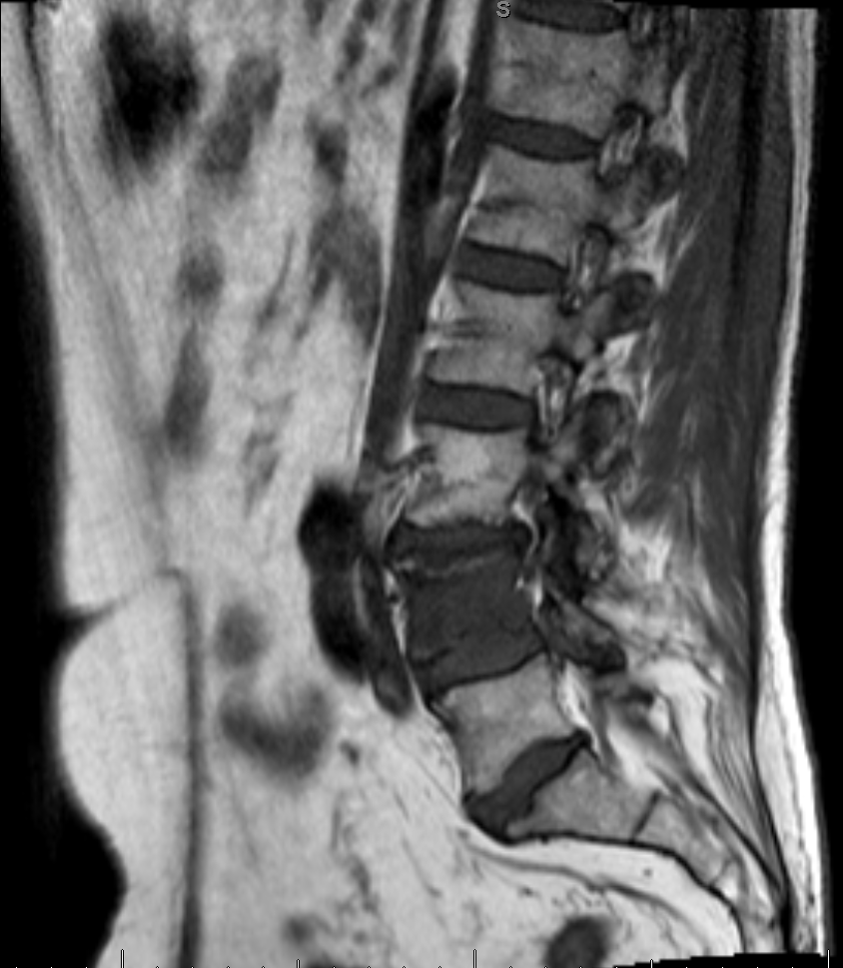
Case – Dr Plimack: 79-year-old man with hematuria (cont):
Atezolizumab initiated
Response in the lung
At 9 months, PD with new lesion in the spine.
Radiation to spine
Atezolizumab continued beyond PD
Ultimately discontinued after 2 years for PD in the lungs
Genomic testing not available

Slide 98
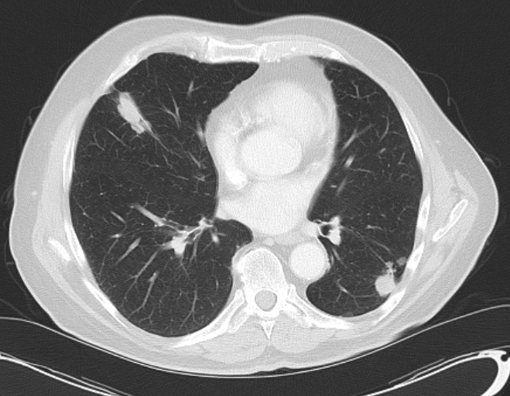
Case – Dr Plimack: 79-year-old man with hematuria (cont):
Next Line Therapy Options
Pembrolizumab
Gemcitabine
Gemcitabine + Carboplatin
Paclitaxel
Docetaxel
Enfortumab Vedotin
Erdafitinib

Slide 99
Case – Dr Plimack: 79-year-old man with hematuria (cont):
Gemcitabine + Carboplatin
Started with Gemcitabine
PD in lung lesions after 9 months → carboplatin added.
At 18 months treatment stopped for chemo break in setting of response, and cumulative toxicity
Molecular testing sent

Slide 100

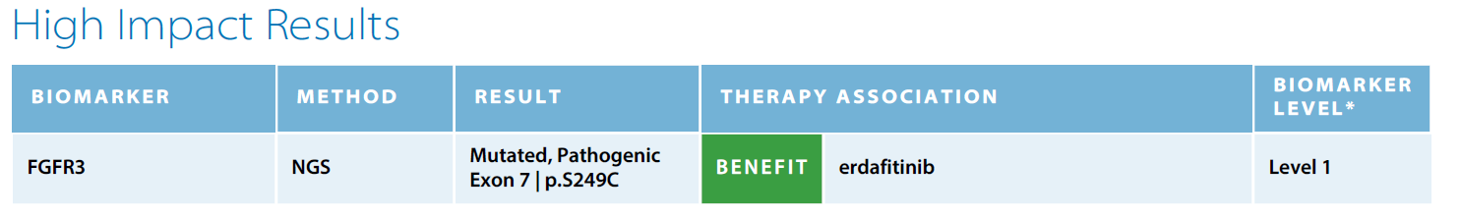

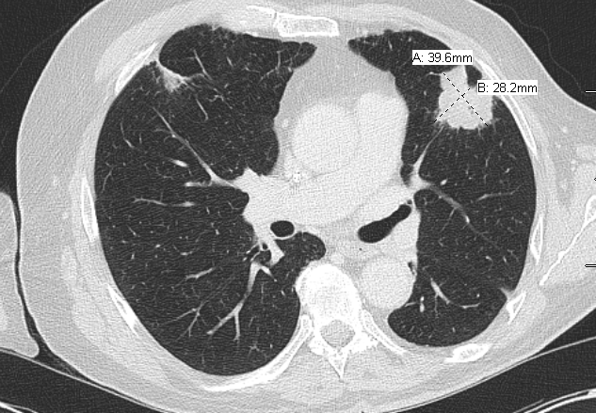
Case – Dr Plimack: 79-year-old man with hematuria (cont):
Molecular Testing
Erdafitinib initiated at standard starting dose: 8 mg daily

Slide 101
Phase II Erdafitinib: oral pan-FGFR (1-4) inhibitor
Notable AEs: Hyperphosphatemia, skin/nail changes, central retinopathy
Siefker Radtke ASCO 2018
Loriot et al NEJM 2019

Slide 102
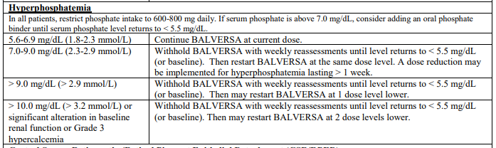
 Phosphorous
Erdafitinib
Erdafitinib
Erdafitinib
Erdafitinib
initiated
8 mg Daily
Erdafitinib
Held
Erdafitinib
Restarted 6 mg daily
Erdafitinib
Erdafitinib
Erdafitinib
Erdafitinib
Erdafitinib
Hold per
package
insert
Normal
Range
2.4 - 4.4

Slide 103
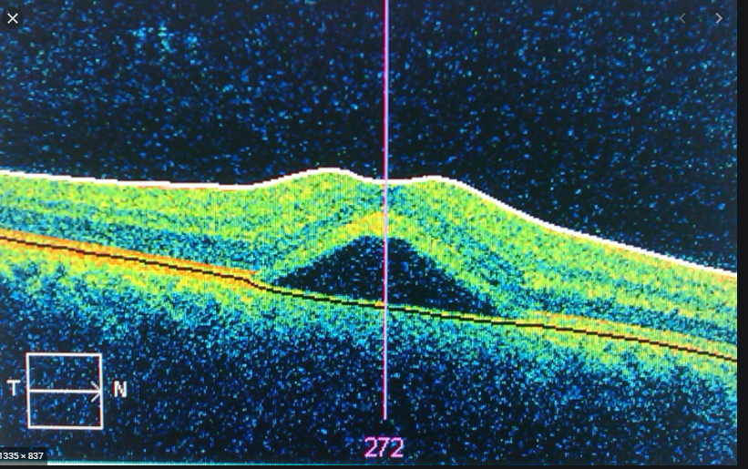
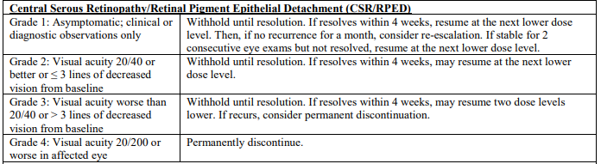
Case – Dr Plimack: 79-year-old man with hematuria (cont):
Central Serous Retinopathy
Routine monthly eye exams
At month 2, retinal imaging showed CSR
No changes in visual acuity

Slide 104
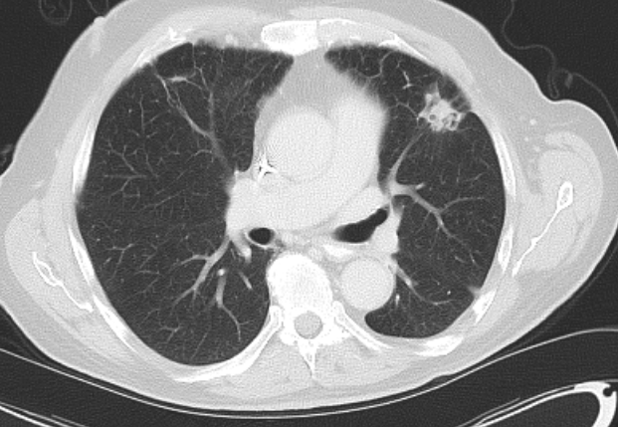
Case – Dr Plimack: 79-year-old man with hematuria (cont):
Erdafitinib: Response at 6 mg daily

