Slide 1
Expert Second Opinion:
HER2-Positive Breast Cancer
Tuesday, June 22, 2021
5:00 PM – 6:00 PM ET
Faculty
Erika Hamilton, MD
Ian E Krop, MD, PhD
Joyce O’Shaughnessy, MD
Moderator
Neil Love, MD

Slide 2



Faculty
Erika Hamilton, MD
Director, Breast and Gynecologic Research Program
Sarah Cannon Research Institute/Tennessee Oncology
Nashville, Tennessee
Joyce O’Shaughnessy, MD
Celebrating Women Chair in Breast
Cancer Research
Baylor University Medical Center
Director, Breast Cancer Research Program
Texas Oncology
US Oncology
Dallas, Texas
Ian E Krop, MD, PhD
Associate Chief, Division of Breast Oncology
Dana-Farber Cancer Institute
Associate Professor of Medicine
Harvard Medical School
Boston, Massachusetts

Slide 3
Commercial Support
This activity is supported by educational grants from AstraZeneca Pharmaceuticals LP, Daiichi Sankyo Inc, Exact Sciences Inc, Lilly, Merck, Novartis, Puma Biotechnology Inc and Seagen Inc.

Slide 4
Dr Love — Disclosures
Dr Love is president and CEO of Research To Practice. Research To Practice receives funds in the form of educational grants to develop CME activities from the following companies: AbbVie Inc, Adaptive Biotechnologies Corporation, Agios Pharmaceuticals Inc, Alexion Pharmaceuticals, Amgen Inc, Array BioPharma Inc, a subsidiary of Pfizer Inc, Astellas, AstraZeneca Pharmaceuticals LP, Aveo Pharmaceuticals, Bayer HealthCare Pharmaceuticals, BeiGene Ltd, Blueprint Medicines, Boehringer Ingelheim Pharmaceuticals Inc, Bristol-Myers Squibb Company, Celgene Corporation, Clovis Oncology, Daiichi Sankyo Inc, Eisai Inc, Epizyme Inc, Exact Sciences Inc, Exelixis Inc, Five Prime Therapeutics Inc, Foundation Medicine, Genentech, a member of the Roche Group, Gilead Sciences Inc, GlaxoSmithKline, Grail Inc, Halozyme Inc, Helsinn Healthcare SA, ImmunoGen Inc, Incyte Corporation, Ipsen Biopharmaceuticals Inc, Janssen Biotech Inc, administered by Janssen Scientific Affairs LLC, Jazz Pharmaceuticals Inc, Karyopharm Therapeutics, Kite, A Gilead Company, Lilly, Loxo Oncology Inc, a wholly owned subsidiary of Eli Lilly & Company, Merck, Novartis, Novocure Inc, Oncopeptides, Pfizer Inc, Pharmacyclics LLC, an AbbVie Company, Puma Biotechnology Inc, Regeneron Pharmaceuticals Inc, Sanofi Genzyme, Seagen Inc, Sumitomo Dainippon Pharma Oncology Inc, Taiho Oncology Inc, Takeda Oncology, Tesaro, A GSK Company, TG Therapeutics Inc, Turning Point Therapeutics Inc and Verastem Inc.

Slide 5
Research To Practice CME Planning Committee Members,
Staff and Reviewers
Planners, scientific staff and independent reviewers for Research To Practice have no relevant conflicts of interest to disclose.

Slide 6
Dr Hamilton — Disclosures
Advisory Committee | Boehringer Ingelheim Pharmaceuticals Inc, Daiichi Sankyo Inc, Eisai Inc, Genentech, a member of the Roche Group, Lilly, Mersana Therapeutics, Pfizer Inc, Puma Biotechnology Inc, Seagen Inc
Consulting Agreement | Flatiron Health
Contracted Research | AbbVie Inc, Acerta Pharma — A member of the AstraZeneca Group, ArQule Inc, AstraZeneca Pharmaceuticals LP, BerGenBio ASA, Boehringer Ingelheim Pharmaceuticals Inc, Clovis Oncology, Curis Inc, CytomX Therapeutics, Daiichi Sankyo Inc, eFFECTOR Therapeutics Inc, Eisai Inc, EMD Serono Inc, FUJIFILM Pharmaceuticals USA Inc, Genentech, a member of the Roche Group, H3 Biomedicine, Hutchison MediPharma, Immunomedics Inc, InventisBio, Kadmon Corporation, Leap Therapeutics Inc, Lilly, Lycera, MacroGenics Inc, Mallinckrodt Pharmaceuticals, Marker Therapeutics Inc, Medivation Inc, a Pfizer Company, Mersana Therapeutics, Merus BV, Novartis, NuCana, OncoMed Pharmaceuticals Inc, Pfizer Inc, PharmaMar, Radius Health Inc, Regeneron Pharmaceuticals Inc, Rgenix, Seagen Inc, Stemcentrx, Syndax Pharmaceuticals Inc, Syros Pharmaceuticals Inc, Taiho Oncology Inc, Takeda Oncology, Tesaro, A GSK Company, TetraLogic Pharmaceuticals, Verastem Inc, Zymeworks
Travel/Accommodations/ Expenses (payment or reimbursement of actual expenses) | Amgen Inc, AstraZeneca Pharmaceuticals LP, Bayer HealthCare Pharmaceuticals, Bristol-Myers Squibb Company, Clovis Oncology, Eisai Inc, Foundation Medicine, Genentech, a member of the Roche Group, Genzyme Corporation, Guardant Health, Helsinn Healthcare SA, Heron Therapeutics, Lexicon Pharmaceuticals Inc, Lilly, Medivation Inc, a Pfizer Company, Merck, Novartis, Pfizer Inc, Roche Laboratories Inc, Sysmex Corporation, Tesaro, A GSK Company

Slide 7
Dr Krop — Disclosures
Consulting Agreements | AstraZeneca Pharmaceuticals LP, Bristol-Myers Squibb Company, Daiichi Sankyo Inc, Genentech, a member of the Roche Group, MacroGenics Inc
Contracted Research | Daiichi Sankyo Inc, Genentech, a member of the Roche Group, Pfizer Inc, Taiho Oncology Inc
Data and Safety Monitoring Board/Committee | Merck, Novartis

Slide 8
Dr O’Shaughnessy — Disclosures
Consulting Agreements | AbbVie Inc, Agendia Inc, Amgen Inc, Aptitude Health, AstraZeneca Pharmaceuticals LP, Bayer HealthCare Pharmaceuticals, Bristol-Myers Squibb Company, Celgene Corporation, Clovis Oncology, Daiichi Sankyo Inc, Eisai Inc, G1 Therapeutics, Genentech, a member of the Roche Group, Gilead Sciences Inc, Grail Inc, Halozyme Inc, Heron Therapeutics, Immunomedics Inc, Ipsen Biopharmaceuticals Inc, Lilly, Merck, Myriad Genetic Laboratories Inc, Nektar, Novartis, Pfizer Inc, Pharmacyclics LLC, an AbbVie Company, Pierre Fabre, Puma Biotechnology Inc, Roche Laboratories Inc, Samsung Bioepis, Sanofi Genzyme, Seagen Inc, Syndax Pharmaceuticals Inc, Synthon, Taiho Oncology Inc, Takeda Oncology
Speakers Bureau | Lilly, Pfizer Inc, Seagen Inc

Slide 9
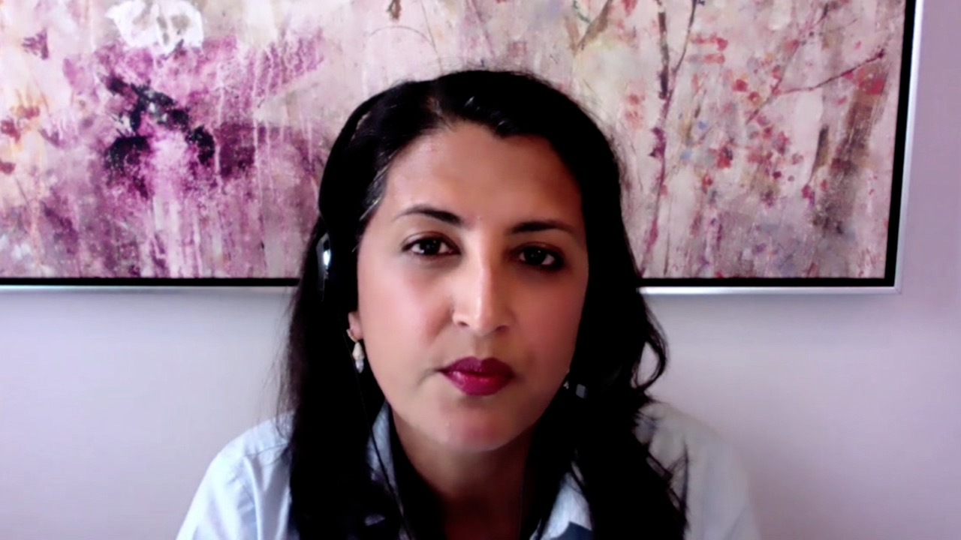

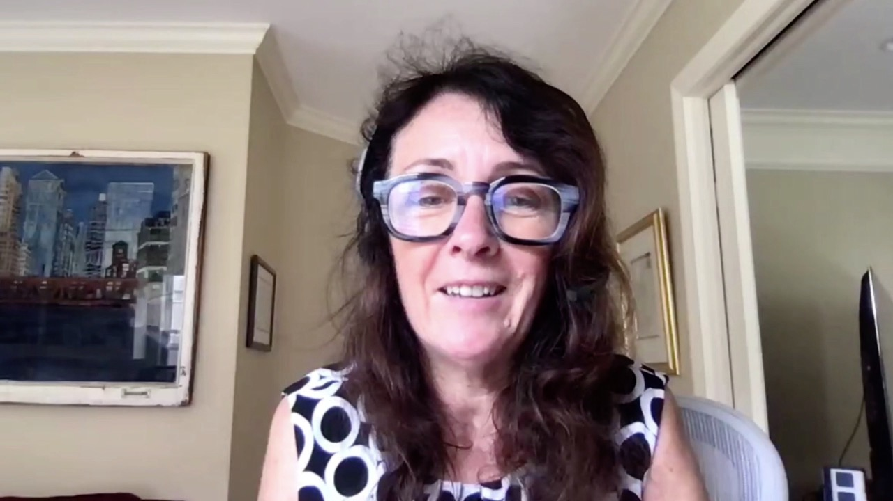
Contributing Oncologists
Reshma Mahtani, DO
Associate Professor of Medicine
Co-Leader, Breast Cancer Program
Sylvester Cancer Center
University of Miami
Miami, Florida
Ann Partridge, MD, MPH
Vice Chair of Medical Oncology
Director, Program for Young Women with Breast Cancer
Director, Adult Survivorship Program
Dana-Farber Cancer Institute
Professor of Medicine
Harvard Medical School
Boston, Massachusetts
Ruth O’Regan, MD
Chair, Department of Medicine
Charles A Dewey Professor of Medicine
University of Rochester
Rochester, New York

Slide 10
Agenda
Module 1: Role of Immunotherapy in HER2-Positive Metastatic Breast Cancer (mBC)?
Dr Mahtani: A 56-year-old woman with ER-positive, HER2-positive mBC enrolled on a clinical trial of nivolumab/ipilimumab
Module 2: Management of HER2-Positive mBC
Dr Partridge: A 30-year-old woman with ER-positive, HER2-positive mBC
Dr Mahtani: A 72-year-old woman with HER2-positive mBC
Dr O’Regan: A 58-year-old woman with ER-negative, HER2-positive mBC
Dr Partridge: A 50-year-old woman with ER-positive, HER2-positive mBC
Module 3: Considerations in the Care of Patients with Localized HER2-Positive Breast Cancer
Dr Mahtani: A 44-year-old woman with 5-cm ER-positive, HER2-positive localized breast cancer
Dr O’Regan: A 53-year-old woman with 4.5-mm ER-positive, HER2-positive breast cancer

Slide 11
Agenda
Module 1: Role of Immunotherapy in HER2-Positive Metastatic Breast Cancer (mBC)?
Dr Mahtani: A 56-year-old woman with ER-positive, HER2-positive mBC enrolled on a clinical trial of nivolumab/ipilimumab
Module 2: Management of HER2-Positive mBC
Dr Partridge: A 30-year-old woman with ER-positive, HER2-positive mBC
Dr Mahtani: A 72-year-old woman with HER2-positive mBC
Dr O’Regan: A 58-year-old woman with ER-negative, HER2-positive mBC
Dr Partridge: A 50-year-old woman with ER-positive, HER2-positive mBC
Module 3: Considerations in the Care of Patients with Localized HER2-Positive Breast Cancer
Dr Mahtani: A 44-year-old woman with 5-cm ER-positive, HER2-positive localized breast cancer
Dr O’Regan: A 53-year-old woman with 4.5-mm ER-positive, HER2-positive breast cancer

Slide 12
Case Presentation – Dr Mahtani: A 56-year-old woman with ER-positive, HER2-positive metastatic breast cancer enrolled on a clinical trial of nivolumab/ipilimumab
Dr Reshma Mahtani
2011: Neoadjuvant TCH for cT2N1 ER+/HER2+ tumor, adjuvant radiation,
maintenance trastuzumab x 1 yr, AI completed in 2017
2018: Developed left SC adenopathy and imaging revealed retropectoral, axillary and mediastinal nodes, biopsy confirmed ER+/HER2+ recurrence
Paclitaxel x 14 months → progressive disease extensively involving chest wall
T-DM1 with neratinib on clinical trial → PD after 3 cycles
NGS: TMB-high, PD-L1 10%
Nivolumab with ipilimumab on protocol → dramatic flare of disease in chest wall after first cycle
Rapid clearing after 2nd dose; all systemic disease now controlled (complete response by RECIST on imaging); response ongoing since 2019 on single agent nivolumab
Questions
What do you see as the role of immunotherapy in HER2-positive breast cancer?

Slide 13
FDA Grants Accelerated Approval to Pembrolizumab with Trastuzumab and Chemotherapy as First-Line Therapy for HER2-Positive Gastric Cancer
Press Release – May 5, 2021
“On May 5, 2021, the Food and Drug Administration granted accelerated approval to pembrolizumab in combination with trastuzumab, fluoropyrimidine- and platinum-containing chemotherapy for the first-line treatment of patients with locally advanced unresectable or metastatic HER2 positive gastric or gastroesophageal junction (GEJ) adenocarcinoma.
Approval was based on the prespecified interim analysis of the first 264 patients of the ongoing KEYNOTE-811 (NCT03615326) trial, a multicenter, randomized, double‑blind, placebo‑controlled trial in patients with HER2‑positive advanced gastric or gastroesophageal junction (GEJ) adenocarcinoma who had not previously received systemic therapy for metastatic disease. Patients were randomized (1:1) to receive pembrolizumab 200 mg or placebo every 3 weeks, in combination with trastuzumab and either fluorouracil plus cisplatin or capecitabine plus oxaliplatin.
The main efficacy measure for this analysis was overall response rate (ORR) assessed by blinded independent review committee. The ORR was 74% in the pembrolizumab arm and 52% in the placebo arm (one-sided p-value< 0.0001, statistically significant). The median duration of response (DoR) was 10.6 months for patients treated with pembrolizumab and 9.5 months for those in the placebo arm.”
https://www.fda.gov/drugs/drug-approvals-and-databases/fda-grants-accelerated-approval-pembrolizumab-her2-positive-gastric-cancer

Slide 14
Pembrolizumab plus Trastuzumab and Chemotherapy for HER2+ Metastatic Gastric or Gastroesopahgeal Junction Cancer: Initial Findings of the Global Phase 3 KEYNOTE-811 Study
Janjigian YY et al.
ASCO 2021;Abstract 4013.

Slide 15
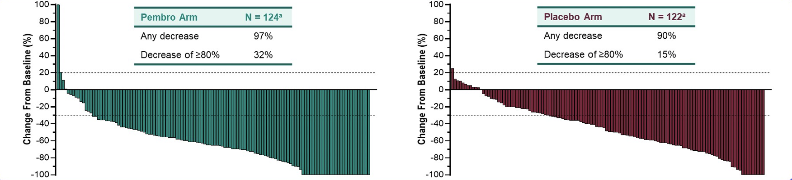
KEYNOTE-811: Confirmed Response at First Interim Analysis
ª Participants with RECIST-measurable disease at baseline and ≥1 post-baseline measurement evaluable for change from baseline in target lesions
Janjigian YY et al. ASCO 2021;Abstract 4013.

Slide 16
Agenda
Module 1: Role of Immunotherapy in HER2-Positive Metastatic Breast Cancer (mBC)?
Dr Mahtani: A 56-year-old woman with ER-positive, HER2-positive mBC enrolled on a clinical trial of nivolumab/ipilimumab
Module 2: Management of HER2-Positive mBC
Dr Partridge: A 30-year-old woman with ER-positive, HER2-positive mBC
Dr Mahtani: A 72-year-old woman with HER2-positive mBC
Dr O’Regan: A 58-year-old woman with ER-negative, HER2-positive mBC
Dr Partridge: A 50-year-old woman with ER-positive, HER2-positive mBC
Module 3: Considerations in the Care of Patients with Localized HER2-Positive Breast Cancer
Dr Mahtani: A 44-year-old woman with 5-cm ER-positive, HER2-positive localized breast cancer
Dr O’Regan: A 53-year-old woman with 4.5-mm ER-positive, HER2-positive breast cancer

Slide 17
A 65-year-old woman with ER-negative, HER2-positive metastatic breast cancer with bone and soft tissue metastases receives first-line THP and second-line T-DM1 but then experiences symptomatic disease progression. What systemic treatment would you most likely recommend next?
Trastuzumab deruxtecan
Tucatinib/trastuzumab/
capecitabine
Trastuzumab/lapatinib
Margetuximab/chemotherapy
N = 47
Survey of live webinar audience

Slide 18
A 65-year-old woman with ER-negative, HER2-positive mBC receives THP followed by T-DM1 on disease progression. She then presents with a single brain metastasis that is resected with no other evidence of progression. Regulatory and reimbursement issues aside, what systemic treatment would you recommend?
Tucatinib + trastuzumab/capecitabine
Continue T-DM1
Trastuzumab deruxtecan
Other
N = 54
Survey of live webinar audience

Slide 19
Case Presentation – Dr Partridge: A 30-year-old woman with ER-positive, HER2-positive metastatic breast cancer
2012: Initial diagnosis of ER-positive, HER2-positive mBC, axillary and vertebral disease
  She did not want HER2-targeted therapy → tamoxifen with leuprolide
  Trastuzumab and zoledronic acid added on PD
2016 – 2020: Multiple lines of therapy for disease progression: lapatinib with trastuzumab (on leuprolide) → T-DM1 → neratinib with fulvestrant on clinical trial → capecitabine/trastuzumab → vinorelbine/capecitabine
7/2020: Trastuzumab deruxtecan with response
5/2021: Doxorubicin/trastuzumab
Questions
In light of recent data such as the WSG-ADAPT HER2+/HR- trial, what do you think about doing early first-line endocrine therapy in ER-positive, HER2-positive breast cancer either alone or in tandem with anti-HER2 therapy such as trastuzumab or pertuzumab, or the combination?
Dr Ann Partridge

Slide 20
Case Presentation – Dr Mahtani: A 72-year-old woman with HER2-positive metastatic breast cancer
Dr Reshma Mahtani
2014: Lumpectomy and ALND for 1.1cm ILC, grade 3, 3/15 positive nodes, ER60%,
PR50%, HER2 3+
2019: Palpated left breast mass → IDC, grade 2, ER50%, PR50%, HER2 2+, FISH positive
Docetaxel/HP → docetaxel stopped → letrozole/HP continued → PD in lung after 6 months (pleural effusions requiring PleurX™ drainage) → T-DM1 for 5 months (still required PleurX drainage)
1/2021: Assumed care of patient who was symptomatic with weight loss, SOB with minimal exertion (using oxygen), increased drainage from PleurX, ECOG PS 2/bordering on 3.
Started trastuzumab deruxtecan → rapid improvement in symptoms, but progressed 5 months later
Tucatinib with trastuzumab/capecitabine and patient is doing well
Questions
How are you sequencing tucatinib and trastuzumab deruxtecan? Are you reserving tucatinib for when a patient develops brain metastases?

Slide 21
Case Presentation – Dr O’Regan: A 58-year-old woman with ER-negative, HER2-positive metastatic breast cancer
Dr Ruth O’Regan
ER-negative, HER2-positive breast cancer metastatic to nodes and lungs
Docetaxel, trastuzumab, pertuzumab with partial response
Trastuzumab/pertuzumab alone → PD 6 months later
T-DM1 with initial response but has progressive disease 9 months later
  No evidence of brain metastases
Enrolled on the HER2CLIMB study with tucatinib x 6 months but discontinued due to diarrhea
Questions
How do you manage diarrhea associated with tucatinib?
In asymptomatic patients, are you screening for brain metastases to make the decision about whether or not to use tucatinib-based treatment or T-DM1 in the second-line setting?
Have you use trastuzumab deruxtecan earlier than the third- or fourth-line setting?

Slide 22
Case Presentation – Dr Partridge: A 50-year-old woman with ER-positive, HER2-positive metastatic breast cancer
Dr Ann Partridge
2015: Initial diagnosis of ER-positive, HER2-positive BC, metastases to the the liver,
lung and peritoneum and bones
THP x 6 months followed by HP alone → tamoxifen → T-DM1
AVIATOR clinical trial of trastuzumab with vinorelbine/avelumab
Tucatinib with trastuzumab/capecitabine
Considering rebiopsy to confirm HER2 status
Germline mutation testing: negative for BRCA 1, BRCA 2 and p53
Question
Would you rebiopsy the tumor at this point?

Slide 23
Clinical Pathway for HER2+ Metastatic Breast Cancer
2021
1st Line
Taxane + trastuzumab + pertuzumab
Severe
visceral
disease
Severe
brain mets
2nd Line
T-DM1
Visceral
disease
Trastuzumab Deruxtecan
Tucatinib + Capecitabine + Trastuzumab
3rd Line
Brain metastases
Capecitabine + Neratinib
Margetuximab + ChemoRx
Capecitabine + lapatinib
Trastuzumab + lapatinib
Trastuzumab + ChemoRx
Endocrine therapy + HER2 inhibition (if ER+)
4th Line
NCCN 2021
Courtesy of Joyce O’Shaughnessy, MD

Slide 24
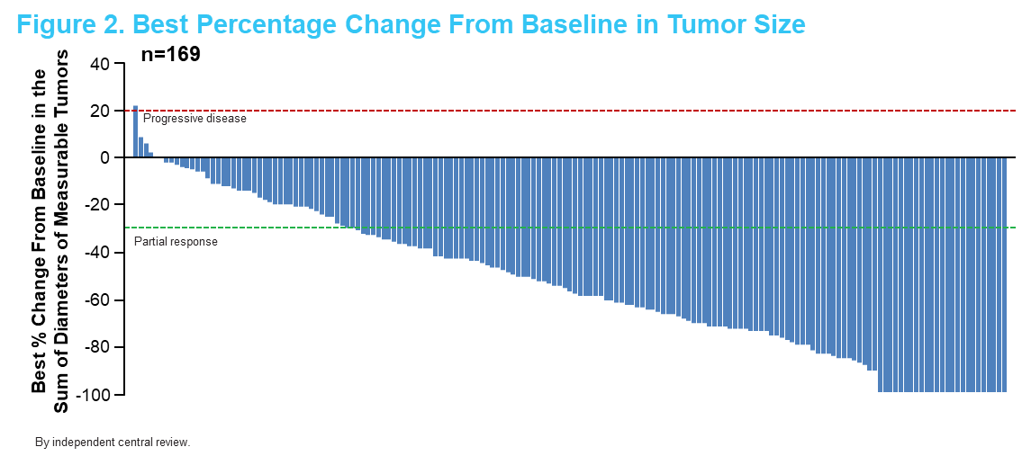
DESTINY-Breast01: Phase 2 Trial of Trastuzumab Deruxtecan (T-DXd) in MBC (Updated Results)
Best percentage change from baseline in tumor size
With increased maturity of the data, the median DOR was 20.8 months (95% CI, 15.0-NE)
DOR, duration of response; NE, not estimable; MBC, metastatic breast cancer; T-DXd, trastuzumab deruxtecan
1. Modi S et al. NEJM 2020;382:610-21; 2. Modi S et al. SABCS, Dec 8-11, 2020. Abstr PD3-06.
Courtesy of Joyce O’Shaughnessy, MD

Slide 25
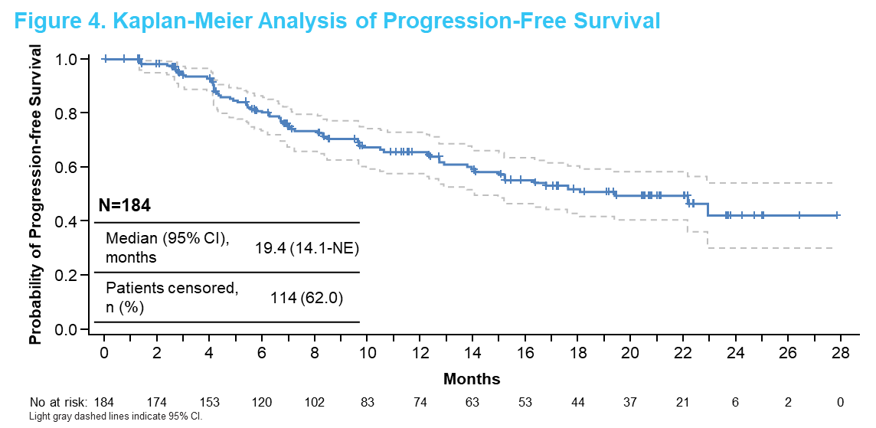
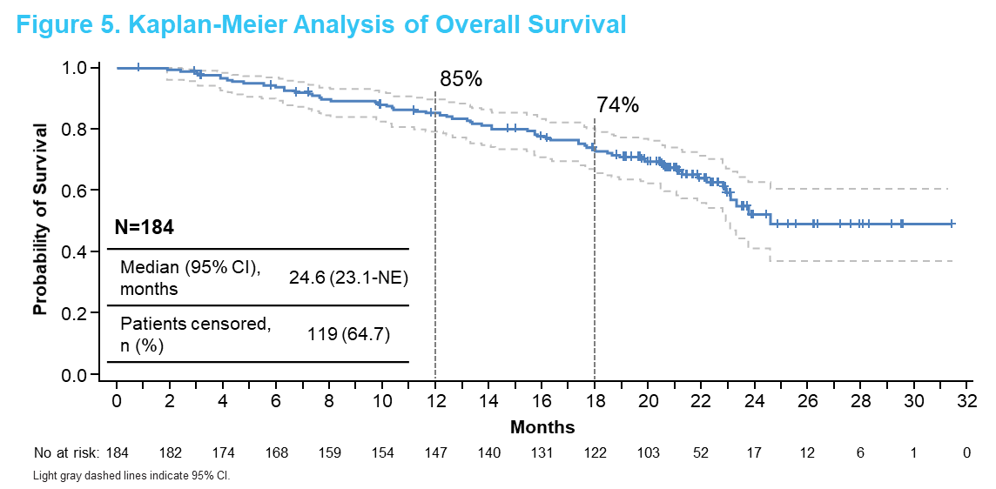
DESTINY-Breast01: Phase 2 Trial of Trastuzumab Deruxtecan (T-DXd) in MBC (Updated Results)
PFS
OS
Median follow-up: 20.5 mos (range, 0.7-31.4 mos)
Median PFS: 19.4 mos (95% CI, 14.1-NE)
Estimated OS: median 24.6 mos (95% CI, 14.1-NE)
  12 mos: 85% (95% CI, 79-90)
  18 mos: 74% (95% CI, 67-80)
MBC, metastatic breast cancer; NE, not estimable; OS, overall survival; PFS, progression-free survival; T-DXd, trastuzumab deruxtecan
1. Modi S et al. NEJM 2020;382:610-21; 2. Modi S et al. SABCS, Dec 8-11, 2020. Abstr PD3-06.
Courtesy of Joyce O’Shaughnessy, MD

Slide 26
Trastuzumab Deruxtecan for HER2 Low Breast Cancer
Similar Benefit for HER2 2+ and 1+
ORR=37%
ORR=35.7%
ORR=38.5%
mPFS = 11.1 mo
Modi S et al, JCO 2020
Courtesy of Joyce O’Shaughnessy, MD
Notes:
Among 54 patients with HER2 los breast cancer who received Trastuzumab deruxtecan, the confirmed objective response rate by independent central review was 37% with a median PFS of 11.1 months. The response rate was similar for those pts with HER2 2+ tumors compared to HER2 1+ tumors

Slide 27
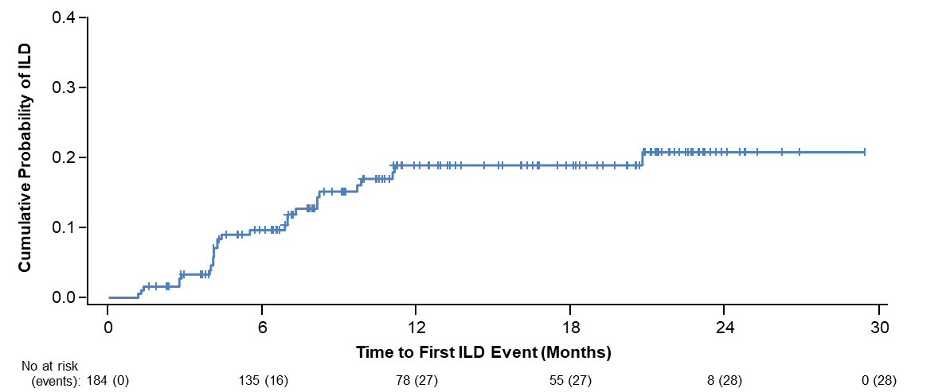
DESTINY-Breast01: Interstitial Lung Disease Associated with Trastuzumab Deruxtecan
Incidence of interstitial lung disease among patients receiving T-DXd 5.4 mg/kg (N = 184)*
Data cutoff | Any grade | Grade 1 | Grade 2 | Grade 3 | Grade 4 | Grade 5
Aug 2019 | 25 (13.6%) | 5 (2.7%) | 15 (8.2%) | 1 (0.5%) | 0 | 4 (2.2%)
Jun 2020 | 28 (15.2%) | 6 (3.3%) | 16 (8.7%) | 1 (0.5%) | 0 | 5 (2.7%)
Cumulative probability of adjudicated drug-related any-grade ILD among patients receiving T-DXd 5.4 mg/kg (N = 184)
*As determined by an independent interstitial lung disease adjudication committee. At data cutoff, 1 grade 1 event and 1 grade 3 event were pending adjudication
ILD, interstitial lung disease; T-DXd, trastuzumab deruxtecan. 1. Modi S et al. NEJM 2020;382:610-21; 2. Modi S et al. SABCS, Dec 8-11, 2020. Abstr PD3-06.
Courtesy of Joyce O’Shaughnessy, MD
Notes:
T-DXd is associated with an important identified risk of ILD; these events are independently adjudicated and actively managed by patient monitoring, dose modification, and adherence to the ILD management guidelines, which were updated over the course of the study
3 new cases of T-DXd–related ILD as determined by an independent adjudication committee were reported (Table 4). 1 Grade 1, 1 Grade 2, and 1 Grade 5
Most ILD events occurred during the first 12 months of treatment (Figure 6); among the patients who did not have an ILD event for ≥12 months, only 1 subsequently developed ILD; 2 cases were pending adjudication at data cutoff

Slide 28
Trastuzumab Deruxtecan (T-DXd) in Patients with HER2+ Metastatic Breast Cancer with Brain Metastases: A Subgroup Analysis of the DESTINY-Breast01 Trial
Jerusalem GH et al.
ASCO 2021;Abstract 526.

Slide 29
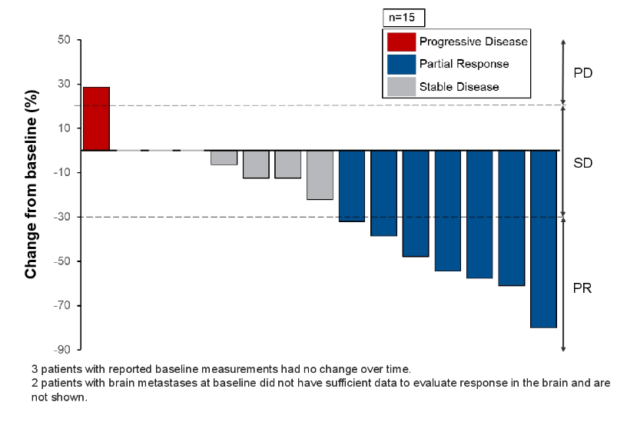
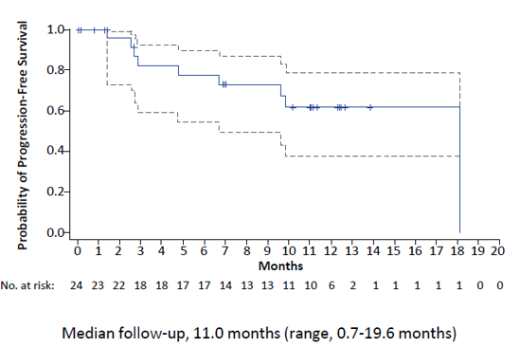
DESTINY Breast-01: Efficacy with T-DXd – CNS Subgroup
Best response in brain lesions in CNS subgroup¹
PFS in CNS subgroup² (n=24)
Median PFS: 18.1 mo
CNS subgroup N=24
Brain lesions at BL n=17
Evaluable for response in brain n=15
Confirmed ORR in CNS subgroup: 58.3%
Median DoR in CNS subgroup: 16.9 months
7/17 pts with brain lesions at BL had a PR in CNS lesions (41.2%)
@ErikaHamilton9
Courtesy of Erika Hamilton, MD
1. Jerusalem G et al ASCO 2021; Abstract 526
2. Jerusalem G et al ESMO Breast 2020
Notes:
In the overall patient population: PD in the brain observed only in 8% of pts
Overall a total of 4 pts of the 48pts who progressed had progression in the CNS ( 2 in the BL CNS subgroup and 2 in the non CNS subgroup)

Slide 30
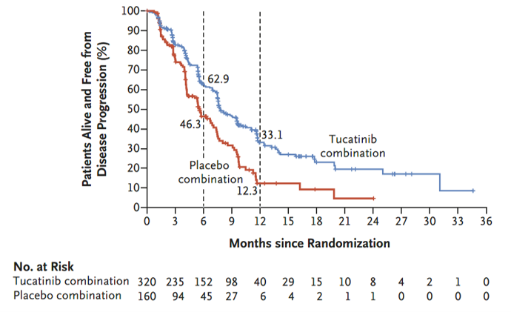
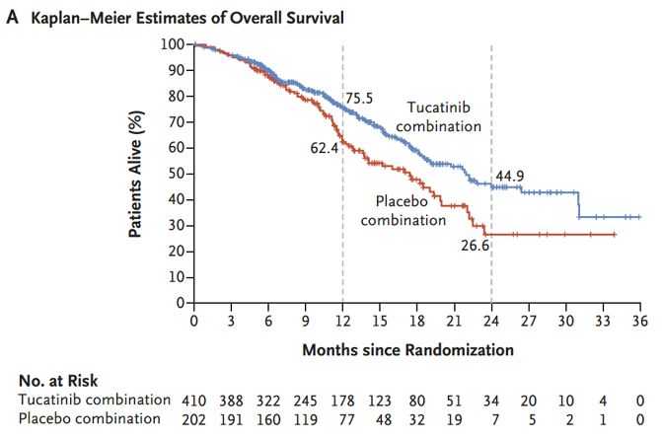
HER2CLIMB:
PFS and OS with Tucatinib in Patients with HER2+ MBC
 | No. of Deaths/No. of Patients | Mediation Duration (95% CI)
Tucatinib combination | 130/140 | 21.9 (18.3 - 31.0)
Placebo combination | 85/202 | 17.4 (13.6 - 19.9)
PFS (primary end‑point analysis population*)
OS (total population†)
 | No. of Events / No. of Patients | Mediation Duration (95% CI)
Tucatinib combination | 178/320 | 7.8 (7.5-9.6)
Placebo combination | 97/160 | 5.6 (4.2-7.1)
 | Hazard ratio for disease progression or death,0.54 (95% CI, 0.42 – 0.71) P<0.001
Hazard ratio for death,0.66 (95% CI, 0.50 – 0.88)
P=0.005
47.5% (n=291) patients had brain metastases at baseline
Patients with both active and stable brain metastases were included
*Estimated PFS at 1 year among first 480 patients randomized; †Estimated OS at 2 years among total population of 612 patients randomized; HR: hazard ratio; ICR: independent central review; ORR: objective response rate; OS: overall survival; PFS: progression-free survival; T-DM1: trastuzumab emtansine
Murthy RK et al. NEJM 2019;382:597-609
Courtesy of Joyce O’Shaughnessy, MD

Slide 31
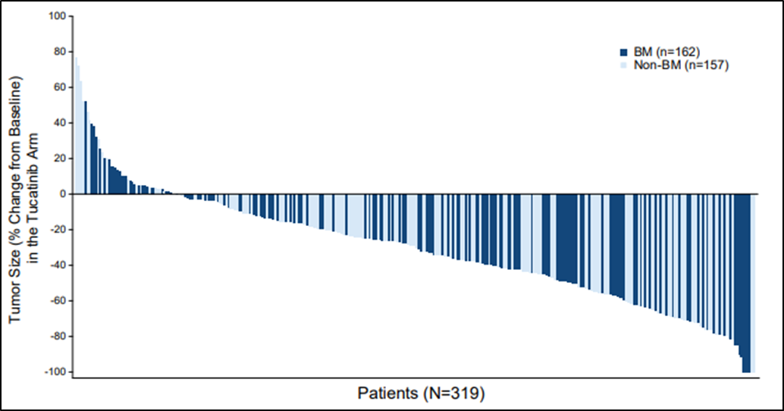
HER2CLIMB: Change in tumor size in the tucatinib arm
Change in tumor size based on RECIST v1.1 on Tucatinib arm
(regardless of presence/absence of brain mets)
BM: Brain mets
@ErikaHamilton9
Courtesy of Erika Hamilton, MD
Bachelot T et al. ESMO 2020

Slide 32
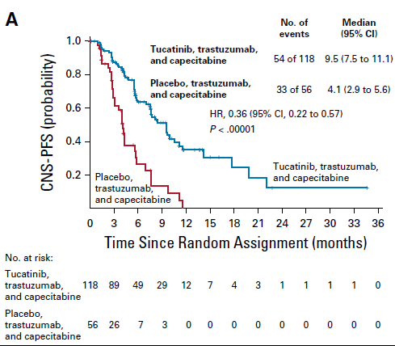
HER2CLIMB: CNS-PFS benefit in patients with brain metastases
 | Median PFS (months)
Tucatinib arm | 9.5
Placebo arm | 4.1
 | HR 0.36 p <0.00001
Risk of progression or death in patients with
active brain mets was reduced by 64%
@ErikaHamilton9
Courtesy of Erika Hamilton, MD
Lin NU et al. JCO 2020
Notes:
Whether tucatinib might delay additional SRS or salvage WBRT will have to be evaluated

Slide 33
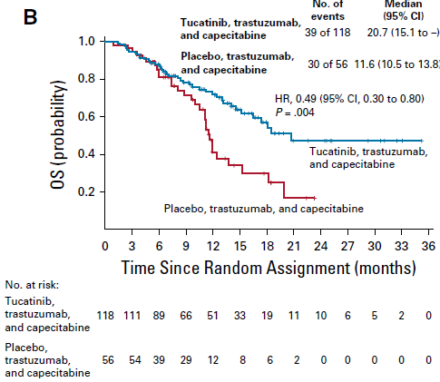
HER2CLIMB: Overall survival in patients with brain metastases
 | Median OS (months)
Tucatinib arm | 20.7
Placebo arm | 11.6
 | HR 0.49 p 0.004
Risk of death in patients with active brain mets was reduced by 51%
Health related QoL assessed in pts with brain mets (n=164):
Addition of Tucatinib to cape/trastuzumab significantly prolonged time to worsening of HRQoL EQ-5D-5L Health Score
Compared to the placebo arm, pts on tucatinib arm has 49% reduction in the risk of deterioration
@ErikaHamilton9
Courtesy of Erika Hamilton, MD
Lin NU et al. JCO 2020
Notes:
Whether tucatinib might delay additional SRS or salvage WBRT will have to be evaluated

Slide 34
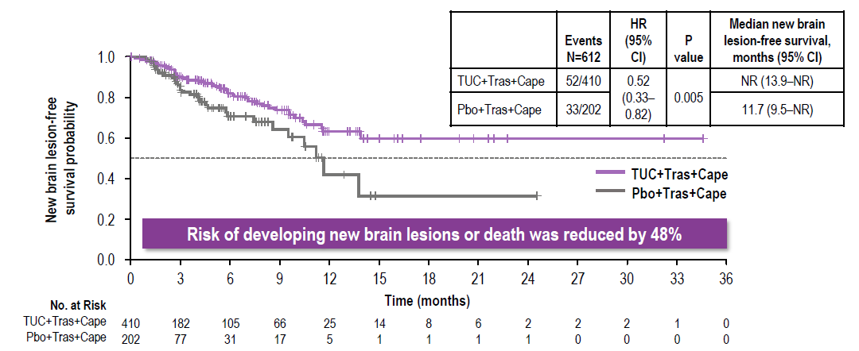
HER2CLIMB: Time to new brain lesions or death (all patients)
@ErikaHamilton9
Courtesy of Erika Hamilton, MD
Bachelot T et al ESMO 2020

Slide 35
NALA:
PFS and OS with Neratinib in Patients with HER2+ MBC
PFS (centrally assessed)
OS (coprimary endpoint)
Mean PFS, Mos
Mean OS, Mos
Neratinib + capecitabine
Lapatinib + capecitabine
Neratinib + capecitabine
Lapatinib + capecitabine
24.0
22.2
1.0
8.8
6.6
1.0
HR, 0.76 (95% CI, 0.63, 0.93), P=0.0059
HR, 0.88 (95% CI, 0.72, 1.07), P=0.2086
0.8
0.8
0.6
0.6
Probability of PFS
Probability of OS
Restriction:
24 mos
Restriction:
48 mos
0.4
0.4
0.2
2.2 mos
0.2
1.7 mos
0
0
0
3
6
9
12
15
18
21
24
27
30
33
36
0
3
6
9
12
15
18
21
24
27
30
33
36
39
42
45
48
51
54
57
Patients
at Risk, n
N + Cape
L + Cape
Mos Since Randomization
Patients
at Risk, n
N + Cape
L + Cape
Mos Since Randomization
307
314
183
183
113
82
69
39
54
24
35
9
20
8
13
3
9
2
7
2
3
2
2
2
2
1
307
314
294
303
275
273
244
240
220
208
182
170
142
132
112
107
82
84
64
67
47
47
34
36
28
27
18
22
15
17
13
12
6
8
4
4
2
3
1
1
PFS, progression-free survival; OS, overall survival
Saura C et al. J Clin Oncol 2020;38:3138-49.
Courtesy of Joyce O’Shaughnessy, MD

Slide 36
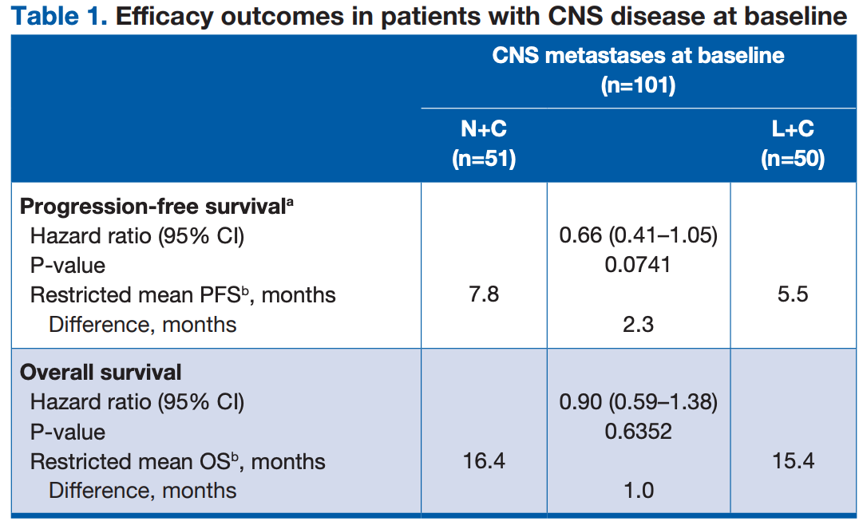


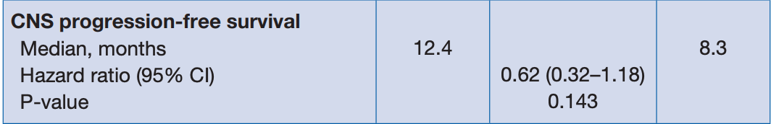
NALA: Outcomes in patients with CNS disease
NALA: Phase III study of Neratinib+capecitabine vs Lapatinib+capecitabine in HER2+ MBC
81 patients (80.2%) had received prior
CNS-directed radiotherapy and/ or surgery
@ErikaHamilton9
Courtesy of Erika Hamilton, MD
Saura C et al. SABCS 2020 Abstract PD13-09

Slide 37
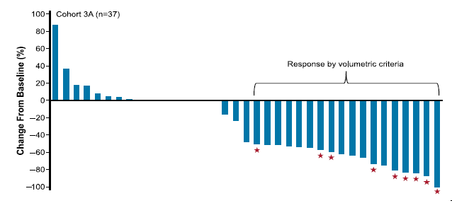
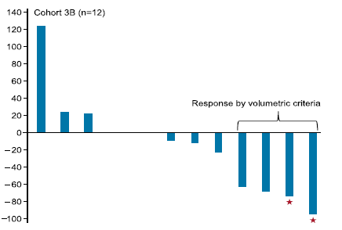
Neratinib+capecitabine for HER2+ BC pts with brain mets
TBCRC 022: Phase II study of Neratinib+capecitabine in HER2+ MBC pts with brain mets
No prior treatment with Lapatinib
Prior treatment with Lapatinib
CNS ORR= 49%
CNS ORR= 33%
★ Patients who also had a CNS response by RANO-brain mets criteria
@ErikaHamilton9
Courtesy of Erika Hamilton, MD
Freedman RA et al. JCO. 2019;37:1081
Notes:
Neratinib +T-DM1 being evaluated in 2nd half of the TBCRC-022 study.

Slide 38
Ongoing Phase 3 Clinical Trials of Investigational Regimens for Advanced HER2+ BC
 | DESTINY02¹ | TULIP² | DESTINY03³ | HER2CLIMB-02⁴
Line of therapy | 3rd-line | 3rd-line | 2nd-line | 2nd-line
Trial design | Phase 3 randomized, open-label, active-controlled | Phase 3 randomized, open-label, active-controlled | Phase 3 randomized, open-label, active-controlled | Phase 3 randomized, double-blind, placebo-controlled
Treatment arms | TDXd Physician’s choice (capecitabine + lapatinib or trastuzumab) | Trastuzumab duocarmazine Physician’s choice | TDXd T-DM1 | Tucatinib + T-DM1 Placebo + T-DM1
Planned patient numbers | ~600 | 345 (planned), 436 (actual) | ~500 | ~460
Prior treatment | HER2 therapies, including T-DM1 | ≥2 HER2-targeted regimens or T-DM1 | Trastuzumab + taxane; no prior HER2-targeted ADC | Trastuzumab + taxane
Primary endpoint | Median ICR PFS | Median ICR PFS | Median ICR PFS | Median INV PFS
Est. completion | Sep 2024 | Jul 2021 | Apr 2023 | Apr 2024
ADC: antibody-drug conjugate; ; ICR, independent review committee; INV, investigator-assessed; PFS, progression-free survival; T-DM1: trastuzumab emtansine; TDXd: trastuzumab deruxtecan
1. www.clinicaltrials.gov NCT03523585; 2. www.clinicaltrials.gov NCT03262935; 3. www.clinicaltrials.gov NCT03529110; 4. Hurvitz SA et al. Ann Oncol 2020;31:S390.
Courtesy of Joyce O’Shaughnessy, MD

Slide 39
Positive Topline Results of Pivotal Phase III TULIP® Study in HER2-Positive Unresectable Locally Advanced or Metastatic BC
The Phase III TULIP study of the antibody-drug conjugate (ADC) trastuzumab duocarmazine (SYD985) versus Physician's Choice in Participants With HER2-positive Locally Advanced or Metastatic Breast Cancer met its primary endpoint of progression-free survival (PFS), demonstrating a statistically significant improvement over physician's choice. PFS is defined as the time from the date of randomization to the date of first documented disease progression or death due to any cause, whichever occurred earlier. The study also demonstrated preliminary supportive overall survival (OS) results.
https://www.prnewswire.com/news-releases/byondis-announces-positive-topline-results-of-pivotal-phase-iii-tulip-study-in-patients
-with-her2-positive-unresectable-locally-advanced-or-metastatic-breast-cancer-301306890.html
Courtesy of Joyce O’Shaughnessy, MD

Slide 40
Phase III DESTINY-Breast09 trial for HER2-positive metastatic BC initiated
The first patient was dosed on the DESTINY-Breast09, a head-to-head phase III trial evaluating the safety and efficacy of trastuzumab deruxtecan (T-DXd) with or without pertuzumab compared to standard of care (THP: taxane, trastuzumab and pertuzumab) as a potential first-line treatment in patients with HER2 positive metastatic breast cancer on June 14, 2021. This is the first trial to evaluate T-DXd in the first-line metastatic setting in patients with HER2 positive breast cancer.
https://www.businesswire.com/news/home/20210614005114/en/DESTINY-Breast09-Head-to-Head-First-Line-Phase-3-Trial-of-
ENHERTU%C2%AE-Initiated-in-Patients-with-HER2-Positive-Metastatic-Breast-Cancer
Courtesy of Joyce O’Shaughnessy, MD

Slide 41
Agenda
Module 1: Role of Immunotherapy in HER2-Positive Metastatic Breast Cancer (mBC)?
Dr Mahtani: A 56-year-old woman with ER-positive, HER2-positive mBC enrolled on a clinical trial of nivolumab/ipilimumab
Module 2: Management of HER2-Positive mBC
Dr Partridge: A 30-year-old woman with ER-positive, HER2-positive mBC
Dr Mahtani: A 72-year-old woman with HER2-positive mBC
Dr O’Regan: A 58-year-old woman with ER-negative, HER2-positive mBC
Dr Partridge: A 50-year-old woman with ER-positive, HER2-positive mBC
Module 3: Considerations in the Care of Patients with Localized HER2-Positive Breast Cancer
Dr Mahtani: A 44-year-old woman with 5-cm ER-positive, HER2-positive localized breast cancer
Dr O’Regan: A 53-year-old woman with 4.5-mm ER-positive, HER2-positive breast cancer

Slide 42
Which neoadjuvant systemic therapy, if any, would you generally recommend for a 65-year-old patient with a 2.5-cm, ER-negative,
HER2-positive, clinically node-negative infiltrating ductal carcinoma (IDC)?
TCHP (TCH/pertuzumab)
Paclitaxel/trastuzumab/pertuzumab
Paclitaxel/trastuzumab
TCH (docetaxel/carboplatin/trastuzumab)
ACTH (doxorubicin/cyclophosphamide/
paclitaxel/trastuzumab)
ACTHP (ACTH/pertuzumab)
None
N = 54
Survey of live webinar audience

Slide 43
A 65-year-old woman with a 3.4-cm, ER-negative, HER2-positive IDC with biopsy-proven positive axillary nodes and receives neoadjuvant TCHP. Regulatory and reimbursement issues aside, what adjuvant anti-HER2 therapy would you recommend if at surgery the patient were found to have a pathologic complete response?
Trastuzumab/pertuzumab
Trastuzumab/pertuzumab → neratinib
T-DM1
Trastuzumab
T-DM1 → neratinib
Trastuzumab → neratinib
N = 63
Survey of live webinar audience

Slide 44
Case Presentation – Dr Mahtani: A 44-year-old woman with 5-cm ER-positive, HER2-positive localized breast cancer
Dr Reshma Mahtani
1/2020: Presents with palpable right breast mass and bloody nipple discharge from
the left nipple she had noted back in July 2019 but attributed to having stopped
breast feeding
  Imaging: multi focal disease in the right breast with largest mass 5-cm extending to subareolar region, prominent right axillary nodes.
  Biopsy: right breast mass and node IDC, grade 3, ER98%, PR25%, HER2 3+
  Biopsy: Left breast with multi-focal disease, no abnormal nodes. Biopsy of largest LEFT breast mass (2cm), IDC, grade 1, ER95%, PR 50%, HER2 1+
Genetic testing: negative (multi-gene panel)
Neoadjuvant TCHP → surgery → complete response on right side, residual low grade IDC, 2cm on left, 0/2 SLN
Completed adjuvant radiation and HP; given OFS and AI
Question
Would you offer this patient extended adjuvant therapy with neratinib?

Slide 45
Case Presentation – Dr O’Regan: A 53-year-old woman with 4.5-mm ER-positive, HER2-positive breast cancer
Dr Ruth O’Regan
Presents with abnormal mammogram for both breasts
  Biopsy: DCIS
Bilateral mastectomies with SLNB (node-negative)
Biopsy: 4.5 mm ER-positive, PR-negative, HER2-positive (IHC3+) breast cancer in right breast
Repeat FISH on tumor sample
Questions
How would you manage her? Would you feel strongly about treating her with paclitaxel/trastuzumab?
Would you give a patient like this T-DM1?

Slide 46
KATHERINE: Invasive Disease-Free Survival
100
80
60
Trastuzumab
T-DM1
Invasive Disease-Free Survival Rate (%)
Trastuzumab T-DM1
(n=743) (n=743)
40
IDFS Events, no. (%) 165 (22.2) 91 (12.2)
Unstratified HR=0.50 (95% CI, 0.39–0.64)
20
P<0.0001
3-year IDFS 77.0% 88.3%
0
0
6
12
18
24
30
36
42
48
54
60
No. at Risk
Trastuzumab
T-DM1
Time (months)
743
676
635
594
555
501
342
220
119
38
4
743
707
681
658
633
561
409
255
142
44
4
Courtesy of Ian E Krop, MD, PhD

Slide 47
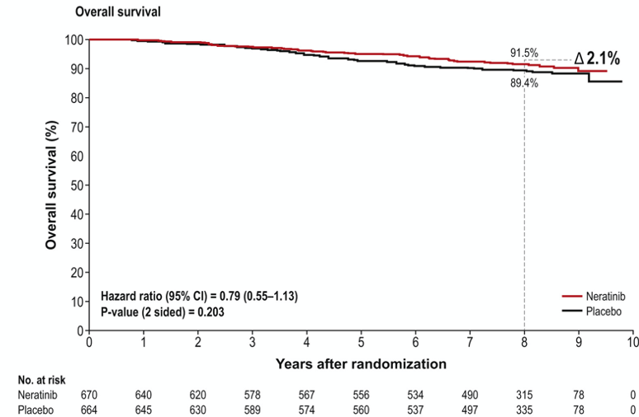
ExteNET: Updated analysis of patients HR+ and ≤1 year from trastuzumab
iDFS at 5yrs
Overall Survival
Chan et al Clin Breast Cancer 2021 Feb;21(1):80-91.e7.
Courtesy of Ian E Krop, MD, PhD

Slide 48
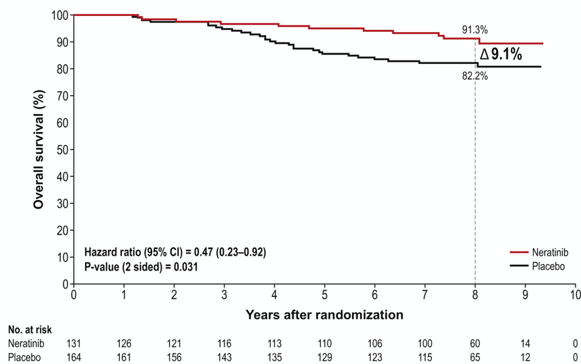
ExteNET: Outcomes in HR+, ≤1 year from trastuzumab, and with residual disease after neoadjuvant therapy
iDFS at 5yrs
Overall Survival
Chan et al Clin Breast Cancer 2021 Feb;21(1):80-91.e7.
Courtesy of Ian E Krop, MD, PhD

Slide 49
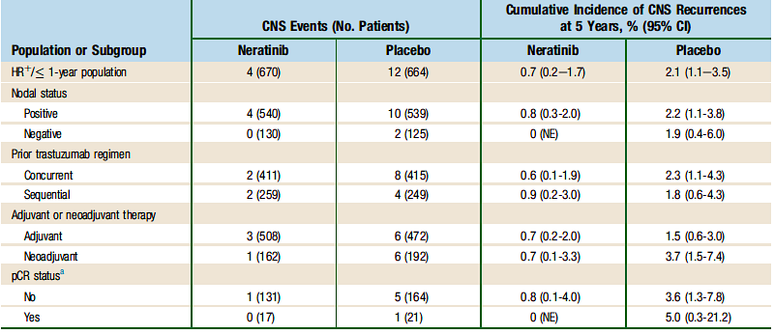
ExteNET: Cumulative incidence of CNS disease as 1st site of recurrence
Chan et al Clin Breast Cancer 2021 Feb;21(1):80-91.e7.
Courtesy of Ian E Krop, MD, PhD

Slide 50
Association Between Treatment Duration and Overall Survival in Early-Stage HER2+ Breast Cancer Patients Receiving Extended Adjuvant Therapy with Neratinib in the ExteNET Trial
Moy B et al.
ASCO 2021;Abstract 540.

Slide 51
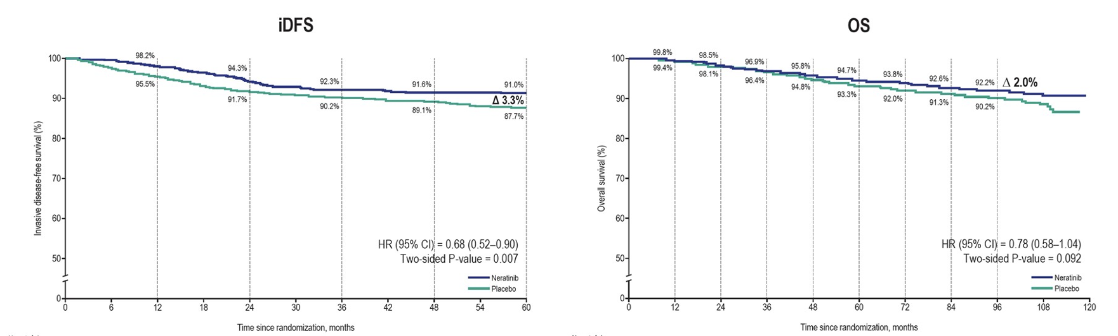
ExteNET: iDFS and OS – Completed Neratinib Therapy
In the ITT population, the HR for OS was reduced from 0.95 to 0.78 upon completion of neratinib therapy.
Moy B et al. ASCO 2021;Abstract 540.

Slide 52


WSG-ADAPT HER2+/HR-
iDFS:
non-pCR vs pCR
5y-iDFS
pCR/is: 98% [90; 100]
non-pCR/is: 82% [69; 90]
HR 0.14, 95%CI: [0.03; 0.64]; p=.011
Patients with
no further CT after pCR
Arm A | Arm B
9 (29.0%) | 30 (79.0%)
Courtesy of Ian E Krop, MD, PhD

Slide 53
Neoadjuvant THP (DAPHNe Study)
Waks A, et al. (N=97)
RCB class | All patients (n=97) | ER+ and/or PR+ (n=65) | ER- and PR- (n=32)
0 (pCR) | 55(56.7%) | 28(43.1%) | 27(84.4%)
1 | 9(9.3%) | 8(12.3%) | 1(3.1%)
2 | 26(26.8%) | 24(36.9%) | 2(6.3%)
3 | 2(2.1%) | 2(3.1%) | 0
Non-pCR → more neoadjuvant therapy | 5(5.2%) | 3(4.6%) | 2(6.3%)
Courtesy of Ian E Krop, MD, PhD

Slide 54
Administration of additional adjuvant cytotoxic chemotherapy (N=92)
Pathologic surgical outcome | Adjuvant chemotherapy received? | No. of patients (%, 95% CI)
pCR (RCB 0) (n=55) | Yes | 1(1.8%) (0.1-9.7)
 | No | 54(98.2%) (90.3-100.0)
Non-pCR, all RCB classes (RCB 1, 2, 3) (n=37) | Yes | 16(43.2%) (27.1-60.5)
 | No | 21(56.8%) (39.5-72.9)
Notes: Trastuzumab emtansine (T-DM1) was NOT considered ”cytotoxic chemotherapy” for this analysis. 5 pts who received additional neoadjuvant AC were excluded (pre-specified) from this analysis.
Among patients who experienced pCR following neoadjuvant THP, the rate of adherence to de-escalated adjuvant HP antibody-only therapy was 98.2% (95% CI 90.3%-100.0%).
Courtesy of Ian E Krop, MD, PhD

Slide 55
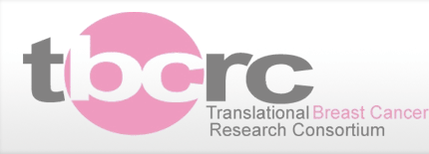
MARGetuximab or Trastuzumab (MARGOT): A Phase 2 Study Comparing Neoadjuvant TMP vs THP in Patients With Stage II/III HER2+ Breast Cancer
N=171
Research blood collection (plasma + PBMCs)
Key eligibility criteria
If pCR (breast and nodes), complete 52 weeks MP/HPª
Anatomic stage II/III HER2+ breast cancer
Breast tumor ≥1.5 cm
ER/PR positive or negative
CD16A genotype FF or FV (confirmed by central testing)
TMP x 12 weeks
Paclitaxel
Margetuximab
Pertuzumab
Definitive surgery OR (if clinical residual disease) biopsy → additional pre-operative chemotherapy
2:1 R
Follow-up for recurrence/
survival
THP x 12 weeks
Paclitaxel
Trastuzumab
Pertuzumab
If no pCR, standard therapy per investigator discretion
Goal: Increase 45% pCR rate on herceptin (THP) to 65% on margetuximab (TMP)
Screen 200+ subjects (VV≈15%)
Patients will be stratified by ER status (<10% vs >10%) and clinical anatomic stage (II vs III)
Biopsy x2:
Baseline
On treatment
Surgical
tissue
collection
Courtesy of Ian E Krop, MD, PhD
ªConcurrent endocrine treatment allowed if HR+. Adjuvant radiation per standard institutional practice.
CD, cluster of differentiation; ER, estrogen receptor; FPI, first patient in; H, trastuzumab; HER2+, human epidermal growth factor receptor 2 positive; HR, hormone receptor; M, margetuximab; P, pertuzumab; PBMC, peripheral blood mononuclear cells; pCR, pathological complete response (defined as RCB [residual cancer burden]=0); PR, progesterone receptor; T, paclitaxel.

Slide 56
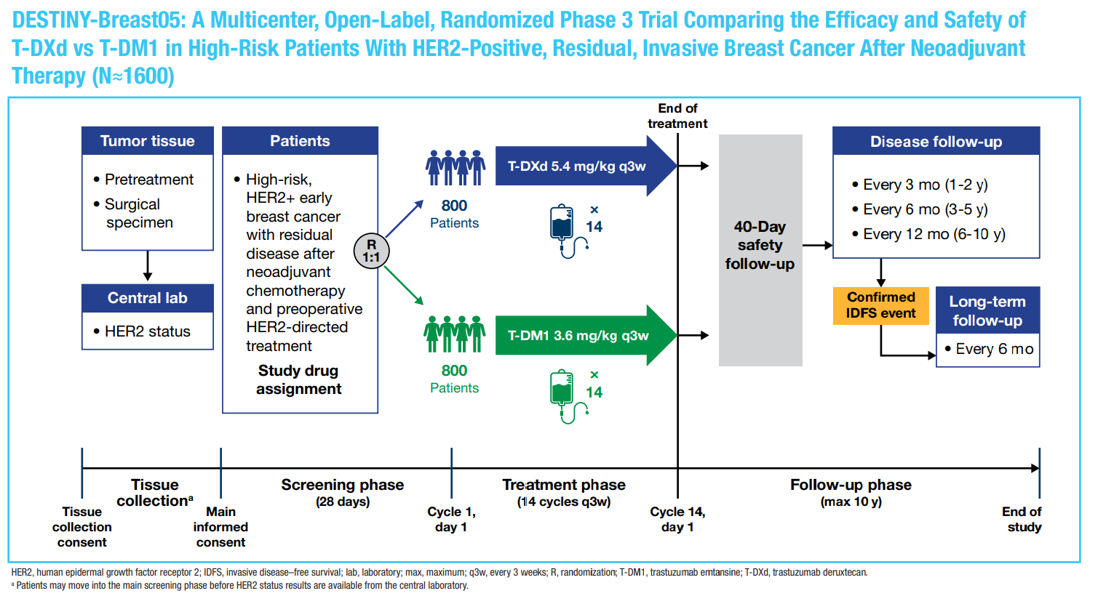
San Antonio Breast Cancer Symposium®, December 8-11, 2020
DESTINY-Breast05 phase 3 trial
– Inoperable breast cancer at presentation
– Operable breast cancer at presentation with node–positive (ypN1-3) disease after neoadjuvant therapy
Geyer et al. SABCS 2020 OT-03-01
Courtesy of Ian E Krop, MD, PhD
This presentation is the intellectual property of the author/presenter. Contact them at alprat@clinic.cat for permission to reprint and/or distribute.

