Slide 1
Current and Future Directions in SCLC Clinical Management
Charles Rudin MD PhD
Hassenfeld Professor and Chief
Thoracic Oncology Service
Memorial Sloan Kettering Cancer Center

Slide 2
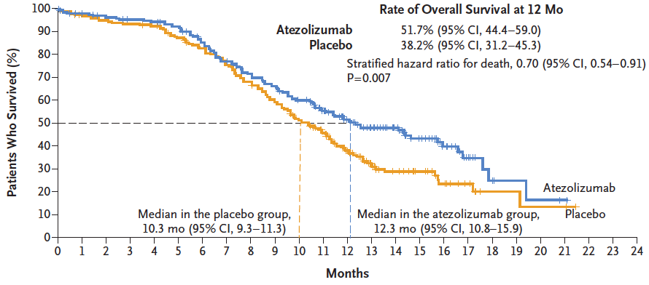
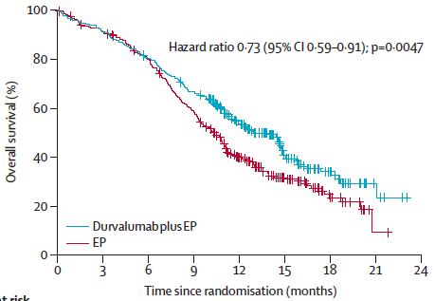
Recent progress in SCLC: IMpower133 and CASPIAN trials
Atezolizumab (IMpower133)
Durvalumab (CASPIAN)
Horn et al., N Engl J Med 2018; Paz-Ares et al., Lancet 2019

Slide 3
IMpower133 and CASPIAN – compare and contrast
Similarities
first line, extensive stage, platinum/etoposide +/- PD-L1 Ab
positive phase III studies for survival (!!)
led to FDA approvals and change in standard of care
Differences
CASPIAN allowed untreated asymptomatic brain mets
CASPIAN allowed cisplatin (investigator choice)
CASPIAN was 3 arms
also explored chemo + durvalumab (PD-L1) + tremelimumab (CTLA-4)

Slide 4
CASPIAN design (IMpower133 similar… 2 arm…)
* EP = etoposide 80-100 mg/m² with either carboplatin AUC 5-6 or cisplatin 75-80 mg/m²
† Pts could receive an additional 2 cycles (up to 6 cycles) and PCI at the investigator's discretion
‡ Patients received an additional dose of tremelimumab after EP
§ By investigator assessment per RECIST v1.1
Paz-Ares et al., ASCO 2020

Slide 5
A lesson from CASPIAN – targeting CTLA-4 did not help
Paz-Ares et al., ASCO 2020

Slide 6
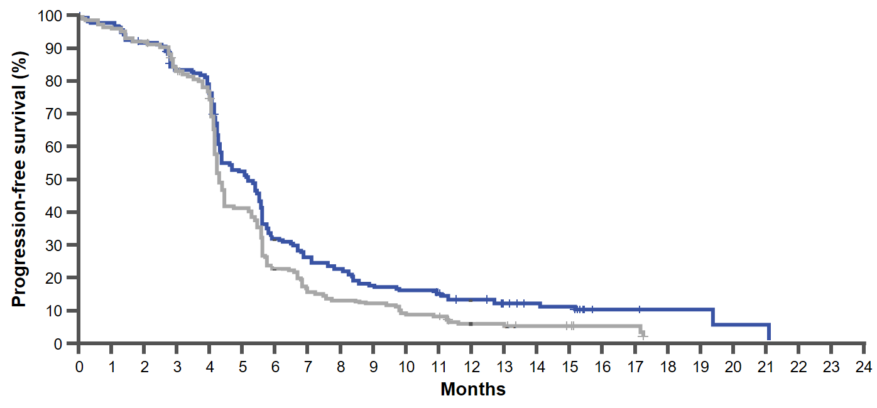
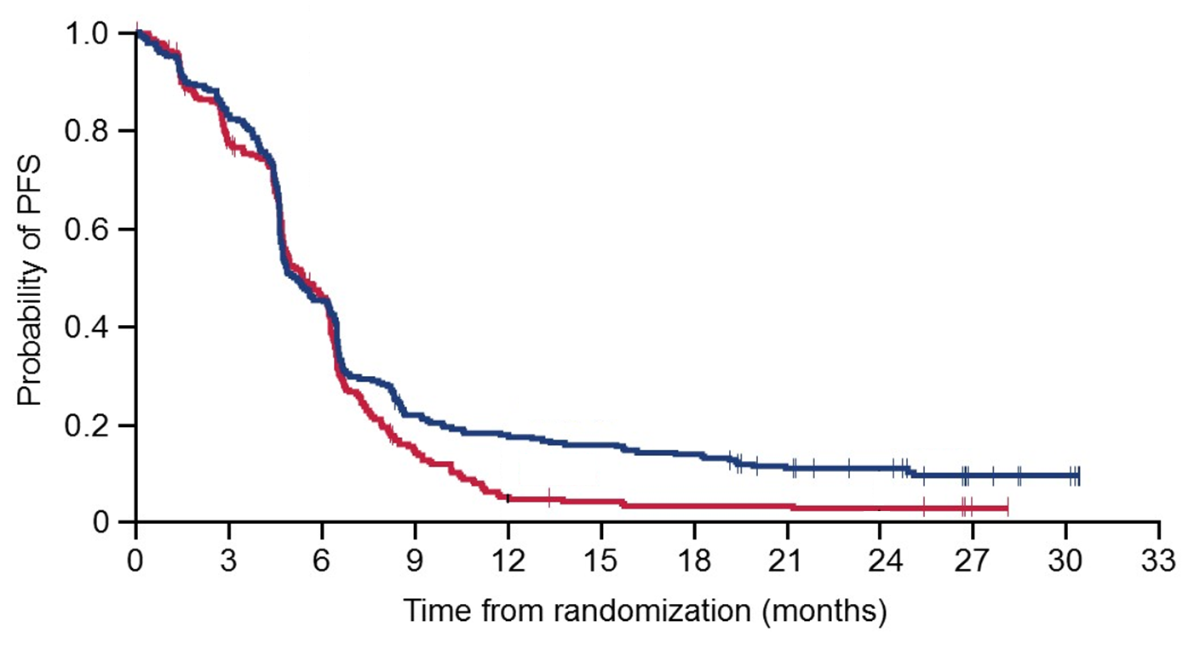
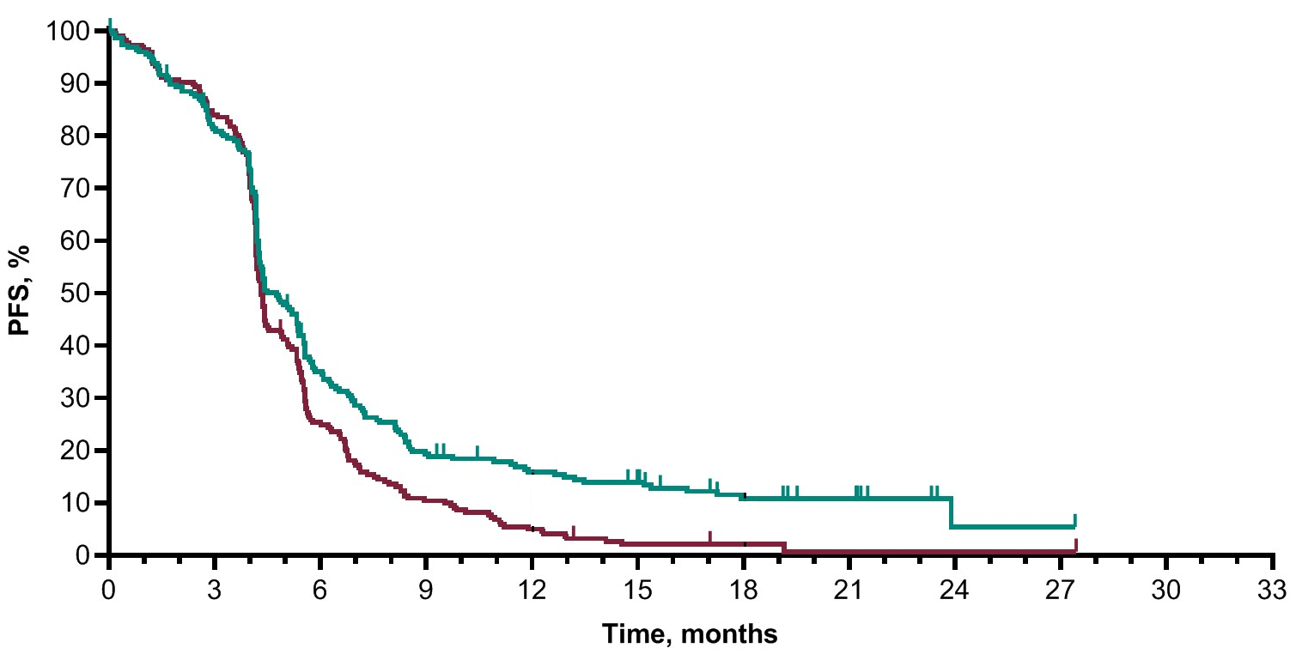
Room to improve
IMpower133
HR 0.77 (0.62, 0.96)
CASPIAN
HR 0.80 (0.66, 0.96)
KEYNOTE-604
HR 0.73 (0.60, 0.88)
12-mo rate
15.9
5.0
12-mo rate
17.9
5.3
12-mo rate
12.6
5.4
24-mo rate
11.0
2.9
18-mo rate
10.8
2.1
4.3
5.2
5.1
5.4
4.3
4.8
Horn et al., N Engl J Med 2018; Paz-Ares et al., Lancet 2019; Rudin et al., J Clin Oncol 2020

Slide 7
First line immunoRX:
good proof of principle –
but not good enough!

Slide 8
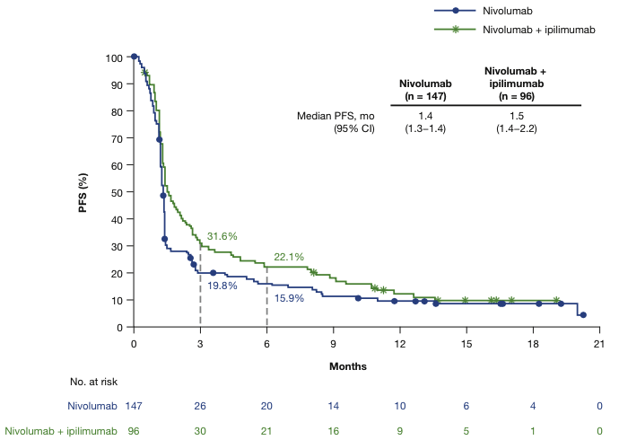
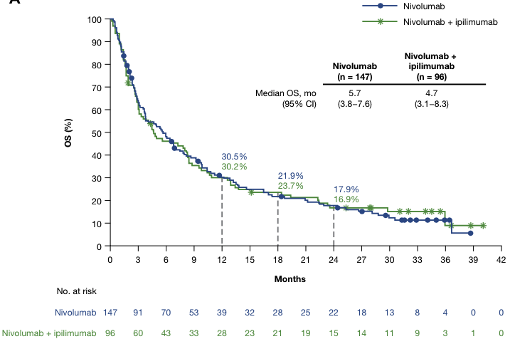
CheckMate 032: randomized cohorts of nivolumab +/- ipilimumab
1 or 2 prior Rx
Nivo 3mg/kg q2wk versus nivo 1mg/kg + ipi 3mg/kg q3wk x 4, followed by nivo 3mg/kg q2wk
PFS
OS
Ready et al., J Thor Oncol 2020

Slide 9
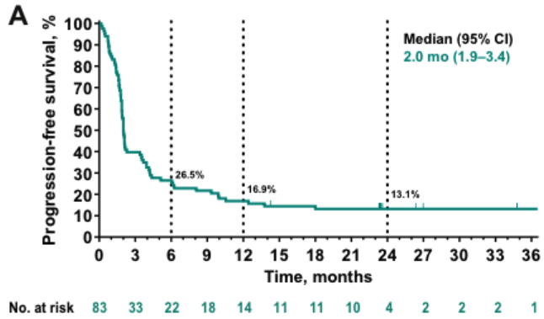
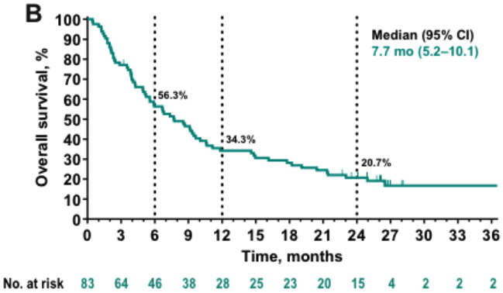
KEYNOTE-028/158 – pembrolizumab in 3rd line and beyond
PFS
$≥$2 prior Rx
N = 19 + 64 = 83
OS
19.3%
Chung et al., J Thor Oncol 2020

Slide 10
Given the use of immunotherapy in the FIRST line therapy for SCLC, what do we do with the THIRD line approvals?

Slide 11
Where do we go from here? Challenges in immunotherapy for SCLC
IO/IO
CTLA-4 blockade overall… disappointing?
Other relevant immune targets
Tigit? NK cells? Macrophages?
IO/targeted RX
DNA damage response inhibition → immune activation?
Epigenetic priming → antigen presentation?
Biomarkers of response
and mechanisms of resistance

Slide 12
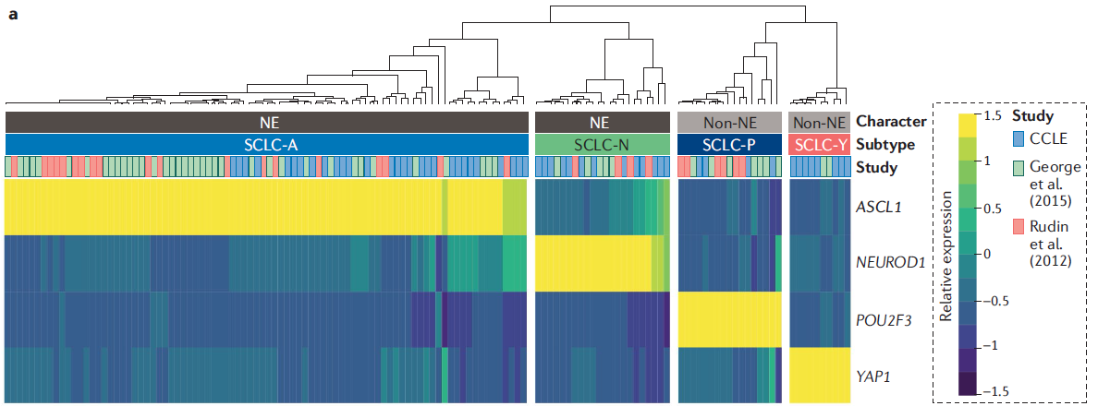
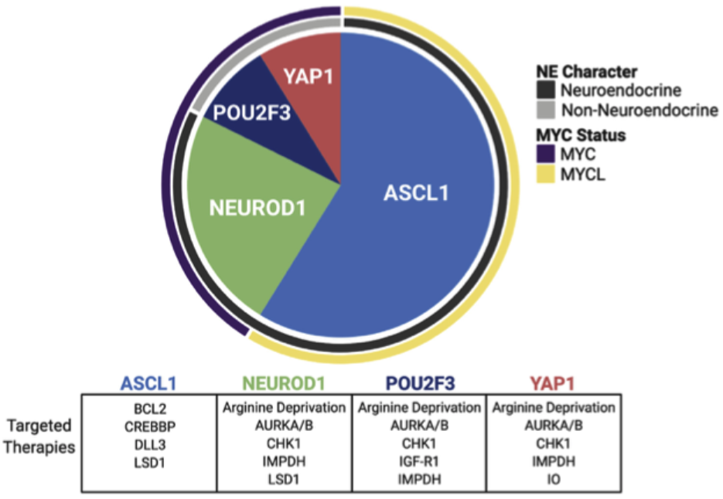
SCLC subtypes defined by transcriptional profiling
Rudin et al., Nature Rev Cancer 2019
Poirier et al., J Thor Oncol 2020

Slide 13
YAP1 subtype – immune “inflamed?”
T-cell inflamed signature
HLA gene expression
Owonikoko et al., ASCO 2020

Slide 14
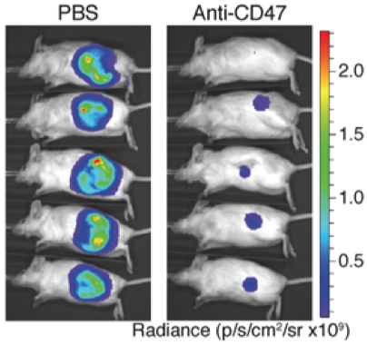
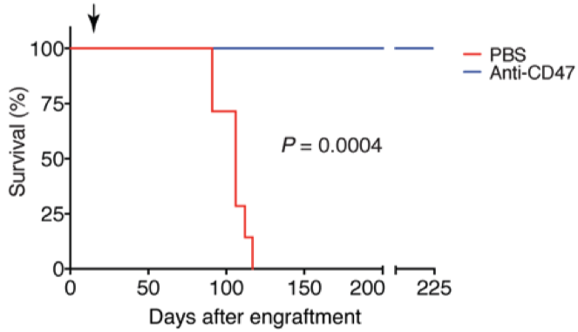
Macrophage activation in SCLC preclinical models
Targeting the CD47 “don’t-eat-me” signal
Weiskopf et al., J Clin Invest 2016

Slide 15
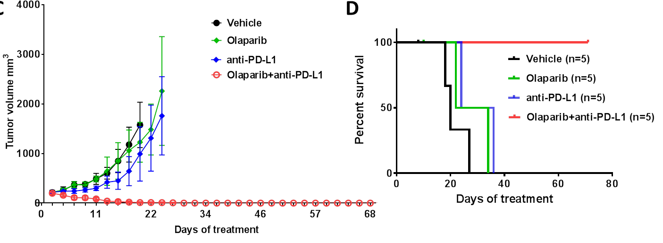
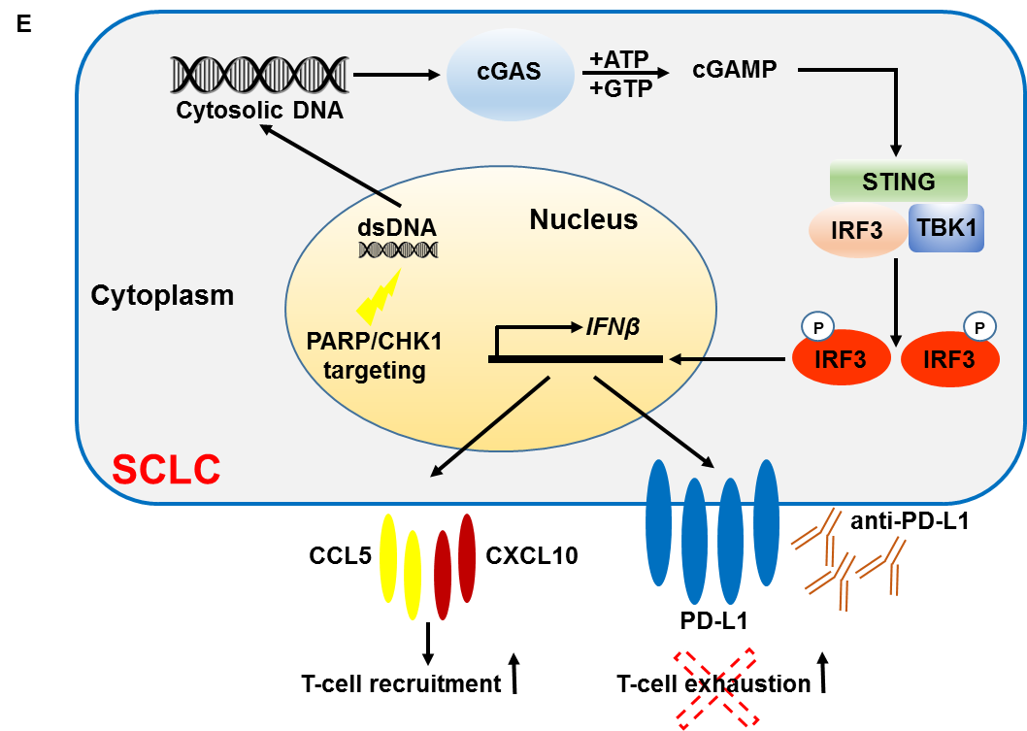
PARPi and PD-1 blockade: preclinical efficacy
Sen et al., Cancer Discov, 2019

Slide 16
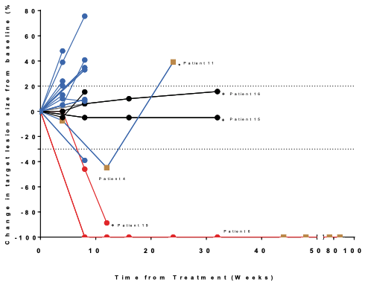
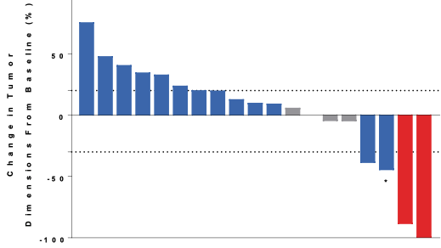
Durvalumab + olaparib in relapsed SCLC patients – initial foray disappointing
Durvalumab 1500mg q4wk Olaparib 300mg BID
N = 20
Thomas et al., J Thor Oncol 2019

Slide 17
Immunotherapy in SCLC: opportunities and challenges
First line chemoIO trials show consistent success
Critical milestone! However:
Durable benefit is concentrated in a small minority (~10%)
What are the biomarkers defining this subset?
What do we do to prime the other 90% for IO response?
Preclinical research is defining new therapeutic strategies
Essential for progress! However:
Preclinical models are imperfect predictors
Clinical translation with mechanistic correlative analyses needed

Slide 18
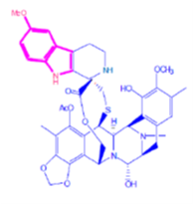
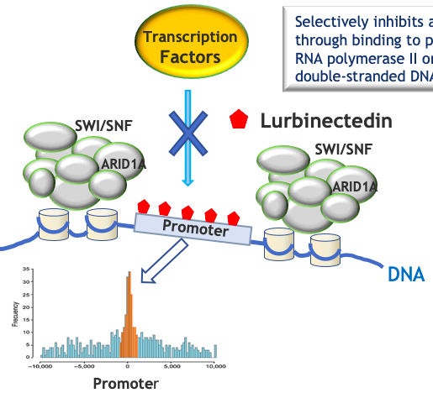
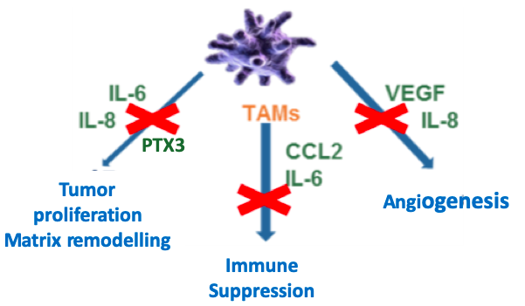
Lurbinectedin – a new drug for recurrent SCLC
How does it work?
Alkylator
Minor groove DNA binder
Tumor-intrinsic effects
Tumor-associated macrophage effects?

Slide 19
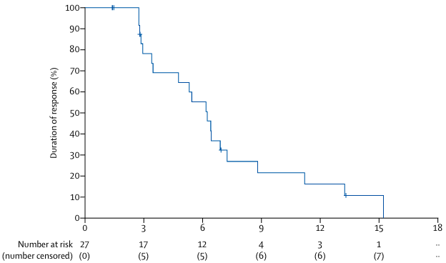
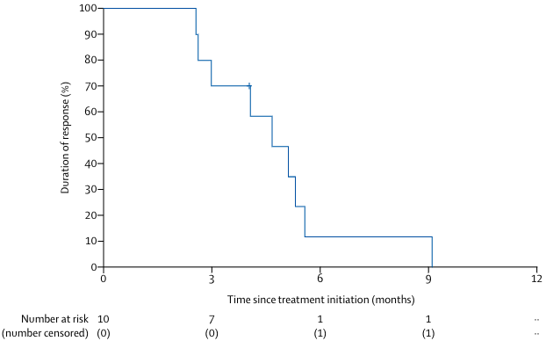
Lurbinectedin – single arm phase II basket trial
Duration of response
CTFI $≥$ 90 days
N = 105
Relapsed SCLC, PS 0-2
No brain mets
3.2mg/m² lurbinectedin q3W
1º endpoint ORR
 | All patients (n=105) | CTFI <90 days (n=45) | CTFI ≥90 days (n=60)
ORR % (95% CI) | 35.2 (26.2-45.2) | 22.2 (11.2-37.1) | 45.0 (32.1-58.4)
DOR, mo (95% CI) | 5.3 (4.1-6.4) | 4.7 (2.6-5.6) | 6.2 (3.5-7.3)
PFS, mo (95% CI) | 3.5 (2.6-4.3) | 2.6 (1.3-3.9) | 4.6 (2.8-6.5)
OS, mo (95% CI) | 9.3 (6.3-11.8) | 5.0 (4.1-6.3) | 11.9 (9.7-16.2)
Duration of response
CTFI < 90 days
CTFI = chemotherapy-free interval
Trigo et al., Lancet Oncol 2020

Slide 20
Lurbinectedin – tox relative to (historical) topotecan
Toxicities |  | Lurbinectedin | Topotecan
 |  | B-005 (n=105) | ACT-1 (n=197) | USPI (n=107)
 |  | % | % | %
Deaths due to TEAEs |  | 1.9 | 11.2 | NA
Grade ≥3 TEAEs | Abdominal pain | 1.0 | NA | 6
 | Dyspnea | 5.7 | 6.6 | 9
 | Fatigue/Asthenia | 12.4 | 12.2 | 15
 | Nausea | 0 | NA | 8
 | Pneumonia | 2.9 | 3.0 | 8
 | Sepsis | 0 | NA | 5
 | Febrile neutropenia | 4.8 | 3.0 | 28
G-CSF | Primary prophylaxis | 0 | 100 | 0
Grade ≥3 heme tox | Anemia | 8.6 | 30.5 | 42
 | Leukopenia | 28.6 | 21.8 | 83.5
 | Neutropenia | 45.7 | 53.8 | 88
 | Thrombocytopenia | 6.7 | 54.3 | 58
Trigo et al., Lancet Oncol 2020; von Pawel et al., J Clin Oncol 2014; von Pawel et al., J Clin Oncol 1999

Slide 21
Inherent cell cycle and genome repair deficiencies in SCLC
G1 checkpoint
G1
ATM, CHK2, p53, p21
Spindle assembly checkpoint
Restriction point
RB, p27
BUB1R, MAD2
PLK1, AURKA/B
Cyclin B/CDK1
M
AURKi
Replication checkpoint(s)
G2 checkpoint
ATM, CHK2, p53
ATR, CHK1, WEE1
ATM, CHK2, p53, p21
G2
ATR, CHK1, WEE1
S
SLFN11
WEE1i
PARPi
EZH2i
ATRi
CHK1i
Drapkin and Rudin, Cold Spring Harbor Perspect Med 2020

Slide 22
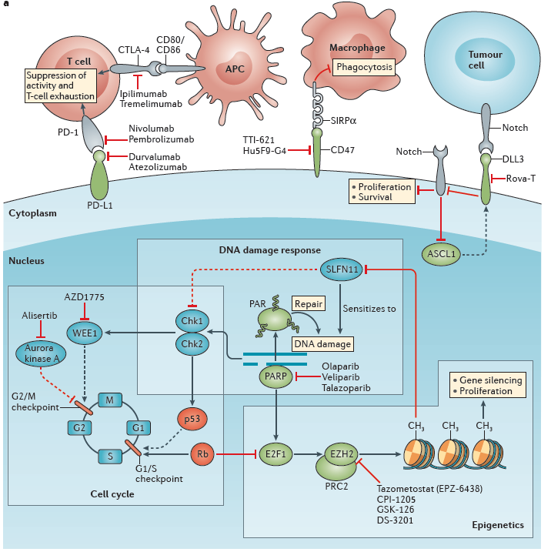
New targets in SCLC – taking several shots on goal
Epigenetic vulnerabilities
EZH2, LSD1, BRD4, others
DLL3
AMG757 BiTE… and more
ImmunoRX
Priming of immune checkpoints – epigenetics and DDRi
Exploiting the unique immunologic landscape
Exploiting cell cycle vulnerabilities
Novel synergies with inhibitors of WEE1, CHK1, AURK-A
DNA damage repair vulnerabilities
PARP inhibitor sensitivity
Rational combinatorial strategies
tazemetostat (EPZ-6488)
Sabari et al., Nature Rev Clin Oncol. 2017

Slide 23
SCLC case scenarios
Charles Rudin MD PhD
Hassenfeld Professor and Chief
Thoracic Oncology Service
Memorial Sloan Kettering Cancer Center

Slide 24
Case 1 – extensive stage SCLC
80 y/o heavy smoker presents with cough, dyspnea, weight loss
No neurologic sxs
PS 80%
Staging w/u
Lung mass with bulky mediastinal LAD, liver metastasis, isolated 0.7cm brain metastasis without significant edema
Liver BX
SCLC

Slide 25
Case 2 – limited stage SCLC
55 y/o former minimal smoker with small volume hemoptysis
No weight loss, minimal dyspnea on exertion
PS 90%
Staging w/u
5 cm LUL mass
2 cm hilar and 2.5 cm subcarinal
Bronch BX
Level 7 LN – combined SCLC with adenocarcinoma

Slide 26
Case 3 – very early stage SCLC
65 y/o heavy smoker, screening CTs reveal progressive peripheral spiculated lung mass
0.6 cm; → 1 year later, 1.8 cm; PET+
Staging w/u no distant disease
Mediastinoscopy NED
Lobectomy
Surg Path
SCLC
pT1bN0M0, stage IA2

Slide 27
Thank you – and I look forward to the discussion!

