Slide 1

EGFR Mutation Positive Non-Small Cell Lung Cancer
Pasi A. Jänne MD, PhD

Slide 2
EGFR Mutation Positive Non-Small Cell Lung Cancer
First line therapy for advanced EGFR-mutant NSCLC
Resistance to first line Osimertinib and treatment strategies
EGFR exon 20 mutant NSCLC
Adjuvant EGFR inhibitor therapy

Slide 3
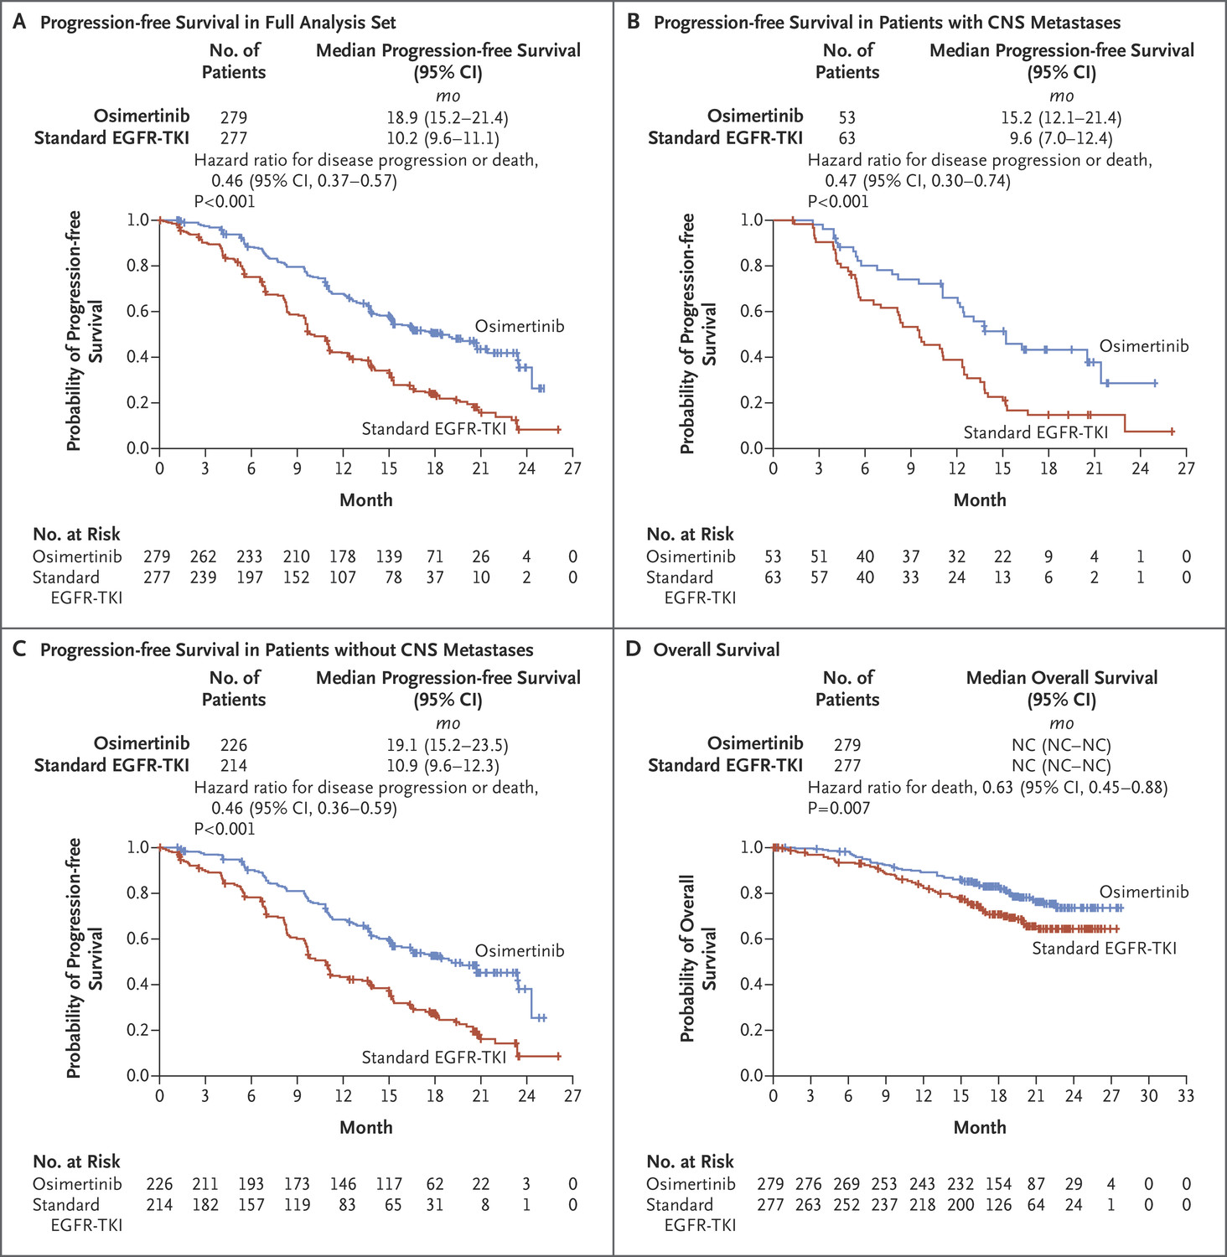
Osimertinib vs. Standard of Gefitinib/Erlotinib – FLAURA trial
Progression Free Survival
Overall Survival
Soria et al. NEJM 2018; Ramalingam et al. NEJM 2020

Slide 4
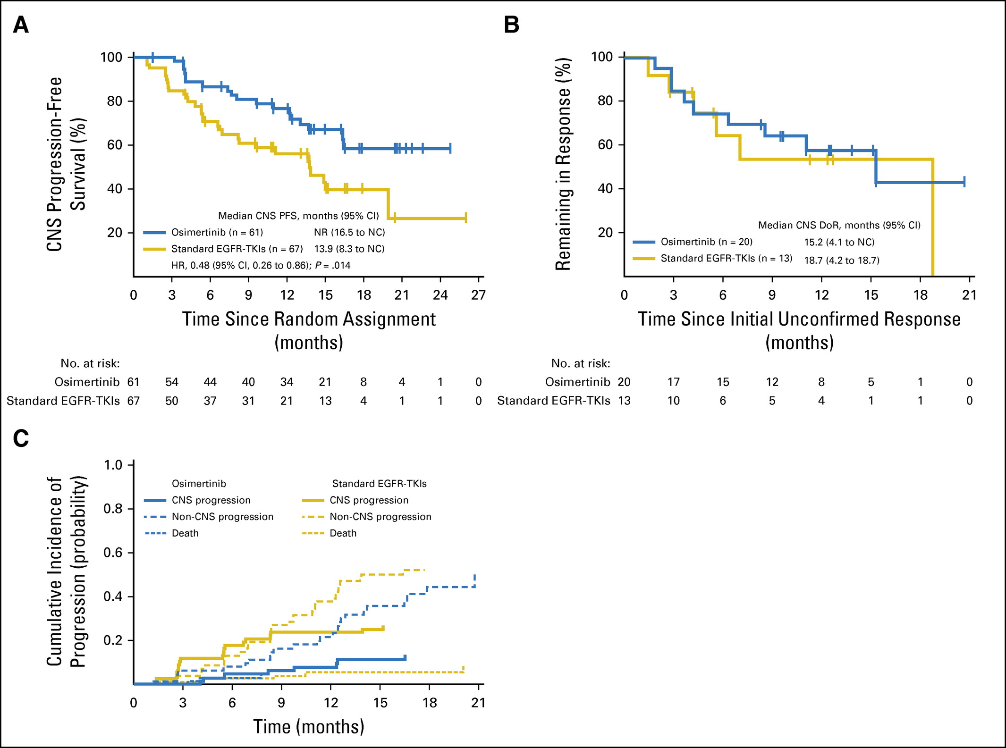
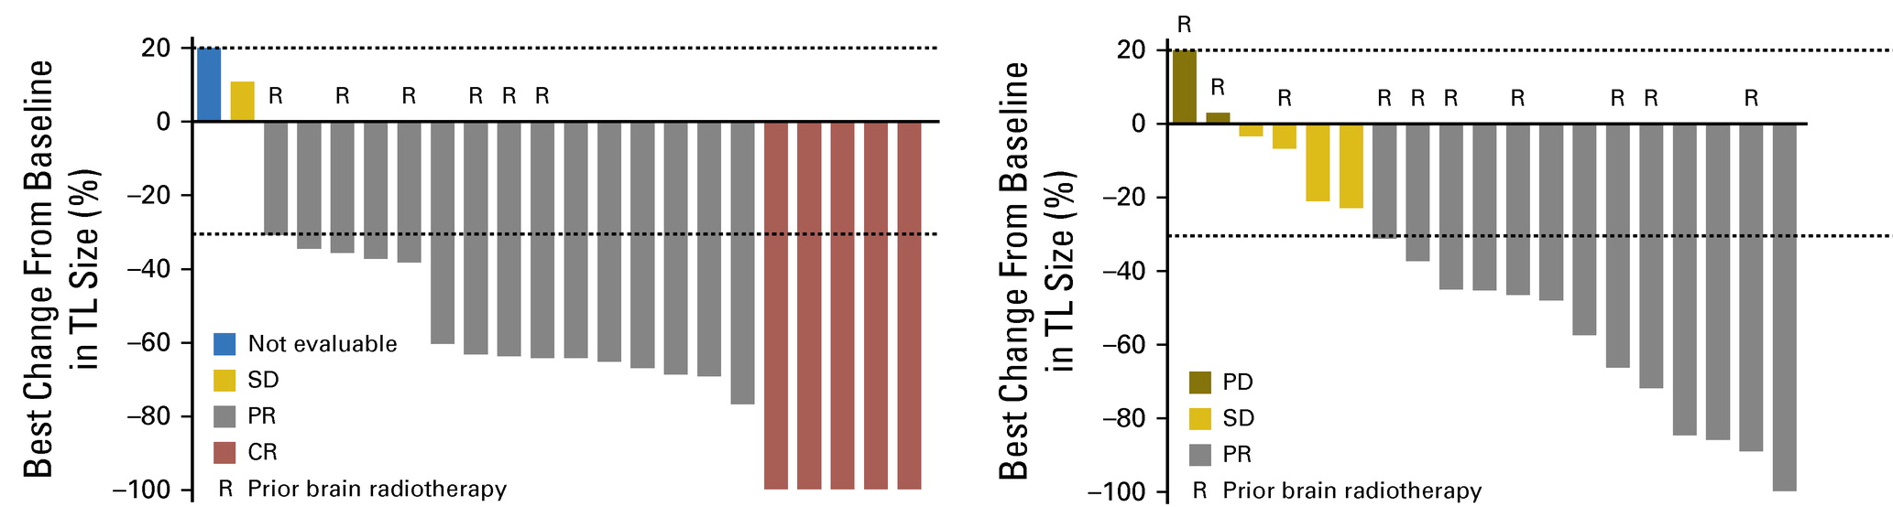
FLAURA: Osimertinib brain penetration associated with improved CNS efficacy vs. SoC EGFR-TKI
Osimertinib
SoC EGFR-TKI
Reungwetwattana T, et al. J Clin Oncol 2018;36:3290–3297.

Slide 5
RELAY: randomised, double-blind study of erlotinib in combination with ramucirumab or placebo in previously untreated patients with metastatic EGFRm NSCLC
Key inclusion criteria
Stage IV NSCLC
EGFRm (Ex19del or L858R)
ECOG PS 0–1
Erlotinib 150 mg/day
+ ramucirumab 10 mg/kg Q2W
(n=224)
Primary endpoint
PFS
Secondary endpoints
OS
ORR
DCR
DoR
Safety
Exploratory endpoint
PFS2
R
Key exclusion criteria
T790M EGFR mutation
Prior treatment with EGFR-TKI or chemotherapy
Brain metastases
1:1
Erlotinib 150 mg/day
+ placebo
(n=225)
Stratification factors:
Sex, geographic region (East Asia vs. other), EGFR status (Ex19del vs. L858R) and EGFR testing method
Treatment until progression or unacceptable toxicity
Nakagawa et al. Lancet Oncol 2019

Slide 6
RELAY: randomised, double-blind study of erlotinib in combination with ramucirumab or placebo in previously untreated patients with metastatic EGFRm NSCLC
PFS
PFS2
 | RAM + ERL n=224 | PBO + ERL n=225
Median, months (95% CI) | 19.4 (15.4, 21.6) | 12.4 (11.0, 13.5)
HR (95% CI) | 0.591 (0.461, 0.760)
P-value | < 0.0001
RAM + ERL
PBO + ERL
 | RAM + ERL n = 224 | PBO + ERL n = 225
Median, months | NR | NR
HR (95% CI) | 0.690 (0.490, 0.972)
No. at risk
RAM+ERL | 224 | 196 | 170 | 154 | 133 | 103 | 69 | 49 | 32 | 20 | 10 | 1 | 0
PBO+ERL | 225 | 196 | 167 | 136 | 99 | 72 | 52 | 37 | 27 | 15 | 4 | 4 | 0
No. at risk
RAM+ERL | 224 | 215 | 208 | 201 | 187 | 165 | 126 | 97 | 71 | 50 | 21 | 7 | 0
PBO+ERL | 225 | 223 | 218 | 208 | 181 | 149 | 115 | 89 | 66 | 45 | 17 | 8 | 0
Interim OS | RAM + ERL N=224 | PBO + ERL N=225
Events | 37 | 42
Censoring rate | 83% | 81%
Median, months | NR | NR
HR (95% CI) | 0.832 (0.532, 1.303)
Nakagawa et al. Lancet Oncol 2019

Slide 7
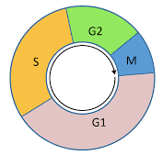
Acquired resistance mechanisms to first line osimertinib treatment (from cfDNA)
No evidence of acquired EGFR T790M
The most common resistance mechanisms were MET amplification and EGFR C797S mutation
Other mechanisms included HER2 amplification, PIK3CA and RAS mutations
EGFR
EGFR
HER2
HER2
HER2
HER2
MET
MET
MET
MET
Secondary EGFR mutations:# C797X: 7%; L718Q+C797S: 1%; L718Q + ex20ins: 1%; S768I: 1%
HER2 amplification: 2%
HER2 mutation: 1%
SPTBN1
ALK
SPTBN1-ALK: 1%
MET amplification: 15%
PIK3CA
PIK3CA mutations: 7%
BRAF mutations (V600E): 3%
RAF
KRAS mutations (G12D/C, A146T): 3%
RAS
mTOR
AKT
p53
MEK
BIM
BCL2
Cell cycle gene alterations
CCND amps: 3%
CCNE1 amps: 2%
CDK4/6 amps: 5%
ERK
Apoptosis
Survival
Proliferation
Ramalingam et al. ESMO 2018
*Resistance mechanism reported may overlap with another; #Two patients had de novo T790M mutations at baseline of whom one acquired C797S at progression

Slide 8
Strategies to Treat First Line Osimertinib Resistance
Rebiopsy progressive disease
Can be used to identify mechanism(s) of resistance and r/o SCLC transformation; cfDNA alternative if bx not feasible
Target the targetable alterations
EGFR C797S, MET, etc.
SAVANNAH trial (MET combo), ORCHARD trial (multiple combos), JNJ-61186372 (Amivantamab) ongoing CHRYSALIS trial
If no targetable alteration
Broader strategies (e.g. U3-1402, also known as patritumab deruxtecan)
Chemotherapy +/- osimertinib

Slide 9
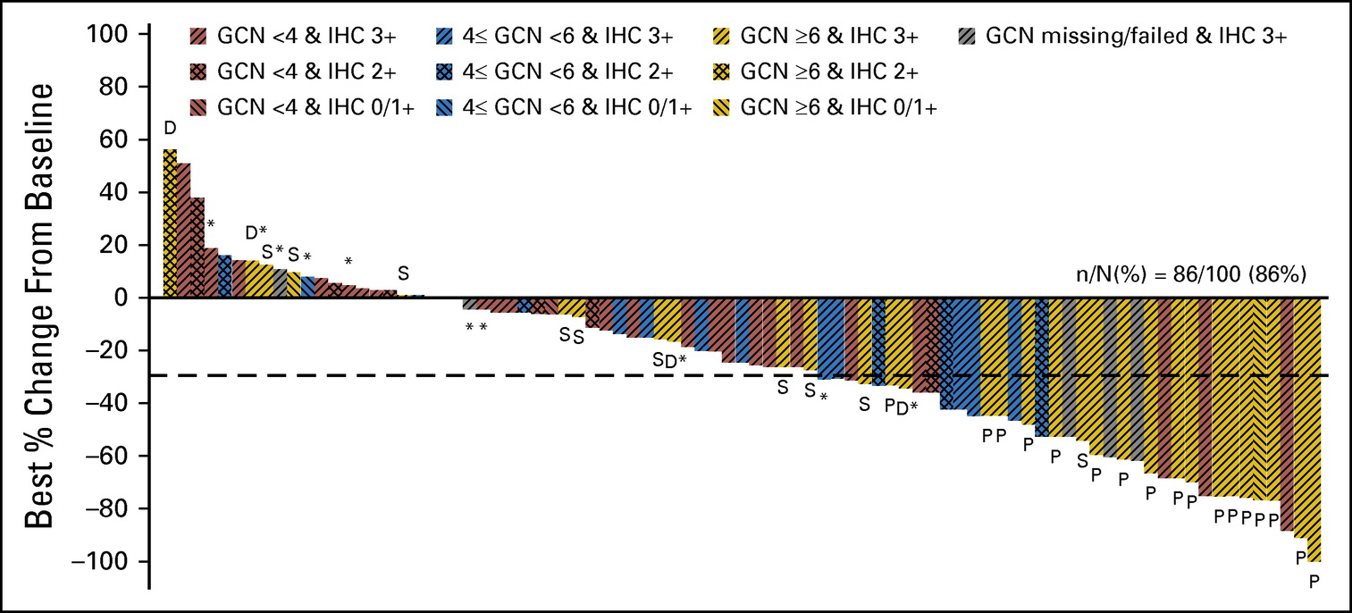
Targeting MET amplification in EGFR-mutant NSCLC with EGFR & MET TKI
Phase Ib trial of Osimertinib & Savolitinib
Phase Ib/II of
Gefitinib & Capmatinib
Sequist et al Lancet Oncol 2020; Wu et al. JCO 2018

Slide 10
EGFR mutant cancers often co-express other ERBB family members
HER2
- Amplification a known resistance mechanism
HER3
-Used to activate PI3K signaling
-Not a known resistance mechanism to EGFR TKIs

Slide 11
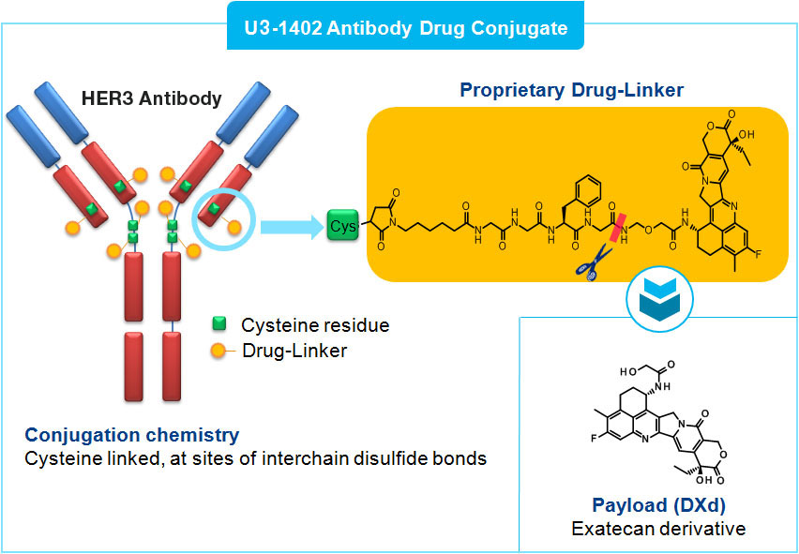
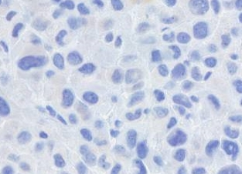
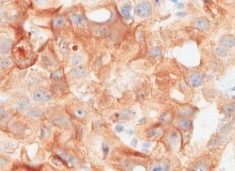
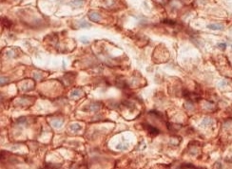
Patritumab deruxtecan (U3-1402) – HER3 antibody-drug conjugate
H-Score: 1
H-Score: 202
H-Score: 248
DFCI 306
DFCI 259
DFCI 284
Tumor volume (mm³)
Conjugation chemistry
The linker is connected to cysteine residue of the antibody
Osimertinib resistant
(Ex19del/BRAF V600E)
Erlotinib resistant
(L858R/T790M negative)
Osimertinib resistant
(Ex19del/T790M)
Phase I clinical trial of patritumab deruxtecan (U3-1402) for patients with osimertinib resistance or EGFR T790M-negative erlotinib resistance is underway (NCT03260491)

Slide 12
Patritumab deruxtecan (U3-1402) Phase 1 Dose Escalation Study Design
Eligibility Criteria
Metastatic/unresectable EGFR-mutant NSCLC and:
T790M-negative after progression on erlotinib, gefitinib, or afatinib; OR
Progressed on osimertinib
Stable brain metastases allowed
Pretreatment tumor tissue (after progression on TKIs) was required for retrospective analysis of HER3 expression
Patritumab deruxtecan Dose Escalation (N = 30)
Patient Dispositionª
Received ≥ 1 dose of patritumab deruxtecan IV Q3W
Ongoing, n = 17
Discontinued, n = 13
Progressive disease: 9
Consent withdrawal: 2
Clinical progression: 1
AE: 1
6.4 mg/kg (n = 5)
5.6 mg/kg (n = 12)
4.8 mg/kg (n = 9)
3.2 mg/kg (n = 4)
Objectives
Primary:
Safety and tolerability of patritumab deruxtecan and RDE determination
Secondary:
Antitumor activity of patritumab deruxtecan
Exploratory:
Biomarkers of patritumab deruxtecan antitumor activity
A phase 1 study of patritumab deruxtecan in NSCLC (NCT03260491). ªData cutoff of May 3, 2019.
AE, adverse event; EGFR, epidermal growth factor receptor; HER3, human epidermal growth factor receptor 3; IV, intravenously; NSCLC, non-small cell lung cancer; Q3W, every 3 weeks; RDE, recommended dose for expansion; TKI, tyrosine kinase receptor.
Yu et al. WCLC 2019

Slide 13
Antitumor Activity of Patritumab Deruxtecan (U3-1402) Across Diverse EGFR TKI Resistance Mechanisms
3.2 mg/kg
4.8 mg/kg
5.6 mg/kg
6.4 mg/kg
PR, confirmed partial response
PR
PR
Best Change in SoD
from Baseline, %
PR
PR
PR
PR
EGFR activating mutationsª | L858R | L858R | L858R | L858R | L858R | L858R | Ex19Δ | Ex19Δ | L858R | L858R | Ex19Δ | Ex19Δ | Ex19Δ | Ex19Δ | Ex19Δ | Ex19Δ | Ex19Δ | Ex19Δ | Ex19Δ | Ex19Δ | L858R | Ex19Δ | Ex19Δ
EGFR resistance mutationsª | T790M |  | T790M | T790M |  |  |  | T790M | T790M |  | T790M |  | T790M |  |  |  | T790M | T790M | T790M | T790M |  | T790M
 | C797S |  |  | C797S |  |  |  | C797S | C797S |  |  |  |  |  |  |  |  | C797S | C797S | C797S | C797S | C797S
BRAF mutationsª |  | V600E
PIK3CA mutationsª |  |  |  |  |  |  |  |  |  |  |  |  | E542K |  | H1047R
Copy number aberrationª |  | CCND3 |  | CDK4 |  |  | CDK4 |  |  |  |  | CDK4 |  | HER2 | CCNE1 |  |  |  |  |  |  |  | MET
A phase 1 study of patritumab deruxtecan in NSCLC (NCT03260491). ªPerformed centrally using OncomineTM Comprehensive Assay v3 from formalin-fixed, paraffin-embedded tumor tissue. Results from local testing are included for patients where tissue was unavailable for central analysis. Additional mutations detected from cfDNA in blood collected prior to treatment with patritumab deruxtecan using GuardantOMNI assay are included. For cfDNA analysis, a minor allelic frequency of 1% was used as a threshold for detection of mutations. The copy number data from cfDNA are not shown.
cfDNA, cell-free DNA; EGFR, epidermal growth factor receptor; HER3, human epidermal growth factor receptor 3; PR, partial response; SoD, sum of diameters; TKI, tyrosine kinase receptor.
Yu et al. WCLC 2019

Slide 14
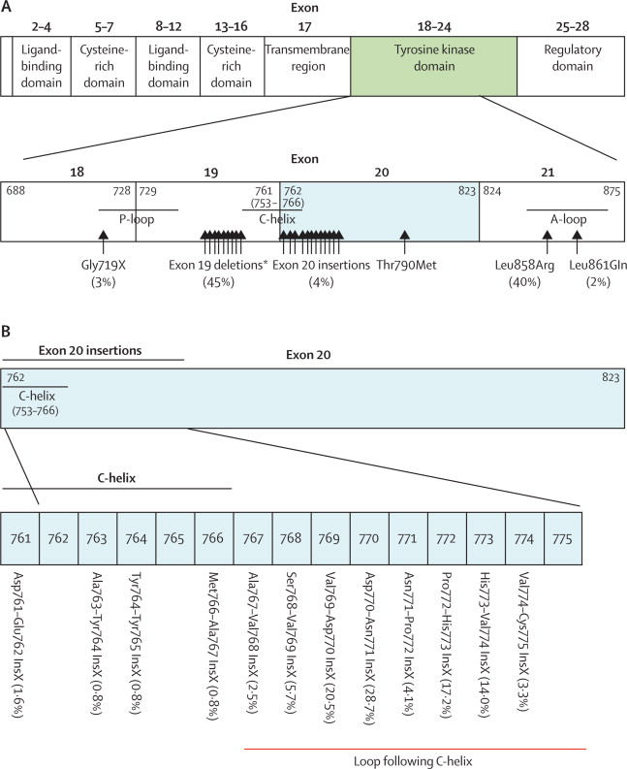
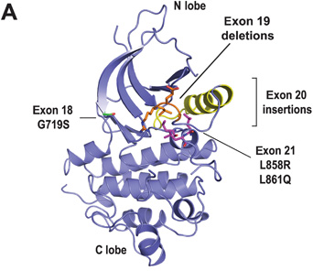
EGFR exon 20 insertion mutations
~ 5-7% of all EGFR mutations
No approved targeted therapies
Yasuda et al. Lancet Oncol 2011

Slide 15
Amivantamab (JNJ-61186372) in EGFR exon 20 mutant NSCLC
N = 39
Median prior # of therapies 1 (0-7)
Prior EGFR TKI: 9 (23%)
Treatment naïve: 6 (15%)
Most common AEs: rash, infusion reaction and paronychia
Dual EGFR/MET antibody
Binds extracellular portion of EGFR
Confirmed ORR: 36% (14/39)
PFS: 8.3 months
Park et al. ASCO 2020

Slide 16
Mobocertinib (TAK-788) in EGFR exon 20 mutant NSCLC
Best Change in Target Lesions (%)
Best Change in Target Lesions (%)
769_ASV
773_NPH
Other Exon 20 Insertion
Exact Variant Unknown
PD
PD
SD
SD
SD
SD
SD
SD
SD
SD
SD
SD
PD
PD
SD
SD
SD
SD
SD
SD
SD
SD
PR
PR
PR
PR
PR
PR
PR
PR
SD
SD
PR
PR
PR
PR
PR
PR
SD
SD
PR
PR
PR
PR
PR
PR
PR
PR
PR
PR
Small molecule EGFR kinase inhibitor
Chemically optimized from osimertinib to be more selective on exon 20 mutants
Prior TKI:
Prior IO:
Mutation:
N | N | N | N | Y | N | N | N | N | N | N | N | Y | N | N | N | N | N | N | N | N | N | Y | Y | N
N | Y | Y | N | Y | N | N | N | N | Y | Y | N | Y | Y | N | Y | Y | Y | N | N | Y | N | Y | Y | Y
770>GY | 773_NPH | 773_NPH | 770_771>AGH | Unknown | Unknown | 769_ASV | 769_ASV | 770_N | 769_ASV | 773_PH | 773_NPH | Unknown | 763_FQEA | 774_HV | 773>SNPY | 772_PNP | Unknown | 769_ASV | 770_NPG | 770_H | 773_NPH | 769_ASV | 769_V | 770_SVD
N = 28
Median prior # of therapies 3 (1-7)
Prior EGFR TKI: 5 (18%)
Treatment naïve: 0 (0%)
Most common AEs: diarrhea, nausea, rash
Confirmed ORR: 43% (12/28)
PFS: 7.3 months
Gonzalvez AACR 2020; Riely et al. ASCO 2019

Slide 17
Osimertinib in EGFR exon 20 mutant NSCLC: Phase II ECOG-ACRIN 5162 study
Osimertinib used at 160 mg
Preclinically more likely to be effective against exon 20 mutants
N = 21 (4 ineligible)
Median prior # of therapies 2 (1-3)
Prior EGFR TKI: NR
Treatment naïve: 0 (0%)
Confirmed ORR: 24% (4/17)
PFS: 9.6 months
Piotrowska et al. ASCO 2020
Most common AEs: diarrhea, fatigue and platelet decrease

Slide 18
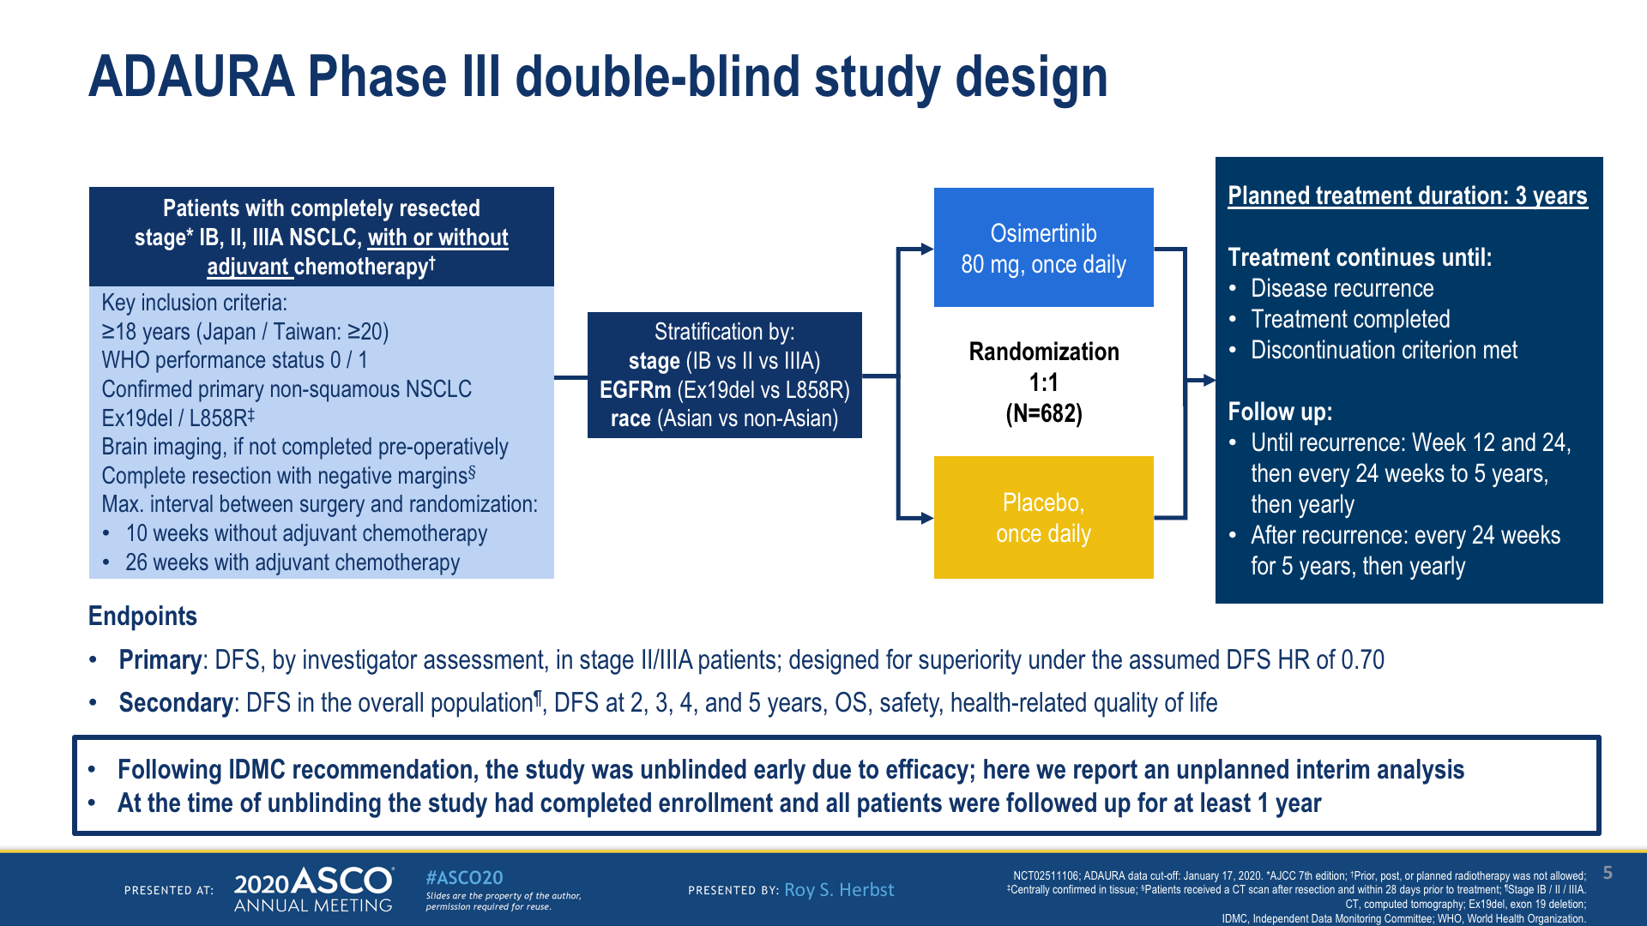

Slide 19
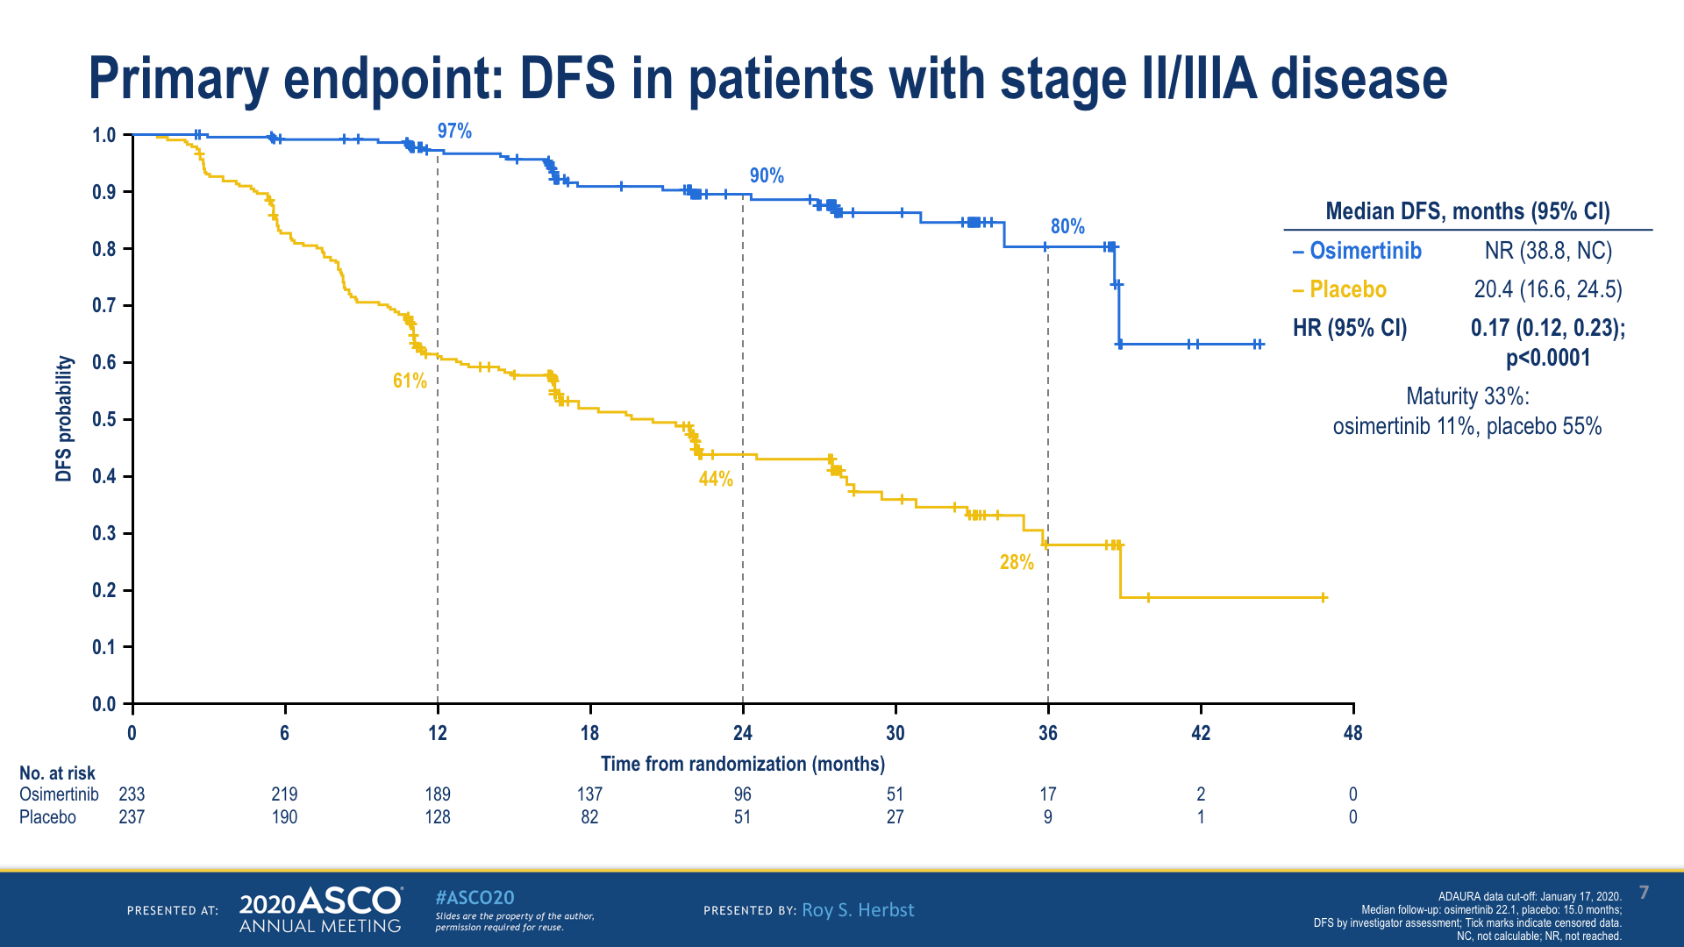
ADAURA primary endpoint: DFS in patients with stage II/IIIA disease

Slide 20
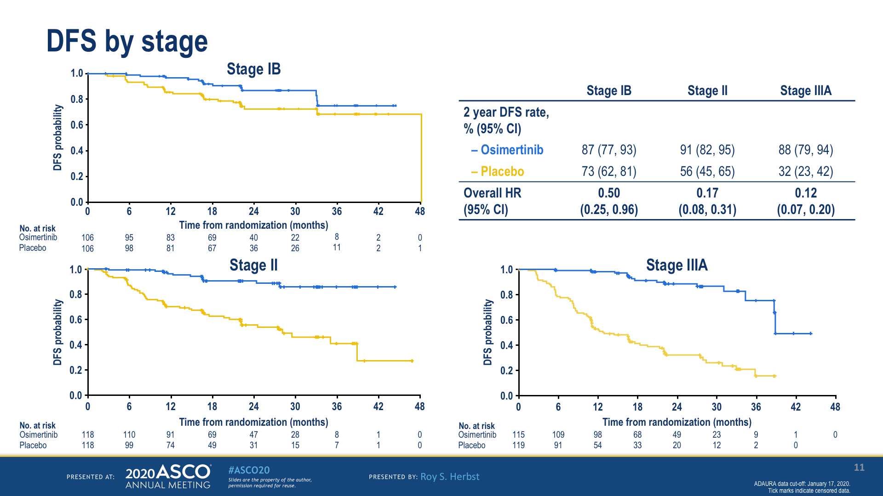
ADAURA: DFS by stage

Slide 21
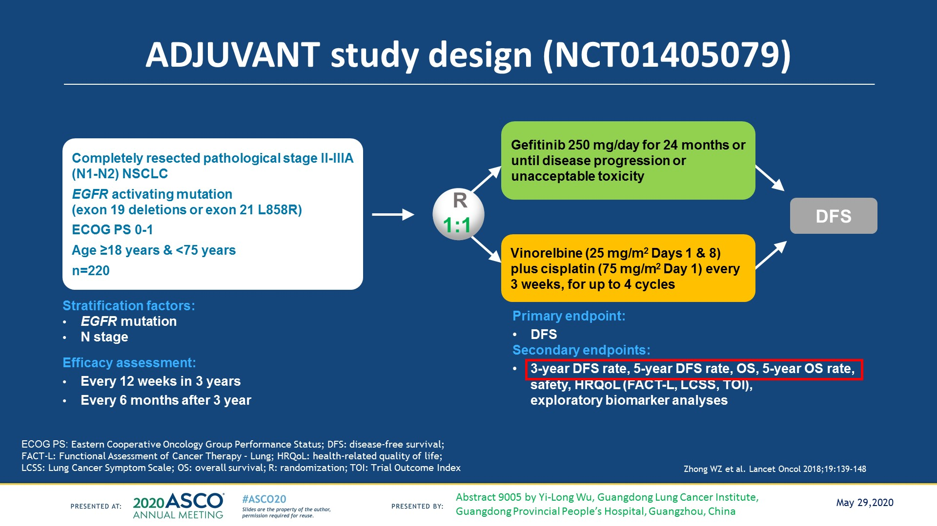
CTONG 1104: ADJUVANT study design (NCT01405079)
Every 6 months after 3 years

Slide 22
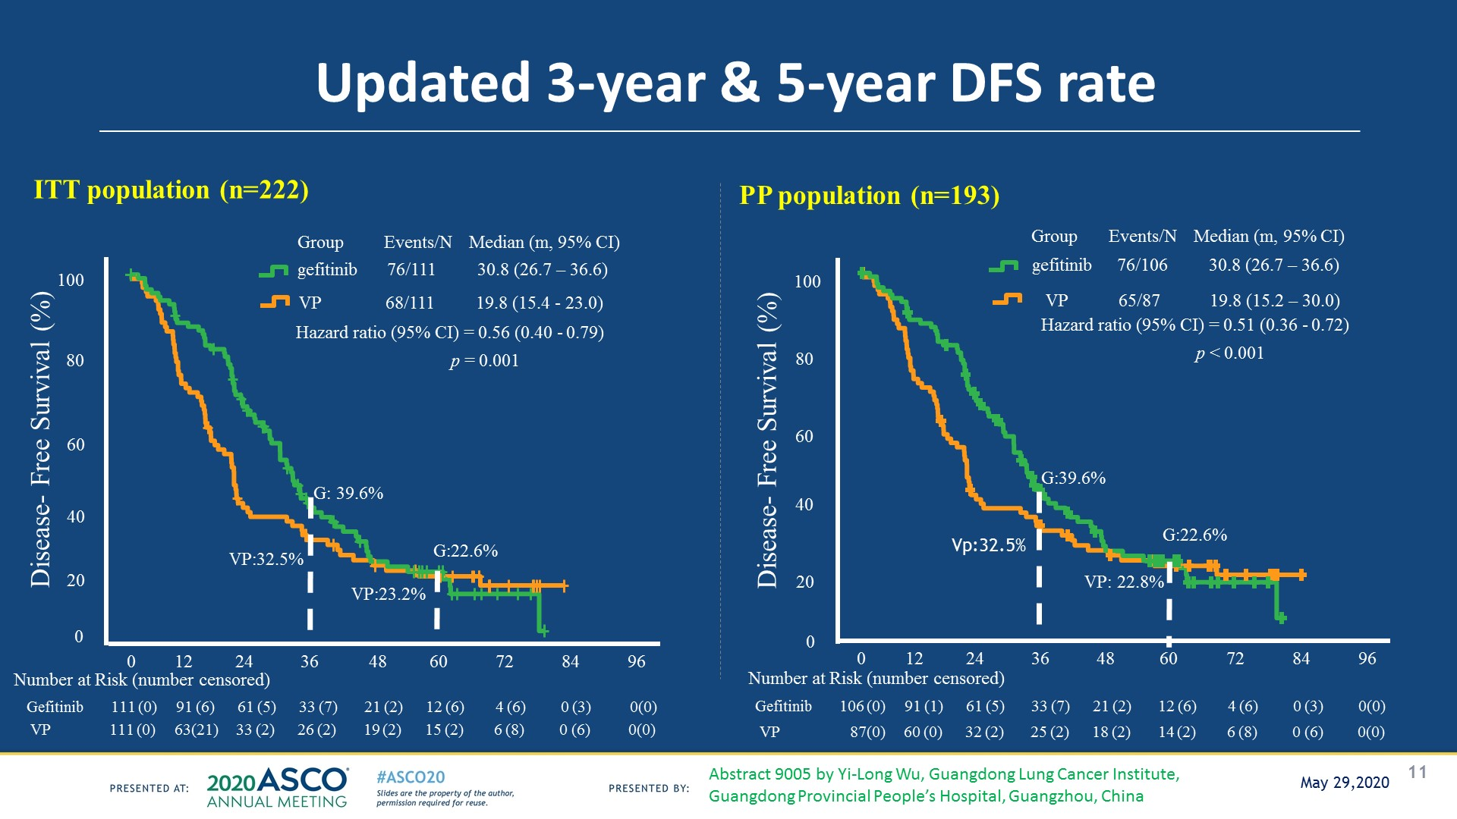
CTONG 1104: Updated 3-year & 5-year DFS rate

Slide 23
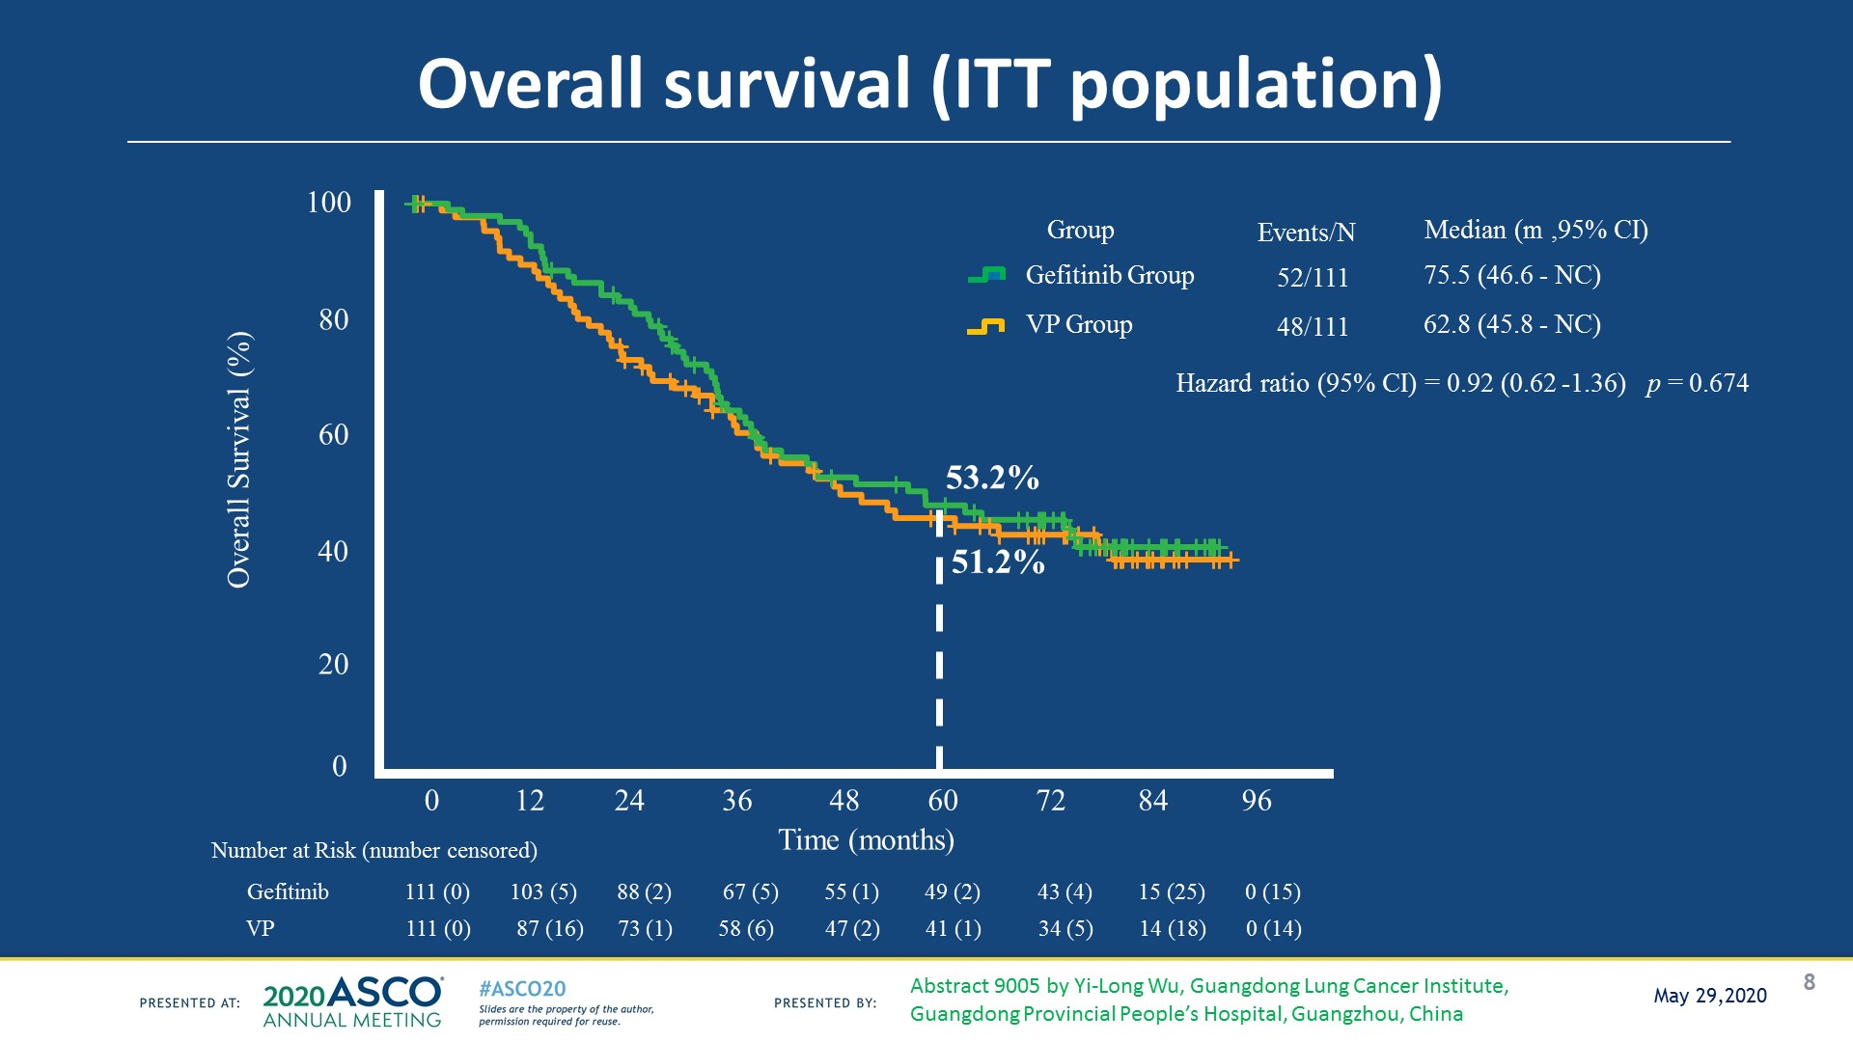
Overall survival (ITT population)
CTONG 1104: Overall survival (ITT population)

Slide 24
Case 1
54 yo female; limited former smoker, presented with progressive cough
CT scan shows LUL lesion with lymphangitic spread; contralateral lung nodules and thoracic spine lesions. Brain MRI reveals 8 small brain lesions without associated edema.
CT guided biopsy reveals adenocarcinoma; genotyping demonstrates an EGFR exon 19 deletion mutation.
You are seeing her as an initial consult

Slide 25
Case 1 continued
She started on first line Osimertinib; cough improved quickly and disappeared after 2 weeks of treatment. Brain MRI shows resolution of brain lesions.
She is tolerating Osimertinib without side effects.
She returns for follow up asking if there is something more that could be done in addition to Osimertinib.

Slide 26
Case 1 continued
She continues on Osimertinib for 2 years. Follow up CT scanning demonstrates growth in the LUL lesion and in the bone metastases. Brain MRI is stable.
Repeat biopsy of the LUL lesions reveals the original EGFR exon 19 deletion but not other targetable alterations.
She returns to discuss the next treatment option.

Slide 27
Case 2
47 yo male never smoker presents with 3 months of back pain. MRI of the lumbar spine reveals a mass in L1 extending into the epidural space. Additional imaging demonstrates a right sided lung mass, liver and adrenal metastases. Brain MRI does not reveal metastases.
A biopsy of the lesion is performed which shows adenocarcinoma. He receives palliative radiation to the lesion.
You send the biopsy for NGS but it is taking a while. The patient would like to start on systemic treatment.

Slide 28
Case 2 Continued
Patient starts treatment with carboplatin/pemetrexed. He has a PR that lasts for 6 months.
Genotyping reveals an EGFR exon 20 insertion mutation.
He starts on afatinib but develops progression within a few months.
He returns to see you for consideration of the next treatment.

Slide 29
Case 3
49 yo woman with known stage IV EGFR L858R mutant NSCLC.
Received first line erlotinib/ramucirumab; had sustained PR but now has progression.
Repeat tumor biopsy demonstrates EGFR L858R but no T790M. Plasma NGS analysis reveals EGFR L858R and T790M.
She receives treatment with Osimertinib; has PR but develops progression 10 months after treatment and is inquiring about the next line of therapy.

