Slide 1
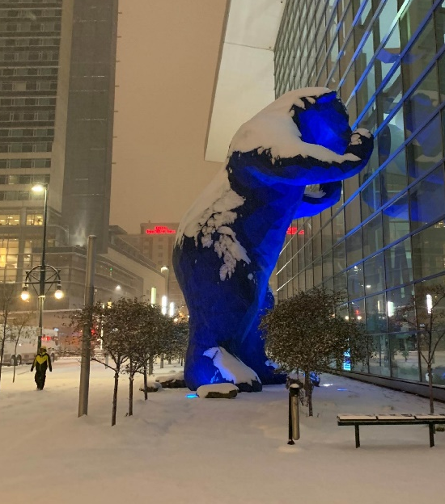
ALK/ROS1 rearranged NSCLC
Denver, Colorado
D. Ross Camidge, MD PhD
Joyce Zeff Chair in Lung Cancer Research
Director of Thoracic Oncology
University of Colorado Cancer Center
RTP, Fall 2020
Notes:
30+15

Slide 2
1st line treatment of advanced ALK+ NSCLC: Today or tomorrow’s challenge?

Slide 3
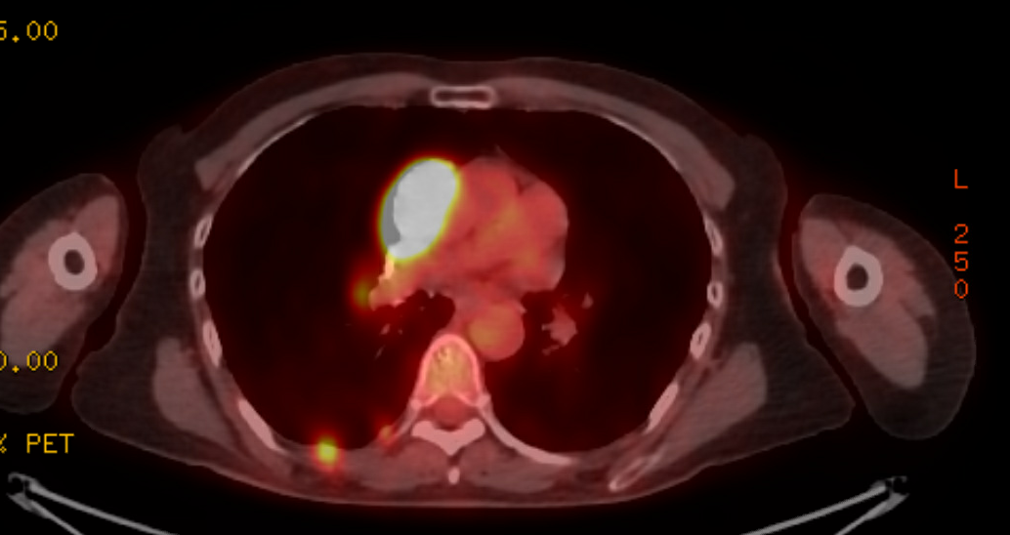
Case 1
67-year-old Caucasian female biologist. Non-smoker.
April 2014 incidentally found Stage 1A adeno resected.
Moved to annual surveillance 2018. April 2020 scan delayed to August 2020 because of COVID.
8/28/20 CT: medial right pleural mass abutting mediastinum, lower right pleural masses and fissural nodules. PET/CT all avid, no additional sites. MRI brain unremarkable. Asymptomatic.
RLL Bx - EML4-ALK

Slide 4
ALEX: Alectinib vs Crizotinib
Enrollment: Aug 2014 – Jan 2016
ALTA-1L: Brigatinib vs Crizotinib
Enrollment: Apr 2016 – Aug 2017
Median duration of follow-up in experimental arm:
Median duration of follow-up in experimental arm:
18.6 mo
 | Alectinib (n=152) | Crizotinib (n=151)
PFS (INV), months | NR | 11.1
HR (95% CI) | 0.47 (0.34-0.65)
PFS (IRC), months | 25.7 | 10.4
HR (95% CI) | 0.50 (0.36-0.70)
11.0 mo
1st interim analysis | Brigatinib (n=137) | Crizotinib (n=138)
PFS (INV), months | NR | 9.2
HR (95% CI) | 0.45 (0.30-0.68)
PFS (IRC), months | NR | 9.8
HR (95% CI) | 0.49 (0.33-0.74)
11.0 months
27.8 mo
 | Alectinib (n=152) | Crizotinib (n=151)
PFS (INV), months | 34.8 | 10.9
HR (95% CI) | 0.43 (0.32-0.58)
PFS (IRC), months | -- | --
HR (95% CI) | --
24.9 mo
2nd interim analysis | Brigatinib (n=137) | Crizotinib (n=138)
PFS (INV), months | 29.4 | 9.2
HR (95% CI) | 0.43 (0.31-0.61)
PFS (IRC), months | 24.0 | 11.0
HR (95% CI) | 0.49 (0.35-0.68)
37.8 mo
 | Alectinib (n=152) | Crizotinib (n=151)
PFS (INV), months | 34.8 | 10.9
HR (95% CI) | 0.43 (0.32-0.58)
PFS (IRC), months | -- | --
HR (95% CI) | --
Primary end points in bold
Abbreviations
NR: Not Reached
HR: Hazard Ratio
PFS: Progression Free Survival
INV: Assessment by investigator
IRC: Assessment by independent radiology committee
NEJM 2017 Peters et al
JTO 2019 Camidge et al
ESMO 2019 Mok et al
NEJM 2018 Camidge et al
JCO 2020 Camidge et al

Slide 5
IRC assessed HR ALEX:ALTA-1L at (closest possible) comparable follow up time points: 0.5 and 0.49
Median PFS (IRC) point estimate: ALEX 25.7 and ALTA-1L 24 mo
Phase III eXalt3 Trial: BIRC-Assessed mPFS (ITT)
100
80
 | Ensartinib (n = 143) | Crizotinib (n = 147)
mPFS (95% CI), mo | 25.8 (21.8-NR) | 12.7 (9.2-6.6)
Hazard ratio (95% CI) | 0.51 (0.35-0.72)
P value (log-rank test) | .0001
60
PFS, %
40
20
0
0
3
6
9
12
15
18
21
24
27
30
33
36
39
42
45
No. at risk
Time, months
 | Median follow-up (range), mo
Ensartinib | 23.8 (0-44)
Crizotinib | 20.2 (0-38)
Ensartinib
143
125
107
98
86
78
72
54
30
21
10
5
1
1
1
0
Crizotinib
147
124
94
75
56
43
32
23
10
6
2
1
1
0
0
0
Ensartinib demonstrated a favorable safety profile. Low-grade rash and transaminitis were the most frequent treatment-related AEs.
NR, not reached.
Dr Leora Horn, Vanderbilt-Ingram Cancer Center, Nashville, TN, USA, @HornLeora
Notes:
Program: v-f-adtte-fref11.sa
Table: Program: v-t-adtte-tref37.sas

Slide 6
Phase III CROWN Trial
Primary Endpoint: PFS by BICR
100
 | Lorlatinib (n=149) | Crizotinib (n=147)
Patients with event, n (%) | 41 (28) | 86 (59)
Median PFS, months (95% CI) | NE (NE–NE) | 9.3 (7.6-11.1)
HR (95% CI) 1-sided P value* | 0.28 (0.19-0.41) <0.001
90
12-month PFS rate:
78% (95% CI, 70–84)
Progression-free Survival
(% of Patients)
80
70
60
Lorlatinib
50
12-month PFS rate:
39% (95% CI, 30–48)
40
30
20
Crizotinib
10
0
18
Months
*By stratified log-rank test.
0
3
6
9
12
15
21
24
27
30
33
No. at Risk
149
147
129
120
118
84
113
62
105
39
73
19
59
16
33
8
20
4
11
2
4
1
2
0
Lorlatinib
Crizotinib
Solomon et al, ESMO 2020
BICR, blinded independent central review; CI, confidence interval; HR, hazard ratio; NE, not estimable; PFS, progression-free survival

Slide 7
WHY?
WHERE DO WE GO FROM HERE?
CROWN PFS by BICR Subgroup Analysis
Number of Patients (n) Lorlatinib Crizotinib
Subgroup
HR (95% CI)
All patients
149
147
0.28 (0.19, 0.41)
Presence of Brain Metastases*
Yes
38
40
0.20 (0.10, 0.43)
No
111
107
0.32 (0.20, 0.49)
Ethnic Origin
Asian
66
65
0.47 (0.27, 0.82)
Non-Asian
83
82
0.19 (0.11, 0.32)
ECOG PS
0/1
146
138
0.28 (0.19, 0.42)
Sex
Male
65
56
0.31 (0.18, 0.54)
Female
84
91
0.26 (0.16, 0.44)
Age
<65 years
90
103
0.22 (0.13, 0.37)
≥65 years
59
44
0.35 (0.20, 0.64)
Smoking Status
Never
81
94
0.24 (0.14, 0.40)
Current/Former
68
52
0.36 (0.20, 0.63)
Histology
Adenocarcinoma
140
140
0.26 (0.18, 0.39)
0.125
0.25
0.50
1.00
2.00
Solomon et al, ESMO 2020
Lorlatinib Better
Crizotinib Better
*Based on BICR assessment. HRs were not calculated due to insufficient numbers of events (<10 events on either treatment arm within the defined subset), as dictated by the Statistical Analysis Plan,
for patients who had ECOG performance status of 2 (2 vs. 8 events) and histology of non-adenocarcinoma (5 vs. 5 events). ECOG PS, Eastern Cooperative Oncology Group performance status; HR, hazard ratio

Slide 8
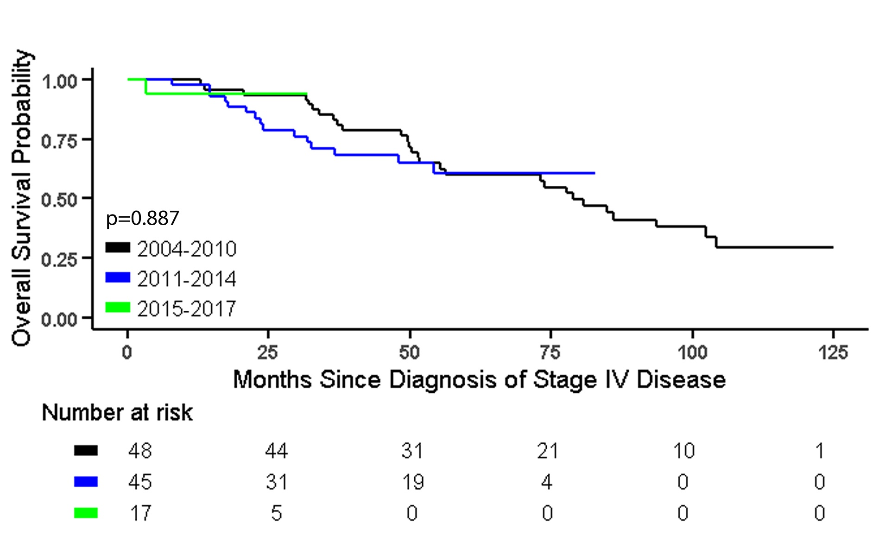
Goals:
Prolonged
Disease
Control
Prolonged
Life
Good Quality of
Life
N=110 ALK+ Stage IV NSCLC
Single institution mOS 81 months
Year of diagnosis, brain mets/not did not influence OS.
Access to next gen TKI drugs, pemetrexed responsiveness and fewer total sites of metastases did.
OS by period during which Stage IV disease was diagnosed
Pacheco et al, JTO 2019

Slide 9
CROWN: All Causality Adverse Events with ≥10% Difference in Frequency
Hypercholesterolemia†
Hypertriglyceridemia†
Edema†
Weight increased
Peripheral neuropathy†
Cognitive effects†
Diarrhea
Anemia
Fatigue†
Hypertension
Vision disorder†
ALT increased
Constipation
Mood effects†
Nausea
AST increased
Vomiting
Hyperlipidemia
Dysgeusia
Decreased appetite
Bradycardia
†Cluster term
ALT, alanine aminotransferase; AST, aspartate aminotransferase.
Solomon et al, ESMO 2020

Slide 10
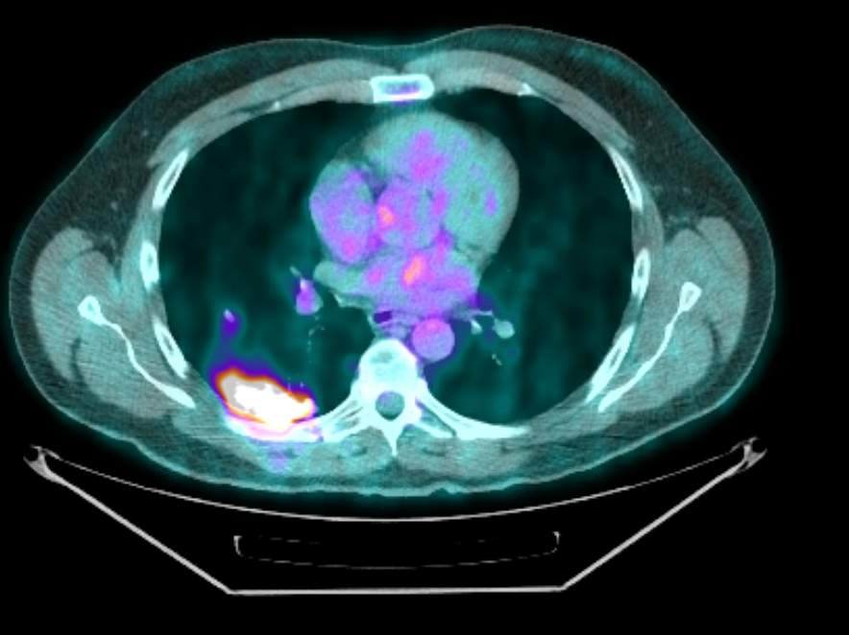
Case 2
Nov 2018
59 year old Caucasian male, handyman, light ex smoker
Sept 2010 presented with cough. Staging showed right perihilar and RLL mass, malignant right pleural effusion. ALK FISH+
First line Rx: cisplatin, docetaxel, and bevacizumab X 6 from 12/2010 to 3/2011, with complete response to Rx. Observation through 9/2011 then PD.
Second line Rx: crizotinib from 9/2011- 11/20/2012 (response) then lung and liver progression
Third line: Dec 2012 clinical trial with ceritinib, response before nodal progression irradiated Sept 2014. Further lung progression in Nov 2018
Rebiopsy lung Nov 2018: EML4-ALK T1151K
Fourth line: Clinical trial with brigatinib from 11/28/18: CR to therapy. Ongoing Oct 2020

Slide 11
ALK Resistance Mutations are More Common After Progression on Second-Generation ALK inhibitors
Crizotinib
N=55
Ceritinib
N=24
Alectinib
N=46
Brigatinib
N=7
G1202R
G1202R
G1202R
amp
L1196M/Q
G1202R
E1210K
G1202del
G1269A
I1171T/N/S
F1174C
≥2 ALK mutations
C1156Y
S1206Y
V1180L
ALK WT
Justin F. Gainor
1. Updated from Gainor JF, Dardaei L, et al. Cancer Discovery 2016; 2. Lin JJ, et al. ASCO 2018.

Slide 12
Impact of detectable ALK mutation on lorlatinib efficacy post next gen ALK TKI ( = risk of 2nd driver presence)
Progression Free Survival from lorlatinib in patients with prior 2nd-gen ALK TKI(s)
– Tumor Tissue
EXP3B,4–5 (n=135)
 | No Mutation (n=81) | ≥1 Mutation (n=29)
Number with event, n (%) | 57 (70.4) | 17 (58.6)
Median PFS, months (95% CI) | 5.4 (3.9, 6.9) | 11.0 (6.9, 22.9)
 | EXP3B,4–5: Prior 2nd-gen TKI (N=139)ª
 | No Mutation^{b} (n=87) | ≥1 Mutation^{b} (n=49)
BOR, n (%) CR PR SD PD IND | 2 (2.3) 21 (24.1) 36 (41.4) 21 (24.1) 7 (8.0) | 1 (2.0) 29 (59.2) 10 (20.4) 5 (10.2) 4 (8.2)
ORR, n (%) 95% CI | 23 (26.4) 17.6, 37.0 | 30 (61.2) 46.2, 74.8
100
80
ªDetected in archival or de novo tumor tissue.
Progression-free survival (%)
60
40
20
0
0
1
2
3
4
5
6
7
8
9
10
11
12
13
14
15
16
17
18
19
20
21
22
23
Time (months)
81
76
56
44
37
34
30
25
23
22
20
20
14
12
8
6
3
3
2
2
2
0
0
0
Shaw et al, AACR 2018
29
29
26
24
24
23
20
18
17
15
14
14
10
8
7
4
3
3
3
3
3
2
2
0

Slide 13
Second drivers: MET - Dagogo-Jack et al, CCR 2020
86 tissue samples post next gen ALK TKI assessed:
11/86 had any level (13%), 4/86 (5%) had high level MET amp
179 plasma samples analyzed, one had MET exon 14 skip mutation (0.05%)
2/73 (3%) tissue samples analyzed had a MET-ST7 fusion – one had CONCURRENT low level and one had high level MET AMP
Clinical data:
One high level MET amp responded to criz but then relapsed with ALK mutations
One MET-ST7/high level MET responded to lorlatinib plus criz

Slide 14
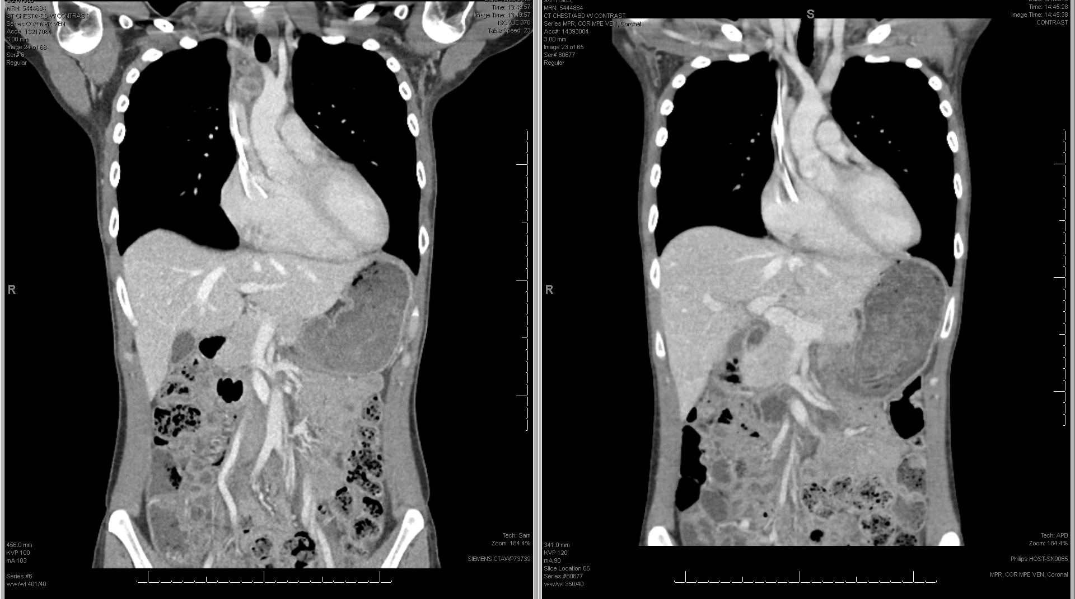
ALK+ NSCLC
Acquired resistance to
Alectinib and Brigatinib
No MET AMP
No MET fusion
No MET exon 14 skip mutation
Cell line shows increased
MET signaling
WHY?
Non MET amp, Non MET mutant increase in MET signaling in cell line post alectinib and brigatinib (+/- radiation and chemo with each at local progression)
4th line Rx: Brigatinib with crizotinib 250mg TWICE DAILY then QD from 12/18.
To present (March 2020 ongoing)
Le AT et al, P1.14-09
Unveiling Hidden
MET-Mediated Primary
Alectinib Resistance in
ALK-Positive NSCLC
WCLC 2019

Slide 15
Advanced ALK+ NSCLC Extra-CNS treatment journey
Camidge, submitted
ALK dominant mechanism of resistance actionable with
different ALK TKI
Selected next line ALK inhibitor
Extra-cranial PD after initial benefit on
ALK inhibitor
not suitable for local ablative therapy (and TKI continuation) alone
Second driver pathway identifiable and actionable
(eg MET fusion/mutation/amp)
Addition of agent targeting second driver to prior ALK inhibitor (if compatible)
Reanalysis of driver state
Resistance mechanism identifiable but not currently actionable (e.g. 2nd drivers without therapy, ALK compound mutations)
Trial of next line ALK inhibitor (chosen based on mutation coverage, cost, convenience, tolerance)
Use close observation
Or pemetrexed-based chemotherapy, consider continuing prior ALK TKI*
No resistance mechanism identifiable
*Esp if CNS disease under control with
prior CNS penetrant TKI

Slide 16

1st line treatment of advanced ROS1+ NSCLC: All about the brain?

Slide 17
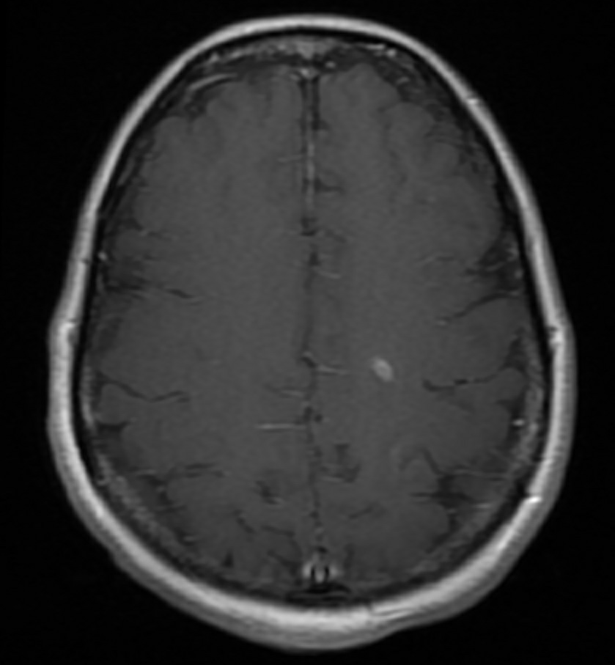
Case 3
37-year-old Hispanic female, accountant, never-smoker.
May 2013 presented with dyspnea
CT: Left hilar mass, AP window node. PET/CT: multiple small bone and liver metastases. MRI brain clear at diagnosis
Liver biopsy: ROS1 FISH+
1st line therapy: November 2013 Crizotinib 250 mg po BID. Excellent response to Rx.
August 2015 and September 2018 solitary CNS mets treated with SRS. Extra-cranial CR continues.

Slide 18
Studies of crizotinib in ROS1 NSCLC
Notes:
Meta analysis weighted by number of patients per study = 13.6 months and ORR = 70%

Slide 19
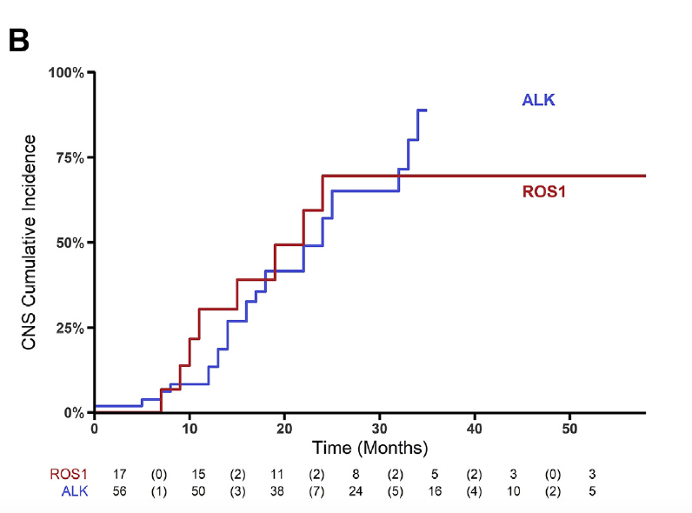
Addressing the CNS - an unmet need on ROS1 NSCLC on crizotinib
  The CNS is a common first site of progression in patients with ROS1+ NSCLC receiving crizotinib (47%)
  Patients with ROS1+ tumors may also benefit from the use of a CNS-penetrant ROS1 inhibitor in the first-line setting
Patil et al. JTO 2018

Slide 20
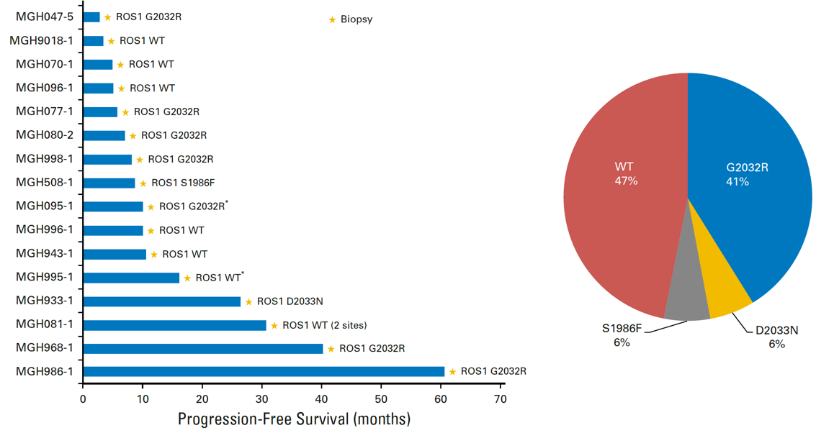
Crizotinib resistance (MGH series. N=16) on-target ROS1
Gainor et al., JCO PO 2017

Slide 21
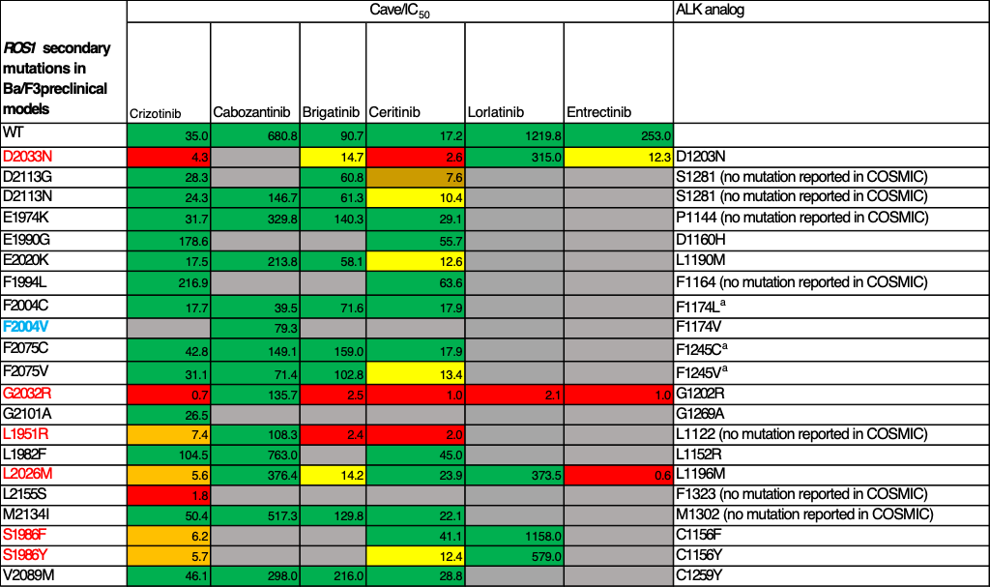
Relative inhibition of ROS1 KDMs by TKIs: coded by exposure potential
Identified in patients, Identified in vitro, Identified in this study
Dimou et al., JCO PO

Slide 22
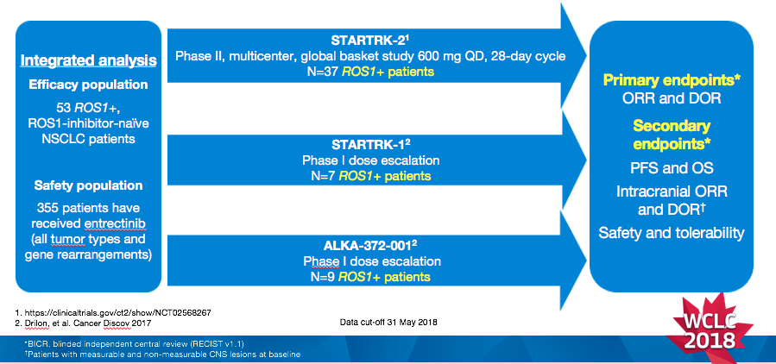
Integrated analysis of three studies: entrectinib in ROS1+ NSCLC
Doebele et al, WCLC 2018
Lancet Oncology, 2019

Slide 23
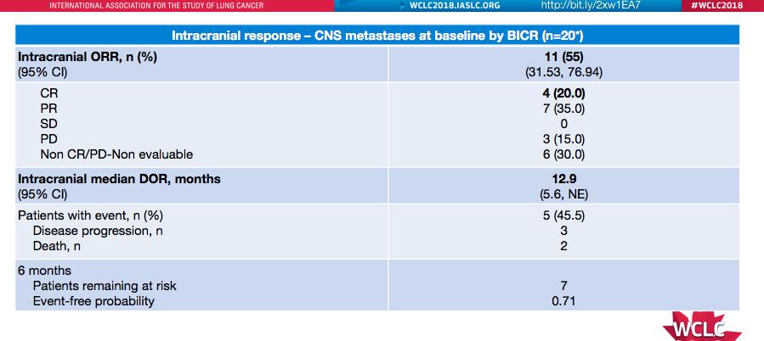
Integrated Analysis of Entrectinib:
Intracranial ORR and DOR (BICR assessment)
Doebele et al, WCLC 2018
Lancet Oncology, 2019
Notes:
IC-ORR of 55%

Slide 24
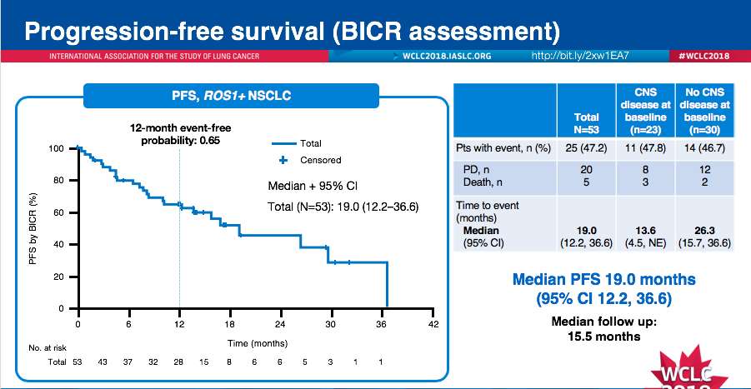
Integrated Analysis of Entrectinib:
Progression-free survival (BICR assessment)
Doebele et al, WCLC 2018
Lancet Oncology, 2019

Slide 25
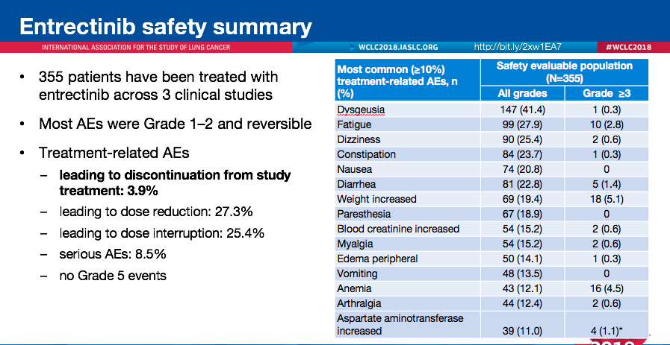
Doebele et al, WCLC 2018
Lancet Oncology, 2019

Slide 26
2nd line treatment of advanced ROS1+ NSCLC: Personalized medicine is still in charge!

Slide 27
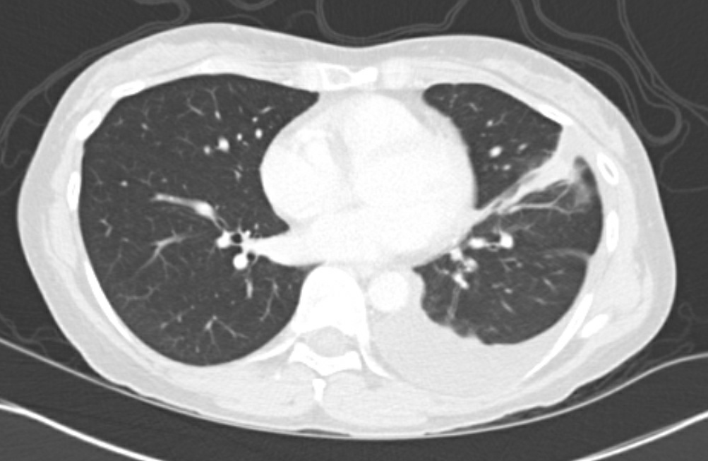
Case 3 continued
Jan 2020
September 2019 five new CNS lesions and
left pleural progression. Cytology positive.
Second Line RX: 11/30/19 Lorlatinib - excellent CNS response.
Jan 2020 Further left pleural progression.
Pleural biopsy showed ROS1 rearrangement with no detectable ROS1 mutation
Third Line RX: Jan 2020 Repotrectinib clinical trial - lung and pleural progression on first scan, CNS remains under control

Slide 28
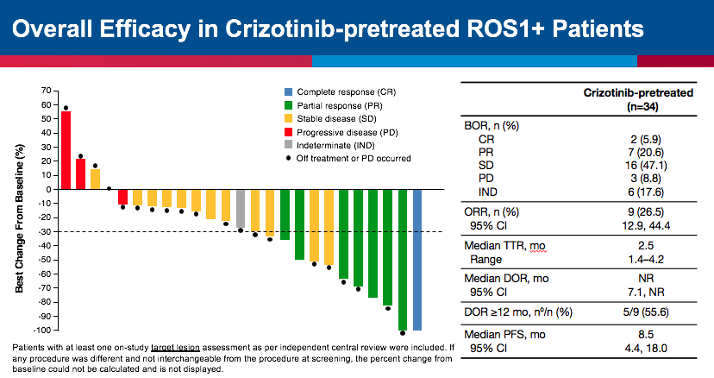
Overall Efficacy of Lorlatinib in Crizotinib-pretreated
ROS1+ Patients
While overcomes resistance to L2026M,
S1986Y/F, and D2033N, not G2032R
Shaw et al, Lancet Oncology 2019

Slide 29
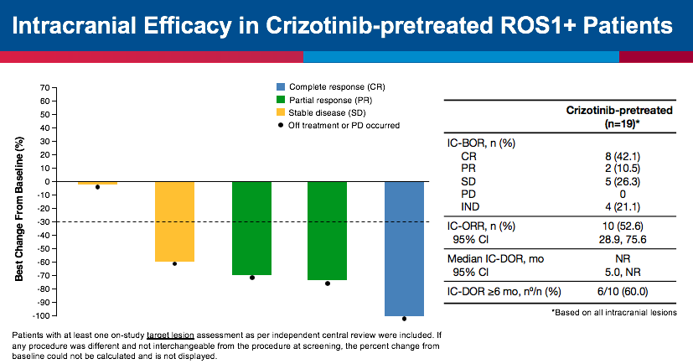
Intracranial Efficacy of Lorlatinib in Crizotinib-pretreated ROS1+ Patients
If crizotinib is not getting into brain, potentially lower chance of developing resistance G2032R
Shaw et al, Lancet Oncology 2019
Notes:
Note difference between ORR and IC-ORR of 26% versus 52.6% in crizotinib-treated patients.

Slide 30
TPX0005
Drilon et al
ESMO 2019

Slide 31
28/93
(30%)
treated
below
160mg
Drilon et al
ESMO 2019

Slide 32
