Slide 1


New treatment paradigms:
Chronic Lymphocytic
Leukemia
John M Pagel, MD, PhD
Affiliate Associate Member, Division of Oncology
University of Washington School of Medicine
Swedish Cancer Institute
Chief of Hematologic Malignancies Program
Seattle, WA

Slide 2
CLL Impacts a Significant Number of Patients Worldwide, Predominantly Affecting Older Patients
With an estimated 191,000 new cases globally, CLL represents 22% to 30% of all leukemia worldwide,
being the most common leukemia in Western countries^{1,2}
Median age at diagnosis³:
Men are ~2X more likely to develop CLL⁵
72
~90% of patients diagnosed
with CLL are >55 years old⁴
1. Union for International Cancer Control. https://www.who.int/selection_medicines/committees/expert/20/applications/CLL.pdf. Accessed November 6, 2019. 2. Combest AJ, et al. J Hematol Oncol Pharm. 2016;6(2):54-56. 3. Eichhorst B, et al. Ann Oncol. 2015;26(suppl 5):v78-v84. 4. Lymphoma Coalition. https://lymphomacoalition.org/images/subtype-reports/CLL_Europe _2017_Report.pdf. Accessed November 6, 2019. 5. Scarfò L, et al. Crit Rev Oncol Hematol. 2016;104:169-182.
Notes:
Key Takeaway
Chronic lymphocytic leukemia (CLL) impacts a large number of patients globally, especially the elderly.
Speaker Notes
CLL is the most common form of leukemia in the Western world and accounts for about one-third of all new leukemia cases¹
CLL represents an estimated 22% to 30% of all leukemia cases worldwide²
CLL has a reduced frequency in Asian countries, including China, India, and Japan, where CLL represents 4% to 10% of all leukemias²
A CLL diagnosis is often based on results from blood tests ordered for routine care or an unrelated condition^{3,4}
The most common presentation is asymptomatic lymphocytosis¹
Up to 80% of patients show no symptoms at the time of diagnosis⁵
Some patients have indolent disease and never require therapy, whereas others may progress rapidly and require treatment¹
Patients are usually elderly at the time of CLL diagnosis and incidence increases with age⁶
Approximately 90% of all patients diagnosed with CLL are more than 55 years old, and the median age at CLL diagnosis is 72 years old⁶
Men have a higher frequency of CLL development than women, with a male-to-female ratio of 1.5-2.1³
References
Union for International Cancer Control. https://www.who.int/selection_medicines/committees/expert/20/applications/CLL.pdf. Accessed November 6, 2019.
Combest AJ, Danford RC, Andrews ER, Simmons A, McAtee P, Reitsma DJ. Overview of the recent developments in chronic lymphocytic leukemia, part 1. J Hematol Oncol Pharm. 2016;6(2):54-56.
Scarfò L, Ferreri AJ, Ghia P. Chronic lymphocytic leukaemia. Crit Rev Oncol Hematol. 2016;104:169-182.
American Cancer Society. Signs and Symptoms of Chronic Lymphocytic Leukemia. https://www.cancer.org/cancer/chronic-lymphocytic-leukemia/detection-diagnosis-staging/signs-symptoms.html. Accessed October 15, 2019.
Bell R. Developing a clinical program based on the needs of patients with chronic lymphocytic leukemia: preparing for illness episodes. J Adv Pract Oncol. 2017;8(5):462-473.
Eichhorst B, Robak T, Montserrat E, et al; ESMO Guidelines Committee. Ann Oncol. 2015;26(suppl 5):v78-v84.

Slide 3
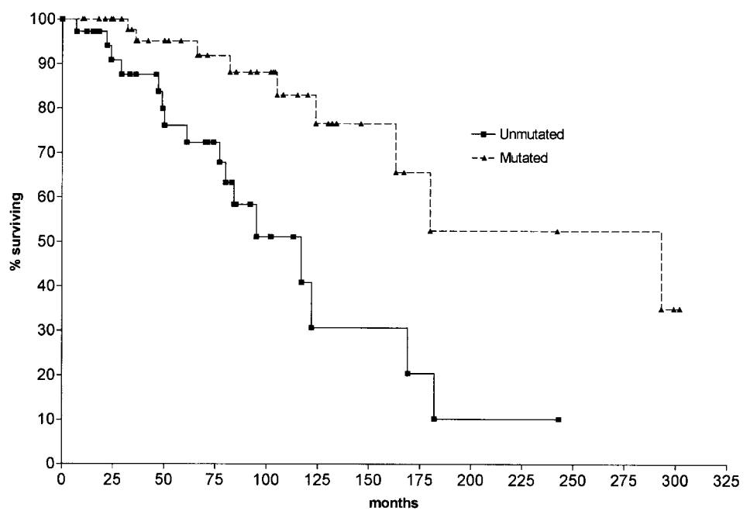
IGHV Mutation Impacts Prognosis
Median survival 293 months
Median survival 117 months
Hamblin TJ, et al. Blood 1999; 94:1848-54.

Slide 4
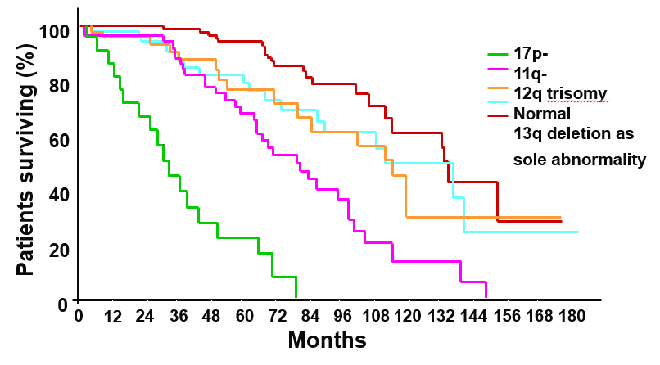
FISH Abnormalities Have Prognostic Value
FISH abnormalities present in 268/325 patients (82%)
Lesion | % | Median Survival (months)
del 13q | 55 | 133
del 11q | 18 | 79
Trisomy 12 | 16 | 114
del 17p | 7 | 32
del 6q | 6 | n/a
Normal | 18 | 111
17p-
11q-
12q trisomy
Normal
13q- as sole abnormality
FISH Lesion | Reference
 | Dohner et al. 1997 | Oscier et al. 1999 | Jarosova et al. 2001 | Dewald et al. 2003 | Sindelarava et al. 2008
del(13q) | 45 | 36 | 18 | 47 | 54
Trisomy 12 | 15 | 15 | 14 | 19 | 16
del(17p) | 10 | 8 | 11 | 6 | 16
del(11q) | 20 | 17 | 11 | 11 | 12
Dohner et al, N Engl J Med. 2000;343:1910.
FISH = fluorescence in situ hybridization

Slide 5
Unmet Needs in CLL
Frontline Treatment Options in Unfit Patients
  Many elderly patients with CLL are considered unfit for intensive therapies and still have limited treatment options due to the greater incidence and severity of comorbidities that increase with age
  There remains a need for treatment options with favourable safety profiles that can be personalized based on patient comorbidities and other factors
Relapsed/Refractory Treatment Options for CLL Patients
  Despite initial response to frontline therapy, most patients relapse and require subsequent treatment¹
  New therapies (including B cell-targeted kinase inhibitors) have replaced the limited options previously available for the treatment of relapsed/refractory patients¹
  However, targeted therapies do not appear curative and there is still a need for treatment options that can be individualized based on patient factors
Shustik C et al. Ann Hematol. 2017;96(7):1185-1196.
Shustik C et al. Ann Hematol. 2017;96(7):1185-1196.
Notes:
Reference:
Shustik C, Bruckler BI, Delage R, et al. Advances in the treatment of relapsed/refractory chronic lymphocytic leukemia. Ann Hematol. 2017;96(7):1185-1196.

Slide 6


Bruton Tyrosine Kinase Inhibitors in Frontline Treatment

Slide 7
RESONATE-2: Ibrutinib vs Chlorambucil for Elderly Pts with CLL/SLL (Phase III)
Ibrutinib
420 mg/day until progression, lack of efficacy
or toxic effects
Treatment-naive CLL/SLL
(N = 269)
Pts ≥65 yrs of age
ECOG 0-1
ANC > 1000; PLTS > 50,000
Adequate liver and kidney function
No del(17p)
Primary Endpoint
PFS (IRC) by iwCLL criteria
Secondary Endpoints
OS, ORR, rate of sustained hematologic improvement, safety
Crossover
upon PD
(n = 43)
Chlorambucil
Days 1, 15 of 28-day cycle
for up to 12 cycles or until toxic effects
Burger JA, et al. N Engl J Med. 2015;373:2425-2437.
Notes:
Pts, patients; PD, progressive disease; PFS, progression-free survival; OS, overall survival

Slide 8
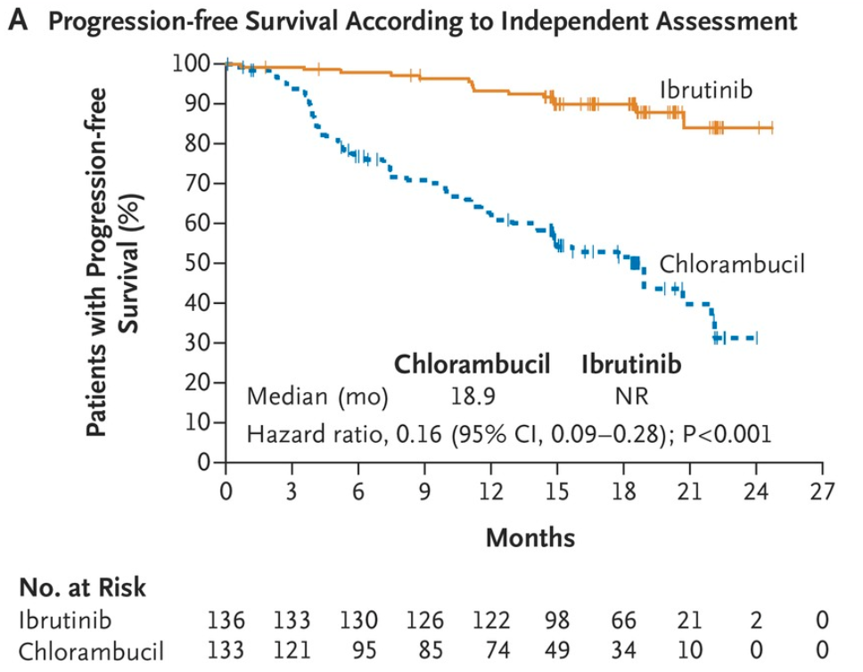
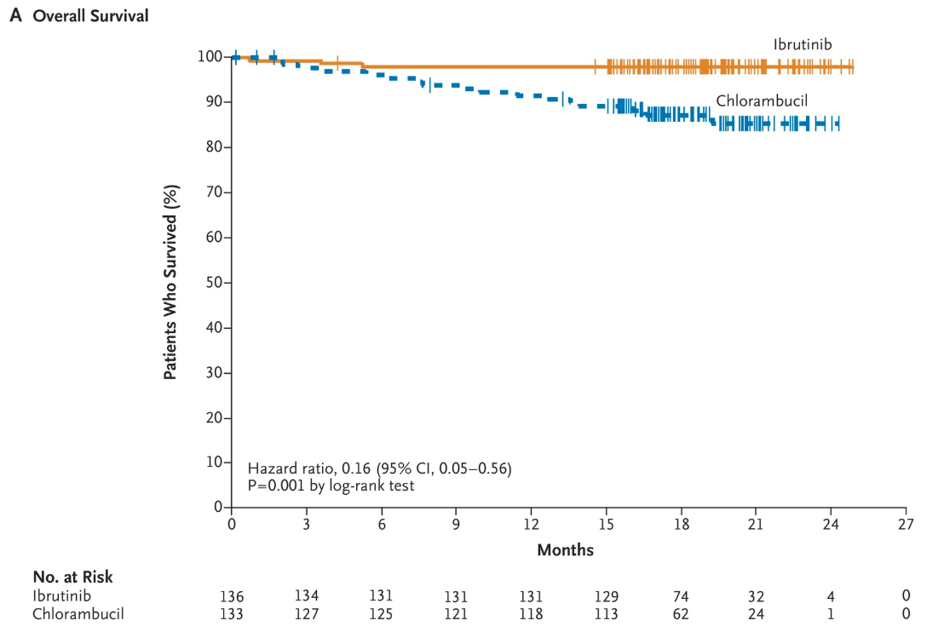
RESONATE-2: Ibrutinib was Superior to Chlorambucil in Elderly Pts with CLL/SLL
PFS
OS
Hazard ratio 0.16 (95% CI 0.05-0.56)
P=0.001 by log-rank test
Burger JA, et al. N Engl J Med. 2015;373:2425-2437.
Notes:
PFS, progression-free survival; OS, overall survival

Slide 9
RESONATE-2: Discontinuations and Dose Reductions
Initial results:¹
Discontinuation of treatment due to AEs occurred less frequently in the ibrutinib group than the chlorambucil group (9% vs. 23%)
Hypertension (observed in 14% of ibrutinib patients) did not require discontinuation or dose reductions
Atrial fibrillation was managed with discontinuation in 2 patients and without dose modification in the remaining 6 patients in the ibrutinib-treated group
Major hemorrhage (occurring in 4% of ibrutinib patients and 2% of chlorambucil patients) led to discontinuation in 3 ibrutinib-treated patients
Long-term results:²
After a median follow-up of 60 months, 41% of ibrutinib-treated patients had discontinued therapy
Dose reductions due to any AE occurred in 27 patients
AE-related treatment discontinuations on ibrutinib decreased over time: 7% of patients in years 0–1, 6% in years 1–2, 5% in years 2–3, 6% in years 3–4, and 1% in years 4–5
1. Burger JA, et al. N Engl J Med. 2015;373:2425-2437. 2. Burger JA, et al. Leukemia 2019; [Epub]

Slide 10
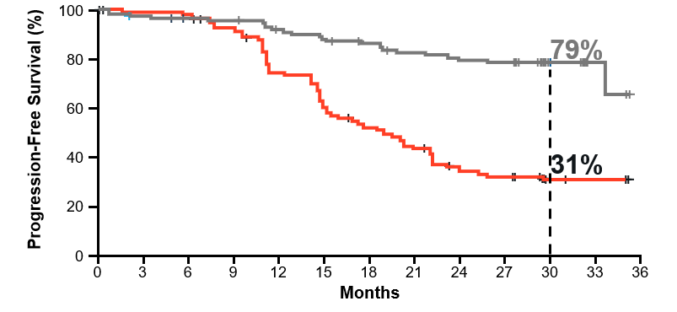
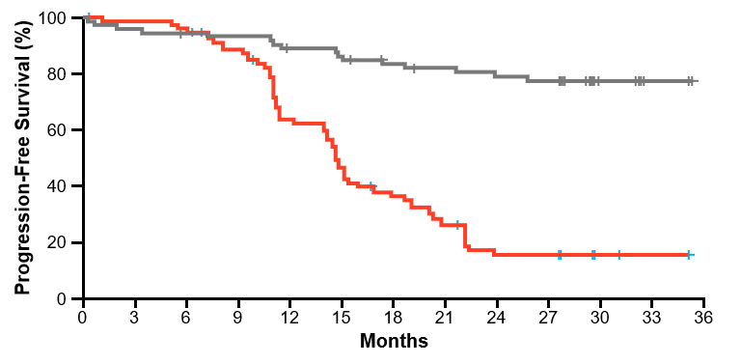
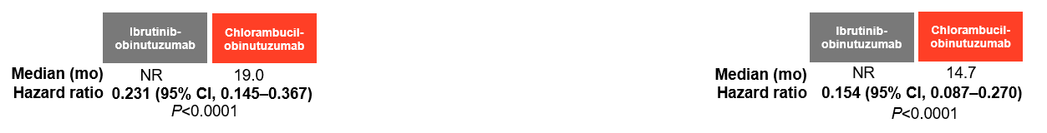
iLLUMINATE: Obinutuzumab + Ibrutinib was Superior to Obinutuzumab + Chlorambucil for Older Patients with CLL/SLL
PFS per IRC in ITT Population
PFS in High-Risk Population
 | Obinutuzumab + Ibrutinib | Obinutuzumab + Chlorambucil
ORR per IRC (per investigator) | 88% (91%) | 73% (81%)
CR/CRi per IRC (per investigator) | 19% (41%) | 8% (16%)
Patients with undetectable MRD | 35% | 25%
OS rate at 30 months | 86% | 85%
High-risk population (del(17p)/TP53 mutation, del(11q), and/or unmutated IGHV.
Moreno C et al. ASH 2018. Abstract 691.
Notes:
Median follow-up 31.3 months
Median treatment duration 29.3 months with I+Ob and 5.1 months with C+Ob

Slide 11
ALLIANCE A041202: Ibrutinib +/- Rituximab Showed Superior PFS over BR in Older CLL Pts (Phase III)
Treatment-Naive CLL
N=547
CLL (IWCLL criteria)
CLL requiring treatment (IWCLL criteria)
Intermediate- or high-risk Rai stage
Bendamustine +
Rituximab (6 cycles)
Ibrutinib (QD)
Primary Endpoint
PFS
1st
Interim Analysis
Randomization
Ibrutinib (QD) +
Rituximab (6 cycles)
PFS (Primary Endpoint)
Median follow-up 32 months
100
88%
80
87%
OS
No significant OS differences among arms
Median OS not reached for any arm
2-year OS estimates
  Arm 1 (BR) 95%
  Arm 2 (I) 90%
  Arm 3 (IR) 94%
60
Progression-Free Survival (%)
74%
40
Arm
Events/
Total
Median
(95% CI)
20
1 (BR)
61/176
41 (38–NE)
2 (I)
31/178
NE (NE–NE)
0
3 (IR)
30/171
NE (NE–NE)
0
6
12
18
24
30
36
42
48
54
Patients at risk
Months
Arm 1 (BR)
176
137
126
120
101
71
44
17
5
0
Arm 2 (I)
178
166
152
145
132
98
55
33
6
0
Arm 3 (IR)
171
161
144
135
126
89
55
32
8
0
Woyach JA et al. ASH 2018. Abstract 6.
Notes:
Key exclusion criteria
No systemic anticoagulation with heparin or warfarin; patients must be off warfarin therapy for at least 30 days prior to enrollment
No unstable angina or uncontrolled arrhythmia

Slide 12
ALLIANCE A041202: Adverse Events, Grade 3 or Higher
 | Arm 1: BR | Arm 2: I | Arm 3: IR | P value (Fisher’s exact test)
≥Grade 3 heme AEs | 61% | 41% | 38% | P<0.0001
≥Grade 3 non-heme AEs | 60% | 72% | 71% | P=0.03
Grade 5 AEs | 2.8% (n=5) | 7.8% (n=14) | 7.7% (n=14) | P=0.07
Unexplained/ unwitnessed death | 1.1% (n=2) | 3.9% (n=7) | 2.2% (n=4) | P=0.24
Woyach JA et al. ASH 2018. Abstract 6.

Slide 13
ECOG-ACRIN E1912: IR was Superior to FCR in CLL/SLL (Phase III)
Treatment-Naive CLL/SLL
N=529
CLL (IWCLL criteria), or SLL (WHO criteria)
Disease requiring treatment
Age ≤70 years
No deletion of 17p13
ECOG PS 0-2
Ibrutinib (QD) +
Rituximab (7 cycles)
Primary Endpoints
PFS, change in QoL
Randomization
2:1
1st Interim Analysis
Fludarabine + Cyclophosphamide + Rituximab (6 cycles)
PFS (All Randomized)
HR=0.352; 95% CI, 0.223-0.558; P<0.0001
OS (All Randomized)
HR=0.168; 95% CI, 0.053-0.538; P=0.0003
Median follow-up 33.4 months
PFS: IR was superior to FCR independent of age, sex, PS, stage or del11q23 presence/absence
IR was superior to FCR for IGHV unmutated, but not mutated patients
100
100
90
90
80
80
70
70
60
60
50
50
40
40
30
P<0.00001
30
P<0.001
20
IR (37 events/354 cases)
20
IR (4 deaths/354 cases)
10
FCR (40 events/175 cases)
10
FCR (10 deaths/175 cases)
0
0
3
6
9
12
15
18
21
24
27
30
33
36
39
42
45
48
0
0
3
6
9
12
15
18
21
24
27
30
33
36
39
42
45
48
Shanafelt TD et al. ASH 2018. Abstract LBA-4.
Notes:
Key exclusion criteria
No warfarin or another vitamin K antagonist in the preceding 30 days
No history of myocardial infarction, unstable angina, or acute coronary syndrome within 6 months prior to registration

Slide 14
ECOG-ACRIN E1912: Adverse Events, Grade 3 or Higher
 | IR | FCR
Grade 3/4 treatment-related AEs | 58% | 72%
 | P=0.0042
Grade 3 and 4 neutropenia | 23% | 44%
 | P<0.0001
Grade 3 and 4 infectious complications | 7.1% | 17.7%
 | P<0.0001
Shanafelt TD et al. ASH 2018. Abstract LBA-4.

Slide 15
In Real-World Clinical Practice, up to 23% of Patients Discontinued Frontline Ibrutinib Due to AEs
A Retrospective Study of Ibrutinib Therapy in Frontline CLL (N=447)
Reasons for Ibrutinib Treatment Discontinuation*
Toxicity
23%
50%
Continued
50%
Discontinued
(n=227/447)
Progression
7%
Death
9%
11%
Other
Median follow-up time was 20 months.
*Median duration of ibrutinib treatment was 15.2 months.
Sharman JP, et al. Blood. 2017;130(suppl 1):4060.
Notes:
Key Takeaway
The clinical benefits of ibrutinib were outweighed by the toxic AEs. About 1 in 4 patients discontinue first-line ibrutinib due to AEs associated with treatment.
Speaker Notes
Although efficacious, ibrutinib cannot maintain benefit for some patients that experience treatment-limited AEs¹
A retrospective analysis of 447 CLL patients treated with ibrutinib found that the median duration of ibrutinib treatment was 15.2 months (range = 0.2-37.9)²
50% of patients discontinued use, with about half discontinuing use due to toxicity²
Other reasons for discontinuation included progression, death, achievement of adequate response, financial reasons, or physician/patient choice²
New treatment options like novel BTKis that are less toxic may be needed to increase the clinical benefit of BTK inhibition in CLL by leading to improved tolerability throughout continuous treatment²
Alternative and/or more selective BTKis may be useful for patients who discontinue treatment due to ibrutinib toxicity¹
References
Awan FT, Schuh A, Brown JR, et al. Acalabrutinib monotherapy in patients with chronic lymphocytic leukemia who are intolerant to ibrutinib. Blood Adv. 2019;3(9):1553-1562.
Sharman JP, Black-Shinn JL, Clark J, Bitman B. Understanding ibrutinib treatment discontinuation patterns for chronic lymphocytic leukemia. Blood. 2017;130(suppl 1):4060.

Slide 16
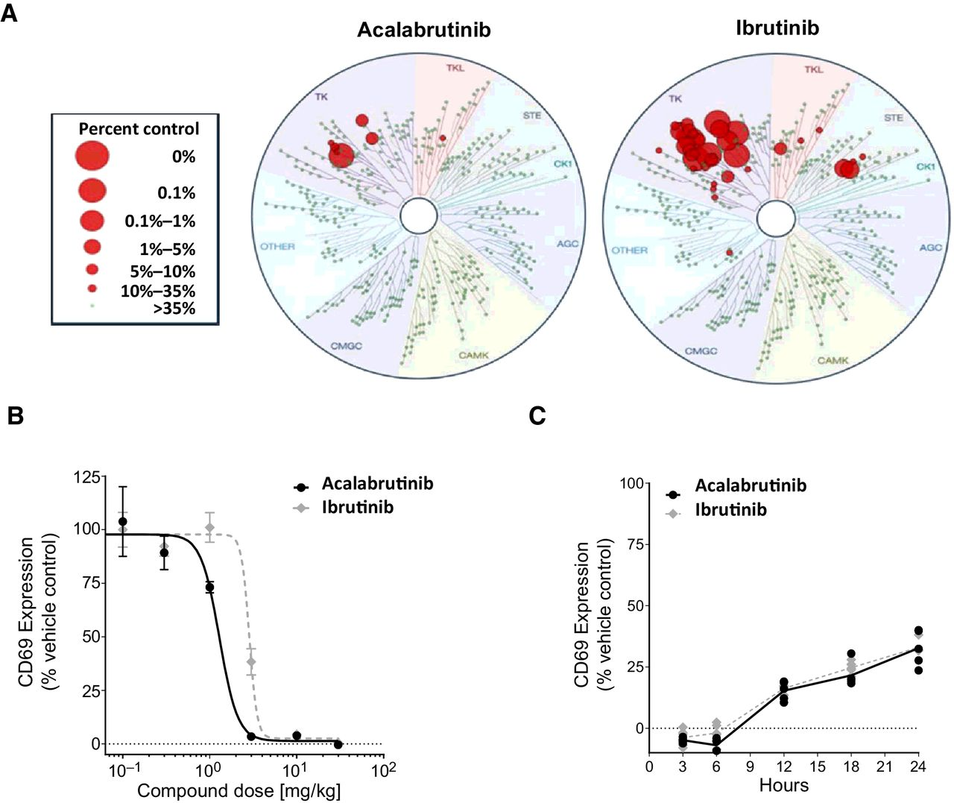
Acalabrutinib versus Ibrutinib
Acalabrutinib
Kinase Inhibition (Average IC₅₀, nM)
Kinase | Acalabrutinib | Ibrutinib
BTK | 5.1 | 1.5
TEC | 126.0 | 10
ITK | > 1000 | 4.9
BMX | 46 | 0.8
TXK | 368 | 2.0
EGFR | > 1000 | 5.3
ERBB2 | ~ 1000 | 6.4
ERBB4 | 16 | 3.4
BLK | > 1000 | 0.1
JAK3 | > 1000 | 32
Selective, covalent 2nd-generation BTK inhibitor
Indicated for R/R MCL and frontline and R/R CLL
Associated with limited off-target effects in preclinical studies
Figure from Herman et al. Clin Cancer Res 2017;23:2831-2841.
Byrd JC, et al. N Engl J Med. 2016;374:323-332.
Barf T, et al. J Pharmacol Exp Ther. 2017;363:240-252.
Notes:
BTK, Bruton tyrosine kinase
Acalabrutinib and ibrutinib were profiled at 1 μmol/L over a panel 395 wild-type human kinases, including mutants, at DiscoveRx kinase assays. The size of the red circles represents the extent of inhibition, with larger circles meaning stronger inhibition compared with control signal as defined in the scale

Slide 17
ELEVATE TN: Obinutuzumab/Chlorambucil, Acalabrutinib/Obinutuzumab or Acalabrutinib in Frontline CLL (Phase III)
Obinutuzumab (6 cycles) +
Chlorambucil (days 1,15 of cycles 1 through 6)
Untreated CLL
N=535
Diagnosis of CD20+ CLL
Active disease meeting ≥1 of the IWCLL 2008 criteria for requiring treatment
No anticoagulation with warfarin or equivalent vitamin K antagonists within 7 days of first dose of study drug
Obinutuzumab (6 cycles) +
Acalabrutinib (BID)
Primary Endpoint
PFS
Randomization
Acalabrutinib (BID)
Sharman JP et al. ASH 2019. Abstract 31.

Slide 18
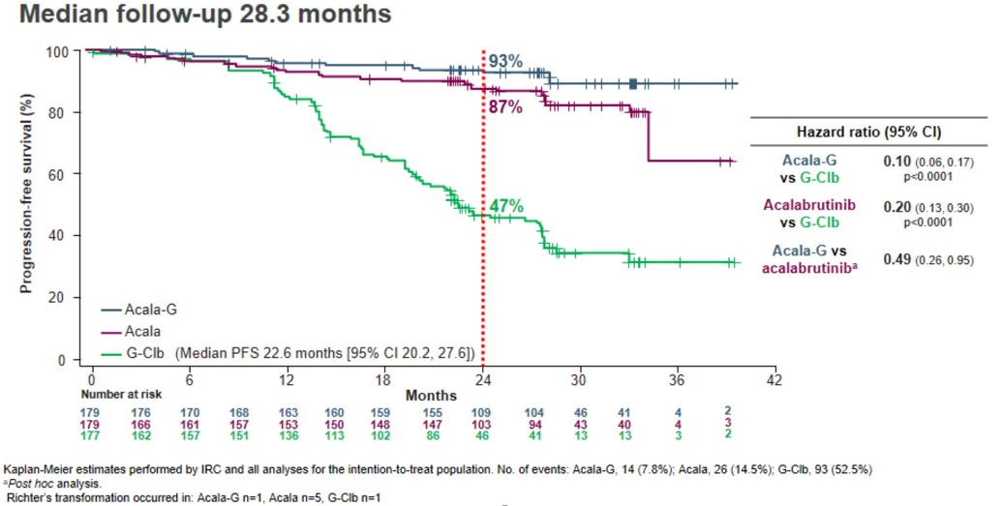
ELEVATE TN: IRC-Assessed PFS for Acalabrutinib ± Obinutuzumab was Superior to Obinutuzumab/Chlorambucil in Frontline CLL
Sharman JP et al. ASH 2019. Abstract 31.
Notes:
Speakers Notes:
Mention that this study was not powered to detect a difference between acalabrutinib and acalabrutinib + obinutuzumab.

Slide 19
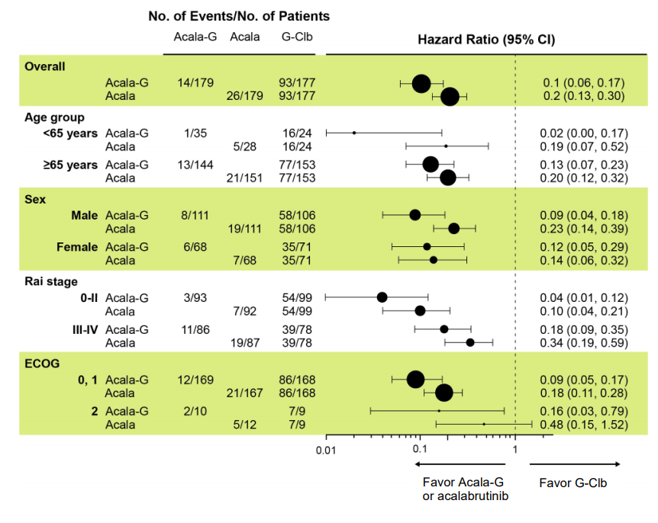
ELEVATE TN: PFS Benefit for Acalabrutinib ± Obinutuzumab was Consistent Across Subgroups
Sharman JP et al. ASH 2019. Abstract 31.

Slide 20
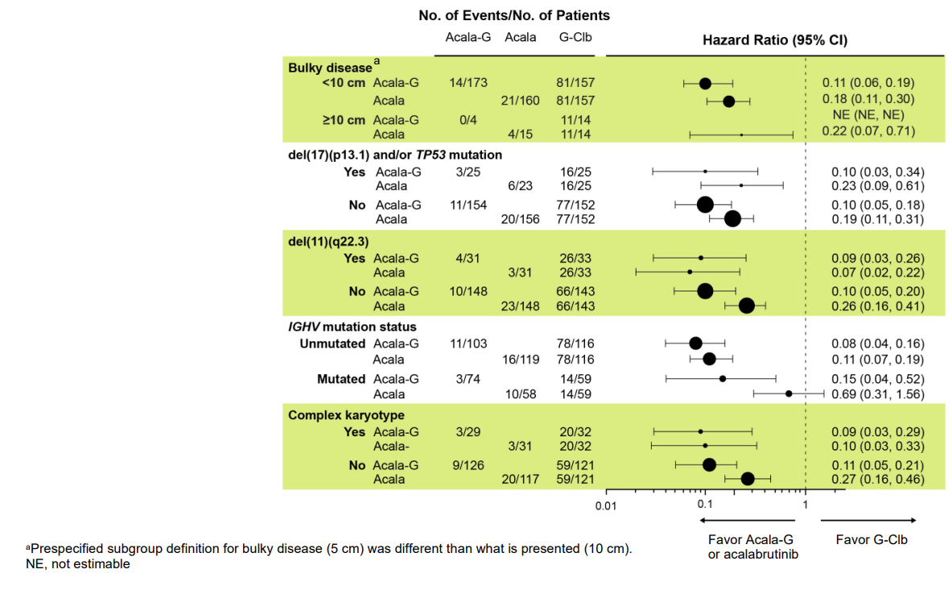
ELEVATE TN: PFS Benefit for Acalabrutinib ± Obinutuzumab was Consistent Across Subgroups
Sharman JP et al. ASH 2019. Abstract 31.

Slide 21
ELEVATE TN: Most Common Adverse Events (≥15% Patients) in Any Treatment Arm
AEs, n (%) | Acala-G N=178 |  | Acalabrutinib N=179 |  | G-Clb N=169
 | Any | Grade ≥3 | Any | Grade ≥3 | Any | Grade ≥3
Headache | 71 (39.9) | 2 (1.1) | 66 (36.9) | 2 (1.1) | 20 (11.8) | 0
Diarrhea | 69 (38.8) | 8 (4.5) | 62 (34.6) | 1 (0.6) | 36 (21.3) | 3 (1.8)
Neutropenia | 56 (31.5) | 53 (29.8) | 19 (10.6) | 17 (9.5) | 76 (45.0) | 70 (41.4)
Fatigue | 50 (28.1) | 3 (1.7) | 33 (18.4) | 2 (1.1) | 29 (17.2) | 1 (0.6)
Contusion | 42 (23.6) | 0 | 27 (15.1) | 0 | 7 (4.1) | 7 (4.1)
Arthralgia | 39 (21.9) | 2 (1.1) | 28 (15.6) | 1 (0.6) | 8 (4.7) | 2 (1.2)
Cough | 39 (21.9) | 0 | 33 (18.4) | 1 (0.6) | 15 (8.9) | 0
URTI | 38 (21.3) | 4 (2.2) | 33 (18.4) | 0 | 14 (8.3) | 1 (0.6)
Nausea | 36 (20.2) | 0 | 40 (22.3) | 0 | 53 (31.4) | 0
Dizziness | 32 (18.0) | 0 | 21 (11.7) | 0 | 10 (5.9) | 0
IRR | 24 (13.5) | 4 (2.2) | 0 | 0 | 67 (39.6) | 9 (5.3)
Pyrexia | 23 (12.9) | 0 | 12 (6.7) | 1 (0.6) | 35 (20.7) | 1 (0.6)
Sharman JP et al. ASH 2019. Abstract 31.
Notes:
Speakers Note:
Make sure to mention that headaches are transient and can be managed with acetaminophen/ibuprofen/caffeine. Headaches do not generally cause discontinuation of therapy.

Slide 22
ELEVATE TN: Discontinuations
AEs led to treatment discontinuation in
  20 patients (11%) on acalabrutinib + obinutuzumab
  16 patients (9%) on acalabrutinib alone
  25 patients (14%) on obinutuzumab + chlorambucil
With >2 years of follow-up, 79.3% of patients in both acalabrutinib-containing arms remained on single-agent acalabrutinib
Sharman JP et al. ASH 2019. Abstract 31.
Notes:
Speaker Note:
AEs requiring discontinuation included pneumonia, infusion reactions, anemia, febrile neutropenia and TLS.

Slide 23
Bruton Tyrosine Kinase Inhibitors in Relapsed/Refractory Treatment
New treatment paradigms: Chronic Lymphocytic Leukemia

Slide 24
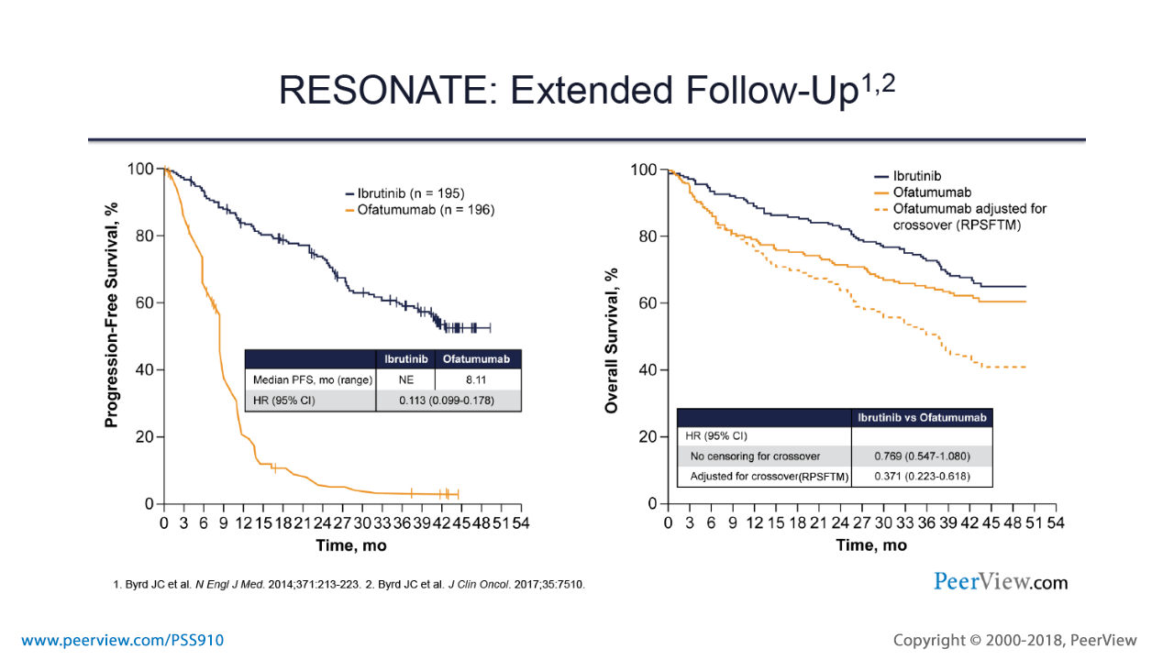
RESONATE: Ibrutinib was Superior to Ofatumumab in R/R CLL/SLL –Extended Follow-up (Phase III)
CLL/SLL diagnosis
N=391
≥ 1 prior therapy
ECOG PS 0-1
Measurable nodal disease by CT
Ibrutinib QD
(n = 195)
Crossover
upon PD
(n = 122)
Ofatumumab (300 mg followed by 2000 mg x 11 doses for 24 wks)
Ibr vs Ofa: Improved heme parameters, FACIT-F/EORTC, fewer hospital visits
Long-term treatment with ibrutinib continues to show sustained PFS and OS regardless of high-risk cytogenetics
Byrd, et al. J Clin Oncol. 2017;35 (no. 15_suppl): 7510. Barrientos, et al. Clin Lymphoma Myleloma Leuk. 2018;18:803-13.
Notes:
PO, by mouth; PD, progressive disease; IV, intravenous; OS, overall survival; PFS, progression-free survival
Ofatumumab IV starting dose of 300 mg followed by 2000 mg x 11 doses for 24 wks

Slide 25
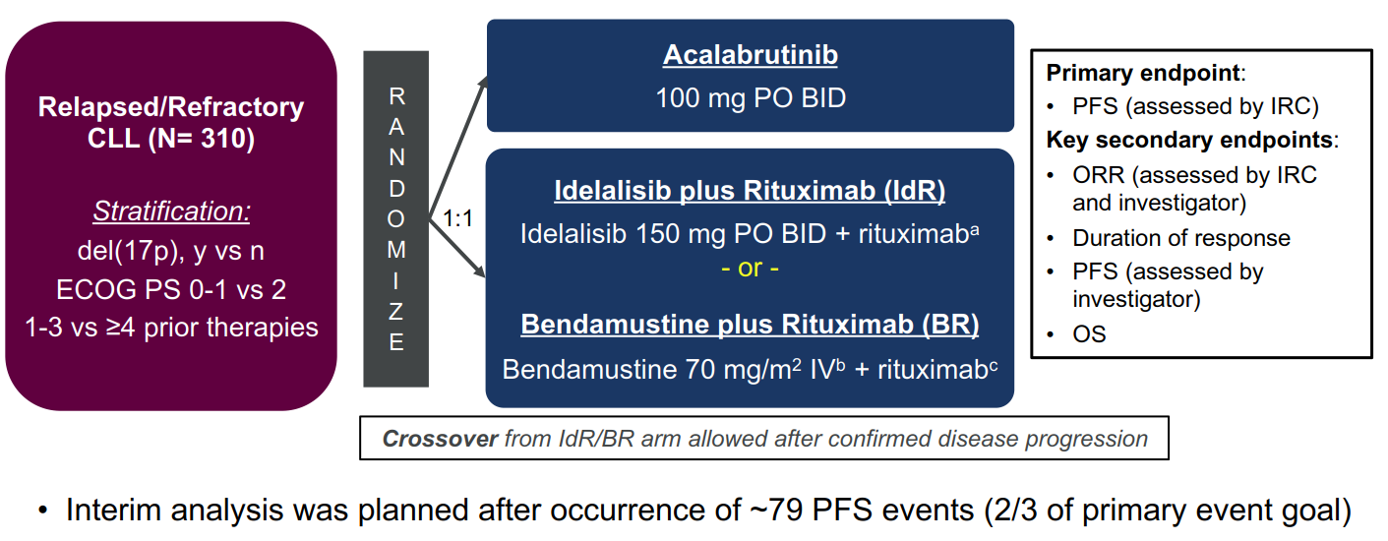
ASCEND: Acalabrutinib vs Rituximab + Idelalisib or Bendamustine in R/R CLL
ªFirst dose at 375 mg/m², subsequent doses (up to 8) at 500 mg/m² every 2 wk for 4 infusions, then every 4 wk for 3 infusions.
^{b}On day 1 and day 2 of each cycle.
^{c}First dose at 375 mg/m², subsequent doses at 500 mg/m² on day 1 of each cycle for up to 6 cycles.
BID = twice daily; CLL = chronic lymphocytic leukemia; ECOG PS = Eastern Cooperative Oncology Group performance status; IRC = independent review committee; IV = intravenous; ORR = overall response rate; OS = overall survival; PFS = progression-free survival; PO = orally.
Ghia. EHA 2019. Abstr LB2606. NCT02970318.

Slide 26
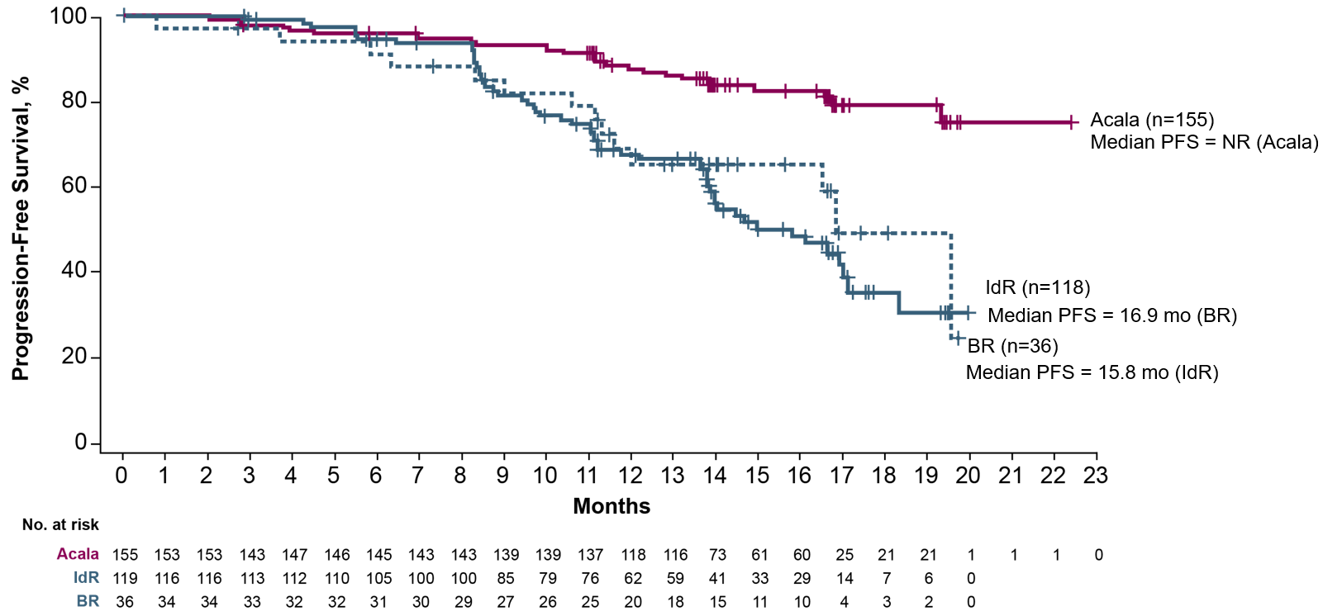
ASCEND: IRC-Assessed PFS was Superior for Acalabrutinib vs IdR or BR
Patients With Events, n (%) | 1-Year PFS, %
27 (17)
88
54 (45)
68
14 (39)
69
HR vs IdR, 0.29 (95% CI: 0.18, 0.46); P<0.0001
HR vs BR, 0.36 (95% CI: 0.19, 0.69); P<0.0001
Acala = acalabrutinib; BR = bendamustine plus rituximab; HR = hazard ratio; IdR = idelalisib plus rituximab; IRC = independent review committee; NR = not reached;
PFS = progression-free survival.
Ghia P et al. Presented at: 15-ICML 2019; June 18-22, 2019; Lugano, Switzerland. Abs 048.

Slide 27
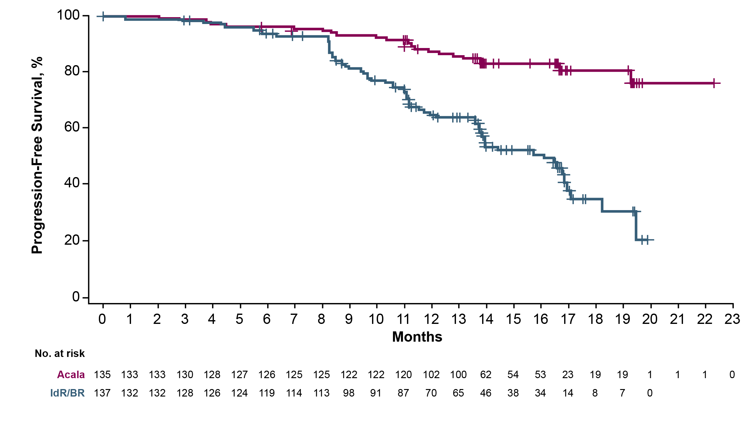
ASCEND: Acalabrutinib was Superior to IdR or BR for IRC-Assessed PFS in Pts With High-Risk Cytogenetic Features
Acala (n=135)
Patients With Events, n (%) | 1-Year PFS, %
Median PFS = NR (Acala)
23 (17)
88
63 (46)
66
IdR/BR (n=137)
Median PFS = 16.2 mo (IdR/BR)
HR, 0.27 (95% CI: 0.17, 0.44); P<0.0001
Ghia P et al. Presented at: 15-ICML 2019; June 18-22, 2019; Lugano, Switzerland. Abs 048.

Slide 28
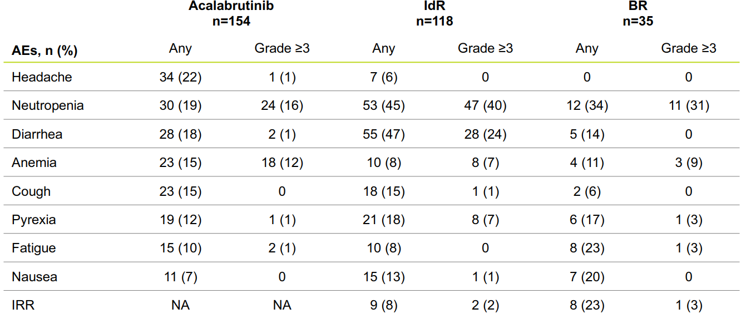
ASCEND: Most Common AEs in ≥15% of Patients in Any Cohort
Ghia P et al. Presented at: 15-ICML 2019; June 18-22, 2019; Lugano, Switzerland. Abs 048.
Notes:
AE = adverse event; BR = bendamustine plus rituximab; IdR = idelalisib plus rituximab; IRR = infusion-related reaction; NA = not applicable

Slide 29
Other New Agents
Bcl-2 Inhibitor Venetoclax
New treatment paradigms: Chronic Lymphocytic Leukemia

Slide 30
CLL14: Venetoclax + Obinutuzumab vs. Chlorambucil + Obinutuzumab for Frontline CLL
514 pts
Tx naïve
CIRS > 6 or CrCl <70 ml/min
Central review
Eligibility
Primary Endpoint:
PFS (invest.)
Secondary Endpoints:
PFS (IRC)
PFS in del(17p)
ORR
OS
MRD (10⁻⁴ )
DOR
TTNT
432 randomized
(ITT pop)
N=216
chlorambucil 0.5mg/kg d1,15 c1-12 +
obinutuzumab (G) 100mg d1, 900mg d2
& 1000mg d8,d15 of c1; 1000mg d1c2-6
6 x 28d cycles
NO crossover
N=216
Obinutuzumab (G) 100mg d1, 900mg d2
& 1000mg d8,d15 of c1; 1000mg d1c2-6
Venetoclax (ven) dose ramp up over 5 wks starting c1d22 ven 400mg for 12 cycles
Fischer et al. N Engl J Med 2019;380:2225

Slide 31
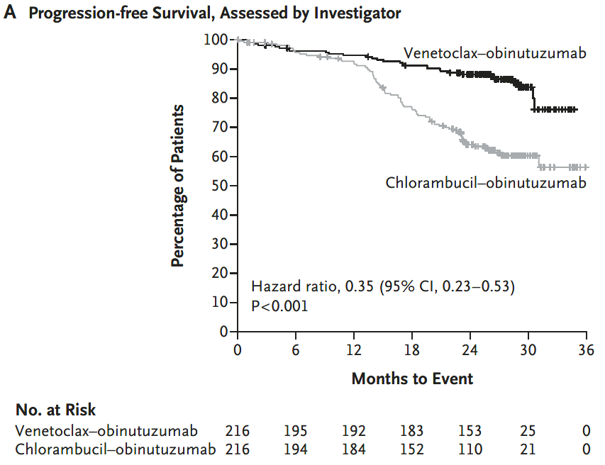
CLL14: Venetoclax + Obinutuzumab was Superior to Chlorambucil + Obinutuzumab in PFS for Frontline CLL
mFollow-up: 28 mos
mTime off treatment: 17mos
24 mo estimate of PFS
venG: 88%
G-chlor: 64%
Fischer et al. N Engl J Med 2019;380:2225

Slide 32
MURANO: Venetoclax + Rituximab vs Bendamustine + Rituximab for R/R CLL (Phase III)
Adult patients with R/R CLL
(N = 389)
CLL (IWCLL diagnostic criteria)
Previously tx w/1-3 lines of therapy, including ≥1 standard chemotherapy-containing regimen
Venetoclax (5-week ramp-up + 6 cycles)
Rituximab (6 cycles)
Primary Endpoints
PFS, PD rate
Bendamustine (6 cycles)
Rituximab (6 cycles)
Hillmen, P; ASCO 2018. Seymour JF et al. ASH 2018. Abstract 184. Seymour JF, et al. New Eng J Med. 2018;378:1107-20.

Slide 33
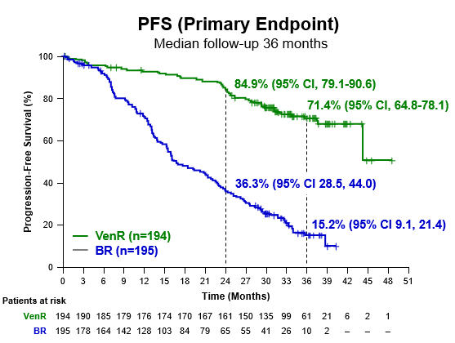
MURANO: Venetoclax + Rituximab was Superior to Bendamustine + Rituximab for PFS in R/R CLL
Outcome | VEN + R (n = 194) | BR (n = 195) | HR (95% CI) | P Value
Median PFS, mos | NR | 17 | 0.17 (0.12-0.23) | < .0001
1-yr PFS, % | 92.7 | 72.5 | -- | --
2-yr PFS, % | 84.9 | 36.3 | -- | --
V + R was consistently favored across subgroups including del(17p) status, TP53 status, baseline IGHV status, & number of prior treatments
Hillmen, P; ASCO 2018. Seymour JF et al. ASH 2018. Abstract 184. Seymour JF, et al. New Eng J Med. 2018;378:1107-20.
Notes:
R/R, relapsed/refractory; DoR, duration of response; C, cycle; PD, progressive disease; PFS, progression-free survival; BR, bendamustine-rituximab
Key exclusion criteria
No warfarin
No history of significant cardiovascular disease
Median follow-up: 23.8 mos (range: 0-37.4)
Venetoclax dose ramp-up 20-400 mg orally daily for 5 wks then 400 mg orally daily for C1-6 +
Rituximab 375 mg/m² on Day 1 of C1,
then 500 mg/m² Day 1 of C2-6
Bendamustine 70 mg/m² on Days 1, 2 of C1-6 + Rituximab 375 mg/m² on Day 1 of C1, then 500 mg/m² Day 1 of C2-6

Slide 34
Opportunity Exists to Improve Treatment for Patients Diagnosed with CLL
Patient preferences for certain treatment features are important when considering treatment options^{1,2} | The definition of high-risk has evolved to now include del17p, TP53 mutated, del11q, IGHV unmutated, and complex karyotype^{3,7-10} | Depending on treatment goals, continuous therapy may be appropriate for long-term disease control¹¹ | Novel therapies have proven efficacy in some high-risk patients, but there is room for improvement^{15,16}
Patients placed the highest relative importance on longer OS/PFS and reduced risk of adverse events | Testing for high-risk genomic features should be performed prior to treatment selection | PFS/OS are relevant end points when assessing long-term disease control¹²⁻¹⁴ | Pathway inhibitors are emerging as the therapy of choice for patients with high-risk CLL¹⁷ Toxicity, discontinuation due to AEs, and logistical challenges may limit their full potential in CLL¹⁸⁻²⁰
1. Mansfield C, et al. Blood Advances. 2017;1(24): 2176-2185. 2. Landfeldt E, et al. Leukemia Research. 2016;40:17-23. 3. Eichhorst B, et al. Ann Oncol. 2015;26(suppl 5):v78-v84. 4. Bell R. J Adv Pract Oncol. 2017;8(5):462-473. 5. Holtzer-Goor KM, et al. Qual Life Res. 2015;24(12):2895-2906. 6. Strati P, et al. Br J Haematol. 2017;178(3):394-402. 7. Malcikova J, et al. Leukemia. 2018;32(5):1070-1080. 8. Rosenquist R, et al. Leukemia. 2017;31(7):1477-1481. 9. Hallek M, et al. Blood. 2018;131(25):2745-2760. 10. National Comprehensive Cancer Network. NCCN Guidelines Version 4.2020. Accessed January 8, 2020. 11. Brander D, et al. Am Soc Clin Oncol Educ Book. 2019;39:487-498. 12. National Institute of Health. Surveillance, Epidemiology, and End Results Program. https://seer.cancer.gov/statfacts/html/clyl.html. Accessed January 20, 2020. 13. Kovacs G, et al. J Clin Oncol. 2016;34(31):3758-3765. 14. US Food and Drug Administration. https://www.fda.gov/regulatory-information/search-fda-guidance-documents/clinical-trial-endpoints-approval-cancer-drugs-and-biologics. Published December, 2018. Accessed January 10, 2020. 15. Moreno C, et al. Lancet Oncol. 2019;20(1):43-56. 16. Fischer K, et al. N Engl J Med. 2019;380(23):2225-2236 (SUPPL). 17. Dreger P, et al. Blood. 2018;132(9):892-902. 18. Sharman JP, et al. Blood. 2017;130(suppl 1):4060. 19. Follows G, et al. Poster presented at: ASH 2019. 20. Venclexta [prescribing information]. North Chicago, IL: AbbVie Inc; and South San Francisco, CA: Genentech USA, Inc; 2019.
Notes:
Speaker Notes
CLL impacts a significant number of patients worldwide. Patients of advanced age are more likely to be diagnosed with CLL^{1,2}
The median age of CLL diagnosis is 72 years³
The number of chronic comorbidities increases with age and therefore quality of life among patients diagnosed with CLL may be at risk⁴
A variety of genetic alterations have been identified and characterized in patients with CLL. Among these alterations, high-risk cytogenetic features, including Del17p, TP53, IGHV unmutated, Del11q, and Complex Karyotype, have been linked with poor outcomes⁵
CLL treatment regimens are typically administered continuously or as fixed durations, and continuous therapy may be appropriate for long-term disease control⁶
PFS and OS are relevant end points when assessing long-term disease control, more so than MRD negativity⁷⁻⁹
The development of novel therapies with proven efficacy has bolstered the treatment of high-risk CLL; however, these regimens are associated with toxicity, intolerability, and logistical challenges that may limit their full potential^{10,11}
References
Union for International Cancer Control. https://www.who.int/selection_medicines/committees/expert/20/applications/CLL.pdf. Accessed November 6, 2019.
Combest AJ, Danford RC, Andrews ER, Simmons A, McAtee P, Reitsma DJ. Overview of the recent developments in chronic lymphocytic leukemia, part 1. J Hematol Oncol Pharm. 2016;6(2):54-56.
Eichhorst B, Robak T, Montserrat E, et al; ESMO Guidelines Committee. Ann Oncol. 2015;26(suppl 5):v78-v84.
Barnett K, Mercer SW, Norbury M, Watt G, Wyke S, Guthrie B. Epidemiology of multimorbidity and implications for health care, research, and medical education: a cross-sectional study. Lancet. 2012;380(9836):37-43.
International CLL-IPI working group. An international prognostic index for patients with chronic lymphocytic leukaemia (CLL-IPI): a meta-analysis of individual patient data. Lancet Oncol. 2016;17(6):779-790.
Brander D, Islam P, Barrientos JC. Tailored treatment strategies for chronic lymphocytic leukemia in a rapidly changing era. Am Soc Clin Oncol Educ Book. 2019;39:487-498.
National Institute of Health. Surveillance, Epidemiology, and End Results Program. https://seer.cancer.gov/statfacts/html/clyl.html. Accessed January 20, 2020.
Kovacs G, Robrecht S, Fink AM, et al. Minimal residual disease assessment improves prediction of outcome in patients with chronic lymphocytic leukemia (CLL) who achieve partial response: comprehensive analysis of two phase III studies of the German CLL Study Group. J Clin Oncol. 2016;34(31):3758-3765.
Food and Drug Administration. Clinical Trial Endpoints for the Approval of Cancer Drugs and Biologics: Guidance for Industry. https://www.fda.gov/regulatory-information/search-fda-guidance-documents/clinical-trial-endpoints-approval-cancer-drugs-and-biologics. Published December, 2018. Accessed January 10, 2020.
Moreno C, Greil R, Demirkan F, et al. Ibrutinib plus obinutuzumab versus chlorambucil plus obinutuzumab in first-line treatment of chronic lymphocytic leukaemia (iLLUMINATE): a multicentre, randomised, open-label, phase 3 trial. Lancet. 2019;20(1):43-56.
Fischer K, Al-Sawaf O, Bahlo J, et al. Venetoclax and obinutuzumab in patients with CLL and coexisting conditions. N Engl J Med. 2019;380(23):2225-2236.

Slide 35
Case Study 1: 58 year-old male with treatment-naïve CLL
Presentation and CLL Characteristics
  Attorney in town
    Plays golf most weekends; enjoys travel and visiting grandchildren
  December 2016: lymphocytosis (9.5×10³/μL)
  2017: referred to the hematologist due to progressive lymphocytosis
    Immunophenotype was consistent with CLL
    Laboratory studies: ALC 15×10³/μL; Hb 14.1 g/dL; Plt 175×10³/μL;
    FISH in peripheral blood: del(13q14)
    Unmutated IGHV
    Active surveillance
  Summer 2020: Laboratory studies: ALC 136×10³/μL; Hb 8.4 g/dL; Plt 102×10³/μL
    Physical exam: small to moderate palpable adenopathy in the neck, no visceromegalies
    ECOG PS 1, some fatigue
    CT imagining shows
    Widespread adenopathy above and below the diaphragm. Most adenopathy 1.7-2.3 cm but largest 4.2 cm in retroperitoneum
Comorbidities
  Hypertension, h/o DVT
  Co-medications: apixaban, losartan, and amlodipine
Notes:
Moderator:
“I’d like to ask each of you to share an example from your practice describing how identified a patient with CLL in the last year that you started on a 1st line treatment. We’ll Start with Dr. Moreno and move to Dr. Pagel.”
How did that patient arrive/end up at your clinic/practice? What symptoms did they present with initially?
Were they referred to you with test results in hand? If so, which tests?
Based on the patient’s presentation, what (additional) diagnostic tests did you order? Are there tests that you choose not to order? Why?
Based on the results of these tests, what course of treatment did you recommend? Why?
Did your patient’s preference inform your treatment recommendation?

Slide 36
Case Study 2: 75 year-old male with treatment naïve CLL
Presentation and CLL Characteristics
  Retired and diagnosed with CLL in 2018
    Immunophenotype: CD5+, CD23+, CD20+(dim) small lymphocytes
    FISH in peripheral blood: del(11q), del(17p)
    Unmutated IGHV
    Active surveillance
  Summer 2020
    ECOG PS 1, fatigue and abdominal discomfort, can hardly play tennis
    Physical exam: spleen ~17 cm; adenopathy 2 cm in palpable nodal regions
  Laboratory studies: ALC 45×10³/mL; Hb 9 g/dL; Plt 90×10³/mL; ANC 1.2×10³/mL
    9 months ago: ALC 3×10³/mL; Hb 12 g/dL; Plt150×10³/mL; ANC 2.7×10³/mL
  CT imaging: conglomerate LN mass upper abdomen measuring up to 10.5 cm in diameter; other nodes up to 3.5 cm
  PET: SUVs 2-4, LDH 245 (220 ULN)
  Comorbidities
  Mild chronic kidney disease
  No known cardiac disease and normal liver function
  Co-medication: atorvastatin

Slide 37
Patient Case 3: CLL
79-yr-old man with type 2 diabetes, chronic kidney disease, and hypertension presented to the ED with coughing and shortness of breath
  CT scan revealed bibasilar infiltrates consistent with pneumonia with multiple small thoracic nodes up to 1.4 cm, splenomegaly, extensive mesenteric adenopathy
  FNA and core needle biopsy of an axillary node demonstrated a lambda-restricted B-cell population expressing CD5, CD20(dim), CD200, CD23, and
  NOT expressing cyclin D1
CBC: WBC 5.6, ANC 2.8, ALC 2.1, Hb 10.8, HCT 31.2, PLTs 179
Peripheral blood flow cytometry demonstrated the same clone; IGHV was unmutated
FISH was normal; sequencing revealed mutation in TP53

Slide 38
New treatment paradigms:
Chronic Lymphocytic
Leukemia
THANK YOU
John M Pagel, MD, PhD
Affiliate Associate Member, Division of Oncology
University of Washington School of Medicine
Swedish Cancer Institute
Chief of Hematologic Malignancies Program
Seattle, WA

