Slide 1
Oncology Today — Follicular Lymphoma Edition:
An Enduring Multimedia Review Focused on
Recently Published and Emerging Research
Faculty
Carla Casulo, MD
John P Leonard, MD
Moderator
Neil Love, MD

Slide 2
Oncology Today: Follicular Lymphoma
Module 1: Current Management of Newly Diagnosed FL
Observation versus rituximab monotherapy
GALLIUM – Obinutuzumab/chemotherapy followed by obinutuzumab maintenance
RELEVANCE – Lenalidomide/rituximab (R²) in the up-front setting
Module 2: Selection and Sequencing of Therapies for Relapsed/Refractory (R/R) FL
Management of early progression of disease (POD24)
AUGMENT – R² for patients with R/R disease
Tazemetostat – Recent FDA approval of EZH2 inhibitor
ZUMA-5 – CAR T-cell therapy axicabtagene ciloleucel (axi-cel) in R/R indolent NHL
Mosunetuzumab – Anti-CD20 and anti-CD3 bispecific antibody
Module 3: Integration of PI3 Kinase Inhibition into the Management of FL
Similarities and differences between copanlisib, duvelisib and idelalisib
Data supporting FDA approval of these agents, including DYNAMO

Slide 3
Case Presentation — Dr Leonard: 70-year-old man with diffuse LAN
Observed over one year
Cervical biopsy non diagnostic
LAN progressed in groin, mild leg edema
Biopsy showed FL grade 1
Receiving treatment with single-agent rituximab on a clinical trial adding Vitamin D vs placebo (study is led by U Rochester)

Slide 4
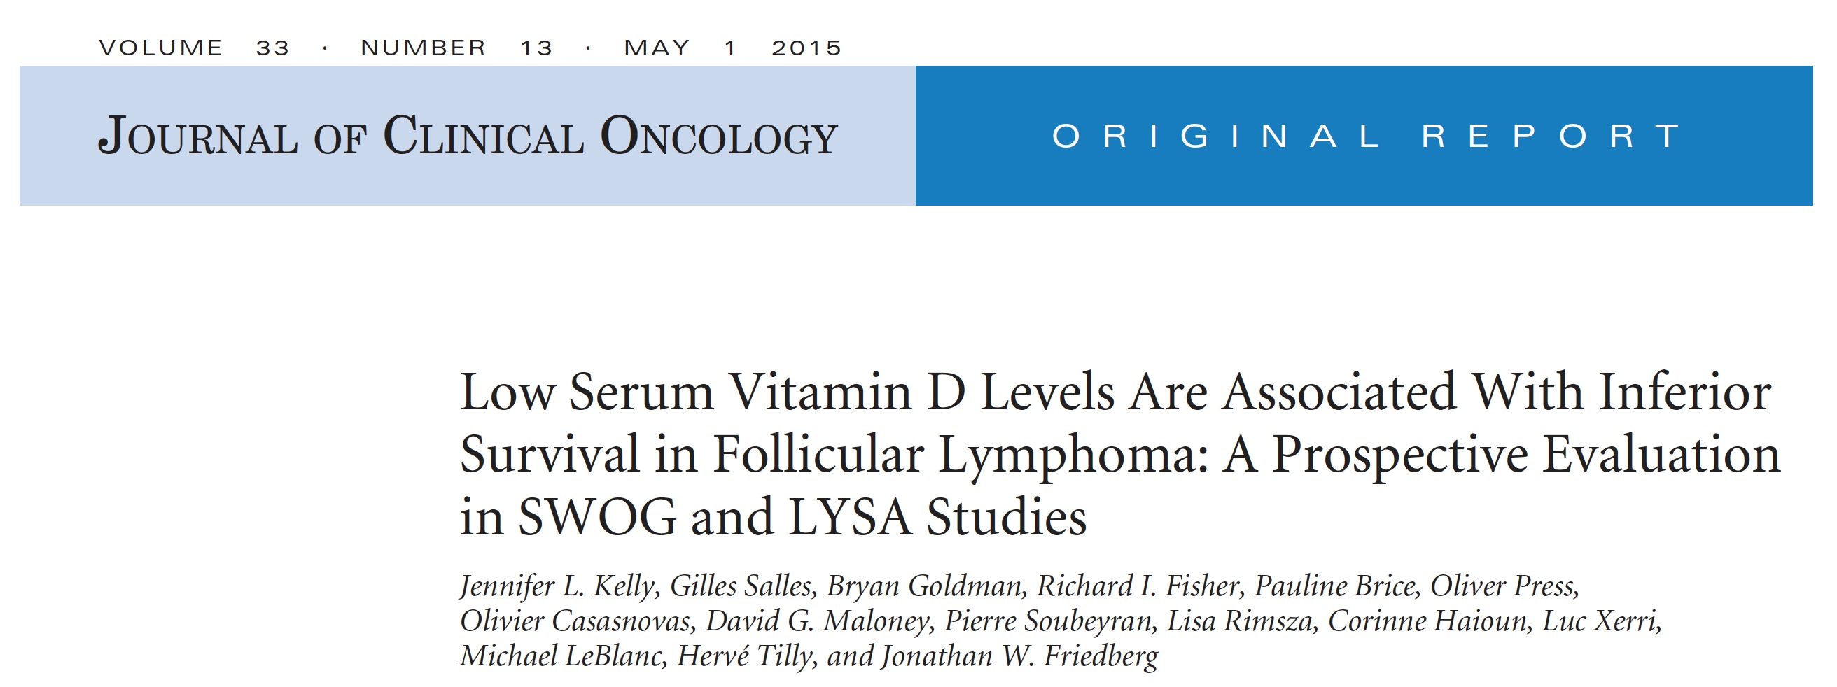

Slide 5
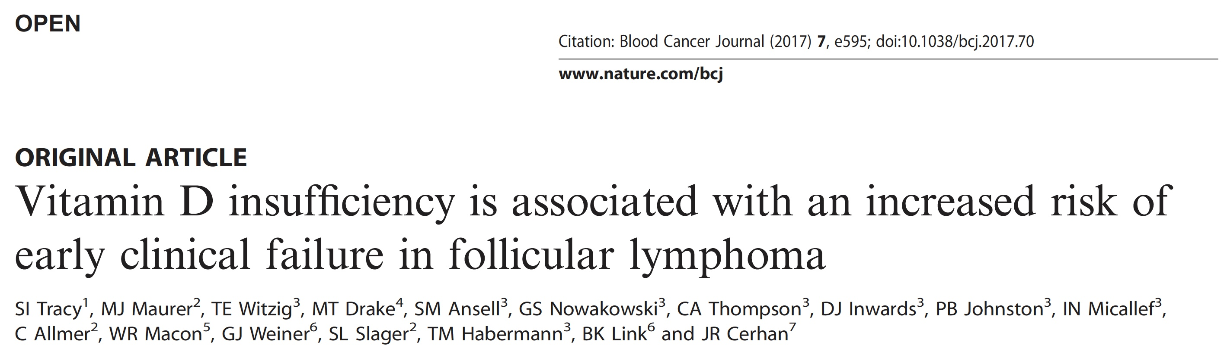

Slide 6

Case Presentation — Dr Casulo: 50-year-old woman with grade 2 follicular lymphoma
Patient is a 50-year-old school teacher in good health
In May 2020 she developed axillary lymphadenopathy
Mammogram: left axillary lymph node measuring 4.3 x 3.5 x 2.5 cm
Core needle biopsy: grade 2 follicular lymphoma
PET: axillary lymphadenopathy, 4.5 cm (SUV 5), retroperitoneal lymph nodes, 11.2 x 4.3 cm (SUV 6), left mesenteric nodal mass, 4.8 x 6.5 cm, (SUV 6) with mild left sided hydronephrosis

Slide 7
Case Presentation — Dr Casulo: 50-year-old woman with grade 2 follicular lymphoma — Treatment
Obinutuzumab/Bendamustine:
  Obinutuzumab days 1, 8, 15 of cycle 1, then monthly x 6 cycles
  Bendamustine days 1, 2 x 6 cycles
End of treatment PET:
  Complete response (Deauville 2)
Initiated maintenance obinutuzumab

Slide 8
Case Presentation — Dr Casulo: 76-year-old man with grade 3a follicular lymphoma
76-year-old man, history of HTN, DM, diverticulosis
In 2016, surveillance CT for pulmonary nodules showed new mediastinal, hilar and axillary lymphadenopathy, 3.5-6 cm. Abdominal CT: 2.8 x 3.5 cm gastrohepatic and mesenteric lymphadenopathy
Mediastinoscopy/biopsy: grade 3a follicular lymphoma
PET: hypermetabolic lymphadenopathy, SUV 9-12
Treatment: R-CHOP x 6 → complete metabolic response

Slide 9
Case Presentation — Dr Casulo: 76-year-old man with grade 3a follicular lymphoma — Subsequent course
March 2020, developed dyspnea, cough. CXR showed large pleural effusion. COVID negative, pleural fluid showed atypical lymphocytes
Exam: cervical and supraclavicular lymphadenopathy
PET: cervical, supraclavicular, mediastinal lymphadenopathy, large BL pleural effusions
Core biopsy: grade 2 follicular lymphoma
Treatment: Lenalidomide/Rituximab

Slide 10
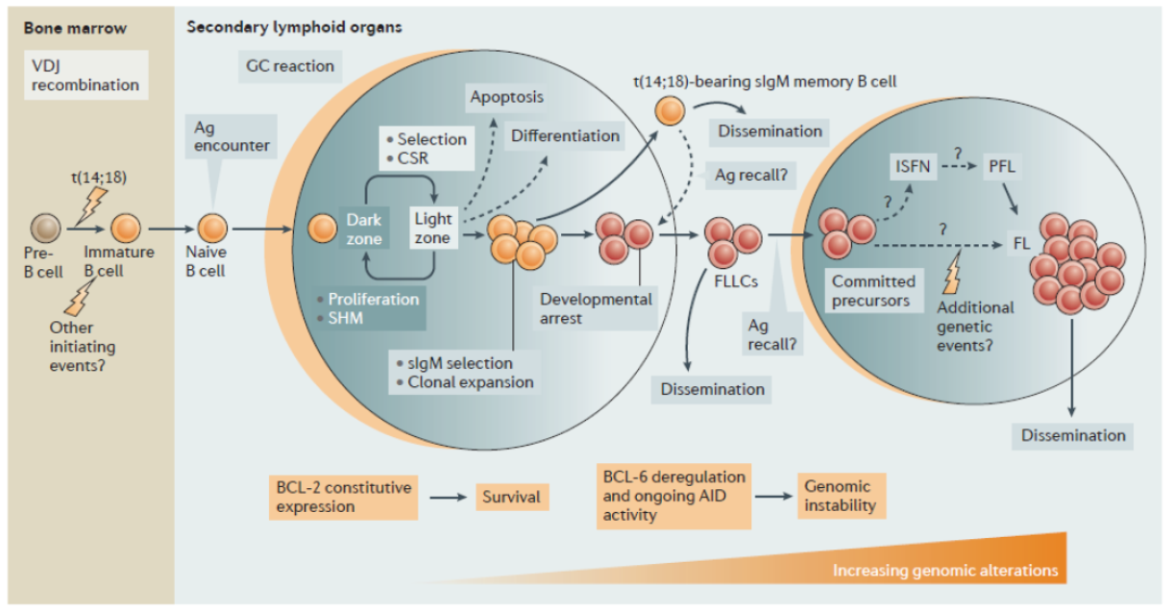
Follicular lymphoma pathogenesis

Slide 11
How can FL patients present?
Lymphadenopathy
Palpable mass, edema
Splenomegaly
Abnormal blood counts
Skin lesions, endoscopy findings
Staging: Exam, labs, imaging (CT, PET), ? BM
Courtesy of John P Leonard, MD

Slide 12
What follicular lymphoma patients need treatment?
1. Brice P, et al. J Clin Oncol. 1997:15:1110-7.
2. Ardeshna KM, et al. Lancet. 2003;362:516-22.

Slide 13
Considerations in the choice of therapy for a FL patient at diagnosis or relapse
Indications for therapy
Bulk of disease
Comorbidities
Toxicity concerns
Interest in and availability of clinical trials
Risk of transformation
Grade (typically I treat FL grade 1, 2 and 3A similarly)
Courtesy of John P Leonard, MD

Slide 14
One general framework for initial therapy for FL
R = Rituximab, G = Obinutuzumab
Kahl BS, Yang DT. Blood. 2016; 127:2055-63.
Courtesy of John P Leonard, MD

Slide 15
My approach to limited stage FL initial treatment
Watch and wait acceptable
  Particularly if suspicion of disease elsewhere or alternatively low chance of needing therapy soon (resected low volume disease, some older patients)
RT acceptable – location/size dependent
Generally have not yet adapted combined modality therapy
  Not sure of value for early vs later (if relapse) systemic treatment
  Is a short course of rituximab reasonable/of value vs early chemo-based combined modality rx?
Do not over-emphasize concept of “cure” vs “functional cure” given favorable long-term prognosis

Slide 16
My approach to low tumor burden, advanced stage FL
Watch and wait acceptable (encouraged)
  Often at least for some time to allow patient to understand disease and me to get a sense of pace over time
Rituximab x 4 if desires therapy/minimal symptoms/findings without maintenance
Chemoimmunotherapy or other emerging combinations (lenalidomide/rituximab) if patient prefers a longer remission and prefers efficacy/toxicity tradeoffs – less common
  Tends to be a minority of patients but very much “style”

Slide 17
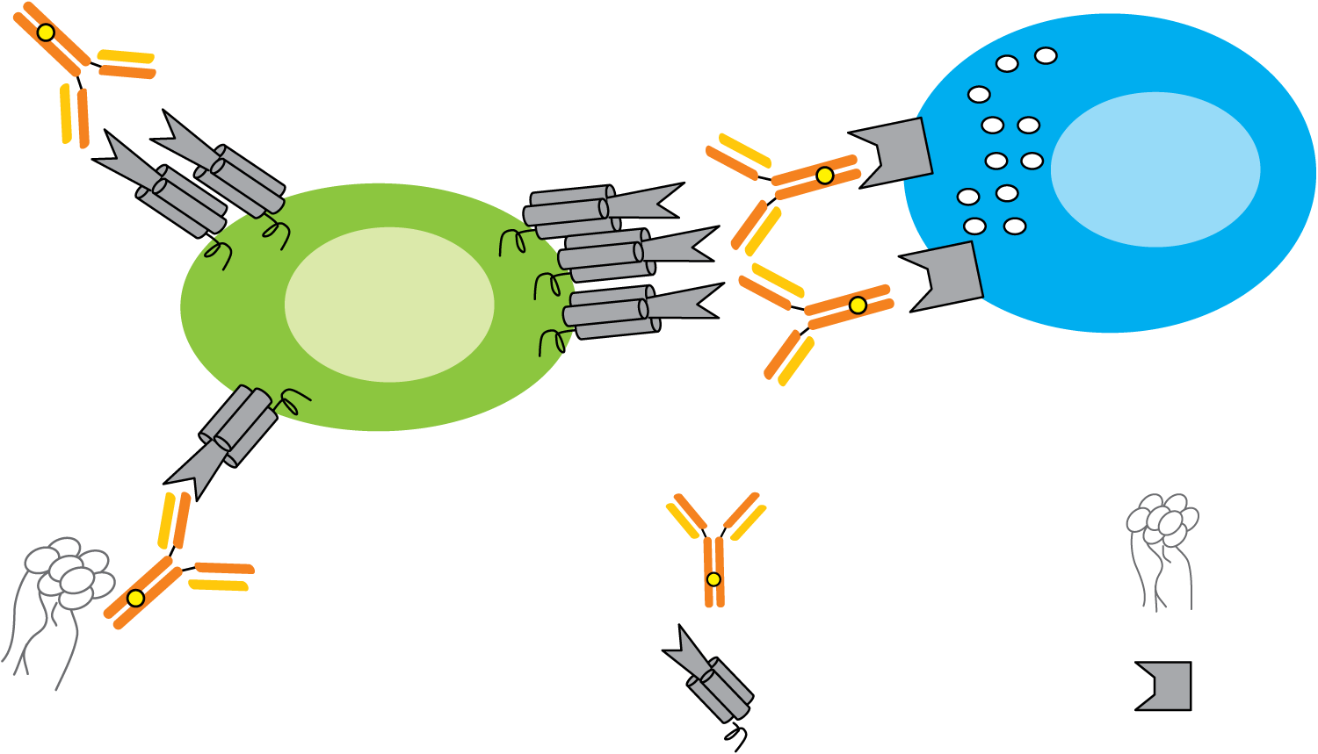
Differences between Rituximab (Type I Antibody) and Obinutuzumab (Type II Antibody)
Increased direct cell death
Type II character…
…due to alternative geometry (elbow-hinge modification) versus type I antibody e.g., rituximab
…non-apoptotic immunogenic cell death
Increased effector cell-mediated
ADCC and ADCP
Increased affinity for FcγRIII receptors on immune effector cells…
…due to glycoengineered Fc region
Effector cell
B cell
Decreased CDC activity
Type II character…
…due to alternative binding geometry versus type I antibody e.g., rituximab
Obinutuzumab
Complement
CD20
FcγRIII
ADCC = antibody-dependent cell-mediated cytotoxicity; ADCP = antibody-dependent cellular phagocytosis; CDC = complement-dependent cytotoxicity
Tobinai K et al. Adv Ther 2017;34(2):324-56.

Slide 18

Front Line Treatment of Follicular Lymphoma
GALLIUM: Obinutuzumab vs Rituximab-based Induction plus Maintenance
1202 patients FL
Grade 1-3a, advanced stage,
Meeting GELF criteria
Marcus et al. NEJM 2017, 377: 1331-44
Courtesy of Carla Casulo, MD

Slide 19
GALLIUM: Efficacy
Progression- Free Survival
Overall Survival
3 year PFS: 80% vs 73%
(HR 0.66; 95% CI 0.51-0.85; p=0.001)
3 year OS: 94% vs 92%
Courtesy of Carla Casulo, MD

Slide 20
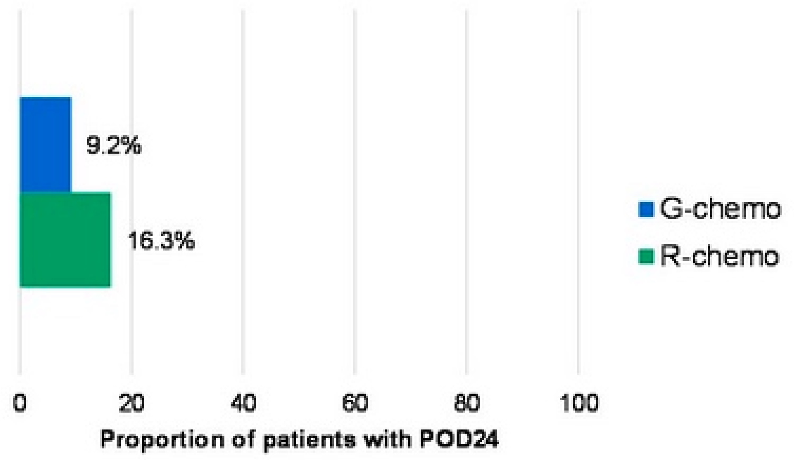
GALLIUM: Proportion of Patients with Progression of Disease within 24 Months (POD24)
Average HR-based reduction in risk of POD24 with G-chemo relative to R-chemo was 47.6%
Townsend W et al. ASCO 2020; Abstract 8023.

Slide 21
GALLIUM Adverse Events of Interest
GALLIUM Adverse Events of Interest
Courtesy of Carla Casulo, MD
Notes:
-Here 64 pts (55 evaluable pts) with dlbcl 22 ABC, 33 GCB, med age 64. 25 mg lenalidomide on days 1-10 of a 21 day cycle
-lenalidomide plus R-CHOP (R2CHOP) was associated with similar outcomes in non-GCB and GCB subtypes, with 2-year progression-free survival (PFS) rates of 60% and 59%, respectively, and 2-year overall survival (OS) rates of 83% and 75%, respectively.

Slide 22
RELEVANCE: Lenalidomide Plus Rituximab (R²) vs R-chemo with R maintenance
Courtesy of Carla Casulo, MD
Morschhauser et al. NEJM 2018; 379: 934-47

Slide 23
RELEVANCE: Efficacy
CR/Cru at 120 weeks
3-year PFS
3-year PFS: 77% R² vs 78% R-chemo
Median follow-up 38 months
Courtesy of Carla Casulo, MD

Slide 24
Safety and Toxicity
GALLIUM | Frequency (obinutuzumab) | RELEVANCE (R²) | Frequency
Grade 3-5 SAE | 74.6% vs 67.8% | Diarrhea | 37% vs 19%
SAE | 46.1% vs 39.9% | Cutaneous reactions | 43% vs 24%
Infusion reactions | 59.3% vs 48.9% | Rash | 29% vs 8%
Fatal events (Bendamustine) | 13% vs 2% | Myalgias | 14% vs 6%
Post hoc analysis: superior for women receiving obinutuzumab (HR 0.49; 95% CI, 0.33-0.74)
Courtesy of Carla Casulo, MD

Slide 25
Role of Rituximab Maintenance: PRIMA
R-CHOP (N=885)
R-CVP (N=272)
R-FCM (N=45)
Rituximab Q2 months x 2 years
Observation
Rituximab 3 yr PFS 75%
Observation 3 yr PFS 75%
10 year follow up:
PFS 51% vs 35%;
R maintenance vs Obs
Courtesy of Carla Casulo, MD
Salles et al. Lancet 2011; 377: 42-51
Notes:
No difference in OS at 10 year fu

Slide 26
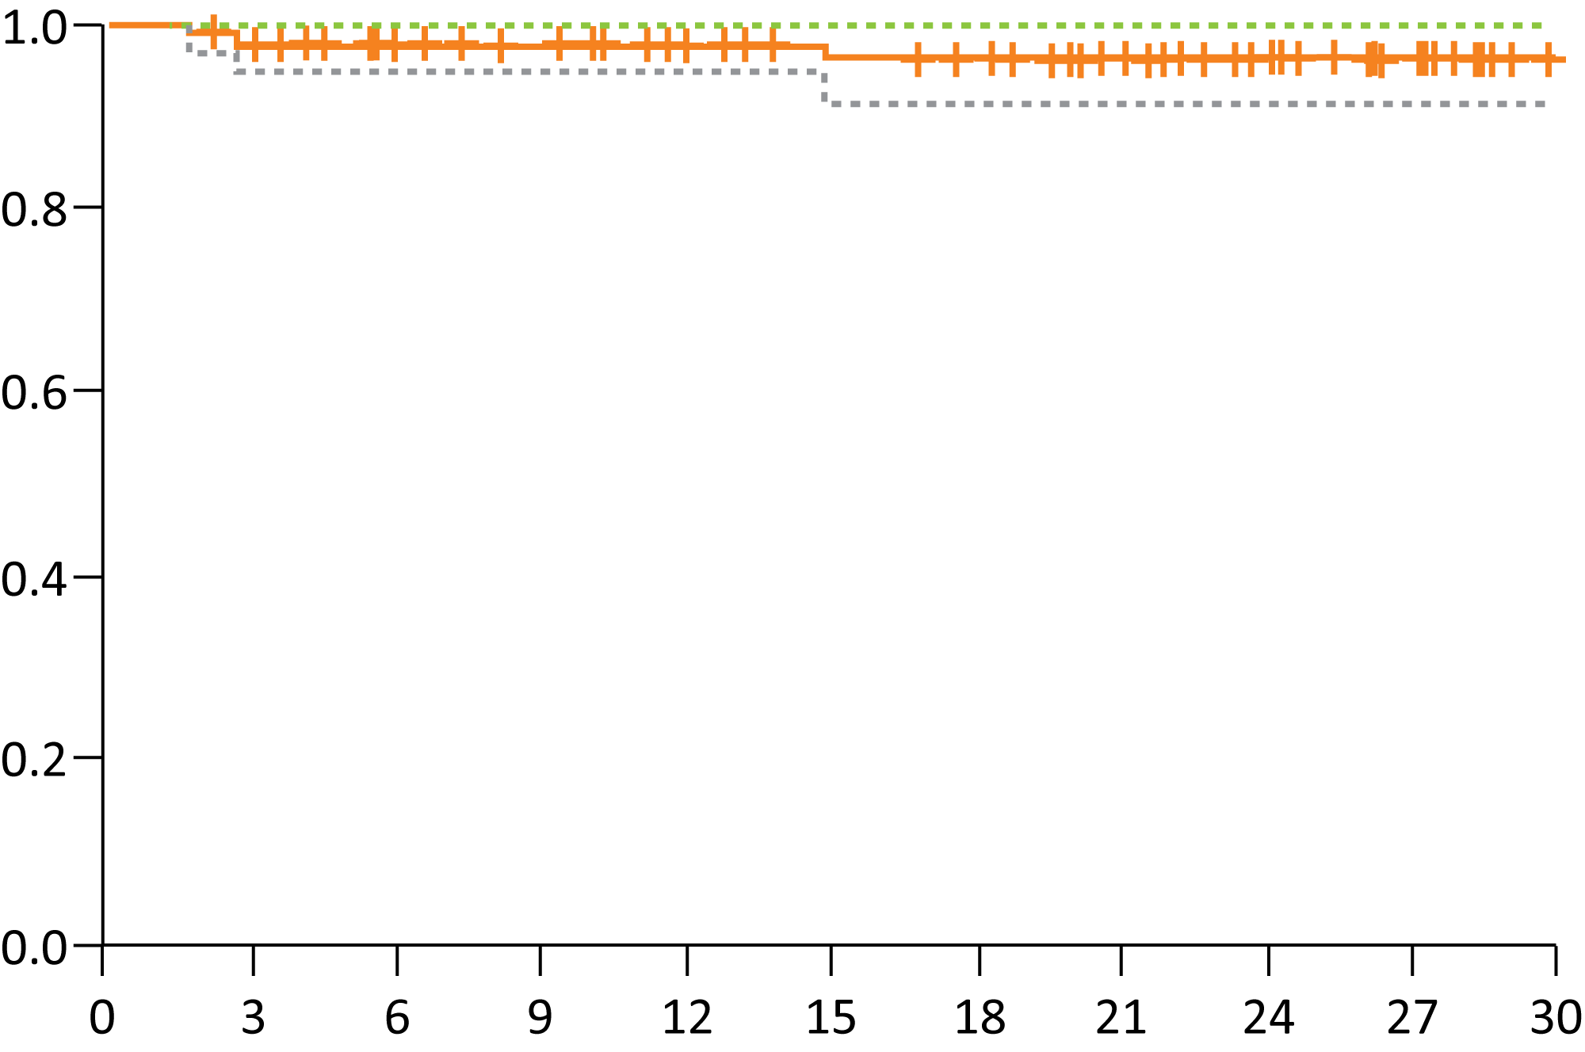
Results of a Phase II Trial of Obinutuzumab in Combination with Lenalidomide in Untreated High-Burden FL
Progression-Free Survival
ORR = 98% (85 CR, 1 PR)
  CR at first response assessment = 92%
No deaths have been observed to date.
11 patients discontinued therapy due
to AEs.
  Most common reason: upper respiratory tract infection (n = 5)
  Other reasons include bradycardia with sick sinus syndrome, urinary tract infection, constipation and abdominal pain.
Most common Grade ≥3 AEs: neutropenia, rash, lung infection and neutropenic fever
Probability
Median follow-up = 22 months
2-year PFS = 96%
Time (months)
Nastoupil LJ et al. Proc ASH 2019;Abstract 125.

Slide 27
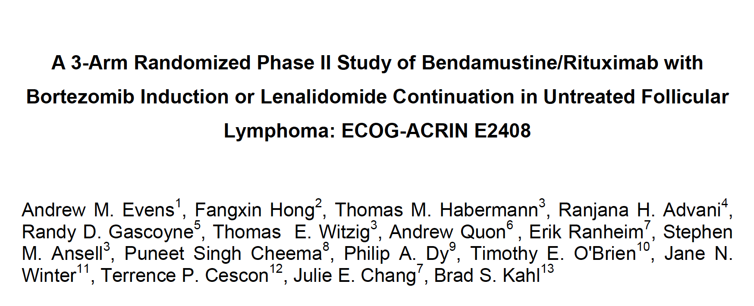
Clin Cancer Res 2020;[Online ahead of print].

Slide 28
ECOG-ACRIN E2408: Phase II Trial Design
Treatment
Maintenance
NCT01216683
High-risk FL (FLIPI 1 score 3-5 or GELF high tumor burden) N = 258
BR
Rituximab
BR + bortezomib (BVR)
Rituximab
BR
Lenalidomide and rituximab
Primary endpoints: Complete remission rate of BR vs BVR induction
1-year DFS with maintenance rituximab vs rituximab and lenalidomide
Sharman J et al. Clin Cancer Res 2020;[Online ahead of print].

Slide 29
Regulatory and reimbursement issues aside, what would be your most likely initial treatment choice for a 78-year-old patient with Stage III, Grade 1/2 follicular lymphoma (FL) with fatigue and symptomatic bulky adenopathy who requires treatment?
R-bendamustine
R-CHOP or R-CVP
Obinutuzumab/bendamustine
Rituximab (R) alone
Rituximab/lenalidomide
Obinutuzumab alone
Survey of 50 US-based medical oncologists, June 2020

Slide 30
Regulatory and reimbursement issues aside, what would be your most likely initial treatment choice for a 60-year-old patient with Stage IV, Grade 3A FL with fatigue and symptomatic bulky adenopathy who requires treatment?
R-bendamustine
R-CHOP or R-CVP
Obinutuzumab (O)/bendamustine
O-CHOP or O-CVP
Rituximab (R) alone
Rituximab/lenalidomide
Survey of 50 US-based medical oncologists, June 2020

Slide 31
My approach to higher tumor burden, advanced stage FL
Bendamustine + Rituximab induction most commonly
  Less toxicity, ? greater/similar efficacy to R-CHOP
  However, if concern for occult transformation, consider R-CHOP
Maintenance R of limited value (PFS but not OS, unclear QOL)
  Not routine for me but offered/acceptable
Lenalidomide + Rituximab of limited value (if tox profile preferred)
Obinutuzumab of limited value (PFS but not OS, unclear QOL)
  Not routine for me but offered/acceptable
  No subcutaneous option
  Perhaps “commits” to maintenance based on GALLIUM
  Potentially more infection with maintenance after B-antibody
Courtesy of John P Leonard, MD

Slide 32
My approach to following FL patients in remission
Tailor followup to risk of relapse (extent of prior disease, CR vs PR,
possibility of occult transformation)
Periodic history, physical exam, labs (every 4-6 months initially,
longer interval over time)
Minimize surveillance imaging in asymptomatic patients
Encourage “return to normalcy” as much as possible
Courtesy of John P Leonard, MD

Slide 33
Key questions in initial management of follicular lymphoma
What will it take to “dislodge” watch and wait as a standard option?
  Randomized trial with OS benefit? Clear QOL benefit? Evidence of “cure”?
How will we ever define a “cure”?
  Potentially “cured” patients can relapse 15+ years later
  Should “functional cure” be the goal and how is that defined?
How can we better characterize and choose individualized “QOL targeted” rx?
  For regimens with similar OS, value of PFS benefit largely concordant with QOL
Can we move to risk-adapted treatment (induction, consolidation, maintenance)?
  Role of prognostic scores, tumor/patient profiling, PET, MRD, ctDNA, other modalities
Courtesy of John P Leonard, MD

Slide 34
Oncology Today: Follicular Lymphoma
Module 1: Current Management of Newly Diagnosed FL
Observation versus rituximab monotherapy
GALLIUM – Obinutuzumab/chemotherapy followed by obinutuzumab maintenance
RELEVANCE – Lenalidomide/rituximab (R²) in the up-front setting
Module 2: Selection and Sequencing of Therapies for Relapsed/Refractory (R/R) FL
Management of early progression of disease (POD24)
AUGMENT – R² for patients with R/R disease
Tazemetostat – Recent FDA approval of EZH2 inhibitor
ZUMA-5 – CAR T-cell therapy axicabtagene ciloleucel (axi-cel) in R/R indolent NHL
Mosunetuzumab – Anti-CD20 and anti-CD3 bispecific antibody
Module 3: Integration of PI3 Kinase Inhibition into the Management of FL
Similarities and differences between copanlisib, duvelisib and idelalisib
Data supporting FDA approval of these agents, including DYNAMO

Slide 35
Case Presentation — Dr Leonard: 65-year-old man with follicular lymphoma
Bendamustine and rituximab
Relapsed 1 year later
PET showed normal blood counts except mild thrombocytopenia
PET showed multiple lymph node sites in 2-3 cm range and SUV 12
Biopsy showed FL
Lenalidomide/obinutuzumab (4 months in, responding)

Slide 36
Case Presentation — Dr Leonard: 58-year-old woman with follicular lymphoma and bulky disease
Declined chemotherapy
Rituximab single agent with PR → Progression 9 months later
Repeat biopsy showed FL
Now starting bendamustine/obinutuzumab

Slide 37
Case Presentation — Dr Casulo: 61-year-old man with advanced stage FL
61-year-old man, truck driver, with no PMH
2006: Diagnosed with advanced stage, grade 2 FL (age 47)
Treatment: R-CVP → CR by CT
2018: Progressive abdominal pain, ascites, weight loss, night sweats (now 59)
PET: extensive bulky abdominal lymphadenopathy, above and below diaphragm, numerous bony lesions; SUV 4-6.
  Excisional biopsy: grade 1 FL

Slide 38
Case Presentation — Dr Casulo: 61-year-old man with advanced stage FL — Treatment and course
Treatment: R-CHOP x 6 → near CR (Deauville 4 in 2 LNs)
6 months later, abdominal pain, increased abdominal girth, large ascites. Paracentesis: atypical lymphocytes
Imaging shows extensive disease, hepatosplenomegaly
Laparoscopic biopsy: grade 2 FL
Enrolled on ZUMA-5 Study: Anti-CD19 CAR T-cell therapy
Day 30 PET: Complete response
Doing well in remission

Slide 39
Case Presentation — Dr Casulo: 54-year-old woman with low grade, high tumor burden FL
54-year-old woman with asthma, obesity
March 2017: Diagnosed with advanced stage, low grade, high tumor burden FL
Treatment: Bendamustine/Rituximab x 6 → CR
June 2018: noted rapidly growing chest wall mass
PET: widespread recurrence, above and below diaphragm SUV 4-6.
  Excisional biopsy: grade 1 FL

Slide 40
For Early Treatment Failure: A Prospective Strategy
Umbralisib +
Obinutuzumab
SWOG 1608
FL progressing within 2 years or refractory to CHOP or Bendamustine based therapy
(N=135)
Stratify:
-maintenance therapy
-lack of CR/ early POD
PI: Paul Barr
Lenalidomide +
Obinutuzumab
CHOP/Benda+
Obinutuzumab
Primary clinical objective: CR by PET/CT after 6 cycles
Secondary clinical objectives: 30 month EFS – censoring allowed for ASCT
Primary translational objective: Validation of m7-FLIPI
Courtesy of Carla Casulo, MD

Slide 41
Case Presentation — Dr Casulo: 54-year-old woman with low grade, high tumor burden FL — Treatment
Randomized to umbralisib/obinutuzumab arm
Treatment after 6 cycles → Partial response
Continued for 12 cycles → Complete response
October 2019: rapid re-growth chest wall mass
Biopsy: grade 1 follicular lymphoma
Treatment: R-CHOP x 6 cycles → Complete response
BMT referral for ASCT

Slide 42
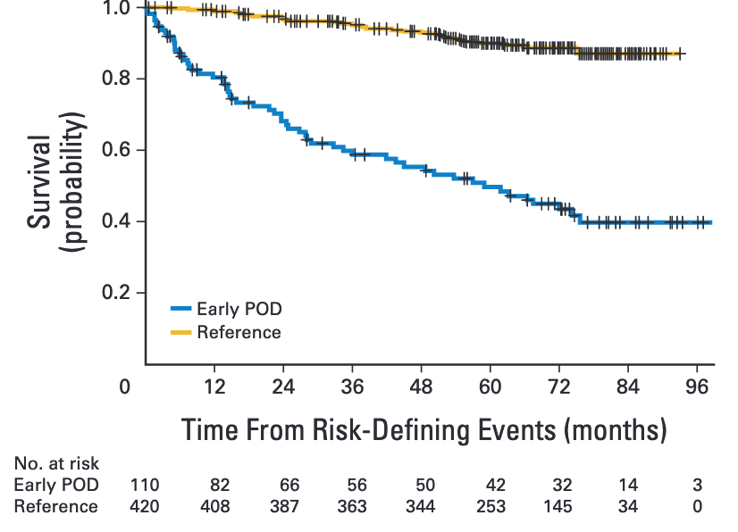
LymphoCare: Early Relapse of FL After R-CHOP Defines Patients at High Risk for Death
Patients with early progression of disease defined as those whose disease progressed within 24 months of diagnosis (POD24).
Casulo C et al. J Clin Oncol 2015;33:2516-22.

Slide 43
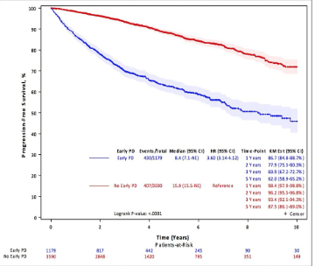
Validation of POD24 as an Early Clinical Endpoint of Poor Survival in FL
Pooled analysis of 13 randomized clinical trials of patients with FL in the pre- and post-rituximab eras (N = 5,453)
Predictors of early death/progression:
Male gender
Poor PS
High FLIPI score
Elevated baseline B2M
Casulo C et al. Proc ASH 2017; Abstract 412.

Slide 44
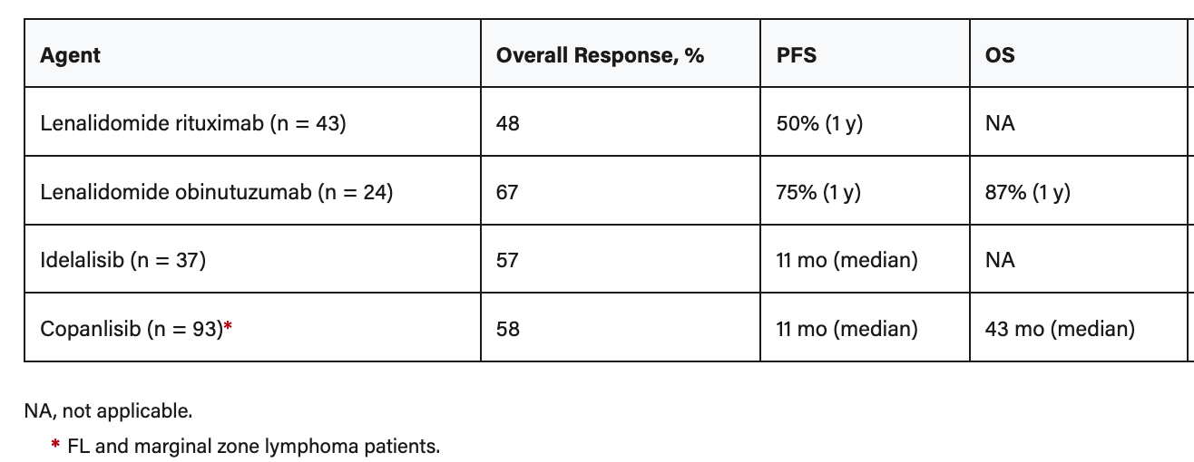
Efficacy of Targeted Therapy in Early Relapsing FL (POD24)
Casulo C and PM Barr. Blood 2019;133(14):1540-47.

Slide 45
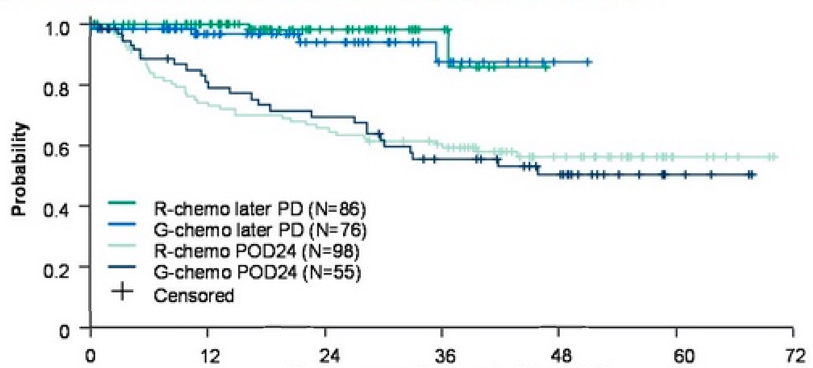
GALLIUM: Post-Progression Survival: POD24 versus Later Progressive Disease
At a median follow up of 76.5 months, 43% of POD24 patients had died
(G-chemo: 25, R-chemo: 41), while only 3.7% of patients with later PD had died
Post-Progression Survival (months)
Townsend W et al. Proc ASCO 2020; Abstract 8023.

Slide 46
S1608: Randomized phase II trial in early progressing or refractory FL
FL progressing within 2 years or refractory to bendamustine or CHOP based therapy
Stratify:
-maintenance therapy
-lack of CR / early POD
Mandatory specimen submission
Umbralisib
+
Obinutuzumab
Lenalidomide
+
Obinutuzumab
CHOP or Benda
+
Obinutuzumab
N =45
N =45
N =45
Primary clinical objective: CR by PET/CT
Primary translational objective: Validation of m7-FLIPI in this high-risk population
Courtesy of John P Leonard, MD
Notes:
REGISTRATION/RANDOMIZATION (1:1:1)
Stratify:
1) previous maintenance vs. no maintenance
2) refractory status (lack of CR after first line therapy vs. disease relapse within 2 years of first line therapy)
1 year of therapy, except CHOP (6 cycles)
Asa with lenalidomide, PJP ppx with TGR-1202

Slide 47
What are considerations in approaching a patient with recurrent FL?
Do they have transformation?
Do they need treatment (vs observation)?
Duration of prior response
Age and comorbidities
Prior therapies
Courtesy of John P Leonard, MD

Slide 48
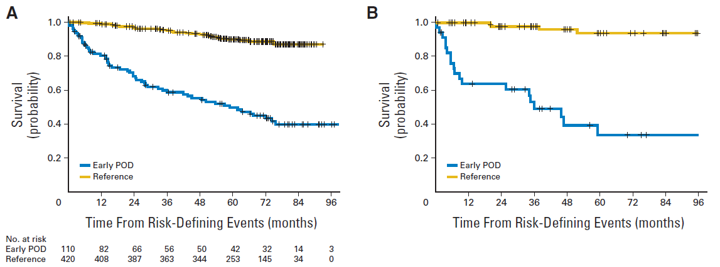
Early relapse of FL defines high risk group needing better therapies
Early progression of disease (POD)
Stage 2-4 FL
N = 588
R-CHOP
No POD within
2 years of diagnosis
Casulo C, et al. J Clin Oncol. 2015;33(23):2516-2522.
Courtesy of John P Leonard, MD

Slide 49
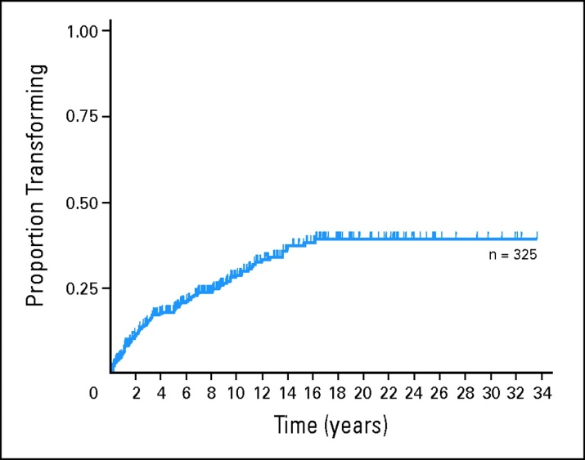
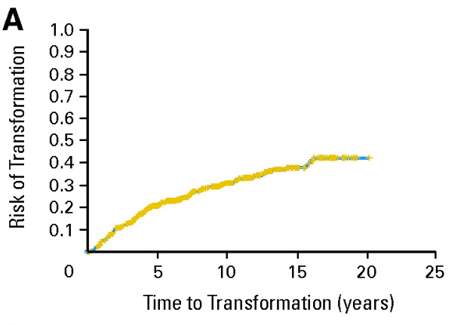
Incidence of transformed lymphoma
freedom from transformation
cumulative incidence of transformation
actuarial risk of transformation
31%
30%
28%
Lyon: n=220 St. Barts: n=325 Vancouver: n=600
Transformation rate ~ 30% at 10 years
Bastion Y et al. J Clin Oncol, 1997; Montoto S et al. J Clin Oncol 2007
Al-Tourah AJ et al. J Clin Oncol, 2008;
Courtesy of John P Leonard, MD

Slide 50
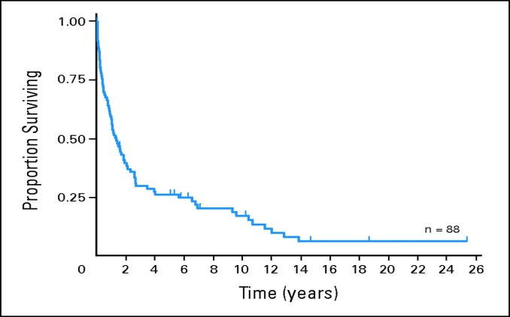
Historical outcomes for patients with TL
Median survivals range from 1-2 years
Lyon St. Barts Vancouver
Typically treated with DLBCL regimens and autoSCT
More favorable if “de novo transformation”
Al-Tourah AJ et al. J Clin Oncol, 2008; Montoto S et al. J Clin Oncol 2007; Bastion Y et al. J Clin Oncol, 1997
Courtesy of John P Leonard, MD

Slide 51
Histological transformation: Associated with poor prognosis
Patients with histological transformation have a shorter OS of 3.8 years
compared to 6.4 years for patients with FL histology at recurrence
OS from first progression according to transformation
Patients with progression from maintenance (ITT population)
1.0
0.8
0.6
Survival probability
0.4
0.2
No
Yes
Censored
Log rank p < 0.0001
0
0
1
2
3
4
5
6
7
OS from first recurrence (years)
No | 154 | 141 | 116 | 89 | 62 | 24 | 5 | 0
Yes | 40 | 29 | 21 | 15 | 12 | 9 | 0
Sarkozy C, et al. J Clin Oncol. 2016;34:2575-82.
Courtesy of John P Leonard, MD

Slide 52
Does PET identify histologic transformation?
YES:
In patients with known HT, 18 of 33 biopsies (55%) had SUV >10 and 16 (48%) >13
SUVmax in a transformed lymphoma PET scan ranged from 3.2 to 40, mean 15, median 12. 25 of 40 patients (63%) presented with SUVmax >10 and 20 (50%) >13
NO: In Gallium study, baseline SUVmax not correlated w/HT
Patient count
Patient count
Noy et al, Ann Oncol 2009, Barrington et al, Blood 2020
Courtesy of John P Leonard, MD

Slide 53
Is early progression after “non-chemotherapy” initial regimen so unfavorable?
174 patients from Alliance studies, 28% early progressors
Rituximab + antibody or lenalidomide (no chemotherapy)
5 year overall survival 90% vs 74%
Lansigan et al, Cancer Medicine 2018
Courtesy of John P Leonard, MD

Slide 54
Is early progression in the PET scan era so unfavorable?
FOLL05 R-Chemo treated patients
CT-staged early progressors 5 year OS 65%
PET-staged early progressors 5 year OS 74%
Batlevi et al, Eur J Cancer 2020
Courtesy of John P Leonard, MD

Slide 55
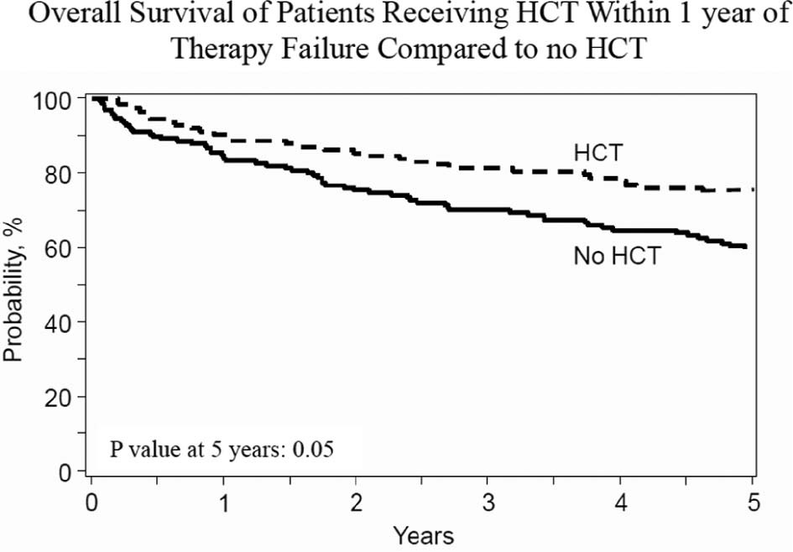
Autologous SCT in early progressor FL
Retrospective analysis NLCS/CIBMTR
349 early progressors on rituximab-based ICT (2 years)
Matched, half received auto-SCT, half did not
5-year OS 60 and 67% (p = 0.16)
(n = 123)
Improved OS when receiving auto-SCT within 1 year of treatment failure
5 yr OS with auto-HCT 73%
5 yr OS without auto-HCT 60%
p-value 0.05
Casulo C, et al. Biol Blood Marrow Transplant. 2018;24:1163-71.
Courtesy of John P Leonard, MD

Slide 56
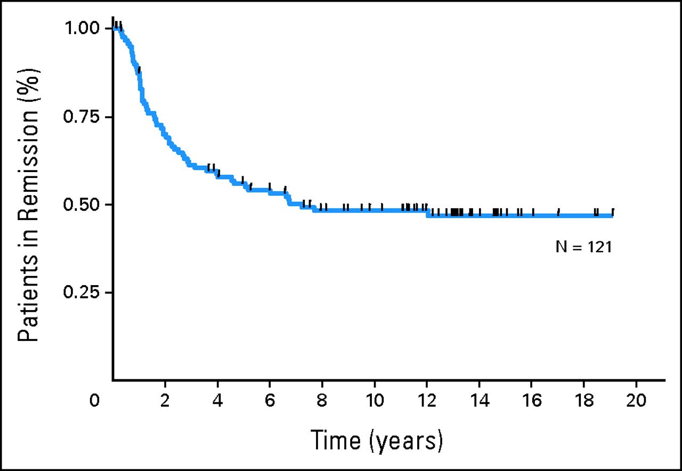
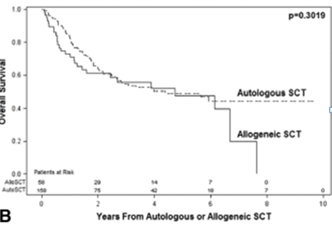
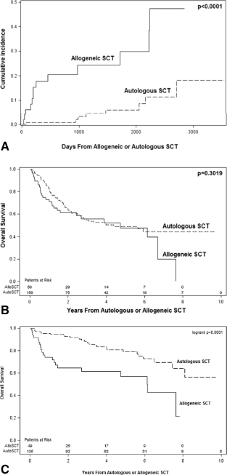
Stem cell transplantation in high-risk FL
Autologous SCT in second remission for FL
NCCN FL database: auto-SCT vs. allo-SCT
N= 121, median FU 13 yrs
Pre-rituximab era
60 patients have relapsed
15 deaths from MDS/AML
Apparent PFS plateau at 48%
3 yr FFS similar:
57% auto vs. 52% allo
OS: ASCT better
3 yr OS: 87% auto vs. 61% allo
Rohatiner AZ, et al. J Clin Oncol. 2007 ;25:2554-9. Evens AM, et al. Cancer. 2013;119:3662-71.
Courtesy of John P Leonard, MD

Slide 57
Key agents for recurrent FL
Rituximab retreatment
Novel anti-CD20s (generally in combination)
Radioimmunotherapy
Lenalidomide + rituximab
PI3K inhibitors
Novel agents
Auto/Allo SCT
Courtesy of John P Leonard, MD

Slide 58
AUGMENT: R² vs rituximab monotherapy in R/R iNHL
≤ 12 cycles or until PD, relapse, or intolerability
Relapsed/refractory
FL and MZL
(N = 358)
R-lenalidomide (R²)
Rituximab: 375 mg/m² d1, 8, 15, 22 of cycle 1; d1 of cycles 2-5
Lenalidomide: 20 mg/d*, d1-21/28 (12 cycles)
5-year follow-up for OS, SPMs, subsequent treatment, and histological transformations
1:1
*10 mg if CrCl between 30 to 59 mL/min.
R-placebo
Rituximab: 375 mg/m² d1, 8, 15, 22 of cycle 1; d1 of cycles 2-5
Placebo: matched capsules (12 cycles)
Stratification
Prior rituximab (yes vs no)
Time since last therapy (≤ 2 vs > 2 y)
Histology (FL vs MZL)
Key eligibility criteria
MZL or FL (grades 1-3a) in need of treatment
≥ 1 prior chemotherapy, immunotherapy or chemoimmunotherapy
Not rituximab refractory
Prophylactic anticoagulation / antiplatelet Rx recommended for at risk patients
Growth factor use was allowed per ASCO/ESMO guidelines^{1,2}
Primary endpoint: PFS by IRC (2007 IWG criteria w/o PET)
Leonard et al. JCO 2019
NCT01938001
1. Crawford et al. Ann Oncol. 2010;21 Suppl 5:248-251. 2. Smith et al. J Clin Oncol. 2015;33:3199-3212.
Courtesy of John P Leonard, MD

Slide 59
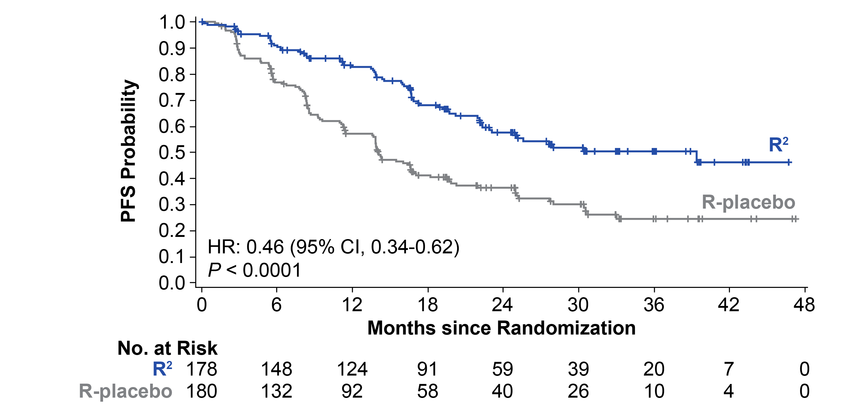
AUGMENT primary endpoint:
Progression-free survival (ITT, IRC)
PFS by IRC*
Median follow up: 28.3 months
Median PFS | R² (n = 178) | R-placebo (n = 180) | HR (95% CI) | P Value
By IRC, mo (95% CI) | 39.4 (22.9-NE) | 14.1 (11.4-16.7) | 0.46 (0.34-0.62) | < 0.0001
By investigator, mo (95% CI) | 25.3 (21.2-NE) | 14.3 (12.4-17.7) | 0.51 (0.38-0.69) | < 0.0001
*Censoring rules based on FDA guidance.
Data cutoff June 22, 2018.
Leonard et al. JCO 2019
Courtesy of John P Leonard, MD

Slide 60
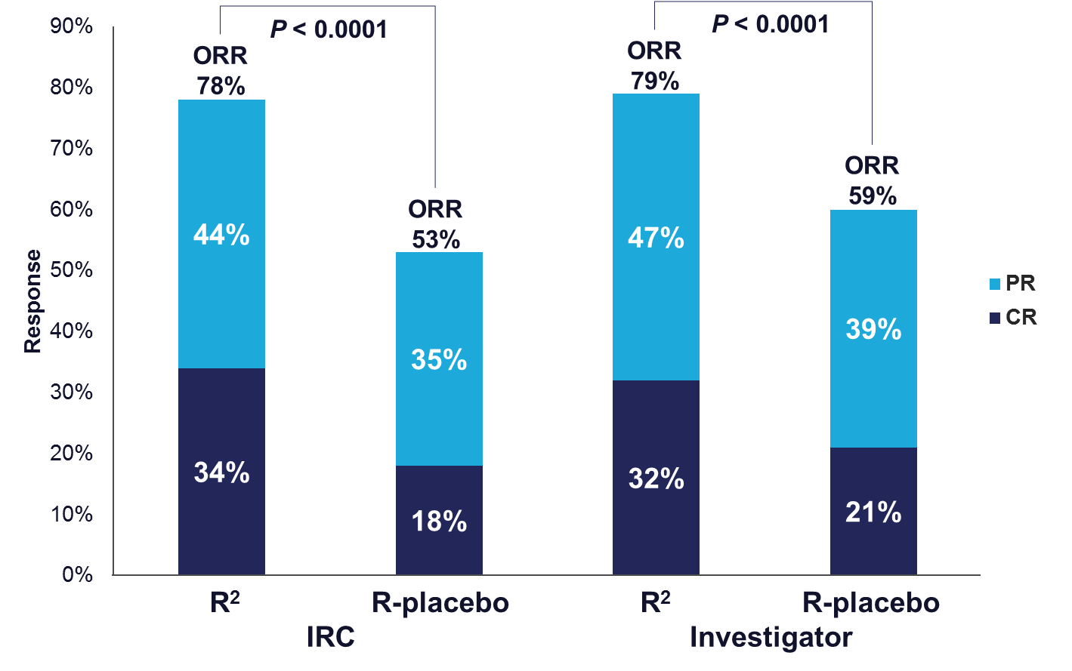
AUGMENT response data (ITT)
Median DOR was 36.6 mo (95% CI, 22.9-NR) for R² vs 21.7 mo (95% CI, 12.8-27.6) for R-placebo,
HR 0.53 (95% CI, 0.36-0.79), P = 0.0015
Response and progression outcomes were assessed by a blinded, independent central review using 2007 IWG criteria based on computed axial tomography/magnetic resonance imaging (CT/MRI) scans. Patients with gastric mucosa-associated lymphoid tissue lymphoma underwent endoscopy for response evaluation. Bone marrow biopsy was required to confirm CR.
Data cutoff June 22, 2018.
Leonard et al. JCO 2019
Courtesy of John P Leonard, MD

Slide 61





Follicular Lymphoma and EZH2
EZH2 an epigenetic regulator of gene expression and cell fate decisions¹
EZH2 is required for normal B-cell biology and germinal center formation²
  Oncogenic mutations in EZH2 suppress exit from germinal state and “lock” B cells in this state thereby transforming into a cancer²
EZH2 biology relevant in both mutant (MT) and wild-type (WT) EZH2 FL
  ~20% of patients with FL also have EZH2 gain of function mutations³
Germinal Center Reaction
EZH2
EZH2
EZH2
Dark Zone Light Zone
Plasma cell
(makes antibodies)
Naive B-cell
Apoptosis
Oncogenic
Mutations in EZH2
Memory B-cell (remembers pathogens)
X
Tazemetostat
Germinal Center Derived Neoplasms
Tazemetostat, an investigational, selective, oral inhibitor of EZH2 has shown antitumor activity in non-Hodgkin’s lymphoma patients with either MT or WT EZH2^{4,5}
1. Gan L, et al. Biomark Res. 2018;6(1):10; 2. Béguelin W, et al. Cancer Cell. 2013;23(5)677-692. 3. Bödör C, et al. Blood. 2013;122:3165-3168. 4. Italiano A, et al. Lancet Oncol. 2018;19(5):649-59; 5. Morschhauser F, et al. Hematol Oncol. 2017 Jun;35:24-5.
Courtesy of John P Leonard, MD

Slide 62
Phase 2 Multicenter Study of Tazemetostat, an EZH2 Inhibitor, in Patients with Relapsed or Refractory Follicular Lymphoma
Franck Morschhauser et al.
ASH 2019; Abstract 123.

Slide 63
Tazemetostat ORR in EZH2 mutant and wild type populations (recurrent FL)
 | EZH2 Mutant Cohort (n=45) |  | EZH2 WT Cohort (n=54)
Parameter | Investigator | IRC | Investigator | IRC
ORR, n (%) | 35 (78) | 31 (69) | 18 (33) | 19 (35)
CR, n (%) | 4 (9) | 6 (13) | 3 (6) | 2 (4)
PR, n (%) | 31 (69) | 25 (56) | 15 (28) | 17 (31)
SD, n (%) | 10 (22) | 13 (29) | 16 (30) | 18 (33)
PD, n (%) | 0 | 1 (2)^{c} | 16 (30) | 12 (22)
DOR, months, median (95% CI) | 8.3 (5.5–13.8) | 10.9 (7.2–NE) | 14.7 (7.6–NE) | 13.0 (5.6–NE)
Morschhauser, ICML 2019
Courtesy of John P Leonard, MD
Notes:
Table 14.2.1.1
Figure 2.7.3.2

Slide 64
FDA Granted Accelerated Approval to Tazemetostat for Follicular Lymphoma
Press Release – June 18, 2020
“The Food and Drug Administration granted accelerated approval to tazemetostat, an EZH2 inhibitor, for adult patients with relapsed or refractory (R/R) follicular lymphoma (FL) whose tumors are positive for an EZH2 mutation as detected by an FDA-approved test and who have received at least 2 prior systemic therapies, and for adult patients with R/R FL who have no satisfactory alternative treatment options.
Today, the FDA also approved the cobas EZH2 Mutation Test (Roche Molecular Systems, Inc.) as a companion diagnostic for tazemetostat.
Approval was based on two open-label, single-arm cohorts (Cohort 4 - EZH2 mutated FL and Cohort 5 - EZH2 wild-type FL) of a multi-center trial (Study E7438-G000-101, NCT01897571) in patients with histologically confirmed FL after at least 2 prior systemic therapies. EZH2 mutations were identified prospectively using formalin-fixed, paraffin-embedded tumor samples, which were centrally tested using the cobas® EZH2 Mutation Test. Patients received tazemetostat 800 mg orally twice daily until confirmed disease progression or unacceptable toxicity.”
www.fda.gov/drugs/fda-granted-accelerated-approval-tazemetostat-follicular-lymphoma

Slide 65
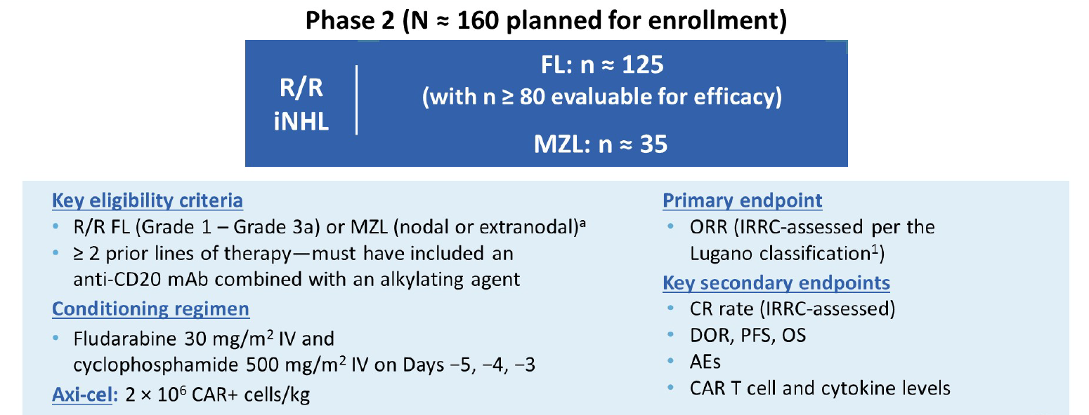
ZUMA-5: Phase II Trial of Axicabtagene Ciloleucel (Axi-Cel) in R/R Indolent NHL
Jacobsen C et al. Proc ASCO 2020; Abstract 8008.
Notes:
mFU for KM curves (28.3 mo)

Slide 66
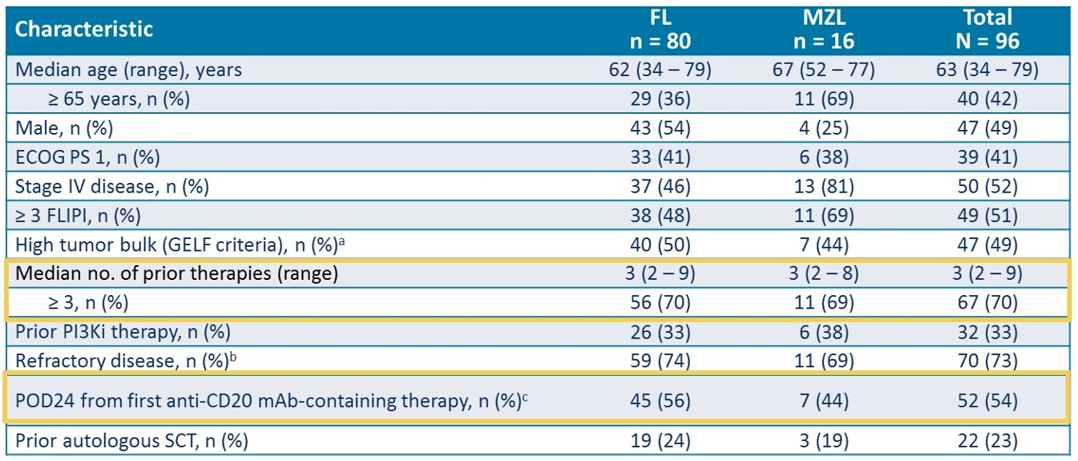
ZUMA-5: High Risk FL and MCL
>50% of efficacy evaluable patients had adverse prognostic features
Patel K. ASCO 2020 Discussant

Slide 67
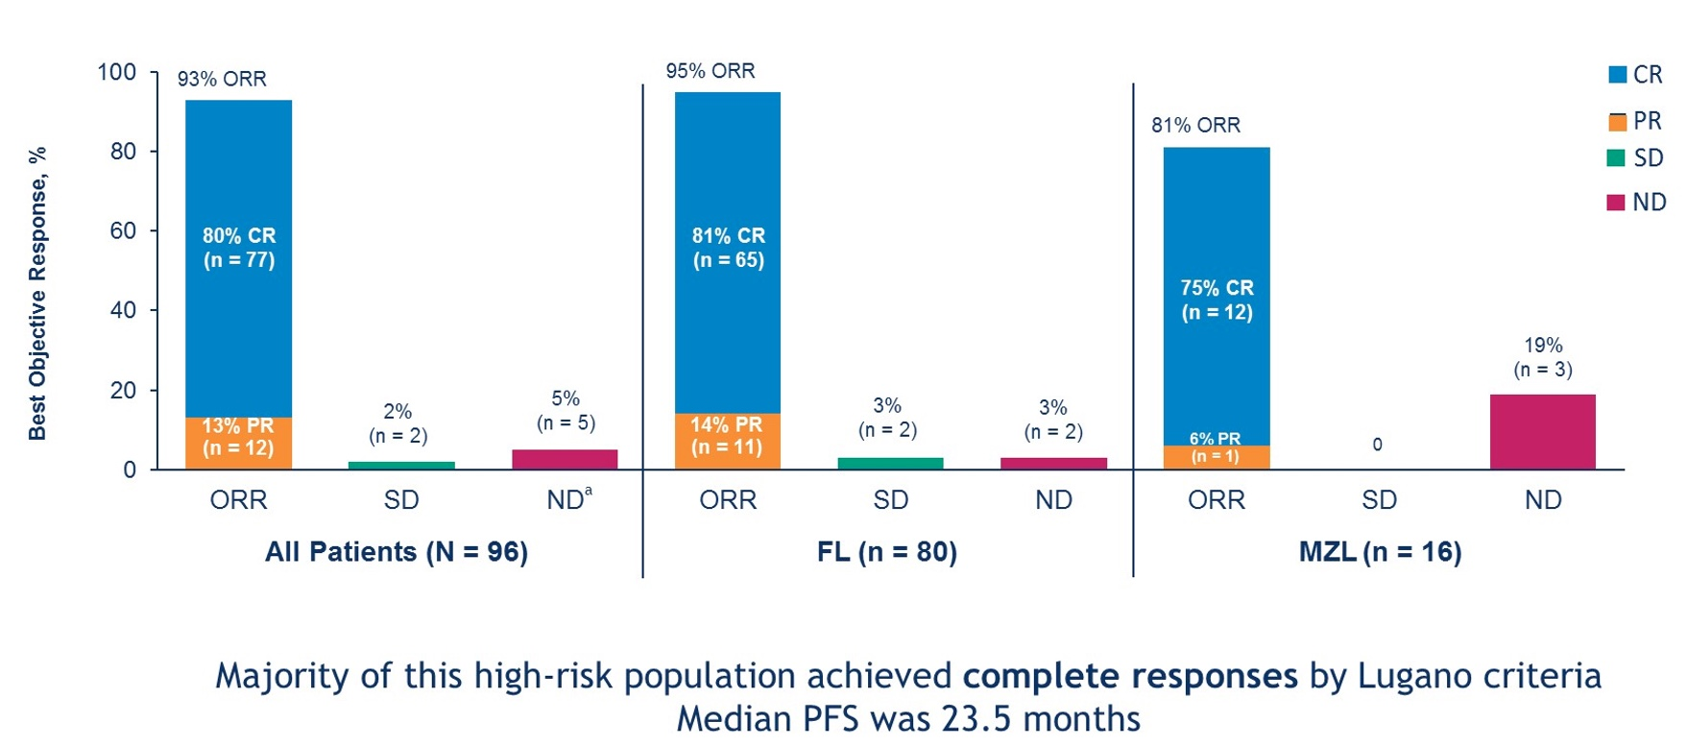
ZUMA-5: High ORR, High CR Rate
Patel K. ASCO 2020 Discussant

Slide 68
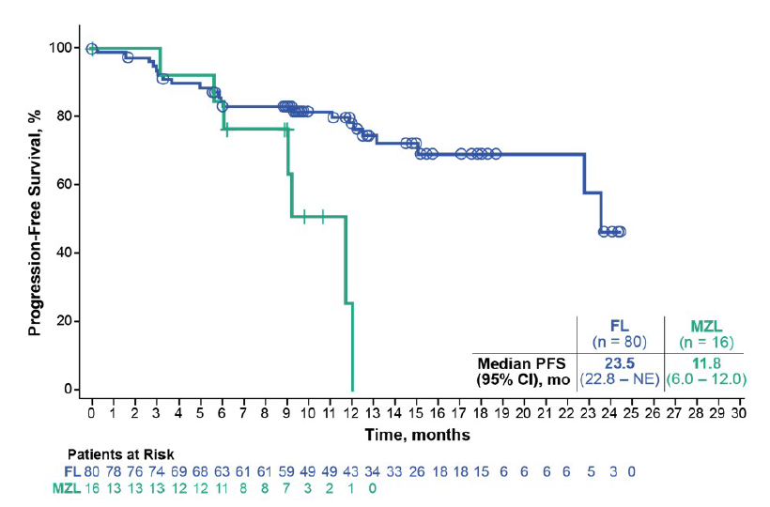
ZUMA-5: Key Efficacy Findings
ORR: FL 95% (CR 81%), MZL 81% (CR 75%)
Median PFS: FL 23.5 mo, MZL 1.8 mo
  68% of pts with FL had ongoing response
Median time to peak CAR T cell levels was 8 days (range 8-371 days)
  Anti-CD19 CAR T cells detectable at 18 mo in 13/15 (87%) pts with samples
PFS
Bartlett N et al. Proc ASCO 2020; Discussant.
Notes:
mFU for KM curves (28.3 mo)

Slide 69
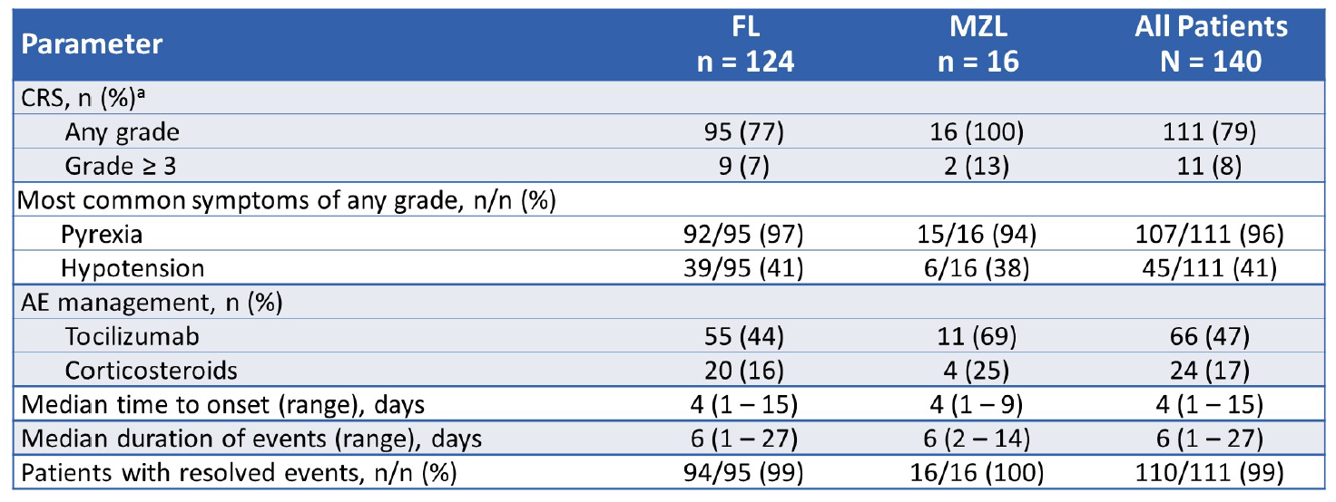
ZUMA-5: Cytokine Release Syndrome
Grade 4 CRS occurred in 1 pt with MZL; Grade 5 CRS occurred in 1 pt with FL
No pt had ongoing CRS as of the cutoff date
Jacobsen C et al. Proc ASCO 2020; Abstract 8008.
Notes:
mFU for KM curves (28.3 mo)

Slide 70
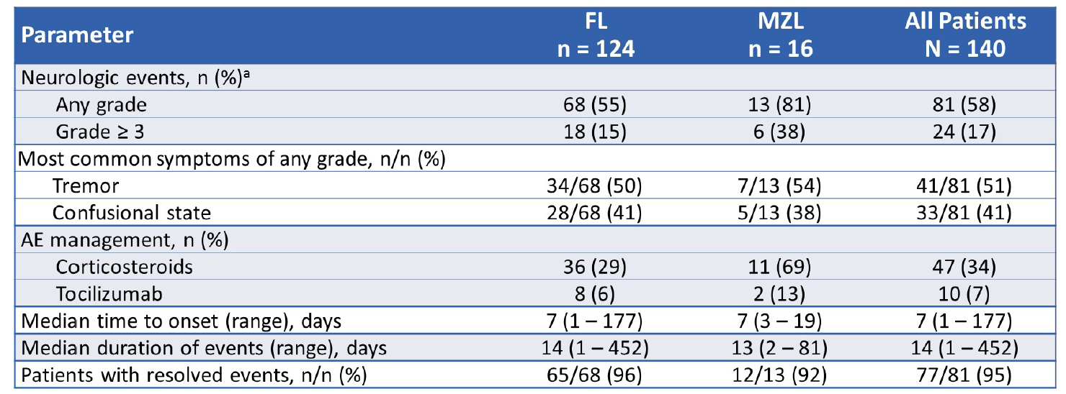
ZUMA-5: Neurologic Events
Grade 4 neurologic events were reported for 2 pts with FL; No Grade 5 neurologic events were reported
Events were ongoing at the cutoff date in 4 pts: Grade 1 and 2 paresthesia, Grade 1 attention disturbance, and Grade 1 memory impairment
Jacobsen C et al. Proc ASCO 2020; Abstract 8008.
Notes:
mFU for KM curves (28.3 mo)

Slide 71
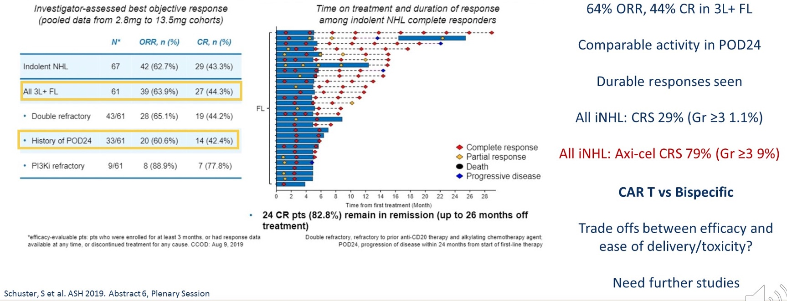
ASCO 2020 ZUMA-5 Discussant: Response Rates and Duration in Indolent NHL
Mosunetuzumab
Patel K. ASCO 2020 Discussant

Slide 72
ZUMA-5: Conclusions and Next Steps…
CAR T cell therapy active in FL and MZL
Duration of response “somewhat” disappointing for both histologies
  In DLBCL start seeing plateau at around 6-12 months
  No hint of plateau in DoR curves at 18 months
Are toxicity and expense worth it?
  Need longer follow-up to answer this question accurately
Many active agents approved (Len, PI3K inhibitors) and in clinical trials (bi-specific Ab, anti-CD47 Ab, MOR Ab, etc) for indolent lymphoma
  Unclear where CAR T will fit in the line-up
  Need to show superior OS compared to less toxic therapies
  Needs to “cure” pts
Bartlett N et al. Proc ASCO 2020; Discussant.
Notes:
mFU for KM curves (28.3 mo)

Slide 73
FDA Grants Breakthrough Therapy Designation for CD20xCD3 Bispecific Cancer Immunotherapy Mosunetuzumab Recognizing its Potential in Follicular Lymphoma
Press release – July 14, 2020
“The investigational CD20xCD3 T-cell engaging bispecific mosunetuzumab has been granted Breakthrough Therapy Designation (BTD) by the US Food and Drug Administration (FDA) for the treatment of adult patients with relapsed or refractory (R/R) follicular lymphoma who have received at least two prior systemic therapies.
This designation was granted based on encouraging efficacy results observed in the phase I/Ib GO29781 study [NCT02500407] investigating mosunetuzumab in R/R non-Hodgkin lymphoma (NHL). The safety profile of this T-cell engaging bispecific was consistent with its mechanism of action.”
https://www.roche.com/investors/updates/inv-update-2020-07-14b.htm

Slide 74
Mosunetuzumab Induces Complete Remissions in Poor Prognosis Non-Hodgkin Lymphoma Patients, Including Those Who Are Resistant to or Relapsing After Chimeric Antigen Receptor T-Cell (CAR-T) Therapies, and Is Active in Treatment through Multiple Lines
Stephen J Schuster et al.
ASH 2019; Abstract 6. (Plenary)

Slide 75
GO2971: Responses in Indolent NHL
100
0.4/1.0/2.8 mg
0.8/2.0/4.2 mg
1.0/2.0/6.0 mg
0.8/2.0/6.0 mg
1.0/2.0/9.0 mg
1.0/2.0/13.5 mg
80
ORR: 62.7% (42/67)
CR: 43.3% (29/67)
60
40
Best Change in SPD (%)
20
0
-20
-40
-60
-80
-100
Schuster SJ et al. ASH 2019; Abstract 6.

Slide 76
GO2971 Adverse Events
Adverse Events, n (%) | N = 270
Treatment-related AE | 190 (70.4)
Treatment-related grade 3-5 AE | 92 (34.1)
Treatment-related serious AE | 51 (18.9)
Fatal AE not including neoplasm progression | 5* (1.9)
Discontinuation due to AE | 7 (2.6)
Dose interruption/modification due to AE | 54 (20.0)
Common Adverse Events
CRS | 78 (28.9)
Neutropenia | 65 (24.1)
Fatigue | 55 (20.4)
Hypophosphatemia | 52 (19.3)
Diarrhea | 45 (16.7)
Pyrexia | 44 (16.3)
Schuster SJ et al. ASH 2019; Abstract 6.

Slide 77
Conclusions
Chemotherapy/SCT approaches are standard for appropriate patients with recurrent FL with transformation
Numerous other options now available for non-transformed recurrent FL patients
  Quality of life and patient preferences are key
Better tools for patient selection are needed
CAR-T of interest but needs followup and comparative studies
Courtesy of John P Leonard, MD

Slide 78
Regulatory and reimbursement issues aside, what is your usual second-line therapy for a 65-year-old patient with FL who achieves a complete response to BR followed by 2 years of rituximab maintenance but then experiences disease relapse 4 years later?
Obinutuzumab/bendamustine
Rituximab/lenalidomide
Re-treatment with BR
R-CHOP
Chemotherapy → autologous transplant
Idelalisib/rituximab
Copanlisib
Idelalisib
Survey of 50 US-based medical oncologists, June 2020

Slide 79
What is your usual third-line treatment for a patient with FL who receives first-line BR, second-line lenalidomide/rituximab and then develops disease progression?
Idelalisib
Copanlisib
Duvelisib
R-CHOP
Obinutuzumab +/- chemotherapy
CAR T-cell therapy
Allogeneic bone marrow transplant
Survey of 50 US-based medical oncologists, June 2020

Slide 80
Oncology Today: Follicular Lymphoma
Module 1: Current Management of Newly Diagnosed FL
Observation versus rituximab monotherapy
GALLIUM – Obinutuzumab/chemotherapy followed by obinutuzumab maintenance
RELEVANCE – Lenalidomide/rituximab (R²) in the up-front setting
Module 2: Selection and Sequencing of Therapies for Relapsed/Refractory (R/R) FL
Management of early progression of disease (POD24)
AUGMENT – R² for patients with R/R disease
Tazemetostat – Recent FDA approval of EZH2 inhibitor
ZUMA-5 – CAR T-cell therapy axicabtagene ciloleucel (axi-cel) in R/R indolent NHL
Mosunetuzumab – Anti-CD20 and anti-CD3 bispecific antibody
Module 3: Integration of PI3 Kinase Inhibition into the Management of FL
Similarities and differences between copanlisib, duvelisib and idelalisib
Data supporting FDA approval of these agents, including DYNAMO

Slide 81
Case Presentation — Dr Leonard: 85-year-old woman with follicular lymphoma, diffuse LAN and anemia
Single-agent rituximab
  Responded for 10 months → PD with symptoms
Bendamustine/obinutuzumab with 14-month response → PD
Repeat biopsy showing FL
Symptomatic cervical LAN but diffuse disease elsewhere
Now starting idelalisib

Slide 82
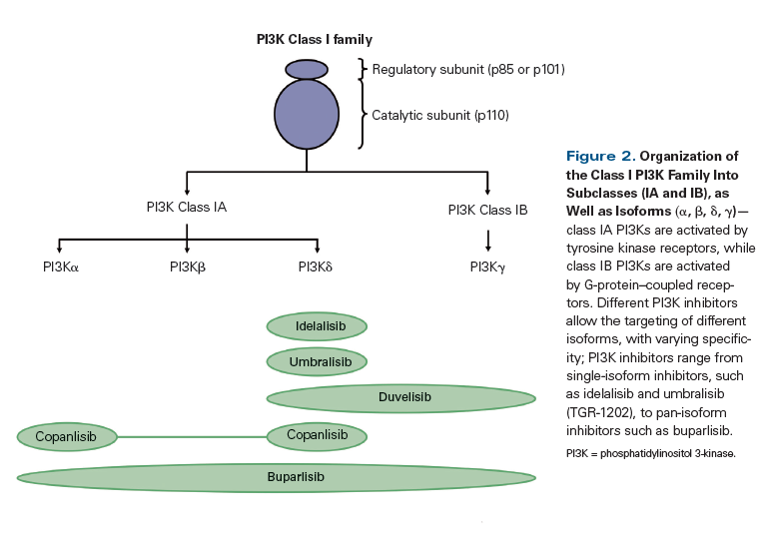
Targeting
Phosphatidylinositol (PI3) Kinases
Nearly universally expressed family of enzymes downstream of B-cell receptor
Courtesy of Carla Casulo, MD
Burger and Weistner Nat Rev Can, 2018; 18: 148-67

Slide 83
Approved PI3 Kinase Inhibitors in Lymphoma/CLL
Idelalisib – δ inhibitor, double refractory, ORR 57%, CR 6%, PFS 11 months.
Copanlisib – pan class 1; α, δ inhibition, ORR 59%; CR 14%, PFS 11 months
Duvelisib – γ, δ inhibitor, ORR 42%, median PFS 9.5 months
Gopal et al. NEJM 2014 370: 1008-1018; Dreyling et al, J Clin Oncol, 2017 Sep 1;28 (9) 2169-2178; Flinn et al. J Clin Oncol 2019 37: 1-11
Courtesy of Carla Casulo, MD

Slide 84
Approved PI3K Inhibitors for FL: Indication and Dosing
 | Idelalisib¹ | Copanlisib² | Duvelisib³
Mechanism of action | Selective PI3Kδ inhibitor | Dual inhibitor of PI3Kδ,α | Dual inhibitor of PI3Kδ,γ
Indication | Relapsed FL after at least 2 prior systemic therapies | Relapsed FL after at least 2 prior systemic therapies | R/R FL after at least 2 prior systemic therapies
Dosing | 150 mg orally, twice daily | 60 mg as a 1-hour IV infusion weekly (3 weeks on, 1 week off) | 25 mg orally, twice daily
¹ Gopal AK et al. N Engl J Med 2014;370(11):1008-18; Idelalisib package insert, January 2018.
² Dreyling M et al. J Clin Oncol 2017;35(35):3898-905; Copanlisib package insert, September 2017.
³ Flinn IW et al. J Clin Oncol 2019;[Online ahead of print]; Zinzani PL et al. Proc EHA 2017;Abstract S777; Duvelisib package insert, September 2018.

Slide 85
Comparison of FDA-Approved PI3 Kinase Inhibitors
Agent | Idelalisib | Copanlisib | Duvelisib
Route | Oral- BID | IV | Oral- BID
Indication | Relapsed CLL/SLL, FL | Relapsed FL | Relapsed CLL/SLL, FL
Toxicities | Diarrhea – 14% Pneumonitis – 4% Cytopenias – 28% Hepatotoxicity – 18% Infections – 21% | Hyperglycemia – 41% Hypertension – 26% Cytopenias – 24% Rash – 3% Diarrhea Hepatotoxicity | Diarrhea – 18% Cytopenias – 24-42% Rash – 5% Pneumonitis – 5% Hepatotoxicity – 5%
Efficacy | FL: ORR – 54% CR – 8% CLL: ORR – 58% | ORR – 59% CR – 20% | ORR 78% (CLL/SL), 42% (FL)
Prophylaxis | PJP prophylaxis CMV monitoring or prophylaxis | PJP prophylaxis CMV monitoring or prophylaxis | PJP prophylaxis CMV monitoring or prophylaxis

Slide 86
Idelalisib: selective PI3K inhibitor in double refractory iNHL
Single-arm phase 2 study (n = 125)
Rituximab + alkylator-refractory iNHL
Idelalisib 150 mg b.i.d. continuously
Therapy maintained until progression
Long-term
follow-up
75
Tumour response
50
ORR 57%
CR 6%
25
0
FL (n = 72)
SLL (n = 28)
MZL (n = 15)
LPL/WM (n = 10)
SPD of measured lymph nodes (best % change from baseline)
−25
−50
−75
−100
2 patients had no baseline evaluation
1 patient had disease progression
on the basis of lymph node biopsy,
no baseline evaluation
Individual patients (n = 125)
Gopal AJ, et al. N Engl J Med. 2014;370:1008-18.
Courtesy of John P Leonard, MD

Slide 87
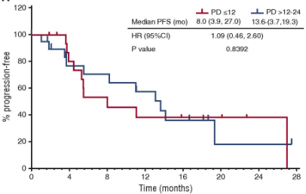
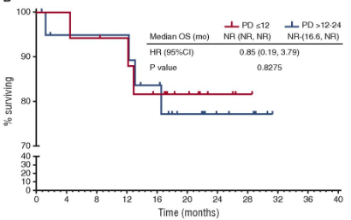
Idelalisib in “early progressor” FL
Retrospective analysis of 37 FL patients with progression
within 24 months of initial chemoimmunotherapy
ORR 57%, CR 13%
PFS
OS
Gopal AK, et al Blood. 2017;129:3037-9.
Courtesy of John P Leonard, MD

Slide 88
CHRONOS-1: Copanlisib in Patients With Relapsed, Indolent or Aggressive NHL
Phase 2 study 142 patients with relapsed or refractory indolent lymphoma after ≥2 lines of therapy
Copanlisib 60 mg intravenously on days 1, 8, and 15 of a 28-
day cycle.
Primary end point was ORR; secondary end points included duration of response, PFS, OS. In addition, safety and gene expression were evaluated
Courtesy of John P Leonard, MD
Notes:
In this phase II study, 142 patients with relapsed or refractory indolent lymphoma after two or more
lines of therapy were enrolled to receive copanlisib 60 mg intravenously on days 1, 8, and 15 of a 28-
day cycle. The primary end point was objective response rate; secondary end points included
duration of response, progression-free survival, and overall survival. In addition, safety and gene
expression were evaluated.

Slide 89
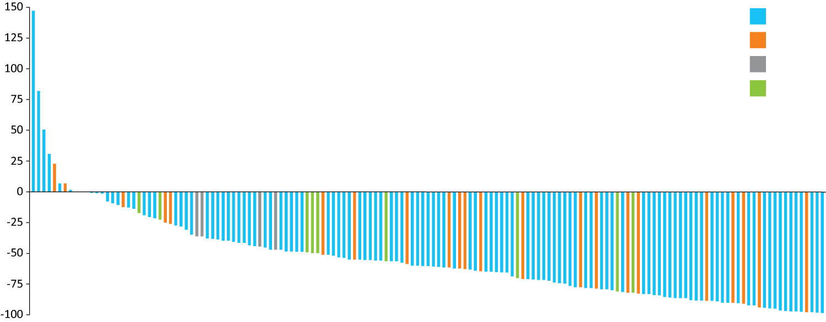
Combined Analysis of Phase I and II Studies of Copanlisib in R/R Indolent B-Cell Lymphoma
 | FL (N = 127)
Objective response rate | 58.3%
Complete response | 18.1%
Median duration of response | 12.9 mo
FL
MZL
LPL/WM
SLL
Best change in target lesion size from baseline (%)
Individual patients (n = 152)
FL = follicular lymphoma; MZL = marginal zone lymphoma; LPL/WM = lymphoplasmacytic lymphoma/Waldenström macroglobulinemia; SLL = small lymphocytic lymphoma
Zinzani PL et al. Proc ESMO 2018;Abstract 1006O.

Slide 90
Efficacy of Copanlisib in Patients with FL with Early Relapse (<24 months)
Response | Copanlisib (n = 102)
 | POD <24 mo (n = 68) | POD >24 mo (n = 34)
Objective response | 60.3% | 58.8%
Complete response | 22.1% | 17.7%
Partial response | 38.2% | 41.2%
Median duration of response | 14.9 mo | 14.1 mo
Median PFS | 11.3 mo | 17.6 mo
POD = progression of disease
Santoro A et al. Proc ASH 2018;Abstract 395.

Slide 91
Duvelisib in recurrent indolent NHL
(Oral PI3K delta/gamma inhibitor)
Indolent lymphoma patients “double refractory” to rituximab and chemotherapy/radioimmunotherapy
25 mg po BID continuous dosing (w/PCP prophylaxis)
129 subjects, 83 with FL, median age 65, median 3 prior rx
ORR 46%, median duration 9.9 months
Principal toxicities cytopenias, diarrhea
Led to FDA approval
Zinzani et al, ICML 2017
Courtesy of John P Leonard, MD

Slide 92
Clinical Investigator Perspectives on the Current and Future Management of Multiple Myeloma
A Meet The Professor Series
Shaji K Kumar, MD
Mark and Judy Mullins Professor of Hematological Malignancies
Consultant, Division of Hematology
Professor of Medicine
Mayo Clinic
Rochester, Minnesota

