Slide 1
Novel Induction/Maintenance Strategies in Acute Myeloid Leukemia
Jeffrey Lancet, MD
Chair, Dept of Malignant Hematology
Moffitt Cancer Center
Tampa, FL

Slide 2
Secondary AML: What is it?
Composite definition alluding to AML:
- Arising from prior myeloid malignancy
- Following cytotoxic chemotherapy or radiation therapy
with prior MDS
with MDS-related cytogenetics
with multilineage dysplasia
AML with MRC*
De-novo
Secondary
AML from MPN
t-AML
* 2016 WHO criteria

Slide 3
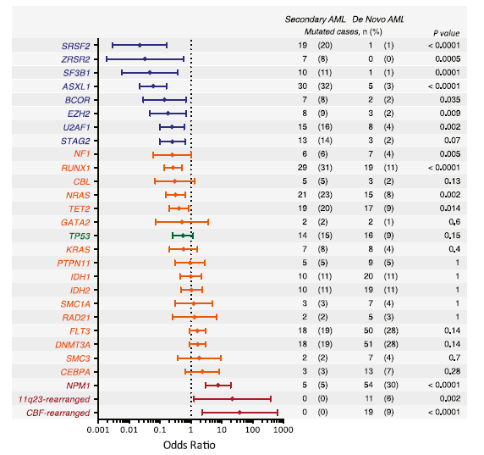
Mutations Define AML Ontogeny
Lindsley, et al. Blood 2015; 125:1367

Slide 4
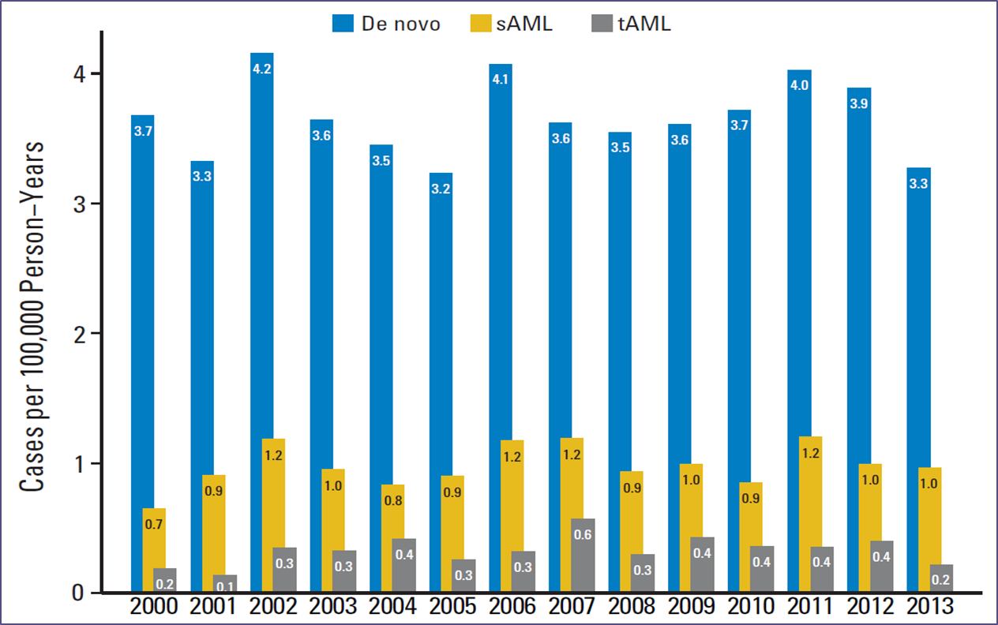
Epidemiology of Secondary AML
Granfeldt Østgård et al., JCO, 2015

Slide 5
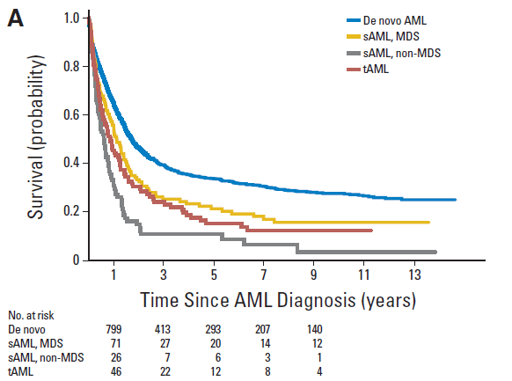
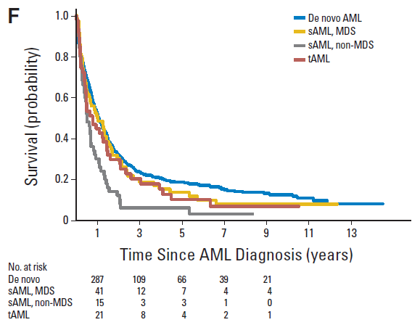
Clinical Outcomes in Secondary AML
All patients
Age ≥ 60
Granfeldt Østgård et al., JCO, 2015

Slide 6
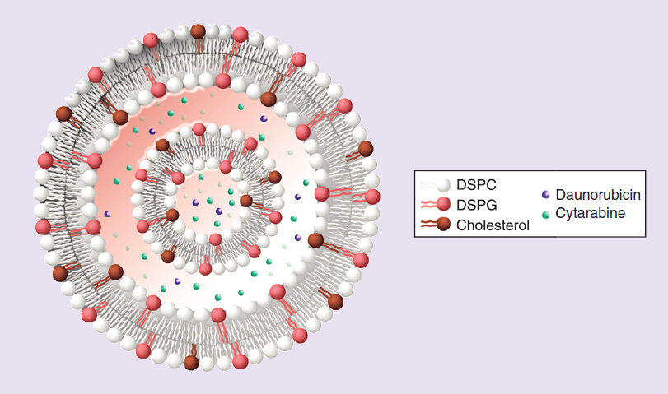
CPX-351
100 nm bilamellar liposomes
5:1 molar ratio of cytarabine to daunorubicin
1 unit = 1.0 mg cytarabine plus 0.44 mg daunorubicin
Tolcher and Mayer. Future Oncol 2018; 14:1317
Notes:
So with that introduction, here is the drug product you’ve all been waiting for: CPX-351 – Liposomally encapsulated cytarabine and daunorubicin in a fixed molar ratio of 5:1. I’ll point out that this is a small liposome of about 100 nm. Better bioavailability and longer circulating half life.

Slide 7
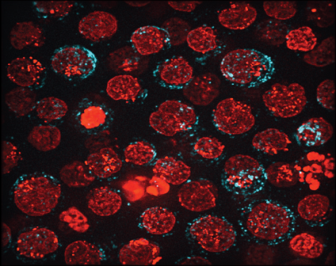
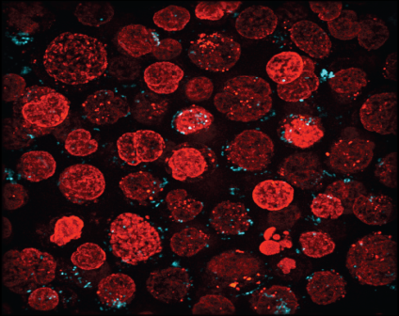
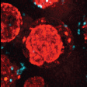
CPX-351 uptake in leukemic cells
30 min 24 hr
Lim, et al. Leuk Res 2010
Notes:
Shown from preclinical modeling using Cyan fluorescent lipid label shows that liposomes are taken up whole into vacuoles inside leukemia cells, assuring delivery of the 2 drugs at the synergistic molar ratio. Subsequent intracellular release of daunorubicin leads to nuclear drug accumulation (red fluorescence)

Slide 8
CPX-351 maintains synergistic molar ratio and prolonged plasma exposure
cytarabine:daunorubicin after the day 5 at 24 units/m2
10
9
8
Fixed molar ratio maintained
For 24 hours after final dose
7
6
1001
5
2002
4
3004
3
2
1
0
4
8
12
16
20
24
TIME (hr)
Cytarabine t _{½} = 31 hours
Daunorubicin t _{½} = 22 hours
Mean plasma after day 5 infusion at 24 units/m2
D & A detectable 7 days at
completion of infusion
Feldman, et al. J Clin Oncol 2011; 29:979
Feldman, et al. J Clin Oncol 2011
Notes:
We then proceeded to a phase 1 FIH clinical trial, and found some really intriguing. PK results, showing prolonged maintenance of the ratio within the plasma and prolonged overall drug exposure, up to 7 days. Clinically, the drug induced remissions in several patients with relapsed or refractory AML.

Slide 9
Randomized phase 2 trial of CPX-351 vs 7+3 induction for older patients with AML
CPX-351 (n=84)
100 units/m² IV days 1, 3, 5
  Up to 2 inductions and 2 consolidations
Eligibility
Newly diagnosed
Ages 60- 75
Able to tolerate intensive therapy
PS 0-2
7+3 (n=41)
Daunorubicin 60 mg/m²
Cytarabine 100 mg/m²
Primary Endpoint:
CR+CR_{i} rate
Notes:
Led to interest in developing a randomized phase 2 in order to better delineate efficacy in a hard-to-treat patient population.

Slide 10
Randomized phase 2 trial of CPX-351 vs 7+3 induction for older patients with AML: Clinical Results
 | Overall (n=126) |  | Secondary (n=52)
 | CPX-351 (n=84) | 7+3 (n=41) | CPX-351 (n=33) | 7+3 (n=19)
MLFS Rate | 84.5% | 66.7% | 81.8% | 64.7%
CR Rate | 48.8% | 48.8% | 36.4% | 31.6%
CRi Rate | 17.9% | 2.4% | 21.2% | 0%
Response Rate | 66.7% | 51.2% | 57.5% | 31.6%
60-Day Mortality | 4.7% | 14.6% | 6.1% | 31.6%
EFS (median) | 6.5 months | 2.0 months | 4.5 months | 1.3 months
OS (median) | 14.7 months | 12.9 months | 12.1 months | 6.1 months
Lancet, et al. Blood 2014
Notes:
While we did observe a superior overall response rate with CPX-351 compared to 7+3, the most intriguing results were in patients with secondary AML, where the ORR was 25% higher and survival doubled. Hypothesizing that this group could be most amenable to benefit…

Slide 11
Study 301: Randomized phase 3 trial of CPX-351 vs 7+3 in older pts with secondary AML
CPX-351 (n=135)
100 units/m² IV days 1, 3, 5
  Up to 2 inductions and 2 consolidations
Eligibility
Newly diagnosed
Secondary AML
  From MDS
  t-AML
Ages 60- 75
Able to tolerate intensive therapy
PS 0-2
7+3 (n=135)
Daunorubicin 60 mg/m²
Cytarabine 100 mg/m²
Primary Endpoint:
Overall survival
Notes:
We then designed a large phase 3 study to test this hypothesis in patients with sAML. Early results showed a CR rate of 48% vs 33%, and survival data expected to be released sometime in Q1 2016.

Slide 12
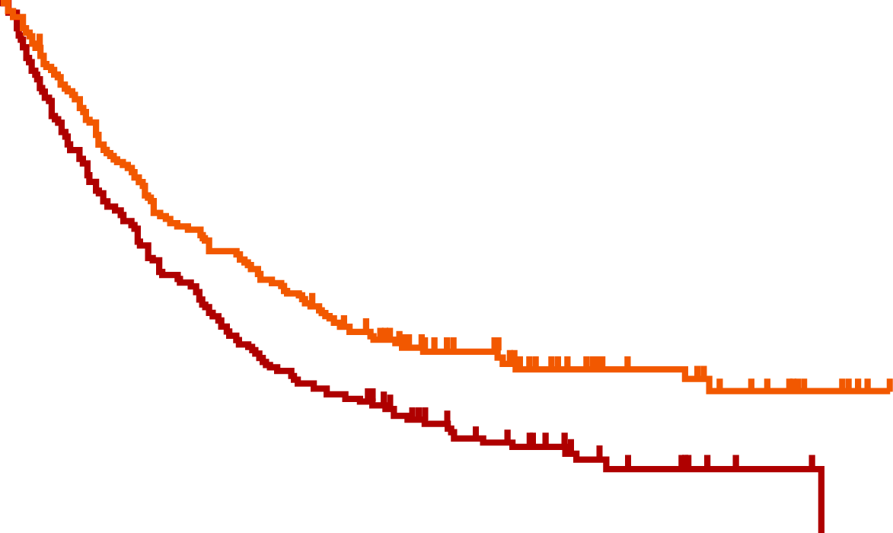
Study 301: Overall Survival
Kaplan-Meier Curve for Overall Survival
ITT Analysis Population
100
Events/N
Median Surv. (95% CI)
80
CPX-351
7+3
104/153
132/156
9.56 (6.60, 11.86)
5.95 (4.99, 7.75)
60
Hazard Ratio = 0.69
p-value = 0.005
Survival (%)
40
20
0
0
3
6
9
12
15
18
21
24
27
30
33
36
Months from Randomization
153
156
122
110
CPX-351
7+3
92
77
79
56
62
43
46
31
34
20
21
12
16
7
11
3
5
2
1
0
Lancet, et al. J Clin Oncol 2018; 36:2684

Slide 13
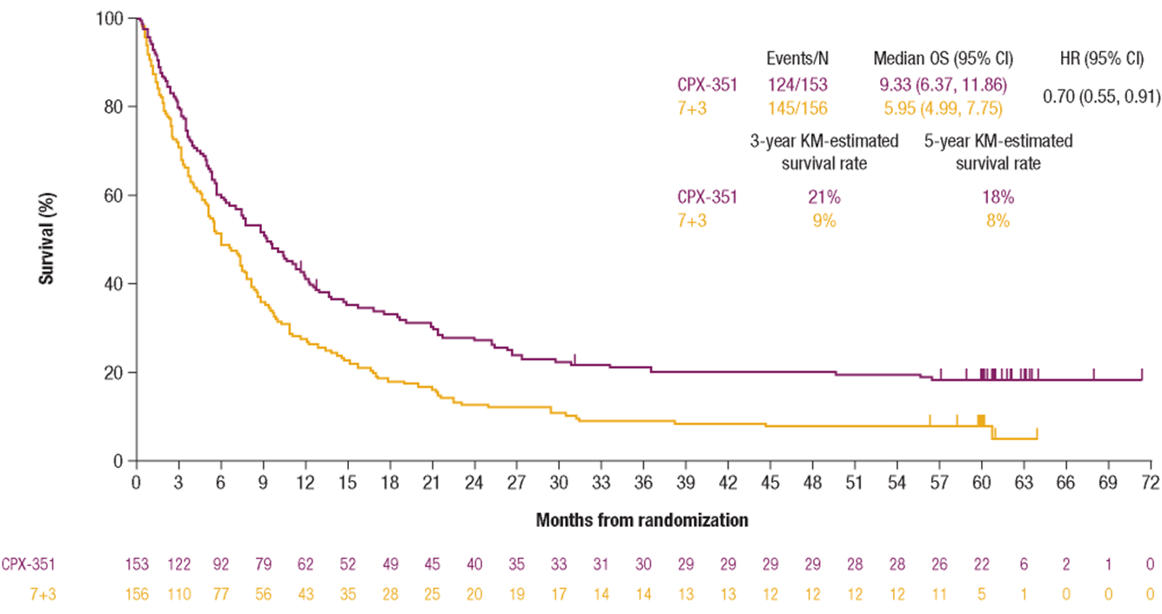
Study 301: Five-Year Followup
Lancet, et al. ASCO 2020

Slide 14
Study 301: Response rates
p = 0.016
p = 0.040
Patients (%)
Odds Ratio (95% Conf. Int.)
1.69 (1.03, 2.78)
1.77 (1.11, 2.81)
Lancet, et al. J Clin Oncol 2018; 36:2684

Slide 15
Study 301: Count recovery for patients achieving CR or CRi
 | ANC ≥ 500/uL |  | Platelets ≥ 50,000/uL
 | CPX-351 | 7 + 3 | CPX-351 | 7 + 3
Patients Receiving 1 Induction | n=58 | n=34 | n=58 | n=34
Median (days) | 35 | 29 | 36.5 | 29
Patients Receiving 2 Inductions | n=15 | n=18 | n=15 | n=18
Median (days) | 35 | 28 | 35 | 24
Lancet, et al. J Clin Oncol 2018; 36:2684

Slide 16
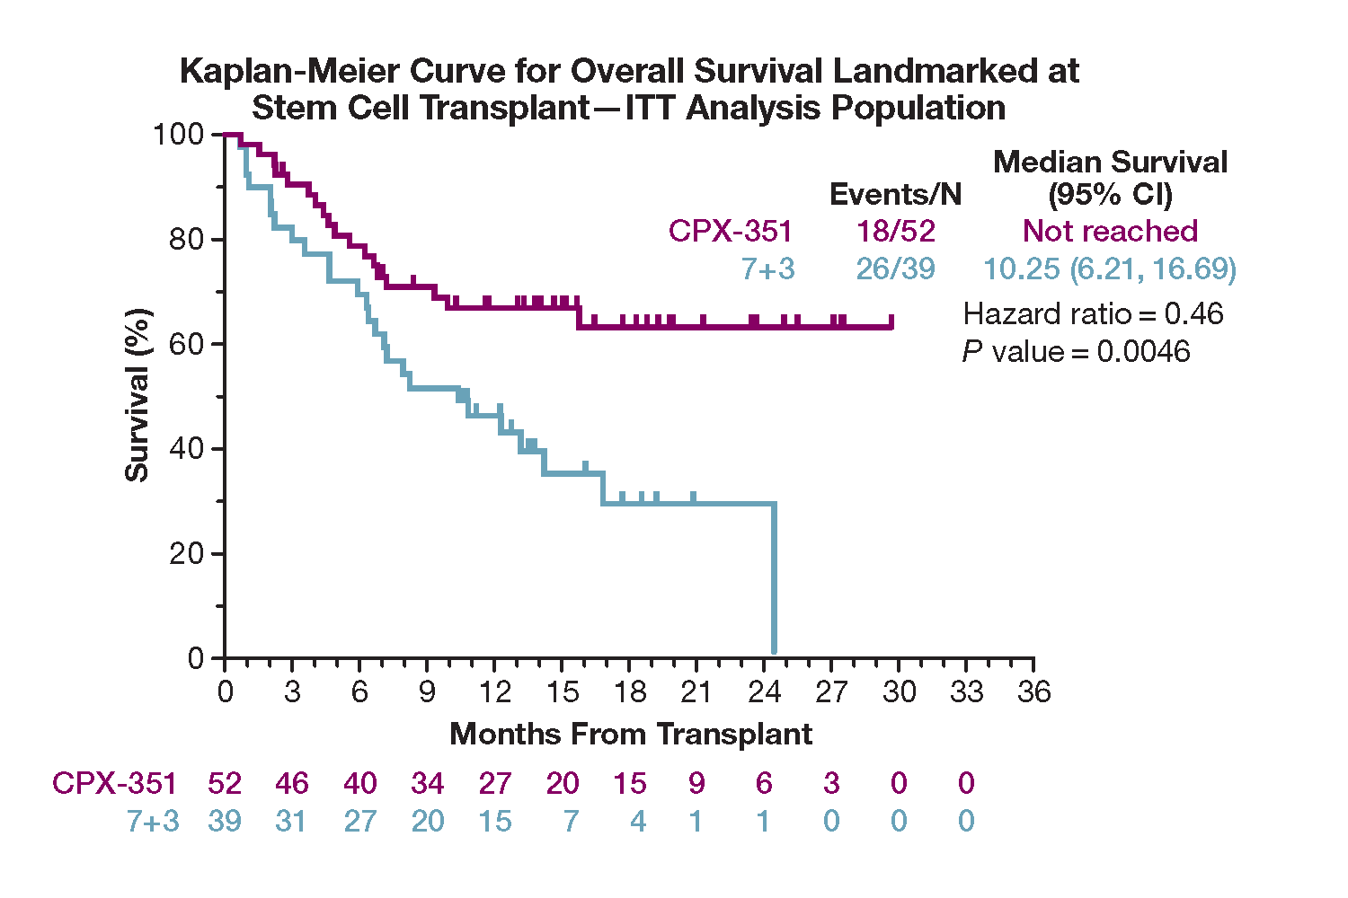
Study 301: Survival Landmarked from Time of Transplant
  CPX-351 median OS not reached vs 10.25 months for 7+3
  HR of 0.46 favoring CPX-351 (P=0.0046)
  Cox proportional hazards HR, including transplant as a time-dependent covariate, was 0.51 (95% CI, 0.35–0.75; P=0.0007), favoring CPX-351
Lancet, et al. J Clin Oncol 2018; 36:2684
16

Slide 17
Selected Ongoing Combination Trials with CPX-351
+ Quizartinib in FLT-ITD mutated AML
+ Glasdegib in AML with MRC or t-AML
+ Gemtuzumab Ozogamicin in relapsed/refractory AML
+ Ivosidenib/Enasidenib in IDH1/2 mutated AML
+ Venetoclax in new AML

Slide 18
Maintenance Therapies in AML
While remissions are achievable in AML, a majority of patients will experience relapse, in particular older patients and those with adverse molecular profile
While potentially curative, allogeneic stem cell transplant is not suitable for many patients, especially older adults
Effective AML maintenance therapy strategies are needed to reduce relapse rates and prolong survival, without causing significant toxicity or reducing QoL
  Until recently, no AML maintenance therapy has demonstrated improvement in OS¹⁻³.
1. Buyse. Blood. 2011;117:7007. 2. Goldstone. Blood. 2001;98:1302. 3. Boumber. Leukemia. 2012;26:2428.

Slide 19
CC-486
Oral formulation of Azacitidine (AZA)
Potential for extended dosing schedule
  parenteral AZA with short plasma half-life¹
  AZA incorporation into DNA is S-phase restricted²
  extending AZA exposure could increase leukemic cell exposure to AZA
Early studies demonstrated tolerability of CC-486 in 14d and 21d schedules³
Efficacy and feasability in earlier studies makes CC-486 an attractive option for consideration of maintenance therapy
1. Garcia-Manero, et al. J Clin Oncol 2011; 29:2521. 2. Li, et al. Cancer Res 1970; 30:2770. 3. Garcia-Manero, et al. Leukemia 2016; 30:889

Slide 20
Phase III QUAZAR AML-001: CC-486 as Maintenance Therapy in First-Remission AML—Study Design
Multicenter, randomized, placebo-controlled, double-blind, phase III study
Primary endpoint: overall survival
Key secondary endpoints: relapse-free survival, health-related QoL, and safety
Stratified by age, prior MDS/CMML, cytogenetic risk, and consolidation
Patients aged ≥ 55 yrs with de novo or secondary AML in first CR/CRi with IC; ECOG PS 0-3; intermediate or poor risk cytogenetics; ineligible for HSCT; adequate BM recovery
(N = 472)
CC-486 300 mg
QD x 14 days (28-day cycle)*
n = 238
Until death, withdrawal of consent, study termination, or loss to follow-up
Placebo
QD x 14 days (28-day cycle)*
n = 234
*Response assessment every 3 cycles. Patients with CR/CRi remained on treatment, patients with 5-15% BM blasts had option to increase treatment to 21 days/cycle, patients with > 15% BM blasts stopped treatment.
Wei. ASH 2019. Abstr LBA_3.
Notes:
AML, acute myeloid leukemia; BM, bone marrow; CMML, chronic myelomonocytic leukemia; CRi, CR with incomplete blood count; ECOG PS, Eastern Cooperative Oncology Group performance status; HSCT, hematopoietic stem cell transplant; IC, induction chemotherapy; MDS, myelospastic syndromes; QoL, quality of life.

Slide 21
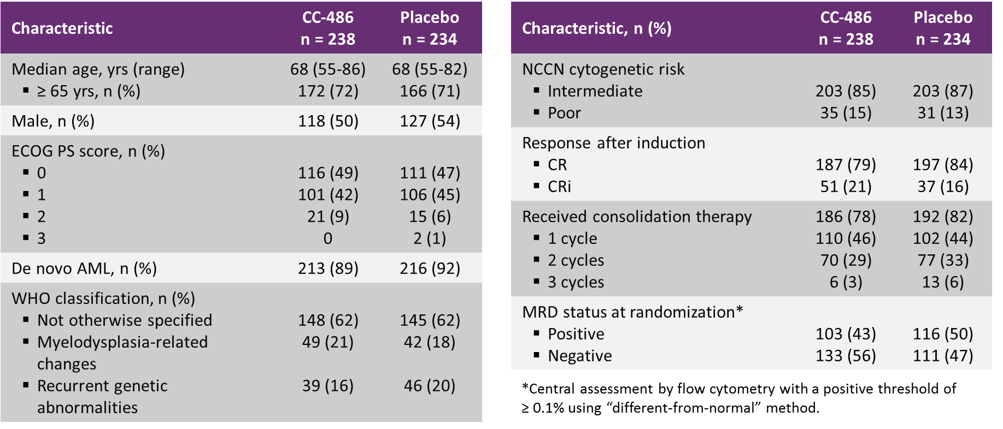
QUAZAR AML-001: Baseline Characteristics
Wei. ASH 2019. Abstr LBA_3.

Slide 22
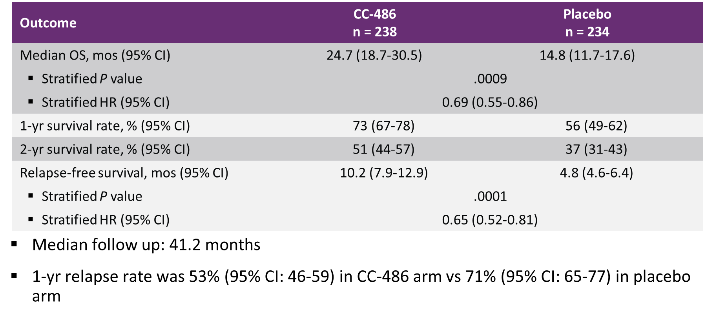
QUAZAR AML-001: Survival
Wei. ASH 2019. Abstr LBA_3.

Slide 23
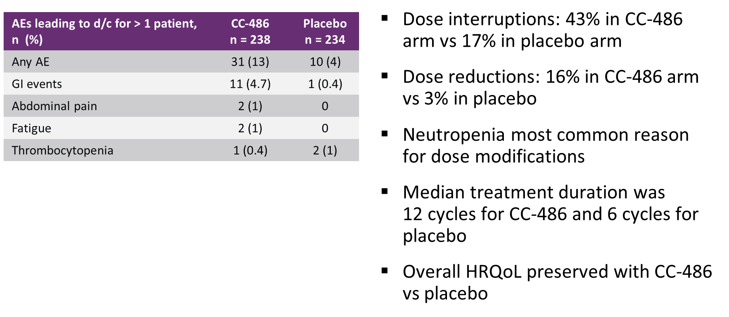
QUAZAR AML-001: Adverse Events Resulting in Dosing Modification or Discontinuation
Wei. ASH 2019. Abstr LBA_3.

Slide 24
Case 1
69 year old man, history of monoclonal gammopathy of unknown significance (MGUS), prostate cancer treated with localized radiation therapy. Presented to primary care physician with 3-4 week history of increasing fatigue and shortness of breath with exertion. He is an avid golfer but unable to play due to symptoms. Workup included a CBC, which revealed WBC 2.2 x 10^3/uL, Hb 7.6 g/dL, platelets 101 x 10^3/uL. Referred to hematologist/oncologist for further workup.
Bone marrow biopsy performed 1 week later. Revealed hypercellularity at 85%. Increased myeloblasts at 41% and trilineal dysplasia. Cytogenetics revealed deletion 7q in 12/20 metaphases. Next generation sequencing panel revealed mutations of CUX1, TET2, RUNX1.
Patient received induction chemotherapy with CPX-351. Day 14 bone marrow biopsy revealed hypocellularity, < 5% blasts. Recovery at day 32 to ANC > 1000, platelets > 100. Hospital course was complicated by febrile neutropenia, drug-induced skin rash, nodular pneumonia.
Patient currently under consideration for allogeneic stem cell transplant, awaiting final donor confirmation and dental clearance.

Slide 25
Case 2
74 year old man, history of myelodysplastic syndrome x 2 years. Treated initially with erythropoietin stimulating agent. Then due to worsening anemia, began treatment with Lenalidomide with transfusion independence that lasted for 7 months, followed by worsening anemia and general pancytopenia. Also with history of hypertension, gout, osteoarthritis, pulmonary hypertension.
CBC at time of workup for worsening anemia revealed WBC 1.9 x 10^3/uL, Hb 8.4 g/dL, Platelets 22 x 10^3/uL. A bone marrow biopsy was performed that revealed 90% cellularity, 21% blasts, trilineage dysplasia. Cytogenetics normal. Next generation sequencing panel revealed mutations of TET2, ASXL1.
Given excellent performance status despite co-existing medical illnesses, chose to pursue treatment with CPX-351. Day 14 bone marrow biopsy was hypocellular with < 5% blasts. Count recovery of ANC > 1000 and platelets > 1000 occurred, but not until day 45. Hospital course was complicated by C. difficile colitis, fluid overload/pulmonary edema, general deconditioning. Patient discharged to skilled nursing/rehab facility for 2 weeks prior to going home.
Repeat bone marrow biopsy following discharge from SNF revealed 70% cellularity, < 5% blasts, persistent trilineal dysplasia. WBC 4.4 x 10^3/uL, Hb 10.1 g/dL, Platelets 79 x 10^3/uL.
Patient is not considered a suitable candidate for consolidation chemotherapy or bone marrow transplant. In light of lack of suitable options, he opted for conservative monitoring.

