Slide 1
Oncology Grand Rounds
New Agents and Strategies in Prostate Cancer
Tuesday, June 30, 2020
5:00 PM – 6:30 PM ET
Faculty
Robert Dreicer, MD, MS
Kara M Olivier, NP, APRN-BC
Victoria Sinibaldi, RN, MS, CS, CANP, BC
Matthew R Smith, MD, PhD
Moderator
Neil Love, MD

Slide 2
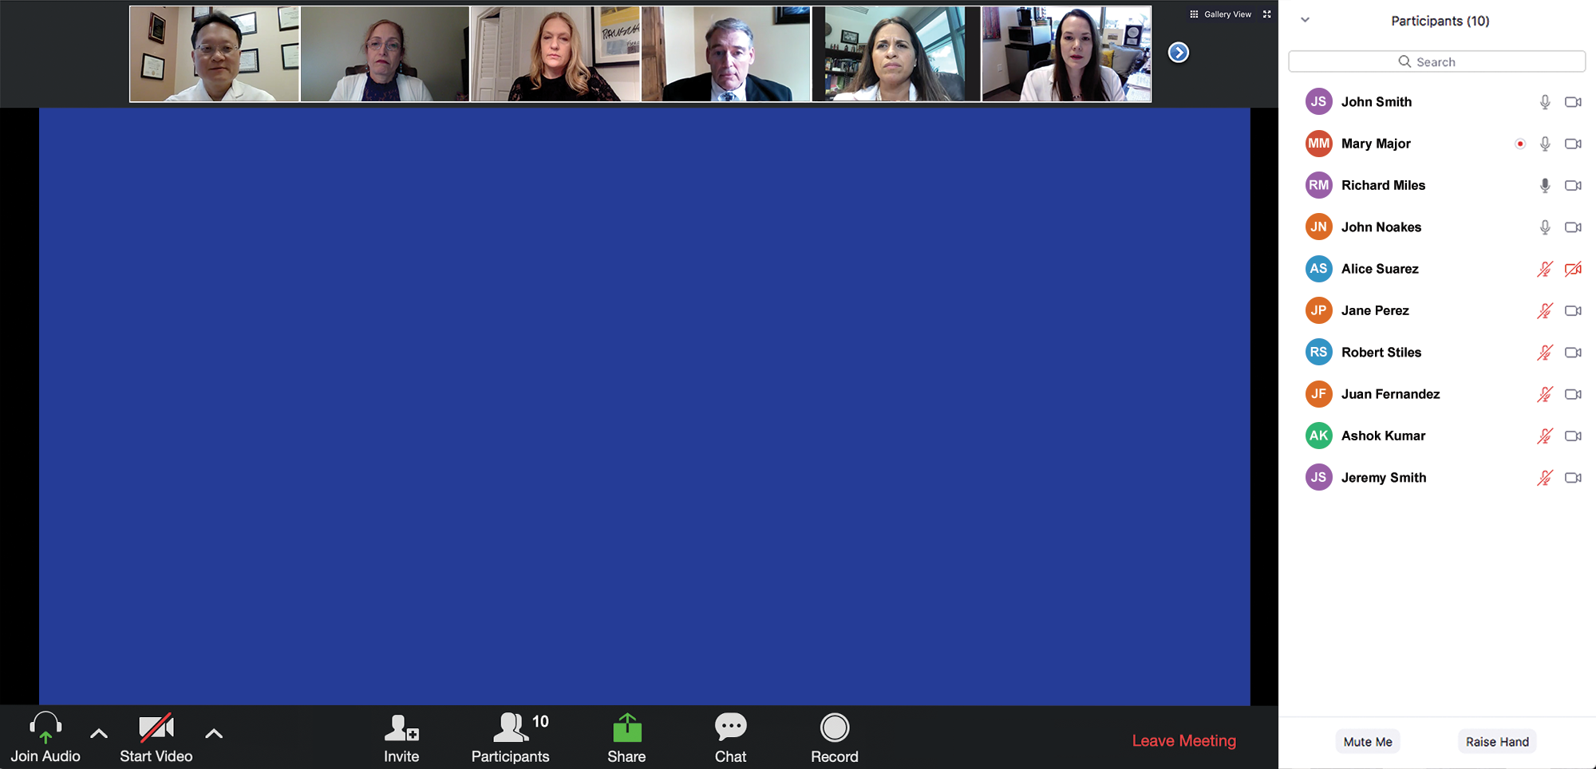

Familiarizing yourself with the Zoom interface
How to participate in the chat
Join the chat to send in questions or troubleshoot

Slide 3
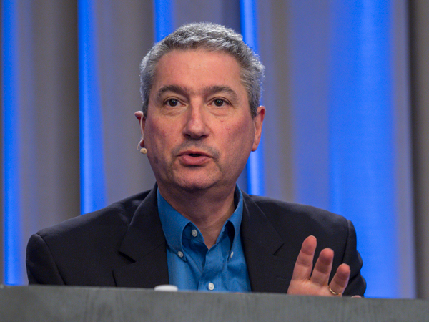
About the Enduring Program
This webinar is being video
and audio recorded.
The proceedings from today will
be edited and developed into
an enduring web-based
video/PowerPoint program.
An email will be sent to all attendees when the activity is available.
To learn more about our education programs visit our website, www.ResearchToPractice.com
Notes:
3
3

Slide 4
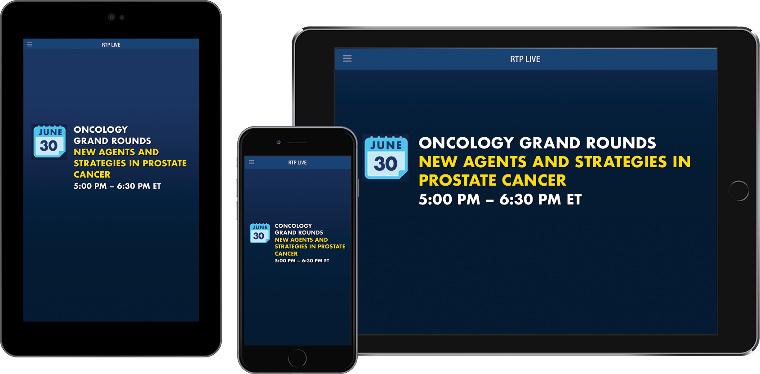
Make the Meeting Even More Relevant to You
Download the RTP Live app on your smartphone or tablet to access program information, including slides being presented during the program:
www.ResearchToPractice.com/RTPLiveApp
Notes:
4
4

Slide 5


Slide 6
Conversations with the Investigators:
Prostate Cancer
Wednesday, July 1, 2020
5:00 PM – 6:00 PM ET
Faculty
Robert Dreicer, MD, MS
Daniel P Petrylak, MD
Christopher Sweeney, MBBS
Moderator
Neil Love, MD

Slide 7
COVID-19
AND
LUNG
CANCER
What We Know, What We Don’t Know and
What It All Means for Current Patient Care – A Live CME Webinar
Thursday, July 2, 2020
12:00 PM – 1:00 PM ET
Moderator
Neil Love, MD
Faculty
Leora Horn, MD, MSc
Naiyer A Rizvi, MD
Lecia V Sequist, MD, MPH

Slide 8
Oncology Grand Rounds
New Agents and Strategies in Prostate Cancer
Tuesday, June 30, 2020
5:00 PM – 6:30 PM ET
Faculty
Robert Dreicer, MD, MS
Kara M Olivier, NP, APRN-BC
Victoria Sinibaldi, RN, MS, CS, CANP, BC
Matthew R Smith, MD, PhD
Moderator
Neil Love, MD

Slide 9
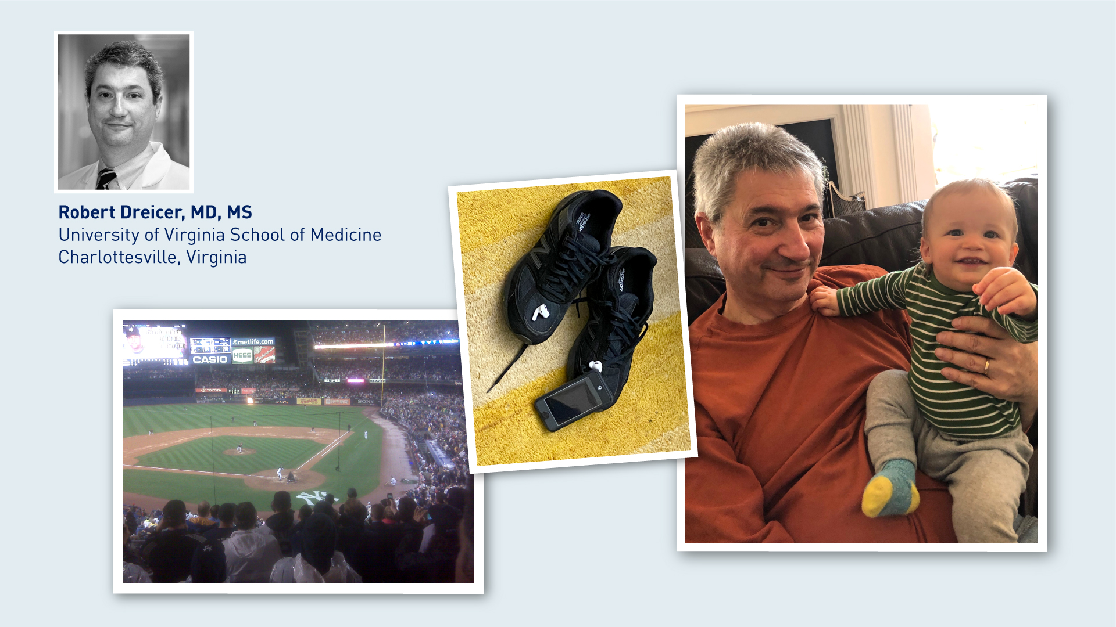

Slide 10


Slide 11
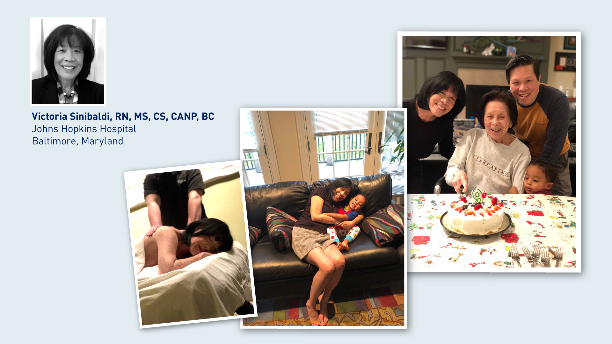

Slide 12


Slide 13
Agenda
Case 1: 56-year-old man
Discussion: Overview of prostate cancer treatment
Case 2: 75-year-old man
Discussion: Management of M0 prostate cancer
Case 3: 57-year-old man
Discussion: Management of metastatic hormone-sensitive prostate cancer
Case 4: 56-year-old man
Discussion: Management of metastatic castration-resistant prostate cancer; emerging agents and strategies

Slide 14
Case 1: 56-year-old man (from the practice of Ms Olivier)
12/2019: Gleason 5+4
Treatments:
  Radical prostatectomy
  Androgen deprivation
  Salvage radiation therapy
  Secondary endocrine treatment (abiraterone/prednisone)

Slide 15
Overview of Prostate Cancer
Natural history of prostate cancer; biology; PSA
Hormonal strategies
Local and systemic treatments

Slide 16
Clinical Disease States Model of Prostate Cancer¹
Death from
other causes
Noncastrate prostate cancer
Castrate prostate cancer
Clinical Metastases
Clinically
localized disease
Rising PSA:
noncastrate
Clinical metastases:
noncastrate
Clinical metastases:
castrate
Rising PSA:
castrate
Death from
disease
Two defining criteria
Rising PSA in the setting of castrate testosterone levels (<50 ng/dL)
No radiographically identifiable metastasis

Slide 17
Abiraterone may be challenging to administer to a patient …
a. With Crohn’s disease
b. With diabetes
c. With peripheral neuropathy
d. On a proton pump inhibitor
e. All of the above

Slide 18
Men with complete testosterone suppression have minimal or no sexual libido.
a. Agree
b. Disagree
c. I don’t know

Slide 19
Prostate Cancer
Prostate cancer is still a major health problem in the US.
Approximately 191,930 new cases; approximately 33,330 deaths are expected to occur in 2020.
With these large numbers, it is more likely that nurses will be seeing these patients in their practice.
It becomes imperative that nurses keep abreast of current patient issues, current treatments, their associated side effects, and nursing interventions that can help to mitigate problems and ensure quality care.
Treatment depends on diagnosis (stage and grade of the tumor), co-morbidies, prior therapies, performance status and patient’s desires in terms of goals of treatment and QOL.
Patient-centered strategies to optimize symptom management and improve patient adherence to therapies and outcomes are of paramount importance.
Courtesy of Victoria Sinibaldi, RN, MS, CS, CANP, BC

Slide 20
Considerations
Side effects of ADT in young men related to muscle loss, fatigue and sexual health impact quality of life.
Prioritize access to adequate support for management of sexual health and mental health.
Ongoing discussion regarding rationale for treatment and how it’s related to long term survival.
Courtesy of Kara M Olivier, NP, APRN-BC

Slide 21
Balancing the benefits/risks of treatment
Risks
Shared decision making: goals of patient
Benefits
Delayed progression
Psychological benefits of receiving treatment
Expense: COST $$$$... ↓ QOL
ED and ↓ libido
Hot flashes
Changes in mood/ ↓cognition
↓ strength/ muscle mass
Osteoporosis
Anemia, fatigue
Metabolic syndrome
Cardiac risk, DM
Improved survival
Courtesy of Victoria Sinibaldi, RN, MS, CS, CANP, BC

Slide 22
Agenda
Case 1: 56-year-old man
Discussion: Overview of prostate cancer treatment
Case 2: 75-year-old man
Discussion: Management of M0 prostate cancer
Case 3: 57-year-old man
Discussion: Management of metastatic hormone-sensitive prostate cancer
Case 4: 56-year-old man
Discussion: Management of metastatic castration-resistant prostate cancer; emerging agents and strategies

Slide 23
Case 2: 75-year-old man with M0 prostate cancer (from the practice of Ms Sinibaldi)
2001: High-risk PCa (Gleason 3+4 = 7) → Radical prostatectomy (+ left SV, -nodes) → salvage RT → Clinical trial of HT + docetaxel, with eventual biochemical progression
Intermittent HT (LHRH + bicalutamide), ultimately requiring CHT
2015: Enzalutamide 160mg added LHRH therapy
  Poor tolerance even with dose reduction to 80 mg and subsequently to 80 mg every other day
  Significant fatigue, severe diarrhea, nausea and vomiting
  2018: Discontinuation of the AR targeted therapy, continue LHRH alone
Asymptomatic, good PS, PSA rising
3/2020
  PSA 12.01 ng/ml
  PSADT < 7 months
  CT and bone scan: NED
Initiated darolutamide

Slide 24
Management of Nonmetastatic Castration-Resistant Prostate Cancer (CRPC)
Types of hormonal treatment
Androgen deprivation
Antiandrogens
  Enzalutamide, darolutamide, apalutamide

Slide 25
Men with detectable PSA levels after radical prostatectomy almost always die of metastatic disease.
a. Agree
b. Disagree
c. I don’t know

Slide 26
There is no discernible difference in the side-effect profiles of enzalutamide, darolutamide and apalutamide.
a. Agree
b. Disagree
c. I don’t know

Slide 27
Definition of nmCRPC
Patients with rising PSA despite ongoing ADT and no detectable metastases by conventional imaging (bone scan and CT or MRI)
Most patients with nmCRPC are presumed to have occult metastatic disease not detected by conventional imaging
Courtesy of Matthew R Smith, MD, PhD

Slide 28
Context
Men with nmCRPC are at significant risk for metastatic disease and prostate cancer–specific death¹
Metastases are a major cause of morbidity and mortality^{2,3}
Prevention of metastases represents an important unmet medical need

Slide 29
nmCRPC Is a Deadly Disease¹
1.0
Median time to metastasis:
29.5 months
Median overall survival:
44.8 months
0.8
0.6
Proportion of Subjects
Alive Without Bone Metastases
0.4
0.2
0
0
3
6
9
12
15
18
21
24
27
30
33
36
39
42
45
Study Month
N =
716
667
549
466
402
359
336
286
234
184
139
127
91
50
20
4
N =
716
696
666
638
600
562
528
497
450
379
310
254
202
140
87
36

Slide 30
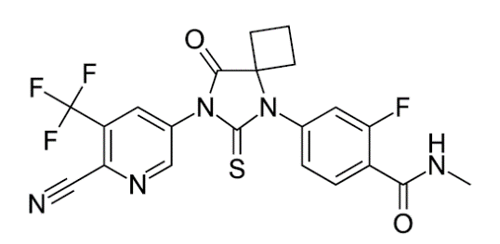
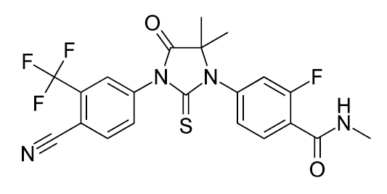
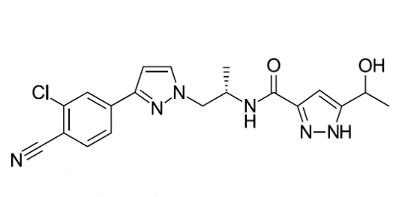
Next-Generation Androgen Receptor Inhibitors^{1,2}
Apalutamide
Enzalutamide
Darolutamide
Apalutamide and enzalutamide have similar structures
Darolutamide is structurally distinct from apalutamide and enzalutamide, characterized by low blood–brain barrier penetration^{1,2,} and may have improved tolerability

Slide 31
Oral Anti Androgens Approved For M0 Prostate Cancer – How do you choose?
Enzalutamide
  Cautious with patients with a history of falls and seizure
Apalutamide
  Risk of rash
Darolutamide
  Mild fatigue
  *For all patients monitor CBC/diff, comprehensive metabolic panel and PSA.
Courtesy of Kara M Olivier, NP, APRN-BC

Slide 32
Nursing implications: oral agents
Nurses need to be aware that there needs to be a shift in management from provider to patient
Nurses need to become familiar with the oral agents and develop educational strategies to ensure patient understanding of medication, dosing and administration, potential side effects, symptom management, self care measures, proactive follow-up.
Stress the import’ of need to keep scheduled visits and contact the health care provider when side effects develop. If side effects are not reported, necessary adjustments will not be made and serious consequences can occur and have impact on their life and further therapy.
Courtesy of Victoria Sinibaldi, RN, MS, CS, CANP, BC

Slide 33
Nursing implications: oral agents (cont.’)
Nurses need to be aware of factors that affect patient compliance and reporting
Patients are often reluctant to notify the provider because they fear that their therapy may be interrupted or dose lowered
  Most side effects resolve with brief interruption of therapy
  Any necessary dose reduction is simply to customize a dose that the individual needs
  A dose reduction does not necessarily decrease the efficacy of the treatment
Communication, education, organization, and trusting relationship are key!!
Courtesy of Victoria Sinibaldi, RN, MS, CS, CANP, BC

Slide 34
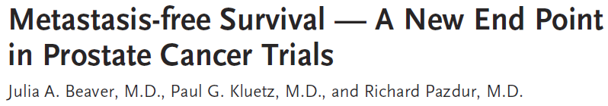
FDA Approval of Apalutamide¹
  Apalutamide approved on 2/14/2018
  First drug approved by the FDA for nmCRPC
  First approval based on metastasis-free survival

Slide 35
SPARTAN: Apalutamide vs Placebo
Study Design^{1,2}
Key Eligibility Criteria
M0 CRPC (central review)
Baseline PSA ≥2 ng/mL
Rising PSA despite castrate testosterone level (≤50 ng/dL)
PSADT ≤10 months
Apalutamide (240 mg/d)
+ ADT
N = 1,207
R
2:1
Placebo
+ ADT
Primary endpoint: MFS
Secondary endpoints: Safety, time to PSA progression, time to symptomatic progression, OS, PSA response, QOL
78% of patients in placebo group received subsequent approved therapy for mCRPC

Slide 36
PROSPER: Enzalutamide vs Placebo
Study Design^{1,2}
Key Eligibility Criteria
M0 CRPC (central review)
Rising PSA despite castrate testosterone level (≤50 ng/dL)
Baseline PSA ≥2 ng/mL
PSADT ≤10 months
Enzalutamide (160 mg/d)
+ ADT
N = 1,401
R
2:1
Placebo + ADT
Primary endpoint: MFS (defined as time from randomization to radiographic progression or death within 112 days of treatment discontinuation)
Secondary endpoints: Safety, time to PSA progression, time to use of new antineoplastic therapy, OS, PSA response, and QOL
48% of patients in placebo group received subsequent approved therapy for mCRPC

Slide 37
ARAMIS: Darolutamide vs Placebo
Study Design^{1,2}
Key Eligibility Criteria
nmCRPC
Baseline PSA ≥2 ng/mL
PSADT ≤10 mo
Darolutamide
(2 x 300 mg tablets BID)
+ ADT
n = 955
Primary
analysis:
MFS
N = 1,509
R
Final analysis:
OS
2:1
Placebo BID + ADT
n = 554
Primary endpoint: MFS
Secondary endpoints: OS, time to first symptomatic skeletal event, time to initiation of first cytotoxic chemotherapeutic, time to pain progression, safety, and tolerability
37% of patients in placebo group received subsequent approved therapy for mCRPC

Slide 38
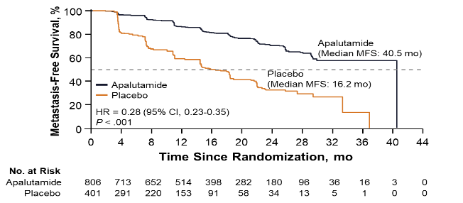
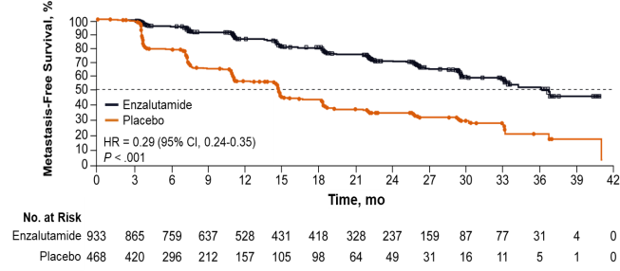
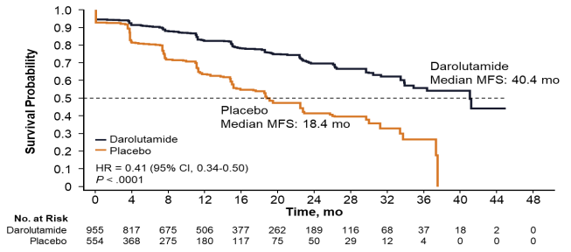
Primary Endpoint: Metastasis-Free Survival
SPARTAN¹
Apalutamide
72% reduction of distant progression or death
Median MFS: APA 40.5 vs PBO 16.2 months
24-month MFS benefit
PROSPER²
Enzalutamide
71% reduction of distant progression or death
Median MFS: ENZA 36.6 vs PBO 14.7 months
22-month MFS benefit
ARAMIS³
Darolutamide
59% reduction of distant progression or death
Median MFS: DARO 40.4 vs PBO 18.4 months
22-month MFS benefit
1. Smith MR et al. N Engl J Med. 2018;378:1408-1418. 2. Hussain M et al. N Engl J Med. 2018;378:2465-2474. 3. Fizazi K et al. N Engl J Med. 2019;380:1235-1246.

Slide 39
Adverse Events of Interest
Safetyª | SPARTAN¹ |  | PROSPER² |  | ARAMIS³
 | APA (n = 803) | PBO (n = 398) | ENZA (n = 930) | PBO (n = 465) | DARO (n = 954) | PBO (n = 554)
Any AEs, n (%) | 775 (96.5) | 371 (93.2) | 808 (87) | 360 (77) | 794 (83.2) | 426 (76.9)
Any serious AEs, n (%) | 199 (24.8) | 92 (23.1) | 226 (24) | 85 (18) | 237 (24.8) | 111 (20.0)
AEs leading to discontinuation, % | 11.0 | 7.0 | 9.0 | 6.0 | 8.9 | 8.7
AEs leading to death, n (%) | 10 (1.2) | 1 (0.3) | 32 (3.4) | 3 (0.7) | 37 (3.9) | 18 (3.2)
AEs (all grades), %
Fatigue | 30.4 | 21.1 | 33.0 | 14.0 | 12.1 | 8.7
Hypertension | 24.8 | 19.8 | 12.0 | 5.0 | 6.6 | 5.2
Rash | 23.8 | 5.5 | 0 | 0 | 2.9 | 0.9
Falls | 15.6 | 9.0 | 11.0 | 4.0 | 4.2 | 4.7
Fractures | 11.7 | 6.5 | N/A | N/A | 4.2 | 3.6
Mental impairment disorders | 5.1 | 3.0 | 5.0 | 2.0 | 0.4 | 0.2
ª AE reporting every 4 weeks in SPARTAN and every 16 weeks in PROSPER and ARAMIS.
1. Smith MR et al. N Engl J Med. 2018;378:1408-1418. 2. Hussain M et al. N Engl J Med. 2018;378:2465-2474. 3. Fizazi K et al. N Engl J Med. 2019;380:1235-1246.

Slide 40
Agenda
Case 1: 56-year-old man
Discussion: Overview of prostate cancer treatment
Case 2: 75-year-old man
Discussion: Management of M0 prostate cancer
Case 3: 57-year-old man
Discussion: Management of metastatic hormone-sensitive prostate cancer
Case 4: 56-year-old man
Discussion: Management of metastatic castration-resistant prostate cancer; emerging agents and strategies

Slide 41
Case 3: 57-year-old man with de novo metastatic prostate cancer (from the practice of Ms Olivier)
10/2019: Diagnosed with metastatic prostate cancer to lymph nodes
11/2019: TRUS-biopsies: Gleason 4+4=8 (4+3, 3+4 in multiple cores), PSA 45.9
12/2019: mpMRI: 1.6-cm PI-RADS 5 lesion with abutment of the capsule, multiple enlarged iliac nodes (largest 2.6 cm) consistent with metastasis
  CT scan: 0.7 cm retrocaval node
  Bone scan: Negative for metastatic disease
12/2019: GnRH antagonist + degarelix
  PSA after 1 month: 14.4
  PSA after 2 months: 5.6
  PSA after 3 months: 1.07
2/2020: Transitioned to LHRH agonist (leuprolide)
3/2020: Completed RT, initiates enzalutamide
  PSA after 1 month: 0.10
  Fatigue but otherwise active

Slide 42
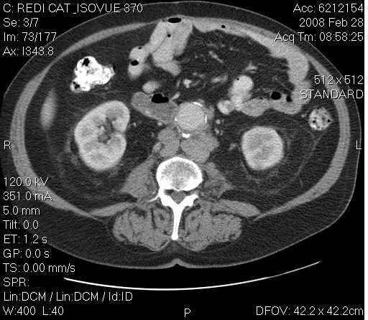
57-year-old man with de novo metastatic prostate cancer (from the practice of Ms Olivier)
Abdominal/Pelvic CT
Lymph Node

Slide 43
Strategies in the Management of Metastatic Hormone-Sensitive Prostate Cancer
De novo metastatic disease versus recurrent disease
Risks and benefits of androgen deprivation
Additional benefits
  Enzalutamide, darolutamide, apalutamide, abiraterone
Chemotherapy versus oral endocrine therapy
COVID-19 considerations

Slide 44
Men who have metastatic prostate cancer on initial diagnosis have the greatest chance for sustained response with androgen deprivation and…
a. An antiandrogen
b. Docetaxel
c. Either an antiandrogen or docetaxel — no difference
d. I don’t know

Slide 45
Selected FDA Approved Drugs in Advanced Prostate Cancer
Docetaxel: cytotoxic/taxane (fatigue, diarrhea, peripheral neuropathy, muscle cramps)
Cabazitaxel: cytotoxic/taxane (fatigue, myelosupression)
Abiraterone: lyase inhibitor (dramatically inhibits testosterone production) LFT abnormalities, hypertension
Enzalutamide: androgen receptor antagonist (fatigue, cognitive issues)
Apalutamide: androgen receptor antagonist (fatigue, cognitive issues)
Courtesy of Robert Dreicer, MD, MS

Slide 46
Clinical Decision-Making Hormone-Sensitive Metastatic Disease
Patient factors
  Performance status
  Co-morbidities, i.e. pre-existing peripheral neuropathy
  I hate taking pills doc etc.
Disease factor
  Extent of disease, volume of disease, presence/absence of visceral i.e. liver metastases
  Non AR biology, i.e. poor psa expresser, significant neuroendocrine features
Economic factors
  Non viable co-pay or oral agents
Courtesy of Robert Dreicer, MD, MS

Slide 47
Choosing Oral Antiandrogen
Age
Comorbidities
  Diabetes
  History of seizure
  Falls
  Performance status
  Concomitant medications
Courtesy of Kara M Olivier, NP, APRN-BC

Slide 48
Monitoring
Evaluation two weeks after initiating treatment with physical exam and safety laboratory monitoring
  CBC/differential, comprehensive metabolic panel
Based on tolerability can move to monthly follow up with serial labs and PSA
Restaging scans within six months of initiating treatment
Courtesy of Kara M Olivier, NP, APRN-BC

Slide 49
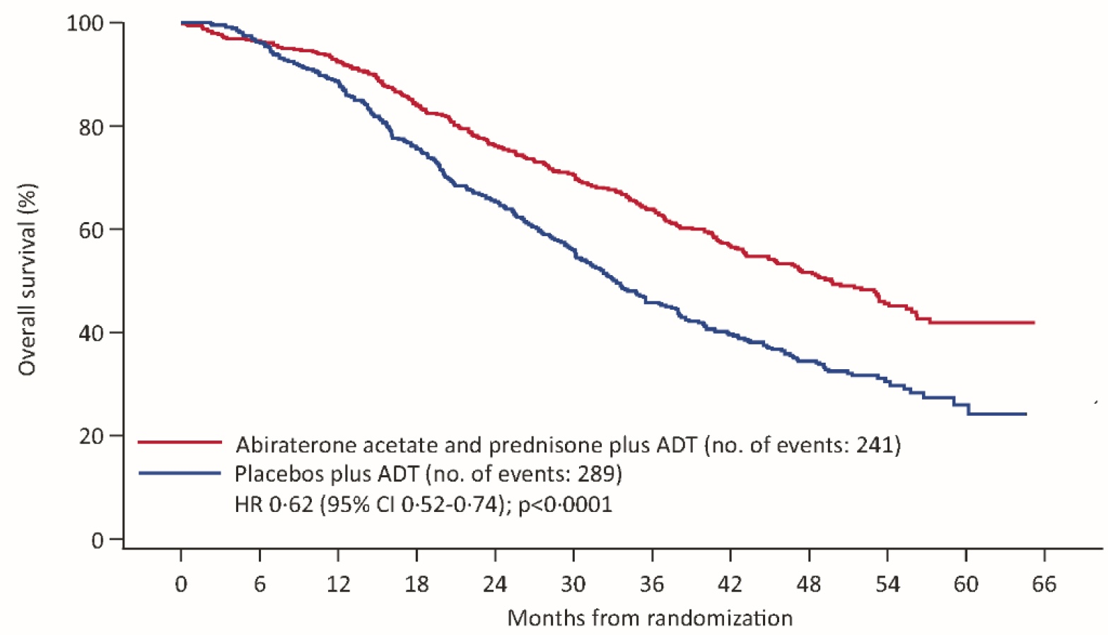
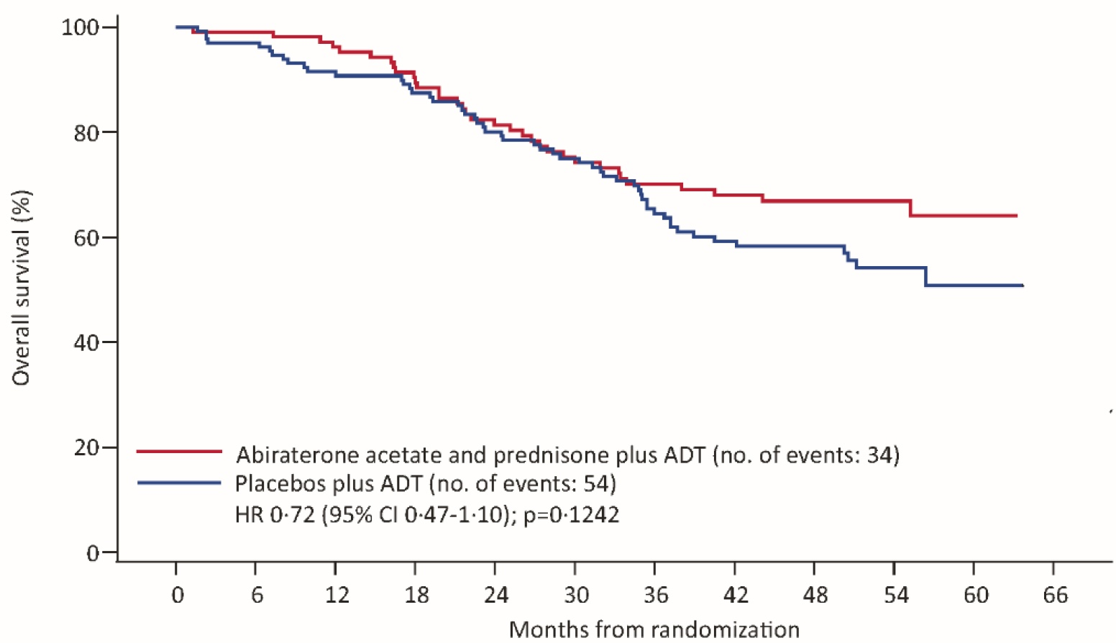
LATITUDE Final Overall Survival Analysis By Volume of Disease (CHAARTED definition*)
High-Volume Disease
Low-Volume Disease
 | ADT + AA + P (n = 487) | ADT + Placebo (n = 468) | HR | P-value
mOS | 49.7 mo | 33.3 mo | 0.62 | <0.0001
 | ADT + AA + P (n = 110) | ADT + Placebo (n = 133) | HR | P-value
mOS | Not reached | Not reached | 0.72 | 0.1242
*CHAARTED definition of low vs high volume: Presence of visceral mets and/or ≥ bone mets, with one outside the vertebral column or pelvis
Fizazi K et al. Lancet Oncol 2019;20:686-700. Chi et al 2019 GU Cancers Symposium; Abstract 141.

Slide 50
Summary Results for ADT + Enzalutamide (ARCHES) and Apalutamide (TITAN) in Metastatic HSPC
 | ARCHES (N = 1150) |  | TITAN (N = 1052)
Characteristics | 2/3rd High Volume 17% prior docetaxel 25% prior RP/XRT |  | 2/3rd High Volume; 10% prior docetaxel 17% prior RP/XRT
 | ADT + Enzalutamide (n = 574) | ADT (n = 576) | ADT + Apalutamide (n = 955) | ADT (n = 554)
Radiographic PFS | NR | 19.0 mo | NR | 22.1 mo
 | HR (overall): 0.39 HR (prior docetaxel): 0.52 HR (high volume): 0.43 HR (low volume): 0.25 |  | HR (overall): 0.48 HR (prior docetaxel): 0.47 HR (high volume): 0.53 HR (low volume): 0.36
Overall Survival | NR | NR | NR | NR
 | HR: 0.81 (Immature) |  | HR (overall): 0.67 HR (prior docetaxel): 1.27 HR (high volume): 0.68 HR (low volume): 0.67
NR, not reached
Armstrong AJ et al. J Clin Oncol 2019;[Epub ahead of print]. Chi KN et al. N Engl J Med 2019;381(1):13-24.

Slide 51
Agenda
Case 1: 56-year-old man
Discussion: Overview of prostate cancer treatment
Case 2: 75-year-old man
Discussion: Management of M0 prostate cancer
Case 3: 57-year-old man
Discussion: Management of metastatic hormone-sensitive prostate cancer
Case 4: 56-year-old man
Discussion: Management of metastatic castration-resistant prostate cancer; emerging agents and strategies

Slide 52
Case 4: 56-year-old man with metastatic castration resistant prostate cancer (from the practice of Ms Sinibaldi)
~2015: Diagnosed with metastatic prostate cancer, with diffuse bony metastases and significant retroperitoneal lymphadenopathy (Initial PSA: 1550)
LHRH + bicalutamide + docetaxel x 6 (completed 12/2015)
  PSA nadir 9 → 20 in 2017
2017: Abiraterone/prednisone → PD
5/2019: Symptomatic bone pain (PSA: 75.5) →Palliative EBRT to areas of painful mets
06/2019: Radium-223 x 1 before developing worsening multifocal bone pain
07/2019: Cabazitaxel + prednisone 10 mg
3/30/20 Follow-up: PSA 98→20, near complete resolution of pain (off narcotics)
Currently, recommending a treatment break, with close PSA monitoring
  Options upon disease progression: Cabazitaxel, radium-223, enzalutamide

Slide 53
Management of Metastatic Castration-Resistant Prostate Cancer (mCRPC)
Radium-223
Sipuleucel-T
Cabazitaxel
Evolving treatment paradigms
  Lutetium 177 PSMA radionuclide therapy
  PARP inhibitors
    Genomic evaluation
    Approved PARP inhibitors: Olaparib, rucaparib

Slide 54
Timeline of FDA Approvals in Metastatic
Castration-Resistant Prostate Cancer
Survival
Radium-223
Enzalutamide
Cabazitaxel
Docetaxel
Abiraterone + prednisone
Sipuleucel-T
1992
1996
2000
2004
2008
2012
Strontium-89
Samarium-153
Zoledronic acid
Denosumab
Mitoxantrone
Palliation
Metastatic disease was defined by conventional imaging (eg, bone scan, CT scans)
Courtesy of Matthew R Smith, MD, PhD

Slide 55
Metastatic Castration-Resistant Prostate Cancer (mCRPC)
Defined: evidence of metastatic disease, with “castrate levels” of testosterone (< 50 ng/dL) with evidence of progression on imaging studies and/or rising PSA
Courtesy of Robert Dreicer, MD, MS

Slide 56
Therapeutic Decision Making in Metastatic Castration-Resistant Prostate Cancer (mCRPC)
mCRPC space increasingly impacted by movement of primarily AR directed therapies early in the treatment course
  Known resistance pathways of AR resistance limits utility of crossover of current agents
Clinical factors
  Symptoms yes/no
  Biochemical or overt radiographic progression
  Prior therapies
  Durability of initial ADT response
Courtesy of Robert Dreicer, MD, MS

Slide 57
Selected FDA Approved Drugs in Advanced Prostate Cancer
Sipuleucel-T
  autologous cellular immunotherapy designed to stimulate a patient’s own immune system against prostate cancer, MOA unknown
  Minimal toxicity, apharesis required
Radium-223
  Radiopharmaceutical, alpha particle
  GI toxicity, typically mild, important to remind patients re: lack of PSA activity
  Administered by nuclear medicine or radiation oncology physicians
  Important to monitor patients monthly as NO activity against non bone metastastic sites
Courtesy of Robert Dreicer, MD, MS

Slide 58
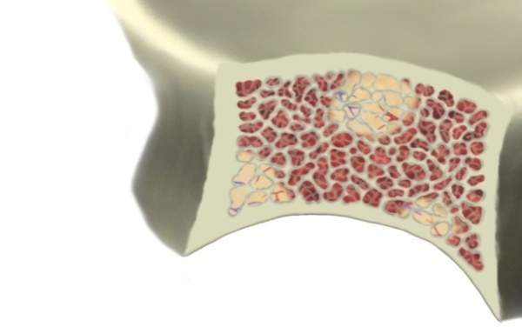

Range of an α-emitting Radiopharmaceutical Compared to a β-emitter
Short range of α-particles could reduce bone marrow exposure¹
Bone
Marrow
Tumor
Bone Mineral
(Hydroxyapatite)
Radionuclide
Range of α-particle
(short range – ~2 to 10
cell diameters²)
Range of β-particle
(long range
– 10 to 1000 cell diameters²)
References: 1. Henriksen G, et al. Cancer Res. 2002;62:3120–3125. 2. Brechbiel MW. Dalton Trans. 2007;43:4918-4928.

Slide 59
Nursing implications: Radium-223
Rad-223 is safe and effective and targets tumor cells in the bone.
Rad-223 -form of liquid radiation, administered IV, given every 4 weeks x6.
Explain characteristics of RAD-223- has a short range that does limit damage to healthy cells.
Data using this modality have shown improvement in QOL with improvement in pain, improved OS (by 3.6 months), delay in SSEs.
Patients often focus on PSA. Point out that a decline in PSA is not an expected result of Rad-223; Patient benefits have been observed in the absence of a decreasing PSA.
Courtesy of Victoria Sinibaldi, RN, MS, CS, CANP, BC

Slide 60
Nursing implications: Radium-223
Fatigue
GI: Nausea, Vomiting, Diarrhea
Peripheral edema
Pancytopenia: Anemia, Lymphopenia, leukopenia, thrombocytopenia, neutropenia
Black tarry stools
CP, Chills, Cough
Erythema at the injection site
Courtesy of Victoria Sinibaldi, RN, MS, CS, CANP, BC

Slide 61
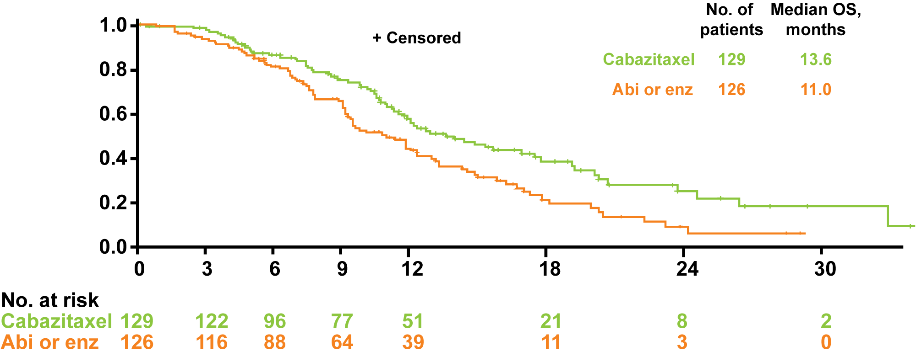
CARD: Cabazitaxel vs Abiraterone or Enzalutamide in mCRPC Previously Treated with Docetaxel and an Androgen-Signaling-Targeted Inhibitor
Overall survival (key secondary endpoint)
Summary of AEs | Cabazitaxel | Abi or Enza
Grade ≥3 AE | 56.3% | 52.4%
AE leading to Tx discontinuation | 19.8% | 8.9%
AE leading to death | 5.6% | 11.3%
Kaplan-Meier estimate
HR = 0.64
p = 0.008
Time (months)
CARD met its primary objective: Cabazitaxel more than doubled rPFS versus abiraterone or enzalutamide
de Wit R et al; CARD Investigators. N Engl J Med 2019;381(26):2506-18.

Slide 62
Nursing Implications: Cabazitaxel chemotherapy
Impt.’ to know the results of the CARD trial: Improved benefit of use of cabazitaxel over abiraterone or enzalutamide as SOC in patients who had prior docetaxel within 12 months: improved pFS and overall survival
Patient improvement: Mobility, self-care, usual activities, pain/discomfort, and anxiety/depression.
Dosing and administration: 20 mg/m2 IV Q 21 days (7 -10 cycles or until DLT or PD)
Close monitoring for S/E imperative: fatigue, hypersensitivity reactions, nausea/vomiting, renal failure, neutropenia w/wo fever, diarrhea, constipation, hypotension, neuropathy, hematuria/cystitis, belching, heartburn, back pain.
Courtesy of Victoria Sinibaldi, RN, MS, CS, CANP, BC

Slide 63
Novel Agents for mCRPC
Poly(ADP-ribose) polymerase (PARP) inhibitors
  Directed at targeting cancers with defective DNA-damage repair
  Prostate cancer, most common defects in BRCA 1, BRCA 2 and ATM genes
  Side effects include progressive anemia, fatigue, GI side effects indigestion, nausea/vomiting, diarrhea, headaches
PSMA (prostate specific membrane antigen) targeted therapies
  In combination with a number of molecules: Lutetium, radioactive iodine, T cell targeting combinations

Slide 64
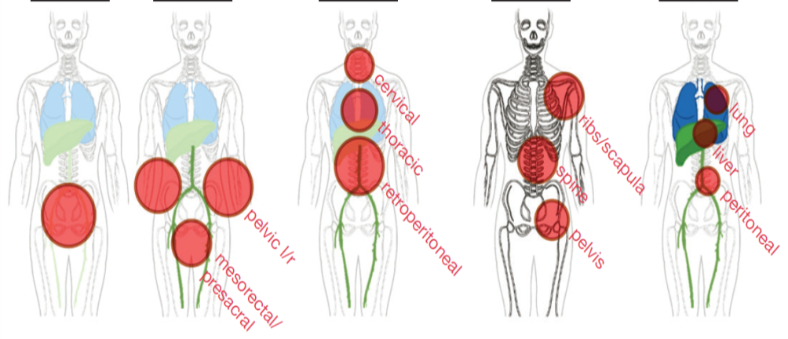
PSMA-PET Results in Patients With High-Risk nmCRPC
(nmCRPC, Negative Conventional Imaging, PSADT <10 mo)¹
N = 200
Category Based on miTNM Stage, n (%) | All patients (N = 200)
M0 T0N0M0 (no PC lesion) TrN0M0 T0N1M0 TrN1M0 | 91 (46) 4 (2) 48 (24) 13 (7) 26 (13)
Any M1 T0N0M1 T0N1M1 TrN0M1 TrN1M1 | 109 (55) 31 (16) 42 (21) 9 (5) 27 (14)
N/M disease extent Unifocal (1 lesion) Oligometastatic (2-3 lesions) Multiple/disseminated (≥ 4 lesions) | 29 (15) 28 (14) 91 (46)
n = 196
n = 4
Tr 55%
N1 54%
M1a 39%
M1b 24%
M1c 6%ª
The size of the red circle is proportional to lesion prevalence.
PSMA-PET was positive in 196 of 200 (98%) patients;
55% of patients had any distant metastatic disease

Slide 65
FDA approves olaparib for HRR gene-mutated metastatic castration-resistant prostate cancer
Press Release – May 19, 2020
On May 19, 2020, the Food and Drug Administration approved olaparib for adult patients with deleterious or suspected deleterious germline or somatic homologous recombination repair (HRR) gene-mutated metastatic castration-resistant prostate cancer (mCRPC), who have progressed following prior treatment with enzalutamide or abiraterone.
Efficacy was investigated in PROfound (NCT02987543), an open-label, multicenter trial randomizing (2:1) 256 patients to olaparib 300 mg twice daily and 131 patients to investigator’s choice of enzalutamide or abiraterone acetate. All patients received a GnRH analog or had prior bilateral orchiectomy. Patients were divided into two cohorts based on their HRR gene mutation status. Patients with mutations in either BRCA1, BRCA2, or ATM were randomized in Cohort A (N=245); patients with mutations among 12 other genes involved in the HRR pathway were randomized in Cohort B (N=142); those with co-mutations (Cohort A gene and a Cohort B gene) were assigned to Cohort A.
https://www.fda.gov/drugs/drug-approvals-and-databases/fda-approves-olaparib-hrr-gene-mutated-metastatic-castration-resistant-prostate-cancer

Slide 66
FDA grants accelerated approval to rucaparib for BRCA-mutated metastatic castration-resistant prostate cancer
Press Release – May 15, 2020
The Food and Drug Administration granted accelerated approval to rucaparib for patients with deleterious BRCA mutation (germline and/or somatic)-associated metastatic castration-resistant prostate cancer (mCRPC) who have been treated with androgen receptor-directed therapy and a taxane-based chemotherapy.
Efficacy was investigated in TRITON2 (NCT02952534), an ongoing, multi-center, single arm clinical trial in 115 patients with BRCA-mutated (germline and/or somatic) mCRPC who had been treated with androgen receptor-directed therapy and taxane-based chemotherapy. Patients received rucaparib 600 mg orally twice daily and concomitant GnRH analog or had prior bilateral orchiectomy.
https://www.fda.gov/drugs/fda-grants-accelerated-approval-rucaparib-brca-mutated-metastatic-castration-resistant-prostate

Slide 67


Slide 68
Thank you for joining us!
CNE (NCPD) credit information will be emailed to each participant tomorrow morning.

