Slide 1
The Current and Future Role of Immune Checkpoint Inhibitors and Other Novel Therapies in Urothelial Bladder Cancer
Thursday, July 9, 2020 5:00 PM – 6:00 PM ET
Faculty
Arjun Balar, MD Siamak Daneshmand, MD
Ashish M Kamat, MD, MBBS Jonathan E Rosenberg, MD
Moderator Neil Love, MD

Slide 2
Faculty
Arjun Balar, MD
Associate Professor Department of Medicine
Director, Genitourinary Medical Oncology Program
NYU Perlmutter Cancer Center
New York, New York
Ashish M Kamat, MD, MBBS
Professor of Urologic Oncology (Surgery)
Wayne B Duddlesten Professor of Cancer Research
Department of Urology, Division of Surgery
The University of Texas MD Anderson Cancer Center
Houston, Texas
Siamak Daneshmand, MD
Associate Professor of Urology (Clinical Scholar)
Director of Urologic Oncology
Director of Clinical Research
Urologic Oncology Fellowship Director
USC/Norris Comprehensive Cancer Center
Institute of Urology
Los Angeles, California
Jonathan E Rosenberg, MD
Chief, Genitourinary Medical Oncology Service
Division of Solid Tumor Oncology
Enno W Ercklentz Chair
Memorial Sloan Kettering Cancer Center
New York, New York

Slide 3
Dr Love — Disclosures
Dr Love is president and CEO of Research To Practice. Research To Practice receives funds in the form of educational grants to develop CME activities from the following commercial interests: AbbVie Inc, Acerta Pharma — A member of the AstraZeneca Group, Adaptive Biotechnologies, Agendia Inc, Agios Pharmaceuticals Inc, Amgen Inc, Array BioPharma Inc, a subsidiary of Pfizer Inc, Astellas, AstraZeneca Pharmaceuticals LP, Bayer HealthCare Pharmaceuticals, Biodesix Inc, bioTheranostics Inc, Blueprint Medicines, Boehringer Ingelheim Pharmaceuticals Inc, Boston Biomedical Inc, Bristol-Myers Squibb Company, Celgene Corporation, Clovis Oncology, Daiichi Sankyo Inc, Dendreon Pharmaceuticals Inc, Eisai Inc, EMD Serono Inc, Exelixis Inc, Foundation Medicine, Genentech, a member of the Roche Group, Genmab, Genomic Health Inc, Gilead Sciences Inc, GlaxoSmithKline, Grail Inc, Guardant Health, Halozyme Inc, Helsinn Healthcare SA, ImmunoGen Inc, Incyte Corporation, Infinity Pharmaceuticals Inc, Ipsen Biopharmaceuticals Inc, Janssen Biotech Inc, administered by Janssen Scientific Affairs LLC, Jazz Pharmaceuticals Inc, Kite, A Gilead Company, Lexicon Pharmaceuticals Inc, Lilly, Loxo Oncology Inc, a wholly owned subsidiary of Eli Lilly & Company, Merck, Merrimack Pharmaceuticals Inc, Myriad Genetic Laboratories Inc, Natera Inc, Novartis, Oncopeptides, Pfizer Inc, Pharmacyclics LLC, an AbbVie Company, Prometheus Laboratories Inc, Puma Biotechnology Inc, Regeneron Pharmaceuticals Inc, Sandoz Inc, a Novartis Division, Sanofi Genzyme, Seattle Genetics, Sirtex Medical Ltd, Spectrum Pharmaceuticals Inc, Taiho Oncology Inc, Takeda Oncology, Tesaro, A GSK Company, Teva Oncology, Tokai Pharmaceuticals Inc, Tolero Pharmaceuticals and Verastem Inc.

Slide 4
Dr Balar — Disclosures
Consulting Agreements | AstraZeneca Pharmaceuticals LP, Genentech, a member of the Roche Group, Janssen Biotech Inc, Merck, Nektar, Pfizer Inc, Seattle Genetics
Contracted Research | AstraZeneca Pharmaceuticals LP, Genentech, a member of the Roche Group, Immunomedics Inc, Janssen Biotech Inc, Merck, Nektar, Pfizer Inc, Seattle Genetics

Slide 5
Dr Daneshmand — Disclosures
Advisory Committee | Ferring Pharmaceuticals, Janssen Biotech Inc, Photocure Inc
Consulting Agreements | AbbVie Inc, Aduro Biotech, Bristol-Myers Squibb Company, Ferring Pharmaceuticals, Janssen Biotech Inc, Johnson & Johnson Pharmaceuticals, Nucleix, Olympus, Pacific Edge Ltd, Photocure Inc, QED Therapeutics, Seattle Genetics
Contracted Research | Bristol-Myers Squibb Company, Janssen Biotech Inc, MDxHealth, Photocure Inc, QED Therapeutics, Taris Biomedical LLC
Data and Safety Monitoring Board/Committee | Spectrum Pharmaceuticals Inc
Ownership Interest | Taris Biomedical LLC

Slide 6
Dr Kamat — Disclosures
Advisory Committee and Consulting Agreements | Abbott Laboratories, Arquer Diagnostics, Asieris Pharmaceuticals, AstraZeneca Pharmaceuticals LP, Bristol-Myers Squibb Company, Cepheid, CG Oncology Inc, Eisai Inc, enGene Inc, Ferring Pharmaceuticals, Imagine Pharma, Janssen Biotech Inc, MDxHealth, Medexus Pharma Inc, Merck, Pfizer Inc, Photocure Inc, Protara Therapeutics Inc, Rainier Therapeutics, Roivant Sciences Ltd, Seattle Genetics, Sesen Bio, Theralase Technologies Inc, TMC Innovation, US Biotest Inc
Contracted Research | Bristol-Myers Squibb Company, Cubist Pharmaceuticals Inc, FKD Therapies Oy, Heat Biologics Inc, Merck, National Institutes of Health, Photocure Inc, SPORE (NIH Grant), SWOG Cancer Research Network, The Leo & Anne Albert Institute for Bladder Cancer Care and Research
Patent | CyPRIT-Cytokine Panel for Response to Intravesical Immunotherapy joint with UT/MDACC

Slide 7
Dr Rosenberg — Disclosures
Consulting Agreements | Astellas, AstraZeneca Pharmaceuticals LP, Bayer HealthCare Pharmaceuticals, Boehringer Ingelheim Pharmaceuticals Inc, Bristol-Myers Squibb Company, Genentech, a member of the Roche Group, GlaxoSmithKline, Janssen Biotech Inc, Merck, Mirati Therapeutics, Seattle Genetics
Contracted Research | Astellas, AstraZeneca Pharmaceuticals LP, Bayer HealthCare Pharmaceuticals, Genentech, a member of the Roche Group, QED Therapeutics, Seattle Genetics
Data and Safety Monitoring Board/Committee | Rainier Therapeutics

Slide 8
Agenda
MODULE 1: Immune Checkpoint Inhibitors for Non-Muscle-Invasive Urothelial Bladder Cancer (UBC)
MODULE 2: Immune Checkpoint Inhibitors as Neoadjuvant/ Adjuvant Therapy for Muscle-Invasive UBC
MODULE 3: Immune Checkpoint Inhibitors in Advanced UBC
MODULE 4: Current and Future Roles of Recently FDA-Approved Novel Therapies

Slide 9
MODULE 1: Immune Checkpoint Inhibitors for Non-Muscle-Invasive Urothelial Bladder Cancer (UBC) — Dr Kamat
Clinical data supporting FDA approval of pembrolizumab for BCG-unresponsive NMIBC
SWOG 1605: Atezolizumab in high-risk, BCG-unresponsive NMIBC
Case: 68-year-old man with NMIBC
Case: 62-year-old woman with NMIBC

Slide 10
BCG: Mechanism of Action
Courtesy of Ashish M Kamat, MD, MBBS
Innate Immunity
Adaptive Immunity
PD-1/PD-L1
PD-1/PD-L1
4-1BB
CTLA-4
STING
OX40
GITR
TIM3
CD40
ADA2R
CSF-1R
Ag Vaccines
IDO1
rAdIfN/Syn3
KIR2DL
4-1BB
Kitamura H et al, Cancers 2011;3:3055-72 Shelley MD et al, Cochrane Database of Systemic Reviews 2006;2:1-29 Slide: Noah Hahn

Slide 11
Courtesy of Ashish M Kamat, MD, MBBS
BCG is the ORIGINAL
~ 1.2 Million Doses of BCG used globally for Bladder Cancer

Slide 12
BCG Failure: ~ 30% at 1 yr; ~ 40% at 2-3 yrs
Hemdan et al. J Urol 2014; 191: 1244. Courtesy of Ashish M Kamat, MD, MBBS

Slide 13
Classification of BCG Failure
Courtesy of Ashish M Kamat, MD, MBBS
BCG refractory: | Persistent HG disease at 6 months despite adequate BCG. Also includes any stage/grade progression by 3 months after iBCG cycle (i.e., T1HG at 3 months after initial Ta, or CIS).
BCG relapsing: | Recurrence of HG disease after achieving a disease-free state at 6 months following adequate BCG. Previously been subdivided based on time to recurrence after stopping BCG (i.e., early [< 12 months], intermediate [1-2 years] or late [> 24 months])
BCG intolerant: | Disease persistence due to inability to receive adequate BCG* due to toxicity.
BCG unresponsive: | BCG refractory + BCG relapsing disease (within 6- 12 months of last BCG exposure) Meant to denote a subgroup of patients at highest risk of recurrence and progression for whom additional BCG therapy is not a feasible option. These patients can be considered for single arm studies.
* For clinical trials, adequate BCG therapy is when a patient has received at least 5 of 6 induction instillations and at least 1 maintenance (2 of 3 instillations) in a 6-month period.
Kamat AM, et al. J Clin Oncol. 2016;34(16):1935-44.

Slide 14
KEYNOTE-057: Single-Arm, Open-Label Phase 2 Study (NCT02625961)
Patients
HR NMIBC patients unresponsive to BCG who refuse or are ineligible for cystectomy
Patients with papillary disease must have fully resected disease at study entry
Two cohorts
Cohort A (n = 130): CIS with or without papillary disease (high-grade Ta or T1)
Cohort B (n = 130): papillary disease (high-grade Ta or any T1) without CIS
Evaluations with cystoscopy, cytology, ± biopsy Q12W × 2 y, then Q24W × 2 y and once yearly thereafter
and
CT urogram Q24W × 2 y or more frequently as clinically indicated
Primary End Points
CR (absence of HR NMIBC) in Cohort A
DFS in Cohort B
Pembrolizumab 200 mg Q3W
Secondary End Points
CR (absence of any disease ‒ high-risk or low-risk NMIBC) in cohort A
DOR in cohort A
Safety/tolerability
Continue assessments and pembrolizumab until recurrence of high-risk NMIBC, PD, or
24 months of treatment complete
If no persistence or recurrence of HR NMIBC at any assessment
If HR NMIBC present at any assessment
Discontinue treatment; enter survival follow-up
ASCO 2019
Courtesy of Ashish M Kamat, MD, MBBS

Slide 15
New FDA Approval in NMIBC
Courtesy of Ashish M Kamat, MD, MBBS
January 8, 2020
Pembrolizumab is approved for the treatment of patients with BCG-unresponsive, high-risk, NMIBC with carcinoma in situ (CIS) with or without papillary tumors who are ineligible for, or who have elected not to undergo, cystectomy
FDA Prescribing Information.

Slide 16
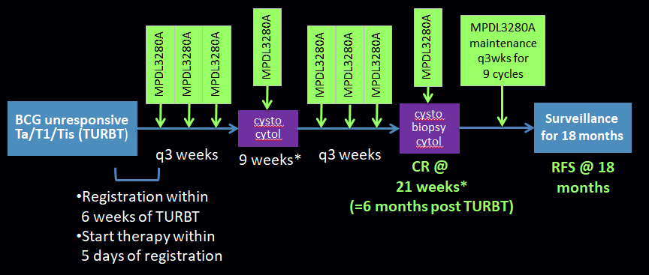
SWOG-S1605: Atezolizumab (MPDL3280A) in BCG Unresponsive High Risk NMIBC
PI: Black, Singh: ASCO 2020
Courtesy of Ashish M Kamat, MD, MBBS

Slide 17
Would you generally offer/recommend pembrolizumab to a 50-year-old otherwise healthy patient with BCG-unresponsive non-muscle-invasive urothelial bladder cancer (UBC)?
Urologists
Medical oncologists
Yes
No
Survey of 25 US-based medical oncologists and 25 US-based urologists, July 2020.

Slide 18
Would you generally offer/recommend pembrolizumab to a 70-year-old patient with BCG-unresponsive non-muscle-invasive UBC and minor comorbidities?
Urologists
Medical oncologists
Yes
No
Survey of 25 US-based medical oncologists and 25 US-based urologists, July 2020.

Slide 19
Would you generally offer/recommend pembrolizumab to an 80-year-old patient with BCG-unresponsive non-muscle-invasive UBC and significant comorbidities?
Urologists
Medical oncologists
Yes
No
Survey of 25 US-based medical oncologists and 25 US-based urologists, July 2020.

Slide 20
Optimal candidates for pembrolizumab in high-risk non-muscle-invasive UBC

Slide 21
A 68-year-old man undergoes TURBT: pT1 high-grade UBC + CIS. Second resection: pTis. BCG is started. Cystoscopy after 3 months: 0.3-cm papillary tumor. Blue light-aided TURBT: pTa low-grade UBC. What would you recommend?
Continue BCG maintenance
Stop BCG
I don’t know

Slide 22
Case Presentation – Dr Kamat: 68-Year-Old Man with NMIBC
68-year-old man
Has history of confirmed pTa low-grade bladder cancer 6 yrs ago
Stopped surveillance, now with hematuria
Medical history: diabetes type II, ECOG PS 0

Slide 23
Case Presentation – Dr Kamat: 68-Year-Old Man with NMIBC (cont)
Initial workup: Cysto and CTU
TURBT: pT1 high-grade + CIS
Second resection: pTis
Treatment with BCG started
Follow-up
Cystoscopy after 3 months: 0.3 cm papillary tumor
Blue light aided TURBT: confirms pTa low grade

Slide 24
Case Presentation – Dr Kamat: 68-Year-Old Man with NMIBC (cont)
Options?
LG recurrence on BCG therapy is not considered a failure in this case
Continued on BCG maintenance therapy; finished 3 yr maintenance
Currently NED 7 yrs out

Slide 25
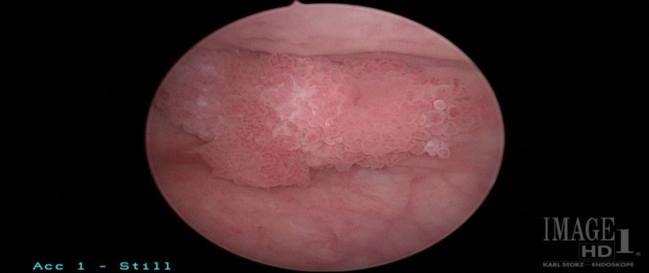
Case Presentation – Dr Kamat: 62-Year-Old Woman with NMIBC
Healthy Lady (62 yr old), gross hematuria work-up
CTU etc (imaging) negative
1 cm tumors, high posterior wall
TURBT done – high grade T1 disease, muscle present, not involved
Image © Dr Kamat, MD Anderson Cancer Center

Slide 26
Case Presentation – Dr Kamat: 62-Year-Old Woman with NMIBC (cont)
Undergoes reTUR – no residual tumor
Has a discussion of options and selects BCG therapy
Patient undergoes induction BCG, full dose, x 6 weeks
3 month evaluation – NED on cysto/cytology
Receives maintenance BCG
6 mos – positive cytology, cystoscopy negative
Blue light showed patchy areas of tumor
Biopsy performed: path showed CIS
All pathology reviewed by second pathologist and confirmed

Slide 27
Case Presentation – Dr Kamat: 62-Year-Old Woman with NMIBC (cont)
Mentions she cannot undergo cystectomy on religious grounds
Options?

Slide 28
Case Presentation – Dr Kamat: 62-Year-Old Woman with NMIBC (cont)
Patient counselled on options
Given the T1Hg and CIS, elected to undergo Pembro treatment
3 mos evaluation – negative cytology and cystoscopy
Early days, yet

Slide 29
MODULE 2: Immune Checkpoint Inhibitors as Neoadjuvant/ Adjuvant Therapy for Muscle-Invasive UBC — Dr Daneshmand
Anti-PD-1/PD-L1 antibodies in the neoadjuvant (PURE-01, ABACUS) and adjuvant (IMvigor010) settings
Ongoing trials evaluating anti-PD-1/PD-L1 antibodies in early disease settings
Case: A 77-year-old woman with MIBC

Slide 30
Neoadjuvant Systemic Treatment of Breast Cancer
Path CR > 50%, neoadjuvant preferred
ER-negative, HER2-negative (triple-negative, [TNBC])
HER2-positive: Post-op T-DM1
Low path CR; Surgery usually first
ER-positive, HER2-negative
Key Current Question: Addition of IO to neoadjuvant chemotherapy for TNBC

Slide 31
Outcomes with Cystectomy
5yr & 10yr DSS for ≤T2N0M0 60-85%
5yr DSS for extravesical (T3) disease 50%
Node-positive disease who have undergone a thorough lymph node dissection: 25-30%
Surgical factors influencing outcome:
soft tissue margin
extent of lymph node dissection
Courtesy of Siamak Daneshmand, MD

Slide 32
Adjuvant Chemotherapy
Offered to patients at high-risk for disease recurrence:
Positive lymph nodes (pN+)
T3b/T4 disease
Value of adjuvant chemotherapy has not been definitely proven
Several adjuvant chemotherapy trials have been conducted but they have been challenged by poor accrual and failure to reach predetermined end-points.
Courtesy of Siamak Daneshmand, MD

Slide 33
Adjuvant Chemotherapy for Invasive Bladder Cancer: A 2013 Updated Systematic Review and Meta-Analysis of Randomized Trials
945 patients included in 9 randomized trials
OS: pooled HR (9 trials) 0.77 (95%CI 0.59–0.99; p=0.049)
DFS: pooled HR (7 trials) 0.66 (95%CI 0.45–0.91; p=0.014)
DFS benefit more apparent in nodal metastasis (p=0.010)
LIMITATIONS
Smaller size/flawed individual trials
Variation in eligibility criteria in individual trial, lack of individual patient data
Slide Courtesy of Dr. Petros Grivas
Leow JJ, Eur Urol. 2014;66(1):42-54
Courtesy of Siamak Daneshmand, MD

Slide 34
IMvigor010 Study Design
Key eligibilityª
High-risk MIUC (bladder, renal pelvis, ureter)
Radical cystectomy/RNU within ≤ 14 weeks with lymph node dissection
ypT2-T4a or ypN+ for patients treated with neoadjuvant chemotherapy^{b}
pT3-T4a or N+ for patients not treated with neoadjuvant chemotherapy^{c}
No postsurgical radiation or AC
If no prior NAC given, patient was ineligible for or declined cisplatin-based AC
ECOG PS 0-2
Tissue sample for PD-L1 testing
Atezolizumab 1200 mg q3w
(16 cycles or 1 y)
R 1:1
No crossover allowed
Disease recurrence/ survival follow-up
Observation^{d} q3w
(16 cycles or 1 y)
Stratification factors^{c}
Number of LNs resected (<10 vs. ≥10) | Tumor stage (≤pT2 vs. pT3/pT4)
Prior neoadjuvant chemo (Yes vs. No) | PD-L1 status^{e} (IC0/1 vs. IC2/3)
LN status (+ vs. – )
Primary endpoint: DFS (ITT population)
Key secondary endpoint: OS (ITT population)
Exploratory analyses: DFS and OS by PD-L1 status
Safety
Courtesy of Siamak Daneshmand, MD
Hussain MHA et al. ASCO 2020;Abstract 5000.

Slide 35
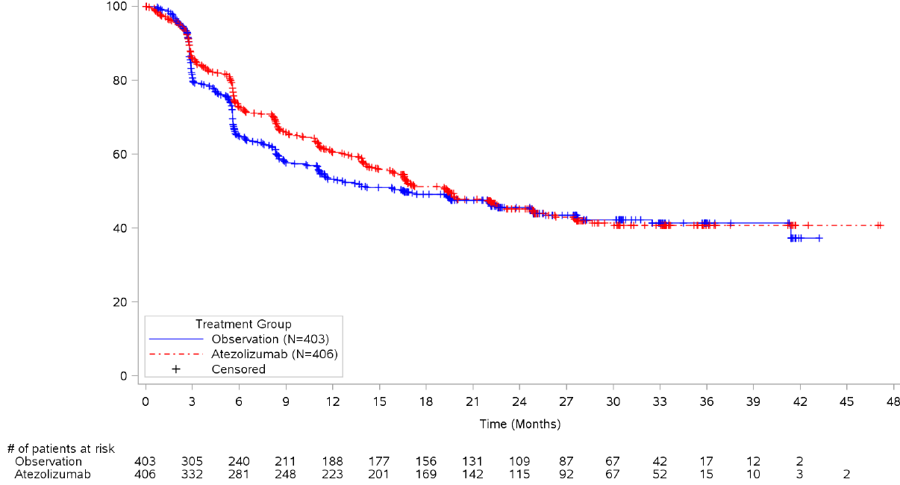
DFS in ITT Population
Arm, (95% CI) | Atezolizumab (n = 406) | Observation (n = 403)
DFS events, n (%) | 212 (52) | 208 (52)
Median DFS (95% CI), mo | 19.4 (15.9, 24.8) | 16.6 (11.2, 24.8)
18-mo DFS rate (95% CI), % | 51 (46, 56) | 49 (44, 54)
DFS HR (95% CI)ª | 0.89 (95% CI: 0.74, 1.08)
Atezolizumab
Observation
Courtesy of Siamak Daneshmand, MD
Hussain MHA et al. ASCO 2020;Abstract 5000.

Slide 36
A 65-year-old man begins neoadjuvant dose-dense MVAC for muscle-invasive UBC but discontinues therapy after 2 cycles due to significant difficulty tolerating therapy, including a decline in creatinine clearance to 45 mL/min. The patient undergoes cystectomy, which reveals significant residual disease and a positive pelvic lymph node. PD-L1 = 20%. What adjuvant systemic therapy, if any, would you recommend?
Urologists
Medical oncologists
Anti-PD-1/PD-L1 antibody
Carboplatin-based chemotherapy
Cisplatin-based chemotherapy
None
Survey of 25 US-based medical oncologists and 25 US-based urologists, July 2020.

Slide 37
A 77-year-old woman is s/p cystectomy for pT3aN0M0 UBC. Would you recommend adjuvant chemotherapy?
Yes
No
I don’t know

Slide 38
Case Presentation – Dr Daneshmand: A 77-Year-Old Woman with MIBC
77yo female underwent TURBT on 8/27/2014 with pathology revealing squamous cell carcinoma (pure).
Oct 2014 → Anterior Pelvic Exent/ePLND/ileal conduit
Path: HG UC with Squamous diff (20%), pT3aN0(0/43)M0
Completed 4 cycles of Gem/Cis in 3/2015
Courtesy of Sia Daneshmand, MD

Slide 39
Case Presentation – Dr Daneshmand: A 77-Year-Old Woman with MIBC (cont)
18 months later – August 2016
LUL Lung Nodule x 2
Biopsy: Metastatic UC
No other site of disease
Courtesy of Sia Daneshmand, MD

Slide 40
Case Presentation – Dr Daneshmand: A 77-Year-Old Woman with MIBC (cont)
Underwent SBRT in two fractions Oct-Nov 2016
Treated with atezolizumab on 11/15/2016
Developed pneumonitis 5/22/2017
Treated with Steroids and Tx discontinued
CT 6/30/2020: NED
Courtesy of Sia Daneshmand, MD

Slide 41
MODULE 3: Immune Checkpoint Inhibitors in Advanced UBC — Dr Balar
Pembrolizumab and atezolizumab as first-line treatment of metastatic UBC (mUBC)
FDA approval of avelumab as first-line maintenance (JAVELIN Bladder 100)
Available data with anti-PD-1/PD-L1 antibodies combined with other systemic therapies in mUBC
Case: 70-year-old man with metastatic urothelial cancer
Case: 78-year-old man with metastatic urothelial cancer

Slide 42
Major changes to locally advanced/metastatic UC treatment paradigm since 2016
First-line therapy remains platinum-based combination chemotherapy for most patients
Immunotherapy in first-line setting for cisplatin-ineligible patients with PD-L1-high tumors
Maintenance immunotherapy to become standard following chemotherapy
Two novel agents approved in 2019
Erdafitinib targeting FGFR pathway alterations
Enfortumab vedotin antibody-drug conjugate targeting Nectin-4
Courtesy of Jonathan E Rosenberg, MD

Slide 43
Chemotherapy - before the checkpoint era<br />Note the “tail” on the curve for cisplatin
Presented By Elizabeth Plimack at TBD

Slide 44
Regulatory Updates for Anti-PD-1/PD-L1 Therapy in Advanced Cis-Ineligible UC
Requires the use of an FDA-approved companion diagnostic test to determine PD-L1 levels in tumor tissue
Pembrolizumab is indicated for the treatment of patients with locally advanced or metastatic UC who are not eligible for cisplatin-containing chemotherapy and whose tumors express PD-L1 (CPS ≥10) as determined by an FDA-approved test, or in patients who are not eligible for any platinum-containing chemotherapy regardless of PD-L1 status
Atezolizumab is indicated for the treatment of patients with locally advanced or metastatic UC who are not eligible for cisplatin-containing chemotherapy and whose tumors express PD-L1 (PD-L1–stained tumor-infiltrating immune cells covering ≥5% of the tumor area), as determined by an FDA-approved test, or are not eligible for any platinum-containing therapy regardless of PD-L1 status
Courtesy of Arjun V Balar, MD

Slide 45
KEYNOTE-361: BREAKING NEWS!
Update on Phase 3 KEYNOTE-361 Trial Evaluating Pembrolizumab as Monotherapy and in Combination with Chemotherapy in Patients with Advanced or Metastatic Urothelial Carcinoma
June 09, 2020
KENILWORTH, N.J. --(BUSINESS WIRE)-- The Phase 3 KEYNOTE-361 trial evaluating pembrolizumab, an anti-PD-1 therapy, in combination with chemotherapy for the first-line treatment of patients with advanced or metastatic urothelial carcinoma (bladder cancer) did not meet its pre-specified dual primary endpoints of overall survival (OS) or progression-free survival (PFS), compared with standard of care chemotherapy. In the final analysis of the study, there was an improvement in OS and PFS for patients treated with pembrolizumab in combination with chemotherapy (cisplatin or carboplatin plus gemcitabine) compared to chemotherapy alone; however, these results did not meet statistical significance per the pre-specified statistical plan. The monotherapy arm of the study was not formally tested, since superiority was not reached for OS or PFS in the pembrolizumab combination arm. The safety profile of pembrolizumab in this trial was consistent with previously reported studies, and no new safety were identified. Results will be presented at an upcoming medical meeting and will be discussed with regulatory authorities.
Courtesy of Arjun V Balar, MD

Slide 46
JAVELIN Bladder 100 study design (NCT02603432)
All endpoints measured post randomization (after chemotherapy)
Primary endpoint
OS
Primary analysis populations
All randomized patients
PD-L1+ population
Secondary endpoints
PFS and objective response per RECIST 1.1
Safety and tolerability
PROs
CR, PR, or SD with standard 1st-line chemotherapy (4-6 cycles)
Cisplatin + gemcitabine or
Carboplatin + gemcitabine
Unresectable locally advanced or metastatic UC
Avelumab 10 mg/kg IV Q2W + BSC* n=350
Treatment-free interval 4-10 weeks
R 1:1
Until PD, unacceptable toxicity, or withdrawal
N=700
BSC alone* n=350
Stratification
Best response to 1st-line chemo (CR or PR vs SD)
Metastatic site (visceral vs non-visceral)
PD-L1+ status was defined as PD-L1 expression in ≥25% of tumor cells or in ≥25% or 100% of tumor-associated immune cells if the percentage of immune cells was >1% or ≤1%, respectively, using the SP263 assay; 358 patients (51%) had a PD-L1–positive tumor
BSC, best supportive care; CR, complete response; IV, intravenous; PR, partial response; PRO, patient reported outcome; Q2W, every 2 weeks; R, randomization; RECIST 1.1, Response Evaluation Criteria in Solid Tumors version 1.1; SD, stable disease
*BSC (eg, antibiotics, nutritional support, hydration, or pain management) was administered per local practice based on patient needs and clinical judgment; other systemic antitumor therapy was not permitted, but palliative local radiotherapy for isolated lesions was acceptable
Powles T et al. ASCO 2020;Abstract LBA1.
Courtesy of Arjun V Balar, MD

Slide 47
JAVELIN Bladder 100: OS in the overall population
100
Median OS (95% CI), months
Avelumab + BSC | 21.4 (18.9, 26.1)
BSC alone | 14.3 (12.9, 17.9)
90
Overall survival, %
80
71%
70
61%
Stratified HR 0.69 (95% CI, 0.56, 0.86)
P<0.001
60
58%
50
40
44%
30
20
10
0
0
2
4
6
8
10
12
14
16
18
20
22
24
26
28
30
32
34
36
38
No. at risk
Avelumab + BSC
BSC
Months
350
342
318
294
259
226
196
167
145
122
87
65
51
39
26
15
11
5
3
0
350
335
304
270
228
186
153
125
105
83
68
55
41
33
18
12
9
2
1
0
OS was measured post randomization (after chemotherapy); the OS analysis crossed the prespecified efficacy boundary based on the alpha-spending function (P<0.0053)
Powles T et al. ASCO 2020;Abstract LBA1.
Courtesy of Arjun V Balar, MD

Slide 48
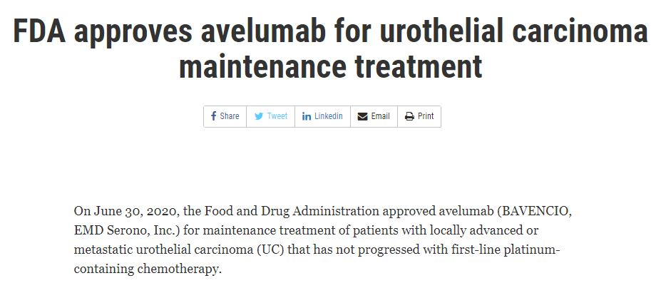
On June 30, 2020, the Food and Drug Administration approved avelumab for maintenance treatment of patients with locally advanced or metastatic urothelial carcinoma (UC) that has not progressed with first-line-platinum containing chemotherapy.
Courtesy of Arjun V Balar, MD

Slide 49
Switch maintenance in mUC:<br />Phase II trial<br />HCRN GU14-182
Presented By Elizabeth Plimack at TBD

Slide 50
Slide 13
Presented By Elizabeth Plimack at TBD

Slide 51
Post platinum, is switch maintenance checkpoint inhibition preferred over a treatment break followed by second line?
Presented By Elizabeth Plimack at TBD

Slide 52
JAVELIN 100 ushers In two paradigm shifts in the treatment of metastatic urothelial cancer
Presented By Elizabeth Plimack at TBD

Slide 53
What would you generally recommend for a patient who experiences disease recurrence 9 months after cystectomy and adjuvant chemotherapy for muscle-invasive UBC?
Medical oncologists
Pembrolizumab
Atezolizumab
Other immunotherapy
Test for FGFR gene alterations and administer erdafitinib if positive
Other chemotherapy
Survey of 25 US-based medical oncologists, July 2020.

Slide 54
What would you generally recommend for a patient who experiences disease recurrence 18 months after cystectomy and adjuvant chemotherapy for muscle-invasive UBC?
Medical oncologists
Pembrolizumab
Atezolizumab
Other immunotherapy
Test for FGFR gene alterations and administer erdafitinib if positive
Other chemotherapy
Survey of 25 US-based medical oncologists, July 2020.

Slide 55
Have you discontinued or would you discontinue anti-PD-1/ PD-L1 antibody therapy for a patient with metastatic UBC who is experiencing a durable response?
Medical oncologists
I have
I have not but would for the right patient
I have not and would not
Survey of 25 US-based medical oncologists, July 2020.

Slide 56
Regulatory and reimbursement issues aside, would you administer anti-PD-1/ PD-L1 antibody maintenance to a 70-year-old man with mUBC and a creatinine of 1.9 who achieves a partial response to first-line carboplatin/gemcitabine?
Yes, avelumab
Yes, pembrolizumab
Yes, other
No
I don’t know

Slide 57
In general, how often do you believe pembrolizumab should be administered?
Every 3 weeks
Every 6 weeks
I don’t know

Slide 58
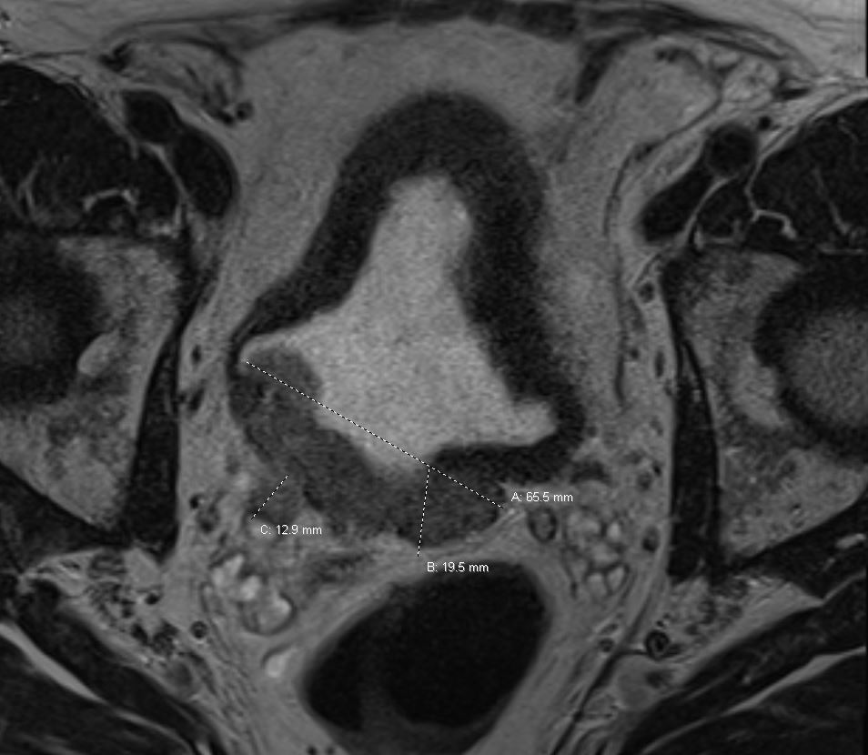
Case Presentation – Dr Balar: 70-Year-Old Man with Metastatic Urothelial Cancer
70 year old man, former smoker and hypothyroidism presented to NYU ED on 11/11/2018 c/o right flank pain.
Found to have atrophic left kidney and AKI due to right sided hydronephrosis from a large bladder mass
11/20/2018 Cytoscopy/TURBT: large papillary/sessile mass obscuring right UO
Pathology: muscle-invasive urothelial cancer
Right ureteral stent
11/21/2018 MRI AP with contrast: 5.4 cm posterolateral bladder wall mass, no metastatic disease
12/19/2018 Hgb 13.2; creatinine 0.90, normal LFTs
ECOG PS 0
Courtesy of Arjun V Balar, MD

Slide 59
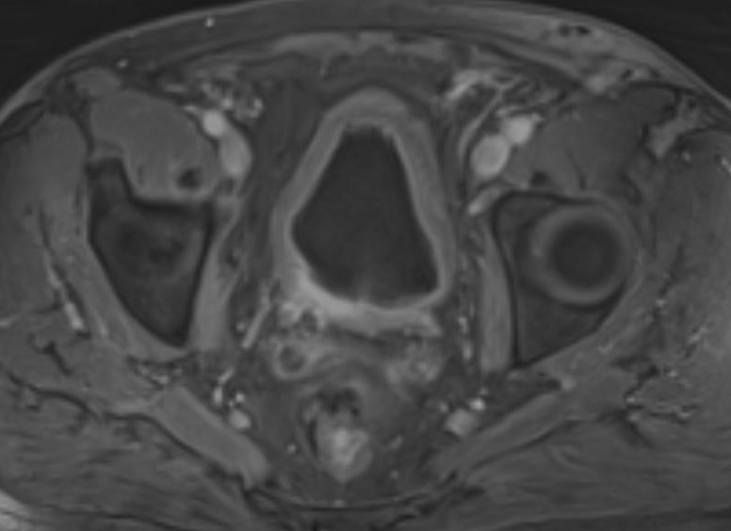
Case Presentation – Dr Balar: 70-Year-Old Man with Metastatic Urothelial Cancer (cont)
Counseled about treatment options, refuses radical cystectomy, interested in bladder preservation therapy
Enrolled to NYU S15-00220 phase II study of pembrolizumab
Anti-PD-1 added to Trimodal bladder preservation therapy (Maximal TURBT followed by Hypofractionated radiation therapy and twice weekly gemcitabine)
Receives treatment between 1/25/2019 through 4/22/2019
6/24/2019 Post-treatment cystoscopy/TUR of tumor bed
no residual carcinoma; normal urine cytology
6/21/2019 CT Chest/MR Urogram:
Previous bladder tumor no longer visualized, mucosal enhancement consistent with treatment effect
No metastatic disease
Courtesy of Arjun V Balar, MD

Slide 60
Case Presentation – Dr Balar: 70-Year-Old Man with Metastatic Urothelial Cancer (cont)
On surveillance doing well
1/3/2020 MRI AP: New metastatic retroperitoneal lymph nodes, largest 4.9 x 2.1 cm in left para-aortic region; normal bladder but progressive right ureteral stricture
Creatinine: 1.90, ECOG PS 0
Treated with Gemcitabine and Carboplatin x 6 cycles (2/6/2020 through 5/27/2020)
6/24/2020 MRI AP: Moderate response in RP adenopathy (largest 2.5 x 1.8 cm), no new metastases
ECOG PS remains 0
What’s the next step?
Treatment break or maintenance immunotherapy?
Courtesy of Arjun V Balar, MD

Slide 61
Case Presentation – Dr Balar: 78-Year-Old Man with Metastatic Urothelial Cancer
78 year old practicing psychologist
PMH: Low-risk Prostate Cancer on AS and BPH
Presented with gross hematuria in October 2018; CT AP confirmed a large bladder mass
11/26/2018 Cystoscopy/TURBT: 6 cm mass posterior wall/bladder dome
Muscle-invasive urothelial cancer
Referred to medical oncology in 12/20/2018 he reported feeling generally well (ECOG PS 0), however at the end of the visit, he incidentally reported mass-like thickening and rigidity of his penis
Courtesy of Arjun V Balar, MD

Slide 62
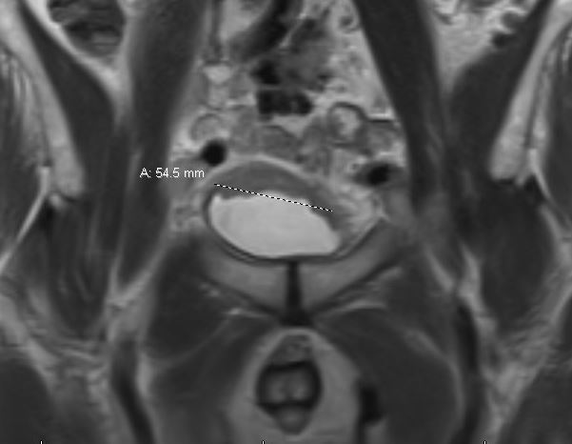
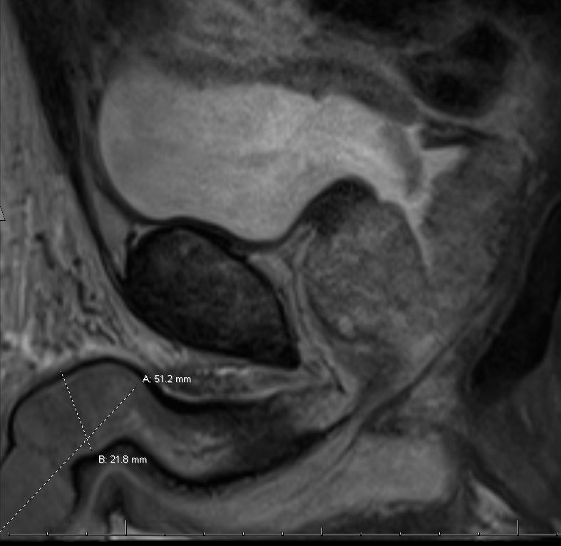
Case Presentation – Dr Balar: 78-Year-Old Man (cont)
12/21/2018 MR Urogram:
12/26/2018 FNA of Penile Mass: Malignant cells consistent with metastatic urothelial cancer
Courtesy of Arjun V Balar, MD

Slide 63
Case Presentation – Dr Balar: 78-Year-Old Man with Metastatic Urothelial Cancer (cont)
ECOG PS 0
12/24/2018 Labs: Hgb 11.8; Cr 1.00, normal LFTs
Treatment Discussion:
Cisplatin-based chemotherapy
Adamant about avoiding chemotherapy
Interested only in “natural treatments”
Willing to accept immunotherapy as a “natural treatment”
12/2018 TURBT tissue tested for PD-L1
CPS 50% (clone 22C3)
Courtesy of Arjun V Balar, MD

Slide 64
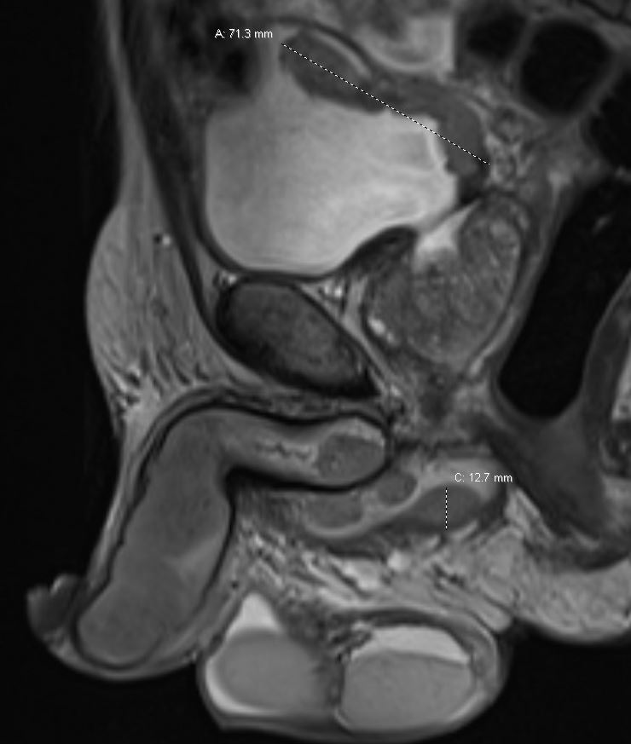
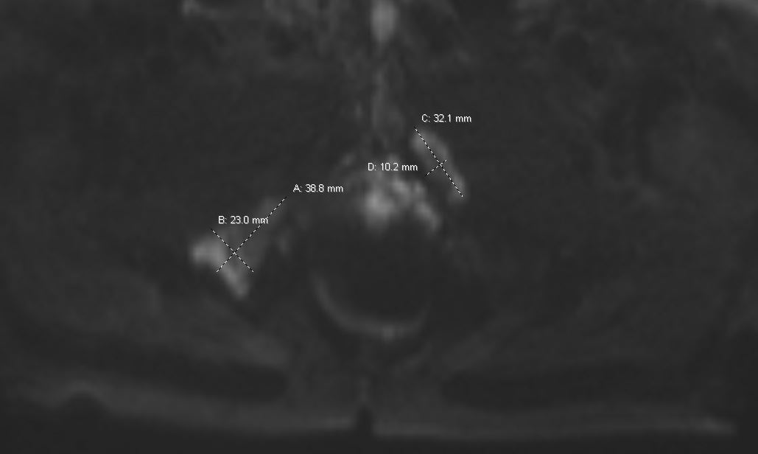
Case Presentation – Dr Balar: 78-Year-Old Man (cont)
Multiple visits/treatment discussions
Begins single agent pembrolizumab on 1/14/2019 and receives a total of 3 cycles
Penile mass less firm, urinating normally after 2nd cycle, complicated by fatigue
3/14/2019 CT/MRI: POD, new/increasing penile lesions, new bone metastases, new and increasing sub-cm pulmonary nodules
Courtesy of Arjun V Balar, MD

Slide 65
Case Presentation – Dr Balar: 78-Year-Old Man with Metastatic Urothelial Cancer (cont)
Despite imaging, patient feels very well, urinating normally, no symptoms concerning for disease progression
Refuses further treatment with pembrolizumab (last dose 2/25/2019), still unwilling to consider chemotherapy
4/17/2019 CT Chest and MRI Urogram: continued progression in bladder mass, mild increase in penile lesions, stable osseous metastases, some lung nodules smaller
Despite continued progression, refuses further evaluation/interventions since he feels so well.
Courtesy of Arjun V Balar, MD

Slide 66
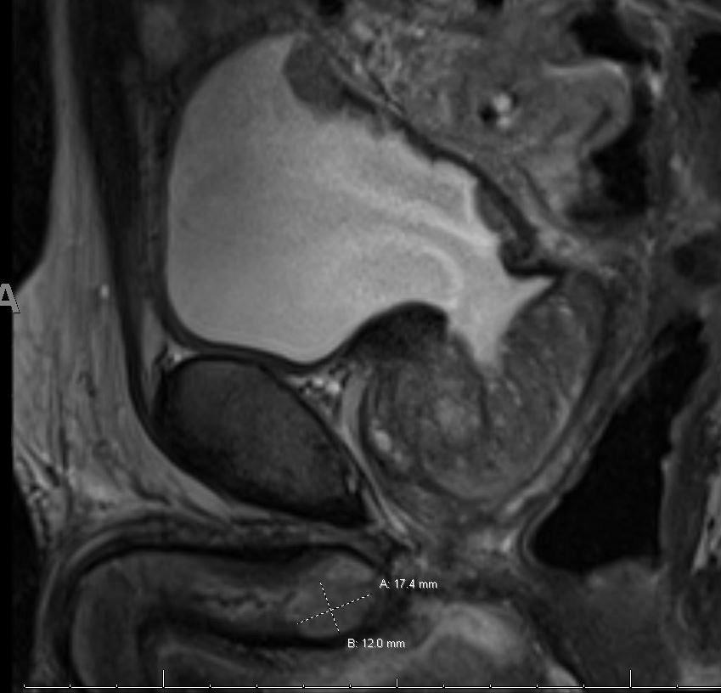
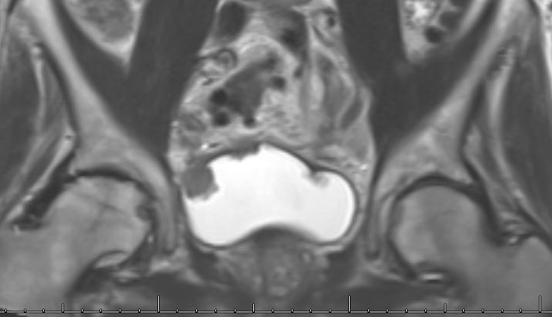
Case Presentation – Dr Balar: 78-Year-Old Man (cont)
6/5/2019 MRI Urogram: decreasing bladder, penile and pelvic nodal metastases, stable bone
Courtesy of Arjun V Balar, MD

Slide 67
MODULE 4: Current and Future Roles of Recently FDA-Approved Novel Therapies — Dr Rosenberg
Clinical research data leading to FDA approvals of erdafitinib and enfortumab vedotin
Adverse event profiles of erdafitinib and enfortumab vedotin; monitoring and management strategies
FDA Breakthrough Therapy: Enfortumab vedotin combined with pembrolizumab
Case: 74-year-old man with mUBC
Case: 74-year-old woman with mUBC

Slide 68
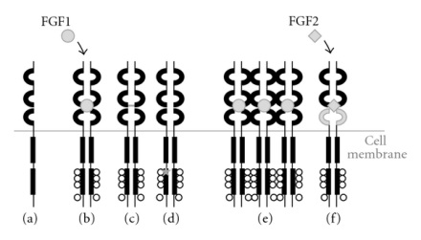
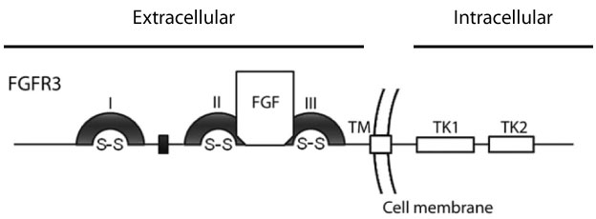
Fibroblast Growth Factor Receptor 3 is a therapeutic target in mUC
Mutation frequency in non-invasive disease is >50% in Ta tumors
Mutations and fusions are less common in advanced UC
Mutation 5-15%
Fusion 3-5% using NGS
FGFR3 activation can occur by mutation, overexpression or gene fusion
FGFR3 signals via PI3K, PKC, RAS/MAP kinase pathways
Mutation leads to ligand independent dimerization
Fusion/translocation
TACC3
FGFR3
Overexpression
Courtesy of Jonathan E Rosenberg, MD

Slide 69
Erdafitinib is the first targeted therapy approved for advanced bladder cancer
Accelerated approval April 12, 2019
Indicated in tumors with FGFR3 or FGFR2 alterations
Progression during or following prior platinum-containing chemotherapy
Dosing:
8 mg daily
Increase to 9 mg daily if serum phosphorus level is <5.5 mg/dL (and no ocular disorders or ≥ grade 2 toxicity) at days 14-21 of therapy
Continue until disease progression or unacceptable toxicity occurs
Monthly ophthalmologic exams x 4 then q3 months
Courtesy of Jonathan E Rosenberg, MD

Slide 70
Phase II BLC2001 Trial
Enrolled 99 patients with FGFR 1-3 alterations
88% had prior chemotherapy, 22% prior immunotherapy
12% had no prior systemic therapy
Majority had visceral metastases
Objective response rate 40% with 3% CR rate (per investigator)
Median TTR 1.4 months
Median DOR 5.6 months
5/12 patients without prior therapy responded (not FDA approved population)
Y Loriot et al. N Engl J Med 2019;381:338-348. Courtesy of Jonathan E Rosenberg, MD

Slide 71
Some patients treated with erdafitinib have responses >1 year
Response to Treatment, According to Subgroup.
Y Loriot et al. N Engl J Med 2019;381:338-348. Courtesy of Jonathan E Rosenberg, MD
Notes:
Figure 1. Response to Treatment, According to Subgroup. Panel A shows the rate of complete or partial response to continuous daily treatment with erdafitinib among patients in the selected-regimen group, according to subgroup. The safety profile allowed for a dose escalation from 8 mg to 9 mg of erdafitinib per day in 41 of the 99 patients who met target levels for serum phosphate. Panel B shows the duration and type of response in 47 patients, of whom 40 had a confirmed response (the primary end point) and 7 had an unconfirmed response. All objective responses required confirmation by an additional scan within 6 weeks after the first assessment. Race was reported by the patients. Scores on the Eastern Cooperative Oncology Group (ECOG) scale range from 0 (no disability) to 5 (death).

Slide 72
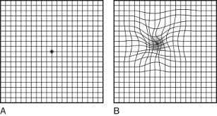
BLC2001: Toxicity of erdafitinib
55% of patients required dose reductions
41% of patients were able to escalate to 9 mg daily
59% required subsequent dose reductions
46% of patients had grade 3 or higher AE attributable to treatment
Most common toxicities are hyperphosphatemia (on-target effect), stomatitis, and diarrhea
Central serous retinopathy in 21% of patients, 3% grade 3
Generally reversible
Amsler grid testing
Y Loriot et al. N Engl J Med 2019;381:338-348. Courtesy of Jonathan E Rosenberg, MD

Slide 73
Enfortumab Vedotin: Nectin-4 Targeted Therapy
Binds to antigen
Cell cycle arrest and apoptosis
Courtesy of Jonathan E Rosenberg, MD

Slide 74
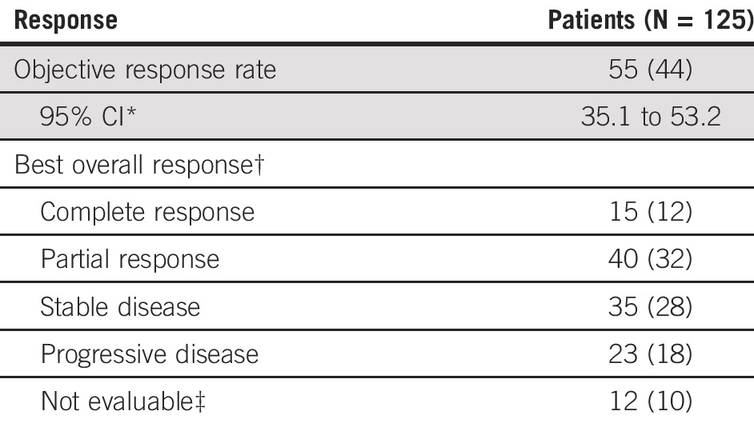
Phase II EV-201 Trial: Enfortumab Vedotin has high antitumor activity in refractory patients
Single arm phase II study in mUC patients previously treated with platinum-based chemotherapy and immunotherapy
ORR 44%
Similar to phase I data
12% complete responses
Responses seen in patients with liver metastases
Median TTR is 1.8 months
Median DOR is 7.6 months
Courtesy of Jonathan E Rosenberg, MD
Rosenberg et al. J Clin Oncol. 2019; 29; 2592-2600

Slide 75
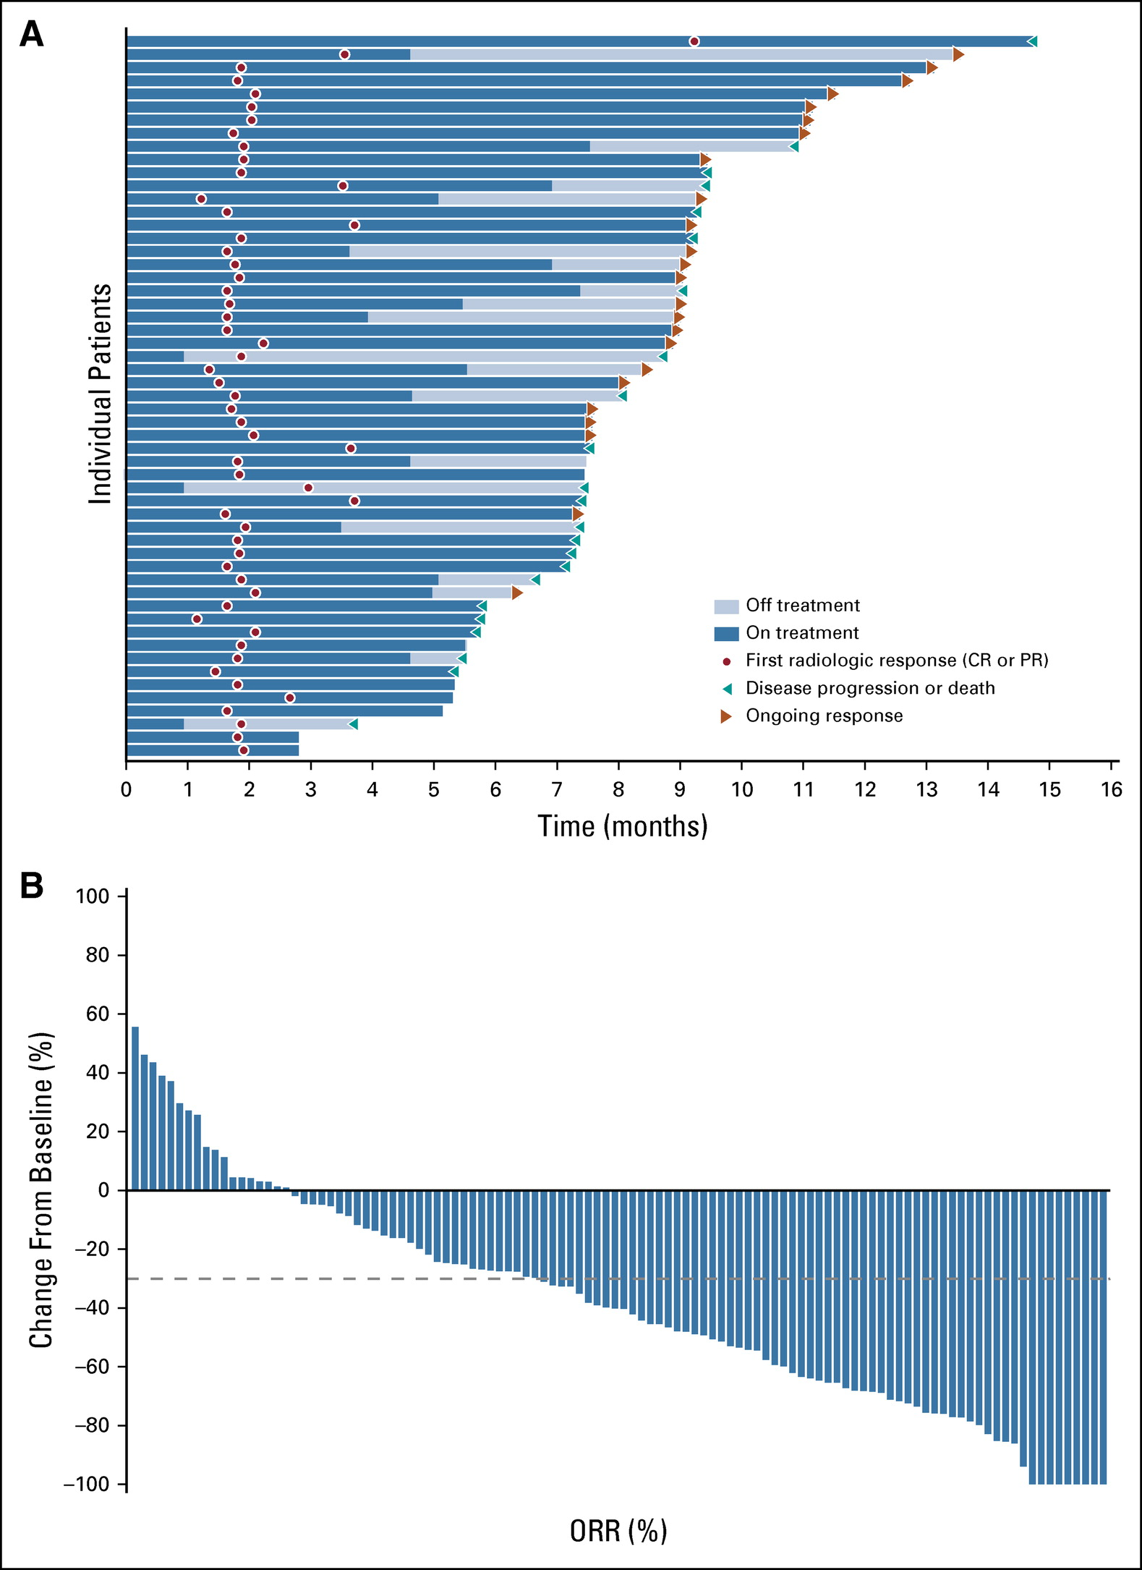
EV-201: Majority of patients have tumor reduction, many responses ongoing
Courtesy of Jonathan E Rosenberg, MD
Rosenberg et al. J Clin Oncol. 2019; 29; 2592-2600

Slide 76
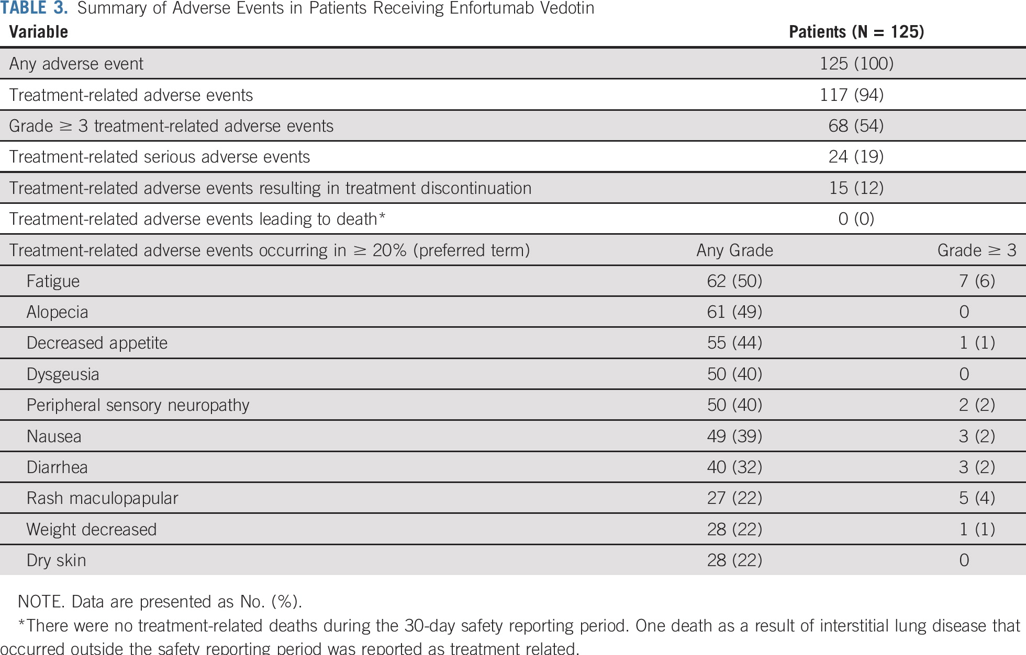
EV-201: Common Enfortumab Vedotin toxicities include fatigue, rash, neuropathy
Courtesy of Jonathan E Rosenberg, MD
Rosenberg et al. J Clin Oncol. 2019; 29; 2592-2600

Slide 77
Enfortumab vedotin in mUC
FDA approved for platinum- and IO-previously treated patients
Based on high ORR, front-line testing is being explored
Preclinical and clinical data with MMAE (cytotoxic payload of EV) suggest it may lead to immunogenic cell death
EV-103 is a multi-cohort Phase I/II trial testing EV combinations in mUC
Courtesy of Jonathan E Rosenberg, MD

Slide 78
EV-103: First-line Cohorts of Enfortumab Vedotin + Pembrolizumab
Enfortumab vedotin 1.25 mg/kg + pembrolizumab (200 mg) in 1L cisplatin-ineligible la/mUC patients (N=45)
Dosing: Enfortumab vedotin on days 1 and 8 and pembrolizumab on day 1 of every 3-week cycle
Enfortumab vedotin exposure: Comparable to enfortumab vedotin monotherapy on 4-week schedule (Days 1, 8, and 15)²
Primary endpoints: adverse events (AEs), lab abnormalities
Key secondary endpoints: dose-limiting toxicities, ORR, DOR, PFS, OS
Patient Population
Locally Advanced or Metastatic Urothelial Carcinoma
Dose
Escalation¹
enfortumab vedotin + pembrolizumab
cisplatin-ineligible
(n=5)
Dose Expansion Cohort A
enfortumab vedotin + pembrolizumab
cisplatin-ineligible
(n=40)
Rosenberg, et al. GU Cancers Symposium 2020
¹ Not included in the current analysis: Three 1L pts treated with EV 1 mg/kg + pembrolizumab 200 mg and two 2L pts treated with EV 1.25 mg/kg + pembrolizumab 200 mg
² Rosenberg JE et al. J Clin Oncol 2019;37(29):2592-600.
Courtesy of Jonathan E Rosenberg, MD

Slide 79
How would you generally sequence enfortumab vedotin and erdafitinib for a patient with metastatic UBC who is eligible to receive both agents?
Medical oncologists
Enfortumab vedotin → erdafitinib
Erdafitinib → enfortumab vedotin
I don’t know
Survey of 25 US-based medical oncologists, July 2020.

Slide 80
What would you generally recommend for a patient with FGFR wild-type UBC metastatic to the liver who receives first-line cisplatin/gemcitabine followed by maintenance avelumab and experiences disease progression during the maintenance avelumab?
Medical oncologists
Enfortumab vedotin
Nivolumab/ipilimumab
Other
Survey of 25 US-based medical oncologists, July 2020.

Slide 81
What would you generally recommend as second-line therapy for a patient with UBC metastatic to the liver who receives first-line cisplatin/gemcitabine but experiences disease progression and is found to have an FGFR3 mutation?
Medical oncologists
Erdafitinib
Enfortumab vedotin
Atezolizumab
Pembrolizumab
Other
Survey of 25 US-based medical oncologists, July 2020.

Slide 82
In a patient with progressive metastatic UBC with an FGFR genetic alteration, would you generally administer erdafitinib prior to enfortumab vedotin?
Yes
No, I would administer enfortumab vedotin first
I don’t know

Slide 83
Case Presentation – Dr Rosenberg: 74-Year-Old Man with mUBC
74 yo man with h/o muscle invasive bladder cancer s/p cystectomy in 2017
Relapse 1 year later with lung nodules and received gem/carbo
PD 2 months after completing 6 cycles of therapy (stable disease best response)
Received pembrolizumab with best response as stable disease for 6 months then PD in pelvis
Severe pelvic pain requiring high doses of opiates due to tumor invading pelvic sidewall
Enrolled on trial of enfortumab vedotin.
Pain relief by c1d15. Course complicated by grade 1 neuropathy and grade 2 rash including blistering rash on ankles. Managed with topical corticosteroids and silver sulfadiazine with improvement.
Treated for 9 months with partial response in measurable disease
POD in sacrum with severe pain. Radiotherapy administered for palliation. Pt resumed therapy with EV as other disease was stable. However, imaging 3 months later showed progression in liver. Pt’s condition deteriorated significantly and he died 8 weeks later without receiving additional systemic therapy.

Slide 84
Case Presentation – Dr Rosenberg: 74-Year-Old Woman with mUBC
74 yo woman with renal insufficiency s/p RC with progression of disease 1 year later in lung and lymph nodes. NGS performed and showed FGFR3 mutation (S249C)
Pt initially treated with gemcitabine and carboplatin with initial response to therapy.
Erdafitinib initiated, phosphorus at 2 weeks was 4.6 and so dose was escalated to 9 mg daily.
4 weeks later, developed grade 3 stomatitis, and grade 3 fingernail changes. Stomatitis managed with dexamethasone rinses and fingernails treated with oral antibiotics for paronychia.
Erdafitinib held for 2 weeks, and resumed at 6mg once stomatitis improved and paronychia resolved.
Scans after 3 months with stable disease overall. Continues on erdafitinib 6 mg dosing with grade 1 stomatitis managed with dexamethasone rinses.

