Slide 1
Liquid Biopsy for Cancer Screening
Eric A. Klein, MD
Professor and Chair
Glickman Urological and Kidney Institute
Cleveland Clinic Lerner College of Medicine

Slide 2
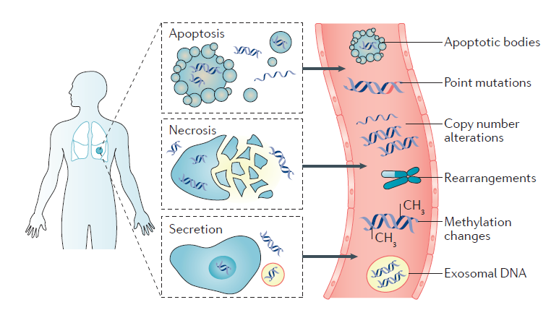
Tumors Shed Biological Substrates
Wan et al, Nat Rev Cancer, 2017

Slide 3
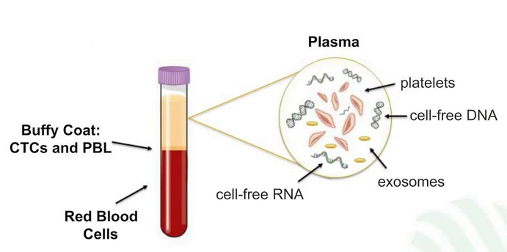
Liquid Biopsy
NGS can detect driver mutations with variant allele fractions <1% in plasma cfDNA
Schwarzenbach et al, Nat Rev Cancer 11:426, 2011
Mellert et al, J Molec Diagn 19;404, 2017
Notes:
Voiceover: An independent test set was used to assess performance and the consistency between training and test suggests no evidence of overfitting.

Slide 4
Notes:
Voiceover: An independent test set was used to assess performance and the consistency between training and test suggests no evidence of overfitting.

Slide 5
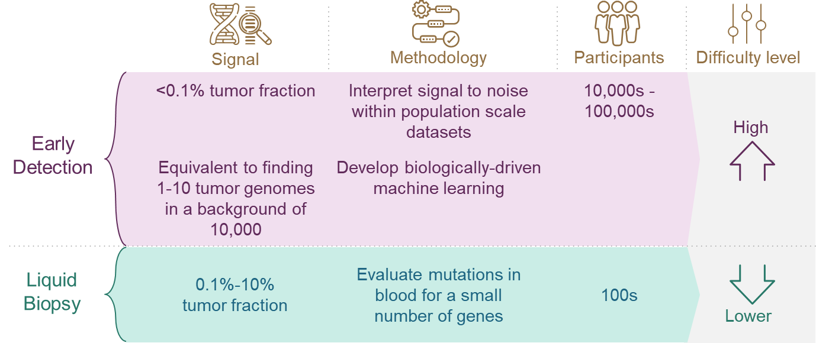
Liquid Biopsy Early Detection vs. Established Cancer
Established
Cancer
Notes:
Voiceover: An independent test set was used to assess performance and the consistency between training and test suggests no evidence of overfitting.

Slide 6
Liquid Biopsy
Enabling Technologies
Microfluidics
Droplet-based digital PCR
Next Generation Sequencing
Notes:
Voiceover: An independent test set was used to assess performance and the consistency between training and test suggests no evidence of overfitting.

Slide 7
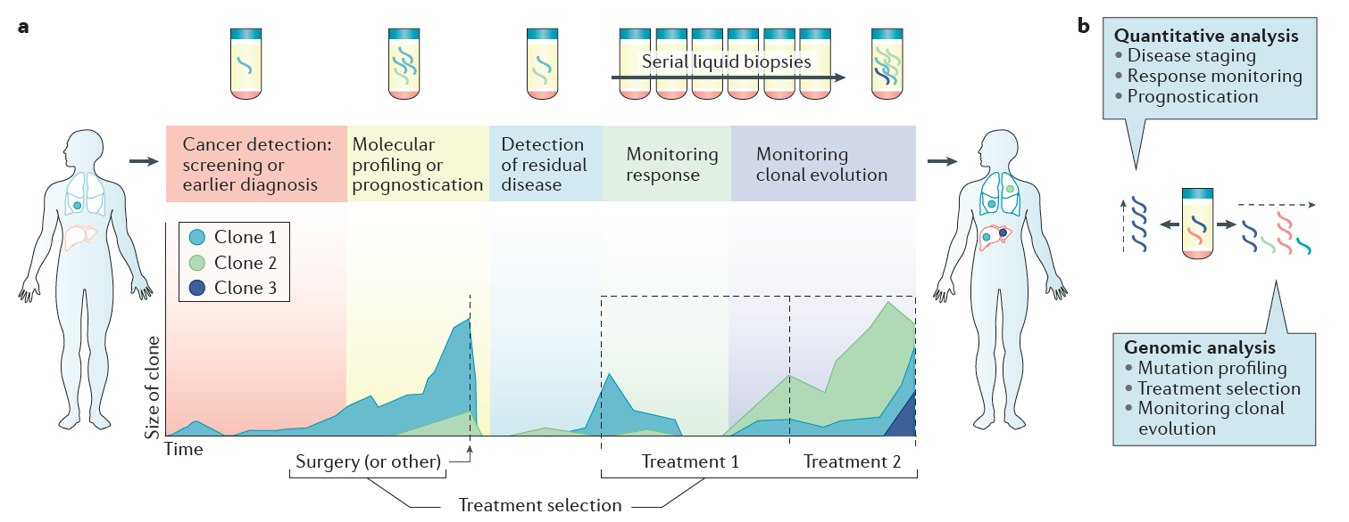
Role of Liquid Biopsy in Cancer
Wan et al, Nat Rev Cancer, 2017

Slide 8
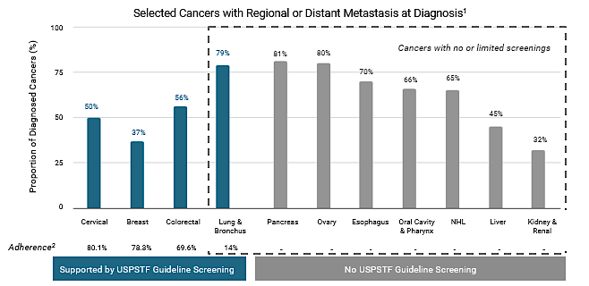
The Unmet Need in Cancer Screening
¹Siegel R, et al. Cancer Statistics, 2018. CA Cancer J Clin. 2018;68(1):7-30.
²Centers for Disease Control and Prevention, National Center for Chronic Disease Prevention and Health Promotion, Division of Population Health. BRFSS Prevalence & Trends Data. 2015. https://www.cdc.gov/brfss/brfssprevalence. Accessed January 6, 2020. Zahnd, et al. Am J Prev Med 2019;57(2):250−255

Slide 9
Requirements for a Screening Test
High sensitivity
Very high specificity (>99%)
Low cost/high throughput
Easy to administer
Minimal harm
Notes:
Voiceover: An independent test set was used to assess performance and the consistency between training and test suggests no evidence of overfitting.

Slide 10
Published Studies
CancerSeek
PanSEER
Circulating Cancer Genome Atlas (CCGA)
Notes:
Voiceover: An independent test set was used to assess performance and the consistency between training and test suggests no evidence of overfitting.

Slide 11
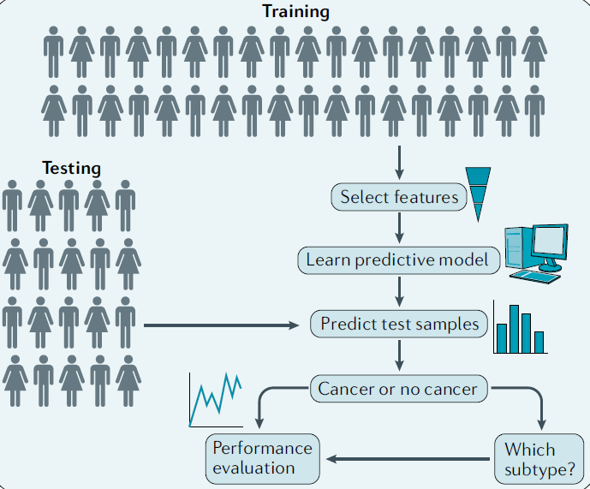
Study Design
Li and Zhou, Nat Rev Clin Oncol doi.org/10.1038/s41571-020-0420-0

Slide 12
CancerSEEK
Study population
Analytic Strategy
N = 1,005
All with Stage I – III Cancer
Most were symptomatic
Ovary
Liver
Stomach
Pancreas
Esophagus
Colorectum
Lung
Breast
Targeted mutation detection
Protein immunoassay
Cohen et al, Science 359:926, 2018

Slide 13
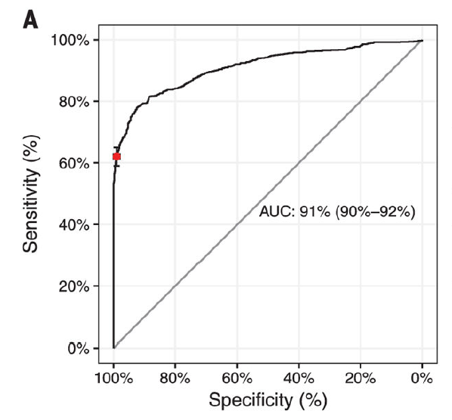
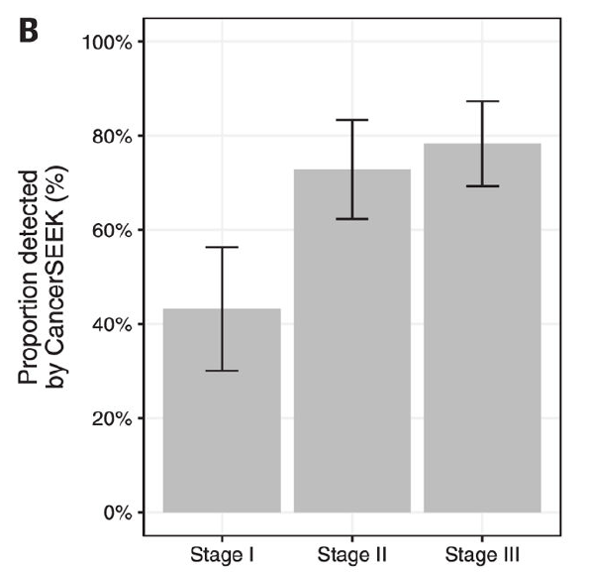
CancerSEEK
Overall Performance
Detection by Stage
62% sensitivity
@ >99% specificity
Cohen et al, Science 359:926, 2018

Slide 14
CancerSEEK
Prediction of Tissue of Origin
Detection by Tumor Type
(all stages)
Cohen et al, Science 359:926, 2018

Slide 15
PanSEER
Study population
Analytic Strategy
Taizhou Longitudinal Study
N = 123,115 stored plasma
Longitudinal follow-up
605 Healthy individuals*
223 with known cancer
Targeted
methylation
+
*191 developed stomach, esophageal,
colorectal, lung or liver cancer w/in 4 years
Chen et al, Nature Communications doi.org/10.1038/s41467-020-17316-z

Slide 16
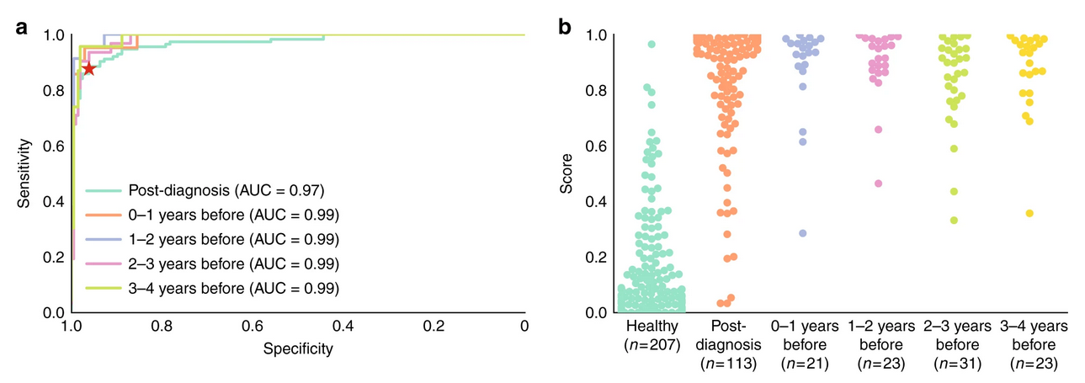
PanSEER
88% sensitivity
@ 96% specificity
Chen et al, Nature Communications doi.org/10.1038/s41467-020-17316-z

Slide 17
CCGA Study Design
~15,000 participants
70% cancer : 30% non-cancer
12,200 reserved for future studies
Enrollment 8/16 – 2/19
2,800 participants:
Prespecified case-control substudy
1,628 cancer; 1,172 non-cancer
Training Set: 1,785
Clinically Locked
Test Set: 1,010
Clinically Locked
Liu et al, Ann of Oncol doi.org/10.1016/j.annonc.2020.06.008

Slide 18
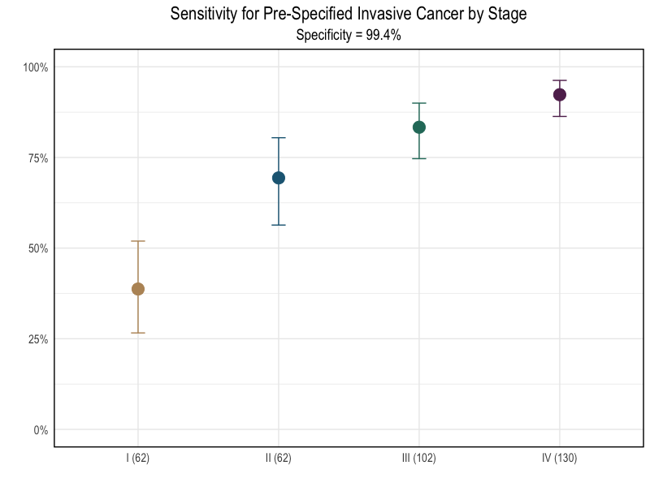
CCGA Results
More than 50 cancers detected
100%
Pre-specified cancer set:.
Anus
Bladder
Colon/Rectum
Esophagus
Head and Neck
Liver / Bile-Duct
Lung
Lymphoma
Ovary
Pancreas
Plasma Cell Neoplasm
Stomach
75%
Sensitivity
50%
Overall sensitivity
76% (95% CI: 72-81%)
at
99.3% specificity
25%
0%
I
(62)
Cancer Stage (n)
II
(62)
III
(102)
IV
(130)
Liu et al, Ann of Oncol doi.org/10.1016/j.annonc.2020.06.008

Slide 19
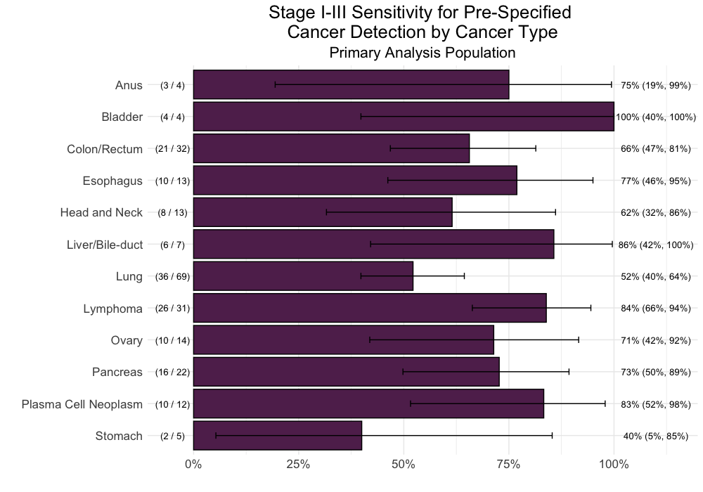
CCGA Results Detection Rates for stages I-III
Sensitivity reported
at 99.3% specificity
Anus (4) (1,2,1)
75%
Bladder (4) (0,2,2)
100%
Colon / Rectum (32) (7,10,15)
66%
Esophagus (13) (1,5,7)
77%
Head and Neck (13) (3,4,6)
62%
Liver / Bile-Duct (7) (2,2,3)
86%
Lung (69) (27,11,31)
52%
Lymphoma (31) (7,12,12)
84%
Ovary (14) (1,1,12)
71%
Pancreas (22) (8,6,8)
73%
Plasma Cell Neoplasm (12) (4,4,4)
83%
Stomach (5) (1,3,1)
40%
0%
25%
50%
75%
100%
Liu et al, Ann of Oncol doi.org/10.1016/j.annonc.2020.06.008

Slide 20
CCGA - Tissue of Origin
% of Predictions Correctly Called
Predicted TOO
Actual TOO
Liu et al, Ann of Oncol doi.org/10.1016/j.annonc.2020.06.008

Slide 21
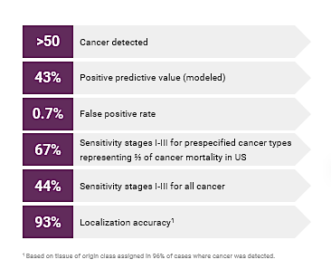
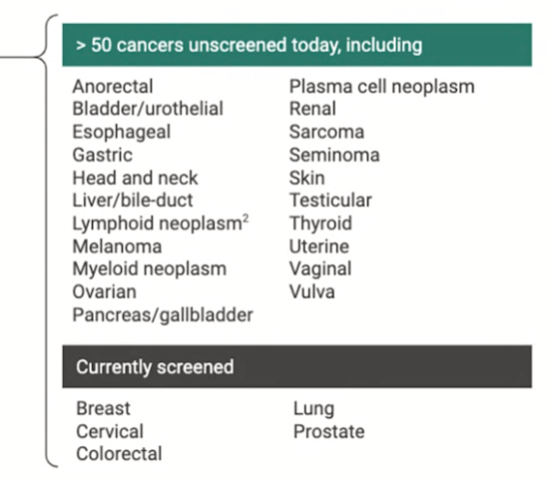
CCGA Summary
Liu et al, Ann of Oncol doi.org/10.1016/j.annonc.2020.06.008

Slide 22
CCGA - High Specificity is Feasible
8/948 (0.8%) non-cancer controls had a positive signal
3 subsequently diagnosed w/in a few months with:
Endometrial cancer, stage II
Ovarian cancer, stage III
Lung cancer, stage IV
5-year follow-up will enable identification of participants who are subsequently diagnosed
Notes:
Continuation from previous slide: ...Given that some noncancer participants resulted in a cancer-like signal, this suggests that the specificity is underestimated and that it may be higher once F/U is collected on all patients.
We are following these 8 participants, and previously reported that two of those 5 participants in the training set were subsequently diagnosed with cancer: one with stage 2 endometrial cancer, and one with stage 3 ovarian cancer. We also recently learned that a third of those five “non-cancer” participants with a cancer-like signal was diagnosed with stage IV lung cancer. To date, none of the “non-cancer” participants with a cancer-like signal in the test set has been subsequently diagnosed with cancer.
Other notes:
-We do not have follow-up on *all* non-cancer participants yet, so may not be accounting for other subsequently diagnosed cancers in the non-cancer cohort that did not result in a “cancer-like” signal upon blood draw for this study.
-5-year follow-up will enable identification of participants who are subsequently diagnosed with cancer. This is important, as we expect a latent rate of undiagnosed cancer of approximately 1%. To account for this, we report sensitivity at a 98% specificity instead of 99%, which would be confounded by undiagnosed cancers. Indeed, so far we have observed 3 of the 5 “false positives” in participants without cancer in the training set subsequently diagnosed with cancer….
If asked, here are additional details on the training set “false positives”:
Endometrial cancer: identified 3 months after blood draw.
Ovarian cancer: identified 2 months after blood draw.
Lung cancer: identified 15 months after blood draw.
It is important to note that this is a research study, and as such is not returning results to participants. The diagnoses - particularly the lung cancer diagnosis - are extremely unfortunate for the participants, but are encouraging for the assays’ ability to detect cancer prior to the onset of symptoms.

Slide 23
Conclusions
Advances in genomic technology allow detection of biologic substrates in body fluids at clinically meaningful levels
Liquid biopsy has potential to impact cancer management
Screening/Early Detection
Molecular profiling/prognosis/targeted therapy
Detection of Residual Disease
Real time monitoring of treatment response
Monitoring of treatment-emergent resistance
3 studies have laid the foundation for large scale screening of healthy populations for common cancers that have no established screening paradigms
Notes:
Voiceover: An independent test set was used to assess performance and the consistency between training and test suggests no evidence of overfitting.

