Slide 1
Gastroesophageal Cancers — Dr Catenacci
Daniel Catenacci, MD
Associate Professor
Director, GI Medical Oncology
University of Chicago
November 2, 2020

Slide 2
Gastroesophageal Cancers
Current Standards
HER2 beyond progression
First line immunotherapy
Perioperative immunotherapy

Slide 3
Gastroesophageal Cancers
Current Standards
HER2 beyond progression
First line immunotherapy
Perioperative immunotherapy

Slide 4
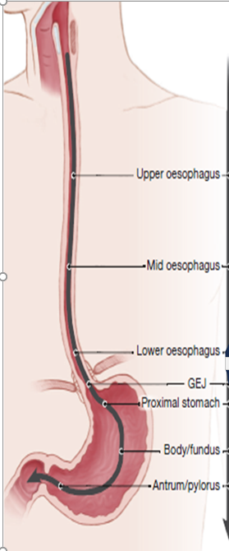
Stage IV
GEC
1L treatment
1LM treatment
2L treatment
3L treatment
HER2+
HER2-
HER2+
HER2+/HER2-
HER2+
HER2+/HER2-
MSI-H
Eso SCC
FOLFOX
FOLFOX
5FU
Paclitaxel
Irinotecan/
FOLFIRI
Paclitaxel
Irinotecan/
FOLFIRI
Trifluridine/Tipiracil
ATTRACTION 3
KN 181 CPS >10
KN 181 CPS <10
KN 590 CPS <10
KN 590 CPS >10
40-
58%
42-
60%
Eso AC
KN 062 CPS >1
KN 181
GEJ AC
15-
48%
52-
85%
ToGA
CM 649 CPS >5
ATTRCN-2 (Asia)
GC AC
KN 061
TAGS
KN059 CPS >1
JAVELIN 100
REGARD/
RAINBOW
Destiny-Gastric01
JAVELIN 300
GATSBY
T-ACT
LoGIC
ATTRCN 4 PFS/ OS
TyTAN
JACOB
35-
60%
60%
15%
72%
Previous
IO studies
KN062
JAVLN 100
KN61
KN181
ATTRCN-3
ATTRCN-2
KN59
JAVLN 300
Recent ESMO
IO studies
CM649
KN590
ATTRCN-4
Ongoing Studies
KN811
SPOTLIGHT/
GLOW
CM648
KN859
DESTINY-04
MAHOGANY
SKYSCRAPER-08
FIGHT
LEAP 14/15
Mountaineer-02

Slide 5
First Line Management of Advanced Gastroesophageal Adenocarcinoma
BSC ¹
FAMTX ²
mOS = ~10-11m
1yr OS = ~40%
2yr OS = ~15-20%
5yr OS < ~2%
SP ³
FP ⁴
IF ⁵
EOF ⁶
DCF ⁴
ECF ⁶
ECX ⁶
EOX ⁶
XP ⁷
FOLFIRI ⁸
FOLFOX ⁹
mOS Months
0
2
4
6
8
10
12
BSC = best supportive care; MTX = methotrexate; S = S-1; A = doxorubicin
F = 5-FU; C/P = cisplatin; I = irinotecan; E = epirubicin; O = oxaliplatin; D = docetaxel
Murad, et al. Cancer 1993 2. Vanhoefer, et al. JCO 2000 3. Ajani, et al. ASCO 2009 4. Van Cutsem, et al. JCO 2006
5. Dank, et al. Ann Oncol 2008
6. Cunningham, et al. NEJM 2008 7. Kang, et al. Ann Oncol 2009
8. Guimbaud, et al. JCO 2014
9. Shah, et al. JAMA ONC 2016

Slide 6
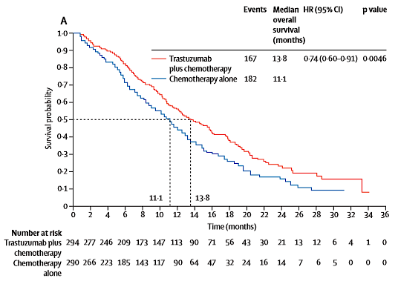
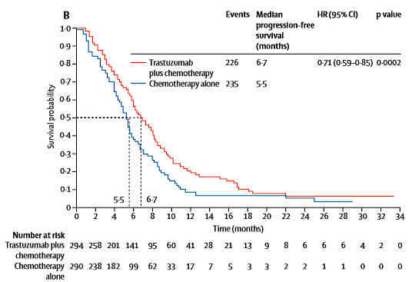
The ToGA phase III study
Bang et al. Trastuzumab in combination with chemotherapy versus chemotherapy alone for treatment of HER2-positive advanced gastric or gastro-oesophageal junction cancer (ToGA): a phase 3, open-label, randomised controlled trial. Lancet 2010

Slide 7
ToGA: Subgroup analysis by HER2 status
N | Median OS (months) | HR | 95% CI
584 | 11.1 vs. 13.8 | 0.74 | 0.60, 0.91
61 70 159 256 15 | 7.2 vs. 10.6 10.2 vs. 8.7 10.8 vs. 12.3 12.3 vs. 17.9 17.7 vs. 17.5 | 0.92 1.24 0.75 0.58 0.83 | 0.48, 1.76 0.70, 2.20 0.51, 1.11 0.41, 0.81 0.20, 3.38
131 446 | 8.7 vs. 10.0 11.8 vs. 16.0 | 1.07 0.65 | 0.70, 1.62 0.51, 0.83
Subgroup
Screened ~4000 pts
All
Pre-planned analysis
IHC 0/FISH+
IHC 1+/FISH+
IHC 2+/FISH+
IHC 3+/FISH+
IHC 3+/FISH-
Exploratory analysis
IHC 0 or 1+/FISH+
IHC 2+/FISH+ or IHC 3+
0.2
0.4
0.6
1
2
3
4
5
Favours trastuzumab
Risk ratio
Favours no trastuzumab
Interaction of treatment effect with HER2 result in exploratory analysis, p=0.0368
Bang et al. Trastuzumab in combination with chemotherapy versus chemotherapy alone for treatment of HER2-positive advanced gastric or gastro-oesophageal junction cancer (ToGA): a phase 3, open-label, randomised controlled trial. Lancet 2010

Slide 8
BSC ¹
FAMTX ²
SP ³
FP ⁴
IF ⁵
EOF ⁶
DCF ⁴
All-comers
mOS = ~10-11m
1yr OS = ~40%
2yr OS = ~15-20%
5yr OS < ~2%
ECF ⁶
ECX ⁶
EOX ⁶
XP ⁷
FOLFIRI ⁸
FOLFOX ⁹
HER2+
mOS = ~14-16m
1yr OS = ~55-65%
2yr OS = ~25-30%
5yr OS < ~10-15%
X/FP+/-T¹⁰
HER2 (+) (IHC0-3+/FISH+)
+T
X/FP+/-T¹⁰
HER2 IHC3+ or IHC2+/FISH+
+T
X/FP+/-T¹⁰
HER2 IHC3+/FISH+
+T
mOS Months
0
2
4
6
8
10
12
14
16
18
Murad, et al. Cancer 1993 2. Vanhoefer, et al. JCO 2000 3. Ajani, et al. ASCO 2009 4. Van Cutsem, et al. JCO 2006
5. Dank, et al. Ann Oncol 2008 6. Cunningham, et al. NEJM 2008 7. Kang, et al. Ann Oncol 2009 8. Guimbaud, et al. JCO 2014
9. Shah et al. JAMA Oncol 2016. 10. Bang et al. Lancet 2010.
Notes:
HER2 control: 11.1 HER2 treatment 13.8 (HR 0.74) (ITT analysis)
HER2 control: 11.8 HER2 treatment 16 (HR 0.65) (>IHC2+/FISH+, IHC3+/FISH-)
HER2 HIGH: 12.3 HER2 treatment 17.8 (HR 0.58) (IHC3+/FISH+)

Slide 9
Antiangiogenesis for EGA: 2L
Line | Trial | N | Treatment | 1⁰ Endpt | mOS | HR | Δ | mPFS | HR | Δ | RR | Δ
2L | Fuchs et al Lancet 2013 REGARD | 335 | Placebo Ramucirumab | OS | 3.5 5.2 | 0.78 p=0.047 | +1.7 | 1.3 2.1 | 0.48 | +0.8 | 3% 3% | 0
2L | Wilke et al Lancet Oncol 2014 RAINBOW | 665 | Paclitaxel-Plbo Paclitaxel-Ram | OS | 7.4 9.6 | 0.8 p=0.017 | +2.2 | 2.9 4.4 | 0.64 | +1.5 | 16% 27% | +11
3L | Li et al J Clin Oncol 2016 | 267 | Placebo Apatinib | OS/PFS | 4.7 6.5 | 0.71 p=0.015 | +1.8 | 1.8 2.6 | 0.44 | +0.8 | 0 3% | +3
3L | Kang et al ESMO 2019 ANGEL | 460 | Placebo Apatinib | OS | 5.1 5.8 | 0.93 p=N.S. | +0.7 | 1.8 2.8 | 0.57 | +1.0 | 0 7% | +7

Slide 10
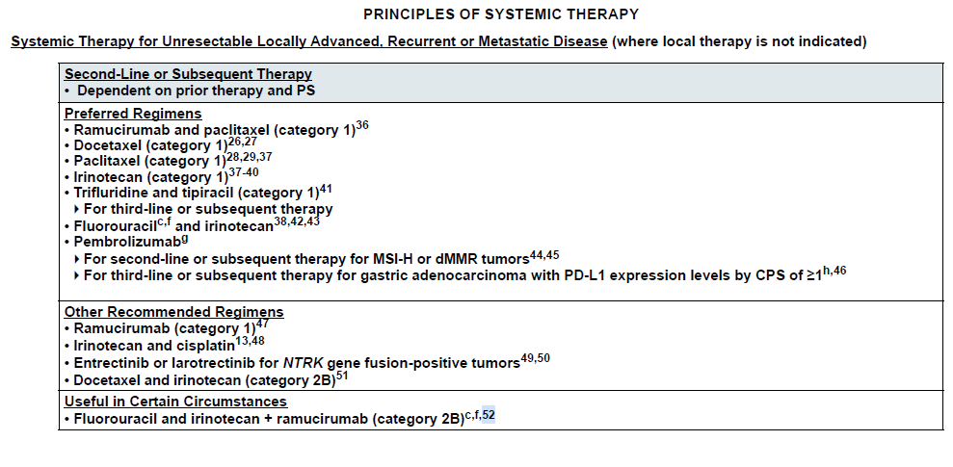

FOLFIRI-Ram Second line

Slide 11
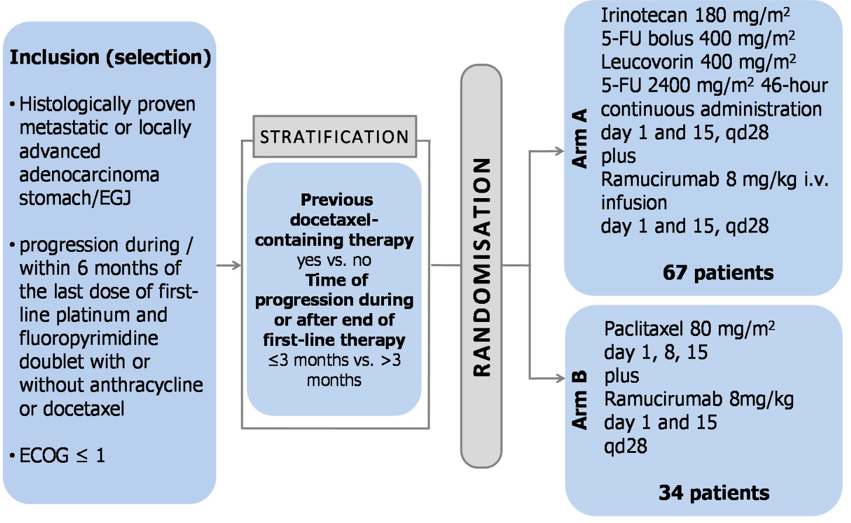
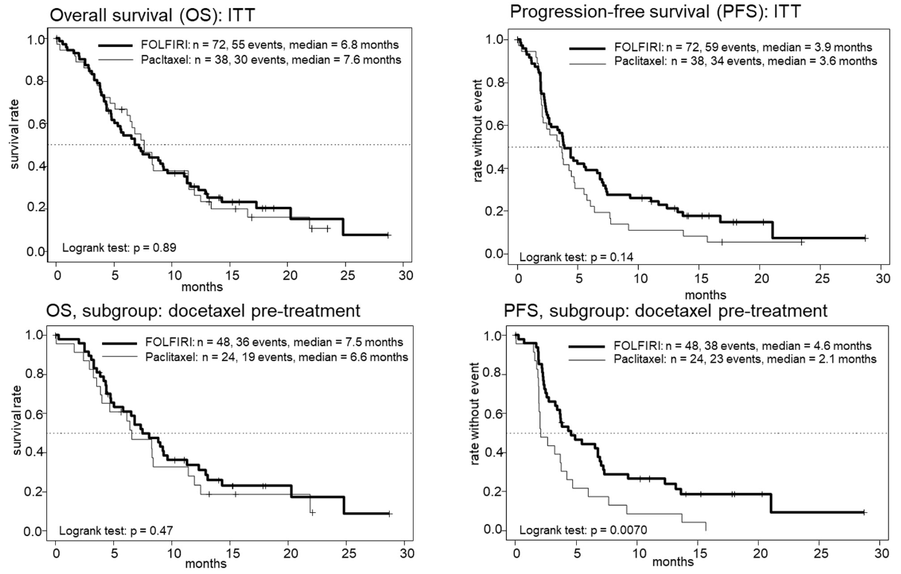
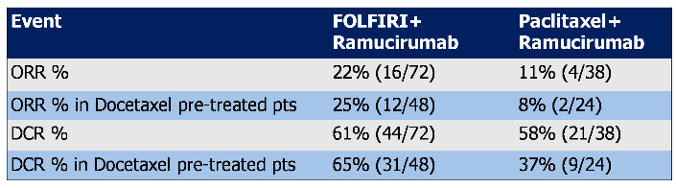
FOLFIRI-Ram Second line
Lorenzen et al. FOLFIRI plus ramucirumab versus paclitaxel plus ramucirumab as second-line therapy for patients with advanced or metastastic gastroesophageal adenocarcinoma with or without prior docetaxel- results from the phase II RAMIRIS Study of the AIO. ASCO Abstr 4514 2020

Slide 12
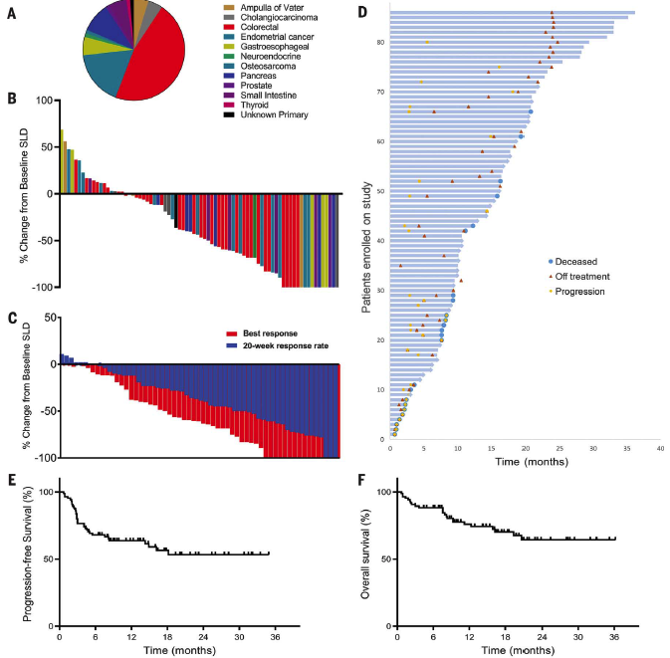
Immune Checkpoint Blockade for EGA
MSI-High
N= 86 MSI-H pts
12 different tumor types
GEA:
TCGA 23%
Stage IV <3%
ORR 3/5 = 60%
FDA approval 2L+ Pan-tumor
N=149, historical control
Le et al. Mismatch repair deficiency predicts response of solid tumors to PD-1 blockade. Science 2017
FDA Approves Pembrolizumab for Microsatellite Instability-High and Mismatch Repair Deficient Cancers. May 23, 2017

Slide 13
MSI-High: negative prognostic & positive predictive biomarker
ITT
MSI-High (~2-3%)
KEYNOTE-059 (3L+)
ITT = any PD-L1
KEYNOTE-061 (2L)
ITT₂ = PD-L1 CPS>1
KEYNOTE-062 (1L)
ITT = PD-L1 CPS>1
Chao et al. Pembrolizumab in microsatellite instability-high advanced gastric/gastroesophageal junction cancer by line of therapy. GI ASCO 2020 Abstract 430

Slide 14
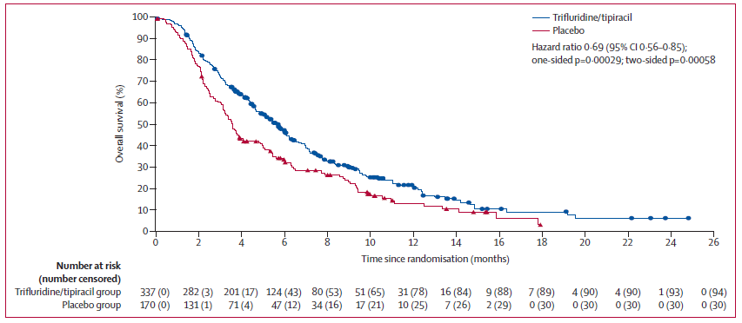
Trifluridine/Tipiracil 3L+
Shitara et al. Trifluridine/tipiracil v placebo in patients with heavily pretreated metastatic gastric cancer (TAGS): a randomised, double-blind, placebo-controlled, phase 3 trial. Lancet Oncol 2018

Slide 15
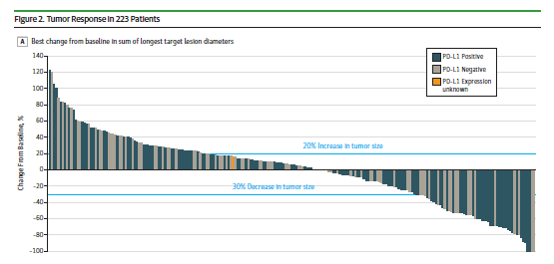
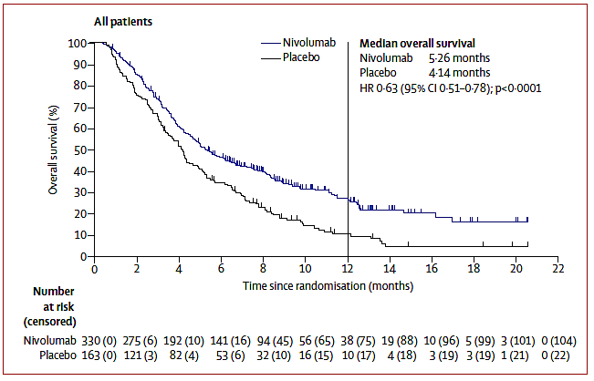
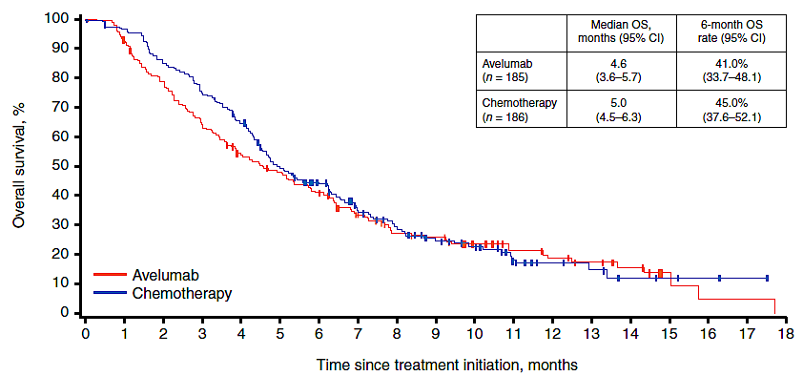
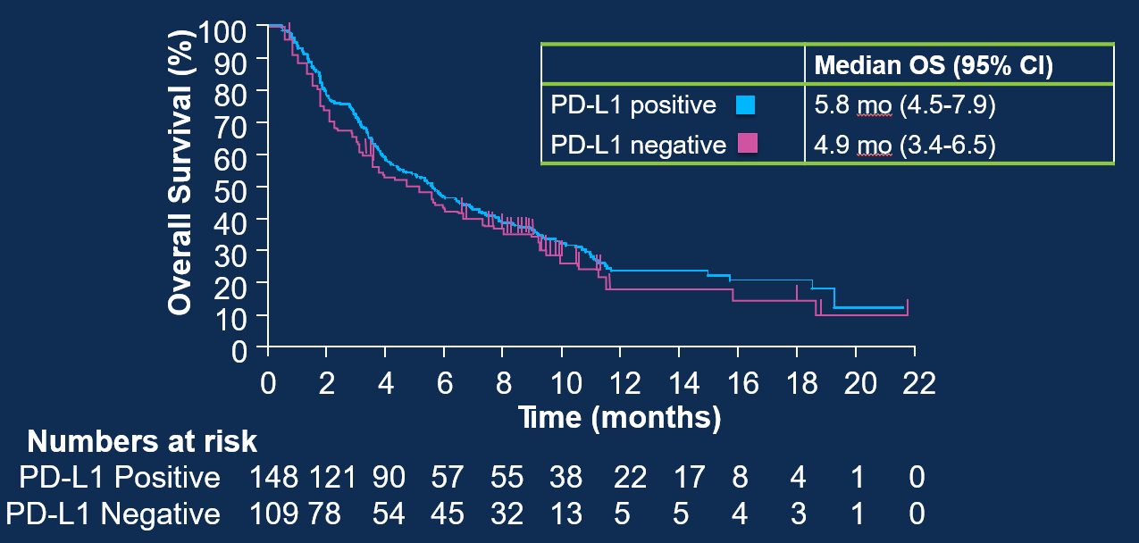
Anti-PD-1/L1 in 3L+
Kang et al. ATTRACTION-02. Lancet 2017
Fuchs et al. KEYNOTE 059 Cohort 1. JAMA Oncol 2018
Bang et al. JAVELIN 300. Annals Oncol 2018

Slide 16
GEA Standard Therapy: Metastatic Disease
Cytotoxics: 5FU, platinum, irinotecan, taxane, TAS102
Few targeted/IO therapies incorporated into routine care:
Marker Incidence Treatment Therapy Line FDA Approval Benefit
HER2++ ~15% Chemo+Trastuzumab 1L 2010 HR 0.65
none 100% Chemo+Ramucirumab 2L 2014/15 HR 0.8
MSI-High ~2-3% Pembrolizumab 2L+ 2017* HR? (0.33)
PDL1+ CPS>1 ~50-60% Pembrolizumab 3L+ 2017 * HR? (marginal)
*Conditional approval

Slide 17
Gastroesophageal Cancers
Current Standards
HER2 beyond progression
First line immunotherapy
Perioperative immunotherapy

Slide 18
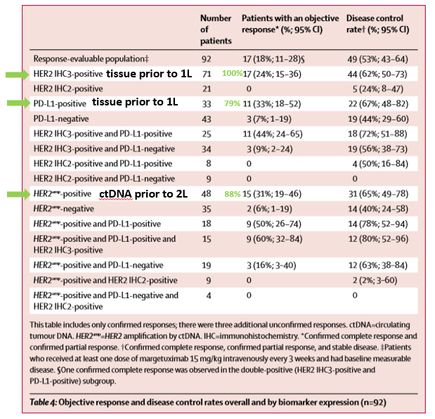
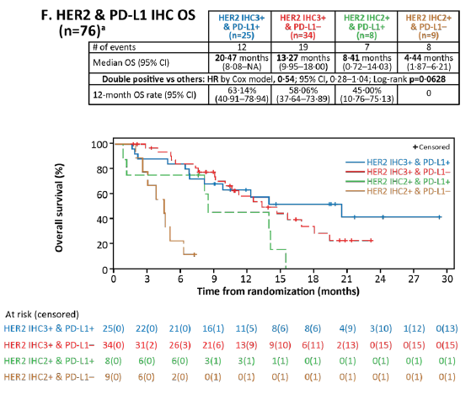
Second Line – Margetuximab/Pembrolizumab
Catenacci et al. Margetuximab plus pembrolizumab for previously treated, HER2-positive GEA (CP-MGAH22–05): a single-arm, phase 1b–2 trial. Lancet Oncology 2020

Slide 19
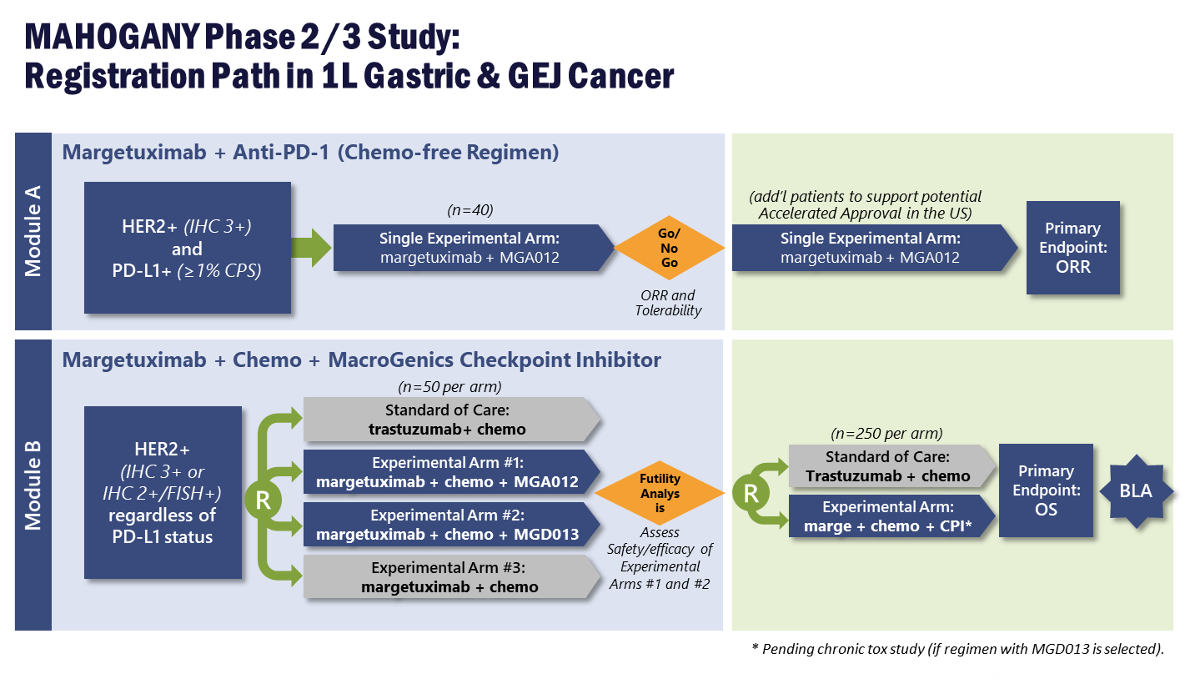
First Line – Margetuximab/Pembrolizumab
Catenacci et al. Margetuximab plus pembrolizumab for previously treated, HER2-positive GEA (CP-MGAH22–05): a single-arm, phase 1b–2 trial. Lancet Oncology 2020

Slide 20
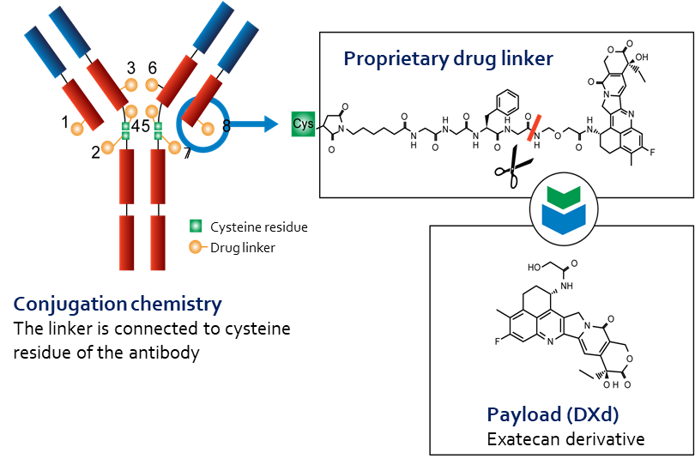
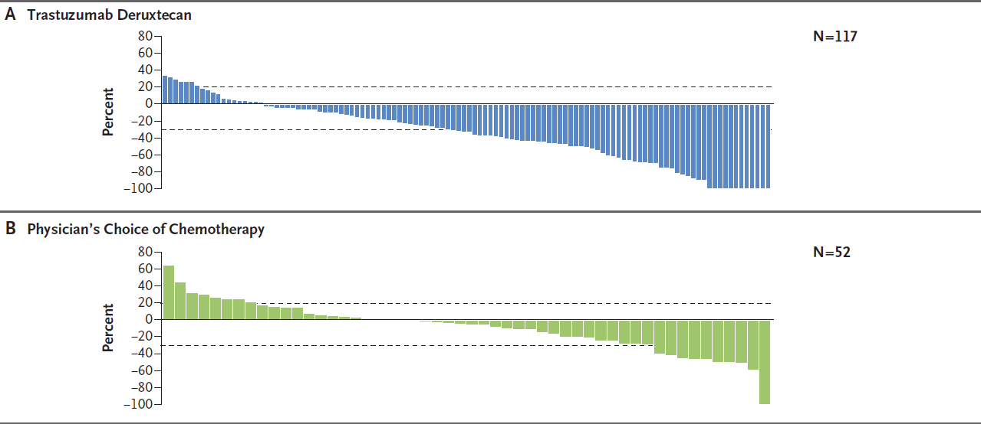
Third Line – Trastuzumab Deruxtecan: Mechanism of Action and Response
N= 125 pts
R 2:1
100% Asian
51%
14%
Shitara et al. Trastuzumab Deruxtecan in Previously Treated HER2-Positive Gastric Cancer. NEJM 2020

Slide 21
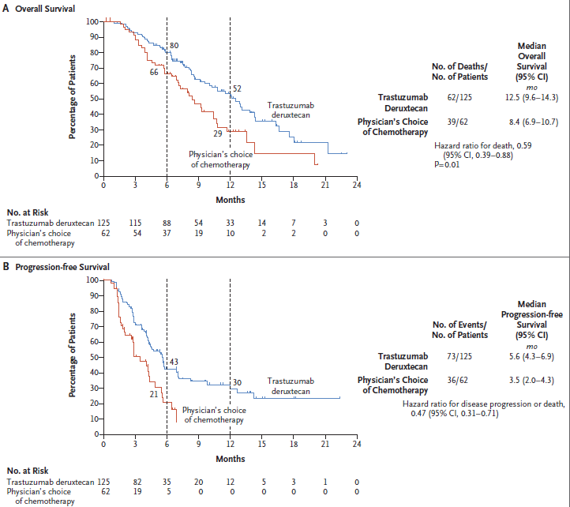
Third Line – Trastuzumab Deruxtecan: Survival
Irinotecan or paclitaxel
Shitara et al. Trastuzumab Deruxtecan in Previously Treated HER2-Positive Gastric Cancer. NEJM 2020

Slide 22
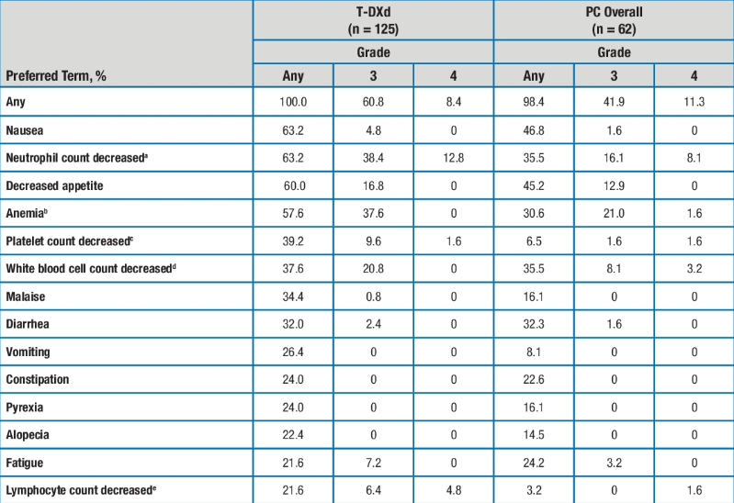
DESTINY-Gastric01: TRAE in ≥20% of Pts
Pneumonitis:
12 patients (9.6%)
G1/2: 9 (7.2%)
G1: 3 (2.4%)
G2: 6 (4.8%)
G3/4: 3 (2.4%)
G3: 2 (1.6%)
G4: 1 (0.8%)
Shitara K, et al. ASCO 2020. Abs 4513.

Slide 23
FDA Grants Breakthrough Therapy Designation for Trastuzumab Deruxtecan for HER2-Positive Gastric or GEJ Adenocarcinoma Press Release – May 11, 2020
“Trastuzumab deruxtecan has been granted Breakthrough Therapy Designation (BTD) in the US for the treatment of patients with HER2-positive unresectable or metastatic gastric or gastroesophageal junction adenocarcinoma who have received two or more prior regimens including trastuzumab. The FDA granted BTD based on data from the registrational Phase II DESTINY-Gastric01 trial and data from the Phase I trial published in The Lancet Oncology. In DESTINY-Gastric01, patients treated with trastuzumab deruxtecan demonstrated a statistically significant and clinically meaningful improvement in ORR, the primary endpoint, and OS, a key secondary endpoint, versus patients treated with investigator’s choice of chemotherapy (irinotecan or paclitaxel monotherapy).
The overall safety and tolerability profile in DESTINY-Gastric01 was consistent with that seen in the Phase I trial. The most common adverse events were haematologic and gastrointestinal including neutrophil count decrease, anaemia, nausea and decreased appetite. There were cases of drug-related interstitial lung disease (ILD) and pneumonitis, the majority of which were Grade 1 and 2, with two Grade 3 and one Grade 4. No ILD-related deaths (Grade 5) occurred in patients with gastric cancer in the Phase I trial or in the Phase II DESTINY-Gastric01 trial.”
https://www.astrazeneca.com/media-centre/press-releases/2020/enhertu-granted-breakthrough-therapy-designation-in-the-us-for-her2-positive-metastatic-gastric-cancer.html

Slide 24
Gastroesophageal Cancers
Current Standards
HER2 beyond progression
First line immunotherapy
Perioperative immunotherapy

Slide 25
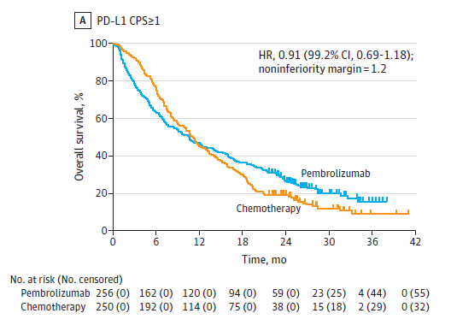
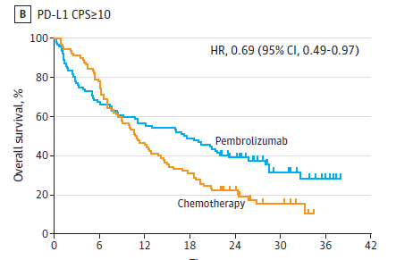
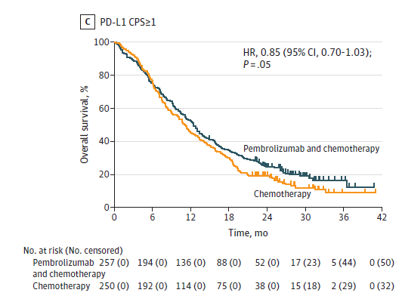
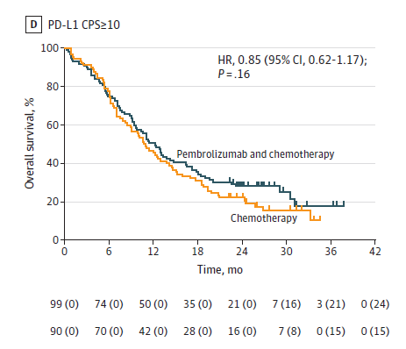
KN 062 (1L GEJ AC/GC AC, selected by CPS >1 only)
Pembro Monotx vs FP/Cisplatin
Pembro + FP/Cisplatin vs
Placebo + FP/Cisplatin
Shitara et al. Keynote 062. JAMA Oncol 2020

Slide 26
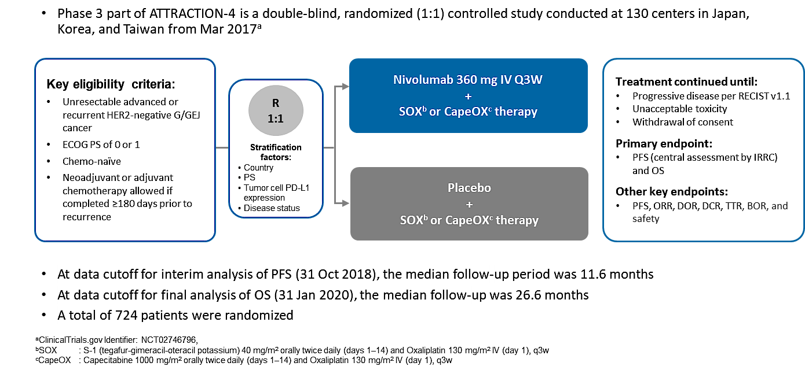
ATTRACTION04 (1L GEJ AC/GC AC)
Primary endpoints:

Slide 27
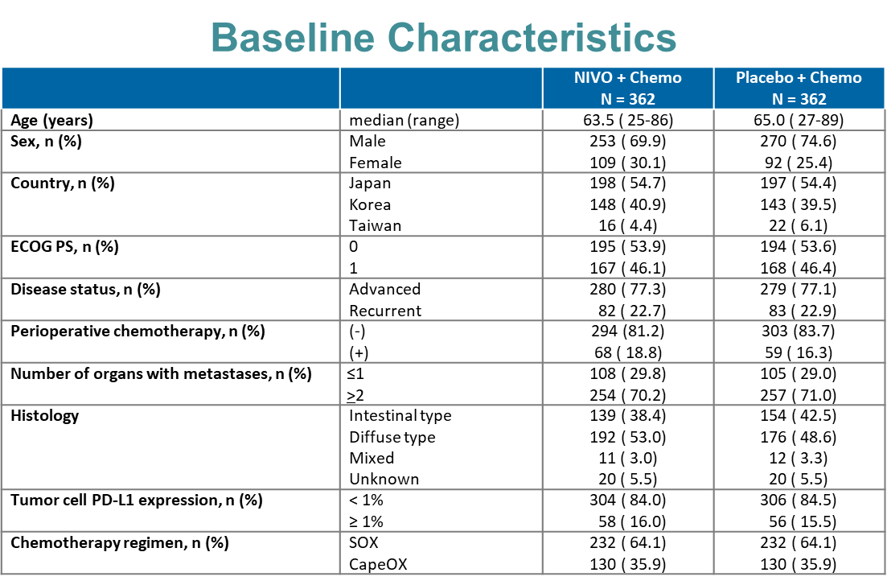
ATTRACTION04 (1L GEJ AC/GC AC)

Slide 28
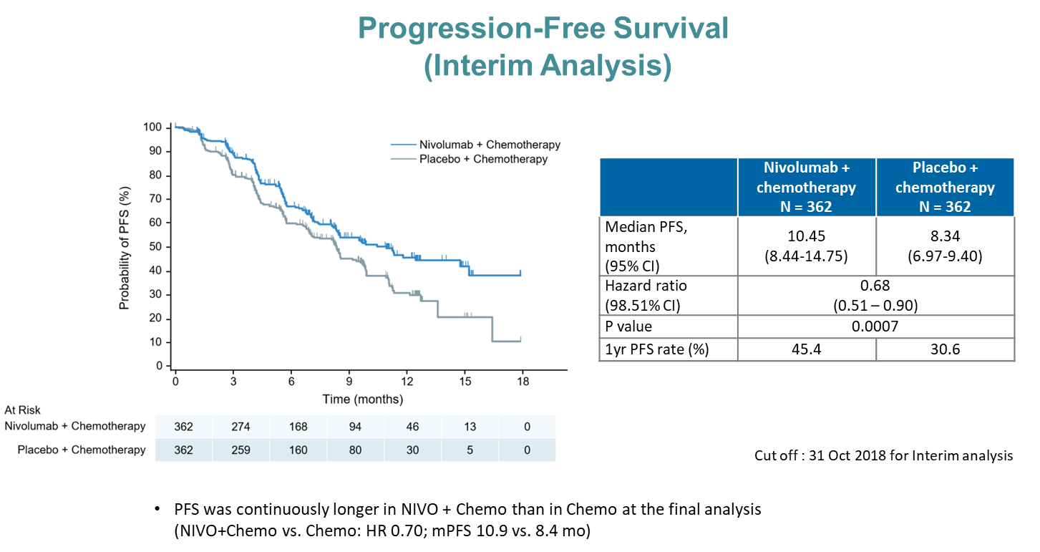
ATTRACTION04 (1L GEJ AC/GC AC)

Slide 29
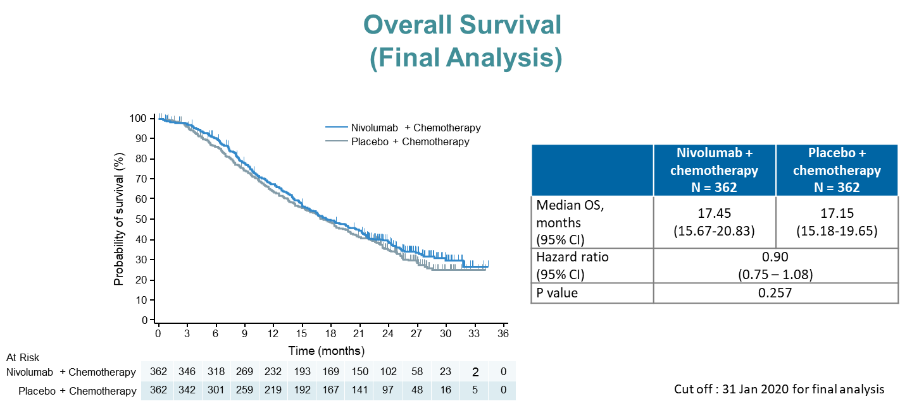
ATTRACTION04 (1L GEJ AC/GC AC)

Slide 30
ATTRACTION-4
Adverse Event Summary
 | Nivolumab + chemotherapy N = 359, n (%) |  |  | Placebo + chemotherapy N = 358, n (%)
Patients, n (%) | Any grade | Grade 3–4 | Grade 5 | Any grade | Grade 3–4 | Grade 5
AEs
Any | 358 ( 99.7) | 249 ( 69.4) | 8 ( 2.2) | 357 ( 99.7) | 226 ( 63.1) | 6 ( 1.7)
Serious AEs | 135 ( 37.6) | 103 ( 28.7) | 8 ( 2.2) | 120 ( 33.5) | 89 ( 24.9) | 6 ( 1.7)
AEs leading to discontinuation | 38 ( 10.6) | 19 ( 5.3) | 5 ( 1.4) | 26 ( 7.3) | 12 ( 3.4) | 4 ( 1.1)
AEs leading to dose delay or reduction | 314 ( 87.5) | 190 ( 52.9) | 2 ( 0.6) | 312 ( 87.2) | 170 ( 47.5) | 1 ( 0.3)
Drug-related AEs
Any | 351 ( 97.8) | 205 ( 57.1) | 3 ( 0.8) | 349 ( 97.5) | 174 ( 48.6) | 2 ( 0.6)
Serious AEs | 88 ( 24.5) | 66 ( 18.4) | 3 ( 0.8) | 51 ( 14.2) | 33 ( 9.2) | 2 ( 0.6)
AEs leading to discontinuation | 22 ( 6.1) | 11 ( 3.1) | 3 ( 0.8) | 17 ( 4.7) | 8 ( 2.2) | 2 ( 0.6)
AEs leading to dose delay or reduction | 307 ( 85.5) | 169 ( 47.1) | 0 | 291 ( 81.3) | 140 ( 39.1) | 0
Cut off: 31 Jan 2020 for final analysis
AE, adverse event

Slide 31
ATTRACTION-4
Drug-related adverse events with potential immunologic etiology
 | Nivolumab + chemotherapy N = 359, n (%) |  |  | Placebo + chemotherapy N = 358, n (%)
Select Drug-related AEs, n (%) | Any grade | Grade 3–4 | Grade 5 | Any grade | Grade 3–4 | Grade 5
Endocrine | 41 ( 11.4) | 8 ( 2.2) | 0 | 12 ( 3.4) | 0 | 0
Gastrointestinal | 129 ( 35.9) | 21 ( 5.8) | 0 | 113 ( 31.6) | 19 ( 5.3) | 0
Hepatic | 83 ( 23.1) | 14 (3.9) | 1 ( 0.3) | 68 ( 19.0) | 12 ( 3.4) | 0
Hypersensitivity/Infusion reaction | 48 ( 13.4) | 12 ( 3.3) | 0 | 26 ( 7.3) | 4 ( 1.1) | 0
Pulmonary | 12 ( 3.3) | 4 ( 1.1) | 0 | 7 (2.0) | 1 ( 0.3) | 0
Renal | 9 ( 2.5) | 1 ( 0.3) | 0 | 4 ( 1.1) | 1 ( 0.3) | 0
Skin | 134 ( 37.3) | 14 ( 3.9) | 0 | 86 ( 24.0) | 4 ( 1.1) | 0
Cut off: 31 Jan 2020 for final analysis
AE, adverse event

Slide 32
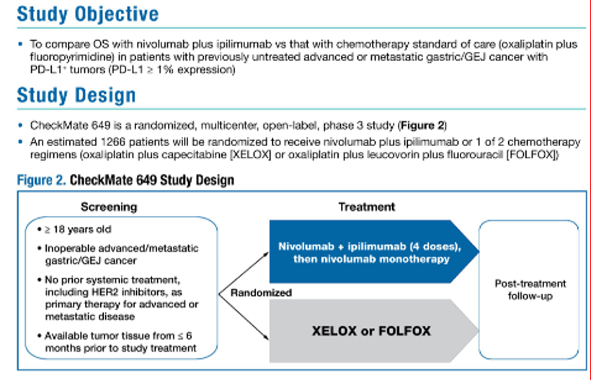
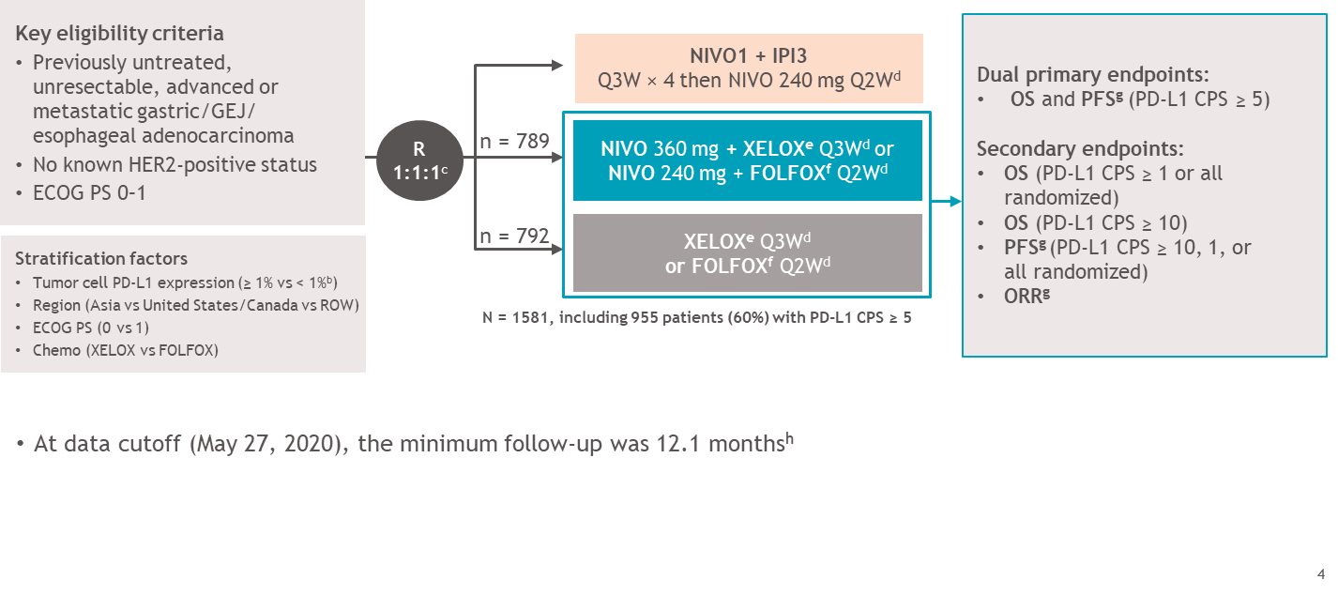
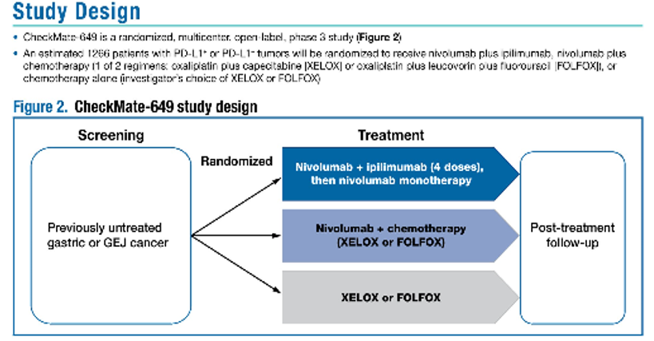
CM 649 (1L GEJ AC/GC AC)
Terminated Nivo/Ipi arm
Increased sample size to ~800/arm
Notes:
633/arm

Slide 33
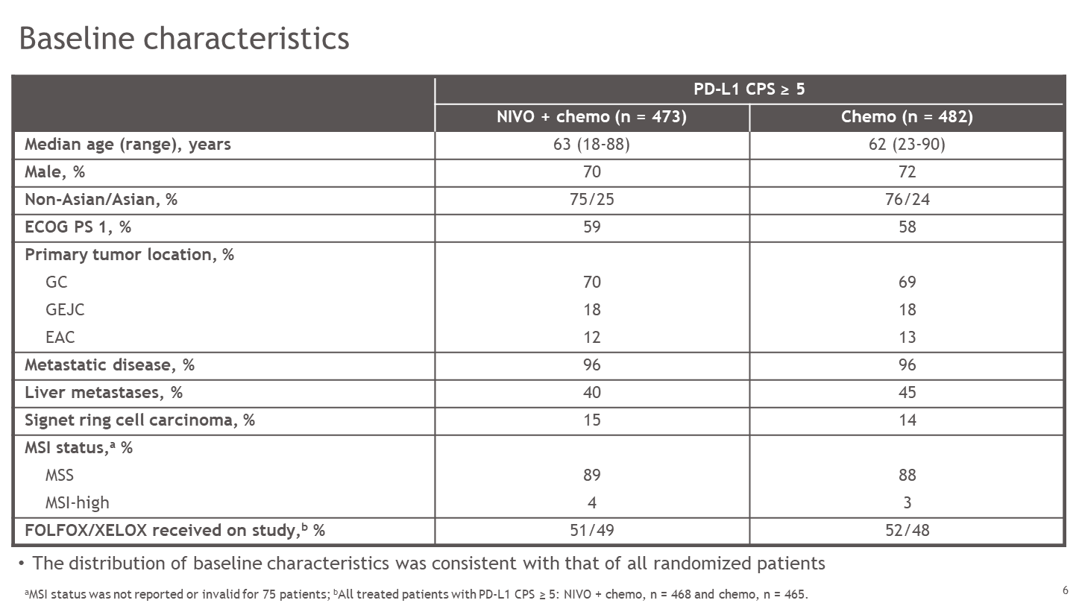
CM 649 (1L GEJ AC/GC AC)

Slide 34
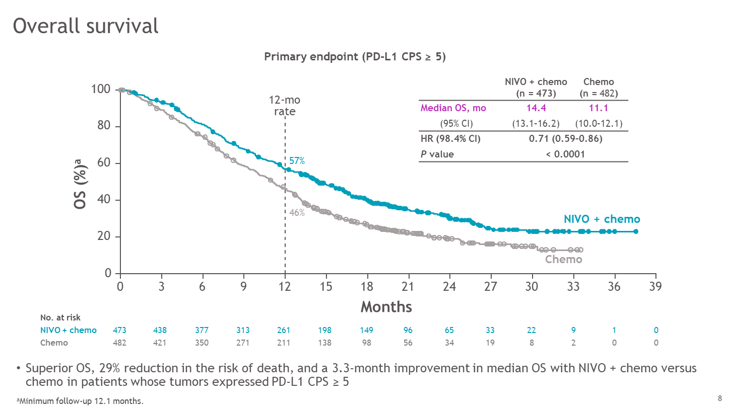
CM 649 (1L GEJ AC/GC AC)

Slide 35
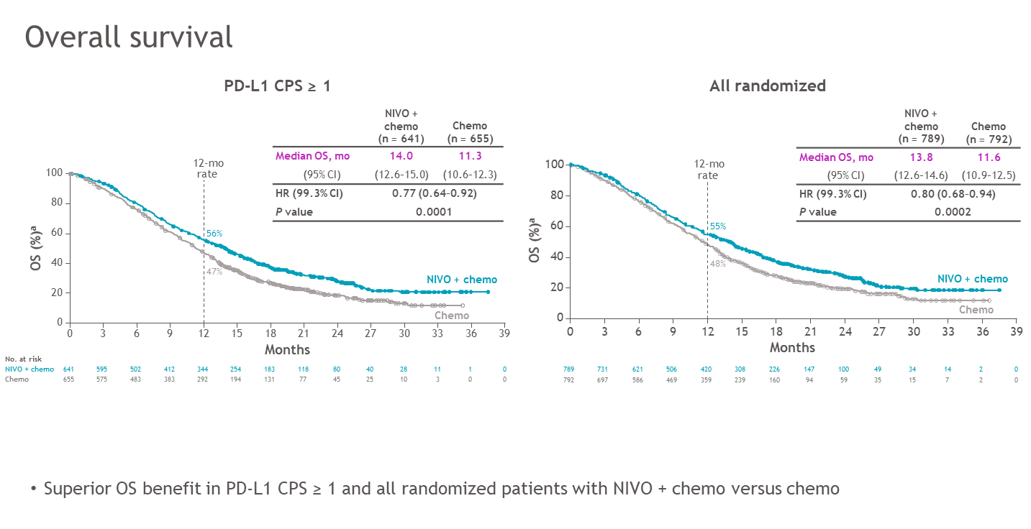
CM 649 (1L GEJ AC/GC AC)
CPS>5 CPS>1 All
HR 0.71 → 0.77 → 0.8
Pts# 473 → 473+168 → 641+148

Slide 36
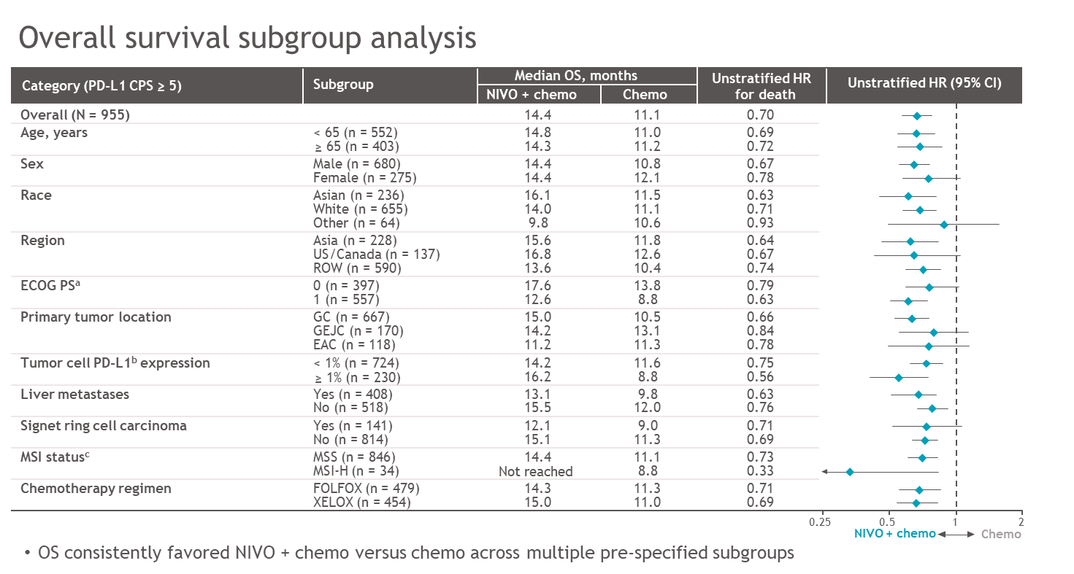
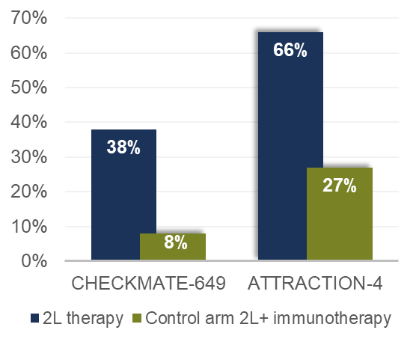
CM 649 (1L GEJ AC/GC AC)
 | CheckMate 649 CPS ≥5 | ATTRACTION-4 All patients
Median OS (m) | 14.4 vs 11.1 | 17.5 vs 17.2
OS gain (m) | 3.3 | 0.3
OS HR (95*% CI) | 0.71 (0.59 – 0.86) | 0.90 (0.75 – 1.08)

Slide 37
Treatment-related adverse events
CheckMate 649
Patients, n (%) | All treatedª
 | NIVO + chemo (n = 782)^{b} |  | Chemo (n = 767)^{b}
 | Any grade | Grade 3–4 | Any grade | Grade 3–4
Any TRAEs^{c} | 738 (94) | 462 (59) | 679 (89) | 341 (44)
Serious TRAEs^{c} | 172 (22) | 131 (17) | 93 (12) | 77 (10)
TRAEs leading to discontinuation^{c} | 284 (36) | 132 (17) | 181 (24) | 67 (9)
Treatment-related deaths | 12^{d} (2) |  | 4e (< 1)
The most common any-grade TRAEs (≥ 25%) across both arms were nausea, diarrhea, and peripheral neuropathy
The incidence of TRAEs in patients whose tumors expressed PD-L1 CPS ≥ 5 was consistent with all treated patients across both arms
ªPatients who received ≥ 1 dose of study drug; ^{b}Assessed in all treated patients during treatment and for up to 30 days after the last dose of study treatment; ^{c}There were 4 grade 5 events in the NIVO + chemo arm, 1 case each of cerebrovascular accident, febrile neutropenia, gastrointestinal inflammation, and pneumonia. There were no grade 5 events in the chemo arm; ^{d}One event each of febrile neutropenia, gastrointestinal bleeding, gastrointestinal toxicity, infection, interstitial lung disease, intestinal mucositis, neutropenic fever, pneumonia, pneumonitis, pulmonitis, septic shock (capecitabine-related), and stroke. ^{e}One event each of diarrhea-associated toxicity, asthenia and severe hiporexy, pulmonary thromboembolism, and interstitial pneumonia.
Notes:
37

Slide 38
Treatment-related adverse events with potential immunologic etiology
CheckMate 649
Select TRAEs^{b,c}, n (%) | All treatedª
 | NIVO + chemo N = 782 |  | Chemo N = 767
 | Any grade | Grade 3–4^{d} | Any grade | Grade 3–4
Endocrine | 107 (14) | 5 (<1) | 3 (<1) | 0
Gastrointestinal | 262 (34) | 43 (5) | 207 (27) | 25 (3)
Hepatic | 203 (26) | 29 (4) | 134 (17) | 16 (2)
Pulmonary | 40 (5) | 14 (2) | 4 (<1) | 1 (<1)
Renal | 26 (3) | 6 (<1) | 8 (1) | 1 (<1)
Skin | 214 (27) | 26 (3) | 105 (14) | 6 (<1)
Grade 3–4 select TRAEs events occurred in ≤ 5% of patients and there were no grade 5 events
The incidence of select TRAEs in patients whose tumors expressed PD-L1 CPS ≥ 5 was consistent with all treated patients across both arms
ªPatients who received ≥ 1 dose of study drug; ^{b}Treatment-related select AEs are those with potential immunologic etiology that require frequent monitoring/intervention; ^{c}Assessed in all treated patients during treatment and for up to 30 days after the last dose of study treatment; ^{d}The most common grade 3–4 select TRAEs (≥ 2%) in the NIVO + chemo arm were diarrhea (n = 35), increased aspartate aminotransferase (n = 12), and pneumonitis (n = 12).

Slide 39
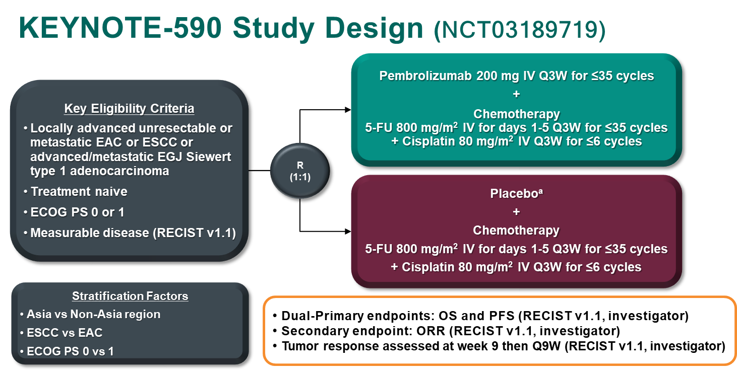
KN 590 (1L EsoSCC/EsoAC/GEJAC) Similar eligibility to 2L KN 181

Slide 40
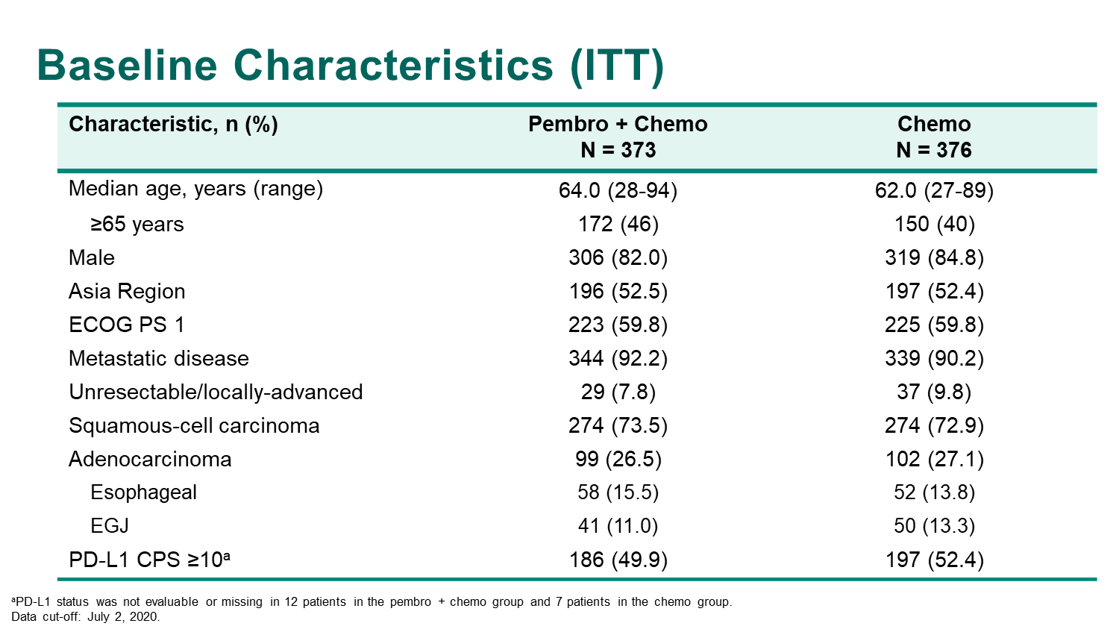
KN 590 (1L EsoSCC/EsoAC/GEJAC) Similar eligibility to 2L KN 181
N=749

Slide 41
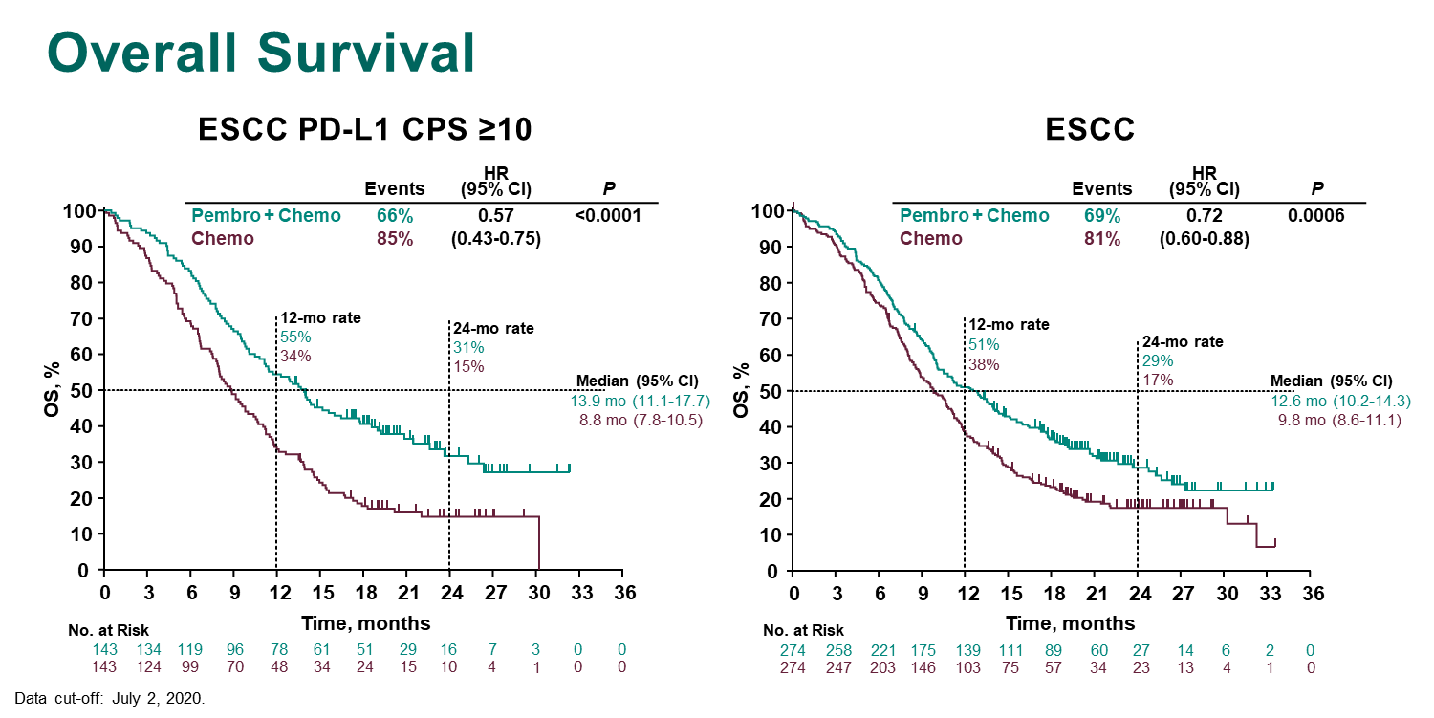
KN 590 (1L EsoSCC/EsoAC/GEJAC) Similar eligibility to 2L KN 181

Slide 42
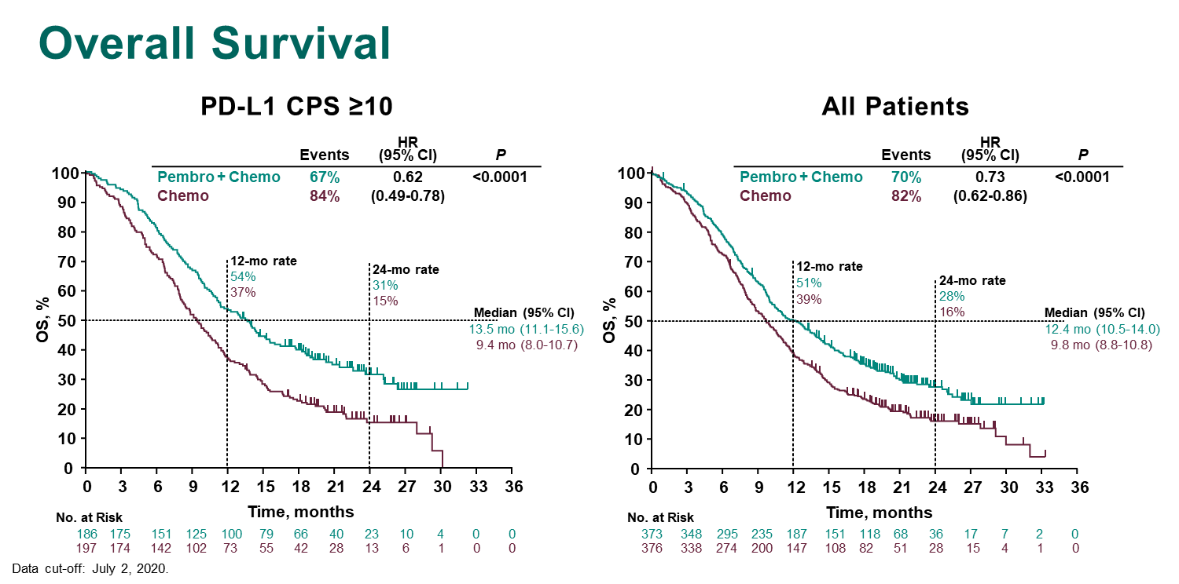
KN 590 (1L EsoSCC/EsoAC/GEJAC) Similar eligibility to 2L KN 181

Slide 43
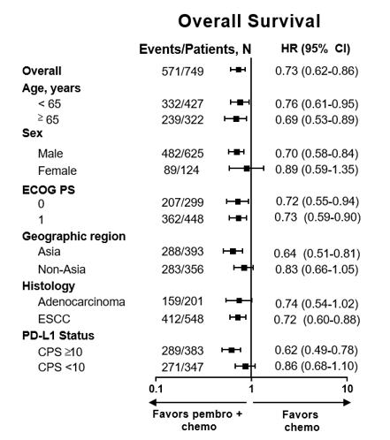
KN 590 (1L EsoSCC/EsoAC/GEJAC) Similar eligibility to 2L KN 181
383/730 CPS>10
=52.5%
286 CPS>10 SCC
286/548= 52%
383-286
=97 CPS>10 AC
97/201 = 48%

Slide 44
Adverse Events (AEs) in all Treated Patients
AEs | Pembro + Chemo N = 370 | Chemo N = 370
Any | 100% | 99.5%
Treatment-related | 98.4% | 97.3%
Grade ≥3 | 71.9% | 67.6%
Led to discontinuation | 19.5% | 11.6%
Led to death | 2.4% | 1.4%
Immune-mediated AEs and infusion reactions | 25.7% | 11.6%
Grade ≥3 | 7.0% | 2.2%
Grade
1-2
3-5
Pembro + Chemo
Chemo
Nausea
Decreased appetite
Anemia
Fatigue
Decreased neutrophil
count
Vomiting
Diarrhea
Neutropenia
Stomatitis
Decreased
White blood
cells
Increased
blood
creatinine
Decreased
platelet
count
Mucosal
Inflammation
ªTreatment-related events with ≥15% incidence in any treatment arm; Data cut-off: July 2, 2020.

Slide 45
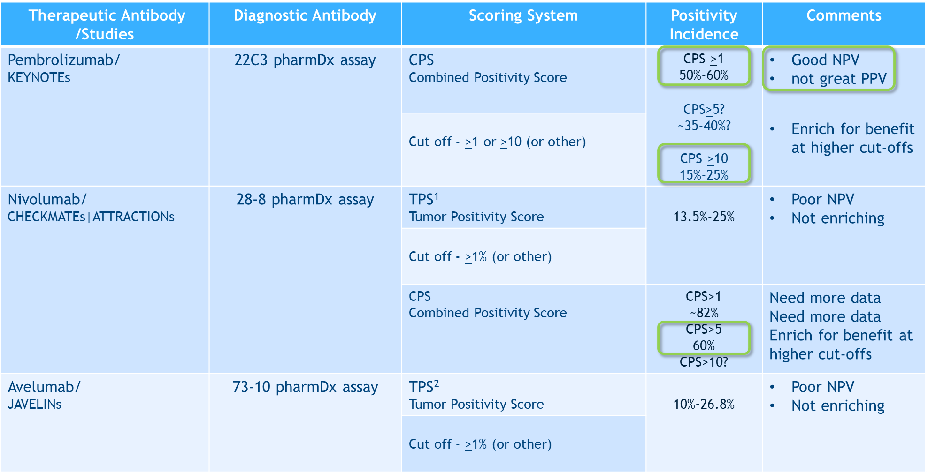
PD-L1 Diagnostic Antibodies

Slide 46
1L GEC Studies IO+Chemo Compared
TRIAL | Size | Chemo | Placebo? | SCC/AC | EsoSCC/ EGJAC/GC | Asian (%) | Biomarker/Histo | Biomarker Incidence | Ab | OS HR
KN 062 | 507 | Cisplatin | Yes | 0/100 | 0/30/70 | 25% | CPS>1 | 60% | 22C3 | 0.85 NS (neg)
 | 189 |  |  |  |  |  | CPS>10 | 15-20% | 22C3 | 0.85 NS (neg)
KN 590 | 286 | Cisplatin | Yes | 73/27 | 73/27/0 |  | SCC + CPS>10 | 52% | 22C3 | 0.57
 | 383 |  |  |  |  |  | CPS>10 | 50% | 22C3 | 0.62
 | 548 |  |  |  |  |  | SCC |  |  | 0.72
 | 749 |  |  |  |  | 52% |  |  |  | 0.73
CM649 | 955 | Oxaliplatin | No | 0/100 | 0/30/70 |  | CPS>5 | 60% | 28-8 | 0.71
 | 1296 |  |  |  |  |  | CPS>1 | 82% | 28-8 | 0.77
 | 1581 |  |  |  |  | 25% |  |  |  | 0.8
ATTRCN4 | 724 | Oxaliplatin | Yes | 0/100 | 0/0/100 | 100% |  |  |  | 0.68/0.9

Slide 47
Stage IV
GEC
1L treatment
1LM treatment
2L treatment
3L treatment
HER2+
HER2-
HER2+
HER2+/HER2-
HER2+
HER2+/HER2-
MSI-H
Eso SCC
FOLFOX
FOLFOX
5FU
Paclitaxel
Irinotecan/
FOLFIRI
Paclitaxel
Irinotecan/
FOLFIRI
Trifluridine/Tipiracil
ATTRACTION 3
KN 181 CPS >10
KN 181 CPS <10
KN 590 CPS <10
KN 590 CPS >10
40-
58%
42-
60%
Eso AC
KN 062 CPS >1
KN 181
GEJ AC
15-
48%
52-
85%
ToGA
CM 649 CPS >5
ATTRCN-2 (Asia)
GC AC
KN 061
TAGS
KN059 CPS >1
JAVELIN 100
REGARD/
RAINBOW
Destiny-Gastric01
JAVELIN 300
GATSBY
T-ACT
LoGIC
ATTRCN 4 PFS/ OS
TyTAN
JACOB
35-
60%
60%
15%
72%
Previous
IO studies
KN062
JAVLN 100
KN61
KN181
ATTRCN-3
ATTRCN-2
KN59
JAVLN 300
Recent ESMO
IO studies
CM649
KN590
ATTRCN-4
Ongoing Studies
KN811
SPOTLIGHT/
GLOW
CM648
KN859
DESTINY-04
MAHOGANY
SKYSCRAPER-08
FIGHT
LEAP 14/15
Mountaineer-02

Slide 48
Gastroesophageal Cancers
Current Standards
HER2 beyond progression
First line immunotherapy
Perioperative immunotherapy

Slide 49
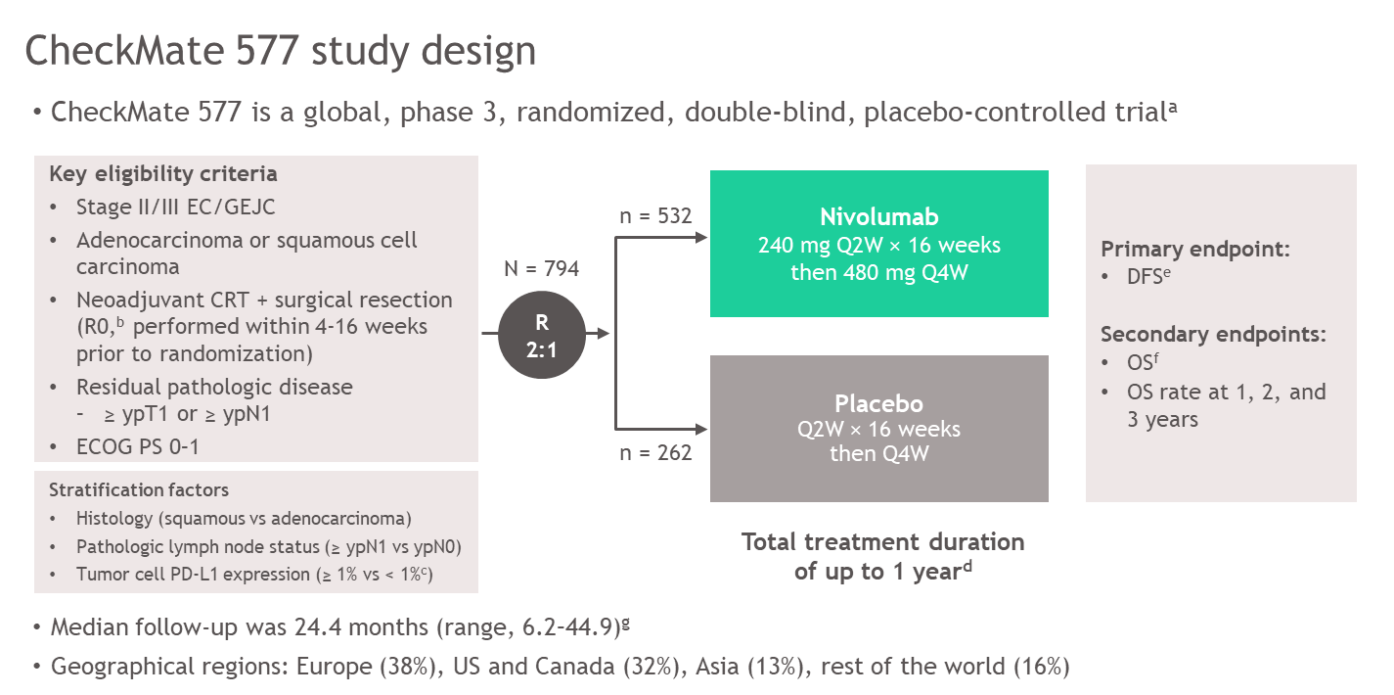
CM 577(Adj EsoSCC/EsoAC/GEJAC)

Slide 50
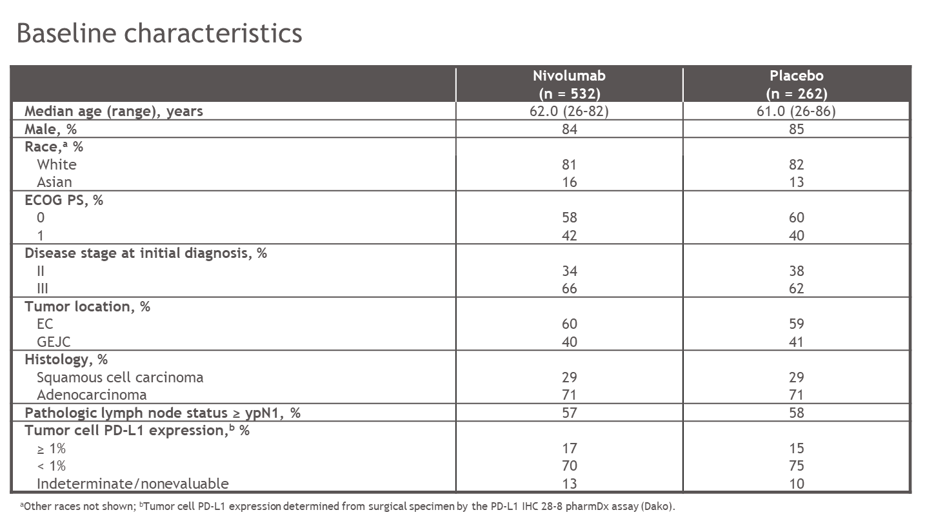
CM 577(Adj EsoSCC/EsoAC/GEJAC)

Slide 51
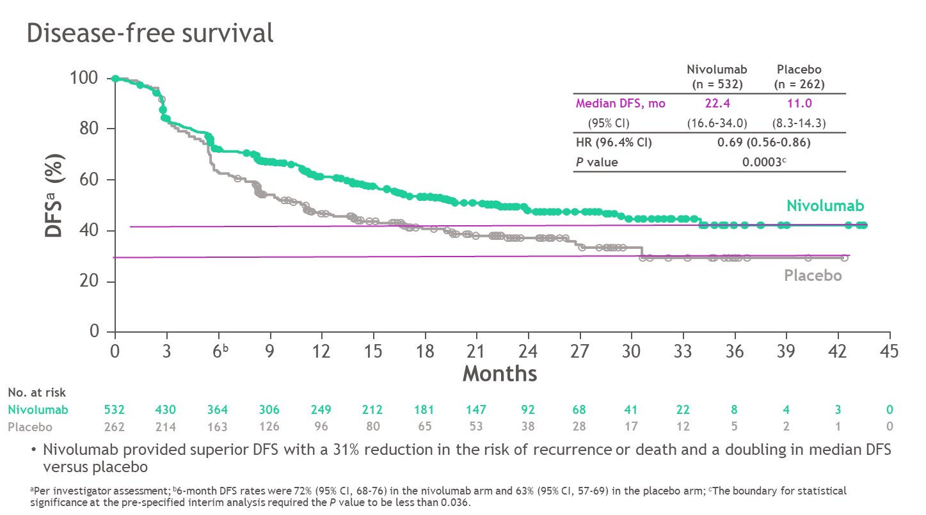
CM 577(Adj EsoSCC/EsoAC/GEJAC)

Slide 52
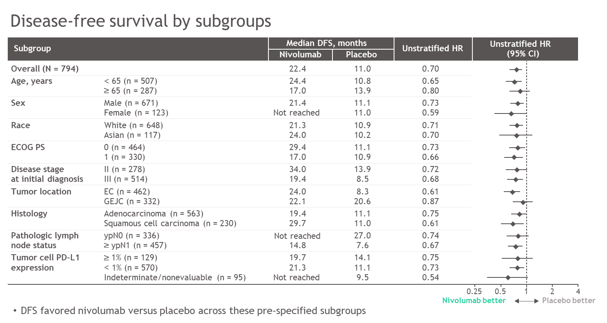
CM 577(Adj EsoSCC/EsoAC/GEJAC)
CPS?
AC?
GEJ?
Longer DFS/OS f/u

Slide 53
Safety summary
CheckMate 577
Patients, n (%) | Nivolumabª n = 532 |  | Placeboª n = 260
 | Any grade | Grade 3–4 | Any grade | Grade 3–4
Any AEs^{b} | 510 (96) | 183 (34) | 243 (93) | 84 (32)
Serious AEs | 158 (30) | 107 (20) | 78 (30) | 53 (20)
AEs leading to discontinuation | 68 (13) | 38 (7) | 20 (8) | 16 (6)
Any TRAEs^{b,c} | 376 (71) | 71 (13) | 119 (46) | 15 (6)
Serious TRAEs^{c} | 40 (8) | 29 (5) | 7 (3) | 3 (1)
TRAEs leading to discontinuation^{c} | 48 (9) | 26 (5) | 8 (3) | 7 (3)
TRAEs in ≥10% of treated patients in either arm^{b}
Fatigue | 90 (17) | 6 (1) | 29 (11) | 1 (< 1)
Diarrhea | 88 (17) | 2 (< 1) | 39 (15) | 2 (< 1)
Pruritus | 53 (10) | 2 (< 1) | 9 (3) | 0
Rash | 52 (10) | 4 (< 1) | 10 (4) | 1 (< 1)
Nivolumab was well tolerated and the majority of TRAEs were grade 1 or 2
ªPatients who received ≥1 dose of study treatment; ^{b}Events reported between first dose and 30 days after last dose of study drug; ^{c}Only 1 grade 5 TRAE was recorded in either arm (cardiac arrest in the nivolumab arm that was reported as not treatment related after database lock).

Slide 54
Treatment-related adverse events with potential immunologic etiology
CheckMate 577
Select TRAEs,^{b,c} n (%) | Nivolumabª n = 532 |  | Placeboª n = 260
 | Any grade | Grade 3–4 | Any grade | Grade 3–4
Endocrine | 93 (17) | 5 (< 1) | 6 (2) | 0
Gastrointestinal | 91 (17) | 4 (< 1) | 40 (15) | 3 (1)
Hepatic | 49 (9) | 6 (1) | 18 (7) | 4 (2)
Pulmonary | 23 (4) | 6 (1) | 4 (2) | 1 (< 1)
Renal | 7 (1) | 1 (< 1) | 2 (< 1) | 0
Skin | 130 (24) | 7 (1) | 28 (11) | 1 (< 1)
The majority of select TRAEs were grade 1 or 2
Grade 3–4 select TRAEs occurred in ≤ 1% of patients in the nivolumab arm and there were no grade 5 select TRAEs
The most common grade 3–4 select TRAEs in the nivolumab arm were pneumonitis (n = 4) and rash (n = 4) (0.8% each); in the placebo arm, these events occurred in 1 patient each (0.4%)
ªPatients who received ≥ 1 dose of study treatment; ^{b}Select TRAEs are those with potential immunologic etiology that require frequent monitoring/intervention; ^{c}Events reported between first dose and 30 days after last dose of study drug.

Slide 55
CM-577 ypT+/N+ R0
Locally Advanced
GEC
HER2-
HER2+
Eso SCC
CROSS
CROSS
RTOG1010
Eso AC
FLOT4
FLOT4
GEJ AC
PETRARCA
GC AC
Previous
IO studies
Recent ESMO
IO studies
CM577
Ongoing Studies
ESOPEC
NeoAegis
KN975 dCRT
INNOVATION
TOPGEAR
KN585
SKYSCRAPER-07 dCRT

Slide 56
Gastroesophageal Cancers
Standard PERIOPERATIVE: FLOT or CROSS
Anti-HER2 Failed/Terminated, Anti-VEGF failed/pending
Standard 1L: Chemo or Chemo +Trastuzumab
Anti- HER2 Failed in 1L Phase III studies
Standard 2L: Chemo + Ramucirumab
: pembrolizumab MSI-H, Eso SCC CPS >10
Anti- HER2 Failed in 2L Phase III studies
Stardard 3L : Chemo (taxane/irinotecan)
Trifluridine/Tipiracil
pembrolizumab CPS >10
Current Standards
HER2 1L & beyond progression
Many new promising agents
(margetuximab, DS8201a, Tucatinib, ZW25 and others)
Combination with IO?

Slide 57
Gastroesophageal Cancer: ESMO2020 1L IO + Chemo & Adjuvant IO
First line immunotherapy
1
KEYNOTE 590
2
ATTRACTION04
SCC > AC
PDL1 > 10 > 5 > 1
Asian > non Asian
Non-placebo>placebo
Oxaliplatin=Cisplatin
3
CM649
4
CM577
Perioperative immunotherapy

Slide 58
Gastroesophageal Cancer: ESMO2020
SCC CPS> 10
AC CPS>10?
SCC?
AC?
1
KEYNOTE 590
2
ATTRACTION04
Positive PFS
Negative OS? → CPS?
CPS>5
CPS>1?
ALL?
3
CM649
4
CM577
SCC
AC?
CPS?

Slide 59
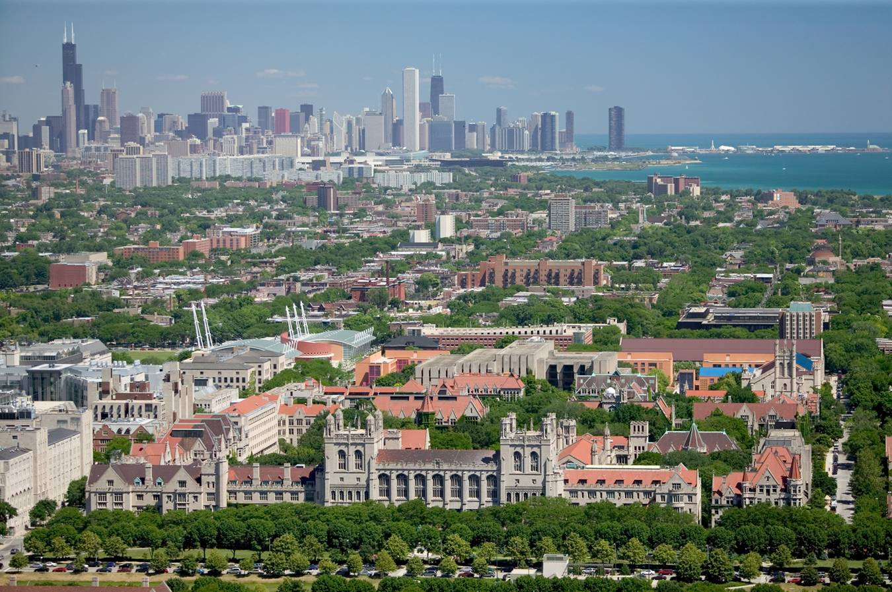
Thank You

Slide 60
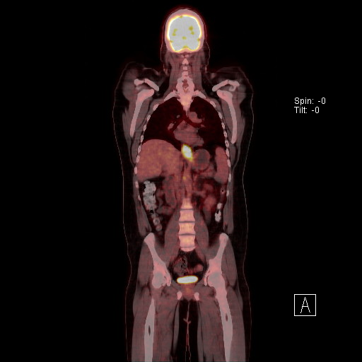
Case 1
38 year M with obesity & dysphagia, diagnosed with distal esophageal adenocarcinoma 1/12/18
Neoadjuvant CROSS (carbo/paclitaxel/RT)
Surgery ypT2N1MxR0 4/27/18
Received adjuvant FLOT x 4 to ~8/18
Recurred diffusely M1 LNs 11/18 (<6 months)
HER2 neg, MSS, PD-L1 CPS 5, TMB low
Treated with FOLFIRI-Ram ‘2L’
To 5/2020 (~1.5 years) eventual PD
3L pembrolizumab (PD after 2 cycles)
4L Trifluridine/Tipiracil (PD after 2 cycles)
Hospice

Slide 61
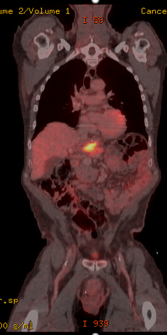
Case 2
71 year M diagnosed with dysphagia and found to have distal esophageal adenocarcinoma 1/3/13
Neoadjuvant CROSS (carbo/paclitaxel/RT)
Surgery ypT2N0MxR0 5/10/13
No Adjuvant therapy
Recurred locally, M1 LNs, & lung 5/15
HER2 neg, MSI-High, PD-L1 CPS 65, TMB 58 mt/Mb
Treated with FOLFOX x8 → PD
2L pembrolizumab x 1 year, C1D1 1/7/16 → CR
NED to present (approaching 5 years!)
PET/CT 12/17/15 Tumor recurrence at the surgical bed infiltrating the distal presumed gastrojejunostomy site, the adjacent pancreas and encasing the celiac branch vessels.

Slide 62
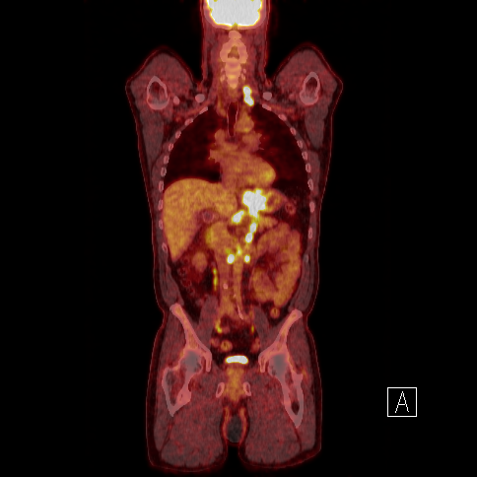
Case 3
61 year M with rheumatoid arthritis, presented with dysphagia & diagnosed GEJ/cardia adenocarcinoma 2/2016
HER2 pos, MSS, PD-L1 CPS 50, TMB 4 mt/Mb
Treated with FOLFOX+trastuzumab x8 →
-cumulative neuropathy
-5FU-Trastuzumab x 20 (~1 yr)
HER2 neg, MSS, PD-L1 CPS 2, TMB 3 mt/Mb
2L FOLFIRI-Ram x 28 (Just over 2 years)
3L Trifluridine/Tipiracil to present (almost 1 yr)

