Slide 1
Key Questions and Emerging Research
in the Management of HER2-Positive Breast Cancer
Wednesday, July 8, 2020
5:00 PM – 6:00 PM ET
Faculty
Lisa A Carey, MD
Ian E Krop, MD, PhD
Moderator
Neil Love, MD

Slide 2


Faculty
Lisa A Carey, MD
Richardson and Marilyn Jacobs Preyer Distinguished Professor for Breast
Cancer Research
Deputy Director for Clinical Sciences
Lineberger Comprehensive Cancer Center
Chapel Hill, North Carolina
Ian E Krop, MD, PhD
Associate Chief, Division of Breast Oncology
Dana-Farber Cancer Institute
Associate Professor of Medicine
Harvard Medical School
Boston, Massachusetts

Slide 3
Dr Love — Disclosures
Dr Love is president and CEO of Research To Practice. Research To Practice receives funds in the form of educational grants to develop CME activities from the following commercial interests: AbbVie Inc, Acerta Pharma — A member of the AstraZeneca Group, Adaptive Biotechnologies, Agendia Inc, Agios Pharmaceuticals Inc, Amgen Inc, Array BioPharma Inc, a subsidiary of Pfizer Inc, Astellas, AstraZeneca Pharmaceuticals LP, Bayer HealthCare Pharmaceuticals, Biodesix Inc, bioTheranostics Inc, Blueprint Medicines, Boehringer Ingelheim Pharmaceuticals Inc, Boston Biomedical Inc, Bristol-Myers Squibb Company, Celgene Corporation, Clovis Oncology, Daiichi Sankyo Inc, Dendreon Pharmaceuticals Inc, Eisai Inc, EMD Serono Inc, Exelixis Inc, Foundation Medicine, Genentech, a member of the Roche Group, Genmab, Genomic Health Inc, Gilead Sciences Inc, GlaxoSmithKline, Grail Inc, Guardant Health, Halozyme Inc, Helsinn Healthcare SA, ImmunoGen Inc, Incyte Corporation, Infinity Pharmaceuticals Inc, Ipsen Biopharmaceuticals Inc, Janssen Biotech Inc, administered by Janssen Scientific Affairs LLC, Jazz Pharmaceuticals Inc, Kite, A Gilead Company, Lexicon Pharmaceuticals Inc, Lilly, Loxo Oncology Inc, a wholly owned subsidiary of Eli Lilly & Company, Merck, Merrimack Pharmaceuticals Inc, Myriad Genetic Laboratories Inc, Natera Inc, Novartis, Oncopeptides, Pfizer Inc, Pharmacyclics LLC, an AbbVie Company, Prometheus Laboratories Inc, Puma Biotechnology Inc, Regeneron Pharmaceuticals Inc, Sandoz Inc, a Novartis Division, Sanofi Genzyme, Seattle Genetics, Sirtex Medical Ltd, Spectrum Pharmaceuticals Inc, Taiho Oncology Inc, Takeda Oncology, Tesaro, A GSK Company, Teva Oncology, Tokai Pharmaceuticals Inc, Tolero Pharmaceuticals and Verastem Inc.

Slide 4
Dr Carey — Disclosures
No financial interests or affiliations to disclose.

Slide 5
Dr Krop — Disclosures
Consulting Agreements | Context Therapeutics, Daiichi Sankyo Inc, Genentech, a member of the Roche Group, MacroGenics Inc, Roche Laboratories Inc, Taiho Oncology Inc
Contracted Research | Daiichi Sankyo Inc, Genentech, a member of the Roche Group, Pfizer Inc, Roche Laboratories Inc
Data and Safety Monitoring Board/Committee | Merck, Novartis

Slide 6




Community Oncologists
Patricia A DeFusco, MD
Director, Breast Program
Hartford HealthCare Cancer Institute
Hartford Hospital
Hartford, Connecticut
Nick C Leasure, MD
Assistant Section Chief
Section of Hematology and Oncology
Tower Health Medical Group
Reading, Pennsylvania
Justin Peter Favaro, MD, PhD
Oncology Specialists of Charlotte
Charlotte, North Carolina
YanJun Ma, MD
Tennessee Oncology
Murfreesboro, Tennessee

Slide 7
Agenda
Module 1: Localized HER2-Positive Breast Cancer — Dr Carey
Key Recent Data Sets
  Adjuvant: APHINITY update (pertuzumab); ATEMPT — T-DM1 vs HP
  Postneoadjuvant: KATHERINE — T-DM1 for residual disease
Cases/Questions from General Medical Oncologists
Faculty Cases
Module 2: HER2-Positive Metastatic Breast Cancer — Dr Krop
Key Recent Data Sets
  HER2CLIMB: Tucatinib/trastuzumab/capecitabine
  DESTINY-Breast01: Trastuzumab deruxtecan
  NALA: Neratinib/capecitabine
Cases/Questions from General Medical Oncologists
Faculty Cases

Slide 8
Early HER2+ Breast Cancer Treatment Timeline
Trastuzumab
(H)
Pertuzumab
(added to H)
Neratinib
(after H)
T-DM1
(in RD)
TH/T-DM1
in stage 1
Tailoring
to risk…
2005
2013-18
2018
2019
2017-19
2020+
APT/
ATEMPT
COMPASS
DECRESCENDO
Key trials
Many
APHINITY
ExteNET
KATHERINE
△ outcome
>10% ↑
RFS/OS
all
~ 2-3% ↑
RFS
esp N+
~2-3% ↑
RFS
esp ER+
10% ↑
RFS
RFS > 95%
?
Courtesy of Lisa A Carey, MD

Slide 9
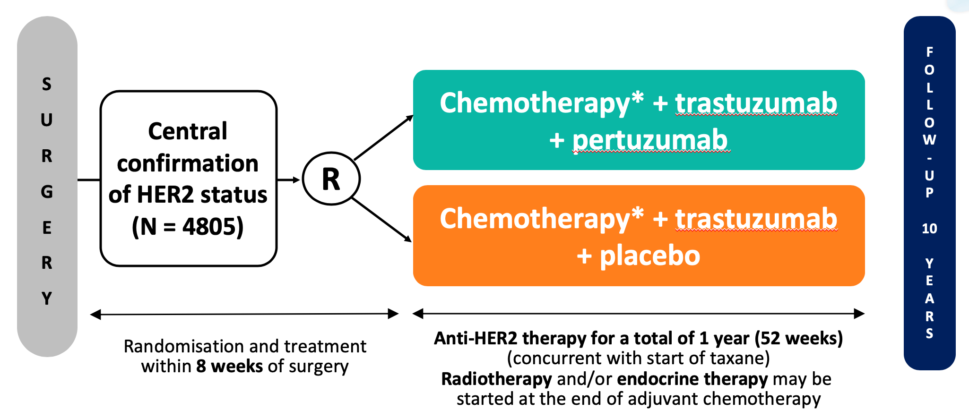
APHINITY – Lessons Learned from the Update
ASCO/NEJM 2017:
3y iDFS HR 0.81 (△1.7%)
> 3% benefit ER-, N+
Diarrhea, esp with TCHP (18%)
+ trastuzumab
+ trastuzumab
Courtesy of Lisa A Carey, MD
Von Minckwitz et al, NEJM 2017

Slide 10
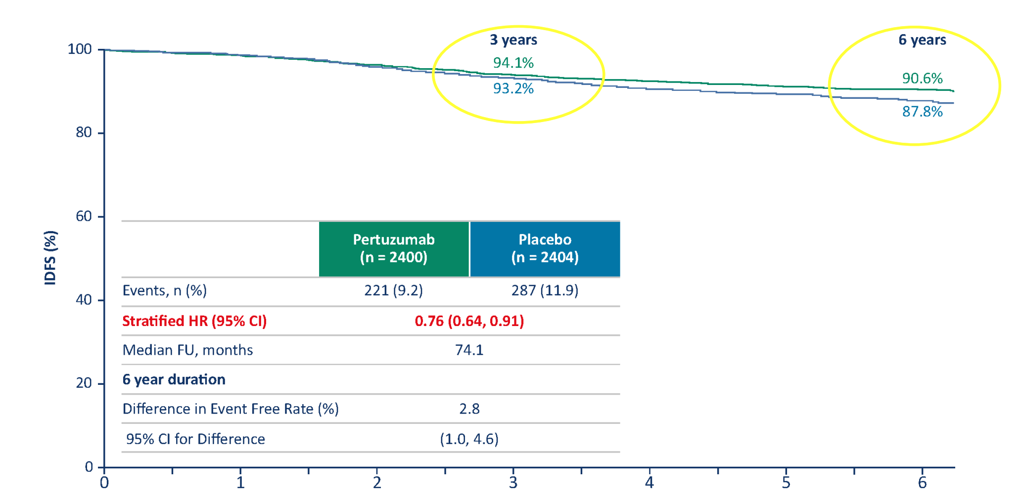
APHINITY @ SABCS 2019
2nd interim analysis, 74m follow-up
Time to first iDFS event:
Little effect in N-
4.5% absolute △ in N+
Unlike 2017 benefit seen in both ER+ and ER-
No new cardiac safety signals
Courtesy of Lisa A Carey, MD
Piccart M et al, AACR-SABCS 2019

Slide 11
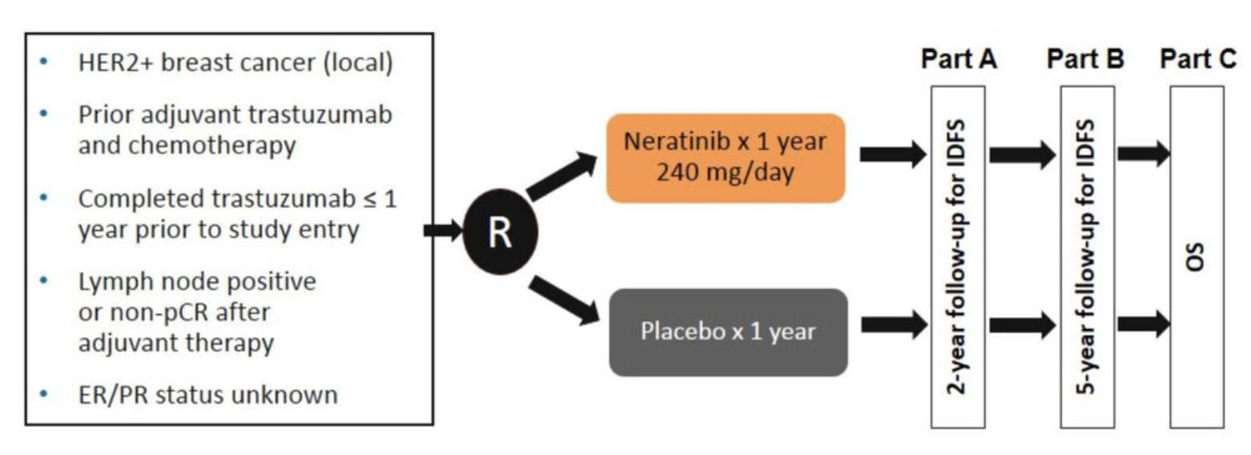
Neratinib: Extended Adjuvant Anti-HER2 Therapy
ExteNET
iDFS @ 5y:
87.7% vs 90.2% (△2.5%)
Esp in Asia, HR+, 4+ LN
Study population received chemo+H.
Behavior post HP or T-DM1?
Gr3+ Diarrhea 40%
→ structured intensive prophylaxis with loperamide x 1-2m
CONTROL Trial: additional maneuvers may help (budesonide, colestipol,) dose escalation
Martin M et al, Lancet Oncol 2017; Barcenas CH et al, Ann Oncol 2020
Notes:
120 mg/d x 1wk, 160mg/d x 1wk, then 240 mg/d. Grade 3+ D = 15%, discontinuation d/t D = 3% (vs 20% with loperamide alone)

Slide 12
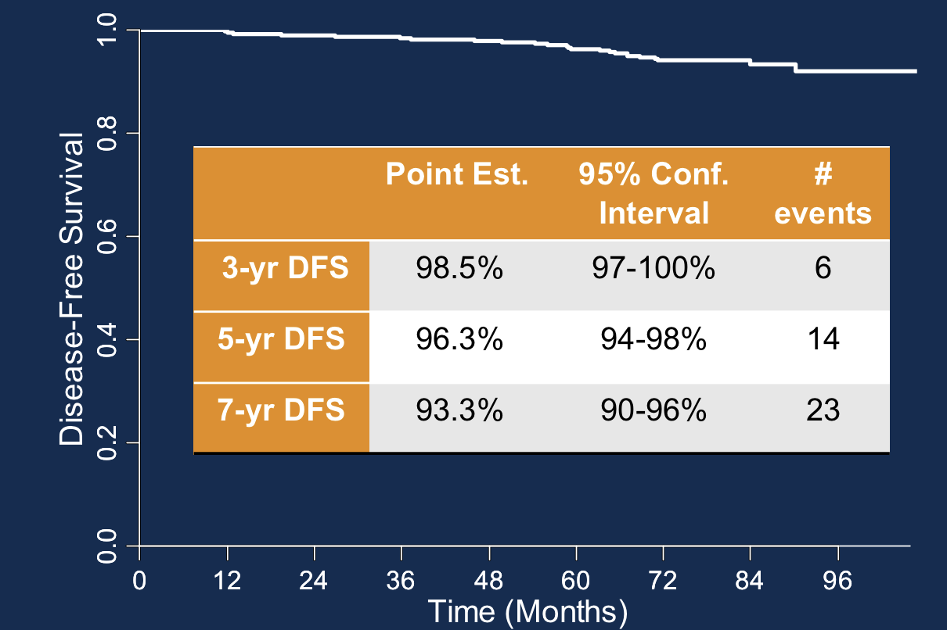
APT and ATEMPT: Optimizing Rx of Stage I HER2+
APT: 12 weeks TH, trastuzumab to 1y
Single arm beat-the-threshold trial
Practice-changing for low anatomic risk HER2+ BC.
Courtesy of Lisa A Carey, MD
Tolaney S et al, JCO 2019

Slide 13
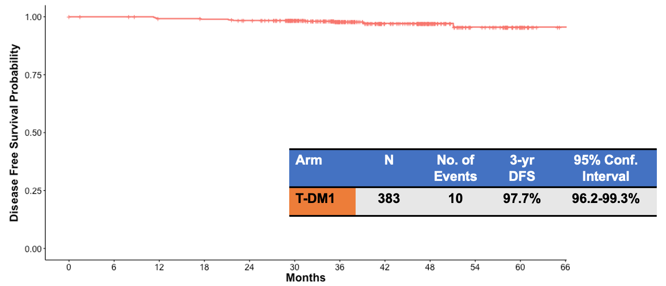
ATEMPT (TBCRC 033): T-DM1 in Stage I
N = 383
T-DM1
3.6 mg/kg IV q3 wks x 17
1º endpoint
iDFS T-DM1 arm
Stage 1 HER2+
N0 or N1mic allowed
3
N = 497
1
N = 114
TH
43% T1a-b, 57% T1c
75% ER+
Side effects T-DM1 vs TH:
 | T-DM1 | TH
Gr 2+ PN | 11% | 23%
Plt ↓ | 11% | 1%
LFT abnl | 10% | 5%
Asx EF ↓* | 1% | 6%
D/C from tox | 17% | 6%
4 recurrences, 2 distant
* < 1% CHF either arm
Courtesy of Lisa A Carey, MD
Tolaney S et al, AACR-SABCS 2019

Slide 14
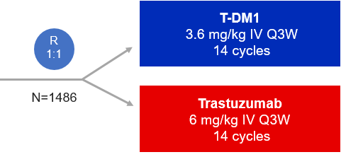
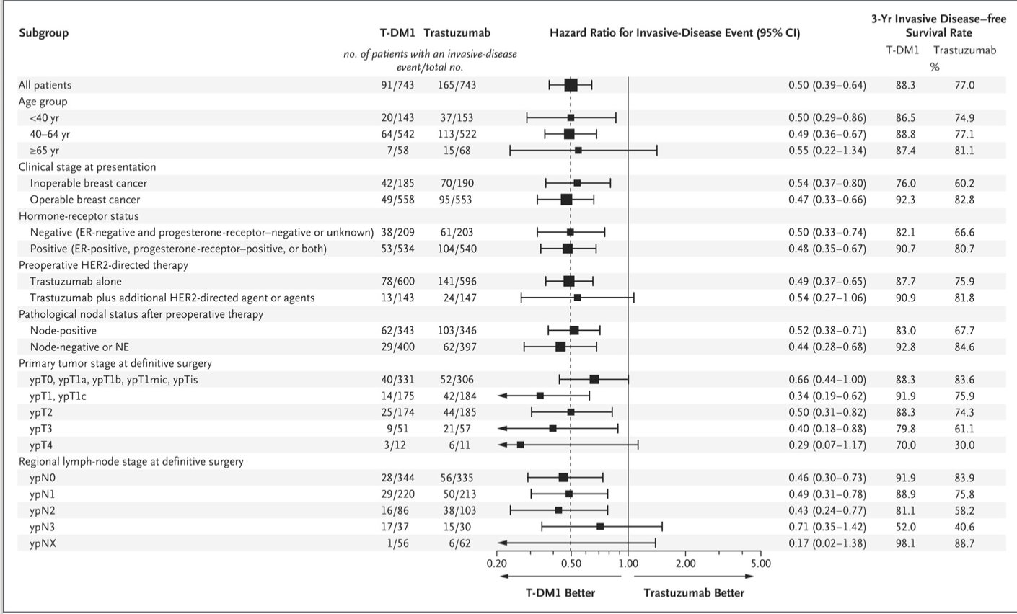
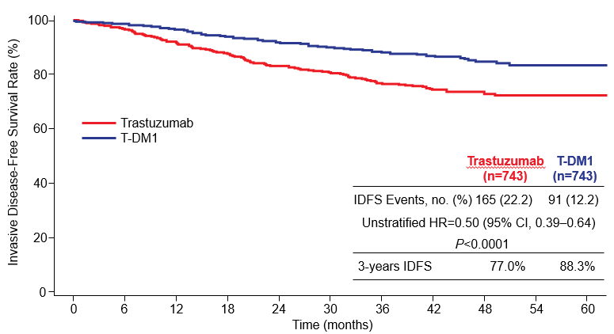
KATHERINE
KATHERINE:
HER2+
Residual disease after chemo + H
ER-
ER+
H
HP
ypN+
ypN-
<ypT1b
<ypT1c
ypT2
ypT3
EFS ER-, LN+ still 82-83%
Very few received pertuzumab
Courtesy of Lisa A Carey, MD
Von Minckwitz et al, NEJM 2018

Slide 15
Strategies for Treatment of Early HER2+ Breast Cancer
Clinical stage | Initial Rx | Path stage | Adjuvant phase*
Stage I cT1N0 | Surgery | pT1aN0 | No systemic therapy (ET prn)
 |  | pT1b-c,N0 | TH x 12 wk, H to 6-12m
Stage II cT2-3N0 cT0-2N1 | Neoadjuvant Rx Chemo + H (HP if LN+) | pCR | H or HP to 1y
 |  | Residual disease | T-DM1 x 14 cycles
Stage III cT3N1 cT4N(any) cT(any)N2-3 | Neoadjuvant Rx Chemo + HP | pCR | H or HP to 1y
 |  | Residual disease | T-DM1 x 14 cycles Consider neratinib x 1y if ER+
Surgery first Stage II-III | Neoadjuvant recommended! | Stage II-III | Chemo + H (HP if LN+) Consider neratinib x 1y if ER+ and 4+ LN
*ET recommended if HR+
Courtesy of Lisa A Carey, MD

Slide 16
Agenda
Module 1: Localized HER2-Positive Breast Cancer — Dr Carey
Key Recent Data Sets
  Adjuvant: APHINITY update (pertuzumab); ATEMPT — T-DM1 vs HP
  Postneoadjuvant: KATHERINE — T-DM1 for residual disease
Cases/Questions from General Medical Oncologists
  35-year-old woman with locally recurrent ER/PR+, HER2+ IDC
  38-year-old woman with 3-cm, node-positive ER/PR+, HER2+ IDC
Faculty Cases

Slide 17
A 35-year-old woman with ER-positive, HER2-positive BC receives neoadjuvant TCHP, adjuvant trastuzumab and adjuvant AI. Four years later she has a 5-cm in-breast recurrence and receives neoadjuvant TCHP with a pathologic complete response. What adjuvant therapy would you recommend?
Trastuzumab/pertuzumab → neratinib
Trastuzumab/pertuzumab
Trastuzumab → neratinib
T-DM1
T-DM1 → neratinib
Trastuzumab
Other
N = 163
Survey of live webinar audience

Slide 18
What is the size of the smallest tumor for which you would recommend neoadjuvant systemic therapy for a patient with ER-negative, HER2-positive, node-negative infiltrating ductal carcinoma (IDC)?
Which neoadjuvant systemic therapy, if any, would you generally recommend for a 77-year-old woman with a 2-cm, ER-positive, HER2-positive, node-negative IDC? (Dr Favaro)
Smallest tumor size
Neoadjuvant systemic therapy
2 cm
None
2 cm
None
2 cm
None
1 cm
TCH
0.2 cm
Paclitaxel/trastuzumab
1.5 cm
THP
THP = paclitaxel/trastuzumab/pertuzumab; TCH = docetaxel/carboplatin/trastuzumab

Slide 19
An 80-year-old woman presents with a 0.5-cm, ER-negative, HER2-positive, node-negative IDC. Regulatory and reimbursement issues aside, what adjuvant systemic therapy would you recommend?
None
Paclitaxel/trastuzumab
T-DM1
TCH
T-DM1 (for 6 months or less)
T-DM1

Slide 20
A 60-year-old woman presents with a 1.3-cm, ER-negative, HER2-positive IDC with 1 positive sentinel node. Would you incorporate adjuvant pertuzumab and/or postadjuvant neratinib into this patient’s treatment?
What would be your approach if the patient had ER-positive IDC?
ER-negative
ER-positive
Pertuzumab
Pertuzumab
Pertuzumab
Pertuzumab and neratinib
Pertuzumab
Pertuzumab
Pertuzumab
Pertuzumab and neratinib
Pertuzumab
Pertuzumab (discuss neratinib)
Pertuzumab
Pertuzumab

Slide 21
Reimbursement issues aside, would you like to substitute the subcutaneous formulation of pertuzumab, trastuzumab and hyaluronidase–zzxf for standard intravenous pertuzumab and trastuzumab for patients with HER2-positive breast cancer in your practice?
Yes, for all patients
Yes, for all patients
Yes, for all patients
Yes, for all patients
Yes, for select patients
Yes, for all patients

Slide 22
Which neoadjuvant systemic therapy, if any, would you recommend for a 38-year-old woman with a 3-cm ER-positive, HER2-positive IDC with 1 positive node?
TCHP
Paclitaxel/trastuzumab/
pertuzumab
ACTHP
ACTH
Paclitaxel/trastuzumab
TCH
None
Other
N = 203
Survey of live webinar audience

Slide 23
Which neoadjuvant systemic therapy, if any, would you generally recommend for a 38-year-old woman with a 3-cm,
ER-positive, HER2-positive IDC with 1 positive axillary node on biopsy?
TCHP
TCHP
TCHP
TCHP
TCHP
TCHP
TCHP = docetaxel/carboplatin/trastuzumab/pertuzumab

Slide 24
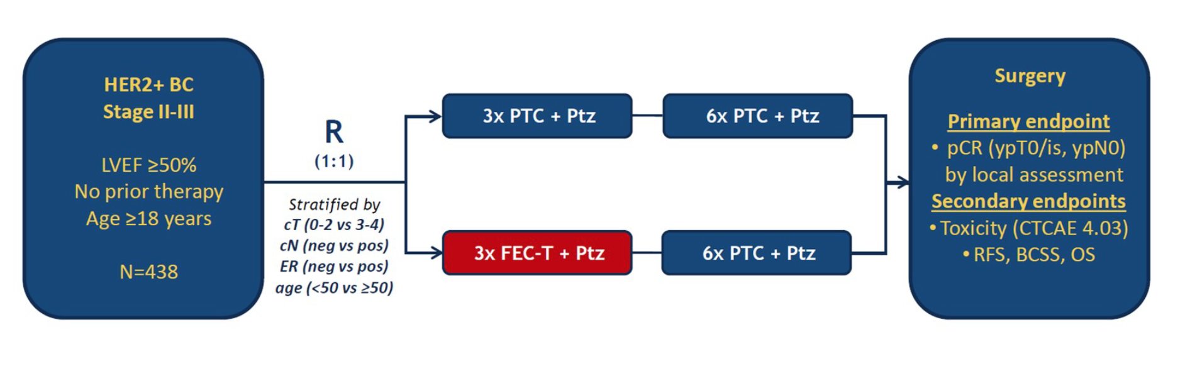
TRAIN-2: Phase III Trial of Neoadjuvant Chemotherapy with or without Anthracyclines in the Presence of Dual HER2 Blockade
PTC + Ptz = paclitaxel/trastuzumab/carboplatin + pertuzumab
FEC-T + Ptz = FEC + traszutumab + pertuzumab
Primary endpoint pCR (PTC + Ptz vs FEC-T = Ptz): 68% vs 67% (p=0.95)
Outcome was consistent across prespecified subgroups (cT, cN, HR status, age)
van Ramhorst MS et al. Lancet Oncol 2018;19(12):1630-40; van der Voort A et al. ASCO 2020;Abstract 501.

Slide 25
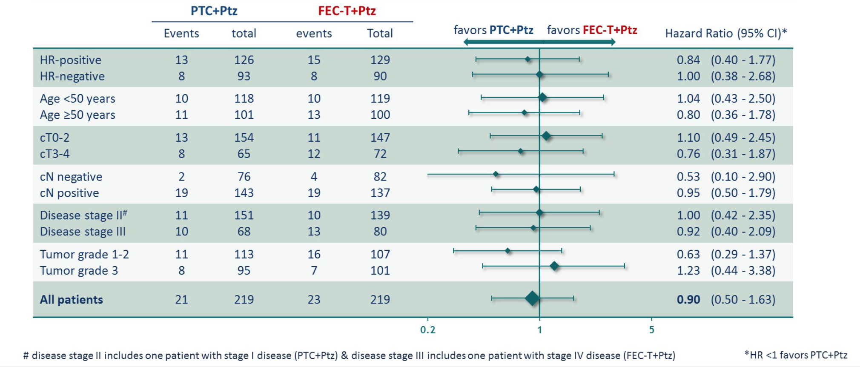
TRAIN-2 Event-Free Survival: 3-Year Follow-Up
van der Voort A et al. ASCO 2020;Abstract 501.

Slide 26
TRAIN-2 Safety: 3-Year Follow-Up
Most common Grade ≥3 hematologic AEs | PTC + Ptz (n = 218) | FEC-T + Ptz (n = 220)
Neutropenia | 54% | 60%
Anemia | 21% | 20%
Thrombocytopenia | 19% | 18%
Febrile neutropenia | 1% | 10%
Cardiotoxicity | PTC + Ptz (n = 218) | FEC-T + Ptz (n = 220) | p-value
LVEF decrease ≥10% or LVEF <50% | 22% | 36% | 0.0016
LVEF decrease ≥10% and LVEF <50% | 3% | 8% | 0.044
2 patients (1%) in the FEC-T + Ptz arm developed chemotherapy-associated acute leukemia
van der Voort A et al. ASCO 2020;Abstract 501.

Slide 27
Agenda
Module 1: Localized HER2-Positive Breast Cancer — Dr Carey
Key Recent Data Sets
  Adjuvant: APHINITY update (pertuzumab); ATEMPT — T-DM1 vs HP
  Postneoadjuvant: KATHERINE — T-DM1 for residual disease
Cases/Questions from General Medical Oncologists
  35-year-old woman with locally recurrent ER/PR+, HER2+ IDC
  38-year-old woman with 3-cm, node-positive ER/PR+, HER2+ IDC
Faculty Cases
  46-year-old woman with a 6-mm, node-negative ER/PR-, HER2+ IDC
  33-year-old woman with ER-, HER2+ IDC and postneoadjuvant residual disease

Slide 28
A 46-year-old woman presents with extensive DCIS and is found to have
6 mm of ER/PR-negative, HER2-positive, node-negative invasive disease. What adjuvant systemic therapy, if any, would you recommend?
Paclitaxel/trastuzumab
Paclitaxel/trastuzumab/
pertuzumab
T-DM1
TCHP
None
TCH
Other
N = 43
Survey of live webinar audience

Slide 29
Case Presentation – Dr Carey: 46-Year-Old Woman with ER-negative/HER2-Positive, Node-Negative IDC
46 yo woman with extensive DCIS + breast mass
Right mastectomy/SN: 6mm ER-, PR-, HER2 3+ IDC, SN negative
Randomized to T-DM1 arm of ATEMPT
  Grade 1 peripheral neuropathy, fatigue, rash, and nausea likely from T-DM1
  Ran Boston Marathon while on T-DM1
NED @ 5+y, no residual toxicities, still a runner!
*ET recommended if HR+

Slide 30
Case Presentation – Dr Carey: 33-Year-Old Woman with ER-negative/HER2-Positive, Node-Positive IDC
33 yo woman with right nipple changes and mass, clinical 8mm, 3 abnormal LN. Biopsy + grade 3 IDC, ER-, PR-, HER2 3+
TCHP x 6 cycles
  clinical CR
  Nausea / vomiting despite Rx, grade 1 PN
Partial mastectomy w/ AND + ypT0N1 (1/26 LN with RD), RT
Adjuvant T-DM1 tolerated well – grade 1 nausea only first few days post infusion.
NED <2y from dx.

Slide 31
Agenda
Module 1: Localized HER2-Positive Breast Cancer — Dr Carey
Key Recent Data Sets
  Adjuvant: APHINITY update (pertuzumab); ATEMPT — T-DM1 vs HP
  Postneoadjuvant: KATHERINE — T-DM1 for residual disease
Cases/Questions from General Medical Oncologists
Faculty Cases
Module 2: HER2-Positive Metastatic Breast Cancer — Dr Krop
Key Recent Data Sets
  HER2CLIMB: Tucatinib/trastuzumab/capecitabine
  DESTINY-Breast01: Trastuzumab deruxtecan
  NALA: Neratinib/capecitabine
Cases/Questions from General Medical Oncologists
Faculty Cases

Slide 32
Treatment Paradigm for Metastatic HER2+ Breast Cancer
(Circa 2019)
1st Line
2nd Line
3rd Line -10th Line+
THP
T-DM1
Chemotherapy + Trastuzumab
Capecitabine + lapatinib
Endocrine therapy (ET) + HL or HP
Efficacy of chemotherapy + trastuzumab is limited in ≥3rd line
  PFS ≈ 5 months
  ORR ≈ 20%
*e.g. control arms of SOPHIA and HER2CLIMB trials
Slide adapted from S Tolaney ASCO 2018. Courtesy of Ian E Krop, MD, PhD
Notes:
So with all these new agents, where do we currently stand with our current treatment approach for metastatic HER2+ disease, and where may we be heading?
The first line standard remains a taxane with trastuzumab and pertuzumab with use of endocrine therapy after discontinuation of taxane in hormone + disease, followed by T-DM1 in the 2nd line setting, and chemotherapy with anti-HER2 therapy in the 3rd line and beyond setting. Endorcine therapy with dual anti HER2 therapy can also be incorporating along the way for pts with hormone receptor positive disease, but should be reserved primarily for pts with limited tumor burden and pts with contraindications to chemotherapy.
What therapies may we see in the future?
There is interest in exploring the use of checkpoint inhibition with first line THP.
There are also studies exploring use of cdk 4/6 inhibitors in the first and later line setting for patients with metastatic hormone receptor positive, HER2+ disease.
The new drug Ab conjugates may replace T-DM1 in the 2nd line seeing, or may be utilized in 3rd line and beyond setting after progression on T-DM1.
The new tyrosine kinase inhibitors are being explored with capecitabine and may demonstrate activity in the 3rd line setting.
And finally
Margetiuxmab is a Fc optimized monoclonal antibody that binds to the same epitope as trastuzumab but may have enhanced immune effector function and is being studies in the 3rd line registrational study with chemotherapy.
This list demonstrates much hope for continued improvement in outcomes for our patients living with metastatic HER2+ disease.

Slide 33
HER2CLIMB Trial Design
Key Eligibility Criteria
HER2+ metastatic breast cancer
Prior treatment with trastuzumab, pertuzumab, and T-DM1
ECOG performance status 0 or 1
Brain MRI at baseline
  Previously treated stable brain metastases
  Untreated brain metastases not needing immediate local therapy
  Previously treated progressing brain metastases not needing immediate local therapy
  No evidence of brain metastases
Tucatinib + Trastuzumab + Capecitabine
(21-day cycle)
Tucatinib 300 mg PO BID
+
Trastuzumab 6 mg/kg Q3W (loading dose 8 mg/kg C1D1)
+
Capecitabine 1000 mg/m² PO BID (Days 1-14)
N=410
R*
(2:1)
Placebo + Trastuzumab + Capecitabine
(21-day cycle)
Placebo
+
Trastuzumab 6 mg/kg Q3W (loading dose 8 mg/kg C1D1)
+
Capecitabine 1000 mg/m² PO BID (Days 1-14)
N=202
*Stratification factors: presence of brain metastases (yes/no), ECOG status (0 or 1), and region (US or Canada or rest of world)
https://clinicaltrials.gov/ct2/show/NCT02614794
Murthy RK et al. SABCS 2019;Abstract GS1-01. Courtesy of Ian E Krop, MD, PhD

Slide 34
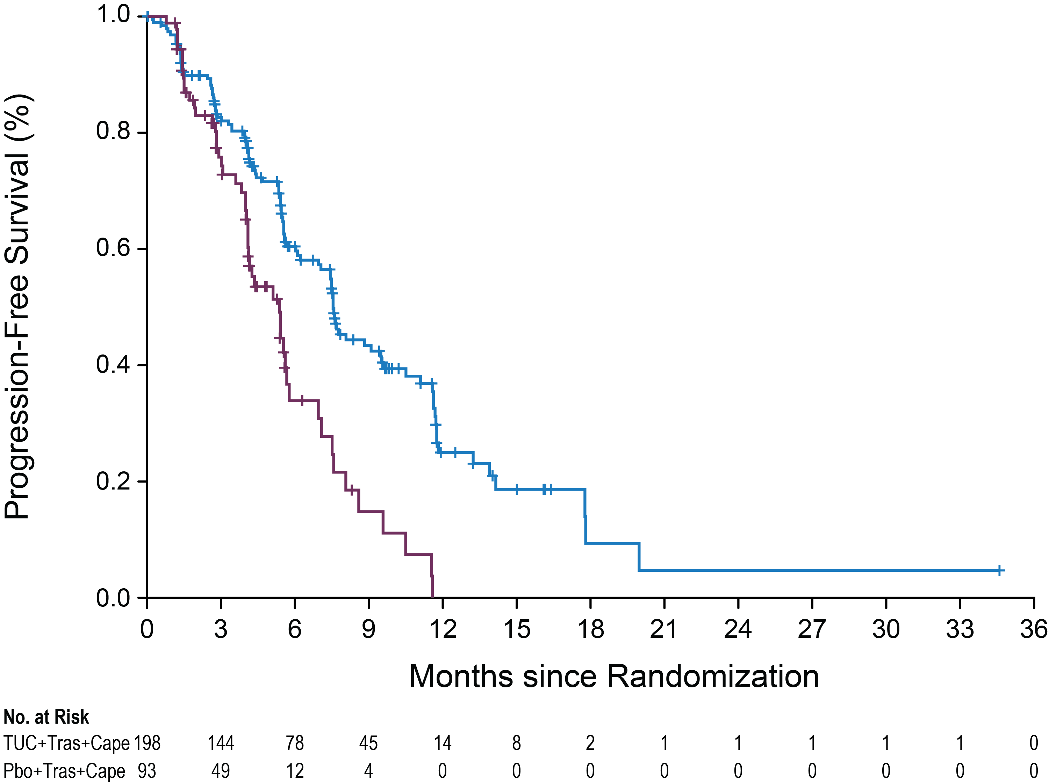
Progression-Free Survival for Patients with Brain Metastases
 | Events N=291 | HR (95% CI) | P Value
TUC+Tras+Cape | 106/198 | 0.48 (0.34, 0.69) | <0.00001
Pbo+Tras+Cape | 51/93
60%
Risk of progression or death in patients with brain metastases was reduced by 52% in the total population
One-year PFS (95% CI):
TUC+Tras+Cape 25% (17, 34) | Pbo+Tras+Cape 0%
Median PFS (95% CI):
7.6 months (6.2, 9.5) | 5.4 months (4.1, 5.7)
Median
34%
25%
0%
  Prespecified efficacy boundary for PFS_{BrainMets} (P=0.0080) was met at the first interim analysis.
  Data cut off: Sep 4, 2019
Murthy RK et al. SABCS 2019;Abstract GS1-01. Courtesy of Ian E Krop, MD, PhD

Slide 35
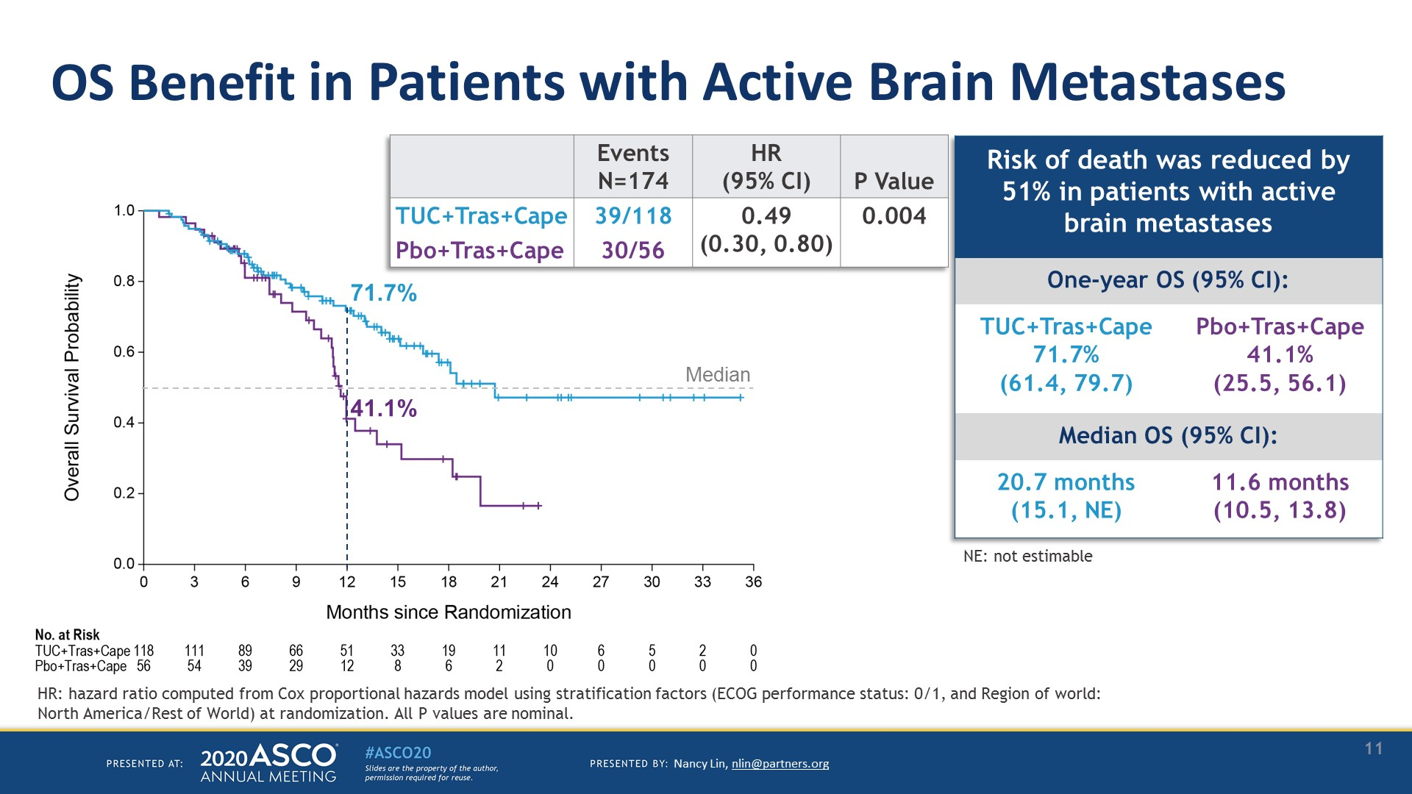
OS Benefit in Patients with Active Brain Metastases
Presented by Nancy Lin. Courtesy of Ian E Krop, MD, PhD
Presented By Nancy Lin at TBD

Slide 36
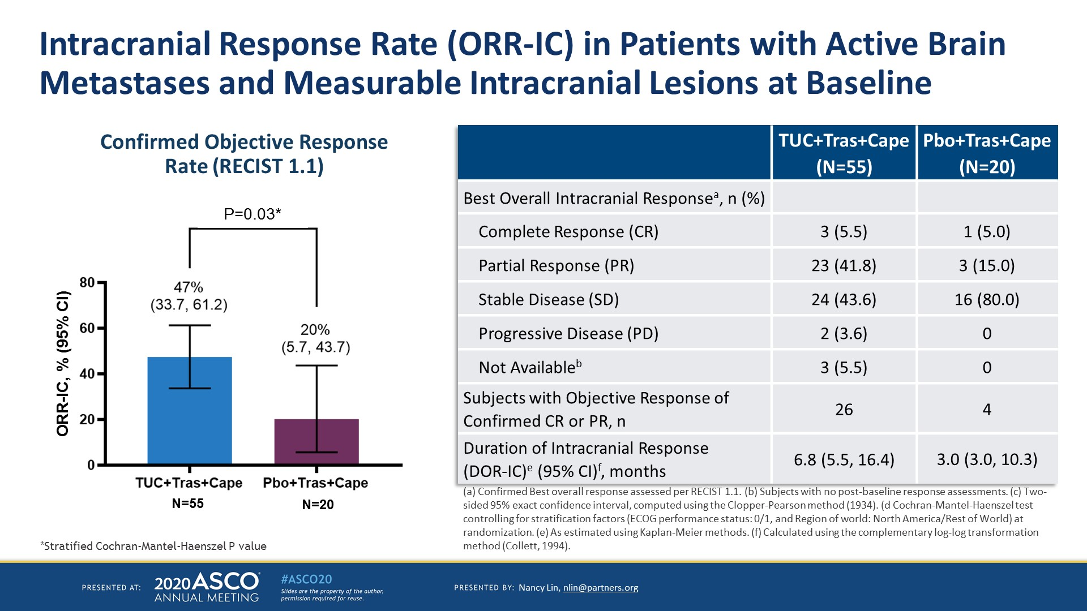
Intracranial Response Rate (ORR-IC) in Patients with Active Brain Metastases and Measurable Intracranial Lesions at Baseline
Presented by Nancy Lin. Courtesy of Ian E Krop, MD, PhD
Presented By Nancy Lin at TBD

Slide 37
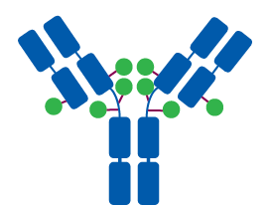
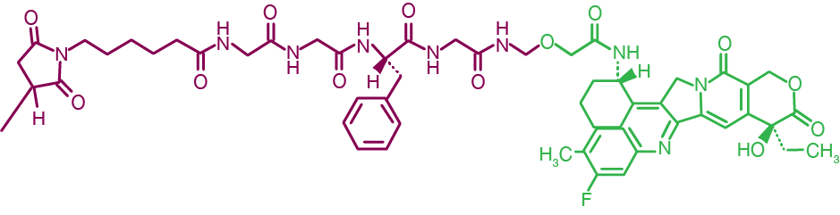
Trastuzumab Deruxtecan (DS-8201) is a Novel ADC Designed to Deliver an Optimal Antitumor Effect
Trastuzumab deruxtecan is an ADC composed of 3 components:
A humanized anti-HER2 IgG1 mAb with the same
amino acid sequence as trastuzumab
A topoisomerase I inhibitor payload, an exatecan derivative
A tetrapeptide-based cleavable linker
Payload MOA:
topoisomerase I inhibitor
High potency of payload
High drug to antibody ratio ≈ 8
Humanized anti-HER2
IgG1 mAb¹⁻³
Deruxtecan^{1,2}
Payload with short systemic half-life
Stable linker-payload
Tetrapeptide-Based Cleavable Linker
Tumor-selective cleavable linker
Topoisomerase I Inhibitor payload
(DXd)
Membrane-permeable payload
Krop IE et al. SABCS 2019;Abstract GS1-03.
Courtesy of Ian E Krop, MD, PhD
Notes:
Figure:
1/Nakada/2019/p178/Figure8/col1/para1/
all/p183/col2/para2/
L1-8;
2/Ogitani/ClinCanRes/2016/p5098/col2/para1/ln1-2/
p5100/Figure1A
3/Trail/2018/
p127/fig 1
All boxes: 1/Nakada/2019/p178/Figure 8/
box 1: 2/Ogitani/ClinCanRes/2016/p5098/col1/para2/ln4;
box 2: 2/Ogitani/ClinCanRes/2016/p5100/col1/para1/all; Figure 1C;
box 3: 2/Ogitani/ClinCanRes/2016/p5100/Figure 1 B;
box 4: 1/Nakada/2019/p180/col2/para1/ln1-3; 3/Ogitani/ClinCanRes/2016/p5105/Figure 5 D;
box 5: 2/Ogitani/ClinCanRes/2016/p5100/col2/para2/ln4-8; p5101/Figure 2 E;
box 6: 2/Ogitani/ClinCanRes/2016/p5098/col1/para2/ln3-4;
box 7: 4/Ogitani/CaSci/2016/p1044/col1/para1/ln28-32;
3 components:
1/Nakada/2019/p178/Figure 8/ col1/para1/all;
2/Ogitani/ClinCanRes/2016/p5098/col1/para2/ln2-4

Slide 38
DS-8201’s membrane-permeable payload can attack neighbouring cancer cells (i.e. a bystander effect)
ADCC= antibody-dependent cellular cytotoxicity; HER2=human epidermal growth factor receptor 2; Topo-1=topoisomerase I.
Notes:
Key takeaway: T-DXd targets HER2-expressing tumors and releases the topoisomerase I payload intracellularly leading to cell death; permeable free drug is able to act on neighboring cancer cells demonstrating a bystander effect. Additionally, T-DXd has antibody-dependent cellular cytotoxicity (ADCC) and AKT cell signaling inhibition similar to trastuzumab.

Slide 39
DS-8201’s membrane-permeable payload can attack neighbouring cancer cells (i.e. a bystander effect)
ADCC= antibody-dependent cellular cytotoxicity; HER2=human epidermal growth factor receptor 2; Topo-1=topoisomerase I.
Notes:
Key takeaway: T-DXd targets HER2-expressing tumors and releases the topoisomerase I payload intracellularly leading to cell death; permeable free drug is able to act on neighboring cancer cells demonstrating a bystander effect. Additionally, T-DXd has antibody-dependent cellular cytotoxicity (ADCC) and AKT cell signaling inhibition similar to trastuzumab.

Slide 40

DESTINY-Breast01: Best Change in Tumor Size
40
n=168
20
0
-20
Best % Change From Baseline in the Sum of Diameters of Measurable Tumors
-40
-60
Confirmed ORR: 60.9%ª
(95% CI, 53.4%–68.0%)
11 CRs
-80
-100
By independent central review.
The line at 20% indicates progressive disease; the line at −30% indicates partial response.
ª Includes all patients who received T-DXd 5.4 mg/kg (intent-to-treat analysis; N=184).
Krop IE et al. SABCS 2019;Abstract GS1-03.
Courtesy of Ian E Krop, MD, PhD

Slide 41
DESTINY-Breast01: Adverse Events of Special Interest: Interstitial Lung Disease
 | Patients who received T-DXd 5.4 mg/kg (N=184)
Preferred Term, n (%) | Grade 1 | Grade 2 | Grade 3 | Grade 4 | Grade 5 | Any Grade/ Total
Interstitial lung disease | 5 (2.7) | 15 (8.2) | 1 (0.5) | 0 | 4 (2.2) | 25 (13.6)
Drug related; ILD was determined by the Independent ILD Adjudication Committee based on 44 preferred terms.
Among the 25 total events:
  Median time to investigator-reported onset was 193 days (range, 42-535 days)
  17 of 20 patients with grade ≥2 ILD received corticosteroids
  7 patients recovered, 2 were recovering, 12 were either outcome unknown or not followed until resolution, and 4 died
  Of the 4 fatal cases, onset was from 63-148 days, 3 received steroids as part of treatment, and death occurred 9-60 days after diagnosis
Recommendations: Monitor for symptoms. Hold T-DXd and start steroids as soon as ILD is suspected
Krop IE et al. SABCS 2019;Abstract GS1-03.
Courtesy of Ian E Krop, MD, PhD

Slide 42
Effect of trastuzumab deruxtecan in heavily pretreated*
HER2-low metastatic breast cancer
Clinical activity (by independent review)
ORR
 | Overall | 37%
 | HER2 2+ | 39%
 | HER2 1+ | 36%
 | ER+ | 40% (N=47)
 | ER- | 14% (N=7)
PFS
 | Overall | 11.1 months
  *median of 7.5 prior regimens
Modi et al, JCO 2020 38:1888. Courtesy of Ian E Krop, MD, PhD

Slide 43

NALA study design
Neratinib 240 mg/d +
Capecitabine 1500 mg/m² 14/21 d
Loperamide (cycle 1)ª
Follow-up
(survival)
Inclusion criteria
Metastatic breast cancer (MBC)
Centrally confirmed HER2+ disease
≥2 lines of HER2-directed therapy for MBC
Asymptomatic and stable brain
metastases permitted
PD
R
(1:1)
No endocrine therapy permitted
Lapatinib 1250 mg/d +
Capecitabine 2000 mg/m² 14/21 d
n=621
PD
Stratification variables
Number of prior HER2 therapies for MBC
Disease location
HR status
Geographic location
Endpoints
Co-primary: PFS (centrally confirmed) and OS
Secondary: PFS (local), ORR, DoR, CBR, intervention for CNS metastases, safety, health outcomes
Saura C et al. ASCO 2019;Abstract 1002. Courtesy of Ian E Krop, MD, PhD
Loperamide 4 mg with first dose of neratinib, followed by 2 mg every 4 h for first 3 d, then loperamide 2 mg every 6–8 h until end of Cycle 1. Thereafter as needed
Adam Brufsky
Notes:
The design of the NALA study is shown here.
Patients had MBC with centrally confirmed HER2+ disease and had previously received 2 or more lines of HER2-directed therapy in the metastatic setting. Importantly, patients with asymptomatic or stable brain metastases were allowed in the trial.
A total of 621 patients were randomized 1:1 to neratinib + capecitabine or lapatinib + capecitabine.
Patients in the neratinib arm received neratinib 240 mg orally once daily, plus capecitabine 1500 mg/m² on days 1–14 out of every 21 days.
Diarrhea prophylaxis with loperamide was mandatory during cycle 1; beyond cycle 1, loperamide was used as needed at the investigator’s discretion.
Patients in the lapatinib arm received lapatinib 1250 mg orally once daily, plus capecitabine 2000 mg/m² on days 1–14 out of every 21 days.
Endocrine therapy was not permitted in patients with Hormone receptor positive disease
Patients were stratified according to number of prior HER2 therapies for MBC, disease location, HR status, and geographic location.
Two co-primary endpoints were defined: centrally confirmed PFS and OS.
Secondary endpoints included locally defined PFS, ORR, DoR, CBR, intervention for CNS metastases, safety, and health outcomes.

Slide 44
Centrally confirmed PFS (co-primary endpoint)
NALA
1.0
Hazard ratio (95% CI) | Log-rank p-value
0.76 (0.63–0.93) | 0.0059
0.9
0.8
Neratinib + Capecitabine
Lapatinib + Capecitabine
0.7
0.6
0.5
47%
PFS probability
0.4
38%
29%
0.3
0.2
16%
0.1
15%
7%
0
0
3
6
9
12
15
18
21
24
27
30
33
36
Time since randomization (months)
No. at risk:
N+C
307
183
113
69
54
35
20
13
9
7
3
2
2
L+C
314
183
82
39
24
9
8
3
2
2
2
2
1
Saura C et al. ASCO 2019;Abstract 1002. Courtesy of Ian E Krop, MD, PhD
Adam Brufsky
Notes:
Centrally confirmed PFS curves are shown here. As you can see while medians are similar the curves start separating just before the 6 month time point
At 6 months, more patients were free of progression in the neratinib + capecitabine arm compared to the lapatinib containing arm.
The curves continued to separate and at 12 months and 18 months, the neratinib containing arm had a higher percentage of patients that were progression free compared to the lapatinib arm.
The Hazard ratio was 0.76 with a p-value of 0.0059
As you can see from the shape of the curve, the risk of recurrence was not constant over time - when tested, the proportional hazards assumption did not hold. In this situation, the analysis plan had pre-specified that the difference between the two arms would be tested using a Restricted means analysis

Slide 45
Neratinib and Capecitabine for CNS disease
(TBCRC 022)
Phase 2 trial of patients with progressive HER2+ brain metastases (N=49)
Patients received neratinib (240 mg po QD) and capecitabine (750 mg/m² BID 14d on/7d off)
Efficacy in cohort without previous lapatinib (N=37):
  49% CNS objective response rate*
  5.5 mo median PFS
*≥50% reduction in sum of target CNS lesion volumes without progression of nontarget lesions, new lesions, escalating steroids, progressive neurologic signs or symptoms, or non-CNS progression
Freedman R et al. JCO 2019 37:1081. Courtesy of Ian E Krop, MD, PhD

Slide 46
How to Best Sequence New ≥3rd-Line Agents?
 | Trastuzumab Deruxtecan | Tucatinib + Tras/Cape | Neratinib + Capecitabine | Margetuximab + Chemo
PROS | Very high ORR | OS and PFS benefit | PFS benefit | Well tolerated
 | Durable benefit Long PFS | Activity in both treated and progressive brain mets | Delays time to CNS Rx | Benefit may be larger in pts with low affinity FcR (FF/FV)
 | Activity maintained in pts with treated brain mets | Manageable toxicity profile |  | Can be combined with multiple chemotherapy partners
CONS | ILD is serious potential risk | Absolute PFS benefit modest | Serious diarrhea is common | Benefit modest
 | No data on efficacy in progressive brain mets |  | Benefit modest
Courtesy of Ian E Krop, MD, PhD

Slide 47
Approach to Therapy for Metastatic HER2+ disease: Move to Personalization
Current Approach for Metastatic HER2+ Breast Cancer
1st Line
Taxane + trastuzumab + pertuzumab
2nd Line
T-DM1
No or minor CNS disease
Significant CNS disease
3rd Line
Trastuzumab deruxtecan
Tucatinib
Trastuzumab/capecitabine
4th Line
Tucatinib
Trastuzumab/capecitabine
Trastuzumab deruxtecan
5th Line+
Trastuzumab+ chemotherapy
or
Margetuximab+ chemotherapy (if low affinity FcR genotype)
Courtesy of Ian E Krop, MD, PhD
Notes:
So with all these new agents, where do we stand with our current treatment approach for metastatic HER2+ disease, and where may we be heading?
The first line standard remains a taxane with trastuzumab and pertuzumab with use of endocrine therapy after discontinuation of taxane in hormone + disease, followed by T-DM1 in the 2nd line setting, and chemotherapy with anti-HER2 therapy in the 3rd line and beyond setting. Endorcine therapy with dual anti HER2 therapy can also be incorporating along the way for pts with hormone receptor positive disease, but should be reserved primarily for pts with limited tumor burden and pts with contraindications to chemotherapy.
What therapies may we see in the future?
There is interest in exploring the use of checkpoint inhibition with first line THP.
There are also studies exploring use of cdk 4/6 inhibitors in the first and later line setting for patients with metastatic hormone receptor positive, HER2+ disease.
The new drug Ab conjugates may replace T-DM1 in the 2nd line seeing, or may be utilized in 3rd line and beyond setting after progression on T-DM1.
The new tyrosine kinase inhibitors are being explored with capecitabine and may demonstrate activity in the 3rd line setting.
And finally
Margetiuxmab is a Fc optimized monoclonal antibody that binds to the same epitope as trastuzumab but may have enhanced immune effector function and is being studies in the 3rd line registrational study with chemotherapy.
This list demonstrates much hope for continued improvement in outcomes for our patients living with metastatic HER2+ disease.

Slide 48
Agenda
Module 2: HER2-Positive Metastatic Breast Cancer (mBC) — Dr Krop
Key Recent Data Sets
  HER2CLIMB: Tucatinib/trastuzumab/capecitabine
  DESTINY-Breast01: Trastuzumab deruxtecan
  NALA: Neratinib/capecitabine
Cases/Questions from General Medical Oncologists
  38-year-old woman with HER2+ mBC; progression on THP including new brain mets
  75-year-old woman with HER2+ mBC; progression on THP → T-DM1 including leptomeningeal mets
Faculty Cases

Slide 49
A 38-year-old woman with ER-negative, HER2-positive mBC receives THP but after 1 year experiences disease progression, including multiple brain metastases. What systemic treatment would you recommend next?
Tucatinib/trastuzumab/
capecitabine
T-DM1
Trastuzumab deruxtecan
Neratinib/capecitabine
Neratinib/paclitaxel
Trastuzumab/lapatinib
Other
N = 184
Survey of live webinar audience

Slide 50
A 38-year-old woman with ER-negative, HER2-positive metastatic breast cancer receives THP but after 1 year experiences disease progression, including multiple brain metastases. Regulatory and reimbursement issues aside, what systemic treatment would you recommend next?
T-DM1
Tucatinib + trastuzumab/capecitabine
T-DM1
Tucatinib + trastuzumab/capecitabine
T-DM1
Tucatinib + trastuzumab/capecitabine

Slide 51
A woman in her 70s with ER-negative, HER2-positive metastatic breast cancer receives THP followed by T-DM1 on progression. She now presents with further disease progression but no evidence of CNS involvement. Regulatory and reimbursement issues aside, what systemic treatment would you recommend?
Tucatinib + trastuzumab/capecitabine
Trastuzumab deruxtecan
Depends on disease burden, symptomatic vs asymptomatic progression
Tucatinib + trastuzumab/capecitabine
Trastuzumab deruxtecan
Trastuzumab deruxtecan

Slide 52
A 75-year-old woman with ER-negative, HER2-positive mBC who received THP then T-DM1 now presents with further disease progression, including significant leptomeningeal metastases. What systemic treatment would you recommend?
Tucatinib/trastuzumab/ capecitabine
Trastuzumab deruxtecan
Neratinib/capecitabine
Trastuzumab/chemotherapy
Neratinib/paclitaxel
Trastuzumab/lapatinib
Other
N = 186
Survey of live webinar audience

Slide 53
A woman in her 70s with ER-negative, HER2-positive metastatic breast cancer receives THP followed by T-DM1 on progression. She now presents with further disease progression, including significant leptomeningeal metastases. Regulatory and reimbursement issues aside, what systemic treatment would you recommend?
Tucatinib + trastuzumab/capecitabine
Tucatinib + trastuzumab/capecitabine
Tucatinib + trastuzumab/capecitabine
Tucatinib + trastuzumab/capecitabine
Tucatinib + trastuzumab/capecitabine
Tucatinib + trastuzumab/capecitabine

Slide 54
A woman with ER-negative, HER2-positive metastatic breast cancer receives THP followed by T-DM1 on progression. She presents with further disease progression, including new brain metastases, and is started on tucatinib/trastuzumab/capecitabine with sustained response followed by limited disease progression in the brain only. Regulatory and reimbursement issues aside, in addition to local therapy, what systemic treatment would you recommend?
Continue tucatinib + trastuzumab/capecitabine
Trastuzumab deruxtecan
Continue tucatinib + trastuzumab/capecitabine
Continue tucatinib + trastuzumab/capecitabine
Trastuzumab deruxtecan
Continue tucatinib + trastuzumab/capecitabine

Slide 55
Have you or would you administer tucatinib/trastuzumab without capecitabine to a patient with HER2-positive metastatic breast cancer who has been unable to tolerate capecitabine in the past? (Dr Ma)
I have not but would for the right patient
I have not but would for the right patient
I have not but would for the right patient
I have not but would for the right patient
I have not but would for the right patient
Only on clinical trial and for a rare patient

Slide 56
Have you or would you administer trastuzumab deruxtecan to a patient with HER2-low metastatic breast cancer outside of a clinical trial setting?
I have not but would for the right patient
I have not and would not
I have not but would for the right patient
I have
I have not and would not
I have not but would for the right patient

Slide 57
Agenda
Module 2: HER2-Positive Metastatic Breast Cancer (mBC) — Dr Krop
Key Recent Data Sets
  HER2CLIMB: Tucatinib/trastuzumab/capecitabine
  DESTINY-Breast01: Trastuzumab deruxtecan
  NALA: Neratinib/capecitabine
Cases/Questions from General Medical Oncologists
  38-year-old woman with HER2+ mBC; progression on THP including new brain mets
  75-year-old woman with HER2+ mBC; progression on THP → T-DM1 including leptomeningeal mets
Faculty Cases
  40-year-old woman with HER2+ mBC; progression on THP → T-DM1 including new brain mets
  54-year-old woman with HER2+ mBC (liver, adrenal); progression on trastuzumab/pertuzumab-based chemotherapy → T-DM1

Slide 58
A 40-year-old woman with HER2-positive mBC receives THP then T-DM1. She presents with further disease progression including multiple new brain metastases. What systemic treatment would you recommend next?
Tucatinib/trastuzumab/ capecitabine
Trastuzumab deruxtecan
Neratinib/capecitabine
Neratinib/paclitaxel
Trastuzumab/lapatinib
Other
N = 131
Survey of live webinar audience

Slide 59
Case Presentation – Dr Krop: 40-year-old woman with ER-positive, HER2-positive mBC
40 yo elementary school teacher initially presented in 2011 with mammographically detected mass in L breast
  Core bx: IDC, grade 3, ER+ PR- HER2 3+
Mastectomy: 2.1 cm poorly differentiated IDC.
  SLNB: 1 positive LN
Adjuvant TCH, started on tamoxifen/OS

Slide 60
Case Presentation – Dr Krop: 40-year-old woman with ER-positive, HER2-positive mBC (cont)
2015: left hip and mid back pain
  Scans show multiple bone lesions, 2 cm liver lesion and sub-centimeter pulmonary nodules
  Liver bx: ER+PR-HER2 3+ adenoCA c/w breast primary
Started on paclitaxel/trastuzumab/pertuzumab
  Had near complete response after 4 cycles
  Asymptomatic
  Continued two more cycles of THP, then stopped paclitaxel can continued HP alone

Slide 61
Case Presentation – Dr Krop: 40-year-old woman with ER-positive, HER2-positive mBC (cont)
3/2017 Progression in liver, remained asymptomatic
  Reintroduced paclitaxel with HP
5/2017: further liver progression
  Started T-DM1
9/2017: complete response in liver, bone lesions stable, pulmonary nodules no longer visible
  Tolerating T-DM1 well

Slide 62
Case Presentation – Dr Krop: 40-year-old woman with ER-positive, HER2-positive mBC (cont)
8/18: Persistent R-sided headache
  MRI: innumerable brain lesions, largest 0.7
  Restaging CT: stable bone lesions, no other disease
  Whole brain RT
  Continue T-DM1
6/19: Headache returned
  MRI: progression in 4 lesions, largest 1.4 cm

Slide 63
Case Presentation – Dr Krop: 40-year-old woman with ER-positive, HER2-positive mBC (cont)
7/19: Started on HER2CLIMB study
  Headaches improved
9/19
  MRI:PR in brain
  CT: extracranial disease stable
6/20: continues on capecitabine/trastuzumab/tucatinib

Slide 64
Case Presentation – Dr Krop: 54-year-old woman with ER-negative, HER2-positive mBC
2017: 54 year old town clerk of a small town in NE. She presented with palpable R breast mass
  Bx: ER-PR-HER2 3+ poorly differentiated ductal cancer
  Neoadjuvant ACTHP
  Lumpectomy/SLND: 2cm residual cancer, 1/3 nodes positive
  Adjuvant radiation
  Continued 1 year of HP
3/2019: RUQ abdominal pain
  Scans show multiple liver lesions, largest 3.4cm
  Liver bx demonstrates metastatic carcinoma, ER-PR-HER2 2+ FISH ratio 3.2
  Started on vinorelbine/HP
  Abdominal pain improved

Slide 65
Case Presentation – Dr Krop: 54-year-old woman with ER-negative, HER2-positive mBC (cont)
7 /2019: disease progression in liver
  Started T-DM1
10/19: abdominal pain worsened, CT: modest progression in liver
  Started eribulin/trastuzumab
  Abdominal pain improved

Slide 66
Case Presentation – Dr Krop: 54-year-old woman with ER-negative, HER2-positive mBC (cont)
1/20: abdominal pain recurs
  Scans: progression in liver, new adrenal lesion, grade 2 transaminase elevation
2/20: Started trastuzumab deruxtecan
  Abdominal pain resolves, LFTs normalize
  Initially had nausea, but resolved with ondansetron
  Back to work
5/20: scans: no clearly defined liver lesions, adrenal lesion resolved

