Slide 1
Novel and Emerging Therapeutic Strategies in the Management of Non-Small Cell Lung Cancer
Matthew Gubens, MD, MS Associate Professor, Thoracic Medical Oncology University of California, San Francisco San Francisco, California

Slide 2
Grand Rounds Program Steering Committee
Alexander E Drilon, MD
Clinical Director
Developmental Therapeutics Clinic
Associate Attending Physician Thoracic Oncology Service
Memorial Sloan Kettering Cancer Center
New York, New York
Nasser H Hanna, MD
Professor of Medicine
Tom and Julie Wood Family Foundation Professor of Lung Cancer Clinical Research
Indiana University
Indianapolis, Indiana
Matthew Gubens, MD, MS
Associate Professor
Thoracic Medical Oncology
University of California, San Francisco
San Francisco, California
Leora Horn, MD, MSc
Associate Professor of Medicine
Ingram Associate Professor of Cancer Research
Director, Thoracic Oncology Research Program
Assistant Vice Chairman for Faculty Development
Vanderbilt University Medical Center
Nashville, Tennessee

Slide 3
Grand Rounds Program Steering Committee
Nathan A Pennell, MD, PhD
Associate Professor
Hematology and Medical Oncology
Cleveland Clinic Lerner College of Medicine of Case Western Reserve University
Director, Cleveland Clinic Lung
Cancer Medical Oncology Program
Cleveland, Ohio
Lecia V Sequist, MD, MPH
Associate Professor of Medicine
Harvard Medical School
Center for Thoracic Cancers
Massachusetts General Hospital Cancer Center
Boston, Massachusetts
Suresh S Ramalingam, MD
Professor of Hematology and Medical Oncology
Assistant Dean for Cancer Research
Emory University School of Medicine
Deputy Director
Winship Cancer Institute
Atlanta, Georgia
Heather Wakelee, MD
Professor of Medicine
Division of Oncology
Stanford University School of Medicine
Stanford Cancer Institute
Stanford, California

Slide 4
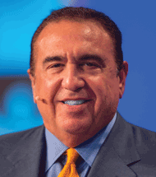
Grand Rounds Program Steering Committee
Project Chair Neil Love, MD Research To Practice Miami, Florida

Slide 5
Novel and Emerging Therapeutic Strategies in the Management of Non-Small Cell Lung Cancer
Module 1: Evolving Paradigms for Patients with NSCLC and EGFR Tumor Mutations
Clinical development, validation and current nonresearch role of plasma-based assays
Incidence and identification of less frequently occurring EGFR tumor mutations
Design, efficacy and toxicity findings from the Phase III FLAURA trial
Available data with and current clinical role of EGFR TKIs for patients with CNS metastases
Module 2: Immune Checkpoint Inhibition for Patients with Locally Advanced NSCLC
Biologic rationale for the evaluation of anti-PD-1/PD-L1 antibodies
Durvalumab consolidation after successful completion of chemoradiation therapy
Module 3: Recently Approved and Investigational Immunotherapeutic Combinations for Patients with Metastatic NSCLC
Available data with FDA-approved and emerging chemoimmunotherapy combinations
Findings from trials evaluating anti-PD-1/PD-L1 and anti-CTLA-4 combinations
Management of immune-related adverse events

Slide 6
A plasma mutation assay ordered for a patient with newly diagnosed metastatic non-small cell lung cancer (NSCLC) demonstrates an EGFR exon 19 mutation. Is that result adequate to initiate treatment with an EGFR tyrosine kinase inhibitor? If no actionable mutation were identified in plasma mutation testing, would that result be adequate to determine if targeted therapy would not be useful?
EGFR exon 19 mutation: Initiate EGFR TKI?
No actionable mutation by plasma test: Avoid targeted therapy?
Yes, but I would send tissue for an assay
No, a tissue assay might reveal a targetable mutation
Yes
No, a tissue assay might reveal a targetable mutation
Yes
No, a tissue assay might reveal a targetable mutation
Yes
No, a tissue assay might reveal a targetable mutation
Yes
No, a tissue assay might reveal a targetable mutation
Yes, but I would send tissue for an assay
No, a tissue assay might reveal a targetable mutation
Yes, but I would send tissue for an assay
No, a tissue assay might reveal a targetable mutation
Yes
No, a tissue assay might reveal a targetable mutation

Slide 7
Targetable Alteration Prevalence in NSCLC Using Next-Generation Sequencing on Plasma Samples
n = 4,521 consecutive patients with nonsquamous NSCLC
EGFR driver, 27.8%
≥1 druggable target, 34.5%
(EGFR T790M, 7.4%)
No druggable target, 65.5%
ALK/ROS1, 2.5%
ERBB2 indels, 1.6%
MET ex14, 1.5%
BRAF V600E, 1.1%
A high concordance with orthogonal clinical plasma- and tissue-based genotyping methods was observed
Odegaard JI et al. Clin Cancer Res 2018;24(15):3539-49.

Slide 8
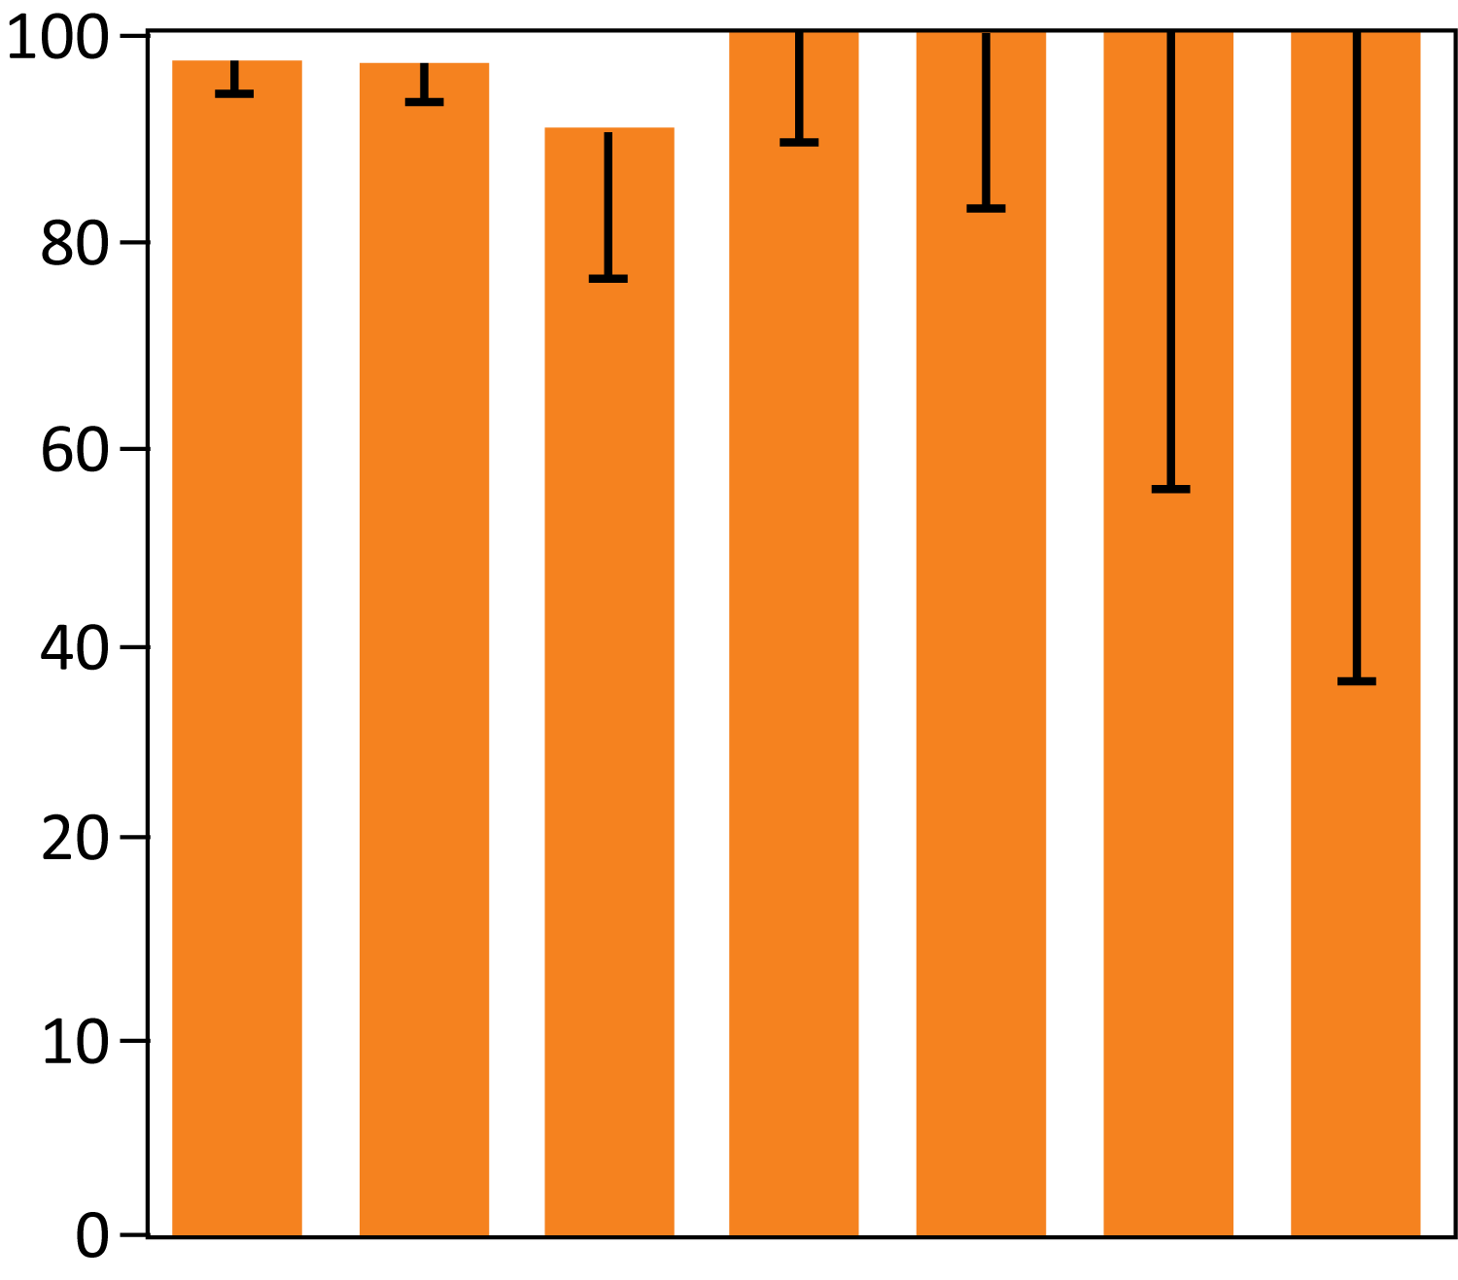
Concordance between Liquid Biopsy and Tissue Genotyping Results in Samples from 543 Patients with NSCLC
Potential advantages of liquid biopsies
Sample derived from entire tumor burden
Noninvasive; allows for longitudinal analyses
Sample is likely enriched for most biologically aggressive and clinically relevant tumor cells
More accurate therapeutic targeting due to quantitative accuracy in detecting dominant versus subclonal alterations
Positive predictive values (%)
291
181
37
26
16
5
3
= n
EGFR ex19
EGFR L858R
ALK/ROS1
KRAS G12
EGFR ex20
BRAF V600E
MET ex14sk
Positive concordance ranged from 92% to 100%
Odegaard JI et al. Clin Cancer Res 2018;24(15):3539-49.

Slide 9
2017 CAP-IASLC-AMP Guidelines: Role of Plasma-Based Assays to Identify EGFR Tumor Mutations
Currently, insufficient evidence to support cfDNA as the primary diagnostic tool in newly diagnosed adenocarcinoma
In cases where tissue is limited and/or insufficient for molecular testing, cfDNA assay can be used to identify EGFR tumor mutations
cfDNA assays can identify EGFR T790M in EGFR mutated patients who progressed on EGFR TKI; if negative, tumor tissue should be evaluated
Note: sensitivity of cfDNA analysis is lower (60-70%) so a negative mutation finding does not exclude the possibility of a mutation.
Specificity is high – low (<5-20% false positive rate)
Courtesy of Anne S Tsao, MD

Slide 10
Approved and Investigational Treatment for EGFR Tumor Mutation Subtypes in NSCLC
Mutation subtype | Approved drugs | Key investigational drugs
Common mutations: 19 del, L858R | Gefitinib, erlotinib, afatinib, osimertinib, dacomitinib | Nazartinib, icotinib
Uncommon mutations: G719X, L861Q, S768I | Afatinib | Osimertinib**
Exon 20 insertions | None | Poziotinib, TAK-788
Complex variants (rare): KDD, fusions | (Available TKIs potentially active*) | —
*Gallant JN et al. Cancer Discov 2015;5(11):1155-63; Konduri K et al. Cancer Discov 2016;6(6):601-11.
**Cho JH et al. Proc WCLC 2018;Abstract OA10.05.
Courtesy of Geoffrey Oxnard, MD

Slide 11
Poziotinib for NSCLC with EGFR or HER2 Exon 20 Mutations
 | EGFR exon 20 mutation (n = 40)* | HER2 exon 20 mutation (n = 12)
ORR at 8 weeks | 58% | 50%
Median PFS | 5.6 mo | —
Select Grade ≥3 AEs | EGFR exon 20 mutation (n = 50)
Any Grade ≥3 AE | 60%
Skin rash | 27.5%
Diarrhea | 12.5%
*Evaluable patients
Toxicities in the HER2 cohort were similar to those in the EGFR cohort except for 1 case of Grade 5 pneumonitis that was possibly drug related.
Heymach J et al. Proc WCLC 2018;Abstract OA02.06.

Slide 12
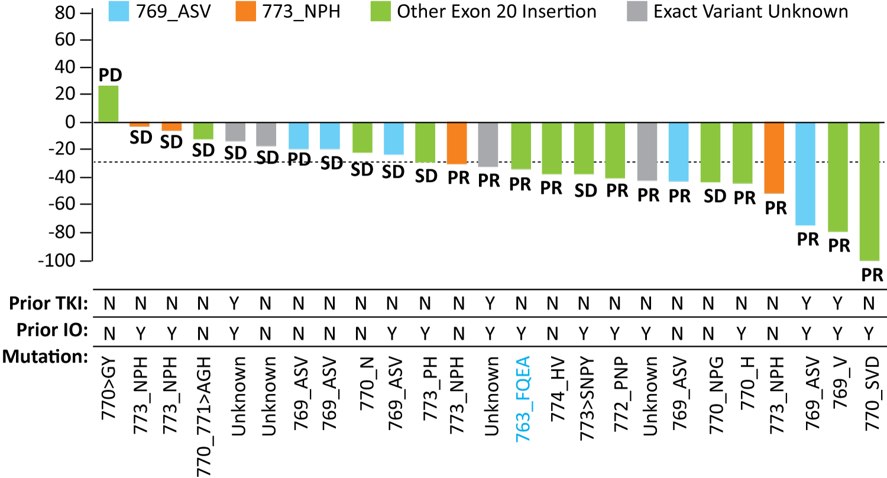
Phase I/II Study of the Oral EGFR/HER2 Exon 20 Inhibitor TAK-788 for Refractory, Advanced NSCLC
Confirmed ORR, 43% (n = 28)
Exon 20 insertion variant | No. of patients | No. of confirmed responders | Confirmed ORR
769_ASV | 5 | 2 | 40%
773_NPH | 4 | 2 | 50%
Exact variant unknown | 4 | 2 | 50%
Other | 15 | 6 | 40%
Best change in target lesions (%)
Most treatment-related AEs were Grade 1-2 and were reversible
Common Grade ≥3 AEs were diarrhea (18%), nausea (6%), increased lipase (6%) and increased amylase (4%)
Janne PA et al. ASCO 2019;Abstract 9007.

Slide 13
What first-line therapy would you recommend for a patient with asymptomatic metastatic nonsquamous NSCLC with an EGFR exon 19 deletion and a PD-L1 tumor proportion score (TPS) of . . .
TPS 90%
TPS 10%
Osimertinib
Osimertinib
Osimertinib
Osimertinib
Osimertinib
Osimertinib
Osimertinib
Osimertinib
Osimertinib
Osimertinib
Osimertinib
Osimertinib
Osimertinib
Osimertinib
Osimertinib
Osimertinib

Slide 14
FLAURA: A Phase III Study of Osimertinib versus Gefitinib or Erlotinib as First-Line Treatment for Advanced NSCLC with EGFR Tumor Mutation
Patients with locally advanced or metastatic NSCLC
Key inclusion criteria ≥18 years WHO PS 0 or 1 Exon 19 deletion/L858R (enrollment by local or central EGFR testing) No prior systemic anticancer/EGFR TKI therapy Stable CNS metastases allowed
Osimertinib (80 mg po qd) (n = 279)
Stratification by mutation status (exon 19 deletion/ L858R) and race (Asian/non-Asian)
R
Randomized 1:1
Crossover allowed
EGFR TKI SoC: gefitinib (250 mg po qd) or erlotinib (150 mg po qd) (n = 277)
Primary endpoint: Progression-free survival based on investigator assessment (per RECIST 1.1)
Key secondary endpoints: Objective response rate, overall survival and quality of life
www.clinicaltrials.gov. Accessed October 2018.

Slide 15
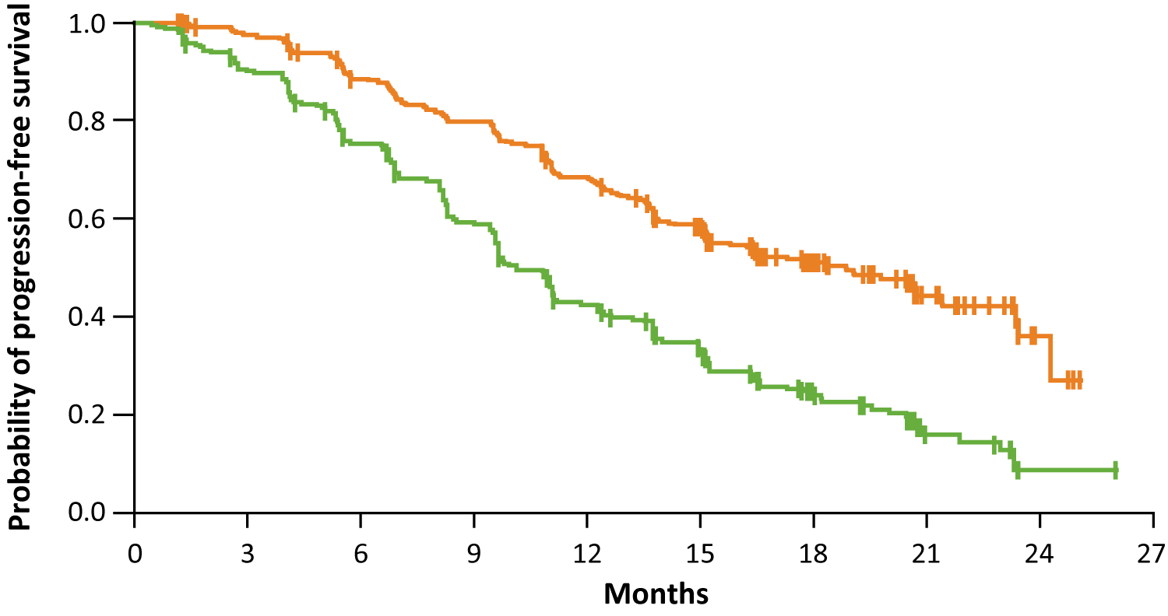
Osimertinib in Patients with NSCLC and EGFR Tumor Mutations
FLAURA primary endpoint: PFS for patients with EGFR exon 19 del or L858R mutation¹
Osimertinib (n = 279)
Median PFS = 18.9 mo
HR = 0.46
p < 0.001
Standard EGFR-TKI (n = 277)
Median PFS = 10.2 mo
Interim Overall Survival (data immature), HR = 0.63, p = 0.007²
¹ Soria JC et al. N Engl J Med 2018;378(2):113-25.
² Planchard D et al. Proc ELCC 2018;Abstract 128O.

Slide 16
Osimertinib Significantly Improves Survival in the Phase III FLAURA Trial for First-Line Treatment of NSCLC with EGFR Mutation Press Release – August 9, 2019
“Osimertinib showed a statistically-significant and clinically-meaningful improvement in OS, a secondary endpoint in the FLAURA Phase III trial, compared with erlotinib or gefitinib, both of which were previous standard-of-care (SoC) treatments in this setting...
The OS results from the FLAURA trial will be presented at a forthcoming medical meeting.”
www.astrazeneca.com/media-centre/press-releases/2019/tagrisso-significantly-improves-overall-survival-in-the-phase-iii-flaura-trial-for-1st-line-egfr-mutated-non-small-cell-lung-cancer-09082019.html

Slide 17
FLAURA: Adverse Events (AEs)
AE (any grade) | Osimertinib (N = 279) | Standard EGFR TKI (N = 277)
Any AE | 98% | 98%
Any AE (Grade ≥3) | 34% | 45%
Any AE leading to death | 2% | 4%
Any serious AE | 22% | 25%
Any AE leading to discontinuation | 13% | 18%
Specific AE (any grade)
Rash or acne | 58% | 78%
Diarrhea | 58% | 57%
Upper respiratory tract infection | 10% | 6%
Prolonged QT interval on ECG | 10% | 4%
Soria JC et al. N Engl J Med 2018;378(2):113-25.

Slide 18
Phase II Study of Osimertinib in Patients with Metastatic or Recurrent NSCLC and Uncommon EGFR Mutations
 | Uncommon EGFR tumor mutations
 | G719A/C/D/S/X | L861Q | S7681
ORR, n (%) | 10/19 (52.6%) | 7/9 (77.8%) | 3/8 (37.5%)
Study population selected for patients with activating EGFR mutations other than exon 19 deletion, L858R, T790M and exon 20 insertion
Cho JH et al. Proc WCLC 2018;Abstract OA10.05.

Slide 19
A patient with asymptomatic metastatic nonsquamous NSCLC with an EGFR exon 19 deletion and a PD-L1 TPS of 60% is receiving first-line osimertinib and develops a new solitary brain metastasis with no evidence of disease progression elsewhere. What would you recommend?
Continue osimertinib and manage the brain met with local therapy
Continue osimertinib and manage the brain met with local therapy
Continue osimertinib and manage the brain met with local therapy
Continue osimertinib and manage the brain met with local therapy
Continue osimertinib and manage the brain met with local therapy
Continue osimertinib and manage the brain met with local therapy
Continue osimertinib and manage the brain met with local therapy
Continue osimertinib and manage the brain met with local therapy

Slide 20
CNS Efficacy of Osimertinib in Patients with Advanced NSCLC and EGFR Tumor Mutations on the AURA3 and FLAURA Trials
AURA3¹ | CNS full-analysis set (cFAS) |  | CNS evaluable for response (cEFR)
 | Osimertinib (n = 75) | Platinum/pem (n = 41) | Osimertinib (n = 30) | Platinum/pem (n = 16)
CNS ORR | 40% | 17% | 70% | 31%
Median CNS DoR | 8.9 mo | 5.7 mo | 8.9 mo | 5.7 mo
FLAURA² | Full-analysis set |  | Evaluable for response
 | Osimertinib (n = 61) | EGFR TKIs (n = 67) | Osimertinib (n = 22) | EGFR TKIs (n = 19)
CNS ORR | 66% | 43% | 91% | 68%
Median CNS DoR | Not reached | 14.4 mo | 15.2 mo | 18.7 mo
cFAS = measurable/nonmeasurable baseline CNS lesions; cEFR = ≥1 measurable CNS lesion
¹ Wu YL et al. J Clin Oncol 2018;36(26):2702-9; ² Reungwetwattana T et al. J Clin Oncol 2018;[Epub ahead of print].

Slide 21
BLOOM: Response to Osimertinib in EGFR+ NSCLC with Brain Metastases (BM) and Leptomeningeal Metastases (LM)
(n = 16)
(n = 4)
16 of 20 patients are still undergoing treatment at data cut-off on December 12, 2016.
Myung-Ju A et al. Proc ASCO 2017;Abstract 2006.

Slide 22
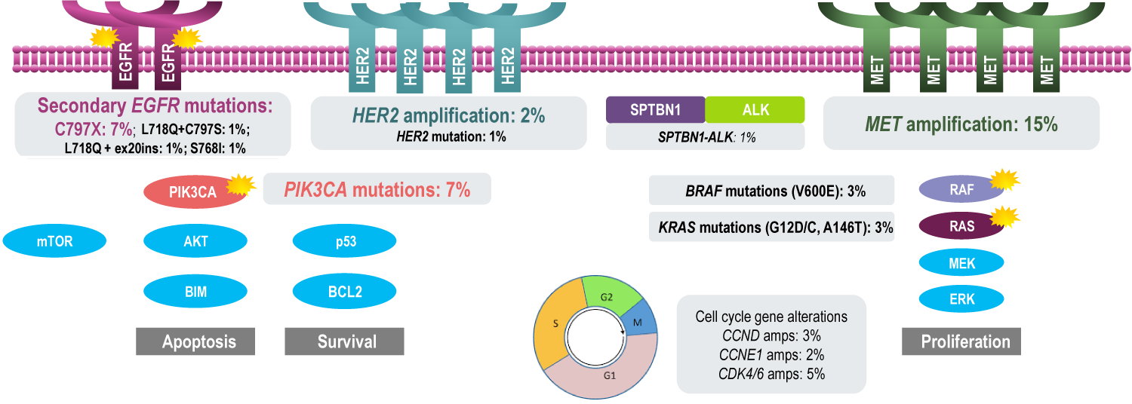
FLAURA: Candidate Mechanisms for Acquired Resistance with Osimertinib
In 129 plasma samples from patients treated with comparator EGFR TKI (gefitinib or erlotinib), the most common acquired resistance mechanisms in the comparator EGFR-TKI group were EGFR T790M (47%), MET amplification (4%) and HER2 amplification (2%)
No osimertinib-treated patients (n = 91) showed evidence of T790M-mediated acquired resistance
Ramalingam SS et al. Proc ESMO 2018;Abstract LBA50.

Slide 23
For a patient with metastatic nonsquamous NSCLC with an EGFR exon 19 deletion and a PD-L1 TPS of 60% who receives first-line osimertinib with response and then disease progression, would you recommend repeat mutation testing?
Yes, both liquid and tissue biopsy
Yes, both liquid and tissue biopsy
Yes, liquid biopsy
Yes, both liquid and tissue biopsy
No
No
Yes, tissue biopsy
Yes, tissue biopsy

Slide 24
If a patient with asymptomatic metastatic nonsquamous NSCLC with an EGFR exon 19 deletion and a PD-L1 TPS of 60% responded to first-line osimertinib and then experienced disease progression, what would be your second-line treatment recommendation if the patient had acquired no further actionable mutations?
Chemotherapy
Atezolizumab/carbo/paclitaxel + bevacizumab
Pembrolizumab/carbo/pemetrexed
Atezolizumab/carbo/paclitaxel + bevacizumab
Atezolizumab/carbo/paclitaxel + bevacizumab
Chemotherapy
Atezolizumab/carbo/paclitaxel + bevacizumab if no hx of CNS mets. Chemo + osimertinib if any hx of CNS mets that are currently well controlled
Carbo/pemetrexed/bevacizumab

Slide 25
Novel and Emerging Therapeutic Strategies in the Management of Non-Small Cell Lung Cancer
Module 1: Evolving Paradigms for Patients with NSCLC and EGFR Tumor Mutations
Clinical development, validation and current nonresearch role of plasma-based assays
Incidence and identification of less frequently occurring EGFR tumor mutations
Design, efficacy and toxicity findings from the Phase III FLAURA trial
Available data with and current clinical role of EGFR TKIs for patients with CNS metastases
Module 2: Immune Checkpoint Inhibition for Patients with Locally Advanced NSCLC
Biologic rationale for the evaluation of anti-PD-1/PD-L1 antibodies
Durvalumab consolidation after successful completion of chemoradiation therapy
Module 3: Recently Approved and Investigational Immunotherapeutic Combinations for Patients with Metastatic NSCLC
Available data with FDA-approved and emerging chemoimmunotherapy combinations
Findings from trials evaluating anti-PD-1/PD-L1 and anti-CTLA-4 combinations
Management of immune-related adverse events

Slide 26
In general, do you recommend durvalumab as consolidation treatment after chemoradiation therapy for patients with locally advanced NSCLC? Based on available data and your own clinical experience, what is the likelihood that a patient would be able to successfully complete 1 year of durvalumab as consolidation therapy?
Consolidation durvalumab?
Likelihood of completing 1 year
Yes
70%
Yes
70%
Yes
40%
Yes
80%
Yes
75%
Yes
75%
Yes
70%
Yes
60%

Slide 27
What are the shortest and longest periods of time that you would wait after the completion of chemoradiation therapy to begin treatment with consolidation durvalumab?
Shortest period
Longest period
1 day
56 days
14 days
84 days
1 day
90 days
1 day
42 days
14 days
45 days
14 days
90 days
7 days
56 days
1 day
42 days

Slide 28
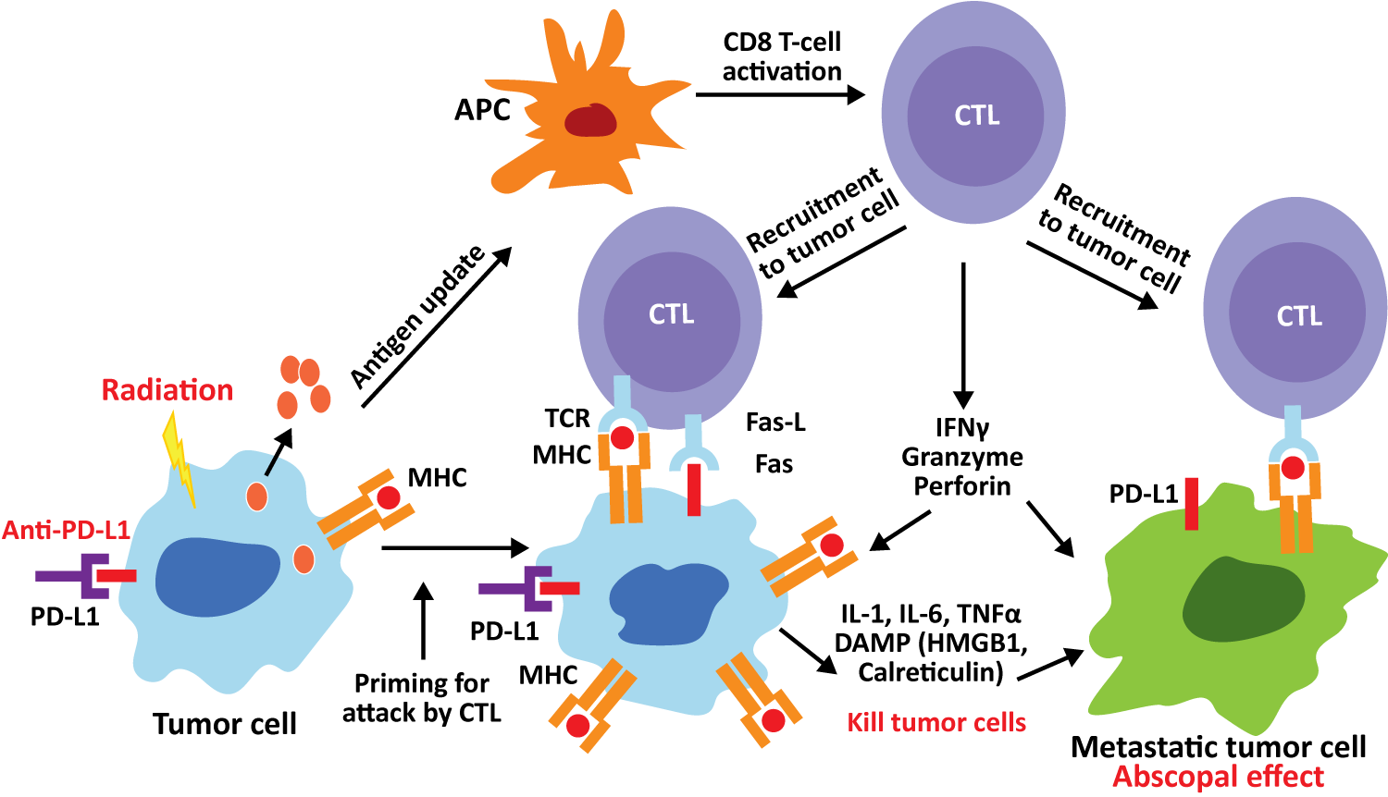
Rationale for Immune Checkpoint Inhibitors After Chemoradiation Therapy for Locally Advanced NSCLC
Chemoradiation therapy may increase neoantigen production, which promotes T-cell infiltration
Immune checkpoint inhibitors prevent PD-1/PD-L1 proteins from interfering with cytotoxic T-cell response
Chen HHW et al. Oncotarget 2017;8(37):62742-58.

Slide 29
PACIFIC: Phase III Trial of Durvalumab After Chemoradiation Therapy in Stage III, Locally Advanced, Unresectable NSCLC
Stage III, locally advanced, unresectable NSCLC with no disease progression after definitive platinum-based cCRT (≥2 cycles)
18 years or older
WHO PS 0 or 1
Estimated life expectancy of
>12 weeks
Archived tissue
All-comers population
Durvalumab 10 mg/kg q2wk for up to 12 months N = 476
Coprimary endpoints
PFS by BICR using RECIST v1.1*
Overall survival
1-42 days post-cCRT
2:1 randomization, stratified by age, sex and smoking history N = 713
Key secondary endpoints
ORR (per BICR)
DoR (per BICR)
Safety and tolerability
Placebo 10 mg/kg q2wk for up to 12 months N = 237
cCRT = concurrent chemoradiation therapy
www.clinicaltrials.gov. Accessed February 2019; Antonia SJ et al. N Engl J Med 2017;377(20):1919-29

Slide 30
PACIFIC: PFS by Blinded Independent Central Review in the Intention-to-Treat Population (Primary Endpoint)
 | Durvalumab (N = 476) | Placebo (N = 237)
Median PFS, months | 16.8 | 5.6
12-month PFS rate | 55.9% | 35.3%
18-month PFS rate | 44.2% | 27.0%
1.0
0.9
0.8
0.7
0.6
0.5
0.4
0.3
0.2
0.1
0.0
PFS probability
Durvalumab
Stratified hazard ratio = 0.52
Two-sided p < 0.001
Placebo
0
3
6
9
12
15
18
21
24
27
Time from randomization (months)
No new safety signals were observed, and the most common Grade 3 or 4 adverse event associated with durvalumab compared to placebo was pneumonia (4.4% and 3.8%, respectively).
OS data were immature at the time of this analysis.
Antonia SJ et al. N Engl J Med 2017;377(20):1919-29.

Slide 31
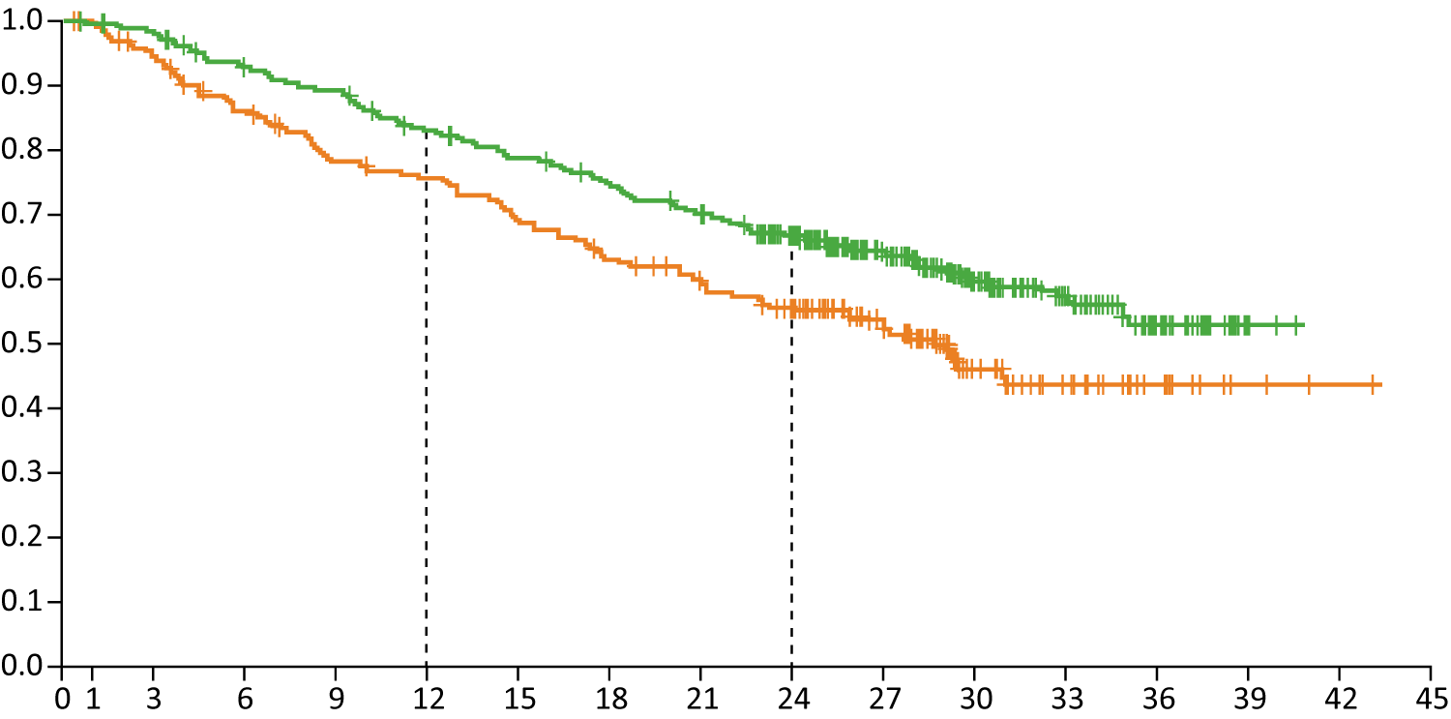
PACIFIC: Overall Survival in the Intention-to-Treat Population
 | Durvalumab (N = 476) | Placebo (N = 237)
Median OS, months | NR | 28.7
12-month OS rate | 83.1% | 75.3%
24-month OS rate | 66.3% | 55.6%
Probability of overall survival
Durvalumab
Placebo
Stratified hazard ratio = 0.68
Two-sided p = 0.0025
Months since randomization
Antonia SJ et al. N Engl J Med 2018;379(24):2342-50.

Slide 32
PACIFIC: Grade 3 or 4 Toxicity with Durvalumab After Chemoradiation in Stage III NSCLC
Adverse events (Grade 3 or 4) | Durvalumab (N = 475) | Placebo (N = 234)
Any Grade 3 or 4 | 29.9% | 26.1%
Cough | 0.4% | 0.4%
Pneumonitis or radiation pneumonitis | 3.4% | 2.6%
Dyspnea | 1.5% | 2.6%
Diarrhea | 0.6% | 1.3%
Pneumonia | 4.4% | 3.8%
Anemia | 2.9% | 3.4%
A total of 30.5% of the patients in the durvalumab group and 26.1% of those in the placebo group had Grade 3 or 4 adverse events of any cause.
Adverse events leading to discontinuation of treatment were about 15.4% in the durvalumab group and 9.8% in the placebo group.
Antonia SJ et al. N Engl J Med 2017;377(20):1919-29; Antonia SJ et al. N Eng J Med 2018;379(24):2342-50.

Slide 33
In general, do you recommend durvalumab as consolidation treatment after chemoradiation therapy for patients with locally advanced NSCLC with . . .
EGFR mutation
ALK rearrangement
Yes
Yes
Yes
Yes
Yes
Yes
Yes
Yes
Yes
Yes
Yes
Yes
No
No
Yes
Yes

Slide 34
PACIFIC: PFS by PD-L1 Status and EGFR Tumor Mutation Status
Subgroup
Durvalumab
Placebo
Unstratified Hazard Ratio for Disease Progression or Death
no. of patients
Durvalumab Better
Placebo Better
No significant between-group differences (p < 0.05) were noted in either PD-L1 expression or EGFR tumor mutation status
Antonia SJ et al. N Engl J Med 2017;377(20):1919-29.

Slide 35
In general, do you recommend durvalumab as consolidation treatment after chemoradiation therapy for patients with locally advanced NSCLC who are experiencing . . .
Mild esophagitis
Mildly symptomatic pneumonitis
Yes
No
Yes
No
Yes
Yes
Yes
No
Yes
No
Yes
No
Yes
No
Yes
No until some improvement noted

Slide 36
For a patient who receives definitive chemoradiation therapy followed by 1 year of durvalumab but experiences subsequent disease progression, would you consider rechallenging with an anti-PD-1/PD-L1 antibody at some point in their treatment course?
Consider rechallenge?
Condition
Yes
Remote recurrence from end of durvalumab, high PD-L1/TMB
Yes
Even if PD during 1 year of durvalumab, would offer w/ chemo ± bev
Yes
>1 year off therapy
Yes
>1 year out from completion of durvalumab
Yes
If fairly long time between stopping tx and recurrence, or might consider in combo with chemo
Yes
Chemotherapy + PD-1 inhibition
Yes
If >6 months had passed
Yes
In combo with chemo

Slide 37
Select Ongoing Studies of Immune Checkpoint Inhibitor Monotherapy or Combination Therapy for Locally Advanced NSCLC
Clinical Trial | Phase | Patients Enrolled | Primary Estimated Completion Date
KEYNOTE-671 (NCT03425643): A Trial of Platinum Doublet Chemotherapy +/-Pembrolizumab (MK-3475) as Neoadjuvant/Adjuvant Therapy for Participants with Resectable Stage IIB or IIIA NSCLC | III | 786 | January 2024
KEYNOTE-799 (NCT03631784): A Trial of Pembrolizumab in Combination With Chemotherapy and Radiotherapy in Stage III NSCLC | II | 216 | December 2020
PACIFIC 6 (NCT03693300): A Study to Determine Safety of Durvalumab After Sequential Chemo Radiation in Patients With Unresectable Stage III NSCLC | II | 150 | December 2022
www.clinicaltrials.gov; Accessed February 2019.

Slide 38
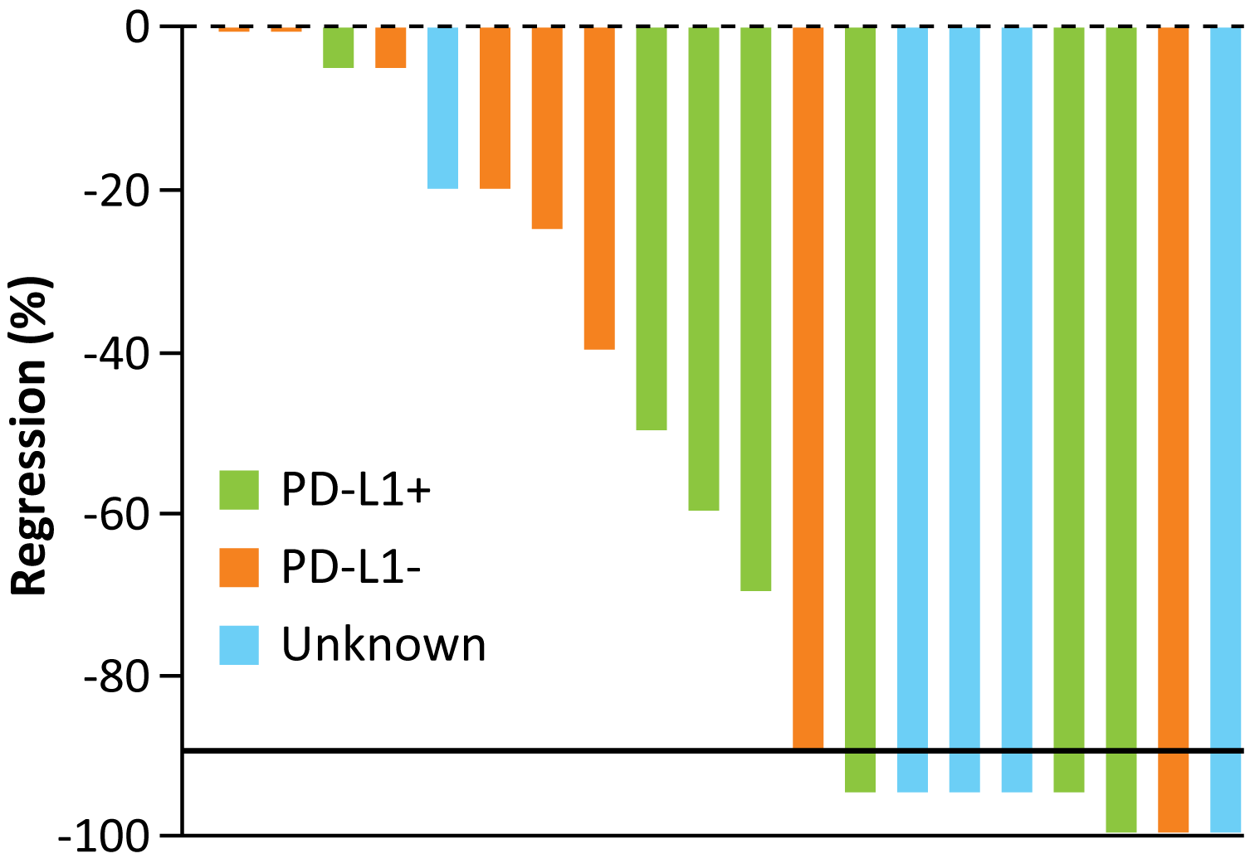
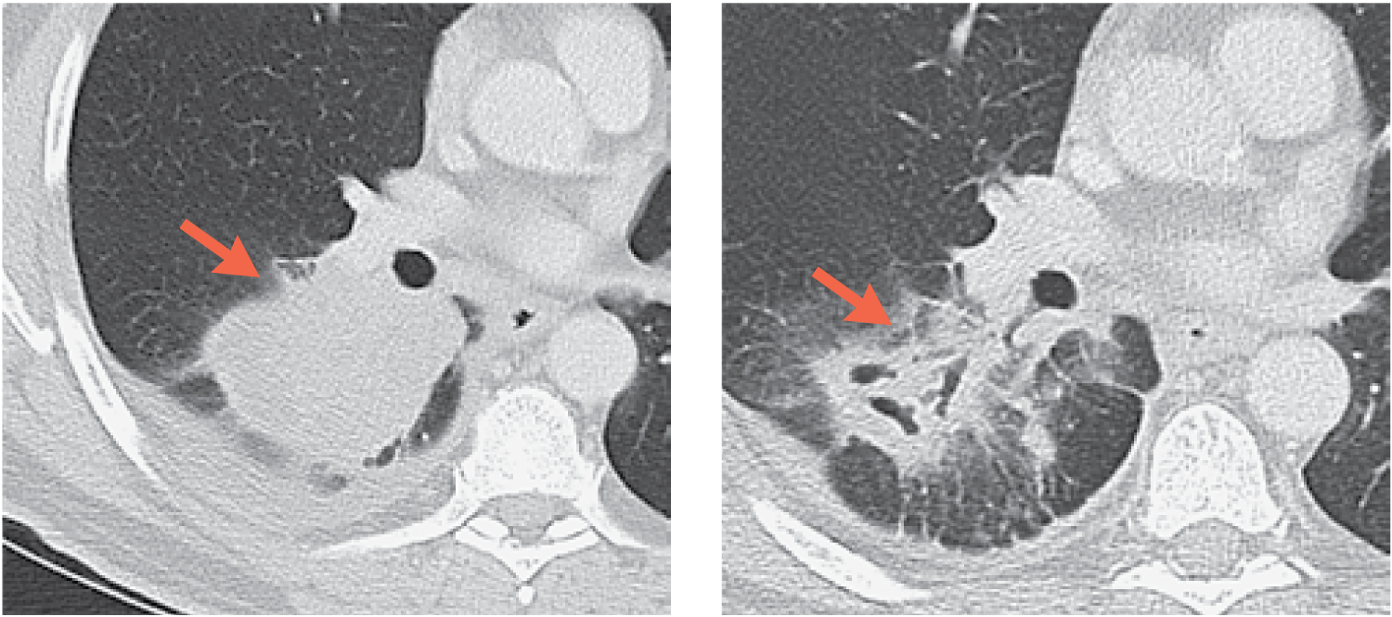
Pilot Study of Neoadjuvant Nivolumab in Resectable NSCLC
2 preoperative doses of nivolumab administered every 2 weeks in patients with untreated, surgically resectable early (Stage I, II, or IIIA) NSCLC, with surgery planned ~4 weeks after first dose
Patient 1: Smoker, Stage IIB squamous lung cancer
n = 20
Pretreatment imaging
8-cm primary tumor
Week 4 (before surgery)
35% shrinkage with tumor cavitation
Treatment-related AEs of any grade occurred in 5/22 (23%) patients; only 1 event was Grade ≥3
Forde PM et al. N Engl J Med 2018;378(21):1976-86.

Slide 39
Novel and Emerging Therapeutic Strategies in the Management of Non-Small Cell Lung Cancer
Module 1: Evolving Paradigms for Patients with NSCLC and EGFR Tumor Mutations
Clinical development, validation and current nonresearch role of plasma-based assays
Incidence and identification of less frequently occurring EGFR tumor mutations
Design, efficacy and toxicity findings from the Phase III FLAURA trial
Available data with and current clinical role of EGFR TKIs for patients with CNS metastases
Module 2: Immune Checkpoint Inhibition for Patients with Locally Advanced NSCLC
Biologic rationale for the evaluation of anti-PD-1/PD-L1 antibodies
Durvalumab consolidation after successful completion of chemoradiation therapy
Module 3: Recently Approved and Investigational Immunotherapeutic Combinations for Patients with Metastatic NSCLC
Available data with FDA-approved and emerging chemoimmunotherapy combinations
Findings from trials evaluating anti-PD-1/PD-L1 and anti-CTLA-4 combinations
Management of immune-related adverse events

Slide 40
Which first-line treatment regimen would you recommend for a 65-year-old patient with asymptomatic metastatic nonsquamous lung cancer and no identified targetable mutations with a PD-L1 TPS of 60%? A TPS of 10%?
TPS 60%
TPS 10%
Pembrolizumab
Carbo/pemetrexed/ pembrolizumab
Pembrolizumab
Carbo/pemetrexed/ pembrolizumab
Pembrolizumab
Carbo/pemetrexed/ pembrolizumab
Pembrolizumab
Carbo/pemetrexed/ pembrolizumab
Pembrolizumab
Carbo/pemetrexed/ pembrolizumab
Pembrolizumab
Carbo/pemetrexed/ pembrolizumab
Carbo/pemetrexed/ pembrolizumab
Carbo/pemetrexed/ pembrolizumab
Pembrolizumab
Carbo/pemetrexed/ pembrolizumab

Slide 41
What first-line treatment regimen would you recommend for a 65-year-old patient with asymptomatic metastatic squamous cell lung cancer and a PD-L1 TPS of 10%? A TPS of 60%?
TPS 10%
TPS 60%
Pembrolizumab/carbo/ nab paclitaxel
Pembrolizumab
Pembrolizumab/carbo/ nab paclitaxel
Pembrolizumab
Pembrolizumab/carbo/ paclitaxel
Pembrolizumab
Pembrolizumab/carbo/ nab paclitaxel
Pembrolizumab
Pembrolizumab/carbo/ paclitaxel
Pembrolizumab
Pembrolizumab/carbo/ paclitaxel
Pembrolizumab
Pembrolizumab/carbo/ nab paclitaxel
Pembrolizumab
Pembrolizumab/carbo/ paclitaxel
Pembrolizumab

Slide 42
How long would you continue treatment with an anti-PD-1/ PD-L1 antibody for a patient with metastatic NSCLC who at first evaluation has achieved a . . .
Complete clinical response
Partial clinical response
Indefinitely or until disease progression/toxicity
Indefinitely or until disease progression/toxicity
2 years
2 years
Indefinitely or until disease progression/toxicity
Indefinitely or until disease progression/toxicity
2 years
2 years
2 years
2 years
2 years
2 years
Indefinitely or until disease progression/toxicity
Indefinitely or until disease progression/toxicity
2 years
2 years

Slide 43
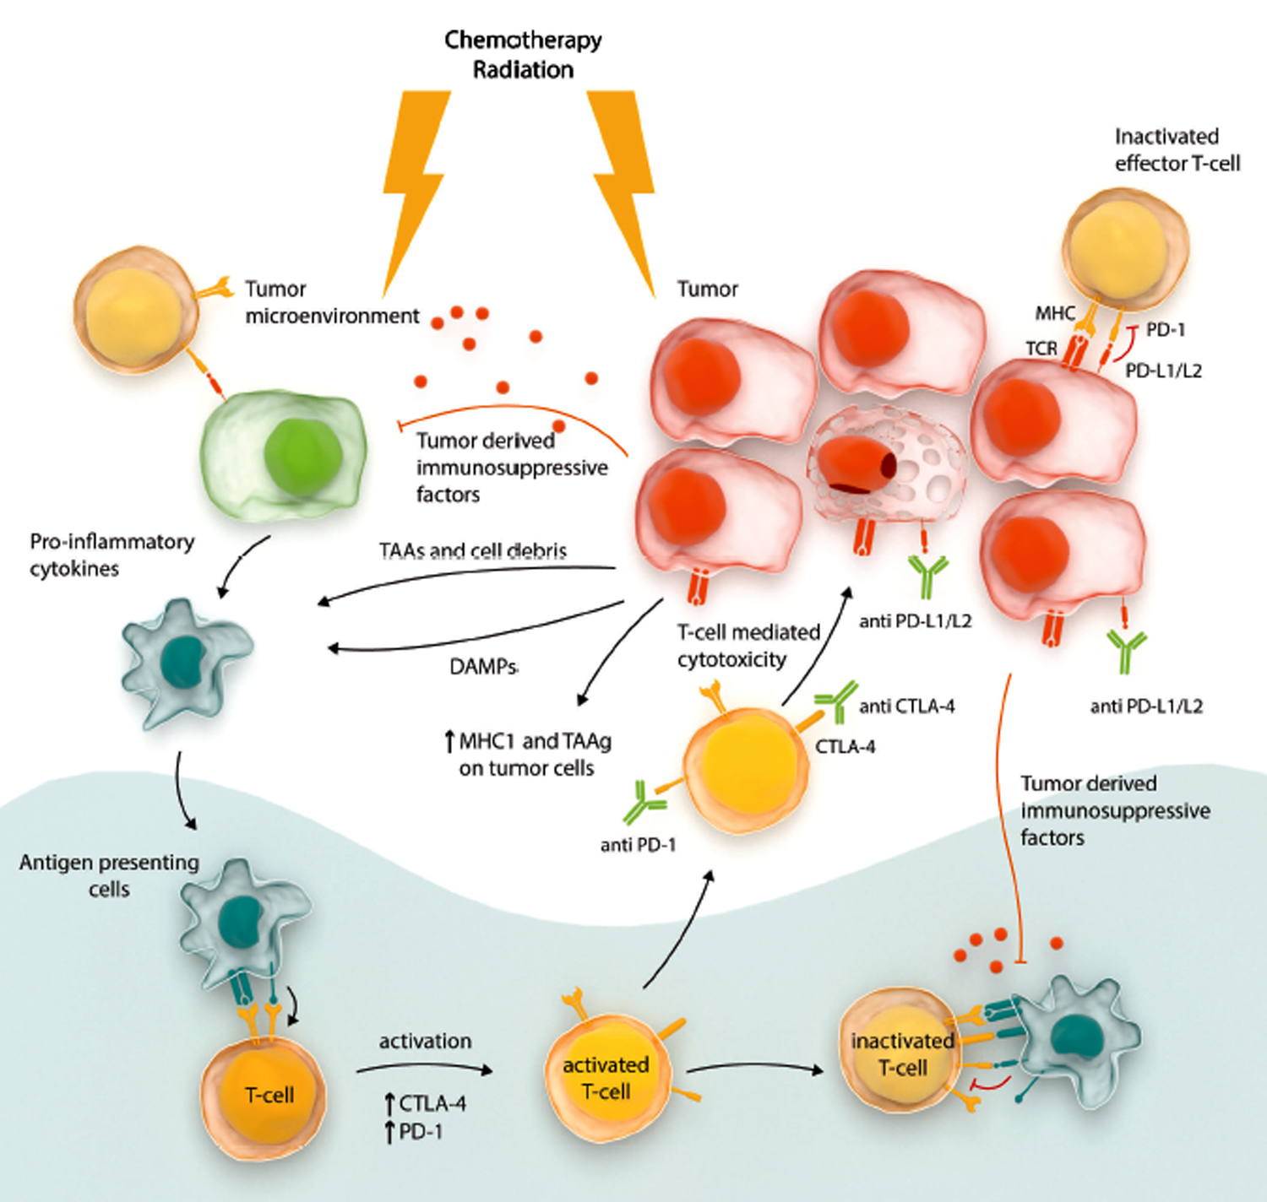
Rationale for Potential Synergy between Immune Checkpoint Inhibitors and Chemotherapy
Chemotherapy directly induces pro-inflammatory effects in the tumor microenvironment
Immune checkpoint inhibitors facilitate T-cell activation and T-cell-mediated anti-tumor cytotoxicity, overcoming inhibitory effects caused by tumor derived immunosuppressive factors
Hude I et al. Haematologica 2017;102(1):30-42.

Slide 44
Select Trials of Immune Checkpoint Inhibitor Therapy in Nonsquamous NSCLC
Name | Setting | Eligibility criteria for PD-L1 status | Randomization | Findings
KEYNOTE-024^{1,2} | 1L | PD-L1 TPS ≥50% | Pembrolizumab Platinum-based chemo | PFS (HR 0.50, p < 0.001) OS (HR 0.49, p < 0.001)
KEYNOTE-042³ | 1L | PD-L1 TPS ≥1% | Pembrolizumab Platinum-based chemo | TPS ≥50% OS (HR 0.69, p = 0.0003) TPS ≥20% OS (HR 0.77, p = 0.0020) TPS ≥1% OS (HR 0.81, p = 0.0018)
KEYNOTE-189⁴ | 1L | — | Pembrolizumab + pemetrexed/platinum Placebo + pemetrexed/ platinum | OS (HR 0.49, p < 0.001) PFS (HR 0.52, p < 0.001)
¹Reck M et al. J Clin Oncol 2019;37(7):537-46; ²Reck M et al. N Engl J Med 2016;375(19):1823-33; ³Lopes G et al. Proc ASCO 2018;Abstract LBA4; ⁴Gandhi L et al. N Engl J Med 2018;378(22):2078-92.

Slide 45
Select Trials of Immune Checkpoint Inhibitor Therapy in Nonsquamous NSCLC
Name | Setting | Eligibility criteria for PD-L1 status | Randomization | Findings
IMpower132¹ | 1L | — | Atezolizumab + pemetrexed + carboplatin or cisplatin → atezolizumab + pemetrexed Pemetrexed + carboplatin or cisplatin → pemetrexed | PFS (HR 0.596, p < 0.0001) Interim OS (HR 0.813, p = 0.0797)
IMpower130² | 1L | — | Atezolizumab + nab paclitaxel + carboplatin → atezolizumab Nab paclitaxel + carboplatin → BSC or pemetrexed | PFS (HR 0.64, p < 0.0001) OS (HR 0.79, p = 0.033)
IMpower150³ | 1L | — | Atezolizumab + carboplatin/paclitaxel (ACP) → atezolizumab Bevacizumab + carboplatin/paclitaxel (BCP) → bevacizumab Atezolizumab + BCP (ABCP) → atezolizumab + bevacizumab | WT (ABCP vs BCP) PFS (HR 0.62, p < 0.001) Teff-high WT (ABCP vs BCP) PFS (HR 0.51, p < 0.001)
BSC = best supportive care; WT = wild-type genotype
¹ Papadimitrakopoulou VA et al. Proc WCLC 2018;Abstract OA05.07; ² West H et al. Lancet Oncol 2019;20(7):924-37; ³ Socinski MA et al. N Engl J Med 2018;378(24):2288-301.

Slide 46
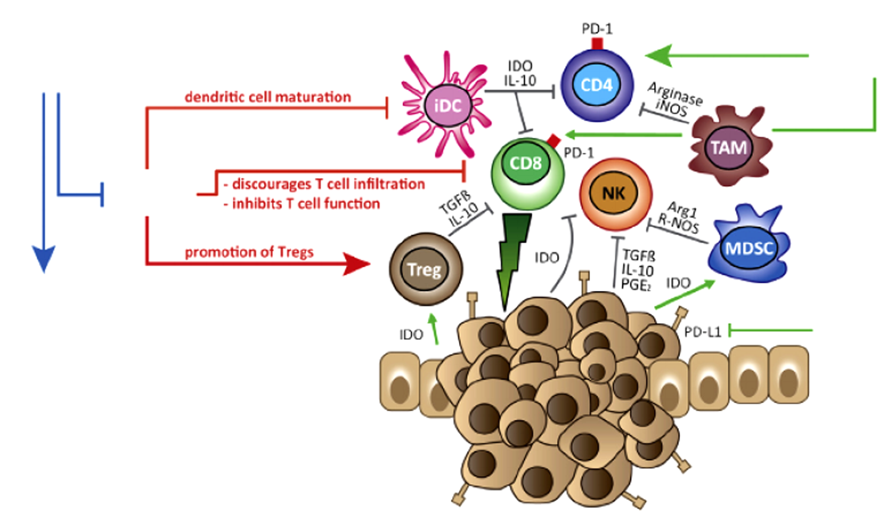
Rationale for Immune Checkpoint Inhibitors and Anti-Angiogenic Agents in Advanced NSCLC
Anti-angiogenic agent
Anti-PD-1
VEGF
Vessel normalization
Anti-PD-L1
Manegold C et al. J Thorac Oncol 2017;12(2):194-207.

Slide 47
Select Phase III Trials Combining Chemotherapy and Immune Checkpoint Inhibitors in Squamous NSCLC
Name | Setting | Randomization | Findings
KEYNOTE-407¹ | 1L | Pembrolizumab + carboplatin + paclitaxel or nab paclitaxel Placebo + carboplatin + paclitaxel or nab paclitaxel | PFS (HR 0.56, p < 0.001) OS (HR 0.64, p < 0.001)
IMpower131² | 1L | Atezolizumab + carboplatin + paclitaxel → atezolizumab Atezolizumab + carboplatin + nab paclitaxel → atezolizumab Carboplatin + nab paclitaxel → BSC | Atezo + CnP vs CnP PFS (HR 0.71, p = 0.0001) 1st interim OS (HR 0.96, p = 0.6931)
CnP = carboplatin/nab paclitaxel
¹Paz-Ares L et al. N Engl J Med 2018;379(21):2040-51; ²Jotte RM et al. Proc ASCO 2018;Abstract LBA9000.

Slide 48
Select Ongoing Phase III Trials of Immune Checkpoint Inhibitors Alone and Combined with Chemotherapy in Advanced NSCLC
Clinical trial | Setting | Patients enrolled | Randomization | Estimated primary completion
JAVELIN Lung 100 (NCT02576574) | 1L | 1,224 | Avelumab Platinum-based chemotherapy | October 2019
NCT03003962 | 1L | 662 | Durvalumab Platinum-based chemotherapy | September 2019
NCT03117049 | 1L; Nonsquamous | 530 | Nivolumab + chemotherapy + bevacizumab Placebo + chemotherapy + bevacizumab | April 2020
CheckMate 9LA (NCT03215706) | 1L | 700 | Nivolumab + ipilimumab + chemotherapy Chemotherapy | August 2019
www.clinicaltrials.gov; Accessed February 2019.

Slide 49
Anti-PD-1/PD-L1 and CTLA-4 Combination Treatment: Select Ongoing Trials
Clinical trial | Phase | Patients enrolled | Primary estimated completion date
POSEIDON (NCT03164616): Study of Durvalumab + Tremelimumab With Chemotherapy or Durvalumab With Chemotherapy or Chemotherapy Alone as First-Line Therapy for Patients With Metastatic NSCLC | III | 1,000 | September 2019
NEPTUNE (NCT02542293): Study of First-Line Therapy with Durvalumab and Tremelimumab Versus SoC Chemotherapy for Advanced NSCLC | III | 952 | March 2019
CheckMate-9LA (NCT03215706): A Study of Nivolumab and Ipilimumab Combined With Chemotherapy Compared to Chemotherapy Alone as First-Line Therapy for Metastatic NSCLC | III | 700 | August 2019
NCT03409614: Cemiplimab (Anti-PD-1 Antibody), Ipilimumab (Anti-CTLA-4 Antibody), and Platinum-based Doublet Chemotherapy as First-Line Therapy for Advanced NSCLC with PD-L1 Expression <50% | III | 690 | July 2022
www.clinicaltrials.gov; Accessed February 2019.

Slide 50
A patient is experiencing a good response to an anti-PD-1/PD-L1 antibody for metastatic NSCLC. What would you recommend if on routine imaging the patient has radiographic evidence of pneumonitis in 1 lobe of the lung but is not experiencing any symptoms? What would you recommend if the patient presents with mild shortness of breath (SOB) and cough and is found to have radiographic evidence of pneumonitis in both lungs?
Evidence of pneumonitis in 1 lobe, no symptoms
Evidence of pneumonitis in both lungs, mild SOB and cough
Continue antibody, start steroids, pulmonary consult
Hold antibody, administer corticosteroids, resume when toxicity has improved
Continue antibody
Hold antibody, administer corticosteroids, resume when toxicity has improved
Continue antibody
Discontinue antibody
Continue antibody
Discontinue if decreased O₂ saturation; else hold, administer steroids, resume when improved
Hold antibody and resume when toxicity has improved
Discontinue antibody
Hold antibody and resume when toxicity has improved
Discontinue antibody
Discontinue antibody
Discontinue antibody and administer steroids
Continue antibody
Discontinue antibody

Slide 51
A patient who is experiencing a good response to an anti-PD-1/ PD-L1 antibody for metastatic NSCLC reports an increase in stool movements. What would you recommend if the number of stools per day were . . .
3 stools over baseline per day
6 stools over baseline per day
Hold antibody, administer corticosteroids, resume at same/reduced dose when toxicity has improved
Hold antibody, administer corticosteroids, resume at same/reduced dose when toxicity has improved
Hold antibody, resume when toxicity has improved
Hold antibody, administer corticosteroids, possibly resume when toxicity has resolved off steroids
Hold antibody, administer corticosteroids, resume when toxicity has improved
Discontinue antibody
Hold antibody, resume when toxicity has improved
Discontinue antibody and administer steroids
Continue antibody
Hold antibody, resume when toxicity has improved
Hold antibody, administer corticosteroids, resume when toxicity has improved
Discontinue antibody
Continue antibody
Hold antibody, administer corticosteroids, resume when toxicity has improved
Continue antibody
Hold antibody, administer corticosteroids, resume when toxicity has improved

Slide 52
A patient who is experiencing a good response to an anti-PD-1/PD-L1 antibody for metastatic NSCLC presents with an elevated TSH level. What would you recommend if the TSH level were 8 mIU/L with no symptoms? TSH level 15 mIU/L with increasing fatigue?
TSH 8 mIU/L, no symptoms
TSH 15 mIU/L, increasing fatigue
Continue antibody
Continue antibody and add thyroid hormone supplement
Continue antibody
Continue antibody
Continue antibody
Continue antibody
Continue antibody and add thyroid hormone supplement
Continue antibody and add thyroid hormone supplement
Continue antibody
Continue antibody
Continue antibody
Continue antibody and add thyroid hormone supplement
Begin thyroid hormone and continue antibody
Hold antibody, administer thyroid hormone, resume when toxicity has improved
Continue antibody
Continue antibody

Slide 53
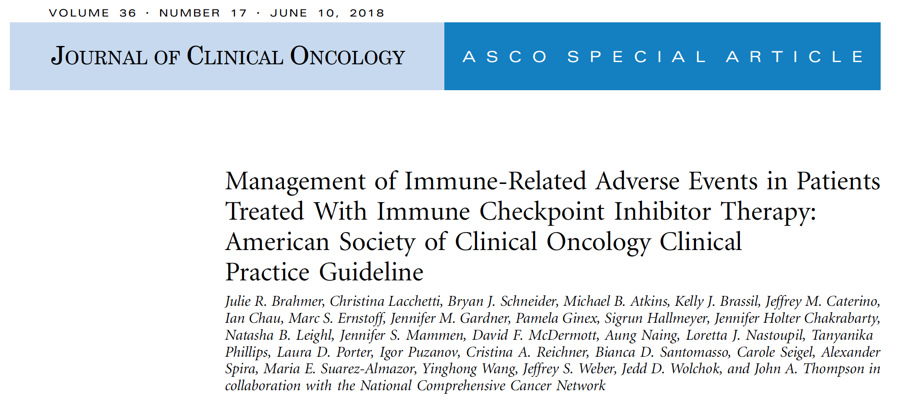
J Clin Oncol 2018;36(17):1714-68.

Slide 54
ASCO Guideline: Management of IRAEs in Patients Receiving Immune Checkpoint Inhibitor Therapy
Toxicity grade | General recommendations
Grade 1 | Continue with close monitoring, with the exception of some neurologic, hematologic, and cardiac toxicities.
Grade 2 | Therapy may be suspended and resumed when symptoms revert to grade 1 or less. Corticosteroids may be administered.
Grade 3 | Suspension of therapy and the initiation of high-dose corticosteroids. Corticosteroids should be tapered over the course of at least 4 to 6 weeks. Some refractory cases may require infliximab or other immunosuppressive therapy.
Grade 4 | Permanent discontinuation is recommended, with the exception of endocrinopathies that have been controlled by hormone replacement.
Brahmer JR et al. J Clin Oncol 2018;36(17):1714-68.

