Slide 1
Colorectal Cancer

Slide 2
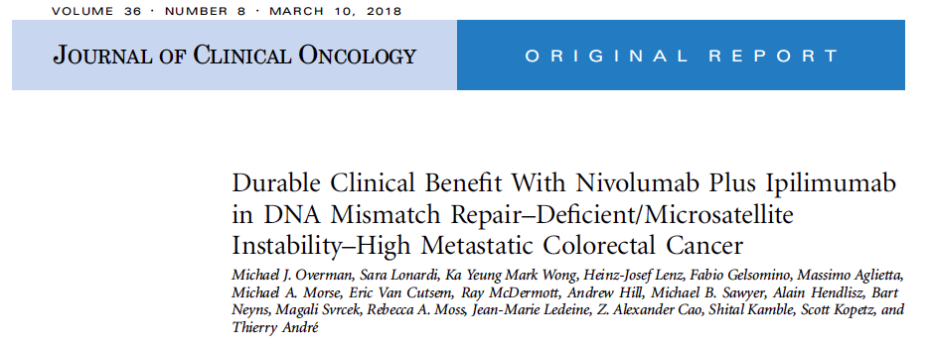
J Clin Oncol 2018;36(8):773-9.

Slide 3
CheckMate 142: Phase II Multicohort Trial Design
NCT02060188
Nivolumab Monotherapy (Cohort 1)
Nivolumab + Ipilimumab (Cohorts 2 & 3)
Nivolumab + Ipilimumab + Cobimetinib (Cohort 4)
Nivolumab + Relatlimab (BMS-986016) (Cohort 5)
Nivolumab + Daratumumab (Cohort 6)
Eligibility (N = 340)
Histologically confirmed metastatic or recurrent CRC dMMR/MSI-H positive by local laboratory ≥1 prior line of therapy
Primary endpoint: Objective response rate
Cohort 2: Dose-escalation phase (0.3 mg/kg – 3 mg/kg Nivo + 1 – 3 mg/kg Ipi every
2 or 3 weeks until disease progression)
Cohort 3: Nivo dosed every 2 weeks + Ipi dosed every 6 weeks
This study reports the efficacy and safety results of patients who received 3 mg/kg Nivo + 1 mg/kg Ipi once every 3 weeks (4 doses) → 3 mg/kg Nivo once every 2 weeks
Overman MJ et al. J Clin Oncol 2018;36(8):773-9; Clinicaltrials.gov.

Slide 4
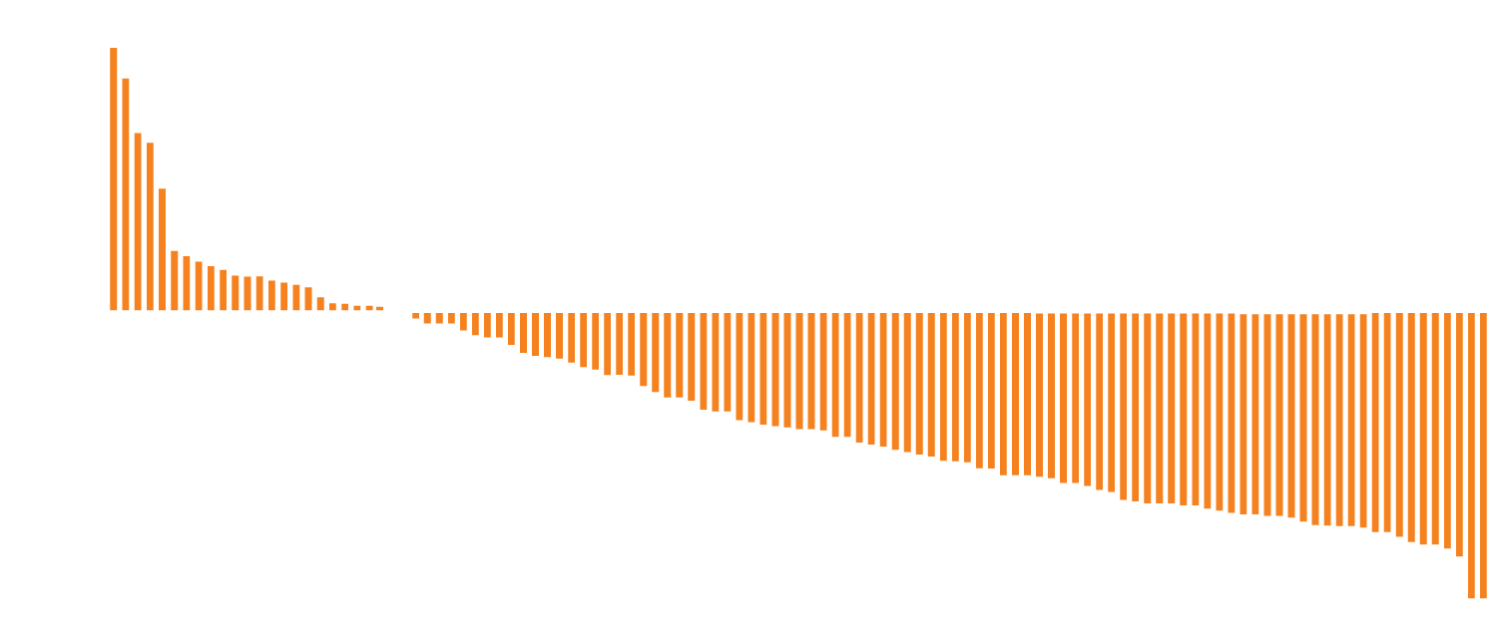
CheckMate 142: Response and Survival by Investigator Assessment
Best change from baseline in target lesion
Among evaluable patients (n = 115), 78% had a reduction in tumor burden from baseline
20
Best reduction from baseline
in target lesion size (%)
-30
All patients (N = 119)
Objective response rate = 55%
  CR = 3%
Disease control rate (≥12 weeks) = 80%
Responses were durable; 94% of responders with ongoing responses
The median duration of response = not reached
Median PFS and OS = not reached
  12-mo PFS = 71%
  12-mo OS = 85%
Overman MJ et al. J Clin Oncol 2018;36(8):773-9.

Slide 5
CheckMate 142: Nivolumab + Ipilimumab: Select AEs in >10% of Patients
Treatment-related AE (N = 119) | Grade 1-2 | Grade 3 | Grade 4
Diarrhea | 20% | 2% | 0
Fatigue | 16% | 2% | 0
Pruritus | 15% | 2% | 0
Increased AST | 7% | 8% | 0
Hypothyroidism | 13% | 1% | 0
Nausea | 12% | 1% | 0
Increased ALT | 5% | 7% | 0
Rash | 9% | 2% | 0
Hyperthyroidism | 11% | 0 | 0
Overman MJ et al. J Clin Oncol 2018;36(8):773-9.

Slide 6
Efficacy and Safety Results from IMblaze370, a Randomised Phase III Study Comparing Atezolizumab + Cobimetinib and Atezolizumab Monotherapy vs Regorafenib in Chemotherapy Refractory Metastatic Colorectal Cancer
Bendell J et al.
Proc ESMO 2018;Abstract LBA-004.

Slide 7
IMblaze370: Phase III Trial Design
Atezolizumab 840 mg IV q2wk
+ cobimetinib 60 mg oral 21/7 days
N = 363
Unresectable locally advanced or metastatic CRC Received ≥2 prior regimens of cytotoxic chemotherapy for metastatic disease ECOG PS 0-1 MSI-H capped at 5%
R
Atezolizumab 1,200 mg IV q3wk
Loss of clinical benefit
2:1:1
Regorafenib 160 mg oral 21/7 days
Primary endpoint: OS (versus regorafenib)
Stratification by:
  Extended RAS mutation status (≥50% of patients in each arm)
  Time since diagnosis of first metastasis (<18 mo vs ≥18 mo)
Bendell J et al. Proc ESMO 2017;Abstract LBA-004.

Slide 8
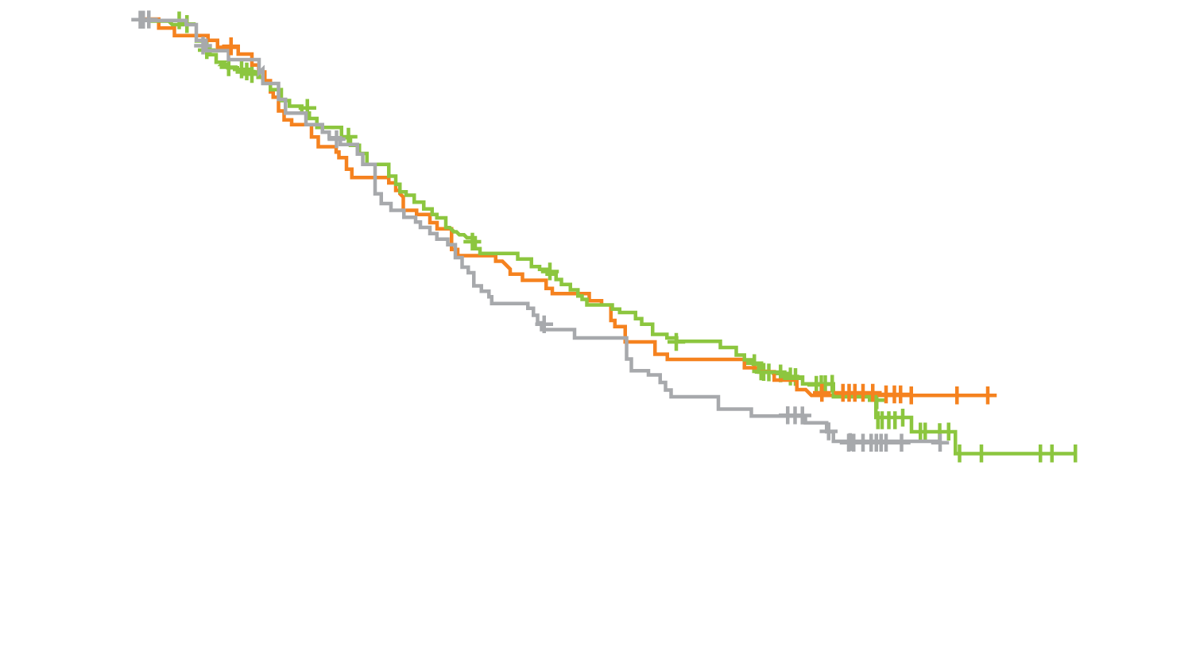
IMblaze370: Survival and Response Results
 | Atezo + cobi (n = 183) | Atezo (n = 90) | Rego (n = 90)
Median OS, mo | 8.9 | 7.1 | 8.5
HR vs rego | 1.00 | 1.19 | N/A
P-value | 0.9871 | 0.3360 | N/A
12-mo OS, % | 38.5% | 27.2% | 36.6%
Atezo + cobi
Atezo
Rego
Outcome | Atezo + cobi (n = 183) | Atezo (n = 90) | Rego (n = 90)
Median PFS | 1.9 mo | 1.9 mo | 2.0 mo
HR (PFS) vs regorafenib | 1.25 | 1.39 | Not applicable
ORR | 2.7% | 2.2% | 2.2%
Median duration of response | 11.4 mo | 4.8 mo | 9.2 mo
Bendell J et al. Proc ESMO 2017;Abstract LBA-004.

Slide 9
IMblaze370: Select AEs Occurring in ≥20% of Patients
All Grade AE | Atezo + cobi (n = 179) | Atezo (n = 90) | Rego (n = 80)
Diarrhea | 117 (65%) | 17 (19%) | 30 (38%)
Rash | 83 (46%) | 8 (9%) | 19 (24%)
Nausea | 66 (37%) | 19 (21%) | 11 (14%)
Fatigue | 64 (36%) | 23 (26%) | 37 (46%)
Pyrexia | 59 (33%) | 14 (16%) | 20 (25%)
Decreased appetite | 48 (27%) | 22 (24%) | 33 (41%)
Hypertension | 9 (5%) | 4 (4%) | 25 (31%)
Palmar-plantar erythrodysesthesia | 3 (2%) | 1 (1%) | 42 (53%)
(n = 119)
Safety in the atezolizumab + cobimetinib arm was consistent with the known safety profiles of the individual agents.
Bendell J et al. Proc ESMO 2017;Abstract LBA-004.

Slide 10
Regorafenib Dose Optimization Study (ReDOS): Randomized Phase II Trial to Evaluate Dosing Strategies for Regorafenib in Refractory Metastatic CRC (mCRC) — An ACCRU Network Study
Regorafenib Dose Optimization Study (ReDOS): Randomized Phase II Trial to Evaluate Escalating Dosing Strategy and Pre-Emptive Topical Steroids for Regorafenib in Refractory Metastatic Colorectal Cancer (mCRC) — An ACCRU Network Study
Bekaii-Saab TS et al. Gastrointestinal Cancers Symposium 2018;Abstract 611.
Bekaii-Saab TS et al. Proc ESMO 2018;Abstract O-014.

Slide 11
ReDOS: Phase II Trial Design
Randomization 1:1:1:1 (Progression on previous standard therapy, including EGFRi if KRAS WT)
WEEK of C1 |  | DOSE
1 | Starting dose C1 | 80 mg
2 |  | 120 mg
3 | Endose C1 | 160 mg
4 |  | off
WEEK of C2+ |  | DOSE
1 |  | Dose from C1
Arm A 1
Regorafenib
start low
+ pre-emptive
strategy for
Palmar-plantar
erythrodysesthesia
syndrome (PPES)
Arm A 2
Regorafenib
start low dose
+ reactive
strategy for
Palmar-plantar
erythrodysesthesia
syndrome (PPES)
Arm B 1
Regorafenib 160 mg PO daily for 21 days
+ pre-emptive
strategy for
Palmar-plantar
erythrodysesthesia
syndrome (PPES)
Arm B 2
Regorafenib 160 mg PO daily for 21 days
+ reactive
strategy for
Palmar-plantar
erythrodysesthesia
syndrome (PPES)
Dose-escalation arm (Arm A)
Standard dose arm (Arm B)
Primary endpoint: Proportion of patients who complete 2 cycles of treatment and initiate cycle 3 in both arms
Bekaii-Saab TS et al. Gastrointestinal Cancers Symposium 2018;Abstract 611.

Slide 12

ReDOS: Clinical Outcomes
Proportion of patients starting cycle 3 (N = 116)
p = 0.0281ª
43%
Percentage of patients
24%
Escalating
dose
Standard
dose
ª Fisher’s exact test (1-sided)
Survival | Esc dose (n = 54) | Std dose (n = 62) | HR | p-value
Median OS | 9.0 mo | 5.9 mo | 0.65 | 0.0943
Median PFS | 2.5 mo | 2.0 mo | 0.89 | 0.5534
Bekaii-Saab TS et al. Gastrointestinal Cancers Symposium 2018;Abstract 611;
Bekaii-Saab TS et al. Proc ESMO 2018;Abstract O-014.

Slide 13
ReDOS: Select AEs
Grade 3/4 AE | Escalating dose (n = 54) |  | Standard dose (n = 62)
 | Grade 3 | Grade 4 | Grade 3 | Grade 4
HFSR | 8 (14.8%) | 0 | 10 (16.1%) | 0
Abdominal pain | 9 (16.7%) | 0 | 4 (6.5%) | 0
Hypertension | 4 (7.4%) | 0 | 9 (14.5%) | 0
Hyponatremia | 2 (3.7%) | 1 (1.9%) | 4 (6.5%) | 1 (1.6%)
Dehydration | 0 | 0 | 5 (8.1%) | 0
Dyspnea | 1 (1.9%) | 1 (1.9%) | 3 (4.8%) | 0
Lymphopenia | 4 (7.4%) | 0 | 0 | 0
Maculopapular rash | 0 | 0 | 3 (4.8%) | 0
(n = 119)
HFSR = hand-foot skin reaction
Multiple quality of life (QoL) parameters were favorable with the escalating dose vs standard dose strategy primarily at week 2 of cycle 1
Bekaii-Saab TS et al. Gastrointestinal Cancers Symposium 2018;Abstract 611; Bekaii-Saab TS et al. Proc ESMO 2018;Abstract O-014.

Slide 14
REVERCE: Randomized Phase II Study of Regorafenib Followed by Cetuximab versus the Reverse Sequence for mCRC Patients Previously Treated with Fluoropyrimidine, Oxaliplatin, and Irinotecan
Shitara K et al.
Gastrointestinal Cancers Symposium 2018;Abstract 557.

Slide 15
REVERCE: Phase II Trial Design
Metastatic CRC Treatment failure with fluoropyrimidines, oxaliplatin and irinotecan Anti-EGFR naïve KRAS exon 2 WT Patients with minor RAS mutations* are excluded since March 2015 * KRAS exon 3 (codon 59/61), exon 4 (codon 117/146), NRAS exon 2 (codon 12/13), exon 3 (codon 59/61) and exon 4 (codon 117/146)
R-C
arm
Regorafenib
160 mg
3 weeks on,
1 week off
PD or unacceptable toxicities
Cetuximab
(+ irinotecan)
PD or unacceptable toxicities
1:1
Treatment 1
(T x1)
Treatment 2 (T x2)
Regorafenib
160 mg
3 weeks on,
1 week off
Cetuximab
(+ irinotecan)
C-R
arm
Stratified by intent to use irinotecan at enrollment, prior history of bevacizumab and institutions
Clinical trial identifier UMIN000011294
Primary endpoint: OS
Secondary endpoints include: TTF, PFS, ORR, DCR, toxicities and QoL
Enrollment was discontinued in September 2016 due to slow accrual
Shitara K et al. Gastrointestinal Cancers Symposium 2018;Abstract 557.

Slide 16
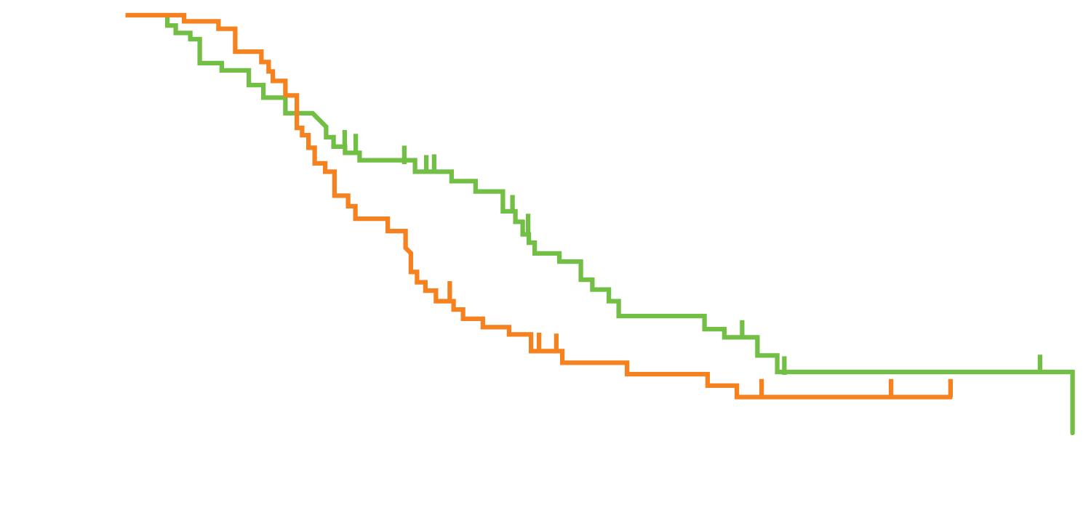
REVERCE: Primary Endpoint (OS)
 | Event/N | % | Median (months)
R-C | 37/51 | 73% | 17.4
C-R | 44/50 | 88% | 11.6
HR* = 0.61; stratified log rank p = 0.029 * Adjusted by intent to use irinotecan Median follow-up: 29.0 months
Proportion
Months
OS was longer in the R → C arm compared to the C → R arm and this was consistent across all subgroups:
  Median OS in left-sided primary (n = 81): 20.5 mo vs 11.9 mo (p = 0.011)
  Median OS in RAS/RAF wild-type dx (n = 86): 18.2 mo vs 12.7 mo (p = 0.036)
Shitara K et al. Gastrointestinal Cancers Symposium 2018;Abstract 557.

Slide 17
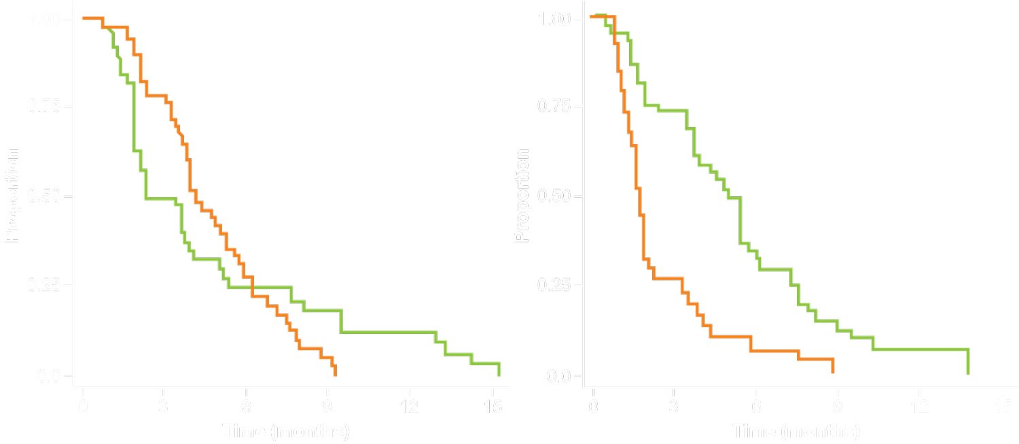
REVERCE: Secondary Endpoints
PFS1 (PFS of T x1)
PFS2 (PFS of T x2)
R-C (Rego) (n = 51)
R-C (Cmab) (n = 44)
C-R (Cmab) (n = 50)
C-R (Rego) (n = 42)
 | Event/N | Median (months)
R-C (Rego) | 39/51 | 2.4
C-R (Cmab) | 47/50 | 4.2
HR = 0.97 Stratified log rank p = 0.91
 | Event/N | Median (months)
R-C (Cmab) | 38/44 | 5.2
C-R (Rego) | 37/43 | 1.8
HR = 0.29 Stratified log rank p < 0.0001
Shitara K et al. Gastrointestinal Cancers Symposium 2018;Abstract 557.

Slide 18
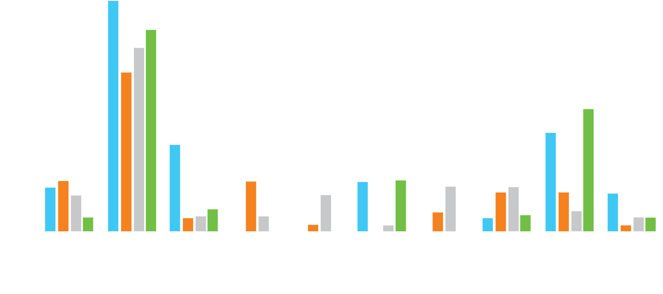
REVERCE: Safety (Grade ≥3 AEs in ≥10% of Patients)
73%
Tx1 (R)
Tx1 (C)
Tx2 (C)
Tx2 (R)
64%
58%
50%
39%
27%
31%
14%
16%
16%
16%
16%
14%
14%
11%
11%
13%
12%
12%
5%
5%
7%
5%
6%
5%
6%
5%
5%
4%
2%
2%
4%
2%
Tx1 = Treatment 1 (regorafenib or cetuximab); Tx2 = Treatment 2 (cetuximab or regorafenib)
No unexpected safety signals
Safety and QoL were comparable between the two arms
Shitara K et al. Gastrointestinal Cancers Symposium 2018;Abstract 557.

Slide 19
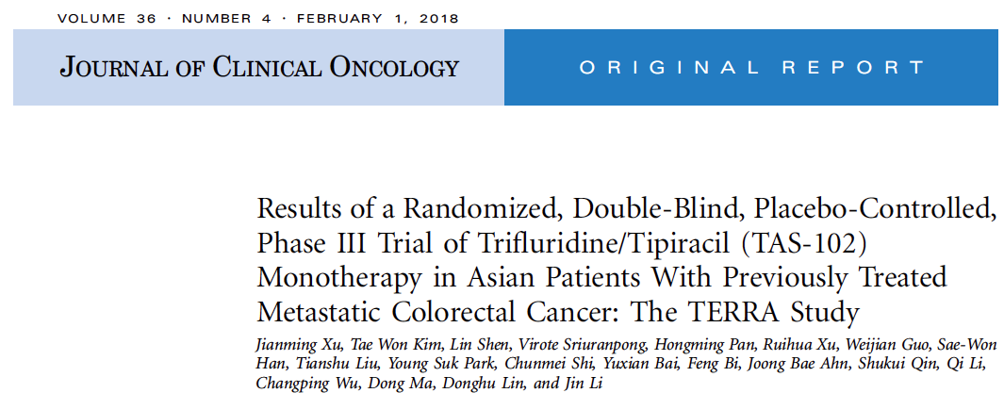
J Clin Oncol 2018;36(4):350-8.

Slide 20
TERRA: Phase III Trial Design
NCT01955837
Eligibility (N = 406)
Patients with adenocarcinoma of the colon or rectum Known KRAS status Refractory or intolerant to ≥2 prior chemotherapy regimens ECOG PS 0-1
TAS-102
(n = 271)
2:1
R
Placebo
(n = 135)
Primary endpoint: OS
Xu J et al. J Clin Oncol 2018;36(4):350-8; Clinicaltrials.gov.

Slide 21
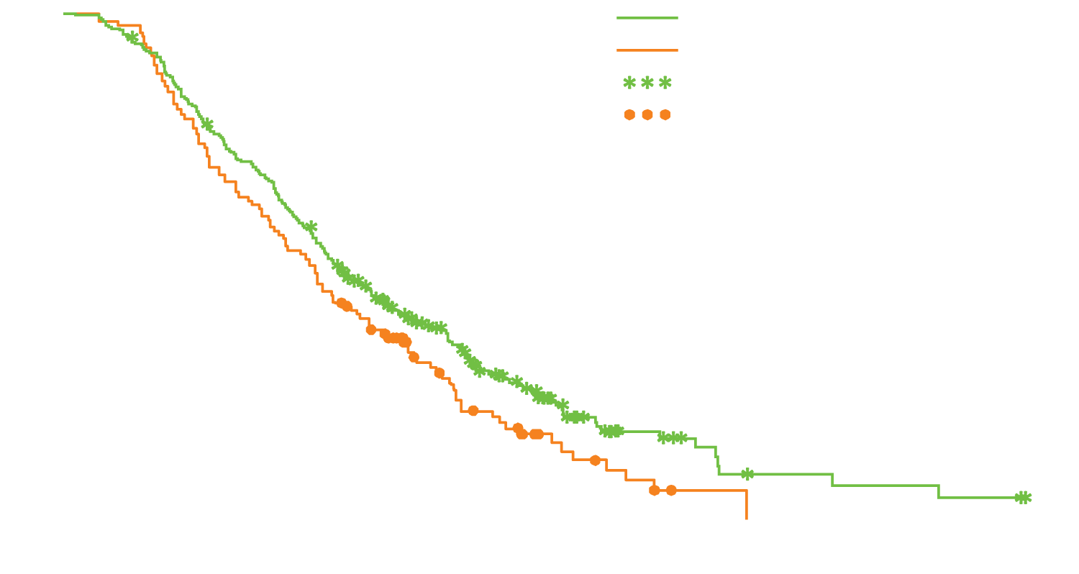
TERRA: Survival and Response in ITT Population
TAS-102 (n = 271)
Placebo (n = 135)
Censored patients for trifluridine/tipiracil
Censored patients for placebo
OS
Prespecified subgroup analysis of OS showed a favorable trend for increased TAS-102 effect for all parameters except age.
Overall survival (%)
Median 7.8 mo
Median 7.1 mo
HR, 0.79; p = 0.035
Follow-up (months)
Survival | TAS-102 | Placebo | HR | p-value
Median PFS (n = 271, 135) | 2.0 mo | 1.8 mo | 0.43 | <0.001
DCR (n = 261, 130) | 44.1% | 14.6% | — | <0.001
Xu J et al. J Clin Oncol 2018;36(4):350-8.

Slide 22
TERRA: Select AEs
(n = 119)
Event | TAS-102 (n = 271) |  | Placebo (n = 135)
 | Any grade | Grade ≥3 | Any grade | Grade ≥3
Anemia | 77.1% | 17.7% | 38.5% | 5.9%
Leukopenia | 70.1% | 20.7% | 3.0% | 0
Neutropenia | 67.2% | 33.2% | 0.7% | 0
Lymphopenia | 53.9% | 14.4% | 25.2% | 2.2%
Increased total bilirubin | 36.5% | 7.0% | 20.7% | 7.4%
Thrombocytopenia | 35.4% | 3.0% | 7.4% | 1.5%
Fatigue | 20.3% | 1.5% | 6.7% | 0
Bone marrow failure | 1.8% | 1.1% | 0 | 0
No treatment-related deaths were reported.
Xu J et al. J Clin Oncol 2018;36(4):350-8.

Slide 23
Phase Ib/II Study of Cancer Stemness Inhibitor Napabucasin in Combination with FOLFIRI ± Bevacizumab in mCRC Patients
Bendell J et al.
Proc ESMO 2017;Abstract LBA-003.

Slide 24
Phase Ib/II Trial Design
Eligibility (N = 82)
Patients with metastatic CRC Previously treated
Napabucasin (240 mg PO BID) +
FOLFIRI (biweekly IV) +/-
bevacizumab (5 mg/Kg)
Disease progression or other discontinuation criterion
Endpoints: Recommended Phase II dose (R2PD) and activity
There was no dose-limiting or unexpected toxicity or significant PK interactions.
Bendell J et al. Proc ESMO 2017;Abstract LBA-003.

Slide 25
Phase Ib/II Trial: Response
All patients | ORR | DCR
ITT (n = 82) | 14 (17%) | 55 (67%)
Evaluable (n = 66) | 14 (21%) | 55 (83%)
≥Second-line FOLFIRI-naïve | ORR | DCR
ITT (n = 50) | 8 (16%) | 33 (66%)
Evaluable (n = 39) | 8 (21%) | 33 (85%)
≥Second-line FOLFIRI-pretreated | ORR | DCR
ITT (n = 82) | 6 (19%) | 22 (69%)
Evaluable (n = 66) | 6 (22%) | 22 (81%)
(n = 119)
Napabucasin with or without bevacizumab showed encouraging signs of efficacy in patients with pretreated mCRC including those pretreated with FOLFIRI +/- bevacizumab
Bendell J et al. Proc ESMO 2017;Abstract LBA-003.

Slide 26
Phase Ib/II Trial: Treatment-Emergent AEs
Event (n = 82) | Grade 3
Diarrhea | 15 (18%)
Fatigue | 6 (7%)
Hypokalemia | 2 (2%)
Hyponatremia | 1 (1%)
Hypophosphatemia | 1 (1%)
Dehydration | 1 (1%)
Abdominal pain | 1 (1%)
Vomiting | 1 (1%)
Weight loss | 1 (1%)
(n = 119)
The most common AEs included Grade 1/2 diarrhea, cramping, nausea, vomiting, fatigue and anorexia.
Grade 4 diarrhea was observed in 1 patient.
All AEs resolved with dose reduction and supportive care.
Bendell J et al. Proc ESMO 2017;Abstract LBA-003.

Slide 27
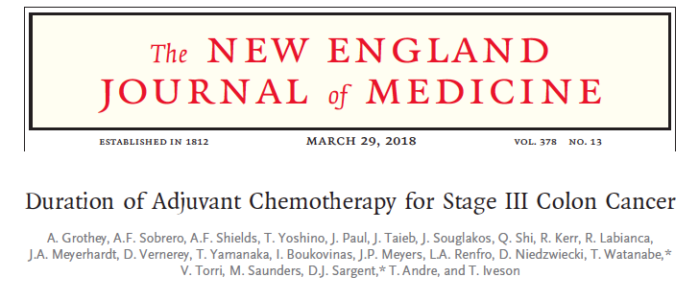
N Engl J Med 2018;378(13):1177-88.

Slide 28

Pooled Analysis of 6 Randomized Phase III Trials: Disease-Free Survival (DFS) in Overall Population
6 months
adjuvant therapy
(n = 6,410)
(n = 6,424)
3 months
adjuvant therapy
At 41.8 mo, noninferiority of 3 mo vs 6 mo adjuvant therapy was not confirmed:
  HR = 1.07
  p = 0.11 for noninferiority of 3 mo therapy
  p = 0.045 for superiority of 6 mo therapy
Grothey A et al. N Engl J Med 2018;378(13):1177-88.

Slide 29
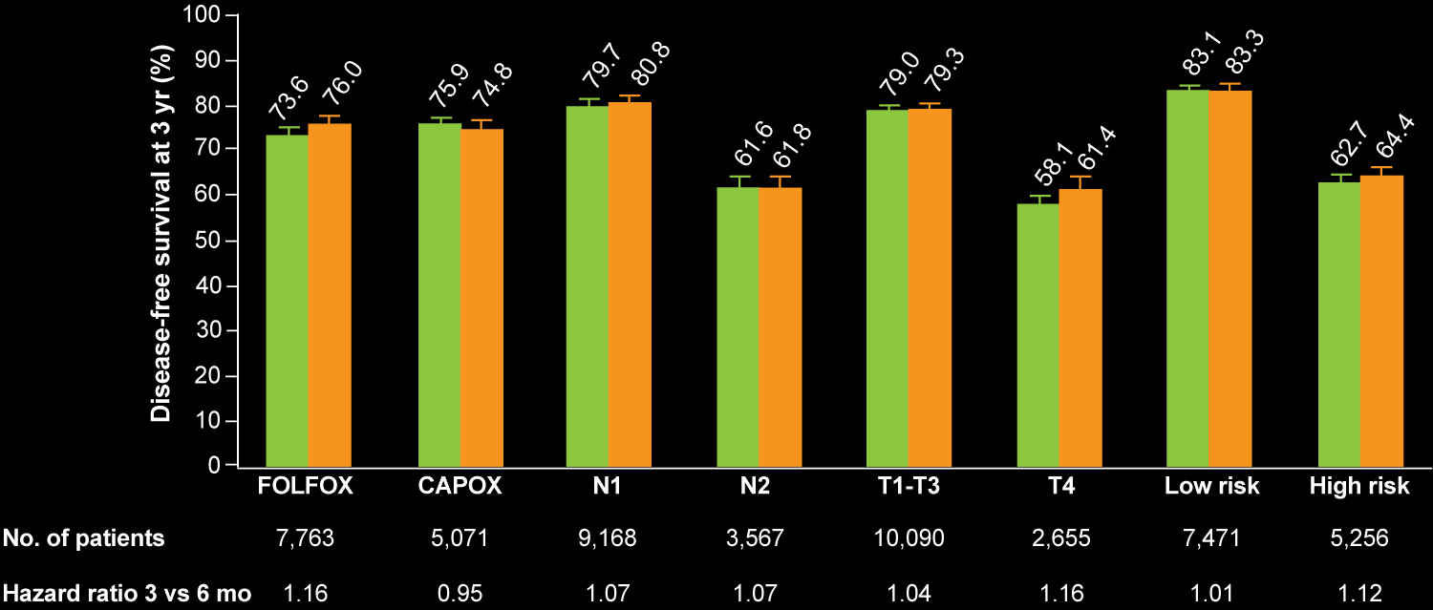
3-Year DFS in the Overall Population and By Subgroup
Treatment duration: 3 months 6 months
3-year DFS | 3 mo (n = 6,424) | 6 mo (n = 6,410) | HR | p-value
Overall population | 74.6% | 75.5% | Not reported | Not reported
Grothey A et al. N Engl J Med 2018;378(13):1177-88.

Slide 30
Select Adverse Events (AEs) According to Treatment and Duration of Therapy
Grade 3/4 AEs | FOLFOX |  | CAPOX
 | 3 mo | 6 mo | 3 mo | 6 mo
Peripheral sensory neurotoxicity | 2.5% | 15.9% | 2.6% | 8.9%
Diarrhea | 4.7% | 7.2% | 7.4% | 8.8%
Neutropenia | 20.3% | 26.6% | 7.7% | 11.9%
Thrombocytopenia | 1.0% | 1.8% | 2.1% | 4.2%
Nausea | 1.6% | 2.2% | 3.0% | 3.1%
Mucositis | 0.7% | 1.6% | 0.3% | 0.9%
Hand-foot syndrome | 0 | 0.3% | 0.7% | 2.6%
Grothey A et al. N Engl J Med 2018;378(13):1177-88.

Slide 31
Gastric Cancer

Slide 32
RAINFALL: A Randomized, Double-Blind, Placebo-Controlled Phase III Study of Cisplatin (Cis) plus Capecitabine (Cape) or 5FU with or without Ramucirumab (RAM) as First-Line Therapy in Patients with Metastatic Gastric or Gastroesophageal Junction (G-GEJ) Adenocarcinoma
Fuchs CS et al.
Gastrointestinal Cancers Symposium 2018;Abstract 5.

Slide 33
RAINFALL: Phase III Trial Design
1:1
(N = 645)
Patient population
Treatment-naïve patients with metastatic G-GEJ adenocarcinoma HER2-negative ECOG PS 0/1
Ramucirumab 8 mg/kg
IV D1, D8 + cisplatin* +
capecitabine† q3wk
Until disease progression or intolerable toxicity
R
Placebo + cisplatin* + capecitabine† q3wk
* Cisplatin 80 mg/m² d1 (IV), maximum of 6 cycles
† Capecitabine 1,000 mg/m² BID (PO)
† 5-FU 800 mg/m² d1-5 (IV) was allowed for patients unable to swallow capecitabine
Primary endpoint: PFS
Fuchs CS et al. Gastrointestinal Cancers Symposium 2018;Abstract 5.

Slide 34
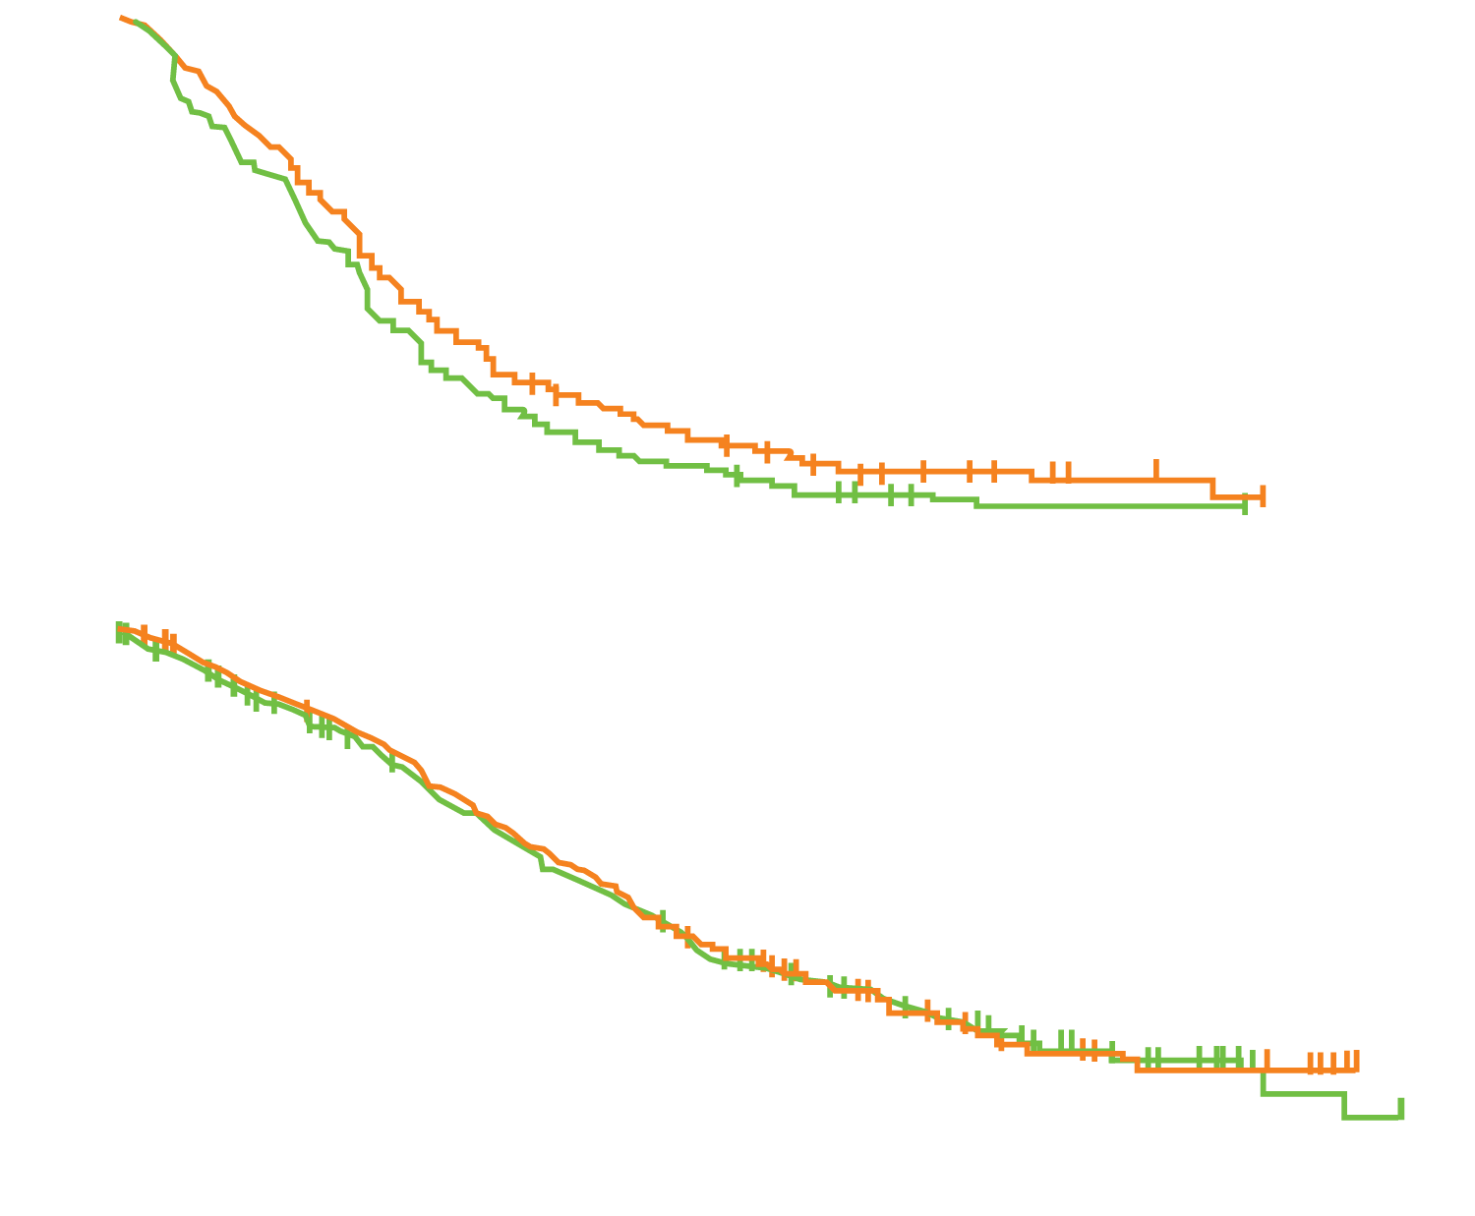
RAINFALL: Survival and Response in ITT Population
PFS for total ITT population (N = 645) | Ramucirumab + Cape/5-FU+Cis | Placebo + Cape/5-FU+Cis
Patients | 326 | 319
Median (mo) | 5.85 | 5.55
HR, p-value | 0.75, p = 0.0024
Progression-free survival (%)
Censored observation
Time (months)
OS for total ITT population (N = 645) | Ramucirumab + Cape/5-FU+Cis | Placebo + Cape/5-FU+Cis
Patients | 326 | 319
Median (mo) | 11.17 | 10.74
HR, p-value | 0.96, p = 0.68
Overall survival (%)
Best overall response rate = 41% (ramucirumab)
vs 36% (placebo),
p = 0.1696
Censored observation
Time (months)
Fuchs CS et al. Gastrointestinal Cancers Symposium 2018;Abstract 5.

Slide 35
RAINFALL: Select AEs in ≥5% of Patients
(n = 119)
Event | Ramucirumab/Cape/5-FU/Cis (n = 323) |  | Placebo/Cape/5-FU/Cis (n = 315)
 | Any grade | Grade ≥3 | Any grade | Grade ≥3
Neutropenia | 54% | 26% | 53% | 27%
Decreased appetite | 41% | 6.5% | 32% | 3.2%
Anemia | 34% | 12% | 37% | 14%
Thrombocytopenia | 34% | 7.7% | 19% | 3.5%
Hand-foot syndrome | 31% | 8.7% | 20% | 3.8%
Bleeding events* | 25% | 3.4% | 14% | 4.1%
Hypertension | 22% | 9.9% | 7.3% | 1.6%
Proteinuria | 19% | 2.5% | 11% | 0.6%
* Includes hemorrhagic events
No new or unexpected safety findings emerged.
Fuchs CS et al. Gastrointestinal Cancers Symposium 2018;Abstract 5.

Slide 36
Safety and Efficacy of Pembrolizumab Monotherapy in Patients with Previously Treated Advanced Gastric and Gastroesophageal Junction Cancer: Phase 2 Clinical KEYNOTE-059 Trial
Pembrolizumab (Pembro) vs Paclitaxel (PTX) for Previously Treated Advanced Gastric or Gastroesophageal Junction (G/GEJ) Cancer: Phase 3 KEYNOTE-061 Trial
Pembrolizumab versus Paclitaxel for Previously Treated, Advanced Gastric or Gastro-Oesophageal Junction Cancer (KEYNOTE-061): A Randomised, Open-Label, Controlled, Phase 3 Trial
Fuchs CS et al.
JAMA Oncol 2018;[Epub ahead of print].
Fuchs CS et al.
Proc ASCO 2018;Abstract 4062.
Shitara K et al.
Lancet 2018;[Epub ahead of print].

Slide 37
KEYNOTE-059: Phase II Multicohort Trial Design
Cohort 1 Patients
≥2 prior lines of chemotherapy
Pembrolizumab
200 mg q3wk
Treat for
24 months
or until progression,
intolerable toxicity or other reason
Follow-up for survival by telephone
until death, withdrawal
or study end
Pembrolizumab 200 mg q3wk + cisplatin 80 mg/m² q3wk +
5-FU 800 mg/m² q3wk or capecitabine 1,000 mg/m² BID q3wk
Cohort 2 Patients
No prior therapy
Cohort 3 Patients
No prior therapy
PD-L1-positive
Pembrolizumab
200 mg q3wk
Endpoints: Response, survival and safety
Response assessments by RECISTv1.1: First scan at 9 weeks after cycle 1, then every 6 weeks for the first year, followed by every 9 weeks
Fuchs CS et al. JAMA Oncol 2018;[Epub ahead of print]; Fuchs CS et al. Proc ASCO 2017;Abstract 4003.

Slide 38
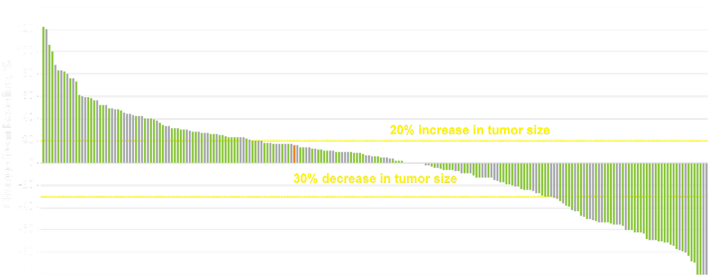
KEYNOTE-059 (Cohort 1): Survival and Response
Best change from baseline in sum of longest target lesion diameters by PD-L1 expression (n = 223)
PD-L1-Positive
PD-L1-Negative
PD-L1 Expression unknown
Patients with reduction:
All patients = 42.4%
PD-L1-positive = 47.3%
PD-L1-negative = 36.3%
Clinical outcome | N = 259
Objective response rate | 30 (11.6%)
Disease control rate | 70 (27.0%)
Median PFS | 2.0 mo
Median OS | 5.6 mo
Fuchs CS et al. JAMA Oncol 2018;[Epub ahead of print]; Fuchs CS et al. Proc ASCO 2017;Abstract 4003.

Slide 39
KEYNOTE-059 (Cohort 1): Select AEs (N = 259)
(n = 119)
Treatment-related AEs | Any grade | Grade 3/4
Fatigue | 18.9% | 2.3%
Rash | 8.5% | 0.8%
Anemia | 6.9% | 2.7%
Nausea | 6.9% | 0.8%
Diarrhea | 6.6% | 1.2%
Immune-mediated AEs | Any grade | Grade 3/4
Hypothyroidism | 8.9% | 0.4%
Colitis | 2.3% | 1.2%
Pneumonitis | 1.9% | 0.8%
Severe skin reactions | 1.5% | 1.5%
Patients who received corticosteroids for immune-mediated AEs: 13
Patients who experienced drug interruption due to immune-mediated AEs: 10
Fuchs CS et al. JAMA Oncol 2018;[Epub ahead of print]; Fuchs CS et al. Proc ASCO 2017;Abstract 4003.

Slide 40
KEYNOTE-061: Phase III Trial Design
Eligibility (N = 592)
Unresectable locally advanced or metastatic adenocarcinoma of the stomach or GEJ Progression after first-line platinum and fluoropyrimidine-containing therapy ECOG PS 0-1 Provision of a sample for PD-L1 assessment
Pembrolizumab (200 mg q3wk)
for up to 35 cycles
(n = 296)
1:1
R
Paclitaxel (80 mg/m² d1,8,15
of 4-week cycles)
(n = 296)
Primary endpoints: OS and PFS in the CPS ≥1 population
Prior to randomization, patients were stratified by geographic location, ECOG PS, time to progression on first-line therapy and PD-L1 CPS.
Fuchs CS et al. Proc ASCO 2018;Abstract 4062; Shitara K et al. Lancet 2018;[Epub ahead of print].

Slide 41
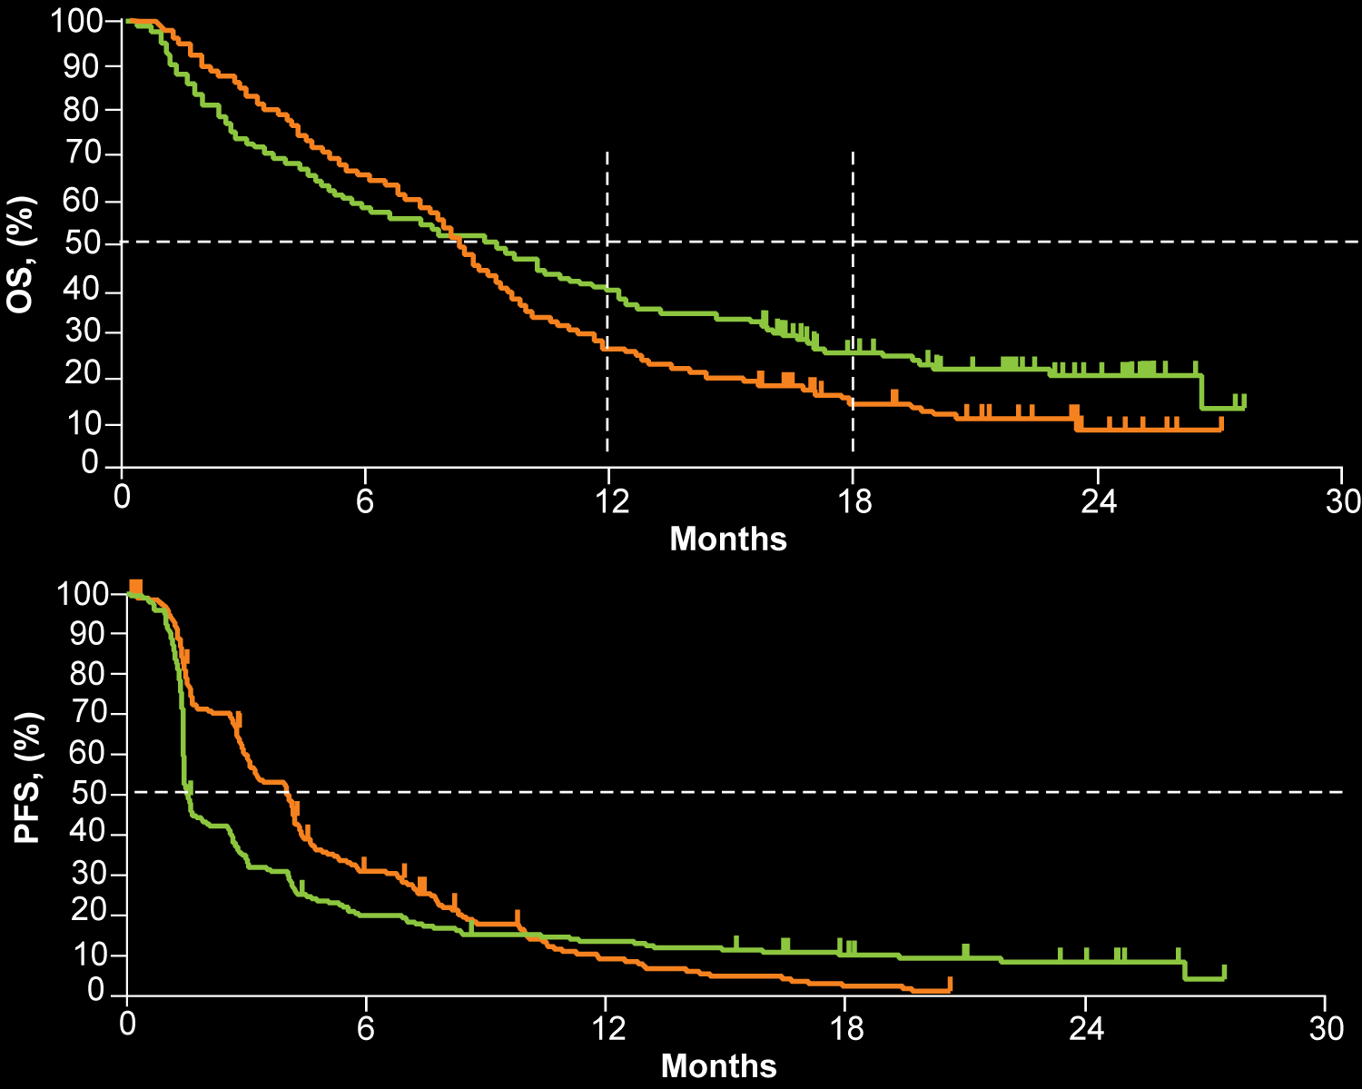
KEYNOTE-061: Survival and Response (CPS ≥1)
OS
OS | Pembro (n = 196) | Paclitaxel (n = 199)
Median OS | 9.1 mo | 8.3 mo
HR; p-value | 0.82; 0.0421
39.8%
27.1%
25.7%
14.8%
Pembro did not reach the prespecified level of statistical significance for improving OS over paclitaxel.
PFS | Pembro (n = 196) | Paclitaxel (n = 199)
Median PFS | 1.5 mo | 4.1 mo
HR; p-value | 1.27; NR
PFS
Response rate:
Pembro = 15.8%
Paclitaxel = 13.6%
Fuchs CS et al. Proc ASCO 2018;Abstract 4062; Shitara K et al. Lancet 2018;[Epub ahead of print].

Slide 42
KEYNOTE-061: Select AEs in the Overall Population
(n = 119)
Event | Pembrolizumab (n = 294) |  | Paclitaxel (n = 276)
 | Any grade | Grade ≥3 | Any grade | Grade ≥3
Fatigue | 35 (12%) | 7 (2%) | 64 (23%) | 13 (5%)
Decreased appetite | 24 (8%) | 2 (<1%) | 43 (16%) | 0
Hypothyroidism | 23 (8%) | 0 | 1 (<1%) | 0
Nausea | 17 (6%) | 1 (<1%) | 50 (18%) | 2 (<1%)
Hyperthyroidism | 12 (4%) | 0 | 1 (<1%) | 0
Anemia | 10 (3%) | 7 (2%) | 39 (14%) | 12 (4%)
Pneumonitis | 8 (3%) | 2 (<1%) | 0 | 0
Colitis | 3 (1%) | 1 (<1%) | 4 (1%) | 3 (1%)
Peripheral neuropathy | 1 (<1%) | 0 | 40 (14%) | 6 (2%)
Alopecia | 1 (<1%) | 0 | 111 (40%) | 3 (1%)
Shitara K et al. Lancet 2018;[Epub ahead of print].

Slide 43
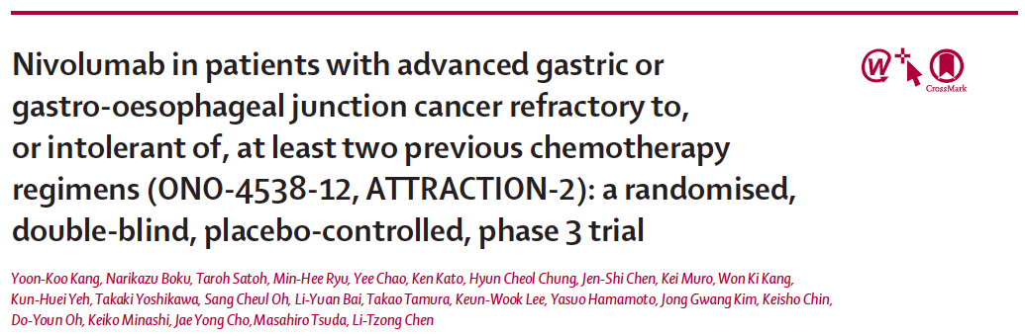
Lancet 2017;390(10111):2461-71.

Slide 44
ATTRACTION-02: Phase III Trial Design
Eligibility (N = 493)
Unresectable advanced or recurrent gastric or GEJ adenocarcinoma Received ≥2 prior chemotherapy regimens ECOG PS 0-1 No prior anti-PD-1/PD-L1 therapy No prior therapeutic antibody or pharmacotherapy for T-cell regulation
Nivolumab (3 mg/kg, q2wk)
(n = 330)
2:1
R
Placebo
(n = 163)
Primary endpoint: OS in the ITT population
Prior to randomization, patients were stratified by country, ECOG PS and the number of organs with metastases.
Kang YK et al. Lancet 2017;390(10111):2461-71.

Slide 45
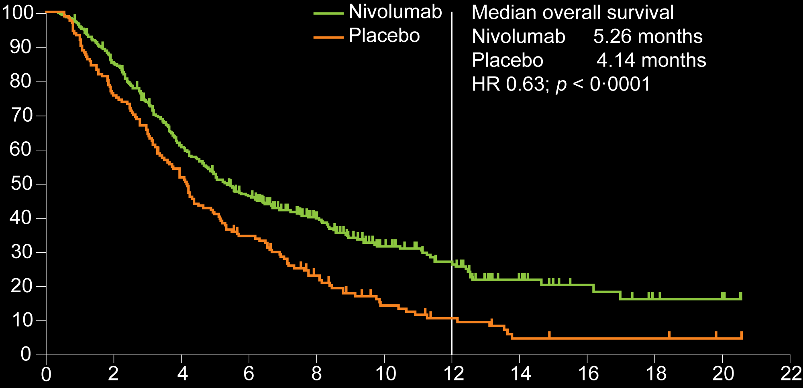
ATTRACTION-02: Survival and Response
n = 330
Overall survival (%)
12-month OS rate
n = 163
26.2%
18-month OS rate
Median follow-up
Nivolumab = 8.87 mo
Placebo = 8.59 mo
16.2%
10.9%
5.0%
Months
Outcome | Nivolumab | Placebo | HR | p-value
Median PFS (n = 330, 163) | 1.61 mo | 1.45 mo | 0.60 | <0.0001
Objective response (n = 268, 131) | 30 (11.2%) | 0 | — | NR
Kang YK et al. Lancet 2017;390(10111):2461-71.

Slide 46
ATTRACTION-02: Select Treatment-Related AEs
Event | Nivolumab (n = 330) |  | Placebo (n = 161)
 | Any grade | Grade 3/4 | Any grade | Grade 3/4
Pruritus | 30 (9%) | 0 | 9 (6%) | 0
Diarrhea | 23 (7%) | 2 (1%) | 3 (2%) | 0
Decreased appetite | 16 (5%) | 4 (1%) | 7 (4%) | 1 (1%)
ILD | 6 (2%) | 1 (<1%) | 0 | 0
Maculopapular rash | 4 (1%) | 0 | 1 (<1%) | 0
Colitis | 2 (1%) | 1 (<1%) | 0 | 0
Hypothyroidism | 2 (1%) | 0 | 0 | 0
Pneumonitis | 1 (<1%) | 1 (<1%) | 0 | 0
ILD = interstitial lung disease
Treatment-related AEs leading to death: Nivolumab (2%) vs placebo (1%).
No new safety signals were observed.
Kang YK et al. Lancet 2017;390(10111):2461-71.

Slide 47
Overall Survival Results from a Phase III Trial of Trifluridine/Tipiracil versus Placebo in Patients with Metastatic Gastric Cancer Refractory to Standard Therapies (TAGS)
Tabernero J et al.
Proc ESMO GI 2018;Abstract LBA-002.

Slide 48
TAGS: Phase III Trial Design
NCT02500043
Eligibility (N = 507)
Unresectable metastatic gastric or GEJ adenocarcinoma Received ≥2 prior chemotherapy regimens ECOG PS 0-1 No prior TAS-102
TAS-102 +
Best Supportive Care (BSC)
(n = 337)
2:1
R
Placebo +
BSC
(n = 170)
Primary endpoint: OS in the ITT population
Prior to randomization, patients were stratified by geographic region (Japan vs rest of the world), ECOG PS (0 vs 1) and prior treatment with ramucirumab.
Tabernero J et al. Proc ESMO GI 2018;Abstract LBA-002; Clinicaltrials.gov.

Slide 49
TAGS: Survival and Safety Outcomes
(n = 119)
Outcome* | TAS-102 (n = 337) | Placebo (n = 170) | HR | p-value
Median OS | 5.7 mo | 3.6 mo | 0.69 | 0.0003
12-mo OS | 21.2% | 13.0%
Median PFS | 2.0 mo | 1.8 mo | 0.57 | <0.0001
4-mo PFS | 26.8% | 7.7%
6-mo PFS | 14.6% | 6.4%
* At data cutoff (31 March 2018)
Grade ≥3 AEs occurred in 266 (79.4%) for TAS-102 vs 97 (57.7%) for placebo
Grade 3/4 hematologic AEs with TAS-102 include: Neutropenia (38.1%), leukopenia (21.0%), anemia (18.6%) and lymphopenia (18.9%).
  Of the 38.1% who experienced Grade 3/4 neutropenia, 6 (1.8%) experienced febrile neutropenia.
No new safety signals were observed.
Tabernero J et al. Proc ESMO GI 2018;Abstract LBA-002.

Slide 50
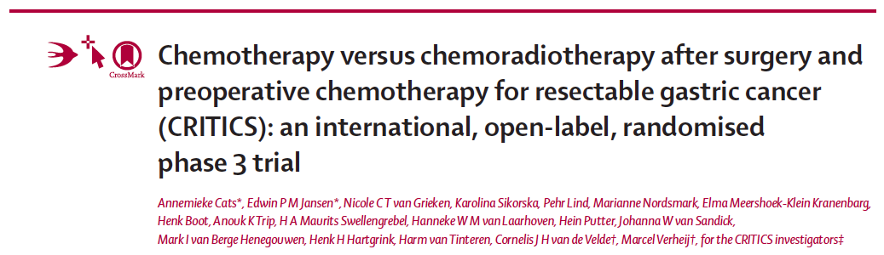
Lancet Oncol 2018;19(5):616-28.

Slide 51
CRITICS: Phase III Adjuvant Trial Design
NCT00407186
Eligibility (N = 788)
Stage Ib-IVa resectable gastric adenocarcinoma No distant metastases Localized disease in the stomach or GEJ with the tumor bulk in the stomach Performance status WHO 0-1
Chemotherapy
Surgery
Chemotherapy
1:1
R
Tissue and blood banking
Health-related quality of life
Chemotherapy
Surgery
Chemoradiotherapy
Chemotherapy includes: Epirubicin, cisplatin, oxaliplatin and capecitabine
Primary endpoint: OS in the ITT population
Cats A et al. Lancet Oncol 2018;19(5):616-28; Verheij M et al. Proc ASCO 2016;Abstract 4000.

Slide 52
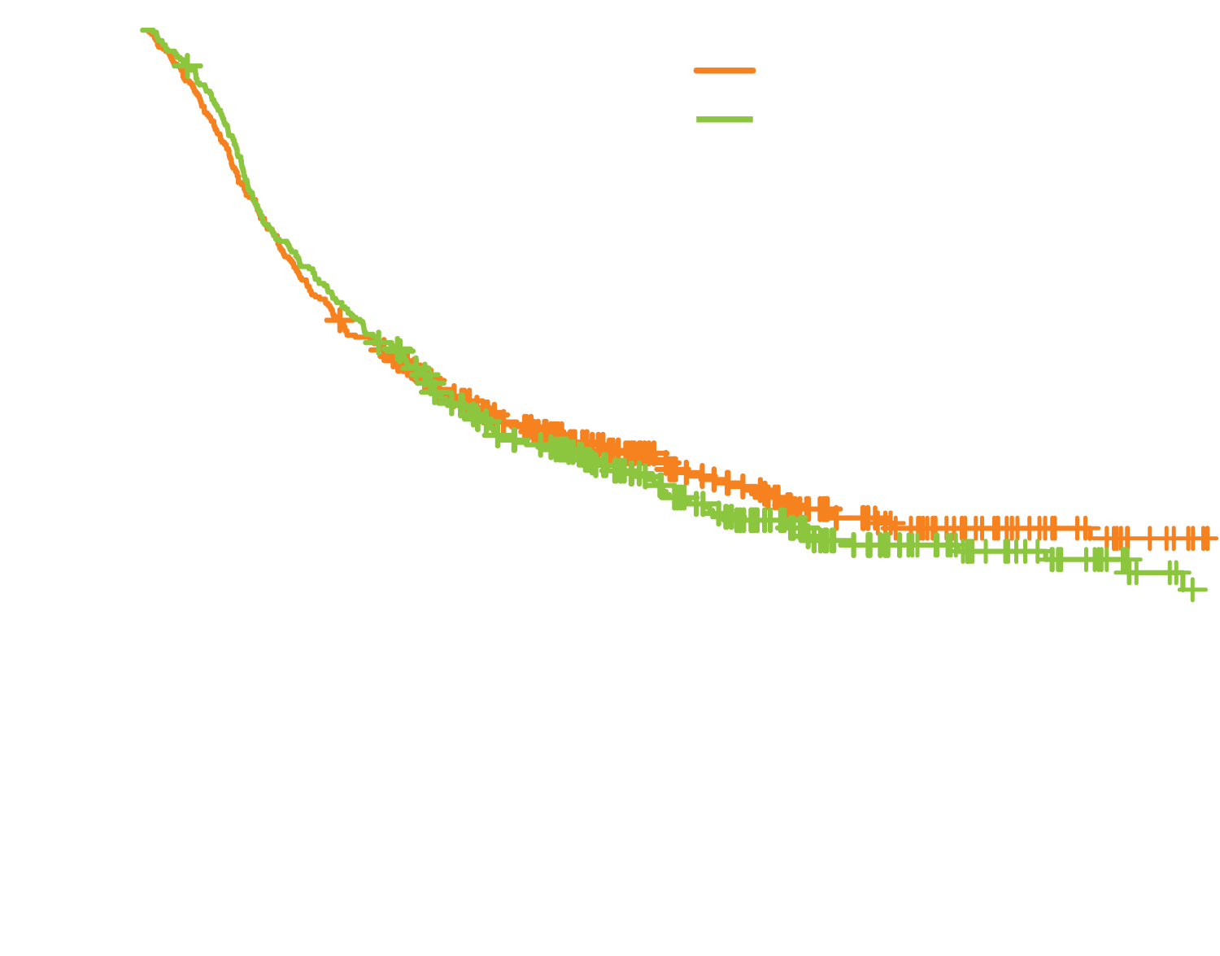
CRITICS: Survival Outcomes
OS
Chemotherapy group (n = 393)
Chemoradiotherapy group (n = 395)
Median = 43 mo
5-y OS:
Chemo = 42%
ChemoRT = 40%
Median = 37 mo
Median follow-up = 61.4 mo
HR 1.01; p = 0.90
Outcome | Chemo (n = 393) | ChemoRT (n = 395) | HR | p-value
Median EFS | 28 mo | 25 mo | 0.99 | 0.92
5-y EFS | 39% | 38%
Cats A et al. Lancet Oncol 2018;19(5):616-28.

Slide 53
CRITICS: Select Treatment-Related AEs
Grade 3-5 AE | Preop chemo* (n = 781) | Postop chemo (n = 233) | Postop chemoRT (n = 245)
Neutropenia | 250 (32%) | 79 (34%) | 11 (4%)
Diarrhea* | 102 (13%) | 13 (6%) | 8 (3%)
Infection without neutropenia* | 67 (9%) | 10 (4%) | 14 (6%)
Thromboembolic event | 65 (8%) | 5 (2%) | 3 (1%)
Mucositis/stomatitis | 32 (4%) | 6 (3%) | 2 (<1%)
Anemia | 24 (3%) | 1 (<1%) | 2 (<1%)
GI obstruction* | 10 (1%) | 2 (<1%) | 2 (<1%)
Cardiac arrhythmia* | 6 (<1%) | 0 | 0
Thrombocytopenia | 5 (<1%) | 1 (<1%) | 4 (2%)
Sudden death* | 1 (<1%) | 0 | 0
* Includes Grade 5 AEs
Cats A et al. Lancet Oncol 2018;19(5):616-28.

Slide 54
Pancreatic Cancer

Slide 55
Unicancer GI PRODIGE 24/CCTG PA.6 Trial: A Multicenter International Randomized Phase III Trial of Adjuvant mFOLFIRINOX versus Gemcitabine (gem) in Patients with Resected Pancreatic Ductal Adenocarcinomas
Conroy T et al.
Proc ASCO 2018;Abstract LBA4001.

Slide 56
PRODIGE 24/CCTG PA.6: Phase III Trial Design
NCT01526135
Eligibility (N = 493)
R0/R1 resected PDAC Able to receive chemotherapy within 12 weeks of resection ECOG PS 0-1 No prior radiotherapy or chemotherapy No metastatic disease
mFOLFIRINOX
1:1
R
Gemcitabine
Primary endpoint: Disease-free survival (DFS)
Prior to randomization, patients were stratified by center, resection margin (R0 vs R1), CA19-9 level (≤90 vs 91-179 U/mL) and pN0 (<12 vs ≥examined nodes) vs pN1.
Conroy T et al. Proc ASCO 2018;Abstract LBA4001; Clinicaltrials.gov.

Slide 57
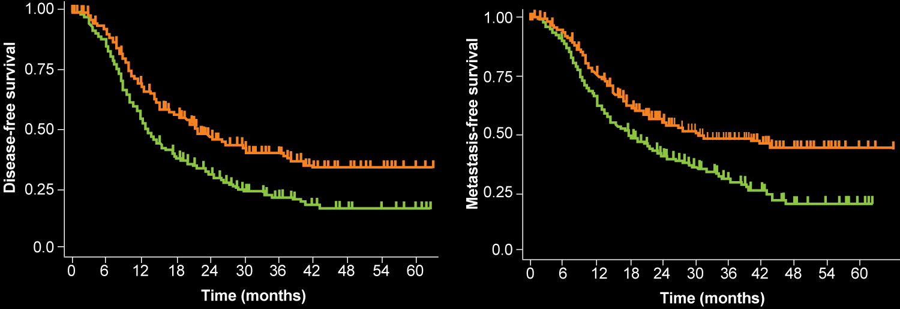
PRODIGE 24/CCTG PA.6: Survival Outcomes
A: Gemcitabine
B: mFolfirinox
A: Gemcitabine
B: mFolfirinox
DFS
MFS
Stratified HR = 0.58
p < 0.0001
Stratified HR = 0.59
p < 0.0001
Median DFS = 21.6 mo
Median MFS = 30.4 mo
n = 247
n = 247
n = 246
Median DFS = 12.8 mo
Median MFS = 17.7 mo
n = 246
DFS = disease-free survival; MFS = metastasis-free survival; DSS = disease-specific survival
Outcome | mFOLFIRINOX (n = 247) | Gem (n = 246) | HR | p-value
Median OS | 54.4 mo | 35.0 mo | 0.64 | 0.003
3-year DSS | 66.2% | 51.2% | 0.63 | 0.003
Conroy T et al. Proc ASCO 2018;Abstract LBA4001.

Slide 58
PRODIGE 24/CCTG PA.6: Select AEs
(n = 119)
Grade 3/4 AE | mFOLFIRINOX (n = 238) | Gemcitabine (n = 243)
G-CSF use* | 59.9% | 3.7%
Neutropenia | 28.4% | 26.0%
Diarrhea* | 18.6% | 3.7%
Peripheral sensory neuropathy* | 9.3% | —
Vomiting* | 5% | 1.2%
Febrile neutropenia | 2.9% | 3.7%
Mucositis* | 2.5% | 0
Thrombocytopenia* | 1.3% | 4.5%
Hand-foot syndrome* | 0.4% | —
Anemia | 0 | 0.4%
*p < 0.05
Conroy T et al. Proc ASCO 2018;Abstract LBA4001.

Slide 59
Preoperative Chemoradiotherapy versus Immediate Surgery for Resectable and Borderline Resectable Pancreatic Cancer (PREOPANC-1): A Randomized, Controlled, Multicenter Phase III Trial
Van Tienhoven G et al.
Proc ASCO 2018;Abstract LBA4002.

Slide 60
PREOPANC-1: Phase III Trial Design
Eligibility (N = 248)
Resectable or borderline resectable pancreatic cancer WHO performance status 0-1
Explorative laparotomy → standard adjuvant chemotherapy
1:1
R
Chemoradiotherapy* → explorative laparotomy → standard adjuvant chemotherapy
* Preoperative chemoradiotherapy consisted of 15 times of 2.4 Gray (Gy) combined with gemcitabine, 1,000 mg/m² on d1, 8 and 15, preceded and followed by a cycle of gemcitabine
Primary endpoint: OS in ITT population
Prior to randomization, patients were stratified by resectability and institution.
Van Tienhoven G et al. Proc ASCO 2018;Abstract LBA4002.

Slide 61
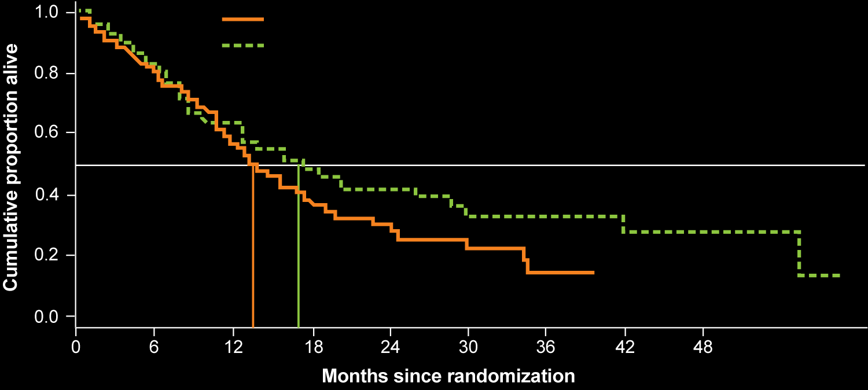
PREOPANC-1: Survival in ITT population
OS
Explorative laparotomy (n = 127)
Radiochemotherapy followed by explorative laparotomy (n = 119)
P-value stratified logrank test: 0.0742
HR = 0.74
p = 0.074
Median OS = 17.1 mo
17.1
Median OS = 13.7 mo
13.7
Survival | Radiochemotherapy (n = 119) | Explorative laparotomy (n = 127) | HR | p-value
Median DFS | 9.9 mo | 7.9 mo | 0.71 | 0.023
Median DMFI | 18.4 mo | 10.6 mo | 0.71 | 0.013
Median LRFI | Not reached | 11.8 mo | 0.55 | 0.002
DMFI = distant metastases-free interval; LRFI = locoregional recurrence-free interval; NR = not reached
Van Tienhoven G et al. Proc ASCO 2018;Abstract LBA4002.

Slide 62
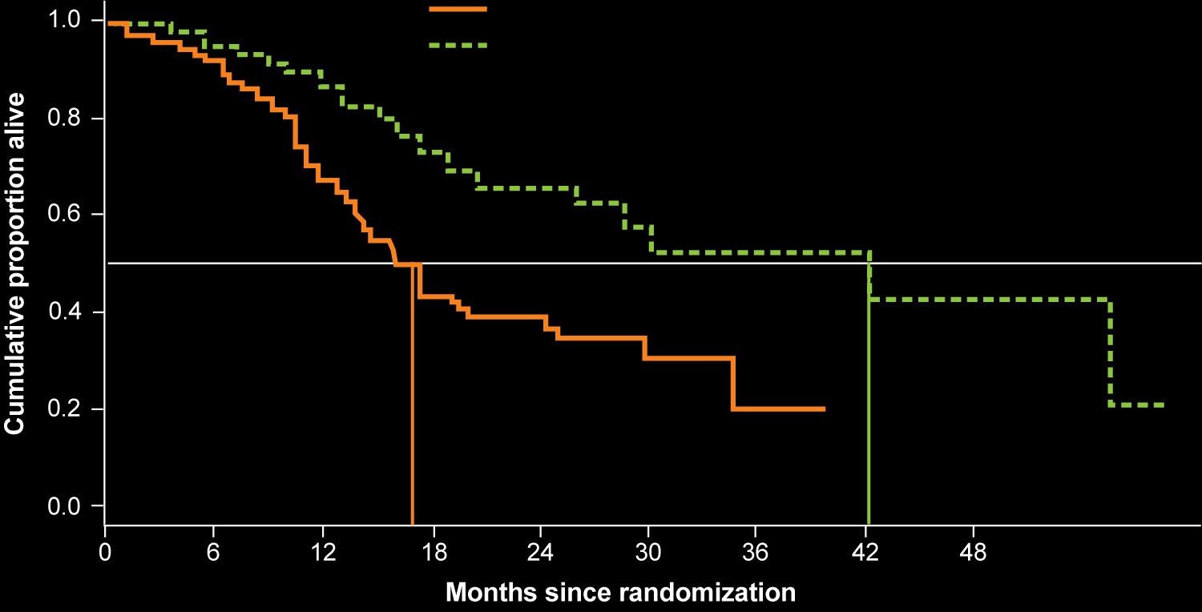
PREOPANC-1: Subset Analysis of OS in Patients After R0/R1 Resection
OS
Explorative laparotomy (n = 91)
Radiochemotherapy followed by explorative laparotomy (n = 72)
P-value stratified logrank test: 3e-04
p < 0.001
Median OS = 42.1 mo
Median OS = 16.8 mo
16.8
42.1
Van Tienhoven G et al. Proc ASCO 2018;Abstract LBA4002.

Slide 63
FOLFIRINOX until Progression, FOLFIRINOX with Maintenance Treatment, or Sequential Treatment with Gemcitabine and FOLFIRI.3 for First-Line Treatment of Metastatic Pancreatic Cancer: A Randomized Phase II Trial (PRODIGE 35-PANOPTIMOX)
Dahan L et al.
Proc ASCO 2018;Abstract 4000.

Slide 64
PRODIGE 35 PANOPTIMOX: Phase II Trial Design
FOLFIRINOX* x 12 cycles
(Arm A)
NCT02352337
Eligibility (N = 273)
Metastatic pancreatic cancer No prior chemotherapy
1:1:1
FOLFIRINOX x 8 cycles → 5-FU/
LV† for disease control and re-introduction of FOLFIRINOX in case of progression
(Arm B)
R
‡ Sequential treatment with FOLFIRINOX for 2 mo and gemcitabine for 2 mo
(Arm C)
* Oxaliplatin 85 mg/m², irinotecan 180 mg/m², LV 200 mg/m², 5-FU bolus 400 mg/m², 5-FU infusion 2,400 mg/m² for 46 h; 14 d cycle
† LV 200 mg/m², 5-FU bolus 400 mg/m², 5-FU infusion 2,400 mg/m² for 46 h; 14 d cycle
‡ Irinotecan 90 mg/m² d1, LV 200 mg/m², 5-FU bolus 400 mg/m², 5-FU infusion 2,400 mg/m² for 46 h, irinotecan 90 mg/m² on d3;
14 d cycle and gemcitabine 1,000 mg/m² on d1, 8, 15; 28 d cycle
Primary endpoint: 6-month PFS rate
Prior to randomization, patients were stratified by center, biliary stent and age (<65 vs >65 y).
Dahan L et al. Proc ASCO 2018;Abstract 4000; Clinicaltrials.gov.

Slide 65
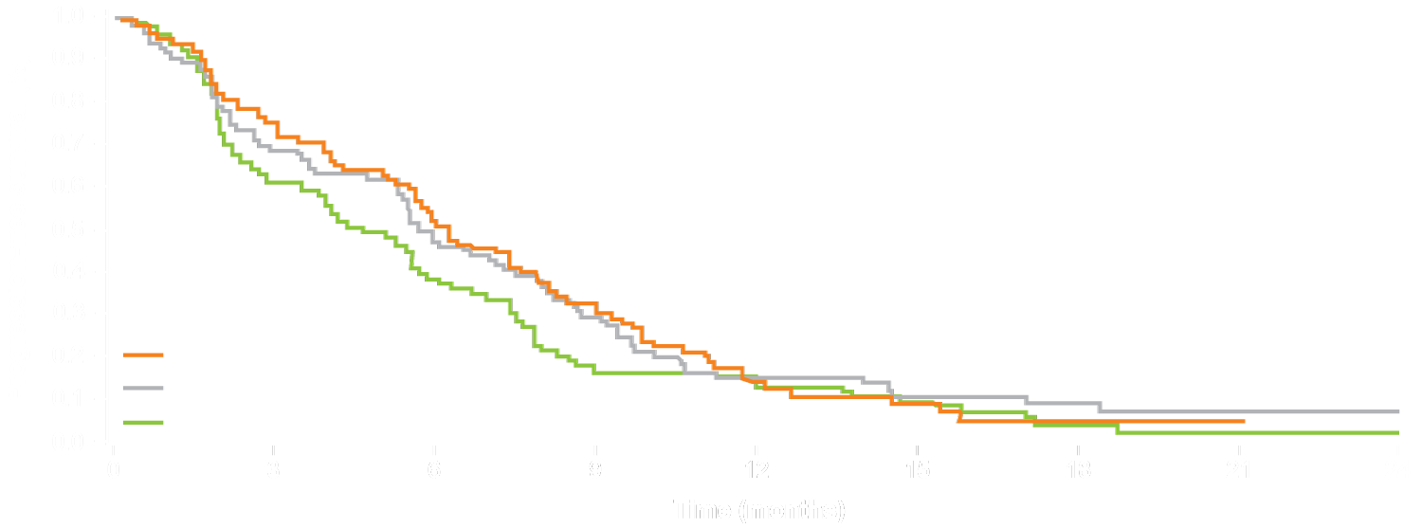
PANOPTIMOX: Survival and Response
PFS in ITT Population
Primary endpoint | Arm A (n = 87) | Arm B (n = 91) | Arm C (n = 88)
6-mo PFS | 41 (47.1%) | 40 (44.0%) | 30 (34.1%)
* PFS defined as first progression of any chemo received
In Arm B:
PFS2 (progression during FOLFIRINOX)
= 7.1 months
Arm A: FOLFIRINOX
Arm B: Maintenance
Arm C: FIR/GEM
Survival | Arm A (n = 91) | Arm B (n = 92) | Arm C (n = 90)
Median PFS | 6.3 mo | 5.7 mo | 4.5 mo
12-mo PFS | 14.7% | 14.9% | 12.9%
Median OS | 10.1 mo | 11.0 mo | 7.3 mo
12-mo OS | 43.3% | 44.1% | 28.5%
Objective response rate: 37.3% (Arm A) vs 38.3% (Arm B) vs 27.0% (Arm C)
Dahan L et al. Proc ASCO 2018;Abstract 4000.

Slide 66
PANOPTIMOX: Select AEs
(n = 119)
Grade 3/4 AE | Arm A (n = 88) | Arm B (n = 91) | Arm C (n = 87)
Neutropenia | 25 (28.4%) | 23 (25.3%) | 28 (32.2%)
Febrile neutropenia | 1 (1.1%) | 5 (5.5%) | —
Thrombocytopenia | 4 (4.5%) | 5 (5.5%) | 7 (8.0%)
Anemia | 6 (6.8%) | 7 (7.7%) | 6 (6.9%)
Asthenia | 22 (25.0%) | 28 (30.8%) | 28 (32.2%)
Vomiting | 11 (12.5%) | 13 (14.3%) | 13 (14.9%)
Diarrhea | 10 (11.4%) | 16 (17.6%) | 16 (18.4%)
Sensory neuropathy | 9 (10.2%) | 17 (18.7%) | 0
Treatment-related deaths (n = 2): Sepsis on the FOLFIRNOX arm (n = 1) and hypertonicity-induced coma on the FIR/GEM arm (n = 1)
Grade 3/4 neurotoxicity: 10.2% (Arm A) vs 18.7% (Arm B)
Dahan L et al. Proc ASCO 2018;Abstract 4000.

Slide 67
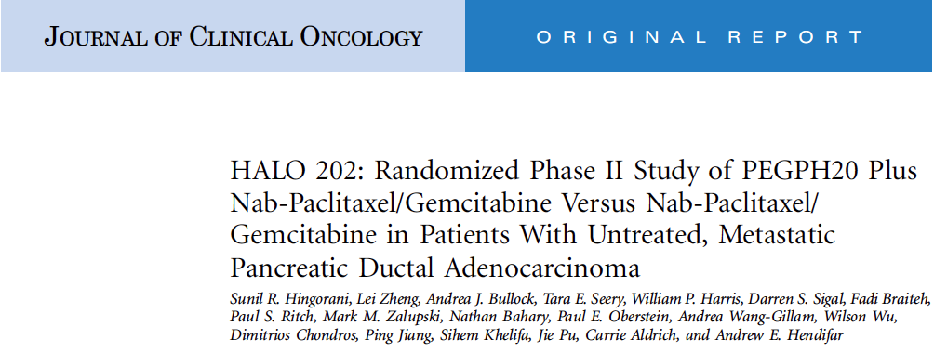
J Clin Oncol 2018;36(4):359-66.

Slide 68
HALO 202: Phase II Trial Design
PEGPH20 +
Nab paclitaxel +
Gemcitabine
(PAG)
Eligibility (N = 279)
Previously untreated metastatic pancreatic ductal adenocarcinoma with liver and/or lung metastases Karnofsky PS ≥70%
R
Nab paclitaxel +
Gemcitabine
(AG)
Primary endpoints: PFS overall and thromboembolic (TE) event rate
Tumor hyaluronan (HA) levels were measured retrospectively using a novel affinity histochemistry assay
Hingorani SR et al. J Clin Oncol 2018;36(4):359-66.

Slide 69
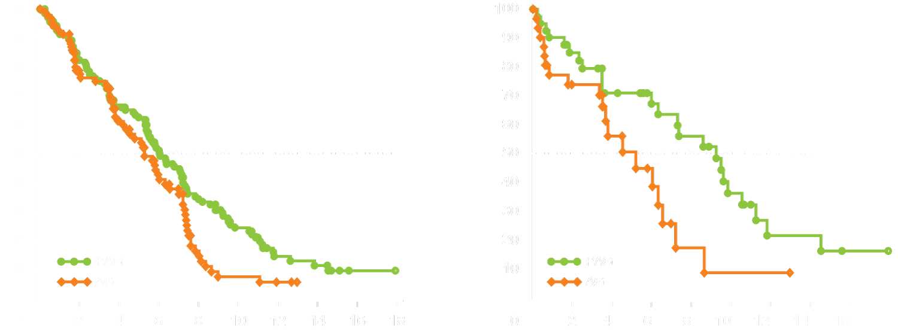
HALO 202: PFS and OS Results
Pts with HA-high tumors in Stages 1 & 2 (ITT population)
Overall PFS for Stages 1 & 2 (Evaluable Pts)
Stages 1 + 2 (HA-High) | PAG (n = 49) | AG (n = 35)
Events | 24 | 19
Median PFS, mo | 9.2 | 5.2
HR | 0.51
P-value | 0.048
Stages 1 + 2 | PAG (n = 139) | AG (n = 92)
Events | 100 | 65
Median PFS, mo | 6.0 | 5.3
HR | 0.73
P-value | 0.049
K-M Estimate of PFS (%)
K-M Estimate of PFS (%)
Study duration (months)
Study duration (months)
Median OS (Stages 1 & 2) | PAG | AG | HR | p-value
All patients (n = 166, 113) | 9.6 mo | 9.2 mo | 0.90 | 0.45
Pts with HA-high tumors (n = 49, 35) | 11.5 mo | 8.5 mo | 0.96 | 0.88
Hingorani SR et al. J Clin Oncol 2018;36(4):359-66.

Slide 70
HALO 202: TE Event Rate
Study stage | Enoxaparin prophylaxis dose | TE Rate (%)* |  | p-value
 |  | PAG | AG
Stage 1 (until 12/2016)† | N/A | 32/74 (43%) | 15/61 (25%) | 0.03
Stage 2 (as of 12/2016)‡ | 40 mg/d§ 1 mg/kg/d Overall | 5/18 (28%) 7/68 (10%) 12/86 (14%) | 2/7 (29%) 2/32 (6%) 4/39 (10%) | 1.0 0.71 0.77
* 2 arterial events each were reported in stage 1 and stage 2; none was considered to be treatment related.
† A brief clinical hold was instituted owing to an imbalance in TE events observed between arms (stage 1). The study was resumed with the exclusion of patients at high risk for TE events, and all patients received enoxaparin prophylaxis (stage 2).
‡ The incidence of all-grade adverse events of bleeding was similar across treatment arms (36.0% PAG vs 35.9% AG).
§ The dose for patients in the 40-mg/d group was subsequently adjusted to 1 mg/kg/d. Some patients may have received enoxaparin doses other than 40 mg/d.
Hingorani SR et al. J Clin Oncol 2018;36(4):359-66.

Slide 71
HALO 202: Select Treatment-Related AEs Occurring in ≥25% of Patients
Event | PAG (n = 160) |  | AG (n = 100)
 | Any grade | Grade ≥3 | Any grade | Grade ≥3
Fatigue | 72% | 21% | 66% | 16%
Peripheral edema* | 63% | 5% | 26% | 4%
Muscle spasms* | 56% | 13% | 3% | 1%
Nausea | 49% | 5% | 47% | 4%
Diarrhea | 40% | 7% | 39% | 5%
Anemia | 39% | 17% | 38% | 20%
Neutropenia* | 34% | 29% | 19% | 18%
Peripheral neuropathy | 29% | 6% | 31% | 8%
Myalgia* | 26% | 5% | 7% | 0%
Thrombocytopenia | 26% | 16% | 17% | 9%
* Statistically significant differences observed between arms.
Hingorani SR et al. J Clin Oncol 2018;36(4):359-66.

Slide 72
HALO-109-301: Ongoing Phase III Trial Design
NCT02715804
Estimated enrollment (N = 570)
Patients with previously untreated pancreatic ductal adenocarcinoma Hyaluronan-high Stage IV disease ECOG PS 0-1
PEGPH20 +
Nab paclitaxel +
Gemcitabine
R
Placebo +
Nab paclitaxel +
Gemcitabine
Primary endpoints: PFS and OS
Secondary endpoints include: Objective response, duration of response and safety
Clinicaltrials.gov.

Slide 73
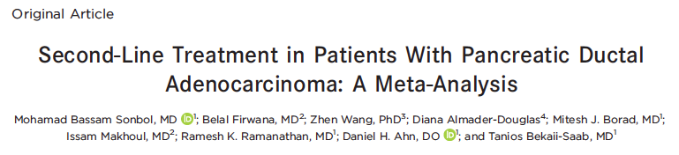
Cancer 2017;123(23):4680-6.

Slide 74
Meta-Analysis: Study Methods
Phase II and Phase III randomized controlled trials for patients with pancreatic ductal adenocarcinoma (PDAC) that progressed after first-line treatment
32 full-text articles assessed for eligibility
5 studies met the inclusion criteria (N = 895)
550 citations obtained by the search strategy
518 citations excluded by screening titles/abstracts
27 articles excluded due to no comparative arm
Primary objective: To determine the efficacy of combining a fluoropyrimidine (FP) with oxaliplatin (FPOX) or various irinotecan formulations (FPIRI) as second-line therapy for patients with PDAC
Outcomes of interest: OS and PFS
Sonbol MB et al. Cancer 2017;123(23):4680-6.

Slide 75
Meta-Analysis: OS and PFS
5 trials (N = 895 patients) were identified comparing second-line FP alone to FP combinations including either FPOX or FPIRI for PDAC.
FPOX vs FP demonstrated a modest improvement in PFS but not OS:
  PFS HR = 0.81; p = 0.02
  OS HR = 1.03; p = 0.90
FPIRI vs FP demonstrated an improvement in both PFS and OS:
  PFS HR = 0.64; p = 0.005
  OS HR = 0.70; p = 0.004
Combination of FP with oxaliplatin or various irinotecan formulations appears to improve PFS in comparison to single-agent FP.
FPIRI, but not FPOX, appears to confer an OS advantage.
Sonbol MB et al. Cancer 2017;123(23):4680-6.

Slide 76
Phase 1b/2 Trial of Cancer Stemness Inhibitor Napabucasin (NAPA) + Nab-Paclitaxel (nPTX) and Gemcitabine (Gem) in Metastatic Pancreatic Adenocarcinoma (mPDAC)
Bekaii-Saab TS et al.
Proc ASCO 2018;Abstract 4110.

Slide 77
Phase Ib/II Trial Design
Eligibility (N = 59)
Metastatic pancreatic adenocarcinoma (PDAC) not previously treated in the metastatic setting
Napabucasin (240 mg PO BID) +
Nab paclitaxel (125 mg/m²) +
Gemcitabine (1,000 mg/m²) weekly for
3 of every 4 weeks
Disease progression
or unacceptable
toxicity or death
Primary endpoints: R2PD, safety and tolerability
Napabucasin at 240 mg BID can be combined with nab paclitaxel and gemcitabine at full dose.
Bekaii-Saab TS et al. Proc ASCO 2018;Abstract 4110.

Slide 78
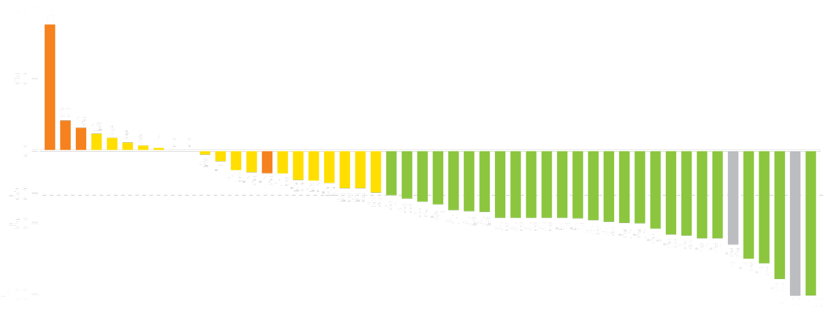
Phase Ib/II Trial: Response and Survival Outcomes
CR
PR
SD
PD
All patients (n = 59)
Best overall response rate (All pts) = 47.5%
Disease control rate (All pts) = 78%
Complete response = 2 (3.4%)
Partial response = 26 (44.1%)
Change from baseline (%)
Partial response
*Lymph nodes decreased to <10 mm in short axis. **Some non-target lesions remain
The ongoing Phase III CanStem111P trial is evaluating the efficacy of napabucasin + nab paclitaxel + gem as first-line therapy for patients with metastatic PDAC (NCT02993731).
Survival | Phase I/IIb trial (n = 59) | Pts meeting CanStem111P criteria (n = 29)
Median OS | 9.59 mo | 12.62 mo
Median PFS | 7.06 mo | 7.10 mo
Bekaii-Saab TS et al. Proc ASCO 2018;Abstract 4110.

Slide 79
Phase I/II Trial: Select Treatment-Emergent AEs in ≥20% of Patients
(n = 119)
Event (n = 59) | Any grade | Grade ≥3
Diarrhea | 41 (69.5%) | 5 (8.5%)
Fatigue | 39 (66.1%) | 10 (16.9%)
Nausea | 27 (45.8%) | 1 (1.7%)
Peripheral neuropathy | 23 (39.0%) | 4 (6.8%)
Peripheral edema | 19 (32.2%) | 3 (5.1%)
Neutropenia | 15 (25.4%) | 14 (23.7%)
Anemia | 15 (25.4%) | 8 (13.6%)
Fever | 14 (23.7%) | 2 (3.4%)
GI AEs seen with napabucasin were mainly Grade 1 or 2 and were manageable with supportive measures.
Grade 3 GI AEs were low and resolved upon withholding napabucasin.
Bekaii-Saab TS et al. Proc ASCO 2018;Abstract 4110.

Slide 80
CanStem111P: Ongoing Phase III Trial Design
NCT02993731
Estimated Enrollment (N = 1,132)
Metastatic PDAC Previously untreated ECOG PS 0-1 Available archival tumor tissue No brain or leptomeningeal metastases
Napabucasin +
Nab paclitaxel +
Gemcitabine
R
Nab paclitaxel +
Gemcitabine
Primary endpoint: OS in all patients
Secondary endpoints include: OS in patients with biomarker-positive disease, PFS, response and safety
Bekaii-Saab TS et al. Proc ASCO 2018;Abstract 4110; Clinicaltrials.gov.

Slide 81
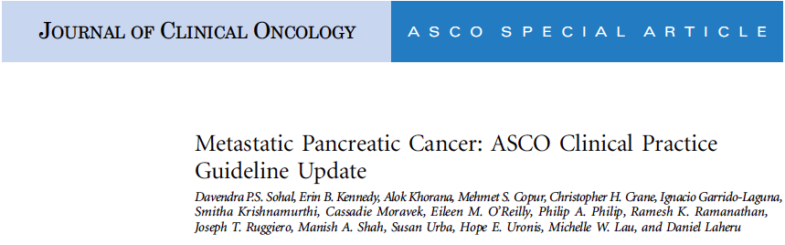
J Clin Oncol 2018;36(24):2545-56.

Slide 82
ASCO Clinical Practice Guideline Update for Metastatic Pancreatic Cancer
Treatment stage | Recommendation
Initial assessment | Use a multiphase CT scan of chest/abdomen/pelvis for dx extent Evaluate baseline PS, symptom burden and comorbidity profile Discuss care goals, pt preferences and support systems with pt Use a multidisciplinary team to formulate treatment plans Clinical trial information should be offered
1L treatment | ECOG PS 0-1: FOLFIRINOX or gemcitabine/nab paclitaxel ECOG PS 2: Gemcitabine alone or with capecitabine or erlotinib ECOG PS ≥3: Case-by-case basis only with emphasis on optimizing supportive care measures
2L treatment | Routine testing for dMMR/MSI-H by IHC, PCR or NGS if considered candidate for immune checkpoint inhibitor therapy If dMMR/MSI-H positive, pembrolizumab is recommended If pt received 1L FOLFIRINOX, has ECOG PS 0-1/favorable comorbidity profile, consider gemcitabine/nab paclitaxel If pt received 1L gem/nab, has ECOG PS 0-1/favorable comorbidity profile, consider 5-FU/nal-IRI (preferred) or 5-FU + irinotecan or oxaliplatin
Sohal DPS et al. J Clin Oncol 2018;36(24):2545-56.

Slide 83
ASCO Clinical Practice Guideline Update for Metastatic Pancreatic Cancer (Continued)
Treatment stage | Recommendation
2L treatment cont’d | If pt has ECOG PS 2 or a comorbidity profile precluding more aggressive regimens, consider gemcitabine or 5-FU
≥3L treatment | No data are available for therapy with a cytotoxic agent. Clinical trial participation is encouraged
Palliative care | Pts should undergo full assessment of symptom burden, psychological status and social supports as early as possible, preferably at first visit
Pain and symptom management | Pts should be offered aggressive treatment of pain and symptoms of the cancer and/or anticancer therapy
Follow-up and surveillance | Pts on active anticancer therapy off protocol: Offer imaging to assess first response at 2-3 months from treatment initiation. Use of CT scans with contrast are preferred. Routine use of PET scans is not recommended. No data exist on the duration of anticancer therapy. An ongoing discussion of care goals and assessment of treatment response and tolerability should guide decisions to hold or discontinue cancer-directed therapy.
Sohal DPS et al. J Clin Oncol 2018;36(24):2545-56.

Slide 84
Hepatocellular Cancer

Slide 85
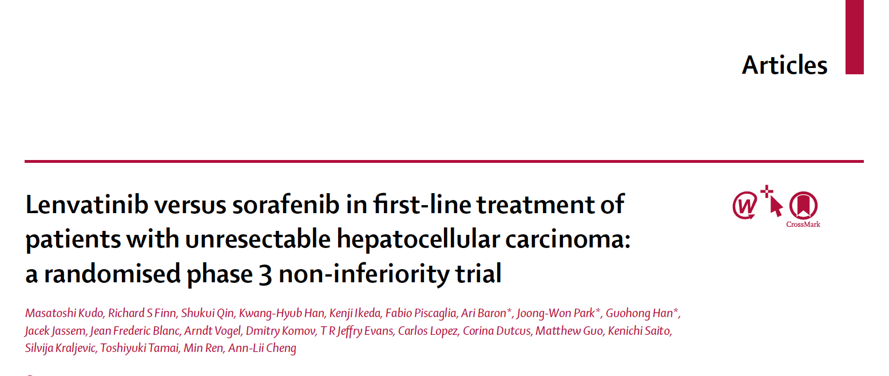
Lancet 2018;391(10126):1163-73.

Slide 86
REFLECT: Phase III Trial Design
NCT01761266
Eligibility (N = 954)
Unresectable HCC No prior systemic therapy BCLC Stage B or C Child-Pugh A ECOG PS 0-1
Lenvatinib
(n = 478)
1:1
R
Sorafenib
(n = 476)
Primary endpoint: OS
Kudo M et al. Lancet 2018;391(10126):1163-73; Clinicaltrials.gov.

Slide 87
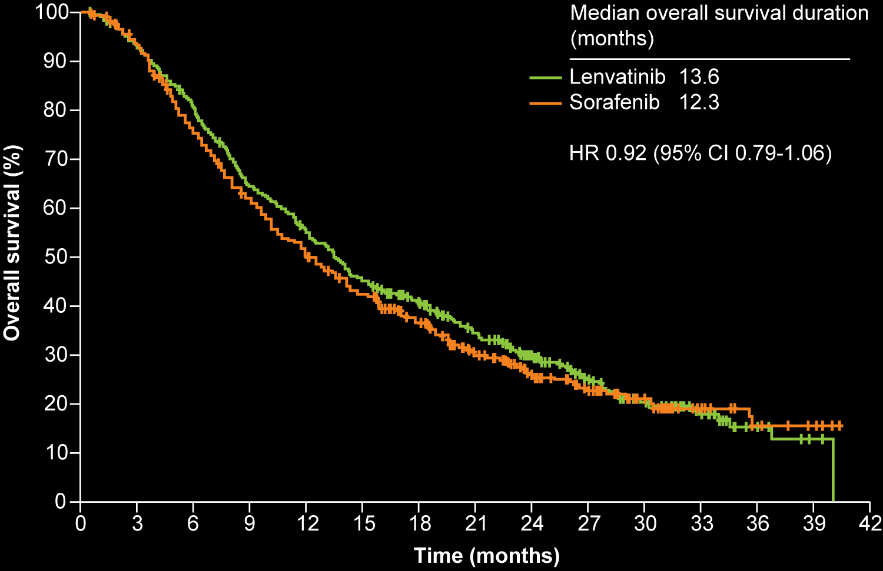
REFLECT: Survival and Response
OS
Lenvatinib showed noninferiority in terms of OS compared to sorafenib
Lenvatinib (n = 478)
Sorafenib (n = 476)
Outcomes | Lenvatinib (n = 478) | Sorafenib (n = 476) | HR* or OR† | p-value
Median PFS | 7.4 mo | 3.7 mo | *0.66 | <0.0001
Median time to progression (TTP) | 8.9 mo | 3.7 mo | *0.63 | <0.0001
Objective response rate | 24.1% | 9.2% | †3.13 | <0.0001
Kudo M et al. Lancet 2018;391(10126):1163-73.

Slide 88
REFLECT: Select Treatment-Emergent AEs
Adverse event | Lenvatinib (n = 476) |  | Sorafenib (n = 475)
 | Any grade | Grade ≥3 | Any grade | Grade ≥3
Hypertension | 42% | 23% | 30% | 14%
Diarrhea | 39% | 4% | 46% | 4%
Decreased appetite | 34% | 5% | 27% | 1%
Decreased weight | 31% | 8% | 22% | 3%
Fatigue | 30% | 4% | 25% | 4%
Palmar-plantar erythrodysesthesia | 27% | 3% | 52% | 11%
Proteinuria | 25% | 6% | 11% | 2%
Dysphonia | 24% | <1% | 12% | 0%
Nausea | 20% | 1% | 14% | 1%
Decreased platelet count | 18% | 5% | 12% | 3%
Vomiting | 16% | 1% | 8% | 1%
Kudo M et al. Lancet 2018;391(10126):1163-73.

Slide 89
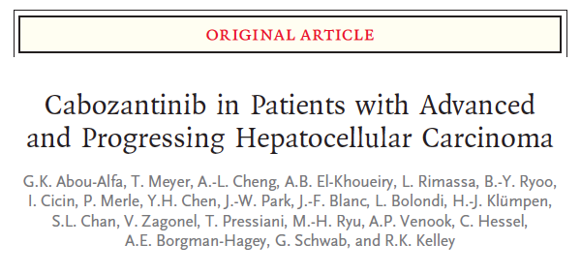
N Engl J Med 2018;379(1):54-63.

Slide 90
CELESTIAL: Phase III Trial Design
Eligibility (N = 760)
Patients with HCC not amenable to curative treatment Child-Pugh A Received prior sorafenib Disease progression after ≥1 prior systemic therapy for HCC Received ≤2 prior systemic regimens for advanced HCC ECOG PS 0-1 No uncontrolled hypertension
Cabozantinib
60 mg PO QD
2:1
R
Placebo
PO QD
Primary endpoint: OS
Prior to randomization, patients were stratified by disease etiology (HBV, HCV, other), region (Asia vs other), presence of macrovascular invasion and/or extrahepatic spread of disease (yes or no)
Abou-Alfa GK et al. N Engl J Med 2018;379(1):54-63; Abou-Alfa G et al. Gastrointestinal Cancers Symposium 2018;Abstract 207.

Slide 91
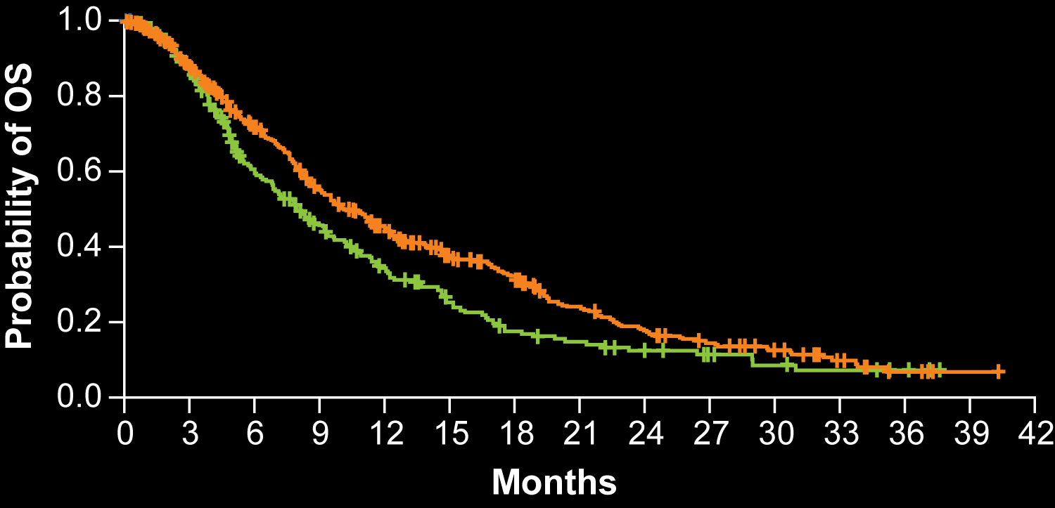
CELESTIAL: Survival and Response
OS (All patients)
Median OS | Cabozantinib (n = 470) | Placebo (n = 237) | HR | p-value
All patients | 10.2 mo | 8.0 mo | 0.76 | 0.005*
Median OS | n = 331 | n = 164 | HR | p-value
Prior sorafenib only | 11.3 mo | 7.2 mo | 0.70 | NR
*Critical p-value ≤0.021 for second interim analysis
Placebo (n = 237)
Cabozantinib (n = 470)
Median PFS | Cabozantinib | Placebo | HR | p-value
All patients (n = 470, 237) | 5.2 mo | 1.9 mo | 0.44 | <0.001
Prior sorafenib only (n = 331, 164) | 5.5 mo | 1.9 mo | 0.40 | NR
Objective response rate | Cabozantinib | Placebo | Odds ratio | p-value
All patients (n = 470, 237) | 4% | 0.4% | NR | 0.0086
Abou-Alfa GK et al. N Engl J Med 2018;379(1):54-63; Abou-Alfa G et al. Gastrointestinal Cancers Symposium 2018;Abstract 207.

Slide 92
CELESTIAL: AEs
Grade 3/4 AE | Cabozantinib (n = 467) | Placebo (n = 237)
Palmar-plantar erythrodysesthesia | 17% | 0%
Hypertension | 16% | 2%
Increased AST | 12% | 7%
Fatigue | 10% | 4%
Diarrhea | 10% | 2%
Asthenia | 7% | 2%
Decreased appetite | 6% | <1%
Anemia | 4% | 5%
Treatment-related Grade 5 AEs:
  Cabozantinib (6 patients): Hepatic failure, esophagobronchial fistula, portal vein thrombosis, upper GI hemorrhage, pulmonary embolism, hepatorenal syndrome
  Placebo (1 patient): Hepatic failure
Abou-Alfa GK et al. N Engl J Med 2018;379(1):54-63; Abou-Alfa G et al. Gastrointestinal Cancers Symposium 2018;Abstract 207.

Slide 93
Updated OS Analysis from the International, Phase 3, Randomized, Placebo-Controlled RESORCE Trial of Regorafenib for Patients with Hepatocellular Carcinoma (HCC) who Progressed on Sorafenib Treatment
Bruix J et al.
Proc ESMO World Congress GI 2017;Abstract O-009.

Slide 94
RESORCE: Phase III Trial Design
Eligibility (N = 573)
Unresectable HCC Barcelona Clinic Liver Cancer (BCLC) Stage B or C Child-Pugh A liver function Radiologic progression on sorafenib ECOG PS 0-1
Regorafenib
160 mg/day
(n = 379)
2:1
R
Placebo
(n = 194)
Primary endpoint: OS
Bruix J et al. Proc ESMO World Congress GI 2017;Abstract O-009; Bruix J et al.
Lancet 2017;289(10064):56-66.

Slide 95
RESORCE: Updated OS Analysis
 | Regorafenib (n = 379) | Placebo (n = 194) | HR | p-value
Median OS (updated) | 10.7 mo | 7.9 mo | 0.61 | <0.0001
12-mo OS | 47% | 28%
18-mo OS | 32% | 16%
30-mo OS | 16% | 7%
OS results favored regorafenib in all preplanned subgroup analyses.
Conclusion: The results of the updated OS analysis with a longer follow-up from the RESORCE trial confirm the results of the primary OS analysis showing that regorafenib is an effective treatment option for patients with HCC who progress on prior sorafenib treatment.
Bruix J et al. Proc ESMO World Congress GI 2017;Abstract O-009.

Slide 96
REACH-2: A Randomized, Double-Blind, Placebo-Controlled Phase 3 Study of Ramucirumab versus Placebo as Second-Line Treatment in Patients with Advanced Hepatocellular Carcinoma (HCC) and Elevated Baseline Alpha-Fetoprotein (AFP) Following First-Line Sorafenib
Zhu AX et al.
Proc ASCO 2018;Abstract 4003.

Slide 97
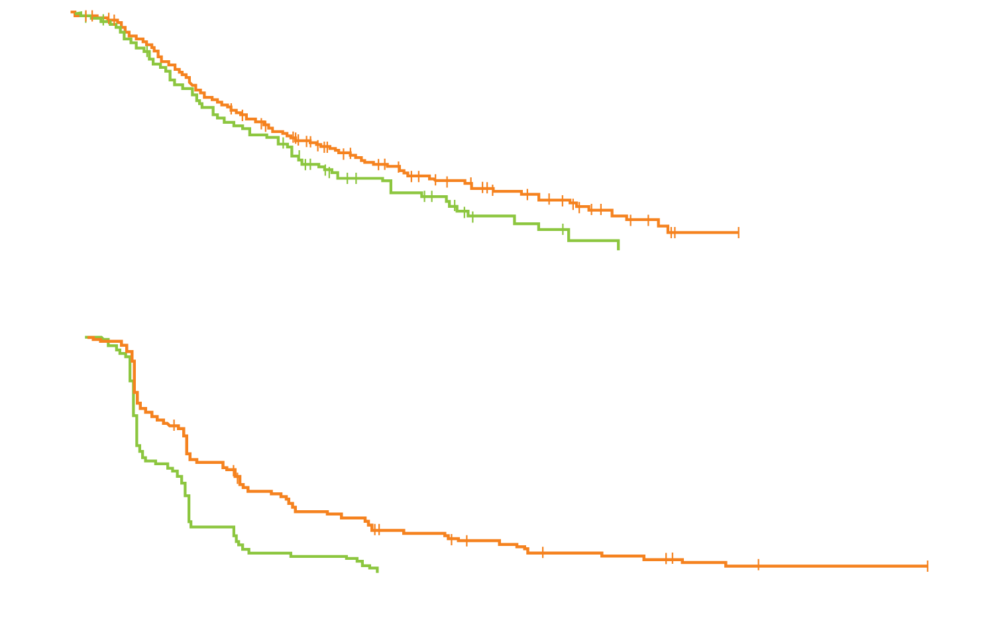
REACH-2: Survival
OS | Ramucirumab (n = 197) | Placebo (n = 95) | HR | p-value
Median OS | 8.5 mo | 7.3 mo | 0.710 | 0.0199
Median durations of follow-up were 7.9 months for ramucirumab, 6.6 months for placebo
Censored
Ramucirumab
Placebo
PFS | Ramucirumab (n = 197) | Placebo (n = 95) | HR | p-value
Median PFS | 2.8 mo | 1.6 mo | 0.452 | <0.0001
Censored
Ramucirumab
Placebo
Zhu AX et al. Proc ASCO 2018;Abstract 4003.

Slide 98
REACH-2: Select AEs
Event | Ramucirumab (n = 197) |  | Placebo (n = 95)
 | Any grade | Grade ≥3 | Any grade | Grade ≥3
Fatigue | 27.4% | 3.6% | 16.8% | 3.2%
Peripheral edema | 25.4% | 1.5% | 13.7% | 0
Hypertension | 24.4% | 12.2% | 12.6% | 5.3%
Decreased appetite | 23.4% | 1.5% | 20.0% | 1.1%
Proteinuria | 20.3% | 2.0% | 4.2% | 0
Abdominal pain | 19.8% | 1.5% | 12.6% | 2.1%
Ascites | 17.8% | 4.1% | 7.4% | 2.1%
Diarrhea | 16.2% | 0 | 14.7% | 1.1%
Zhu AX et al. Proc ASCO 2018;Abstract 4003.

Slide 99
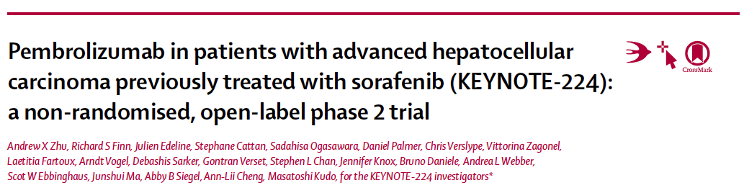
Lancet Oncol 2018;19(7):940-52.

Slide 100
KEYNOTE-224: Phase II Trial Design
NCT02702414
Eligibility (N = 59)
HCC Progression on or intolerance to sorafenib Child-Pugh A BCLC Stage B or C ECOG PS 0-1
Pembrolizumab
200 mg q3wk for up to 2 y
Survival follow-up
Primary endpoint: Objective response rate
Zhu AX et al. Lancet Oncol 2018;19(7):940-52.

Slide 101

KEYNOTE-224: Response and Survival Results
Maximum Percentage Changes from Baseline in Target Lesions
Study cohort (n = 104) Uninfected (n = 57) HCV infected (n = 26) HBV infected (n = 21)
Change from baseline (%)
Objective response rate = 18/104 (17%)
  CR = 1 (1%)
Disease control rate = 64/104 (62%)
Median time to response = 2.1 mo
Median duration of response = Not reached
Median OS = 12.9 mo; 12-mo OS = 54%
Median PFS = 4.9 mo; 12-mo PFS = 28%
Zhu AX et al. Lancet Oncol 2018;19(7):940-52.

Slide 102
KEYNOTE-224: Select Treatment-Related AEs
Event (N = 104) | All Grade | Grade ≥3
Fatigue | 22 (21%) | 4 (4%)
Increased AST | 14 (13%) | 7 (7%)
Decreased appetite | 7 (7%) | 1 (1%)
Increased ALT | 9 (9%) | 4 (4%)
Hyperbilirubinemia | 5 (5%) | 2 (2%)
Dyspnea | 5 (5%) | 1 (1%)
Anemia | 3 (3%) | 1 (1%)
Adrenal insufficiency | 3 (3%) | 2 (2%)
Cardiac failure | 1 (1%) | 1 (1%)
One death associated with ulcerative esophagitis was attributed to treatment.
Immune-mediated hepatitis occurred in 3 (3%) patients, but there were no reported cases of viral flares.
Zhu AX et al. Lancet Oncol 2018;19(7):940-52.

Slide 103
KEYNOTE-240: Ongoing Phase III Trial Design
NCT02702401
Estimated enrollment (N = 408)
Patients with previously treated advanced HCC BCLC Stage B or C Child-Pugh A liver function Radiologic progression on or intolerance to sorafenib ECOG PS 0-1
Pembrolizumab
(200 mg q3wk for up to 2 y)
+
BSC
2:1
R
Placebo
+
BSC
Primary endpoints: OS and PFS
Clinicaltrials.gov.

Slide 104
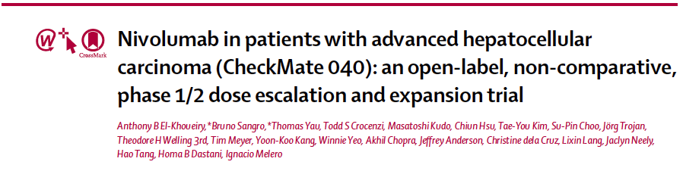
Lancet 2017;389(10088):2492-502.

Slide 105
CheckMate 040: Phase I/II Trial Design
Eligibility (N = 262)
Dose escalation (n = 48)
3 + 3 design
Dose expansion (n = 214)
3 mg/kg
n = 6
n = 9
n = 10
n = 10
n = 13
Sorafenib untreated or intolerant (n = 56)
Without
viral
hepatitis
0.1 mg/kg
(n = 1)
0.3 mg/kg
(n = 3)
1.0 mg/kg
(n = 3)
3.0 mg/kg
(n = 3)
10 mg/kg
(n = 13)
Sorafenib progressor
(n = 57)
HCV
infected
0.3 mg/kg
(n = 3)
1.0 mg/kg
(n = 4)
3.0 mg/kg
(n = 3)
HCV infected
(n = 50)
HBV
infected
0.1 mg/kg
(n = 5)
0.3 mg/kg
(n = 3)
1.0 mg/kg
(n = 3)
3.0 mg/kg
(n = 4)
HBV infected
(n = 51)
HCV = Hepatitis C virus; HBV = Hepatitis B virus
Primary endpoints: Safety and tolerability (dose-escalation phase); objective response rate (dose-expansion phase)
El-Khoueiry AB et al. Lancet 2017;389(10088):2492-502.

Slide 106
CheckMate 040: Response and Survival Outcomes
Response | Uninfected untreated/ intolerant (n = 56) | Uninfected progressor (n = 57) | HCV infected (n = 50) | HBV infected (n = 51) | All pts (n = 214)
Objective response | 13 (23%) | 12 (21%) | 10 (20%) | 7 (14%) | 42 (20%)
Complete response | 0 | 2 (4%) | 0 | 1 (2%) | 3 (1%)
Median DoR | 8.4 mo | NYR | 9.9 mo | NYR | 9.9 mo
Median OS | NYR | 13.2 mo | NYR | NYR | NYR
6-mo OS | 89% | 75% | 85% | 84% | 83%
9-mo OS | 82% | 63% | 81% | 70% | 74%
Median PFS | 5.4 mo | 4.0 mo | 4.0 mo | 4.0 mo | 4.0 mo
NYR = not yet reached; DoR = duration of response
Nivolumab at a dose of 3 mg/kg was chosen for the dose-expansion phase
Objective response: 15% (dose escalation) and 20% (dose expansion)
El-Khoueiry AB et al. Lancet 2017;389(10088):2492-502.

Slide 107
CheckMate 040: Select AEs – Dose-Escalation Phase
Grade 3/4 AE | 0.1 mg/kg (n = 6) | 0.3 mg/kg (n = 9) | 1 mg/kg (n = 10) | 3 mg/kg (n = 10) | 10 mg/kg (n = 13) | All pts (n = 48)
Fatigue | 1 (17%) | 0 | 0 | 0 | 0 | 1 (2%)
Increased AST | 0 | 2 (22%) | 2 (20%) | 1 (10%) | 0 | 5 (10%)
Increased ALT | 0 | 2 (22%) | 0 | 1 (10%) | 0 | 3 (6%)
Increased lipase | 1 (17%) | 0 | 4 (40%) | 1 (10%) | 0 | 6 (13%)
Increased amylase | 0 | 0 | 1 (10%) | 1 (10%) | 0 | 4 (4%)
Anemia | 0 | 0 | 1 (10%) | 0 | 0 | 1 (2%)
There were no treatment-related deaths
There were 3 AEs leading to discontinuation (1 each in the 0.3 mg/kg, 3 mg/kg and 10 mg/kg arms)
El-Khoueiry AB et al. Lancet 2017;389(10088):2492-502.

Slide 108
CheckMate 459: Ongoing Phase III Trial Design
NCT02576509
Estimated enrollment (N = 726)
Patients with previously untreated advanced HCC Patients ineligible for surgical and/or locoregional therapies Child-Pugh A ECOG PS 0-1 No known or suspected autoimmune disease
Nivolumab
R
Sorafenib
Primary endpoint: OS
Clinicaltrials.gov.

