Slide 1
Please note, these are the actual video-recorded proceedings from the live CME event and may include the use of trade names and other raw, unedited content.

Slide 2
Breakfast with the Investigators Management of Melanoma Saturday, June 2, 2018
6:45 AM – 7:45 AM Chicago, Illinois
Faculty
Michael A Postow, MD
Prof Caroline Robert, MD, PhD
Jeffrey Weber, MD, PhD
Moderator Neil Love, MD

Slide 3
RTP ASCO Symposia

Slide 4
Agenda
Module 1: Evolving Treatment Approaches for Patients with Localized or Locally Advanced Disease
Module 2: Integration of BRAF/MEK Inhibitors into the Management of BRAF-Mutated Disease
Module 3: Immune Checkpoint Inhibitors in Metastatic Melanoma; Management of Autoimmune Toxicities

Slide 5
Module 1:
Evolving Treatment Approaches for Patients with Localized or Locally Advanced Disease
Notes:
5
5
5

Slide 6
FDA Approvals/Indications for Adjuvant Treatment of Localized or Locally Advanced Melanoma
Agent | Indication | Pivotal trial
Dabrafenib plus trametinib | Adjuvant treatment of melanoma with BRAF V600E or V600K mutation, as detected by an FDA-approved test, and involvement of lymph node(s), following complete resection | COMBI-AD
Nivolumab | Adjuvant treatment of melanoma with lymph node involvement | CHECKMATE 238
Ipilimumab | Adjuvant treatment of melanoma with pathologic involvement of regional lymph nodes of >1 mm in patients who have undergone complete resection, including total lymphadenectomy | EORTC-18071
https://www.accessdata.fda.gov; Accessed on May 24, 2018

Slide 7
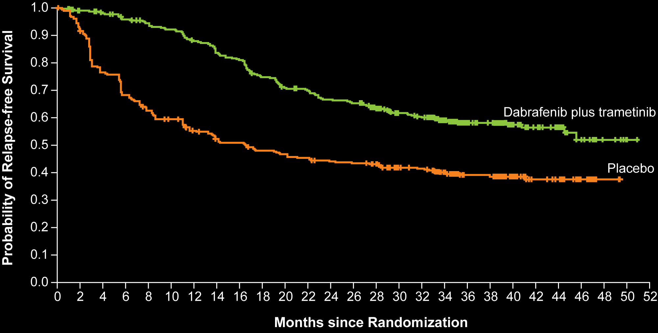
COMBI-AD: Relapse-Free Survival (RFS) with Adjuvant Dabrafenib/ Trametinib for Completely Resected, Stage III BRAF V600-Mutant Melanoma
Cohort | Median RFS (mo) | 1-y RFS | 2-y RFS | 3-y RFS | HR | p-value
Dabrafenib + trametinib | NR | 88% | 67% | 58% | 0.47 | <0.001
Placebo | 16.6 | 56% | 44% | 39%
Long GV et al. N Engl J Med 2017;377:1813-23.

Slide 8
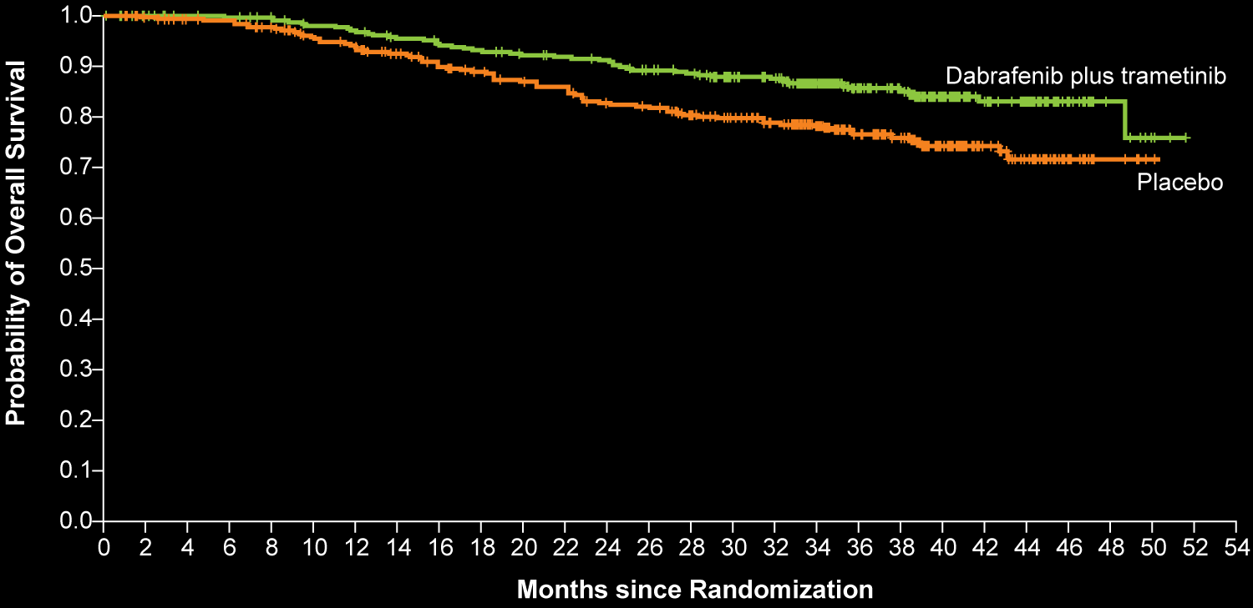
COMBI-AD: Overall Survival (OS) in Completely Resected, Stage III BRAF V600-Mutant Melanoma
Cohort | Median OS (mo) | 1-YR OS | 2-YR OS | 3-YR OS | HR | p-value
Dabrafenib + trametinib | NR | 97% | 91% | 86% | 0.57 | 0.0006
Placebo | NR | 94% | 83% | 77%
Long GV et al. N Engl J Med 2017;377:1813-23.

Slide 9
COMBI-AD: Select Adverse Events in Completely Resected, Stage III BRAF V600-Mutant Melanoma
Any adverse event (AE) | Dabrafenib plus trametinib (N = 435) | Placebo (N = 432)
Any AE | 97.0% | 88.0%
Any AE Grade ≥3 | 41.0% | 14.0%
Any AE leading to discontinuation | 26.0% | 3.0%
Specific AE
Pyrexia | 63.0% | 11.0%
Diarrhea | 33.0% | 15.0%
Influenza-like illness | 15.0% | 7.0%
Peripheral edema | 13.0% | 4.0%
Long GV et al. N Engl J Med 2017;377:1813-23.

Slide 10
Adjuvant therapy with nivolumab (NIVO) versus ipilimumab (IPI) after complete resection of stage III/IV melanoma: Updated results from a phase III trial (CheckMate 238)
Jeffrey S Weber, MD, PhD
ASCO 2018;Abstract 9502.
Monday, June 4, 2018, 8:00 AM – 11:00 AM
Arie Crown Theater

Slide 11
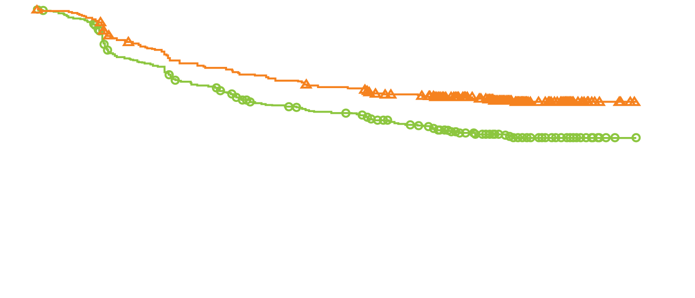
CheckMate 238: Recurrence-Free Survival with Adjuvant Nivolumab versus Ipilimumab in the Intention-To-Treat Population
Nivolumab: 154 events/453 patients
Recurrence-free survival (%)
Ipilimumab: 206 events/453 patients
Cohort | Median RFS (mo) | 1-y RFS | 1.5-y RFS | HR | p-value
Nivolumab | NR | 71% | 66% | 0.65 | <0.001
Ipilimumab | NR | 61% | 53%
Months
Weber J et al. N Engl J Med 2017;377:1824-35.

Slide 12
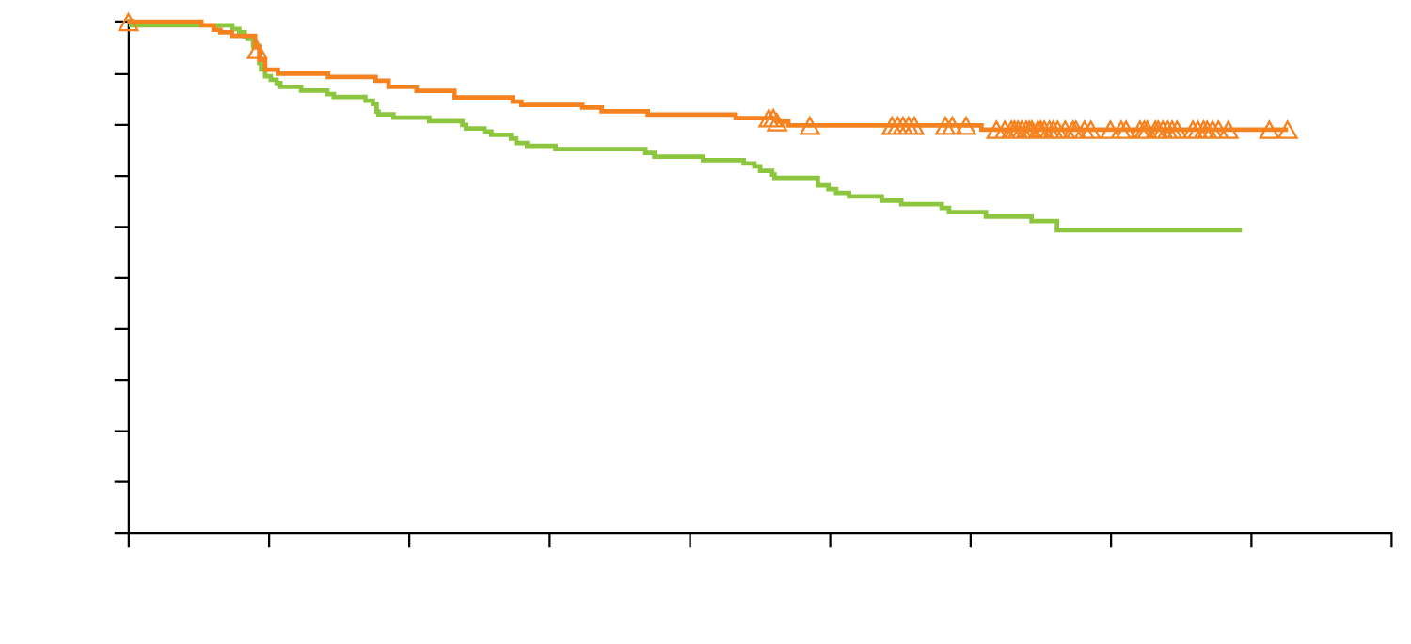
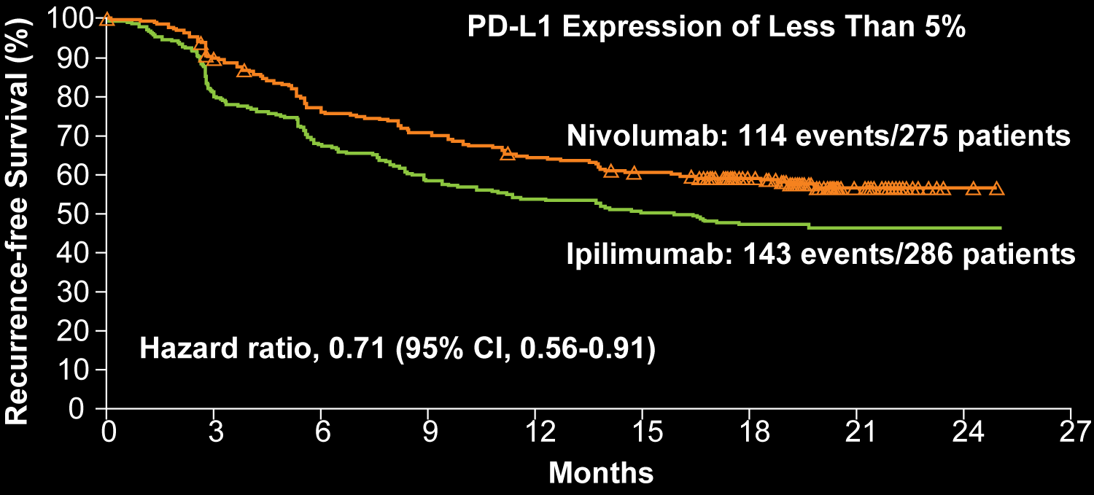
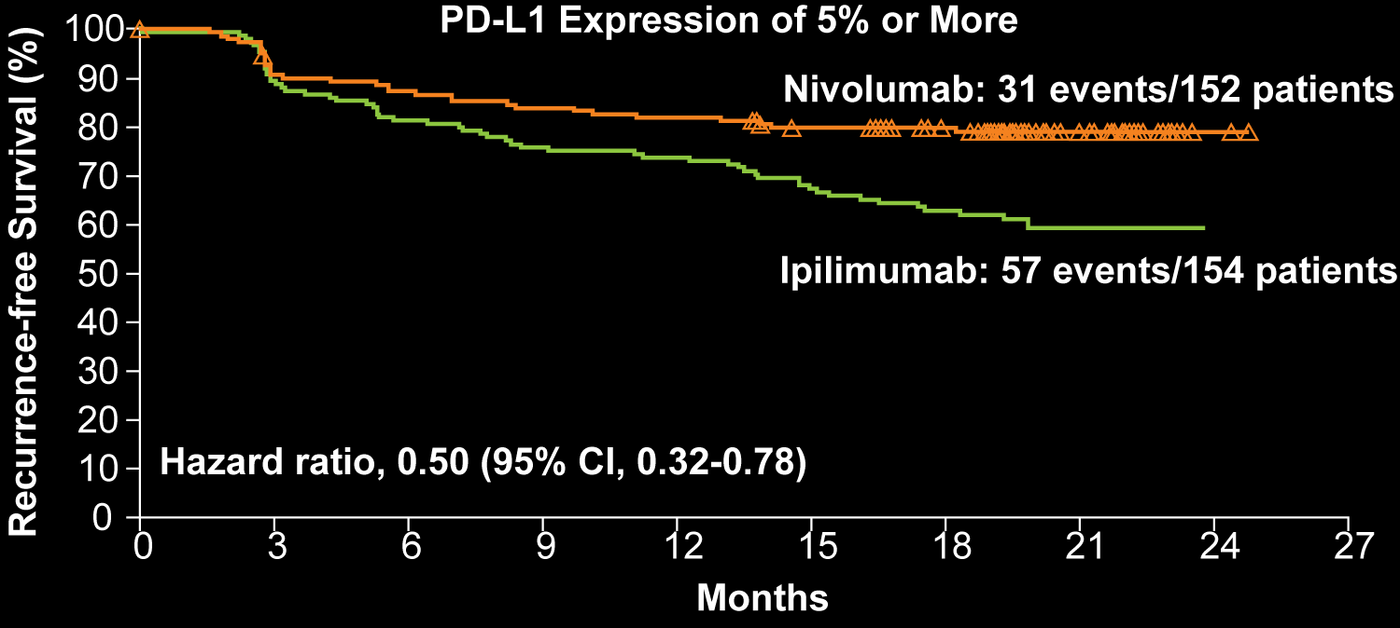
CheckMate 238: Kaplan-Meier Estimates of Recurrence-Free Survival by PD-L1 Expression
 | PD-L1 Expression of Less Than 5% |  |  | PD-L1 Expression of 5% or More
Cohort | 1-y RFS | HR | 95% CI | 1-y RFS | HR | 95% CI
Nivolumab | 64% | 0.71 | 0.56-0.91 | 82% | 0.50 | 0.32-0.78
Ipilimumab | 54% |  |  | 74%
Weber J et al. N Engl J Med 2017;377:1824-35.

Slide 13
Adjuvant Therapy with Nivolumab versus Ipilimumab After Complete Resection of Stage III/IV Melanoma: Updated Results from a Phase III Trial (CheckMate 238)
 | Nivolumab (n = 453) | Ipilimumab (n = 453) | HR | p-value
RFS, 24-mo rates
ITT population | 62.6% | 50.2% | 0.66 | <0.0001
Stage IIIB | 70.8% | 60.7%
Stage IIIC | 58.0% | 45.4%
Stage IV | 58.0% | 44.3%
PD-L1 ≥5% | 75.5% | 58.4%
PD-L1 <5% | 55.2% | 45.5%
BRAF mutant | 61.9% | 51.7%
BRAF wild-type | 63.5% | 46.2%
DMFS, 24-mo rates | 70.5% | 63.7% | 0.76 | 0.034
Weber J et al. ASCO 2018;Abstract 9502.

Slide 14
CheckMate 238: Adverse Events with Adjuvant Nivolumab versus Ipilimumab in Resected Stage III or IV Melanoma
Any AE | Nivolumab (n = 452) | Ipilimumab (n = 453)
Any AE | 96.9% | 98.5%
Any AE Grade ≥3 | 25.4% | 55.2%
Any AE leading to death | 0.0% | 0.4%
Any serious AE | 17.5% | 40.4%
Any AE leading to discontinuation | 9.7% | 42.6%
Specific AE
Pruritus | 23.2% | 33.6%
Diarrhea | 24.3% | 45.9%
Hypothyroidism | 10.8% | 6.8%
Abdominal pain | 6.4% | 10.2%
Weber J et al. N Engl J Med 2017;377:1824-35.

Slide 15
KEYNOTE-054: Primary Endpoints (Recurrence-Free Survival) for Adjuvant Pembrolizumab versus Placebo in Resected Stage III Melanoma
ITT
PD-L1-positive tumors
Cohort | Intention-to-treat (n = 1,019) |  |  | PD-L1-positive tumors (n = 853)
 | 1-y RFS | HR | p-value | 1-y RFS | HR | p-value
Pembrolizumab | 75% | 0.57 | <0.001 | 77% | 0.54 | <0.001
Placebo | 61% |  |  | 63%
Eggermont AMM et al. N Engl J Med 2018;378(19):1789-1801.

Slide 16
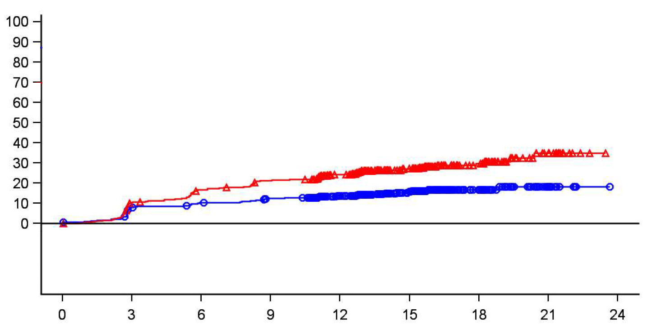
KEYNOTE-054: Secondary Endpoint for Adjuvant Pembrolizumab versus Placebo in Resected Stage III Melanoma
Cohort | Cumulative incidence of distant metastasis as first recurrence site (18 mo) | HR | 99% CI
Pembrolizumab (n = 514) | 17% | 0.53 | 0.37-0.76
Placebo (n = 505) | 30%
Cumulative incidence of distant metastasis
Months
Eggermont AMM et al. N Engl J Med 2018;378(19):1789-1801.

Slide 17
KEYNOTE-054: Adverse Events with Adjuvant Pembrolizumab versus Placebo in Resected Stage III Melanoma
Any AE | Pembrolizumab (N = 509) | Placebo (N = 502)
Any grade | 93.3% | 90.2%
Any AE Grade ≥3 | 31.6% | 18.5%
Any treatment-related AE | 77.8% | 66.1%
Any immune-related AE | 37.3% | 9.0%
Specific AE
Rash | 16.1% | 10.8%
Diarrhea | 19.1% | 16.7%
Dyspnea | 5.9% | 3.0%
Pneumonitis/interstitial lung disease | 3.3% | 0.6%
Eggermont AMM et al. N Engl J Med 2018;378(19):1789-1801.

Slide 18
Select Ongoing Phase II/III Trials in Adjuvant Therapy for Melanoma
NCT identifier | Phase | Enrollment | Description
NCT02506153 | III | 1,378 | HD Interferon or Ipilimumab Pembrolizumab
NCT01274338 | III | 1,500 | HD Ipilimumab Recombinant Interferon alpha-2b LD Ipilimumab
NCT03068455/CheckMate 915 | III | 2,000 | Nivolumab + Ipilimumab Nivolumab
NCT02362594 | III | 1,019 | Pembrolizumab Placebo
NCT03220009 | II | 100 | Nivolumab, Ipilimumab, Surgery, Active Surveillance Nivolumab, Ipilimumab, Surgery, Nivolumab
https://www.clinicaltrials.gov; Accessed on May 29, 2018

Slide 19
Module 1:
Evolving Treatment Approaches for Patients with Localized or Locally Advanced Disease
Cases
Notes:
19
19
19

Slide 20
Case (Dr Postow)
32 year old woman undergoes resection for 2.4 mm, non-ulcerated melanoma on her left arm.
Sentinel lymph node biopsy reveals 1 sentinel lymph node with 2 mm of microscopic melanoma (BRAF V600E mutant).
She does not have a completion lymph node dissection.

Slide 21
Case (Dr Weber)
A 48 year old man had a dark lesion on his back that had been there for decades begin to change in size, color and shape, noticed by his wife.
Biopsy revealed a 3.2 mm ulcerated melanoma.
He was referred to a surgeon, and had a WLE and sentinel lymph node biopsy with clear margins but 2 positive sentinel nodes, both greater than 2 mm.
PET CT scan and MRI brain were negative.
He was diagnosed as having T3bN2aM0, resected stage IIIC melanoma.
Genomic testing showed that the patient was BRAF-/NRAS+.
The patient was offered off-protocol adjuvant nivolumab at 480 mg every 4 weeks for 13 doses over one year .

Slide 22
Case (Dr Weber)
The patient began treatment, and at week 3 noted a rash on the arms and some itching, all controlled with topical steroids
Week 12 scans showed no disease, and adjuvant therapy continued
At week 24 the patient began to complain of pain and discomfort in the hands and shoulders requiring ibuprofen daily but controlled
Low grade rash, itching and arthritic pains continued for the duration of the 52-week regimen, during which all scans were negative for disease recurrence. Fatigue at 75% energy began at week 36 and continued
During that time, all side effects were managed symptomatically, and even though offered a break or a change to stop therapy, the patient declined, and finished treatment on schedule without recurrence

Slide 23
Case (Prof Robert)
49-year-old man
June 2015: Nodular melanoma on the left leg, Breslow 5 mm, no ulceration, no regression, BRAF V600E; CT scan: normal
July 2015: Wide excision + 2 positive left inguinal sentinel nodes
September 2015: Complete lymphadenectomy: 10N+/18
Enrolled in the EORTC 1325 adjuvant trial: Pembrolizumab versus placebo: C1, 21 December; last infusion, 12 December 2016
No adverse event

Slide 24
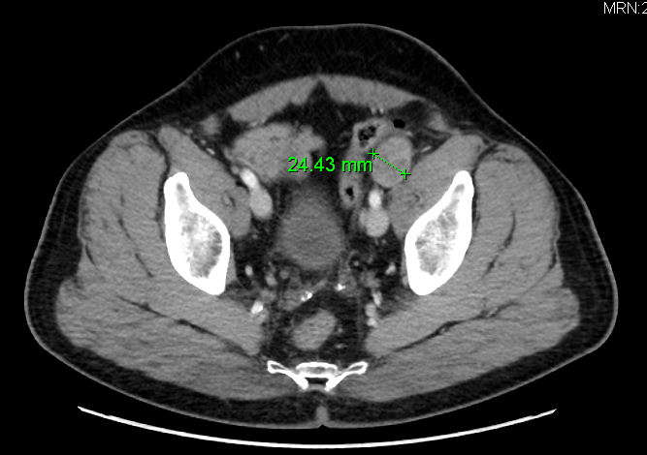
Case (Prof Robert)
January 2018: left iliac lymph node relapse
Unblinding: patient was in active arm
Cross-over to pembrolizumab treatment
This addresses the question of the efficacy of anti-PD1 therapy in patients who have received
an anti-PD1 mAb in the adjuvant setting

Slide 25
Module 2:
Integration of BRAF/MEK Inhibitors into the Management of BRAF-Mutated Disease
Notes:
25
25
25

Slide 26
FDA Approvals/Indications for BRAF/MEK Inhibitors in Metastatic Melanoma
Agent | Indication | Pivotal trial
Dabrafenib/trametinib | BRAF V600E or V600K mutation-positive unresectable or metastatic melanoma | COMBI-d COMBI-v
Vemurafenib/cobimetinib | BRAF V600E or V600K mutation-positive unresectable or metastatic melanoma | coBRIM
https://www.accessdata.fda.gov; Accessed on May 24, 2018

Slide 27
Overall survival in COLUMBUS: A phase 3 trial of encorafenib (ENCO) plus binimetinib (BINI) vs vemurafenib (VEM) or enco in BRAF-mutant melanoma
Reinhard Dummer, MD
ASCO 2018;Abstract 9504.
Monday, June 4, 2018, 8:00 AM – 11:00 AM
Arie Crown Theater

Slide 28
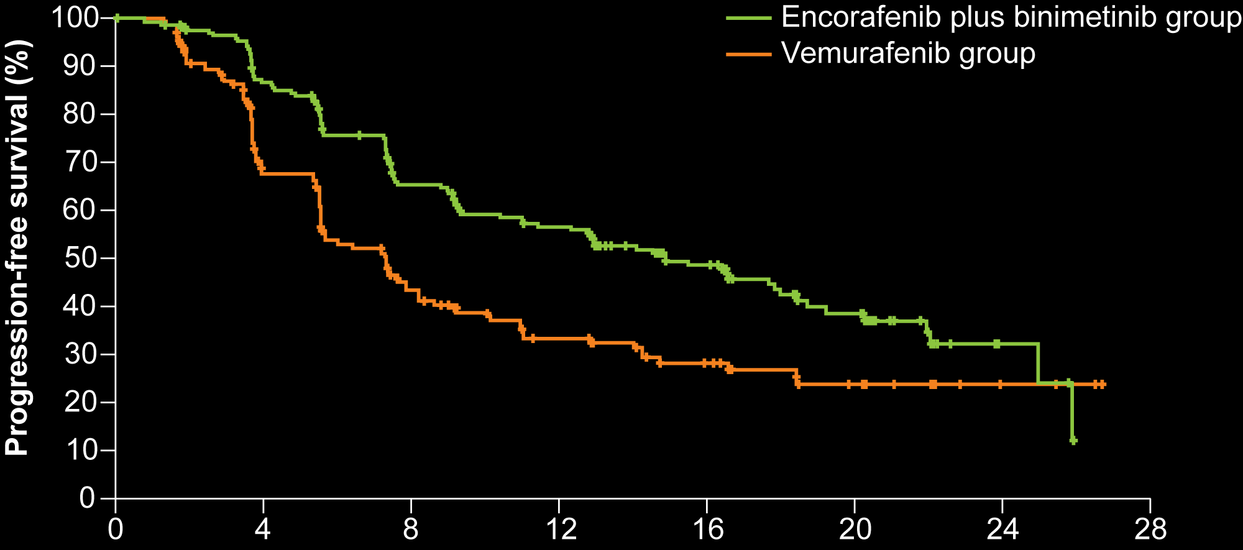
COLUMBUS: Progression-Free Survival with Encorafenib + Binimetinib versus Vemurafenib in BRAF-Mutant Melanoma
Cohort | Median PFS (mo) | HR | p-value
Encorafenib + binimetinib | 14.9 | 0.54 | <0.0001
Vemurafenib | 7.3
Time since randomisation (months)
Dummer R et al. Lancet Oncol 2018;19:603-15.

Slide 29
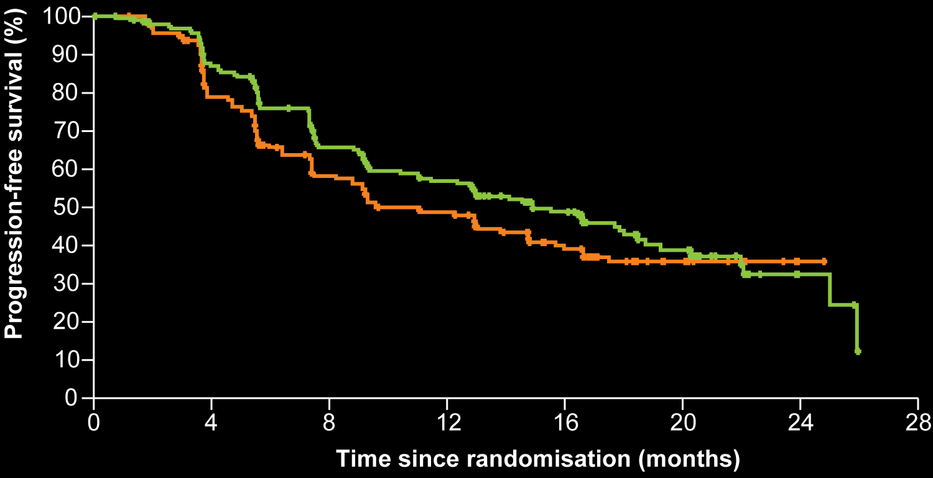
COLUMBUS: Progression-Free Survival with Encorafenib + Binimetinib versus Encorafenib in BRAF-Mutant Melanoma
Cohort | Median PFS (mo) | HR | p-value
Encorafenib + binimetinib | 14.9 | 0.75 | 0.051
Encorafenib | 9.6
Dummer R et al. Lancet Oncol 2018;19:603-15.

Slide 30
COLUMBUS: A Phase III Trial of Encorafenib/Binimetinib versus Vemurafenib or Encorafenib for BRAF-Mutant Melanoma
 | Encorafenib + binimetinib (N = 192) | Encorafenib (N = 194) | Vemurafenib (N = 191) | HRª | p-value
Median OS | 33.6 mo | 23.5 mo | 16.9 mo | 0.61 | <0.001
Median PFS | 14.9 mo | 9.6 mo | 7.3 mo | 0.51 | Not reported
ªHazard ratio measuring OS and PFS in encorafenib + binimetinib versus vemurafenib
Dummer R et al. ASCO 2018;Abstract 9504

Slide 31
COLUMBUS: Adverse Events with Encorafenib/Binimetinib versus Vemurafenib or Encorafenib for BRAF-Mutant Melanoma
Any AE | Encorafenib + binimetinib (N = 192) | Encorafenib (N = 192) | Vemurafenib (N = 186)
Any AE Grade ≥3 | 58% | 66% | 63%
Any serious AE | 34% | 34% | 37%
Any AE leading to discontinuation | 6% | 10% | 14%
Specific AE
Nausea | 42% | 38% | 34%
Diarrhea | 37% | 14% | 34%
Vomiting | 30% | 27% | 15%
Pyrexia | 19% | 15% | 28%
Dummer R et al. Lancet Oncol 2018;19:603-15.

Slide 32
KEYNOTE-022: Update of Phase I Study of First-Line Pembrolizumab + Dabrafenib and Trametinib for BRAF-Mutant Advanced Melanoma
 | Confirmed responses only (N = 15)ª | Confirmed + unconfirmed responses (N = 15)
ORR, n(%) | 10 (67) | 11 (73)
CR | 2 (13) | 2 (13)
PR | 8 (53) | 9 (60)
SD | 4 (27) | 4 (27)
PD | 0 | 0
NE | 1 (7)^{b} | 0
Median time to response (range), mo | 2.8 (2.2-3.0) | 2.8 (2.2-3.0)
Median duration of response (range), mo | NR (2.8-26.5) | NR (1.6-26.5)
ªResponses were confirmed during a subsequent response assessment; ^{b}Confirmed response was not evaluable (NE) due to the first response assessment being within 6 weeks from randomization.
Ribas A et al. Proc ESMO 2017;Abstract 1216O.

Slide 33
Select Ongoing Clinical Trials of Combination Immunotherapy and Targeted Agents in Metastatic Melanoma
NCT | Phase | Enrollment | Description
NCT02967692/COMBI-i | III | 538 | PDR001(anti-PD-1 antibody) + dabrafenib + trametinib Placebo + dabrafenib + trametinib
NCT02908672/TRILOGY | III | 500 | Atezolizumab + cobimetinib + vemurafenib (720 mg) Placebo + cobimetinib + vemurafenib (960 mg)
NCT03235245 | II | 270 | Nivolumab + ipilimumab Encorafenib + binimetinib + nivolumab + ipilimumab
NCT02968303 | II | 200 | Induction (vemurafenib + cobimetinib) then ipi + nivo No induction, up-front ipi + nivo
NCT02910700 | II | 60 | Nivolumab + dabrafenib + trametinib Nivolumab + trametinib
NCT02631447 | II | 230 | LGX818 + MEK162 until PD → nivo + ipi → nivo until PD Nivo + ipi → nivo until PD → LGX818 + MEK162 until PD LGX818 + MEK162 → nivo + ipi → nivo until PD → LGX818 + MEK162 until PD
https://www.clinicaltrials.gov; Accessed on May 24, 2018

Slide 34
Module 2:
Integration of BRAF/MEK Inhibitors into the Management of BRAF-Mutated Disease
Cases
Notes:
34
34
34

Slide 35
Case (Dr Postow): BRAF mutant patient receiving BRAF + MEK with toxicity
61 year old woman with BRAF V600E mutant melanoma started pembrolizumab in 8/2015 with disease response in her lung but eventual progression in liver metastases by 11/2017.
Started dabrafenib + trametinib in 11/2017 with no side effects and disease response by 1st scan in 2/2018.
Developed fever to 105 degrees in 5/2018 with Grade 2 elevation in AST/ALT/alkaline phosphatase.
Held drugs for 3 days; fever abated; resumed dabrafenib + trametinib with low grade fever and discontinued treatment again.

Slide 36
Case (Dr Weber)
A 52 year old female with a history of stage IIIC resected melanoma was placed on a clinical trial of ipilimumab at 1 mg/kg and nivolumab at 3 mg/kg.
She had no disease on scans and tolerated treatment well by the week 12 evaluation.
At week 16 she developed a new scalp lesion that was biopsied, showed metastatic melanoma.
CT scans showed multiple lung lesions ranging from 1-2.5 cm, and retroperitoneal adenopathy up to 3 cm; MRI brain was negative.
Genomic testing showed that she was BRAF V600K positive.
She was placed on a trial of encorafenib and binimetinib .

Slide 37
Case (Dr Weber)
The palpable disease shrank within a day or two of starting treatment, and the patient developed a rash on the legs that was quite itchy.
The symptoms responded to topical therapies, and at week 2 at the first evaluation there was a near CR of her disease.
The treatment was continued, and at week 24 there was a complete response.
The patient continued therapy, and has been on treatment for 2 years while maintaining a CR.
She requested to be taken off therapy, but the oncologist insisted on her staying on treatment, which she continues to tolerate well.

Slide 38
Module 3:
Immune Checkpoint Inhibitors in Metastatic Melanoma; Management of Autoimmune Toxicities
Notes:
38
38
38

Slide 39
FDA Immunotherapy Approvals/Indications in Metastatic Melanoma
Agent | Indication | Pivotal trial
Pembrolizumab | Unresectable or metastatic melanoma | KEYNOTE-002 KEYNOTE-006
Nivolumab | BRAF V600 wild-type or mutation-positive unresectable or metastatic melanoma as first-line therapy or following disease progression on ipilimumab/BRAF inhibitor | CHECKMATE 037 CHECKMATE 066
Nivolumab/ipilimumab | Unresectable or metastatic melanoma | CHECKMATE 069
Ipilimumab | Unresectable or metastatic melanoma | MDX010-20
https://www.accessdata.fda.gov; Accessed on May 24, 2018

Slide 40
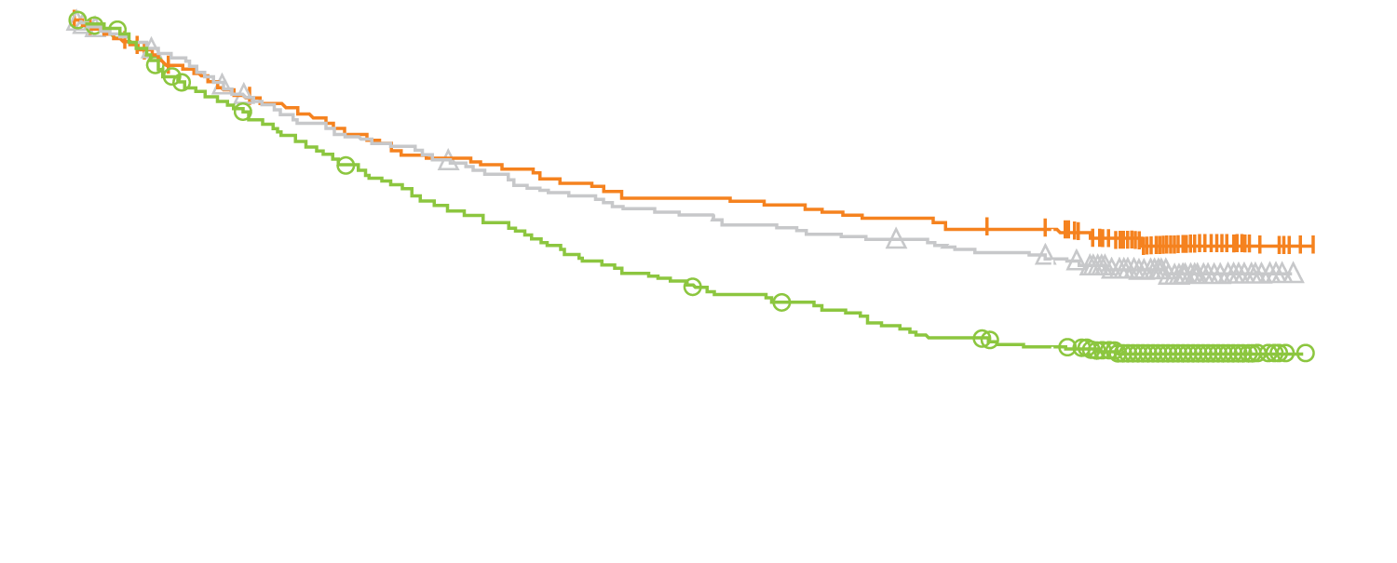
CheckMate 067: Overall Survival with Combined Nivolumab and Ipilimumab in Advanced Melanoma
Cohort | Median OS (mo) | 2-y OS | HR | p-value
Nivolumab plus ipilimumab | NR | 64% | 0.55 | p < 0.001
Nivolumab | 37.6 | 59% | 0.63 | p < 0.001
Ipilimumab | 19.9 | 45% | — | —
58%
Nivolumab plus ipilimumab
Patients who survived (%)
Nivolumab
52%
Ipilimumab
34%
Months
Wolchok JD et al. N Engl J Med 2017;377:1345-1356.

Slide 41
CheckMate 067: Adverse Events with Combined Nivolumab and Ipilimumab in Advanced Melanoma
Any AE | Nivolumab plus ipilimumab (n = 313) | Nivolumab (n = 313) | Ipilimumab (n = 311)
Any AE | 96.0% | 86.0% | 86.0%
Any AE Grade ≥3 | 59.0% | 21.0% | 28.0%
Any AE leading to death | <1.0% | <1.0% | <1.0%
Any AE leading to discontinuation | 39.0% | 12.0% | 16.0%
Specific AE
Rash | 30.0% | 23.0% | 22.0%
Pruritus | 35.0% | 21.0% | 36.0%
Dyspnea | 12.0% | 6.0% | 4.0%
Pneumonitis | 7.0% | 2.0% | 2.0%
Wolchok JD et al. N Engl J Med 2017;377:1345-1356.

Slide 42
4-year survival and outcomes after cessation of pembrolizumab after 2-years in patients with ipilimumab-naïve advanced melanoma in KEYNOTE-006
Long GV et al.
ASCO 2018;Abstract 9503.
Monday, June 4, 2018, 8:00 AM – 11:00 AM
Arie Crown Theater

Slide 43
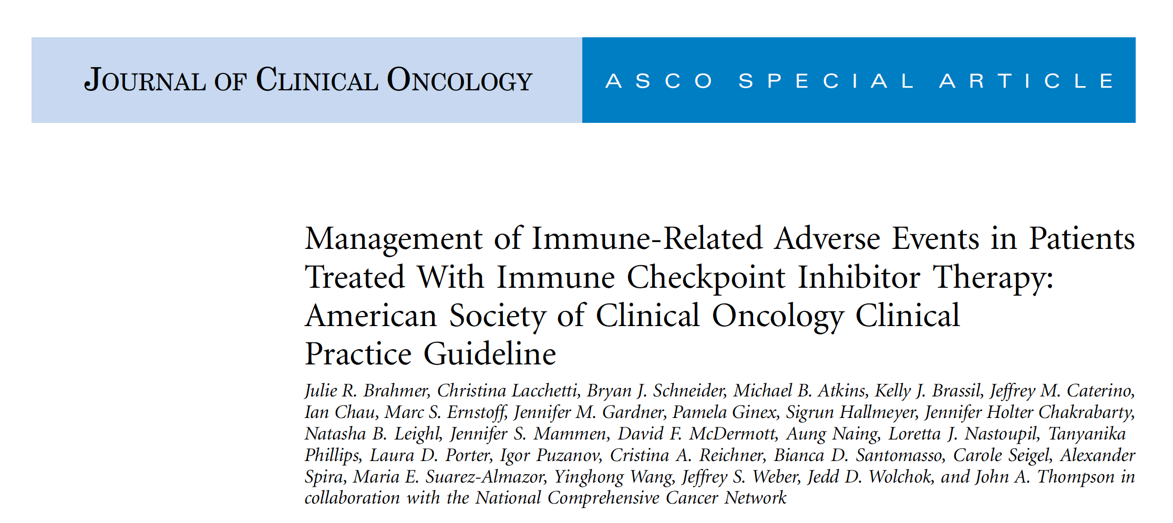
Brahmer JR et al. J Clin Oncol 2018;[Epub ahead of print].

Slide 44
General Recommendations for Management of Immune-Related Adverse Events from Immune Checkpoint Inhibitor (ICPi) Therapy
Toxicity grade | Recommendation
Grade 1 | Continued ICPi therapy with close monitoring, with the exception of some neurologic, hematologic and cardiac toxicities
Grade 2 | ICPi therapy may be suspended for most toxicities, with consideration of resuming when symptoms revert to Grade 1 or less Corticosteroids may be administered
Grade 3 | Generally warrant suspension of ICPis and the initiation of high-dose corticosteroids Corticosteroids should be tapered over the course of at least 4 to 6 weeks Some refractory cases may require infliximab or other immunosuppressive therapy
Grade 4 | Permanent discontinuation of ICPis is recommended, with the exception of endocrinopathies that have been controlled by hormone replacement
Brahmer JR et al. J Clin Oncol 2018;[Epub ahead of print].

Slide 45
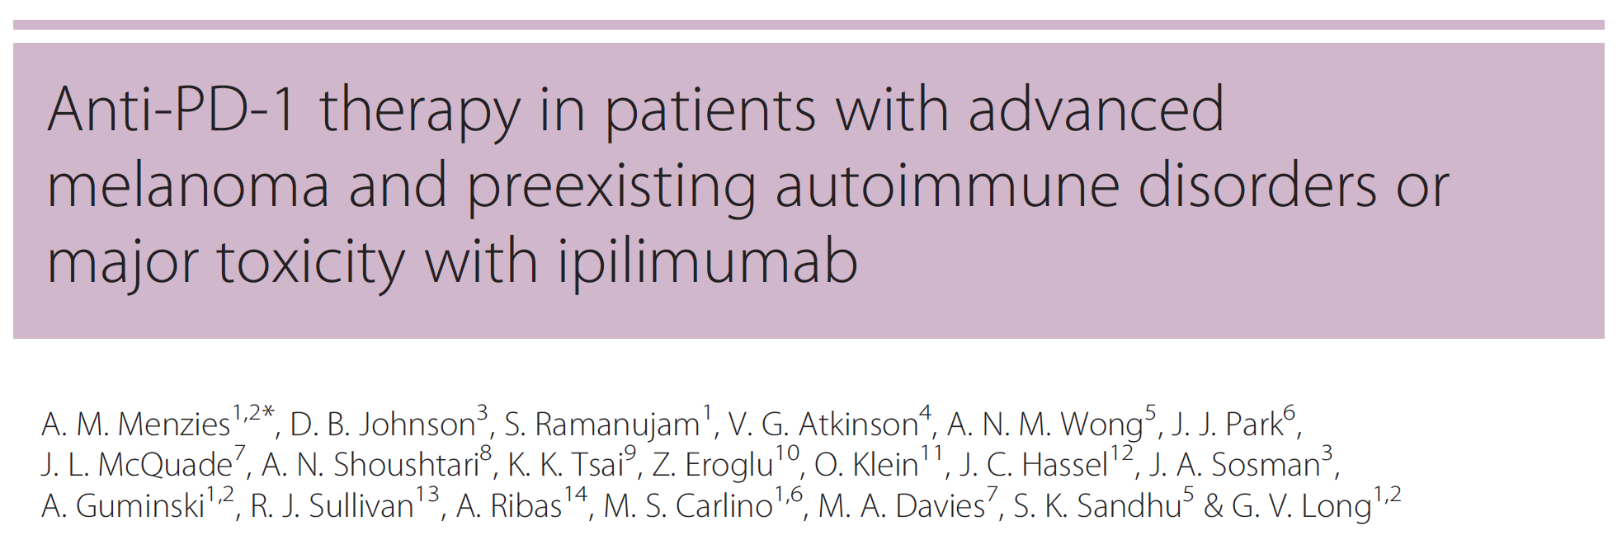
Johnson DB et al. JAMA Oncol 2016;2(2):234-240; Menzies AM et al. Ann Oncol 2017;28(2):368-376.

Slide 46
Prevalence of Autoimmune Comorbidities with Metastatic Melanoma
Newly diagnosed metastatic melanoma
No pre-existing autoimmune disorder
Pre-existing autoimmune disorder
Johnson DB et al. JAMA Oncol 2016;2(2):234-240; Menzies AM et al. Ann Oncol 2017;28(2):368-376.

Slide 47
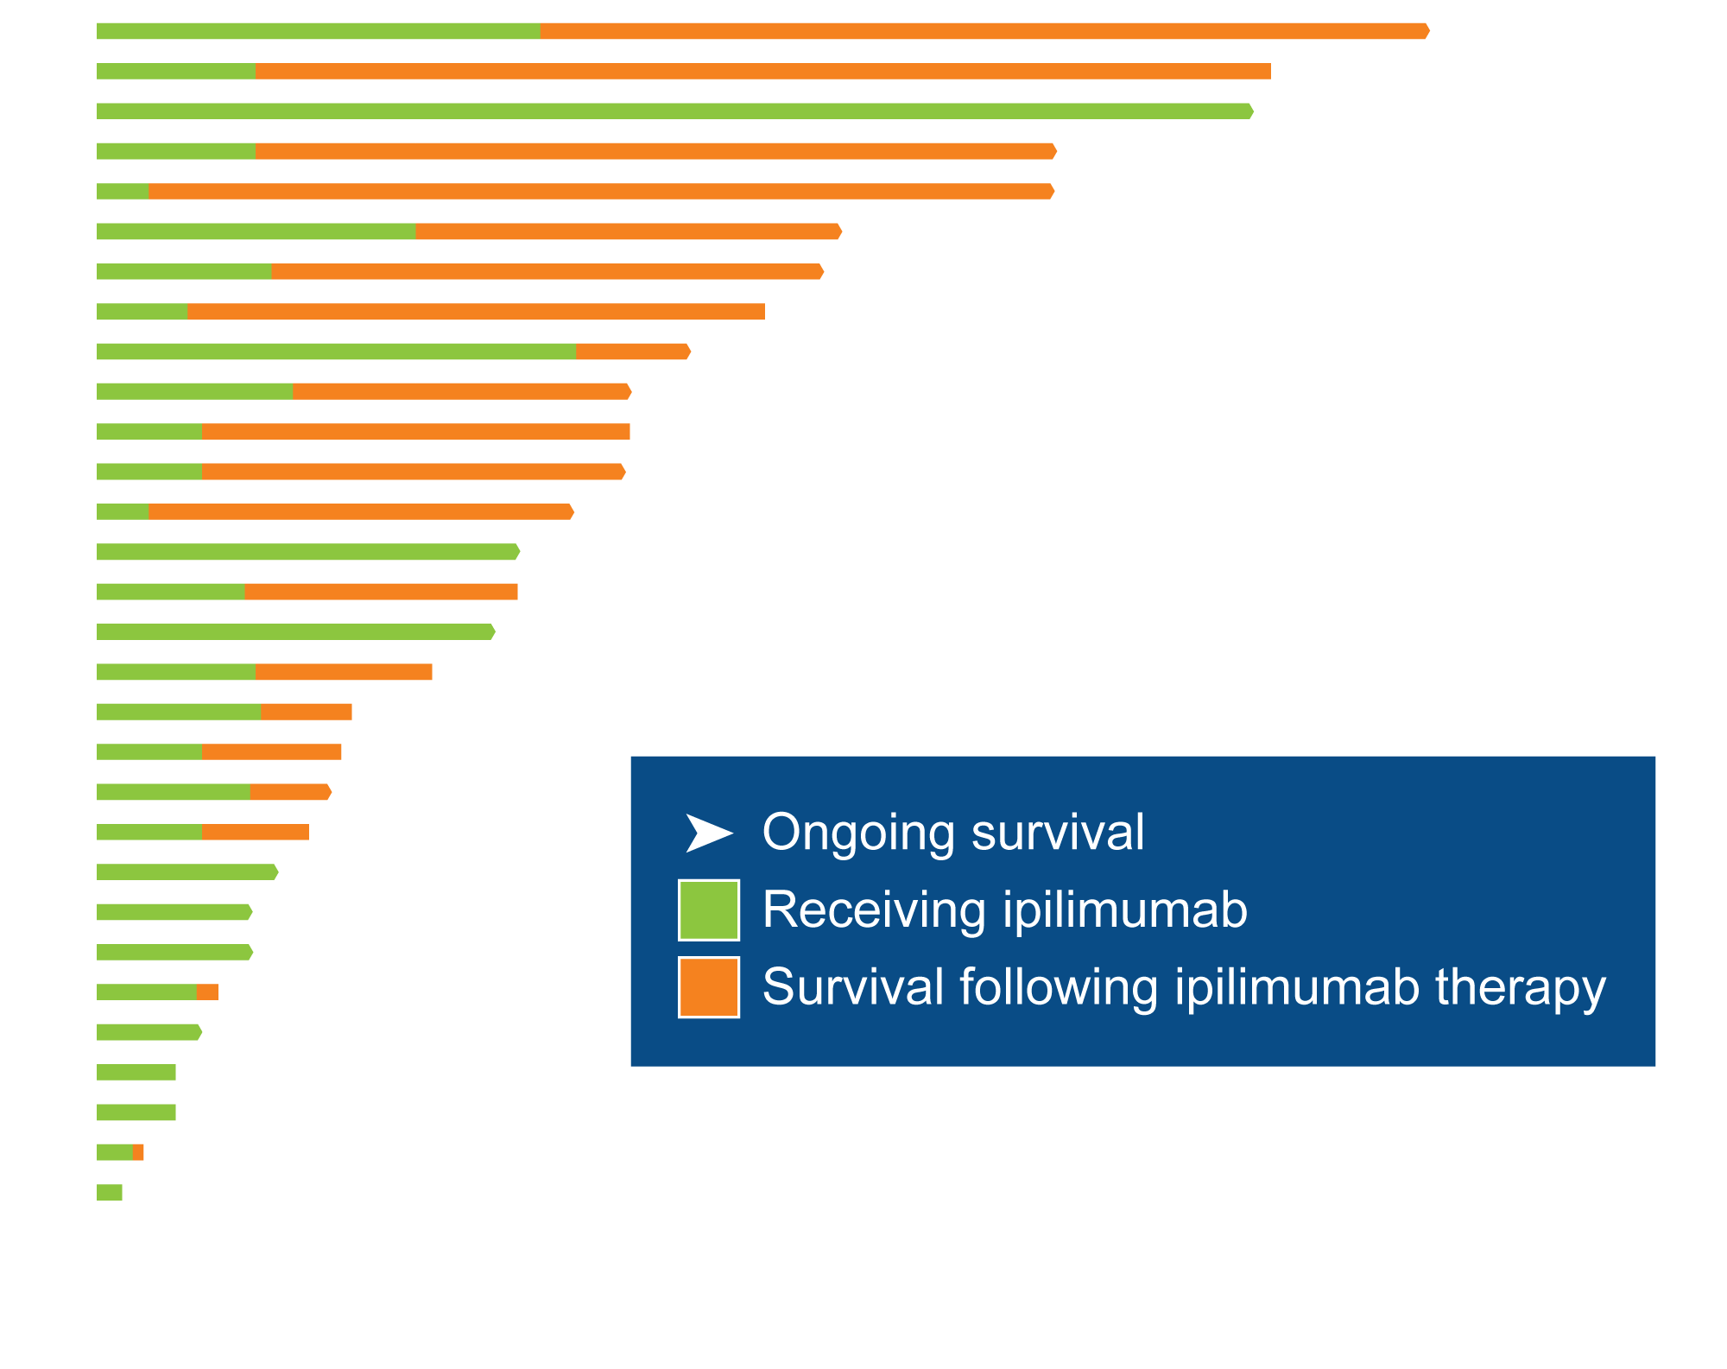
Response, Duration of Ipilimumab Therapy and Survival for Patients with Metastatic Melanoma and Preexisting Autoimmune Disorders
 | N (%)
Exacerbation of autoimmune disease requiring treatment | 8 (27)
Grade 3-5 immune-related AE | 10 (33)
Johnson DB et al. JAMA Oncol 2016;2(2):234-240

Slide 48
Module 3:
Immune Checkpoint Inhibitors in Metastatic Melanoma; Management of Autoimmune Toxicities
Cases
Notes:
48
48
48

Slide 49
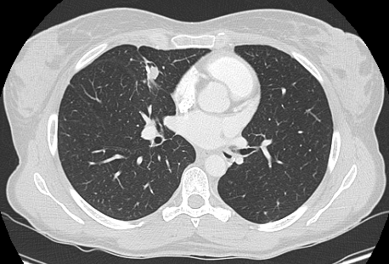
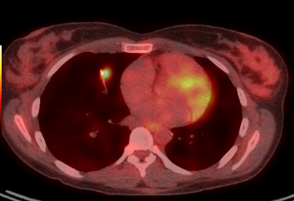
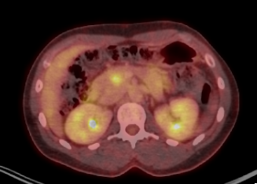
Case (Prof Robert)
Woman born in 1983
2013: dorsal 0.65 mm SSM
July 2014: Unique lung metastasis surgically removed
November 2015: lung relapse: surgery
May 2016: Pancreatic metastasis 13 mm proven by biospy

Slide 50
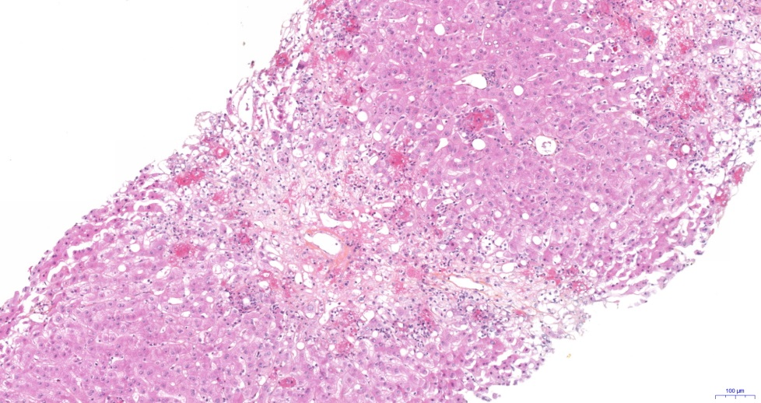
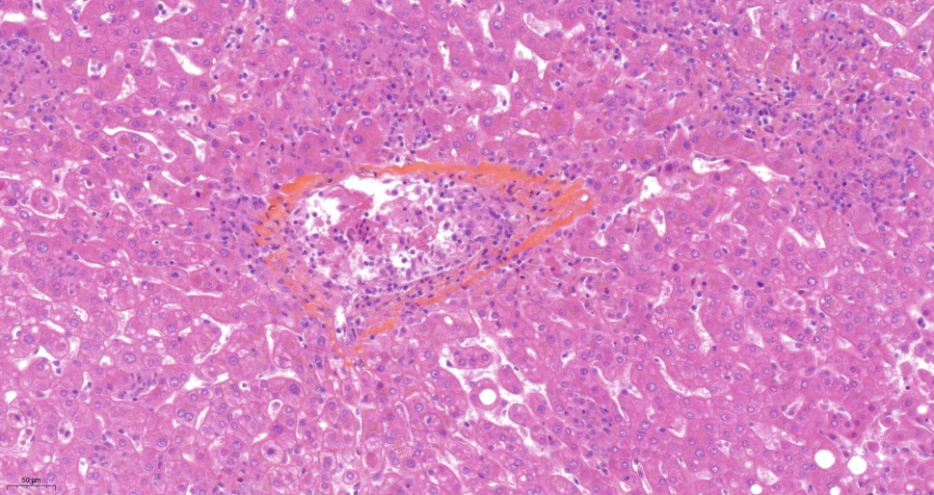
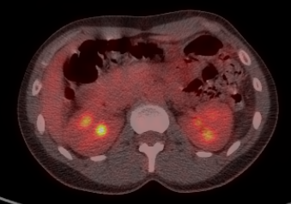
Case (Prof Robert)
Combination ipilimumab + nivolumab, initiated on June 20th
After second infusion : grade 3 hepatitis
Liver biopsy : granulomatous hepatitis
Resolution with oral steroids 1 mg/kg
First evaluation after 3 month : PR - 61%
6 months : CR

Slide 51
Case (Dr Postow): Metastatic melanoma responding to checkpoint inibitors + toxicity
55 year old man with a history of exposure to harmful dust as part of construction efforts after September 11, 2001 World Trade Center attacks.
He had a cough and a CT scan of his chest in 5/2017 showed subcm pulmonary nodules that were followed.
PET scan in 11/2017 showed enlargement of nodule to 1.3 by 1.1cm with hypermetabolism and a left cervical lymph node.
A biopsy confirmed metastatic melanoma of unknown primary. No BRAF mutation.

Slide 52
Case (Dr Postow)

Slide 53
Case (Dr Postow): Incidental Small Brain Mets

Slide 54
Case (Dr Postow): Follow-up
Started nivolumab + ipilimumab on 12/26/17.
In early 2/2018, after two doses of nivolumab + ipilimumab, significant headaches and fatigue.

Slide 55
Case (Dr Postow): Follow-up
Started nivolumab + ipilimumab on 12/26/17.
In early 2/2018, after two doses of nivolumab + ipilimumab, significant headaches and fatigue.
12/16/2018
2/14/2018

Slide 56
Case (Dr Postow): Follow-up
ACTH = 6.3 pg/mL (7.4-64.3)
Cortisol = 14.9 mcg/dL (5-25)
TSH = 0.86 mIU/L (0.60-4.80)
AST/ALT elevated to grade 2
Given prednisone 1 mg/kg with immediate symptom resolution
As of 5/2018, still on prednisone taper with 10 mg/kg and increased fatigue when trying to come off prednisone, suspicious for secondary adrenal insufficiency

Slide 57
Case (Dr Postow): Pituitary inflammation resolved on MRI
2/14/2018
3/20/2018
Brain metastases also disappeared!

Slide 58
Case (Dr Postow) Summary
This is a case where a patient had small brain metastases and developed acute hypophysitis due to nivolumab + ipilimumab.
Need to tell radiologist to look at pituitary gland.
Steroids can have palliative benefit even without documented secondary adrenal insufficiency.
Efficacy for anti-PD-1 agents (and combo) in the brain for small asymptomatic metastases not requiring steroids.

Slide 59
Epacadostat (E) plus Pembrolizumab (P) versus Pembrolizumab Alone in Patients (pts) with Unresectable or Metastatic Melanoma: Results of the Phase 3 ECHO-301/KEYNOTE-252 Study
Long GV et al. ASCO 2018;Abstract 108 Sunday, June 3, 2018, 9:45 AM – 11:15 AM McCormick Place Hall D1

Slide 60
ECHO-301/KEYNOTE-252: Epacadostat + Pembrolizumab versus Pembrolizumab Alone in Unresectable or Metastatic Melanoma
 | Epacadostat + Pembrolizumab (N = 354) | Pembrolizumab (N = 352) | HR | p-value
ORR | 34.2% | 31.5% | — | —
Median PFS, months | 4.7 | 4.9 | 1.00 | 0.517
1-year PFS | 37% | 37% | — | —
1-year OS | 74% | 74% | 1.13 | 0.807
Long GV et al. ASCO 2018;Abstract 108.

Slide 61
Antitumor Activity in a Phase I/IIa Study of Relatlimab + Nivolumab in Melanoma Previously Treated with Anti-PD-1/PD-L1 Therapy
 | Allª (N = 61) | LAG-3 ≥ 1%^{b} (N = 33)
ORR, n (%)^{c} | 7 (11.5)^{d} | 6 (18)^{d}
Best overall response, n (%)^{c}
CR | 1 (1.6) | 1 (3.0)
PR | 6 (9.8)^{d} | 5 (15)^{d}
SD | 23 (38) | 15 (45)
PD | 25 (41) | 8 (24)
Clinical progression^{e} | 6 (9.8) | 4 (12)
DCR (CR + PR + SD), n (%)^{c} | 30 (49) | 21 (64)
ORR was 11.5% and DCR was 49%
LAG-3 expression (≥1%) enriched for response
Median duration of response was not reached (range, 0.1+ to 39+)
ª Response-evaluable patients; ^{b} Immune-cell LAG-3 expression evaluated by IHC. ^{c} Tumor response evaluated by investigator per RECIST v1.1. ^{d} One unconfirmed response. ^{e} Occurred prior to first radiographic scan.
Ascierto PA et al. Proc ESMO 2017;Abstract LBA18.

Slide 62
Select Ongoing Clinical Trials of Combination Immunotherapy
NCT identifier | Phase | Enrollment | Description
NCT02714218 | III | 483 | Nivolumab 3 mg/kg + ipilimumab 1 mg/kg Ipilimumab 3 mg/kg + nivolumab 1 mg/kg Nivolumab 6 mg/kg + ipilimumab 1 mg/kg
NCT02224781 | III | 300 | Dabrafenib + trametinib then ipilimumab + nivolumab Ipilimumab + nivolumab then dabrafenib + trametinib
NCT02460068 | III | 168 | Fotemustine Fotemustine + ipilimumab Ipilimumab + nivolumab
NCT03301636 | II/III | 624 | Indoximod + pembrolizumab Pembrolizumab + placebo Nivolumab + indoximod Nivolumab + placebo
NCT03470922 | II/III | 700 | Relatlimab + nivolumab Nivolumab
NCT02523313 | II | 312 | Nivolumab + placebo Nivolumab + ipilimumab Double placebo control
https://www.clinicaltrials.gov; Accessed on May 24, 2018

