Slide 1
As it pertains to the last patient in your practice who died of metastatic nonsquamous non-small cell lung cancer (NSCLC) with no targetable mutation for whom you provided care for at least 9 months:
How attached did you feel to this patient emotionally?
N = 79
Notes:
1
1

Slide 2
Notes:
2
2

Slide 3
How attached did you feel to this patient emotionally?
(56 oncologists who entered 3 patients into survey: Average score for all 3 patients; 3 = very attached, 2 = somewhat attached;
1 = not very attached; 0 = not at all attached)
Median: 2.15
Notes:
3
3

Slide 4
In general, is there anything you would have approached differently with regard to this patient's care?
N = 79
Notes:
4
4

Slide 5
Can you identify any specific or general things that you did for this patient at a personal level that were beneficial with regard to his/her psychosocial well-being (eg, providing advice on dealing with family issues, providing emotional support during periods of sadness)?
N = 79
Notes:
5
5

Slide 6
As it pertains to the last patient in your practice who died of metastatic nonsquamous NSCLC with no targetable mutation for whom you provided care for at least 9 months:
At any time did the patient's tumor undergo next-generation sequencing?
N = 79
Notes:
6
6

Slide 7
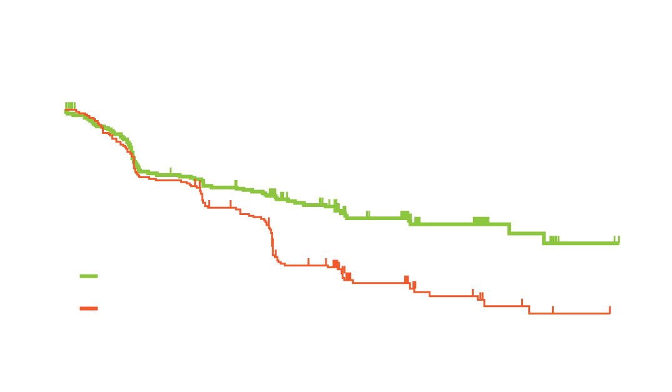
KEYNOTE-024: A Phase III Trial of First-Line Pembrolizumab versus Chemotherapy in Advanced NSCLC
ORR
Progression-Free Survival
CR
PR
 | Events, n | Median, mo | HR (95% Cl) | p
Pembro | 73 | 10.3 | 0.50 | <0.001
Chemo | 116 | 6.0 | (0.37-0.68)
45% ORR is the best RR ever reported in the 1st-line setting
Time to response is identical between pembrolizumab and chemotherapy
PFS is improved by 4.3 months (HR of 0.50)
Improvement of PFS in all subgroups (except female/never smokers)
Patient groups with strongest signal of PFS benefit included those with SCC (HR of 0.35)
Reck M et al. N Engl J Med 2016;375(19):1823-33, Proc ESMO 2016;Abstract LBA8_PR.

Slide 8
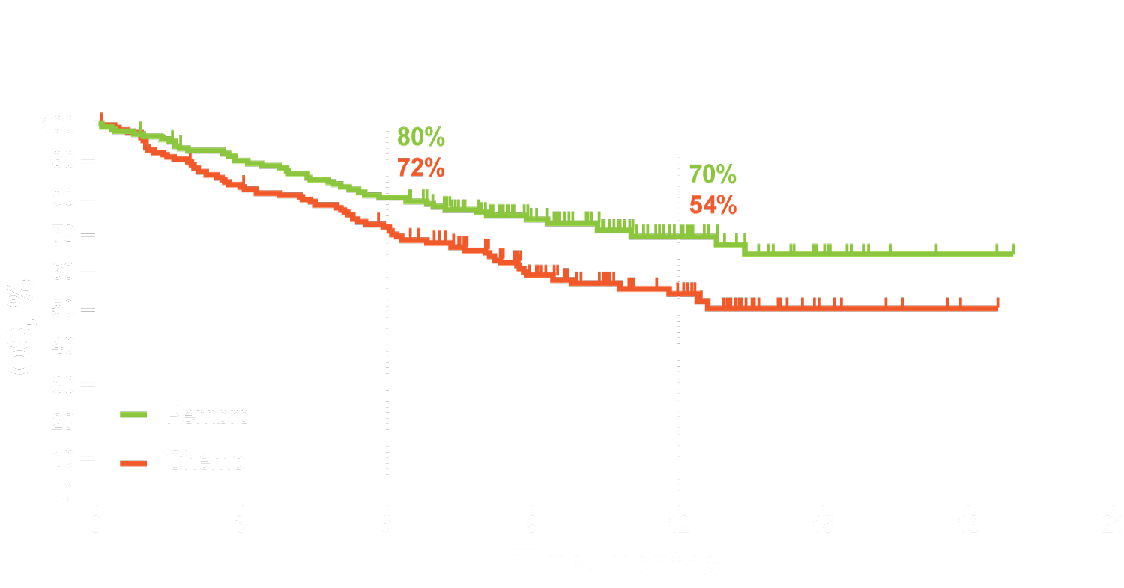
KEYNOTE-024: Overall Survival
 | Events, n | Median, mo | HR (95% Cl) | p
Pembro | 44 | NR | 0.60 | 0.005
Chemo | 64 | NR | (0.41-0.89)
Clear survival benefit
Estimated rate of OS at 12 months: 70% (pembro) vs 54% (chemo)
HR for death: 0.60
Crossover was limited to 50% of the patients
Reck M et al. N Engl J Med 2016;375(19):1823-33; Proc ESMO 2016;Abstract LBA8_PR.

Slide 9
As it pertains to the last patient in your practice who died of metastatic nonsquamous NSCLC with no targetable mutation for whom you provided care for at least 9 months:
Pembrolizumab: Tolerability
4 (67%)
2 (33%)
Very tolerable, no dose/schedule modifications necessary
Somewhat tolerable, but issues manageable with dose reductions and/or schedule modifications
n = 6
Notes:
9
9

Slide 10
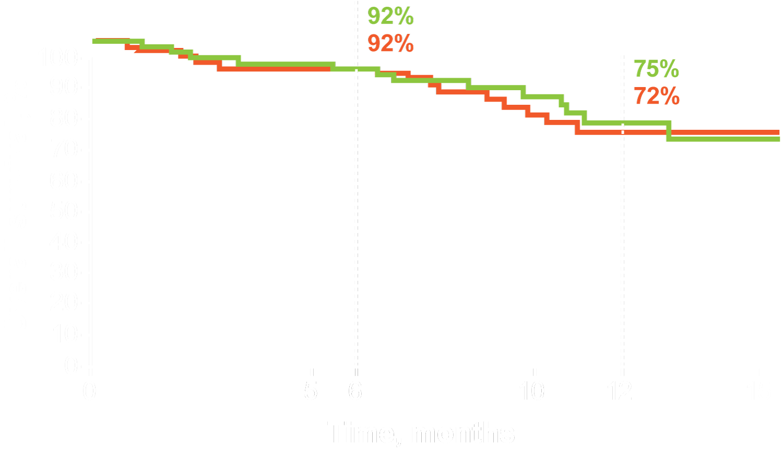
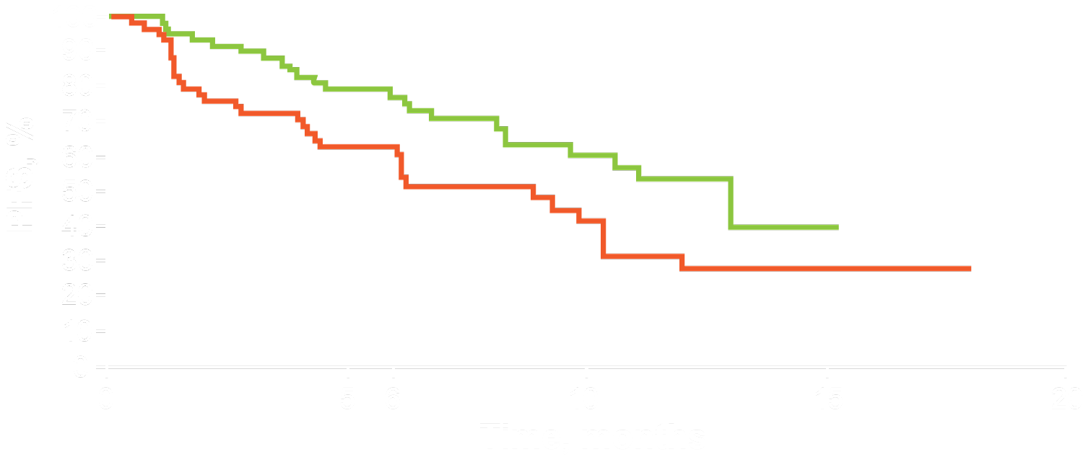
KEYNOTE-021: Carboplatin and Pemetrexed ± Pembrolizumab for Advanced Nonsquamous NSCLC
Pembro + chemo
Chemo alone
 | Events, n | Median | HR (95% Cl)
Pembro + chemo (n = 60) | 23 | 13.0 mo | 0.53 (0.31-0.91)
Chemo alone (n = 63) | 33 | 8.9 mo | p = 0.0102
 | Events, n | HR (95% Cl)
Pembro + chemo | 13 | 0.90 (0.42-0.91)
Chemo alone | 14
Median PFS improved by 4.1 months
No difference in OS
Estimated rate of OS at 12 months: 75% (combo) vs 72% (CT)
In chemotherapy arm, crossover is 51% to anti-PD-1/PD-L1 therapies (pembrolizumab and others)
Langer C et al. Lancet Oncol 2016;17(11):1497-508, Proc ESMO 2016;Abstract LBA46_PR.

Slide 11
As it pertains to the last patient in your practice who died of metastatic nonsquamous NSCLC with no targetable mutation for whom you provided care for at least 9 months:
Did you have an end-of-life/DNR discussion with the patient?
How long prior to the patient's death did that discussion occur?
Median: 3 months
N = 79
Notes:
11
11

Slide 12
As it pertains to the last patient in your practice who died of metastatic nonsquamous NSCLC with no targetable mutation for whom you provided care for at least 9 months:
Did the patient enter a hospice program?
N = 79
Notes:
12
12

Slide 13
At any time did the patient undergo RAS testing?
N = 77
What were the results?
Of these, 40 patients (83%) received an EGFR antibody.
N = 71
Notes:
13
13

Slide 14
CALGB/SWOG 80405: Side of Primary Tumor
TRANSVERSE N = 66
RIGHT
N = 293
(27%)
LEFT
N = 732
(68%)
Courtesy of John L Marshall, MD

Slide 15
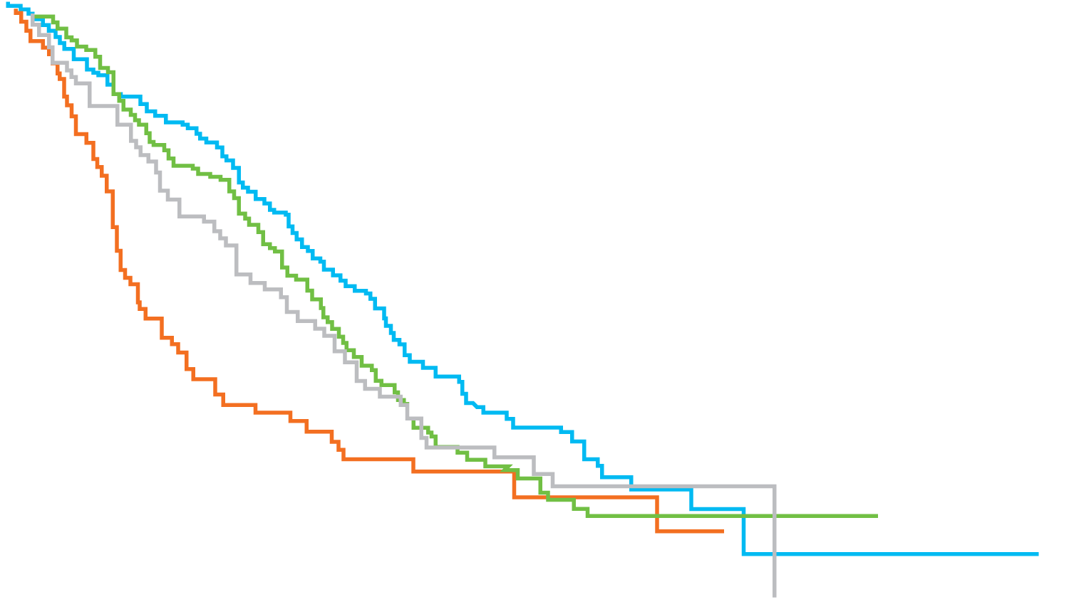
CALGB/SWOG 80405: Overall Survival (OS) by Tumor Location (RAS Wild Type)
100
 | OS (95% CI), months |  | HR (95% CI) | p-value*
 | Left | Right
Cetuximab (n=173 vs 71) | 39.3 (32.9-42.9) | 13.6 (11.3-19.0) | 0.55 (0.39-0.79) | 0.001
Bevacizumab (n=152 vs 78) | 32.6 (28.3-36.2) | 29.2 (22.4-36.9) | 0.88 (0.62-1.25) | 0.50
80
% Event Free
60
40
20
0
0
12
24
36
48
60
72
84
96
108
Time From Study Entry, Months
* Adjusted for biologic, protocol CT, prior adjuvant therapy, prior radiation therapy, age, sex, synchronous disease, in-place primary and liver metastases
Venook A et al. ESMO 2016.

Slide 16
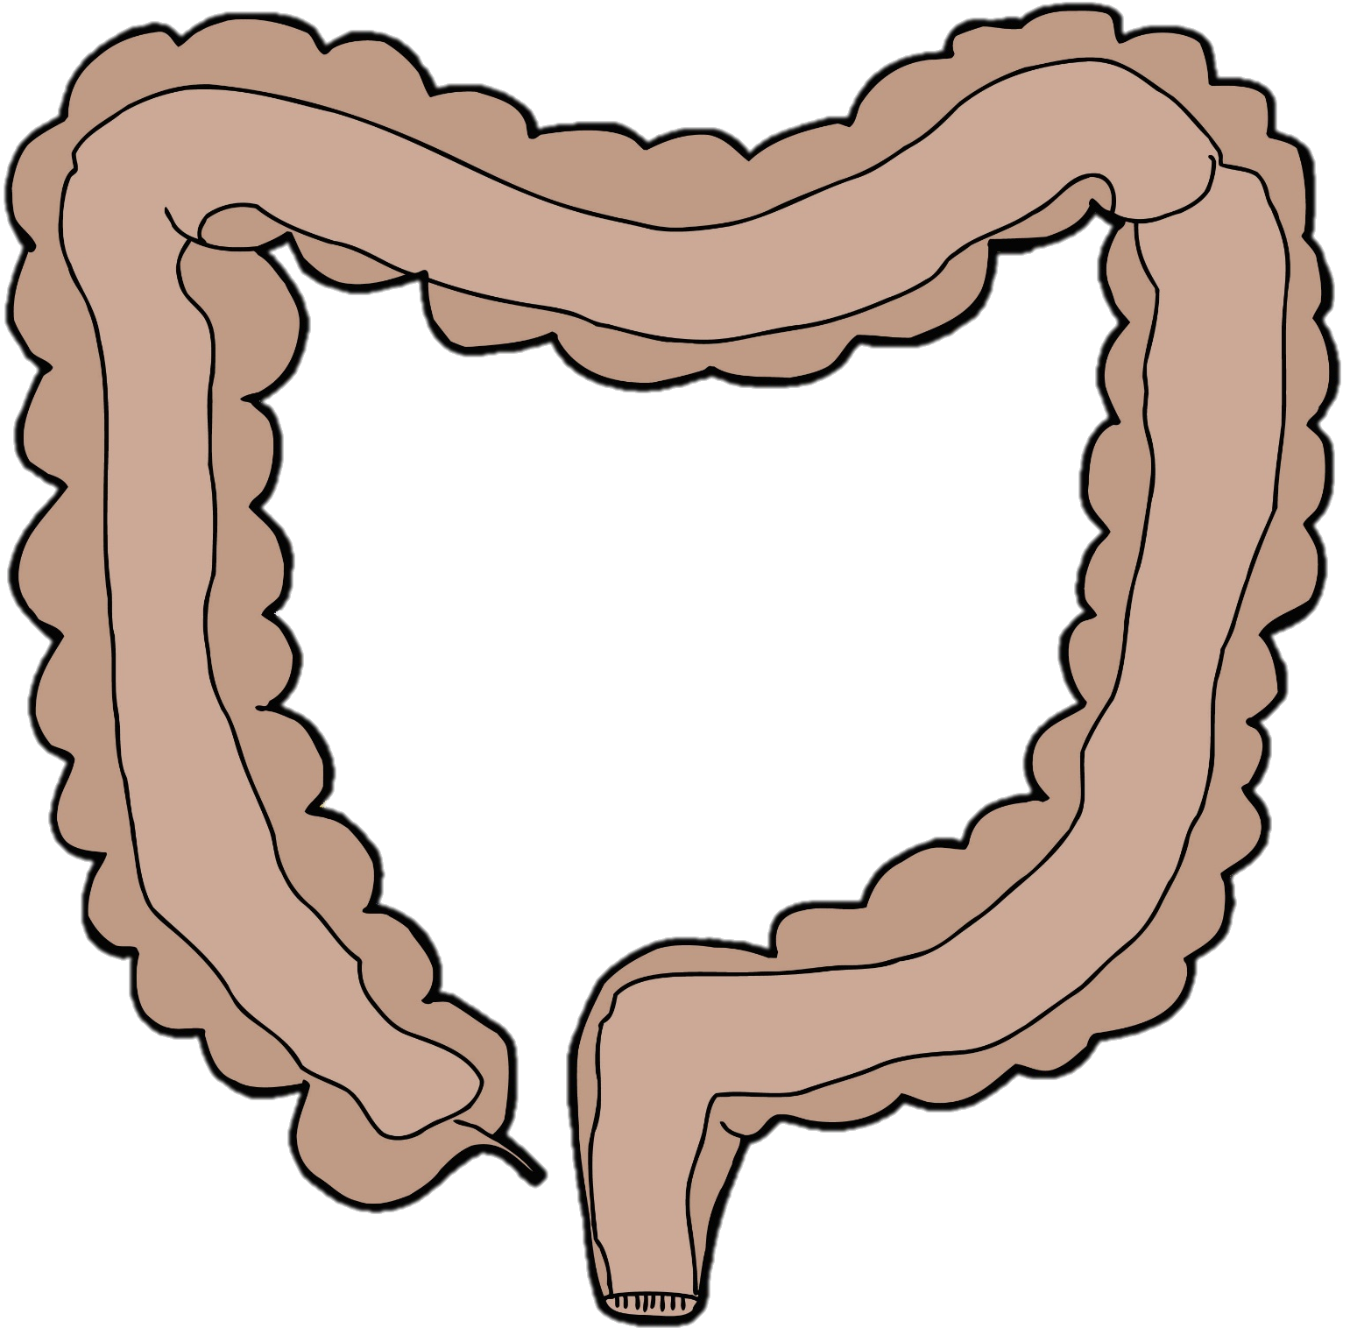
RAS
MSI
BRAF
PIK3CA
PTEN
RAS
KRAS
HER2/NEU
APC
TP53
RAS
KRAS
HER2/NEU
APC
TP53
Courtesy of John L Marshall, MD

Slide 17
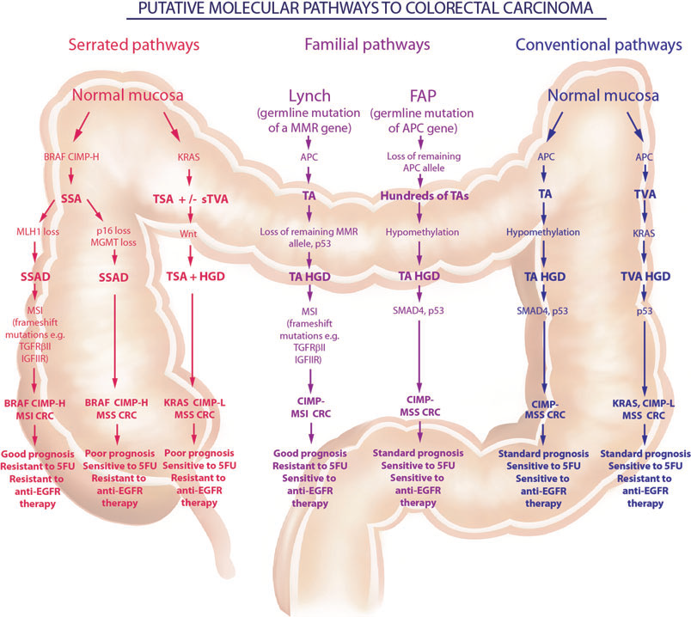
MIDGUT
HINDGUT
Bettington M et al. Histopathology 2013;62(3):367-86.
Bettington, et al. Histopathology. 2013.
Notes:
Bettington M, et al. Histopathology. 2013;62:367-386.

Slide 18
Phase II Pilot Study of Vemurafenib in Patients with Metastatic BRAF-Mutated Colorectal Cancer
Response rate, 5%
95% CI, < 1 to 26
RECIST Response (%)
Patients
Kopetz S et al. J Clin Oncol 2015;33(34):4032-8.

Slide 19
Comparison of Response Rate and Progression-Free Survival for BRAF-Mutated Colorectal Cancer
Regimen | Response rate | PFS | Citation
Single/doublet BRAF/MEK
Vemurafenib | 5% | 2.1 months | Kopetz, ASCO ‘10
Dabrafenib | 11% | NR | Falchook, Lancet ‘08
Encorafenib | 16% | NR | Gomez-Roca, ESMO ‘14
Dabrafenib + trametinib | 12% | 3.5 months | Corcoran, ASCO ‘14
Doublet with EGFR
Vemurafenib + panitumumab | 13% | 3.2 months | Yeager, CCR ’14
Vemurafenib + cetuximab | 20% | 3.2 months | Tabernero, ASCO ‘14
Encorafenib + cetuximab | 23% | 4.0 months | Tabernero, ESMO ‘14
Dabrafenib + panitumumab | 10% | 3.4 months | Atreya, ASCO ‘15
Triplet with EGFR
Vemurafenib + cetuximab + irinotecan | 35% | 7.7 months | Hong, ASCO ‘15
Dabrafenib + trametinib + panitumumab | 26% | 4.1 months | Atreya, ASCO ‘15
Encorafenib + cetuximab + alpelisib | 32% | 4.4 months | Tabernero et al ESMO ’14

Slide 20
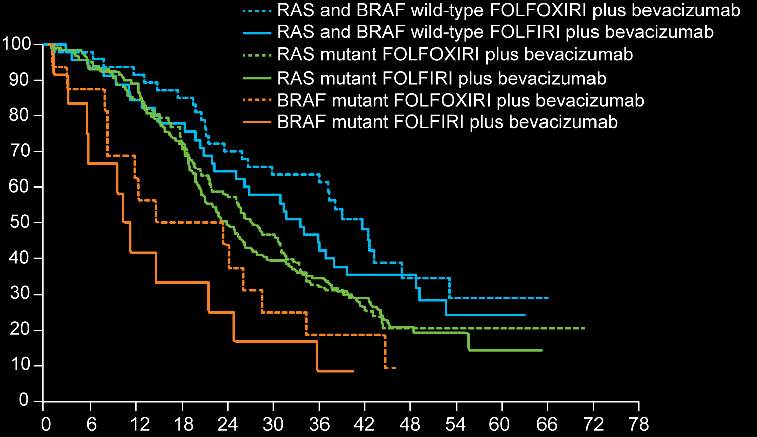
TRIBE: Phase III Study of FOLFOXIRI/Bevacizumab versus FOLFIRI/Bevacizumab as First-Line Treatment for Metastatic Colorectal Cancer
Overall survival (%)
Follow-up (months)
Cremolini C et al. Lancet Oncol 2015;316(13):1306-15.

Slide 21
FDA Approval of Pembrolizumab for Microsatellite Instability-High (MSI-H) or Mismatch Repair-Deficient (dMMR) Solid Tumors
N = 149 patients (90 CRC, 59 non-CRC) with MSI-H or dMMR cancers across 5 uncontrolled, multicohort, multicenter, single-arm trials
Objective response rate (ORR) = 39.6% (95% CI: 31.7, 47.9)
11 complete responses
48 partial responses
Response ≥6 months = 78%
ORR similar for CRC (36%) and non-CRC (46%)
On May 23, 2017, the US FDA granted accelerated approval to pembrolizumab for patients with unresectable or metastatic, MSI-H or dMMR solid tumors that have progressed after prior treatment and who have no satisfactory alternative treatment options or with MSI-H or dMMR colorectal cancer that has progressed after treatment with a fluoropyrimidine, oxaliplatin and irinotecan.
https://www.fda.gov/drugs/informationondrugs/approveddrugs/ucm560040.htm

Slide 22
As it pertains to the last patient in your practice who died of metastatic colorectal cancer (CRC) for whom you provided care for at least 9 months:
Systemic treatment regimens administered in any line
N = 77
Notes:
22
22

Slide 23
FOLFOX/bevacizumab: Line of therapy
n = 62
Notes:
23
23

Slide 24
FOLFIRI/bevacizumab: Tolerability
9 (25%)
26 (72%)
1 (3%)
Very tolerable, no dose/schedule modifications necessary
Somewhat tolerable, but issues manageable with dose reductions and/or schedule modifications
Significant tolerability issues that required discontinuation
n = 36
Notes:
24
24

Slide 25
Chemotherapy/aflibercept: Tolerability
6 (86%)
1 (14%)
Somewhat tolerable, but issues manageable with dose reductions and/or schedule modifications
Significant tolerability issues that required discontinuation
n = 7
Notes:
25
25

Slide 26
Case Discussion: A 60-Year-Old Woman with Right-Sided KRAS Mutation-Positive Metastatic Colorectal Cancer (mCRC)
2010: Patient presents with abdominal pain and distension and is diagnosed with mCRC:
Right-sided colon mass and a large pelvic mass
MSI stable, KRAS mutation-positive, BRAF wild type
Surgery → NED
FOLFOX/bevacizumab → capecitabine/bevacizumab maintenance
Multiple lines of therapy for disease progression:
FOLFIRI/bevacizumab
Irinotecan/aflibercept

Slide 27
Regorafenib: Line of therapy
n = 37
Notes:
27
27

Slide 28
TAS-102: Line of therapy
n = 30
Notes:
28
28

Slide 29
Regorafenib: Tolerability
4 (11%)
26 (72%)
6 (17%)
Very tolerable, no dose/schedule modifications necessary
Somewhat tolerable, but issues manageable with dose reductions and/or schedule modifications
Significant tolerability issues that required discontinuation
n = 36
Notes:
29
29

Slide 30
Regorafenib: Duration of therapy (months)
Median: 3
n = 37
Notes:
30
30

Slide 31
Case Discussion: A 60-Year-Old Woman with Right-Sided KRAS Mutation-Positive mCRC
2010: Patient presents with abdominal pain and distension and is diagnosed with mCRC:
Right-sided colon mass and a large pelvic mass
MSI stable, KRAS mutation-positive, BRAF wild type
Surgery → NED
FOLFOX/bevacizumab → capecitabine/bevacizumab maintenance
Multiple lines of therapy for disease progression:
FOLFIRI/bevacizumab
Irinotecan/aflibercept
Regorafenib
TAS-102
Patient enters hospice care

Slide 32
As it pertains to the last patient in your practice who died of metastatic CRC for whom you provided care for at least 9 months:
Did the patient enter a hospice program?
N = 77
Notes:
32
32

Slide 33
How long prior to death did the patient enter hospice? (Months)
Median: 2
n = 72
Notes:
33
33

Slide 34
How attached did you feel to this patient emotionally?
N = 77
Notes:
34
34

Slide 35
Did you feel a sense of satisfaction providing care to this patient?
N = 77
Notes:
35
35

Slide 36
As it pertains to the last patient in your practice who died of advanced epithelial ovarian cancer (OC) for whom you provided care for at least 9 months:
At any time did the patient undergo BRCA mutation testing?
N = 77
Notes:
36
36

Slide 37
At any time did the patient's tumor undergo next-generation sequencing?
N = 77
Notes:
37
37

Slide 38
As it pertains to the last patient in your practice who died of advanced epithelial OC for whom you provided care for at least 9 months:
Did the patient make use of any complementary or alternative therapies while undergoing treatment for advanced/metastatic disease?
N = 77
Notes:
38
38

Slide 39
Which complementary or alternative therapies did the patient use? (Please select all that apply)
N = 137
Notes:
39
39

Slide 40
Were there any important goals that this patient was able to achieve between the diagnosis of advanced disease and death (eg, attending a child's wedding or graduation, traveling on a trip-of-a-lifetime vacation)?
N = 77
Notes:
40
40

Slide 41
Please describe up to 3 examples.
Graduation from high school, traveling to meet her kids
Graduation, wedding
Was able to attend birth of her first grandchild
Family wedding
Traveling
Granddaughter graduation, cruise
Attend a marriage of granddaughter, travel, attend musical events
Graduation, wedding, vacation
Granddaughter admission to medical school
Attending grandchild's graduation
25th anniversary
Grandchild’s graduation
Attend graduations, attend weddings
Graduation, vacation
Birth of granddaughter, visit to family members
Grandchildren
Vacation, graduation of her grandson
Birth of grandchild
Grandchild birthday, grandchild graduation, ex-husband’s funeral
Granddaughter graduation
Birth of first grandchild
Traveling on a trip, attending sister's wedding
Notes:
41
41

Slide 42
Did the patient enter a hospice program?
N = 77
Notes:
42
42

Slide 43
How long prior to death did the patient enter hospice? (Months)
Median: 2
n = 67
Notes:
43
43

Slide 44
ENGOT-OV16/NOVA Trial Design
Accrual: N = 553
(N = 203) gBRCA^{mut}
2:1
Niraparib 300 mg
Eligibility
Platinum-sensitive, recurrent ovarian cancer with high-grade serous histology Received and sensitive to at least 2 platinum-based regimens CR or PR and disease progression more than 6 months after last round of platinum-based chemo Germline BRCA mutant or mutation-negative* based on BRACAnalysis
R
Placebo
Niraparib 300 mg
R
Placebo
(N = 350) non-gBRCA^{mut}
2:1
Primary endpoint: PFS in gBRCAmut and non-gBRCAmut cohorts (HRD-positive subset followed by overall)
https://gciggroup.com/system/files/2015_Oct_NSGO_ENGOT-OV16-NOVA-MIRZA.pdf

Slide 45
ENGOT-OV16/NOVA: Progression-Free Survival
Median PFS | Niraparib | Placebo | Hazard ratio | p-value
Germline BRCA mutation (n = 138; 65) | 21.0 mo | 5.5 mo | 0.27 | <0.001
No germline BRCA mutation with HRD positivity (n = 106; 56) | 12.9 mo | 3.8 mo | 0.38 | <0.001
No germline BRCA mutation with HRD negativity (n = 92; 42) | 6.9 mo | 3.8 mo | 0.58 | 0.02
No germline BRCA mutation (n = 234; 116) | 9.3 mo | 3.9 mo | 0.45 | <0.001
Mirza MR et al. N Engl J Med 2016;375(22):2154-64.

Slide 46
As it pertains to the last patient in your practice who died of advanced epithelial ovarian cancer for whom you provided care for at least 9 months:
At any time did the patient undergo BRCA mutation testing?
N = 77
Notes:
46
46

