Slide 1
Case Discussion
A 64-year old woman diagnosed with monoclonal gammopathy of undetermined significance (MGUS) in September 2015
She has been monitored over time and has had a slight increase in her proteins.
There was no evidence of end-organ damage, and her PET scan was negative.

Slide 2
Indications for Considering Treatment (IMWG Consensus Guidelines)
At least 1 of the CRAB Criteria (evidence of end-organ damage)
CRAB criteria
Hypercalcemia | Serum calcium >2.75 mmol/L (>11 mg/dL)
Renal failure | Serum creatinine >2 mg/dL or creatinine clearance <40 mL per min
Anemia | Hb >2.0 g/dL below the lower limit of normal or a hemoglobin value <10.0 g/dL
Bone | ≥1 osteolytic lesions on skeletal radiography, CT or PET-CT
New myeloma defining events: The biomarkers
≥60% clonal bone marrow plasma cells
Serum involved/uninvolved free light chain ratio ≥100
>1 focal bone lesion on MRI
Rajkumar SV et al. ASCO 2016 Education Session.

Slide 3
QuiRedex Trial of Len/Dex in High-Risk SMM
Phase III study of len/dex vs observation for pts with high-risk smoldering MM
Efficacy | Len/dex (n = 57) | Observation (n = 62) | HR, p-value
Median time to progression | Not reached | 23 mo | 0.24, <0.0001
Median OS | Not reached | Not reached | 0.43, 0.024
Mateos MV et al. Lancet Oncol 2016;17:1127-36.

Slide 4
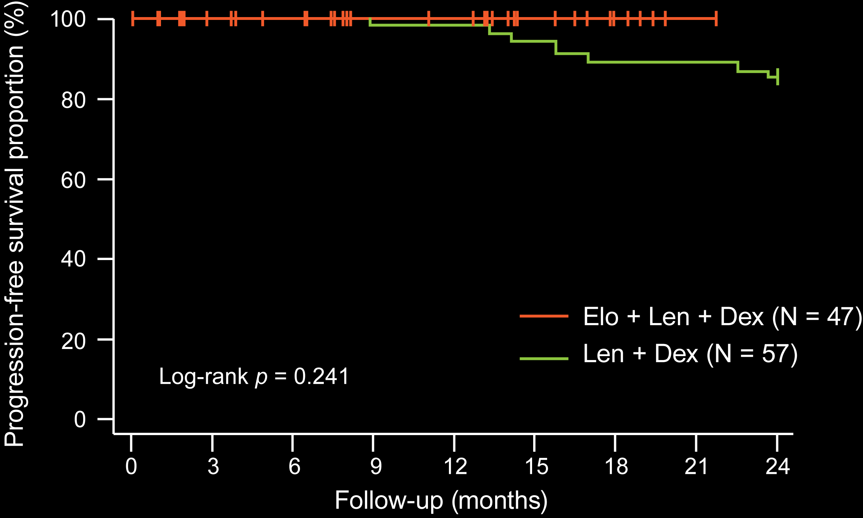
Phase II Trial of Elo/Len/Dex in High-Risk Smoldering MM
PFS
≥PR = 19/23 (82.6%); CR + VGPR + PR + MR = 23/23 (100%)
Subsequent to this interview, these data were presented at ASH 2016
With permission from Ghobrial IM et al. Proc ASH 2016;Abstract 976.

Slide 5
Case Discussion
An 87-year-old man initially diagnosed with smoldering myeloma 2 years earlier
Presents with lytic bone disease and anemia and is considered to have symptomatic multiple myeloma

Slide 6
Case Discussion
An 87-year-old man is initially diagnosed with smoldering myeloma
Presents 2 years later with lytic bone disease and anemia and is then considered to have symptomatic multiple myeloma
He receives RVd-lite → lenalidomide maintenance and is currently in a CR

Slide 7
TOURMALINE MM2: A Phase III Trial of Ixazomib/Len/Dex vs Len/Dex for Newly Diagnosed MM
NCT01850524
Ixazomib + lenalidomide + dexamethasone
Enrollment (n = 701)
Newly diagnosed MM Not eligible for stem cell transplant
R
Placebo + lenalidomide + dexamethasone
Primary endpoint: PFS
www.clinicaltrials.gov. Accessed June 2017

Slide 8
TOURMALINE-MM1: Oral Ixazomib with Len/Dex for MM
Phase III trial of pts with relapsed/refractory MM treated with ixazomib and lenalidomide/dex (ixazomib group) or placebo and lenalidomide/dex (placebo group)
Efficacy | Ixazomib group (n = 360) | Placebo group (n = 362) | HR, p-value
Median PFS | 20.6 mo | 14.7 mo | 0.74, 0.01
ORR | 78% | 72% | —, 0.04
Median overall survival: not reached in either group
Moreau P et al. N Engl J Med 2016;374(17):1621-34.

Slide 9
SWOG S0777: VRd versus Rd for Newly Diagnosed MM
Phase III study of VRd versus Rd for pts with newly diagnosed MM without intent for immediate ASCT
Outcome | VRd | Rd | HR, p-value
Median PFS (n = 242, 229) | 43 mo | 30 mo | 0.712, 0.0018
Median OS (n = 242, 229) | 75 mo | 64 mo | 0.709, 0.025
ORR (n = 216, 214) | 81.5% | 71.5% | —
Durie B et al. Lancet 2017;389:519-27.

Slide 10
IFM 2009 Trial: RVD with Transplant versus RVD Alone for Newly Diagnosed MM
Phase III study of patients with transplant-eligible, newly diagnosed MM
Treatment: RVD with transplant versus RVD alone followed by len maintenance (1 y)
Outcome | Transplant (n = 350) | RVD (n = 350) | HR, p-value
Median PFS | 50 mo | 36 mo | 0.65, <0.001
Overall survival (4 y) | 81% | 82% | 1.16, 0.87
Response Complete response Partial response | 59% 11% | 48% 20% | —, 0.03
Attal M et al. N Engl J Med 2017;376(14):1311-20.

Slide 11
Predictive Value of Minimal Residual Disease (MRD) in the IFM 2009 Trial
Bone marrow MRD evaluation (pre- and postmaintenance) in patients with ≥VGPR
Prediction of PFS by MRD status as determined by NGS
(Patients in CR) | PFS (3 y) in pts achieving CR
 | MRD-negative (<10⁻⁶) | MRD-positive (≥10⁻⁶)
Premaintenance | 87% | 63%
Postmaintenance | 92% | 64%
Avet-Loiseau H et al. Proc ASH 2015;Abstract 191.

Slide 12
DETERMINATION: A Phase III Trial of RVD with or without ASCT for Newly Diagnosed MM
NCT01208662
RVD
Estimated enrollment (n = 660)
Newly diagnosed MM ≤65 y
R
RVD + ASCT
Patients in both arms will receive lenalidomide maintenance until disease progression
Primary endpoint: PFS
www.clinicaltrials.gov. Accessed June 2017

Slide 13
Case Discussion
A 76-year-old man diagnosed with multiple myeloma in 2006
Progressed through multiple lines of therapy including lenalidomide/dexamethasone (dex) and ixazomib/lenalidomide/dex
Received daratumumab plus pomalidomide/dex in June 2016 and is faring well

Slide 14
Management of Daratumumab-Associated Infusion-Related Reactions
“For a busy oncology practice in the community, I always say there’s two things that people are doing. One is: They’re splitting doses. But probably the most important one is: Just give as much as you can on Day 1, and you’re going to flush some of that reaction. So by the time you get to the second week – and it’s true with most of the monoclonals – then you tend not to have reactions. So it’s just Day 1 that needs to be managed.”
Dr Rafael Fonseca

Slide 15
POLLUX: A Phase III Trial of Daratumumab/Len/ Dex for Relapsed/Refractory MM
Patients with MM (n = 569) who had received 1 or more prior therapies received daratumumab and len/dex (DRd) or len/dex (Rd)
Efficacy | DRd (n = 286) | Rd (n = 283) | HR, p-value
Median PFS PFS (12 mo) | Not reached 83.2% | 18.4 mo 60.1% | 0.37, <0.001
Overall response rate | 92.9% | 76.4% | —, <0.001
Most common Grade 3/4 adverse events: neutropenia, thrombocytopenia, anemia
Daratumumab-associated infusion-related reactions reported in 47.7% of patients, mostly Grade 1/2
Dimopoulos MA et al. N Engl J Med 2016;375(14):1319-31.

Slide 16
Phase III CASTOR Trial of Daratumumab and Bortezomib/Dex for Relapsed/Refractory MM
Patients with relapsed/refractory MM (n = 498) received bortezomib/dex (Rd) alone or in combination with daratumumab (DVd)
Efficacy | DVd (n = 251) | Vd (n = 247) | HR, p-value
Median PFS PFS (12 mo) | Not reached 60.7% | 7.2 mo 26.9% | 0.39, <0.001
Overall response rate | 82.9% | 63.2% | —, <0.001
Most common Grade 3/4 adverse events: neutropenia, thrombocytopenia, anemia
Daratumumab-associated IRRs: 47.7% of patients, mostly Grade 1/2
Palumbo A et al. N Engl J Med 2016;375:754-66.

Slide 17
Case Discussion
A 45-year-old man who was diagnosed 4 years ago with MM
Received RVD with transplant followed by len maintenance for 18 mo
Progressed with bone disease and received radiation therapy and carfilzomib/pomalidomide/dex and achieved a VGPR

Slide 18
Case Discussion
A 45-year-old man who was diagnosed 4 years ago with MM
Received RVD with transplant followed by len maintenance for 18 mo
Progressed with bone disease and received radiation therapy and carfilzomib/pomalidomide/dex and achieved a VGPR
Experienced relapse again, received daratumumab/len/ dex and has achieved a PR

Slide 19
POLLUX and CASTOR Trials of Daratumumab for Relapsed/Refractory MM
POLLUX
Efficacy | DRd (n = 286) | Rd (n = 283) | HR, p-value
Median PFS | Not reached | 18.4 mo | 0.37, <0.001
Overall response rate | 92.9% | 76.4% | —, <0.001
CASTOR
Efficacy | DVd (n = 251) | Vd (n = 247) | HR, p-value
Median PFS | Not reached | 7.2 mo | 0.39, <0.001
Overall response rate | 82.9% | 63.2% | —, <0.001
Dimopoulos MA et al. N Engl J Med 2016;375(14):1319-31. Palumbo A et al. N Engl J Med 2016;375:754-66.

Slide 20
PAVO: A Phase Ib Study of Subcutaneous Daratumumab (DARA) for Relapsed/Refractory MM
Patients with relapsed/refractory MM (n = 41) received 1,200 mg and 1,800 mg subcutaneous DARA in combination with human hyaluronidase enzyme (rHuPH20) to facilitate absorption.
Preliminary data suggest that subcutaneous DARA-PH20 may enable similar response rates to IV DARA monotherapy.
At the 1,800-mg dose of DARA-PH20, overall response rate: 41%
Infusion-related reactions (IRRs) were reported in 9/41 pts (22%) and were mostly Grade 1/2.
All IRRs developed ≤6 h of the first SC infusion and were controlled with antihistamines, corticosteroids, antiemetics or a bronchodilator.
Subsequent to this interview, these data were presented at ASH 2016
Usmani SZ et al. Proc ASH 2016;Abstract 1149.

Slide 21
Venetoclax (VEN) for Relapsed/Refractory MM
Phase I study of VEN monotherapy for pts with relapsed/refractory MM
Efficacy | All pts (n = 66) | t(11;14) | No t(11;14)
Overall response rate ≥VGPR | 21% 15% | 40% 27% | 6% 6%
Median time to progression | 2.6 mo | 6.6 mo | 1.9 mo
Grade 3/4 hematologic AEs: thrombocytopenia (32%), neutropenia (27%), anemia (23%), leukopenia (23%)
No TLS events reported
Kumar S et al. Proc IMW 2017;Abstract 129.

Slide 22
Venetoclax with Bortezomib/Dex for Relapsed/Refractory MM
Phase Ib study of pts with relapsed/refractory MM treated with venetoclax/bortezomib/dex
Response | All pts (n = 65) | BTZ nonrefractory (n = 44) | BTZ refractory (n = 21)
Overall response rate | 68% | 89% | 24%
Stringent CR | 5% | 7% | 0%
CR | 12% | 18% | 0%
VGPR | 23% | 32% | 5%
PR | 28% | 32% | 19%
Moreau P et al. Proc ASH 2016;Abstract 975.

Slide 23
Phase II Study of Pembrolizumab/Pomalidomide/ Dex for Relapsed/Refractory MM
Response | ITT (n = 48) | Double refractory (n = 32) | High risk (n = 27)
ORR | 60% | 66% | 56%
sCR/CR | 8% | 4% | 11%
VGPR | 19% | 18% | 4%
PR | 33% | 44% | 41%
Median follow-up = 15.6 mo
Median duration of response = 14.7 mo
Badros AZ et al. Proc ASH 2016;Abstract 490; Badros A et al. Blood 2017;[Epub ahead of print].

Slide 24
KEYNOTE-023: Pembrolizumab/Lenalidomide/ Dex for Relapsed/Refractory MM
Phase I study of pembrolizumab with lenalidomide/dex
N = 34 patients with R/R MM after disease progression on ≥2 prior therapies
Objective response rate:
– All evaluable patients: 13/17 (76%)
– Lenalidomide-refractory disease: 5/9 (56%)
Few low-grade immune-related adverse events
San Miguel et al. Proc ASH 2015;Abstract 505.

Slide 25
Response to CAR-BCMA T-Cell Therapy and Adverse Events
Pts with advanced relapsed/refractory MM enrolled: n = 12
Method: Single infusion of anti-BCMA CAR T cells after a 3-day regimen of cyclophosphamide/fludarabine
CAR-BCMA T cells eliminated plasma cells without direct organ damage.
Significant antimyeloma responses were associated with the highest levels of CAR-BCMA T cells in the blood.
Toxicites consistent with cytokine release syndrome (including fever, hypotension and dyspnea) were substantial but reversible.
Ali SA et al. Blood 2016;128(13):1688-700. Proc ASH 2015;Abstract LBA-1.

