Slide 1
RESORCE: A Phase III Trial of Second-Line Regorafenib for HCC
Eligibility (n = 573)
Patients with HCC
Progression on sorafenib
Child-Pugh A liver function
2:1
Regorafenib 160 mg/d
(n = 379)
R
Placebo
(n = 194)
Outcome | Regorafenib (n = 379) | Placebo (n = 194) | HR | p-value
Median OS | 10.6 mo | 7.8 mo | 0.63 | <0.0001
Median PFS | 3.1 mo | 1.5 mo | 0.46 | <0.0001
Bruix J et al. Lancet 2017;389(10064):56-66.

Slide 2
Phase III Trials of Sorafenib in HCC
SHARP trial¹ | Sorafenib (n = 299) | Placebo (n = 303) | HR | p-value
Median OS | 10.7 mo | 7.9 mo | 0.69 | <0.001
Asia-Pacific trial² | Sorafenib (n = 150) | Placebo (n = 76) | HR | p-value
Median OS | 6.5 mo | 4.2 mo | 0.68 | 0.014
¹ Llovet JM et al. N Engl J Med 2008;359(4):378-90;
² Cheng AL et al. Lancet Oncol 2009;10(1):25-34.

Slide 3
RESORCE: A Phase III Trial of Second-Line Regorafenib for HCC
Eligibility (n = 573)
Patients with HCC
Progression on sorafenib
Child-Pugh A liver function
2:1
Regorafenib 160 mg/d
(n = 379)
R
Placebo
(n = 194)
Outcome | Regorafenib (n = 379) | Placebo (n = 194) | HR | p-value
Median OS | 10.6 mo | 7.8 mo | 0.63 | <0.0001
Almost half of the regorafenib group (184 [49%] of 374) received the full protocol dose (160 mg/day) with no reductions.
Bruix J et al. Lancet 2017;389(10064):56-66.

Slide 4
Study 304 (REFLECT): A Phase III Trial of First-Line Lenvatinib or Sorafenib for HCC
Eligibility (n = 954)
Patients with unresectable HCC
BCLC Stage B or C
Child-Pugh A liver function
ECOG PS 0-1
1:1
Lenvatinib 12 mg (or 8 mg) QD (oral)
(n = 478)
R
Sorafenib 400 mg BID (oral)
(n = 476)
Outcome | Lenvatinib (n = 478) | Sorafenib (n = 476) | HR | p-value
Median OS | 13.6 mo | 12.3 mo | 0.92 | —
Median TTP | 8.9 mo | 3.7 mo | 0.63 | <0.00001
ORR | 24% | 9% | — | <0.00001
Subsequent to this interview, these data were presented at ASCO 2017.
Cheng AL et al. Proc ASCO 2017;Abstract 4001.

Slide 5
RESORCE: A Phase III Trial of Second-Line Regorafenib for HCC
Eligibility (n = 573)
Patients with HCC
Progression on sorafenib
Child-Pugh A liver function
2:1
Regorafenib 160 mg/d
(n = 379)
R
Placebo
(n = 194)
Almost half of the regorafenib group (184 [49%] of 374) received the full protocol dose (160 mg/day) with no reductions.
Drug-related adverse events led to interruptions or dose reductions in 202 (54%) patients in the regorafenib group.
Bruix J et al. Lancet 2017;389(10064):56-66.

Slide 6
RESORCE Phase III Trial: Select Adverse Events
Event | Regorafenib (n = 374) |  | Placebo (n = 193)
 | All | Grade 3/4 | All | Grade 3/4
Hand-foot skin reaction | 53% | 13% | 8% | 1%
Diarrhea | 41% | 3% | 15% | 0%
Fatigue | 40% | 9% | 32% | 5%
Hypertension | 31% | 15% | 6% | 5%
Increased blood bilirubin | 29% | 10% | 18% | 11%
Increased AST | 25% | 11% | 20% | 11%
Ascites | 16% | 4% | 16% | 6%
Increased ALT | 15% | 3% | 11% | 3%
Bruix J et al. Lancet 2017;389(10064):56-66.

Slide 7
CheckMate 040: Phase I/II Trial Design
Patients with advanced HCC
Dose escalation (n = 48)
3 + 3 design
Dose expansion (n = 214)
3 mg/kg
n = 6
n = 9
n = 10
n = 10
n = 13
Sorafenib untreated or intolerant (n = 56)
Without viral hepatitis
0.1 mg/kg (n = 1)
0.3 mg/kg (n = 3)
1.0 mg/kg (n = 3)
3.0 mg/kg (n = 3)
10 mg/kg (n = 13)
Sorafenib progressor (n = 57)
HCV infected
0.3 mg/kg (n = 3)
1.0 mg/kg (n = 4)
3.0 mg/kg (n = 3)
HCV infected (n = 50)
HBV infected
0.1 mg/kg (n = 5)
0.3 mg/kg (n = 3)
1.0 mg/kg (n = 3)
3.0 mg/kg (n = 4)
HBV infected (n = 51)
El-Khoueiry AB et al. Lancet 2017;389(10088):2492-502.

Slide 8
CheckMate 040: Response and Safety
During dose-escalation phase (n = 48):
Nivolumab showed a manageable safety profile, including acceptable tolerability.
46 (96%) discontinued treatment
Incidence of treatment-related adverse events (AEs) did not seem to be associated with dose; no maximum tolerated dose was reached.
12 (25%) had Grade 3/4 treatment-related AEs.
30 (63%) died (not determined to be related to nivolumab).
Nivolumab 3 mg/kg was chosen for dose expansion.
El-Khoueiry AB et al. Lancet 2017;389(10088):2492-502.

Slide 9
CheckMate 040: Phase I/II Trial Design
Dose escalation (n = 48)
3 + 3 design
Dose expansion (n = 214)
3 mg/kg
n = 6
n = 9
n = 10
n = 10
n = 13
Sorafenib untreated or intolerant (n = 56)
Without viral hepatitis
0.1 mg/kg (n = 1)
0.3 mg/kg (n = 3)
1.0 mg/kg (n = 3)
3.0 mg/kg (n = 3)
10 mg/kg (n = 13)
Sorafenib progressor (n = 57)
HCV infected
0.3 mg/kg (n = 3)
1.0 mg/kg (n = 4)
3.0 mg/kg (n = 3)
HCV infected (n = 50)
HBV infected
0.1 mg/kg (n = 5)
0.3 mg/kg (n = 3)
1.0 mg/kg (n = 3)
3.0 mg/kg (n = 4)
HBV infected (n = 51)
With nivolumab at 3 mg/kg:
ORR (dose-expansion phase) = 42/214 (20%)
El-Khoueiry AB et al. Lancet 2017;389(10088):2492-502.

Slide 10
CheckMate 040: Survival Results
Outcomes | Dose escalation (n = 48)* | Dose expansion (n = 214)†
Median OS | 15 mo | NR
6-month OS | 66% | 83%
9-month OS | 66% | 74%
Median PFS | 3.4 mo | 4.0 mo
6-month PFS | Not reported | 37%
9-month PFS | Not reported | 28%
* 37/48 (77%) had previously received sorafenib
† 145/214 (68%) of patients had previously received sorafenib
NR = not reached
Median OS – uninfected, prior sorafenib in dose-expansion phase (n = 57) = 13.2 mo
El-Khoueiry AB et al. Lancet 2017;389(10088):2492-502.

Slide 11
CheckMate 040: Treatment Outcomes
Nivolumab | Dose escalation (n = 48) | Dose expansion (n = 214)
ORR | 7 (15%) | 42 (20%)
Median DoR | 17 mo | 9.9 mo
DCR | 28 (58%) | 138 (64%)
9-month OS | 66% | 74%
El-Khoueiry AB et al. Lancet 2017;389(10088):2492-502.

Slide 12
Select Ongoing Trials of Immune Checkpoint Inhibitors for Patients with Advanced HCC
Trial name/identifier | N | Phase | Setting | Treatment arms
CheckMate 459 (NCT02576509) | 726 | III | First line | Nivolumab Sorafenib
CheckMate 040 (NCT01658878) | 620 | I/II | 2 parts*/5 cohorts (C1-5) Uninfected HCV infected HBV infected Advanced HCC Child-Pugh B | Nivo at different doses (C1-3) Nivo at a specific dose (C1-3) 1L Nivo vs sorafenib (C4) Nivo vs ipilimumab (C4) Nivo (C5)
16-C-0135 (NCT02821754) | 90 | I/II | Advanced BCLC Stage B/C Intra/extrahepatic cholangiocarcinoma | Tremelimumab + durvalumab +/- (TACE or RFA or cryoablation) (C1)
* The 2 parts are dose escalation and dose expansion.
Clinicaltrials.gov (Accessed July 2017).

Slide 13
Phase II Trial of Tremelimumab Monotherapy in HCC with Chronic Hepatitis C
Outcomes | n = 17
ORR | 17.6%
DCR | 76.4%
Time to progression | 6.48 mo
Median OS | 8.2 mo
Sangro B et al. J Hepatol 2013;59(1):81-8.

Slide 14
Ongoing CheckMate 040 Trial
Trial name/identifier | N | Phase | Setting | Treatment arms
CheckMate 040 (NCT01658878) | 620 | I/II | 2 parts*/5 cohorts (C1-5) Uninfected HCV infected HBV infected Advanced HCC Child-Pugh B | Nivo at different doses (C1-3) Nivo at a specific dose (C1-3) 1L Nivo vs sorafenib (C4) Nivo + ipilimumab (C4) Nivo (C5)
* The 2 parts are dose escalation and dose expansion.
Clinicaltrials.gov (Accessed July 2017).

Slide 15
CheckMate 040: Select Adverse Events
Dose-escalation cohort | Nivolumab 3 mg/kg (n = 10) |  | All patients (n = 48)
 | All grades | Grade 3/4 | All grades | Grade 3/4
Increased AST | 1 (10%) | 1 (10%) | 10 (21%) | 5 (10%)
Increased ALT | 2 (20%) | 1 (10%) | 7 (15%) | 3 (6%)
Increased lipase | 2 (20%) | 1 (10%) | 10 (21%) | 6 (13%)
Increased amylase | 2 (20%) | 1 (10%) | 9 (19%) | 2 (4%)
One patient without viral hepatitis who received nivolumab 3 mg/kg discontinued due to treatment-related ALT and AST increases without concomitant changes in liver function.
El-Khoueiry AB et al. Lancet 2017;389(10088):2492-502.

Slide 16
Case Discussion
A 74-year-old man presents with chronic hepatitis B with no evidence of portal hypertension or cirrhosis.
Patient has a single 6.5-cm lesion and is diagnosed with moderately differentiated HCC with microscopic vascular invasion
Patient underwent surgical liver resection
The margins were negative
Patient is placed on surveillance and is alive 4 years later with no evidence of recurrence

Slide 17
Case Discussion
A 71-year-old man with hepatitis B presents with abdominal pain and weight loss
He has elevated liver enzymes with an alpha-fetoprotein level of 1,000
Imaging revealed a heterogenously enhancing infiltrating mass of 6 cm with extension of the tumor.
He has tumor thrombosis into the right and left portal veins.

Slide 18
Case Discussion
A 71-year-old man with hepatitis B presents with abdominal pain and weight loss
He has elevated liver enzymes with an alpha-fetoprotein (AFP) level of 1,000 ng/mL
Imaging revealed a heterogenously enhancing infiltrating mass of 6 cm with extension of the tumor.
He has tumor thrombosis into the right and left portal veins.
A biopsy revealed poorly differentiated HCC and Child-Pugh A cirrhosis.
Patient is diagnosed with BCLC Stage C HCC.
Received first-line sorafenib → nivolumab for about 14 months on a trial upon progression

Slide 19
Case Discussion
A 68-year-old woman without viral hepatitis B, but with a metabolic syndrome, diabetes and steatohepatitis NASH presents with upper-quadrant pain and weight loss
Patient is diagnosed with NASH-related HCC with Child-Pugh A cirrhosis
Ultrasound revealed 2 liver masses, 4 and 6.5 cm
Received TACE with doxorubicin beads → response, but with residual disease

Slide 20
Case Discussion
A 68-year-old woman without viral hepatitis B, but with a metabolic syndrome, diabetes and steatohepatitis NASH presents with upper-quadrant pain and weight loss
Patient is diagnosed with NASH-related HCC with Child-Pugh A cirrhosis
Ultrasound revealed 2 liver masses, 4 and 6.5 cm
Received TACE with doxorubicin beads → response, but with residual disease
RFA therapy → observation for 14 months with no active disease → developed new liver lesion adjacent to treated large mass with invasion into the main portal vein → sorafenib

Slide 21
Case Discussion
A 69-year-old man with a compensated HCV-cirrhosis
2012: Patient has a single HCC (6 cm), no macrovascular invasion (MVI) or extrahepatic spread (EHS) Child-Pugh A, ECOG PS 0, bilirubin level of 1 mg/dL and no portal hypertension
Segmental resection: R0, no satellites, microvascular invasion

Slide 22
Liver Transplantation for Small HCC in Patients with Cirrhosis
Outcomes | All pts (n = 48) | Pts who met the Milan criteria (n = 35) | Patients whose tumors exceeded the limits (n = 13)
4-year OS | 75% | 85% | 50%
4-year RFS | 83% | 92% | 59%
Overall mortality rate (n = 48) = 17%
In this group of 48 patients with early-stage tumors, tumor–node-metastasis status, the number of tumors, the serum AFP concentration, treatment received before transplantation and 10 other variables were not significantly correlated with survival.
Conclusions:
Liver transplantation is an effective treatment for small, unresectable HCC in patients with cirrhosis.
Mazzaferro V et al. N Engl J Med 1996;334(11):693-9.

Slide 23
Case Discussion
A 69-year-old man with a compensated HCV-cirrhosis
2012: Patient has a single HCC (6 cm), no macrovascular invasion (MVI) or extrahepatic spread (EHS) Child-Pugh A, ECOG PS 0, bilirubin level of 1 mg/dL and no portal hypertension
Segmental resection: R0, no satellites, microvascular invasion

Slide 24
Case Discussion
A 69-year-old man with a compensated HCV-cirrhosis
2012: Patient has a single HCC (6 cm), no macrovascular invasion (MVI) or extrahepatic spread (EHS) Child-Pugh A, ECOG PS 0, bilirubin level of 1 mg/dL and no portal hypertension
Segmental resection: R0, no satellites, microvascular invasion
2014: Multinodular HCC recurrence: 3 nodules (max: 4 cm). Patient has Child-Pugh A, ECOG 0, no MVI-EHS, AFP: 100 ng/mL
Chemoembolization (TACE x 3): partial response

Slide 25
Case Discussion
A 69-year-old man with a compensated HCV-cirrhosis
2012: Patient has a single HCC (6 cm), no macrovascular invasion (MVI) or extrahepatic spread (EHS) Child-Pugh A, ECOG PS 0, bilirubin level of 1 mg/dL and no portal hypertension
Segmental resection: R0, no satellites, microvascular invasion
2014: Multinodular HCC recurrence: 3 nodules (max: 4 cm). Patient has Child-Pugh A, ECOG 0, no MVI-EHS, AFP: 100 ng/mL
Chemoembolization (TACE x 3): partial response
2016: Progression in main HCC nodule: 5 cm, satellites and branch portal vein thrombosis; Child-Pugh A, ECOG PS 1, bilirubin 1.5 mg/dL, AFP: 600 ng/mL.

Slide 26
Case Discussion
A 69-year-old man with a compensated HCV-cirrhosis
2012: Patient has a single HCC (6 cm), no macrovascular invasion (MVI) or extrahepatic spread (EHS) Child-Pugh A, ECOG PS 0, bilirubin level of 1 mg/dL and no portal hypertension
Segmental resection: R0, no satellites, microvascular invasion
2014: Multinodular HCC recurrence: 3 nodules (max: 4 cm). Patient has Child-Pugh A, ECOG 0, no MVI-EHS, AFP: 100 ng/mL
Chemoembolization (TACE x 3): partial response
2016: Progression in main HCC nodule: 5 cm, satellites and branch portal vein thrombosis; Child-Pugh A, ECOG PS 1, bilirubin 1.5 mg/dL, AFP: 600 ng/mL.
Treatment strategy? (a) TACE; (b) Sorafenib; (c) TARE (Y-90); (d) Radiation therapy

Slide 27
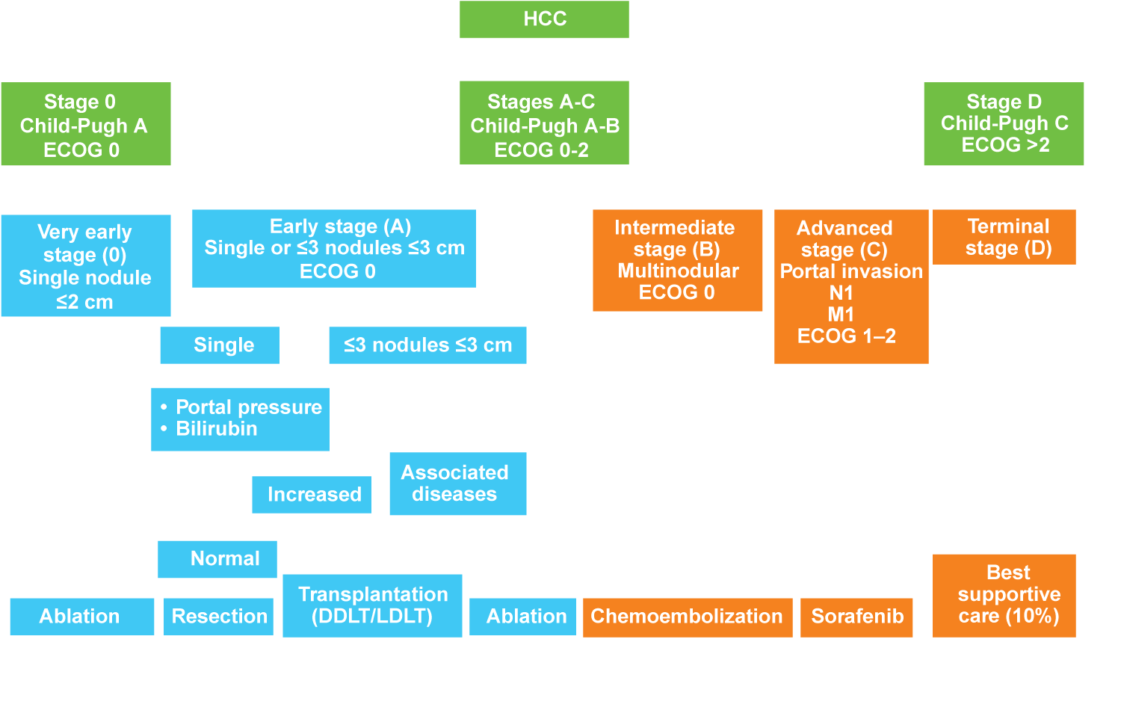
BCLC Staging and Treatment Schedule
Unresectable HCC
Llovet JM et al. Nat Rev Dis Primers 2016;2:16018.

Slide 28
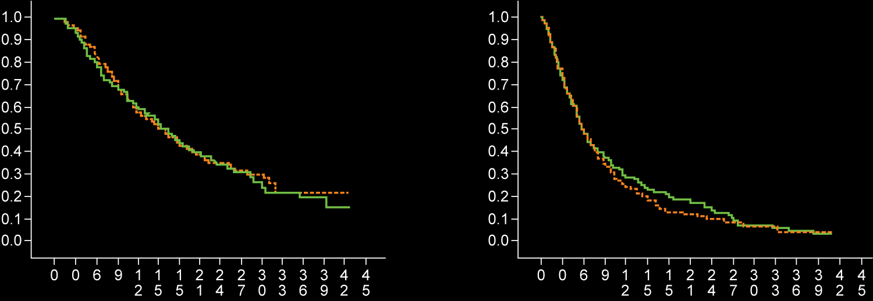
Intermediate – Advanced HCC: Redefining “Unresectable” HCC — Natural History (BCLC B and C)
Survival BCLC B stage (n = 370)
Survival BCLC C stage (n = 376)
Stage 0
Median survival: Placebo 15.8m
Seocalcitol 15.1m
Stage 1
Median survival: Placebo 5.7m
Seocalcitol 5.6m
Survival
Survival
Time since treatment start (months)
Time since treatment start (months)
RCT seocalcitol vs placebo (n = 746)
Courtesy of Josep M Llovet, MD, PhD

Slide 29
BCLC Staging and Treatment Schedule
Llovet JM et al. Nat Rev Dis Primers 2016;2:16018.

Slide 30
Evidence and Recommendations for HCC Therapies
Sorafenib
1
Chemoembolization
Adjuvant therapy after reseaction
RF (<5 cm), RF/PEI (<2 cm)
LDLT
Resection
OLT-Milan
2
Internal radiation
Levels of evidence
OLT-extended
Neoadjuvant therapy in waiting list
Downstaging
3
External/palliative radiation therapy
C
B
A
C
B
A
2 (weak)
1 (strong)
Grade of recommendation
EASL-EORTC clinical practice guidelines. J Hepatol 2012;56(4):908-43.

Slide 31
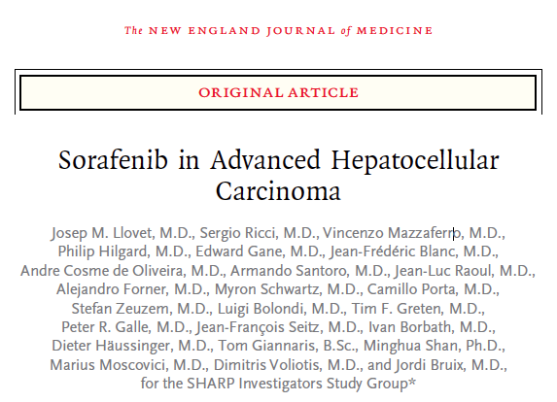
Systemic Therapies: Sorafenib
Clinical Practice Summary
Systemic therapies
Sorafenib is the standard systemic therapy for HCC. It is indicated for patients with well-preserved liver function (Child-Pugh A class) and with advanced tumors (BCLC C) or those tumors progressing upon locoregional therapies (evidence 1iA; recommendation 1A)
There are no clinical or molecular biomarkers available to identify the best responders to sorafenib (evidence 1A; recommendation 2A)
Systemic chemotherapy, tamoxifen, immunotherapy, anti-androgen and herbal drugs are not recommended for the clinical management of HCC (evidence 1-2A; recommendation 1A/B)
SHARP trial results
Median OS (N = 602):
Sorafenib = 10.7 mo
Placebo = 7.9 mo
HR = 0.69
p < 0.001
EASL-EORTC clinical practice guidelines. J Hepatol 2012;56(4):908-43;
Llovet JM et al. N Engl J Med 2008;359(4):378-90.

Slide 32
SHARP: Subgroup Analysis
Subgroup domain | Group evaluated | Number of patients |  | OS (mo)
 |  | Sor | PI | Sor | PI | HR
Tumor burden | MVI/EHS both absent | 90 | 91 | 14.5 | 10.2 | 0.52
 | MVI/EHS both present | 209 | 212 | 8.9 | 6.7 | 0.77
 | MVI absent | 190 | 179 | 14.1 | 10.2 | 0.74
 | MVI present | 108 | 123 | 8.1 | 4.9 | 0.68
 | EHS absent | 140 | 153 | 14.1 | 7.9 | 0.55
 | EHS present | 159 | 150 | 8.9 | 8.3 | 0.85
Performance status | ECOG PS 0 | 161 | 164 | 13.3 | 8.8 | 0.68
 | ECOG PS 1-2 | 138 | 139 | 8.9 | 5.6 | 0.71
Tumor stage | BCLC B | 54 | 51 | 14.5 | 11.4 | 0.72
 | BCLC C | 245 | 252 | 9.7 | 7.0 | 0.70
Prior therapy | Prior curative treatment | 81 | 77 | 11.9 | 8.8 | 0.79
 | Prior TACE | 86 | 90 | 11.9 | 9.9 | 0.75
MVI = microvascular invasion
Bruix J et al. J Hepatol 2012;57(4):821-9.

Slide 33
Alternative Therapies for MVI in HCC: Surgical Resection
Series | Number of patients | Survival |  | Predictors of outcome
 |  | Median (mo) | 5 year (%)
Wu | 112 | NA | 27 | NA
Ohkubo | 47 | NA | 24 | Tumor size 10 cm, satellites, margins
Poon | 20 | 6 | NA | NA
Fan | 83 | 13 | 14 | Adjuvant CT
Fan | 108 | 14 | 15 | Adjuvant CT, tumor size 10 cm
Pawlik | 102 | 11 | 10 | Fibrosis
Le Treut | 26 | 9 | 13 | NA
Chen | 438 | 16 | 12 | Extent of invasion
Zhou | 381 | NA | 12 | NA
Ikai | 78 | 9 | 22 | Ascites, INR, tumor size 5 cm
Liang | 86 | 10 | 9 | Adjuvant treatment, grade, tumor size
Shimada | 22 | 7 | 0 | NA
Ban | 45 | 20 | 22 | AFP <2,000, serosal invasion
Inoue | 49 | 19 | 40 | NA
Kondo | 48 | 13 | NA | Total bilirubin, alkaline phosphatase, extent of invasion
Ruzzenente | 17 | 10 | 20 | NA
Shi | 406 | 6 | 13 | Extent of invasion
Retrospective Study by Roayaie et al.
N = 165
Median OS = 13.1 mo
5-year OS = 14%
Retrospective studies, underpowered; selection bias; lack of ITT analysis
Hypothesis generating
Roayaie S et al. Ann Surg Oncol 2013;20(12):3754-60.

Slide 34
Alternative Therapies for MVI in HCC: Loco-regional Therapies (TACE and Radiation Therapy)
Author | Treatment (n) | Survival
Xue, BMC Gastro 2013 | TACE (923) | Meta-analysis
Gorodetski, Eur Rad 2016 | TACE (95) TACE-DEB (38) | 5 mo 3.3 mo
Zhu K, Radiology 2014 | TACE+S (46) TACE (45) | 13 mo 6 mo
Memon K, J Hep 2013 | Y-90 Child-Pugh A (45) Y-90 Child-Pugh B (28) | 13.8 mo 6.5 mo
Nakazawa, BMC Gastro 2014 | Sorafenib (40) Radiation therapy (57) | 4.3 mo 5.9 mo
Retrospective studies, underpowered
Selection bias; lack of ITT analysis
Hypothesis generating

Slide 35
Radioembolization ⁹⁰Y for Portal Vein Invasion in HCC
Prospective/Retrospective Studies
Reporting on long-term outcome after ⁹⁰Y radioembolization
Reference | Child-Pugh A | Intermediate stage |  | Branch PVT |  | Main PVT |  | Branch or main PVT
 |  | N | OS | N | OS | N | OS | N | OS
Hilgard et al. (N = 108) | A/B | 51 | 16.4 |  |  |  |  | 33 | 10
Salem et al. (N = 291) | A | 48 | 17.3 | 19 | 16.6 | 16 | 7.7 | 35 | 10.4
 | B | 35 | 13.5 | 27 | 6.5 | 30 | 4.5 | 57 | 5.6
Sangro et al. (N = 325) | A | 82 | 18.4 | 44 | 10.7 | 32 | 9.7 | 76 | 10.2
 | B | 5 | 3.6
Mazzaferro et al. (N = 51) | A | 15 | 18 | 23 | 17 | 5 | 9
 | B | 2 | — | 6 | 8 | 1 | 5
Hypothesis generating
Select ongoing large-scale randomized trials with ⁹⁰Y radioembolization in HCC
Salem R et al. Hepatol 2013;58(6):2188-97.

Slide 36
Select Large-Scale Randomized Trials with ⁹⁰Y Radioembolization in HCC
Trial name/identifier | N | Phase | Setting | Treatment arms
PREMIERE (NCT00956930) | 45 | II | Untreatable with RFA or surgery | Radioembolization TACE
SORAMIC (NCT01126645) | 529 | II | Unresectable | RFA → Sorafenib or placebo Sorafenib +/- SIRT
SIRveNIB (NCT01135056) | 360 | III | Locally advanced | Sorafenib SIR-Spheres
SARAH (NCT01482442) | 496 | III | Advanced | Sorafenib SIR-Spheres
STOP-HCC (NCT01556490) | 390 | III | Unresectable | Sorafenib Sorafenib + TheraSphere
YES-P (NCT01887717) | 328 | III | Advanced with portal vein thrombosis | Sorafenib TheraSphere
Clinicaltrials.gov (Accessed July 2017).

Slide 37
Case Discussion
A 69-year-old man with a compensated HCV-cirrhosis
2012: Patient has a single HCC (6 cm), no macrovascular invasion (MVI) or extrahepatic spread (EHS) Child-Pugh A, ECOG PS 0, bilirubin level of 1 mg/dL and no portal hypertension
Segmental resection: R0, no satellites, microvascular invasion
2014: Multinodular HCC recurrence: 3 nodules (max: 4 cm). Patient has Child-Pugh A, ECOG 0, no MVI-EHS, AFP: 100 ng/mL
Chemoembolization (TACE x 3): partial response
2016: Progression in main HCC nodule: 5 cm, satellites and branch portal vein thrombosis; Child-Pugh A, ECOG PS 1, bilirubin 1.5 mg/dL, AFP: 600 ng/mL.
Patient received sorafenib → disease progression

Slide 38
RESORCE: A Phase III Trial of Second-Line Regorafenib for HCC
Eligibility (n = 573)
Patients with HCC
Progression on sorafenib
Child-Pugh A liver function
2:1
Regorafenib 160 mg/d
(n = 379)
R
Placebo
(n = 194)
Outcome | Regorafenib (n = 379) | Placebo (n = 194) | HR | p-value
Median OS | 10.6 mo | 7.8 mo | 0.63 | <0.0001
Bruix J et al. Lancet 2017;389(10064):56-66.

Slide 39
Molecular Therapies Tested in HCC (Phase III)
Targeted population | Phase III comparision
Adjuvant | Prevent recurrences | Sorafenib vs placebo (STORM)* Retinoids vs placebo*
Intermediate HCC | Improve TACE | RF vs RF-Dox* TACE +/- sorafenib* TACE +/- brivanib*
Advanced HCC | First line | Sorafenib +/- erlotinib* Sorafenib vs brivanib* Sorafenib vs sunitinib* Sorafenib vs linifanib* Sorafenib +/- doxorubicin* Sorafenib +/- Y90 Sorafenib vs lenvatinib Sorafenib vs nivolumab
 | Second line | Brivanib vs placebo* Everolimus vs placebo* Ramucirumab vs placebo* Regorafenib vs placebo Tivantinib vs placebo Cabozantinib vs placebo Pembrolizumab vs placebo
* RCT halted or with unconclusive or negative results
Courtesy of Josep M Llovet, MD, PhD

Slide 40
Molecular Therapies Tested in HCC (Phase III)
Targeted population | Phase III comparision
Adjuvant | Prevent recurrences | Sorafenib vs placebo (STORM)* Retinoids vs placebo*
Intermediate HCC | Improve TACE | RF vs RF-Dox* TACE +/- sorafenib* TACE +/- brivanib*
Advanced HCC | First line | Sorafenib +/- erlotinib* Sorafenib vs brivanib* Sorafenib vs sunitinib* Sorafenib vs linifanib* Sorafenib +/- doxorubicin* Sorafenib +/- Y90 Sorafenib vs lenvatinib Sorafenib vs nivolumab
 | Second line | Brivanib vs placebo* Everolimus vs placebo* Ramucirumab vs placebo* Regorafenib vs placebo Tivantinib vs placebo Cabozantinib vs placebo Pembrolizumab vs placebo
* RCT halted or with unconclusive or negative results
Courtesy of Josep M Llovet, MD, PhD

Slide 41
Reasons Why Randomized Trials are Negative in HCC
Limited understanding of molecular drivers
Lack of translation of knowledge into trial design
Two diseases: HCC and Cirrhosis
Balance between efficacy and toxicity
Sunitinib, linifanib
Difficult trial design
Noninferiority concept (brivanib, linifanib)
Surrogate endpoints of survival? TTP (contradictory data), ORR
Moving to Phase III without clear signals
Sunitinib, erlotinib
Drugs are not powerful enough
Brivanib, linifanib, erlotinib, everolimus, ramucirumab, doxorubicin
Courtesy of Josep M Llovet, MD, PhD

Slide 42
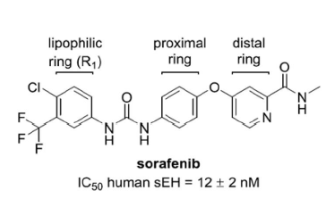
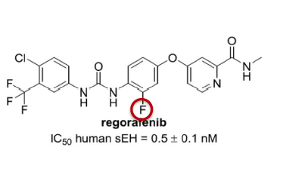
Phase II Trial of Second-Line Regorafenib
Dose | Efficacy (n = 36) | Safety (n = 36)
 |  | Event | All | Grade ≥3
160 mg PO QD (21 d on/7 d off) | DCR: 72% | HFSR | 53% | 14%
 | PR: 3% | Diarrhea | 53% | 6%
 | SD: 69% | Fatigue | 53% | 17%
 | Median TTP: 4.3 mo | Hypothyroidism | 42% | 0%
 | Median OS: 13.8 mo | Hypertension | 36% | 3%
Bruix J et al. Eur J Cancer 2013;49(16):3412-9.

Slide 43
RESORCE: A Phase III Trial of Second-Line Regorafenib for HCC
Eligibility (n = 573)
Patients with HCC
Progression on sorafenib
Child-Pugh A liver function
2:1
Regorafenib 160 mg/d
(n = 379)
R
Placebo
(n = 194)
Outcome | Regorafenib (n = 379) | Placebo (n = 194) | HR | p-value
Median OS | 10.6 mo | 7.8 mo | 0.63 | <0.0001
Bruix J et al. Lancet 2017;389(10064):56-66.

Slide 44
RESORCE Phase III Trial: Select Adverse Events
Event | Regorafenib (n = 374) |  | Placebo (n = 193)
 | All | Grade 3/4 | All | Grade 3/4
Hand-foot skin reaction | 53% | 13% | 8% | 1%
Diarrhea | 41% | 3% | 15% | 0%
Fatigue | 40% | 9% | 32% | 5%
Hypertension | 31% | 15% | 6% | 5%
Bruix J et al. Lancet 2017;389(10064):56-66.

Slide 45
Case Discussion
A 69-year-old man with a compensated HCV-cirrhosis
2012: Patient has a single HCC (6 cm), no macrovascular invasion (MVI) or extrahepatic spread (EHS) Child-Pugh A, ECOG PS 0, bilirubin level of 1 mg/dL and no portal hypertension
Segmental resection: R0, no satellites, microvascular invasion
2014: Multinodular HCC recurrence: 3 nodules (max: 4 cm). Patient has Child-Pugh A, ECOG 0, no MVI-EHS, AFP: 100 ng/mL
Chemoembolization (TACE x 3): partial response
2016: Progression in main HCC nodule: 5 cm, satellites and branch portal vein thrombosis; Child-Pugh A, ECOG PS 1, bilirubin 1.5 mg/dL, AFP: 600 ng/mL.
Patient received sorafenib → disease progression

Slide 46
Lenvatinib as First-Line Therapy: Activity
 | Inclusion criteria | Exclusion criteria | PR (%) | SD (%) | TTP (months) | OS (months)
Lenvatinib Phase I | Advanced HCC, CP-A, B | Simultaneous cancers, ascites, effusion, brain metastases, portal vein shunt, use of CYP3A4 | 20 | 45 | 3.7 | —
Lenvatinib Phase II | Advanced HCC, CP-A, previous 1 line of systemic treatment | Simultaneous cancers, ascites, effusion, brain metastases, portal vein shunt, use of CYP3A4 | 32.6 | 45.7 | 7.49 | 13.9
Sorafenib Phase I | Advanced, biopsy- proven HCC, chemo-naïve, CP-A/B, ECOG PS 0-1 | Tumor of mixed histology, pregnant or lactating, those requiring systemic anticancer therapy, biologic response modifiers | 2.2 | 33.6 | 4.2 | 9.2
Brivanib Phase II | Advanced HCC, second-line therapy, CLIP score 3 or less, ECOG PS 0-2 | Active bacterial infection, HIV, significant cardiovascular disease | 4.3 | 41.3 | 2.7 | 9.79
Sunitinib Phase II | Advanced HCC, chemo-naïve, ECOG PS 0-1, CP <B8 | Previous chemotherapy | 12 | 42.1 | 2.8 | 5.8
CP = Child-Pugh
Courtesy of Josep M Llovet, MD, PhD

Slide 47
Lenvatinib vs Sorafenib: Adverse Events and Ongoing Trial
Adverse event | Lenvatinib Phase II; all grades (%) | Sorafenib SHARP trial; all grades (%)
Fatigue | 54 | 22
Hand-foot syndrome | 65 | 21
Anorexia | 59 | 14
Diarrhea | — | 39
Hypertension | 76 | 5
Thrombocytopenia | 52 | —
Proteinuria | 54 | —
Leukopenia | — | 7.9
Subsequent to this interview, the results of the Phase III REFLECT open-label, noninferiority trial of lenvatinib vs sorafenib were presented at ASCO 2017.
Ikeda K et al. Proc ESMO 2012;Abstract 737P; Llovet JM et al. N Engl J Med 2008; 359(4):378-90. Clinicaltrials.gov (Accessed July 2017).

Slide 48
CheckMate 040: A Phase I/II Trial of Nivolumab in Advanced HCC
Dose escalation (n = 48)
3 + 3 design
Dose expansion (n = 214)
3 mg/kg
n = 6
n = 9
n = 10
n = 10
n = 13
Sorafenib untreated or intolerant (n = 56)
Without viral hepatitis
0.1 mg/kg (n = 1)
0.3 mg/kg (n = 3)
1.0 mg/kg (n = 3)
3.0 mg/kg (n = 3)
10 mg/kg (n = 13)
Sorafenib progressor (n = 57)
HCV infected
0.3 mg/kg (n = 3)
1.0 mg/kg (n = 4)
3.0 mg/kg (n = 3)
HCV infected (n = 50)
HBV infected
0.1 mg/kg (n = 5)
0.3 mg/kg (n = 3)
1.0 mg/kg (n = 3)
3.0 mg/kg (n = 4)
HBV infected (n = 51)
El-Khoueiry AB et al. Lancet 2017;389(10088):2492-502.

Slide 49
CheckMate 040: A Phase I/II Trial of Nivolumab in Advanced HCC
Dose escalation (n = 48)
3 + 3 design
Dose expansion (n = 214)
3 mg/kg
n = 6
n = 9
n = 10
n = 10
n = 13
Sorafenib untreated or intolerant (n = 56)
Without viral hepatitis
0.1 mg/kg (n = 1)
0.3 mg/kg (n = 3)
1.0 mg/kg (n = 3)
3.0 mg/kg (n = 3)
10 mg/kg (n = 13)
Sorafenib progressor (n = 57)
HCV infected
0.3 mg/kg (n = 3)
1.0 mg/kg (n = 4)
3.0 mg/kg (n = 3)
HCV infected (n = 50)
HBV infected
0.1 mg/kg (n = 5)
0.3 mg/kg (n = 3)
1.0 mg/kg (n = 3)
3.0 mg/kg (n = 4)
HBV infected (n = 51)
Cohort | N | ORR | 9-month OS | Median OS
Dose-escalation cohort | 48 | 7 (15%) | 66% | 15 mo
Dose-expansion cohort | 214 | 42 (20%) | 74% | Not reached
Median OS – uninfected, prior sorafenib in dose-expansion phase (n = 57) = 13.2 mo
El-Khoueiry AB et al. Lancet 2017;389(10088):2492-502.

Slide 50
CheckMate 459: An Ongoing Phase III Trial
Target accrual (n = 726)
Pts with advanced HCC
Not eligible for surgical and/or locoregional therapies or
Progressive disease after surgical and/or locoregional therapies
Child-Pugh A
ECOG PS 0-1
No prior liver transplant
Nivolumab
R
Sorafenib
Primary endpoints: OS and ORR
Clinicaltrials.gov (Accessed July 2017).

Slide 51
Ongoing Trials of Combinations of Immune Checkpoint Inhibitors for HCC
Trial name/identifier | N | Phase | Setting | Treatment arms
16-C-0135 (NCT02821754) | 90 | I/II | Advanced BCLC Stage B/C Intra/extra hepatic cholangiocarcinoma | Tremelimumab + durvalumab +/- (TACE or RFA or cryoablation) (C1)
CheckMate 040 (NCT01658878) | 620 | I/II | 2 parts*/5 cohorts (C1-5) Uninfected HCV infected HBV infected Advanced HCC Child-Pugh B | Nivo at different doses (C1-3) Nivo at a specific dose (C1-3) 1L Nivo vs sorafenib (C4) Nivo + ipilimumab (C4) Nivo (C5)
* The 2 parts are dose escalation and dose expansion.
Clinicaltrials.gov (Accessed July 2017).

