Slide 1
Case Discussion: Second Opinion
55 year-old woman with recurrent ovarian cancer
Underwent an optimal cytoreductive surgery and placement of an intraperitoneal catheter
Disease progressed through multiple lines of chemotherapy
BRCA1 mutation detected
Received single-agent olaparib as primary therapy on a clinical trial

Slide 2
PARP Inhibitors: Common Side Effects
“One of the class effects has been gastrointestinal toxicities — some nausea, dyspepsia, anorexia, occasional vomiting, and some lower GI effects, which is diarrhea. But it’s mostly upper GI effects.” Ursula A Matulonis, MD

Slide 3
Importance of BRCA Testing for Patients with Ovarian Cancer
“… This is the one way that we can help prevent ovarian cancer. We don’t have screening mechanisms at all, but we do have a way of identifying high-risk women, and it’s exactly here. You’ve got a patient who’s got the unfortunate diagnosis. Well, let’s make some good from this and disseminate that information to the rest of the family, that they should undergo testing.” Ursula A Matulonis, MD

Slide 4
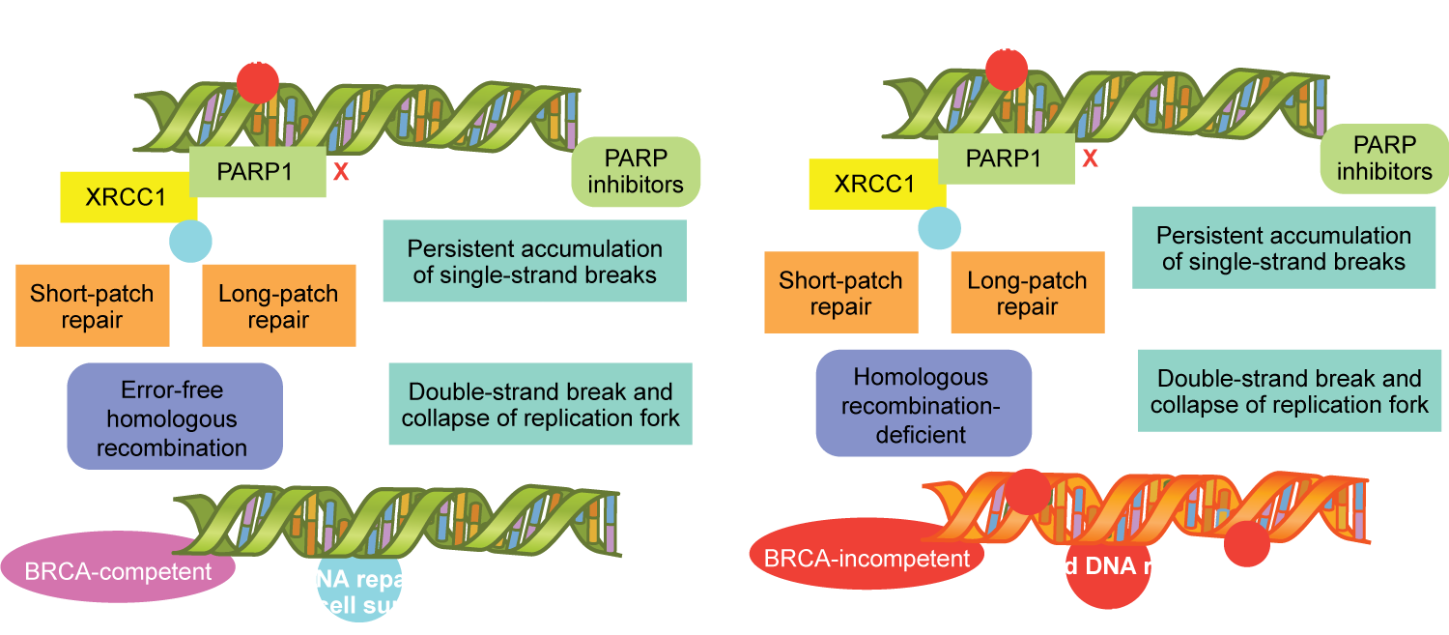
DNA Repair and PARP Inhibition
Functional BRCA
Dysfunctional BRCA
McLornan DP et al. N Engl J Med 2014;371(18):1725-35.

Slide 5
ENGOT-OV16/NOVA: A Phase III Trial of Niraparib Maintenance in Platinum-Sensitive, Recurrent Ovarian Cancer
Niraparib 300 mg QD until PD
Germline BRCA mutation (n = 203)
R
Accrual (n = 553)
Platinum-sensitive, recurrent OC ≥2 platinum-based regimens
2:1
Placebo
2:1
Niraparib 300 mg QD until PD
No germline BRCA mutation* (n = 350)
R
Placebo
* Patient tumors were tested for homologous recombination deficiency (HRD)
Primary endpoint: PFS
Mirza MR et al. N Engl J Med 2016;375(22):2154-64.

Slide 6
Study 19: A Phase II Trial of Olaparib Maintenance in Platinum-Sensitive Relapsed Ovarian Cancer
All patients | Olaparib (n = 136) | Placebo (n = 129) | Hazard ratio (HR) | p-value
Median PFS | 8.4 mo | 4.8 mo | 0.35 | <0.001
Median OS | 29.8 mo | 27.8 mo | 0.73 | 0.025
BRCA1 mutation positive | n = 48 | n = 45 | HR | p-value
Median OS | 33.4 mo | 26.6 mo | 0.60 | NR
BRCA2 mutation positive | n = 26 | n = 17 | HR | p-value
Median OS | 57.2 mo | 40.7 mo | 0.62 | NR
NR = Not reported
Ledermann J et al. N Engl J Med 2012;366(15):1382-92
Ledermann JA et al. Lancet Oncol 2016;17(11):1579-89.

Slide 7
Press Release – October 26, 2016 Positive results from the Phase III SOLO-2 trial to determine the efficacy of Olaparib (300 mg BID) as monotherapy for the maintenance treatment of platinum-sensitive relapsed, BRCA-mutated ovarian cancer
“Results from the trial demonstrate a clinically-meaningful and statistically-significant improvement of progression-free survival (PFS) among patients treated with olaparib compared to placebo and provide additional evidence to support the potential use of olaparib in this patient population. Importantly, the median PFS in the olaparib arm of SOLO-2 substantially exceeded that observed in the Phase II maintenance study in patients with platinum-sensitive relapsed ovarian cancer (Study 19).”
https://www.astrazeneca.com/media-centre/press-releases/2016/lynparza-phase-iii-solo-2-trial-shows-significant-progression-free-survival-benefit-261020161.html

Slide 8
ENGOT-OV16/NOVA Trial: Median PFS
 | Niraparib | Placebo | HR | p-value
Germline BRCA mutation (n = 138, 65) | 21.0 mo | 5.5 mo | 0.27 | <0.001
No germline BRCA mutation with HRD positivity (n = 106, 56) | 12.9 mo | 3.8 mo | 0.38 | <0.001
No germline BRCA mutation (n = 234, 116) | 9.3 mo | 3.9 mo | 0.45 | <0.001
Mirza MR et al. N Engl J Med 2016;375(22):2154-64.

Slide 9
Case Discussion: Second Opinion
45 year-old woman with Stage IIIA serous ovarian cancer
Germline BRCA2 mutation-positive
Optimal debulking → carboplatin/paclitaxel x 6 cycles
Patient currently has no evidence of disease, normal CA-125 levels
Would you prescribe niraparib maintenance for this patient?

Slide 10
SOLO-1: A Phase III Trial of Olaparib Monotherapy for BRCA-Mutated Ovarian Cancer
Accrual (n = 397)
Newly diagnosed, high-risk ovarian cancer Prior platinum-based chemotherapy Presence of deleterious or suspected deleterious BRCA1/2 mutation
Olaparib (300 mg BID)
R
Placebo (300 mg BID)
Primary endpoint: PFS
Clinicaltrials.gov; NCT01844986

Slide 11
PAOLA-1: An Ongoing Phase III Trial of Olaparib with Bevacizumab as Maintenance Therapy for Advanced Ovarian Cancer
Accrual (n = 612)
Newly diagnosed, high-grade ovarian, fallopian tube or peritoneal cancer FIGO Stage IIIB-IV Completed first-line platinum/taxane therapy ≥3 cycles of bevacizumab with last 3 cycles of platinum-based chemotherapy Presence of BRCA1/2 mutation
Olaparib + bevacizumab
R
Placebo + bevacizumab
Primary endpoint: PFS
Clinicaltrials.gov; NCT02477644

Slide 12
Select Ongoing Trials of Immune Checkpoint Inhibitor Therapy for Patients with Ovarian Cancer
Trial name | Phase | N | Treatment arms | Population
NCT02657889 (TOPACIO) | I/II | 114 | Pembrolizumab + Niraparib | Recurrent ovarian or TNBC
NCT02520154 | II | 30 | Pembrolizumab + paclitaxel + carboplatin | Newly diagnosed ovarian
NCT02853318 | II | 40 | Pembrolizumab + bevacizumab + cyclophosphamide | Recurrent ovarian, fallopian tube or primary peritoneal
NCT02873962 | II | 38 | Nivolumab + bevacizumab | Relapsed epithelial ovarian, fallopian tube or peritoneal
Clinicaltrials.gov (accessed January 2017)

Slide 13
Case Discussion: Second Opinion
62-year-old woman with recurrent ovarian cancer
Germline BRCA mutation-positive
Initiating third-line therapy with olaparib 400 mg PO BID
After 4 weeks on olaparib, hemoglobin drops from 10.5 g/dL to 8.5 g/dL
No evidence of bleeding or hemolysis
Should this patient receive an erythropoiesis stimulating agent?

Slide 14
Case Discussion: Second Opinion
54-year-old woman with germline BRCA2 mutation-positive disease receives olaparib
Patient does well on olaparib for 10 months, at which point slow, asymptomatic growth of peritoneal metastatic nodules is noted
Should this patient continue on olaparib with the addition of a new agent (eg, chemotherapy or bevacizumab)?

Slide 15
Side Effects Associated with PARP Inhibitors
“…As a class effect, PARP inhibitors have two main toxicities. One is gastrointestinal, and then secondly bone marrow suppression. So, I think you have to expect both when you start any of these PARP inhibitors in patients...
I think the GI toxicity is pretty much the same. And I’ve been impressed how some patients are just more sensitive to the GI toxicity. I guess what we don’t have yet – and that decision-making is not there yet – if you’ve got three, or even two PARP inhibitors in play, and you start off with one and you say, ‘Wow! You’re having a lot of nausea from this drug. Let’s see if we switch you to another one, what will happen.’”
Ursula A Matulonis, MD

Slide 16
PARP Inhibitors: Management of Treatment-Associated Nausea in Patients
“If a patient starts to develop some nausea or vomiting, or anorexia or dyspepsia… more often than not those side effects will get better. Exactly why that occurs, not sure, but those side effects tend to get better.
In a less ideal world, you’d give that patient a break. For PARP inhibitors, these drugs are meant to be given continuously… Unless the patient is having a lot of distress, I think taking away the PARP inhibitor, may not be the best thing to do.”
Ursula A Matulonis, MD

Slide 17
PARP Inhibitors: Comparison of Dosage and Administration
 | Olaparib | Rucaparib | Niraparib
Available dosage form* | 50 mg capsule | 300 mg tablet | 100 mg tablet
Dosing and administration | 400 mg twice daily, oral (800 mg total) | 600 mg twice daily, oral (1,200 mg total) | 300 mg once daily, oral
Total number of capsules/tablets per day | 16 | 4 | 3
* The SOLO-1 and SOLO-2 trials evaluated a 300 mg twice daily dosing of olaparib in a higher dosage tablet form. This formulation is not currently FDA approved.
Olaparib package insert; Rucaparib package insert; www.clinicaltrials.gov

Slide 18
Case Discussion: Second Opinion
54-year-old woman with high-grade serous ovarian cancer
Achieved a CR with carboplatin/paclitaxel (IV) x 6 cycles
CA-125 spiked after 11 months and received 2 lines of therapy afterwards

Slide 19
Case Discussion: Second Opinion
54-year-old woman with high-grade serous ovarian cancer
Achieved a CR with carboplatin/paclitaxel (IV) x 6 cycles
CA-125 spiked after 11 months and received 2 lines of therapy afterwards
Tested for BRCA status at this point and disease was found to be BRCA mutation-positive
She is currently receiving olaparib (3 months)
When would you observe evidence of an objective response?

Slide 20
Recommendations for BRCA1 and BRCA2 Testing
“… Despite that agreement and despite guidelines that have come from SGO, ASCO and others, we still have a number of people… with as many as 20 to 40 percent, depending on which paper you read, not getting tested in patients who have epithelial ovarian cancer, which is very unfortunate.”
Thomas J Herzog, MD

Slide 21
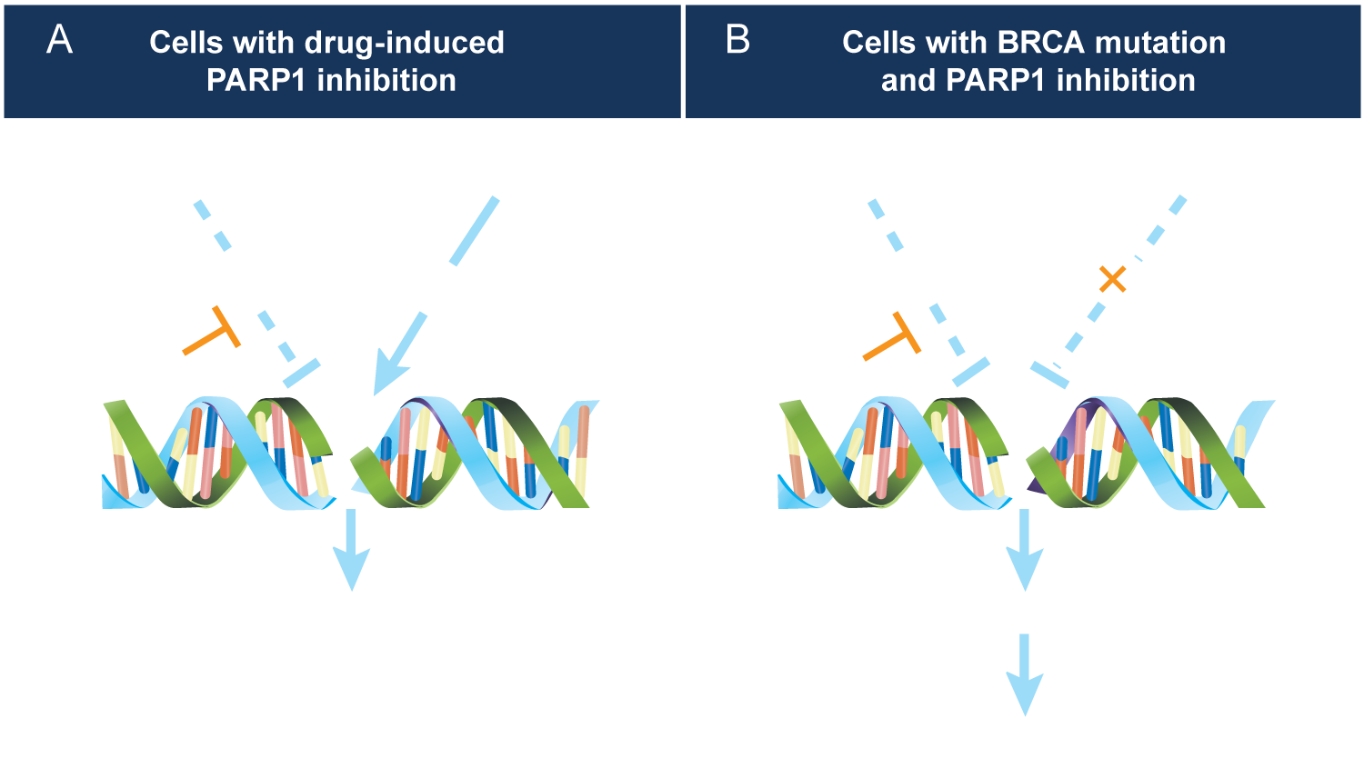
Mechanism of Cell Death from Synthetic Lethality Induced by PARP Inhibition
Iglehart JD. N Engl J Med 2009;361(2):189-91.

Slide 22
ENGOT-OV16/NOVA Trial of Niraparib Maintenance Therapy: Median PFS Results
 | Niraparib | Placebo | Hazard ratio | p-value
Germline BRCA mutation (n = 138, 65) | 21.0 mo | 5.5 mo | 0.27 | <0.001
HRD positive with somatic BRCA mutations (n = 35, 12) | 20.9 mo | 11.0 mo | 0.27 | 0.02
HRD positive with wild-type BRCA (n = 71, 44) | 9.3 mo | 3.7 mo | 0.38 | <0.001
No germline BRCA mutation, HRD negative (n = 92, 42) | 6.9 mo | 3.8 mo | 0.58 | 0.02
No germline BRCA mutation (n = 234, 116) | 9.3 mo | 3.9 mo | 0.45 | <0.001
Mirza MR et al. N Engl J Med 2016;375(22):2154-64.

Slide 23
Phase II OV21/PETROC Trial vs Phase III GOG 252 Trial for Patients with Stage II-IV Disease
OV21/PETROC¹ (Stage IIB-IV) | IV chemo (n = 101) | IP chemo (n = 102) | HR (p-value)
Median PFS | 11.3 mo | 12.5 mo | 0.82 (0.27)
Median OS | 38.1 mo | 59.3 mo | 0.80 (0.40)
GOG 252² | IV carbo + bev | IP carbo + bev | IP cisplatin + bev
Median PFS (Stage II-III) | 26.8 mo | 28.7 mo* | 27.8 mo*
Median PFS (Stage III, no visible residual disease) | 31.3 mo | 31.8 mo* | 33.8 mo*
* No significant difference versus IV carboplatin
¹ Mackay H et al. Proc ASCO 2016;Abstract LBA5503; ² Walker JL et al. Proc SGO 2016;Abstract LBA6.

Slide 24
ENGOT-OV16/NOVA Biomarker Populations
553 patients enrolled
203 gBRCAmut
Primary efficacy
350 non-gBRCAmut
Primary efficacy
162 HRD-positive
Primary efficacy
134 HRD-negative
Primary efficacy
54 HRD not determined
Primary efficacy
47 Somatic BRCAmut
Exploratory
115 BRCA wildtype
Exploratory
26 Inconclusive result
14 Inadequate specimen
14 Missing specimen
gBRCAmut = germline BRCA mutation; HRD = homologous recombination deficiency
Mirza MR et al. N Engl J Med 2016;375(22):2154-64.

Slide 25
Clinical Implications of the ENGOT-OV16/NOVA Trial Results
Which patients benefit the most from niraparib maintenance therapy?
Based on prolongation of PFS:
Patients with germline BRCA mutations benefit (HR = 0.27; p < 0.001)
Patients with HRD-positive somatic BRCA mutations benefit (HR = 0.27; p = 0.02), and their response is similar to that of patients with germline BRCA mutations
Even patients without germline BRCA mutation and with HRD-negative disease benefit (HR = 0.58; p = 0.02).
Michael Birrer, MD, PhD

Slide 26
Comparison of PARP Inhibitors
Olaparib, niraparib and rucaparib
Niraparib is associated with higher thrombocytopenia
Rucaparib is associated with higher anemia
Toxicities are manageable
Veliparib
Binds more weakly to target than olaparib, niraparib and rucaparib
Potentially easier to combine with chemotherapy
Talazoparib
Has a higher binding capacity than other PARP inhibitors
Michael Birrer, MD, PhD

