Slide 1
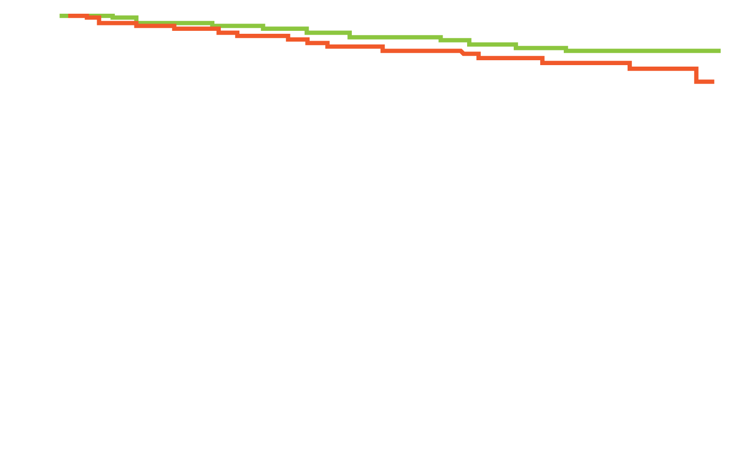
MA17R: Disease-Free Survival with Extended Adjuvant Letrozole in Postmenopausal Women with Early-Stage Breast Cancer (BC)
 | Letrozole (n = 959) | Placebo (n = 959)
5-year DFS | 95% | 91%
HR = 0.66; p = 0.01
Percentage
Letrozole
Placebo
Time (years)
DFS = disease-free survival
5-year overall survival: Letrozole 93%, placebo 94%, (p nonsignificant)
Distant recurrence rate: Letrozole 4.4%, placebo 5.5%
Goss PE et al. N Engl J Med 2016;375(3):209-19.

Slide 2
Trials of Checkpoint Inhibitors in Triple-Negative BC (TNBC)
Phase IB KEYNOTE-012: Pembrolizumab in advanced TNBC
N = 27 women with PD-L1-positive tumors evaluable for response
Objective response rate (ORR) = 18.5%
Duration of response: Not yet reached
Phase IA study of atezolizumab in TNBC
N = 21 women with PD-L1-positive tumors evaluable for response
ORR = 19%
Duration of response: Not yet reached
Nanda R et al. J Clin Oncol 2016;34(21):2460-7; Emens LA et al. Proc AACR 2015;Abstract 6317.

Slide 3
Atezolizumab with Nab Paclitaxel for Metastatic TNBC
Response | First line (n = 13) | Second line (n = 9) | Third line + (n = 10)
Confirmed objective response | 46% | 22% | 40%
Complete response | 8% | 0 | 0
Partial response | 38% | 22% | 40%
Stable disease | 38% | 67% | 30%
Adams S et al. Proc ASCO 2016;Abstract 1009.

Slide 4
ASCO Practice Guideline: Use of the 21-Gene Recurrence Score® (RS) to Guide Adjuvant Systemic Therapy Decisions for ER-Positive, Node-Positive BC
For a patient with ER/PR-positive, HER2-negative, node-positive BC, the clinician should not use the 21-gene RS to guide adjuvant treatment decisions.
Harris LN et al. J Clin Oncol 2016;34(10):2460-7.

Slide 5
HERITAGE: A Phase III Trial of Proposed Trastuzumab Biosimilar Myl-1401O in HER2-Positive Metastatic BC (mBC)
 | Myl-1401O + taxane (n = 230 ) | Trastuzumab + taxane (n = 228)
ORR at 24 weeks | 69.6% | 64.0%
95% CI | 63.62-75.51 | 57.81-70.26
Ratio of ORR: Myl-1401O/ trastuzumab (FDA) | 1.09
Difference in ORR (EMEA) | 5.53
Results confirmed efficacy equivalence based on ratio of ORR and difference in ORR.
No difference was observed in median LVEF between the 2 study arms.
Similar immunogenicity was observed.
Rugo HS et al. JAMA 2016;[Epub ahead of print].

Slide 6
BCIRG-006: Ten-Year Follow-Up
DFS (≥4 positive nodes): TCH = 62.9%, AC→TH = 62.8%, AC→T = 53.6%
Therapeutic index:
 | AC → TH | TCH
DFS events | 269 | 279
Grade 3/4 CHF | 21 | 4
Totals | 290 | 283
Rx-related leukemias | 7 (8)* | 0 (1)†
Sustained LVEF loss >10% | 200 | 97
CHF = congestive heart failure
* Only in patients who received AC; † Leukemia developed after treatment with CHOP
Slamon DJ et al. San Antonio Breast Cancer Symposium 2015;Abstract S5-04.

Slide 7
Joint Analysis of the ABC Phase III Trials Comparing TC to Anthracycline/Taxane-Based Chemotherapy for High-Risk HER2-Negative BC
Treatment | N | Events | 4-year IDFS
TC | 2,094 | 220 | 882.2%
TaxAC | 2,062 | 179 | 90.7%
Alive and invasive disease free (%)
= 2.5%
HR = 1.23, 95% CI (1.01-1.50) P = 0.04
2,005 | 1,599 | 1,014 | 858 | 594 | 358 | 136
1,965 | 1,575 | 1,007 | 847 | 566 | 317 | 132
Years from randomization
TaxAC = taxane/anthracycline
Blum JL et al. Proc ASCO 2016;Abstract 1000.

Slide 8
Management of the Axilla in a Patient with Primary Invasive BC That Is Node-Positive on Biopsy Who Achieves a Complete Clinical Response to Neoadjuvant Systemic Therapy
Palpable axillary adenopathy
What is your usual approach to the axilla at that point?
Would you generally perform an axillary dissection if the sentinel node were positive?
Love N et al. San Antonio Breast Cancer Symposium 2015;Abstract P1-14-20.

Slide 9
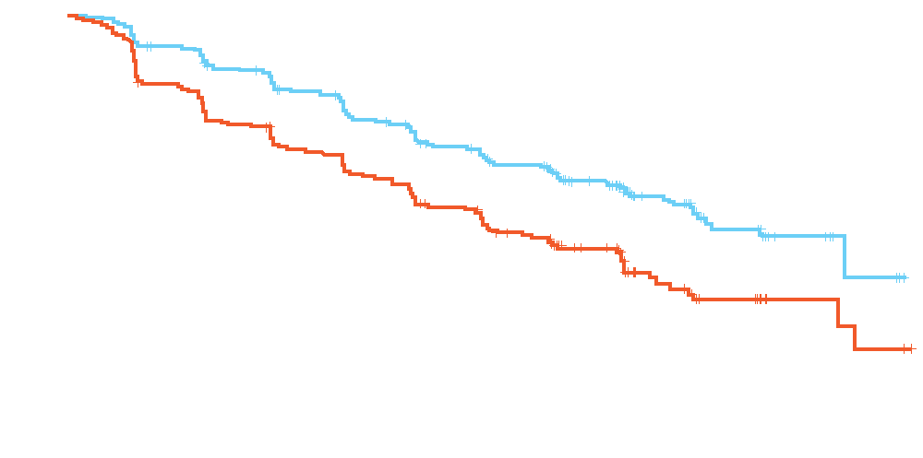
PALOMA-2: Palbociclib with Letrozole versus Letrozole for ER-Positive Advanced BC
 | PAL + LET (N = 444) | PBO + LET (N = 222)
Median PFS | 24.8 | 14.5
HR; 1-sided p-value | 0.58; p < 0.000001
PFS = progression-free survival
Progression-Free Survival, %
PAL + LET
PBO (placebo) + LET
Time, months
Objective response with palbociclib/letrozole = 42%, and with placebo/letrozole = 35%, (odds ratio 1.40, p = 0.0310)
Overall survival data not yet mature
Finn RS et al. Proc ASCO 2016;Abstract 507.

Slide 10
MONARCH 1: A Phase II Study of Single-Agent Abemaciclib in HR-Positive, HER2-Negative mBC After Chemotherapy
Investigator-assessed response | Abemaciclib 200 mg (N = 132)
Confirmed ORR (CR + PR) | 19.7%
Complete response (CR) | 0%
Partial response (PR) | 19.7%
Clinical benefit rate (ORR + stable disease ≥6 mo) | 42.4%
Change from baseline (%)
Dickler MN et al. Proc ASCO 2016;Abstract 510.

Slide 11
BOLERO-2: Everolimus and Exemestane for HR-Positive, HER2-Negative Advanced BC
Outcome | Everolimus + exemestane | Placebo + exemestane | HR; p-value
Median PFS | 7.8 mo | 3.2 mo | 0.45; <0.0001
Median OS* (n = 485, 239) | 31.0 mo | 26.6 mo | 0.89; 0.14
* Final analysis
Discontinuation due to adverse events (AEs): Everolimus arm (29%), placebo (5%)
Grade 3/4 AEs and serious AEs: Everolimus 55%, placebo 33%
Piccart M et al. Ann Oncol 2014;25(12):2357-62.

Slide 12
Is There a Role for the 21-Gene Signature in Invasive Lobular Carcinoma?
135 cases with invasive lobular carcinoma were retrospectively evaluated.
80% of invasive lobular carcinoma was of the classical subtype, and all tumors were ER-positive and HER2-negative.
Overall 21-gene signature RS:
Low risk (LR): 63%
Intermediate risk (IR): 35.5%
High risk: 1.5%
Patients in the IR category were significantly more likely to undergo chemotherapy (CT) than patients in the LR category (54% versus 18%; p < 0.0001).
RS played a role in decision-making on CT in 74% of cases overall.
Conlon N et al. Breast J 2015;21(5):514-19.

Slide 13
TAILORx: Prospective Validation of a 21-Gene Expression Assay in BC
Analysis of 1,626 women with an RS of 0 to 10 who received endocrine therapy without chemotherapy
Clinical parameter | 5-year rate
Invasive disease-free survival | 93.8%
Freedom from BC recurrence at distant site | 99.3%
Overall survival | 98.0%
Sparano JA et al. N Engl J Med 2015;373(21):2005-14.

Slide 14
Case Discussion
A 45-year-old woman with a T2N1M0, ER 100%, PR 10%, HER2-negative IDC with 3 of 15 positive axillary lymph nodes
S/p breast-conserving surgery
A 70-gene prognostic panel assessment demonstrated a low risk of recurrence
Patient received AC → taxane

Slide 15
Prognostic and Predictive Value of the 21-Gene RS in Women with Node-Positive, ER-Positive BC
Retrospective analysis of 367 specimens (tamoxifen, n = 148; CAF-T, n = 219) from patients on the SWOG-8814 trial for postmenopausal women with node-positive, ER-positive BC
RS was prognostic in the tamoxifen-alone group (p = 0.006; HR 2.64)
There was no benefit of chemotherapy in patients with a low RS (score <18; log-rank p = 0.97; HR 1.02)
A significant benefit with chemotherapy was reported for those with a high RS (score ≥31; log-rank p = 0.033; HR 0.59)
CAF-T = cyclophosphamide, doxorubicin and fluorouracil before tamoxifen
Albain KS et al. Lancet Oncol 2010;11:55-65

Slide 16
MA17R: A Phase III Trial of Extended Adjuvant Letrozole
 | Letrozole (n = 959) | Placebo (n = 959) | HR (p-value)
5-year DFS rate | 95% | 91% | 0.66 (0.01)
5-year OS rate | 93% | 94% | 0.97 (0.83)
Annual incidence rate –contralateral BC | 0.21% | 0.49% | 0.42 (0.007)
OS = overall survival
Goss PE et al. N Engl J Med 2016:375(3):209-19.

Slide 17
EBCTCG Meta-Analysis
Analysis of 91 trials with 46,138 women with ER-positive BC alive and disease free after 5 years of endocrine therapy
Risk of any BC event in T1N0 BC
21%
T1N0
14%
Any BC event
7%
ET for 5 years
Years since diagnosis
Annual event rate (and no. of events), by 5-year time period
T1N0 (n = 16,000): 1.4% (807) 1.7% (309) 1.8% (54)
21% risk of any BC event in years 5-20 (14% distant recurrence + 7% local or contralateral)
Pan H et al. Proc ASCO 2016;Abstract 505.

Slide 18
MONARCH 1: A Phase II Study of Abemaciclib
Change from baseline (%)
Investigator-assessed response | Abemaciclib 200 mg (N = 132)
Confirmed ORR (CR + PR) | 19.7%
Clinical benefit rate (ORR + stable disease ≥6 mo) | 42.4%
Median PFS | 6.0 mo
Median overall survival | 17.7 mo
Dickler MN et al. Proc ASCO 2016;Abstract 510.

Slide 19
MONARCH 1: Select AEs
Select most common AEs | All grades | Grade 3 | Grade 4
Creatinine increase | 98.5% | 0.8% | 0
Diarrhea | 90.2% | 19.7% | 0
Neutrophil decrease | 87.7% | 22.3% | 4.6%
Platelet count decrease | 41.4% | 2.3% | 0
Dickler MN et al. Proc ASCO 2016;Abstract 510.

Slide 20
Case Discussion
A 55-year-old postmenopausal woman with ER-positive, HER2-negative mBC
Disease progressed through multiple therapies
Exemestane/everolimus initiated
Two months later, tumor markers started decreasing and she appeared to be responding, but she presented with a cough and was found to have pulmonary infiltrates thought to be everolimus-related pneumonitis
Treatment was withheld, and she received corticosteroids and recovered

Slide 21
Case Discussion
A 49-year-old woman diagnosed in 2009 with high-grade DCIS and treated with lumpectomy
Patient underwent mastectomy because of close margins
Pathology showed microinvasion and ER-negative, HER2-positive disease
Received tamoxifen till 2012, when she presented with a right parasternal mass and multiple enlarged lymph nodes

Slide 22
Case Discussion
A 49-year-old woman diagnosed in 2009 with high-grade DCIS and treated with lumpectomy
Patient underwent mastectomy because of close margins
Pathology showed microinvasion and ER-negative, HER2-positive disease
Received tamoxifen till 2012, when she presented with a right parasternal mass and multiple enlarged lymph nodes
Received pertuzumab, trastuzumab and docetaxel followed by maintenance pertuzumab/trastuzumab and achieved a good response
Two years later, recurrence in upper right chest wall
T-DM1 initiated with complete response

Slide 23
Case Discussion
A 65-year-old woman with a 1.2-cm Grade II, ER/PR strongly positive, HER2-negative IDC
21-gene RS: 15
Received 5 years of tamoxifen therapy after not tolerating an aromatase inhibitor
Breast Cancer Index testing: Score of 6.6, corresponding to a 7.8% risk of distant recurrence
Continues on observation

Slide 24
EBCTCG Analysis: Risk of Distant Recurrence by Tumor and Nodal Status
Subgroup | 10 years | 15 years | 20 years
T1N0 | 4% | 9% | 14%
T1N1 (1-3 nodes) | 8% | 15% | 23%
T1N2 (4-9 nodes) | 16% | 30% | 41%
T2N0 | 8% | 14% | 21%
T2N1 (1-3 nodes) | 12% | 20% | 29%
T2N2 (4-9 nodes) | 20% | 35% | 47%
Pan H et al. Proc ASCO 2016;Abstract 505.

Slide 25
Prognostic and Predictive Value of the 21-Gene RS for Women with Node-Positive, ER-Positive BC
Retrospective analysis of 367 specimens (tamoxifen, n = 148; CAF-T, n = 219) from patients on the SWOG-8814 trial of postmenopausal women with node-positive, ER-positive BC
RS was prognostic in the tamoxifen-alone group (p = 0.006; HR 2.64)
There was no benefit of chemotherapy in patients with a low RS (score <18; log-rank p = 0.97; HR 1.02)
A significant benefit with chemotherapy was reported for those with a high RS (score ≥31; log-rank p = 0.033; HR 0.59)
CAF-T = cyclophosphamide, doxorubicin and fluorouracil before tamoxifen
Albain KS et al. Lancet Oncol 2010;11:55-65.

Slide 26
MINDACT Study Design
Diagnosis of breast cancer, screening, informed consent
Surgery
Local pathology (T1-3, 0 to 3 positive nodes, ER status, HER2 status)
Frozen tumor sample shipment, RNS extraction, microarray, analysis
Enrollment
Clinical risk (c) Adjuvant! Online
Genomic risk (g) 70-gene signature
c Low/g Low
Discordant
c High/g High
c Low/g High
c High/g Low
Radiation therapy
No chemotherapy
Chemotherapy
Cardoso F et al. N Engl J Med 2016;375(8):717-29.

Slide 27
MINDACT: DMFS at 5 Years in Discordant Risk Group c High/g Low
 | Intent-to-treat population |  | Per-protocol population
 | CT (n = 749) | No CT (n = 748) | CT (n = 592) | No CT (n = 636)
DMFS (%) | 95.9% | 94.4% | 96.7% | 94.8%
 | HR = 0.78; p-value = 0.27 |  | HR = 0.65; p-value = 0.11
DMFS = distant metastasis-free survival; CT = chemotherapy
Patients with c High/g Low risk, including 48% who were node-positive, had a 5-year DMFS rate >94%, whether randomly assigned to adjuvant chemotherapy or not.
Cardoso F et al. N Engl J Med 2016;375:717-29.

