Slide 1
Please note, these are the actual video-recorded proceedings from the live CME event and may include the use of trade names and other raw, unedited content. Select slides from the original presentation are omitted where Research To Practice was unable to obtain permission from the publication source and/or author. Links to view the actual reference materials have been provided for your use in place of any omitted slides.

Slide 2
Challenging Cases in Lung Cancer
Oncologist and Nurse Investigators Consult on Actual Patients from the Practices of the Invited Faculty Friday, April 26, 2013
6:30 AM – 8:00 AM
Washington, DC
Faculty
Ann Culkin, RN, OCN
Beth Eaby-Sandy, MSN, CRNP, OCN
Rogerio C Lilenbaum, MD
Lecia V Sequist, MD, MPH
Moderator Neil Love, MD

Slide 3
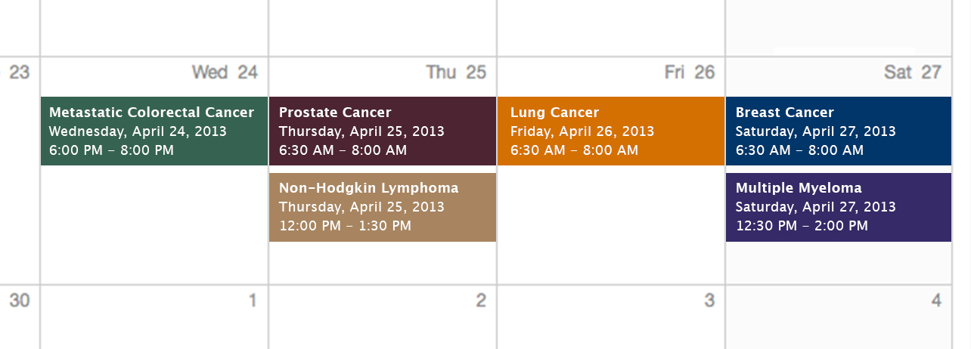
Challenging Cases Oncologist and Nurse Investigators Consult on Actual Patients from the Practices of the Invited Faculty

Slide 4
Themes — Challenging Cases in Oncology A 10-Hour Integrated Curriculum
Challenges associated with the incorporation of new research findings and newly approved agents into practice
Patient education on potential risks and benefits of specific oncologic treatments
Monitoring and management of treatment side effects and toxicities

Slide 5
Themes — Challenging Cases in Oncology A 10-Hour Integrated Curriculum
Participation in ongoing clinical trials as an important patient option
Psychosocial impact of cancer diagnosis and treatment — why all patients, even those with the same disease, are different
Strategies to cope with the stress of being an oncology professional

Slide 10
Agenda
Module 1: Care of patients with EGFR mutations 55 yo woman and never smoker presents with EGFR mutation-positive metastatic lung adenocarcinoma — Ms Culkin
Module 2: Chemobiologic therapy in the front-line and maintenance settings 51 yo woman and previous heavy smoker with pan-wild-type metastatic lung adenocarcinoma — Ms Eaby-Sandy 61 yo factory manager with progressive metastatic NSCLC through multiple lines of therapy is now responding to nab paclitaxel — Ms Eaby-Sandy

Slide 11
Agenda
Module 3: ALK- and ROS1-Positive NSCLC 54 yo owner of a company is undergoing crizotinib therapy after being diagnosed with EML4-ALK translocation-positive lung adenocarcinoma — Ms Culkin

Slide 12
New Agents/Regimens Recently Approved by the FDA
Cancer Type | Agent | Approval Date
Colorectal | Bev on progression | 1/13
 | Regorafenib | 9/12
 | Aflibercept | 8/12
Prostate | Enzalutamide | 8/12
 | Abiraterone | 4/11
 | Cabazitaxel | 6/10
 | Sipuleucel-T | 4/10
NHL: ALCL | Brentuximab vedotin | 8/11
NHL: T-cell lymphoma | Romidepsin | 11/09
 | Pralatrexate | 9/09
Cancer Type | Agent | Approval Date
Lung | Nab paclitaxel | 10/12
 | Crizotinib | 8/11
Breast | T-DM1 | 2/13
 | Everolimus | 7/12
 | Pertuzumab | 6/12
 | Eribulin | 11/10
Multiple myeloma | Pomalidomide | 2/13
 | Carfilzomib | 7/12
www.fda.gov

Slide 13
MODULE 1: Care of Patients with EGFR Tumor Mutations

Slide 14
Case (from the practice of Ms Culkin)
55 yo married woman (never smoker) with children in college presents in October 2012 with a cough and wheezing
Workup reveals a primary EGFR-mutant (exon 19 del) adenocarcinoma with lung, brain, liver and bone metastases
Erlotinib was administered and complete response observed in all sites, despite moderate rash and diarrhea
The patient’s daughters are concerned that the EGFR “mutation” is hereditary, putting them at risk for lung cancer

Slide 15
Incidence of Single Driver Mutations
Kris MG et al. 12th Annual Targeted Therapies in Lung Cancer 2012

Slide 16
Selection of first-line therapy for patients with EGFR mutation-positive NSCLC

Slide 17
Phase III EURTAC Study Design
Chemonaїve Stage IIIB/IV NSCLC EGFR exon 19 deletion or exon 21 L858R mutation ECOG PS 0-2 (n = 174)
Erlotinib
PD
R
Crossover
Platinum-based doublet chemotherapy
PD
Primary endpoint
Progression-free survival (PFS)
Rosell R et al. Lancet Oncol 2012;13(3):239-46.

Slide 18
EURTAC: Response, PFS and OS
 | Erlotinib (n = 86) | Chemotherapy (n = 87)
Overall response (CR + PR) | 58% | 15%
Median progression-free survival | 9.7 mos | 5.2 mos
Median overall survival | 19.3 mos | 19.5 mos
Crossover effect?
Rosell R et al. Lancet Oncol 2012;13(3):239-46.

Slide 19
EURTAC: Select Grade ≥3 Adverse Events (AEs)
Select Grade ≥3 AEs | Erlotinib (n = 84) | Chemo (n = 82)
Treatment-related AEs | 45% | 67%
Rash | 13% | 0%
Neutropenia | 0% | 22%
Anemia | 1% | 4%
Increased aminotransferase | 2% | 0%
Treatment-related deaths | 1% | 2%
Rosell R et al. Lancet Oncol 2012;13(3):239-46.

Slide 20
Strategies to effectively manage the dermatotoxicity associated with EGFR-directed therapy

Slide 21
Skin Rash from Tyrosine Kinase Inhibitors
Most frequent dermatologic side effect reported is acneiform eruption.
Affects mainly face, upper chest and/or back.
Also known as acne, acneiform skin reaction/rash, follicular rash, and maculopapular skin rash.
Ricciardi S et al. Clin Lung Cancer 2009;10(1):28-35.

Slide 22
Clinical Grades of Erlotinib-Induced Rash
Mild
Generally localized papulopustular reaction
Minimally symptomatic
No impact on daily activities
No sign of superinfection
Moderate
Generalized papulopustular reaction
Mild pruritus or tenderness
Minimal impact on daily activities
No sign of superinfection
Severe
Generalized papulopustular reaction
Severe pruritus or tenderness
Significant impact on daily activities
Potential for superinfection or has become superinfected
Saif MW et al. JOP 2008;9(3):267-74.

Slide 23
Prophylaxis of Dermatologic Toxicities with EGFR Inhibitors
Within first 6 weeks of EGFR TKI administration
Employ proactive approach
Thick, alcohol-free emollient cream
Sunscreen ≥SPF15, preferably with zinc oxide or titanium dioxide
Good hygiene
Lynch TJ et al. Oncologist 2007;12:610-21.

Slide 24
Management of Dermatologic Toxicities with EGFR Inhibitors
Hydrocortisone 2.5% cream
Clindamycin 1% gel
Pimecrolimus 1% cream
Doxycycline 100 mg BID
Minocycline 100 mg BID
Methylprednisolone dose pack
Erlotinib dose reduction or discontinuation
Lynch TJ et al. Oncologist 2007;12:610-21.

Slide 25
Erlotinib versus Afatinib
Erlotinib
Oral
FDA approved
Reversible EGFR TKI
Common side effects
Diarrhea
Rash/acne
Afatinib
Oral
Investigational agent
Granted FDA priority review 1/2013
Irreversible ErbB family blockade
Activity against T790M mutation
Common side effects
Diarrhea
Rash

Slide 26
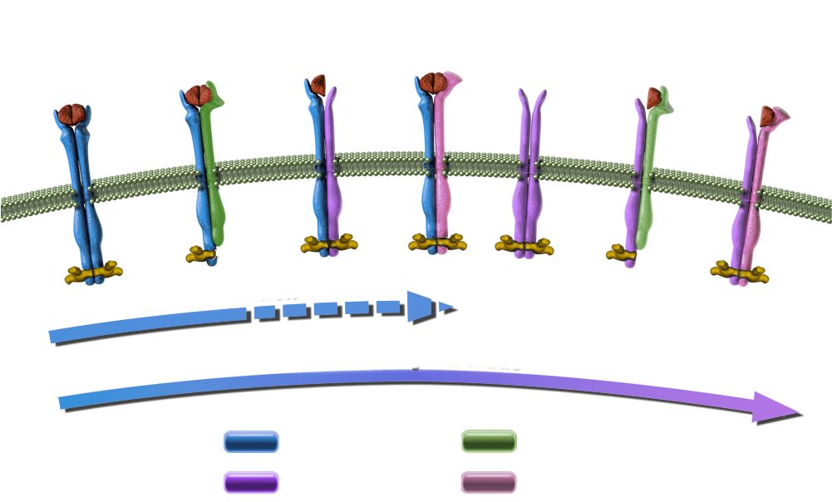
Afatinib: An Irreversible ErbB Family Blocker
Afatinib is an orally available, irreversible ErbB family blocker with high efficacy potential
Inhibition of ErbB family receptor heterodimerization
In vitro activity against EGFR-resistant T790M mutation
Adapted from Li D et al. Oncogene 2008;27:4702-11.

Slide 27
Phase III LUX-Lung 3 Study for Patients with Treatment-Naïve Advanced Lung Cancer
Stage IIIB/IV lung adenocarcinoma
EGFR mutation in tumor
R 2:1
Afatinib
Cisplatin + Pemetrexed
Primary endpoint: PFS
Secondary endpoints: ORR, DCR, DoR, tumor shrinkage, OS, patient-reported outcomes, safety, PK
Yang JC et al. Proc ASCO 2012;Abstract LBA7500.

Slide 28
LUX-Lung 3: Response and PFS (Independent Review)
 | Afatinib (n = 230) | Cis/pem (n = 115)
Response rate | 56.1% | 22.6%
Median progression-free survival | 11.1 mos | 6.9 mos
Yang JC et al. Proc ASCO 2012;Abstract LBA7500.

Slide 29
Possible Afatinib-Related AEs
Most Common AEs
Diarrhea
Rash/acne
Stomatitis/mucositis
Paronychia
Dry skin
Yang JC et al. Proc ASCO 2012;Abstract LBA7500.

Slide 30
Therapeutic options for patients with EGFR mutations and disease progression on first-line erlotinib

Slide 31
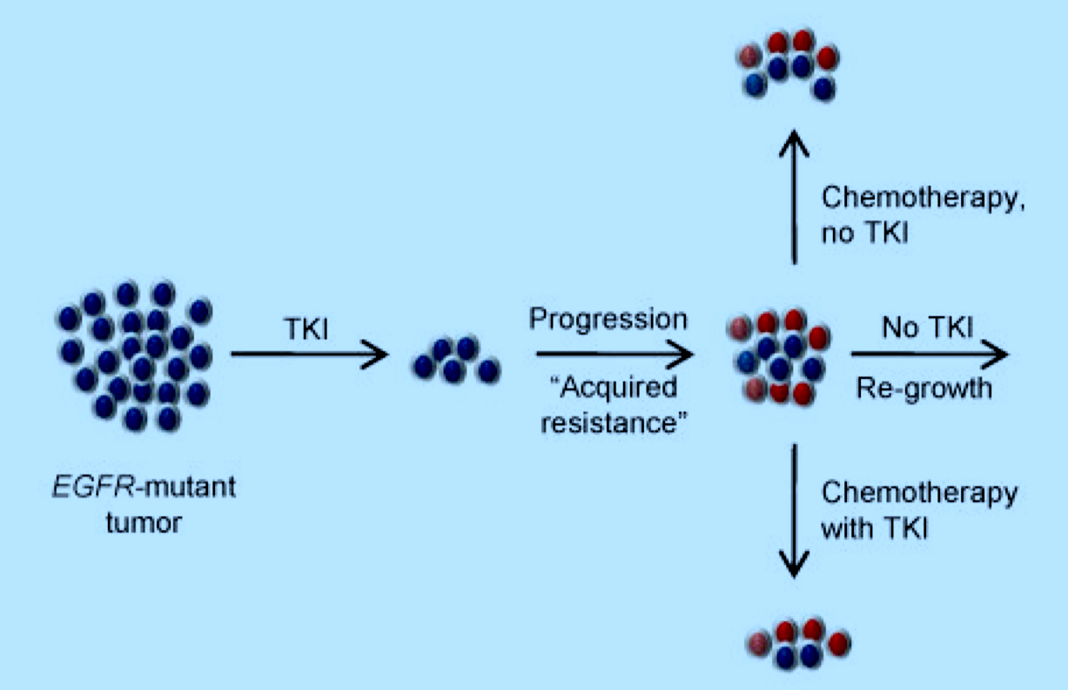
Treatment Options After Acquired Resistance to EGFR TKIs
Adapted from Oxnard GR et al. Clin Cancer Res 2011;17(17):5530-7.

Slide 32
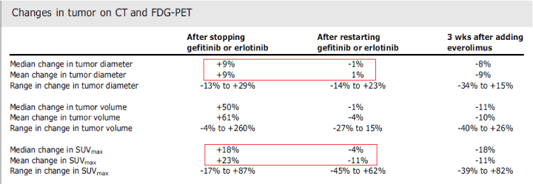
Cessation of EGFR TKI Upon Disease Progression
Riely GJ et al. Clin Cancer Res 2007;13(17):5150-5; Mok T. Mechanisms of resistance and treatment strategies, 2013.

Slide 33
Studies Evaluating Continuation of EGFR TKI After Progression in Patients with an EGFR Mutation
Trial Identifier | Phase | N | Study Arms
ASPIRATION (Asia) | II | 204 | Erlotinib continuation after PD or not (physician’s choice)
IMPRESS (NCT01544179) | III | 250 | Gefitinib continuation + cisplatin/pemetrexed Placebo + cisplatin/pemetrexed
Vanderbilt Study (PI: Leora Horn) | III | 120 | Erlotinib re-treatment after chemotherapy +/- erlotinib
www.clinicaltrials.gov, April 2013.

Slide 34
Phase Ib Study of Afatinib/Cetuximab
EGFR-mutant Advanced NSCLC Progressing on erlotinib or gefitinib N = 100
Afatinib + Cetuximab
ORR: 30%
Median PFS: 4.7 mos
Median DoR: 8 mos
Grade 3 Rash: 18%
Grade 3 Diarrhea: 7%
Janjigian YY et al. Proc ESMO 2012;Abstract 1227O.

Slide 35
Afatinib + cetuximab at MTD: Responses by T790M mutation
T790M+
T790M–
EGFR wt
Uninformative for T790M
50
40
30
20
10
0
–10
–20
–30
–40
–50
–60
–70
–80
–90
–100
–110
Maximum percentage decrease from baseline (%)
0 5 10 15 20 25 30 35 40 45 50 55 60 65 70 75 80 85 90 95
100
Patient index sorted by maximum % decrease
With permission from Janjigian YY et al. Proc ESMO 2012;Abstract 12007O.

Slide 36
Best Response Rates
Response | T790 Mutation Status |  | Total (n = 96)
 | T790M+ (n = 53) | T790M- (n = 39)
Clinical benefit rate | 81% | 64% | 75%
Median duration of response | 6.4 mos | 9 mos | 8 mos
Janjigian YY et al. Proc ESMO 2012;Abstract 12007O.
Notes:
36
36

Slide 37
Other Novel EGFR Inhibitors (eg, Dacomitinib)

Slide 38
Phase II Trial Design
Eligibility (N = 188)
Histologically confirmed advanced NSCLC Progression after 1-2 prior chemotherapy regimens Available tumor tissue No prior EGFR inhibitor
Erlotinib 150 mg/d PO (n = 94)
R
Dacomitinib 45 mg/d PO (n = 94)
Primary endpoint: Progression-free survival (PFS)
PFS: 2.86 mos (dacomitinib) vs 1.91 mos (erlotinib)
Ramalingam SS et al. J Clin Oncol 2012;30(27):3337-44.

Slide 39
MODULE 2: Chemobiologic Therapy in the Front-Line and Maintenance Settings

Slide 40
Case (from the practice of Ms Eaby-Sandy)
51 yo woman diagnosed with metastatic pan-wild-type adenocarcinoma in the bone and liver
Experiences disease progression on carboplatin/pemetrexed/bevacizumab followed by bevacizumab maintenance
Currently enrolling on AvaALL trial of switch chemotherapy with or without continuation of bevacizumab
Though formerly a heavy smoker at diagnosis, the patient has been able to quit with electronic cigarettes; she takes a variety of supplements ordered online

Slide 41
AvaALL Phase IIIb Study Design
Primary endpoint: OS
Stage IIIB/IV non-squamous NSCLC treated with platinum-doublet (4-6 cycles) + bevacizumab PLUS ≥2 cycles of bevacizumab maintenance
Chemo
+ bevacizumab
ICC + bevacizumab
ICC
± bevacizumab
R 1:1
PD₁
PD₂
PD₃
Chemo
ICC
ICC
Enroll
Chemo: Agents for second-line treatment of NSCLC limited to erlotinib, pemetrexed or docetaxel
ICC: The investigator’s choice of chemotherapeutic agents
PD_{1, 2, 3}: Progressive disease stage 1, 2, 3
Gridelli C et al. Clin Lung Cancer 2011;12(6):407-11.

Slide 42
Contraindications to the use of bevacizumab in patients with NSCLC

Slide 43
Potential Contraindications to Bevacizumab
Squamous cell histology
Hemoptysis
Recent myocardial infarction
Recent stroke
Active diverticulitis or history of diverticular abscess
Untreated brain metastases

Slide 44
Possible Bevacizumab-Associated Side Effects and Complications
Common Side Effects
Epistaxis
Rhinitis
Headache
Hypertension
Gr 3/4: 5-18%
Proteinuria
Serious Side Effects
Hemorrhage
Thromboembolism
GI perforation
Wound-healing complications
Reversible posterior leukoencephalopathy syndrome (RPLS)

Slide 45
Case (from the practice of Ms Eaby-Sandy)
61 yo man who quit smoking in 1981 presented with metastatic lung adenocarcinoma in 2011
Single-agent docetaxel administered after disease progression on carboplatin/pemetrexed/bevacizumab
Diffuse pneumonitis requiring hospitalization occurs after 2nd cycle, for which the patient continues to receive oxygen
Nanoparticle albumin-bound (nab) paclitaxel administered, resulting in a response after 2 cycles and limited toxicity
Patient is a factory manager actively involved in his church who submitted an advanced directive last June

Slide 46
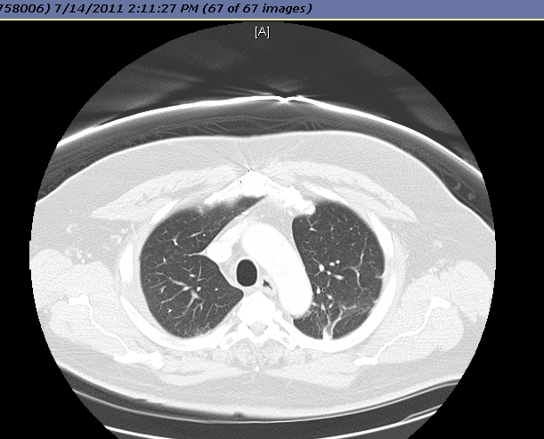
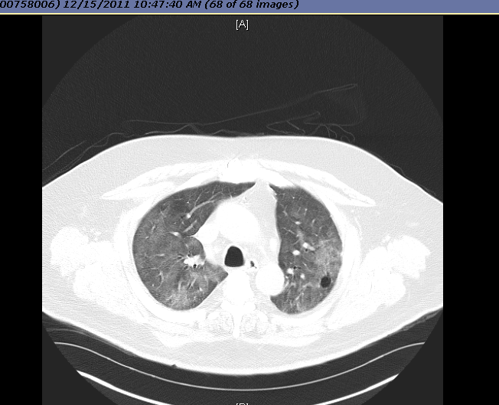
Case: Pre- and Postdocetaxel Pneumonitis
Pre-treatment
Post-treatment
Courtesy of Beth Eaby-Sandy.

Slide 47
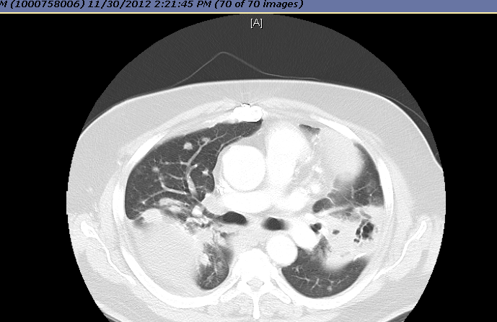
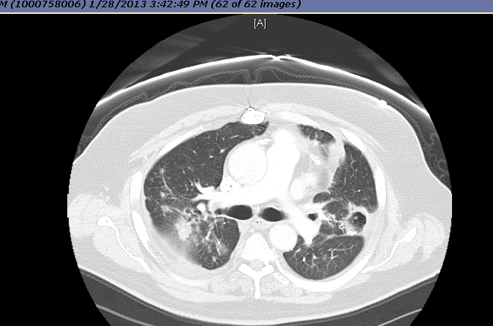
Case: Lung Metastasis Prior and Midcourse Through Therapy with Nab Paclitaxel
Pre-treatment
Post-treatment
Courtesy of Beth Eaby-Sandy.

Slide 48
FDA approval and rational integration of nab paclitaxel into the treatment algorithm for NSCLC

Slide 49
FDA Approves Nab Paclitaxel in Combination with Carboplatin for NSCLC
On October 11, 2012, the US Food and Drug Administration approved paclitaxel protein-bound particles for injectable suspension, albumin-bound (nab-paclitaxel) for use in combination with carboplatin for the initial treatment of patients with locally advanced or metastatic non-small cell lung cancer (NSCLC) who are not candidates for curative surgery or radiation therapy.
Approval was based on prior approval of paclitaxel and the positive results of the CA031 trial
http://www.cancer.gov/cancertopics/druginfo/fda-nanoparticle-paclitaxel

Slide 50
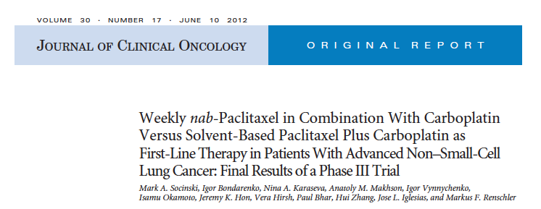
Socinski MA et al. J Clin Oncol 2012;30(17):2055-62.

Slide 51
CA031 Study Design
Nab paclitaxel Carboplatin No Premedication
Chemonaïve PS 0-1 Stage IIIb/IV NSCLC N = 1,052
R 1:1
Paclitaxel Carboplatin With Premedication of Dexamethasone + Antihistamines
Socinski MA et al. J Clin Oncol 2012;30(17):2055-62.

Slide 52
Response and Survival Outcomes: Nab-P versus Paclitaxel
ORR
ITT: 33% vs 25%
Squamous: 41% vs 24%
Progression-Free Survival
ITT: 6.3 vs 5.8 mos
Overall Survival
ITT: 12.1 vs 11.2 mos
≥ 70 yo: 19.9 vs 10.4 mos
Socinski MA et al. J Clin Oncol 2012;30(17):2055-62.

Slide 53
Possible Side Effects Associated with Nab Paclitaxel and Solvent-based Paclitaxel
Grade | nab-PC (n = 514) |  | sb-PC (n = 524)
 | 3 | 4 | 3 | 4
Neutropenia* | 33% | 14% | 32% | 26%
Thrombocytopenia† | 13% | 5% | 7% | 2%
Anemia† | 22% | 5% | 6% | <1%
Febrile neutropenia§ | <1% | <1% | 1% | <1%
Fatigue§ | 4% | <1% | 6% | <1%
Sensory neuropathy* | 3% | 0% | 11% | <1%
*p<0.05 in favor of nab-PC; †p<0.05 in favor of sb-PC; §NSD between arms
Socinski MA et al. J Clin Oncol 2012;30(17):2055-62.

Slide 54
MODULE 3: ALK- and ROS1-Positive NSCLC

Slide 55
Case (from the practice of Ms Culkin)
54 yo woman and never smoker presented in January 2012 with visual changes and left-sided paralysis
Symptoms were suggestive of a stroke thought to be related to an underlying adenocarcinoma of the lung with pleural involvement
An EML4-ALK translocation was found; patient received crizotinib that resulted in tumor regression
A new pleural effusion was noted in December and treated with VATS pleurodesis; crizotinib continued
The patient is an avid marathon runner/triathlete who owns a company and has 3 daughters in college
She is engaged to a “high-profile” man she met on a blind date

Slide 56
Incidence of ALK/ROS1 alterations

Slide 57
ALK and ROS1 Encode Related Receptor Tyrosine Kinases
Ron
ROS1
ALK
LTK
PTK7
Brock TG, Receptors and Tyrosine Kinases
http://www.caymanchem.com/app/template/Article.vm/article/2187

Slide 58
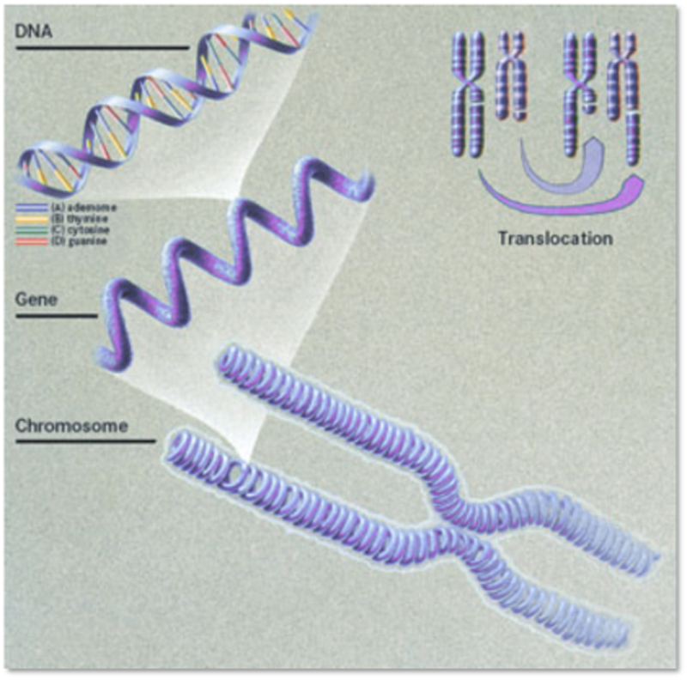
ALK Rearrangement in Cancer
Chromosomal translocation most common ALK abnormality in cancer
Rearrangement of genetic info when parts of one chromosome break off and fuse with another, or flip around (inversion)
Results in new gene and expression of fusion protein
Adapted from Cancer Genome Atlas, National Cancer Institute

Slide 59
Available clinical data and ongoing trials with crizotinib for patients with ALK/ROS1-positive NSCLC

Slide 60
PROFILE 1007: Crizotinib-Related Adverse Events
Most AEs mild and manageable
Common side effects
Visual disturbance
Diarrhea
Nausea
Vomiting
Hypogonadism
Most Grade 3/4 AEs < 5% of patients, except:
Elevated transaminases: 16%
Neutropenia: 13%
Pulmonary embolism: 5%
Shaw AT et al. Proc ESMO 2012;Abstract LBA1_PR.

Slide 61
Activity of Crizotinib in ALK+ NSCLC Update of the Phase 2 Study*
Validates the activity of crizotinib in ALK+ lung cancer
Waterfall plot almost identical to Phase I study
50-60% of patients had a confirmed partial or complete response
*n=240 response-evaluable patients from the mature population, and excludes patients with early death, indeterminate response and non-measurable disease
Kim et al., ASCO 2012

Slide 62
Crizotinib resistance and ongoing investigation of novel ALK inhibitors

Slide 63
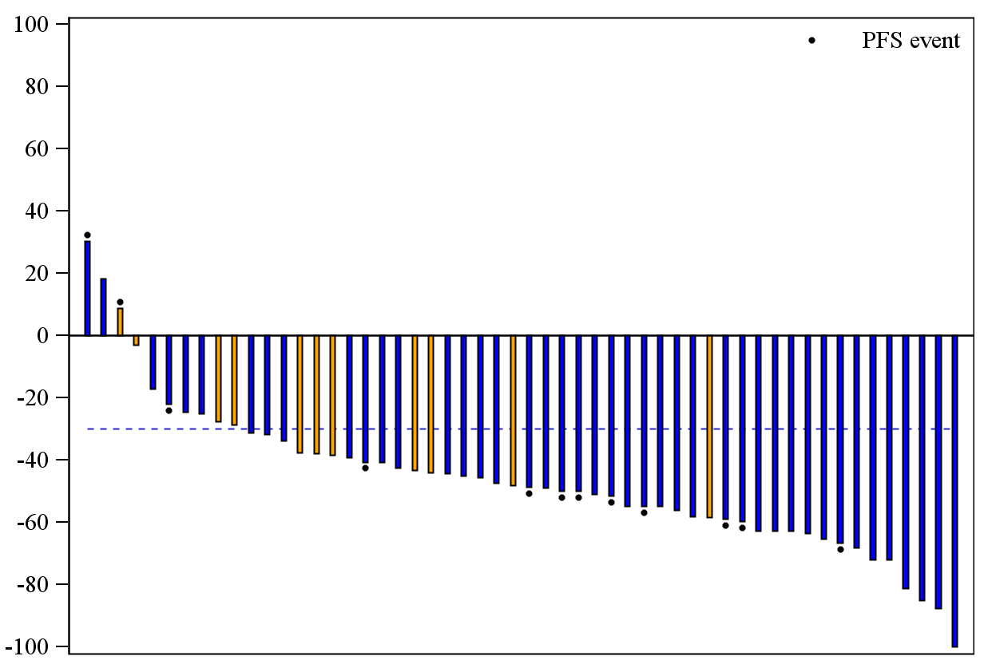
LDK378 Induces Responses in the Majority of Crizotinib-Resistant Patients
100
Best % change from baseline
LDK378 400–750 mg PO qd; lung cancer patients only
80
60
40
20
Best (%) change from baseline
0
–20
–40
–60
–80
Progression or death
–100
Prior crizotinib Crizotinib-naïve
With permission from Shaw et al., ESMO 2012

Slide 64
Typical response to LDK378
Baseline
After 3.5 weeks
With permission from Shaw et al., ESMO 2012

