Slide 1
Please note, these are the actual video-recorded proceedings from the live CME event and may include the use of trade names and other raw, unedited content. Select slides from the original presentation are omitted where Research To Practice was unable to obtain permission from the publication source and/or author. Links to view the actual reference materials have been provided for your use in place of any omitted slides.

Slide 2
Challenging Cases in Metastatic Colorectal Cancer (CRC)
Oncologist and Nurse Investigators Consult on Actual Patients from the Practices of the Invited Faculty Wednesday, April 24, 2013
6:00 PM – 8:00 PM
Washington, DC
Faculty
Charles S Fuchs, MD, MPH
Axel Grothey, MD
Jessica Mitchell, RN, CNP, MPH
Tammy Triglianos, RN, MS, APRN, BC, AOCNP
Moderator Neil Love, MD

Slide 3
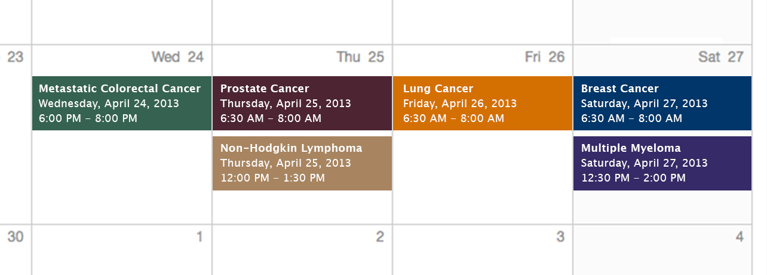
Challenging Cases Oncologist and Nurse Investigators Consult on Actual Patients from the Practices of the Invited Faculty

Slide 4
Themes — Challenging Cases in Oncology A 10-Hour Integrated Curriculum
Challenges associated with the incorporation of new research findings and newly approved agents into practice
Patient education on potential risks and benefits of specific oncologic treatments
Monitoring and management of treatment side effects and toxicities

Slide 5
Themes — Challenging Cases in Oncology A 10-Hour Integrated Curriculum
Participation in ongoing clinical trials as an important patient option
Psychosocial impact of cancer diagnosis and treatment — why all patients, even those with the same disease, are different
Strategies to cope with the stress of being an oncology professional

Slide 10
Agenda
MODULE 1:
62 yo woman with K-ras-mutant metastatic CRC — Ms Mitchell
MODULE 2:
27 yo man with primary colon cancer and liver metastases — Ms Triglianos
MODULE 2:
56 yo man with a primary rectosigmoid cancer and widespread metastases — Ms Mitchell

Slide 11
Agenda
MODULE 3:
72 yo man presents with liver metastases from colon cancer — Ms Triglianos
MODULE 4:
46 yo woman with K-ras wild-type metastatic CRC — Ms Mitchell
MODULE 5:
42 yo woman who undergoes HIPEC chemotherapy followed by FOLFIRI/bevacizumab and regorafenib — Ms Triglianos

Slide 12
New Agents/Regimens Recently Approved by the FDA
Cancer Type | Agent | Approval Date
Colorectal | Bev on progression | 1/13
 | Regorafenib | 9/12
 | Aflibercept | 8/12
Prostate | Enzalutamide | 8/12
 | Abiraterone | 4/11
 | Cabazitaxel | 6/10
 | Sipuleucel-T | 4/10
NHL: ALCL | Brentuximab vedotin | 8/11
NHL: T-cell lymphoma | Romidepsin | 11/09
 | Pralatrexate | 9/09
Cancer Type | Agent | Approval Date
Lung | Nab paclitaxel | 10/12
 | Crizotinib | 8/11
Breast | T-DM1 | 2/13
 | Everolimus | 7/12
 | Pertuzumab | 6/12
 | Eribulin | 11/10
Multiple myeloma | Pomalidomide | 2/13
 | Carfilzomib | 7/12
www.fda.gov

Slide 13
MODULE 1: NEW AGENTS AND TREATMENT STRATEGIES FOR METASTATIC COLORECTAL CANCER (mCRC)

Slide 14
Case (from the practice of Ms Mitchell)
62 yo married woman is followed for a year with anemia
Develops metastatic K-ras-mutant CRC to the liver and lungs
Received multiple lines of systemic treatment including various chemo agents plus bevacizumab
Hypertension requiring 3 medications
Currently receiving regorafenib
Continued hypertension, very mild hand-foot syndrome
Patient and family deeply resentful at the lost opportunity for earlier diagnosis and took legal action against the primary care team
Notes:
14
14
14

Slide 15
Impact of K-ras Mutation Status on Selection of Systemic Treatment

Slide 16
Impact of K-ras Status on Treatment Selection for mCRC
K-ras mutations in codons 12 and 13 predict for lack of response to EGFR antibodies cetuximab or panitumumab
K-ras mutant and wild type responsive to anti-VEGF agents

Slide 17
Sequencing of Systemic Agents in K-ras Wild-Type or K-ras-Mutant CRC
First-line
Chemo A + bevacizumab
PD
Chemo B + bevacizumab or aflibercept
Second-line
PD
Regorafenib can be used third line for mutant K-ras and third or fourth line for wild-type K-ras (NCCN guidelines v.3.2013)
Third-line
Anti-EGFR (cetuximab)
± irinotecan
PD
Fourth-line
Regorafenib
Courtesy of Eric Van Cutsem, MD, PhD - 2013

Slide 18
Recent Clinical Trial Data Evaluating the Continuation of Bevacizumab for Patients with Disease Progression on First-Line Chemotherapy/Bevacizumab

Slide 19
Patterns of Chemotherapy (CT) Use in a Cohort of US Patients with Metastatic Colorectal Cancer
Line of Therapy | % Patients | Median Duration
First | 100% | 170 days
Second | 53% | 139 days
Third | 28% | 135 days
Fourth | 13% | 126 days
Among 51% of patients who received bevacizumab (bev) in first line, 34% continued bev beyond progression in second line.
Abrams TA et al. Proc ASCO 2012;Abstract 3537.

Slide 20
FDA Approves New Use of Bevacizumab Plus Chemotherapy in mCRC
“On January 23, 2013, the US Food and Drug Administration approved bevacizumab for use in combination with fluoropyrimidine-irinotecan or fluoropyrimidine-oxaliplatin based chemotherapy for the treatment of patients with metastatic colorectal cancer (mCRC) whose disease has progressed on a first-line bevacizumab-containing regimen.”
The approval is based on positive results from the Phase III ML18147 study.
FDA's Office of Hematology and Oncology Products Press Release, January 23, 2013
Notes:
20
20
20

Slide 21
Bevacizumab Beyond Progression (BBP) BRiTE: Nonrandomized, Observational Cohort Study
Unresectable mCRC treated with first-line chemotherapy + bevacizumab (n = 1,953)
First progression
(n = 1,445)
Median Overall Survival: 19.9 v. 31.8 mos
Overall Survival Beyond PD: 9.5 v. 19.2 mos
Physician decision (no randomization)
No post-PD treatment (n = 253)
No bevacizumab post-PD (n = 531)
Bevacizumab post-PD (n = 642)
Grothey A et al. JCO 2008;26:5326-34.

Slide 22
TML (ML18147): Phase III Study of Bevacizumab Beyond First Disease Progression
Standard second-line CT
Progression on bevacizumab + standard first-line CT (either oxaliplatin or irinotecan-based) (n = 820)
R
Bevacizumab + standard second-line CT
CT switch:
Oxaliplatin → Irinotecan
Irinotecan → Oxaliplatin
Median survival: 11.2 vs 9.8 months
Arnold D et al. Proc ASCO 2012;Abstract CRA3503.

Slide 23
Toxicities Associated with Long-Term Anti-VEGF Therapy; Selection and Use of Antihypertensive Medications

Slide 24
Possible Side Effects Associated with Bevacizumab
Common Side Effects
Nosebleeds
Rhinitis
Headache
Hypertension
Proteinuria
Lacrimation disorder
Serious Side Effects
Hemorrhage
Thromboembolism
GI perforation
Wound-healing complications
Reversible posterior leukoencephalopathy syndrome (RPLS)

Slide 25
Selection of Second-Line Therapy

Slide 26
Agents Targeting the VEGF Pathway
VEGF-A
Anti-VEGFR2 antibody (ramucirumab)
Anti-VEGF antibody (bevacizumab)
Soluble VEGF receptor (Ziv-aflibercept)
VEGFR-1
VEGFR-2
VEGFR-3
P
P
P
P
P
P
P
P
P
P
P
P
Endothelial cell
Small-molecule inhibitors of VEGFR (regorafenib, PTK-787, AZD2171, motesanib, sunitinib, sorafenib, pazopanib, axitinib, etc)

Slide 27
FDA Approves Ziv-Aflibercept with FOLFIRI in mCRC
“On August 3, 2012, the US Food and Drug Administration approved ziv-aflibercept injection for use in combination with 5-fluorouracil, leucovorin, irinotecan (FOLFIRI) for the treatment of patients with metastatic colorectal cancer (mCRC) that is resistant to or has progressed following an oxaliplatin‑containing regimen.”
The approval is based on positive results from the Phase III VELOUR trial.
FDA's Office of Hematology and Oncology Products Press Release, August 3, 2012
Notes:
27
27
27

Slide 28
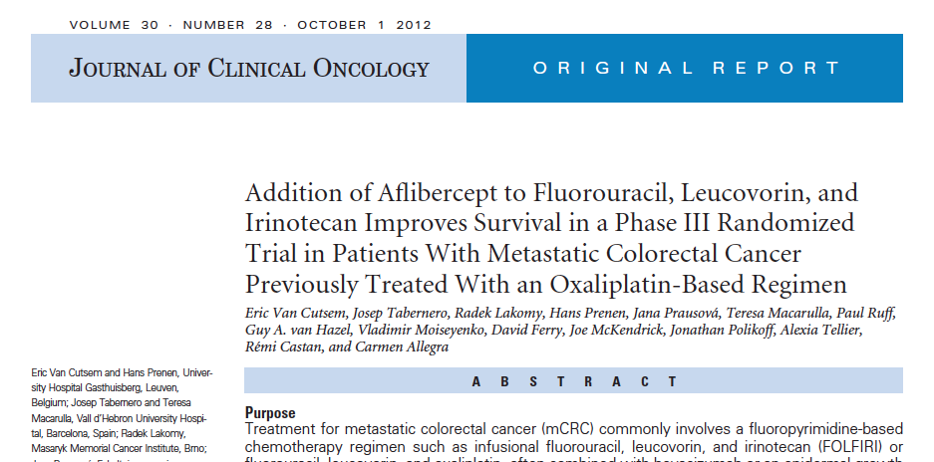
Van Cutsem E et al. J Clin Oncol 2012;30(28):3499-506.

Slide 29
VELOUR: A Phase III Randomized Study with Ziv-Aflibercept versus Placebo in Combination with FOLFIRI in Second-Line mCRC
Placebo +
FOLFIRI
(n = 614)
Patients with mCRC after failure of an oxaliplatin-based regimen in first line
(n = 1,226)
R
Ziv-Aflibercept + FOLFIRI (n = 612)
Median survival: 13.5 vs 12.1 months
Van Cutsem E et al. J Clin Oncol 2012;30(28):3499-506.

Slide 30
Possible Side Effects Associated with Ziv-Aflibercept
Anti-VEGF-Associated Side Effects
Hypertension
Hemorrhage
Arterial and venous thromboembolic events
Proteinuria
Chemotherapy-Like Side Effects
Diarrhea
Asthenic conditions
Stomatitis and ulceration
Infections
Hand-foot syndrome
Cytopenias
Van Cutsem E et al. J Clin Oncol 2012;30(28):3499-506.

Slide 31
Recent FDA Approval of Regorafenib and Integration into Clinical Practice

Slide 32
FDA Approves Regorafenib in mCRC
“On September 27, 2012, the US Food and Drug Administration approved regorafenib, for the treatment of patients with metastatic colorectal cancer (mCRC) who have been previously treated with fluoropyrimidine-, oxaliplatin-, and irinotecan-based chemotherapy, with an anti-VEGF therapy, and, if KRAS wild type, with an anti-EGFR therapy.”
The approval is based on positive results from the Phase III CORRECT trial (Study 14387).
FDA's Office of Hematology and Oncology Products Press Release, September 27, 2012
Notes:
32
32
32

Slide 33
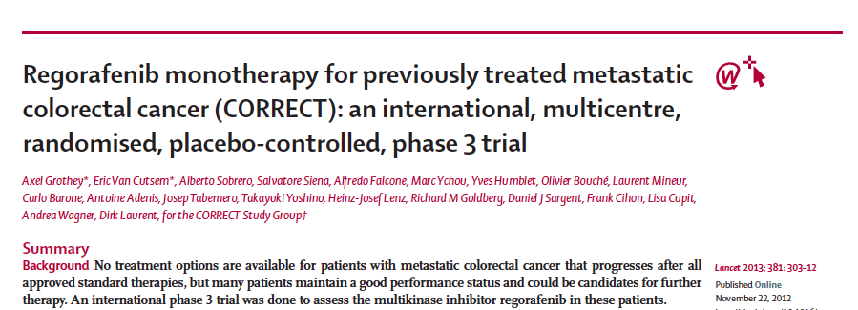
Grothey A et al. Lancet 2013;381(9863):303-12.

Slide 34
CORRECT: Study Design and Survival Outcome
Regorafenib + BSC
Pts with refractory metastatic CRC (n = 760)
2:1
R
Placebo + BSC
Median survival: 6.4 vs 5.0 months
Grothey A et al. Lancet 2013;381(9863):303-12.

Slide 35
Identification and Management of Regorafenib-Related Side Effects

Slide 36
Possible Side Effects Associated with Regorafenib
Hand-foot skin reaction
Fatigue
Diarrhea
Hypertension
Rash or desquamation
Grothey A et al. Lancet 2013;381(9863):303-12.

Slide 37
Possible Side Effects Associated with Regorafenib — Hepatotoxicity
“Severe and sometimes fatal hepatotoxicity has been observed in clinical trials. Monitor hepatic function prior to and during treatment. Interrupt and then reduce or discontinue regorafenib for hepatotoxicity as manifested by elevated liver function tests or hepatocellular necrosis, depending upon severity and persistence.”
Regorafenib Full Prescribing Information, Issued 9/2012

Slide 38
Similarities and Differences in HFS Observed with Commonly Used Anticancer Treatments

Slide 39
Hand-Foot Syndrome
“Palmoplantar erythrodysesthesia”
Most clinically significant dermatologic adverse event associated with multikinase inhibitors with all grade incidences of:
Sorafenib = 60%
Sunitinib = 30%
Regorafenib = 46%
May affect palms, soles and other areas exposed to friction or trauma
Reaction usually appears within first 6 weeks of therapy
Lacouture M. ASCO Post 2012;3(18). www.ascopost.com.

Slide 40
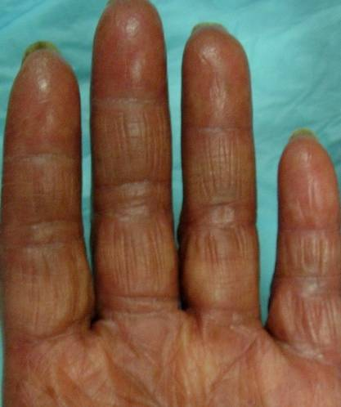
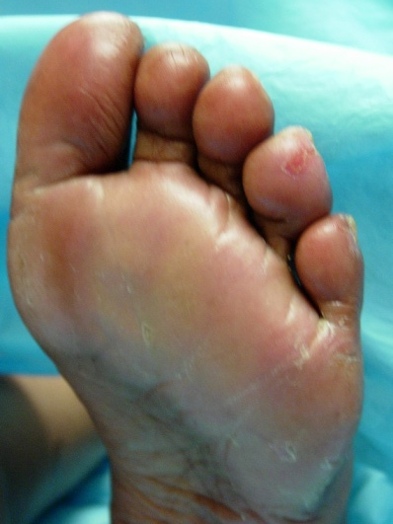
Getting a Handle on Hand-Foot Syndrome?
Topicals
Urea/Lactic acid
Orals
Pyridoxine
Celecoxib
Inflammation
(Tenderness, edema, erythema)
Hyperkeratosis
(Thickening, peeling, cracking)
Topicals
Urea 40% cream
Salicylic acid cream
Clobetasol 0.05% cream
Courtesy of M Lacouture.

Slide 41
Case (from the practice of Ms Mitchell)
62 yo married woman is followed for a year with anemia
Develops metastatic K-ras-mutant CRC to the liver and lungs
Received multiple lines of systemic treatment including various chemo agents plus bevacizumab
Hypertension requiring 3 medications
Currently receiving regorafenib
Continued hypertension, very mild hand-foot syndrome
Patient and family deeply resentful at the lost opportunity for earlier diagnosis and took legal action against the primary care team
Notes:
41
41
41

Slide 42
MODULE 2: MANAGEMENT OF SIMULTANEOUSLY OCCURING PRIMARY TUMORS AND METASTASES

Slide 43
Case (from the practice of Ms Triglianos)
27 yo married army sergeant with a 3 yo daughter
Presents with primary colon cancer and liver metastases
FOLFOX/bevacizumab x 12
No major toxicity
Response in primary tumor and liver
Exercises every day to maintain “emotional balance”
Notes:
43
43
43

Slide 44
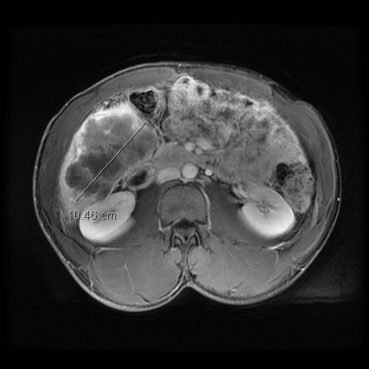
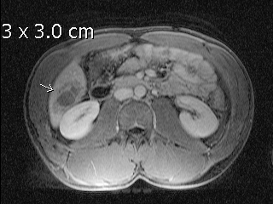
Case: Liver Metastases Prior and Midcourse Through Therapy
Prior to Therapy
Midcourse
10.46 cm
Courtesy of T. Triglianos

Slide 45
Potential Risks and Benefits of Not Resecting the Primary Tumor

Slide 46
Role of Up-Front Systemic Therapy for Patients Presenting with a Primary Tumor and Simultaneous Metastatic Disease

Slide 47
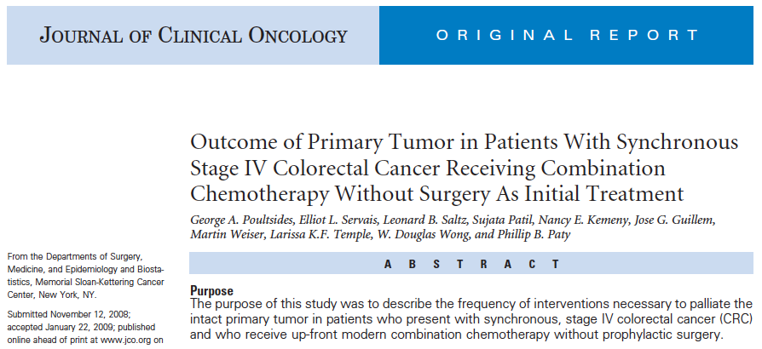
Poultsides GA et al. J Clin Oncol 2009;27(20):3379-84.

Slide 48
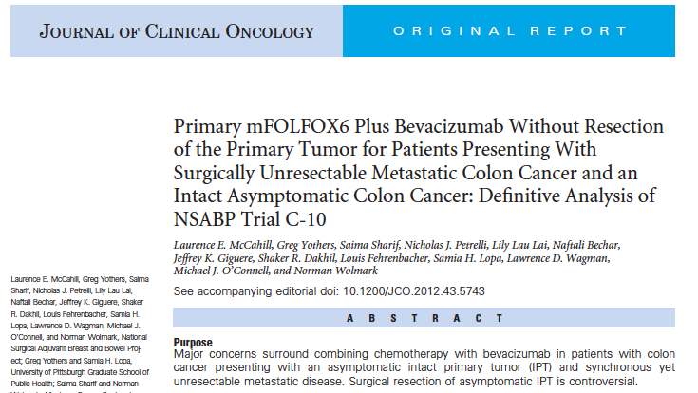
McCahill LE et al. J Clin Oncol 2012;30(26):3223-8.

Slide 49
NSABP C-10: Phase II Trial of mFOLFOX6 + Bevacizumab without Resection of the Primary Tumor for Patients with Unresectable Metastatic Colon Cancer
Asymptomatic, intact primary tumor (IPT)
Unresectable metastases
(n = 86)
mFOLFOX6 +
Bevacizumab
12 patients (14%) with major morbidity related to IPT
10 patients required surgery
2 patients died
McCahill LE et al. J Clin Oncol 2012;30(26):3223-8.

Slide 50
Rationale for and Appropriate Timing of Bevacizumab Discontinuation for Patients Scheduled to Undergo Surgery

Slide 51
Case (from the practice of Ms Triglianos)
27 yo married army sergeant with a 3 yo daughter
Presents with primary colon cancer and liver metastases
FOLFOX/bevacizumab x 12
No major toxicity
Response in primary tumor and liver
Exercises every day to maintain “emotional balance”
Notes:
51
51
51

Slide 52
Case (from the practice of Ms Mitchell)
56-year-old man who was a very successful, extremely hard-working banking executive
Presents with a primary rectosigmoid tumor and widespread metastatic disease
FOLFOX/bevacizumab
Dramatic symptom improvement and tumor regression
Prior to the diagnosis spent little time with his family
Since the diagnosis his lifestyle has changed dramatically
Notes:
52
52
52

Slide 53
Case: Liver Metastases Treated with
FOLFOX/Bevacizumab
May 2012: Colorectal cancer metastatic to the liver
Patient received FOLFOX/bevacizumab; noticeably less burden of disease visible in July 2012

Slide 54
Case: Rectal Mass Treated with FOLFOX/ Bevacizumab
May 2012: Patient receives FOLFOX/bevacizumab for rectal mass
July 2012: A response is seen on follow-up imaging

Slide 55
MODULE 3: CLINICAL APPROACHES FOR POTENTIALLY CURABLE HEPATIC METASTASES

Slide 56
Case (from the practice of Ms Triglianos)
72-year-old college professor with medically controlled schizophrenia who was divorced from his wife of 40 years 2 years ago
Diagnosed in 2005 with Stage II colon cancer
Now presents with biopsy-proven liver metastases
Capecitabine plus bevacizumab
Notes:
56
56
56

Slide 57
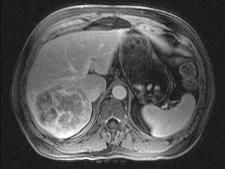
Case: Initial Scan of Liver Metastases
Courtesy of T. Triglianos
Notes:
57
57
57

Slide 58
Potential Role of Diet and Exercise in Reducing the Risk of CRC Recurrence

Slide 59
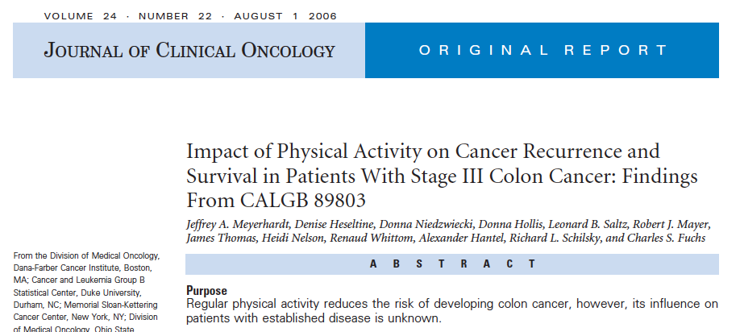
Patients who engaged in the equivalent of walking 6 or more hours per week at an average pace had a significant 47% improvement in disease-free survival.
Meyerhardt JA et al. J Clin Oncol 2006;24(22):3535-41.
Notes:
59
59
59

Slide 60
MODULE 4: ROLE OF EGFR ANTIBODIES IN mCRC

Slide 61
Case (from the practice of Ms Mitchell)
46-year-old single woman lives with her mother
K-ras wild-type mCRC responds to treatment with FOLFOX/cetuximab
Severe treatment-associated dermatologic toxicity
Her face is erythematous, tender and painful
Previously very socially active but now feels so disfigured that she cannot leave her home or go to work
After disease progression: Switched to FOLFIRI/bev
After 4 cycles: Diagnosed with a pulmonary embolus
Started on irinotecan and cetuximab
Notes:
61
61
61

Slide 62
Integration of EGFR Antibodies (Cetuximab, Panitumumab) Into Treatment of K-ras Wild-Type Disease

Slide 63
Optimal Approach to Prevention and Management of Dermatologic Complications Associated with EGFR Antibodies

Slide 64
EGFR Antibody-Induced Rash
Red papulopustules
Pruritus, tenderness in 62%
Cetuximab
All grade: 85%
Grade 3: 10%
Sheperd et al NEJM 2004; Rosell et al, Ann Oncol 2007; Van Cutsem et al, J Clin Oncol 2008; Geyer et al. J Clin Oncol 2008

Slide 65
Lacouture ME et al. J Clin Oncol 2010;28(8)1351-57.

Slide 66
STEPP: Pre-emptive versus Reactive Treatment for Skin Toxicities Associated with the EGFR Antibodies
Pre-emptive skin treatment consisted of:
Skin moisturizer applied daily
Sunscreen before heading outdoors
Topical steroid applied at bedtime
Doxycycline
Pre-emptive skin treatment resulted in:
Decreased Grade ≥2 dermatologic toxicities
Less impairment of quality of life
Lacouture ME et al. J Clin Oncol 2010;28(8)1351-57.
Notes:
66
66
66

Slide 67
Incidence of Infusion Reactions in Patients Receiving EGFR Antibodies

Slide 68
MODULE 5: MANAGEMENT OF mCRC WITH HEATED INTRAPERITONEAL CHEMOTHERAPY (HIPEC)

Slide 69
Case (from the practice of Ms Triglianos)
42-year-old unmarried woman who lives with her mother and previously worked with mentally disabled people
Metastatic CRC
Receives heated intraperitoneal chemotherapy (HIPEC) for peritoneal metastases
FOLFIRI/bevacizumab
Regorafenib
Patient is becoming progressively depressed in response to her medical condition and does not wish to receive antidepressants
Notes:
69
69
69

Slide 70
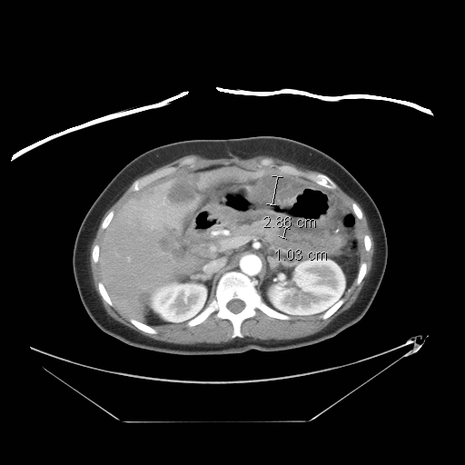
Case: Peritoneal Disease
2.86 cm
1.03 cm
Courtesy of T. Triglianos

Slide 71
Role of HIPEC in the Therapeutic Management of mCRC

Slide 72
Hyperthermic Intraperitoneal Chemotherapy (HIPEC)
Life expectancy from peritoneal metastases is very short: 18-48 months from mCRC
Significant morbidity and death from disease progression in abdominal cavity
HIPEC
Intensive regional treatment to site of micrometastases
Delivers chemo and hyperthermia to all serosal surfaces
Hyperthermia: Direct lethal effect on tumor, potentiates cytotoxicity of chemo
Improves survival, QOL and pain
Limits unnecessary toxicity from chemo
Zhu Y et al. J Gastrointest Oncol 2013;4(1):62-71.

Slide 73
How HIPEC Works

