Slide 1
Please note, these are the actual video-recorded proceedings from the live CME event and may include the use of trade names and other raw, unedited content. Select slides from the original presentation are omitted where Research To Practice was unable to obtain permission from the publication source and/or author. Links to view the actual reference materials have been provided for your use in place of any omitted slides.

Slide 2
Challenging Cases in Breast Cancer
Oncologist and Nurse Investigators Consult on Actual Patients from the Practices of the Invited Faculty Saturday, April 27, 2013
6:30 AM – 8:00 AM
Washington, DC
Faculty
Kimberly L Blackwell, MD
Lisa A Carey, MD
Georgia Litsas, MSN, ANP-BC, AOCNP
G Lita Smith, RN, ACNP
Moderator Neil Love, MD

Slide 3
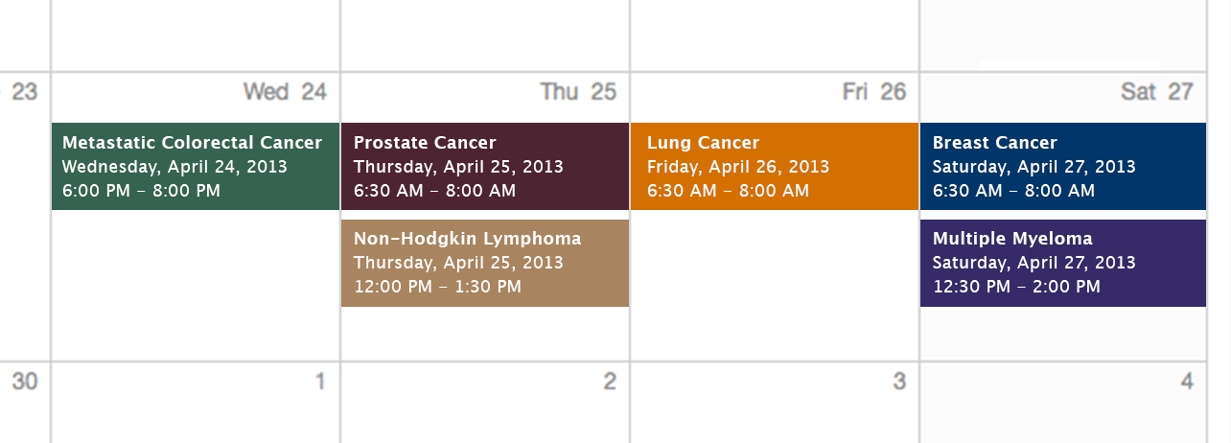
Challenging Cases Oncologist and Nurse Investigators Consult on Actual Patients from the Practices of the Invited Faculty

Slide 4
Themes — Challenging Cases in Oncology A 10-hour Integrated Curriculum
Challenges associated with the incorporation of new research findings and newly approved agents into practice
Patient education on potential risks and benefits of specific oncologic treatments
Monitoring and management of treatment side effects and toxicities

Slide 5
Themes — Challenging Cases in Oncology A 10-hour Integrated Curriculum
Participation in ongoing clinical trials as an important patient option
Psychosocial impact of cancer diagnosis and treatment — why all patients, even those with the same disease, are different
Strategies to cope with the stress of being an oncology professional

Slide 6


Slide 7


Slide 8


Slide 9


Slide 10
Agenda
Module 1: Current Management of Advanced HER2-Positive Breast Cancer (BC) 47 yo woman was diagnosed in 2003 with ER-positive, HER2-positive, node-positive BC — Ms Litsas 63 yo woman presented in 2008 with back pain and was found to have biopsy-proven metastatic ER/PR-negative BC — Ms Smith

Slide 11
Agenda
Module 2: Role of Chemotherapy for Patients with HER2-Negative Metastatic BC 54 yo woman was diagnosed with liver metastases while receiving adjuvant AC for node-positive, ER-positive, HER2-negative BC — Ms Litsas
Module 3: Sequential Management of ER-Positive, HER2-Negative Metastatic BC 68 yo woman underwent lumpectomy in 2011 for a 4.8-cm BC — Ms Smith

Slide 12
New Agents/Regimens Recently Approved by the FDA
Cancer Type | Agent | Approval Date
Colorectal | Bev on progression | 1/13
 | Regorafenib | 9/12
 | Aflibercept | 8/12
Prostate | Enzalutamide | 8/12
 | Abiraterone | 4/11
 | Cabazitaxel | 6/10
 | Sipuleucel-T | 4/10
NHL: ALCL | Brentuximab vedotin | 8/11
NHL: T-cell lymphoma | Romidepsin | 11/09
 | Pralatrexate | 9/09
Cancer Type | Agent | Approval Date
Lung | Nab paclitaxel | 10/12
 | Crizotinib | 8/11
Breast | T-DM1 | 2/13
 | Everolimus | 7/12
 | Pertuzumab | 6/12
 | Eribulin | 11/10
Multiple myeloma | Pomalidomide | 2/13
 | Carfilzomib | 7/12
www.fda.gov

Slide 13
MODULE 1: Current Management of Advanced HER2-Positive Breast Cancer (BC)

Slide 14
Case (from the practice of Ms Litsas)
2003: A 37 yo woman s/p surgical resection of an ER+, HER2+, node+ BC
NSABP HER2 adjuvant trial: Randomly assigned to chemo without trastuzumab followed by tamoxifen
2008: Extensive mets to the liver, brain and bone
Subsequently: 7 lines of anti-HER2 treatment with chemo
1/2013: Started on trastuzumab emtansine (T-DM1) on a compassionate use protocol
Four days after the first dose: Epistaxis, platelet count of 21,000
Dose reduction
Repeat scans: Significant antitumor response
Pt is in a difficult financial situation and has had many conflicts and complaints about her care in the oncology clinic

Slide 15


Slide 16
HER2+ breast cancer as a chronic disease

Slide 17
MBC: Duration of Chemotherapy (CT) by Line and Subset
Line of CT | Patients (n) | HR+ | TNBC | HER2+
1st | 205 | 6.5 months | 5.8 months | 9.0 months
2nd | 159 | 4.4 months | 3.3 months | 5.1 months
3rd | 122 | 3.6 months | 2.8 months | 6.3 months
4th | 81 | 4.0 months | 3.4 months | 4.7 months
5th | 56 | 3.5 months | 2.6 months | 4.0 months
6th | 34 | 3.3 months | 2.0 months | 4.2 months
HR = hormone receptor; TNBC = triple-negative breast cancer
Seah et al. Proc ASCO 2012;Abstract 6089.

Slide 18
Optimal sequencing of anti-HER2 therapies in the metastatic setting

Slide 19
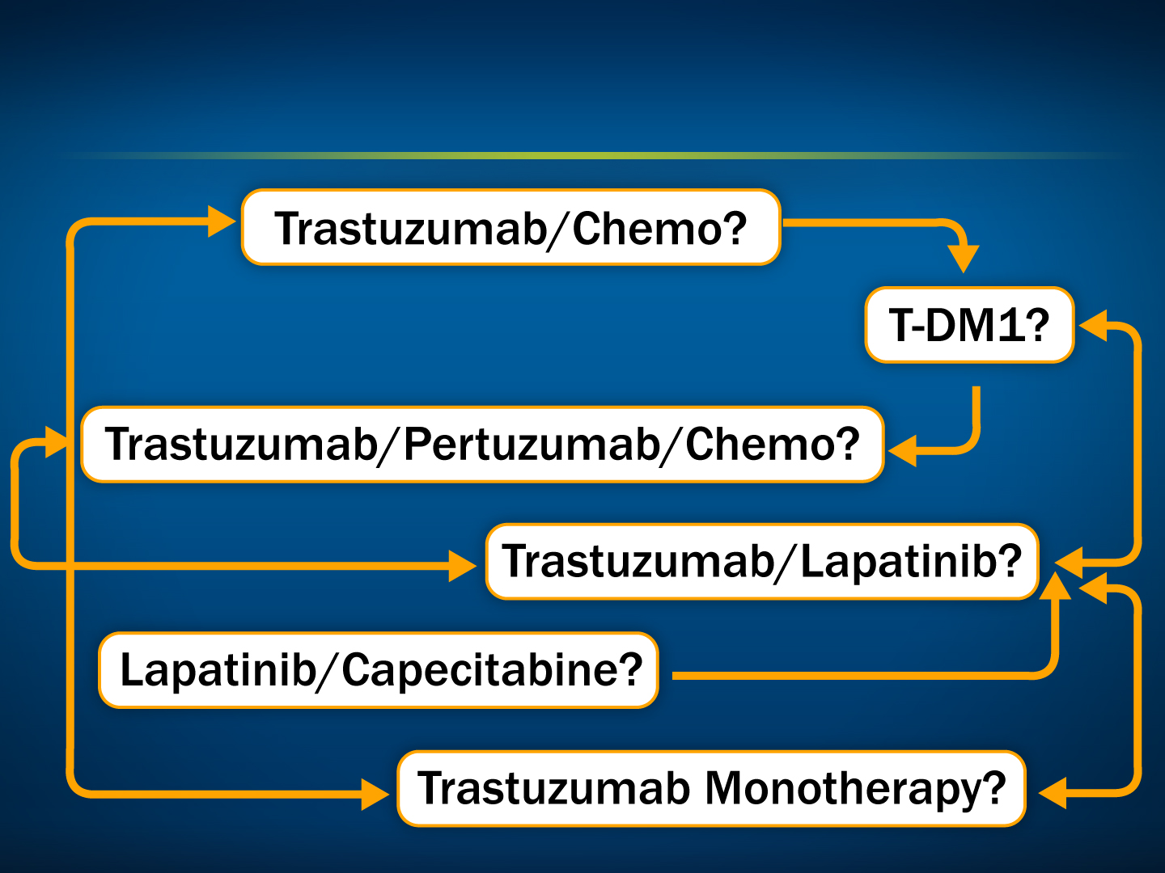
Increasing Options for Sequencing Treatments in HER2+ Metastatic BC

Slide 20
Recent FDA approvals of pertuzumab and T-DM1

Slide 21
FDA Approves Pertuzumab Plus Trastuzumab and Docetaxel in HER2+ Metastatic BC
“On June 8, 2012, the Food and Drug Administration approved pertuzumab injection for use in combination with trastuzumab and docetaxel for the treatment of patients with HER2-positive metastatic breast cancer who have not received prior anti-HER2 therapy or chemotherapy for metastatic disease.”
This approval is based upon positive results from the Phase III CLEOPATRA study.
http://www.cancer.gov/cancertopics/druginfo/fda-pertuzumab

Slide 22
FDA Approves Ado-Trastuzumab Emtansine (T-DM1) for HER2+ Metastatic BC
“On February 22, 2013, the Food and Drug Administration (FDA) approved ado-trastuzumab emtansine for use as a single agent for the treatment of patients with HER2-positive, metastatic breast cancer who previously received treatment with trastuzumab and a taxane, separately or in combination. Patients should either have been treated for metastatic disease or developed disease recurrence during or within six months of completing adjuvant therapy.”
This approval is based upon positive results from the Phase III EMILIA study.
http://www.cancer.gov/cancertopics/druginfo/fda-ado-trastuzumab-emtansine

Slide 23
Integration of novel anti-HER2 agents into the treatment algorithm

Slide 24

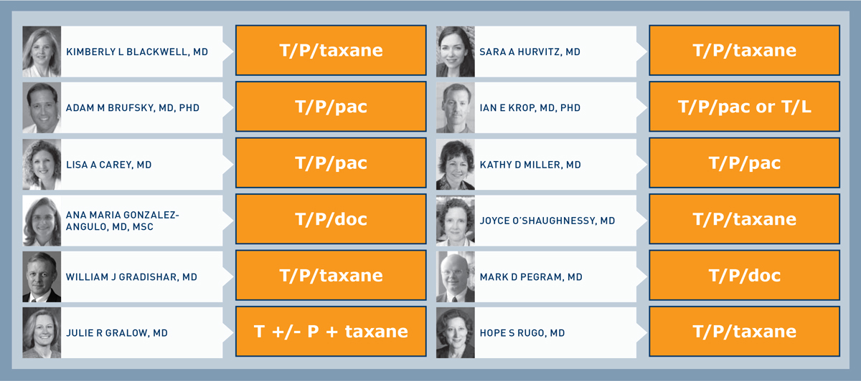
What is your usual first-line treatment for a 60-year-old asymptomatic patient with a HER2-positive/ER-negative primary breast tumor and metastatic disease?
T = trastuzumab, P = pertuzumab, L = lapatinib
Research To Practice Survey of Clinical Investigators — Second Opinion Breast 2013.

Slide 25
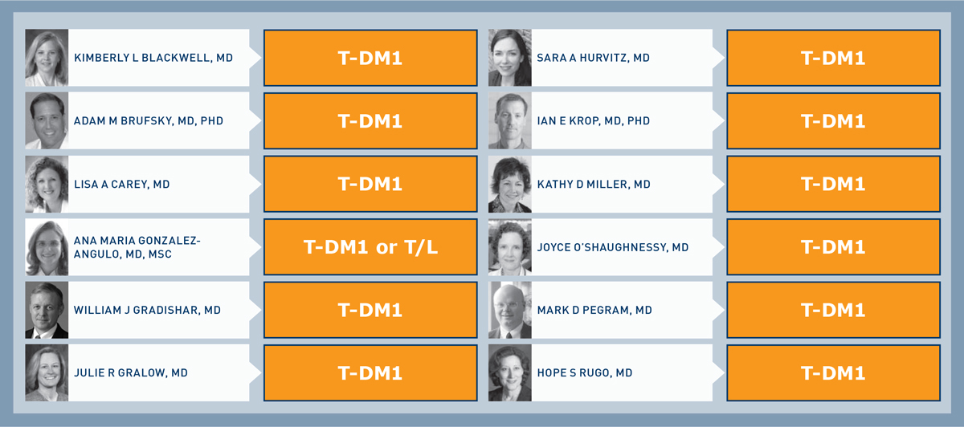
What is your usual second-line treatment (assuming initial response to 1st line) for a 60-year-old asymptomatic patient with a HER2-positive/ER-negative primary breast tumor and metastatic disease?
T = trastuzumab, P = pertuzumab, L = lapatinib
Research To Practice Survey of Clinical Investigators — Second Opinion Breast 2013.

Slide 26
Mechanism of action and recent clinical trial data of pertuzumab

Slide 27
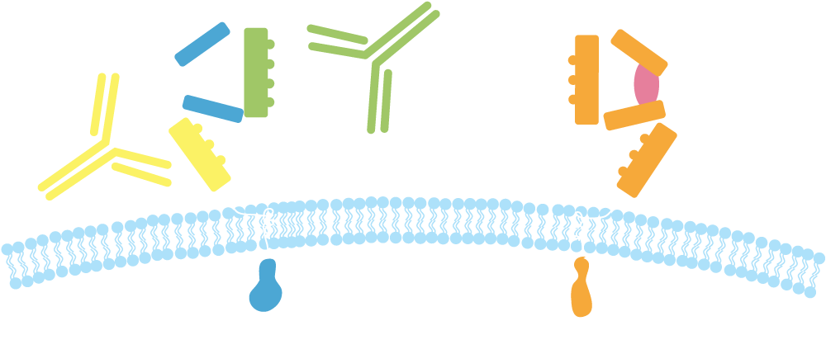
Pertuzumab and Trastuzumab: Mechanisms of Action
Pertuzumab
HER2
Trastuzumab
HER1/3/4
Dimerization domain
Subdomain IV
Trastuzumab:
Inhibits ligand-independent HER2 signaling
Activates ADCC
Prevents HER2 ECD shedding
Pertuzumab:
Inhibits ligand-dependent HER2 dimerization and signaling
Activates ADCC
ADCC = antibody-dependent cell-mediated cytotoxicity; ECD = extracellular domain

Slide 28
Swain SM et al. Confirmatory Overall Survival (OS) Analysis of CLEOPATRA: A Randomized, Double-Blind, Placebo-Controlled Phase III Study with Pertuzumab (P), Trastuzumab (T), and Docetaxel (D) in Patients (pts) with HER2-Positive First-Line (1L) Metastatic Breast Cancer (MBC). SABCS 2012;Abstract P5-18-26.

Slide 29
Phase III CLEOPATRA Study
Centrally confirmed HER2+ locally recurrent, unresectable or metastatic BC (MBC)
≤1 hormonal regimen for MBC
Prior (neo)adjuvant systemic rx, incl trastuzumab and/or taxane allowed if followed by DFS ≥12 mo
Baseline LVEF ≥ 50%; no CHF or LVEF < 50% during or after prior trastuzumab
N = 406
Docetaxel + Trastuzumab + Placebo
R
1:1
Docetaxel + Trastuzumab + Pertuzumab
N = 402
Median PFS 18.5 mos vs 12.4 mos¹
OS: 34% reduction in risk of death²
¹Baselga J et al. N Engl J Med 2012;366(2):109-19. ²Swain S et al. SABCS 2012;Abstract P5-18-26.

Slide 30
CLEOPATRA: Updated Overall Survival (Median follow-up: 30.1 months)
Outcome | Pertuzumab/trastuzumab/docetaxel (n = 402) | Placebo/trastuzumab/docetaxel (n = 406) | Hazard ratio | p-value
Median OS | Not reached | 37.6 months | 0.66 | 0.0008
Estimated 3-y OS | 50.4% | 65.8% | — | —
There was a 34% reduction in the risk of death.
Swain SM et al. Lancet Oncol 2013;14(6):461-71.

Slide 31
CLEOPATRA: Updated Progression-Free Survival (Median follow-up: 30.1 months)
Outcome | Pertuzumab/trastuzumab/docetaxel (n = 402) | Placebo/trastuzumab/docetaxel (n = 406) | Hazard ratio
Median PFS | 18.7 months | 12.4 months | 0.69
There was a 31% reduction in the risk of disease progression with the addition of pertuzumab.
Swain SM et al. Lancet Oncol 2013;14(6):461-71.

Slide 32
CLEOPATRA: Response and Survival Analyses
Endpoint | Ptz + T + D | Pla + T + D
3-yrs OS | 66% | 50%
Median PFS | 19 mos | 12 mos
ORR | 80% | 69%
Baselga J et al. N Engl J Med 2012;366(2):109-19.
Swain SM et al. Lancet Oncol 2013;14(6):461-71.

Slide 33
CLEOPATRA Safety Analysis
Safety profile similar between groups
No increase in left ventricular systolic dysfunction with the addition of pertuzumab
Increased incidence of ≥ Grade 3 AEs with pertuzumab
Diarrhea: 8% vs 5%
Febrile neutropenia: 14% vs 8%
All grade rash: 34% vs 24%
Baselga J et al. N Engl J Med 2012;366(2):109-19.

Slide 34
Selection of a chemotherapeutic partner for trastuzumab/pertuzumab

Slide 35
A Phase II Study of Pertuzumab, Trastuzumab, and Weekly Paclitaxel in Patients with HER2-Overexpressing Metastatic Breast Cancer
Datko F et al.
SABCS 2012;Abstract P5-18-20.

Slide 36


Phase II Study Design
HER2-positive mBC (IHC 3+ or FISH ≥2.0)
0-1 prior treatments in metastatic setting
Measurable or non-measurable disease
Ejection fraction ≥50%
No cardiac morbidities within 12 months
Target accrual n = 69
q week Paclitaxel
q 3 weeks Pertuzumab
q 3 weeks Trastuzumab
q 4 cycles
ECHO
Datko F et al. SABCS 2012;Abstract P5-18-20.

Slide 37
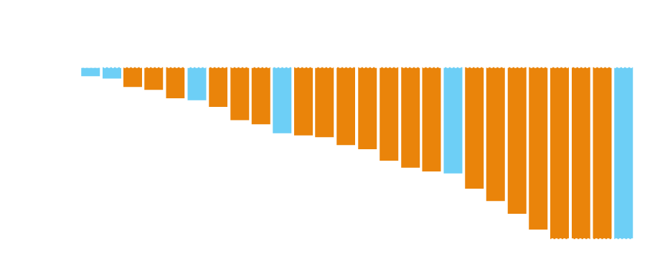
Efficacy
Efficacy at 6 months | Evaluable (N = 33) | Intention to Treat (N = 36)
Progression free | 76% | 69%
Complete response | 9% | 8%
Partial response | 42% | 39%
Stable disease | 24% | 22%
Best Response in Evaluable Patients with Measurable Disease (N = 26)
1st line treatment
2nd line treatment
* Received adjuvant trastuzumab
With permission from Datko F et al. SABCS 2012;Abstract P5-18-20.

Slide 38
Antibody-drug conjugates and the mechanism of action of T-DM1

Slide 39
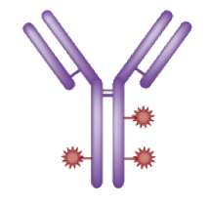





Trastuzumab Emtansine (T-DM1): Mechanisms of Action
Immune effector cell
HER2
T-DM1
HER2
T-DM1
Inhibition of HER2 shedding
Fcγ receptor
Antibody-dependent cellular cytotoxicity (ADCC)
Internalization
Emtansine release
P
P
P
P
P
Inhibition of HER2 signaling
P
Inhibition of microtubule polymerization
Lysosome
PI3K
MAPK
Nucleus
Adapted from LoRusso PM et al. Clin Cancer Res 2011.

Slide 41
Phase III EMILIA Study
1:1
HER2-positive LABC or MBC (N = 991)
Prior taxane and trastuzumab
Progression on metastatic treatment or within 6 months of adjuvant treatment
T-DM1
3.6 mg/kg q3w IV
PD
R
Capecitabine
1000 mg/m² PO bid, days 1–14, q3w
+
Lapatinib
1250 mg/day PO qd
PD
Median OS: 30.9 vs 25.1 mos
Median PFS: 9.6 vs 6.4 mos
Verma S et al. N Engl J Med 2012;367:1783-1791.

Slide 42
Phase III EMILIA Trial Results: Progression-Free Survival (PFS) by Independent Review
 | T-DM1 (n = 495) | Cape/lap (n = 496) | Hazard ratio | p-value
Median PFS | 9.6 mo | 6.4 mo | 0.65 | <0.001
ORR: 43.6% (T-DM1) vs 30.8% (cape/lap); p < 0.001
Verma S et al. N Engl J Med 2012;367(19):1783-91.

Slide 43
Second Interim Analysis of Overall Survival (OS)
 | T-DM1 (n = 495) | Cape/lap (n = 496) | Hazard ratio | p-value
Median OS (second interim analysis) | 30.9 mo | 25.1 mo | 0.68 | <0.001
Estimated 1-y OS | 85.2% | 78.4% | — | —
Estimated 2-y OS | 64.7% | 51.8% | — | —
Verma S et al. N Engl J Med 2012;367(19):1783-91.

Slide 44
Incidence and management of T-DM1-induced thrombocytopenia

Slide 45
T-DM1-Associated Thrombocytopenia
 | Lapatinib + Capecitabine (N = 488) |  | T-DM1 (N = 490)
Adverse Event | Any Grade | Grade 3 or 4 | Any Grade | Grade 3 or 4
Thrombocytopenia | 2.5% | 0.2% | 28.0% | 12.9%
1st occurrence of Grade 3 or 4 thrombocytopenia typically occurs during the 1st two cycles of T-DM1 treatment
Majority able to continue treatment with dose modifications
2% of patients discontinued T-DM1 due to thrombocytopenia
Verma S et al. N Engl J Med 2012;367(19):1783-91.

Slide 46
Other treatment options for HER2-positive disease

Slide 47
Case (from the practice of Ms Smith)
2008: A 58 yo woman presents with back pain
Biopsy-proven ER/PR-, HER2+ mBC, small primary breast lesion
Receives multiple single-agent chemos + trastuzumab, lapatinib/trastuzumab
Bone mets treated with kyphoplasty, radiation to L4 and zoledronic acid
Currently receiving trastuzumab and gemcitabine and has never received pertuzumab or T-DM1

Slide 48
Ongoing trials evaluating T-DM1 and pertuzumab in the adjuvant and metastatic settings

Slide 49
APHINITY: A Phase III Adjuvant Study Design
Target Accrual: 4,800 (Open to enrollment)
Resected HER2+ BC
Node+ (except T0)
Baseline LVEG ≥55
Chemotherapy
Trastuzumab x 1 yr
Pertuzumab x 1 yr
R
Chemotherapy
Trastuzumab x 1 yr
Placebo x 1 yr
Primary endpoint: Invasive disease-free survival
www.clinicaltrials.gov, April 2013
www.ibcsg.org, April 2013
ClinicalTrials.gov Identifer: NCT01358877

Slide 50
Phase III MARIANNE Study Design
Target Accrual: 1,095 (Active, not recruiting)
HER2+, locally recurrent or metastatic BC
No prior treatment for metastatic BC
T-DM1
R
T-DM1 + pertuzumab
Taxane + trastuzumab
www.clinicaltrials.gov, April 2013
ClinicalTrials.gov Identifier: NCT01120184

Slide 51
MODULE 2: Role of Chemotherapy for Patients with HER2-Negative Metastatic BC

Slide 52
Case (from the practice of Ms Litsas)
A 54 yo woman diagnosed with liver mets while receiving adjuvant AC for ER+, HER2-, node+ BC
Receives multiple lines of chemo and endocrine treatment
June 2012: Met with the oncology team to decide whether to enter a hospice program or make another attempt at chemo
Patient hopes to go to Cape Cod with her family for a vacation

Slide 53
Mechanism of action; efficacy and safety data with eribulin

Slide 54
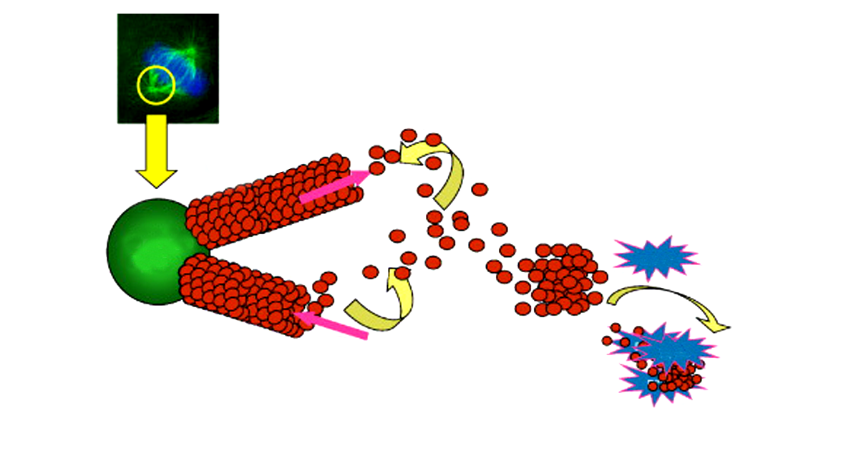
Mechanism of Action of Eribulin
Eribulin, which is derived from a sea sponge, works by inhibiting microtubules – the scaffolding of cancer cells.
1
Eribulin inhibits microtubule growth
Eribulin
Tubulin polymerization
Growing microtubule
Eribulin causes nonproductive tubulin aggregates
3
Spindle Pole
Eribulin
Tubulin depolymerization
Shortening microtubule
2
Eribulin
Eribulin has no effect on microtubule shortening
Nonproductive tubulin aggregate
Adapted from Jordan MA et al. Mol Cancer Ther 2005;4:1086-1095.

Slide 55
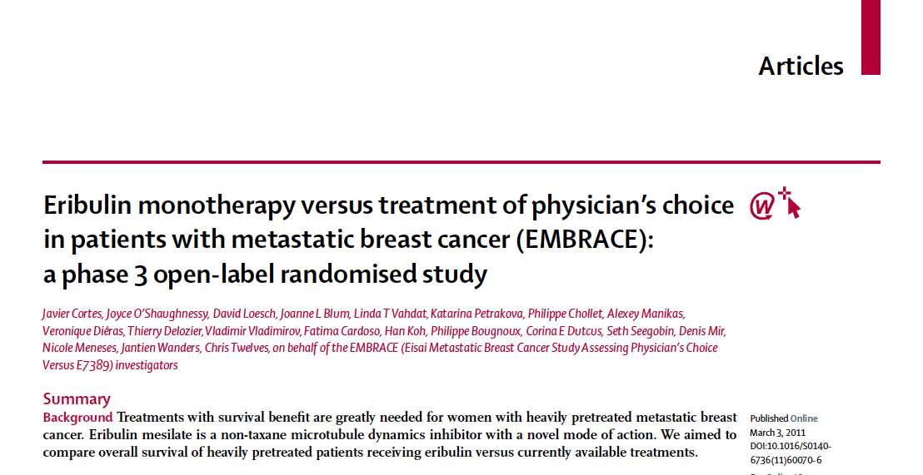
Cortes J et al. Lancet 2011;377(9769):914-23.

Slide 56
EMBRACE: A Phase III Trial of Eribulin in Locally Recurrent or Advanced BC
Eligibility (n = 762)
Locally recurrent or mBC 2-5 prior chemotherapies Prior anthracycline and taxane Progression ≤6 months of last chemotherapy
2:1
Eribulin mesylate
R
Treatment of physician’s choice
Median OS: 13.1 vs 10.6 mos
Median PFS: 3.7 vs 2.2 mos
Cortes J et al. Lancet 2011;377(9769):914-23.

Slide 57
Recommended Eribulin Administration
 | Starting Dose | Infusion Time | Schedule
Recommended dose | 1.4 mg/m² | 2 to 5 minutes | Days 1 and 8 (21-day cycle)
In patients with
Mild hepatic impairment ^{A} | 1.1 mg/m²
Moderate hepatic impairment ^{B} | 0.7 mg/m²
Moderate renal impairment ^{C} | 1.1 mg/m²
^{A} Child-Pugh A
^{B} Child-Pugh B
^{C} Creatinine clearance of 30-50 mL/min
Eribulin product information

Slide 58
Recommended Eribulin Dose Reductions
Events Requiring Permanent Dose Reduction | Current Dose | Recommended Dose Reduction
Hematologic toxicities ANC <500/mm³ for >7 days or ANC <1,000/mm³ with fever or infection Platelets <25,000/mm³ or platelets <50,000/mm³ requiring transfusion Grade 3 or 4 nonhematologic toxicities Omission or delay of day 8 dose in previous cycle for toxicity | 1.4 mg/m² | 1.1 mg/m²
Any event requiring permanent dose reduction while receiving 1.1 mg/m² | 1.1 mg/m² | 0.7 mg/m²
Any event requiring permanent dose reduction while receiving 0.7 mg/m² | 0.7 mg/m² | Discontinue eribulin
Eribulin product information

Slide 59
A Phase III, Open-Label, Randomized, Multicenter Study of Eribulin Mesylate versus Capecitabine in Patients with Locally Advanced or Metastatic Breast Cancer Previously Treated with Anthracyclines and Taxanes
Kaufman PA et al.
SABCS 2012;Abstract S6-6.

Slide 60
Phase III Study 301 Design
Eligibility (n = 1,102)
Locally advanced or mBC ≤3 prior chemotherapy regimens (≤2 for advanced Dx) Prior taxane and anthracycline in (neo)adjuvant setting for locally advanced or mBC
Eribulin (n = 554)
R
Capecitabine (n = 548)
1,250 mg/m² BID (oral)
d1-14, q21d
Median OS (eribulin vs capecitabine): 15.9 mos vs 14.5 mos
Median PFS (eribulin vs capecitabine): 4.1 mos vs 4.2 mos
Kaufman PA et al. SABCS 2012;Abstract S6-6.

Slide 61
Side Effects of Eribulin and Capecitabine
Eribulin
Neutropenia
Leukopenia
Peripheral sensory neuropathy
Alopecia
Capecitabine
Hand-foot syndrome
Diarrhea
Kaufman PA et al. SABCS 2012;Abstract S6-6.

Slide 62
Recent clinical trial data with nab-paclitaxel

Slide 63
CALGB 40502/NCCTG N063 Randomized Phase III Trial of Weekly Paclitaxel, Compared to Weekly Nanoparticle Albumin Bound Nab-Paclitaxel or Ixabepilone +/- Bevacizumab as First-Line Therapy for Locally Recurrent or Metastatic Breast Cancer
Rugo HS et al.
Proc ASCO 2012;Abstract CRA 1002.

Slide 64
CALGB 40502 Phase III Study of First-Line Bevacizumab Plus Chemotherapy Options for Advanced Breast Cancer
Accrual: 799 of 900 planned
Eligibility
Previously untreated locally recurrent or metastatic breast cancer
At least 12 months since adjuvant taxanes
Peripheral neuropathy ≤grade 1
Treated and stable brain mets allowed
Weekly nab-paclitaxel + bevacizumab
1:1:1
R
Weekly paclitaxel +
bevacizumab
Weekly ixabepilone +
bevacizumab
Patients could discontinue chemotherapy and continue bevacizumab alone after 6 cycles if stable or responding disease
Rugo HS et al. Proc ASCO 2012;Abstract CRA1002.

Slide 65
MODULE 3: Sequential Management of ER-Positive, HER2-Negative Metastatic BC

Slide 66
Case (from the practice of Ms Smith)
2011: A 66 yo woman s/p lumpectomy and adjuvant chemo for a 4.8-cm weakly ER+ (5%), HER2- BC
Less than 1 year later: Recurrence in the breast, axilla and mediastinum
Biopsy shows slightly higher ER values
Gemcitabine/carboplatin x 4, with disease progression
Palliative mastectomy followed by eribulin x 2 but experienced disease progression including a large and painful chest wall mass
Anastrozole and everolimus
No toxicity or side effects
Significant clinical response after 2 cycles
Pt is hopeful and not depressed
She and her husband spend their winters in Arizona

Slide 67
FDA Approves Everolimus in Combination with Exemestane in ER+ Metastatic BC
“On July 20, 2012, the FDA approved everolimus tablets for the treatment of postmenopausal women with advanced hormone receptor-positive, HER2-negative breast cancer in combination with exemestane, after failure of treatment with letrozole or anastrozole.”
This approval is based upon positive results from the Phase III BOLERO-2 study.
www.cancer.gov/cancertopics/druginfo/fda-everolimus

Slide 68
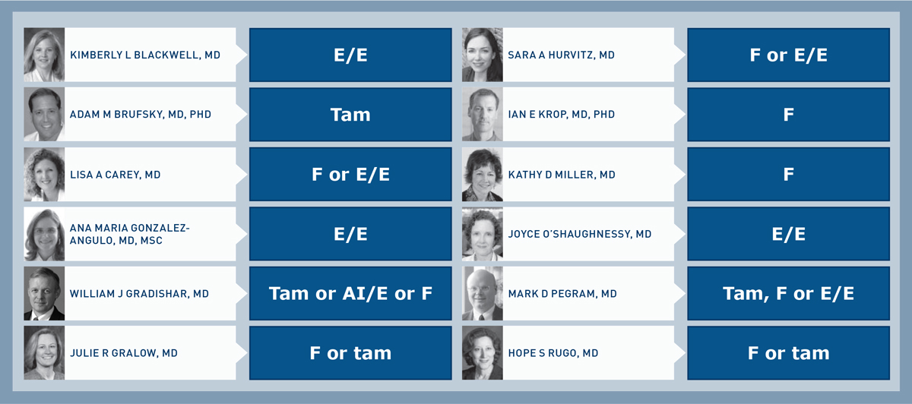
In general, what is your most likely endocrine therapy recommendation for a 65-year-old patient who develops asymptomatic, low-volume metastatic disease after receiving 4 years of an adjuvant nonsteroidal aromatase inhibitor?
F = Fulvestrant; E/E = Everolimus/Exemestane; Tam = tamoxifen
Research To Practice Survey of Clinical Investigators — Second Opinion Breast 2013.

Slide 69
Mechanism of action and available data with everolimus in combination with endocrine therapy

Slide 70
BOLERO-2 Phase III Study
Postmenopausal women
ER+, HER2- metastatic BC
Refractory to letrozole or anastrozole
Everolimus +
Exemestane
(n = 485)
R
Placebo +
Exemestane
(n = 239)
Median PFS: 10.6 vs 4.1 mos
Baselga J et al. N Engl J Med 2012;366(6):520-29.

Slide 71
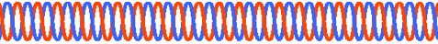
Crosstalk between ER and PI3K/AKT/mTOR Signaling: Rationale for Dual Inhibition
EGFR HER2
E
mTOR activates ER in a ligand-independent manner
Estradiol suppresses apoptosis induced by mTOR blockade
Hyperactivation of the mTOR pathway is observed in endocrine therapy–resistant breast cancer cells
mTOR is a rational target to enhance the efficacy of hormonal therapy
P
P
E
RAS
PI3K
PTEN
RAF
E
AKT
ER
MEK
MAPK
mTOR
E
E
ER target gene transcription
ER
ER
Adapted from: Di Cosimo S, Baselga. Nat Rev Clin Oncol 2010;7:139-47.

Slide 73
Prevention and treatment of everolimus-associated mucositis

