Slide 1
Please note, these are the actual video-recorded proceedings from the live CME event and may include the use of trade names and other raw, unedited content. Select slides from the original presentation are omitted where Research To Practice was unable to obtain permission from the publication source and/or author. Links to view the actual reference materials have been provided for your use in place of any omitted slides.

Slide 2
Meet The Professors
Clinical Investigators Provide Their Perspectives on Real Cases of Metastatic Breast Cancer Monday, June 3, 2013
7:00 PM – 9:00 PM
Chicago, Illinois
Faculty
Community Oncologists
Lisa A Carey, MD
Joyce O’Shaughnessy, MD
Hope S Rugo, MD
Eric P Winer, MD
Denise A Yardley, MD
Lowell L Hart, MD
Robert A Moss, MD
Estelamari Rodriguez, MD, MPH
Moderator Neil Love, MD

Slide 3
Agenda
Module 1 – HER2-Positive Metastatic Disease
Module 2 – Triple-Negative Metastatic Disease
Module 3 – ER-Positive Metastatic Disease
Module 4 – Stage IV NED After Surgical Resection

Slide 4
Meet The Professors
Clinical Investigators Provide Their Perspectives on Real Cases of Metastatic Breast Cancer Monday, June 3, 2013
7:00 PM – 9:00 PM
Chicago, Illinois
Faculty
Community Oncologists
Lisa A Carey, MD
Joyce O’Shaughnessy, MD
Hope S Rugo, MD
Eric P Winer, MD
Denise A Yardley, MD
Lowell L Hart, MD
Robert A Moss, MD
Estelamari Rodriguez, MD, MPH
Moderator Neil Love, MD

Slide 5
Medical oncologists’ clinical experiences and comfort levels with 20 recently approved agents
Proc ASCO 2013;Abstract e17570
Neil Love, Kenneth Carl Anderson, Keith Flaherty, Hagop M Kantarjian, Thomas James Lynch, Joyce O'Shaughnessy, A Oliver Sartor, Alan Paul Venook, Andrew David Zelenetz, Jonathan Moss, Gloria Kelly, Kathryn Ziel

Slide 6
New Agents/Regimens Recently Approved by the FDA
Cancer Type | Agent | Approval Date
Colorectal | Bev on progression | 1/13
 | Regorafenib | 9/12
 | Aflibercept | 8/12
Prostate | Enzalutamide | 8/12
 | Abiraterone | 4/11
 | Cabazitaxel | 6/10
 | Sipuleucel-T | 4/10
NHL: ALCL | Brentuximab vedotin | 8/11
NHL: T-cell lymphoma | Romidepsin | 11/09
 | Pralatrexate | 9/09
Cancer Type | Agent | Approval Date
Lung | Nab paclitaxel | 10/12
 | Crizotinib | 8/11
Breast | T-DM1 | 2/13
 | Everolimus | 7/12
 | Pertuzumab | 6/12
 | Eribulin | 11/10
Multiple myeloma | Pomalidomide | 2/13
 | Carfilzomib | 7/12
www.fda.gov

Slide 7
Module 1: HER2-Positive Metastatic Disease

Slide 8
Case from the practice of Estelamari Rodriguez, MD, MPH
A 65-year-old woman diagnosed with ER+/PR+/ HER2-unknown breast cancer 13 years ago was treated with breast-conserving surgery and 5 years of tamoxifen
She now presents with symptomatic ER+/PR+/HER2+ metastases to the lung, bone, adrenal glands and brain

Slide 9
Pre and post Pertuzumab, Trastuzumab, Docetaxel
7/14/12
11/17/12

Slide 10
Persistent Asymptomatic Brain Metastases
after Treatment with Pertuzumab

Slide 11
Persistent Asymptomatic Brain Metastases
after Treatment with Pertuzumab

Slide 12
Meet The Professors
Clinical Investigators Provide Their Perspectives on Real Cases of Metastatic Breast Cancer Monday, June 3, 2013
7:00 PM – 9:00 PM
Chicago, Illinois
Faculty
Community Oncologists
Lisa A Carey, MD
Joyce O’Shaughnessy, MD
Hope S Rugo, MD
Eric P Winer, MD
Denise A Yardley, MD
Lowell L Hart, MD
Robert A Moss, MD
Estelamari Rodriguez, MD, MPH
Moderator Neil Love, MD

Slide 13
Case from the practice of Lowell L Hart, MD
A 56-year-old woman presented with an 8-cm breast mass with overlying erythema and some ulceration
Biopsy revealed an ER+/PR+/HER2+ (IHC and FISH) infiltrating ductal carcinoma
Workup showed multiple liver metastases
The patient enrolled on the MARIANNE trial (trastuzumab/taxane versus T-DM1 versus T-DM1/pertuzumab)

Slide 14
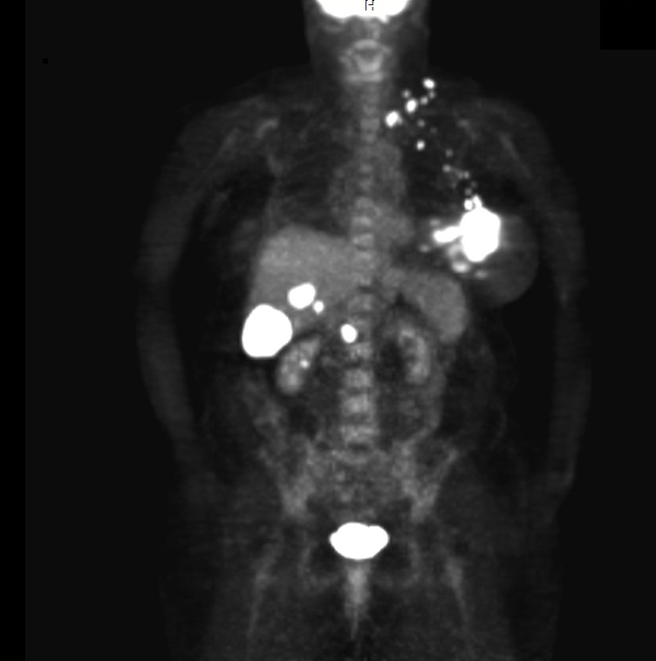

Slide 15
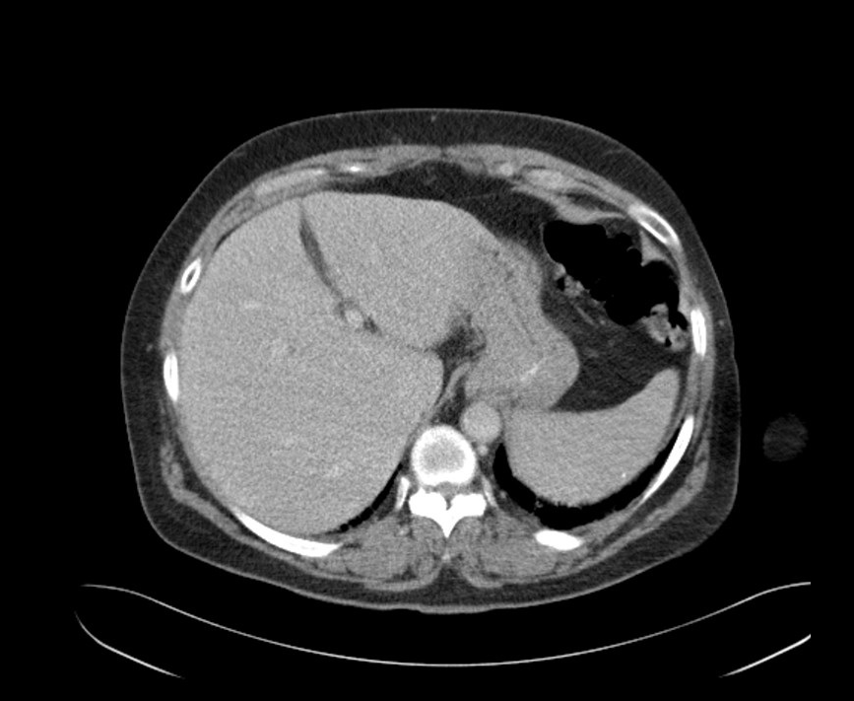

Slide 16
Case from the practice of Lowell L Hart, MD
A 56-year-old woman presented with an 8-cm breast mass with overlying erythema and some ulceration
Biopsy revealed an ER+/PR+/HER2+ (IHC and FISH) infiltrating ductal carcinoma
Workup showed multiple liver metastases
The patient enrolled on the MARIANNE trial (trastuzumab/taxane versus T-DM1 versus T-DM1/pertuzumab)

Slide 17
Meet The Professors
Clinical Investigators Provide Their Perspectives on Real Cases of Metastatic Breast Cancer Monday, June 3, 2013
7:00 PM – 9:00 PM
Chicago, Illinois
Faculty
Community Oncologists
Lisa A Carey, MD
Joyce O’Shaughnessy, MD
Hope S Rugo, MD
Eric P Winer, MD
Denise A Yardley, MD
Lowell L Hart, MD
Robert A Moss, MD
Estelamari Rodriguez, MD, MPH
Moderator Neil Love, MD

Slide 18
What is your usual first-line treatment for patients with HER2-positive/ER-negative metastatic disease and no prior therapy?

Slide 19
What is your usual second-line treatment for patients with HER2-positive/ER-negative metastatic disease and no prior therapy?

Slide 20
How many patients do you have in your practice with HER2-positive mBC and problematic brain mets but disease well controlled outside the brain?

Slide 21
Have you observed dermatologic side effects with pertuzumab?

Slide 22
Meet The Professors
Clinical Investigators Provide Their Perspectives on Real Cases of Metastatic Breast Cancer Monday, June 3, 2013
7:00 PM – 9:00 PM
Chicago, Illinois
Faculty
Community Oncologists
Lisa A Carey, MD
Joyce O’Shaughnessy, MD
Hope S Rugo, MD
Eric P Winer, MD
Denise A Yardley, MD
Lowell L Hart, MD
Robert A Moss, MD
Estelamari Rodriguez, MD, MPH
Moderator Neil Love, MD

Slide 23
In the last 2 years, have you sent any patients in your practice with mBC for surgical removal of the primary tumor?

Slide 24
What first-line treatment would you generally recommend for an asymptomatic patient with low disease burden ER-positive, HER2-positive mBC with no prior therapy?
→
→

Slide 25
Does everolimus add treatment benefit when added to chemo/anti-HER2 treatment in HER2-positive mBC?

Slide 26
Are there situations in which you would use everolimus for the treatment of metastatic HER2-positive breast cancer?

Slide 27
Meet The Professors
Clinical Investigators Provide Their Perspectives on Real Cases of Metastatic Breast Cancer Monday, June 3, 2013
7:00 PM – 9:00 PM
Chicago, Illinois
Faculty
Community Oncologists
Lisa A Carey, MD
Joyce O’Shaughnessy, MD
Hope S Rugo, MD
Eric P Winer, MD
Denise A Yardley, MD
Lowell L Hart, MD
Robert A Moss, MD
Estelamari Rodriguez, MD, MPH
Moderator Neil Love, MD

Slide 28
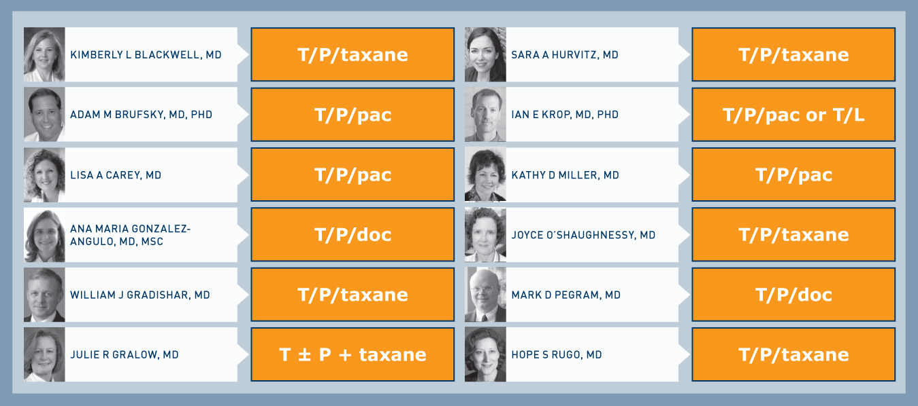
What is your usual first-line treatment for a 60-year-old asymptomatic patient with a HER2-positive/ER-negative primary breast tumor and metastatic disease?
T = trastuzumab, P = pertuzumab, L = lapatinib
Research To Practice Survey of Clinical Investigators — Second Opinion Breast 2013.

Slide 29
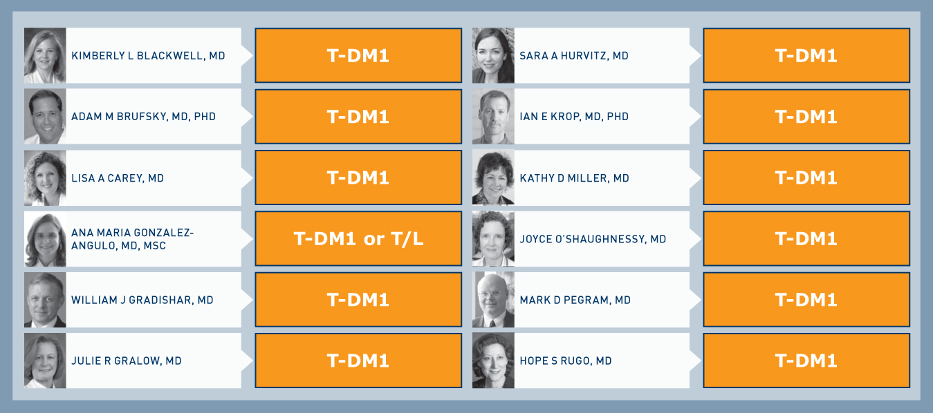
What is your usual second-line treatment (assuming initial response to first line) for a 60-year-old asymptomatic patient with a HER2-positive/ER-negative primary breast tumor and metastatic disease?
T = trastuzumab, L = lapatinib
Research To Practice Survey of Clinical Investigators — Second Opinion Breast 2013.

Slide 30
PERTAIN: Phase II Study of Pertuzumab in combination with Trastuzumab and an Aromatase Inhibitor (AI) for Advanced Metastatic Breast Cancer
Target Accrual: 250 (Active, recruiting)
Pertuzumab +
Trastuzumab + AI
HER2+, hormone receptor-positive, previously untreated metastatic BC
Postmenopausal
1:1
R
Trastuzumab + AI
All patients will receive induction chemotherapy with a taxane for up to 18 weeks
at the investigator’s discretion
Primary endpoint: Progression-free survival
AI = anastrozole or letrozole
Rimawi MF et al. Proc ASCO 2012;Abstract TPS654
www.clinicaltrials.gov; NCT01491737

Slide 31
Phase III, randomized, double-blind, placebo-controlled multicenter trial of daily everolimus plus weekly trastuzumab and vinorelbine in trastuzumab-resistant, advanced breast cancer (BOLERO-3)
O’Regan R et al.
ASCO 2013;Abstract 505.

Slide 32
BOLERO-3: Phase III Multicenter Trial of Daily Everolimus plus Weekly Trastuzumab and Vinorelbine
Accrual: 572 (Closed)
Locally advanced or metastatic HER2-positive breast cancer
Prior taxane therapy
Recurrence or progression on trastuzumab
Everolimus +
Trastuzumab +
Vinorelbine (n = 284)
R
Placebo +
Trastuzumab +
Vinorelbine (n = 285)
Primary endpoint: Progression-free survival

Slide 33
BOLERO-3: Efficacy
Clinical Outcome | Everolimus Arm (n = 284) | Placebo Arm (n = 285)
Overall response rate* | 40.8% | 37.2%
Complete response | 3.2% | 2.5%
Partial response | 37.7% | 34.7%
Stable disease | 48.2% | 41.4%
Progressive disease | 4.9% | 13.0%
Clinical benefit rate† | 59.2% | 53.3%
Progression-free survival | 7.0 months | 5.78 months
Interim overall survival | NSD | NSD
Deaths | 36.3% | 41.1%
NSD = no significant difference
* p = 0.21; † p = 0.09

Slide 34
Meet The Professors
Clinical Investigators Provide Their Perspectives on Real Cases of Metastatic Breast Cancer Monday, June 3, 2013
7:00 PM – 9:00 PM
Chicago, Illinois
Faculty
Community Oncologists
Lisa A Carey, MD
Joyce O’Shaughnessy, MD
Hope S Rugo, MD
Eric P Winer, MD
Denise A Yardley, MD
Lowell L Hart, MD
Robert A Moss, MD
Estelamari Rodriguez, MD, MPH
Moderator Neil Love, MD

Slide 35
Module 2: Triple-Negative Metastatic Disease

Slide 36
Case from the practice of Estelamari Rodriguez, MD, MPH
A 39-year-old woman presented with T3N2M0 triple-negative BC
The patient underwent breast-conserving surgery followed by radiation therapy and then received AC → paclitaxel/bevacizumab on an ECOG trial
Seven months after completion of treatment she presented with a breast recurrence and PET-avid mediastinal adenopathy

Slide 37
39 year old woman with T3N2M0 triple negative BC dx Jan 2009 presents with in breast recurrence and PET avid mediastinal adenopathy 7 mos after completion of adjuvant treatment (March 2010)

Slide 38
39 F with Triple Negative Breast Cancer: Sept 2010: Resolution of PET avid mediastinal adenopathy after carboplatin/gemcitabine, new activity at ileo-colic junction (physiologic)

Slide 39
Jan 2011: 39 year old women with Triple Neg Breast Ca.
Stable Disease after treatment with gemcitabine followed by eribulin for progression of axillary adenopathy.

Slide 40
May 2011: Stable axillary and mediastinal adenopathy after 5 months of eribulin therapy.

Slide 41
Nov 2011: Widespread progression of disease, symptomatic bone and liver metastases. ( treated with ixabepilone, capecitabine, albumin-bound paclitaxel, and vinorelbine with no major response. Patient transitioned to hospice care in Feb 2012.

Slide 42
Meet The Professors
Clinical Investigators Provide Their Perspectives on Real Cases of Metastatic Breast Cancer Monday, June 3, 2013
7:00 PM – 9:00 PM
Chicago, Illinois
Faculty
Community Oncologists
Lisa A Carey, MD
Joyce O’Shaughnessy, MD
Hope S Rugo, MD
Eric P Winer, MD
Denise A Yardley, MD
Lowell L Hart, MD
Robert A Moss, MD
Estelamari Rodriguez, MD, MPH
Moderator Neil Love, MD

Slide 43
A patient with triple-negative breast cancer develops metastatic disease 1 year after completing adjuvant AC > paclitaxel. She responds to carboplatin/gemcitabine and then experiences disease progression. What are your likely next 2 sequential treatments?

Slide 44
A patient with ER-positive, HER2-negative BC develops metastatic disease 1 year after completing adjuvant AC > paclitaxel. Several endocrine treatments are given with minimal benefit and the decision is then made to use chemotherapy. What are your likely next 2 sequential treatments?

Slide 45
Overall, what is your impression of quality of life (QoL) of patients who are receiving capecitabine compared to eribulin?

Slide 46
Do you use nab paclitaxel in the management of patients with mBC?

Slide 47
Median duration of chemotherapy by line and sub-type
Line of CT | Total (n) | HR+(months) | TNBC (months) | HER2+ (months)
1st | 205 | 6.5 | 5.8 | 9.0
2nd | 159 | 4.4 | 3.3 | 5.1
3rd | 122 | 3.6 | 2.8 | 6.3
4th | 81 | 4.0 | 3.4 | 4.7
5th | 56 | 3.5 | 2.6 | 4.0
6th | 34 | 3.3 | 2.0 | 4.2
Seah DS et al. Proc ASCO 2012;Abstract 6089
Notes:
47

Slide 48
Meet The Professors
Clinical Investigators Provide Their Perspectives on Real Cases of Metastatic Breast Cancer Monday, June 3, 2013
7:00 PM – 9:00 PM
Chicago, Illinois
Faculty
Community Oncologists
Lisa A Carey, MD
Joyce O’Shaughnessy, MD
Hope S Rugo, MD
Eric P Winer, MD
Denise A Yardley, MD
Lowell L Hart, MD
Robert A Moss, MD
Estelamari Rodriguez, MD, MPH
Moderator Neil Love, MD

Slide 49
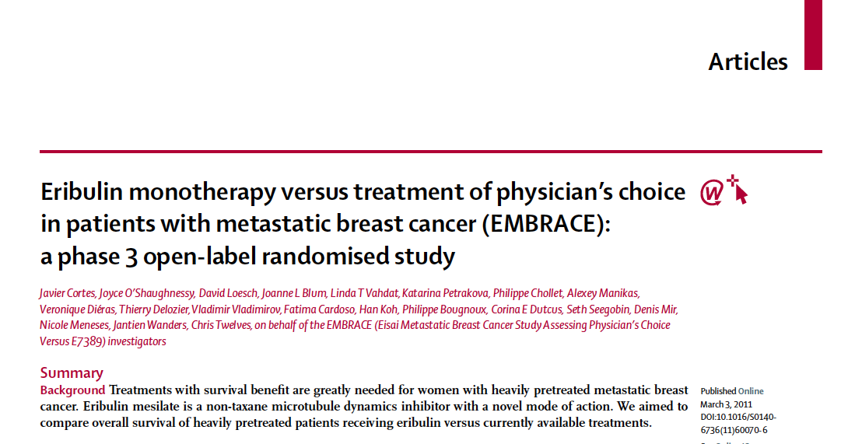
Cortes J et al. Lancet 2011;377(9769):914-23.

Slide 50
A Phase III, Open-Label, Randomized, Multicenter Study of Eribulin Mesylate versus Capecitabine in Patients with Locally Advanced or Metastatic Breast Cancer Previously Treated with Anthracyclines and Taxanes
Kaufman PA et al.
SABCS 2012;Abstract S6-6.

Slide 51
Phase III Study 301 Design
Eligibility (n = 1,102)
Locally advanced or mBC ≤3 prior chemotherapy regimens (≤2 for advanced Dx) Prior taxane and anthracycline in (neo)adjuvant setting for locally advanced or mBC
Eribulin (n = 554)
R
Capecitabine (n = 548)
1,250 mg/m² BID (oral)
d1-14, q21d
Kaufman PA et al. SABCS 2012;Abstract S6-6.

Slide 52
Study 301: Efficacy Analyses
Endpoint | Eribulin (n = 554) | Capecitabine (n = 548) | Hazard ratio (p-value)
Overall survival | 15.9 mo | 14.5 mo | 0.879 (0.056)
HER2-positive | 14.3 mo | 17.1 mo | 0.965
HER2-negative | 15.9 mo | 13.5 mo | 0.838
ER-positive | 18.2 mo | 16.8 mo | 0.897
ER-negative | 14.4 mo | 10.5 mo | 0.779
Triple-negative | 14.4 mo | 9.4 mo | 0.702
Progression-free survival | 4.1 mo | 4.2 mo | 1.079 (0.305)
ORR | 11% | 12% | (0.849)
Clinical benefit rate | 26% | 27%
Kaufman PA et al. SABCS 2012;Abstract S6-6.

Slide 53
Meet The Professors
Clinical Investigators Provide Their Perspectives on Real Cases of Metastatic Breast Cancer Monday, June 3, 2013
7:00 PM – 9:00 PM
Chicago, Illinois
Faculty
Community Oncologists
Lisa A Carey, MD
Joyce O’Shaughnessy, MD
Hope S Rugo, MD
Eric P Winer, MD
Denise A Yardley, MD
Lowell L Hart, MD
Robert A Moss, MD
Estelamari Rodriguez, MD, MPH
Moderator Neil Love, MD

Slide 54
CALGB 40502/NCCTG N063 Randomized Phase III Trial of Weekly Paclitaxel, Compared to Weekly Nanoparticle Albumin Bound Nab-Paclitaxel or Ixabepilone ± Bevacizumab as First-Line Therapy for Locally Recurrent or Metastatic Breast Cancer
Rugo HS et al.
Proc ASCO 2012;Abstract CRA1002.

Slide 55
CALGB-40502: Efficacy Endpoints
 | Paclitaxel (n = 283) | Nab Paclitaxel (n = 271) | Ixabepilone (n = 245)
Median PFS | 10.6 mo | 9.2 mo | 7.6 mo
Median OS | 26 mo | 27 mo | 21 mo
Median TTF | 7.1 mo | 5.4 mo | 5.1 mo
Rugo HS et al. Proc ASCO 2012;Abstract CRA1002.

Slide 56
Meet The Professors
Clinical Investigators Provide Their Perspectives on Real Cases of Metastatic Breast Cancer Monday, June 3, 2013
7:00 PM – 9:00 PM
Chicago, Illinois
Faculty
Community Oncologists
Lisa A Carey, MD
Joyce O’Shaughnessy, MD
Hope S Rugo, MD
Eric P Winer, MD
Denise A Yardley, MD
Lowell L Hart, MD
Robert A Moss, MD
Estelamari Rodriguez, MD, MPH
Moderator Neil Love, MD

Slide 57
Module 3: ER-Positive Metastatic Disease

Slide 58
Case from the practice of Lowell L Hart, MD
A 55-year-old woman was diagnosed in 1997 with an ER+/PR+/HER2- IDC
In 2008, bone and lung metastases were discovered
The patient subsequently received multiple lines of endocrine therapy and chemotherapy
She is currently receiving everolimus/exemestane

Slide 59
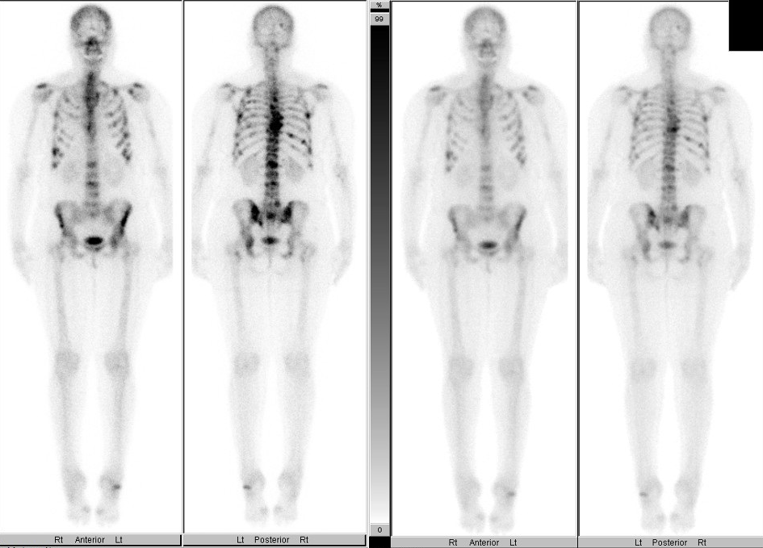

Slide 60
Meet The Professors
Clinical Investigators Provide Their Perspectives on Real Cases of Metastatic Breast Cancer Monday, June 3, 2013
7:00 PM – 9:00 PM
Chicago, Illinois
Faculty
Community Oncologists
Lisa A Carey, MD
Joyce O’Shaughnessy, MD
Hope S Rugo, MD
Eric P Winer, MD
Denise A Yardley, MD
Lowell L Hart, MD
Robert A Moss, MD
Estelamari Rodriguez, MD, MPH
Moderator Neil Love, MD

Slide 61
What would you generally recommend for a postmenopausal ER-positive/HER2-negative patient who develops asymptomatic, low volume metastases after receiving adjuvant anastrozole for 2 years?

Slide 62
Meet The Professors
Clinical Investigators Provide Their Perspectives on Real Cases of Metastatic Breast Cancer Monday, June 3, 2013
7:00 PM – 9:00 PM
Chicago, Illinois
Faculty
Community Oncologists
Lisa A Carey, MD
Joyce O’Shaughnessy, MD
Hope S Rugo, MD
Eric P Winer, MD
Denise A Yardley, MD
Lowell L Hart, MD
Robert A Moss, MD
Estelamari Rodriguez, MD, MPH
Moderator Neil Love, MD

Slide 63
What would you generally recommend for a postmenopausal ER-positive/HER2-negative patient who develops symptomatic, high volume metastases in her liver, lung and bone after receiving adjuvant anastrozole for 2 years?

Slide 64
Meet The Professors
Clinical Investigators Provide Their Perspectives on Real Cases of Metastatic Breast Cancer Monday, June 3, 2013
7:00 PM – 9:00 PM
Chicago, Illinois
Faculty
Community Oncologists
Lisa A Carey, MD
Joyce O’Shaughnessy, MD
Hope S Rugo, MD
Eric P Winer, MD
Denise A Yardley, MD
Lowell L Hart, MD
Robert A Moss, MD
Estelamari Rodriguez, MD, MPH
Moderator Neil Love, MD

Slide 65
Is there a role for the use of the Oncotype DX® assay for patients with ER-positive, HER2-negative mBC?

Slide 66
Prognostic impact of the 21-gene recurrence score in patients presenting with stage IV breast cancer
King TA et al.
ASCO 2013;Abstract 507.

Slide 67
Prognostic Impact of the 21-Gene Recurrence Score in Stage IV Breast Cancer
 | RS <18 (n = 23) | RS 18-30 (n = 29) | RS ≥30 (n = 50) | p-value
Median time to disease progression
ER+ | 32 mo | 22 mo | 12 mo | 0.002
ER+, HER2- | 32 mo | 22 mo | 13 mo | 0.015
Two-year overall survival
ER+ | 100% | 100% | 80% | 0.049
ER+, HER2- | 100% | 100% | 73% | 0.005
King TA et al. Proc ASCO 2013;Abstract 507.

Slide 68
Meet The Professors
Clinical Investigators Provide Their Perspectives on Real Cases of Metastatic Breast Cancer Monday, June 3, 2013
7:00 PM – 9:00 PM
Chicago, Illinois
Faculty
Community Oncologists
Lisa A Carey, MD
Joyce O’Shaughnessy, MD
Hope S Rugo, MD
Eric P Winer, MD
Denise A Yardley, MD
Lowell L Hart, MD
Robert A Moss, MD
Estelamari Rodriguez, MD, MPH
Moderator Neil Love, MD

Slide 69
Module 4: Stage IV NED After Surgical Resection

Slide 70
Case from the practice of Robert A Moss, MD
A 50-year-old woman received dose-dense AC → TH followed by trastuzumab for a total of 1 year and tamoxifen for 2 years before switching to anastrozole as originally planned for an ER+/PR+/HER2+ IDC
The patient was found to have a BRCA2 mutation and during her third year of endocrine treatment underwent prophylactic bilateral oophorectomies, which revealed ER+/PR+/HER2- metastatic disease similar histologically to the previous primary tumor
Staging workup revealed no evidence of disease

Slide 71
Meet The Professors
Clinical Investigators Provide Their Perspectives on Real Cases of Metastatic Breast Cancer Monday, June 3, 2013
7:00 PM – 9:00 PM
Chicago, Illinois
Faculty
Community Oncologists
Lisa A Carey, MD
Joyce O’Shaughnessy, MD
Hope S Rugo, MD
Eric P Winer, MD
Denise A Yardley, MD
Lowell L Hart, MD
Robert A Moss, MD
Estelamari Rodriguez, MD, MPH
Moderator Neil Love, MD

Slide 72
Chemotherapy Prolongs Survival for Isolated Local or Regional Recurrence of Breast Cancer: The CALOR Trial (Chemotherapy as Adjuvant for Locally Recurrent Breast Cancer; IBCSG 27-02, NSABP B-37, BIG 1-02)
Aebi S et al.
Proc SABCS 2012;Abstract S3-2.

Slide 73
Phase III CALOR Trial Design
Eligibility (n = 162)
Chemotherapy (n = 85)
+ endocrine therapy (ET) for
ER+ and/or PR+ BC
+ optional HER2-directed
therapy
First ipsilateral local and/or regional recurrence after surgery
Complete gross excision of recurrence
No evidence of supra- clavicular lymph nodes or distant metastasis
R
No chemotherapy (n = 77)
+ ET for ER+ and/or PR+ BC
+ optional HER2-directed
therapy
Chemotherapy chosen by investigators: ≥2 drugs, 3-6 mo of therapy
Radiation therapy mandatory for patients with microscopically involved margins
Aebi S et al. Proc SABCS 2012;Abstract S3-2.

Slide 74
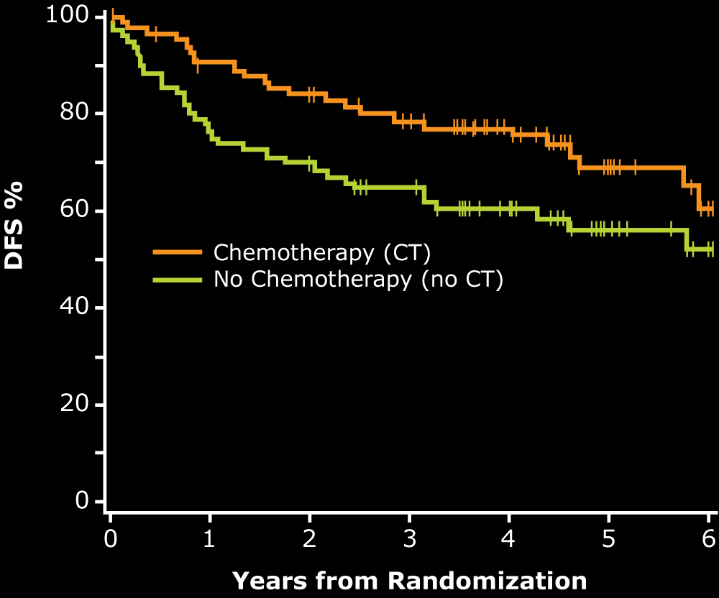
DFS: Overall Population
5-yr DFS
69%
57%
 | Pts | Events | HR | P
CT | 85 | 24 | 0.59 | 0.0455
No CT | 77 | 34
With permission from Aebi S et al. Proc SABCS 2012;Abstract S3-2.

Slide 75
DFS by ER Status
ER+
ER-
5-yr DFS
70%
5-yr DFS
67%
69%
35%
 | Pts | Events | HR | P
CT | 56 | 16 | 0.94 | 0.87
No CT | 48 | 16
 | Pts | Events | HR | P
CT | 29 | 8 | 0.32 | 0.007
No CT | 29 | 18
Univariate interaction term: Treatment x ER: p = 0.044
With permission from Aebi S et al. Proc SABCS 2012;Abstract S3-2.

Slide 76
Meet The Professors
Clinical Investigators Provide Their Perspectives on Real Cases of Metastatic Breast Cancer Monday, June 3, 2013
7:00 PM – 9:00 PM
Chicago, Illinois
Faculty
Community Oncologists
Lisa A Carey, MD
Joyce O’Shaughnessy, MD
Hope S Rugo, MD
Eric P Winer, MD
Denise A Yardley, MD
Lowell L Hart, MD
Robert A Moss, MD
Estelamari Rodriguez, MD, MPH
Moderator Neil Love, MD

