Slide 1
Please note, these are the actual video-recorded proceedings from the live CME event and may include the use of trade names and other raw, unedited content. Select slides from the original presentation are omitted where Research To Practice was unable to obtain permission from the publication source and/or author. Links to view the actual reference materials have been provided for your use in place of any omitted slides.

Slide 2
Myeloma 2012 — Year in Review
Sagar Lonial, MD
Professor
Vice Chair of Clinical Affairs
Director of Translational Research
B-Cell Malignancy Program
Department of Hematology and Medical Oncology
Winship Cancer Institute
Emory University School of Medicine
October 27, 2012
Orlando, Florida

Slide 3
For patients with multiple myeloma (MM), do you generally recommend lenalidomide maintenance after autologous transplant?

Slide 4
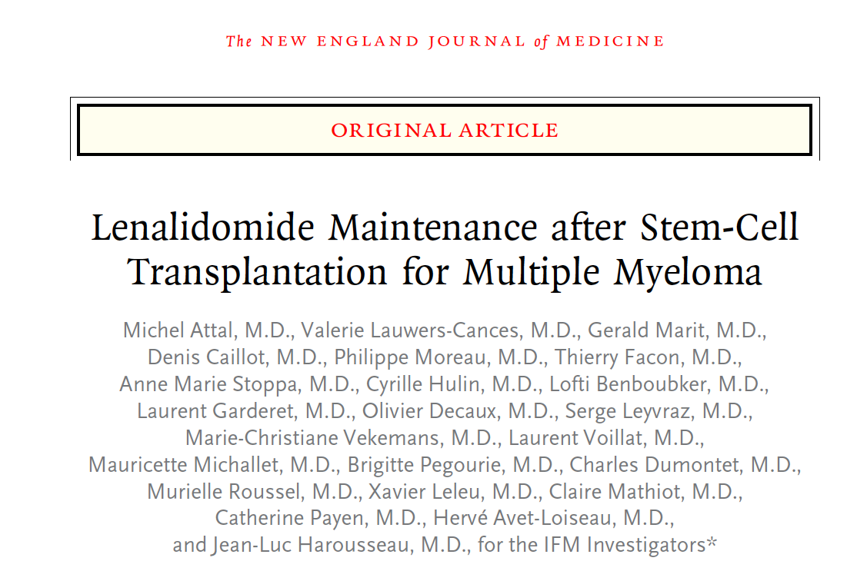
Maintenance Trials
614 patients younger than age 65
10 mg consolidation — then 15 mg vs. placebo until relapse
Primary endpoint PFS
Attal M et al. N Engl J Med 2012;366:1782-1791.

Slide 5
ITT Analysis
Consolidation improved CR/VGPR 58% to 69%
Effect of lenalidomide maintenance versus placebo seen in VGPR (64% vs 49%) and no VGPR (51% vs 18%)
PFS 41 vs 23 months (HR 0.5, p<0.001) (All Groups)
OS not yet different (median OS not yet reached)
Attal M et al. N Engl J Med 2012;366:1782-1791.

Slide 6
Response and SPM
Variable (Independent Review Committee Assessment) | Lenalidomide Group (N = 307) | Placebo Group (N = 307) | P Value
Response at randomization
Response could be evaluated — no. of patients (%) | 266 (87) | 274 (89) | 0.18
Complete response — % | 5 | 8
VGPR — % | 56 | 51
Partial response — % | 38 | 39
Stable disease — % | 1 | 2
Complete response or VGPR — % | 61 | 59 | 0.55
Best response during maintenance
Response could be evaluated — no. of patients (%) | 300 (98) | 293 (95) | 0.07
Complete response — % | 29 | 27
VGPR — % | 55 | 49
Partial response — % | 15 | 23
Stable disease — % | 1 | 1
Complete response or VGPR — % | 84 | 76 | 0.009
More t(4;14)(p16;q32)/-17p in len arm (20.3% vs 11%)
SPM 3.1/100 pt years FU vs 1.2 (len and placebo)
124 lenalidomide pts progressed
    16 lenalidomide, 54 bortezomib, 5 thalidomide
199 in placebo progressed: 90 (of 173 pts with symptomatic disease) received lenalidomide (52%)
Attal M et al. N Engl J Med 2012;366:1782-1791.

Slide 7
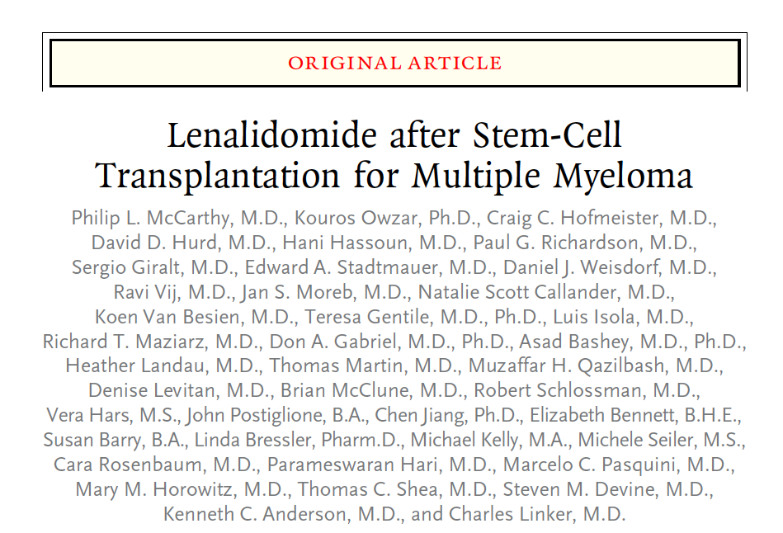
Maintenance Trials
460 patients younger than age 71
Within 100 days post SCT
10 mg vs. placebo until relapse
Primary endpoint PFS
McCarthy PL et al. N Engl J Med 2012;366:1770-1781.

Slide 8
Progression Free Survival
At unblinding 20% len and 44% placebo had progressive disease or died
Of the remaining 128 without disease progression, 86
crossed over
At a median follow-up of 34 mos progression/death rates:
37% vs 58%
Median TTP 46 vs 27 months (p<0.001)
McCarthy PL et al. N Engl J Med 2012;366:1770-1781.

Slide 9
Overall Survival
No data on genetic factors
OS was superior with lenalidomide; 3 yrs 88% vs 80%
SPM occurred in 18 patients who received lenalidomide and 6 patients who received placebo
McCarthy PL et al. N Engl J Med 2012;366:1770-1781.

Slide 10
Cumulative Outcomes
“The cumulative incidence risk of second primary cancers was greater in the lenalidomide group than in the placebo group (P = 0.0008). The cumulative incidence risks of progressive disease and death were greater in the placebo group (P < 0.001 for progression and P = 0.002 for death). All P values are two-sided.”
McCarthy PL et al. N Engl J Med 2012;366:1770-1781.

Slide 11
Pomalidomide With or Without
Low-Dose Dexamethasone in Patients with Relapsed/Refractory Multiple Myeloma: Outcomes in Patients Refractory to
Lenalidomide and Bortezomib
Vij R et al.
Proc ASCO 2012;Abstract 8016.

Slide 12
IMIDs
O
O
H
N
N
O
N
H
O
2
Thalidomide
100-200 mg/d
Lenalidomide
15-25 mg/d
Pomalidomide
1-4 mg/d

Slide 13
MM-002: Phase 2 Study Design
Primary endpoint: PFS
Secondary endpoints: ORR,^{1,2} safety, DOR, OS
Stratification factors: Age (≤75 vs >75 yrs), prior THAL, and 2 vs >2 prior treatments
Progressive
disease
Progressive
disease
POM (4 mg days 1–21
of 28-day cycles)
Option to add LoDEX*
(40 mg/week)
Randomization
Discontinue and follow up for survival and subsequent treatment
POM (4 mg days 1–21 of 28-day cycles) + LoDEX* (40 mg/week)
Progressive
disease
Aspirin (80–100 mg) or equivalent was mandated for all patients
* Patients aged > 75 years had a starting DEX dose of 20 mg/week.
1. Bladé J, et al. Br J Haematol. 1998;102:1115-23; 2. Richardson PG, et al. N Engl J Med 2003;348:2609-17.
Vij R et al. Proc ASCO 2012;Abstract 8016.

Slide 14
MM-002: Best Response by IRAC Review
Using EBMT Criteria, ITT Population
Median number of cycles received was 5 (range 1 - 17)
Disease control (≥ SD) was observed in 76% of overall patients
 | POM (n = 108) | POM + LoDEX (n = 113)
ORR (≥ PR) (%) | 9 | 30
Median DOR*, months | NR | 7.4
≥ MR | 25 | 45
CR | 0 | 1
PR | 9 | 29
MR | 16 | 15
SD | 46 | 35
PD | 16 | 6
Median time to ORR*, months | 2.0 | 1.9
Discrepancies in totals are due to rounding. *For patients who achieved ≥ PR.
Vij R et al. Proc ASCO 2012;Abstract 8016.

Slide 15
To what extent do you use the subcutaneous route of administration of bortezomib for MM?

Slide 16
Given the recent FDA approval of carfilzomib, how have you integrated or how do you intend to integrate this agent into the management of MM for your patients?
In both the induction and refractory/relapsed
disease settings, depending on the patient profile
0%

Slide 17
Stringent Complete Response (sCR) in Patients (pts) with Newly Diagnosed Multiple Myeloma (NDMM) Treated with Carfilzomib (CFZ), Lenalidomide (LEN), and Dexamethasone (DEX)
Jakubowiak AJ et al.
Proc ASCO 2012;Abstract 8011.

Slide 18
Treatment Schema
CRd
Induction
CRd
Maintenance
Lenalidomide
(off protocol)
Transplant-eligible and
-ineligible patients
LEN Cycles 25+
CRd Cycles 1–4
CRd Cycles 5–8
CRd Cycles 9–24
Transplant-eligible
Until disease progression or unacceptable toxicity
≥PR
ASCT
Stem cell collection
Assessments on D1 and 15 of C1 and D1 thereafter using modified IMWG Criteria with nCR
Cycles 1–8
  CFZ Days 1–2, 8–9, 15–16 at assigned doses¹
  LEN 25 mg Days 1–21
  DEX 40 mg weekly Cycles 1-4, 20 mg weekly Cycles 5–8
Cycles 9–24
  CFZ on Days 1–2 and 15–16 only
  CFZ, LEN, DEX at last best tolerated doses
  After Cycle 4, pts could undergo stem cell collection and then continue CRd with the option to proceed to ASCT
1. Jakubowiak AJ, et al. Blood. 2011;118: abstract 631. Jakubowiak AJ et al. Proc ASCO 2012;Abstract 8011.

Slide 19
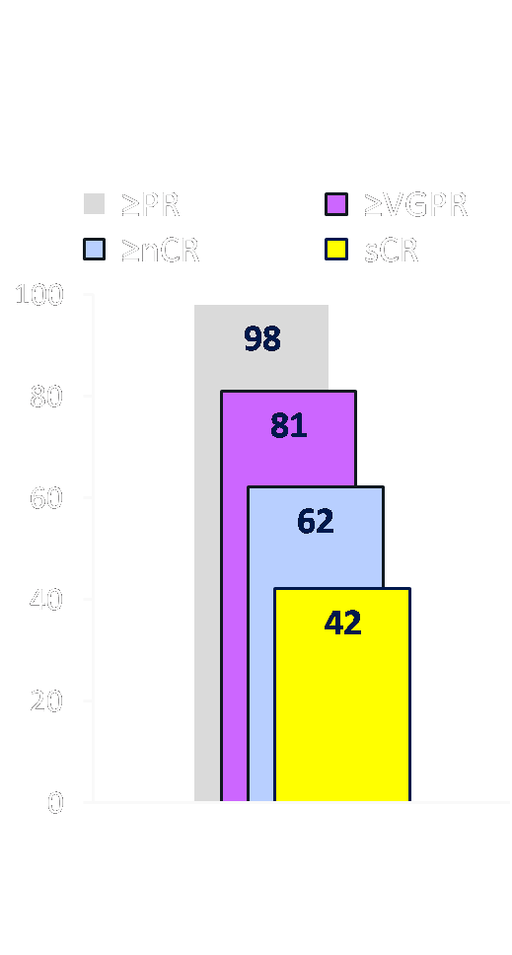
Responses
Initial Response
Best Response²
Change in M-protein level from baseline^{1,2}
C1D15: 51% decrease
C2D1: 67% decrease
C3D1: 81% decrease
Patients (%)
N = 53; median 12 cycles (range 1–25)
¹ Jakubowiak AJ et al. Blood 2012;120(9):1801-9. ² With permission from Jakubowiak AJ et al. Proc ASCO 2012;Abstract 8011.

Slide 20
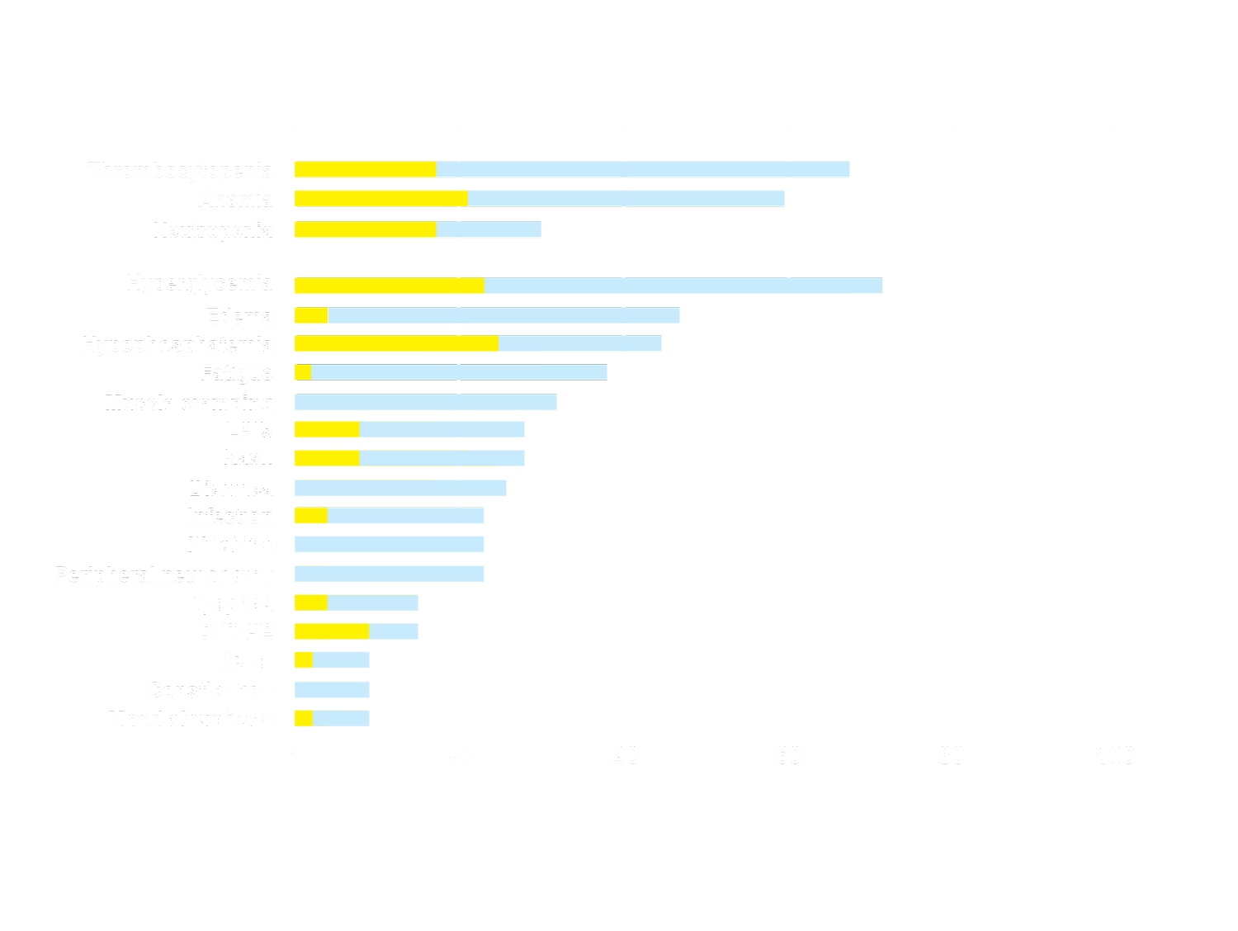
Updated Toxicity of CRd Induction
Grade 3/4
Any Grade
Patients (%)
Toxicity for cycles 1-8 is similar to previously reported¹
Limited dose modifications
¹ Jakubowiak AJ et al. Blood 2011;118:Abstract 631. With permission from Jakubowiak AJ et al. Proc ASCO 2012;Abstract 8011.

Slide 21
Responses after Extended Treatment
With permission from Jakubowiak AJ et al. Proc ASCO 2012;Abstract 8011.

Slide 22
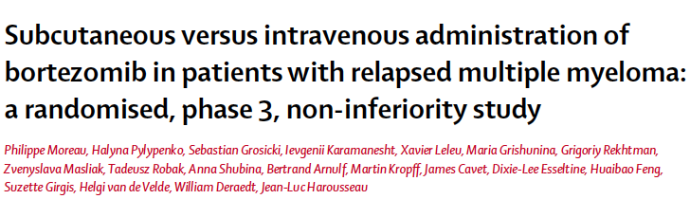
Lancet Oncology, Volume 12, Issue 5, Pages 431-440, May 2011.

Slide 23
SQ Administration of Bortezomib
Randomized Phase 3 study
1-3 previous lines of therapy
Up to eight 21-day cycles of bortezomib
Primary response was noninferiority (4 cy)
222 patients assigned to receive Rx
  145 SQ and 73 IV
ORR same (42% vs. 42%)
  After 8 cycles 52% vs. 52%
Moreau P et al. Lancet Oncology 2011;12(5):431-440.

Slide 24
Results with SQ Bortezomib
Median FU 11.8 mos; no difference in TTP
  10.4 vs. 9.4 mos
One year OS 72% vs. 76%
Grade 3/4 events favored SQ (57% vs. 70%)
PN less common with SQ 38% vs. 53%
(p = 0.04)
  Grade 2 or worse 24% vs. 41% (p = 0.012)
  Grade 3 or worse 6% vs. 16% (p = 0.026)
Moreau P et al. Lancet Oncology 2011;12(5):431-440.

Slide 25
Results with SQ Bortezomib
Median time to first response (response-evaluable analysis) was 3.5 months in both groups (95% CI 2.1–4.2 in the subcutaneous group and 1.7–5.3 in the intravenous group; HR 1.059, 95% CI 0.716–1.567; p=0.772)
No significant difference in time to progression (median 10.4 months, 95% CI 8.5–11.7, in the subcutaneous group vs 9.4 months, 7.6–10.6, in the intravenous group; HR 0.839, 95% CI 0.564–1.249; p=0.387)
No significant difference in progression-free survival: Median 10.2 months, 95% CI 8.1–10.9, vs 8.0 months, 6.7–9.8; HR 0.824, 95% CI 0.574–1.183; p=0.295)
No significant difference in overall survival (1-year survival 72.6%, 95% CI 63.1–80.0, vs 76.7%, 64.1–85.4; p=0.504) between groups (intention-to-treat analysis)
Moreau P et al. Lancet Oncology 2011;12(5):431-440.

Slide 26
MLN9708, an investigational proteasome inhibitor, in combination with lenalidomide and dexamethasone in previously untreated multiple myeloma patients (pts): Evaluation of weekly and twice-weekly dosing
Paul G. Richardson,¹ Jesus G. Berdeja,² Ruben Niesvizky,³ Sagar Lonial,⁴ David Vesole,⁵ Mehdi Hamadani,⁶ Ajai Chari,⁷ Parameswaran Hari,⁸ Myo Htut,⁹ Vivek Roy,¹⁰ Keith Stewart,¹¹ Deborah Berg,¹² Jianchang Lin,¹² Neeraj Gupta,¹² Alessandra Di Bacco,¹² Ai-Min Hui,¹² Shaji K. Kumar¹³
¹Dana-Farber Cancer Institute, Boston, MA; ²Sarah Cannon Research Institute, Nashville, TN; ³Center of Excellence for Lymphoma and Myeloma, Weill Medical College of Cornell University, New York Presbyterian Hospital, New York, NY; ⁴Winship Cancer Institute of Emory University, Atlanta, GA; ⁵The John Theurer Cancer Center at Hackensack UMC, Hackensack, NJ; ⁶West Virginia University, Mary Babb Randolph Cancer Center, Morgantown, WV; ⁷Mount Sinai Medical Center, New York, NY; ⁸Division of Hematology Oncology, Medical College of Wisconsin, Milwaukee, WI; ⁹City of Hope Comprehensive Cancer Center, Duarte, CA; ¹⁰Mayo Clinic, Jacksonville, FL; ¹¹Mayo Clinic, Scottsdale, AZ; ¹²Millennium Pharmaceuticals, Inc., Cambridge, MA;
¹³Division of Hematology, Mayo Clinic, Rochester, MN
Richardson PG et al. Proc ASCO 2012;Abstract 8033.

Slide 27
Patients
Eligibility criteria were identical between studies
Key inclusion criteria:
  ≥18 years old
  ECOG performance status 0–2
  Adequate hepatic and hematologic function
  Creatinine clearance ≥30 mL/min
  Measurable disease:
    Serum M-protein ≥1 g/dL
    Urine M-protein ≥200 mg/24 hours
    Involved free light chain ≥10 mg/dL
Key exclusion criteria:
  Grade ≥2 peripheral neuropathy
  Prior/concurrent deep vein thrombosis/pulmonary embolism
  Prior systemic MM therapy
Richardson PG et al. Proc ASCO 2012;Abstract 8033.

Slide 28
Study Design
Study | Induction |  |  | MLN9708 maintenance
 | MLN9708 | Lenalidomide | Dexamethasone
Weekly | D 1, 8, 15 | 25 mg, D 1–21 | 40 mg, D 1, 8, 15, 22 | D 1, 8, 15
 | Up to 12 x 28-day cycles |  |  | 28-day cycles
Twice-weekly | D 1, 4, 8, 11 | 25 mg, D 1–14 | 20/10 mg (cycles 1–8/9–16), D 1, 2, 4, 5, 8, 9, 11, 12 | D 1, 4, 8, 11
 | Up to 16 x 21-day cycles |  |  | 21-day cycles
Phase 1: oral MLN9708 dose-escalation
  Standard 3+3 schema, 33% dose increments, based on cycle 1 DLTs
Phase 2: oral MLN9708 at the RP2D from phase 1
Each protocol allows for stem cell collection after cycles 3 / 4, with autologous stem cell transplantation (ASCT) deferred until after 6 / 8 cycles in the weekly / twice-weekly studies, respectively
MLN9708 maintenance continued until progression or unacceptable toxicity
Richardson PG et al. Proc ASCO 2012;Abstract 8033.

Slide 29
Preliminary Response in Weekly Dosing Study: Patients Treated
with ≥4 Cycles
Response, n (%)* | Phase 1 (n = 13) | Phase 2 (n = 33) | Total (n = 46)
Median number of cycles | 6 (4–15) | 5 (4–5) | 5 (4–15)
Overall response (≥PR) | 13 (100) | 32 (97)† | 45 (98)†
CR+VGPR | 8 (62) | 13 (39) | 21 (46)
CR | 5 (38) | 7 (21) | 12 (26)
VGPR | 3 (23) | 6 (18) | 9 (20)
*Response assessed using IMWG uniform response criteria
† Only 1 pt did not reach the criteria for PR but achieved a 46% reduction in M-protein by cycle 4 at the data cut-off
Richardson PG et al. Proc ASCO 2012;Abstract 8033.

Slide 30
Preliminary response in twice-weekly dosing study
Response, n (%) | Overall (N = 10)* | Patients treated with ≥4 cycles (n = 6)
Median number of cycles | 4 (1–8) | 6 (4–8)
Overall response (≥PR) | 9 (90)† | 6 (100)
CR+VGPR | 6 (60) | 5 (83)
CR | 1 (10) | 1 (17)
VGPR | 5 (50) | 4 (67)
* 1 pt was not response-evaluable at data cut-off
† Only 1 pt did not reach the criteria for PR, but achieved a 32% reduction in M-protein after cycle 1 at the data cut-off
Response appears to get better with time on treatment
Richardson PG et al. Proc ASCO 2012;Abstract 8033.

Slide 31
A Randomized Phase II Study
of Elotuzumab with Lenalidomide and Low-Dose Dexamethasone in Patients with Relapsed/Refractory Multiple Myeloma
Moreau P et al.
Proc ASCO 2012;Abstract 8020.

Slide 32
Select Multiple Myeloma Trials
Phase III MM 30/CA204-006: Lenalidomide/Dexamethasone with or without Elotuzumab
Eligibility: Previously untreated, transplant-ineligible multiple myeloma
Elotuzumab:
A humanized monoclonal IgG1 antibody product directed to human CS1, a cell surface glycoprotein with homology to the CD2 family of cell surface proteins

