Slide 1
Please note, these are the actual video-recorded proceedings from the live CME event and may include the use of trade names and other raw, unedited content. Select slides from the original presentation are omitted where Research To Practice was unable to obtain permission from the publication source and/or author. Links to view the actual reference materials have been provided for your use in place of any omitted slides.

Slide 2
Year in Review
Multitumor CME Symposium
CML
Hagop Kantarjian
UT MD Anderson Cancer Center
October 27, 2012
Orlando, Fl.

Slide 3
What is your preferred initial treatment for chronic-phase chronic myeloid leukemia (CML)?

Slide 4
For patients with CML, are there situations in which you would consider discontinuing imatinib after a complete molecular response lasting for years?

Slide 5
What I will review
Nilotinib and dasatinib in frontline CML Rx
Ponatinib and bosutinib in salvage CML Rx
CML monitoring; mutations
What is exciting in other leukemias (ALL; CLL)

Slide 6
Nilotinib versus imatinib in patients (pts) with newly diagnosed chronic myeloid leukemia in chronic phase (CML-CP): ENESTnd 3-year (yr) follow-up (f/u)
Kantarjian H, Flinn I, Goldberg S, et al.
JCO 30:abst 6509;2012

Slide 7
ENESTnd: Study Design
R
A
N
D
OMI
Z
ED
*
Nilotinib 300 mg BID (n = 282)
N = 846
217 centers
35 countries
Nilotinib 400 mg BID (n = 281)
Imatinib 400 mg QD (n = 283)
* Stratification by Sokal risk score.
Follow-up of 10 years
ENESTnd met primary endpoint of MMR at 12 mos in pts Rx with nilotinib 300 or 400 mg BID vs imatinib (P < .0001).
Saglio. NEJM:362:2251;2010
Notes:
7

Slide 8
Nilotinib vs Imatinib in Newly Diagnosed Chronic Phase CML
846 pts randomized to nilotinib 300 mg BID (n=282), nilotinib 400 mg BID (n=281), or imatinib 400 mg QD (n=283) Minimum follow-up 36 mo
Outcome | Nil 300 | Nil 400 | IM 400
% CCyR* | 87 | 85 | 77
% MMR** | 73 | 70 | 53
% BCR-ABL ≤0.0032%** | 32 | 28 | 15
% Transformed AP/BP | 3.2 | 2.1 | 6.0
% Survival at 36 months | 95 | 97 | 94
* by 24 months, ** by 36 months
Saglio. Proc ASH 2011;Abstract 452.

Slide 9
ENESTnd: Cumulative Incidence of MMR and MR^{4.5*}
MMR
MR^{4.5}
n
100
Nilotinib 300 mg bid
282
By 3 Years
n
90
Nilotinib 400 mg bid
281
40
Nilotinib 300 mg bid
282
By 3 Years
Imatinib 400 mg qd
283
73%, P < .0001
Nilotinib 400 mg bid
281
80
By 1 Year
Imatinib 400 mg qd
283
32%, P < .0001
70
55%, P < .0001
70%, P < .0001
30
By 1 Year
60
Patients With MR^{4.5}, %
Patients With MMR, %
Δ 17%-20%
11%, P < .0001
50
51%, P < .0001
53%
20
28%, P = .0003
40
Δ 24%-28%
Δ 13%-17%
30
10
7%, P < .0001
20
27%
15%
Δ 6%-10%
10
0
0
1%
0
3
6
9
12
15
18
21
24
27
30
33
36
0
3
6
9
12
15
18
21
24
27
30
33
36
Time Since Randomization, Months
Time Since Randomization, Months
Data cutoff: 27 Jul 2011.
* Equivalent to BCR-ABL transcript levels of ≤ 0.0032% (IS).
Courtesy of Kantarjian. JCO 30: abst 6509; 2012
Notes:
9

Slide 10
ENESTnd: Progression to AP/BP on Rx
P = .0059
P = .0003
P = .0185
P = .0085
Patients, n
0.7%
1.1%
4.2%
0.7%
1.8%
6.0%
Including Clonal Evolution
Nilotinib 300 mg BID
Nilotinib 400 mg BID
Imatinib 400 mg QD
Courtesy of Kantarjian. JCO 30:abst 6509;2012
Notes:
10

Slide 11
Switch to nilotinib versus continued imatinib in patients (pts) with chronic myeloid leukemia in chronic phase (CML-CP) with detectable BCR-ABL after 2 or more years on imatinib: ENEST cmr 12-month (mo) follow-up
Lipton JH, Hughes T, Leber B, et al.
JCO 30:abst 6505;2012

Slide 12
ENESTcmr: Study Design and Endpoints
R
A
N
D
O
M
I
Z
E
Nilotinib 400 mg BID
N = 207
1:1 randomization stratified by:
Prior imatinib (≤ 36 mos, > 36 mos) AND
Prior interferon (None, ≤ 12 mos, > 12 mos)
Imatinib continue same dose
4-year study
ENDPOINTS
Primary
Confirmed CMR (undetectable BCR-ABL) by 12 months
Secondary
Kinetics of molecular response (undetectable, MR⁴ and MR^{4.5} over time)
  RQ-PCR for primary and secondary endpoints was performed every 3 months and assessed at a central laboratory in Adelaide, Australia
Safety profile
Lipton. JCO 30:abst 6505;2012
Notes:
12

Slide 13
ENESTcmr: Results
207 pts with CML-CP treated with imatinib ≥2 years, in CCyR with persistent disease by PCR Randomized to continue imatinib 400-600 mg or change to nilotinib
Outcome by 12 months (%) | Nilotinib 400 mg BID n = 104 | Imatinib 400-600 mg QD n = 103
Confirmed CMR | 13 | 6
CMR | 23 | 11
MR^{4.5} | 33 | 17
MR⁴ | 49 | 26
Discontinued Rx, % | 16 | 4
Adverse event(s) | 9 | 1
Withdrawal of consent | 4 | 1
Death | 1 | 0
Other† | 3 | 2
†Includes pregnancy, protocol violation, and transient loss of MMR.
Lipton. JCO 30:abst 6505;2012
Notes:
13

Slide 14
Dasatinib versus imatinib (IM) in newly diagnosed chronic myeloid leukemia in chronic phase (CML-CP): DASISION 3-year follow-up
Hochhaus A, Shah N, Cortes J, et al.
JCO 30:abst 6504;2012

Slide 15
DASISION (CA180-056): Design
Treatment-naïve CML-CP patients (N=519)
108 Centers
26 Countries
Dasatinib 100 mg QD (N=259)
Long-term
Randomized
follow-up
Imatinib 400 mg QD (N=260)
Stratified by EURO (Hasford) risk score
Primary endpoint: Confirmed CCyR (cCCyR) by 1 year
Hochhaus. JCO 30:abst 6505;2012

Slide 16
Dasatinib vs Imatinib in Newly Diagnosed Chronic Phase CML
519 pts randomized to dasatinib 100 mg QD (n=259) or imatinib 400 mg QD (n=260) Minimum follow-up 24 mo
Outcome* | Das 100 | IM 400
% CCyR | 86 | 82
% MMR | 68 | 55
% BCR-ABL ≤0.0032% | 22 | 12
% Transformed AP/BP | 4 | 6
* by 24 months
Hochhaus. JCO 30:abst 6504;2012

Slide 17
DASISION: Cumulative Incidence of
MMR and MR^{4.5}
Dasatinib 100 mg QD
Imatinib 400 mg QD
MMR
MR^{4.5}
100
P<0.0001
40
80
P=0.00069
64%
68%
30
% with MMR
22%
60
46%
17%
20
% with MR^{4.5}
55%
40
46%
3%
10
12%
20
23%
9%
0
2%
0
0
12
24
36
0
12
24
36
Months
Months
MMR = BCR-ABL ≤0.1%
MR^{4.5} = BCR-ABL ≤0.0032%
With permission from Hochhaus. JCO 30:abst 6504;2012

Slide 18
DASISION: Transformation to AP/BP
CML by 3 Years
Dasatinib 100 mg QD
Imatinib 400 mg QD
16
13
11
Number of patients, n
8
N 259 260 259 260
On study
Including follow-up beyond discontinuation (ITT)
Hochhaus. JCO 30:abst 6505;2012

Slide 19
Select Chronic Myeloid Leukemia Trials
Phase IV CML 16/CAMN107AUS28: Study of Complete Molecular Response (CMR) to Nilotinib in Newly Diagnosed Ph+ CML-CP
Eligibility: Adult patients with newly diagnosed Philadelphia chromosome-positive (Ph+) chronic myelogenous leukemia in chronic phase (CML-CP)
Nilotinib:
Synthetic second-generation BCR-ABL tyrosine kinase inhibitor; available as an oral formulation
  Prevents the activation of BCR-ABL-dependent mitogenic and antiapoptotic pathways

Slide 20
PACE: A Pivotal Phase II Trial of Ponatinib in Patients with CML and Ph+ALL Resistant or Intolerant to Dasatinib or Nilotinib, or with the T315I Mutation
Cortes JE et al.
Proc ASCO 2012;Abstract 6503.

Slide 21
Ponatinib
Oral pan-BCR-ABL TKI with potent activity against native and mutated BCR-ABL and other kinases
Extensive network of optimized molecular contacts
Triple bond to accommodate T315I
Phase I study: MTD 45 mg/d
  DLT pancreatitis
  PACE Primary Objective
  Efficacy of ponatinib in patients with CML or Ph+ ALL
    resistant or intolerant (R/I) to dasatinib or nilotinib,
    or
    with the T315I mutation

Slide 22
PACE Initial Results
Response in CP-CML Cohorts
449 pts resistant or intolerant (R/I) to dasatinib or nilotinib OR with T315I mutation after any TKI Median follow-up 10 months
Response | n Response / N Evaluable (%)
 | Overall N=267 | R/I Cohort N=203 | T315I Cohort N=64
CHR | 249 (93) | 191 (94) | 58 (91)
MCyR* | 144 (54) | 99 (49) | 45 (70)
CCyR | 118 (44) | 76 (37) | 42 (66)
MMR | 79 (30) | 47 (23) | 32 (50)
93% MCyR sustained ≥12 months
*MCyR is the primary endpoint
Cortes JE et al. Proc ASCO 2012;Abstract 6503.

Slide 23
PACE: MCyR Duration
R/I (N=99); T315I (N=45); Total (N=144)
Median follow-up: 10 months
93.3% of MCyR projected to remain in MCyR at 12 months (95% CI: 85%, 97%)
Cortes JE et al. Proc ASCO 2012;Abstract 6503.

Slide 24
Safety and efficacy of bosutinib (SKI-606) in chronic phase Philadelphia chromosome-positive chronic myeloid leukemia patients with resistance or intolerance to imatinib
Cortes JE, Kantarjian HM, Brummendorf TH, Kim DW, Turkina AG, Shen ZX, Pasquini R, Khoury HJ, Arkin S, Volkert A, Besson N, Abbas R, Wang J, Leip E, Gambacorti-Passerini C.
Blood 2011;118(17):4567-76.

Slide 25
Bosutinib in CML-CP post imatinib failure
288 pts Rx with bosutinib 500 mg/D: Imatinib resistant 200; intolerant 88
Parameter Percent
-CHR 86
-MCyR 53
-CCyR 41
-MMR if CCyR 64
-2-yr PFS 79
-2-yr OS 92
Side effects: diarrhea 9%, rash 9%
Cortes JE et al. Blood 2011;118(17):4567-76.

Slide 26
Bosutinib in CML post imatinib failure PFS and survival
1-year PFS: 91%, including 89% of imatinib-resistant and 95% of imatinib-intolerant patients
2-year PFS: 79%, including 73% of imatinib-resistant and 95% of imatinib-intolerant patients
1-year OS: 97%
2-year OS: 92%, including 89% of imatinib-resistant and 98% of imatinib-intolerant patients
Cortes JE et al. Blood 2011;118(17):4567-76.

Slide 27
Criteria for Failure and Suboptimal Response to Imatinib
Time (mo) | Response
 | Failure | Suboptimal | Optimal
3 | No CHR | No CG Response | ≤65% Ph+
6 | No CHR >95% Ph+ | >35% Ph+ | ≤35% Ph+
12 | >35% Ph+ | 1-35% Ph+ | 0% Ph+
18 | ≥5% Ph+ | No MMR | MMR
Any | Loss of CHR Loss of CCgR Mutation CE | Loss of MMR Mutation | Stable or Improving MMR
Baccarani. JCO 2009;27:6041-51

Slide 28
When to Look for Mutations?
Mutation analysis in 1301 pts receiving imatinib or 2nd generation TKI (GIMEMA)
Clinical condition | % Positive
Failure | 27
No CHR at 3 mo | 19
No CyR at 6 mo | 11
No PCyR at 12 mo | 17
No CCyR at 18 mo | 17
Loss CCyR | 31
Loss CHR | 50
Suboptimal | 5
No CyR at 3 mo | 7
No PCyR at 6 mo | 5
No CCyR at 12 mo | 8
No MMR at 18 mo | 0
Loss MMR | 4
Soverini. Blood 118:abst 1208;2011. Kantarjian. Blood 111:1774-1780;2007

Slide 29
Analysis of Mutations in CML
If CG or hematologic relapse, mutation studies help
No role for mutation studies pre-Rx or in imatinib-responding patients
T315I: no role for new TKIs; allo SCT or others (HU, ara-C, HHT, “T315I inhibitors”)
Y253H, E255K/V, F359V/C/I: dasatinib
V299L, T315A, F317L/V/I/C: nilotinib
Kantarjian. Blood 111:1774-1780;2007. Soverini. Blood 118:abst 1208;2011

Slide 30
My Golden Rules in CML
Monitoring
Do not discard a TKI unless there is loss of CGCR (not MMR) at the maximum tolerated adjusted dose that does not cause grade 3-4 or chronic grade 2 (affecting QOL) toxicities
Dose ranges
imatinib 300-400 mg/D (rarely 200 mg/D)
nilotinib 300-400 mg BID
dasatinib 20-100 mg/D
Mutation studies only if CG or hematologic relapse

Slide 31
Patients with myelofibrosis that does not harbor an activating JAK mutation generally do NOT respond to ruxolitinib.

Slide 32
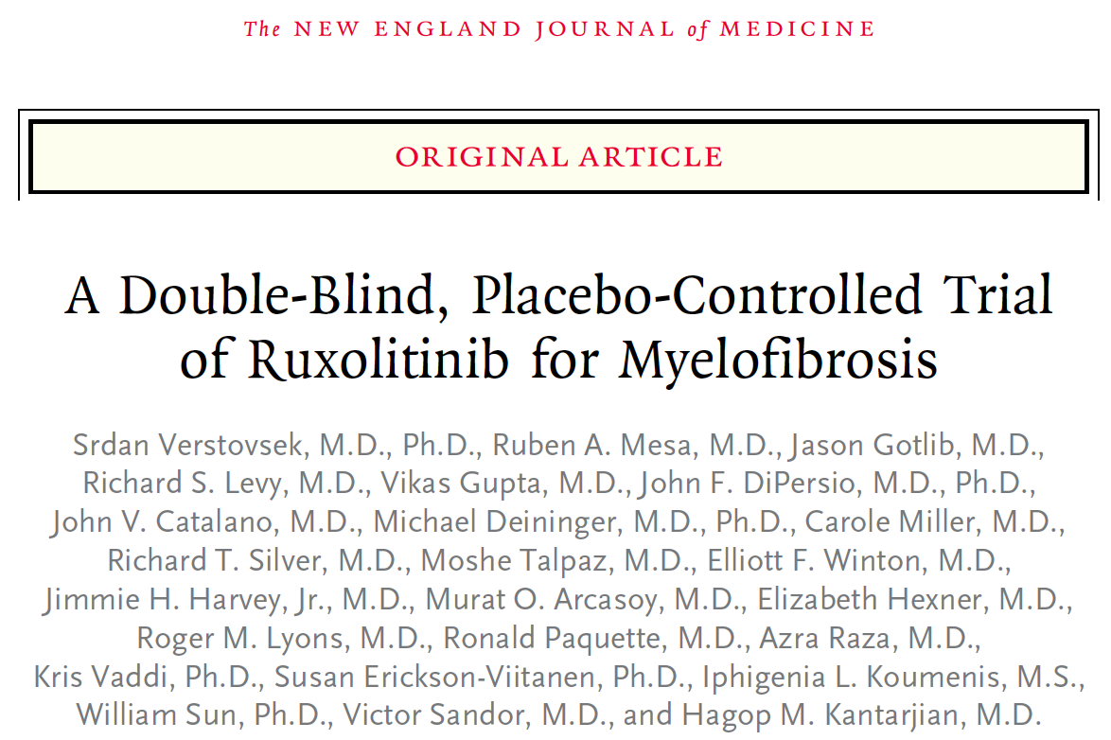
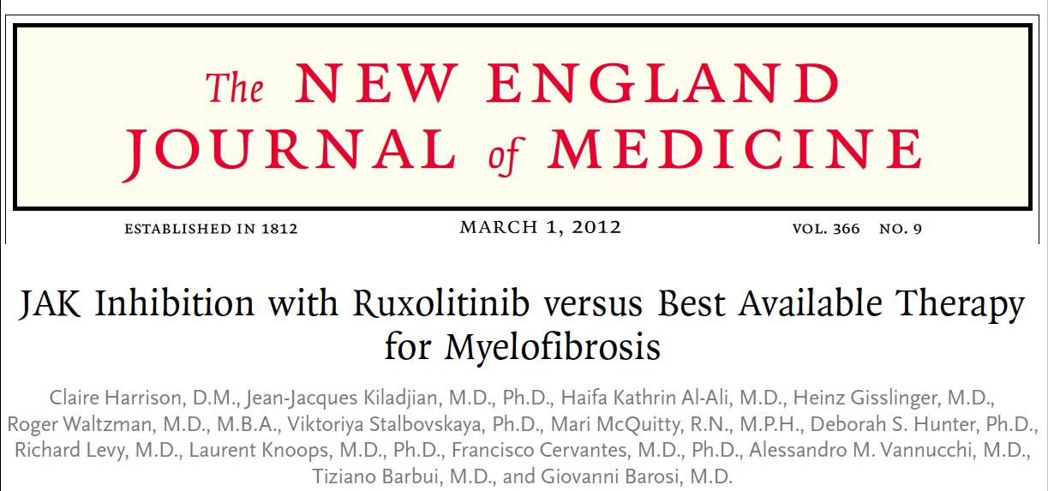
COMFORT-I
COMFORT-II

Slide 33

COMFORT-II: Percent Change from Baseline in Spleen Volume
 | Ruxolitinib | BAT
Decreased spleen volume as best percentage change from baseline | 132 (97%) | 35 (56%)
Increased spleen volume as best percentage change from baseline | 4 (3%) | 28 (44%)
Best percentage change from baseline in spleen volume, as assessed by MRI or CT, at any time within the first 48 weeks of treatment, among patients with a baseline assessment and at least one subsequent assessment
From N Engl J Med, Harrison C et al, JAK Inhibition with Ruxolitinib versus Best Available Therapy for Myelofibrosis, Volume 366, Pages 787-98. Copyright © 2012 Massachusetts Medical Society. Reprinted with permission from Massachusetts Medical Society.

Slide 34
Select Myelofibrosis Trials
Phase II INCB 18424-258: Ruxolitinib in Primary Myelofibrosis (PM), Post-Essential Thrombocythemia-Myelofibrosis (PET-MF) and Post-Polycythemia Vera-Myelofibrosis (PPV-MF)
Eligibility: Bone marrow biopsy-confirmed PM, PET-MF or PPV-MF with platelet counts of 50 x 10⁹/L to 100 x 10⁹/L
Ruxolitinib Phosphate:
An orally bioavailable Janus-associated kinase (JAK) inhibitor with potential antineoplastic and immunomodulating activities
Specifically binds to and inhibits protein tyrosine kinases JAK 1 and JAK 2, which may lead to a reduction in inflammation and an inhibition of cellular proliferation

Slide 35
Inotuzumab Ozogamycin (I0), a CD22 Monoclonal Antibody Conjugated to Calecheamicin, Given Weekly, for Refractory-Relapse Acute Lymphocytic Leukemia (R-R ALL)
Jabbour E et al.
Proc ASCO 2012;Abstract 6501.

Slide 36
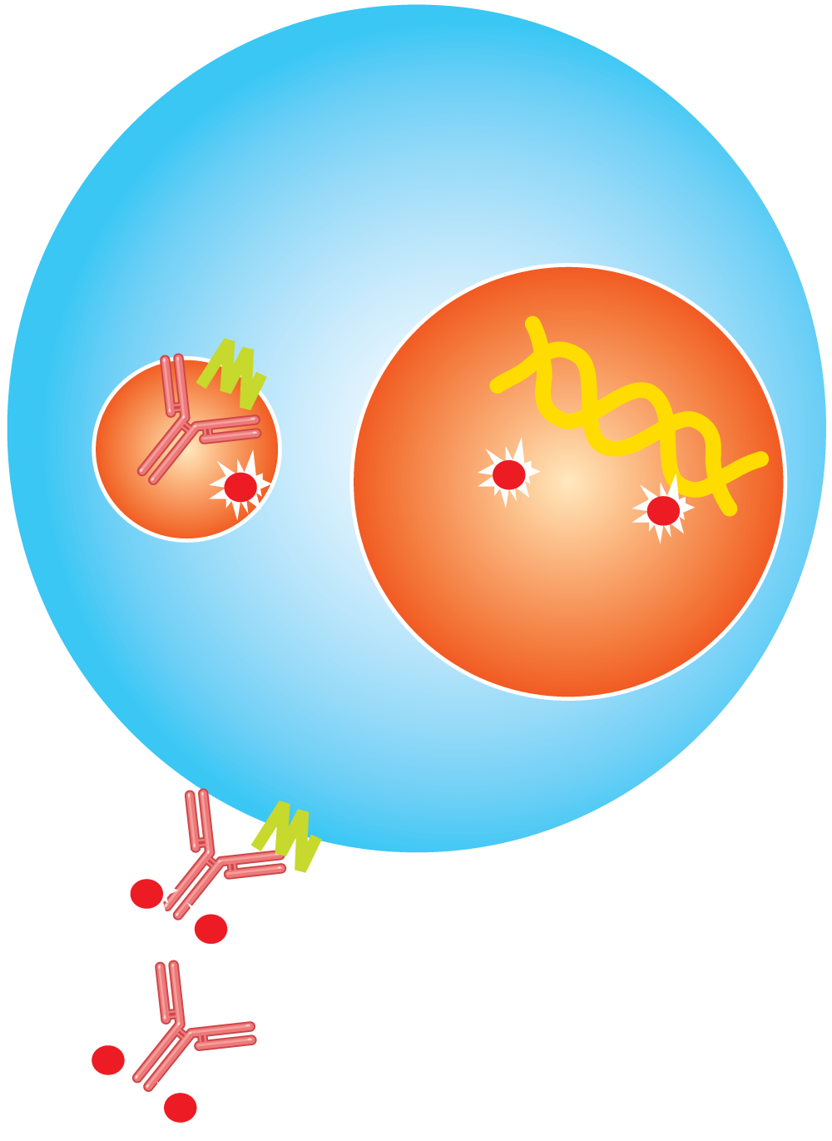
Inotuzumab in ALL: Mechanisms of Action
Tumor Cell
The antibody-antigen complex is rapidly internalized upon binding to CD22
Calicheamicin is released inside the tumor cell
  Calicheamicin is more potent than other cytotoxic chemotherapeutic agents
Calicheamicin binds to DNA, inducing double-stranded DNA breaks
Development of DNA breaks is followed by apoptosis of the tumor cell
Nucleus
Internalization
Calicheamicin binds to DNA
CD22
Inotuzumab ozogamicin
With permission from Jabbour E et al. Proc ASCO 2012;Abstract 6501.

Slide 37
Effect of Anti-CD19 BiTE Blinatumomab on Complete Remission Rate and Overall Survival in Adult Patients with Relapsed/Refractory B-Precursor ALL
Topp M et al.
Proc ASCO 2012;Abstract 6500.

Slide 38
Mode of Action of Anti-CD19 BiTE® Blinatumomab
Blinatumomab is a bispecific T-cell engager (BiTE) antibody
Designed to direct cytotoxic T cells to CD19-expressing cancer cells
Transiently tether resting T cells to tumor cells, leading to concomitant T-cell activation and serial lysis of tumor cells
Bargou R et al. Science 2008;321(5891):974-7.

