Slide 1
Please note, these are the actual video-recorded proceedings from the live CME event and may include the use of trade names and other raw, unedited content. Select slides from the original presentation are omitted where Research To Practice was unable to obtain permission from the publication source and/or author. Links to view the actual reference materials have been provided for your use in place of any omitted slides.

Slide 2
Year in Review 2012 Colorectal Cancer
Daniel G Haller, MD
Professor of Medicine Emeritus
Abramson Cancer Center of the
University of Pennsylvania
Perelman School of Medicine at the
University of Pennsylvania

Slide 3
The types of VEGF ligands bound by aflibercept are essentially identical to those bound by bevacizumab.

Slide 4
A 60-year-old patient with metastatic colon cancer responds to FOLFOX/bevacizumab but after 1 year develops disease progression. The tumor is K-ras mutant. Would you likely use an anti-angiogenic agent at this point outside of a trial (with chemotherapy)?

Slide 5
TARGETED THERAPY FOR mCRC

Slide 6
Biologic Agents in Colorectal Cancer Monoclonal Antibodies
Fab
Fc
Murine Ab
“momab”
Chimeric
Mouse-Human Ab
“ximab”
Humanized Ab
“zumab”
Human Ab
“mumab”
(17-1A,
edrecolomab)
Cetuximab
EGFR
Bevacizumab
Panitumumab
VEGF

Slide 7
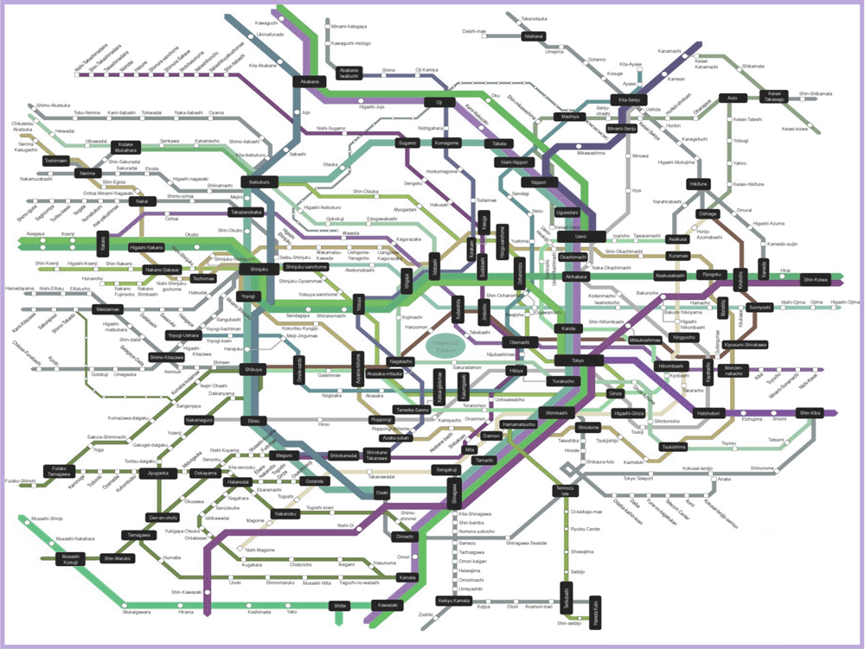
My Concept of Tumor Cell Biology

Slide 8
Bevacizumab vs EGFR Antibodies in mCRC Simplified
Agent | Strength | Weakness
Bevacizumab | Delay in tumor progression Gain in time Toxicity profile | No single agent activity Weak effect on RR No predictive marker
EGFR antibodies | Single agent activity Consistent increase in RR Activity independent of line of therapy Predictive marker | Gain in time to progression moderate Toxicity profile

Slide 9
Bevacizumab beyond progression (BBP) BRiTE: Non-randomized, observational cohort study
BRiTE
total n=1,953
1,445 patients with first PD
932 deaths (21 January 2007 cut-off)
median follow-up 19.6 months
Primary endpoint: survival beyond first progression
Secondary endpoints: safety, OS
Unresectable mCRC treated with first-line chemotherapy + bevacizumab (n=1,953)
First progression
(n=1,445)
Physician decision (no randomization)
No post-PD treatment (n=253)
No bevacizumab post-PD (n=531)
Bevacizumab post-PD (n=642)
PD = disease progression
Grothey A et al. JCO 2008;26:5326.

Slide 10
BRiTE Registry: Bevacizumab Regimens: Investigation Treatment Effects Grothey et al, ASCO, 2007
A longer median OS in the BBP subgroup was observed compared with the No BBP subgroup (Table 4).
Median OS: 19.9 v. 31.8 mos
OS Beyond PD: 9.5 v. 19.2 mos
Grothey A et al. JCO 2008;26:5326.

Slide 11
ML18147 study design (phase III)
Standard second-line CT (oxaliplatin or irinotecan-based) until PD
BEV + standard first-line CT
(either oxaliplatin or irinotecan-based) (n=820)
PD
Randomize 1:1
BEV (2.5 mg/kg/wk) + standard second-line CT (oxaliplatin or irinotecan-based) until PD
CT switch:
Oxaliplatin → Irinotecan
Irinotecan → Oxaliplatin
Primary endpoint | Overall survival (OS) from randomization
Secondary endpoints included | Progression-free survival (PFS) Best overall response rate Safety
Stratification factors | First-line CT (oxaliplatin-based, irinotecan-based) First-line PFS (≤9 months, >9 months) Time from last BEV dose (≤42 days, >42 days) ECOG PS at baseline (0/1, 2)
Study conducted in 220 centres in Europe and Saudi Arabia
Arnold D et al. Proc ASCO 2012;Abstract CRA3503.

Slide 12
TML: Main eligibility criteria
Inclusion
Patients ≥18 years with histologically confirmed diagnosis of mCRC
Eastern Cooperative Oncology Group (ECOG) PS 0–2
PD (≥1 measurable lesion according to RECIST v1 assessed by investigator, documented by CT or MRI), ≤4 weeks prior to start of study treatment
Previously treated with BEV plus standard first-line CT, not candidates for primary metastasectomy
Exclusion (all favoring potential benefit)
Diagnosis of PD >3 months after last BEV administration
First-line patients with PFS in first-line of <3 months
Patients receiving <3 consecutive months of BEV in first-line
Arnold D et al. Proc ASCO 2012;Abstract CRA3503.

Slide 13
TML: OS ITT population
1.0
CT (n=410)
BEV + CT (n=409)
0.8
Unstratifiedª HR: 0.81 (95% CI: 0.69–0.94)
p=0.0062 (log-rank test)
0.6
OS estimate
Stratified^{b} HR: 0.83 (95% CI: 0.71–0.97)
p=0.0211 (log-rank test)
0.4
0.2
9.8 mo
11.2 mo
0
0 6 12 18 24 30 36 42 48
Time (months)
No. at risk
CT 410 293 162 51 24 7 3 2 0
BEV + CT 409 328 188 64 29 13 4 1 0
Median follow-up: CT, 9.6 months (range 0–45.5); BEV + CT, 11.1 months (range 0.3–44.0)
ªPrimary analysis method; ^{b}Stratified by first-line CT (oxaliplatin-based, irinotecan-based), first-line PFS (≤9 months, >9 months), time from last dose of BEV (≤42 days, >42 days), ECOG performance status at baseline (0, ≥1)
With permission from Arnold D et al. Proc ASCO 2012;Abstract CRA3503.

Slide 14
TML: Subgroup analysis of OS: ITT population
Category | Subgroup | n |  | HR (95% CI)
All | All | 819 |  | 0.81 (0.69–0.94)
Patient populationª | AIO | 260 |  | 0.86 (0.67–1.11)
 | ML18147 | 559 |  | 0.78 (0.64–0.94)
Gender | Female | 294 |  | 0.99 (0.77–1.28)
 | Male | 525 |  | 0.73 (0.60–0.88)
Age | <65 years | 458 |  | 0.79 (0.65–0.98)
 | ≥65 years | 361 |  | 0.83 (0.66–1.04)
ECOG performance status | 0 | 357 |  | 0.74 (0.59–0.94)
 | ≥1 | 458 |  | 0.87 (0.71–1.06)
First-line PFS | ≤9 months | 449 |  | 0.89 (0.73–1.09)
 | >9 months | 369 |  | 0.73 (0.58–0.92)
First-line CT | Oxaliplatin-based | 343 |  | 0.79 (0.62–1.00)
 | Irinotecan-based | 476 |  | 0.82 (0.67–1.00)
Time from last BEV | ≤42 days | 630 |  | 0.82 (0.69–0.97)
 | >42 days | 189 |  | 0.76 (0.55–1.06)
Liver metastasis only | No | 592 |  | 0.81 (0.67–0.97)
 | Yes | 226 |  | 0.79 (0.59–1.05)
No. of organs with metastasis | 1 | 307 |  | 0.83 (0.64–1.08)
 | >1 | 511 |  | 0.77 (0.64–0.94)
HR
0 1 2
ªPatient population refers to sequential enrollment of patients in original AIO and subsequent enrollment in ML18147 when study was transferred to Roche. All patients listed under AIO were included in primary analysis
With permission from Arnold D et al. Proc ASCO 2012;Abstract CRA3503.

Slide 15
Best overall response: Measurable disease population
Outcome | CT (n=406) | BEV + CT (n=404)
Respondersª, n (%) | 16 (3.9) | 22 (5.4)
p-value (unstratified) | 0.3113
p-value (stratified) | 0.4315
Complete response, n (%) | 2 (<1) | 1 (<1)
Partial response, n (%) | 14 (3) | 21 (5)
Stable disease, n (%) | 204 (50) | 253 (63)
Disease control rate, n (%) | 220 (54) | 275 (68)
p-value^{b} | <0.0001
PD, n (%) | 142 (35) | 87 (22)
Missing^{c}, n (%) | 44 (11) | 42 (10)
ªPatients with a best overall response of confirmed complete or partial response ^{b}This analysis was not prespecified
^{c}Includes ‘not-evaluable’ or ‘no tumour assessment’ following baseline visit
Arnold D et al. Proc ASCO 2012;Abstract CRA3503.

Slide 16
TML features and findings
Assumes everyone gets bevacizumab 1st line
Very select patient population
Proven tolerant of long-term bevacizumab
PFS 1st line > 3 months
Responses infrequent (4-5%)
Chemotherapy backbone did not matter
BBP increased OS 1.4 months (HR = 0.81)
Arnold D et al. Proc ASCO 2012;Abstract CRA3503.

Slide 17
TML: Missing in abstract presentation
Impact of subsequent treatments
KRAS status
Only 40% received anti-EGFR
BRAF status
OS from diagnosis, not from randomization
Arnold D et al. Proc ASCO 2012;Abstract CRA3503.

Slide 18
Aflibercept (VELOUR)
Fusion protein of key domains from human VEGF receptors 1 and 2 with human IgG Fc¹
Blocks all human VEGF-A isoforms, VEGF-B, and placental growth factor (PlGF)²
High affinity – binds VEGF-A more tightly than native receptors
Holash J et al. Proc Natl Acad Sci USA. 2002;99:11393-11398.
Tew WP et al. Clin Cancer Res. 2010;16:358-366.
Notes:
18

Slide 19
VELOUR Study Design
R
A
N
D
O
M
I
Z
E
Aflibercept 4 mg/kg IV, day 1 + FOLFIRI
q2 weeks
600
Metastatic Colorectal Cancer
1:1
Disease Progression
Death
Stratification factors:
ECOG PS (0 vs 1 vs 2)
Prior bevacizumab
600
Placebo IV, day 1
+ FOLFIRI
q2 weeks
Primary endpoint: overall survival
Sample size: HR=0.8, 90% power, 2-sided type I error 0.05
Final analysis of OS: analyzed at 863rd death event using a 2-sided nominal significance level of 0.0466 (α spending function)
Van Cutsem E at al. ESMO/WCGC 2011;Abstract O-0024.
Notes:
19

Slide 20
VELOUR Key Inclusion Criteria
Pathologically proven metastatic adenocarcinoma of the colon or rectum not amenable to curative treatment
Measurable or non-measurable disease (per RECIST criteria)
Only 1 prior oxaliplatin-containing chemotherapeutic regimen for metastatic disease
Patients who relapsed within 6 months of completion of oxaliplatin-based adjuvant chemotherapy were eligible
~30% of patients had prior bevacizumab
Van Cutsem E at al. ESMO/WCGC 2011;Abstract O-0024.

Slide 21
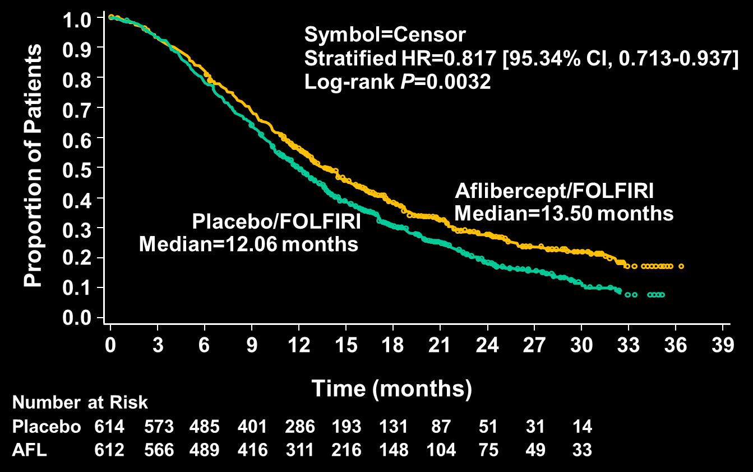
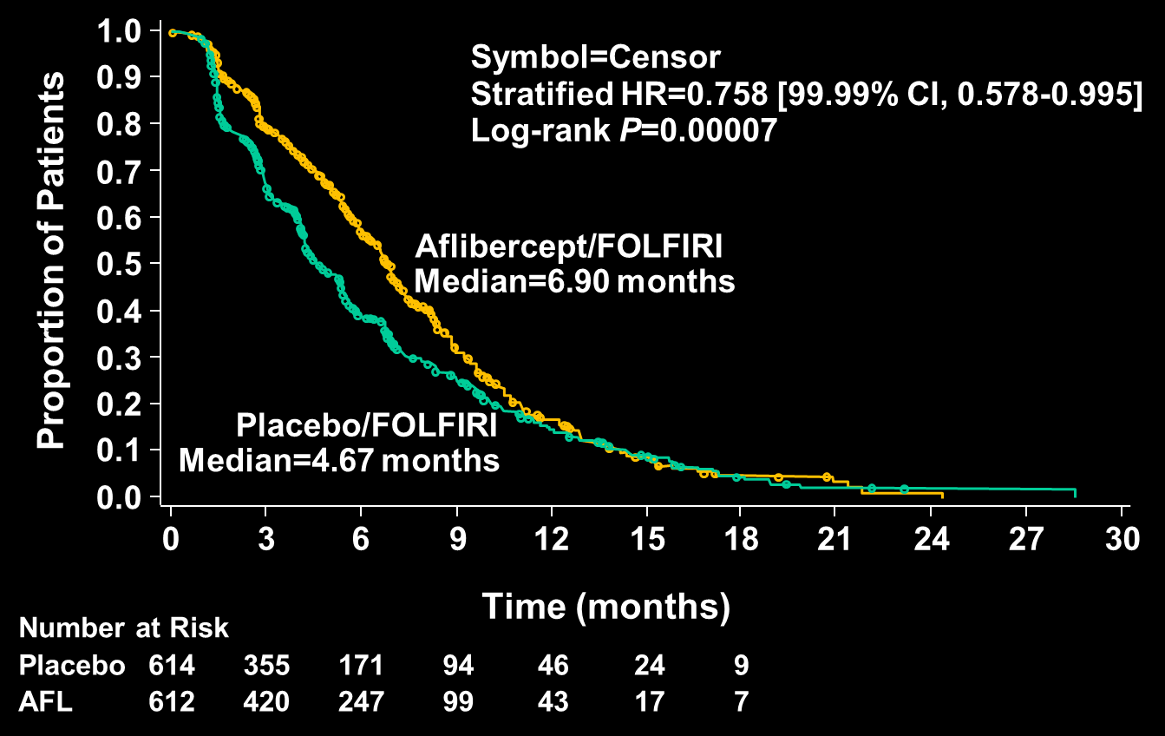
VELOUR Study
Overall results
Adding aflibercept to FOLFIRI in mCRC patients previously treated with an oxaliplatin-based regimen resulted in significant OS and PFS benefits
OS
PFS
With permission from Van Cutsem E et al. ESMO/WCGC 2011, Barcelona, Abstract O-0024.
Notes:
21

Slide 22
Response Rates
E3200:
RR 22.7% vs. 8.6%
for 2nd line
Van Cutsem E at al. ESMO/WCGC 2011;Abstract O-0024.

Slide 23
Consistency of OS and PFS With and Without Prior Bevacizumab
 | Prior Bevacizumab |  |  | No Prior Bevacizumab
 | Placebo/ FOLFIRI (n=187) | Aflibercept/ FOLFIRI (n=186) | Δ | Placebo/ FOLFIRI (n=427) | Aflibercept/ FOLFIRI (n=426) | Δ
OS (months) (95.34% CI) | 11.7 (9.8-13.8) | 12.5 (10.8-15.5) | 0.8 | 12.4 (11.2-13.5) | 13.9 (12.7-15.6) | 1.5
PFS (months) (99.99% CI) | 3.9 (2.9-5.4) | 6.7 (4.8-8.7) | 2.8 | 5.4 (4.2-6.7) | 6.9 (5.8-8.2) | 1.5
Interaction between “treatment arm” and “prior bevacizumab” factor was not significant at the 2-sided 10% level (P=0.57 for OS; P=0.2 for PFS)
Van Cutsem E at al. ESMO/WCGC 2011;Abstract O-0024.

Slide 24
Safety: AEs Leading to Discontinuation
 | Prior Bevacizumab |  | No Prior Bevacizumab
Safety Population, % of Patients | Placebo/ FOLFIRI (n=172) | Aflibercept/ FOLFIRI (n=171) | Placebo/ FOLFIRI (n=433) | Aflibercept/ FOLFIRI (n=440)
Any AE leading to permanent treatment discontinuation | 9.3 | 25.7 | 13.2 | 27.3
Grade 3/4 AEs leading to permanent treatment discontinuation in >1% of patients
Fatigue | 0.6 | 1.8 | 0.7 | 1.8
Diarrhea | 0.6 | 1.8 | 0.2 | 1.8
Hypertension | 0 | 0 | 0 | 2.3
Pulmonary embolism | 0 | 0.6 | 1.6 | 1.4
Asthenia | 0 | 0.6 | 0.2 | 1.4
Dehydration | 0 | 1.2 | 0.2 | 0.7
Rectal hemorrhage | 0 | 1.2 | 0 | 0
Neutropenic infection | 1.2 | 0 | 0 | 0.5
Van Cutsem E at al. ESMO/WCGC 2011;Abstract O-0024.

Slide 25
Regorafenib (BAY 73-4506), an oral multikinase inhibitor targeting multiple tumor pathways¹⁻³
Biochemical activity | Regorafenib IC₅₀ mean ± SD nmol/l (n)
VEGFR1 | 13 | ± 0.4 | (2)
Murine VEGFR2 | 4.2 | ± 1.6 | (10)
Murine VEGFR3 | 46 | ± 10 | (4)
TIE2 | 311 | ± 46 | (4)
PDGFR-β | 22 | ± 3 | (2)
FGFR1 | 202 | ± 18 | (6)
KIT | 7 | ± 2 | (4)
RET | 1.5 | ± 0.7 | (2)
RAF-1 | 2.5 | ± 0.6 | (4)
B-RAF | 28 | ± 10 | (6)
B-RAF^{V600E} | 19 | ± 6 | (6)
Regorafenib
Inhibition of proliferation
Inhibition of tumor microenvironment signaling
Inhibition of
neoangiogenesis
KIT PDGFR
RET
PDGFR-β
FGFR
VEGFR1-3
TIE2
Adapted from: 1. Wilhelm SM et al. Int J Cancer 2011. 2. Mross K et al. Clin Cancer Research 2012. 3. Strumberg D et al. Expert Opin Invest Drugs 2012.

Slide 26
CORRECT: Patients with metastatic colorectal cancer treated with regorafenib or placebo after failure of standard therapy
2:1
Evaluation with CT scan of abdomen and chest every 8 weeks
Multicenter, randomized, double-blind, placebo-controlled, phase III
Stratification: prior anti-VEGF therapy, time from diagnosis of metastatic disease, geographical region
Global trial: 16 countries, 114 centers
Recruitment: May 2010 to March 2011
Van Cutsem E at al. Proc ASCO 2012;Abstract 3502.

Slide 27
Patient eligibility: Key inclusion criteria
Histological or cytological documentation of adenocarcinoma of the colon or rectum
Disease progression during/within 3 months after last administration of or intolerance to approved standard therapies, which had to include:
Fluoropyrimidine, oxaliplatin, irinotecan
Bevacizumab
Cetuximab or panitumumab (if KRAS wild-type)
Measurable or nonmeasurable disease according to Response Evaluation Criteria in Solid Tumors (RECIST) v1.1
Age ≥18 years, Eastern Cooperative Oncology Group performance status (ECOG PS) 0-1, life expectancy ≥3 months
Van Cutsem E at al. Proc ASCO 2012;Abstract 3502.

Slide 28
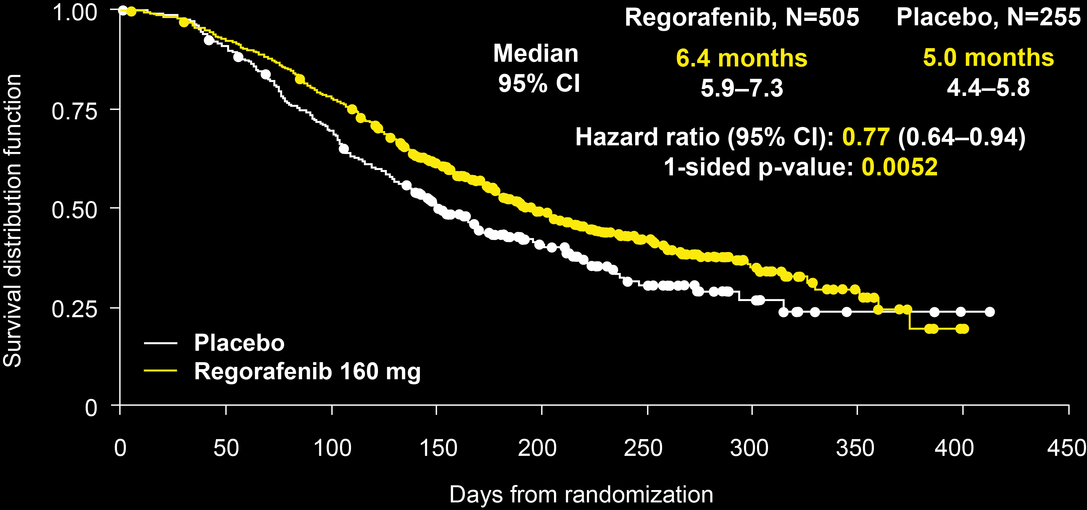
Overall survival (primary endpoint)
Primary endpoint met prespecified stopping criteria at interim analysis (1-sided p<0.009279 at approximately 74% of events required for final analysis)
Eligibility: survival ≥ 90 days
With permission from Van Cutsem E at al. Proc ASCO 2012;Abstract 3502.

Slide 29
What have you heard or read about the tolerability of regorafenib?

