Slide 1
Please note, these are the actual video-recorded proceedings from the live CME event and may include the use of trade names and other raw, unedited content. Select slides from the original presentation are omitted where Research To Practice was unable to obtain permission from the publication source and/or author. Links to view the actual reference materials have been provided for your use in place of any omitted slides.

Slide 2
Year in Review – Breast Cancer
Kathy D Miller, MD
Sheila D Ward Scholar of Medicine
Associate Professor of Medicine
The Indiana University Melvin and
Bren Simon Cancer Center
Orlando, Florida
October 27, 2012

Slide 3
What is your preferred systemic treatment for a woman presenting with primary breast cancer (ER/PR-negative, HER2-positive) and widespread metastases? (PS = 1)

Slide 4
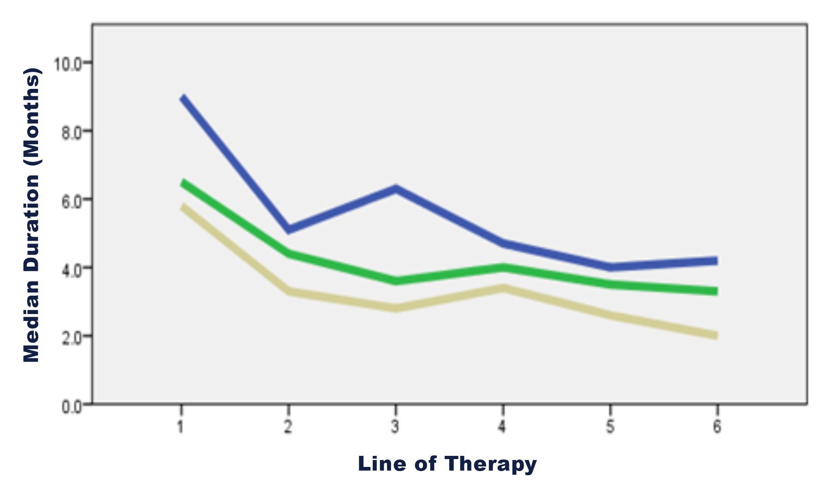
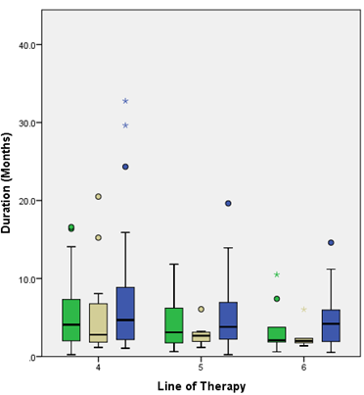
MBC: Duration of therapy by line and subset
HER2+
ER+
TN
HER2+
ER+
TN
With permission from Seah et al. Proc ASCO 2012;Abstract 6089.

Slide 5
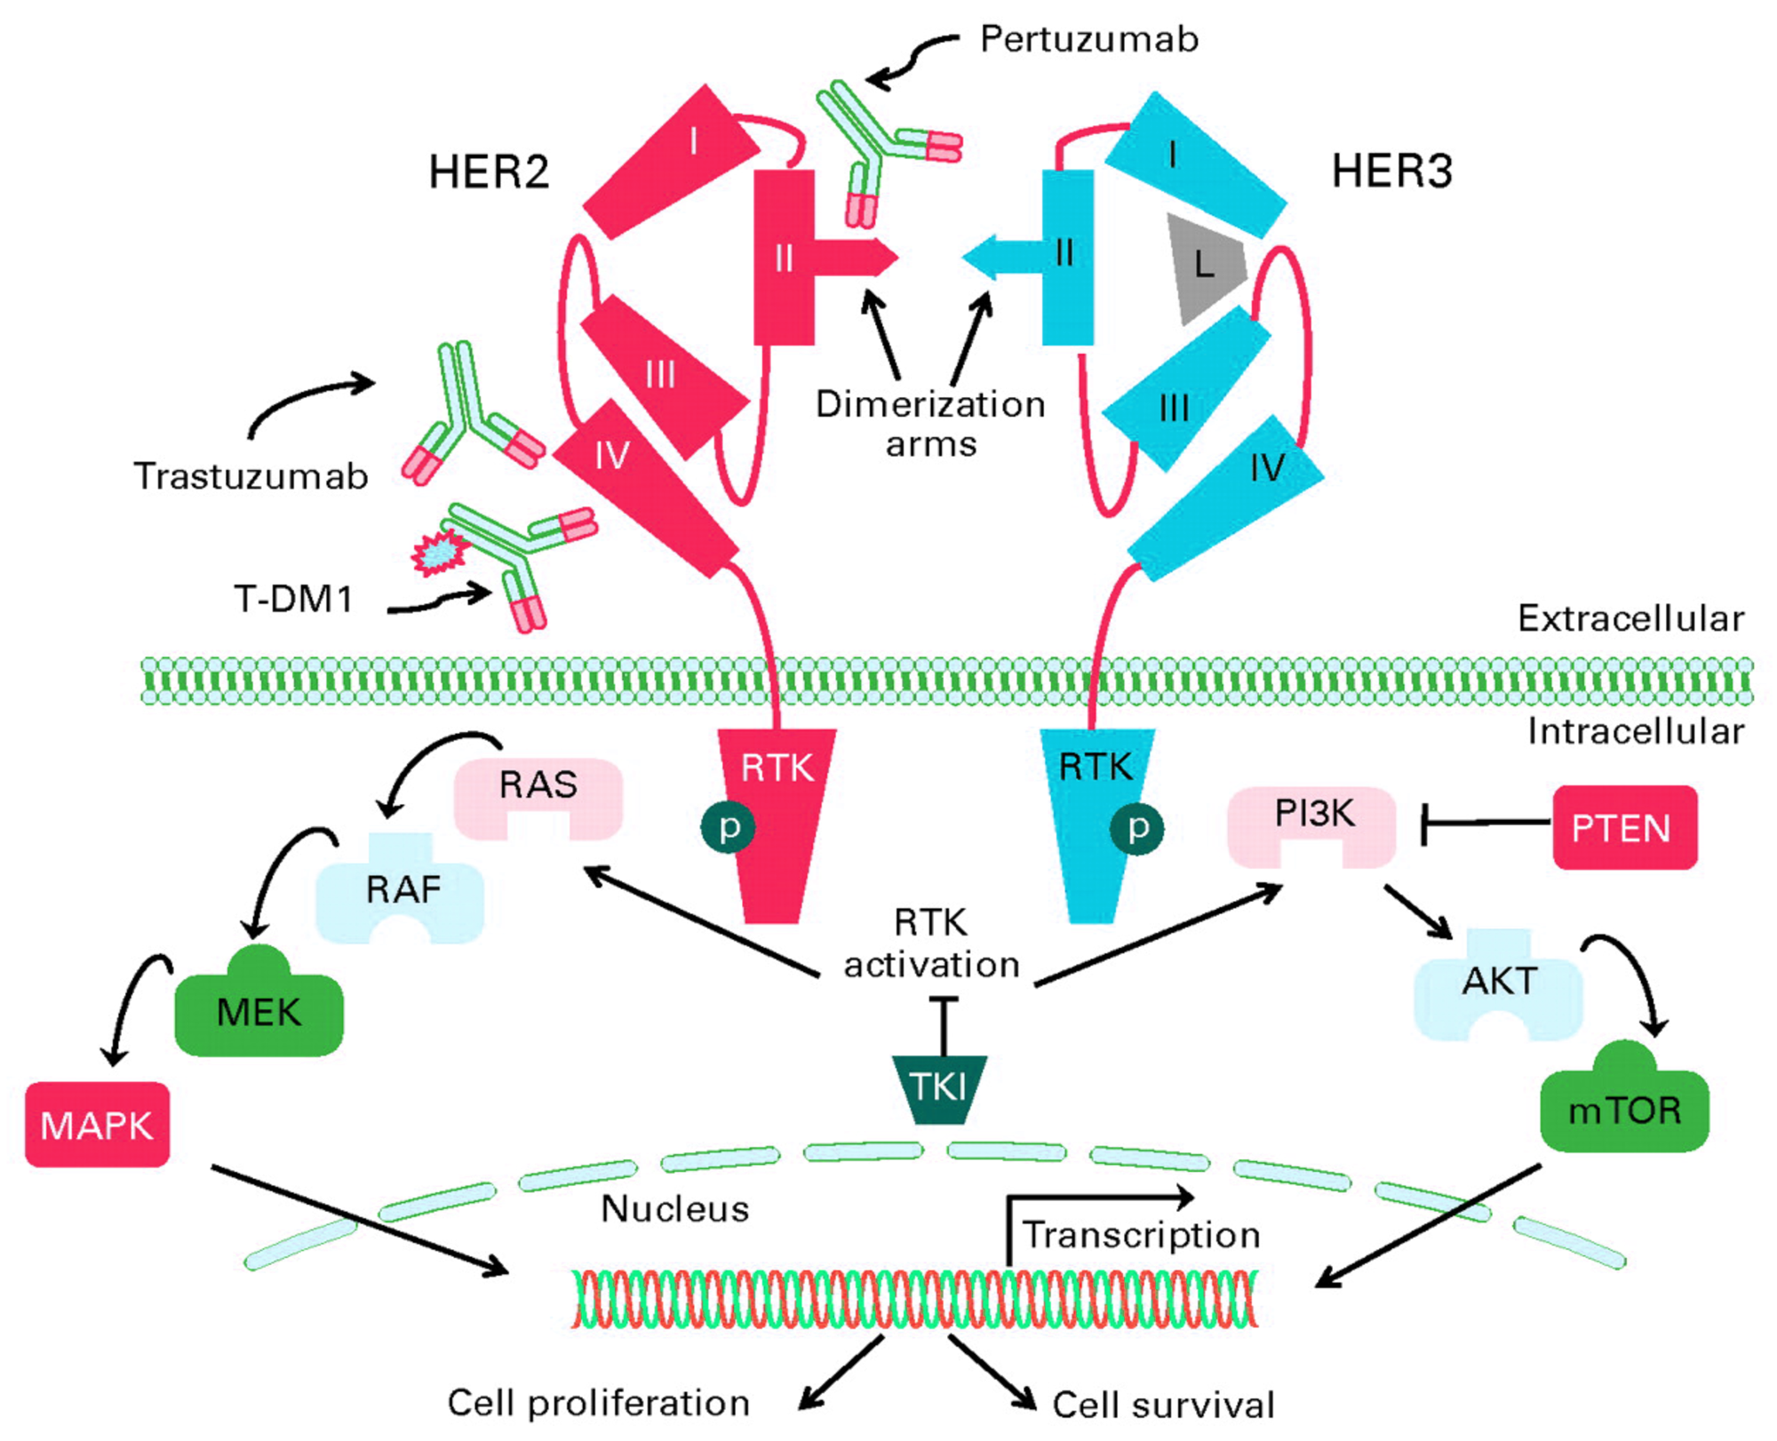
Adapted from Olson EM. J Clin Oncol 2012;30:1712-1714.

Slide 6
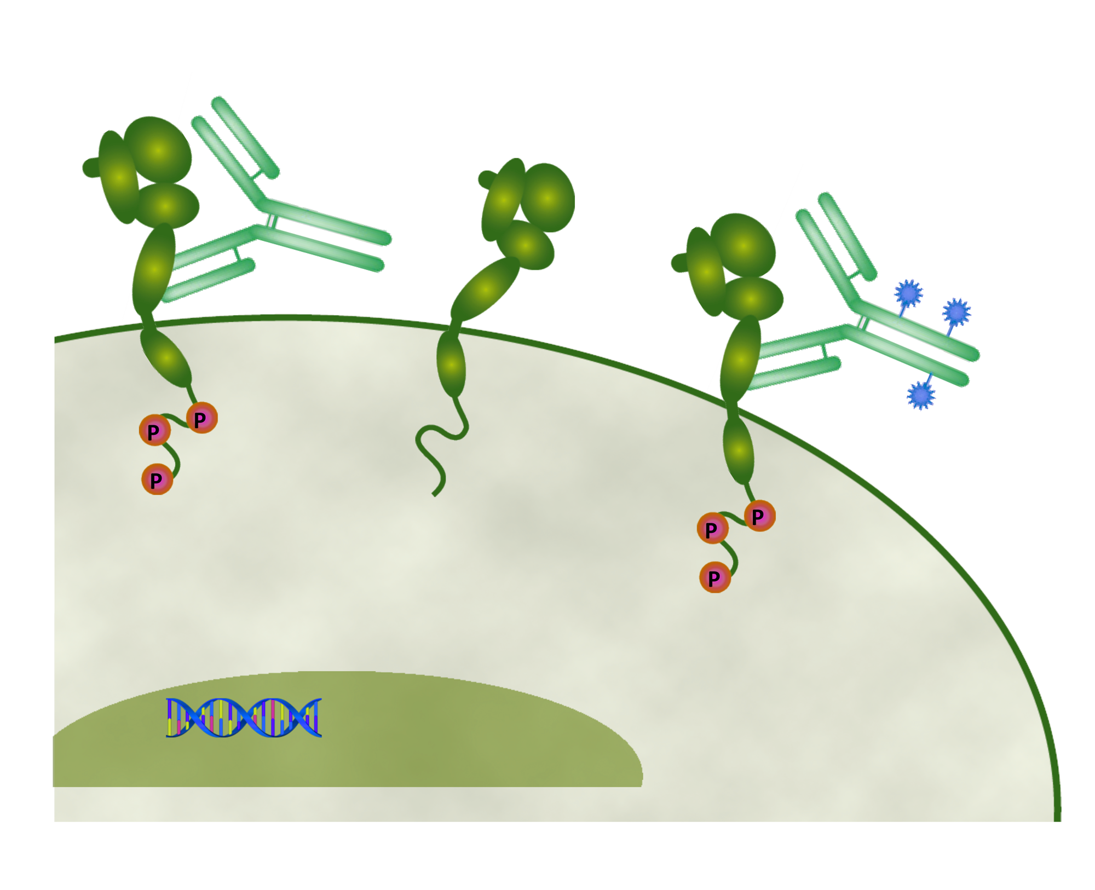

Targeted Therapies for HER2+ Breast Cancer: Trastuzumab, Lapatinib, and T-DM1
Antibody: Trastuzumab
HER2
Cytotoxic:
DM1
Stable
linker:
MCC
Emtansine
Trastuzumab
Lapatinib
T-DM1
Nucleus
Adapted from: Spector NL, Blackwell KL. J Clin Oncol 2009; Nelson MH et al. Ann Pharmacother 2006;
Lewis Phillips GD et al. Cancer Res 2008.

Slide 7
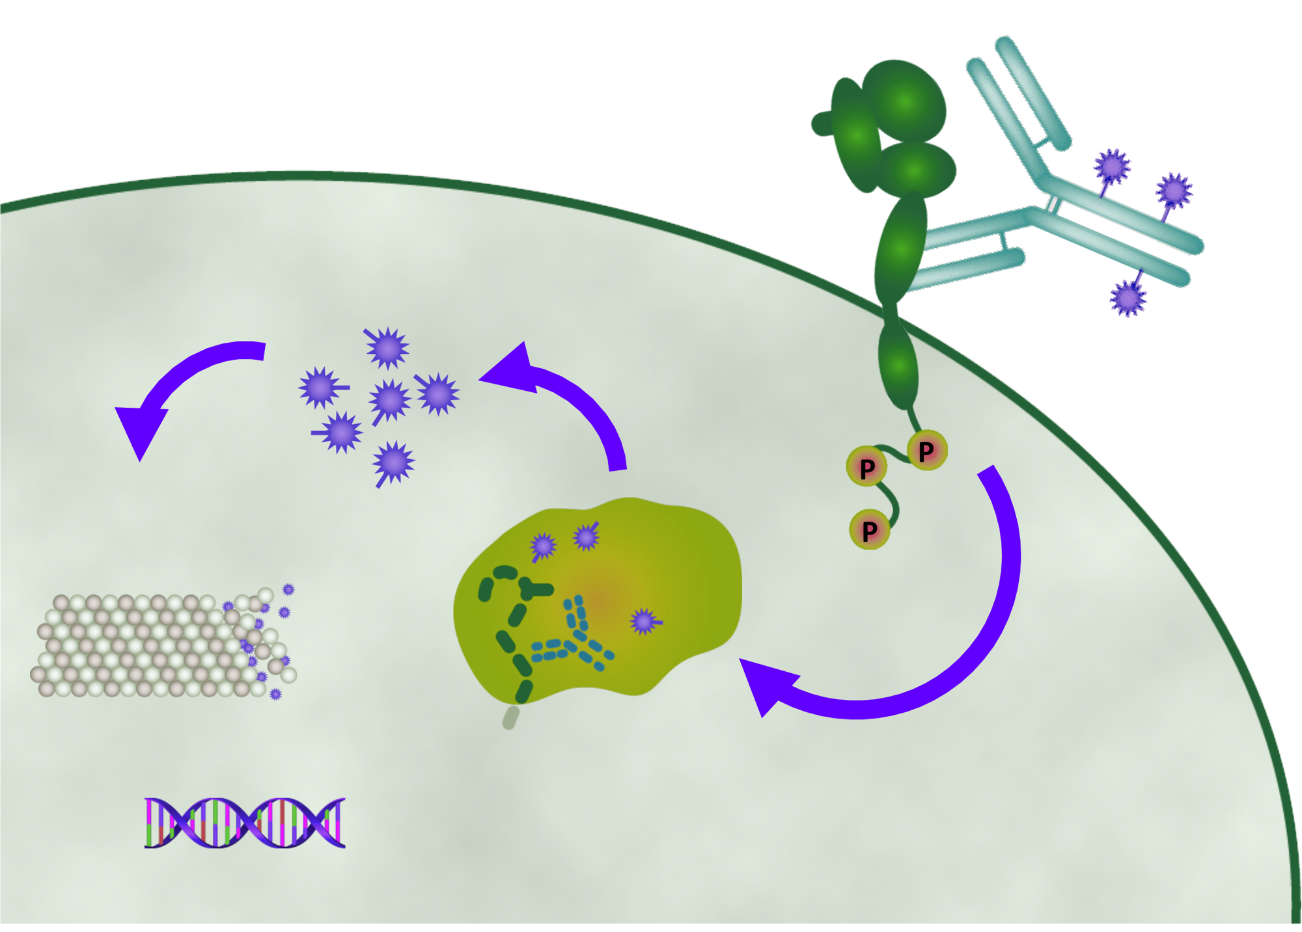

T-DM1: Mechanism of Action
HER2
T-DM1
Emtansine release
Inhibition of microtubule polymerization
Lysosome
Internalization
Nucleus
Adapted from LoRusso PM et al. Clin Cancer Res 2011.

Slide 8
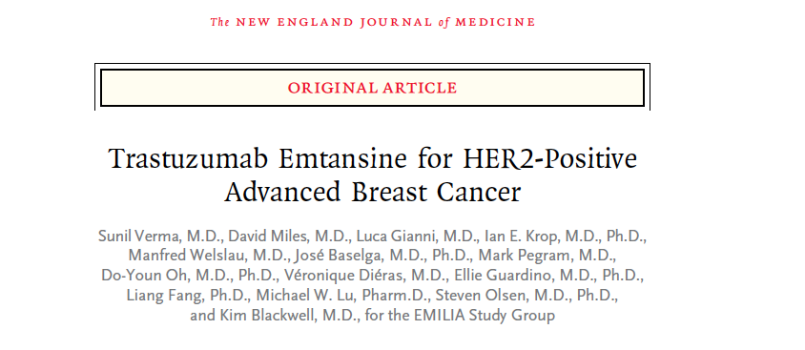
Primary results from EMILIA, a phase III study of trastuzumab emtansine (T-DM1) versus capecitabine (X) and lapatinib (L) in HER2-positive locally advanced or metastatic breast cancer (MBC) previously treated with trastuzumab (T) and a taxane.
Blackwell KL et al. Proc ASCO 2012;Abstract LBA1.
Updated overall survival results from EMILIA, a phase 3 study of trastuzumab emtansine (T-DM1) vs capecitabine (X) and lapatinib (L) in HER2-positive locally advanced or metastatic breast cancer (MBC).
Verma S et al. Proc ESMO 2012;Abstract LBA12.

Slide 9
EMILIA Study Design
HER2+ (central) LABC or MBC (N=980)
Prior taxane and trastuzumab
Progression on metastatic tx or within 6 mos of adjuvant tx
T-DM1
3.6 mg/kg q3w IV
PD
1:1
Capecitabine
1000 mg/m² orally bid, days 1–14, q3w
+
Lapatinib
1250 mg orally qd
PD
Stratification factors: World region, number of prior chemo regimens for MBC or unresectable LABC, presence of visceral disease
Primary end points: PFS by independent review, OS, and safety
Key secondary end points: PFS by investigator, ORR, duration of response, time to symptom progression
Blackwell KL et al. Proc ASCO 2012;Abstract LBA1.

Slide 10
Progression-Free Survival by Independent (IRC) and Investigator (INV) Review
3.2-month absolute difference in median progression-free survival
Investigator-assessed progression-free survival was a secondary endpoint
Results from this analysis were consistent with the independent review
Verma S et al. N Engl J Med 2012;[Epub ahead of print].

Slide 11
Objective Response Rate (ORR) and Duration of Response (DOR) in Patients with Measurable Disease
ORR
DOR
Difference: 12.7% (95% CI, 6.0, 19.4)
  P=0.0002
 | Median, mos (95% CI)
Cap + Lap | 6.5 (5.5, 7.2)
T-DM1 | 12.6 (8.4, 20.8)
43.6%
50
1.0
40
30.8%
0.8
30
0.6
Percent
Proportion progression-free
20
0.4
10
0.2
120/389
173/397
0
0.0
Cap + Lap
T-DM1
0 2 4 6 8 10 12 14 16 18 20 22 24 26 28 30 32 34 36
Time (mos)
No. at risk
Cap + Lap
120
105
77
48
32
14
9
8
3
3
1
1
0
0
0
0
0
0
0
T-DM1
173
159
126
84
65
47
42
33
27
19
12
8
2
0
0
0
0
0
0
With permission from Blackwell KL et al. Proc ASCO 2012;Abstract LBA1.

Slide 12
Overall Survival: Second Interim Analysis
Median overall survival
Lapatinib-capecitabine: 25.1 months
T-DM1: 30.9 months
  Stratified HR, 0.68 (95% CI, 0.55-0.85)
  p < 0.001
  Efficacy stopping boundary, p = 0.0037 or
  hazard ratio, 0.73
Verma S et al. N Engl J Med 2012;[Epub ahead of print].

Slide 13



TDM4450g/BO21976 Study Design
HER2-positive, recurrent locally advanced breast cancer or MBC (N = 137)
Trastuzumab
8 mg/kg loading dose;
6 mg/kg q3w IV
+ Docetaxel
75 or 100 mg/m² q3w
(n = 70)
PDª
Crossover to
T-DM1
(optional)
1:1
T-DM1
3.6 mg/kg q3w IV
(n = 67)
PDª
Randomized, phase II, international, open-label study^{b}
Stratification factors: World region, prior adjuvant trastuzumab therapy, disease-free interval
Primary end points: PFS by investigator assessment, and safety
Data analyses were based on clinical data cutoff Nov 15, 2010 prior to T-DM1 crossover
Key secondary end points: OS, ORR, DOR, CBR, and QOL
ªPatients were treated until PD or unacceptable toxicity.
^{b}This was a hypothesis-generating study; the final PFS analysis was to take place after 72 events had occurred.

Slide 14
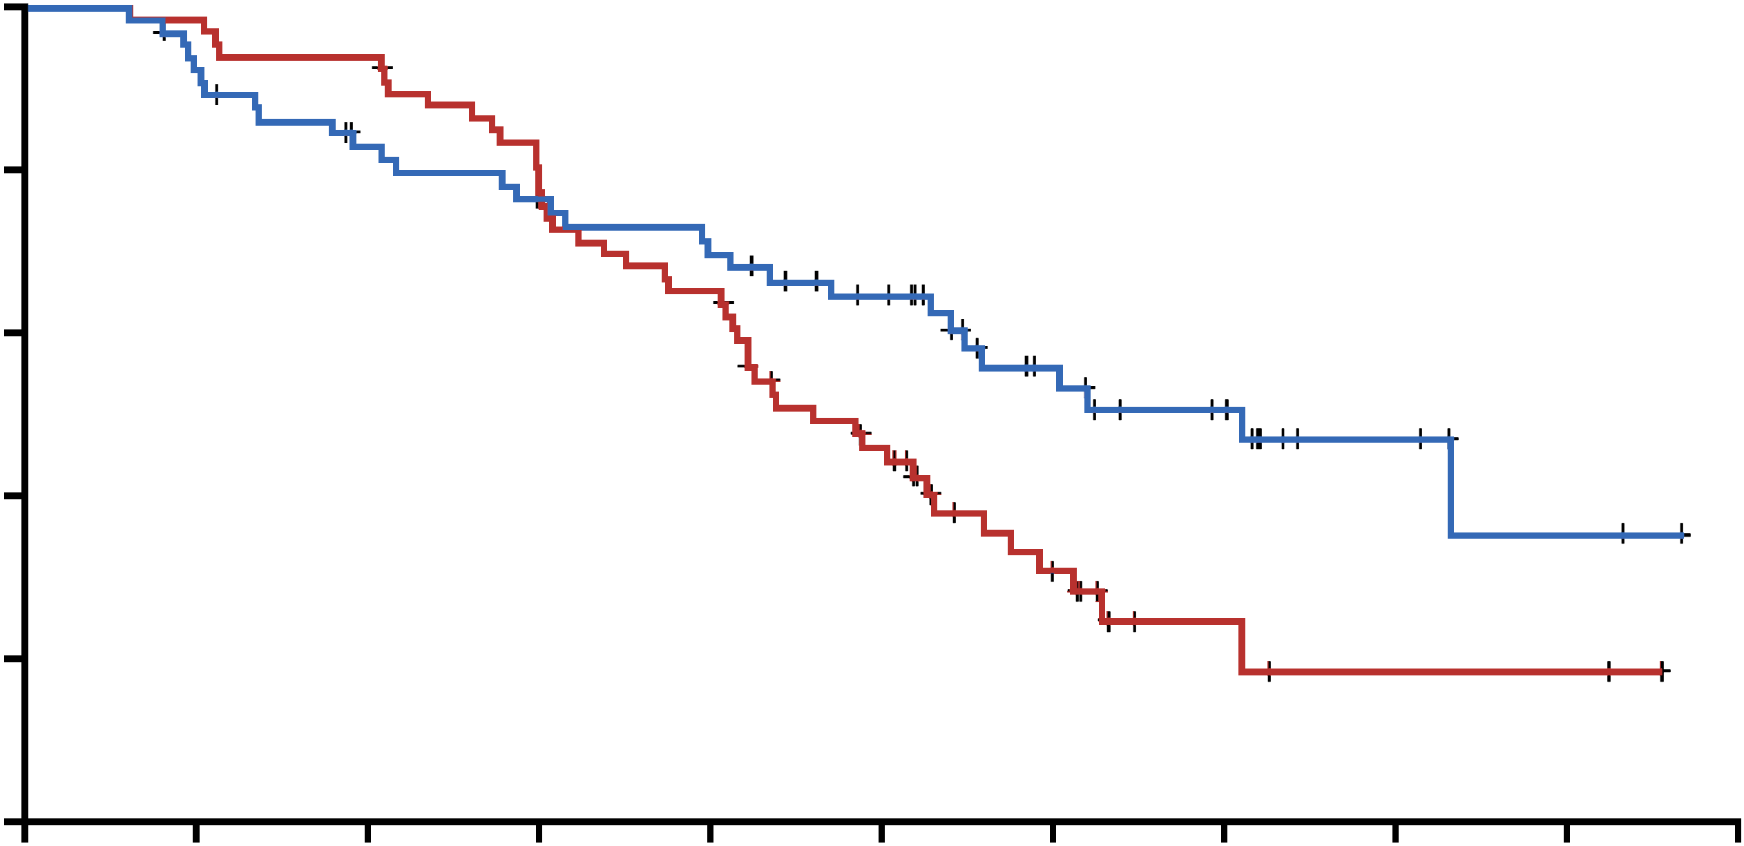
Progression-Free Survival by Investigator
Randomized Patients
Median PFS, mos | Hazard ratio | 95% CI | Log-rank P value
9.2 14.2 | 0.594 | 0.364– 0.968 | 0.0353
1.0
0.8
0.6
0.4
0.2
0.0
Trastuzumab
+ docetaxel (n=70)
T-DM1 (n=67)
Proportion progression-free
Response rates
T-DM1 64%
T+D 58%
0 2 4 6 8 10 12 14 16 18 20
Time (months)
Number of patients at risk
T+D 70 66 63 53 43 27 12 4 2 2 0
T-DM1 67 60 51 46 42 35 22 15 6 3 0
Hazard ratio and log-rank P value were from stratified analysis.
With permission from Hurvitz SA et al. ESMO 2011;Abstract 5001.

Slide 16
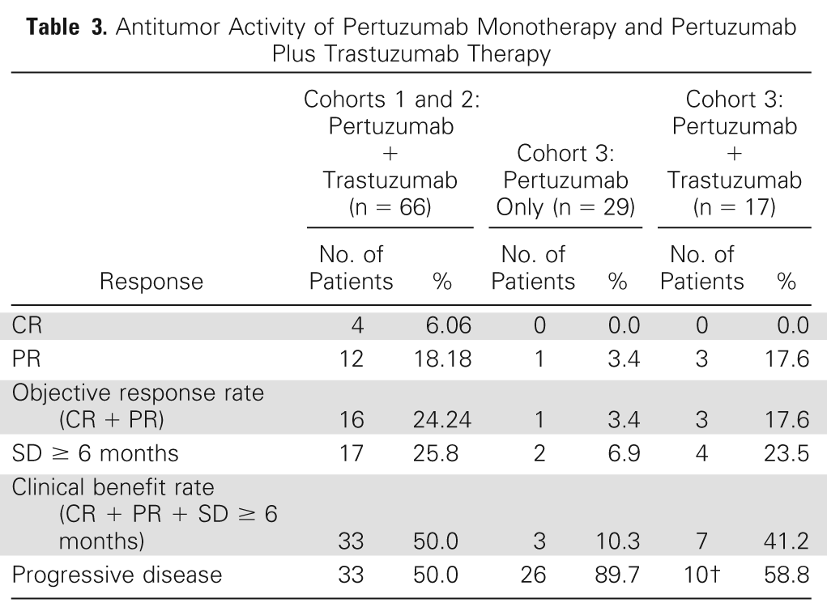
Cortes J et al. J Clin Oncol 2012;30:1594-1600.

Slide 18
CLEOPATRA: Independently Assessed
Disease-Free Survival
Progression-free survival
Pertuzumab, 18.5 mo
Control, 12.4 mo
  Hazard ratio, 0.62 (95% CI, 0.51-0.75)
  p < 0.001
Baselga J et al. N Engl J Med 2012;366:109-119.

Slide 19
MARIANNE
1st line
HER2+ MBC
T-DM1
T-DM1 + pertuzumab
Taxane + trastuzumab
Sponsor: Roche/Genentech
1º end point: PFS
N ~ 1095

Slide 20
ESMO 2012 - Breast
EMILIA: T-DM1 vs Cape/Lap - 2nd Interim OS Analysis. Verma S et al. Abstract LBA12.
  30.9 mo vs. 25.1 mo (HR: 0.68; P<0.001)
  T-DM1 significantly prolonged PFS and OS with less toxicity than lapatinib plus capecitabine in patients with HER2-positive advanced breast cancer previously treated with trastuzumab and a taxane
PHARE: 6 mos vs 12 mos trastuzumab at 3.5 yrs median follow-up. Pivot X et al. Abstract LBA5.
  HR: 1.28; P = 0.29
  Results inconclusive for non-inferiority hypothesis
  Trend favoring the standard 12 months treatment
HERA: 2 yrs versus 1 yr trastuzumab after adjuvant chemotherapy at 8 yrs median follow-up. Gelber RD et al. Abstract LBA6.
  HR: 0.99; P = 0.86
  No evidence of long-term benefit of 2 years compared to 1 year trastuzumab
  Sustained and statistically significant DFS and OS benefit for 1 year trastuzumab versus observation in ITT analyses despite selective crossover
  1 year of trastuzumab remains the standard of care as part of adjuvant therapy for patients with HER2-positive early breast cancer

Slide 21
Select Breast Cancer Trials Open to Florida Cancer Specialists
Phase III APHINITY/BRE 193/BO25126: Chemotherapy + Trastuzumab + Pertuzumab/Placebo as Adjuvant Therapy
Eligibility: Operable HER2-positive primary breast cancer that is node-positive (except T0) or node-negative with at least one protocol-defined risk factor
Pertuzumab:
A humanized monoclonal antibody based on human immunoglobulin G1 (IgG1) framework sequences
Mechanisms of action of trastuzumab and pertuzumab are complementary. Trastuzumab inhibits HER2 extracellular domain shedding; pertuzumab can inhibit dimerization of HER2 with ligand-activated HER family members like HER3 and HER1

Slide 22
A 58-year-old woman with a 2.5-cm, ER-positive, HER2-negative, node-positive infiltrating ductal carcinoma receives AC docetaxel followed by anastrozole. In her fifth year of aromatase inhibitor (AI) therapy she is diagnosed with limited bone metastases. What treatment would you most likely recommend at this point?

Slide 24
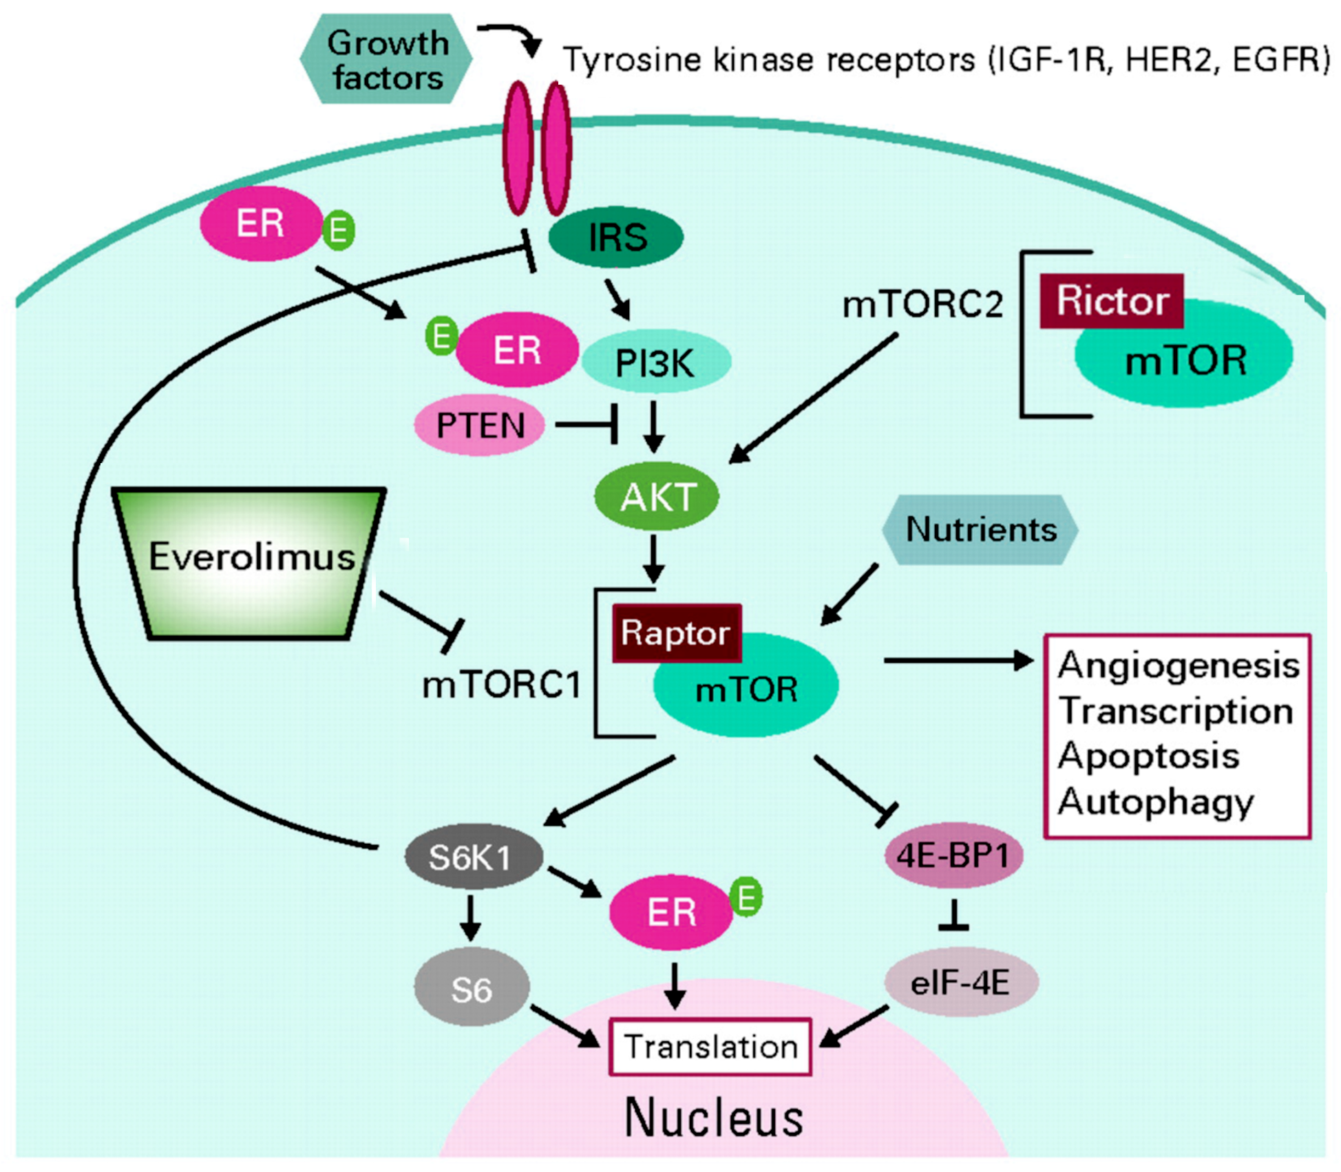
Schematic of the phosphatidylinositol 3-kinase (PI3K)/AKT/mammalian target of rapamycin (mTOR) pathway
ER
Rictor
ER
AKT
Everolimus
Raptor
S6K1
ER
S6
Adapted from Rugo HS, Keck S. J Clin Oncol 2012;30:2707-2709.

Slide 25
Kaplan–Meier Plot of Progression-free Survival.
BOLERO-2
Phase 3 RCT
Exemestane ±
everolimus 10 mg day
ER+ and HER2-neg
AI refractory
ECOG 0-2
Median PFS (local assessment):
Everolimus plus exemestane, 6.9 months
Placebo plus exemestane, 2.8 months
  Hazard ratio for progression or death, 0.43; 95% CI 0.35 to 0.54
  P < 0.001
Median PFS (central assessment):
Everolimus plus exemestane, 10.6 months
Placebo plus exemestane, 4.1 months
  Hazard ratio, 0.36; 95% CI 0.27 to 0.47
  P < 0.001
Baselga J et al. N Engl J Med 2012;366:520-529.

Slide 26
Toxicity %
Stomatitis 56 vs 11
Rash 36 vs 6
Diarrhea 30 vs 16
Dysgeusia 21 vs 5
Wt loss 19 vs 5
Epistaxis 15 vs 1
Edema 14 vs 6
Hyperglycemia 13 vs 2
Pneumonitis 12 vs 0

Slide 27
Efficacy Analysis on the Basis of Local and Central Assessment
 |  | Everolimus and Exemestane (N = 485) | Placebo and Exemestane (N = 239) | P Value |  | Hazard Ratio (95% CI)
Local assessment
Progression-free survival
Events — no. (%) | 202 (42) |  | 157 (66) | <0.001 | 0.43 (0.35–0.54)
Duration — mo
Median | 6.9 |  | 2.8
95% CI | 6.4–8.1 |  | 2.8-4.1
Best overall response — %
Complete response | 0.4 |  | 0.0
Partial response | 9.1 |  | 0.4
Stable disease | 70.1 |  | 58.6
Progressive disease | 9.9 |  | 31.4
Unknown or too early | 10.5 |  | 9.6
Objective response — % (95% CI) | 9.5 (7.0-12.4) |  | 0.4 (0.0-2.3) | <0.001
Baselga J et al. N Engl J Med 2012;366:520-529.

Slide 28
The survival of women with metastatic HER2-negative breast cancer is approximately how much longer now than it was 15 years ago?

Slide 29
CALGB 40502/NCCTG N063H: Randomized Phase III Trial of Weekly Paclitaxel (P) Compared to Weekly Nanoparticle Albumin Bound Nab-Paclitaxel (NP) or Ixabepilone (Ix) with or without Bevacizumab (B) as First-Line Therapy for Locally Recurrent or Metastatic Breast Cancer (MBC)
Rugo HS et al.
Proc ASCO 2012;Abstract CRA1002.

Slide 30
CALGB 40502 - NCCTG N063H - CTSU 40502
An Open Label Phase III Trial of First-Line Therapy for Locally Recurrent or Metastatic Breast Cancer
Exp
1
nab-paclitaxel 150 mg/m² weekly + bevacizumab 10 mg/kg q 2 wks²
N = 900 (planned)
Strata:
Adj taxanes
ER/PR status
Restage q 2 cycles until disease progression
paclitaxel 90 mg/m² weekly + bevacizumab 10 mg/kg q 2 wks¹
Randomize 1:1:1
Control
ixabepilone 16 mg/m² weekly +
bevacizumab 10 mg/kg q 2 wks³
Exp 2
All chemotherapy was given on a 3 week on, one week off schedule
Patients could discontinue chemotherapy and continue bevacizumab alone after 6 cycles if stable or responding disease
1. Miller et al. N Engl J Med 2007. 2. Gradishar et al. J Clin Oncol 2009. 3. Dickson et al. Proc ASCO 2006.

Slide 31
CALGB 40502: Progression-Free Survival by Treatment Arm
Agent | N | Median PFS
Paclitaxel | 283 | 10.6
Nab paclitaxel | 271 | 9.2
Ixabepilone | 245 | 7.6
Comparison | HR | P-value | 95% CI
Nab vs. pac | 1.19 | 0.12 | 0.96-1.49
Ixa vs. pac | 1.53 | < 0.0001 | 1.24-1.90
Rugo HS et al. Proc ASCO 2012;Abstract CRA1002.

Slide 32
CALGB 40502
Overall Survival
Agent | N | Median OS
Paclitaxel | 283 | 26
Nab paclitaxel | 271 | 27
Ixabepilone | 245 | 21
Comparison | HR | P-value | 95% CI
Nab vs. pac | 1.02 | 0.92 | 0.75-1.38
Ixa vs. pac | 1.28 | 0.10 | 0.95-1.72
Rugo HS et al. Proc ASCO 2012;Abstract CRA1002.

Slide 33
Sensory Neuropathy
Arm | Grade |  |  | Grade 3+
 | 2 | 3 | 4
nab (N = 258) | 27% | 24% | 1% | 25% p = 0.012
pac (N = 262) | 27% | 16% | <1% | 16%
ixa (N = 237) | 22% | 22% | 3% | 25% p = 0.022
Rugo HS et al. Proc ASCO 2012;Abstract CRA1002.

Slide 34
Prognostic Impact of the 21-Gene Recurrence Score® Result on Disease-Free and Overall Survival of Node-Positive, ER-Positive Breast Cancer Patients Treated with Adjuvant Chemotherapy: Results from NSABP B-28
Mamounas EP,¹ Tang G,¹ Paik S,¹ Baehner FL,² Liu Q,¹ Jeong J-H,¹ Kim S-R,¹ Butler SM,² Jamshidian F,² Cherbavaz DB,² Shak S,² Julian T,¹ Lembersky B,¹ Wickerham DL,¹ Costantino JP,¹ Wolmark N¹
¹NSABP Operations and Biostatistical Center, Pittsburgh, PA ²Genomic Health, Inc., Redwood City, CA
Mamounas et al. ASCO Breast Cancer Symposium 2012.

Slide 35

Kaplan Meier Curves for Multiple Endpoints by
Recurrence Score® Risk Groups
DFS
DRFI
75.8%
80.9%
P < 0.001
P < 0.001
64.9%
57.0%
55.8%
48.0%
 | N | Events
RS Low | 386 | 109
RS Intermediate | 364 | 162
RS High | 315 | 168
 | N | Events
RS Low | 386 | 85
RS Intermediate | 364 | 134
RS High | 315 | 140
OS
BCSS
90.0%
95.0%
74.7%
78.9%
P < 0.001
63.0%
P < 0.001
68.2%
 | N | Events
RS Low | 386 | 48
RS Intermediate | 364 | 105
RS High | 315 | 121
 | N | Events
RS Low | 386 | 28
RS Intermediate | 364 | 87
RS High | 315 | 102
With permission from Mamounas et al. ASCO Breast Cancer Symposium 2012.

