Slide 1
Year in Review: Clinical Investigator
Perspectives on the Most Relevant New Data Sets and Advances in Oncology
Prostate Cancer
Wednesday, March 1, 2023
5:00 PM – 6:00 PM ET
Faculty
Tanya B Dorff, MD
A Oliver Sartor, MD
Moderator
Neil Love, MD

Slide 2



Faculty
Tanya B Dorff, MD
Associate Professor of Medicine
Department of Medical Oncology
and Developmental Therapeutics
Section Chief, Genitourinary Cancer Program
City of Hope National Medical Center
Los Angeles, California
MODERATOR
Neil Love, MD
Research To Practice
Miami, Florida
A Oliver Sartor, MD
Laborde Professor for Cancer Research
Medical Director, Tulane Cancer Center
Associate Dean for Oncology
Tulane Medical School
New Orleans, Louisiana

Slide 3
Commercial Support
This activity is supported by educational grants from AstraZeneca Pharmaceuticals LP, Janssen Biotech Inc, administered by Janssen Scientific Affairs LLC, and Merck.
Research To Practice CME Planning Committee Members,
Staff and Reviewers
Planners, scientific staff and independent reviewers for Research To Practice have no relevant conflicts of interest to disclose.

Slide 4
Dr Dorff — Disclosures
Advisory Committee | Astellas, AstraZeneca Pharmaceuticals LP, Bayer HealthCare Pharmaceuticals, Janssen Biotech Inc
Contracted Research | Bayer HealthCare Pharmaceuticals, Pfizer Inc

Slide 5
Dr Sartor — Disclosures
Advisory Committee | Advanced Accelerator Applications, AstraZeneca Pharmaceuticals LP, Bayer HealthCare Pharmaceuticals, Bristol-Myers Squibb Company, Clarity Pharmaceuticals, Constellation Pharmaceuticals, Janssen Biotech Inc, Merck, Novartis, Pfizer Inc, Sanofi
Consulting Agreements | Advanced Accelerator Applications, Amgen Inc, ARTbio, Astellas, AstraZeneca Pharmaceuticals LP, Bayer HealthCare Pharmaceuticals, Blue Earth Diagnostics, Clarity Pharmaceuticals, Clovis Oncology, Constellation Pharmaceuticals, Convergent Therapeutics Inc, Dendreon Pharmaceuticals Inc, EMD Serono Inc, Foundation Medicine, Fusion Pharmaceuticals, Genzyme Corporation, Hengrui Therapeutics Inc, ITM Isotopen Technologien München AG, Janssen Biotech Inc, Merck, Morphimmune, Myovant Sciences, Myriad Genetic Laboratories Inc, Noria Therapeutics Inc, Northstar, Novartis, Noxopharm, Pfizer Inc, POINT Biopharma, Progenics Pharmaceuticals Inc, Sanofi, TeneoBio, Telix Pharmaceuticals Limited, Tessa Therapeutics, Theragnostics
Contracted Research | Advanced Accelerator Applications, Amgen Inc, AstraZeneca Pharmaceuticals LP, Bayer HealthCare Pharmaceuticals, Constellation Pharmaceuticals, Invitae, Janssen Biotech Inc, Lantheus, Merck, Novartis, Progenics Pharmaceuticals Inc, TeneoBio
Data and Safety Monitoring Board/Committee | AstraZeneca Pharmaceuticals LP, Janssen Biotech Inc, Myovant Sciences Pfizer Inc
Stock Options/Ownership — Public Company | AbbVie Inc, Cardinal Health, Clarity Pharmaceuticals, Clovis Oncology, GSK, Lilly, United Health Group
Nonrelevant Financial Relationship | NRG Oncology — Co-Chairman of GU Committee, Ratio Therapeutics — Stock ownership

Slide 6
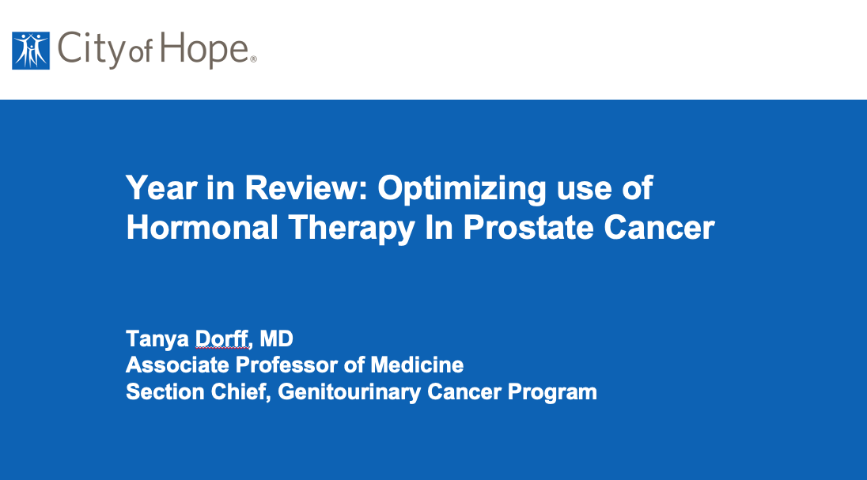
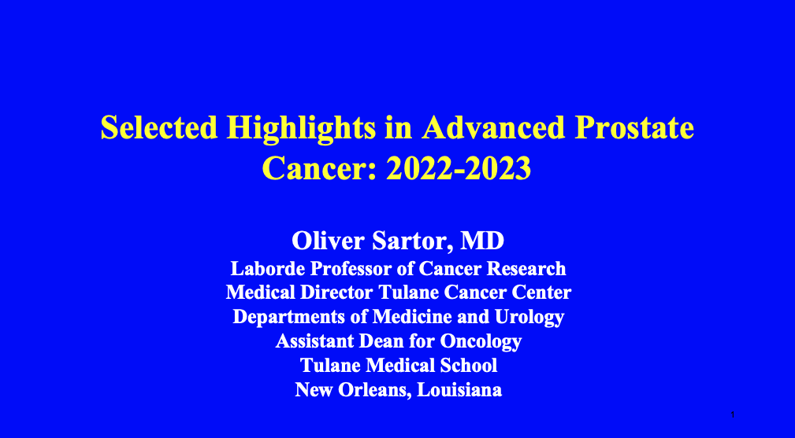

Slide 7
Key Data Sets
Tanya B Dorff, MD
Aggarwal R et al. PRESTO: A phase III, open-label study of androgen annihilation in patients (pts) with high-risk biochemically relapsed prostate cancer (AFT-19). ESMO 2022;Abstract LBA63.
Nguyen P et al. FORMULA-509: A multicenter randomized trial of post-operative salvage radiotherapy (SRT) and 6 months of GnRH agonist with or without abiraterone acetate/prednisone (AAP) and apalutamide (Apa) post-radical prostatectomy (RP). Genitourinary Cancers Symposium 2023;Abstract 303.
Saad F et al. Deep prostate-specific antigen response following addition of apalutamide to ongoing androgen deprivation therapy and long-term clinical benefit in SPARTAN. Eur Urol 2022;81(2):184-92.
Pan A et al. Dermatological adverse events in prostate cancer patients treated with the androgen receptor inhibitor apalutamide. J Urol 2022;207(5):1010-9.
T'jollyn H et al. Efficacy and safety exposure-response relationships of apalutamide in patients with metastatic castration-sensitive prostate cancer: Results from the phase 3 TITAN study. Cancer Chemother Pharmacol 2022;89(5):629-41.

Slide 8
Key Data Sets
Tanya B Dorff, MD (continued)
Attard G et al. Comparison of abiraterone acetate and prednisolone (AAP) or combination enzalutamide (ENZ) + AAP for metastatic hormone sensitive prostate cancer (mHSPC) starting androgen deprivation therapy (ADT): Overall survival (OS) results of 2 randomised phase III trials from the STAMPEDE protocol. ESMO 2022;Abstract LBA62.
Attard G et al. Abiraterone acetate and prednisolone with or without enzalutamide for high-risk non-metastatic prostate cancer: A meta-analysis of primary results from two randomised controlled Phase III trials of the STAMPEDE platform protocol. Lancet 2022;399(10323):447-60
Rush HL et al. Quality of life in men with prostate cancer randomly allocated to receive docetaxel or abiraterone in the STAMPEDE trial. J Clin Oncol 2022;40(8):825-36.
James ND et al. Abiraterone acetate plus prednisolone for metastatic patients starting hormone therapy: 5-year follow-up results from the STAMPEDE randomised trial (NCT00268476). Int J Cancer 2022;151(3):422-34.
Baciarello G et al. Impact of abiraterone acetate plus prednisone in patients with castration-sensitive prostate cancer and visceral metastases over four years of follow-up: A post-hoc exploratory analysis of the LATITUDE study. Eur J Cancer 2022;162:56-64.

Slide 9
Key Data Sets
Tanya B Dorff, MD (continued)
Davis ID et al. Updated overall survival outcomes in ENZAMET (ANZUP 1304), an international, cooperative group trial of enzalutamide in metastatic hormone-sensitive prostate cancer (mHSPC). ASCO 2022;Abstract LBA5004.
Armstrong AJ et al. Improved survival with enzalutamide in patients with metastatic hormone- sensitive prostate cancer. J Clin Oncol 2022;40(15):1616-22.
Smith MR et al. Darolutamide and survival in metastatic, hormone-sensitive prostate cancer.
N Engl J Med 2022;386(12):1132-42.
Hussain MHA et al. Efficacy and safety of darolutamide (DARO) in combination with androgen-deprivation therapy (ADT) and docetaxel (DOC) by disease volume and disease risk in the phase 3 ARASENS study. Genitourinary Cancers Symposium 2023;Abstract 15.
Fizazi K et al. Abiraterone plus prednisone added to androgen deprivation therapy and docetaxel in de novo metastatic castration-sensitive prostate cancer (PEACE-1): A multicentre, open-label, randomised, phase 3 study with a 2 x 2 factorial design. Lancet 2022;399(10336):1695-707.

Slide 10
Key Data Sets
A Oliver Sartor, MD
Hussain M et al. Tumor genomic testing for >4,000 men with metastatic castration-resistant prostate cancer in the Phase III trial PROfound (olaparib). Clin Cancer Res 2022;28(8):1518-30.
Matsubara N et al. Olaparib efficacy in patients with metastatic castration-resistant prostate cancer and BRCA1, BRCA2, or ATM alterations identified by testing circulating tumor DNA. Clin Cancer Res 2023;29(1):92-9.
Thiery-Vuillemin A et al. Pain and health-related quality of life with olaparib versus physician's choice of next-generation hormonal drug in patients with metastatic castration-resistant prostate cancer with homologous recombination repair gene alterations (PROfound): An open-label, randomised, phase 3 trial. Lancet Oncol 2022;23(3):393-405.
Bryce AH et al. Rucaparib for metastatic castration-resistant prostate cancer (mCRPC): TRITON3 interim overall survival and efficacy of rucaparib vs docetaxel or second-generation androgen pathway inhibitor therapy. Genitourinary Cancers Symposium 2023;Abstract 18.
Smith MR et al. Niraparib in patients with metastatic castration-resistant prostate cancer and DNA repair gene defects (GALAHAD): A multicentre, open-label, phase 2 trial. Lancet Oncol 2022;23(3):362-73.

Slide 11
Key Data Sets
A Oliver Sartor, MD (continued)
Clarke NW et al. Abiraterone and olaparib for metastatic castration-resistant prostate cancer. NEJM Evid 2022;1(9).
Saad F et al. Biomarker analysis and updated results from the Phase III PROpel trial of abiraterone (abi) and olaparib (ola) vs abi and placebo (pbo) as first-line (1L) therapy for patients (pts) with metastatic castration-resistant prostate cancer (mCRPC). ESMO 2022;Abstract 1357O.
Clarke N et al. Final overall survival (OS) in PROpel: Abiraterone (abi) and olaparib (ola) versus abiraterone and placebo (pbo) as first-line (1L) therapy for metastatic castration-resistant prostate cancer (mCRPC). Genitourinary Cancers Symposium 2023;Abstract LBA16.
Efstathiou E et al. Niraparib (NIRA) with abiraterone acetate and prednisone (AAP) in patients (pts) with metastatic castration-resistant prostate cancer (mCRPC) and homologous recombination repair (HRR) gene alterations: Second interim analysis (IA2) of MAGNITUDE. Genitourinary Cancers Symposium 2023;Abstract 170.

Slide 12
Key Data Sets
A Oliver Sartor, MD (continued)
Agarwal N et al. TALAPRO-2: Phase 3 study of talazoparib (TALA) + enzalutamide (ENZA) versus placebo (PBO) + ENZA as first-line (1L) treatment in patients (pts) with metastatic castration-resistant prostate cancer (mCRPC). Genitourinary Cancers Symposium 2023;Abstract LBA17.
Hofman MS et al. TheraP: ¹⁷⁷Lu-PSMA-617 (LuPSMA) versus cabazitaxel in metastatic castration-resistant prostate cancer (mCRPC) progressing after docetaxel — Overall survival after median follow-up of 3 years (ANZUP 1603). ASCO 2022;Abstract 5000.
Rahbar K et al. Lutetium-¹⁷⁷-prostate-specific membrane antigen therapy (¹⁷⁷Lu-PSMA) in patients (Pts) with prior radium-223 (223Ra): Safety and effectiveness outcomes. ESMO 2022;Abstract 1392P.
Armstrong A et al. Association between prostate-specific antigen decline and clinical outcomes in patients with metastatic castration-resistant prostate cancer in the VISION trial. ESMO 2022;Abstract 1372P.

Slide 13
Key Data Sets
A Oliver Sartor, MD (continued)
Garje R et al. Systemic therapy update on ¹⁷⁷Lutetium-PSMA-617 for metastatic castration-resistant prostate cancer: ASCO rapid recommendation. J Clin Oncol 2022;40(31):3664-6.
Oudard S et al. Cabazitaxel every 2 weeks versus every 3 weeks in older patients with metastatic castration-resistant prostate cancer (mCRPC): The CABASTY randomized phase III trial. ESMO 2022;Abstract 1363MO.
Petrylak DP et al. Pembrolizumab plus docetaxel for patients with metastatic castration-resistant prostate cancer (mCRPC): Randomized, double-blind, phase 3 KEYNOTE-921 study. Genitourinary Cancers Symposium 2023;Abstract 19.

Slide 14
Agenda
MODULE 1: Castration-Sensitive Prostate Cancer
MODULE 2: PARP Inhibitors in Castration-Resistant Disease
MODULE 3: Radiopharmaceuticals
MODULE 4: Appendix

Slide 15
Agenda
MODULE 1: Castration-Sensitive Prostate Cancer
MODULE 2: PARP Inhibitors in Castration-Resistant Disease
MODULE 3: Radiopharmaceuticals
MODULE 4: Appendix

Slide 16
Key Discussion Questions
For castration-sensitive prostate cancer (CSPC), are clinical outcomes better with the addition of secondary hormonal treatment to androgen deprivation therapy (ADT) versus ADT alone, regardless of clinical stage?
What is the optimal first-line treatment for metastatic CSPC?

Slide 17
Key Data Sets
Tanya B Dorff, MD
Aggarwal R et al. PRESTO: A phase III, open-label study of androgen annihilation in patients (pts) with high-risk biochemically relapsed prostate cancer (AFT-19). ESMO 2022;Abstract LBA63.
Nguyen P et al. FORMULA-509: A multicenter randomized trial of post-operative salvage radiotherapy (SRT) and 6 months of GnRH agonist with or without abiraterone acetate/prednisone (AAP) and apalutamide (Apa) post-radical prostatectomy (RP). Genitourinary Cancers Symposium 2023;Abstract 303.
Saad F et al. Deep prostate-specific antigen response following addition of apalutamide to ongoing androgen deprivation therapy and long-term clinical benefit in SPARTAN. Eur Urol 2022;81(2):184-92.
Pan A et al. Dermatological adverse events in prostate cancer patients treated with the androgen receptor inhibitor apalutamide. J Urol 2022;207(5):1010-9.
T'jollyn H et al. Efficacy and safety exposure-response relationships of apalutamide in patients with metastatic castration-sensitive prostate cancer: Results from the phase 3 TITAN study. Cancer Chemother Pharmacol 2022;89(5):629-41.

Slide 18
Key Data Sets
Tanya B Dorff, MD (continued)
Attard G et al. Comparison of abiraterone acetate and prednisolone (AAP) or combination enzalutamide (ENZ) + AAP for metastatic hormone sensitive prostate cancer (mHSPC) starting androgen deprivation therapy (ADT): Overall survival (OS) results of 2 randomised phase III trials from the STAMPEDE protocol. ESMO 2022;Abstract LBA62.
Attard G et al. Abiraterone acetate and prednisolone with or without enzalutamide for high-risk non-metastatic prostate cancer: A meta-analysis of primary results from two randomised controlled Phase III trials of the STAMPEDE platform protocol. Lancet 2022;399(10323):447-60
Rush HL et al. Quality of life in men with prostate cancer randomly allocated to receive docetaxel or abiraterone in the STAMPEDE trial. J Clin Oncol 2022;40(8):825-36.
James ND et al. Abiraterone acetate plus prednisolone for metastatic patients starting hormone therapy: 5-year follow-up results from the STAMPEDE randomised trial (NCT00268476). Int J Cancer 2022;151(3):422-34.
Baciarello G et al. Impact of abiraterone acetate plus prednisone in patients with castration-sensitive prostate cancer and visceral metastases over four years of follow-up: A post-hoc exploratory analysis of the LATITUDE study. Eur J Cancer 2022;162:56-64.

Slide 19
Key Data Sets
Tanya B Dorff, MD (continued)
Fizazi K et al. Abiraterone plus prednisone added to androgen deprivation therapy and docetaxel in de novo metastatic castration-sensitive prostate cancer (PEACE-1): A multicentre, open-label, randomised, phase 3 study with a 2 x 2 factorial design. Lancet 2022;399(10336):1695-707.
Davis ID et al. Updated overall survival outcomes in ENZAMET (ANZUP 1304), an international, cooperative group trial of enzalutamide in metastatic hormone-sensitive prostate cancer (mHSPC). ASCO 2022;Abstract LBA5004.
Armstrong AJ et al. Improved survival with enzalutamide in patients with metastatic hormone- sensitive prostate cancer. J Clin Oncol 2022;40(15):1616-22.
Smith MR et al. Darolutamide and survival in metastatic, hormone-sensitive prostate cancer.
N Engl J Med 2022;386(12):1132-42.
Hussain MHA et al. Efficacy and safety of darolutamide (DARO) in combination with androgen-deprivation therapy (ADT) and docetaxel (DOC) by disease volume and disease risk in the phase 3 ARASENS study. Genitourinary Cancers Symposium 2023;Abstract 15.

Slide 20
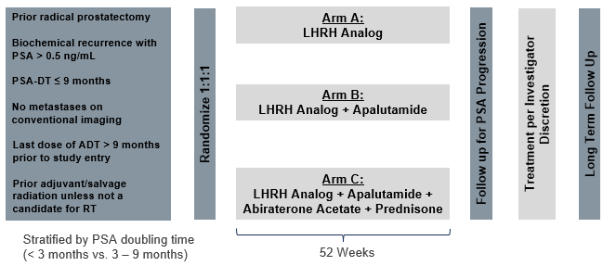
PRESTO: intensified therapy in biochemically recurrent prostate cancer
: PSA PFS, with PSA progression defined as nadir + 2 ng/mL during or > 0.2 ng/mL following treatment confirmed on repeat measurement (> 2 wks)
Courtesy of Tanya B Dorff, MD
Aggarwal ESMO 2022; Abstract LBA63

Slide 21
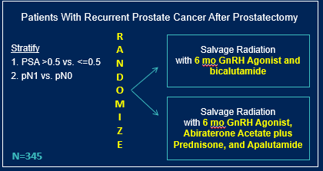
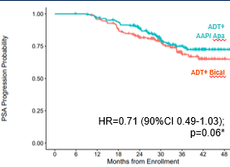
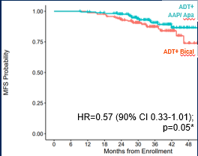
FORMULA509: apalutamide (+ abi) with salvage XRT
PSA >0.5
3 year MFS 84.3% vs. 66.1%
Absolute improvement
18.2% at 3 years (NNT = 5)= 5
Courtesy of Tanya B Dorff, MD
Nguyen ASCO GU 2023; Abstract 303

Slide 22
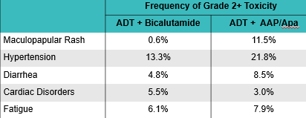
Toxicities with intensified therapy in FORMULA509
Courtesy of Tanya B Dorff, MD
Nguyen ASCO GU 2023; Abstract 303

Slide 23
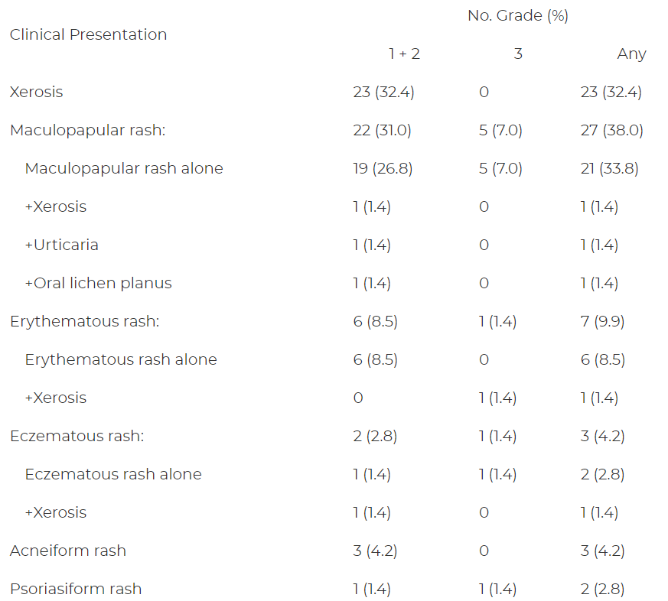
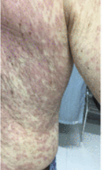
Dermatologic AE with apalutamide
Pan et al. J Urol 2022
Courtesy of Tanya B Dorff, MD

Slide 24
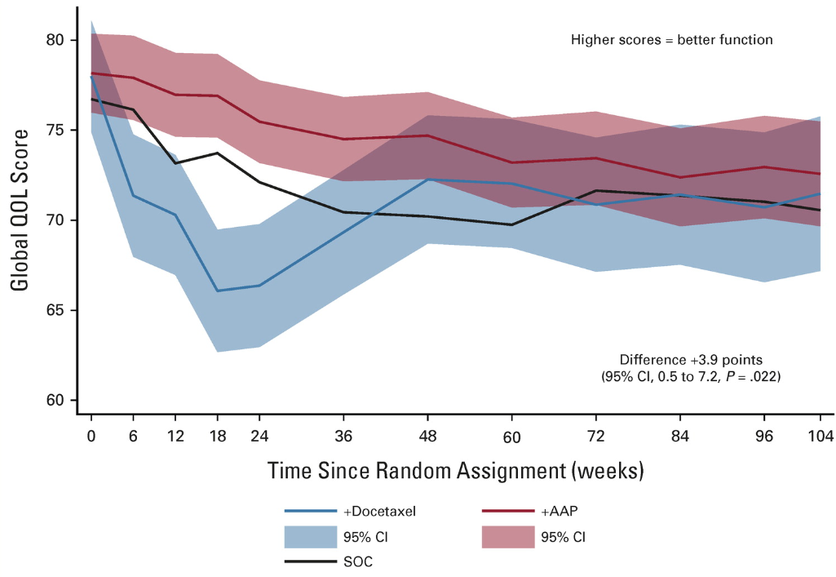
Quality of life with docetaxel or abiraterone in mHSPC (STAMPEDE)
No difference in cognitive or emotional; differences in social and physical function favored abiraterone
Courtesy of Tanya B Dorff, MD
Rush HL et al. J Clin Oncol 2022

Slide 25
Up-front intensification: THE new paradigm in mHSPC
Up front intensification with ARTA
ADT (LHRH)
AND
Abiraterone or
Apalutamide or
Darolutamide or
Enzalutamide
Eligible for Docetaxel
AND?
Docetaxel x 6 doses
No prior primary tx?
AND??
Consider radiation to prostate primary
Metastasis directed therapy for oligomet?
Or.. Consider a triplet trial
Courtesy of Tanya B Dorff, MD

Slide 26
Ongoing mHSPC trials with triplets
Name/Sponsor | ARTA | 3rd agent | Design (n)
AMPLITUDE | Abiraterone | Niraparib | Randomized, HRR+ (788)
TALAPRO-3 | Enzalutamide | Talazoparib | Randomized HRR+ (550)
City of Hope PCF | Abiraterone | Talazoparib | Single arm, Unselected (70)
PSMAddition | Lu177-PSMA-617 | Any ARTA | Randomized, PSMA PET + (1126)
KEYNOTE-991 | Enzalutamide | Pembrolizumab | Randomized (1232)
NCT03951831 | n/a (ADT + Doce) | Cemiplimab | Single arm (20)
MSKCC | Abi/Enza | Atezolizumab | SBRT, Single arm (44)
CABIOS | Abiraterone | Cabozantinib, Nivolumab | Single arm (22)
CASCARA (U Minn) | Abiraterone | Cabazi + Carbo | Single arm (60)
Capitello-281 | Abiraterone | Capivasertib | Randomized, PTEN def (1000)
CYCLONE-3 | Abiraterone | Abemaciclib | Randomized, unselected (900)
Courtesy of Tanya B Dorff, MD

Slide 27
Conclusions
Up-front intensification in mHSPC has been a huge advance
  Doublet (AR targeted agent) for most
  Triplet (with docetaxel) for some (esp hi volume)
  Future state: Biomarkers may identify populations in whom a novel triplet may be highly successful (ex: PARP, PTEN)
Courtesy of Tanya B Dorff, MD

Slide 28
Agenda
MODULE 1: Castration-Sensitive Prostate Cancer
MODULE 2: PARP Inhibitors in Castration-Resistant Disease
MODULE 3: Radiopharmaceuticals
MODULE 4: Appendix

Slide 29
Key Discussion Questions
What is the ideal approach to the use of PARP inhibitors for patients with prostate cancer with and without HRR gene alterations?
What are the short- and long-term toxicity profiles of PARP inhibitors for prostate cancer?

Slide 30
Key Data Sets
A Oliver Sartor, MD
Hussain M et al. Tumor genomic testing for >4,000 men with metastatic castration-resistant prostate cancer in the Phase III trial PROfound (olaparib). Clin Cancer Res 2022;28(8):1518-30.
Thiery-Vuillemin A et al. Pain and health-related quality of life with olaparib versus physician's choice of next-generation hormonal drug in patients with metastatic castration-resistant prostate cancer with homologous recombination repair gene alterations (PROfound): An open-label, randomised, phase 3 trial. Lancet Oncol 2022;23(3):393-405.
Saad F et al. Biomarker analysis and updated results from the Phase III PROpel trial of abiraterone (abi) and olaparib (ola) vs abi and placebo (pbo) as first-line (1L) therapy for patients (pts) with metastatic castration-resistant prostate cancer (mCRPC). ESMO 2022;Abstract 1357O.
Clarke N et al. Final overall survival (OS) in PROpel: Abiraterone (abi) and olaparib (ola) versus abiraterone and placebo (pbo) as first-line (1L) therapy for metastatic castration-resistant prostate cancer (mCRPC). Genitourinary Cancers Symposium 2023;Abstract LBA16.
Clarke NW et al. Abiraterone and olaparib for metastatic castration-resistant prostate cancer. NEJM Evid 2022;1(9).

Slide 31
Key Data Sets
A Oliver Sartor, MD (continued)
Matsubara N et al. Olaparib efficacy in patients with metastatic castration-resistant prostate cancer and BRCA1, BRCA2, or ATM alterations identified by testing circulating tumor DNA. Clin Cancer Res 2023;29(1):92-9
Smith MR et al. Niraparib in patients with metastatic castration-resistant prostate cancer and DNA repair gene defects (GALAHAD): A multicentre, open-label, phase 2 trial. Lancet Oncol 2022;23(3):362-73.
Efstathiou E et al. Niraparib (NIRA) with abiraterone acetate and prednisone (AAP) in patients (pts) with metastatic castration-resistant prostate cancer (mCRPC) and homologous recombination repair (HRR) gene alterations: Second interim analysis (IA2) of MAGNITUDE. Genitourinary Cancers Symposium 2023;Abstract 170.
Agarwal N et al. TALAPRO-2: Phase 3 study of talazoparib (TALA) + enzalutamide (ENZA) versus placebo (PBO) + ENZA as first-line (1L) treatment in patients (pts) with metastatic castration-resistant prostate cancer (mCRPC). Genitourinary Cancers Symposium 2023;Abstract LBA17.

Slide 32
Key Data Sets
A Oliver Sartor, MD (continued)
Bryce AH et al. Rucaparib for metastatic castration-resistant prostate cancer (mCRPC): TRITON3 interim overall survival and efficacy of rucaparib vs docetaxel or second-generation androgen pathway inhibitor therapy. Genitourinary Cancers Symposium 2023;Abstract 18.

Slide 33
Clovis Oncology Files for Chapter 11 Protection and Enters into Agreement to Sell FAP-2286
Press Release: December 12, 2022
“Clovis Oncology, Inc. (NASDAQ:CLVS) (‘Clovis’ or the ‘Company’), a biopharmaceutical company focused on acquiring, developing, and commercializing innovative anti-cancer agents in the U.S., Europe, and additional international markets, today announced that it and certain of its subsidiaries (collectively, the ‘Debtors’) have voluntarily initiated a Chapter 11 proceeding in the United States Bankruptcy Court for the District of Delaware (‘Bankruptcy Court’) and will seek to sell their assets through a court supervised sales process.
The Debtors have filed various ‘first day’ motions with the Bankruptcy Court requesting customary relief that will enable them to transition into Chapter 11 without material disruption to their ordinary course operations, including seeking authority to obtain debtor-in-possession (‘DIP’) financing and pay employee wages and benefits.
Clovis is also actively engaged in discussions with a number of interested parties with respect to a potential sale of one or more of its other assets. Any of those sales would be subject to review and approval by the Bankruptcy Court and compliance with Bankruptcy Court-approved bidding procedures.”
https://ir.clovisoncology.com/investors-and-news/news-releases/press-release-details/2022/Clovis-Oncology-Files-for-Chapter-11-Protection-and-Enters-into-Agreement-to-Sell-FAP-2286/default.aspx

Slide 34
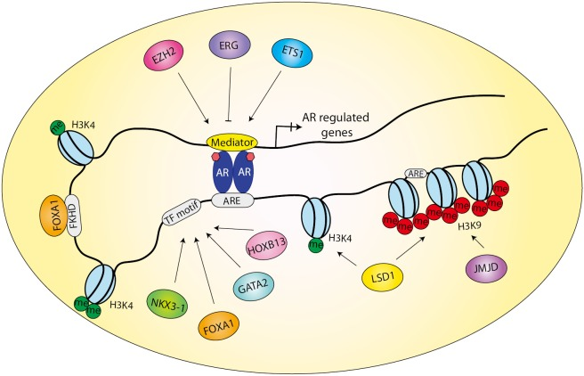
Combination PARP + AR Pathway Inhibition
AR signaling enhances DNA damage repair
ADT upregulated PARP-mediated repair and pre-clinical studies indicate potential synergy between ADT and PARP inhibition
PARP1
JF Goodwin, et al. Cancer Discov 3:1254, 2013; WR Polkinghorn, et al. Cancer Discov 3:1245, 2013; M Asim, e al. Nat Commun 8: 374, 2017; MJ Schiewer , et al. Cancer Discov 2:1134, 2012
Courtesy of A Oliver Sartor, MD

Slide 35
Summary
Combination therapies with PARP are not FDA approved but trials are positive for rPFS
  No OS shown yet in the overall analyses……
  BRCA mutated subsets are substantially positive
  How important is the primary endpoint of rPFS?
    FDA to decide
Courtesy of A Oliver Sartor, MD

Slide 36
Agenda
MODULE 1: Castration-Sensitive Prostate Cancer
MODULE 2: PARP Inhibitors in Castration-Resistant Disease
MODULE 3: Radiopharmaceuticals
MODULE 4: Appendix

Slide 37
Key Discussion Questions
What is the ideal use of ¹⁷⁷Lu-PSMA-617 in clinical practice? To what extent has the shortage affected use?
What are some new developments and ongoing trials with radiopharmaceuticals for prostate cancer?

Slide 38
Manufacturer Halts ¹⁷⁷Lu-PSMA-617 New Patient Starts, Struggles with Radiotherapy’s Supply amid Manufacturing Expansion
Press Release: May 5, 2022
The manufacturer today announced a temporary, voluntary suspension of production at its radioligand therapy production sites in Ivrea, Italy and Millburn, New Jersey. The company has taken this action out of an abundance of caution as it addresses potential quality issues identified in its manufacturing processes. The manufacturer is conducting a thorough review of the situation and currently expects to resolve the issues and resume some supply in the next six weeks.
As a result, the company is temporarily suspending delivery of ¹⁷⁷Lu-PSMA-617 and other radioligand therapies in the US and elsewhere. In addition, the manufacturer is putting a temporary hold on screening and enrollment for ¹⁷⁷Lu-PSMA-617 clinical trials globally. Quality and patient safety are our top priorities. There is currently no indication of any risk to patients from doses previously produced at these sites. Novartis has notified treatment sites to closely monitor patients who have recently been injected and asked them to report any adverse events to patient safety.
We recognize that this situation affects patients, their families and care teams. The manufacturer takes this very seriously and the company is doing everything it can to resolve this issue and resume patient doses as quickly as possible. Health authorities have been informed and will receive additional updates as they are available.
https://www.novartis.com/news/media-releases/novartis-provides-update-production-radioligand-therapy-medicines

Slide 39
Key Data Sets
A Oliver Sartor, MD
Hofman MS et al. TheraP: ¹⁷⁷Lu-PSMA-617 (LuPSMA) versus cabazitaxel in metastatic castration-resistant prostate cancer (mCRPC) progressing after docetaxel — Overall survival after median follow-up of 3 years (ANZUP 1603). ASCO 2022;Abstract 5000.
Rahbar K et al. Lutetium-¹⁷⁷-prostate-specific membrane antigen therapy (¹⁷⁷Lu-PSMA) in patients (Pts) with prior radium-223 (223Ra): Safety and effectiveness outcomes. ESMO 2022;Abstract 1392P.
Armstrong A et al. Association between prostate-specific antigen decline and clinical outcomes in patients with metastatic castration-resistant prostate cancer in the VISION trial. ESMO 2022;Abstract 1372P.
Garje R et al. Systemic therapy update on ¹⁷⁷Lutetium-PSMA-617 for metastatic castration-resistant prostate cancer: ASCO rapid recommendation. J Clin Oncol 2022;40(31):3664-6.

Slide 40
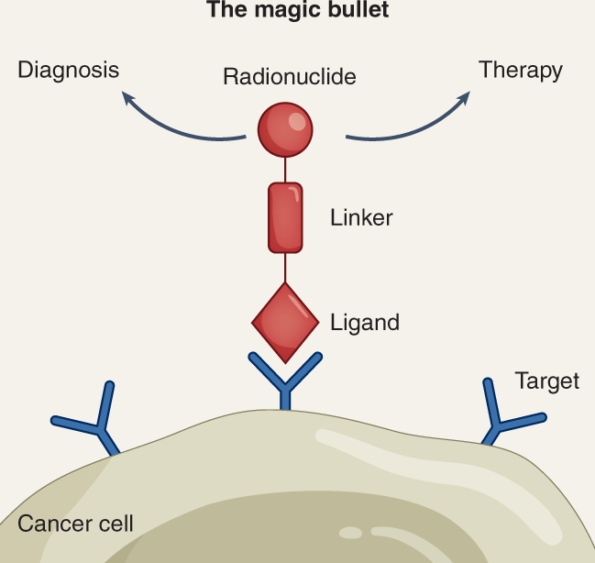
Theranostics:
See it…. Treat it…..Love it!
Cell surface target, a ligand, a linker, and an isotope
Courtesy of A Oliver Sartor, MD

Slide 41
Synergistic opportunities with radiopharmaceuticals
Courtesy of A Oliver Sartor, MD

Slide 42
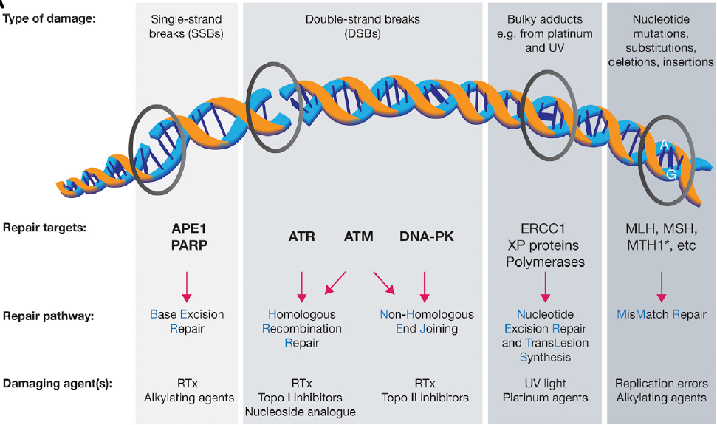
Targeting DNA damage repair pathways in combination with radionuclides
O’Connor, Molecular Cell 60, November 19, 2015
Courtesy of A Oliver Sartor, MD

Slide 43
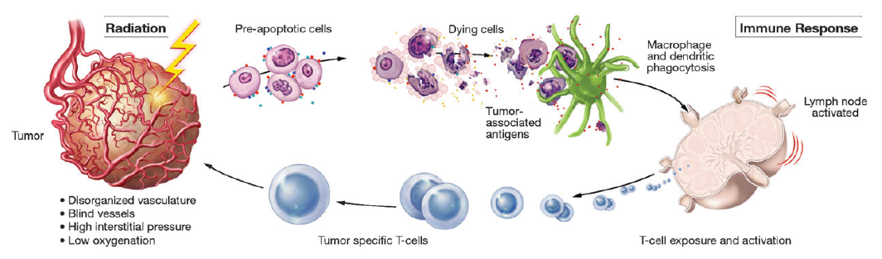
Antigen release from radiated tumor: Synergy with immunotherapies?
Kamrava et al., Molecular Biosystems: 5:1249–1372, 2009
Courtesy of A Oliver Sartor, MD

Slide 44
Radio-conjugates: PSMA targeted alpha emitters (Actinium-225) as 9th line treatment
Kratochwil et a. J Nuc Med 57: 1-4, 2016
Courtesy of A Oliver Sartor, MD

Slide 45
Agenda
MODULE 1: Castration-Sensitive Prostate Cancer
MODULE 2: PARP Inhibitors in Castration-Resistant Disease
MODULE 3: Radiopharmaceuticals
MODULE 4: Appendix

Slide 46
Castration-Sensitive Prostate Cancer

Slide 47
STAMPEDE meta-analysis in non-metastatic prostate CA
  Analyzed new data from two randomized controlled phase 3 trials from a multi-arm, multistage platform protocol to assess standard-of-care (radiation therapy plus 3 years of ADT) to standard-of-care plus abiraterone acetate plus prednisolone with or without enzalutamide for two years in the non-metastatic, high-risk M0 patient population as defined by conventional imaging
  Results showed that men with high-risk non-metastatic prostate cancer who receive ADT with combination therapy have significantly better metastases-free survival and overall survival than those who receive ADT alone
  2 years of abiraterone and prednisolone added to ADT and, if indicated, radiotherapy is a potential new standard treatment for non-metastatic prostate cancer with high-risk features
Courtesy of Tanya B Dorff, MD
Attard G et al Lancet 2022

Slide 48
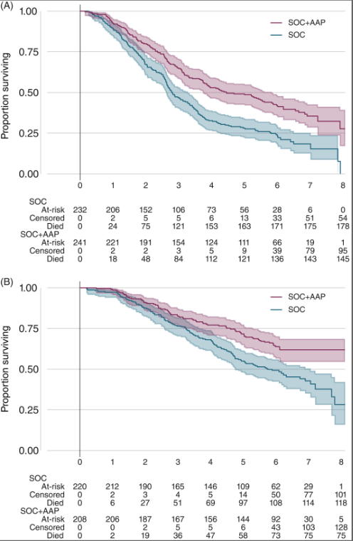
5 year f/u STAMPEDE
Abiraterone
high-risk disease defined as at least two of: ≥3 bone metastases; visceral metastases; Gleason score ≥8
A: high risk OS
B: low risk OS
James et al. Int J Cancer 2022
Courtesy of Tanya B Dorff, MD

Slide 49
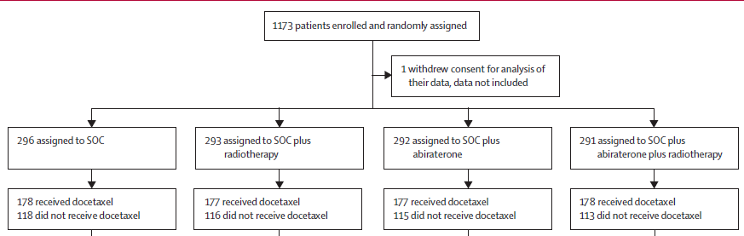
PEACE-1: ADT +/- abiraterone +/- RT to prostate primary. AND +/- docetaxel
Stepwise and factorial design:
  Check for no interaction b/w abi and RT
  Compare ADT (+/- RT) +/- abi
Trial amended to allow doce based on evolving standard of care
  Compare abiraterone in doce vs no doce populations
Courtesy of Tanya B Dorff, MD
Fizazi Lancet 2022

Slide 50
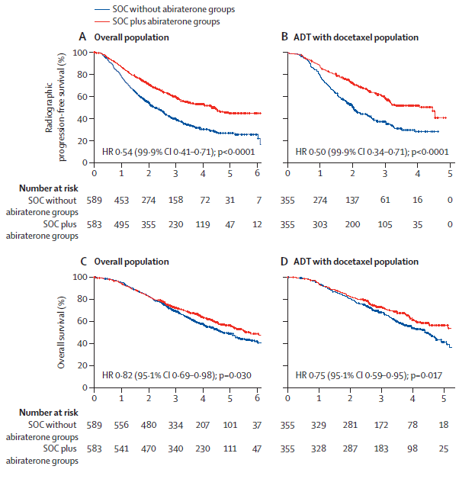
PEACE-1: ADT +/- abiraterone +/- RT to prostate primary. AND +/- docetaxel
No interaction between abi and RT
Overall + for abi (triple)
HR stronger for high volume (0.72; CI 0.55 – 0.95) than low volume (0.83; CI 0.50 – 1.39)
Courtesy of Tanya B Dorff, MD
Fizazi Lancet 2022

Slide 51
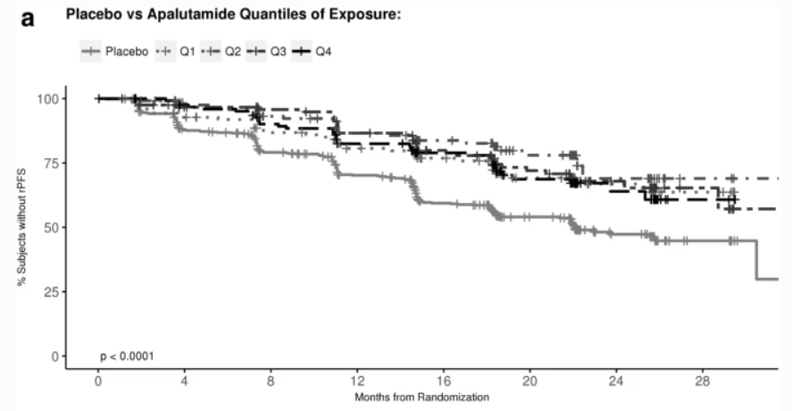
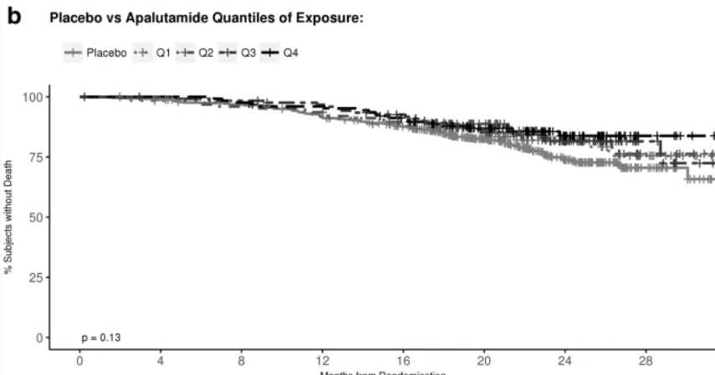
Exposure-response relationship apalutamide mHSPC
Plasma levels achieve steady-state between
4-8 weeks
AUC calculated for each patient during steady state
A: PFS
B: OS
Courtesy of Tanya B Dorff, MD
T'jollyn H et al Chemother Pharmacol 2022

Slide 52
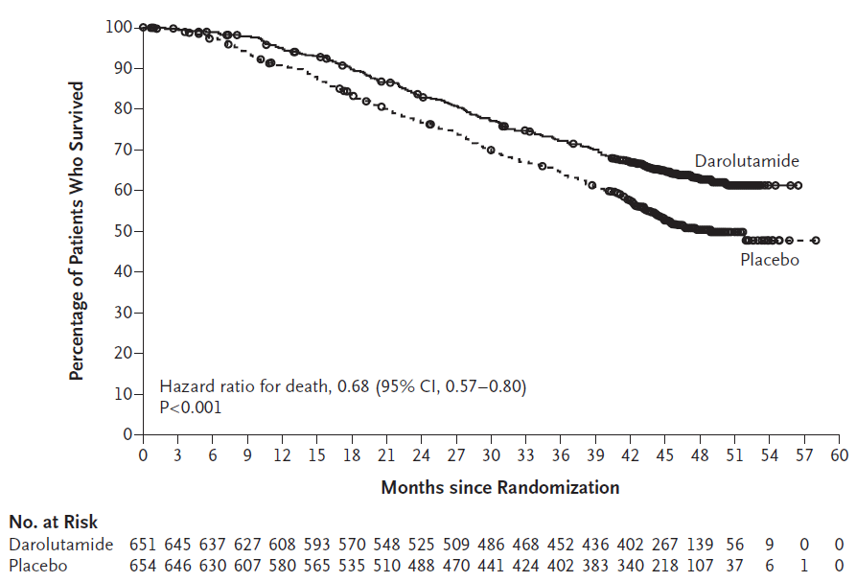
ARASENS: ADT + doce +/- darolutamide
For OS the HR 0.68; 95% CI, 0.57 to 0.80; P<0.001
Appropriate age representation:
  47% age 65-74
  16% age 75-84
Not diverse racially
Toxicity was acceptable:
  Febrile neutropenia 7.8% on each arm
  Death due to AE 4% on each arm
Courtesy of Tanya B Dorff, MD
Smith MR et al. N Engl J Med 2022.

Slide 53
PARP Inhibitors in Castration-Resistant Disease

Slide 54
Improved Survival: Phase III Olaparib Trial (PROfound) in Prostate Cancer
Sept 20, 2020
Courtesy of A Oliver Sartor, MD

Slide 55
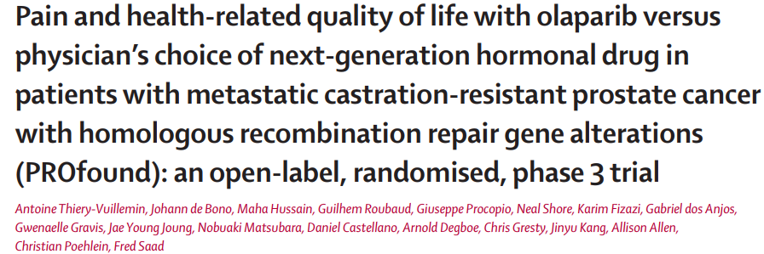
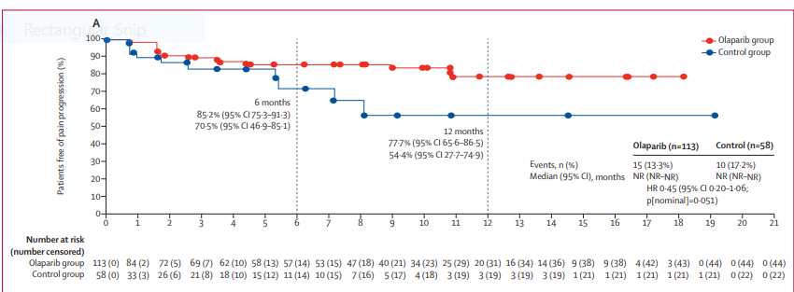
Courtesy of A Oliver Sartor, MD

Slide 56
HRR mutations were determined after randomization
Clarke et al. 2023
Courtesy of A Oliver Sartor, MD

Slide 57
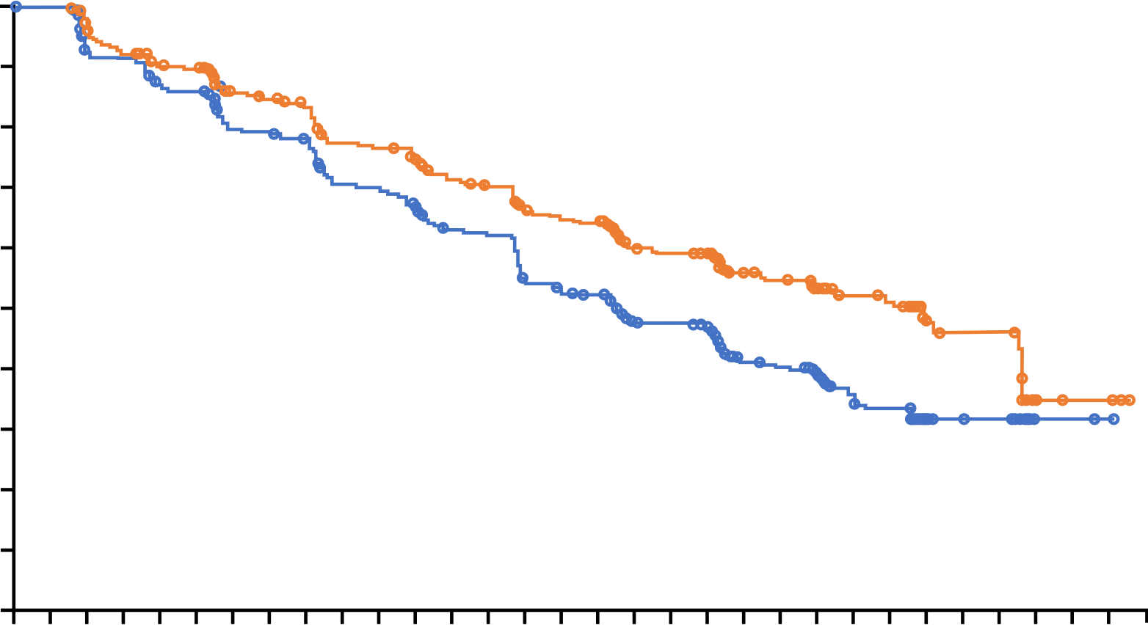
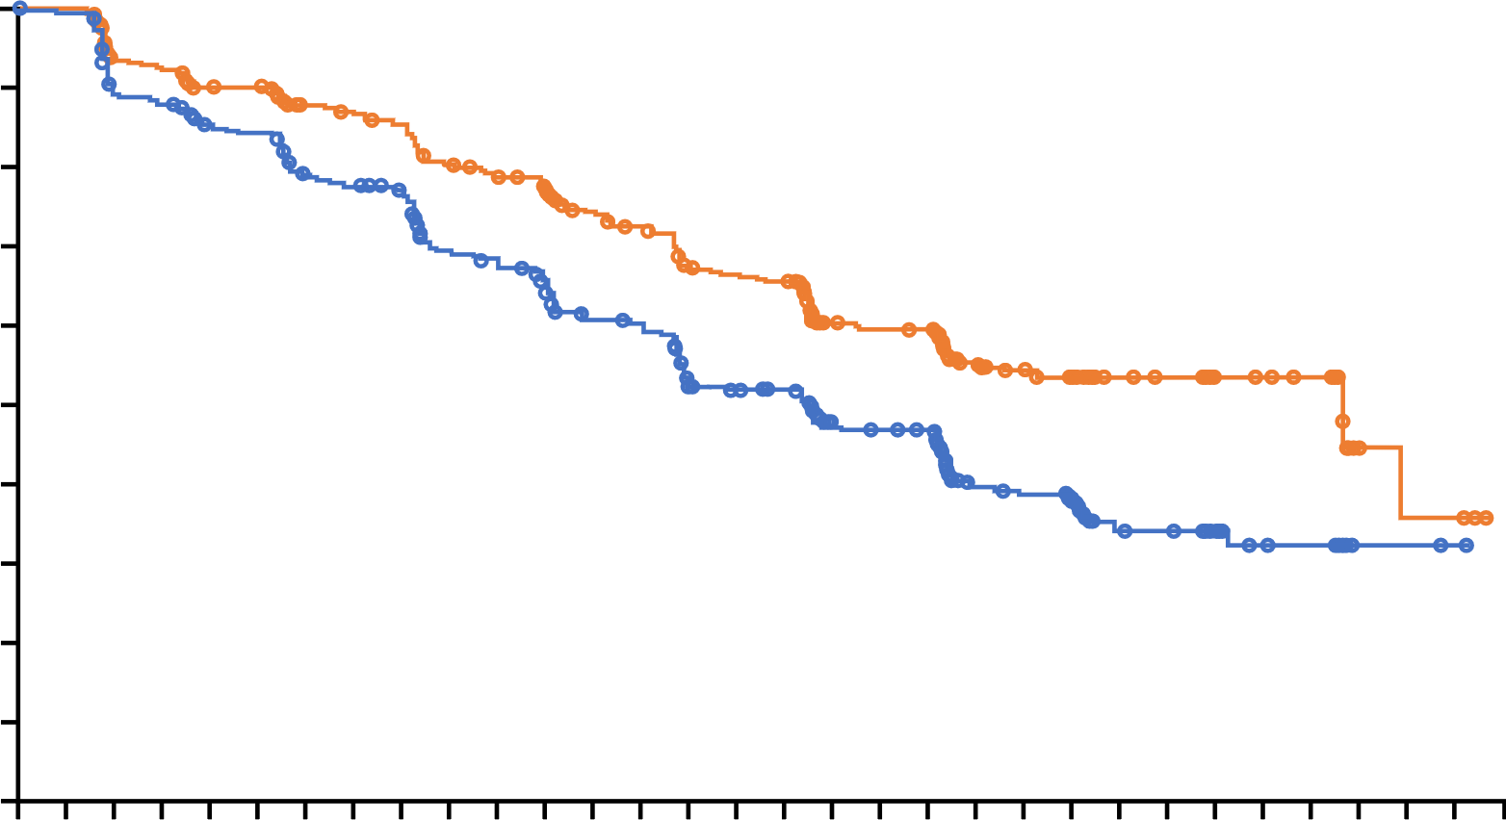
PROpel: primary rPFS results (DCO1)¹
Abiraterone + olaparib significantly prolonged rPFS versus abiraterone + placebo in the ITT population
rPFS by investigator assessment (INV)
rPFS by blinded independent central review (BICR)
 | Abiraterone + olaparib (n=399) | Abiraterone + placebo (n=397)
Events, n (%) | 168 (42.1) | 226 (56.9)
Median, months | 24.8 | 16.6
HR (95% CI) P value | 0.66 (0.54‒0.81) <0.0001
 | 2-sided boundary for significance 0.0324
 | Abiraterone + olaparib (n=399) | Abiraterone + placebo (n=397)
Events, n (%) | 157 (39.3) | 218 (54.9)
Median, months | 27.6 | 16.4
HR (95% CI) P value | 0.61 (0.49‒0.74); <0.0001 (nominal)
1.0
1.0
0.9
0.9
0.8
0.8
0.7
0.7
0.6
0.6
0.5
Probability of rPFS
0.5
Probability of rPFS
0.4
0.4
0.3
0.3
0.2
0.2
0.1
∆ 8.2 months
0.1
∆ 11.2 months
0.0
0
2
4
6
8
10
12
14
16
18
20
22
24
26
28
30
0.0
0
2
4
6
8
10
12
14
16
18
20
22
24
26
28
30
Time from randomization (months)
Time from randomization (months)
Number of patients at risk:
Number of patients at risk:
399
397
395
393
367
359
354
356
340
338
337
334
313
306
309
303
301
297
277
266
274
264
265
249
251
232
244
228
227
198
221
190
219
186
170
143
167
141
163
137
104
87
100
84
87
73
59
45
57
43
28
21
26
17
26
16
5
2
4
2
4
1
0
0
Abiraterone + olaparib
Abiraterone + placebo
Abiraterone + olaparib
Abiraterone + placebo
399
397
389
388
353
345
347
340
332
322
331
319
314
294
309
289
303
282
283
251
275
245
267
226
249
209
240
204
221
177
217
172
215
168
165
131
161
126
159
124
96
73
89
70
80
62
55
39
53
38
30
21
28
16
26
15
5
2
4
2
4
1
0
0
DCO1: 30 July 2021
Median duration of follow-up for investigator-assessed rPFS for censored patients was 19.3 months in the abiraterone and olaparib arm and 19.4 months in the abiraterone and placebo arm (19.3 and 19.2 months, respectively for blinded independent central review).
CI, confidence interval; HR, hazard ratio; ITT, intention-to-treat population.
1. Clarke N et al. NEJM Evidence 2022;EVIDoa2200043.
Courtesy of A Oliver Sartor, MD
Professor Noel Clarke

Slide 58
PROpel: OS at final analysis (DCO3)
In the ITT population, median OS was >7 months longer in the abiraterone + olaparib arm
1.0
 | Abiraterone + olaparib (n=399) | Abiraterone + placebo (n=397)
Events, n (%) | 176 (44.1) | 205 (51.6)
Median, months | 42.1 | 34.7
HR (95% CI) P value | 0.81 (0.67–1.00) 0.0544
 | 2-sided boundary for significance 0.0377
 | 47.9% maturity
0.9
0.8
0.7
0.6
0.5
Probability of OS
0.4
0.3
0.2
∆ 7.4
months
0.1
0.0
0
2
4
6
8
10
12
14
16
18
20
22
24
26
28
30
32
34
36
38
40
42
44
46
48
Number of patients at risk:
Time from randomization (months)
Abiraterone + olaparib
Abiraterone + placebo
399
397
399
395
391
388
385
383
374
376
364
370
349
355
334
337
318
316
312
305
298
301
283
282
273
254
258
241
253
225
246
213
226
201
192
157
135
119
96
84
63
53
29
25
10
7
2
0
0
0
DCO3: 12 October 2022.
Median (range) duration of follow-up for censored patients at DCO3 was 36.6 months (8.3–47.0) in the abiraterone + olaparib arm and 36.5 months (2.9–45.3) in the abiraterone + placebo arm.
Courtesy of A Oliver Sartor, MD
Professor Noel Clarke

Slide 59
Chi et al. ASCO GU 2022
Courtesy of A Oliver Sartor, MD

Slide 60
Courtesy of A Oliver Sartor, MD

Slide 61
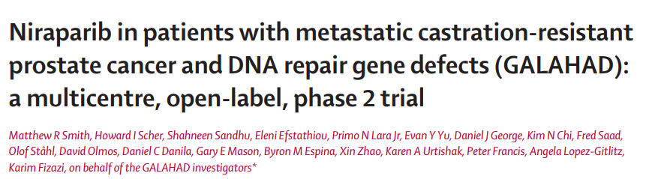
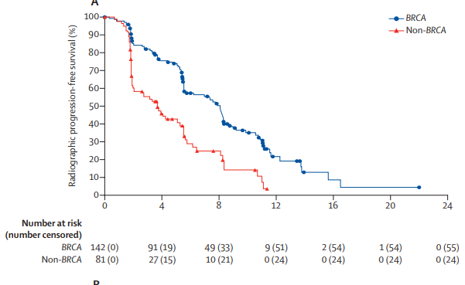
Courtesy of A Oliver Sartor, MD

Slide 62
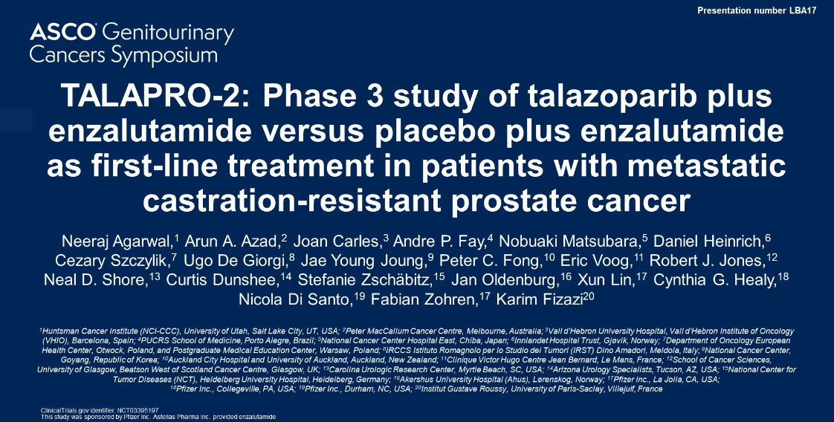
Courtesy of A Oliver Sartor, MD

Slide 63
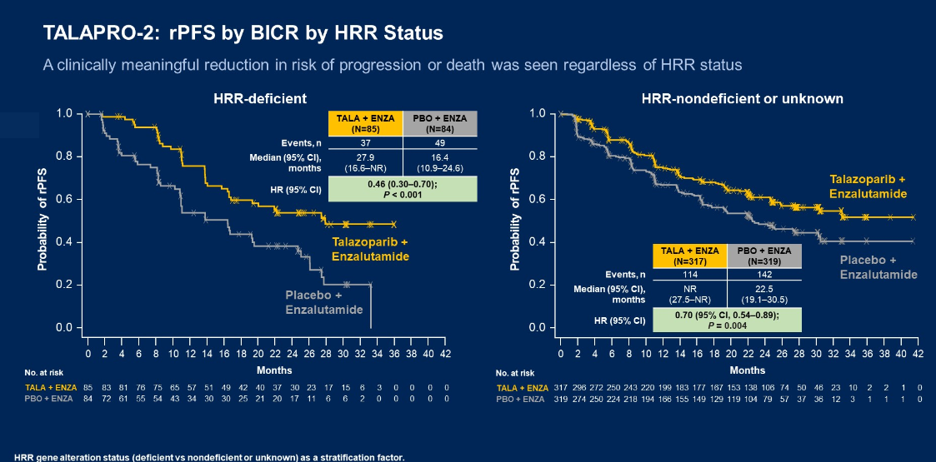
Courtesy of A Oliver Sartor, MD

Slide 64
Radiopharmaceuticals

Slide 65
VISION: ¹⁷⁷Lu-PSMA-617 Phase III trial
VISION met both primary endpoints of OS and rPFS
OS: HR 0.62 (95% CI 0.52-0.74)
rPFS: HR 0.40 (95% CI 0.29-57)
 | ¹⁷⁷Lu-PSMA-617 + SoC (n=551) | SoC alone (n=280)
Median OS, months | 15.3 | 11.3
HR (95% CI) | 0.62 (0.52–0.74)
P value, one-sided | <0.001
 | ¹⁷⁷Lu-PSMA-617 + SoC (n=385) | SoC alone (n=186)
Median rPFS, months | 8.7 | 3.4
HR (95% CI) | 0.40 (0.29–0.57)
P value, one-sided | <0.001
100
100
90
90
80
70
80
60
70
Event-free probability (%)
50
60
40
Event-free probability (%)
30
50
20
40
10
¹⁷⁷Lu-PSMA-617 + SoC (n/N=343/551)
30
0
SoC alone (n/N=187/280)
20
0
2
4
6
8
10
12
14
16
18
20
22
24
26
28
30
32
10
¹⁷⁷Lu-PSMA-617 + SoC (n/N=254/385)
Number still at risk
Time from randomisation (months)
0
SoC alone(n/N=93/196)
¹⁷⁷Lu-PSMA-617
+ SoC
551
535
506
470
425
377
332
289
236
166
112
63
36
15
5
2
0
0
1
2
3
4
5
6
7
8
9
10
11
12
13
14
15
16
17
18
19
20
21
22
23
SoC alone
280
238
203
173
155
133
117
98
73
51
33
16
6
2
0
0
0
Number still at risk
Time from randomisation (months)
¹⁷⁷Lu-PSMA-617
+ SoC
385
373
362
292
272
235
215
194
182
146
137
121
88
83
71
51
49
37
21
18
6
1
1
0
SoC alone
196
146
119
58
36
26
19
14
14
13
13
11
7
7
7
4
3
3
2
2
0
0
0
0
Note: OS positive (HR 0.63) in rPFS subset and rPFS positive
(HR 0.43) in OS subset
Courtesy of A Oliver Sartor, MD

Slide 66
¹⁷⁷Lu-PSMA-617 shows statistically significant and clinically meaningful radiographic progression-free survival benefit in patients with PSMA-positive metastatic castration-resistant prostate cancer
Dec 05, 2022
Ad hoc announcement pursuant to Art.53LR
Phase III PSMAfore trial with ¹⁷⁷Lu-PSMA-617 met the primary endpoint of radiographic progression-free survival for patients with PSMA-positive mCRPC who have been treated with androgen-receptor inhibitor (ARPI) therapy
¹⁷⁷Lu-PSMA-617 becomes the first PSMA-targeted radioligand therapy to demonstrate clinical benefit in mCRPC patients before taxane based chemotherapy, addressing a significant unmet need
Courtesy of A Oliver Sartor, MD

Slide 67
Courtesy of A Oliver Sartor, MD

Slide 68
Other Therapeutic Approaches

Slide 69
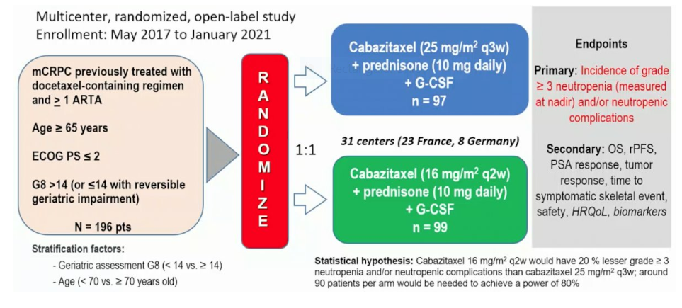
Cabasty Trial
Oudard et al. ESMO 2022
Courtesy of A Oliver Sartor, MD

Slide 70
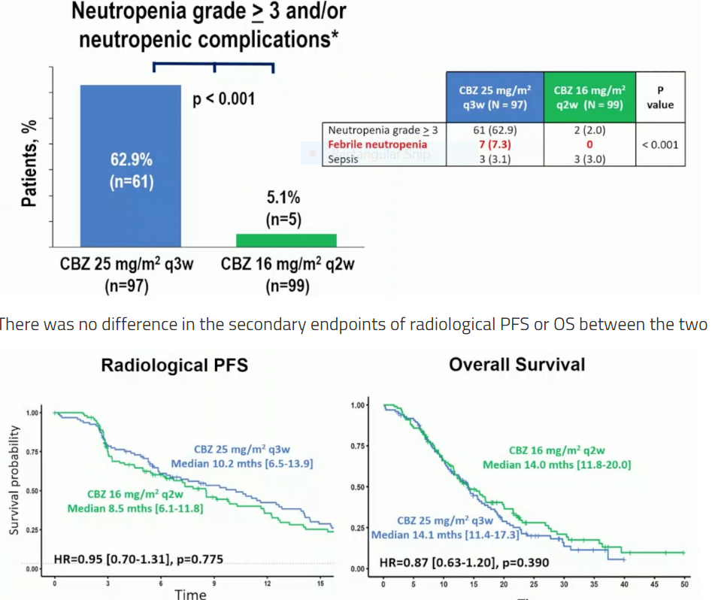
Courtesy of A Oliver Sartor, MD

Slide 71
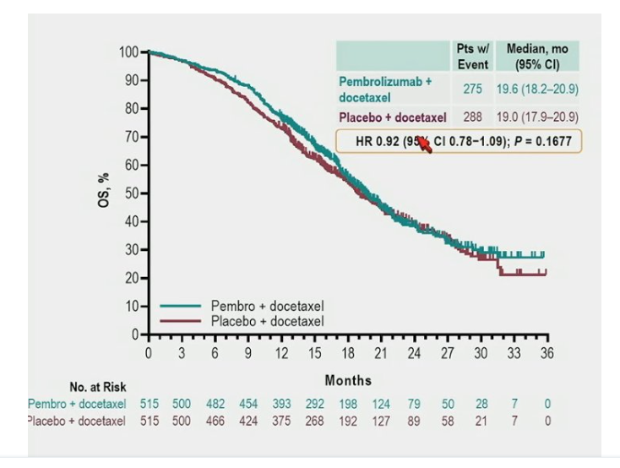
Docetaxel +/- Pembrolizumab
Petrylak et al. ASCO GU 2023
HR 0.92 (95% CI 0.78-1.09); P = 0.1677
Courtesy of A Oliver Sartor, MD

