Slide 1

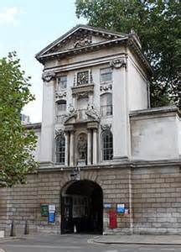

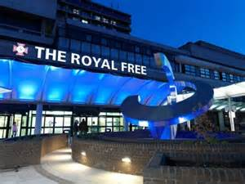
Year in review in clear cell RCC
Thomas Powles
Director of Barts Cancer Center.
Professor of Urology Cancer, Barts Cancer Institute.

Slide 2
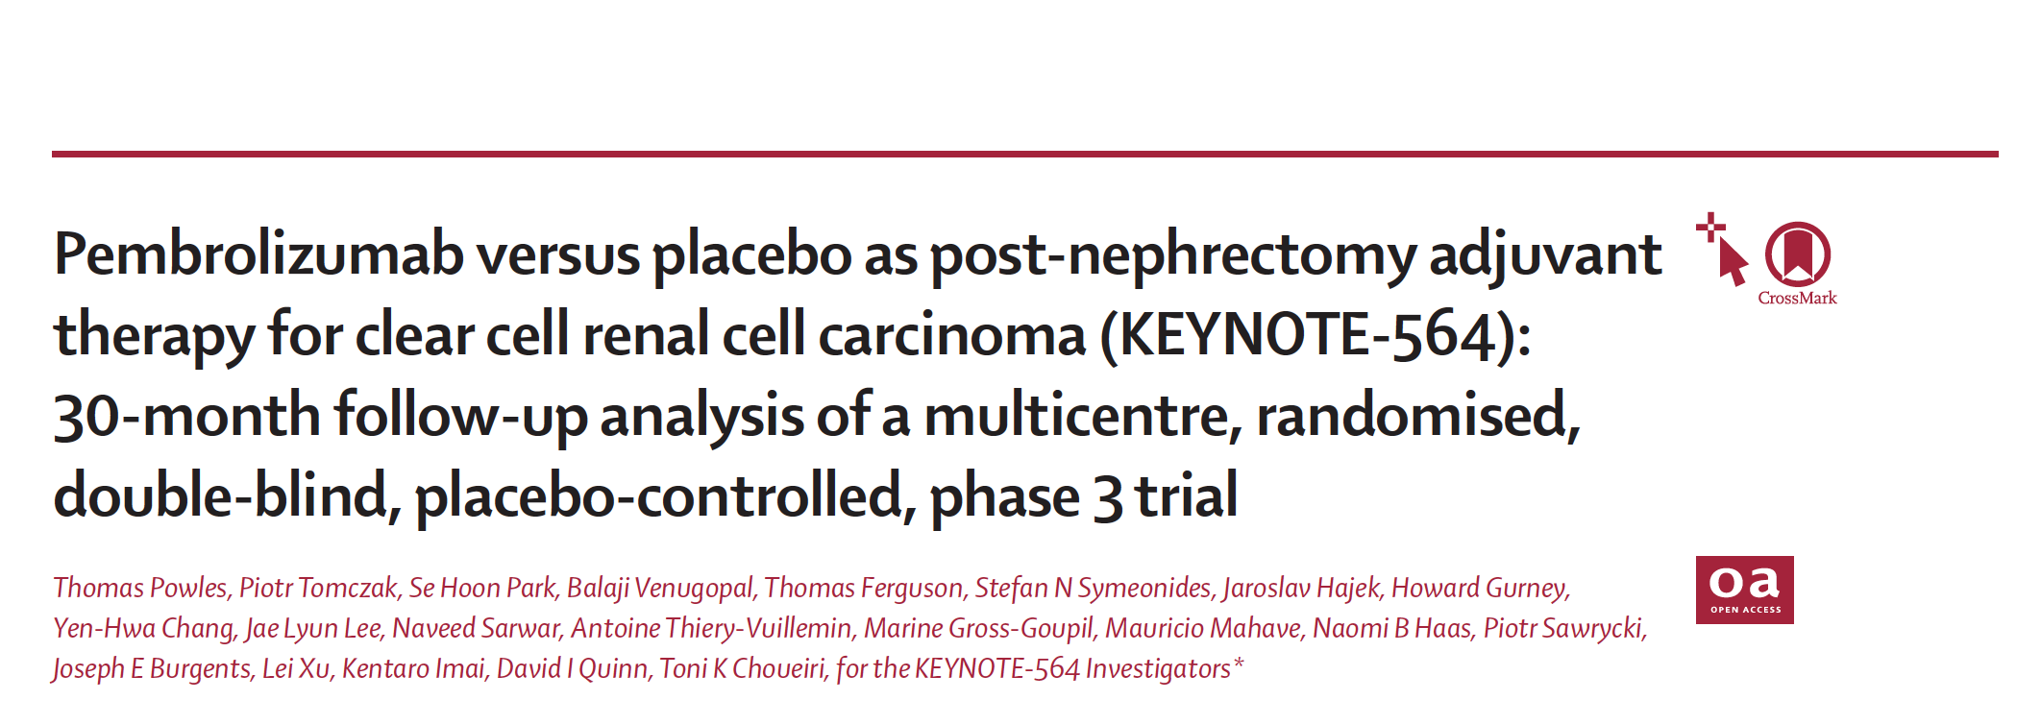
Lancet Oncol 2022;23:1133-44.

Slide 3
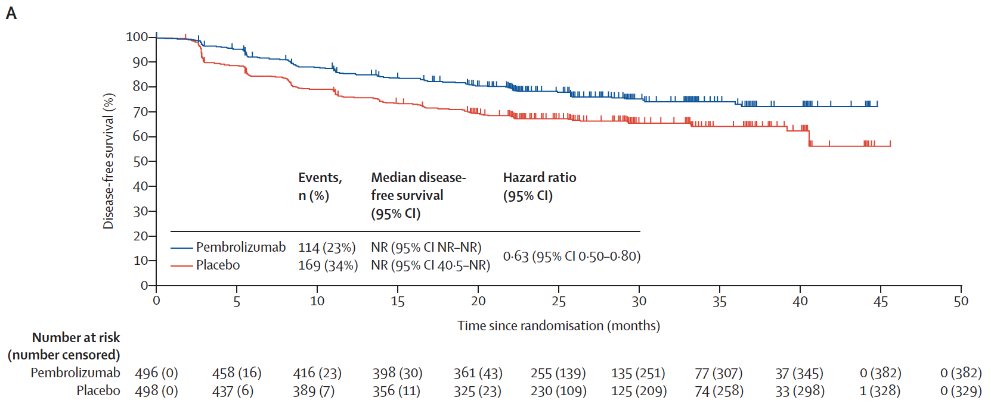
KEYNOTE-564 (Primary Endpoint): Investigator-Assessed DFS (ITT)
Powles T et al. Lancet Oncol 2022;23:1133-44.

Slide 4
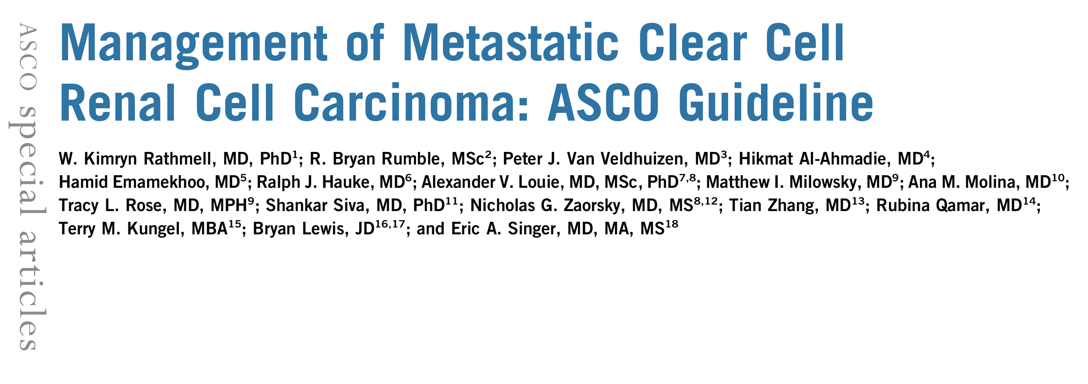
J Clin Oncol 2022;40(25):2957-95.

Slide 5
Overview of Recommendations
The diagnosis of metastatic ccRCC should be made using tissue biopsy of the primary tumor or a metastatic site with the inclusion of markers and/or stains to support the diagnosis.
The International Metastatic RCC Database Consortium risk criteria should be used to inform treatment. Cytoreductive nephrectomy may be offered to select patients with kidney-in-place and favorable- or intermediate-risk disease.
For those who have already had a nephrectomy, an initial period of active surveillance may be offered if they are asymptomatic with a low burden of disease.
Patients with favorable-risk disease who need systemic therapy may be offered an immune checkpoint inhibitor (ICI) in combination with a vascular endothelial growth factor receptor (VEGFR) tyrosine kinase inhibitor (TKI); patients with intermediate or poor risk should be offered a doublet regimen (no recommendation was provided between ICIs or an ICI in combination with a VEGFR TKI).
For select patients, monotherapy with either an ICI or a VEGFR TKI may be offered on the basis of comorbidities. Interleukin-2 remains an option, although selection criteria could not be identified. Recommendations are also provided for second- and subsequent-line therapy as well as the treatment of bone metastases, brain metastases, or the presence of sarcomatoid features.
Rathmell WK et al. J Clin Oncol 2022;40(25):2957-95.

Slide 6
CheckMate 9ER: study design
CheckMate 9ER is a phase 3, randomized, open-label trial of NIVO+CABO versus SUN in patients with untreated clear cell, advanced or metastatic RCC
Stratification factors:
IMDC risk score
Tumor PD-L1 expressionª
Geographic region
N = 651
Key eligibility criteria¹
  Previously untreated advanced or metastatic RCC
  Clear cell component
  Any IMDC risk group
NIVO 240 mg IV Q2W
+ CABO 40 mg PO QD
Treat until RECIST v1.1–defined progression or unacceptable toxicity^{b}
R
1:1
SUN 50 mg PO QD,
cycle of 4 weeks on/
2 weeks off
Median (range) follow-up for OS in ITT patients, 44.0 (36.5–56.5) months
Primary endpoint: PFS per BICR (RECIST v1.1)
Secondary endpoints: OS, ORR per BICR (RECIST v1.1), and safety
ªDefined as the percent of positive tumor cell membrane staining in a minimum of 100 evaluable tumor cells per validated Dako PD-L1 IHC 28-8 pharmDx immunohistochemistry assay. ^{b}NIVO dosing may not exceed a total of 2 years (from cycle 1); CABO and SUN treatment may continue beyond 2 years in the absence of progression or unacceptable toxicity.
Patients may be treated beyond progression.
BICR, blinded independent central review; ITT, intent-to-treat; IV, intravenously; PD-L1, programmed death ligand 1; PO, orally; Q2W, every 2 weeks; QD, once daily; R, randomization; RECIST, Response Evaluation Criteria in Solid Tumors.
1. Choueiri TK, et al. N Engl J Med 2021;384:829–841.
Burotto M et al. ASCO GU 2023;Abstract 603.

Slide 7
PFS per BICR: ITT population
Median PFS per BICR (95% CI), months
NIVO+CABO | 16.6 (12.8–19.8)
SUN | 8.4 (7.0–9.7)
75
HR (95% CI), 0.58 (0.5–0.7)
Progression-free survival (%)
47.7%
50
21.0%
25
27.0%
11.6%
0
0
6
12
18
24
30
36
42
48
Months
No. at risk
NIVO+CABO
323
238
170
136
108
48
6
0
0
SUN
328
163
94
62
47
17
7
2
0
Median follow-up for OS, 44.0 months. Stratified Cox proportional hazard model used for HR.
CI, confidence interval.
Burotto M et al. ASCO GU 2023;Abstract 603.

Slide 8
OS: ITT population
100
Median OS (95% CI), months
NIVO+CABO | 49.5 (40.3–NE)
SUN | 35.5 (29.2–42.3)
79.0%
HR (95% CI), 0.70 (0.6–0.9)
75
68.8%
58.7%
50
Overall survival (%)
49.5%
25
0
0
6
12
18
24
30
36
42
48
54
Months
No. at risk
NIVO+CABO
323
298
272
250
222
207
180
97
25
0
SUN
328
276
240
217
189
168
150
83
17
0
Burotto M et al. ASCO GU 2023;Abstract 603.
Median follow-up for OS, 44.0 months. Stratified Cox proportional hazard model used for HR.

Slide 9
OS: IMDC risk group
100
Favorable
100
Intermediate
75
75
50
Median OS (95% CI), months
NIVO+CABO | NR (40.7-NE)
SUN | 47.6 (43.6-NE)
50
Median OS (95% CI), months
NIVO+CABO | 49.5 (37.6-NE)
SUN | 36.2 (25.7-46.0)
Overall survival (%)
Overall survival (%)
25
25
HR (95% CI), 1.1 (0.6-1.8)
HR (95% CI), 0.75 (0.6-1.0)
0
0
6
12
18
24
30
36
42
48
54
0
0
6
12
18
24
30
36
42
48
54
No. at risk
Months
No. at risk
Months
NIVO+CABO
74
70
67
63
56
55
48
26
9
0
NIVO+CABO
188
176
156
145
132
119
104
55
13
0
SUN
72
68
63
61
55
52
49
27
5
0
SUN
188
164
145
127
111
95
85
49
11
0
100
Median OS (95% CI), months
NIVO+CABO | 34.8 (21.4-NE)
SUN | 10.5 (6.8-20.7)
100
Intermediate/poor
75
75
HR (95% CI), 0.46 (0.3-0.7)
50
50
Overall survival (%)
Overall survival (%)
Median OS (95% CI), months
NIVO+CABO | 49.5 (34.9–NE)
SUN | 29.2 (23.7–36.0)
25
25
Poor
HR (95% CI), 0.65 (0.5–0.8)
0
0
6
12
18
24
30
36
42
48
54
0
0
6
12
18
24
30
36
42
48
54
No. at risk
Months
No. at risk
Months
NIVO+CABO
61
52
49
42
34
33
28
16
3
0
NIVO+CABO
249
228
205
187
166
152
132
71
16
0
SUN
68
44
32
29
23
21
16
7
1
0
SUN
256
208
177
156
134
116
101
56
12
0
Median follow-up for OS, 44.0 months. Unstratified Cox proportional hazard model used for HR.
NE, not estimable.
Burotto M et al. ASCO GU 2023;Abstract 603.

Slide 10
CLEAR trial Lenvatinib and pembrolizumab
Porta CG et al. ESMO 2022;Abstract 1449MO.

Slide 11
Porta CG et al. ESMO 2022;Abstract 1449MO.

Slide 12
Porta CG et al. ESMO 2022;Abstract 1449MO.

Slide 13
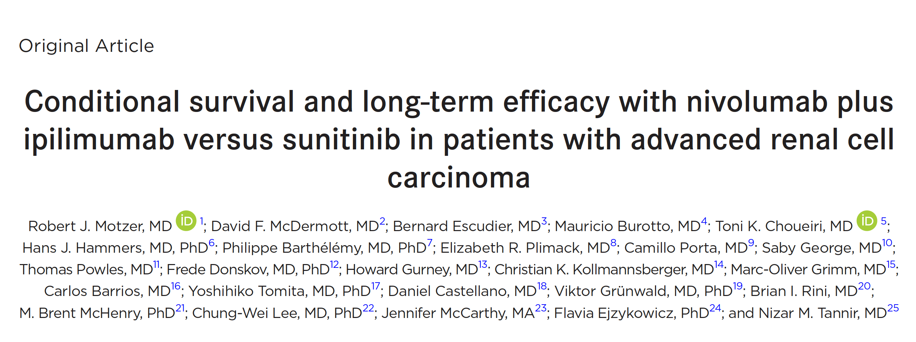
Cancer 2022;128(11):2085-97.
CONCLUSIONS: Durable clinical benefits were observed with NIVO+IPI versus SUN at 5 years, the longest phase 3 follow-up for a first-line checkpoint inhibitor-based combination in patients with aRCC. Conditional estimates indicate that most patients who remained alive or in response with NIVO+IPI at 3 years remained so at 5 years.

Slide 14
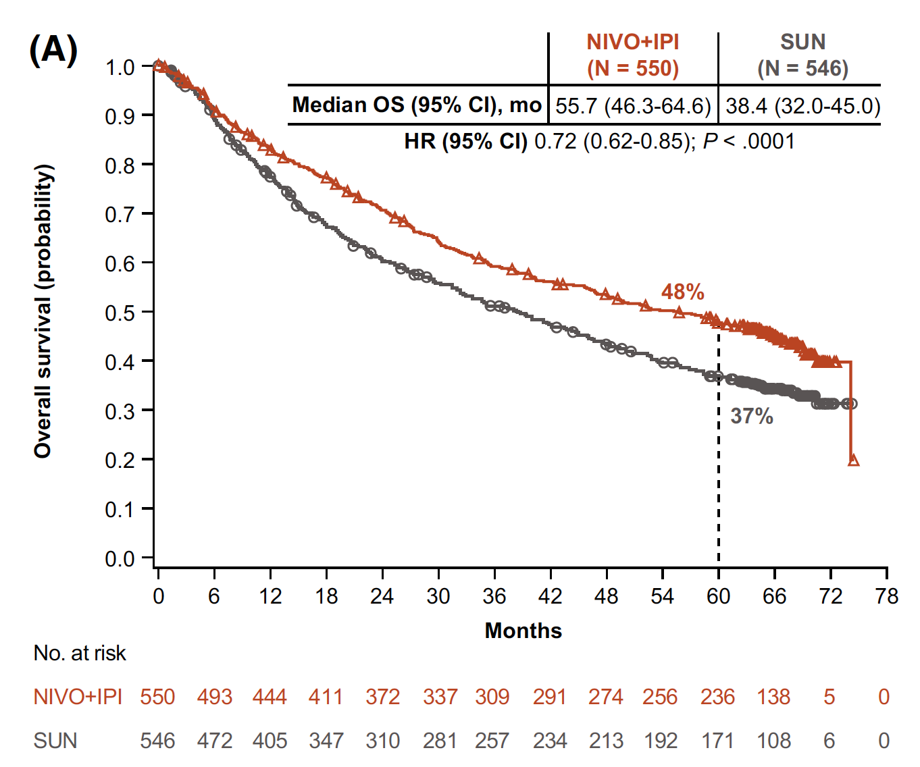
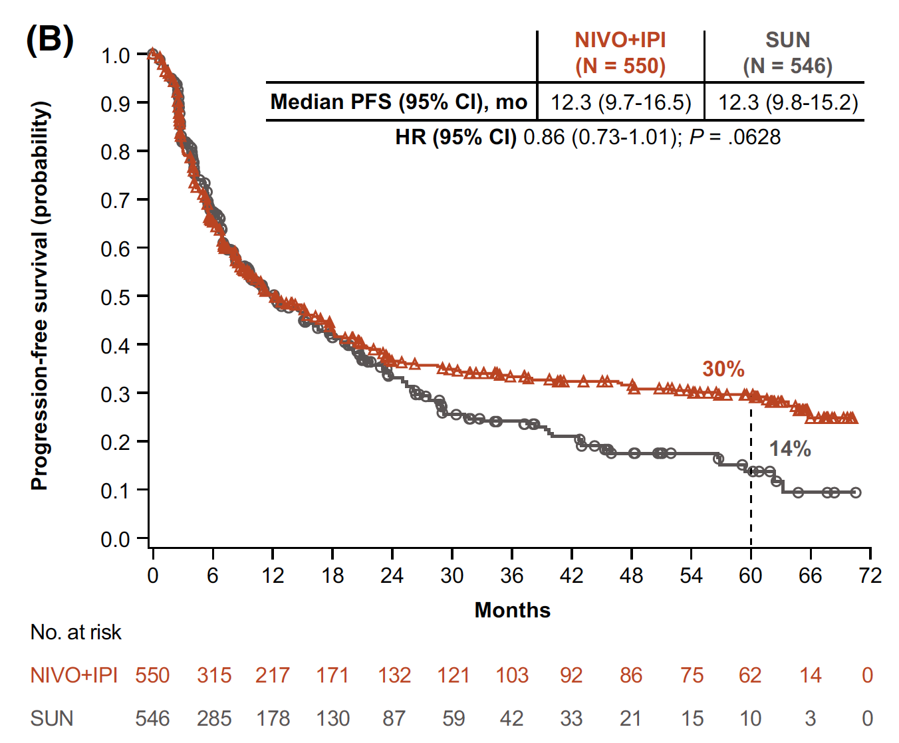
Survival Analyses (ITT Population)
Motzer RJ et al. Cancer 2022;128(11):2085-97.

Slide 15
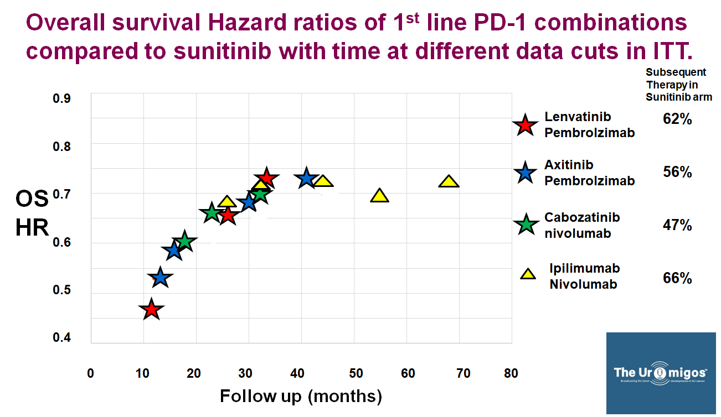
Pembrolizumab
Pembrolizumab
Cabozantinib
GUOncologyNow, Conversations & Trending Topics in GU Cancers: Kidney Cancer, January 2023

Slide 16
Outcomes by IMDC risk in the COSMIC-313 phase 3 trial evaluating cabozantinib plus nivolumab and ipilimumab in first-line advanced RCC of IMDC intermediate or poor risk
Abstract 605
Thomas Powles,¹ Robert J. Motzer,² Laurence Albiges,³ Cristina Suarez,⁴ Fabio A. Schutz,⁵ Daniel Y.C. Heng,⁶ Christine Chevreau,⁷ Ravindran Kanesvaran,⁸ Howard Gurney,⁹ Fong Wang,¹⁰ Fabio Mataveli,¹⁰ Yu-Lin Chang,¹⁰ Maximiliano van Kooten Losio,¹¹ Toni K. Choueiri¹²
¹Barts Cancer Institute, Cancer Research UK Experimental Cancer Medicine Centre, Queen Mary University of London, Royal Free National Health Service Trust, London, UK; ²Memorial Sloan Kettering Cancer Center, New York, NY, USA; ³Institut Gustave Roussy, Université Paris Saclay, Villejuif, France; ⁴Vall d’Hebron Institute of Oncology, Hospital Universitari Vall d’Hebron, Vall d’Hebron Barcelona Hospital Campus, Barcelona, Spain; ⁵Latin American Cooperative Oncology Group, Porto Alegre, Brazil; Beneficência Portuguesa de Sao Paulo, Sao Paulo, Brazil; ⁶Tom Baker Cancer Center, University of Calgary, Calgary, AB, Canada; ⁷Institut Universitaire Du Cancer de Toulouse, Toulouse, France; ⁸National Cancer Centre Singapore, Singapore; ⁹Macquarie University, Macquarie Park NSW, Australia; ¹⁰Exelixis, Inc., Alameda, CA, USA; ¹¹Bristol Myers Squibb, Boudry, Neuchâtel, Switzerland; ¹²Lank Center for Genitourinary Oncology, Dana-Farber Cancer Institute, Brigham and Women’s Hospital, and Harvard Medical School, Boston, MA, USA
Thomas Powles, MD

Slide 17
COSMIC-313 Study Design
Cabo + Nivo + Ipi
Cabo 40 mg PO QD
+ Nivo 3 mg/kg IV Q3W ×4
+ Ipi 1 mg/kg IV Q3W ×4
Advanced RCC (N~840)
No prior systemic therapy* Clear cell component Intermediate or poor risk per IMDC criteria Measurable disease per RECIST v1.1 Karnofsky Performance Status ≥70%
Tumor assessment every 8 weeks per RECIST v1.1‡
Treatment until loss of clinical benefit or intolerable toxicity§
No crossover allowed
Cabo 40 mg PO QD
+ Nivo 480 mg IV Q4W†
R1:1
Placebo + Nivo + Ipi
Stratification
IMDC risk
Region
Placebo PO QD
+ Nivo 3 mg/kg IV Q3W ×4
+ Ipi 1 mg/kg IV Q3W ×4
Placebo PO QD
+ Nivo 480 mg IV Q4W†
Primary endpoint: PFS per RECIST v1.1 by BIRC after the 249th event in the first 550 randomized patients (PITT population)
Secondary endpoint (ongoing): OS after 433 events in all randomized patients (ITT patients)
Additional endpoints: ORR, DOR, and safety
*One prior systemic adjuvant therapy allowed for completely resected RCC and if recurrence occurred ≥6 months after the last dose of adjuvant therapy; adjuvant PD-1 or PD-L1 inhibitor in combination with a CTLA-4 inhibitor not permitted. †Nivolumab given for a maximum of 2 years. ‡Tumor assessment (RECIST v1.1) at week 10, then every 8 weeks through week 50, then every 12 weeks thereafter. §Discontinuation of one agent did not mandate discontinuation of all agents.
BIRC, blinded independent radiology committee; DOR, duration of response; ITT, intention-to-treat; PITT, progression-free survival ITT.
Thomas Powles, MD
Powles T et al. Genitourinary Cancers Symposium 2023;Abstract 605.

Slide 18
PFS With Cabo + Nivo + Ipi Triplet Regimen
A 26% reduction in the risk of progression or death was observed with the triplet regimen compared with the control after 20.2 months (PITT) or 17.7 months (ITT) of follow-up
PITT Population (n=550)
ITT Population (N=855)
1.0
1.0
0.8
0.8
0.6
0.6
Probability of PFS
Probability of PFS
0.4
0.4
0.2
HR 0.74 (95% CI 0.58–0.94)
0.2
HR 0.74 (95% CI 0.61–0.90)
0.0
0
3
6
9
12
15
18
21
24
27
30
0.0
0
3
6
9
12
15
18
21
24
27
30
Months
Months
Cabo + Nivo + Ipi
276
234
170
145
119
97
56
33
10
1
0
Cabo + Nivo + Ipi
428
357
269
232
162
99
56
33
10
1
0
Pbo + Nivo + Ipi
274
185
136
115
99
70
37
19
5
1
0
Pbo + Nivo + Ipi
427
295
221
193
140
71
37
19
5
1
0
 | n | No. of events | Median PFS, mo (95% CI)
Cabo + Nivo + Ipi | 276 | 125 | 16.9 (11.5–NE)
Pbo + Nivo + Ipi | 274 | 141 | 11.3 (7.7–14.0)
 | n | No. of events | Median PFS, mo (95% CI)
Cabo + Nivo + Ipi | 428 | 186 | 15.3 (12.7–22.5)
Pbo + Nivo + Ipi | 427 | 216 | 11.3 (9.3–14.0)
Data cutoff of January 31, 2022: Total of 266 PFS events per RECIST 1.1 by BIRC in PITT (median follow-up, 20.2 mo) and 402 events in ITT population (median follow-up, 17.7 mo)
Pbo, placebo.
Thomas Powles, MD
Powles T et al. Genitourinary Cancers Symposium 2023;Abstract 605.

Slide 19
PFS by IMDC Risk Group (ITT Population)
A 32% reduction in the risk of progression or death was observed with the triplet regimen compared with the control in the intermediate risk
Intermediate (n=642)
Poor (n=213)
1.0
1.0
0.8
0.8
0.6
0.6
Probability of PFS
Probability of PFS
0.4
0.4
0.2
HR 0.68 (95% CI 0.54–0.86)
0.2
HR 0.93 (95% CI 0.64–1.35)
0.0
0
3
6
9
12
15
18
21
24
27
30
0.0
0
3
6
9
12
15
18
21
24
27
30
Months
Months
Cabo + Nivo + Ipi
321
278
211
182
133
81
48
28
10
1
0
Cabo + Nivo + Ipi
107
79
58
50
29
18
8
5
0
Pbo + Nivo + Ipi
321
226
170
146
105
57
30
16
4
1
0
Pbo + Nivo + Ipi
106
69
51
47
35
14
7
3
1
0
 | n | No. of events | Median PFS, mo (95% CI)
Cabo + Nivo + Ipi | 321 | 131 | 17.9 (14.1–NE)
Pbo + Nivo + Ipi | 321 | 161 | 11.3 (8.4–15.3)
 | n | No. of events | Median PFS, mo (95% CI)
Cabo + Nivo + Ipi | 107 | 55 | 9.5 (8.3–15.8)
Pbo + Nivo + Ipi | 106 | 55 | 11.2 (6.0–14.2)
Median follow-up of 17.7 mo; total of 855 patients and 402 PFS events per RECIST 1.1 by BIRC at data cutoff of January 31, 2022.
Thomas Powles, MD
Powles T et al. Genitourinary Cancers Symposium 2023;Abstract 605.

Slide 20
Treatment Exposure by IMDC Risk (Safety Population)
No major differences in exposure between treatment arms in either risk group that can explain the observed differences in efficacy between intermediate- and poor-risk groups
 | Intermediate Risk |  | Poor Risk
 | Cabo + Nivo + Ipi (n=321) | Pbo + Nivo + Ipi (n=320) | Cabo + Nivo + Ipi (n=105) | Pbo + Nivo + Ipi (n=104)
Median duration of exposure of study treatment*, mo (range) | 11.3 (0.3–28.5) | 10.4 (0.3–28.1) | 10.1 (0.2–23.7) | 7.3 (0.1–27.0)
Median duration of exposure of oral study treatment, mo (range) | 10.4 (0.2–28.5) | 10.5 (0.4–28.1) | 9.1 (0.7–23.7) | 8.7 (0.6–27.0)
Median average daily dose of Cabo or Pbo, mg (range) | 22.2 (3.6–40.0) | 36.2 (5.4–40.0) | 25.2 (8.6–40.0) | 36.0 (0.8–40.0)
Median Nivo infusions, no. (range) | 10.0 (1.0–27.0) | 9.0 (1.0–27.0) | 10.0 (1.0–27.0) | 8.0 (1.0–27.0)
Doses of Ipi received, n (%)
4 | 175 (55) | 236 (74) | 74 (70) | 75 (72)
3 | 39 (12) | 42 (13) | 15 (14) | 16 (15)
2 | 84 (26) | 24 (8) | 10 (10) | 4 (4)
1 | 23 ( 7) | 18 (6) | 6 (6) | 9 (9)
Any dose hold due to an AE, n (%)* | 289 (90) | 226 (71) | 94 (90) | 69 (66)
Any dose reduction of Cabo or Pbo due to an AE, n (%) | 179 (56) | 62 (19) | 50 (48) | 23 (22)
Thomas Powles, MD
Powles T et al. Genitourinary Cancers Symposium 2023;Abstract 605.

Slide 21
Safety by IMDC Risk (Safety Population)
Among patients randomized to the triplet regimen, treatment-related AEs led to discontinuation of treatment components in a greater proportion of intermediate-risk compared with poor-risk patients
 | Intermediate Risk |  | Poor Risk
 | Cabo + Nivo + Ipi (n=321) | Pbo + Nivo + Ipi (n=320) | Cabo + Nivo + Ipi (n=105) | Pbo + Nivo + Ipi (n=104)
Treatment-related AEs, n (%) | 319 (99) | 302 (94) | 102 (97) | 85 (82)
Grade 3/4 treatment-related AEs, n (%) | 239 (74) | 134 (42) | 70 (67) | 40 (38)
Grade 3/4 immune-mediated AEs | 166 (52) | 81 (25) | 50 (48) | 19 (18)
Grade 3/4 alanine aminotransferase increased | 95 (30) | 22 (7) | 16 (15) | 4 (4)
Grade 3/4 aspartate aminotransferase increased | 70 (22) | 15 (5) | 16 (15) | 5 (5)
Grade 5 treatment-related AEs ≤100 days,* n (%) | 4 (1) | 2 (1) | 1 (1) | 2 (2)
Treatment-related AE leading to discontinuation, n (%)
Any treatment component | 163 (51) | 82 (26) | 30 (29) | 21 (20)
Cabo or Pbo | 97 (30) | 44 (14) | 21 (20) | 15 (14)
Nivo | 94 (29) | 60 (19) | 15 (14) | 16 (15)
Ipi | 117 (36) | 40 (13) | 12 (11) | 11 (11)
All treatment components (due to the same AE) | 46 (14) | 16 (5) | 5 (5) | 4 (4)
High-dose steroids† received for AEs, n (%) | 192 (60) | 119 (37) | 54 (51) | 30 (29)
Thomas Powles, MD
Powles T et al. Genitourinary Cancers Symposium 2023;Abstract 605.

Slide 22

Biomarker analysis from the phase 3 CheckMate 9ER trial of nivolumab plus cabozantinib versus sunitinib for advanced renal cell carcinoma
HIGHLY CONFIDENTIAL
Toni K. Choueiri,¹ Robert J. Motzer,² Thomas Powles,³ Mauricio Burotto,⁴ Andrea B. Apolo,⁵ Bernard Escudier,⁶ Yoshihiko Tomita,⁷ David McDermott,⁸ David A. Braun,⁹ Celine Han,¹⁰ George Lee,¹⁰ Bhakti Dwivedi,¹⁰ Sai Vikram Vemula,¹⁰ Jun Li,¹⁰ Viktor Fedorov,¹⁰
Saurabh Gupta¹⁰
¹Lank Center for Genitourinary Oncology, Dana-Farber Cancer Institute, Brigham and Women’s Hospital, and Harvard Medical School, Boston, MA; ²Memorial Sloan Kettering Cancer Center, New York, NY; ³Barts Cancer Institute, Cancer Research UK Experimental Cancer Medicine Centre, Queen Mary University of London, Royal Free National Health Service Trust, London, UK; ⁴Bradford Hill Clinical Research Center, Santiago, Chile; ⁵Center for Cancer Research, National Cancer Institute, National Institutes of Health, Bethesda, MD; ⁶Gustave Roussy, Villejuif, France; ⁷Niigata University Graduate School of Medical and Dental Sciences, Niigata, Japan; ⁸Beth Israel Deaconess Medical Center, Boston, MA; ⁹School of Medicine, Yale University,
New Haven, CT; ¹⁰Bristol Myers Squibb, Princeton, NJ
Presentation number D7

Slide 23
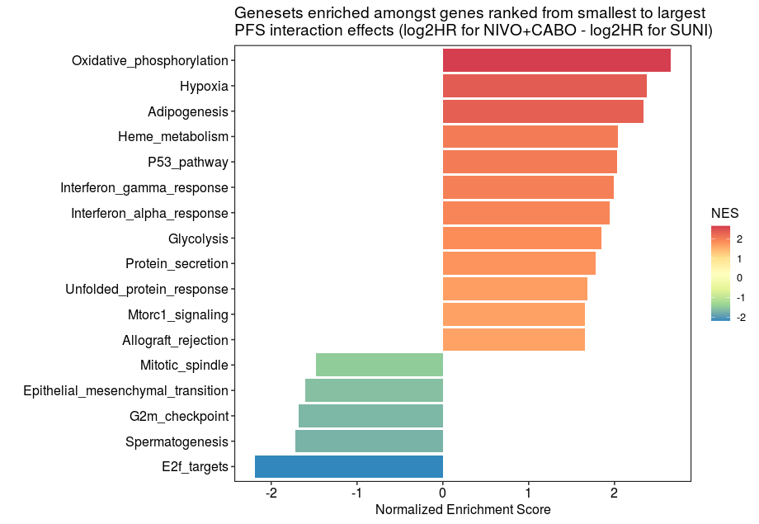
Association of hallmark gene sets and GES with PFS outcomes
Shorter PFS with
NIVO+CABO vs SUNª
Longer PFS with
NIVO+CABO vs SUNª
Individual genes from some enriched hallmark gene sets associated with PFS outcome were prognostic but did not appear to be predictive (data in poster)
In Cox PH analysis, none of the 7 published GES tested were predictive for PFS outcome with NIVO+CABO versus SUN^{b,c}
ªEnriched hallmark gene set results that were significant based on FDR < 0.01 are shown. ^{b}IMmotion150 Angio, IMmotion150 Myeloid Inflammation, IMmotion150 T-effector (T-eff), JAVELIN Renal 101 Immuno Signature, Tumor Inflammation Signature (TIS), Interferon-γ, and epithelial mesenchymal transition (EMT)-8. ^{c}Cox PH analysis was based on FDR < 0.05, after P value correction for FDR and multiple biomarker testing (q values).
FDR, false discovery rate; NES, normalized enrichment score.
Choueiri TK et al. ASCO GU 2023;Abstract 608.

Slide 24
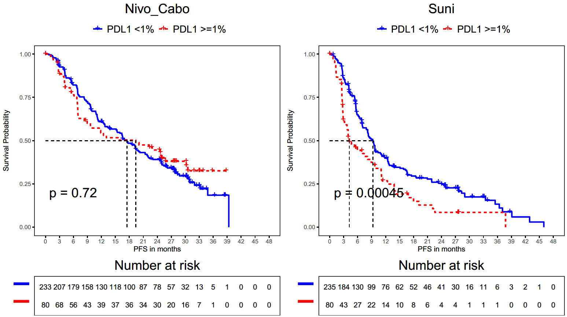
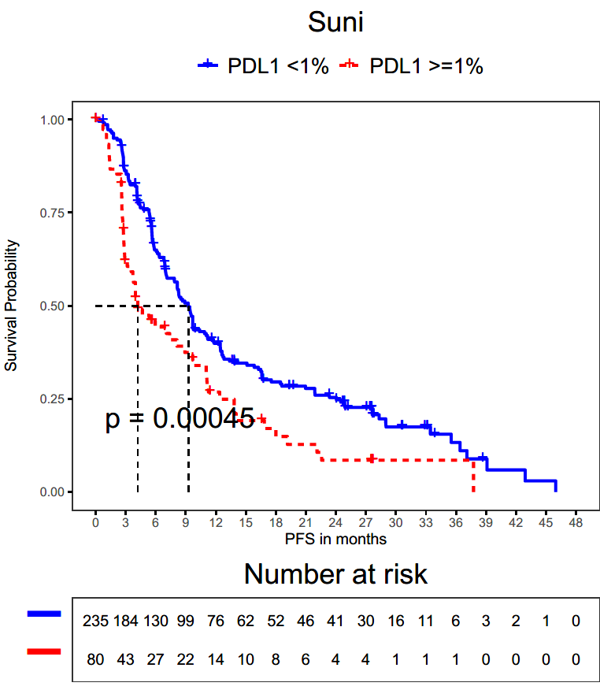

PFS outcomes by tumor PD-L1 status
NIVO+CABO
SUN
ª
ª
In KM analysis, median PFS was numerically improved with NIVO+CABO versus SUN regardless of tumor PD-L1 status
PD-L1 status was not associated with PFS outcome in the NIVO+CABO arm
PD-L1 ≥ 1% was associated with shorter median PFS in the SUN arm
Choueiri TK et al. ASCO GU 2023;Abstract 608.
ªPD-L1 expression was quantified as the percentage of PD-L1–expressing TCs.

Slide 25
PFS outcomes by CD8% and CD8 topology
% of patients in the
CD8 topology analysis
 | Cox PH analysis of PFS outcome by CD8% and CD8 topology^{b}
 | Overall effect, P value | Interaction effect, P value
CD8% | 0.57 | 0.77
CD8 topology | 0.94 | 0.73
Tumor CD8 T-cell
infiltration phenotypeª
In Cox PH analysis, CD8% and CD8 topology were neither prognostic nor predictive for PFS outcomes with NIVO+CABO versus SUN
ªCold denotes tumors with low overall CD8 T cells present; inflamed denotes tumor with high CD8 T cells present in the tumor parenchyma; excluded denotes tumors with CD8 T cells that are primarily present in the tumor stroma. CD8 topology was automatically labeled using a previously developed random forest classifier trained using pathologists’ labels of cold, excluded, and inflamed; the thresholds were not linearly defined. ^{b}CD8 Cox PH analysis used likelihood ratio tests; explanatory variables were treatment arm, CD8% (straight-line function) or CD8 topology (3-level categorical variable), and arm-by-biomarker interaction.
Choueiri TK et al. ASCO GU 2023;Abstract 608.

Slide 26
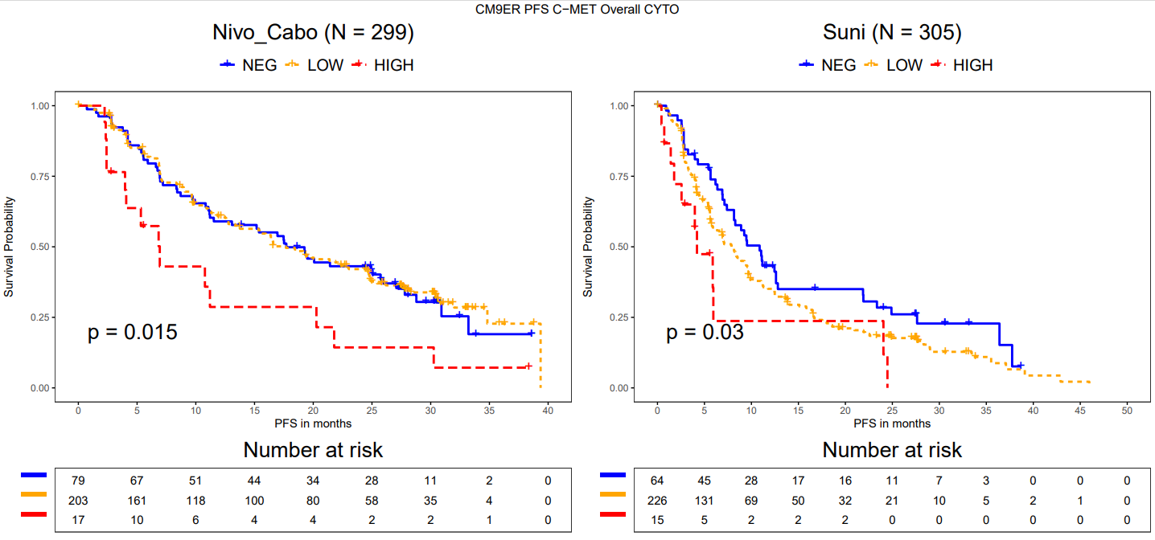

PFS outcomes by cytoplasmic and membrane c-MET
KM analysis of PFS by cytoplasmic c-MET staining category
NIVO+CABO
ª
SUN
ª
Cox PH analysis of PFS outcome by c-MET | Univariable |  | Multivariable
 | Overall effect, P value | Interaction effect, P value | Overall effect, P value | Interaction effect, P value
Cytoplasmic c-MET | 0.03 | 0.32 | 0.04 | 0.19
Membrane c-MET | 0.32 | 0.92 | 0.29 | 0.81
ªNeg, no staining in TCs; low, 1%–49% of TCs with 1+, 2+, and/or 3+ staining; High, ≥ 50% of TCs with 2+ and/or 3+ staining.
Choueiri TK et al. ASCO GU 2023;Abstract 608.

Slide 27
TIVO-3: Study Schema
Randomized Phase 3 Trial in Relapsed or Refractory Advanced Renal Cell Carcinoma
RANDOMIZE 1:1
Tivozanib
1.34 mg once daily for 21 days on and 7 days off,
28-day cycle†
N=175
N=350
ECOG PS 0 or 1
Recurrent/metastatic RCC
Failed at least two prior regimens including
VEGFR-TKI
Stratification:
IMDC Risk Category
Prior therapy (TKI-TKI, TKI-CPI, TKI-Other)
†
Sorafenib
400 mg twice daily†
N=175
Primary Endpoint: PFS
Secondary Endpoints: OS, ORR, DoR, Safety and Tolerability for ITT
†Patients were treated until disease progression or unacceptable toxicity
ECOG, Eastern Cooperative Oncology Group;
TKI, Tyrosine Kinase Inhibitor; CPI, Checkpoint Inhibitor
IMDC, International Metastatic Renal Cell Carcinoma Database Consortium
Rini BI et al Lancet Oncol 2020;21(1):95-104

Slide 28
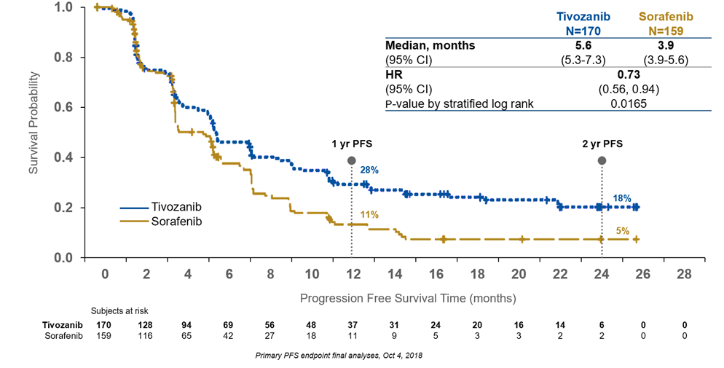

Primary Endpoint- PFS
Rini BI et al Lancet Oncol 2020;21(1):95-104

Slide 29
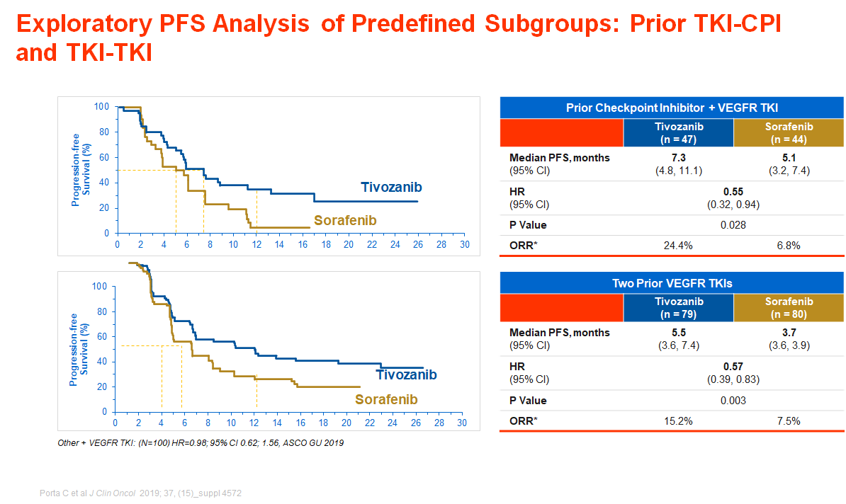

Slide 30
CaboPoint: cabozantinib after checkpoint inhibitor therapy in patients with advanced renal cell carcinoma
Study entry
Pre-treatment period
      study design and patients
      Ongoing phase 2, open-label study conducted across AT, CH, DE, ES, FR, NL, and the UK
Screening
Key inclusion criteria | Key exclusion criteria
Aged ≥ 18 years Histologically confirmed, unresectable, locally advanced or metastatic RCC with a clear cell component Radiographic disease progression following CPI–CPI therapy or CPI in combination with VEGF-targeted therapy (excluding cabozantinib) | Previous use of cabozantinib Presents with untreated brain or leptomeningeal metastases, or current clinical or radiographic progression of known brain metastases
Endpoints
Primary endpoint: ORR per RECIST v1.1 in cohort A, evaluated by independent central review Secondary endpoints: ORR in cohort B by independent central review; ORR for both cohorts by local investigator review; time to responseª; duration of responseª; disease control rateª; progression-free survivalª; overall survival; change in disease-related symptoms; safety and tolerability
Baseline
Cohort A
Patients with disease progression after CPI+CPI therapy (ipilimumab+nivolumab)
Cohort B
Patients with disease progression after CPI+VEGF-targeted therapy
End of treatment
Follow up period
Up to 18 months after the date that the last patients received their first dose of cabozantinib
Follow up period
Up to 18 months after the date that the last patients received their first dose of cabozantinib
End of study
Figure adapted from Albiges et al. 2022.¹
ªEvaluated by independent central and local investigator review. Baseline was defined as the date of cabozantinib initiation. Cabozantinib was initiated in the 15 days after the screening visit. 1L, first-line; CPI, checkpoint inhibitor; ECOG PS, Eastern Cooperative Oncology Group performance status; ORR, objective response rate; RCC, renal cell carcinoma; RECIST, Response Evaluation Criteria in Solid Tumors; VEGF, vascular endothelial growth factor. 1 . Albiges L et al. Future Oncol 2022;18:915–26.

Slide 31
Results: interim efficacy
    After 3 months of follow-up, ORR was 29.5% overall; 31.7% in cohort A, and 25.0% in cohort B (Figure)
    Overall, one patient achieved a complete response and 25 patients experienced partial responses (Figure)
    Overall (N = 88)
    ORR 29.5% (95% CI, 20.3–40.2)ª
    BOR (n = 82)^{b}
    Cohort A (n = 60)
    ORR 31.7% (95% CI, 20.3–45.0)ª
    BOR (n = 57)^{b}
    Cohort B (n = 28)
    ORR 25.0% (95% CI, 10.7–44.9)ª
    BOR (n = 25)^{b}
    1.2%
    (n = 1)
    4.0%
    (n = 1)
    30.5% (n = 25)
    33.3% (n = 19)
    24.0% (n = 6)
    CR
    PR
    SD
    51.2% (n = 42)
    50.9% (n = 29)
    52.0% (n = 13)
    PD
    17.1% (n = 14)
    15.8% (n = 9)
    20.0% (n = 5)
ªInvestigator-assessed ORR was calculated based on the number of patients in each analysis population. ^{b}Percentages of best response (CR, PR, SD, and PD) were calculated based on the number of patients with non-missing values. BOR, best overall response; CI, confidence interval; CR, complete response; ORR, objective response rate; PD, progressive disease; PR, partial response; SD, stable disease.
Albiges L et al. ASCO GU 2020;Abstract 606.

Slide 32
Results: subgroup analyses
      Efficacy with 2L cabozantinib was observed in the overall population across multiple subgroups (Table)
      Efficacy was also observed irrespective of 1L treatment among patients with IMDC intermediate risk (Table)
37.0 (23.2–52.5)
Age
21.4 (10.3–36.8)
31.8 (20.9–44.4)
Sex
22.7 (7.8–45.4)
ECOG PS
38.0 (24.7–52.8)
18.4 (7.7–34.3)
33.3 (18.6–51.0)
IMDC intermediate risk group
40.0 (21.1–61.3)
18.2 (2.3–51.8)
Treatment duration
34.1 (20.1–50.6)
25.5 (13.9–40.4)
51.9 (32.0–71.3)
Number of
metastatic sites
27.3 (10.7–50.2)
15.8 (6.0–31.3)
All subgroups, except IMDC intermediate risk group, present ORR values for the overall population.
1L, first-line; 2L, second-line; CI, confidence interval; ECOG PS, Eastern Cooperative Oncology Group performance status; IMDC, International Metastatic Renal Cell Carcinoma Database Consortium; RCC, renal cell carcinoma.

Slide 33
Merchan J et al. ESMO 2022;Abstract 1447O.

Slide 34
Merchan J et al. ESMO 2022;Abstract 1447O.

Slide 35
Merchan J et al. ESMO 2022;Abstract 1447O.

Slide 36
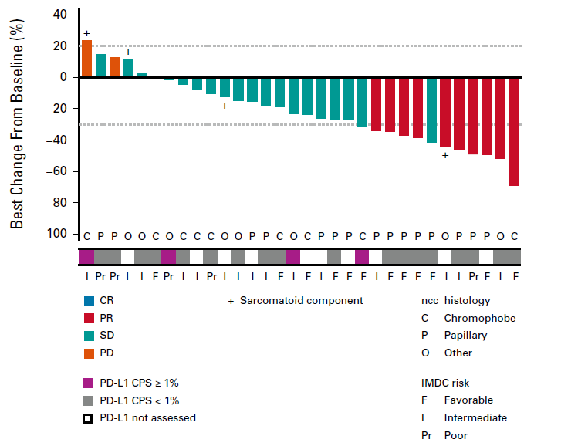
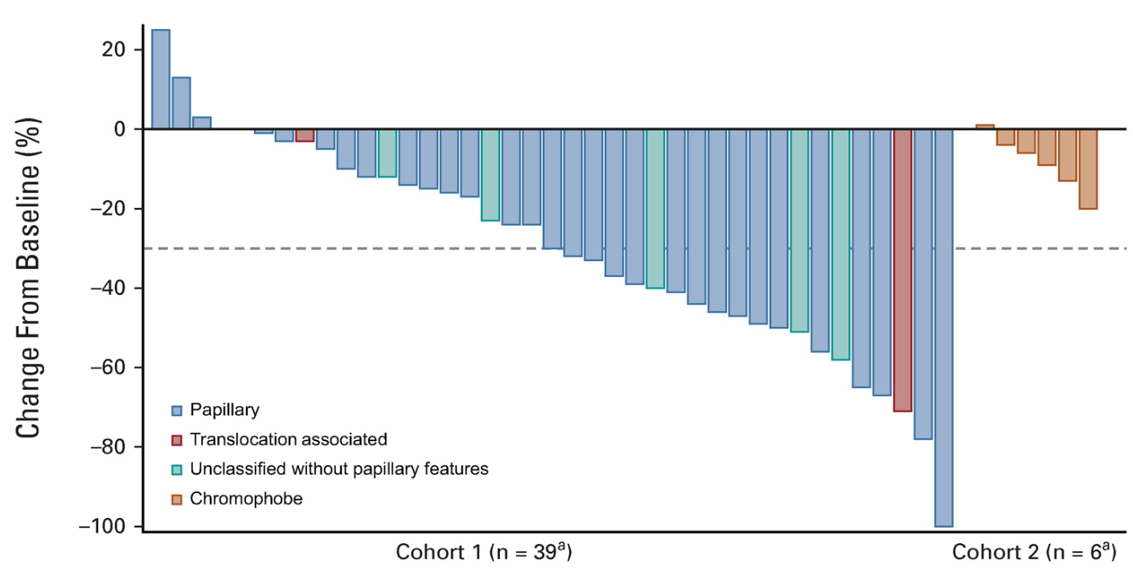
Papillary Renal Cell Carcinoma
What About Combination Therapy?
Cabozantinib/Atezolizumab
Cabozantinib/Nivolumab
RR in papillary RCC (n=32): 47%
RR in papillary RCC (n=15): 47%
Pal et al JCO 2021; Lee CH et al JCO 2022
Sumanta K. Pal, MD, FASCO

Slide 37
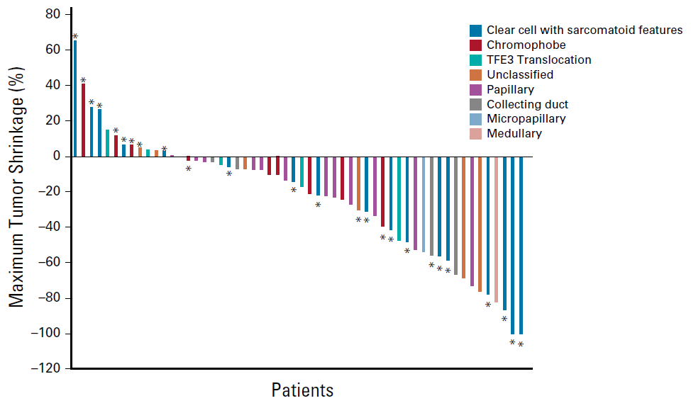
Papillary Renal Cell Carcinoma
Other Combination Therapies …
Bevacizumab/Atezolizumab
Lenvatinib/Pembrolizumab
Total (n=82) | Papillary (n=51)
ORR, % (95% CI) | 47.6 (36.4-58.9)
DCR, % (95% CI) | 79.3 (68.9-87.4)
RR in papillary RCC (n=12): 25%
McGregor et al JCO 2019; Albiges et al ESMO 2022 (Abstr 1448O)
Sumanta K. Pal, MD, FASCO

Slide 38
Summary
We have reached a bit of a plateau in drug development in renal cancer
There is active debate about
GOOD risk disease, The role of TKI and CTLA4
The VEGF TKIs are similar when sequenced after standard first line therapy
HIF-2A seems the most attractive new agent
Biomarker data has been inconclusive
New combinations appear active in papillary renal cancer

