Slide 1
Clinical Investigator Perspectives on the Most Relevant New Datasets and Advances in Oncology:
Bladder Cancer Edition
Matthew Milowsky, MD
George George Gabriel and Frances Gable Villere Distinguished Professor
Section Chief, Genitourinary Oncology

Slide 2
Pembro for BCG-unresponsive HR NMIBC: Cohort B results (KEYNOTE-057)
Necchi A et al. Genitourinary Cancers Symposium 2023;Abstract LBA442.
Notes:
BCG-unresponsive disease is defined as being at least one of the following: • Persistent or recurrent CIS alone or with recurrent Ta/T1 (noninvasive papillary disease/tumor invades the subepithelial connective tissue) disease within 12 months of completion of adequate BCG therapy • Recurrent high-grade Ta/T1 disease within 6 months of completion of adequate BCG therapy • T1 high-grade disease at the first evaluation following an induction BCG course (Steinberg et al. 2016) In this context, adequate BCG therapy is defined as at least one of the following: • At least five of six doses of an initial induction course plus at least two of three doses of maintenance therapy • At least five of six doses of an initial induction course plus at least two of six doses of a second induction course

Slide 3
Pembro for BCG-unresponsive HR NMIBC: Cohort B results (KEYNOTE-057)
Necchi A et al. Genitourinary Cancers Symposium 2023;Abstract LBA442.
Notes:
BCG-unresponsive disease is defined as being at least one of the following: • Persistent or recurrent CIS alone or with recurrent Ta/T1 (noninvasive papillary disease/tumor invades the subepithelial connective tissue) disease within 12 months of completion of adequate BCG therapy • Recurrent high-grade Ta/T1 disease within 6 months of completion of adequate BCG therapy • T1 high-grade disease at the first evaluation following an induction BCG course (Steinberg et al. 2016) In this context, adequate BCG therapy is defined as at least one of the following: • At least five of six doses of an initial induction course plus at least two of three doses of maintenance therapy • At least five of six doses of an initial induction course plus at least two of six doses of a second induction course

Slide 4
Pembro for BCG-unresponsive HR NMIBC: Cohort B results (KEYNOTE-057)
Necchi A et al. Genitourinary Cancers Symposium 2023;Abstract LBA442.
Notes:
BCG-unresponsive disease is defined as being at least one of the following: • Persistent or recurrent CIS alone or with recurrent Ta/T1 (noninvasive papillary disease/tumor invades the subepithelial connective tissue) disease within 12 months of completion of adequate BCG therapy • Recurrent high-grade Ta/T1 disease within 6 months of completion of adequate BCG therapy • T1 high-grade disease at the first evaluation following an induction BCG course (Steinberg et al. 2016) In this context, adequate BCG therapy is defined as at least one of the following: • At least five of six doses of an initial induction course plus at least two of three doses of maintenance therapy • At least five of six doses of an initial induction course plus at least two of six doses of a second induction course

Slide 5
Pembro for BCG-unresponsive HR NMIBC: Cohort B results (KEYNOTE-057)
Necchi A et al. Genitourinary Cancers Symposium 2023;Abstract LBA442.
Notes:
BCG-unresponsive disease is defined as being at least one of the following: • Persistent or recurrent CIS alone or with recurrent Ta/T1 (noninvasive papillary disease/tumor invades the subepithelial connective tissue) disease within 12 months of completion of adequate BCG therapy • Recurrent high-grade Ta/T1 disease within 6 months of completion of adequate BCG therapy • T1 high-grade disease at the first evaluation following an induction BCG course (Steinberg et al. 2016) In this context, adequate BCG therapy is defined as at least one of the following: • At least five of six doses of an initial induction course plus at least two of three doses of maintenance therapy • At least five of six doses of an initial induction course plus at least two of six doses of a second induction course

Slide 6
Pembro for BCG-unresponsive HR NMIBC: Cohort B results (KEYNOTE-057)
Necchi A et al. Genitourinary Cancers Symposium 2023;Abstract LBA442.
Notes:
BCG-unresponsive disease is defined as being at least one of the following: • Persistent or recurrent CIS alone or with recurrent Ta/T1 (noninvasive papillary disease/tumor invades the subepithelial connective tissue) disease within 12 months of completion of adequate BCG therapy • Recurrent high-grade Ta/T1 disease within 6 months of completion of adequate BCG therapy • T1 high-grade disease at the first evaluation following an induction BCG course (Steinberg et al. 2016) In this context, adequate BCG therapy is defined as at least one of the following: • At least five of six doses of an initial induction course plus at least two of three doses of maintenance therapy • At least five of six doses of an initial induction course plus at least two of six doses of a second induction course

Slide 7
Pembro for BCG-unresponsive HR NMIBC: Cohort B results (KEYNOTE-057)
Necchi A et al. Genitourinary Cancers Symposium 2023;Abstract LBA442.
Notes:
BCG-unresponsive disease is defined as being at least one of the following: • Persistent or recurrent CIS alone or with recurrent Ta/T1 (noninvasive papillary disease/tumor invades the subepithelial connective tissue) disease within 12 months of completion of adequate BCG therapy • Recurrent high-grade Ta/T1 disease within 6 months of completion of adequate BCG therapy • T1 high-grade disease at the first evaluation following an induction BCG course (Steinberg et al. 2016) In this context, adequate BCG therapy is defined as at least one of the following: • At least five of six doses of an initial induction course plus at least two of three doses of maintenance therapy • At least five of six doses of an initial induction course plus at least two of six doses of a second induction course

Slide 8
Pembro for BCG-unresponsive HR NMIBC: Cohort B results (KEYNOTE-057)
Necchi A et al. Genitourinary Cancers Symposium 2023;Abstract LBA442.
Notes:
BCG-unresponsive disease is defined as being at least one of the following: • Persistent or recurrent CIS alone or with recurrent Ta/T1 (noninvasive papillary disease/tumor invades the subepithelial connective tissue) disease within 12 months of completion of adequate BCG therapy • Recurrent high-grade Ta/T1 disease within 6 months of completion of adequate BCG therapy • T1 high-grade disease at the first evaluation following an induction BCG course (Steinberg et al. 2016) In this context, adequate BCG therapy is defined as at least one of the following: • At least five of six doses of an initial induction course plus at least two of three doses of maintenance therapy • At least five of six doses of an initial induction course plus at least two of six doses of a second induction course

Slide 9
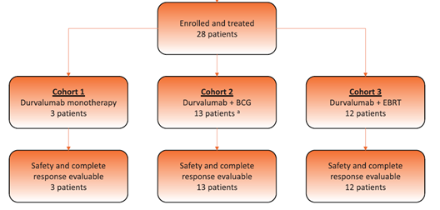
Phase 1 trial of Durvalumab plus BCG or EBRT in BCG-unresponsive NMIBC: HCRN GU16-243 ADAPT-BLADDER
Cohort 1: 1120 mg of D intravenously every 3 wk for maximum of eight cycles.
Cohort 2: D + BCG patients also received full-dose intravesical BCG weekly for 6 wk with BCG maintenance recommended.
Cohort 3: D + EBRT patients received concurrent EBRT (6 Gy 3 in cycle 1 only)
Post-treatment cystoscopy/urine cytology at 3 and 6 mo, with bladder biopsies required at 6 mo.
Hahn NM et al. Eur Urol, 2023. Online ahead of print.
Notes:
All patients received 1120 mg of D intravenously every 3 wk for a maximum of eight cycles. D + BCG patients received concurrent full dose (50 mg wet weight, 8 108 colony forming units) intravesical TICE strain
BCG weekly for the first 6 consecutive weeks. Maintenance BCG treatments according to the SWOG 8507 schedule were strongly recommended but not mandated [16]. D + EBRT patients received concurrent
EBRT to the bladder only (pelvic nodes excluded) consisting of 6 Gy fractions delivered on days 1, 3, and 5 during the first cycle of therapy only.
For the purposes of this guidance, BCG-unresponsive disease is defined as being at least one of the following: • Persistent or recurrent CIS alone or with recurrent Ta/T1 (noninvasive papillary disease/tumor invades the subepithelial connective tissue) disease within 12 months of completion of adequate BCG therapy • Recurrent high-grade Ta/T1 disease within 6 months of completion of adequate BCG therapy • T1 high-grade disease at the first evaluation following an induction BCG course (Steinberg et al. 2016) In this context, adequate BCG therapy is defined as at least one of the following: • At least five of six doses of an initial induction course plus at least two of three doses of maintenance therapy • At least five of six doses of an initial induction course plus at least two of six doses of a second induction course

Slide 10
Toxicity and Efficacy
- 8 (29%) pts across all cohorts
experienced grade 3-4 events
- 4 (14%) pts with dose delays due to
toxicity
4 (14%) discontinued D due to tox
prior to completion of all cycles
- CRs in nearly 2/3 pts across both
combination therapy cohorts
- 12-mo CR 73% in D + BCG cohort
Hahn NM et al. Eur Urol, 2023. Online ahead of print.
Notes:
No association between high PD-L1 expression and durable CR at 12 months seen (20% with high PD-L1).

Slide 11
Conclusions: ADAPT BLADDER
Feasible, safe in BCG-unresponsive NMIBC
Encouraging preliminary efficacy seen
Novel MA-MS ADAPT-BLADDER trial design facilitates rapid evaluation of novel therapies
Justification for further study of combination approaches to BCG-unresponsive NMIBC
Hahn NM et al. Eur Urol, 2023. Online ahead of print.

Slide 12
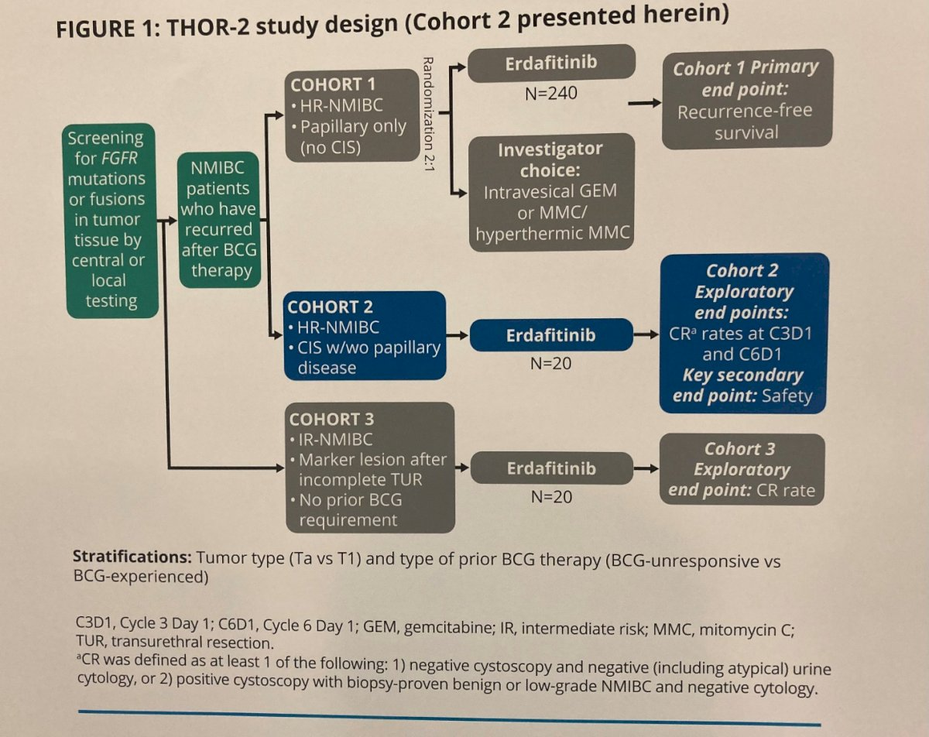
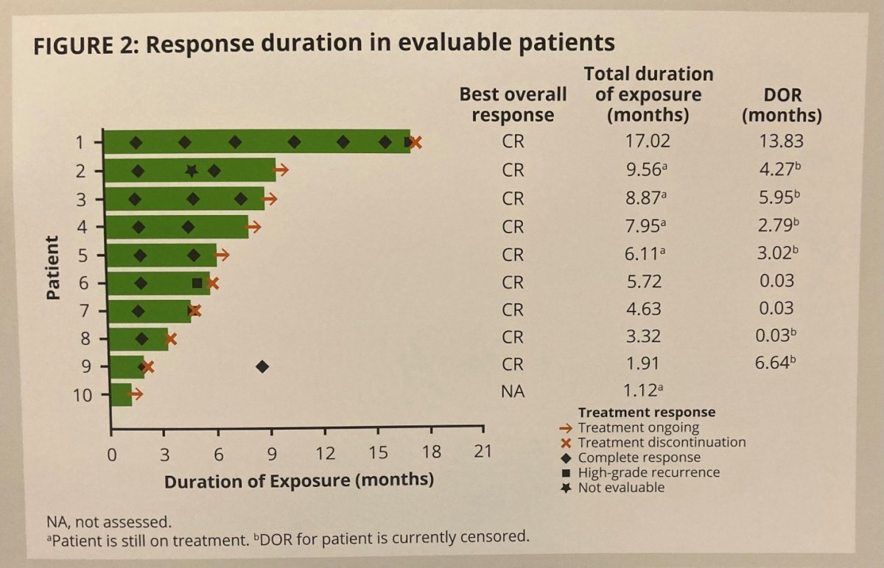
THOR-2 Cohort 2 Interim Analyses
Catto J et al. Genitourinary Cancers Symposium 2023;Abstract 503.

Slide 13
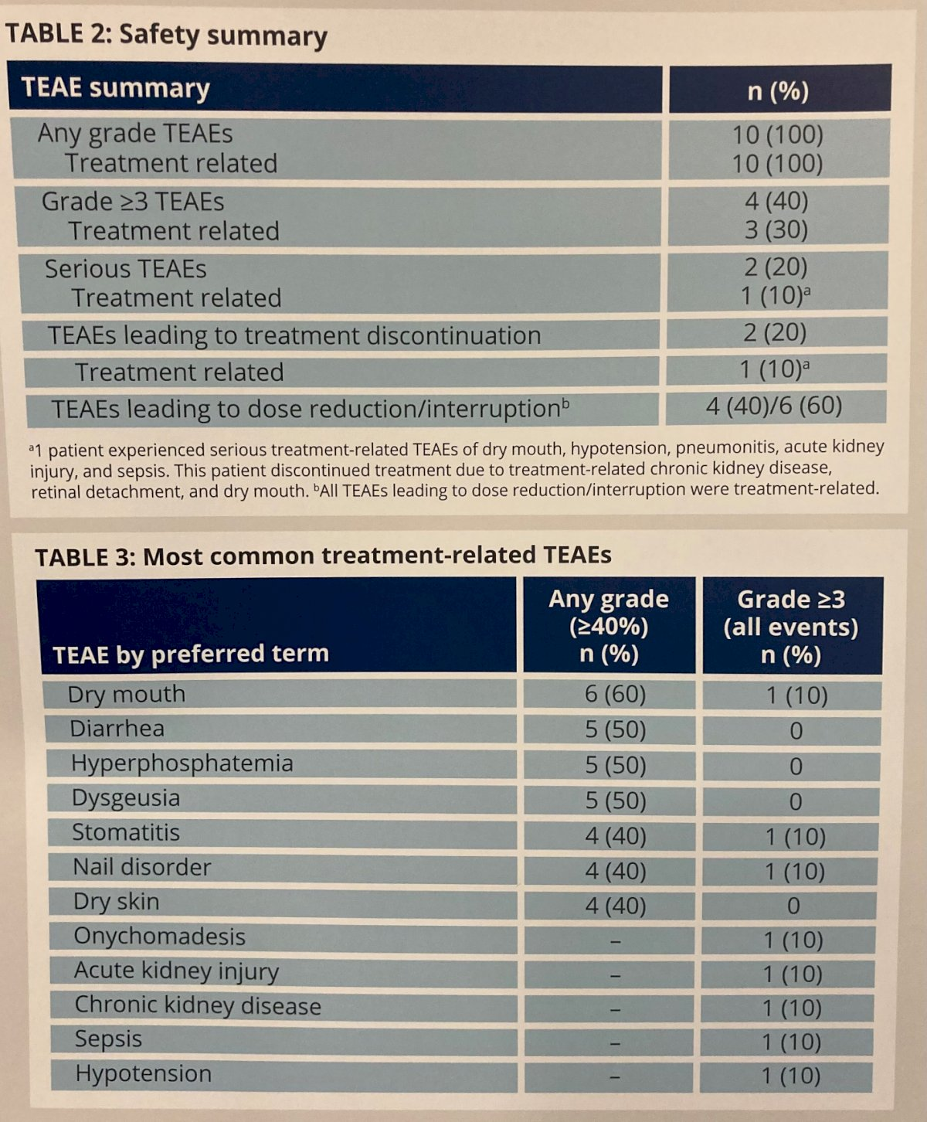
THOR-2 Cohort 2 Interim Analyses
Efficacy observed with erdafitinib in patients
with HR-NMIBC
Toxicity c/w known side effect profile of
erdafitinib
Risk/benefit in NMIBC c/w more advanced
disease
Catto J et al. Genitourinary Cancers Symposium 2023;Abstract 503.

Slide 14
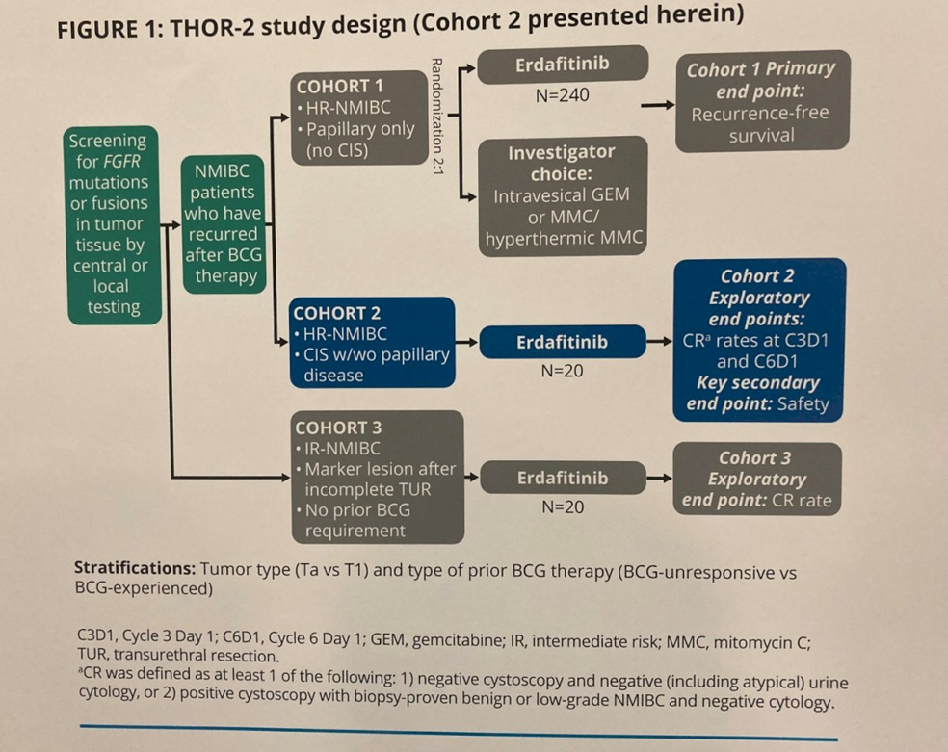
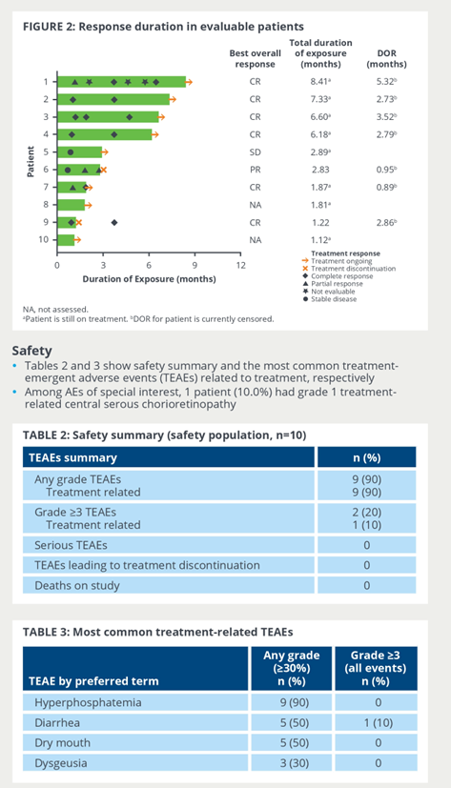
THOR-2 Cohort 3 Interim Analyses
Recurrent IR, all prior tumors low grade (G1-2),
Ta/T1, no prior CIS, progression prob < 5%, recurrence prob > 50%.
Daneshmad et al. Genitourinary Cancers Symposium 2023;Abstract 504.
Notes:
CR rate 75%. All Ta.

Slide 15
Safety, tolerability, and efficacy of a neoadjuvant gemcitabine intravesical drug delivery system (TAR-200) in MIBC: A phase I trial.
Daneshmad S et al. Urol Oncol. 2022;40(7):344.e1-344.e9
Notes:
Fig. 1. TAR-200, a gemcitabine-releasing intravesical system, forming a “pretzel”-like configuration within the bladder. TAR-200 consists of a small, flexible silicone tube filled with gemcitabine (A), designed to release drug directly inside the bladder over the indwelling period (B), and inserted using a TARIS® urinary placement catheter (benchtop illustration) (C).
Refused or ineligible to receive CDDP based NAC.
Patients received two 7-day cycles of intravesical GEM by TAR-200 prior to RC

Slide 16
Conclusions: Phase I Study of TAR-200 in MIBC
Current treatments for MIBC are underutilized
TAR-200 is a novel intravesical gemcitabine delivery system
TAR-200 is safe and well tolerated in patients with MIBC prior to radical cystectomy
Neoadjuvant TAR-200 demonstrated antitumor activity in this phase I study
Daneshmad S et al. Urol Oncol. 2022;40(7):344.e1-344.e9

Slide 17
TPS: Neoadjuvant TAR-200 plus cetrelimab or cetrelimab alone for MIBC
Psutka S et al. Genitourinary Cancers Symposium 2023;Abstract TPS584.

Slide 18
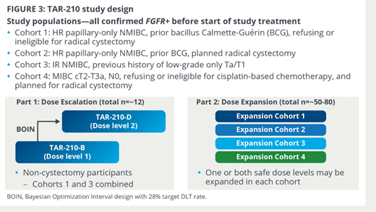
TPS: Safety and efficacy of TAR-210 (Erdafitinib) in NMIBC/MIBC
Vilaseca et al. Genitourinary Cancers Symposium 2023;Abstract TPS583.

Slide 19
Extended follow up results from CheckMate 274 trial
Galsky et al. Genitourinary Cancers Symposium 2023;Abstract LBA443.

Slide 20
Extended follow up results from CheckMate 274 trial
Galsky et al. Genitourinary Cancers Symposium 2023;Abstract LBA443.

Slide 21
Extended follow up results from CheckMate 274 trial
Galsky et al. Genitourinary Cancers Symposium 2023;Abstract LBA443.

Slide 22
Extended follow up results from CheckMate 274 trial
Galsky et al. Genitourinary Cancers Symposium 2023;Abstract LBA443.

Slide 23
Extended follow up results from CheckMate 274 trial
Galsky et al. Genitourinary Cancers Symposium 2023;Abstract LBA443.

Slide 24
Extended follow up results from CheckMate 274 trial
Galsky et al. Genitourinary Cancers Symposium 2023;Abstract LBA443.

Slide 25
IMvigor130 study: Final OS analysis of Atezo vs chemo in untreated la/mUC
Bamias et al. Genitourinary Cancers Symposium 2023;Abstract LBA441.

Slide 26
IMvigor130 study: Final OS analysis of Atezo vs chemo in untreated la/mUC
Bamias et al. Genitourinary Cancers Symposium 2023;Abstract LBA441.

Slide 27
IMvigor130 study: Final OS analysis of Atezo vs chemo in untreated la/mUC
Bamias et al. Genitourinary Cancers Symposium 2023;Abstract LBA441.

Slide 28
IMvigor130 study: Final OS analysis of Atezo vs chemo in untreated la/mUC
Bamias et al. Genitourinary Cancers Symposium 2023;Abstract LBA441.

Slide 29
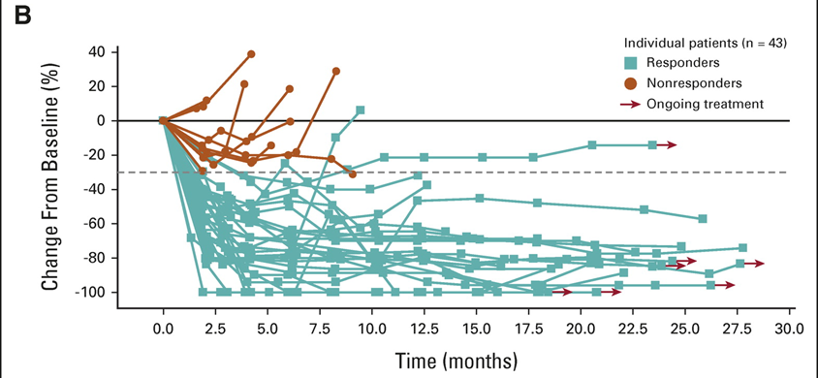
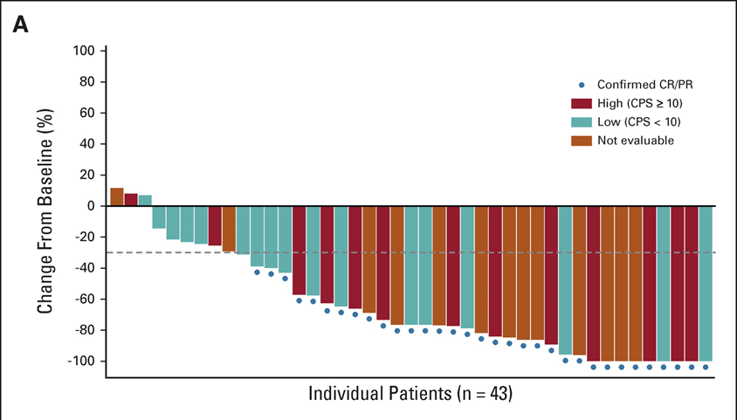
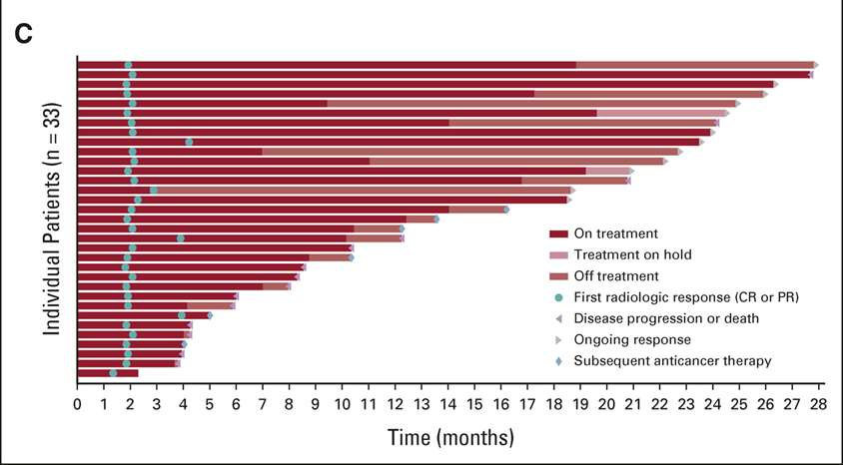
Enfortumab vedotin plus pembrolizumab in previously untreated advanced urothelial cancer (EV-103 Cohort A).
Phase Ib/II, multicenter, open-label study, 1L cisplatin-ineligible patients with la/mUC
EV 1.25 mg/kg once daily on days 1 and 8 and P 200 mg (day 1) IV once daily in 3-wk cycles.
Primary end point was safety.
Key secondary end points included cORR, DOR, and OS.
cORR 73.3% (CR 15.6%)
Hoimes CJ et al. J Clin Oncol. 2023;41(1):22-31.

Slide 30
Enfortumab vedotin plus pembrolizumab in previously untreated advanced urothelial cancer (EV-103 Cohort A).
Most common treatment-related adverse events (TRAEs): peripheral sensory neuropathy (55.6%), fatigue (51.1%), and alopecia (48.9%).
Twenty-nine patients (64.4%) had grade 3 or higher TRAEs; the most common were increased lipase (17.8%), maculopapular rash (11.1%), and fatigue (11.1%).
Hoimes CJ et al. J Clin Oncol. 2023;41(1):22-31.

Slide 31
EV-103 Cohort K: Subgroup analysis of cORR
Milowsky M et al. Genitourinary Cancers Symposium 2023;Abstract 439.

Slide 32
EV-103 Cohort K: EV mono or EV+P in previously untreated cisplatin-ineligible pts with la/mUC
 | EV+P^{b} (n=76) | EV mono^{b} (n=73)
cORR, n (% ) (95% CI) | 49 (64.5) (52.7-75.1) | 33 (45.2) (33.5-57.3)
Median time to objective response (range), mo | 2.07 (1.1-6.6) | 2.07 (1.9-15.4)
Median number of treatment cycles (range) | 11.0 (1-29) | 8.0 (1-33)
100
PD-L1 Score
80
High (CPS ≥10)
Low (CPS <10)
60
Not evaluable
Best overall response
97.1% of assessable patients had tumor reduction
Confirmed CR/PR
40
20
0
Tumor size (% change from baseline)
EV+P
42/49 (85.7%) of responses observed at first assessment (week 9±1 week)
Most common AEs were fatigue, peripheral sensory neuropathy, alopecia, and maculopapular rash
EV mono
Activity is consistent with prior results in 2L+ la/mUC
Safety profile consistent with previous studies
–20
–40
–60
–80
–100
EV+P (n=69)ª
Data cutoff: 10 Jun 2022.
ªOf 76 patients in the EV+P arm, seven patients were not assessable due to non-measurable disease (n=4), post-baseline assessment that was not evaluable (n=2), and lack of post-baseline assessment (n=1).
^{b}There were no formal statistical comparisons between treatment arms.
2L, second-line; AEs, adverse events; BICR, blinded independent central review; CI, confidence interval; cORR: confirmed objective response rate; CPS, combined positive score; CR, complete response; EV, enfortumab vedotin; la/mUC, locally advanced/metastatic urothelial cancer; mono, monotherapy; NR, not reached; P, pembrolizumab; PD-L1, programmed death-ligand-1; PR, partial response; TRAEs, treatment-related adverse events.
Previously presented at ESMO 2022, Rosenberg et al. Study EV-103 Cohort K: Antitumor activity of enfortumab vedotin (EV) monotherapy or in combination with pembrolizumab (P) in previously untreated cisplatin-ineligible patients (pts) with locally advanced or metastatic urothelial cancer (la/mUC).
Rosenberg J et al. ESMO 2022; LBA73.

Slide 33
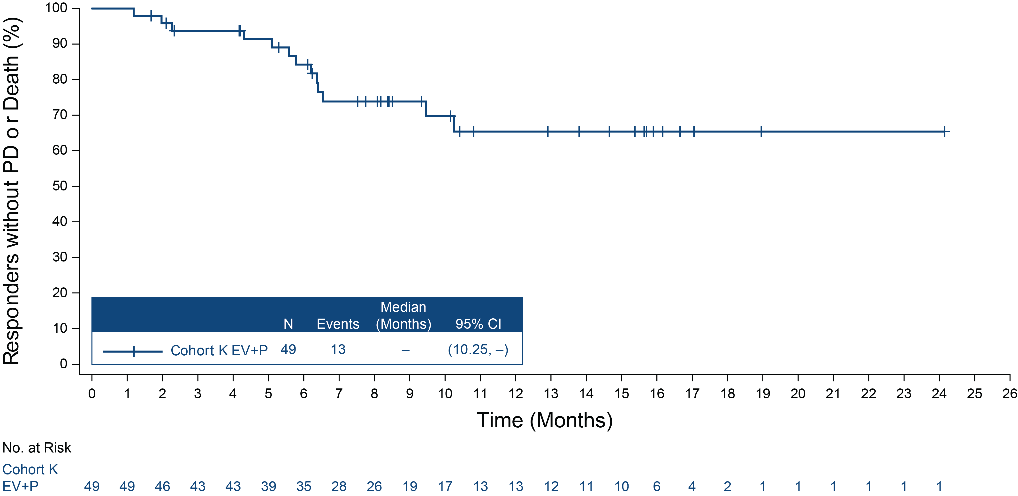
EV-103 Cohort K: EV mono or EV+P in previously untreated cisplatin-ineligible pts with la/mUC
Median DOR for EV+P was not reached; 65.4% of responders were still responding at 12 months
 | EV+P (N=76) | EV Mono (N=73)
Responders, n | 49 | 33
Progression events, n | 13 | 14
mDOR (95% CI), mos | - (10.25, -) | 13.2 (6.14, 15.97)
DOR ≥12 mos, % | 65.4% | 56.3%
Rosenberg J et al. ESMO 2022; LBA73.

Slide 34
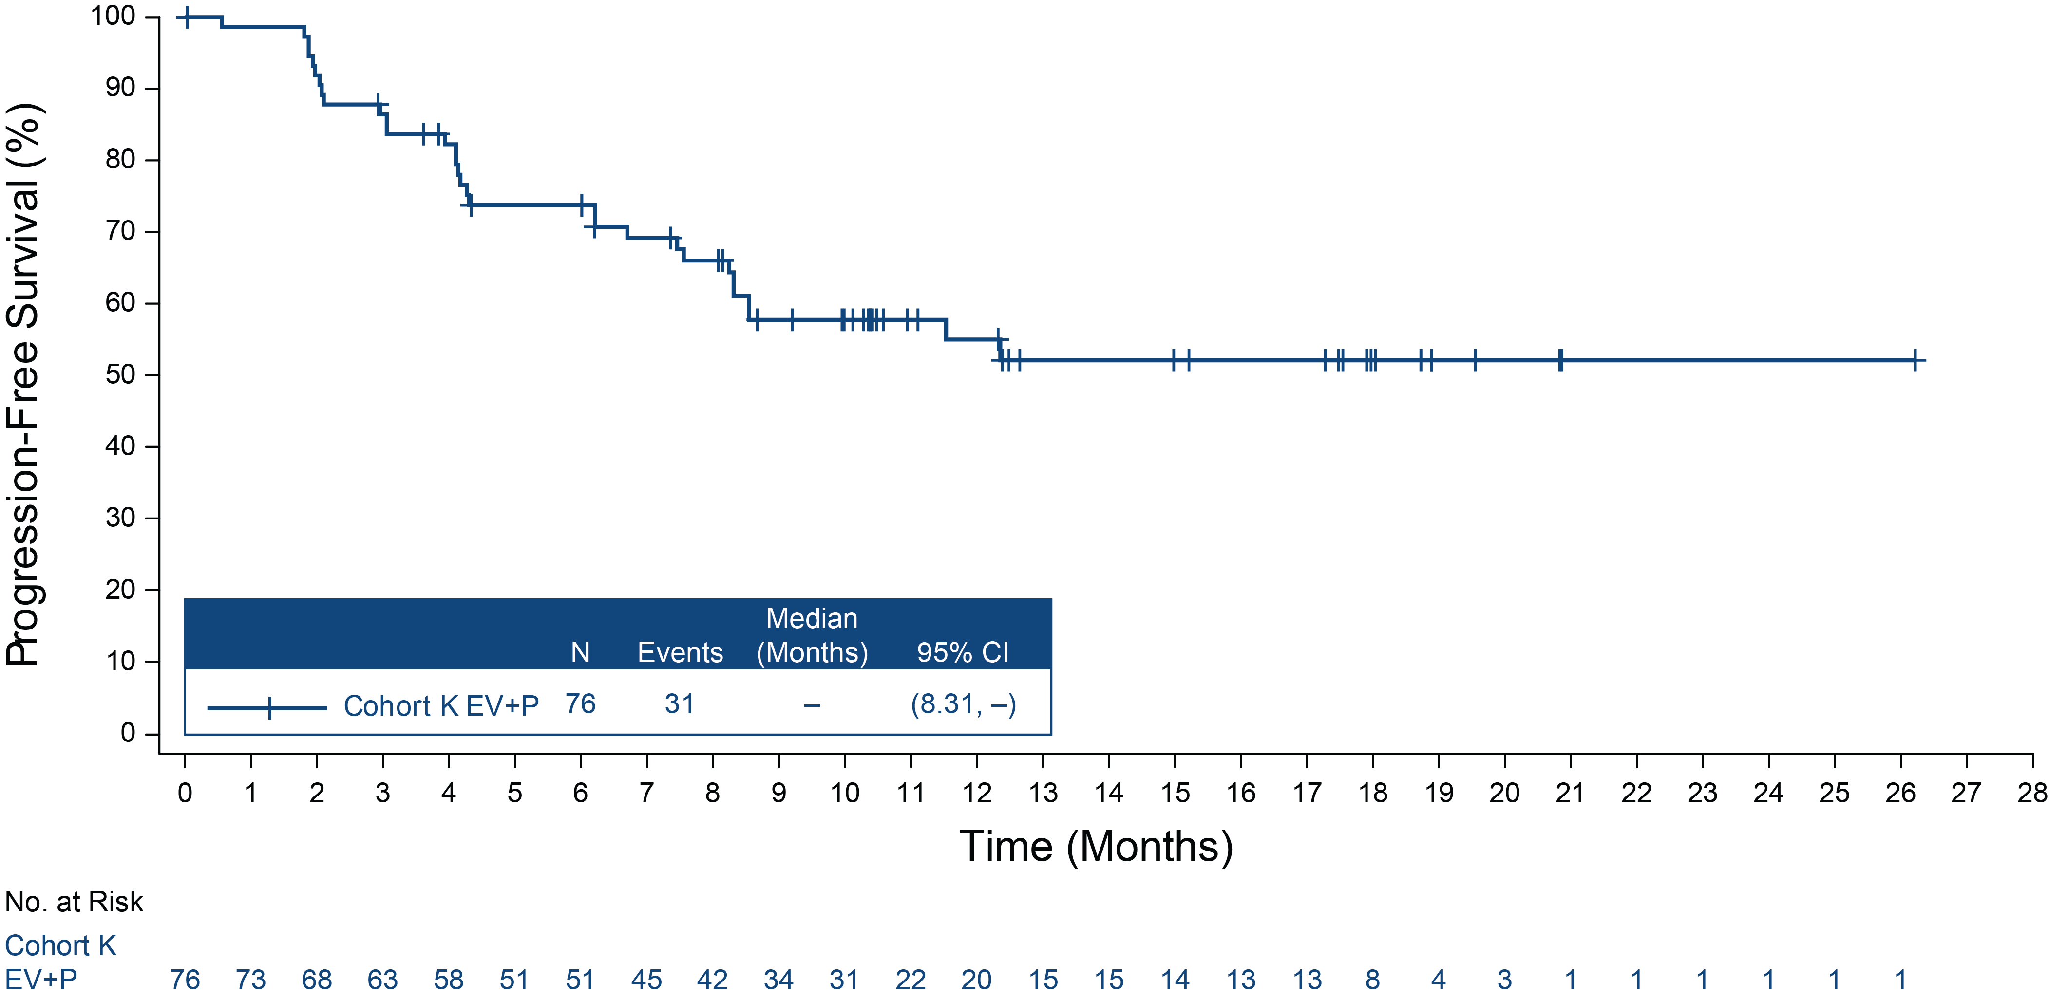
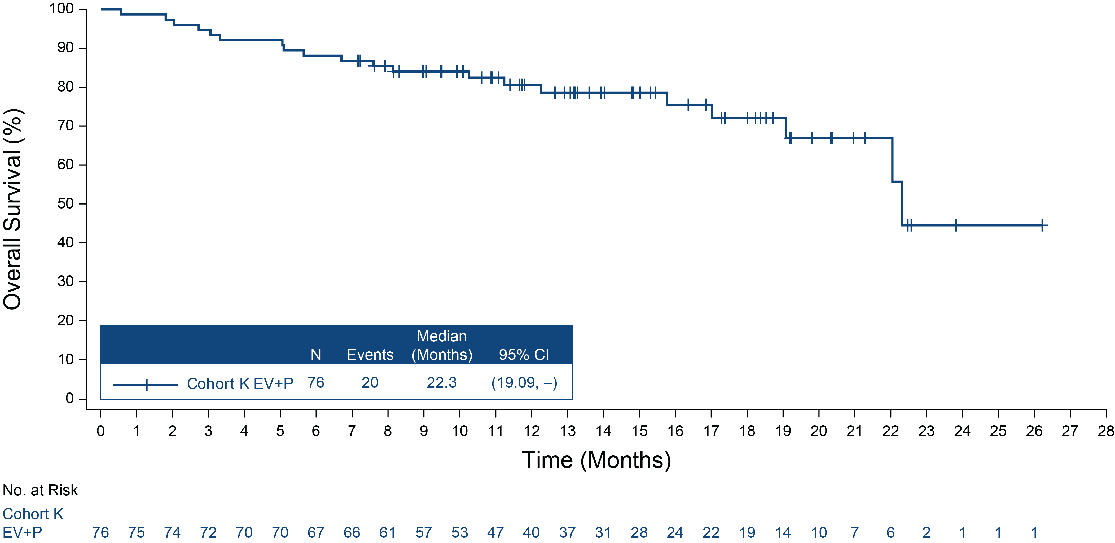
EV-103 Cohort K: EV mono or EV+P in previously untreated cisplatin-ineligible pts with la/mUC
Encouraging PFS and OS for EV+P with data expected to continue to evolve with follow-up
 | EV+P (N=76) | EV Mono (N=73)
PFS events, n | 31 | 38
mPFS (95% CI), mos | - (8.31, -) | 8.0 (6.05, 10.35)
PFS at 12 mos, % | 55.1% | 35.8%
 | EV+P (N=76) | EV Mono (N=73)
OS Events, n | 20 | 26
mOS (95% CI), mos | 22.3 (19.09, -) | 21.7 (15.21, -)
OS at 12 mos, % | 80.7% | 70.7%
Median follow-up time, mos | 14.8 | 15.0
Rosenberg J et al. ESMO 2022; LBA73.
Notes:
EV+P is being further investigated in three ongoing phase 3 trials in 1L la/mUC (EV-302) and MIBC (KN-B15 and KN-905)

Slide 35
EV-103 Cohort K: Subgroup analysis of cORR
O’Donnell P et al. Genitourinary Cancers Symposium 2023;Abstract 499.

Slide 36
EV-103 Cohort K PROs
Milowsky M et al. Genitourinary Cancers Symposium 2023;Abstract 439.

Slide 37
EV-103 Cohort K PROs
Milowsky M et al. Genitourinary Cancers Symposium 2023;Abstract 439.

Slide 38
EV-103 Cohort K PROs
Milowsky M et al. Genitourinary Cancers Symposium 2023;Abstract 439.

Slide 39
EV-103 Cohort K PROs
Milowsky M et al. Genitourinary Cancers Symposium 2023;Abstract 439.

Slide 40
Long-term outcomes in EV-301: 24-month findings from the phase 3 trial of enfortumab vedotin versus chemotherapy in previously treated advanced UC
Rosenberg J et al. ASCO 2022; Abstract 4516.

Slide 41
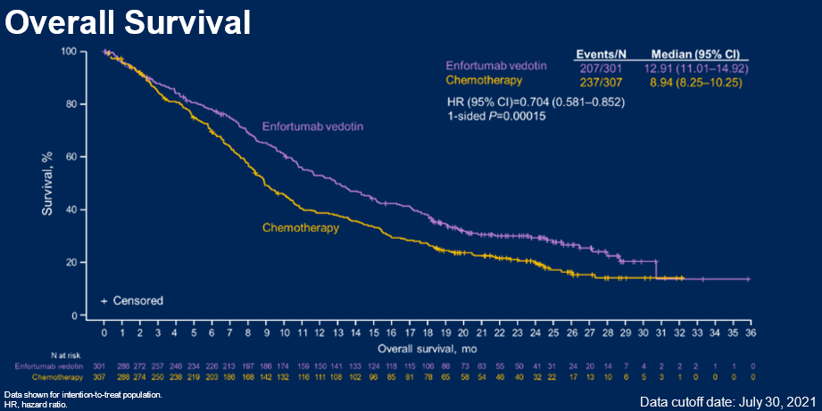
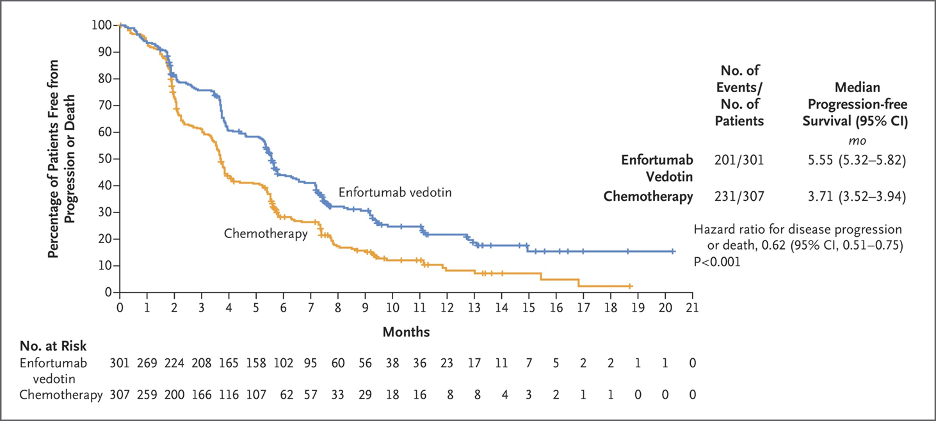
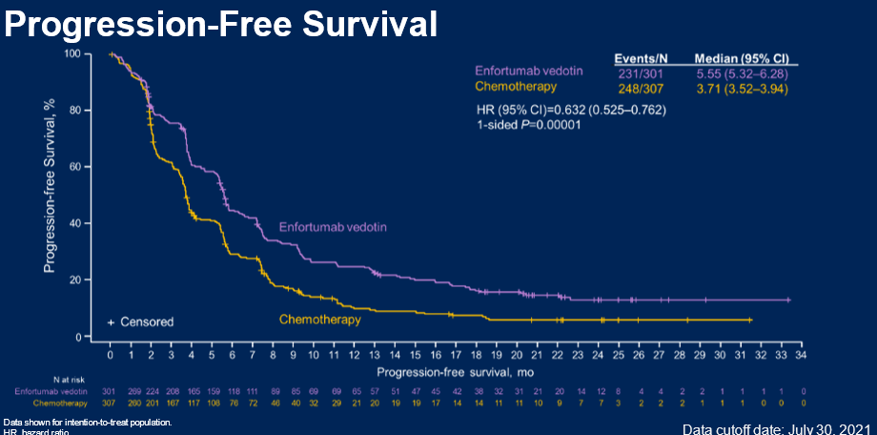
Median Follow-Up 11.1 months
Median Follow-Up ~ 24 months
Median OS (95% CI) mo
12.88 (10.58-15.21)
8.97 (8.05-10.74)
HR, 0.70 (95% CI, 0.56-0.89)
P=0.001
Median OS (95% CI) mo
12.91 (11.01-14.92)
8.94 (8.25-10.25)
HR, 0.70 (95% CI, 0.58-0.86)
P=0.00015
Median PFS (95% CI) mo
5.55 (5.32-5.82)
3.71 (3.52-3.94)
HR, 0.62 (95% CI, 0.51-0.75)
P<0.001
Median PFS (95% CI) mo
5.55 (5.32-6.28)
3.71 (3.52-3.94)
HR, 0.63 (95% CI, 0.53-0.76)
P=0.00001
Powles T et al. N Engl J Med 2021;384:1125-1135
Rosenberg J et al. ASCO 2022; Abstract 4516.
Powles T et al. N Engl J Med. 2021

Slide 42
Efficacy and safety of erdafitinib in patients with locally advanced or metastatic urothelial carcinoma: Long-term follow-up of a phase 2 study
Erdafitinib: oral pan-FGFR (1-4) inhibitor
Patients with metastatic UC and FGFR mutation or fusion (prevalence in metastatic UC: 15% to 20%)
At least 1 prior systemic therapy; prior ICI allowed
Median OS: 13.8 mos (95% CI: 9.8-NR)
100
200
ORR (primary endpoint): 40%
80
100
FGFR mutation FGFR fusion
60
50
OS (%)
Maximal Reduction From Baseline
40
0
20
-50
Deaths n = 40
0
-100
0
3
6
9
12
15
18
Patient
Mos
Siefker-Radtke A et al. Lancet Oncol 2022;23(2):248-58.
Siefker-Radtke. ASCO 2018. Abstr 4503.
Loriot. NEJM. 2019;381:338.

Slide 43
Efficacy and safety of erdafitinib in patients with locally advanced or metastatic urothelial carcinoma: Long-term follow-up of a phase 2 study
PFS
OS
100
8 mg
100
8 mg
Median PFS, all patients: 5.5 mos
R/R after chemo: 5.5 mos
Prior immunotherapy: 5.7 mos
1/2/3 prior lines: 5.5/5.5/5.7 mos
Median OS, all patients: 11.3 mos
R/R after chemo: 10.6 mos
Prior immunotherapy: 10.9 mos
1/2/3 prior lines: 11.3/8.0/11.2 mos
80
80
60
60
PFS (%)
OS (%)
40
40
20
20
0
0
0
3
6
9
12
15
18
21
24
27
30
33
0
3
6
9
12
15
18
21
24
27
30
33
36
Mos
Mos
Patients at Risk, n
Patients at Risk, n
101
67
39
26
19
14
10
8
4
1
1
0
101
90
76
60
46
37
33
30
28
15
8
1
0
Siefker-Radtke A et al. Lancet Oncol 2022;23(2):248-58.
Siefker-Radtke. ASCO 2020. Abstr 5015.

Slide 44
Efficacy and safety of erdafitinib in patients with locally advanced or metastatic urothelial carcinoma: Long-term follow-up of a phase 2 study
TRAEs in > 20% of Patients, n (%) | Erdafitinib 8 mg QD (N = 99)
 | Any Grade | Grade 3
Hyperphosphatemia | 72 (73) | 2 (2)
Stomatitis | 54 (55) | 9 (9)
Dry mouth | 43 (43) | 0
Diarrhea | 37 (37) | 4 (4)
Dysgeusia | 35 (35) | 1 (1)
Dry skin | 32 (32) | 0
Alopecia | 27 (27) | 0
Decreased appetite | 25 (25) | 0
Hand–foot syndrome | 22 (22) | 5 (5)
Fatigue | 21 (21) | 2 (2)
TRAEs of Special Interest or Clinical Importance, n (%)^{[1]} | Erdafitinib 8 mg QD (n = 99)
 | Any Grade | Grade ≥ 3
Hyperphosphatemia | 72 (73) | 2 (2)
Skin events Dry skin Hand–foot syndrome | 48 (49) 32 (32) 22 (22) | 6 (6) 0 5 (5)
Nail events Onycholysis Paronychia Nail dystrophy | 51 (52) 16 (16) 14 (14) 16 (16) | 14 (14) 2 (2) 3 (3) 6 (6)
Ocular events CSR Non-CSR events* | 21 (21) 51 (52) | 3 (3) 5 (5)
*Most common non-CSR events: dry eye, 19%; blurry vision, 16%; increased lacrimation, 11%; conjunctivitis, 9%.
Siefker-Radtke. ASCO 2018.

Slide 45
TROPHY-U-01: Sacituzumab govitecan in platinum-ineligible pts with mUC that progressed after prior checkpoint inhibitor
Petrylak D et al. Genitourinary Cancers Symposium 2023;Abstract 520.

Slide 46
TROPHY-U-01: Sacituzumab govitecan in platinum-ineligible pts with mUC that progressed after prior checkpoint inhibitor
Petrylak D et al. Genitourinary Cancers Symposium 2023;Abstract 520.

Slide 47
TROPHY-U-01: Sacituzumab govitecan in platinum-ineligible pts with mUC that progressed after prior checkpoint inhibitor
Petrylak D et al. Genitourinary Cancers Symposium 2023;Abstract 520.

Slide 48
TROPHY-U-01: Sacituzumab govitecan in platinum-ineligible pts with mUC that progressed after prior checkpoint inhibitor
Petrylak D et al. Genitourinary Cancers Symposium 2023;Abstract 520.

Slide 49
TROPHY-U-01: Sacituzumab govitecan in platinum-ineligible pts with mUC that progressed after prior checkpoint inhibitor
Petrylak D et al. Genitourinary Cancers Symposium 2023;Abstract 520.

Slide 50
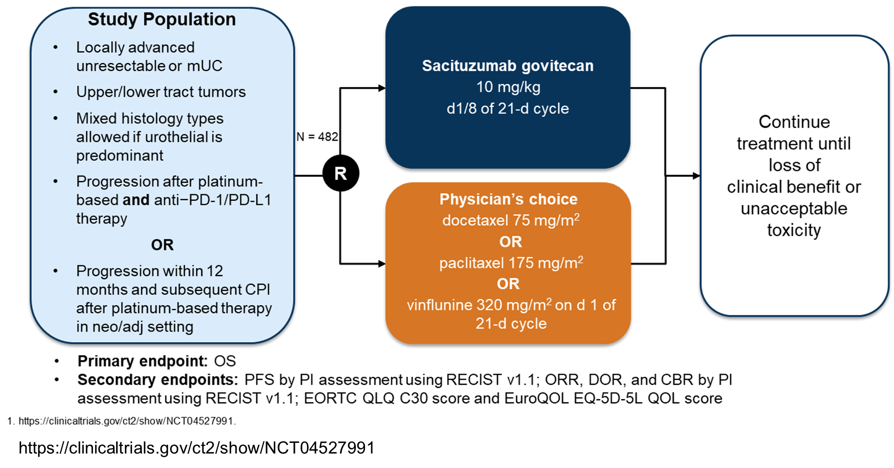
Phase 3 TROPICS-04 study (NCT04527991)

Slide 51
Durvalumab plus olaparib in previously untreated, platinum-ineligible patients with metastatic urothelial carcinoma: A multicenter, randomized, Phase II trial (BAYOU)
Homologous recombination repair gene mutations (HRRm) are common in UC, rendering tumor cells sensitive to PARP inhibition.
Randomized, multicenter, double-blind, phase II trial enrolled untreated, platinum-ineligible patients with mUC.
Patients (N = 154) were randomly assigned 1:1 to receive durvalumab (1,500 mg intravenously once every 4 weeks) plus olaparib (300 mg orally, twice daily) or durvalumab plus placebo.
The primary end point was progression-free survival (PFS) assessed by investigators per RECIST version 1.1. Secondary end points included overall survival in all patients and PFS in patients with HRRm.
Rosenberg et al. J Clin Oncol. 2023;41(1)43-53.

Slide 52
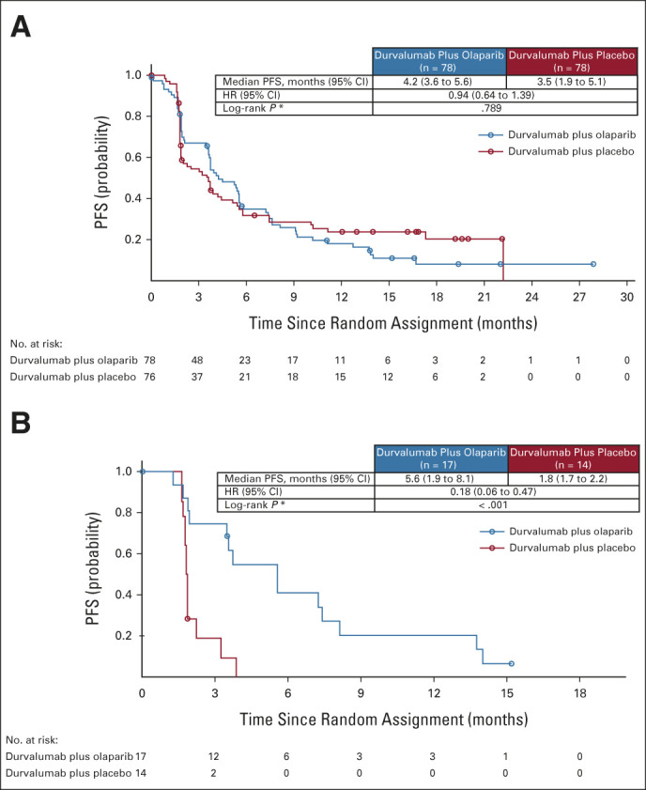
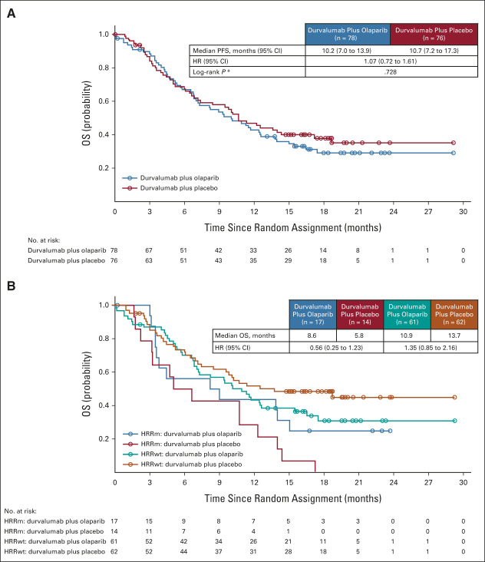
Durvalumab plus olaparib in previously untreated, platinum-ineligible patients with metastatic urothelial carcinoma: A multicenter, randomized, Phase II trial (BAYOU)
Median OS, months (95% CI)
ITT
HRRm
Rosenberg et al. J Clin Oncol. 2023;41(1)43-53.
Notes:
Some of the most common genetic abnormalities in mUC are alterations in DNA damage response (DDR) genes, such as mutations in homologous recombination repair (HRR) genes (eg, BRCA1 and BRCA2),^{6,7} with an overall mutation frequency of approximately 24%.
Adding olaparib to durvalumab did not improve survival outcomes in an unselected mUC population. Efficacy outcomes with durvalumab were similar to those reported for other anti–programmed cell death-1/programmed cell death ligand-1 agents. However, the results of secondary analyses suggest a potential role for PARP inhibition in patients with UC harboring HRRm.

Slide 53
RC-48 ADC
Galsky, M. ASCO Annual Meeting 2022

Slide 54
HER2 ADCs
Galsky, M. ASCO Annual Meeting 2022

Slide 55
RC48 in HER2 2-3+ mUC
RC48 active in HER2 2-3+ mUC (#4520 – Sheng et al)
Sheng et al. J Clin Oncol 40, 2022 (suppl 16; abstr 4520)

Slide 56
RC48 in HER2 1+ mUC
Xu et al. J Clin Oncol 40, 2022 (suppl 16; abstr 4519)

Slide 57
RC48 plus Toripalimab (anti-PD-1)
RC48 + Toripalimab (#4518 – Sheng et al)
Sheng et al. J Clin Oncol 40, 2022 (suppl 16; abstr 4518)

Slide 58
Is there something special about MMAE?
Galsky, M. ASCO Annual Meeting 2022

Slide 59
Thank you for your attention

