Slide 1
Meet The Professor Current and Future Management of Non-Small Cell Lung Cancer with an EGFR Mutation
Pasi A Jänne, MD, PhD Director, Lowe Center for Thoracic Oncology Professor of Medicine, Harvard Medical School
Director, Robert and Renée Belfer Center for Applied Cancer Sciences Director, Chen-Huang Center for EGFR-Mutant Lung Cancers Dana-Farber Cancer Institute Boston, Massachusetts

Slide 2
Meet The Professor Program Participating Faculty
Pasi A Jänne, MD, PhD Director, Lowe Center for Thoracic Oncology
Professor of Medicine, Harvard Medical School Director, Robert and Renée Belfer Center for Applied Cancer Sciences
Director, Chen-Huang Center for EGFR-Mutant Lung Cancers
Dana-Farber Cancer Institute
Boston, Massachusetts
Gregory J Riely, MD, PhD
Attending
Memorial Sloan Kettering Cancer Center
New York, New York
Lecia V Sequist, MD, MPH Director, Center for Innovation in Early Cancer Detection Massachusetts General Hospital Cancer Center The Landry Family Professor of Medicine Harvard Medical School Boston, Massachusetts
Joel W Neal, MD, PhD Associate Professor of Medicine Division of Oncology, Department of Medicine Stanford Cancer Institute Stanford University Palo Alto, California
David R Spigel, MD
Chief Scientific Officer
Sarah Cannon Research Institute
Nashville, Tennessee
David Planchard, MD, PhD
Head of Thoracic Cancer Group
Department of Medical Oncology
Thoracic Group
Gustave Roussy
Villejuif, France
MODERATOR
Neil Love, MD Research To Practice

Slide 3
Commercial Support
This activity is supported by educational grants from AstraZeneca Pharmaceuticals LP, Daiichi Sankyo Inc, and Janssen Biotech Inc, administered by Janssen Scientific Affairs LLC.
Research To Practice CME Planning Committee Members, Staff and Reviewers
Planners, scientific staff and independent reviewers for Research To Practice have no relevant conflicts of interest to disclose.

Slide 4
Dr Jänne — Disclosures
Consulting Agreements | AbbVie Inc, ACEA Biosciences Inc, Accutar Biotech, Allorion Therapeutics, Araxes Pharma, AstraZeneca Pharmaceuticals LP, Bayer HealthCare Pharmaceuticals, Biocartis, Boehringer Ingelheim Pharmaceuticals Inc, Chugai Pharmaceutical Co Ltd, Daiichi Sankyo Inc, Eisai Inc, Genentech, a member of the Roche Group, Ignyta Inc, Kura Oncology, Lilly, Loxo Oncology Inc, a wholly owned subsidiary of Eli Lilly & Company, Mirati Therapeutics Inc, Novartis, Nuvalent, Pfizer Inc, Sanofi, SFJ Pharmaceuticals, Silicon Therapeutics, Syndax Pharmaceuticals Inc, Takeda Pharmaceuticals USA Inc, Transcenta, Voronoi
Contracted Research | Astellas, AstraZeneca Pharmaceuticals LP, Boehringer Ingelheim Pharmaceuticals Inc, Daiichi Sankyo Inc, Lilly, Puma Biotechnology Inc, Revolution Medicines, Takeda Pharmaceuticals USA Inc
Nonrelevant Financial Relationship | Labcorp for postmarketing royalties from Dana-Farber Cancer Institute-owned intellectual property on EGFR mutations licensed to Labcorp

Slide 5
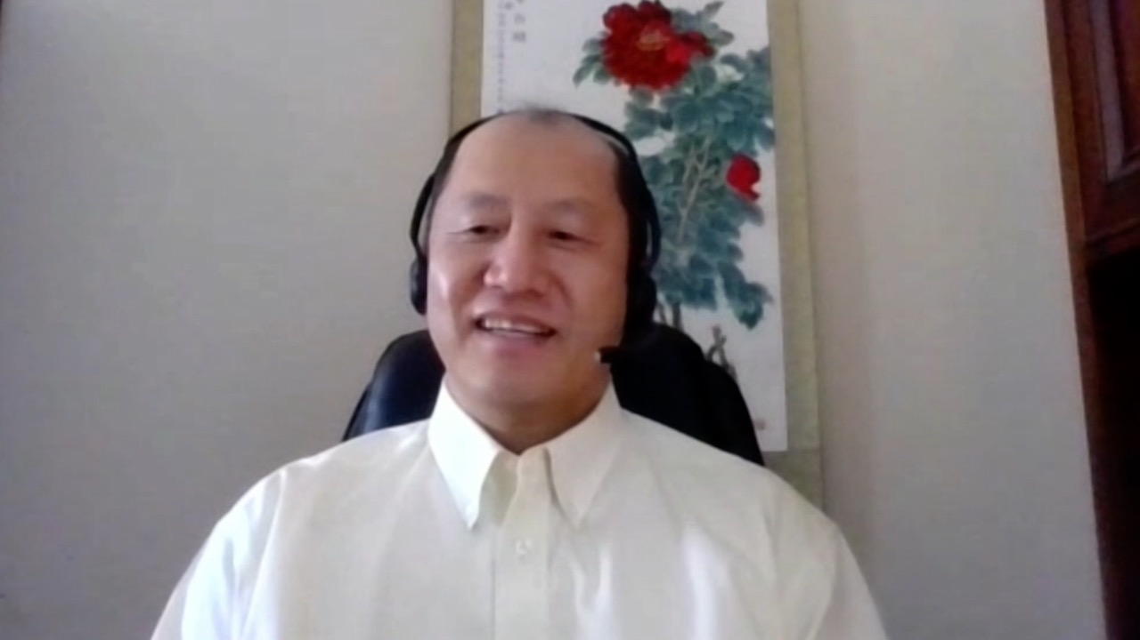
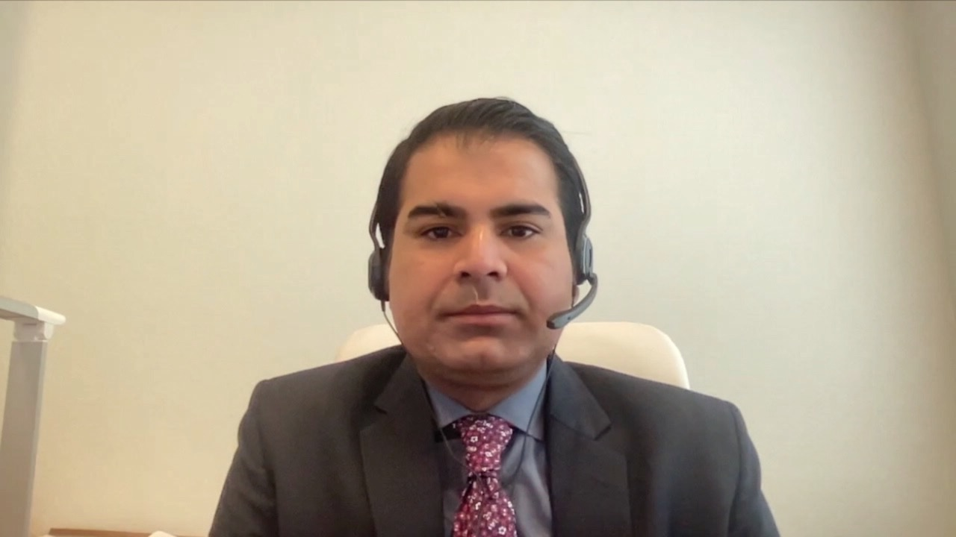
Jennifer L Dallas, MD Novant Health Cancer Institute
Charlotte, North Carolina
Jiaxin (Jason) Niu, MD, PhD
MD Anderson Cancer Center Gilbert, Arizona
Rohit Gosain, MD
UPMC Hillman Cancer Center Jamestown, New York
Namrata I Peswani, MD
UT Southwestern Medical Center Harold C Simmons Comprehensive Cancer Center Richardson, Texas
Rao Mushtaq, MD
National Jewish Health
Thornton, Colorado
Ferdy Santiago, MD
Florida Cancer Specialists
Naples, Florida
Jarushka Naidoo, MB BCH,
Johns Hopkins University Baltimore, Maryland
John Yang, MD
Oncologist
Fall River, Massachusetts

Slide 6
Meet The Professor with Dr Jänne
INTRODUCTION: Journal Club with Dr Jänne – Part 1
MODULE 1: Case Presentations
MODULE 2: Faculty Survey
MODULE 3: Journal Club with Dr Jänne – Part 2
MODULE 4: Appendix of Key Publications

Slide 7
Meet The Professor with Dr Jänne
INTRODUCTION: Journal Club with Dr Jänne – Part 1
MODULE 1: Case Presentations
MODULE 2: Faculty Survey
MODULE 3: Journal Club with Dr Jänne – Part 2
MODULE 4: Appendix of Key Publications

Slide 8
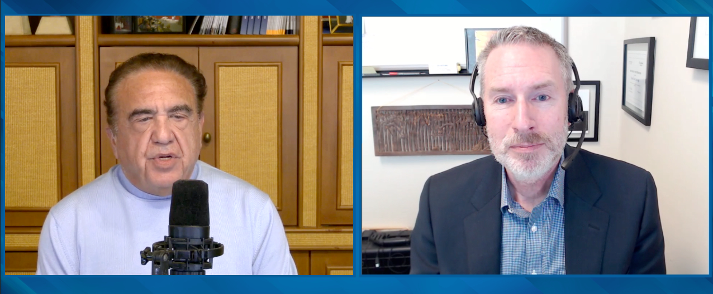
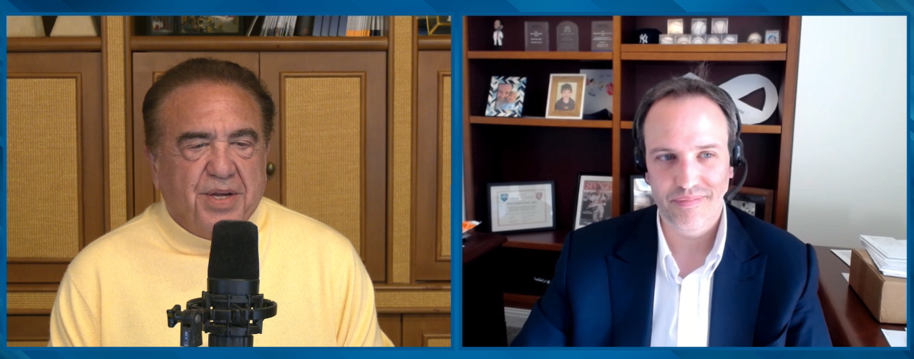

Slide 9
Nat Rev Drug Discov 2021 July;20(7):551-69.

Slide 10
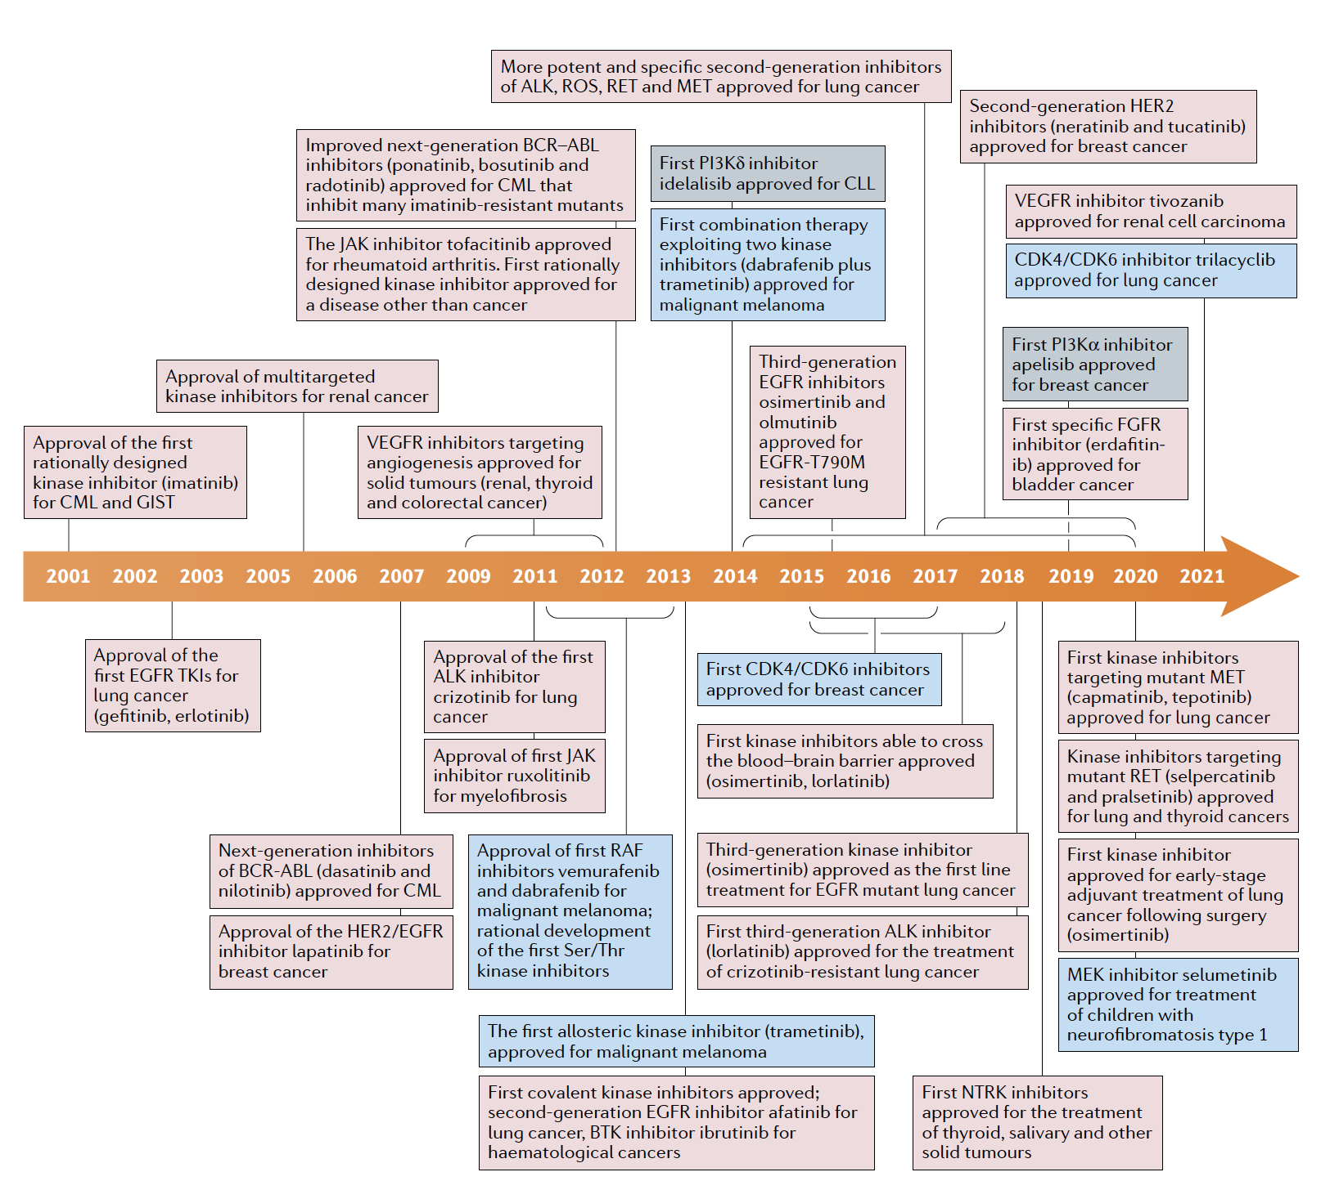
Timeline Depicting Important Events in the Development and Approval of Kinase Inhibitors Over the 20 Years Following Imatinib’s Approval for Treatment of CML in 2001
Cohen P et al. Nat Rev Drug Discov 2021 July;20(7):551-69.

Slide 11
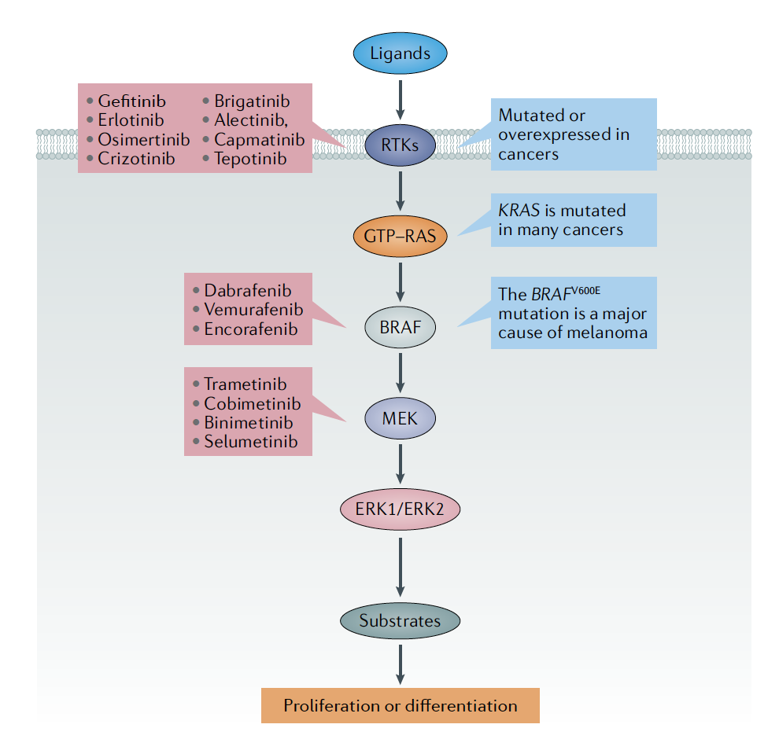
Mutations in the Classical MAP Kinase Cascade Cause Cancer
Cohen P et al. Nat Rev Drug Discov 2021 July;20(7):551-69.

Slide 12
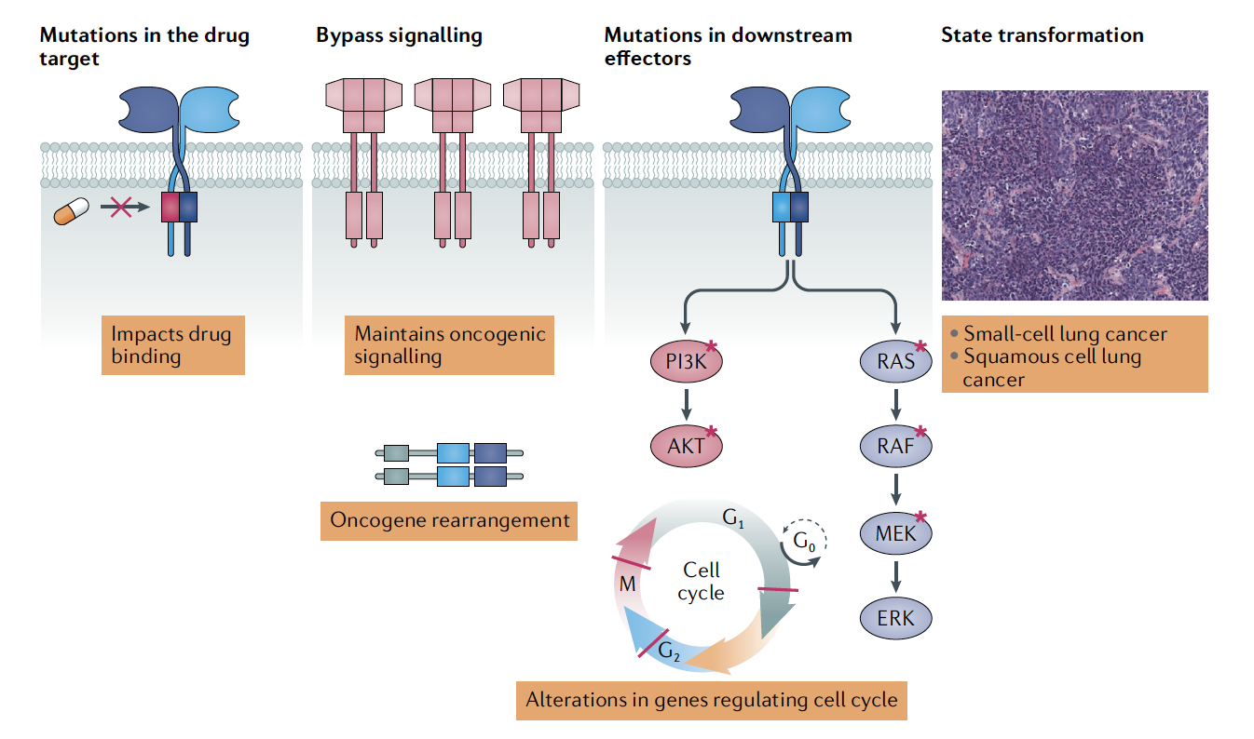
Mechanisms That Can Cause Drug Resistance
Cohen P et al. Nat Rev Drug Discov 2021 July;20(7):551-69.

Slide 13
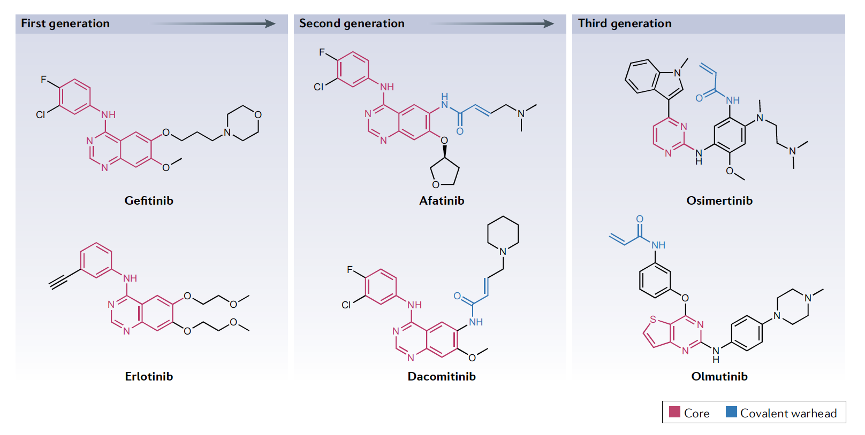
Chemical Structures of First-Generation, Second-Generation and Third-Generation EGFR Inhibitors
Cohen P et al. Nat Rev Drug Discov 2021 July;20(7):551-69.

Slide 14
Binding Modes for First-Generation, Second-Generation and Third-Generation EGFR Inhibitors
Cohen P et al. Nat Rev Drug Discov 2021 July;20(7):551-69.

Slide 15
Nat Cancer 2021 April;2(4):377-91.

Slide 16
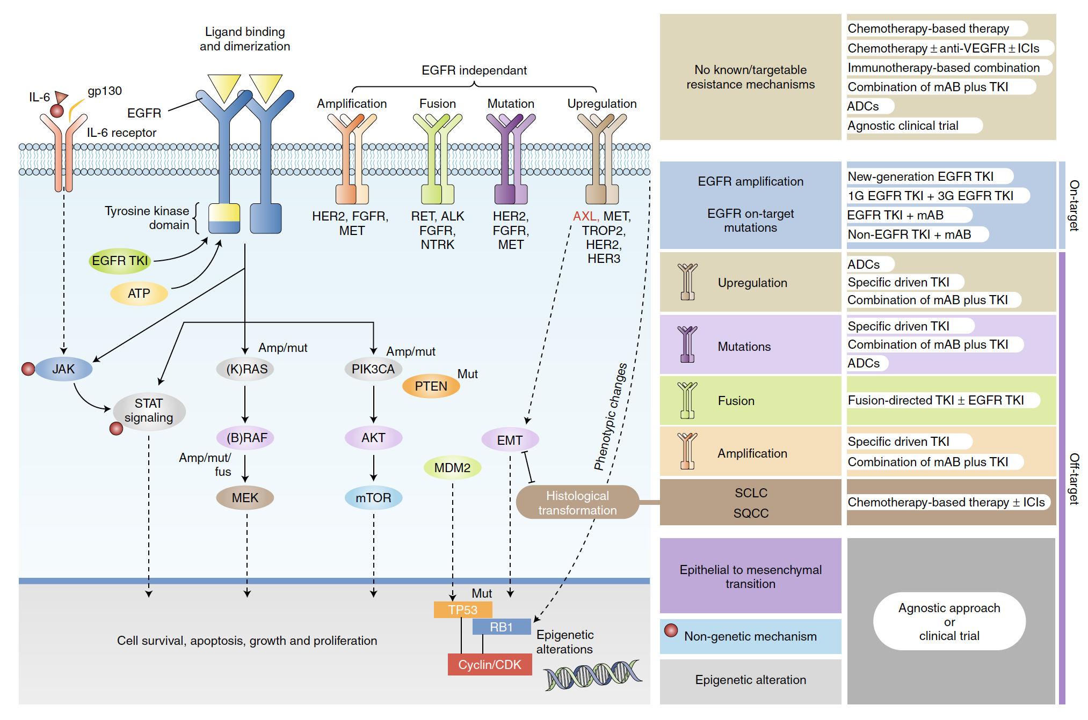
Overview of the EGFR Signal Transduction Pathway Model, with a Focus on the Acquired Resistance Mechanisms and Related Potential Treatment Strategies
Passaro A et al. Nat Cancer 2021 April;2(4):377-91 .

Slide 17
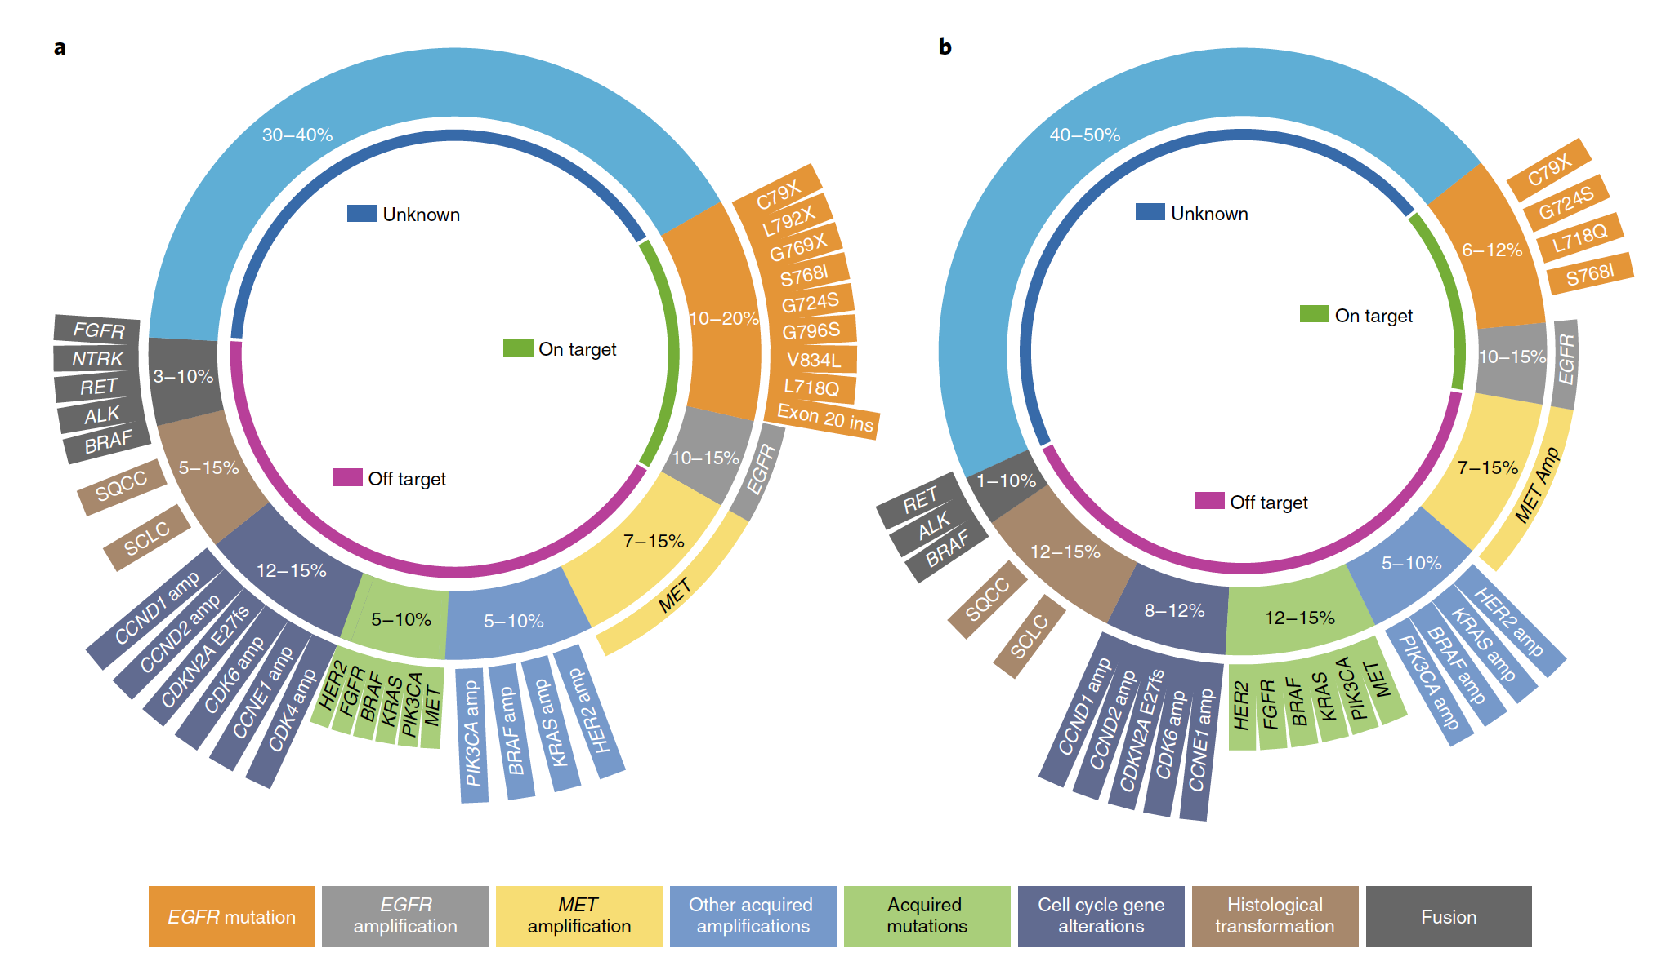
Mechanisms of Resistance to Osimertinib
Passaro A et al. Nat Cancer 2021 April;2(4):377-91 .

Slide 18
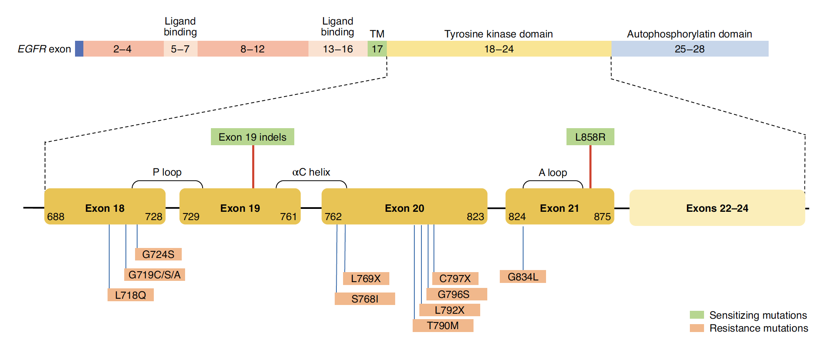
Specific EGFR-Dependent (On-Target) Mutations Acquired After Osimertinib Treatment
Autophosphorylation domain
Passaro A et al. Nat Cancer 2021 April;2(4):377-91 .

Slide 19
Cancer Discov 2021 April;11(4):810-4.

Slide 20
Meet The Professor with Dr Jänne
MODULE 1: Case Presentations – Part 1
Dr Dallas: 67-year-old Asian man with adenocarcinoma of the lung and pleural effusion with EGFR amplification – PD-L1 20%
Dr Gosain: 58-year-old man with metastatic adenocarcinoma of the lung with discordant EGFR testing results and a new mediastinal lesion s/p osimertinib
Dr Peswani: 48-year-old man with metastatic adenocarcinoma of the lung and a brain metastasis with an EGFR exon 19 mutation and PD s/p SBRT and osimertinib, now with an ALK mutation by RNA testing – PD-L1 0
Dr Santiago: 53-year-old man with Stage III unresectable adenocarcinoma of the lung who receives chemoRT and consolidation durvalumab, now with EGFR mutation-positive metastatic recurrence
Dr Naidoo: 70-year-old man with Stage IIIC large cell neuroendocrine carcinoma of the lung and EGFR S768I mutation – PD-L1 1%
Dr Niu: 81-year-old man with metastatic adenocarcinoma of the lung with an EGFR exon 20 insertion mutation and disease progression on mobocertinib
Dr Niu: 74-year-old woman with adenocarcinoma of the lung and an EGFR exon 20 insertion mutation with new bone and brain metastases s/p osimertinib

Slide 21
Case Presentation: 67-year-old Asian man with adenocarcinoma of the lung and pleural effusion with EGFR amplification – PD-L1 20%
Dr Jennifer Dallas (Charlotte, North Carolina)

Slide 22
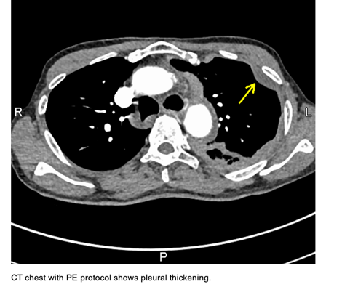

Slide 23
Case Presentation: 58-year-old man with metastatic adenocarcinoma of the lung with discordant EGFR testing results and a new mediastinal lesion s/p osimertinib
Dr Rohit Gosain (Jamestown, New York)

Slide 24
Case Presentation: 48-year-old man with metastatic adenocarcinoma of the lung and a brain metastasis with an EGFR exon 19 mutation and PD s/p SBRT and osimertinib, now with an ALK mutation by RNA testing – PD-L1 0
Dr Namrata Peswani (Richardson, Texas)

Slide 25
Case Presentation: 53-year-old man with Stage III unresectable adenocarcinoma of the lung who receives chemoRT and consolidation durvalumab, now with EGFR mutation-positive metastatic recurrence
Dr Ferdy Santiago (Naples, Florida)

Slide 26
Case Presentation: 70-year-old man with Stage IIIC large cell neuroendocrine carcinoma of the lung and EGFR S768I mutation – PD-L1 1%
Dr Jarushka Naidoo (Baltimore, Maryland)

Slide 27
Case Presentation: 81-year-old man with metastatic adenocarcinoma of the lung with an EGFR exon 20 insertion mutation and disease progression on mobocertinib
Dr Jason Niu (Gilbert, Arizona)

Slide 28
Case Presentation: 74-year-old woman with adenocarcinoma of the lung and an EGFR exon 20 insertion mutation with new bone and brain metastases s/p osimertinib
Dr Jason Niu (Gilbert, Arizona)

Slide 29
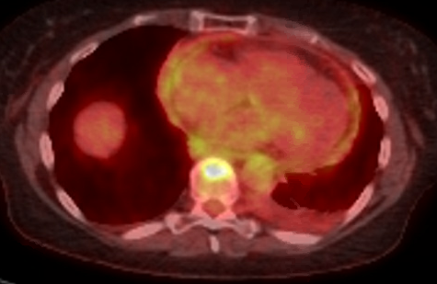
3/2021: Left pleural effusion

Slide 30
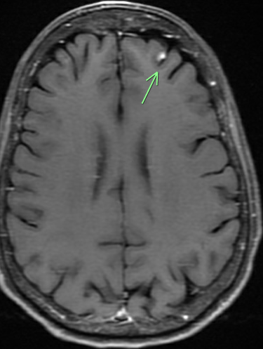
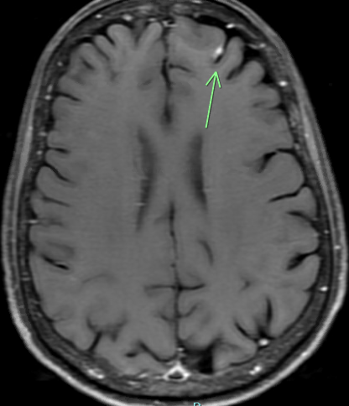
1/2022: Solitary brain metastases

Slide 31
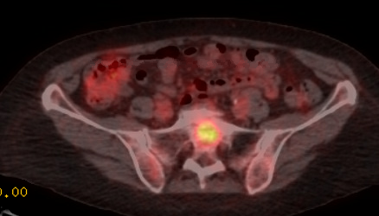
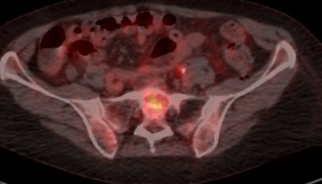
1/2022
3/2022

Slide 33
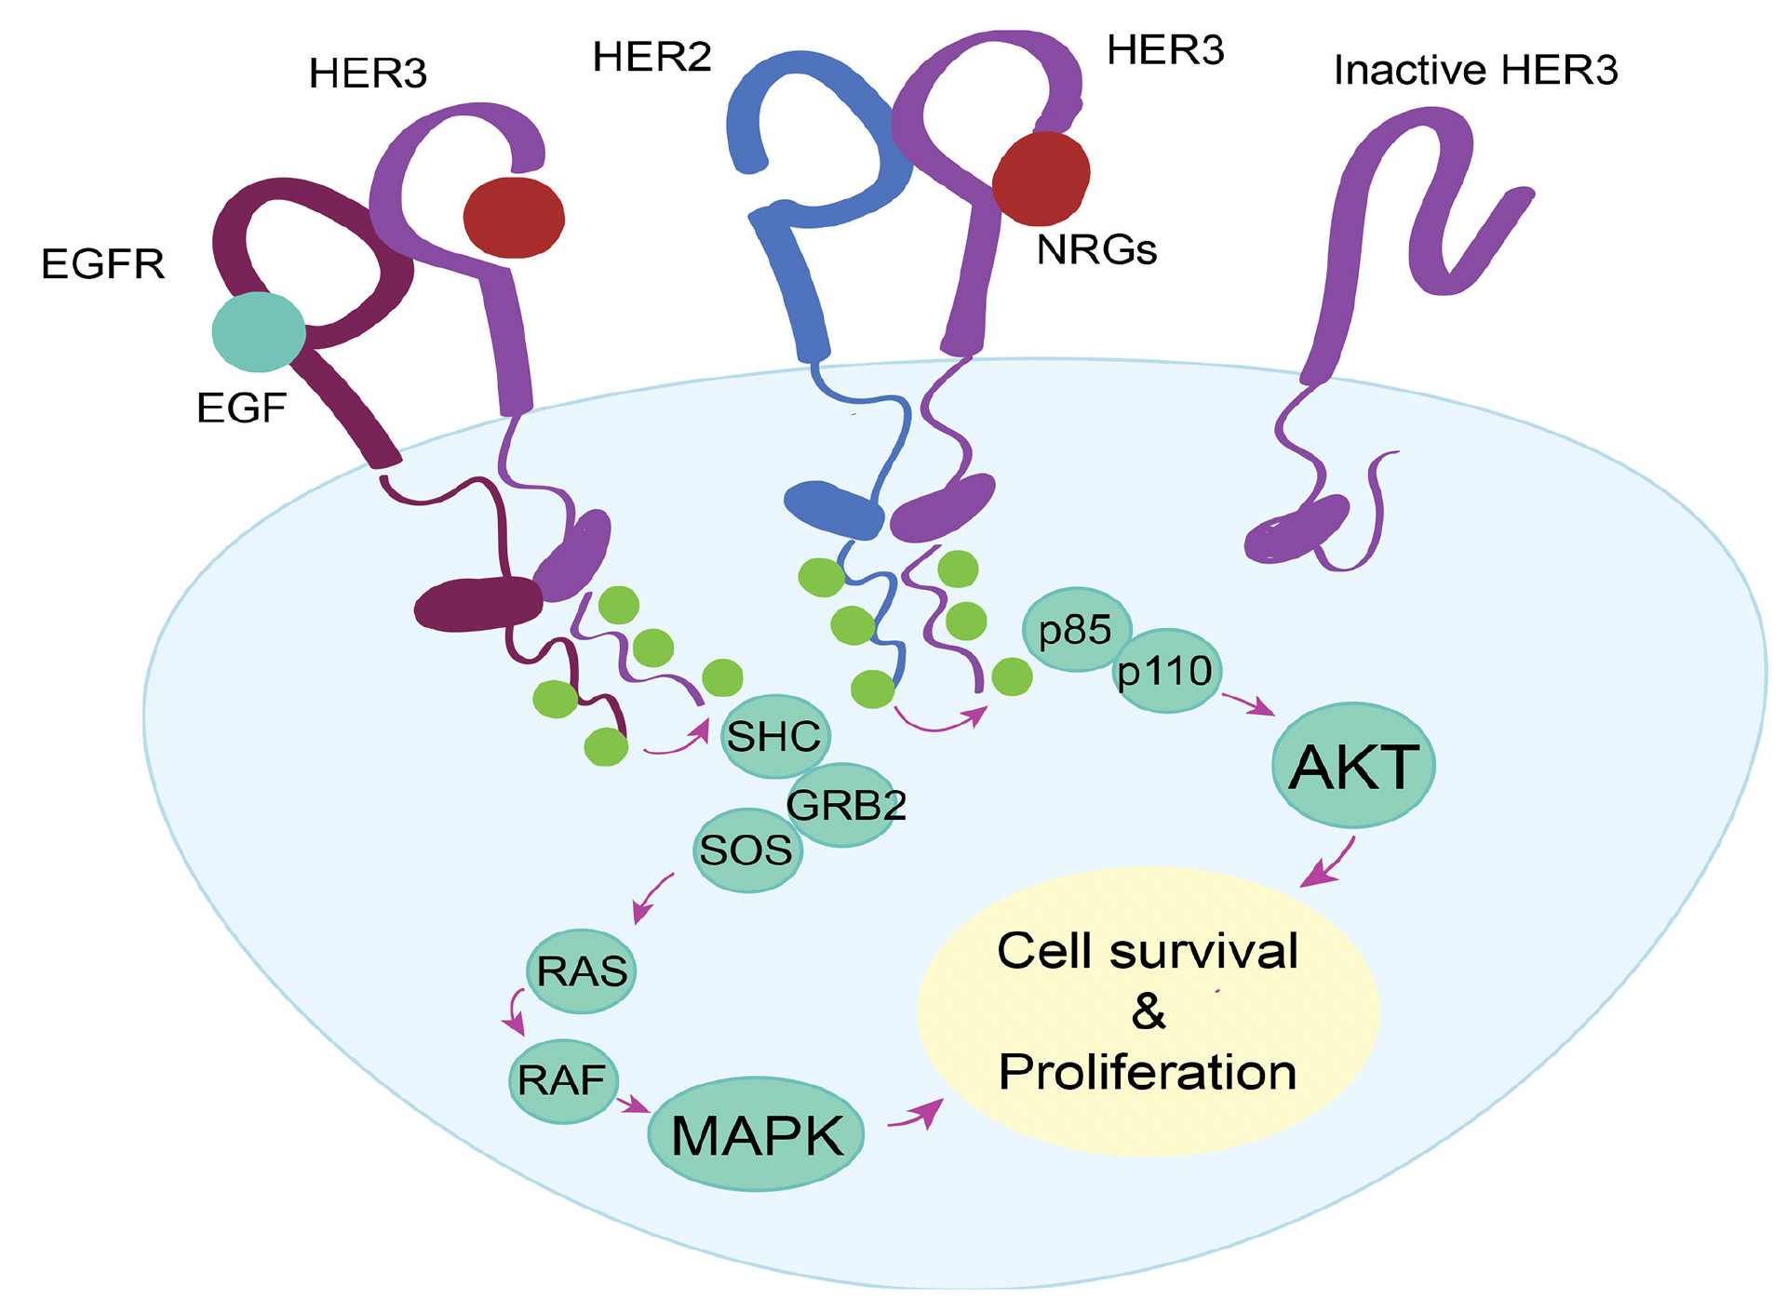
HER3 Dimerization and Signaling Cascade
Haikala HM, Jänne PA. Clin Cancer Res 2021;27(13):3528-39.

Slide 34
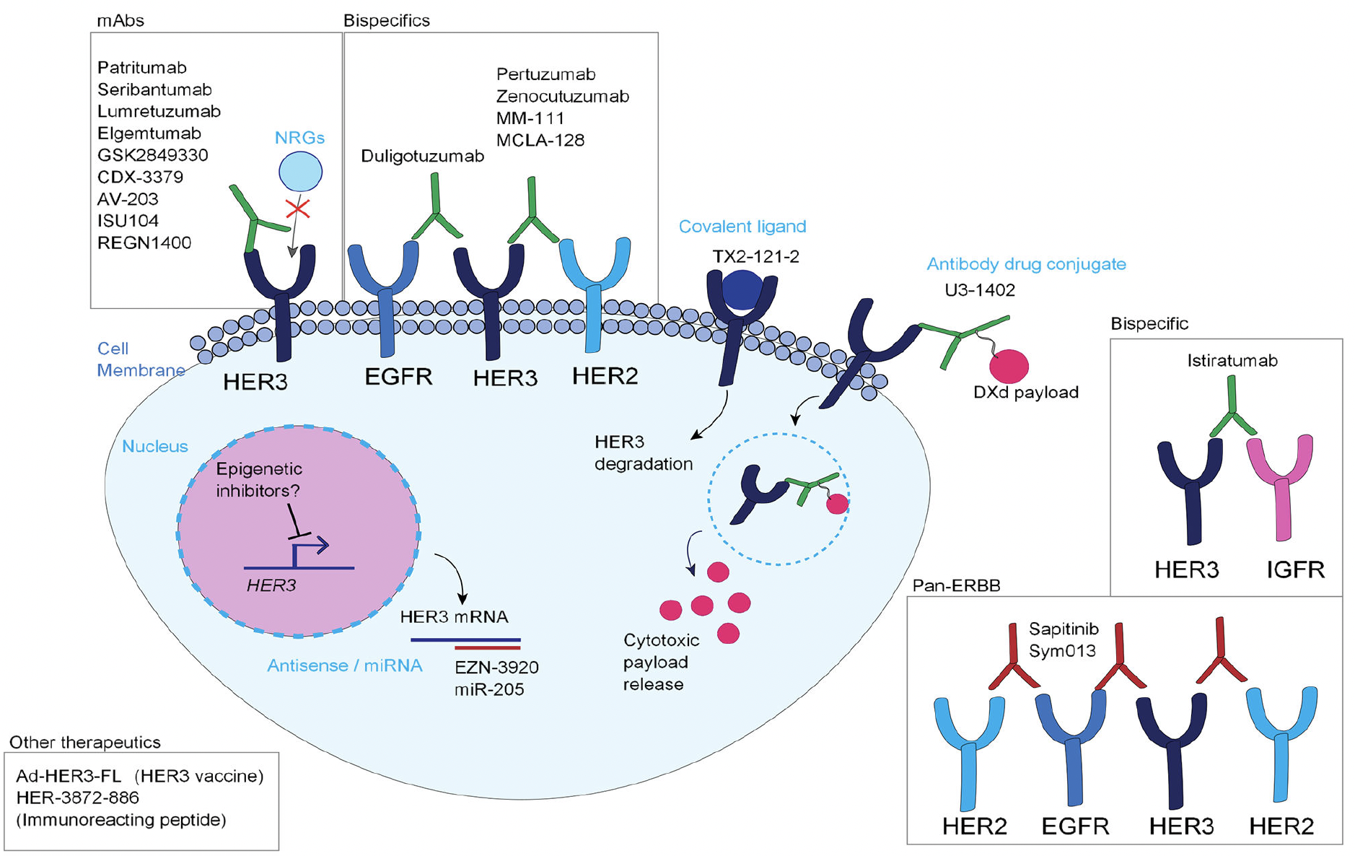
Therapeutic Strategies to Target HER3
Haikala HM, Jänne PA. Clin Cancer Res 2021;27(13):3528-39.

Slide 35
Phase 1 Study of Patritumab Deruxtecan (HER3-DXd; U3-1402) in Combination with Osimertinib in Patients with Advanced EGFR-Mutated NSCLC
Janne PA et al.
ASCO 2022;Abstract TPS3161.

Slide 36
Cancer Discov 2022 January;12(1):74-89.

Slide 37
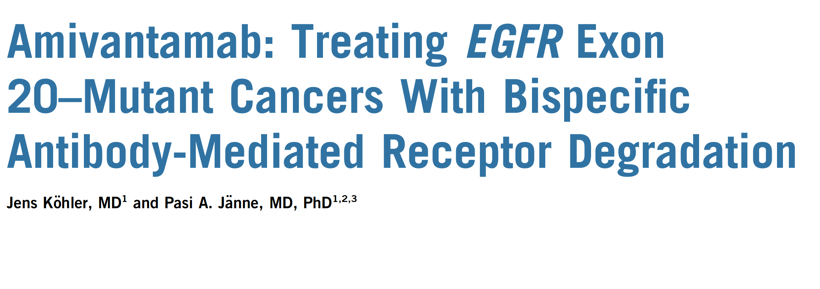
J Clin Oncol 2021 October 20;39(30):3403-6.

Slide 38
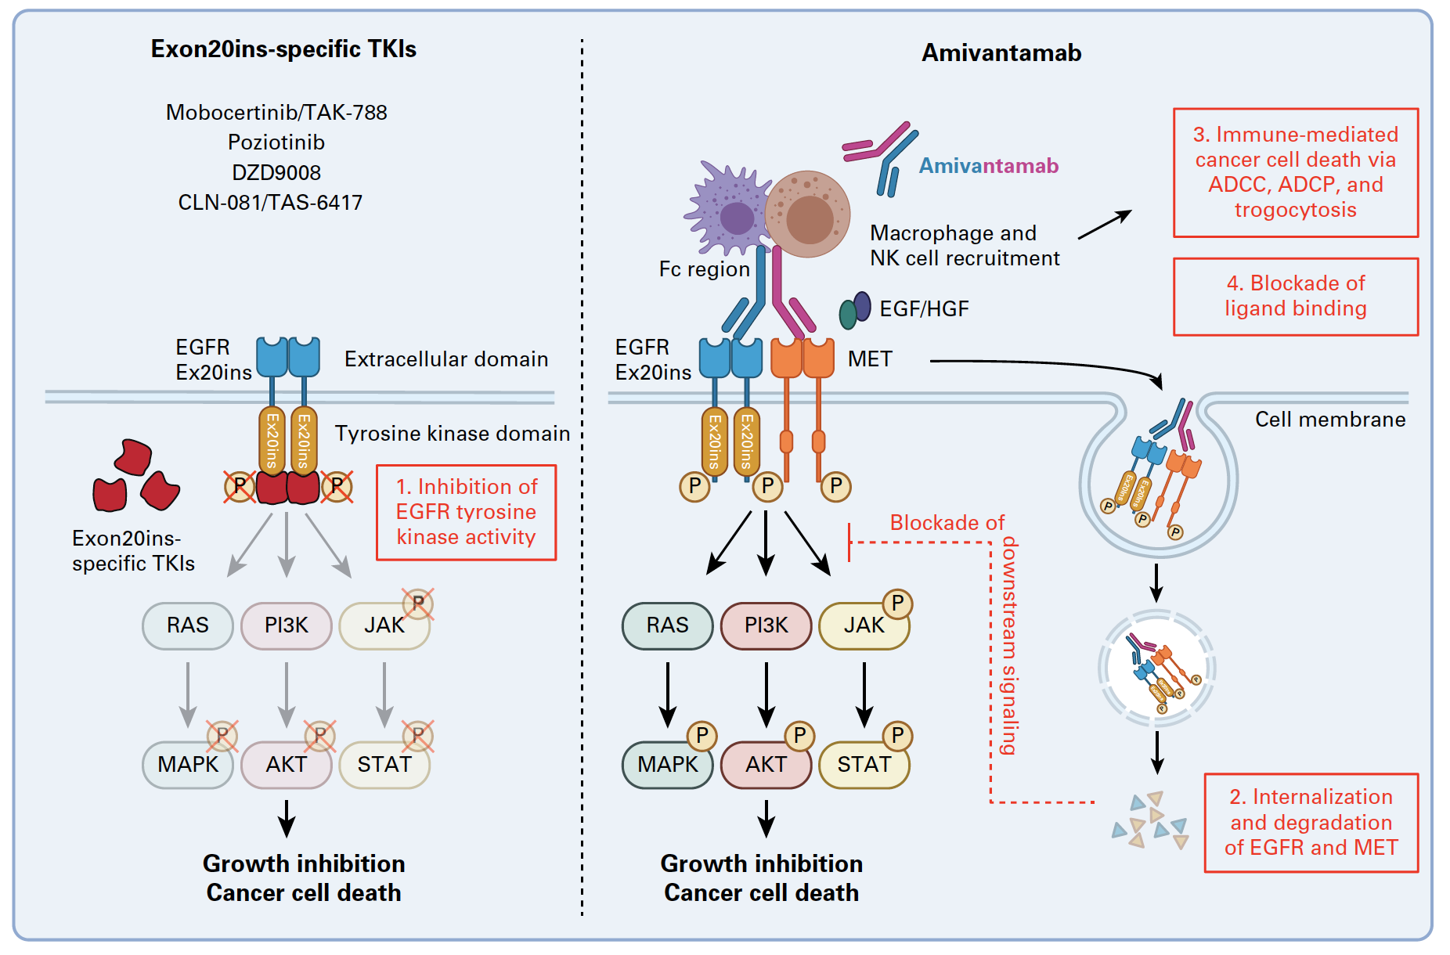
The New Generation of TKIs Selective to EGFR Exon 20 Insertion Mutations (EGFR Ex20ins) Inactivates EGFR Downstream Signaling via the RAS-MAPK, PI3K-AKT-mTOR and JAK-STAT Pathways
Kohler J et al. J Clin Oncol 2021 October 20;39(30):3403-6.

Slide 39
Abstract 9006

Slide 40
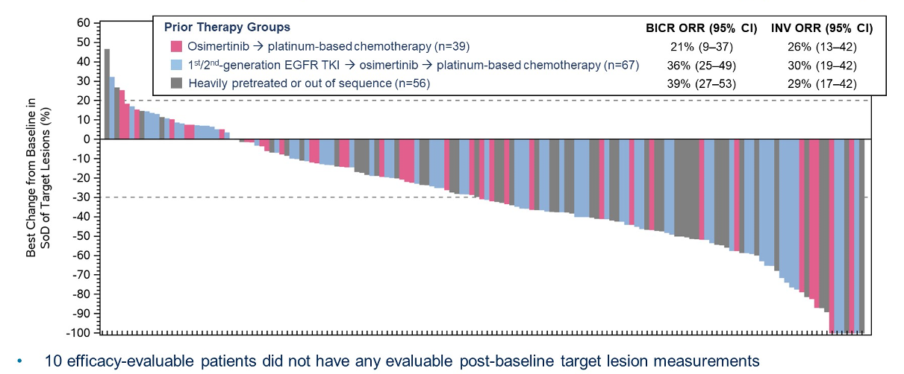
CHRYSALIS-2: Best Antitumor Response and ORR by Prior Therapy Group
BICR = blinded independent central review; ORR = overall response rate; INV = investigator
Shu CA et al. ASCO 2022;Abstract 9006.

Slide 41
Abstract 9008

Slide 42
Amivantamab: EGFR-MET Bispecific Antibody
Krebs MG et al. ASCO 2022;Abstract 9008.

Slide 43
Antitumor Activity of Amivantamab Monotherapy
Krebs MG et al. ASCO 2022;Abstract 9008.

Slide 44
Durable Responses to Amivantamab over Time
Krebs MG et al. ASCO 2022;Abstract 9008.

Slide 45
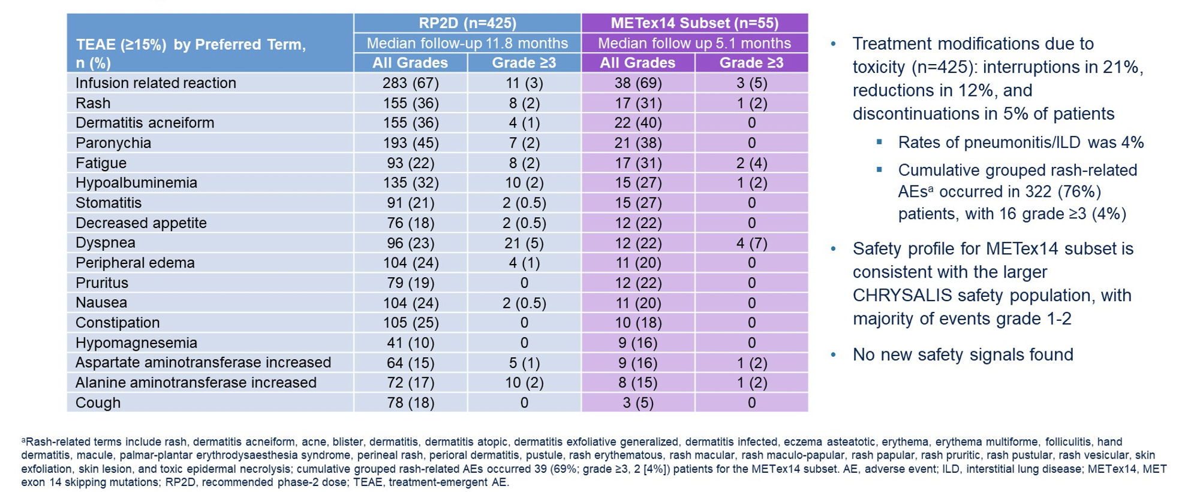
Safety Profile
Krebs MG et al. ASCO 2022;Abstract 9008.

Slide 46
Mobocertinib (TAK-788) in EGFR Exon 20 Insertion (ex20ins) + Metastatic Non-Small Cell Lung Cancer (mNSCLC): Treatment (tx) Beyond Progressive Disease (PD) in Platinum-Pretreated Patients (pts) with and without Intracranial PD
Janne PA et al.
ASCO 2022;Abstract 9099.

Slide 47
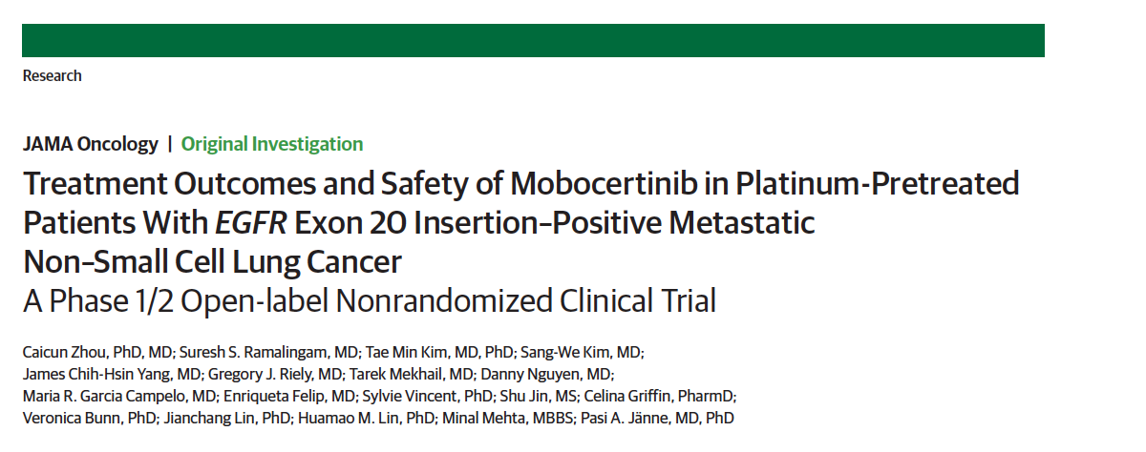
JAMA Oncol 2021;7(12):e214761.

Slide 48
Antitumor Activity of Sunvozertinib in NSCLC Patients with EGFR Exon20 Insertion Mutations after Platinum and Anti-PD(L)1 Treatment Failures
Janne PA et al.
ASCO 2022;Abstract 9015.

Slide 49
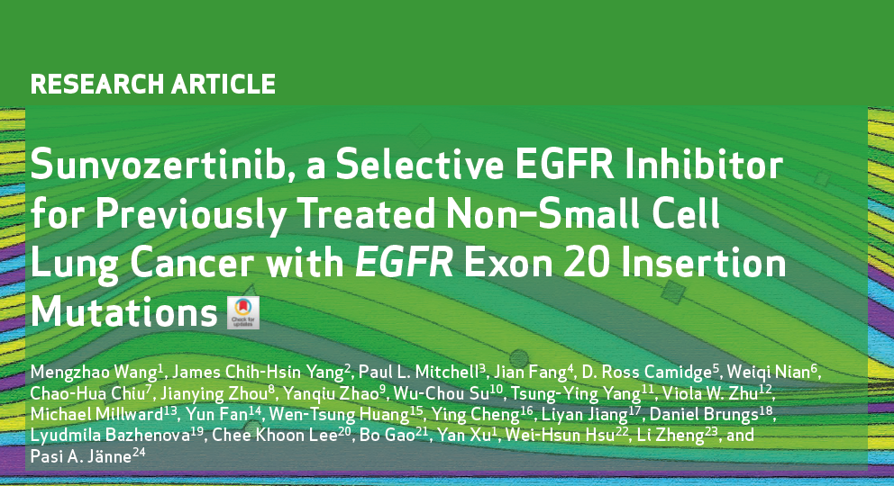
Cancer Discov 2022;12(7):1676-89.

Slide 50
Sunvozertinib in NSCLC Patients with EGFR Exon20 Insertion Mutations: Effect of Prior Treatment
Yang J C-H et al.
IASLC 2022;Abstract EP08.02-029.

Slide 51
Phase 1 Studies of DZD9008, an Oral Selective EGFR/HER2 Inhibitor in Advanced NSCLC with EGFR Exon20 Insertion Mutations
Janne PA et al.
IASLC 2022;Abstract OA15.02.

Slide 52
In general, in which line of therapy would you most likely use trastuzumab deruxtecan for an asymptomatic patient with low-volume metastatic adenocarcinoma of the lung and a HER2 mutation?
First line
Second line
Third line
Beyond third line
I would not use trastuzumab deruxtecan for this patient
I’m not sure

Slide 53
Abstract LBA55

Slide 54
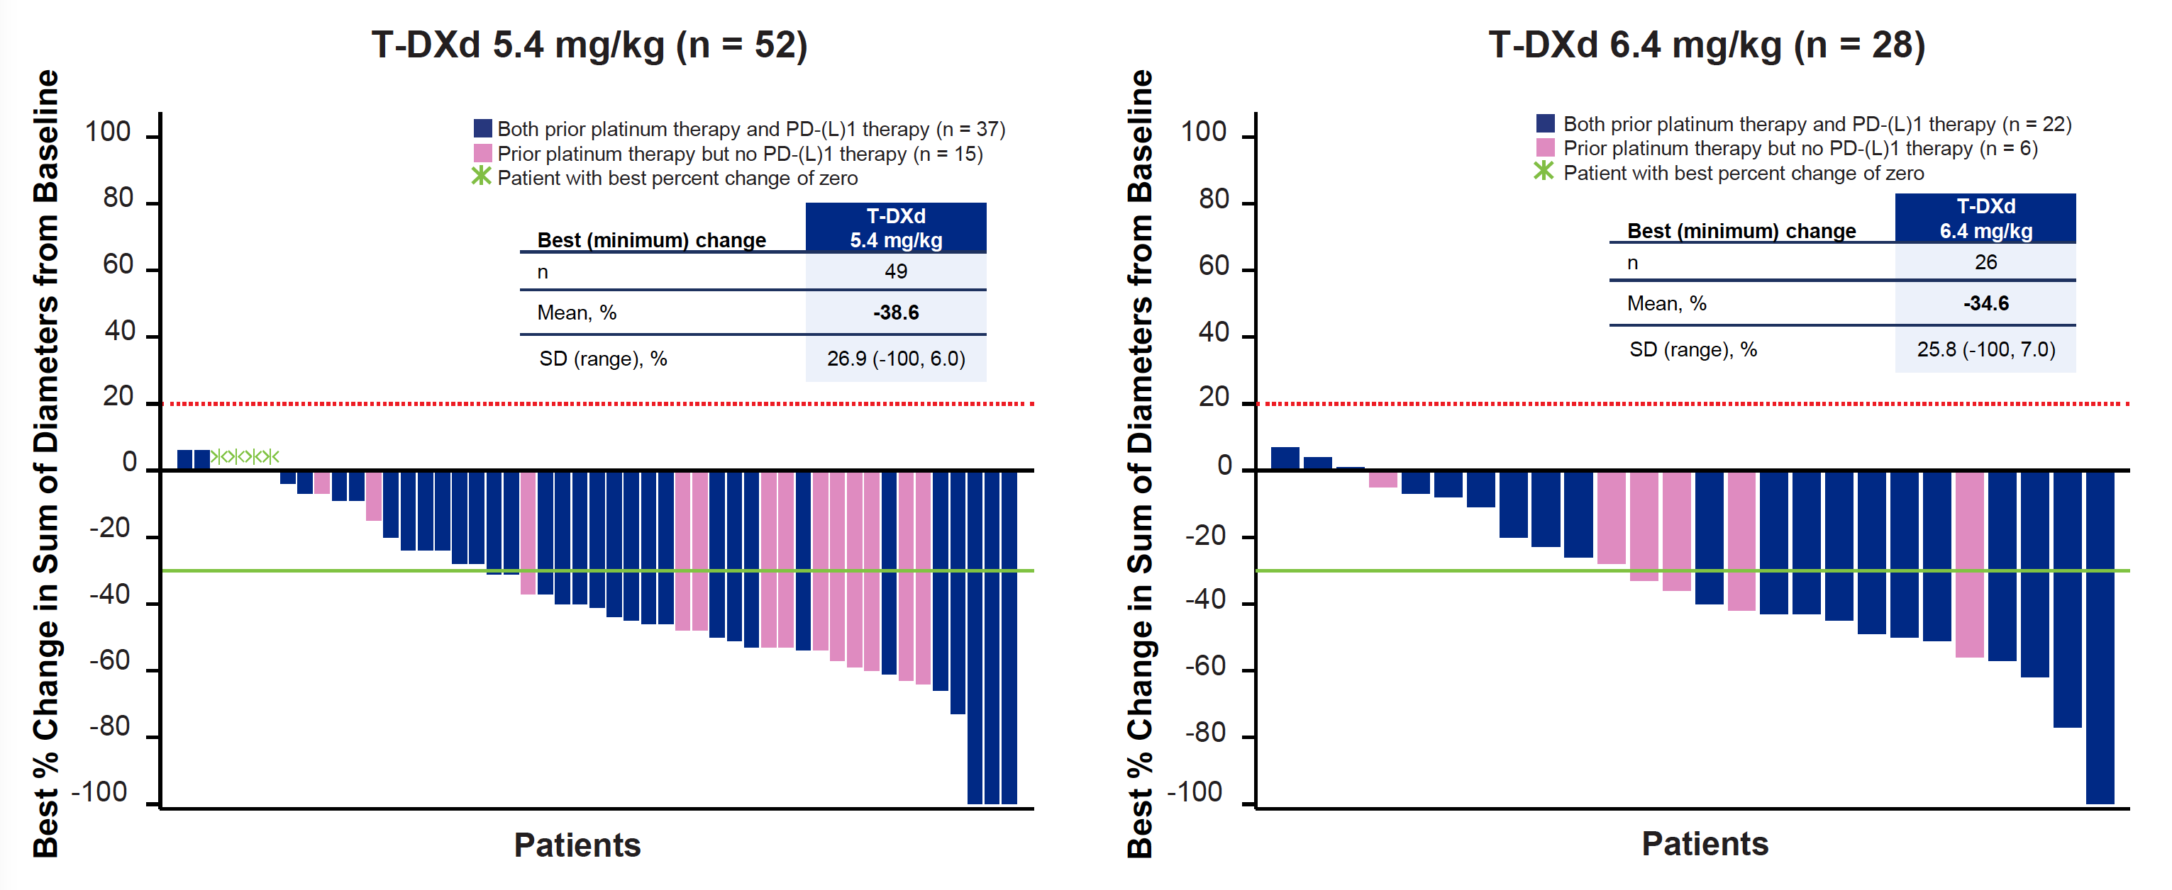
DESTINY-Lung02: Best Percent Change in Tumor Size by BICR
BICR = blinded independent central review
Goto K et al. ESMO 2022;Abstract LBA55.

Slide 55
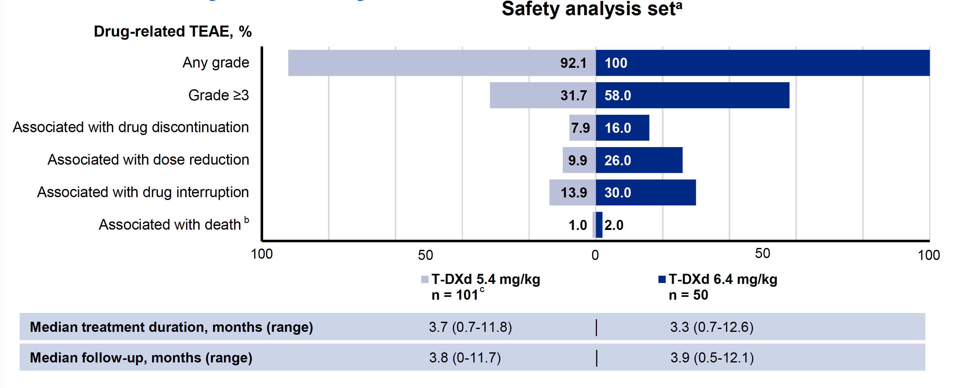
DESTINY-Lung02: Overall Safety Summary
Safety analysis setª
TEAE = treatment-emergent adverse event
Goto K et al. ESMO 2022;Abstract LBA55.

Slide 56
DESTINY-Lung02: Adjudicated Drug-Related Interstitial Lung Disease (ILD)
Goto K et al. ESMO 2022;Abstract LBA55.

Slide 57
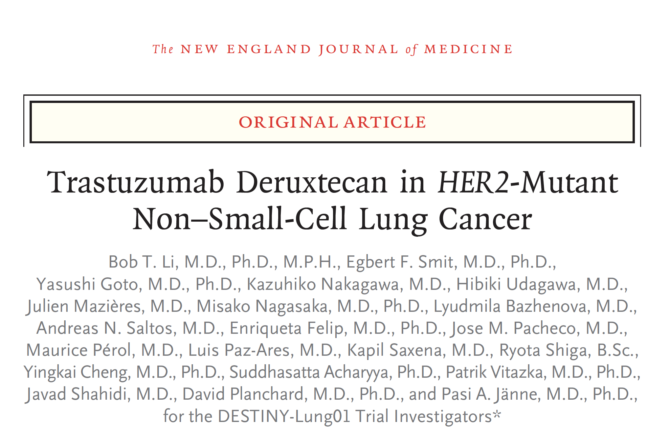
N Engl J Med 2022;386(3):241-51.

Slide 58
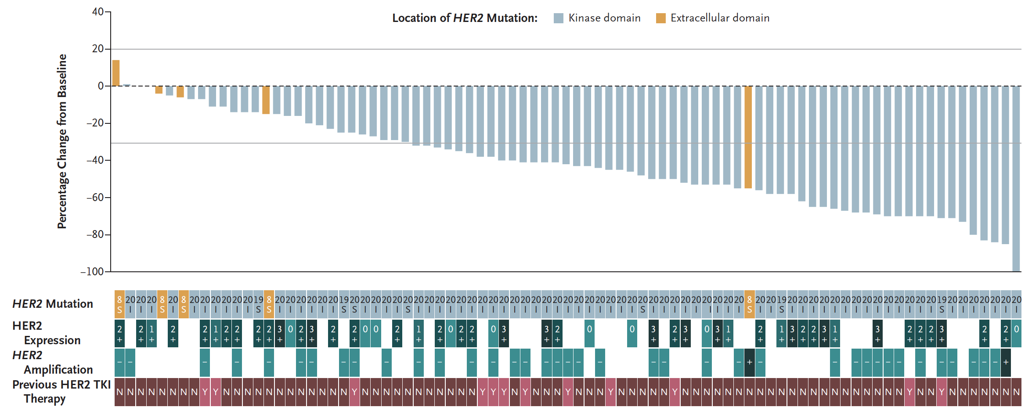
Best Percent Change in Sum of Largest Tumor Diameters
Li BT et al. N Engl J Med 2022;386(3):241-51.

Slide 59
Trastuzumab Deruxtecan in Patients (pts) with HER2-Overexpressing (HER2-OE) Metastatic Non-Small-Cell Lung Cancer (NSCLC): Results from the DESTINY-Lung01 Trial
Smit EF et al.
ESMO 2022;Abstract 975P.

Slide 60
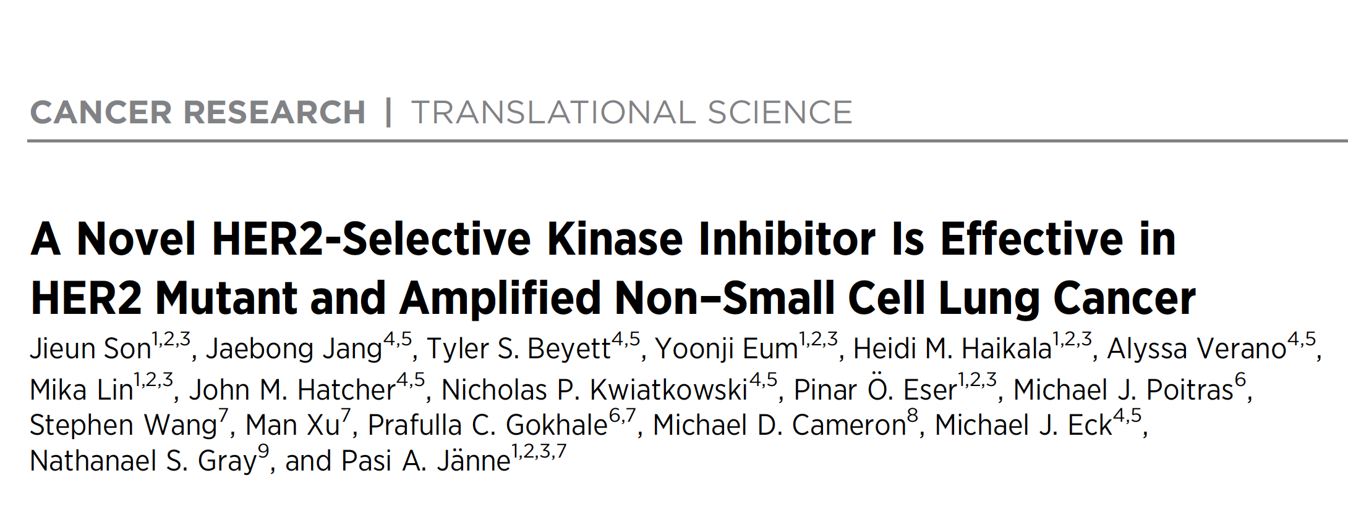
Cancer Res 2022 April 15;82(8):1633-45.

Slide 61
Meet The Professor with Dr Jänne
MODULE 1: Case Presentations – Part 2
Dr Yang: 84-year-old woman with metastatic adenocarcinoma of the lung and EGFR exon 21 mutation, switched to erlotinib due to osimertinib-related toxicities, now with recurrence at the primary site – PD-L1 10%
Dr Niu: 70-year-old Asian man with metastatic adenocarcinoma of the lung and an EGFR exon 19 deletion and brain metastases who receives SBRT and osimertinib but has biopsy-proven SCLC extracranial PD
Dr Mushtaq: 70-year-old woman with EGFR mutation-positive metastatic adenocarcinoma of the lung and brain and bone metastases s/p SRS and osimertinib

Slide 62
Case Presentation: 84-year-old woman with metastatic adenocarcinoma of the lung and EGFR exon 21 mutation, switched to erlotinib due to osimertinib-related toxicities, now with recurrence at the primary site – PD-L1 10%
Dr John Yang (Fall River, Massachusetts)

Slide 63
Case Presentation: 70-year-old Asian man with metastatic adenocarcinoma of the lung and an EGFR exon 19 deletion and brain metastases who receives SBRT and osimertinib but has biopsy-proven SCLC extracranial PD
Dr Jason Niu (Gilbert, Arizona)

Slide 64
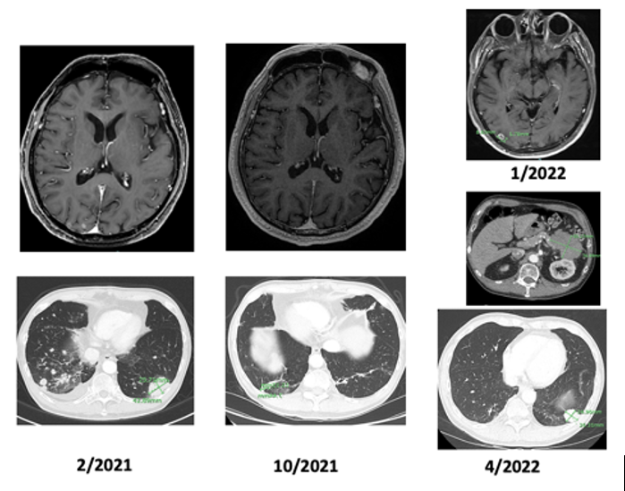

Slide 65
Case Presentation: 70-year-old woman with EGFR mutation-positive metastatic adenocarcinoma of the lung and brain and bone metastases s/p SRS and osimertinib
Dr Rao Mushtaq (Thornton, Colorado)

Slide 66
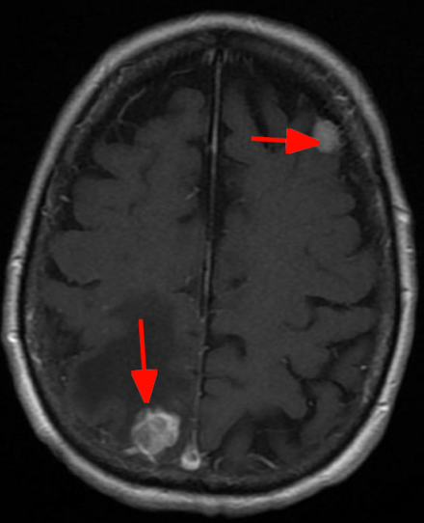

Slide 67
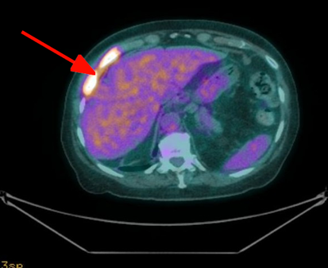
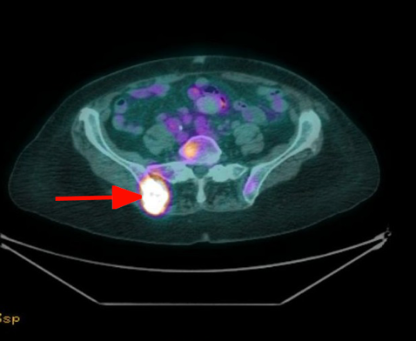

Slide 68
Meet The Professor with Dr Jänne
INTRODUCTION: Journal Club with Dr Jänne – Part 1
MODULE 1: Case Presentations
MODULE 2: Faculty Survey
MODULE 3: Journal Club with Dr Jänne – Part 2
MODULE 4: Appendix of Key Publications

Slide 69
Regulatory and reimbursement issues aside, in general, what adjuvant treatment, if any, would you recommend for an otherwise healthy 65-year-old patient with Stage IB nonsquamous NSCLC with an EGFR exon 19 deletion and a PD-L1 TPS of 50%?
Osimertinib
Osimertinib
None
Chemotherapy → osimertinib
Chemotherapy → osimertinib
None
TPS = tumor proportion score

Slide 70
Regulatory and reimbursement issues aside, in general, what adjuvant treatment, if any, would you recommend for an otherwise healthy 65-year-old patient with Stage IIA nonsquamous NSCLC with an EGFR exon 19 deletion and a PD-L1 TPS of 50%?
Chemotherapy → osimertinib
Chemotherapy → osimertinib
Chemotherapy → osimertinib
Chemotherapy → osimertinib
Chemotherapy → osimertinib
Chemotherapy → osimertinib

Slide 71
What would you most likely recommend as consolidation treatment for a patient with locally advanced NSCLC who has completed chemoradiation therapy and is found to have an EGFR mutation?
Osimertinib
Osimertinib
Consider durvalumab if PD-L1 high, or osimertinib
Osimertinib
Durvalumab or observation
Durvalumab followed by osimertinib

Slide 72
For a patient with metastatic cancer with an EGFR mutation that responds to but then progresses on osimertinib, do you generally continue osimertinib when switching to chemotherapy?
Yes
Yes, if the patient has brain metastases
No
I’m not sure

Slide 73
If an asymptomatic patient with metastatic nonsquamous NSCLC with an EGFR exon 19 deletion and a PD-L1 TPS of 10% responded to first-line osimertinib followed by disease progression, what would be your second-line treatment recommendation if the patient had acquired no further actionable mutations?
Continue osimertinib and add carboplatin/ pemetrexed
Platin/pemetrexed + bevacizumab
Carboplatin/pemetrexed + bevacizumab
Continue osimertinib and add carboplatin/ pemetrexed
Platin/pemetrexed + pembrolizumab
Continue osimertinib and add carboplatin/ pemetrexed

Slide 74
Regulatory and reimbursement issues aside, in which line of therapy would you generally offer an immune checkpoint inhibitor (alone or in combination with chemotherapy) to a patient with metastatic nonsquamous NSCLC and an EGFR exon 19 deletion? Would level of PD-L1 expression have any bearing on this decision?
Third line. No
Beyond third line. No
Beyond third line. Yes
None
Second line. No
Third line. No

Slide 75
Regulatory and reimbursement issues aside, what would be your preferred first-line treatment for a patient with metastatic nonsquamous NSCLC with an EGFR exon 20 insertion mutation and a TPS of 10%?
Chemotherapy
Chemotherapy + bevacizumab
Chemotherapy + bevacizumab
Chemotherapy
Amivantamab
Anti-PD-1/PD-L1 and carboplatin/pemetrexed

Slide 76
Regulatory and reimbursement issues aside, in which line of therapy would you generally offer amivantamab or mobocertinib to a patient with metastatic NSCLC and an EGFR exon 20 insertion mutation?
Second line
Second line
Second line
Second line
Second line
Second line

Slide 77
For a patient with metastatic nonsquamous NSCLC with an EGFR exon 20 insertion mutation to whom you’ve made the determination to administer targeted therapy, which agent do you prefer?
Mobocertinib
Mobocertinib
Mobocertinib
Amivantamab
Amivantamab
No preference

Slide 78
If you could access amivantamab/lazertinib today, would you attempt to administer it prior to chemotherapy in select situations for your patients with metastatic nonsquamous NSCLC with an EGFR mutation experiencing disease progression on osimertinib?
Yes
Yes
Yes
Yes
Yes
No

Slide 79
Meet The Professor with Dr Jänne
INTRODUCTION: Journal Club with Dr Jänne – Part 1
MODULE 1: Case Presentations
MODULE 2: Faculty Survey
MODULE 3: Journal Club with Dr Jänne – Part 2
MODULE 4: Appendix of Key Publications

Slide 80
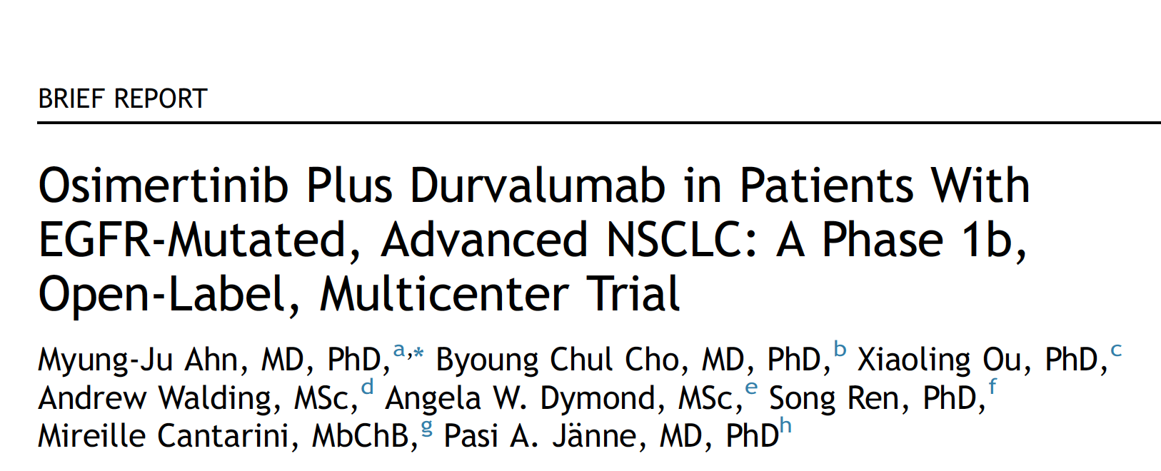
J Thorac Oncol 2022 May;17(5):718-23.

Slide 81
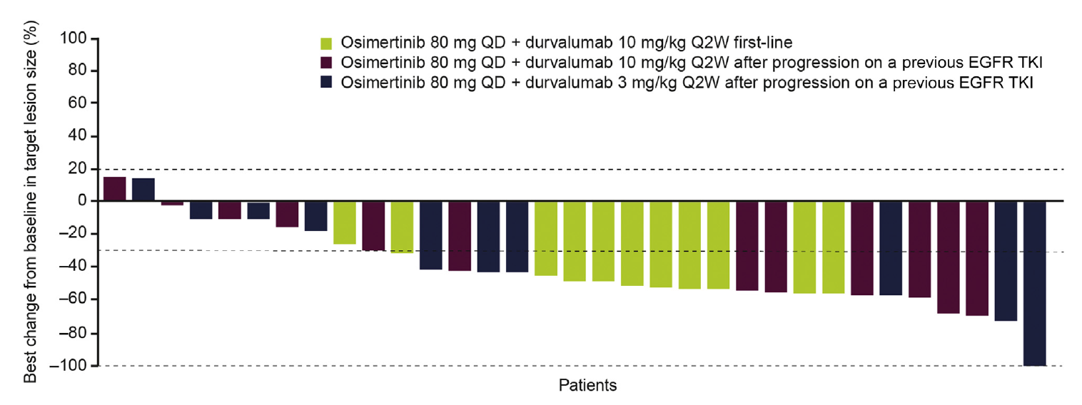
Waterfall Plot of the Best Percent Change from Baseline in Target Lesion Size with Osimertinib and Durvalumab in the First Line and After Disease Progression on a Previous EGFR TKI
Ahn MJ et al. J Thorac Oncol 2022 May;17(5):718-23.

Slide 82
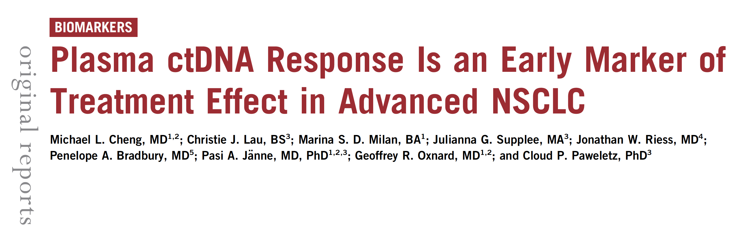
JCO Precis Oncol 2021 February 17;5:PO.20.00419.

Slide 83
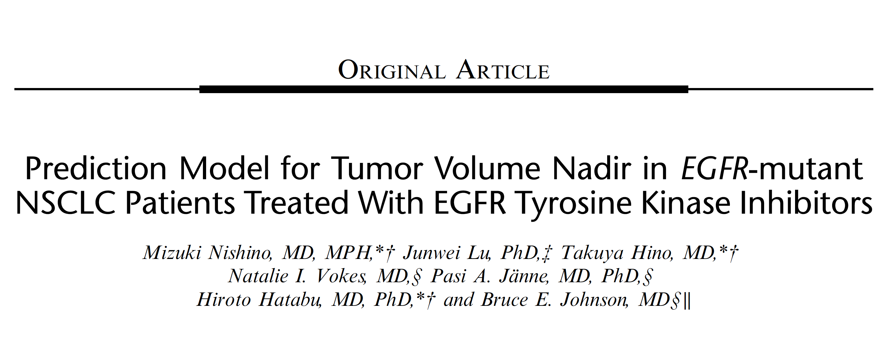
J Thorac Imaging 2021 September 15:[Online ahead of print].

Slide 84
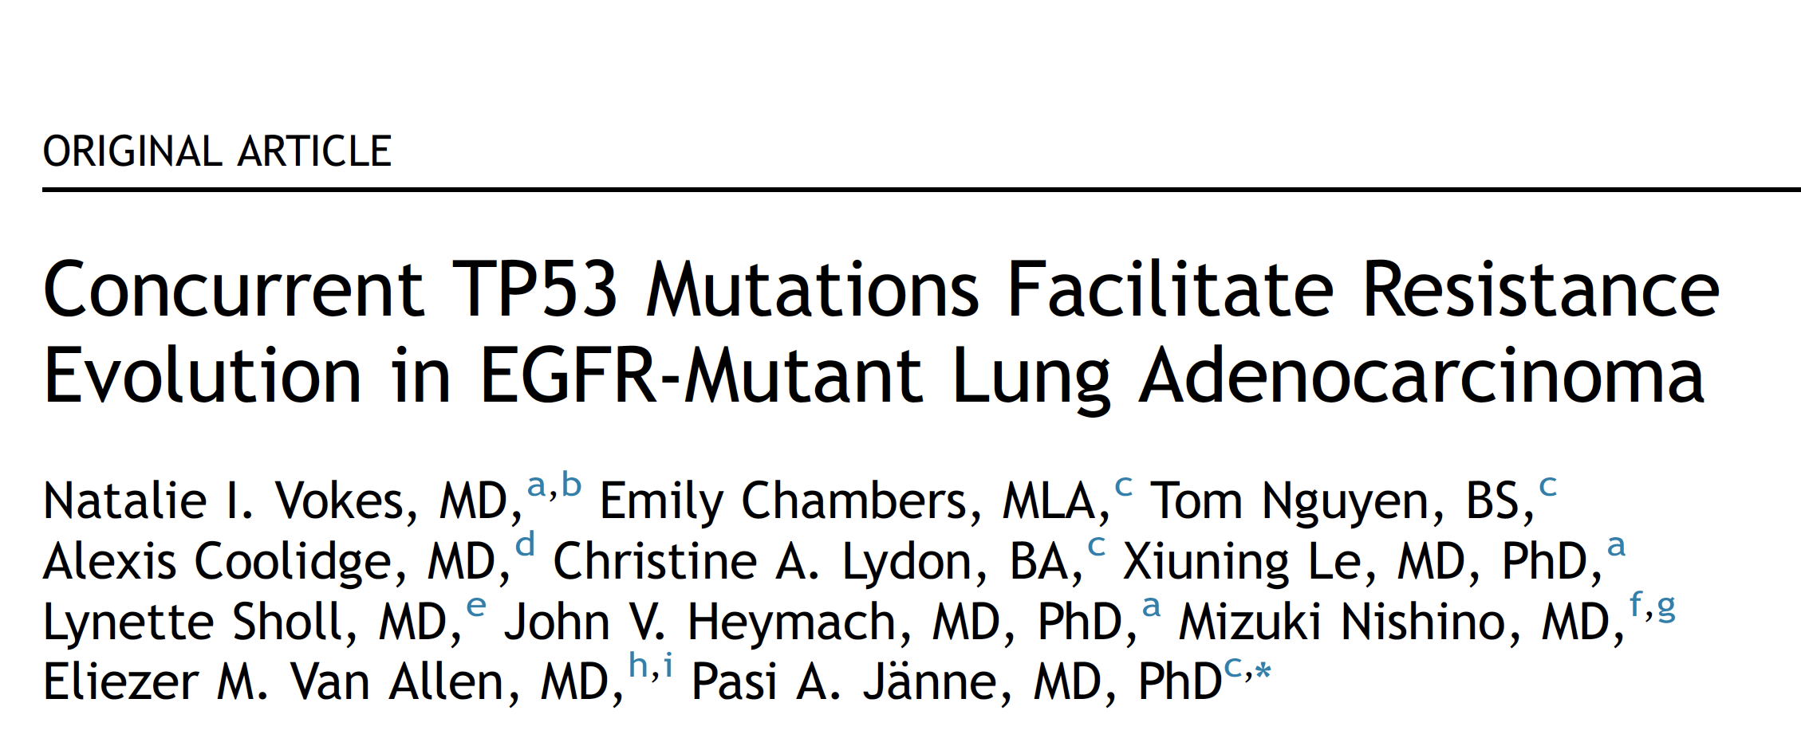
J Thorac Oncol 2022 June;17(6):779-92.

Slide 85
Meet The Professor with Dr Jänne
INTRODUCTION: Journal Club with Dr Jänne – Part 1
MODULE 1: Case Presentations
MODULE 2: Faculty Survey
MODULE 3: Journal Club with Dr Jänne – Part 2
MODULE 4: Appendix of Key Publications

Slide 86
Localized NSCLC with EGFR Mutation

Slide 87
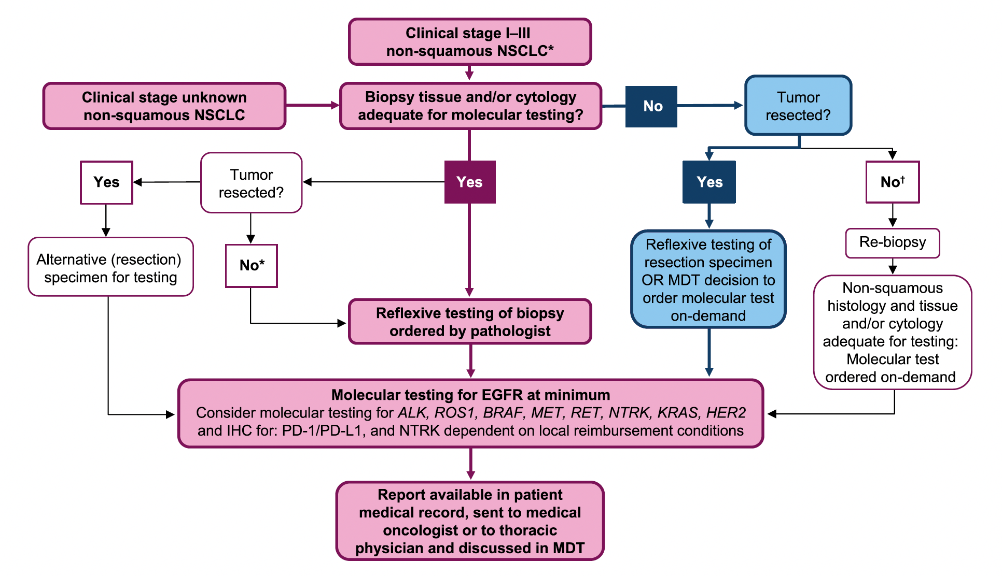
Proposed Algorithm for Molecular Testing in Patients with Stage I to Stage III NSCLC (Resectable and Unresectable)
MDT = multidisciplinary team
Aggarwal C et al. Lung Cancer 2021;162:42-53.

Slide 88
Phase III Trials of Adjuvant EGFR Inhibitors for Localized NSCLC
Study | N | Setting | Regimens | Median F/U | DFS Hazard ratio | OS Hazard ratio
BR 19 | 503 | Stage IB, II, IIA 4% mEGFR | Gefitinib x 2 y Placebo x 2 y | 56.4 mo | 1.22 | 1.24
RADIANT | 973 | Stage IB-IIIA 6.5% mEGFR | Erlotinib x 2 y Placebo x 2 y | 47 mo | 0.90 | 1.13
CTONG1104 | 222 | Stage II-IIIA (N1-N2) 100% mEGFR | Gefitinib x 2 y Cis/vin x 4 | 76.9 mo | 5-y DFS: 22.6% vs 23.2% | 0.92
IMPACT | 232 | Stage IIA-IIIB 100% mEGFR | Gefitinib x 2 y Cis/vin x 4 | 70.1 mo | 0.92 | 1.03
F/U = follow-up; DFS = disease-free survival; OS = overall survival; mEGFR = EGFR mutation-positive; cis/vin = cisplatin/vinorelbine
Melosky B et al. Ther Adv Med Oncol 2021;13:1-15. Sotelo MJ et al. World J Clin Oncol 2021;12(10):912-25.
Belluomini L et al. Cells 2021;10(10):2685.

Slide 89
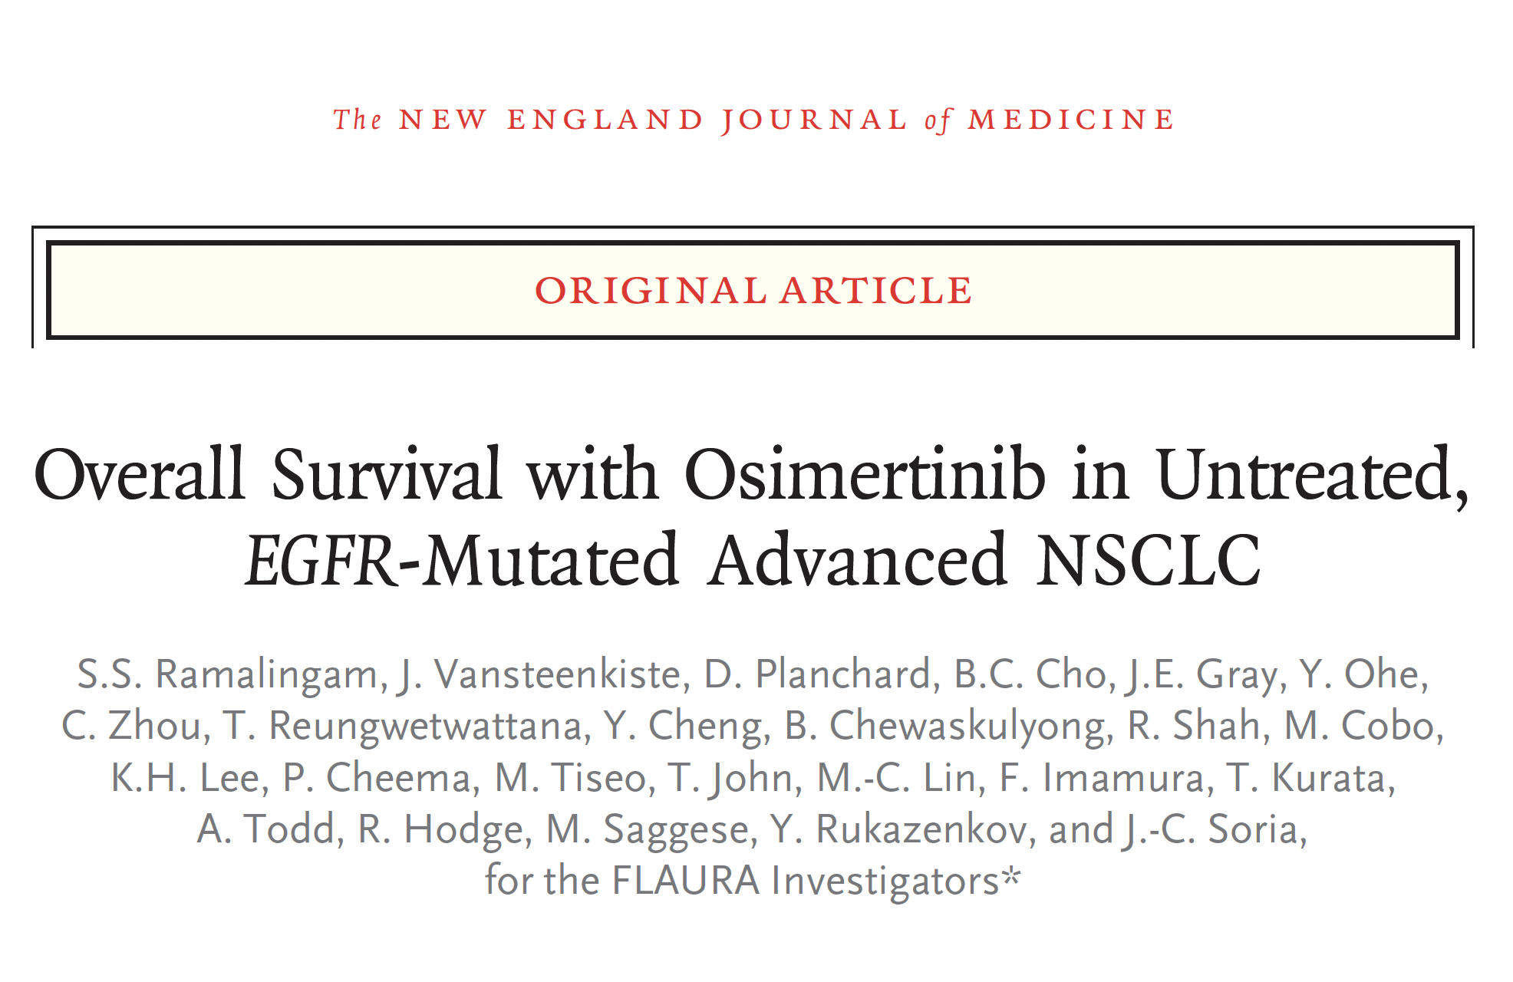
N Engl J Med 2020;382:41-50.

Slide 90
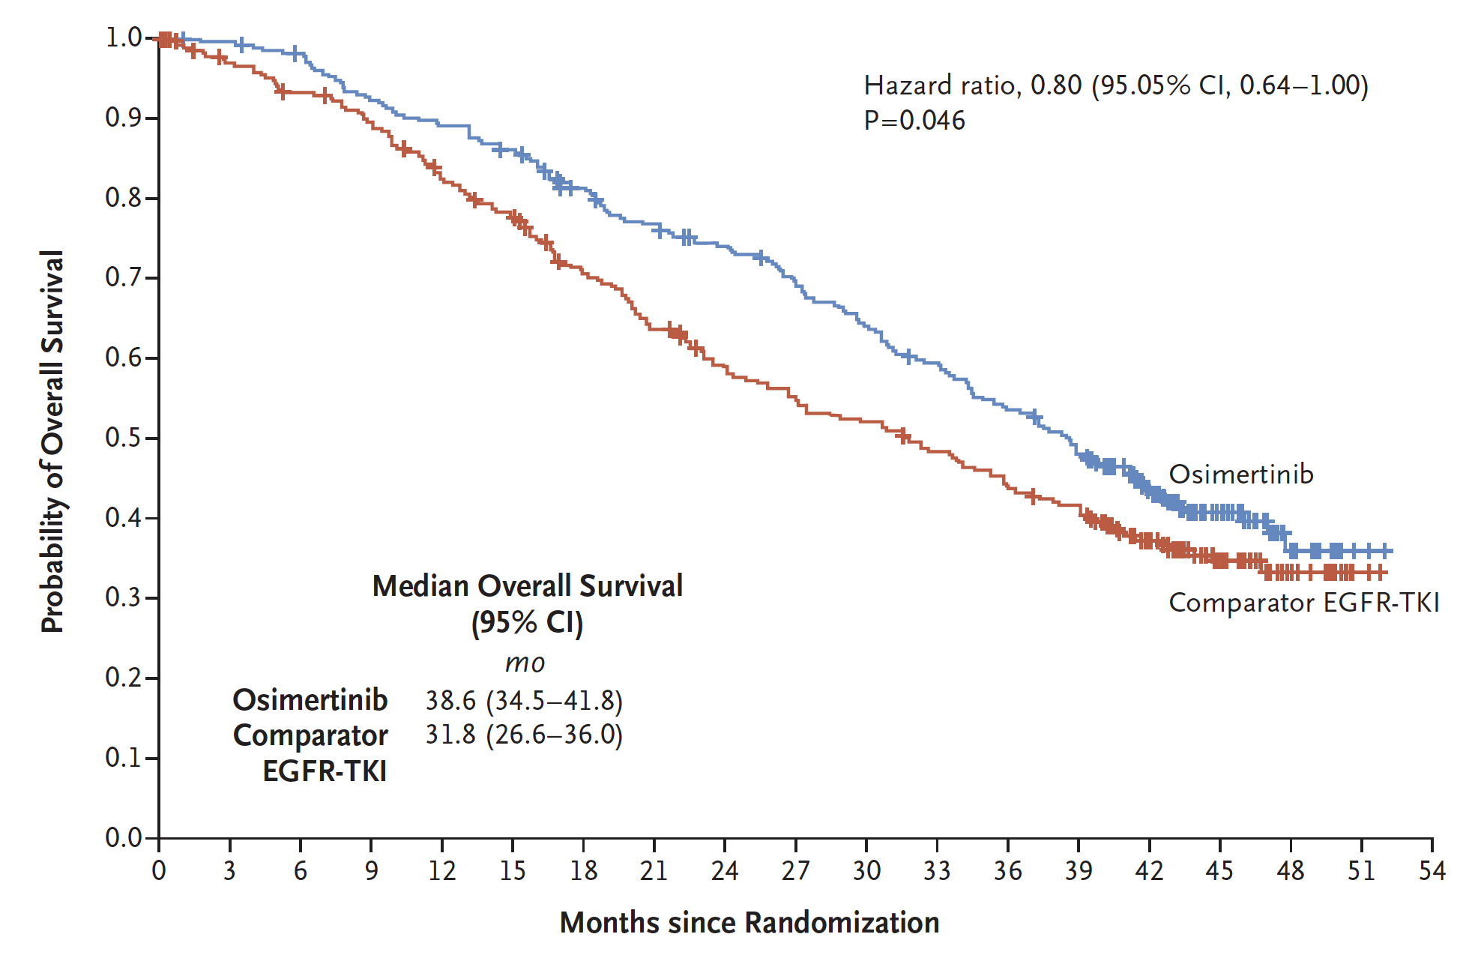
FLAURA: Overall Survival
Overall survival
 | Osimertinib (n = 279) | Comparator EGFR TKI (n = 277)
At 12 mo | 89% | 83%
At 24 mo | 74% | 59%
At 36 mo | 54% | 44%
Hazard ratio, 0.80
p = 0.046
Ramalingam SS et al. N Engl J Med 2020;382;41-50.

Slide 91
Abstract LBA47

Slide 92
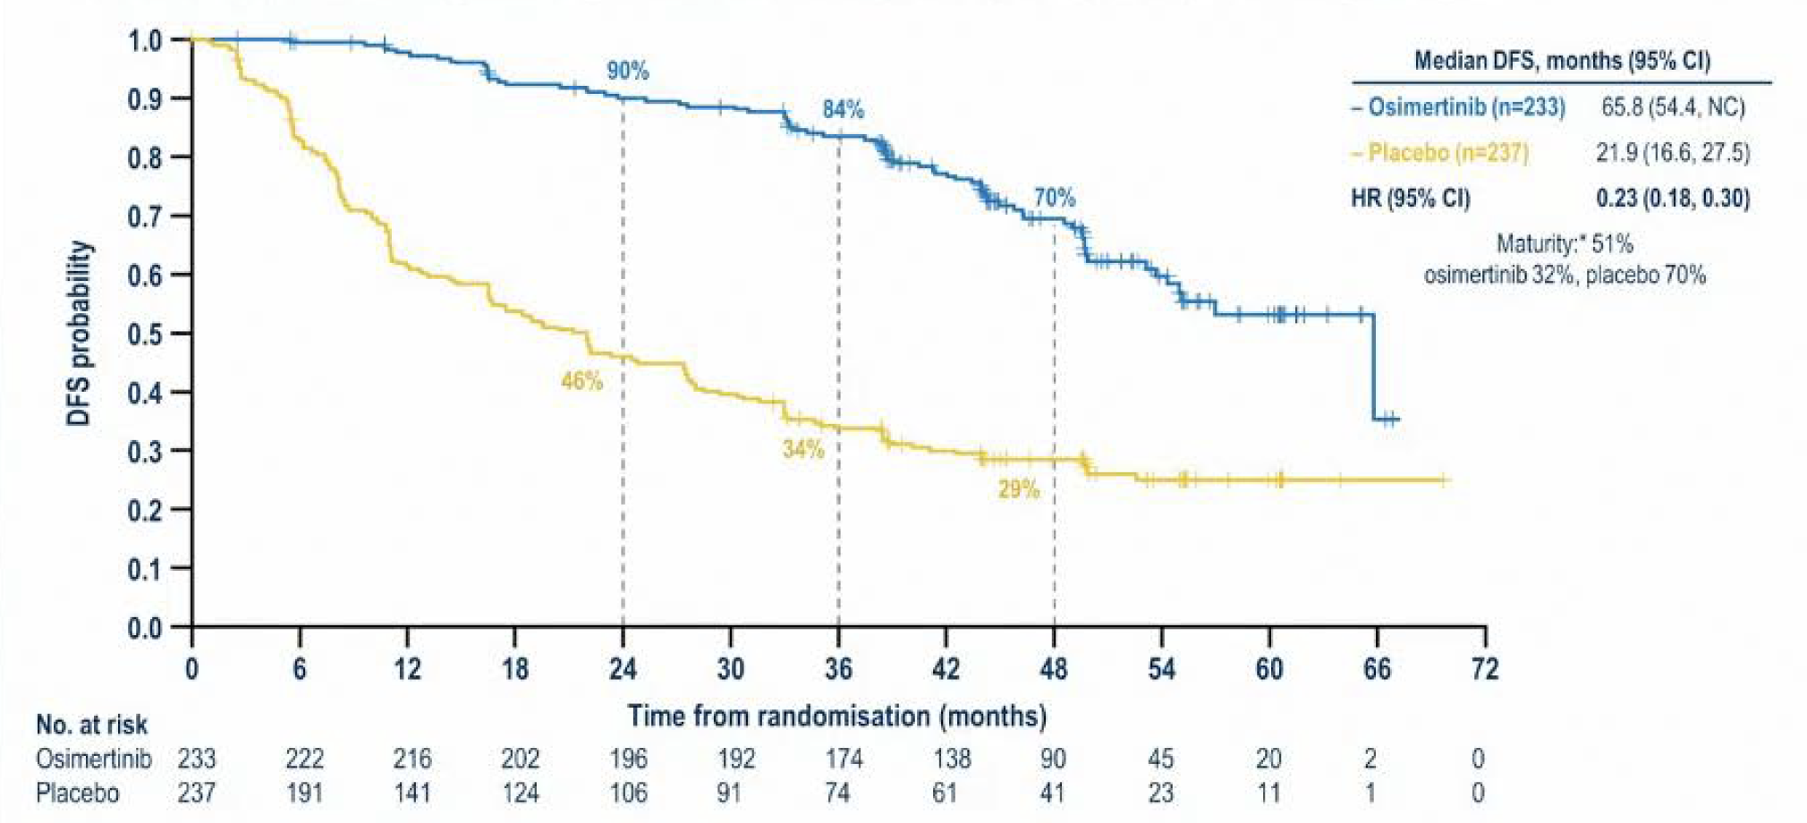
ADAURA Updated Results: DFS in Stage II/IIIA Disease
DFS = disease-free survival
Tsuboi M et al. ESMO 2022;Abstract LBA47.

Slide 93
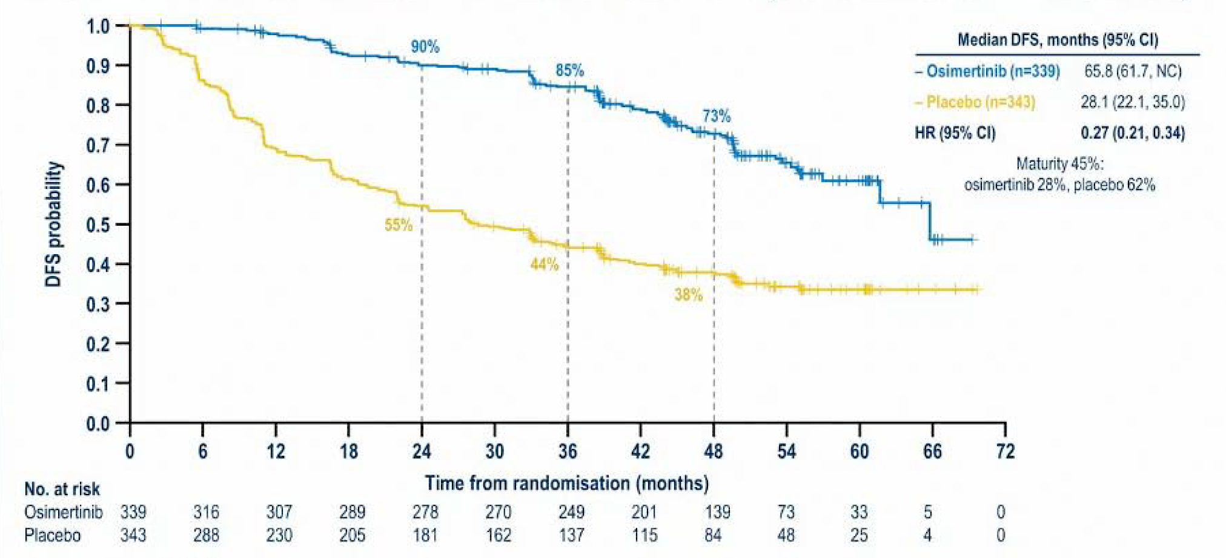
ADAURA Updated DFS Results in the Overall Population (Stage IB/II/IIIA Disease)
Tsuboi M et al. ESMO 2022;Abstract LBA47.

Slide 94
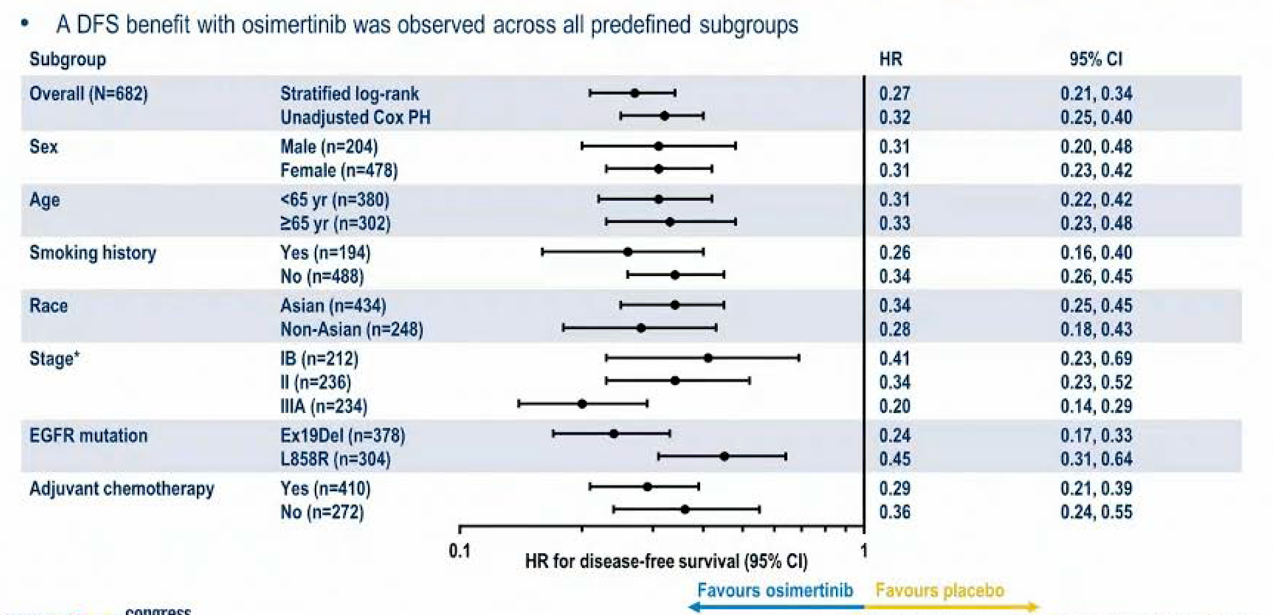
ADAURA Updated DFS Results in Subgroups in the Overall Population
Tsuboi M et al. ESMO 2022;Abstract LBA47.

Slide 95
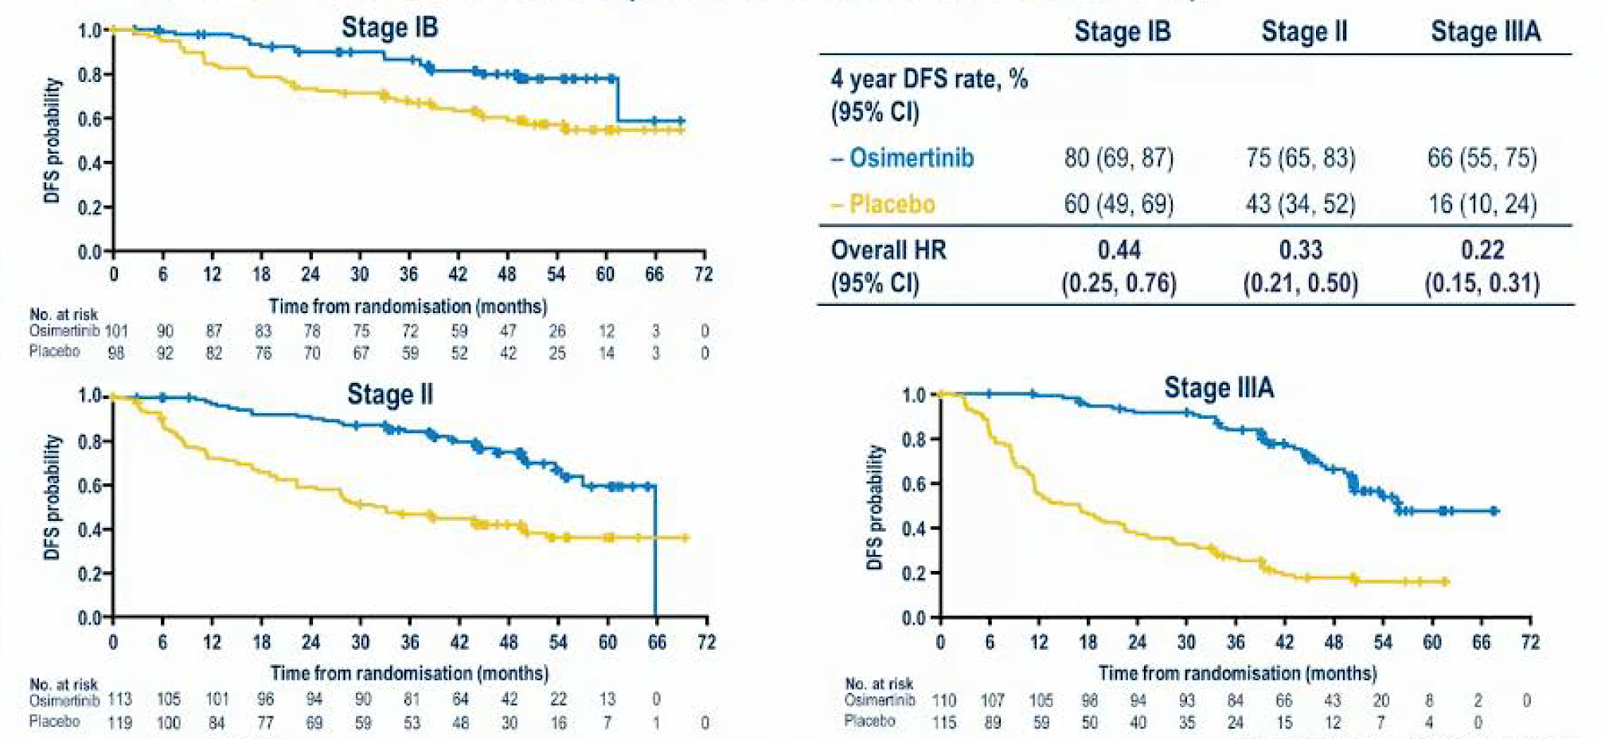
ADAURA Updated DFS by Stage (AJCC/UICC 8th Edition)
Tsuboi M et al. ESMO 2022;Abstract LBA47.

Slide 96
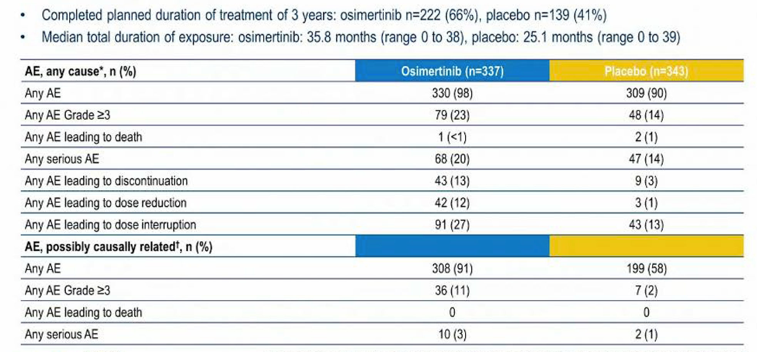
ADAURA Updated Safety Summary
AE = adverse event
Tsuboi M et al. ESMO 2022;Abstract LBA47.

Slide 97
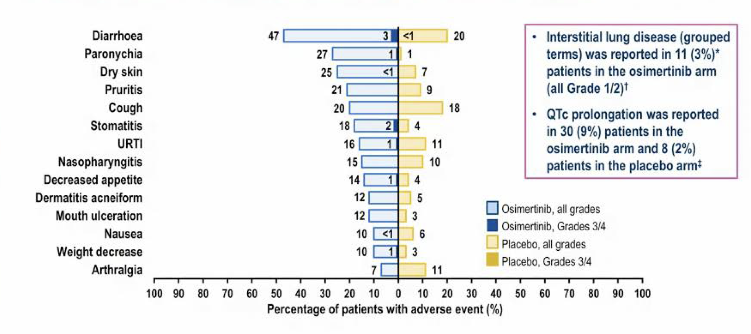
ADAURA Updated Results: All Causality Adverse Events (≥10% of Patients)
URTI = upper respiratory tract infection
Tsuboi M et al. ESMO 2022;Abstract LBA47.

Slide 98
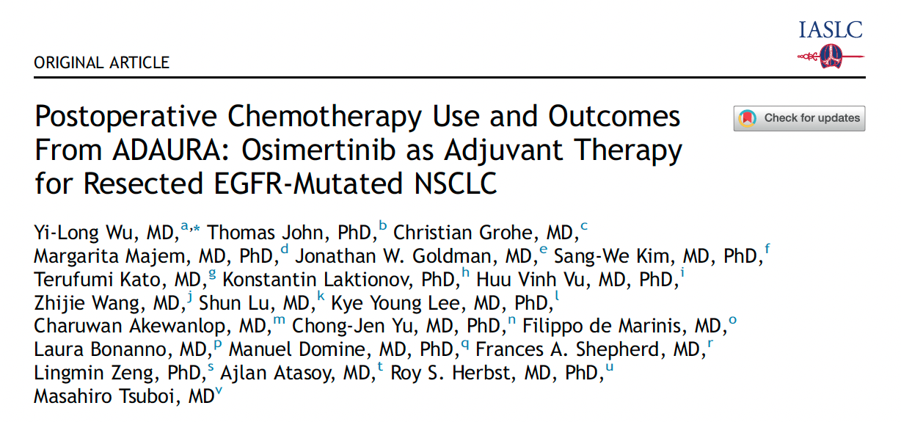
J Thorac Oncol 2022;17(3):423-33.

Slide 99
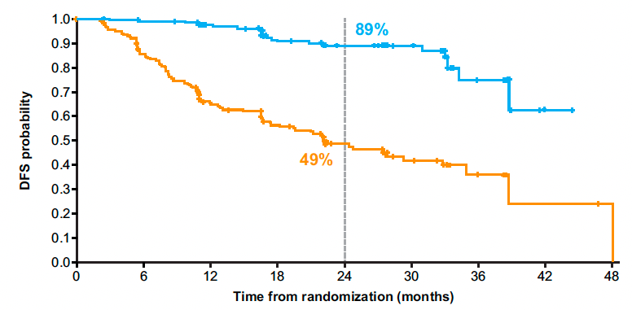
ADAURA: Updated DFS with Adjuvant Osimertinib for Patients Receiving and Not Receiving Adjuvant Chemotherapy
With adjuvant chemotherapy
Without adjuvant chemotherapy
Osimertinib
Osimertinib
Placebo
Placebo
Wu Y-L et al. J Thorac Oncol 2022;17(3):423-33.

Slide 100
ADAURA: Updated DFS with Adjuvant Osimertinib for Patients Receiving and Not Receiving Adjuvant Chemotherapy — Subgroups
Wu Y-L et al. J Thorac Oncol 2022;17(3):423-33.

Slide 101
Clin Cancer Res 2022;[Online ahead of print].

Slide 102
ADAURA: Health-Related Quality of Life over Time
Physical Component Summary
Mental Component Summary
Majem M et al. Clin Cancer Res 2022;[Online ahead of print].

Slide 103
Select Ongoing Phase III Studies of TKIs for Unresected or Unresectable NSCLC with EGFR Mutation
Study | No. of patients | NSCLC stage | Randomization | Est primary completion
NeoADAURA (NCT04351555) | 328 | Unresected II-IIIB N2 | Osimertinib Osimertinib + chemotherapy Chemotherapy | March 2024
PACIFIC-4/RTOG-3515 (NCT03833154) | 733 | Unresected IA2-IA3 | SBRT + osimertinib SBRT + durvalumab SBRT + placebo | June 2025
LAURA (NCT03521154) | 197 | Unresectable III | Chemotherapy → osimertinib maintenance Chemotherapy → placebo maintenance | January 2023
TKI = tyrosine kinase inhibitor; SBRT = stereotactic body radiation therapy
www.clinicaltrials.gov. Accessed June 2022.

Slide 104
Select Ongoing Phase III Studies of TKIs in the Adjuvant Setting for NSCLC with EGFR Mutation
Study | No. of patients | NSCLC stage | Randomization | Est primary completion
ADAURA2 (NCT05120349) | 380 | IA2-IA3 | Osimertinib Placebo | August 2027
FORWARD (NCT04853342) | 318 | II-IIIA | Furmonertinib (AST2818) Placebo | December 2023
EVIDENCE (NCT02448797) | 320 | II-IIIA | Icotinib Standard chemotherapy | June 2022
ICTAN (NCT01996098) | 318 | IIA-IIIA | Chemotherapy → icotinib for 6 mo Chemotherapy → icotinib for 12 mo Chemotherapy | January 2020*
*Recruitment ongoing
www.clinicaltrials.gov. Accessed June 2022.

Slide 105
FDA Approves Atezolizumab as Adjuvant Treatment for NSCLC Press Release: October 15, 2021
“The Food and Drug Administration approved atezolizumab for adjuvant treatment following resection and platinum-based chemotherapy in patients with stage II to IIIA non-small cell lung cancer (NSCLC) whose tumors have PD-L1 expression on ≥ 1% of tumor cells, as determined by an FDA-approved test.
Today, the FDA also approved the VENTANA PD-L1 (SP263) Assay as a companion diagnostic device to select patients with NSCLC for adjuvant treatment with atezolizumab.
The major efficacy outcome measure was disease-free survival (DFS) as assessed by the investigator in the primary efficacy analysis population (n = 476) of patients with stage II-IIIA NSCLC with PD-L1 expression on ≥1% of tumor cells (PD-L1 ≥1% TC). Median DFS was not reached in patients on the atezolizumab arm compared with 35.3 months on the BSC arm (HR 0.66; p = 0.004). In a pre-specified secondary subgroup analysis of patients with PD-L1 TC ≥ 50% stage II-IIIA NSCLC, the DFS HR was 0.43. In an exploratory subgroup analysis of patients with PD-L1 TC 1-49% stage II-IIIA NSCLC, the DFS HR was 0.87.
The recommended atezolizumab dose for this indication is 840 mg every 2 weeks, 1,200 mg every 3 weeks, or 1,680 mg every 4 weeks for up to 1 year.”
https://www.fda.gov/drugs/resources-information-approved-drugs/fda-approves-atezolizumab-adjuvant-treatment-non-small-cell-lung-cancer

Slide 106
Lancet 2021;398(10308):1344-57.

Slide 107
IMpower010 Primary Endpoint: Disease-Free Survival in the PD-L1 ≥1% Tumor Cells Stage II-IIIA Population
Felip E et al. Lancet 2021;398(10308):1344-57.

Slide 108
IMpower010: Disease-Free Survival by EGFR Mutation Status
Felip E et al. Lancet 2021;398(10308):1344-57.

Slide 109
Current and Future Management of Metastatic NSCLC with EGFR Mutation

Slide 110
Select Ongoing Phase III Studies of First-Line Therapy for Patients with Metastatic NSCLC and Activating EGFR Mutations
Study | No. of patients | Randomization | Est primary completion
FLAURA2 | 587 | Osimertinib Osimertinib + platinum-based chemo | April 2023
MARIPOSA | 1,000 | Amivantamab + lazertiniib Osimertinib + placebo Lazertinib + placebo | April 2024
ECOG-ACRIN EA5182 | 300 | Osimertinib Osimertinib + bevacizumab | September 2025
SANOVO* | 320 | Osimertinib + savolitinib Osimertinib + placebo | November 2024
FLETEO | 680 | Osimertinib TY-9591 | May 2025
* Sensitizing EGFR mutation and c-MET overexpression
www.clinicaltrials.gov. Accessed June 2022.

Slide 111
Mechanisms of Acquired Resistance to Osimertinib
Alterations that prevent inhibition of the target receptor tyrosine
Activation of bypass and/or
downstream signalling pathways
Changes in tumour
cell lineage such as
transformation
Cooper AJ et al. Nat Rev Clin Oncol 2022;19(8):499-514.

Slide 112
Broad Range of Resistance Mechanisms in NSCLC with EGFR Mutation After Failure of EGFR TKI Therapy
Janne PA et al. ASCO 2021;Abstract 9007.

Slide 113
Abstract LBA53

Slide 114
Alterations Observed at the Time of First-Line Osimertinib Resistance
Piotrowska Z et al. ESMO 2022;Abstract LBA53.

Slide 115
ELIOS Phase II Study Design
PD = disease progression; PFS = progression-free survival; ORR = objective response rate; DoR = duration of response; DCR = disease control rate; TTD = time to treatment discontinuation or death; TFST = time to first subsequent therapy or death
Piotrowska Z et al. ESMO 2022;Abstract LBA53.

Slide 116
ELIOS Primary Endpoint: High-Frequency Mutations from Baseline to Disease Progression (PAS-ITT)
Piotrowska Z et al. ESMO 2022;Abstract LBA53.

Slide 117
ELIOS Primary Endpoint: Summary of Major Alterations at Baseline and PD (PAS-ITT)
Piotrowska Z et al. ESMO 2022;Abstract LBA53.

Slide 118
Abstract LBA51

Slide 119
APPLE Phase II Study Design
BM = brain metastases; PD = disease progression
Remon J et al. ESMO 2022;Abstract LBA51.

Slide 120
APPLE: Switch to Osimertinib
Remon J et al. ESMO 2022;Abstract LBA51.

Slide 121
APPLE Primary Endpoint: PFS Rate at 18 Months by Investigator Assessment Arm B
Osi = osimertinib
Remon J et al. ESMO 2022;Abstract LBA51.

Slide 122
APPLE: Overall Survival (OS)
Remon J et al. ESMO 2022;Abstract LBA51.

Slide 124
INSIGHT 2 Study Background
TKI = tyrosine kinase inhibitor; 1L = first-line
Mazieres J et al. ESMO 2022;Abstract LBA52.

Slide 125
INSIGHT 2 Phase II Study Design
ORR = objective response rate; IRC = independent review committee
Mazieres J et al. ESMO 2022;Abstract LBA52.

Slide 126
INSIGHT 2: Objective Response Rate of Tepotinib with Osimertinib
ORR = objective response rate; BOR = best overall response; PR = partial response; SD = stable disease; PD = progressive disease; NE = not evaluated; GCN = gene copy number; AE = adverse event
Mazieres J et al. ESMO 2022;Abstract LBA52.

Slide 127
INSIGHT 2: Antitumor Activity of Tepotinib with Osimertinib
Mazieres J et al. ESMO 2022;Abstract LBA52.

Slide 128
INSIGHT 2: Safety Profile
AEs = adverse events; TRAEs = treatment-related AEs
Mazieres J et al. ESMO 2022;Abstract LBA52.

Slide 129
ORCHARD Osimertinib + Savolitinib Interim Analysis: A Biomarker-Directed Phase II Platform Study in Patients with Advanced Non-Small Cell Lung Cancer (NSCLC) Whose Disease Has Progressed on First-Line (1L) Osimertinib
Yu HA et al.
ESMO 2021;Abstract 1239P.

Slide 130
ORCHARD Study Design
Yu HA et al. ESMO 2021;Abstract 1239P.

Slide 131
ORCHARD: Response and Duration of Response
ORR: 41%
ORR = objective response rate; DCO = data cutoff
Yu HA et al. ESMO 2021;Abstract 1239P.

Slide 132
ORCHARD: Incidence of Grade ≥3 Adverse Events
Yu HA et al. ESMO 2021;Abstract 1239P.

Slide 133
Select Ongoing Studies to Overcome Mechanisms of Resistance to EGFR TKIs for Advanced NSCLC
Study/phase | No. of patients | Eligibility | Treatment
SAVANNAH Phase II | 294 | Locally advanced/metastatic EGFR mutation MET amplified/overexpressed PD on osimertinib | Osimertinib + savolitinib
SAFFRON Phase III | 324 | Locally advanced/metastatic EGFR mutation MET amplified/overexpressed PD on osimertinib | Osimertinib + savolitinib Platinum-based doublet
COMPEL Phase III | 204 | Locally advanced/metastatic EGFR mutation Extracranial PD on first-line osimertinib | Platinum/pemetrexed + osimertinib Platinum/pemetrexed + placebo
MARIPOSA-2 Phase III | 500 | Locally advanced/metastatic EGFR mutation PD on osimertinib | Platinum-based chemotherapy + amivantamab + lazertinib Platinum-based chemotherapy
PD = disease progression
www.clinicaltrials.gov. Accessed June 2022.

Slide 134
FDA Grants Breakthrough Therapy Status to Patritumab Deruxtecan for Metastatic NSCLC with EGFR Mutation Press Release: January 4, 2022
“Patritumab deruxtecan (U3-1402), a potential first-in-class HER3 directed antibody-drug conjugate, was granted breakthrough therapy designation by the FDA for the treatment of patients with metastatic or locally advanced, EGFR-mutant non–small cell lung cancer (NSCLC).
The regulatory decision, which is designed to accelerate the development and regulatory review process of potential new therapies, was based on data from a dose escalation study and 2 expansion cohorts from a 3-cohort trial.
Data from a phase 1 trial (NCT03260491) assessing the efficacy of patritumab deruxtecan in a heavily pretreated population of patients with EGFR-mutant NSCLC that have become resistant to other TKIs were read out at the 2021 American Society of Clinical Oncology Annual Meeting: Lung Cancer. A 5.6 mg/kg dose of the treatment resulted in a confirmed objective response rate of 39% (95% CI, 26%-52%) in a population of patients who were previously treated with a TKI and platinum-based therapy (n = 57). Additionally, treatment with patritumab deruxtecan resulted in a disease control rate of 72% (95% CI, 59%-83%), as well as a median progression-free survival of 8.2 months (95% CI, 4.0-not evaluable).
https://www.cancernetwork.com/view/fda-grants-breakthrough-therapy-status-to-patritumab-deruxtecan-for-egfr-metastatic-nsclc

Slide 135
Cancer Discov 2022;12(1):74-89.

Slide 136
Patritumab Deruxtecan (HER3-DXd) Targeting HER3 May Address Multiple EGFR TKI Resistance Mechanisms
HER3-DXd is an antibody-drug conjugate with 3 components:
A fully human anti-HER3 IgG1 mAb (patritumab), covalently linked to:
A topoisomerase I inhibitor payload, an exatecan derivative, via
A tetrapeptide-based cleaver linker
Janne PA et al. ASCO 2021;Abstract 9007.

Slide 137
Responses by Blinded Independent Central Review
Jänne PA et al. Cancer Discov 2022;12(1):74-89.

Slide 138
Summary of Treatment-Emergent Adverse Events (TEAEs)
RDE = recommended dose for expansion
Jänne PA et al. Cancer Discov 2022;12(1):74-89.

Slide 139
Select Grade ≥3 Treatment-Emergent Adverse Events (TEAEs)
Jänne PA et al. Cancer Discov 2022;12(1):74-89.

Slide 140
HERTHENA-Lung02: An Ongoing Phase III Trial of Patritumab Deruxtecan for NSCLC with EGFR Mutation After Failure of an EGFR TKI
Trial identifier: NCT05338970 (Open)
Estimated enrollment: 560
Eligibility
Locally advanced or metastatic nonsquamous NSCLC with EGFR activating mutation 1 or 2 prior lines of an approved EGFR TKI in the metastatic or locally advanced setting, which must include a third-generation EGFR TKI Radiographic disease progression while receiving or after receiving a third-generation EGFR TKI
Patritumab deruxtecan
R
Platinum-based chemotherapy
Primary endpoint: Progression-free survival by blinded independent central review
www.clinicaltrials.gov. Accessed June 2022.

Slide 141
A patient with locally advanced NSCLC who receives definitive chemoradiation therapy followed by 1 year of consolidation durvalumab experiences disease progression 3 months later and is found to have an EGFR exon 19 deletion. Assuming the patient is clinically stable, how long would you like to wait before starting osimertinib?
Would start now
3 mo from last dose of ICI
Consider starting now, but likely erlotinib for 3-6 mo then consider switching
As long as possible depending on the disease tempo
Would start now if local tx not possible
Would start now
ICI = immune checkpoint inhibitor therapy

Slide 142
If an asymptomatic patient with metastatic nonsquamous NSCLC with an EGFR exon 19 deletion and a PD-L1 TPS of 10% responded to first-line osimertinib followed by disease progression, what would be your second-line treatment recommendation if the patient had acquired a MET amplification?
Continue osimertinib and add capmatinib or tepotinib
Continue osimertinib and add capmatinib or tepotinib
Continue osimertinib and add tepotinib Carboplatin/pemetrexed/ bevacizumab
Continue osimertinib and add crizotinib or capmatinib
Continue osimertinib and add capmatinib, tepotinib or savolitinib
Continue osimertinib and add carboplatin/ pemetrexed*
* If MET highly amplified and no EGFRm, capmatinib alone; if MET and EGFRm, then osimertinib/capmatinib (cautiously)

Slide 143
If an asymptomatic patient with metastatic nonsquamous NSCLC with an EGFR exon 19 deletion and a PD-L1 TPS of 10% responded to first-line osimertinib followed by disease progression, what would be your second-line treatment recommendation if the patient had acquired a BRAF V600E mutation?
Continue osimertinib and add carboplatin/ pemetrexed
Continue osimertinib and add dabrafenib/ trametinib
Carboplatin/ pemetrexed + bevacizumab
Continue osimertinib and add carboplatin/ pemetrexed
Continue osimertinib and add dabrafenib/ trametinib
Continue osimertinib and add carboplatin/ pemetrexed*
* If BRAFm alone and no EGFRm, BRAFi/MEKi

Slide 144
A patient with nonsquamous NSCLC with an EGFR exon 19 deletion and systemic and brain metastases has a good response to first-line osimertinib but experiences disease progression and is switched to chemotherapy. Would you continue the osimertinib?
Yes, indefinitely
Yes, indefinitely
Yes, indefinitely, but depends on brain met PD vs systemic PD
Yes, indefinitely
No
Yes, indefinitely
PD = disease progression

Slide 145
Available Therapeutic Strategies for Patients with NSCLC Harboring an EGFR Exon 20 Insertion Mutation

Slide 146
2021;16(3):e0247620.

Slide 147
Global Exon 20 Insertion Rates
Region | EGFR exon 20 insertion among all patients with NSCLC | EGFR exon 20 insertion among patients with NSCLC and EGFR mutations
USA | 0.5%-2.6% | 5%-12%
Latin America | 1.3%-2.1% | 5%-8%
Europe | 0.3%-1.3% | 4%-12%
Asia Pacific | 0.1%-4.0% | 1%-5%
Burnett H et al. PLoS One 2021;16(3):e0247620.

Slide 148
FDA Grants Accelerated Approval to Amivantamab-vmjw for Metastatic NSCLC Press Release: May 21, 2021
“The Food and Drug Administration granted accelerated approval to amivantamab-vmjw, a bispecific antibody directed against epidermal growth factor (EGF) and MET receptors, for adult patients with locally advanced or metastatic non-small cell lung cancer (NSCLC) with epidermal growth factor receptor (EGFR) exon 20 insertion mutations, as detected by an FDA-approved test, whose disease has progressed on or after platinum-based chemotherapy.
FDA also approved the Guardant360® CDx as a companion diagnostic for amivantamab-vmjw.
Approval was based on CHRYSALIS, a multicenter, non-randomized, open label, multicohort clinical trial (NCT02609776) which included patients with locally advanced or metastatic NSCLC with EGFR exon 20 insertion mutations. Efficacy was evaluated in 81 patients with advanced NSCLC with EGFR exon 20 insertion mutations whose disease had progressed on or after platinum-based chemotherapy. Patients received amivantamab-vmjw once weekly for 4 weeks, then every 2 weeks thereafter until disease progression or unacceptable toxicity.”
https://www.fda.gov/drugs/resources-information-approved-drugs/fda-grants-accelerated-approval-amivantamab-vmjw-metastatic-non-small-cell-lung-cancer

Slide 149
J Clin Oncol 2021;39(30):3391-402.

Slide 150
CHRYSALIS: Tumor Reduction and Response
Overall response rate: 40%
Clinical benefit rate: 74%
Park K et al. J Clin Oncol 2021;39(30):3391-402.

Slide 151
CHRYSALIS: Summary of Adverse Events (AEs) and Most Common AEs
Most Common AEs in the Safety Population
Adverse Events | Any Grade | Grade ≥3
Rash | 86% | 4%
Infusion-related reactions | 66% | 3%
Paronychia | 45% | 1%
RP2D = recommended Phase II dose
Park K et al. J Clin Oncol 2021;39(30):3391-402.

Slide 152
Abstract 9006

Slide 153
CHRYSALIS-2: Rationale for Combining Amivantamab and Lazertinib
Shu CA et al. ASCO 2022;Abstract 9006.

Slide 154
CHRYSALIS-2 Study Design
Shu CA et al. ASCO 2022;Abstract 9006.

Slide 155
CHRYSALIS-2: Best Antitumor Response and ORR by Prior Therapy Group
BICR = blinded independent central review; ORR = overall response rate; INV = investigator
Shu CA et al. ASCO 2022;Abstract 9006.

Slide 156
CHRYSALIS-2: Safety Profile
Shu CA et al. ASCO 2022;Abstract 9006.

Slide 157
Abstract 9007

Slide 158
EGFR Exon 20 Insertion Mutations in NSCLC
Yu H et al. ASCO 2022;Abstract 9007.

Slide 159
CLN-081-001 Study Schema
Yu H et al. ASCO 2022;Abstract 9007.

Slide 160
CLN-081-001: Baseline Characteristics
Yu H et al. ASCO 2022;Abstract 9007.

Slide 161
CLN-081-001: Safety Profile
Yu H et al. ASCO 2022;Abstract 9007.

Slide 162
CLN-081-001: Best Percent Change from Baseline and Confirmed Response by Dose Level
Yu H et al. ASCO 2022;Abstract 9007.

Slide 163
CLN-081-001: Conclusions
Yu H et al. ASCO 2022;Abstract 9007.

Slide 164
FDA Grants Accelerated Approval to Mobocertinib for Metastatic NSCLC with EGFR Exon 20 Insertion Mutations Press Release: September 15, 2021
“The Food and Drug Administration granted accelerated approval to mobocertinib for adult patients with locally advanced or metastatic non-small cell lung cancer (NSCLC) with epidermal growth factor receptor (EGFR) exon 20 insertion mutations, as detected by an FDA-approved test, whose disease has progressed on or after platinum-based chemotherapy.
Today, the FDA also approved the Oncomine Dx Target Test as a companion diagnostic device to select patients with the above mutations for mobocertinib treatment.
Approval was based on Study 101, an international, non-randomized, open-label, multicohort clinical trial (NCT02716116) which included patients with locally advanced or metastatic NSCLC with EGFR exon 20 insertion mutations. Efficacy was evaluated in 114 patients whose disease had progressed on or after platinum-based chemotherapy. Patients received mobocertinib 160 mg orally daily until disease progression or intolerable toxicity.”
https://www.fda.gov/drugs/resources-information-approved-drugs/fda-grants-accelerated-approval-mobocertinib-metastatic-non-small-cell-lung-cancer-egfr-exon-20

Slide 165
JAMA Oncol 2021;7(12):e214761

Slide 166
Mobocertinib Activity in Patients with Platinum-Pretreated Metastatic NSCLC with EGFRex20ins Mutation (PPP Cohort)
 | PPP cohort (n = 114) | EXCLAIM cohort (n = 96)
ORR | 35% | 32%
Duration of response | 17.5 mo | Not reached
Median PFS | 7.3 mo | 7.3 mo
Median OS | 24 mo | Not reached
PPP = platinum pretreated patients; ORR = objective response rate
Zhou C et al. JAMA Oncol 2021;7(12):e214761.

Slide 167
Summary of Adverse Events (AEs) and Most Common AEs with Mobocertinib
Zhou C et al. JAMA Oncol 2021;7(12):e214761.

