Slide 1
Year in Review: Clinical Investigators Provide
Perspectives on the Most Relevant New Publications,
Data Sets and Advances in Oncology
Prostate Cancer
Tuesday, December 1, 2020
5:00 PM – 6:00 PM ET
Faculty
Emmanuel S Antonarakis, MD
Andrew J Armstrong, MD, ScM
Moderator
Neil Love, MD

Slide 2


YiR Prostate Cancer Faculty
Emmanuel S Antonarakis, MD
Professor of Oncology and Urology
Johns Hopkins University
The Sidney Kimmel Comprehensive Cancer Center
Baltimore, Maryland
Andrew J Armstrong, MD, ScM
Professor of Medicine, Surgery, Pharmacology and Cancer Biology
Director of Research
Duke Cancer Institute Center for Prostate and Urologic Cancers
Divisions of Medical Oncology and Urology
Duke University
Durham, North Carolina

Slide 3
Commercial Support
This activity is supported by educational grants from Astellas and Pfizer Inc, AstraZeneca Pharmaceuticals LP, Bayer HealthCare Pharmaceuticals, Clovis Oncology, Merck, and Sanofi Genzyme.

Slide 4
Dr Love — Disclosures
Dr Love is president and CEO of Research To Practice. Research To Practice receives funds in the form of educational grants to develop CME activities from the following commercial interests: AbbVie Inc, Acerta Pharma — A member of the AstraZeneca Group, Adaptive Biotechnologies Corporation, Agendia Inc, Agios Pharmaceuticals Inc, Amgen Inc, Array BioPharma Inc, a subsidiary of Pfizer Inc, Astellas, AstraZeneca Pharmaceuticals LP, Bayer HealthCare Pharmaceuticals, Biodesix Inc, bioTheranostics Inc, Blueprint Medicines, Boehringer Ingelheim Pharmaceuticals Inc, Bristol-Myers Squibb Company, Celgene Corporation, Clovis Oncology, Daiichi Sankyo Inc, Dendreon Pharmaceuticals Inc, Eisai Inc, EMD Serono Inc, Epizyme Inc, Exelixis Inc, Foundation Medicine, Genentech, a member of the Roche Group, Genmab, Genomic Health Inc, Gilead Sciences Inc, GlaxoSmithKline, Grail Inc, Guardant Health, Halozyme Inc, Helsinn Healthcare SA, ImmunoGen Inc, Incyte Corporation, Infinity Pharmaceuticals Inc, Ipsen Biopharmaceuticals Inc, Janssen Biotech Inc, administered by Janssen Scientific Affairs LLC, Jazz Pharmaceuticals Inc, Karyopharm Therapeutics, Kite, A Gilead Company, Lexicon Pharmaceuticals Inc, Lilly, Loxo Oncology Inc, a wholly owned subsidiary of Eli Lilly & Company, Merck, Merrimack Pharmaceuticals Inc, Myriad Genetic Laboratories Inc, Natera Inc, Novartis, Oncopeptides, Pfizer Inc, Pharmacyclics LLC, an AbbVie Company, Prometheus Laboratories Inc, Puma Biotechnology Inc, Regeneron Pharmaceuticals Inc, Sandoz Inc, a Novartis Division, Sanofi Genzyme, Seagen Inc, Sirtex Medical Ltd, Spectrum Pharmaceuticals Inc, Sumitomo Dainippon Pharma Oncology Inc, Taiho Oncology Inc, Takeda Oncology, Tesaro, A GSK Company, Teva Oncology, Tokai Pharmaceuticals Inc and Verastem Inc.

Slide 5
Research To Practice CME Planning Committee Members,
Staff and Reviewers
Planners, scientific staff and independent reviewers for Research To Practice have no relevant conflicts of interest to disclose.

Slide 6
Dr Antonarakis — Disclosures
Consulting Agreements | Amgen Inc, Astellas, AstraZeneca Pharmaceuticals LP, Bayer HealthCare Pharmaceuticals, Clovis Oncology, Dendreon Pharmaceuticals Inc, ESSA Pharma Inc, GlaxoSmithKline, Janssen Biotech Inc, Lilly, Medivation Inc, a Pfizer Company, Merck, Sanofi Genzyme
Contracted Research | AstraZeneca Pharmaceuticals LP, Bristol-Myers Squibb Company, Celgene Corporation, Clovis Oncology, Dendreon Pharmaceuticals Inc, Genentech, a member of the Roche Group, Janssen Biotech Inc, Johnson & Johnson Pharmaceuticals, Merck, Novartis, Sanofi Genzyme, Tokai Pharmaceuticals Inc
Ownership Interest (Licenser of Patent) | QIAGEN

Slide 7
Dr Armstrong — Disclosures
Advisory Committee | Astellas, AstraZeneca Pharmaceuticals LP, Bayer HealthCare Pharmaceuticals, Merck
Consulting Agreements | Astellas, AstraZeneca Pharmaceuticals LP, Bayer HealthCare Pharmaceuticals, Genomic Health Inc, Janssen Biotech Inc, Merck, Pfizer Inc, Sumitomo Dainippon Pharma Oncology Inc
Contracted Research | Astellas, AstraZeneca Pharmaceuticals LP, Bayer HealthCare Pharmaceuticals, Bristol-Myers Squibb Company, Constellation Pharmaceuticals, Dendreon Pharmaceuticals Inc, Genentech, a member of the Roche Group, Janssen Biotech Inc, Merck, Novartis, Pfizer Inc, Roche Laboratories Inc
Speakers Bureau | Bayer HealthCare Pharmaceuticals, Dendreon Pharmaceuticals Inc

Slide 8
Key Prostate Cancer Clinical Algorithms:
What We’ve Learned This Year – Part 1
In the treatment algorithm, when should the following generally be recommended?
Post-prostatectomy radiation therapy – Dr Armstrong
Oral GnRH receptor antagonist relugolix – Dr Antonarakis
Androgen deprivation therapy (ADT) for PSA-only relapse after local therapy (M0) –
Dr Armstrong
Adding an antiandrogen agent to ADT in castration-resistant M0 disease – Drs Antonarakis and Armstrong
Utilizing prostate-directed local therapy for metastatic hormone-sensitive prostate cancer (mHSPC) – Dr Antonarakis
Adding an antiandrogen, abiraterone or docetaxel to ADT for mHSPC – Drs Armstrong
and Antonarakis

Slide 9
Key Prostate Cancer Clinical Algorithms:
What We’ve Learned This Year – Part 2
In the treatment algorithm, when should the following generally be recommended?
Endocrine treatment versus chemotherapy after first-line endocrine therapy for
metastatic castration-resistant prostate cancer (mCRPC) – Drs Antonarakis
and Armstrong
Radium-223 in mCRPC – Dr Armstrong
PARP inhibitors in mCRPC; recommended genomic evaluation – Drs Antonarakis
and Armstrong
PSMA-targeted treatment and imaging – Drs Armstrong and Antonarakis
TMPRSS2 and COVID-19 – Dr Antonarakis

Slide 10
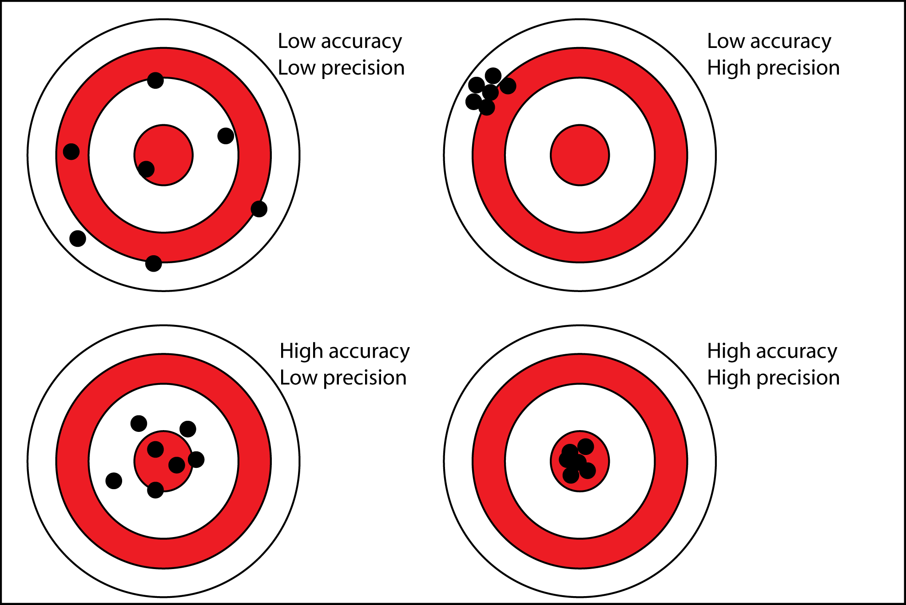
Four Key Advances in 2019-20 in Advanced Prostate Cancer
Improved survival in nmCRPC with new AR therapies
Improved survival in mHSPC with new AR therapies
Cabazitaxel solidified as 3rd line therapy in mCRPC: the CARD trial
Precision medicine comes in mCRPC: homologous repair and PARP inhibition
Courtesy of Andrew J Armstrong, MD, ScM

Slide 11
Treatment Evolution in Metastatic Prostate Cancer
Enzalutamide and Apalutamide M0 CRPC (PROSPER and SPARTAN)
 |  | Cabazitaxel | Sipuleucel-T | Abiraterone | Enzalutamide
 |  | TROPIC | IMPACT | COU-302 | PREVAIL
LHRH
Mitoxantrone
Darolutamide for M0 CRPC (ARAMIS)
Denosumab
2013
1976
1996
2010
2014
2018
2019
2021: PSMA therapeutics?
1940
1980
2004
2011
2012
2015
2017
2019
2020
PROFOUND and TRITON2
PARP inhibitors: olaparib and rucaparib
Antiandrogens
Orchiectomy
Abiraterone
COU-301⁵
Enzalutamide
AFFIRM⁶
Radium-223
ALSYMPCA⁷
Zoledronic acid
Docetaxel TAX-327 SWOG 99-16
mHSPC Enzalutamide and Apalutamide
ARCHES
ENZAMET
TITAN
Docetaxel CHAARTED STAMPEDE
Abiraterone LATITUDE STAMPEDE
1. Tannock IF, et al. N Engl J Med. 2004;351:1502-12. 2. Petrylak D, et al. N Engl J Med. 2004;351:1513-20. 3. de Bono J, et al. Lancet. 2010;376:1147-54. 4. Kantoff PW, et al. N Engl J Med. 2010;363:411-22. 5. de Bono JS, et al. N Engl J Med. 2011;364:1995-2005. 6. Scher HI, et al. N Engl J Med. 2012;367:1187-97. 7. Parker C, et al. N Engl J Med. 2013;369:213-23. 8. Ryan CJ, et al. N Engl J Med. 2013;368:138-48. 9. Beer TM, et al. N Engl J Med. 2014;371:424-33. 10. Sweeney CJ, et al. N Engl J Med. 2015;373:737-46. 11. James ND, et al. Lancet. 2016;387:1163-77. 12. Fizazi K, et al. N Engl J Med. 2017;377:352-60. 13. James ND, et al. N Engl J Med. 2017;377:338-51.
Courtesy of Andrew J Armstrong, MD, ScM

Slide 12
Module 1
In the treatment algorithm, when should post-prostatectomy radiation therapy generally be recommended?
Discussant: Dr Armstrong

Slide 13
3 Trials, Same Result: Evidence-Based Medicine!
TROG 08: Kneebone et al Lancet Oncol 2020
GETUG-AFU 17: Sargos P et al Lancet Oncol 2020
RADICALS: Parker CS et al Lancet Oncol 2020
Implications for men: avoidance of the side effects of radiation in many situations without compromising cure, such as erectile dysfunction and bowel/bladder risks
Courtesy of Andrew J Armstrong, MD, ScM

Slide 14
Module 2
In the treatment algorithm, when should the oral GnRH receptor antagonist relugolix be recommended if it were available?
Discussant: Dr Antonarakis

Slide 15
HERO Phase III Trial: Results Comparing Relugolix, an Oral GnRH Receptor Antagonist, versus Leuprolide Acetate for Advanced Prostate Cancer¹
Oral Relugolix for Androgen-Deprivation Therapy in Advanced Prostate Cancer²
¹ Shore N et al.
ASCO 2020;Abstract 5602.
² Shore ND et al.
N Engl J Med 2020;382(23):2187-96.

Slide 16
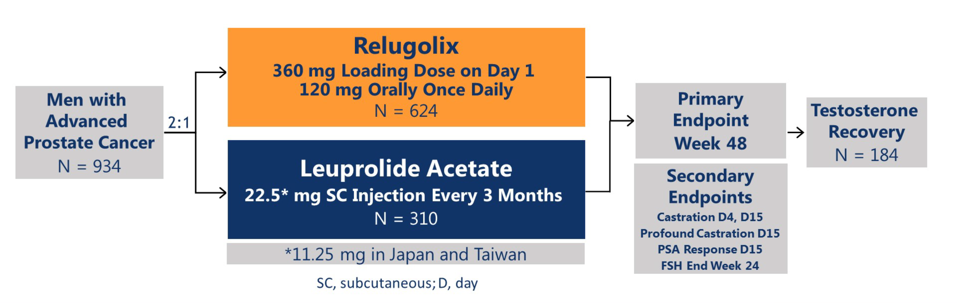
HERO: Ongoing Phase III Trial of Relugolix versus Leuprolide Acetate for Advanced HSPC
Shore N et al. ASCO 2020;Abstract 5602; Shore ND et al. N Engl J Med 2020;382(23):2187-96.

Slide 17
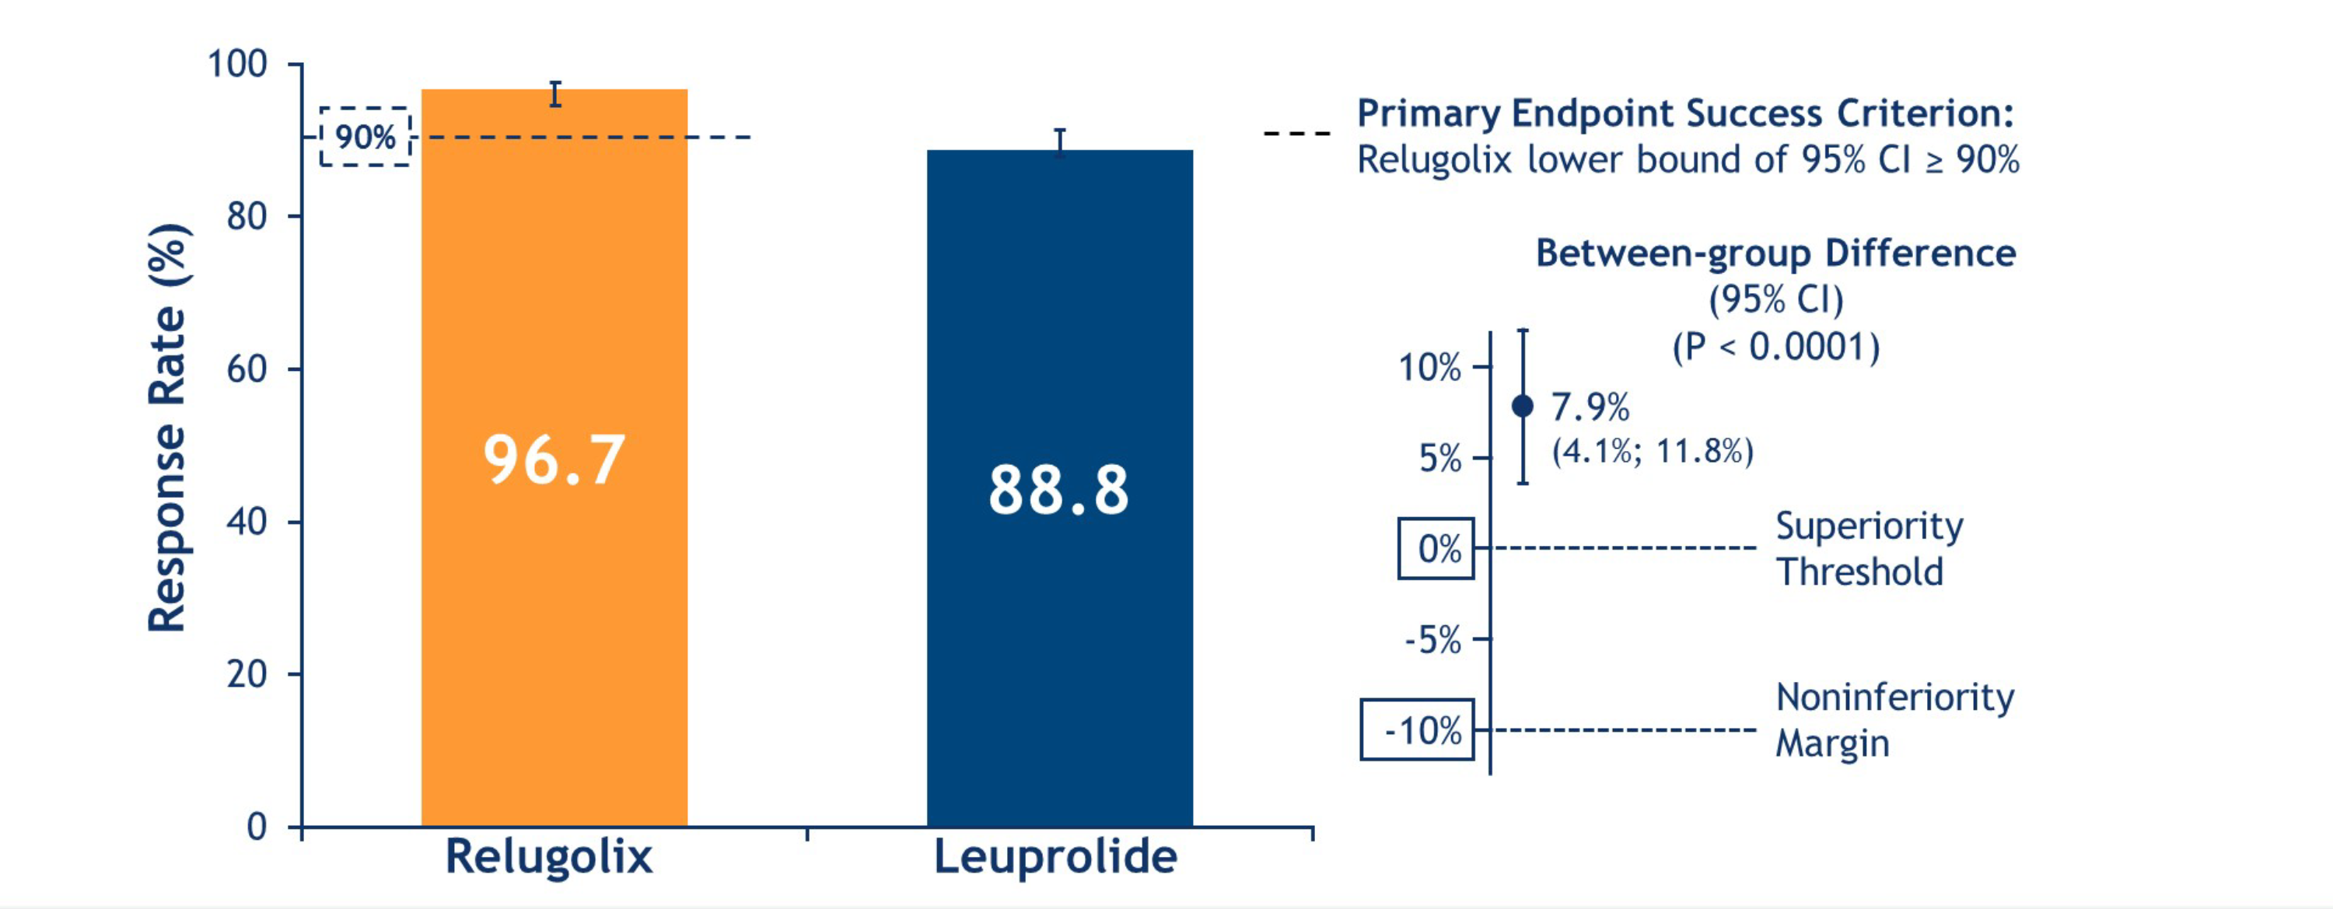
HERO: Primary Endpoint – Sustained Castration
Key Secondary Endpoint – Noninferiority to Leuprolide
Shore N et al. ASCO 2020;Abstract 5602; Shore ND et al. N Engl J Med 2020;382(23):2187-96.

Slide 18
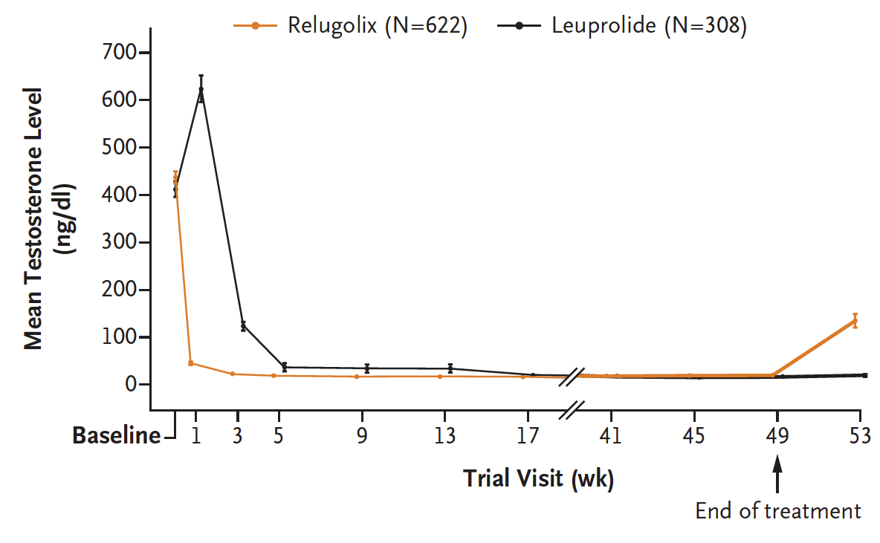
HERO: Mean Testosterone Level among All Patients
Shore ND et al. N Engl J Med 2020;382(23):2187-96.

Slide 19
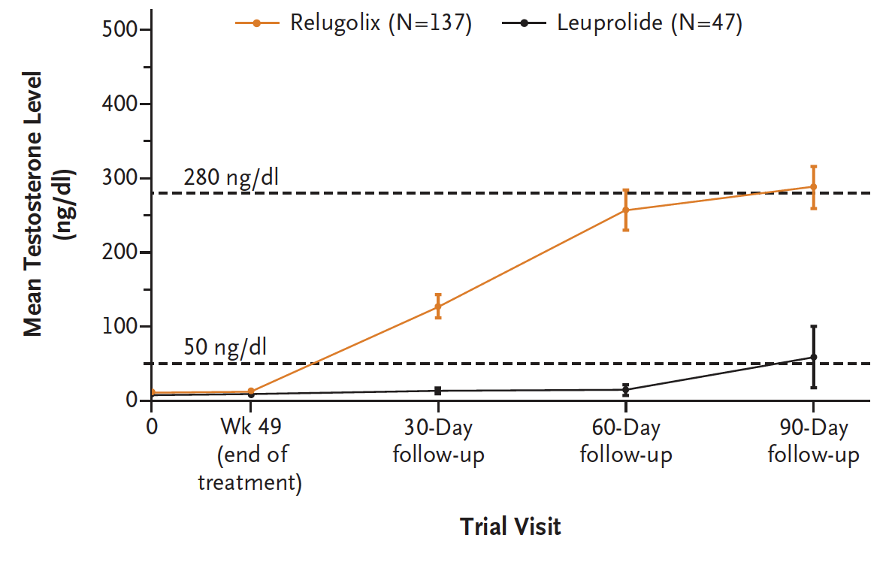
HERO: Mean Testosterone Level in Subgroup Followed for Testosterone Recovery
Shore ND et al. N Engl J Med 2020;382(23):2187-96.

Slide 20
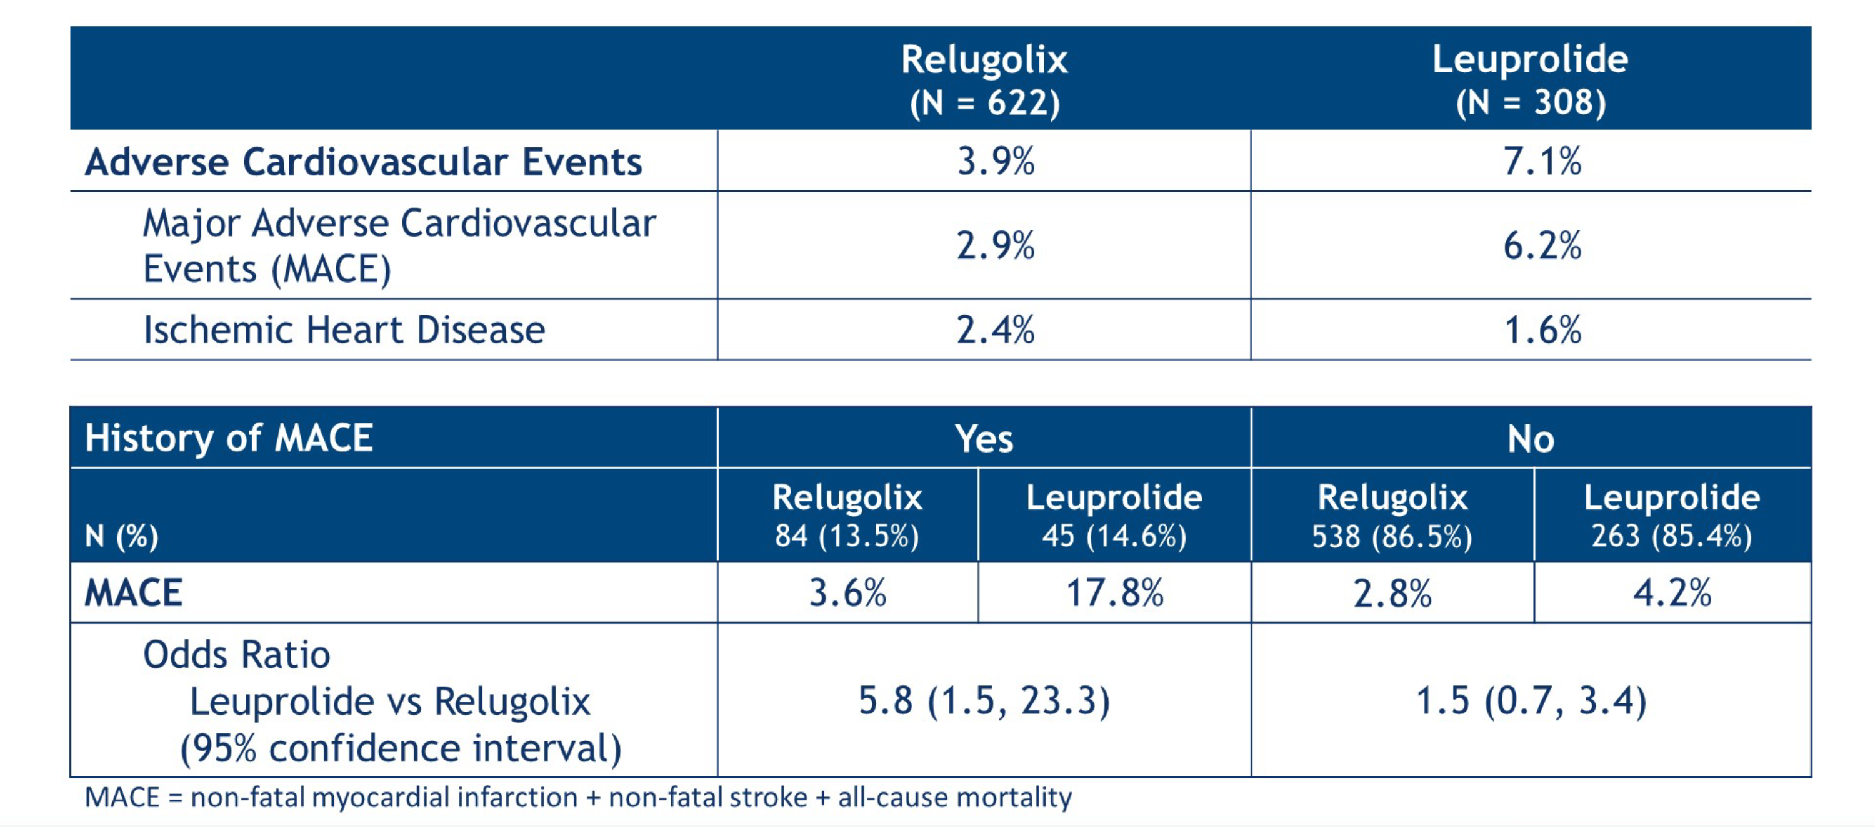
HERO: Cardiovascular Adverse Events
Shore N et al. ASCO 2020;Abstract 5602.

Slide 21
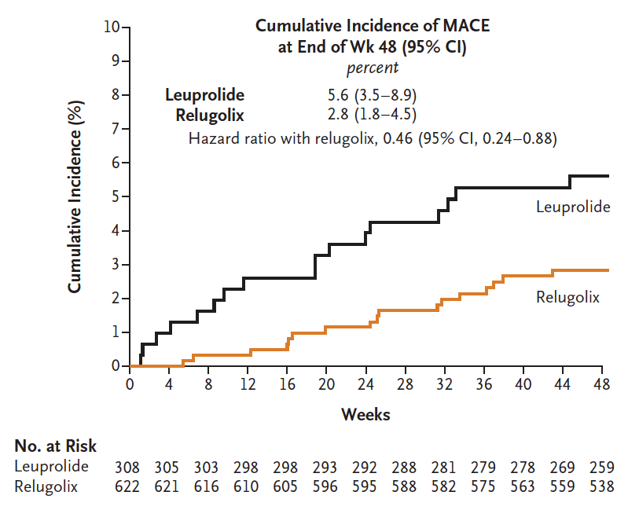
HERO: Cumulative Incidence of Major Adverse Cardiovascular Events (MACE)
Shore ND et al. N Engl J Med 2020;382(23):2187-96.

Slide 22
Module 3
In the treatment algorithm, when should ADT for PSA-only relapse (M0) after local therapy be recommended?
Discussant: Dr Armstrong

Slide 23
What PSA doubling time will generally lead you to initiate ADT for hormone-naïve M0 prostate cancer?
Less than 4 months
Less than 6 months
Less than 10 months
Less than 12 months
Less than 18 months
Less than 24 months
I don’t generally use PSA doubling time as the critical decision factor
ADT = androgen deprivation therapy
N = 75
Survey of live webinar audience

Slide 24
Module 4
In the treatment algorithm, when should an antiandrogen agent be added to ADT for castration-resistant M0 prostate cancer? (Selection of agent)
Discussants: Drs Antonarakis and Armstrong

Slide 25
In general, which is your preferred antiandrogen agent to add to ADT for patients with castration-resistant M0 prostate cancer?
Enzalutamide
Darolutamide
I don’t have a preferred antiandrogen agent
in this setting
Apalutamide
N = 92
Survey of live webinar audience

Slide 26
Recent FDA Approvals of Next-Generation Antiandrogens in Nonmetastatic Castration-Resistant Prostate Cancer
Agent | Approval date | Pivotal study
Darolutamide | July 30, 2020 | ARAMIS
Enzalutamide | July 12, 2018 | PROSPER
Apalutamide | February 14, 2018 | SPARTAN
https://www.fda.gov/drugs/resources-information-approved-drugs/

Slide 27
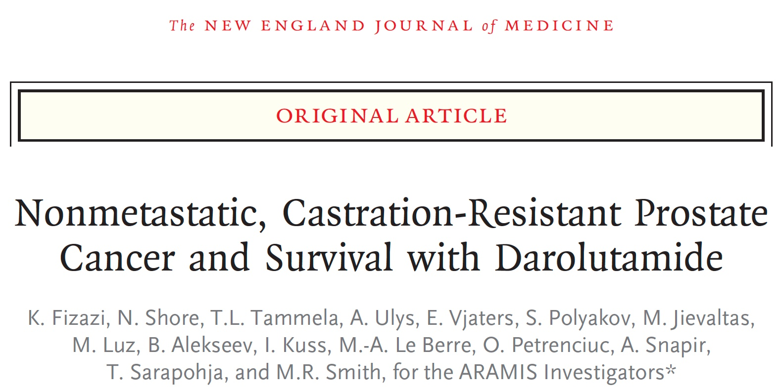
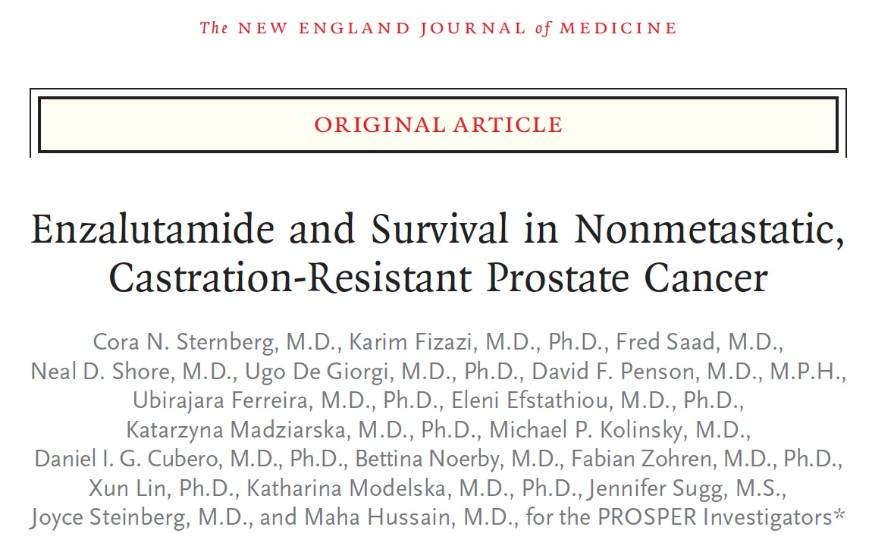
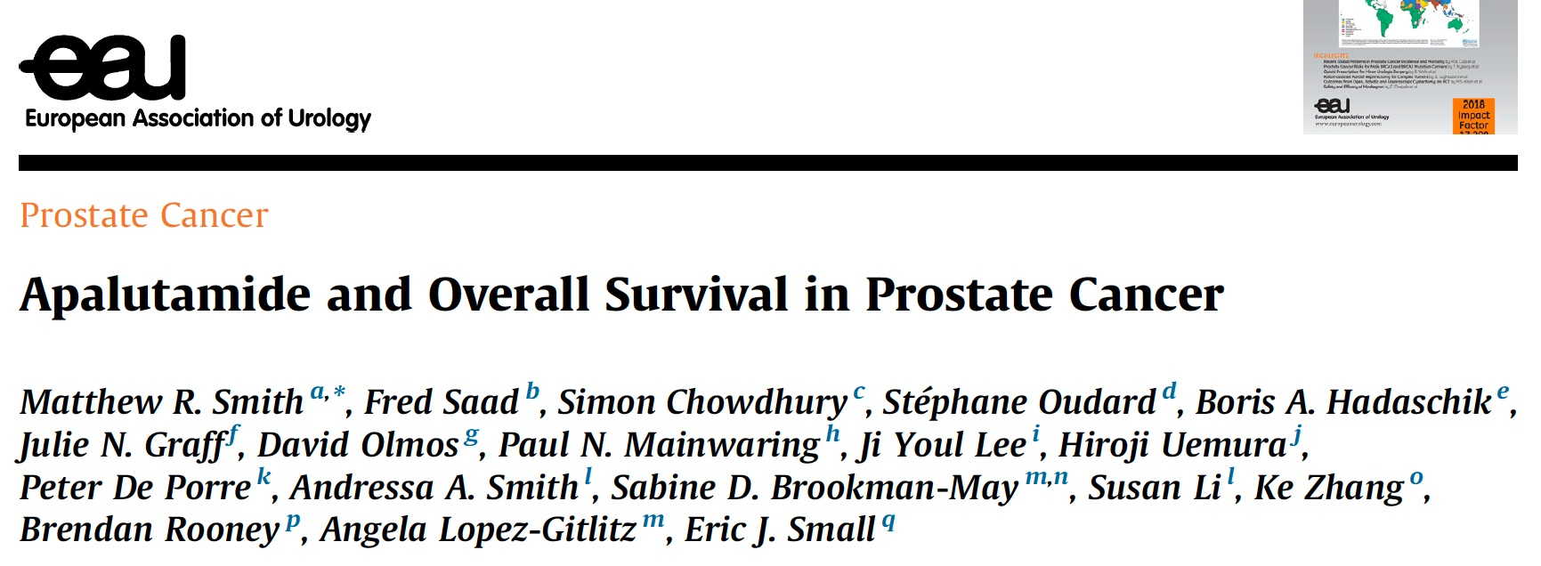
N Engl J Med 2020;382(23):2197-206.
N Engl J Med 2020;383:1040-9.
Eur J Cancer 2020;[Online ahead of print].

Slide 28
Overall Survival: Darolutamide, Enzalutamide, Apalutamide
 | ARAMIS¹ | PROSPER² | SPARTAN³
Antiandrogen | Darolutamide | Enzalutamide | Apalutamide
Median follow-up | 49 mo | 47 mo | 52 mo
Median OS | Not estimated | 57 vs 56 mo | 74 vs 60 mo
OS hazard ratio | 0.69 (p = 0.003) | 0.73 (p = 0.001) | 0.78 (p = 0.0161)
¹ Fizazi K et al; ARAMIS Investigators. N Engl J Med 2020;383:1040-9.
² Sternberg CN et al; PROSPER Investigators. N Engl J Med 2020;382(23):2197-206.
³ Smith MR et al; SPARTAN Investigators. Eur Urol 2020;[Online ahead of print].

Slide 29
Comparison of Toxicities: Darolutamide, Enzalutamide, Apalutamide
Toxicity | ARAMIS |  | PROSPER |  | SPARTAN
 | Darolutamide | Placebo | Enzalutamide | Placebo | Apalutamide | Placebo
Fatigue/asthenia | 16% | 11% | 33% | 14% | 30% | 21%
Falling | 4% | 5% | 11% | 4% | 16% | 9%
Dizziness | 5% | 4% | 10% | 4% | 9% | 6%
Mental impairment | 1% | 2% | 5% | 2% | 5% | 3%
Sternberg CN et al; PROSPER Investigators. N Engl J Med 2020;382(23):2197-206.
Fizazi K et al; ARAMIS Investigators. N Engl J Med 2020;383:1040-9.
Small EJ et al; SPARTAN Investigators. ASCO 2020;Abstract 5516.

Slide 30
Module 5
In the treatment algorithm, when do you use prostate-directed local therapy for mHSPC?
Discussant: Dr Antonarakis

Slide 31
Module 6
In the treatment algorithm, when do you add an antiandrogen agent, abiraterone or docetaxel to ADT for mHSPC? (Selection of agent)
Discussants: Drs Antonarakis and Armstrong

Slide 32
What is your most likely treatment approach for a 75-year-old man presenting de novo with prostate cancer with multiple symptomatic bone metastases and 2 lung metastases?
ADT and enzalutamide
ADT alone
ADT and abiraterone
ADT and docetaxel
ADT with docetaxel and endocrine treatment
ADT and apalutamide
N = 68
Survey of live webinar audience

Slide 33
Recent FDA Approvals of Next-Generation Antiandrogens in Metastatic Hormone-Sensitive Prostate Cancer
Agent | Approval date | Pivotal study
Enzalutamide | December 16, 2019 | ARCHES
Apalutamide | September 17, 2019 | TITAN
https://www.fda.gov/drugs/resources-information-approved-drugs/

Slide 34
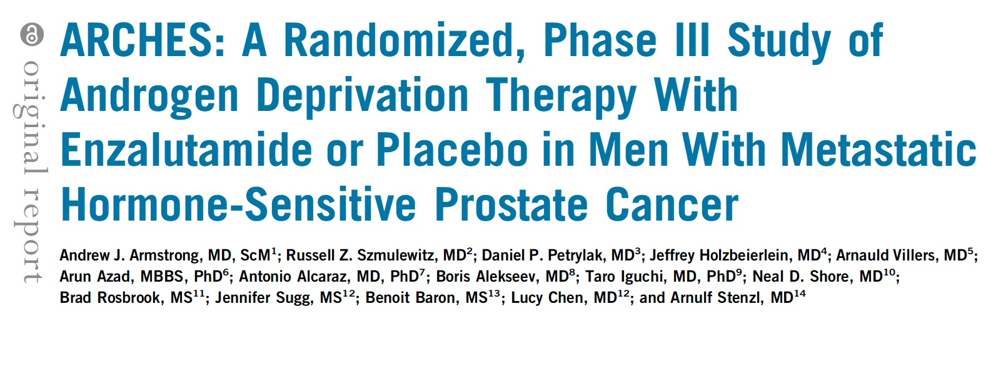
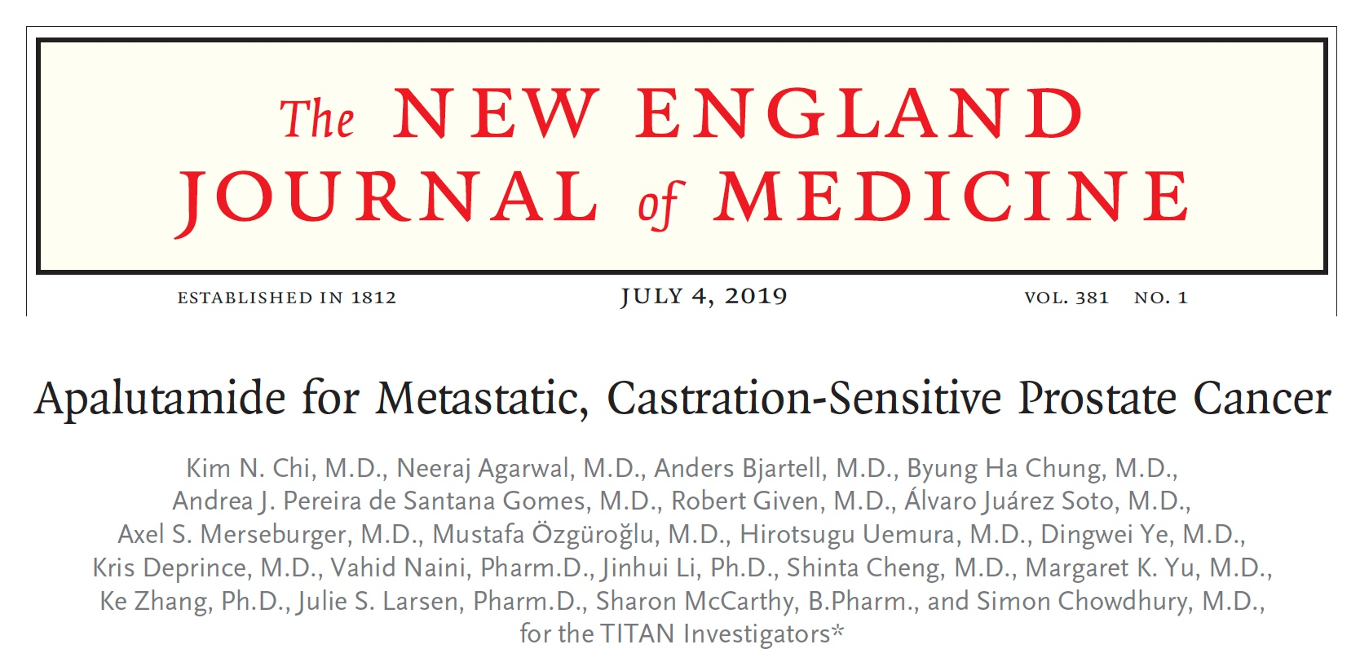
J Clin Oncol 2019;37(32):2974-86.
N Engl J Med 2019;381(1):13-24.

Slide 35
Survival Analyses for ARCHES and TITAN: ADT + Enzalutamide or Apalutamide in Metastatic HSPC
 | ARCHES (N = 1,150) |  | TITAN (N = 1,052)
Characteristics | 2/3rd high volume 17% prior docetaxel 25% prior RP/XRT |  | 2/3rd high volume 10% prior docetaxel 17% prior RP/XRT
 | ADT + enzalutamide (n = 574) | ADT (n = 576) | ADT + apalutamide (n = 955) | ADT (n = 554)
Radiographic PFS | NR | 19.0 mo | NR | 22.1 mo
 | HR (overall): 0.39 HR (prior docetaxel): 0.52 HR (high volume): 0.43 HR (low volume): 0.25 |  | HR (overall): 0.48 HR (prior docetaxel): 0.47 HR (high volume): 0.53 HR (low volume): 0.36
Overall survival | NR | NR | NR | NR
 | HR: 0.81 (immature) |  | HR (overall): 0.67 HR (prior docetaxel): 1.27 HR (high volume): 0.68 HR (low volume): 0.67
NR = not reached
Armstrong AJ et al. J Clin Oncol 2019;37(32):2974-86. Chi KN et al. N Engl J Med 2019;381(1):13-24.

Slide 36
Abiraterone Acetate plus Prednisolone for Hormone-Naïve Prostate Cancer (PCa): Long-Term Results from Metastatic (M1) Patients in the STAMPEDE Randomised Trial (NCT00268476)
James N et al.
ESMO 2020;Abstract 611O.

Slide 37
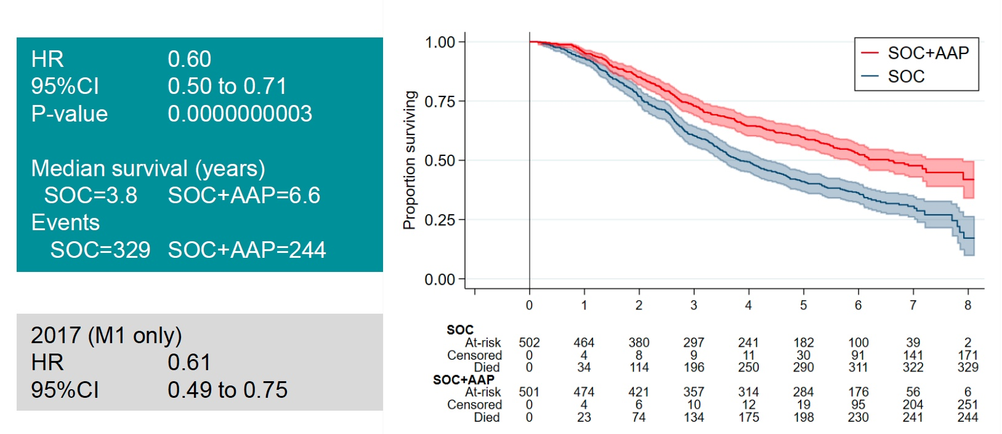
STAMPEDE — SOC + AAP vs SOC: Overall Survival
James N et al. ESMO 2020;Abstract 611O.

Slide 38
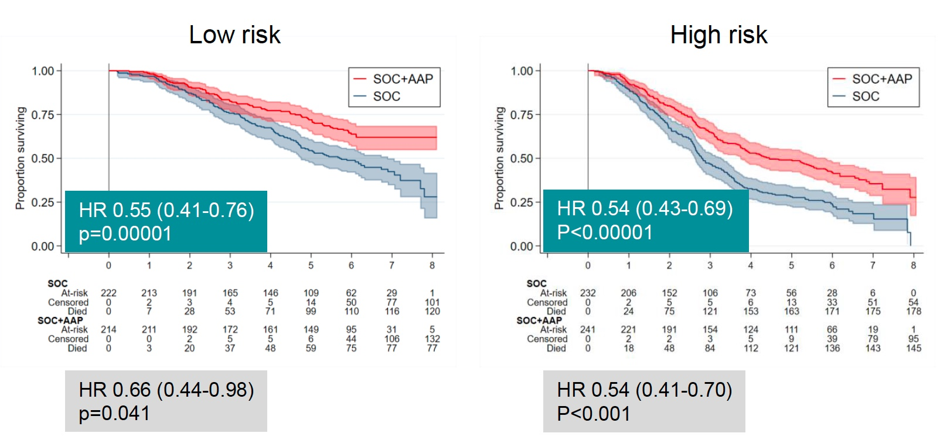
STAMPEDE: Overall Survival by Risk Group (LATITUDE)
James N et al. ESMO 2020;Abstract 611O.

Slide 39
Module 7
In the treatment algorithm, how do you generally approach the selection of endocrine treatment versus chemotherapy after first-line endocrine therapy for mCRPC?
Discussants: Drs Antonarakis and Armstrong

Slide 40
A 75-year-old man presents with BRCA wild-type prostate cancer and bone metastases and receives ADT and docetaxel with progressive disease (PD) 1 year later. He responds to enzalutamide for 9 months, then has symptomatic PD in the bone with new lung lesions. What is your most likely treatment?
Cabazitaxel
Abiraterone
Docetaxel
Other
N = 69
Survey of live webinar audience

Slide 41
CARD: Overall Survival Analysis of Patients with Metastatic Castration-Resistant Prostate Cancer Receiving Cabazitaxel vs Abiraterone or Enzalutamide
Tombal B et al.
ASCO 2020;Abstract 5569.

Slide 42
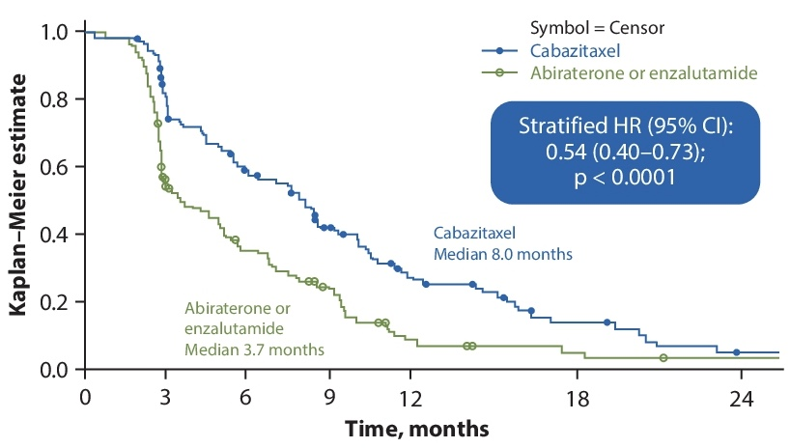
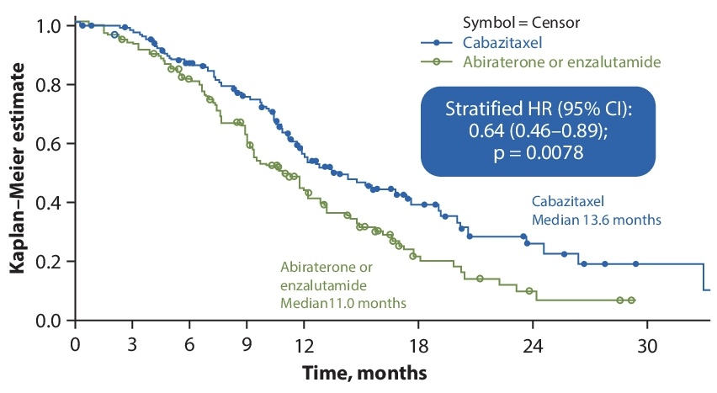
CARD Study of Cabazitaxel: Survival Analyses
rPFS (primary endpoint)
OS (key secondary endpoint)
Tombal B et al. ASCO 2020;Abstract 5569.

Slide 43
Module 8
In the treatment algorithm, how do you generally approach the use of radium-223 for mCRPC?
Discussant: Dr Armstrong

Slide 44
Safety and Overall Survival in Patients with mCRPC Treated with Radium-223 plus Subsequent Taxane Therapy: Second Interim Analysis of REASSURE
Higano CS et al.
ASCO 2020;Abstract 5542.

Slide 45
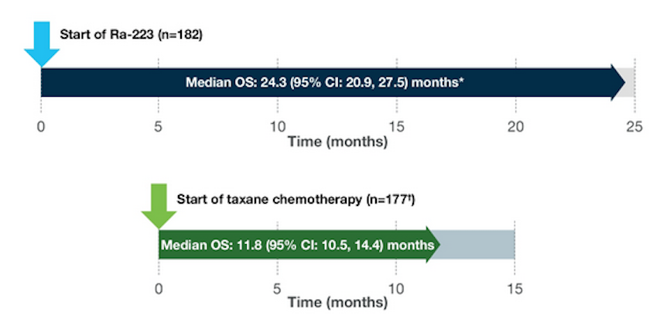
REASSURE: Overall Survival
Higano CS et al. ASCO 2020;Abstract 5542.

Slide 46
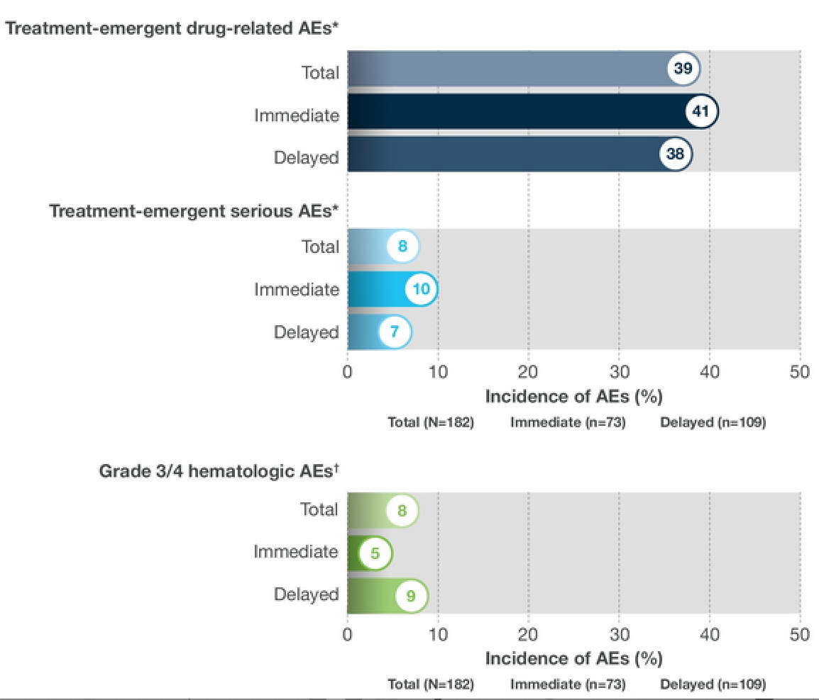
REASSURE: Incidence of Treatment-Emergent Adverse Events with Radium-223 and Grade 3/4 Hematologic AEs During Subsequent Chemotherapy
Higano CS et al. ASCO 2020;Abstract 5542.

Slide 47
Conclusions: REASSURE
Clinical Implications:
  Radium-223 can be administered safely either before or after docetaxel
  If docetaxel is given after radium-223, myelosuppression remains minimal
  Remember to co-administer with denosumab (fragility fracture risk)
Future Directions:
  What combinations will be synergistic (and safe) with radium-223?
    radium-223 + enzalutamide (PEACE III)
    radium-223 + sipuleucel-T
    radium-223 + PARP/ATR inhibitors
  We still need biomarkers (clinical, genomic) of radium-223 sensitivity
Courtesy of Emmanuel S Antonarakis, MD

Slide 48
Module 9
In the treatment algorithm, how do you generally approach the use of PARP inhibitors for mCRPC?
Discussants: Drs Antonarakis and Armstrong

Slide 49
At what point, if any, do you generally recommend a PARP inhibitor to a patient with metastatic prostate cancer and a germline BRCA mutation?
After at least 1 line of both hormonal therapy and chemotherapy
After 1 line of hormonal therapy
As part of first-line treatment, alone or as maintenance therapy
After 1 line of chemotherapy
Other
I generally would not administer a PARP inhibitor
N = 81
Survey of live webinar audience

Slide 50
Recent FDA Approvals of PARP Inhibitors for mCRPC
PARP inhibitor | Approval date | Pivotal study
Olaparib | May 19, 2020 | PROfound
Rucaparib | May 15, 2020 | TRITON2
https://www.fda.gov/drugs/resources-information-approved-drugs/

Slide 51
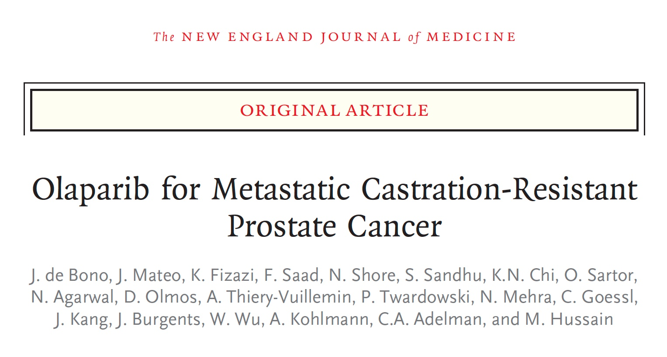
N Engl J Med 2020;382:2091-102.

Slide 52
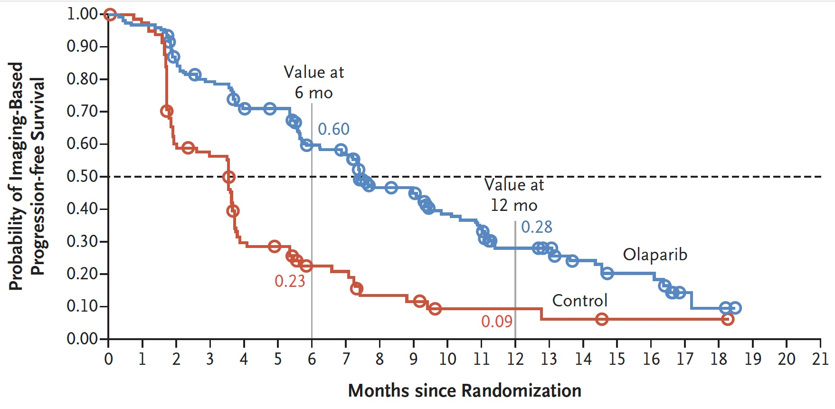
PROfound Primary Endpoint: Imaging-Based PFS with Olaparib for Patients with mCRPC Who Had at Least 1 Alteration in BRCA1, BRCA2 or ATM (Cohort A)
 | Olaparib (n = 162) | Control (n = 83) | HR | p-value
Median iPFS | 7.4 mo | 3.6 mo | 0.34 | <0.001
de Bono J et al; PROfound investigators. N Engl J Med 2020;382(22):2091-102.

Slide 53
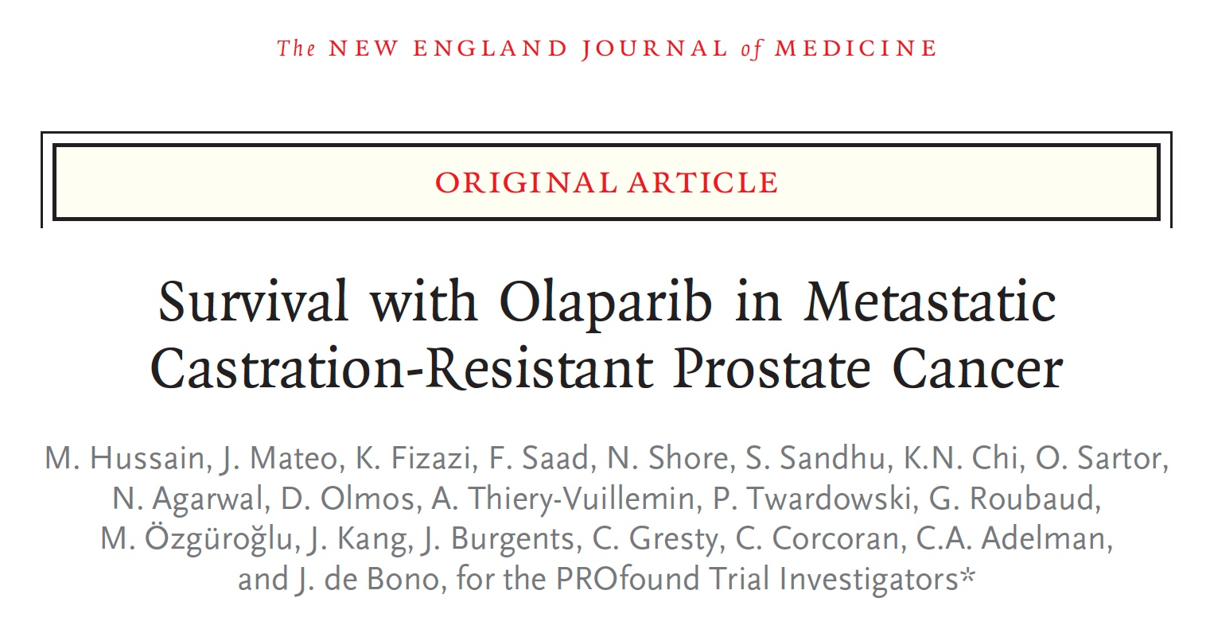
N Engl J Med 2020;[Online ahead of print].

Slide 54
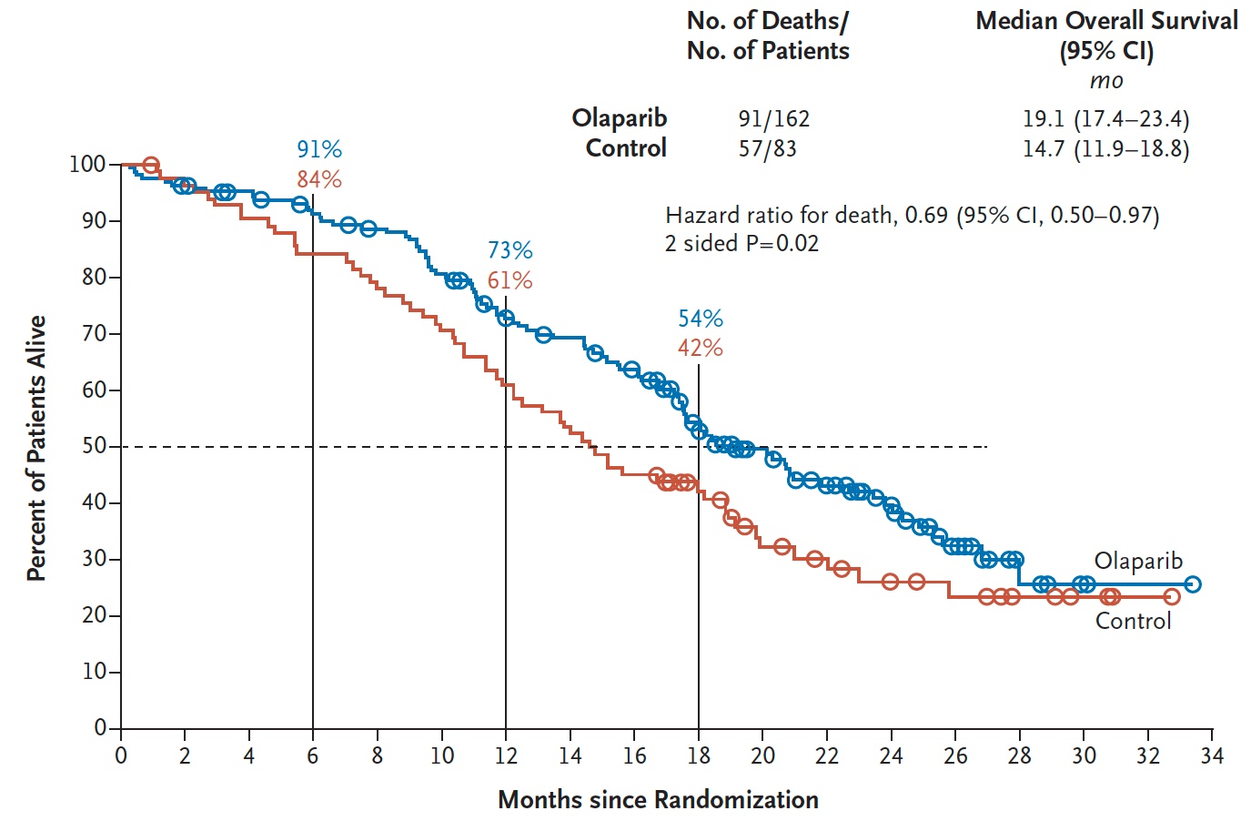
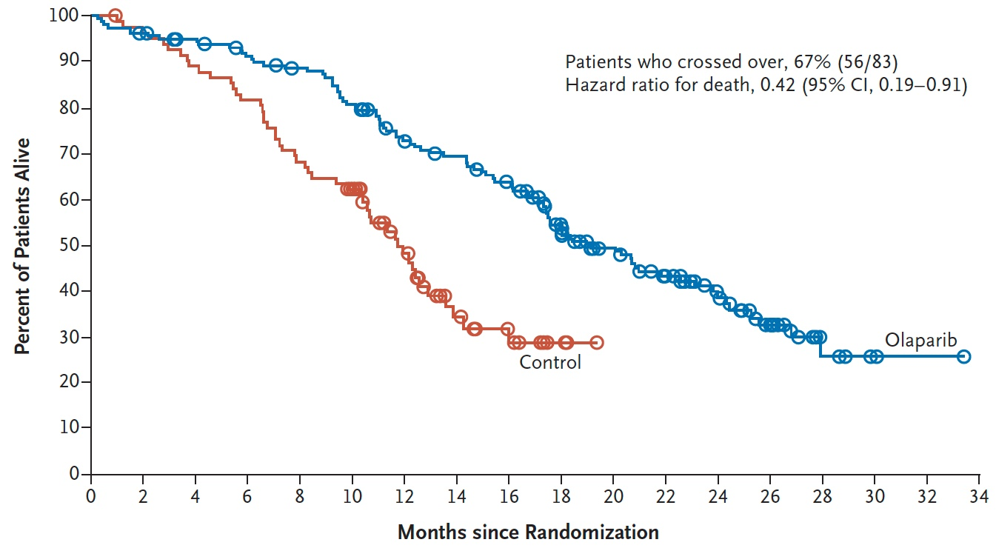
PROfound: Overall Survival with Olaparib for Patients with mCRPC Who Had at Least 1 Alteration in BRCA1, BRCA2 or ATM (Cohort A)
Overall survival
Cross-over adjusted overall survival
Hussain M et al; PROfound investigators. N Engl J Med 2020 Sept 20;[Online ahead of print]. De Bono J et al. ESMO 2020;Abstract 610O.

Slide 55
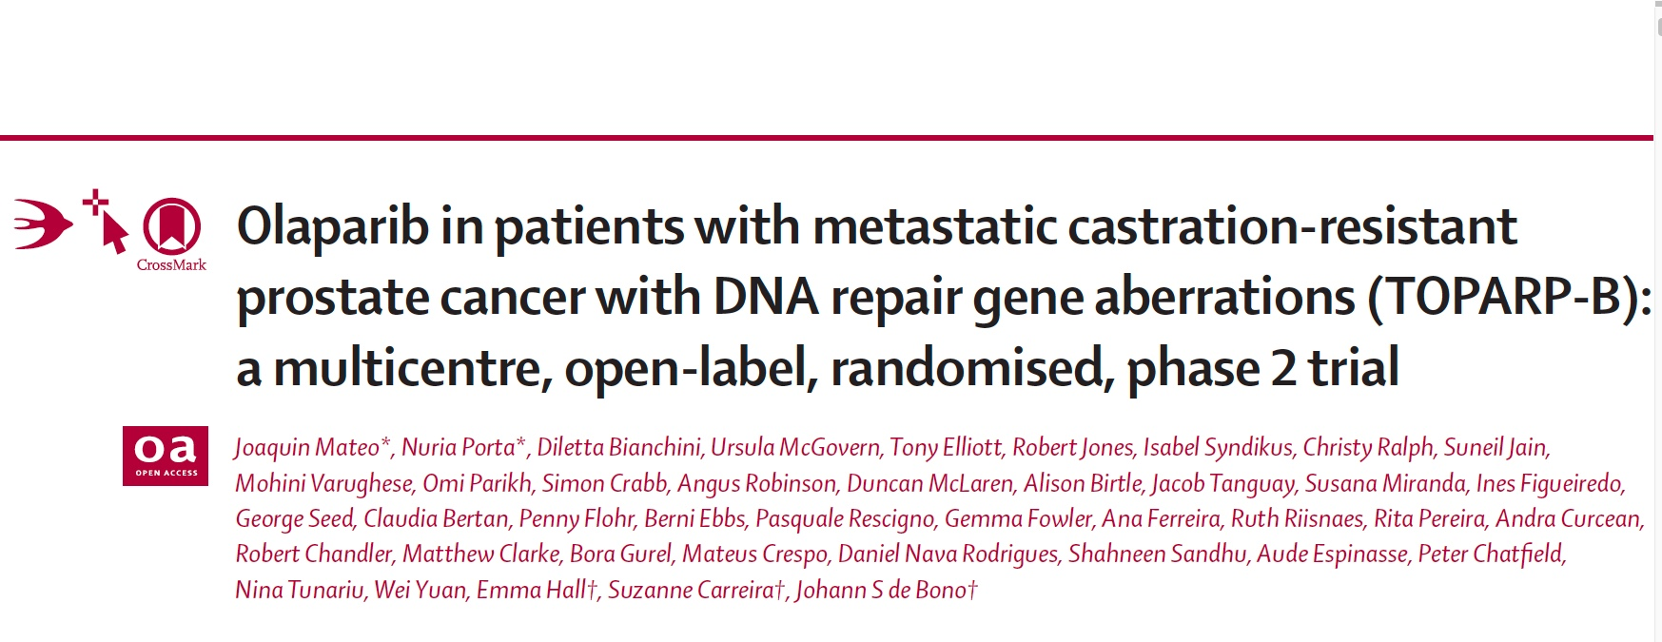
Lancet Oncol 2020;21:162-74.

Slide 56
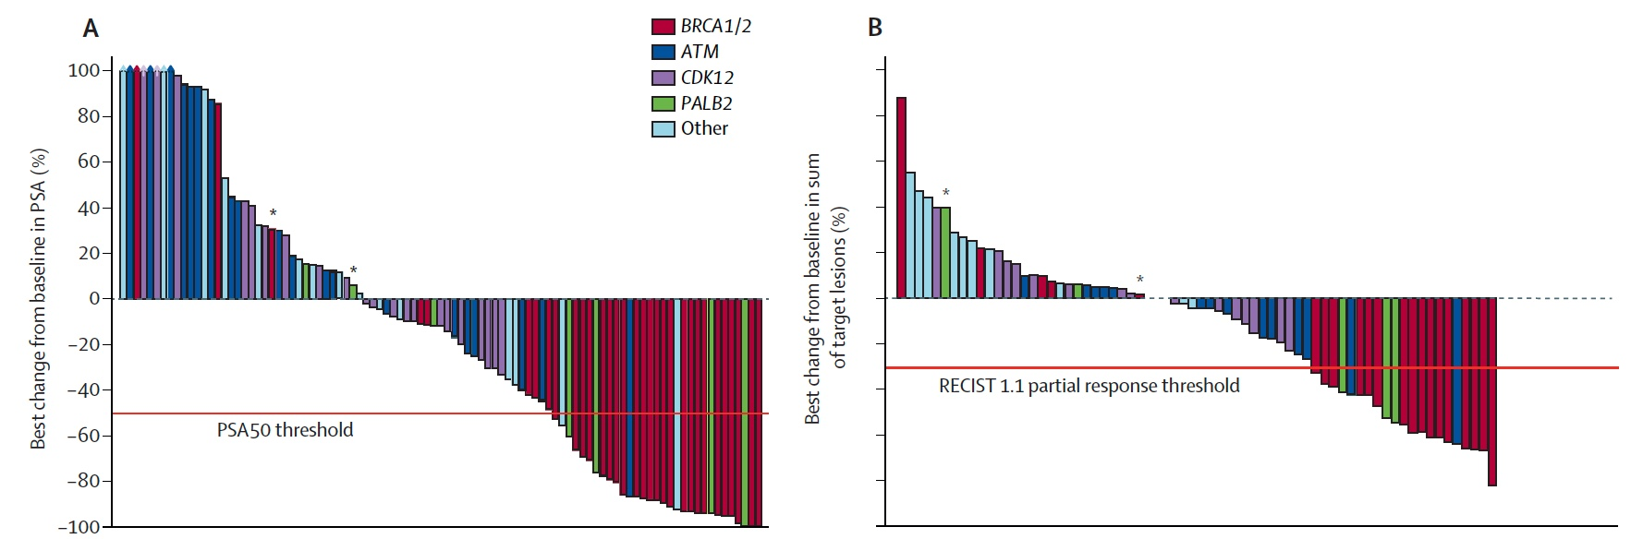
TOPARP-B: Antitumour Activity by Gene Aberration Subgroup (ITT Population, Pooled 300 mg and 400 mg Cohorts)
Combined Composite Response
400 mg Cohort: 25/46 (54.3%)
300 mg Cohort: 18/46 (39.1%)
Mateo J et al. Lancet Oncol 2020;21:162-74.

Slide 57
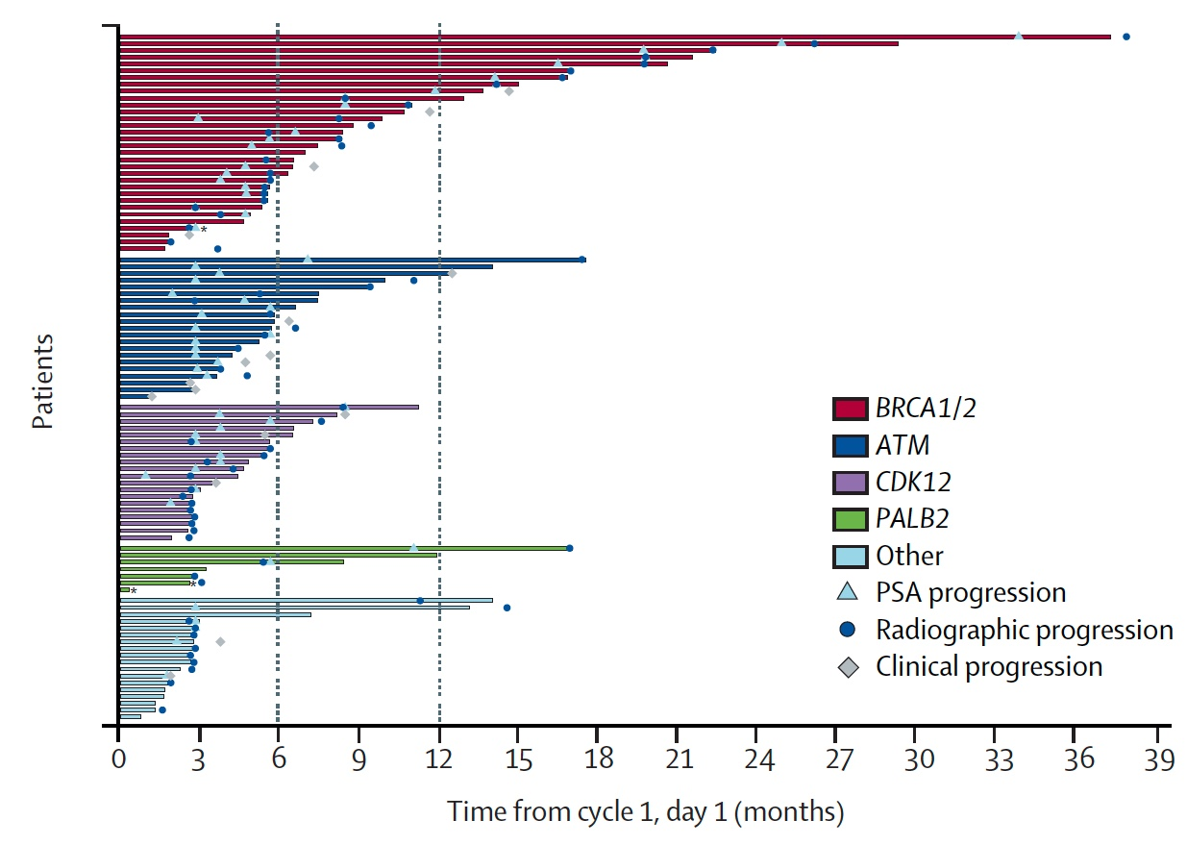
TOPARP-B: Duration of Response by Gene Aberration Subgroup (ITT Population, Pooled 300 mg and 400 mg Cohorts)
Mateo J et al. Lancet Oncol 2020;21:162-74.

Slide 58
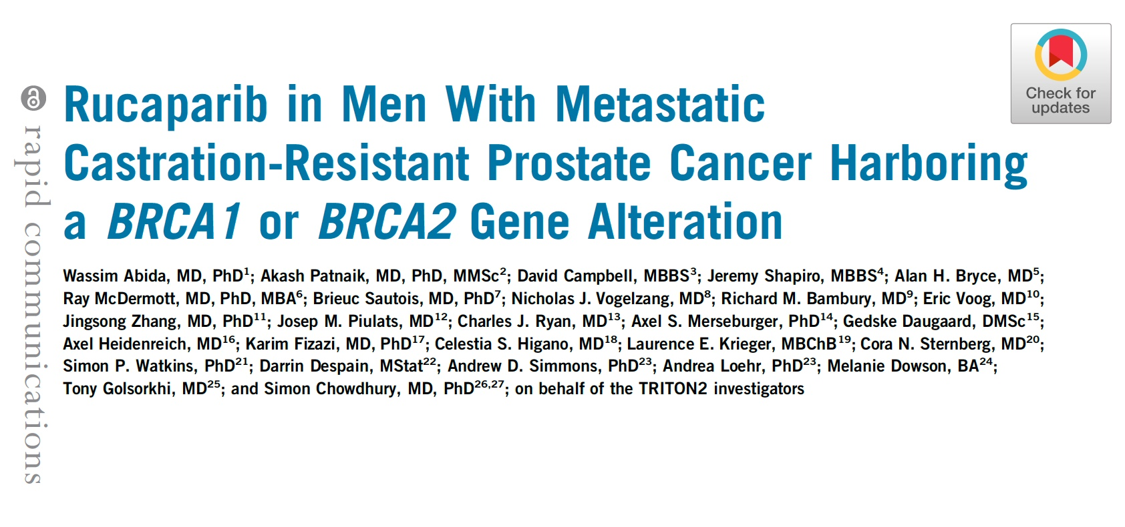
J Clin Oncol 2020;[Online ahead of print].

Slide 59
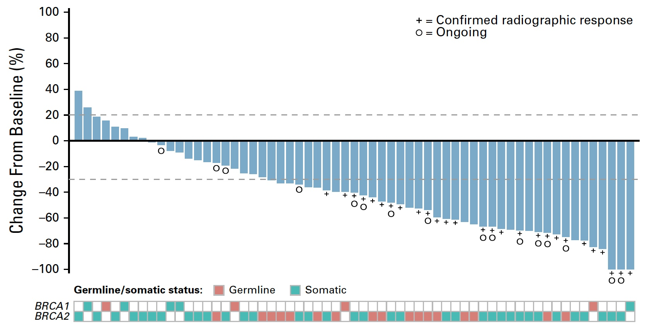
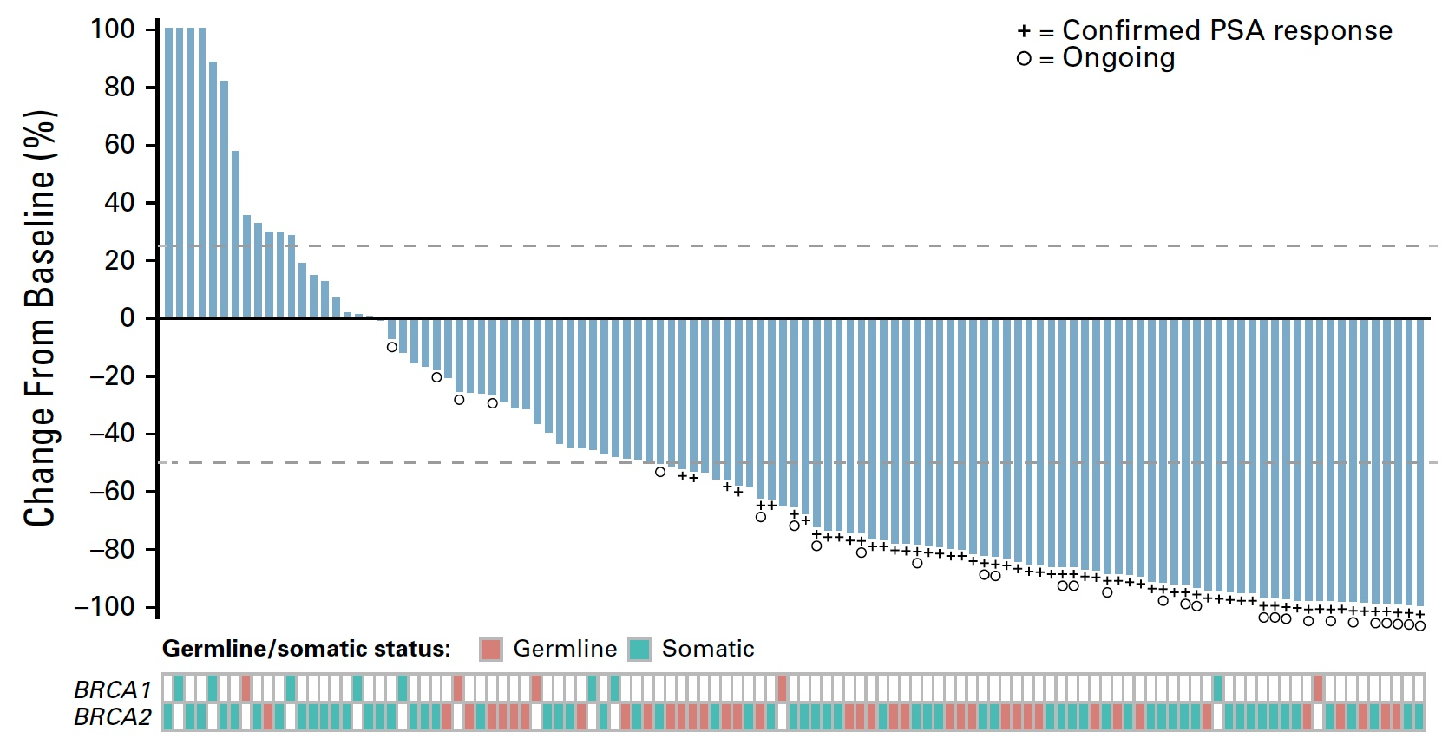
TRITON2: Response to Rucaparib in Patients with mCRPC Harboring a BRCA1 or BRCA2 Gene Alteration
ORR per independent radiology review: 43.5%
Confirmed PSA response rate: 54.8%
Abida W et al. TRITON2 investigators. J Clin Oncol 2020;[Online ahead of print].

Slide 60
Conclusions: TRITON2
Clinical Implications:
  Rucaparib has robust activity in mCRPC pts with BRCA1/2 mutations
  TRITON2 led to accelerated FDA approval of rucaparib in prostate cancer
  Side effects: myelosuppression, fatigue, anorexia, rash, teratogenic
Future Directions:
  Initial FDA approval is contingent upon positive Phase III TRITON3 trial
  Unlikely to get approved for non-BRCA and non-ATM mutations
  CASPAR trial: rucaparib + enzalutamide for first-line mCRPC
  CheckMate 9KD: rucaparib + nivolumab in second-line mCRPC
Courtesy of Emmanuel S Antonarakis, MD

Slide 61
Module 10
What is known about PSMA-targeted treatment and imaging in prostate cancer?
Discussants: Drs Armstrong and Antonarakis

Slide 62
FDA Approves First PSMA-Targeted PET Imaging Drug for Men with Prostate Cancer
Press Release: December 1, 2020
“The U.S. Food and Drug Administration approved Gallium 68 PSMA-11 (Ga 68 PSMA-11) – the first drug for positron emission tomography (PET) imaging of prostate-specific membrane antigen (PSMA) positive lesions in men with prostate cancer.
Ga 68 PSMA-11 is indicated for patients with suspected prostate cancer metastasis (when cancer cells spread from the place where they first formed to another part of the body) who are potentially curable by surgery or radiation therapy. Ga 68 PSMA-11 is also indicated for patients with suspected prostate cancer recurrence based on elevated serum prostate-specific antigen (PSA) levels. Ga 68 PSMA-11 is a radioactive diagnostic agent that is administered in the form of an intravenous injection.
Once administered via injection, Ga 68 PSMA-11 binds to PSMA, which is an important pharmacologic target for prostate cancer imaging because prostate cancer cells usually contain elevated levels of the antigen. As a radioactive drug that emits positrons, Ga 68 PSMA-11 can be imaged by PET to indicate the presence of PSMA-positive prostate cancer lesions in the tissues of the body.”
https://www.fda.gov/news-events/press-announcements/fda-approves-first-psma-targeted-pet-imaging-drug-men-prostate-cancer#:~:text=Today%2C%20the%20U.S.%20Food%20and,in%20men%20with%20prostate%20cancer

Slide 63
TheraP: A Randomised Phase II Trial of ¹⁷⁷Lu-PSMA-617 (LuPSMA) Theranostic versus Cabazitaxel in Metastatic Castration Resistant Prostate Cancer (mCRPC) Progressing After Docetaxel: Initial Results (ANZUP Protocol 1603)
Hoffman S et al.
ASCO 2020;Abstract 5500.

Slide 64
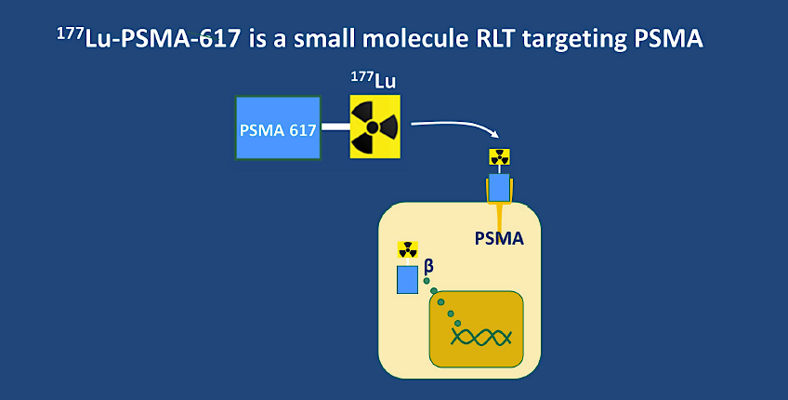
Hoffman S et al. ASCO 2020;Abstract 5500.

Slide 65
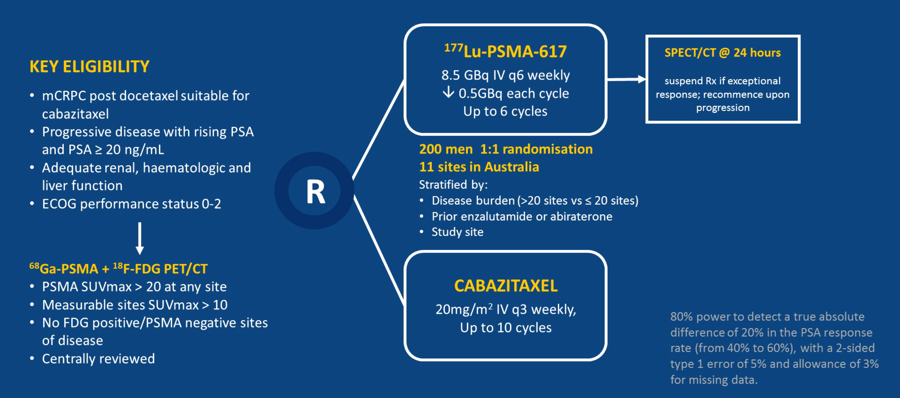
TheraP: ¹⁷⁷Lu-PSMA-617 Theranostic versus Cabazitaxel
Hoffman S et al. ASCO 2020;Abstract 5500.

Slide 66
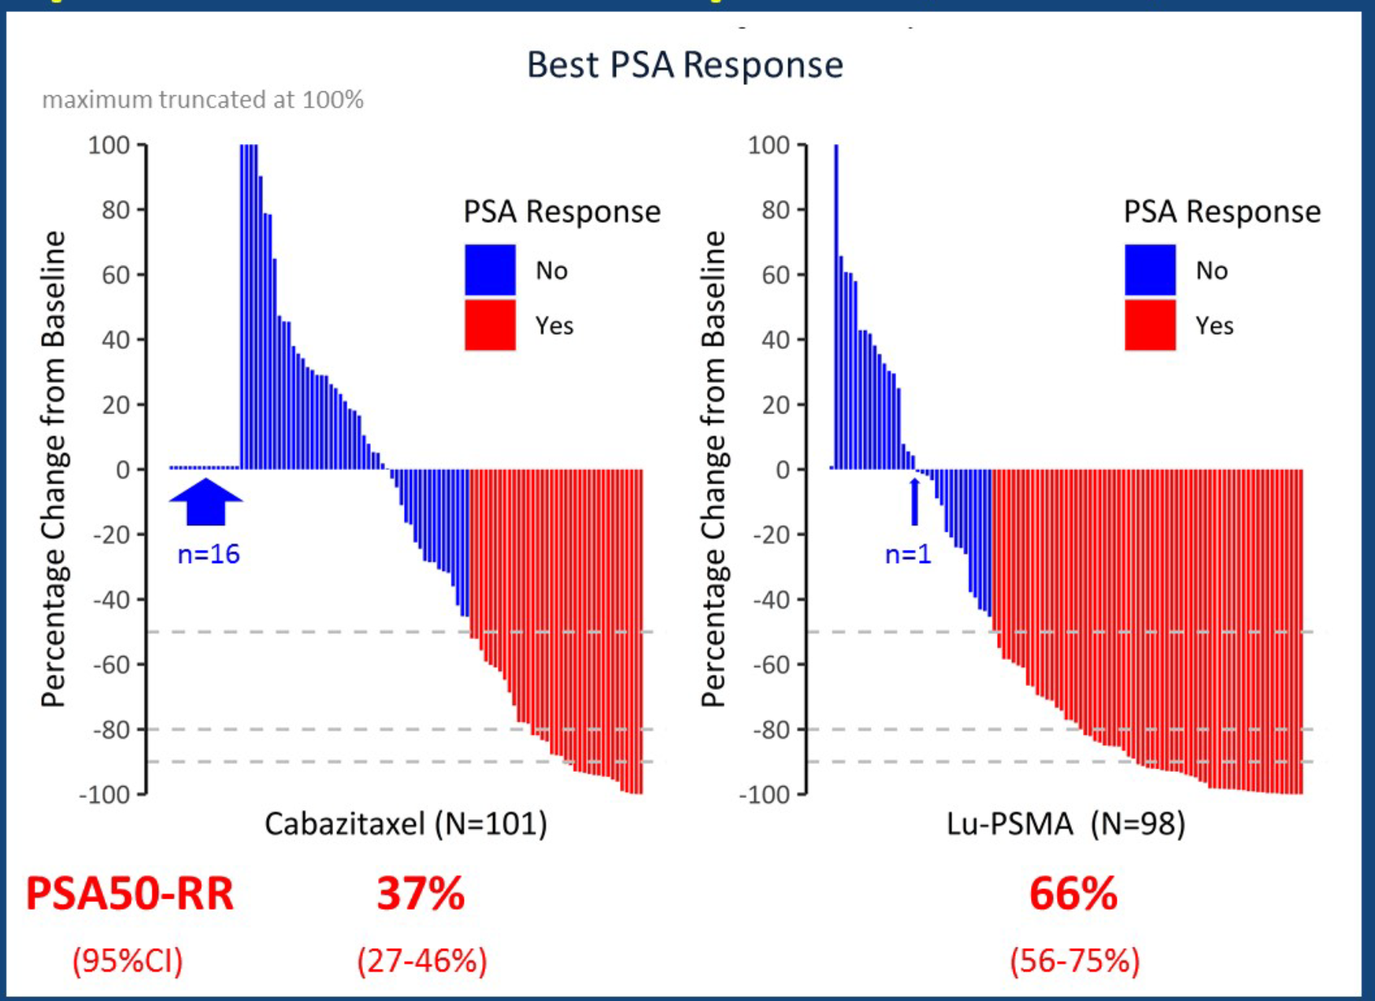
TheraP: Primary Endpoint — PSA Response ≥50% (PSA50-RR)
Primary endpoint: PSA ≥50% response (PSA50-RR)
Lu-PSMA: 29% absolute
(95% CI 16%-42%,
p<0.0001) greater
PSA50-RR compared to
cabazitaxel
For sensitivity analysis
per-protocol, the
difference was 23% (95%
CI 9%-37%; p=0.0016)
Hoffman S et al. ASCO 2020;Abstract 5500.

Slide 67
Module 11
What is known about TMPRSS2 and COVID-19?
Discussant: Dr Antonarakis

Slide 68
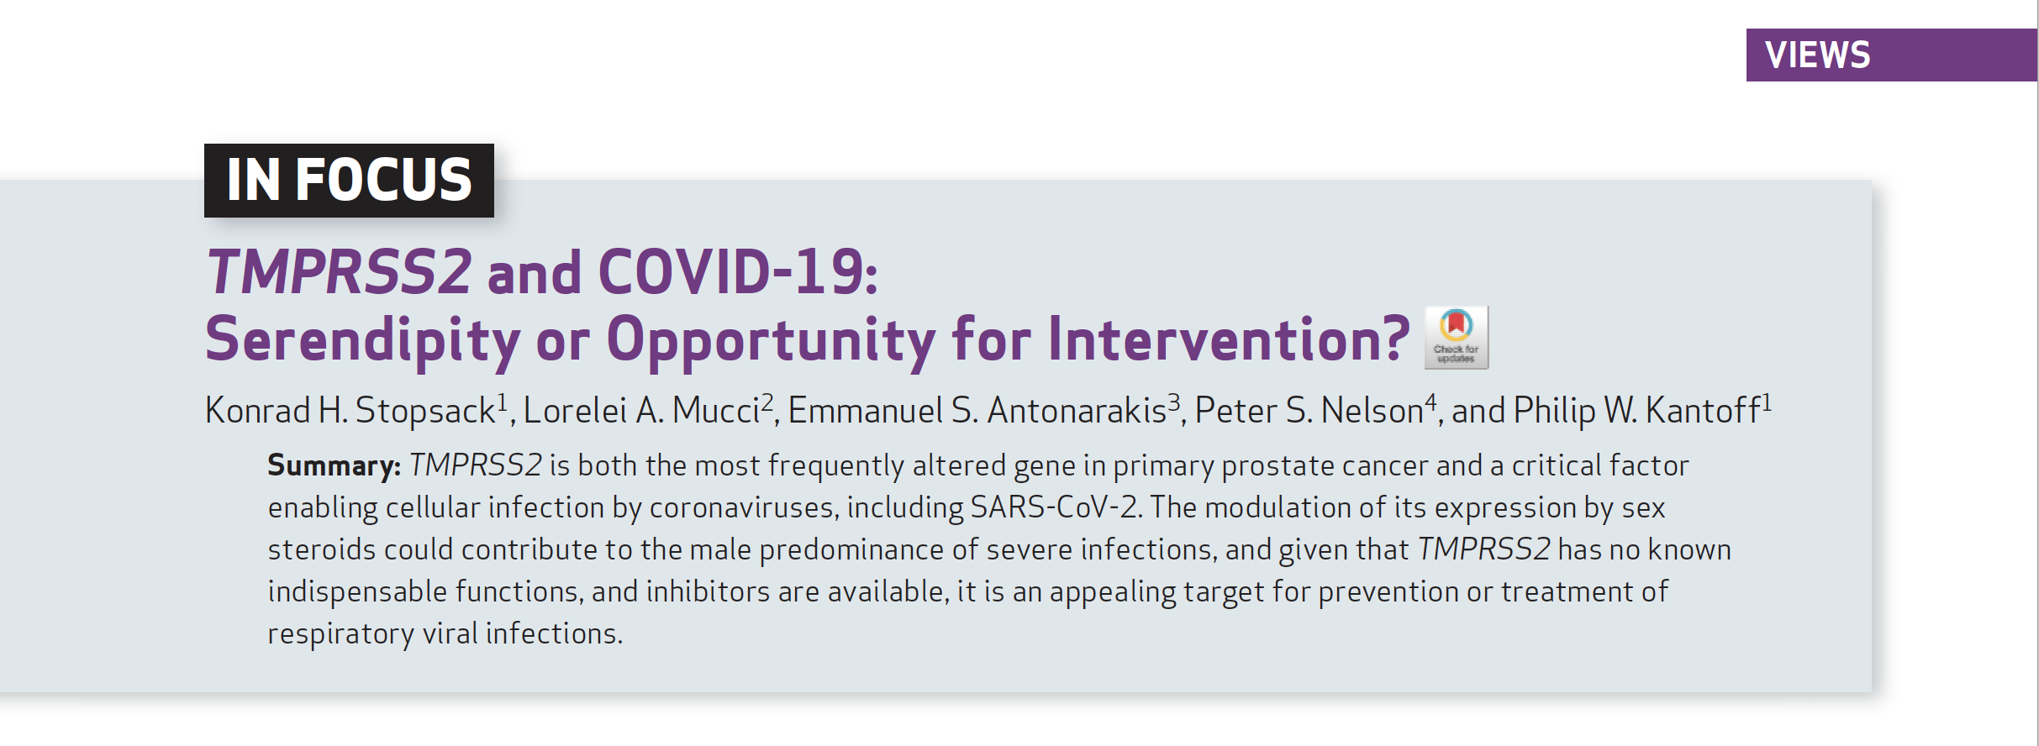
Cancer Discov 2020;10(6):779-82.

