Slide 1
COVID-19
AND LUNG
CANCER
What We Know, What We Don’t Know and What It All Means for Current Patient Care – A Live CME Webinar
Thursday, July 2, 2020
12:00 PM – 1:00 PM ET
Moderator Neil Love, MD
Faculty Leora Horn, MD, MSc Naiyer A Rizvi, MD
Lecia V Sequist, MD, MPH

Slide 2
Faculty
Leora Horn, MD, MSc
Ingram Associate Professor of Cancer Research
Director, Thoracic Oncology Research Program
Assistant Vice Chairman for Faculty Development
Vanderbilt University Medical Center
Nashville, Tennessee
Lecia V Sequist, MD, MPH
Director, Center for Innovation in Early Cancer Detection
Massachusetts General Hospital Cancer Center
The Landry Family Professor of Medicine
Harvard Medical School
Boston, Massachusetts
Naiyer A Rizvi, MD
Price Family Professor of Medicine
Director, Thoracic Oncology and Phase I Immunotherapeutics
Division of Hematology/Oncology
Columbia University Irving Medical Center
New York, New York

Slide 3
Dr Love — Disclosures
Dr Love is president and CEO of Research To Practice. Research To Practice receives funds in the form of educational grants to develop CME activities from the following commercial interests: AbbVie Inc, Acerta Pharma — A member of the AstraZeneca Group, Adaptive Biotechnologies, Agendia Inc, Agios Pharmaceuticals Inc, Amgen Inc, Array BioPharma Inc, a subsidiary of Pfizer Inc, Astellas, AstraZeneca Pharmaceuticals LP, Bayer HealthCare Pharmaceuticals, Biodesix Inc, bioTheranostics Inc, Blueprint Medicines, Boehringer Ingelheim Pharmaceuticals Inc, Boston Biomedical Inc, Bristol-Myers Squibb Company, Celgene Corporation, Clovis Oncology, Daiichi Sankyo Inc, Dendreon Pharmaceuticals Inc, Eisai Inc, EMD Serono Inc, Exelixis Inc, Foundation Medicine, Genentech, a member of the Roche Group, Genmab, Genomic Health Inc, Gilead Sciences Inc, GlaxoSmithKline, Grail Inc, Guardant Health, Halozyme Inc, Helsinn Healthcare SA, ImmunoGen Inc, Incyte Corporation, Infinity Pharmaceuticals Inc, Ipsen Biopharmaceuticals Inc, Janssen Biotech Inc, administered by Janssen Scientific Affairs LLC, Jazz Pharmaceuticals Inc, Kite, A Gilead Company, Lexicon Pharmaceuticals Inc, Lilly, Loxo Oncology Inc, a wholly owned subsidiary of Eli Lilly & Company, Merck, Merrimack Pharmaceuticals Inc, Myriad Genetic Laboratories Inc, Natera Inc, Novartis, Oncopeptides, Pfizer Inc, Pharmacyclics LLC, an AbbVie Company, Prometheus Laboratories Inc, Puma Biotechnology Inc, Regeneron Pharmaceuticals Inc, Sandoz Inc, a Novartis Division, Sanofi Genzyme, Seattle Genetics, Sirtex Medical Ltd, Spectrum Pharmaceuticals Inc, Taiho Oncology Inc, Takeda Oncology, Tesaro, A GSK Company, Teva Oncology, Tokai Pharmaceuticals Inc, Tolero Pharmaceuticals and Verastem Inc.

Slide 4
Dr Horn — Disclosures
Advisory Committee | Amgen Inc, EMD Serono Inc, Genentech, a member of the Roche Group, Xcovery
Consulting Agreements | AstraZeneca Pharmaceuticals LP, EMD Serono Inc, Genentech, a member of the Roche Group, Incyte Corporation, Merck, Xcovery
Contracted Research | Boehringer Ingelheim Pharmaceuticals Inc, Bristol-Myers Squibb Company, Xcovery

Slide 5
Dr Rizvi — Disclosures
No financial interests or affiliations to disclose

Slide 6
Dr Sequist — Disclosures
Advisory Committee | AstraZeneca Pharmaceuticals LP, Genentech, a member of the Roche Group, Janssen Biotech Inc
Contracted Research | AstraZeneca Pharmaceuticals LP, Blueprint Medicines, Boehringer Ingelheim Pharmaceuticals Inc, Genentech, a member of the Roche Group, Loxo Oncology Inc, a wholly owned subsidiary of Eli Lilly & Company, Novartis
Data and Safety Monitoring Board/Committee | Genentech, a member of the Roche Group
Patent Pending | In conjunction with Blueprint Medicines

Slide 7
Agenda
Introduction: Personal impact of COVID-19 on patients, families, oncology professionals
Module 1: Clinical care of the oncology patient without confirmed COVID-19
Module 2: Clinical care of the oncology patient with confirmed COVID-19
Module 3: Ongoing issues

Slide 8
Introduction: Personal impact of COVID-19 on patients, families, oncology professionals

Slide 9
COVID-19 AND CLL
MAY 21, 2020
Understanding the Impact of COVID-19 on the Care of Patients with Chronic Lymphocytic Leukemia – A Live CME Webinar
Moderator Neil Love, MD
Faculty Matthew S Davids, MD, MMSc
Anthony R Mato, MD, MSCE
Jeff Sharman, MD

Slide 10
Faculty
Matthew S Davids, MD, MMSc
Jeff Sharman, MD
Anthony R Mato, MD, MSCE

Slide 11
Agenda
Introduction: Personal impact of COVID-19 on patients, families, oncology professionals
Module 1: Clinical care of the oncology patient without confirmed COVID-19
Module 2: Clinical care of the oncology patient with confirmed COVID-19
Module 3: Ongoing issues

Slide 12
Module 1: Clinical care of the oncology patient without confirmed COVID-19
Procedure in clinics (PPE, screening, visitors, medical procedures, telemedicine)
COVID-19 testing
Systemic treatments and COVID-19 — Risk of infection and complications
Chemotherapy (neutropenia), growth factors
Checkpoint inhibitors
Targeted treatment
Clinical practice patterns
Multiple guidelines/recommendations
Current approaches to chemotherapy, immunotherapy and targeted treatment
Metastatic disease
Stage III inoperable lung cancer
Adjuvant treatment

Slide 13
How many patients with cancer in your practice have had a suspected or confirmed COVID-19 infection?
None
1
2
3
4-10
More than 10

Slide 14
Do you currently order COVID-19 testing for asymptomatic patients who are starting on a systemic anticancer treatment?
Yes, for all systemic regimens
Yes, for chemotherapy only
No

Slide 15
Introduction
Clinical manifestations of COVID-19 range from asymptomatic, to mild symptoms (cold, fever, cough, or other non-specific signs), to severe pneumonia leading to acute respiratory distress syndrome, which occurs in 17–29% of infected individuals
Mortality due to COVID-19 has been reported in about 3% of COVID-19-positive patients in the Chinese population
Main CT findings include multifocal peripheral and basal ground-glass opacities, traction bronchiectasis, and air bronchogram signs. A progressive transition to consolidation, together with pleural effusion, extensive small lung nodules…
Courtesy of Naiyer A Rizvi, MD

Slide 16
Challenges in lung cancer population
Immune checkpoint inhibitor- related pneumonitis has been reported in about 2% of cancer patients with a seemingly higher incidence in patients with lung cancer
Similarly, tyrosine kinase inhibitors can induce radiological patterns of interstitial-like pneumonitis, which develops in 4% of patients with epidermal growth factor receptor-mutant lung cancer treated with osimertinib
Chemotherapy-associated pneumonitis is known to occur in up to 16% of treated patients, and cytotoxic chemotherapy has immunosuppressive activity
Calabro L et al. Lancet Respir Med 2020;8(6):542-544. Courtesy of Naiyer A Rizvi, MD

Slide 17
Module 1: Clinical care of the oncology patient without confirmed COVID-19
Procedure in clinics (PPE, screening, visitors, medical procedures, telemedicine)
COVID-19 testing
Systemic treatments and COVID-19 — Risk of infection and complications
Chemotherapy (neutropenia), growth factors
Checkpoint inhibitors
Targeted treatment
Clinical practice patterns
Multiple guidelines/recommendations
Current approaches to chemotherapy, immunotherapy and targeted treatment
Metastatic disease
Stage III inoperable lung cancer
Adjuvant treatment

Slide 18
Reimbursement and regulatory issues aside, which adjuvant treatment, if any, would you most likely recommend for a patient with Stage IIB adenocarcinoma of the lung and an EGFR exon 19 mutation?
None
Chemotherapy
Chemotherapy → osimertinib
Osimertinib
Other

Slide 19
A patient with metastatic squamous cell carcinoma of the lung and a PD-L1 TPS of 30% tests positive for COVID-19 but is asymptomatic. Which treatment, if any, would you most likely recommend?
None — observation
Chemotherapy
Chemotherapy and immunotherapy
Immunotherapy
Other

Slide 20
Case (Dr Horn): 68-Year-Old Man with Metastatic Squamous Cell Lung Cancer
68-year-old man with newly diagnosed stage IV lung cancer, squamous cell histology, PD-L1 30% presents to clinic to discuss treatment options for his lung cancer.
He was previously positive for COVID-19 with RT-PCR on nasal swab. His symptoms of fatigue, anosmia have resolved. He has been asymptomatic for 6 weeks.
You retest him as part of SOC prior to starting therapy with carboplatin, nab-paclitaxel and pembrolizumab, and he is positive for COVID-19 on RT-PCR.
What do you recommend?
Delay therapy until he is negative
Proceed with therapy as planned
Proceed with pembrolizumab alone
Proceed with nivolumab + ipilimumab

Slide 21
Case (Dr Horn): 70-Year-Old Man with Metastatic SCLC
70-year-old male, smoker with stage IV small cell lung cancer, with metastases to liver, lung and bone is on first-line therapy with carboplatin, etoposide and atezolizumab.
He has received two cycles of therapy and imaging has shown a nice response with a reduction in his disease burden. He comes into clinic on day 8 of cycle 3 with shortness of breath, chest pain and diarrhea.
Imaging shows pneumonitis in bilateral lungs.
How do you proceed?
Test for SARS-CoV-2 and start steroids for presumed pneumonitis
Test for SARS-CoV-2 and hold steroids until you have the results

Slide 22
Factors Associated with Severe COVID-19
Older age
Higher ECOG performance status scores, and
More advanced stage
More likely to have received chemotherapy, radiotherapy, targeted therapy, or immunotherapy but NOT surgery
Last chemotherapy treatment within 2 weeks
Less than one year since cancer diagnosis
Tian et al., Lancet Oncology S1470-2045 (2020). Courtesy of Leora Horn, MD, MSc
This Photo by Unknown Author is licensed under CC BY-SA

Slide 23
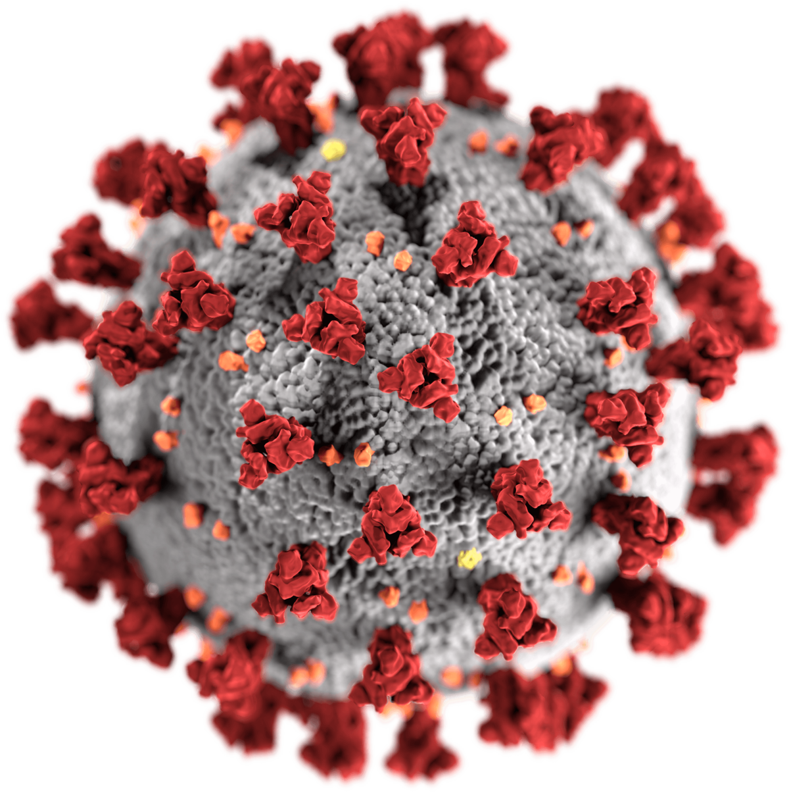
Conclusions
Patients with cancer are at increased risk for mortality from COVID-19 compared to the general population
Patients with lung cancer and hematologic cancer appear to be particularly at risk
Cancer patients appear to be less likely to be offered ICU level care
Conflicting data on which comorbidities impact survival but the presence of any comorbidity is a factor
Older age and chemotherapy administration appear to be associated with worse survival while immunotherapy and targeted therapy do not
No clear evidence on what available therapies for COVID impact cancer patient outcomes
Courtesy of Leora Horn, MD, MSc
This Photo by Unknown Author is licensed under CC BY-SA

Slide 24
Module 2: Clinical care of the oncology patient with confirmed COVID-19
Diagnostic challenges in the lung
Cases and clinical experiences at Columbia University Hospital
COVID-19 at Massachusetts General Hospital — Effects on patient care

Slide 25
Module 2: Clinical care of the oncology patient with confirmed COVID-19
Diagnostic challenges in the lung
Cases and clinical experiences at Columbia University Hospital
COVID-19 at Massachusetts General Hospital — Effects on patient care

Slide 26
 | Diagnosis | Stage | Treatment | Smoking history | Prior chest RT | Co-morbidities | Outcome
62M | Adeno | IV | Observation | Yes | Yes | RT fibrosis | Deceased
78F | EGFRm | IV | Osimertinib | No | No | None | Deceased
53M | Adeno | IV | New diagnosis | Yes | No | None | Recovered
60M | SCC | IIIB | Durvalumab | Yes | Yes | None | Deceased
76F | EGFRm | IV | Gemcitabine | No | Yes | DM, HTN | Deceased
58F | Adeno | IV | PD-1 | Yes | No | None | Recovered
62F | SCC | IV | Chemo/IO | Yes | No | None | Recovered
48F | SCC | IV | PD-1 | No | No | None | Recovered
54M | Adeno | IV | Carbo/paclitaxel | Yes | No | PE, HTN | Deceased
80M | SCLC | IV | VP/carbo | Yes | No | CKD, lymphoma | Recovered
101F | EGFRm | IV | Osimertinib | No | No | None | Deceased
73M | EGFR exon 20 | IV | EGFRi trial | No | Yes | None | Asymptomatic
79 | Adeno | IV | PD-1 | Yes | No | DM, HTN | Low grade fever
52M | SCLC | IV | New diagnosis | Yes | No | DM, HTN, CLL | Recovered
Courtesy of Naiyer A Rizvi, MD

Slide 27
Case (Dr Rizvi): 73-Year-Old Man with mNSCLC and an EGFR Mutation
Age/ Gender | Diagnosis | Stage | Treatment | Smoking history | Prior Chest RT | Co-morbidities | Outcome
73M | EGFR exon 20 | IV | EGFRi trial | No | Yes | None | Asymptomatic

Slide 28
Case (Dr Rizvi): 60-Year-Old Man with Stage IIIB SCC
Age/ Gender | Diagnosis | Stage | Treatment | Smoking history | Prior Chest RT | Co-morbidities | Outcome
60M | SCC | IIIB | Durvalumab | Yes | Yes | None | Deceased
Notes:
March 24 on right

Slide 29
Module 2: Clinical care of the oncology patient with confirmed COVID-19
Diagnostic challenges in the lung
Cases and clinical experiences at Columbia University Hospital
COVID-19 at Massachusetts General Hospital — Effects on patient care

Slide 30
How did this affect our patients?
Those that could not hold treatments (or didn’t want to take on delays) continued therapy
However, many patients delayed treatments, office visits, scans, biopsies, etc
Clinical trial enrollment, collection of research samples, lung cancer screening were all scaled down
Courtesy of Lecia V Sequist, MD, MPH

Slide 31
How did this affect our patients? (2)
~7% of our active lung CA pts were sent for COVID testing, of these ~50% were positive*
Hospitalized COVID/cancer pts were not allowed visitors and initially could not access rehabs, hospice upon discharge (this is now changing)
Among our lung cancer pts with COVID, there was a ~30% mortality*
*Data in preparation by Drs. Gainor, Mooradian, Piper-Vallillo
Courtesy of Lecia V Sequist, MD, MPH

Slide 32
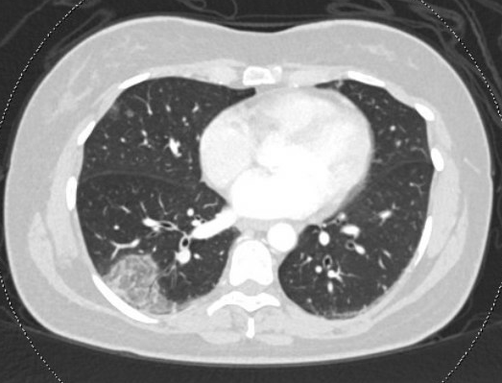
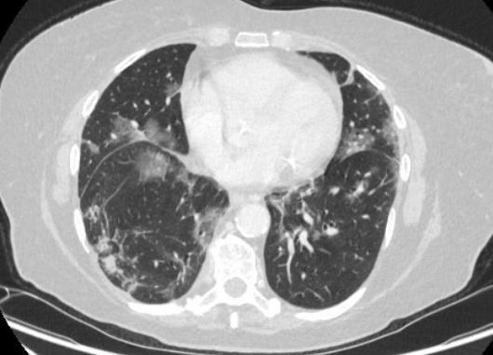
Radiology “quick-study” expertise - diagnosed some pts
47 F (no cancer) with cough, SOB
75 F with RUL lung adeno and chronic cough, getting restaging scans
Courtesy of Lecia V Sequist, MD, MPH

Slide 33
The peak is over, but pts still experiencing:
Changes in Care Environment
New Obstacles
Stress and Isolation
Courtesy of Lecia V Sequist, MD, MPH

Slide 34
The peak is over, but pts still experiencing:
Changes in Care Environment
- Virtual visits mean that pts are either with family or with team, but not both
More difficult to establish rapport
- More difficult to assess symptoms
Courtesy of Lecia V Sequist, MD, MPH

Slide 35
The peak is over, but pts still experiencing:
New Obstacles
- ↑ inequities for low SES & older pts (access to devices, wifi, computer literacy)
- ↓ flexibility in schedule for pts
- Potential ↑ risks of treatments
- Potential ↓ avail of clinical trials
Courtesy of Lecia V Sequist, MD, MPH

Slide 36
The peak is over, but pts still experiencing:
Stress and Isolation
- Limited life expectancy + loss of freedom during this time very difficult
- Family may be distancing to keep pts safe
- Loss of financial security for many
- Anxiety, depression
Courtesy of Lecia V Sequist, MD, MPH

Slide 37
Conclusions
COVID-19 and the changes in society occurring over the last 3 months have had an enormous impact on the health and well-being of cancer patients
I am hopeful because I see our field and our colleagues rising to the challenges and innovating solutions
Calculating the impact of the pandemic must take into account more than just those who were diagnosed with COVID-19
We must work hard to minimize the impact on research and clinical training
Courtesy of Lecia V Sequist, MD, MPH

Slide 38
Module 3: Ongoing issues
Telemedicine — Pros and cons, future cutbacks?
Laboratory and clinical research

Slide 39
What proportion of your current outpatient care is telemedicine or virtual visits (phone, Zoom, etc)?
Less than 10%
10%-20%
21%-40%
41%-60%
61%-80%
Greater than 80%

