Slide 1
Oncology Grand Rounds
New Agents and Strategies in Hodgkin and Non-Hodgkin Lymphomas
Tuesday, June 2, 2020 5:00 PM – 6:30 PM ET
Faculty
Kim Leake, MSN, FNP-C Mollie Moran, APRN-CNP, AOCNP Craig Moskowitz, MD Michael E Williams, MD, ScM
Moderator Neil Love, MD

Slide 2
Dr Love — Disclosures
Dr Love is president and CEO of Research To Practice. Research To Practice receives funds in the form of educational grants to develop CME activities from the following commercial interests: AbbVie Inc, Acerta Pharma — A member of the AstraZeneca Group, Adaptive Biotechnologies, Agendia Inc, Agios Pharmaceuticals Inc, Amgen Inc, Array BioPharma Inc, Astellas, AstraZeneca Pharmaceuticals LP, Bayer HealthCare Pharmaceuticals, Biodesix Inc, bioTheranostics Inc, Blueprint Medicines, Boehringer Ingelheim Pharmaceuticals Inc, Boston Biomedical Inc, Bristol-Myers Squibb Company, Celgene Corporation, Clovis Oncology, Daiichi Sankyo Inc, Dendreon Pharmaceuticals Inc, Eisai Inc, EMD Serono Inc, Exelixis Inc, Foundation Medicine, Genentech, a member of the Roche Group, Genmab, Genomic Health Inc, Gilead Sciences Inc, GlaxoSmithKline, Guardant Health, Halozyme Inc, ImmunoGen Inc, Incyte Corporation, Infinity Pharmaceuticals Inc, Ipsen Biopharmaceuticals Inc, Janssen Biotech Inc, administered by Janssen Scientific Affairs LLC, Jazz Pharmaceuticals Inc, Kite, A Gilead Company, Lexicon Pharmaceuticals Inc, Lilly, Loxo Oncology Inc, a wholly owned subsidiary of Eli Lilly & Company, Merck, Merrimack Pharmaceuticals Inc, Myriad Genetic Laboratories Inc, Natera Inc, Novartis, Oncopeptides, Pfizer Inc, Pharmacyclics LLC, an AbbVie Company, Prometheus Laboratories Inc, Puma Biotechnology Inc, Regeneron Pharmaceuticals Inc, Sandoz Inc, a Novartis Division, Sanofi Genzyme, Seattle Genetics, Sirtex Medical Ltd, Spectrum Pharmaceuticals Inc, Taiho Oncology Inc, Takeda Oncology, Tesaro, A GSK Company, Teva Oncology, Tokai Pharmaceuticals Inc and Tolero Pharmaceuticals.

Slide 3
Ms Leake — Disclosures
No financial interests or affiliations to disclose

Slide 4
Ms Moran — Disclosures
No financial interests or affiliations to disclose

Slide 5
Dr Moskowitz — Disclosures
Advisory Committee | AstraZeneca Pharmaceuticals LP, Bristol-Myers Squibb Company, Merck, Seattle Genetics, Takeda Oncology
Contracted Research | ADC Therapeutics SA, AstraZeneca Pharmaceuticals LP, Merck, Seattle Genetics

Slide 6
Dr Williams — Disclosures
Advisory Committee | AbbVie Inc
Consulting Agreements | Celgene Corporation, Gilead Sciences Inc, TG Therapeutics Inc
Contracted Research | Allos Therapeutics, Celgene Corporation, Gilead Sciences Inc, Janssen Biotech Inc, Pharmacyclics LLC, an AbbVie Company, TG Therapeutics Inc
Speakers Bureau | Xian Janssen Pharmaceutical Ltd

Slide 7
Commercial Support
This activity is supported by educational grants from AstraZeneca Pharmaceuticals LP, Celgene Corporation, Pharmacyclics LLC, an AbbVie Company, and Janssen Biotech Inc, administered by Janssen Scientific Affairs LLC, and Seattle Genetics.

Slide 8
Agenda
Module 1: Diffuse Large B-Cell Lymphoma (DLBCL)
Polatuzumab vedotin, CAR T-cell therapy
Module 2: Hodgkin Lymphoma (HL) and Peripheral T-Cell Lymphoma (PTCL)
Brentuximab vedotin, immune checkpoint inhibitors
Module 3: Follicular Lymphoma (FL)
Lenalidomide/rituximab (R²), PI3K inhibitors
Module 4: Mantle Cell Lymphoma (MCL)
BTK inhibitors (ibrutinib, acalabrutinib, zanubrutinib), venetoclax, lenalidomide
Module 5: Management of Lymphomas in the Era of COVID-19
Telemedicine, minimization of surgeries, reduced infusions and clinic visits

Slide 9
Module 1: Diffuse Large B-Cell Lymphoma (DLBCL)
Polatuzumab vedotin, CAR T-cell therapy

Slide 10
Polatuzumab vedotin is currently approved for the treatment of recurrent diffuse large B-cell lymphoma…
As monotherapy
In combination with BR
In combination with rituximab
In combination with obinutuzumab
I don’t know

Slide 11
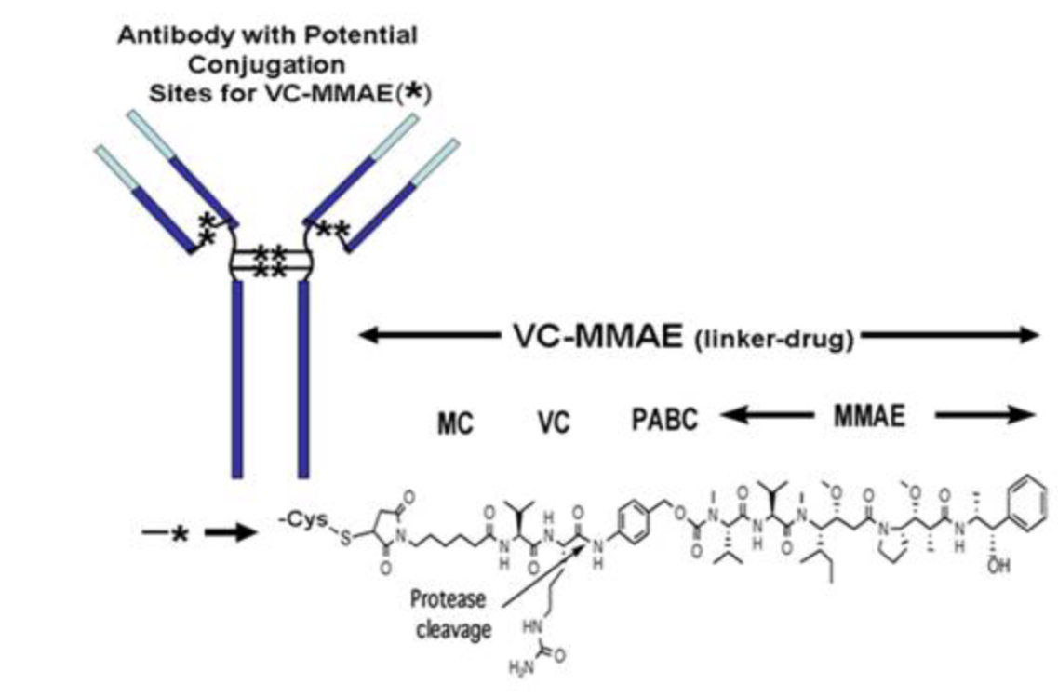
Mechanism of Action of Polatuzumab Vedotin
Polatuzumab vedotin is an antibody-drug conjugate (ADC) consisting of monomethyl auristatin E (MMAE) conjugated to anti-CD22 and CD79b monoclonal antibodies via a cleavable linker molecule
ADC binds to receptor
Antibody with potential
conjugation sites for VC-MMAE ( )
ADC in circulation
ADC-receptor complex is internalized
*
VC-MMAE (linker-drug)
MC
VC
PABC
MMAE
Protease cleavage
Apoptosis (cell death)
Morschhauser F et al. Proc ASCO 2014;Abstract 8519.

Slide 12
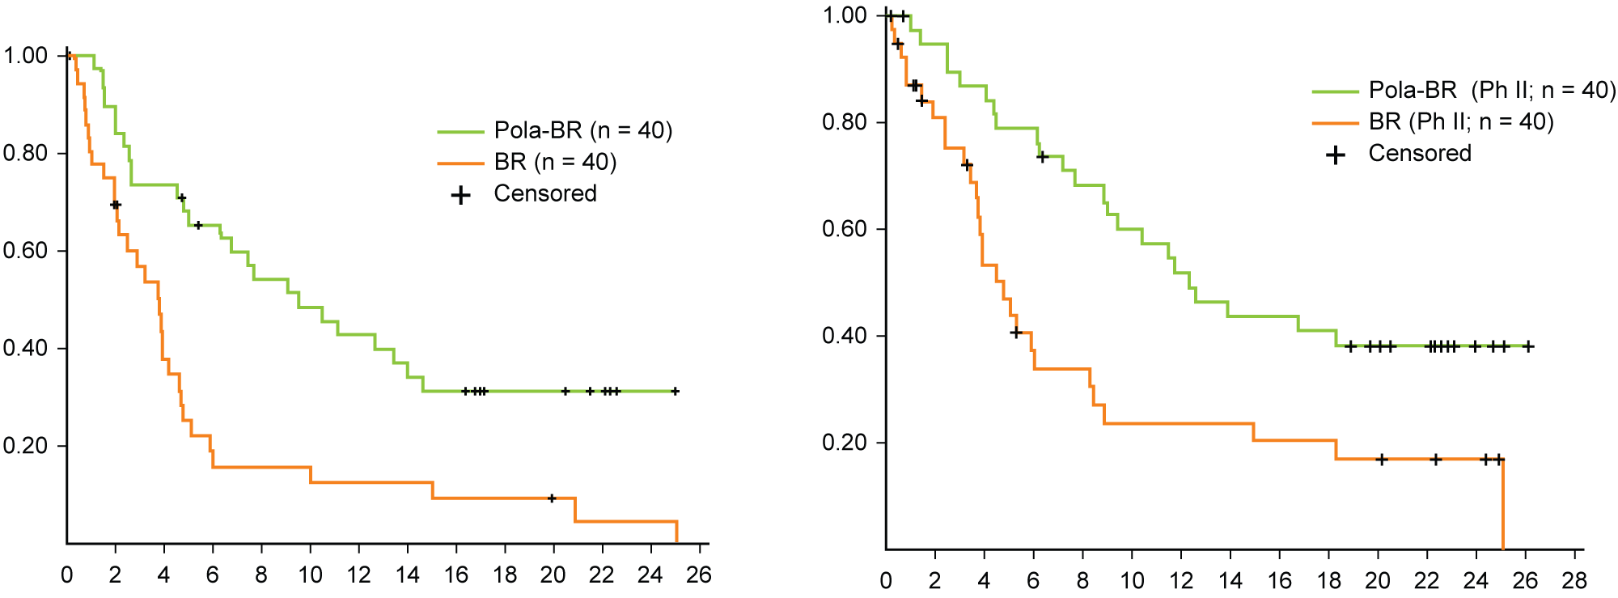
Randomized Phase II Survival Analyses: Polatuzumab Vedotin/BR vs BR in R/R DLBCL
Progression-free Survival
Overall Survival
Progression-Free Survival (probability)
Overall Survival (probability)
Time (months)
Time (months)
 | Pola-BR | BR | HR | P-value
mPFS (IRC) | 9.5 mo | 3.7 mo | 0.36 | <0.001
 | Pola-BR | BR | HR | P-value
mOSS (IRC) | 12.4 mo | 4.7 mo | 0.42 | 0.002
Sehn LH et al. J Clin Oncol 2020;38(2):155-65.

Slide 13
Select Adverse Events: Polatuzumab Vedotin/BR vs BR in R/R DLBCL
 | Pola-BR (n = 39) |  | BR (n = 39)
Adverse Event | All Grades | Grade 3-4 | All Grades | Grade 3-4
Anemia | 54% | 28% | 26% | 18%
Neutropenia | 54% | 46% | 39% | 33%
Thrombocytopenia | 49% | 41% | 28% | 23%
Lymphopenia | 13% | 13% | 0 | 0
Peripheral neuropathy* | 44% | 0 | 8% | 0
* Peripheral neuropathy was Grade 1-2 and resolved in most patients
Sehn LH et al. J Clin Oncol 2020;38(2):155-65.

Slide 14
POLARIX: An Ongoing Phase III Trial of Polatuzumab Vedotin with R-CHP versus R-CHOP for Patients with Untreated DLBCL
Trial identifier: NCT03274492 (Open)
Polatuzumab vedotin + R-CHP
Eligibility (Target N = 875)
CD20-positive, untreated DLBCL
R
Placebo + R-CHOP
Primary endpoint: Progression-free survival
www.clinicaltrials.gov. Accessed April 2019.

Slide 15
A patient with DLBCL should be in adequate physical condition to undergo autologous stem cell transplant in order to be a suitable candidate for CAR T-cell therapy.
Agree
Disagree
I don’t know

Slide 16
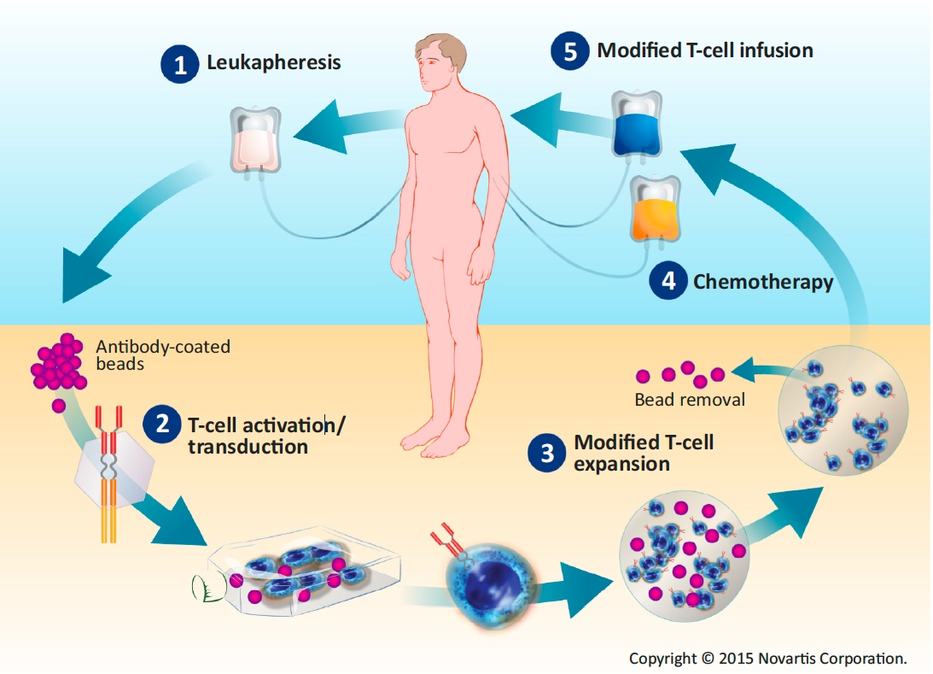
Overview of CAR T-Cell Therapy
7-14 days
Modification, Courtesy, David Porter, MD

Slide 17
Pivotal CAR-T Studies in DLBCL: Study and Patient Characteristics
 | ZUMA-1 Axicabtagene ciloleucel | JULIET Tisagenlecleucel | TRANSCEND NHL 001 Lisocabtagene maraleucel
Evaluable patients | 101 | 93 | 102 (core: 73)
Lymphoma subtypes | DLBCL, transformed lymphoma, PMBCL | DLBCL, transformed lymphoma | DLBCL, transformed lymphoma (core)
≥3 lines of therapy | 69% | 51% | 50%
Refractory to last therapy | 77% | 54% | 67%
Prior auto HCT | 21% | 49% | 38%
Locke F et al; ZUMA-1 Investigators. Lancet Oncol 2019;20(1):31-42.
Schuster SJ et al; JULIET Investigators. N Engl J Med 2019;380(1):45-56.
Abramson JS et al; TRANSCEND NHL 001 Investigators. Proc ASCO 2018;Abstract 7505.

Slide 18
Pivotal CAR-T Studies in DLBCL: Summary of Efficacy
 | ZUMA-1 Axicabtagene ciloleucel | JULIET Tisagenlecleucel | TRANSCEND NHL 001 Lisocabtagene maraleucel
Evaluable patients | 101 | 93 | 102 (core: 73)
Median follow-up | 15.4 mo | 19.3 mo | 12 mo
Best ORR | 83% | 52% | 75%
CR | 58% | 40% | 55%
6-mo ORR | 41% | 33% | 47%
12-mo OS | 59% | 49% | 63%
Locke F et al; ZUMA-1 Investigators. Lancet Oncol 2019;20(1):31-42.
Schuster SJ et al; JULIET Investigators. N Engl J Med 2019;380(1):45-56.
Abramson JS et al; TRANSCEND NHL 001 Investigators. Proc ASCO 2018;Abstract 7505.

Slide 19
Chimeric antigen receptor (CAR) T-cell therapy is commonly associated with…
Prolonged cytopenias
Rash and skin sensitivity
Differentiation syndrome
Fever and hypotension requiring care in the ICU
Peripheral neuropathy
I don’t know

Slide 20
CAR-T-Associated Cytokine Release Syndrome (CRS) and Neurologic Toxicity
CRS — May be mild or life-threatening
Occurs with CART19 activation and expansion
Dramatic cytokine elevations (IL-6, IL10, IFNɤ, CRP, ferritin)
Fevers initially (can be quite high: 105˚F)
Myalgias, fatigue, nausea/anorexia
Capillary leak, headache, hypoxia and hypotension
CRS-related mortality 3% to 10%
Neurologic toxicity — May be mild or life-threatening
Mechanism unclear, referred to as immune effector cell-associated neurotoxicity syndrome (ICANS)
Encephalopathy
Seizures
Delirium, confusion, aphasia, agitation, sedation, coma
Varadarajan I, Lee DW. Cancer J 2019;25(3):223‐30.
Abramson JS et al. ASCO 2019 Education Book.

Slide 21
Cytokine Release Syndrome (CRS): Common Symptoms
CRS
High fevers
Rigors
Myalgia/
arthralgias
Nausea/vomiting/anorexia
Hypotension
Dyspnea/ tachypnea/ hypoxia
Fatigue
Headache
Escalating fevers
Based on CAR T-cell experience
Diagnosis based on clinical symptoms and events

Slide 22
CRES: Timeline of Events
CAR-T therapy administered
Day 5
3 weeks
5 weeks
Phase 1 (Days 0-5)
Concurrent with high fever and other CRS symptoms
Typically shorter duration and lower grade (Grade 1-2)
Anti-IL-6 therapy is effective
Phase 2 (Day 5 onward)
CRS and fever have subsided
Typically longer duration and higher grade (Grade 3+)
Anti-IL-6 therapy is not effective; corticosteroids recommended
Delayed events
10% of patients experienced delayed neurotoxic events, including seizures and episodes of confusion, during the 3rd or 4th week after treatment
Neelapu SS et al. Nat Rev Clin Oncol 2018;15(1):47-62.

Slide 23
59-year-old woman with PMH of CAD, T2DM, and tobacco use (from the practice of Ms Leake)
3/2018: Stage IV DLBCL, GCB subtype, t(14;18), extranodal L ovarian involvement
R-CHOP x 6 with prophylactic intrathecal methotrexate and Ara-C
3/2019: PD in left ovary
R-ICE x 3
7/2019: R-BEAM / autoSCT with consolidative XRT
10/2019: PD (peritoneal lymphomatosis)
11/2019: BR-polatuzumab vedotin x 2 prior to cell collection for CAR T
02/2020: CAR T-cell therapy (cyclophosphamide/fludarabine lymphodepletion)
Tolerated fairly well, with some CRS, neurotoxicity
Currently, in remission and doing well

Slide 24
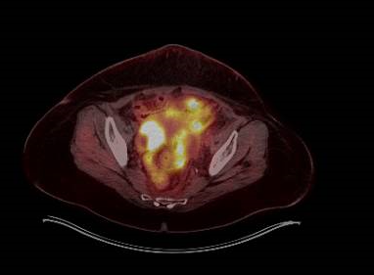
59-year-old woman (from the practice of Ms Leake)
Relapse – prior to polatuzumab vedotin
After 2 cycles of polatuzumab vedotin

Slide 25
59-year-old woman (from the practice of Ms Leake)
Patient Education
Infection risk: Instruct on fever, neutropenia and s/s of infection to include cough, mouth sores
Peripheral neuropathy: Burning, numbness, or tingling that is new or worse, or balance changes.
Tumor lysis: Mood changes, confusion, muscle pain/cramps, heartbeat that does not feel right, seizures, decreased appetite, vomiting or upset stomach
Fatigue: Weakness
PML
Hepatotoxicity: Dark urine, fatigue, stomach pain, light-colored stools, emesis, yellow eyes or skin
Infusion reactions
Constipation/diarrhea
PPX with PJP/HSV prevention.
Bleeding: Coughing up blood, blood in urine, stools (black, red or tarry stools).
Vomiting/nausea
Smoking cessation: Tobacco treatment program through UVA

Slide 26
59-year-old woman (from the practice of Ms Leake)
Symptom Management
Bowel regimen: Constipation (stool softeners, laxatives) or diarrhea (loperamide, probiotics, etc)
Hydration (encourage fluids)
Anti-nausea medication
Mouth care
Chronic pain: Pain regimen prescribed and managed by palliative
Psychosocial Support
Integrate and collaborative SW care into plan of care-financial support, lodging, etc. Patient does not live local and family members not readily available to assist with care
Collaborative care with palliative for chronic pain
Possible antidepressant: Assess need
Mindfulness–based stress

Slide 27
Agenda
Module 1: Diffuse Large B-Cell Lymphoma (DLBCL)
Polatuzumab vedotin, CAR T-cell therapy
Module 2: Hodgkin Lymphoma (HL) and Peripheral T-Cell Lymphoma (PTCL)
Brentuximab vedotin, immune checkpoint inhibitors
Module 3: Follicular Lymphoma (FL)
Lenalidomide/rituximab (R²), PI3K inhibitors
Module 4: Mantle Cell Lymphoma (MCL)
BTK inhibitors (ibrutinib, acalabrutinib, zanubrutinib), venetoclax, lenalidomide
Module 5: Management of Lymphomas in the Era of COVID-19
Telemedicine, minimization of surgeries, reduced infusions and clinic visits

Slide 28
Module 2: Hodgkin Lymphoma (HL) and Peripheral T-Cell Lymphoma (PTCL)
Brentuximab vedotin, immune checkpoint inhibitors

Slide 29
Based on the results of the Phase III ECHELON-1 trial, which of the following regimens resulted in a progression-free survival advantage over standard ABVD as first-line therapy for patients with Stage III or IV classical Hodgkin lymphoma (HL)?
ABVD + bendamustine
ABVD + nivolumab
AVD + brentuximab vedotin
Brentuximab vedotin + nivolumab
I don’t know

Slide 30
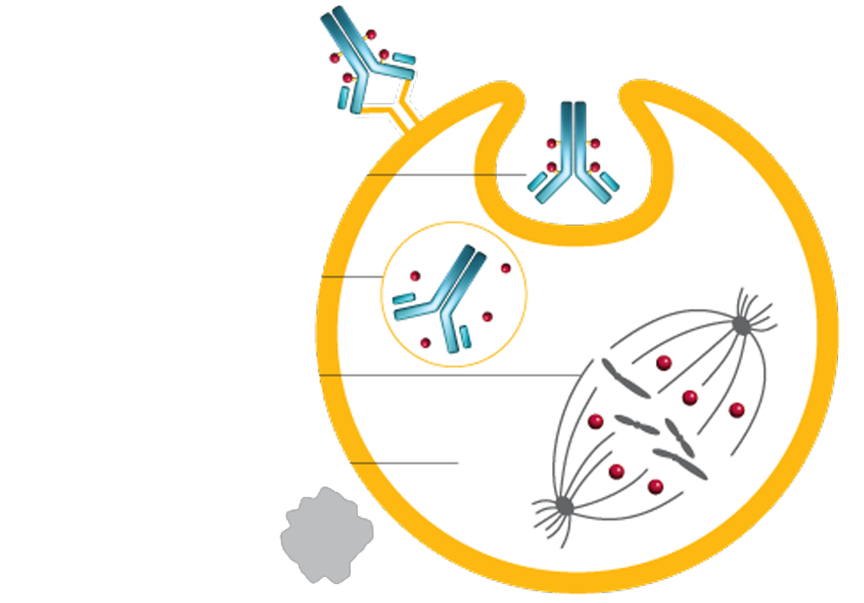
Mechanism of Action of Brentuximab Vedotin
Brentuximab vedotin is an antibody-drug conjugate (ADC) targeted to cells expressing CD30 on their surface
1
ADC binds to CD30 and initiates internalization of the ADC-CD30 complex
2
MMAE is released
3
MMAE binds to tubulin and disrupts the microtubule network
4
Cell cycle arrest
5
Apoptosis (cell death)
Courtesy of Julie M Vose, MD, MBA.

Slide 31
ECHELON-1 Phase III Study Schema
Enrolled (n = 1,334)
Previously untreated Stage III or IV classical Hodgkin lymphoma ECOG PS 0-2 No peripheral sensory or motor neuropathy
Brentuximab vedotin (BV)
+ AVD for up to 6 cycles
(1:1)
R
ABVD for up to 6 cycles
Primary endpoint: Modified progression-free survival
Key secondary endpoint: Overall survival
Straus DJ et al. Proc ASCO 2019;Abstract 7532.
Connors JM et al. N Engl J Med 2018;378:331-44.

Slide 32
Update of ECHELON-1: PFS at 42 Months
Group | BV + AVD | ABVD | Hazard ratio
All patients (ITT) (n = 664, 670) | 82.4% | 76.2% | 0.697
PET2-negative | 85.0% | 79.6% | 0.695
PET2-positive | 68.3% | 51.5% | 0.552
PET2, PET conducted at the end of the second 28-day cycle of treatment
Bartlett NL et al. ASH 2019;Abstract 4026.

Slide 33
ECHELON-2 Phase III Study Schema
Enrolled (N = 452)
CD30-expression (≥10% cells) Previously untreated PTCL Systemic ALCL, including ALK-positive sALCL with IPI≥2, ALK-negative sALCL PTCL-NOS, AITL, ATLL, EATL, HSTCL
BV + CHP
Q3W x 6-8 cycles
R
(1:1)
CHOP
Q3W x 6-8 cycles
Primary endpoint: Modified progression-free survival
Key secondary endpoint: Overall survival
Illidge T et al. EHA 2019;Ab PS1070.

Slide 34
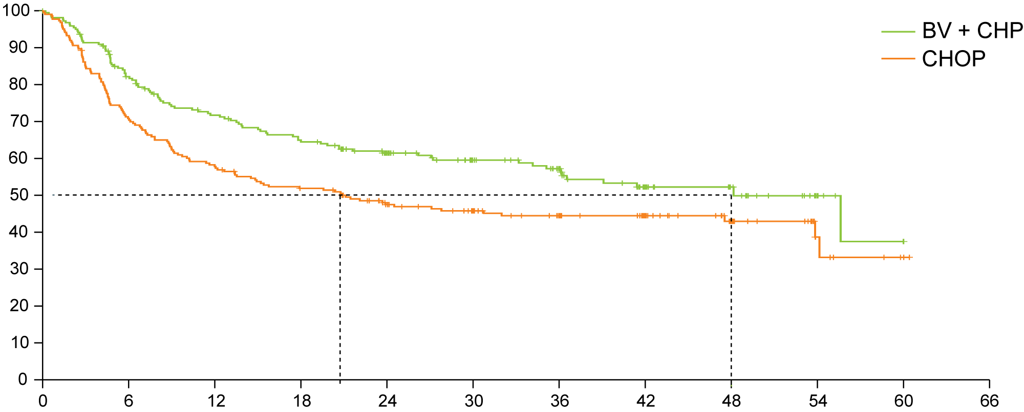
ECHELON-2: Efficacy of Brentuximab Vedotin + CHP versus CHOP in CD30-Positive PTCL
HR 0.71
p = 0.0110
Progression-free survival (%)
Median in CHOP
20.8 months
Median in BV + CHP
48.2 months
Time from randomization (months)
Median OS was not reached in either subgroup (p = 0.0244, HR 0.66), though it was numerically in favor of BV + CHP for key patient subgroups analyzed.
Horwitz S et al. Lancet 2019;393(10168):229-40.

Slide 35
Patients at high risk for disease progression after undergoing transplant for relapsed HL may receive 1 year of consolidation treatment with…
Nivolumab
Brentuximab vedotin
Nivolumab + brentuximab vedotin
Chemotherapy
Other
I don’t know

Slide 36
AETHERA Phase III Trial: BV Consolidation After Transplant
Eligibility (n = 329)
Refractory to front-line Tx
Relapse <12 months after front-line Tx
Relapse ≥12 months after front-line Tx with extranodal disease
BV
R
ASCT
CR, PR or SD to salvage therapy
Placebo
Median PFS update (median 5 years follow-up):
BV: not reached
Placebo: 15.8 mo
No OS benefit at interim analysis (analysis planned for 2020)
Moskowitz CH et al. Lancet 2015;385(9980):1853-62; Sweetenham J et al. Proc ASH 2015;Abstract 3172;
Moskowitz CH et al. Blood 2018;132(25):2639-42.

Slide 37
Relapsed HL can be effectively palliated with systemic therapy but cannot be cured.
Agree
Disagree
I don’t know

Slide 38
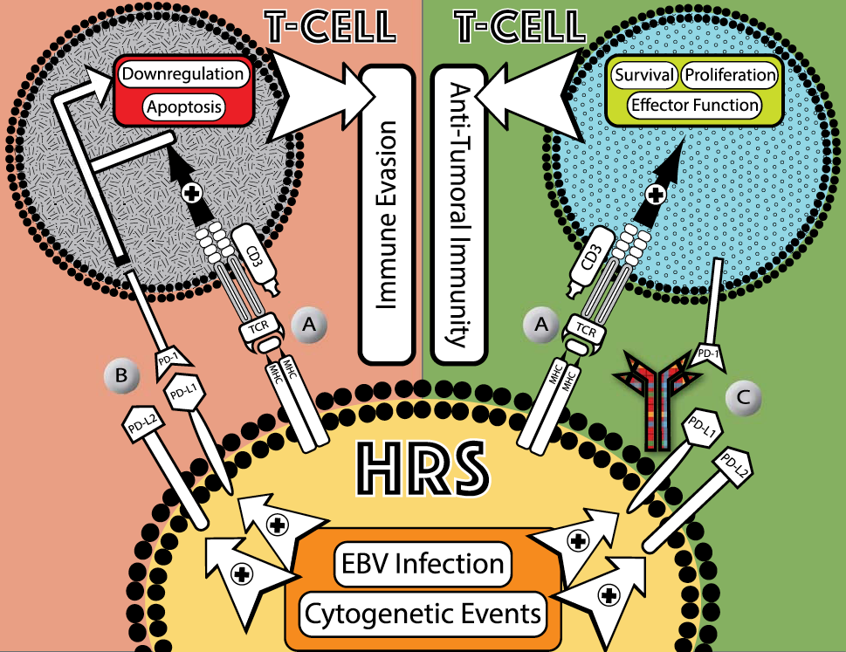
Targeting the PD-1/PD-L1 Axis in HL
HL characterized by small number of malignant Hodgkin Reed-Sternberg cells (HRS) surrounded by normal immune cells
9p24.1 chromosomal abnormalities frequently observed in HRS
More than 90% of HRS have alterations in PD-L1 and PD-L2 loci
Malignant Hodgkin and RS cells overexpress PD-L1/L2 ligands (due to cytogenetic events, infection with EBV)
Villasboas JC, Ansell SA. Cancer J 2016;22(1):17-22; Roemer MGM et al. J Clin Oncol 2016;34(23):2690-7.

Slide 39
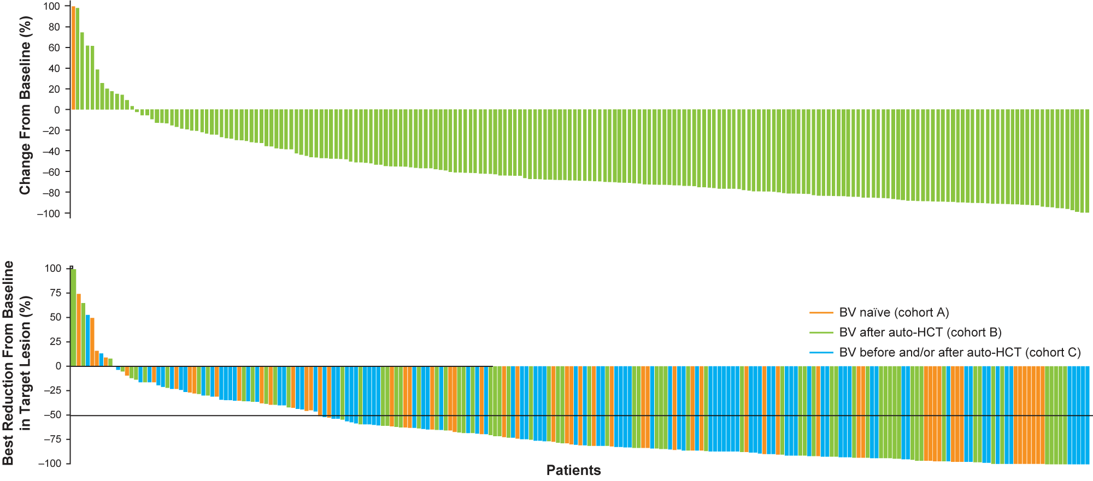
Immune Checkpoint Inhibitors in R/R HL
KEYNOTE-087 (pembrolizumab)
ORR: 69%
CheckMate 205 (nivolumab)
ORR: 69%
Chen R et al. J Clin Oncol 2017;35(19):2125-32; Armand P et al. J Clin Oncol 2018;36(14):1428-39.

Slide 40
31-year-old woman (from the practice of Ms Moran)
2018: Presented to PCP with acute onset of cough – No relief from antibiotics and steroids
ER with palpitations, believed to be due to pseudoephedrine
CTPE: Perivascular LNs 2.6 x 2.3 cm, Hilar LN 2.6 cm, FNA: Negative for malignancy
12/2018 repeat of CT: No change to LNs
4/2019 skin rash biopsy: Positive for erythema nodosum
WBC 12.1, Hgb 10.4, Albumin 3.5, ESR 51
5/2019 repeat CT scan: Increased chest LNs, splenic mass
6/2019 LN Biopsy: Stage IV nodular sclerosing Hodgkin lymphoma (EBER-negative)
IPS 3, Hgb <10.5, Albumin <4
AVD + BV x 6 → PET-negative after 2 cycles, EOT PET: Negative
BV dose reduced C2 due to peripheral neuropathy
Vinblastine decreased by 25% then 50% then discontinued due to peripheral neuropathy

Slide 41
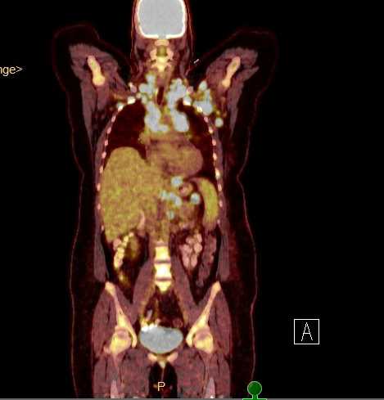
31-year-old woman (from the practice of Ms Moran)
Before AVD + BV
After AVD + BV

Slide 42
Agenda
Module 1: Diffuse Large B-Cell Lymphoma (DLBCL)
Polatuzumab vedotin, CAR T-cell therapy
Module 2: Hodgkin Lymphoma (HL) and Peripheral T-Cell Lymphoma (PTCL)
Brentuximab vedotin, immune checkpoint inhibitors
Module 3: Follicular Lymphoma (FL)
Lenalidomide/rituximab (R²), PI3K inhibitors
Module 4: Mantle Cell Lymphoma (MCL)
BTK inhibitors (ibrutinib, acalabrutinib, zanubrutinib), venetoclax, lenalidomide
Module 5: Management of Lymphomas in the Era of COVID-19
Telemedicine, minimization of surgeries, reduced infusions and clinic visits

Slide 43
Module 3: Follicular Lymphoma (FL)
Lenalidomide/rituximab (R²), PI3K inhibitors

Slide 44
Patients with advanced-stage follicular lymphoma (FL) who are not experiencing symptoms from their disease may receive treatment with…
Observation
Rituximab
Chemotherapy + anti-CD20 antibody
All of the above
a and b only
I don’t know

Slide 45
Do you use subcutaneous rituximab in select patients with lymphoma?
Yes
No
No, but I would like to
I am not familiar with this agent

Slide 46
Rituximab provides long remissions in low tumor burden follicular lymphoma
In patients who responded to Rituximab weekly x 4 doses, a clinical trial compared:
Maintenance R (MR): continue R one dose q3 months until relapse, vs
Retreatment R (RR): at relapse, repeat weekly R x4 doses
Results:
Median time to R failure: 3.9 y (RR) vs 4.3 y (MR)
Few patients at 3 y required chemo: 84% vs 95%
Much less rituximab with RR strategy: 4 vs 18 doses
About 30% remain in remission 5y after R x 4 weekly doses
Conclusion: Favors Rituximab retreatment at time of relapse rather than ongoing maintenance therapy
Rituximab extended schedule or re-treatment trial for low-tumor burden follicular lymphoma: eastern cooperative oncology group protocol e4402. Kahl, Wong, Williams et al. JCO 2014

Slide 47
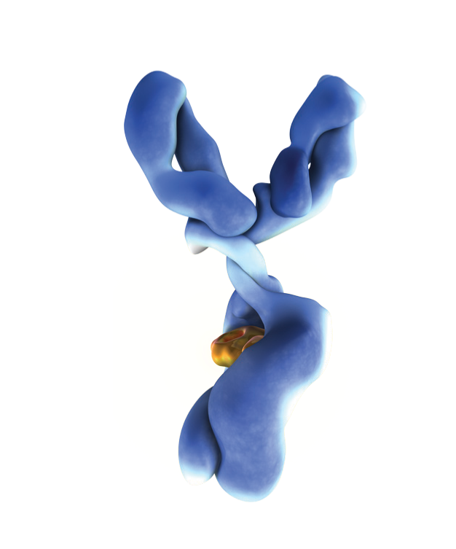
Comparison of Cell Death Induced by Obinutuzumab and Rituximab
Type II anti-CD20 antibody¹
Glycoengineered Fc region³
Up to 100-fold increase in ADCC vs rituximab^{3,4}
Enhanced DCD vs rituximab²
DCD = direct cell death; ADCC = antibody-dependent cell-mediated cytotoxicity
1. Niederfellner G et al. Blood 2011;118:358-67. 2. Alduaij W et al. Blood 2011;117:4519-29.
3. Mössner E et al. Blood 2010;115:4393-402. 4. Herter S et al. Poster presentation at ASH 2010 (Abstract 3925).
Notes:
Results from in vitro studies
GA101: A unique, glycoengineered, Type II anti-CD20 monoclonal antibody
GA101 is a novel monoclonal antibody that binds with high affinity to the extracellular domain of the human CD20 antigen on B cells.^{1–3}
In contrast to rituximab, which recognises a Type I epitope, GA101 recognises a Type II epitope, which is also localised in the extracellular loop of CD20.²
The Fc region of GA101 is glycoengineered to confer improved antibody-dependent cell-mediated cytotoxicity (ADCC).^{1–2}

Slide 48
Which of the following regimens appears to have the same efficacy as bendamustine/rituximab (BR) as first-line treatment for symptomatic follicular lymphoma (FL)?
Rituximab alone
Lenalidomide/rituximab
Obinutuzumab
R-CHOP
None of the above
I don’t know

Slide 49
From a quality-of-life perspective, how would you compare the global tolerability/toxicity of lenalidomide/rituximab to that of BR when used as up-front therapy for FL?
About the same
Lenalidomide/rituximab has less toxicity
BR has less toxicity
I don’t know

Slide 50
Rituximab plus Lenalidomide in Advanced Untreated Follicular Lymphoma: RELEVANCE Study Rituximab and Lenalidomide vs. R-Chemotherapy
R²
R² Maintenance
1st line
FL
N=1000
R + Chemo
Rituximab Maintenance
R + chemo: Investigator’s choice of R-CHOP, R-CVP, BR
R + Oral Len 20 mg d 1-21 for 6 cycles, then Len10 mg
N Engl J Med 379:934-947, September 6, 2018
El J Med
Volume 379(10):934-947
September 6, 2018
Notes:
RELEVANCE is a phase III trial of rituximab plus lenalidomide vs. rituximab plus chemotherapy (R-CHOP, R-CVP or BR). Lenalidomide 20 mg daily is given on days 2 through 22 of a 28 day cycle for 6 cycles, then at a dose of 10 mg daily for up to an additional 18 cycles if a CR is achieved. Rituximab is given at 375 mg/m² on days 1, 8, 15, and 22 of cycle 1 and day 1 of cycles 2 to 6; responding patients continue with rituximab 375 mg/m² every 8 weeks for 12 cycles.

Slide 51
RELEVANCE TRIAL: Summary
Untreated, advanced-stage FL (n=1030)
Phase 3 trial of Len/R vs R-Chemo
After a median follow-up of 39 months:
Complete Remission: Len/R 48% vs R-Chemo 53%
Progression-free survival: 77% vs 78%
Overall Survival: 94% in each arm
Conclusion: Len/R provided similar benefit to R-chemo, with generally fewer toxicities aside from rash

Slide 52
What is the usual second-line therapy for a patient with FL who experiences disease progression on first-line BR?
Re-treatment with BR
Obinutuzumab/bendamustine
Rituximab/lenalidomide
A PI3K inhibitor (eg, idelalisib, copanlisib, duvelisib)
I don’t know

Slide 53
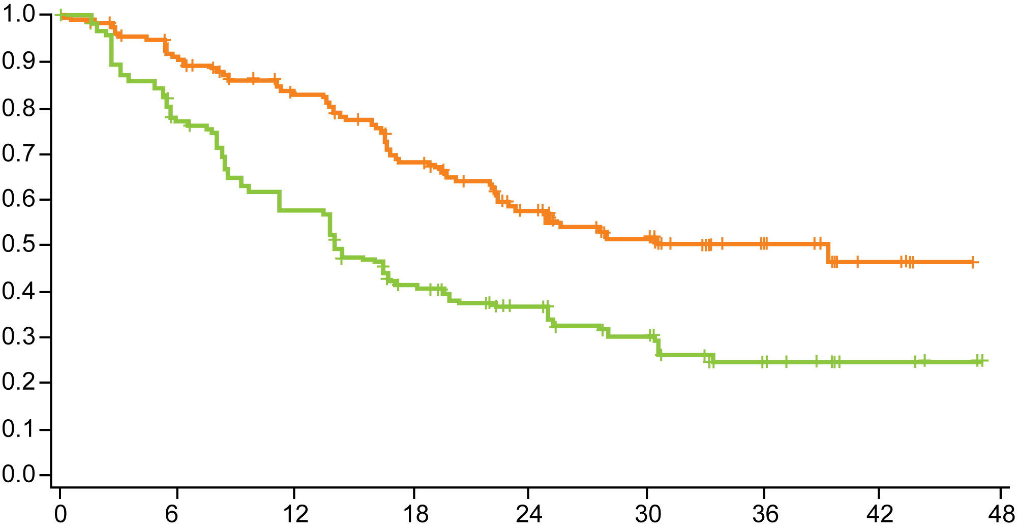
AUGMENT Trial: R² versus Rituximab/Placebo in R/R FL or Marginal Zone Lymphoma
Primary Endpoint: PFS
 | R² (n = 178) | R/placebo (n = 180)
ORR | 78% | 53%
CR | 34% | 18%
Median DOR | 36.6 mo | 21.7 mo
R²
Median = 39.4 mo
Progression-free survival probability (IRC assessment)
p < 0.001
HR = 0.46
Rituximab + placebo
Median = 14.1 mo
Months from randomization
Leonard JP et al. J Clin Oncol 2019;37(14):1188-99.

Slide 54
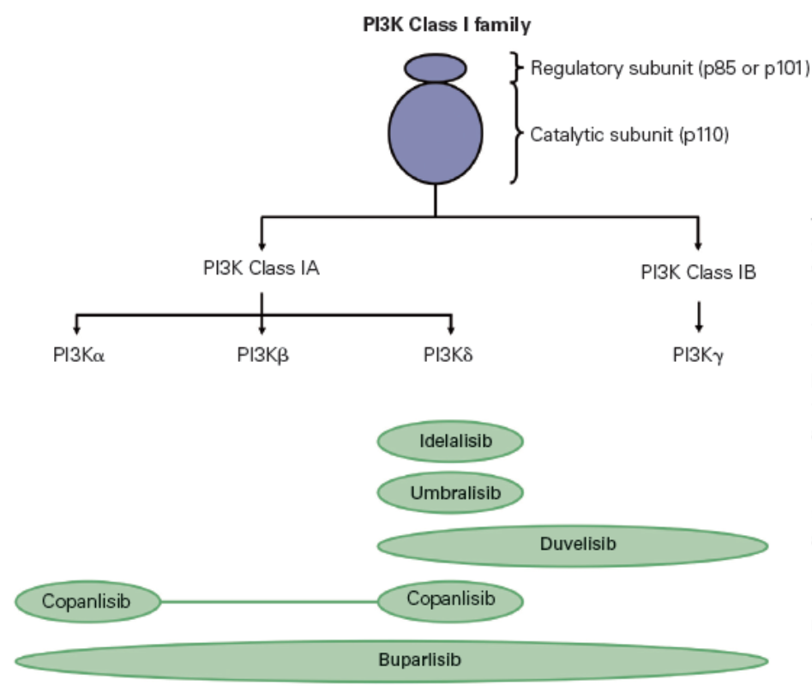
PI3Ki (Phosphatidylinositol 3-kinase inhibitors) in FL
(Greenwell IB et al. Oncology Journal 2017; 31)
Notes:
54

Slide 55
Approved PI3K inhibitors in R/R Follicular Lymphoma
 | Idelalisib | Copanlisib | Duvelisib
FDA approval | Jul 29, 2014 | Sep 14, 2017 | Sep 24, 2018
Isoforms | PI3K delta | Pan-PI3K | PI3K delta/gamma
Formulation | 150 mg PO BID | 60 mg IV Q weekly 3 wks on, 1 wk off | 25 mg PO BID
Indication in FL | Relapsed after at least two prior systemic therapies | Relapsed after at least two prior systemic therapies | Relapsed after at least two prior systemic therapies
Pivotal trial | iNHL, no response to rituximab and an alkylating agent or relapse within 6 mo | Rel/refr FL | Rel/refr FL
Results | iNHL, n=125 ORR 57%, CR 6% | FL, n=104 ORR 59%, CR 14% | FL, n=83 ORR 42%, 1 CR
 | mDOR 12.5 mo | mDOR 12.2 mo | 43% maintained responses for >6mo, 17% maintained responses for >12mo
Side effects | Pneumonitis, transaminitis, colitis | Hyperglycemia, hypertension, infections, neutropenia | Infection, diarrhea or colitis, and pneumonia
S deVos Sep 2019
(Gopal A, et al. NEJM 2014; 370:1008-18)
(https://www.fda.gov/Drugs/Information)

Slide 56
A common side effect among patients receiving copanlisib for relapsed FL is…
Thrombocytopenia
Rash
Hyperglycemia
I don’t know

Slide 57
Patients receiving idelalisib and duvelisib may develop delayed-onset…
Renal dysfunction
Immune-related pneumonitis
Hypothyroidism
All of the above
I don’t know

Slide 58
Very active 75-year-old woman and business owner (from the practice of Ms Leake)
2004: Diagnosed with follicular lymphoma
Spontaneous regression w/o treatment
2013: Recurrent lymphoma
RCHOP x 6
9/2013 Post-treatment PET/CT: Consistent with CR
6/2019: Recurrence, consistent with prior FL transformed to Grade 3b
Rituximab weekly x 4 doses + lenalidomide 20 mg daily x 12
9/2019: Maintenance monthly rituximab x 1 year, continue lenalidomide 20 mg
Changed rituximab to every 2 months due to COVID-19 pandemic
Lenalidomide reduced to 10 mg due to GI cramping

Slide 59
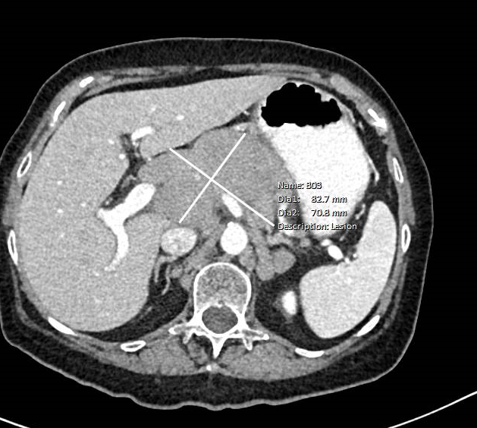
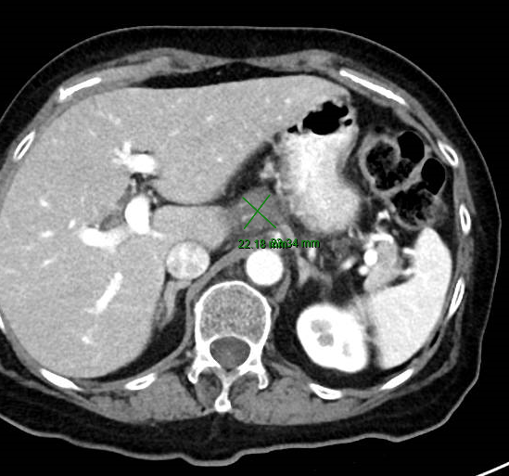
Very active 75-year-old woman (from the practice of Ms Leake)
6/5 – Pre-treatment with R²
11/26/19 – Restage

Slide 60
Very active 75-year-old woman (from the practice of Ms Leake)
Plan of Care
Frequency of rituximab changed to every 2 months due to COVID
Decreased lenalidomide to 10 mg po due to intolerance r/t abdominal cramping and nausea; Improved symptoms since dose change
Reimage for response
Reinforced with each visit- counseling re Rx regimen, symptom management and precautions during COVID epidemic; understands the increased risk for severe infection due to age, lymphoma and current treatment regimen

Slide 61
Very active 75-year-old woman (from the practice of Ms Leake)
Patient Education
Controlled drug: Discussed patient survey and patient/physician agreement with compliance
Hazardous handling of medication; Timing of drug, frequency and storing of medication
Rash and fatigue
GI upset: Constipation, diarrhea, nausea, vomiting and cramping
Peripheral neuropathy
Low blood counts (anemia, thrombocytopenia, neutropenia)
Dosing with frequency and storing.
Monitor for SOB, CP, cough or extremity swelling (PE/DVT): Anticoagulant-aspirin-prophylaxis
May cause dizziness (lenalidomide)
Hepatitis reactivation: Monitor Hep B (rituximab)
PML: Neuro changes
Infection risk: Due to low blood counts and impaired immune system.
Immunization: Low response to vaccines-no live vaccines.

Slide 62
Very active 75-year-old woman (from the practice of Ms Leake)
Symptom management
Fatigue: Encourage exercise, rest and well-balanced meals
Low blood counts: Growth factor for neutropenia or blood products
Neuropathy: Measures to minimize discomfort if present and safety
GI upset: Antiemetic, stool softener/laxative, loperamide
Rash: Topical steroid or antihistamine
Monitor chemistries: Adjust meds prn
Psychosocial support
Continue to support lifestyle changes: Encourage healthy living, exercise, well rounded diet and pursue outside interests
Working is very important for patient: Encourage to continue working but with limitations based on fatigue and ability to perform tasks any given day
Lifestyle: Plays golf, travel and family

Slide 63
85-year-old man with PMH of CAD, HFprEF, HTN, MDD, BPH, osteoarthritis and chronic pain (from the practice of Ms Leake)
12/2016: Low-grade small B-cell Lymphoma with high IgM level, bladder wall involvement and right axilla
BR x 6 (dose reduced due to age, PS)
6/2018: Post-treatment PET/CT: CR
1/2019: Cervical lymph node B cell lymphoma
R-CVP x 1 → mini-R-CHOP x 2 → PD one month later
4/2019: Palliative copanlisib, with dramatic response
7/2019 MRI: Lymphomatous mass T11 vertebral body treated with RT
8/2019: Rapid decline, hospice, patient dies

Slide 64
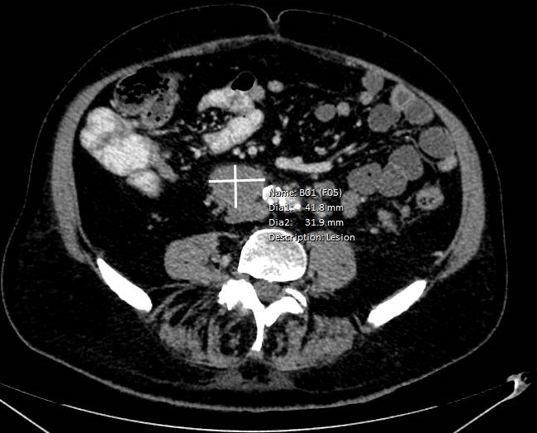
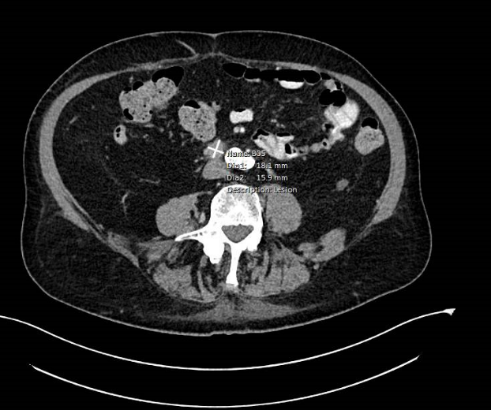
85-year-old man (from the practice of Ms Leake)
Pre-Copanlisib (3/27/2019)
Post-Copanlisib (7/2019)

Slide 65
Agenda
Module 1: Diffuse Large B-Cell Lymphoma (DLBCL)
Polatuzumab vedotin, CAR T-cell therapy
Module 2: Hodgkin Lymphoma (HL) and Peripheral T-Cell Lymphoma (PTCL)
Brentuximab vedotin, immune checkpoint inhibitors
Module 3: Follicular Lymphoma (FL)
Lenalidomide/rituximab (R²), PI3K inhibitors
Module 4: Mantle Cell Lymphoma (MCL)
BTK inhibitors (ibrutinib, acalabrutinib, zanubrutinib), venetoclax, lenalidomide
Module 5: Management of Lymphomas in the Era of COVID-19
Telemedicine, minimization of surgeries, reduced infusions and clinic visits

Slide 66
Module 4: Mantle Cell Lymphoma (MCL)
BTK inhibitors (ibrutinib, acalabrutinib, zanubrutinib), venetoclax, lenalidomide

Slide 67
In general, patients with mantle cell lymphoma (MCL) have a poor short-term prognosis and require treatment even if they are asymptomatic.
Agree
Disagree
I don’t know

Slide 68
Mantle cell lymphoma: Typical Presentation
74% male, average age 63 years
Usually advanced stage at diagnosis
Diffuse adenopathy and splenomegaly
GI tract and other sites of extranodal involvement are common
Clinical spectrum ranges from indolent to very aggressive disease
Notes:
PE, CBC, CMP, LDH
?tumor lysis
Beta2-microglobulin
Hepatitis B
Bone marrow biopsy
CT +/-PET

Slide 69
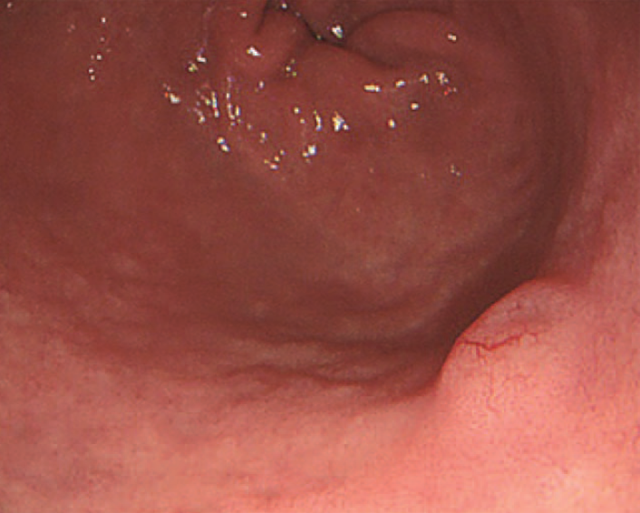
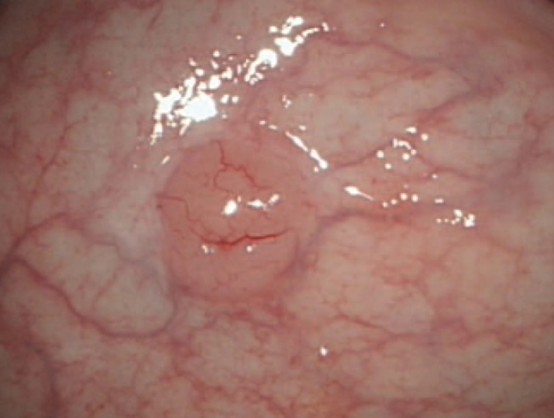
Gastrointestinal Involvement in MCL
Case report: Submucosal lesions in the gastric antrum, duodenal bulb and rectum by endoscopy
Li D et al. Medicine 2017;96:11(e6321).

Slide 70
What is generally the most common second-line therapy for patients with mantle cell lymphoma who experience disease progression on first-line BR?
A BTK inhibitor (eg, ibrutinib, acalabrutinib)
Lenalidomide/rituximab
Bortezomib
Venetoclax
I don’t know

Slide 71
Mechanism of Action of BTK Inhibitors
BCR
LYN
SYK
Ibrutinib
Acalabrutinib
Zanubrutinib
┬
PI3K
delta
BTK
PLCγ2
AKT
GSK-3
NF-kβ
pathway
PKC
mTOR
p70s6k
elf4E
Woyach JA et al. Blood 2012;120(6):1175-84.

Slide 72
Targeted, non-Chemotherapy Approaches for Relapsed/Refractory MCL
Agent | N | Response Rate | mDOR (mo.)
Bortezomib | 155 | 33% | 9.2 m
Temsirolimus | 54 | 22% | 7.1 m
Lenalidomide | 134 | 28% | 16.6 m
Lenalidomide-rituximab | 52 | 57% | 18.9 m
Idelalisib | 40 | 40% | 4 m
Ibrutinib | 111 | 68% | 17.5 m
Acalabrutinib | 124 | 81% | 72% at 12 m
Zanubrutinib | 86 | 84% | 16.7 m
Venetoclax | 28 | 75% | 12 m
Ibrutinib-Venetoclax | 24 | 71% (all CR) | 80% at 12 m

Slide 73
Acalabrutinib in relapsed or refractory mantle cell lymphoma (ACE-LY-004): a single-arm, phase 2 trial
Wang M, et al. Lancet 2018

Slide 74
Acalabrutinib may result in fewer of the toxicities commonly associated with ibrutinib, but it is noteworthy for the occurrence of __________ during the first month of treatment.
Hair loss
Headache
Constipation
Visual disturbances
I don’t know

Slide 75
Acalabrutinib vs. Ibrutinib
in MCL
Acalabrutinib appears to have better safety profile
Very infrequent atrial fibrillation and bleeding events
More headache with acalabrutinib, especially in first weeks of Rx – responds to caffeine
Both are oral agents that have similar efficacy, so choose based on patient factors (e.g., bleeding risk, Afib history)
Acala and Ibrutinib are being tested in combinations with chemotherapy, rituximab or venetoclax in current clinical trials
Zanubrutinib is a newly-approved BTKi that appears to be similar to Acala in response and toxicities

Slide 76
Mechanism of Action of Venetoclax (ABT-199)
Bcl-2 functions to prevent cell death by apoptosis
Venetoclax is specific for Bcl-2 and inhibits its function, thereby removing the block on apoptosis
ABT-199
Bcl-2
Bcl-XL
Tumor cell
Platelet
Adapted from Davids MS, Letai A. Cancer Cell 2013;23(2):139-41.

Slide 77
Revised Dose Ramp-Up to Mitigate the Risk of Tumor Lysis Syndrome When Initiating Venetoclax in Patients With Mantle Cell Lymphoma MS Davids, G von Keudell, CA Portell, JB Cohen, et al J Clin Oncol 2018; 36: 3525-7

Slide 78
Ibrutinib plus venetoclax in MCL: Study Schema
24 MCL patients; 23 relapsed or refractory
Most had very poor risk features
Tam CS et al. N Engl J Med 2018;378:1211-1223
Notes:
Figure 1 Study Schema. Patients received ibrutinib at a dose of 560 mg per day for 4 weeks, before the weekly dose escalation of venetoclax to a target dose of 400 mg per day began. Both drugs were continued until disease progression or an unacceptable level of adverse events occurred. Disease reassessment was performed at weeks 4, 16, 28, 40, and 56 (arrows) by means of CT, with positron-emission tomography (PET) at baseline and at weeks 16 and 56, by means of bone marrow examination, and by means of allele-specific oligonucleotide–polymerase chain reaction (ASO-PCR) assessment of minimal residual disease in peripheral blood.

Slide 79
72-year-old man (from the practice of Ms Moran)
9/2016: Presented to PCP with increased fatigue, DOE and palpable nodes in his neck
Right cervical node biopsy: MCL, BM biopsy: Positive, FISH: t(11;14)
PET scan: Positive above and below diaphram
Endoscopy biopsy: Negative
IPI 2, Hgb 14, WBC 7.2, ECOG 1, LDH 182
10/2016: Ibrutinib 560 mg po daily
11/2016: Hospital admission for neutropenic fevers and pneumonia
10/2017: Sinus surgery for recurrent sinus infections negative aspergillus
Ibrutinib held 7 days prior and 7 days after surgery
12/2019: Patient retired from farming
Patient currently faring well on ibrutinib

Slide 80
Agenda
Module 1: Diffuse Large B-Cell Lymphoma (DLBCL)
Polatuzumab vedotin, CAR T-cell therapy
Module 2: Hodgkin Lymphoma (HL) and Peripheral T-Cell Lymphoma (PTCL)
Brentuximab vedotin, immune checkpoint inhibitors
Module 3: Follicular Lymphoma (FL)
Lenalidomide/rituximab (R²), PI3K inhibitors
Module 4: Mantle Cell Lymphoma (MCL)
BTK inhibitors (ibrutinib, acalabrutinib, zanubrutinib), venetoclax, lenalidomide
Module 5: Management of Lymphomas in the Era of COVID-19
Telemedicine, minimization of surgeries, reduced infusions and clinic visits

Slide 81
Module 5: Management of Lymphomas in the Era of COVID-19
Telemedicine, minimization of surgeries, reduced infusions and clinic visits

Slide 82
Guidance on Lymphomas During the Era of COVID-19
American Society of Hematology (ASH) Resources
COVID-19 and Aggressive Lymphoma: Frequently Asked Questions (v2.1; last updated 5/4/2020)
COVID-19 and Indolent Lymphomas: Frequently Asked Questions (v2.1; last updated 5/4/2020)
COVID-19 and Hodgkin Lymphoma: Frequently Asked Questions (v2.2; last updated 5/4/2020)
European Society of Medical Oncology (ESMO) Resources
ESMO management and treatment adapted recommendations in the COVID-19 era: Diffuse large B-cell lymphoma, Mantle cell lymphoma and Aggressive T-cell lymphomas
ESMO management and treatment adapted recommendations in the COVID-19 era: Indolent B-NHL (Follicular Lymphoma, Marginal Zone Lymphoma, Waldenström’s Macroglobulinaemia)
ESMO management and treatment adapted recommendations in the COVID-19 era: Hodgkin lymphoma
https://www.hematology.org/covid-19/; https://www.esmo.org/guidelines/

Slide 83
Are you restricting the number of visitors allowed in your clinic during the COVID-19 pandemic?
Yes
No
Are the healthcare workers in your clinic required to wear masks or other personal protective equipment (PPE) during the COVID-19 pandemic?
Yes
Are the patients who visit your clinic required to wear masks or other PPE during the COVID-19 pandemic?
Yes
No

Slide 84
How does the amount of time you spend on web-based tele-visits compare to the amount of time you would have spent conducting in-person office visits before the COVID-19 pandemic?
About the same
I spend more time on web-based tele-visits than I did on in-person office visits
I spend less time on web-based tele-visits than I did on in-person office visits
Duration of time spent for each web-based tele-visit (median): 20 minutes

