Slide 1
Oncology Grand Rounds
New Agents and Strategies in
Chronic Lymphocytic Leukemia
Thursday, June 4, 2020
5:00 PM – 6:30 PM ET
Faculty
Amy Goodrich, CRNP
Brad S Kahl, MD
Robin Klebig, APRN, CNP, AOCNP
Jeff Sharman, MD
Moderator
Neil Love, MD

Slide 2
Dr Love — Disclosures
Dr Love is president and CEO of Research To Practice. Research To Practice receives funds in the form of educational grants to develop CME activities from the following commercial interests: AbbVie Inc, Acerta Pharma — A member of the AstraZeneca Group, Adaptive Biotechnologies, Agendia Inc, Agios Pharmaceuticals Inc, Amgen Inc, Array BioPharma Inc, Astellas, AstraZeneca Pharmaceuticals LP, Bayer HealthCare Pharmaceuticals, Biodesix Inc, bioTheranostics Inc, Blueprint Medicines, Boehringer Ingelheim Pharmaceuticals Inc, Boston Biomedical Inc, Bristol-Myers Squibb Company, Celgene Corporation, Clovis Oncology, Daiichi Sankyo Inc, Dendreon Pharmaceuticals Inc, Eisai Inc, EMD Serono Inc, Exelixis Inc, Foundation Medicine, Genentech, a member of the Roche Group, Genmab, Genomic Health Inc, Gilead Sciences Inc, GlaxoSmithKline, Guardant Health, Halozyme Inc, ImmunoGen Inc, Incyte Corporation, Infinity Pharmaceuticals Inc, Ipsen Biopharmaceuticals Inc, Janssen Biotech Inc, administered by Janssen Scientific Affairs LLC, Jazz Pharmaceuticals Inc, Kite, A Gilead Company, Lexicon Pharmaceuticals Inc, Lilly, Loxo Oncology Inc, a wholly owned subsidiary of Eli Lilly & Company, Merck, Merrimack Pharmaceuticals Inc, Myriad Genetic Laboratories Inc, Natera Inc, Novartis, Oncopeptides, Pfizer Inc, Pharmacyclics LLC, an AbbVie Company, Prometheus Laboratories Inc, Puma Biotechnology Inc, Regeneron Pharmaceuticals Inc, Sandoz Inc, a Novartis Division, Sanofi Genzyme, Seattle Genetics, Sirtex Medical Ltd, Spectrum Pharmaceuticals Inc, Taiho Oncology Inc, Takeda Oncology, Tesaro, A GSK Company, Teva Oncology, Tokai Pharmaceuticals Inc and Tolero Pharmaceuticals.

Slide 3
Ms Goodrich — Disclosures
Advisory Committee | AstraZeneca Pharmaceuticals LP, Janssen Biotech Inc

Slide 4
Dr Kahl — Disclosures
Advisory Committee | AstraZeneca Pharmaceuticals LP
Consulting Agreements | AbbVie Inc, Acerta Pharma — A member of the AstraZeneca Group, Genentech, a member of the Roche Group, Pharmacyclics LLC, an AbbVie Company, Roche Laboratories Inc, TG Therapeutics Inc
Contracted Research | Acerta Pharma — A member of the AstraZeneca Group, BeiGene, Celgene Corporation, Genentech, a member of the Roche Group
Data and Safety Monitoring Board | Celgene Corporation

Slide 5
Ms Klebig — Disclosures
No financial interests or affiliations to disclose

Slide 6
Dr Sharman — Disclosures
Advisory Committee, Consulting Agreements and Contracted Research | AbbVie Inc, AstraZeneca Pharmaceuticals LP, Genentech, a member of the Roche Group, Pharmacyclics LLC, an AbbVie Company, TG Therapeutics Inc

Slide 7
Commercial Support
This activity is supported by educational grants from AbbVie Inc, AstraZeneca Pharmaceuticals LP, Genentech, a member of the Roche Group, and Pharmacyclics LLC, an AbbVie Company, and Janssen Biotech Inc, administered by Janssen Scientific Affairs LLC.

Slide 8
Agenda
Module 1: Biology, Clinical Presentation and Workup
Case Presentation: Ms Klebig — 69-year-old man
Module 2: New Agents/Regimens
Case Presentation: Ms Goodrich — 58-year-old man
Module 3: Key Clinical Trials
Case Presentation: Ms Klebig — 76-year-old woman
Module 4: First-Line Treatment Decision-Making
Case Presentation: Ms Goodrich — 84-year-old woman
Module 5: Use of Oncologic Agents to Treat COVID-19

Slide 9
Module 1: Biology, Clinical Presentation and Workup

Slide 10
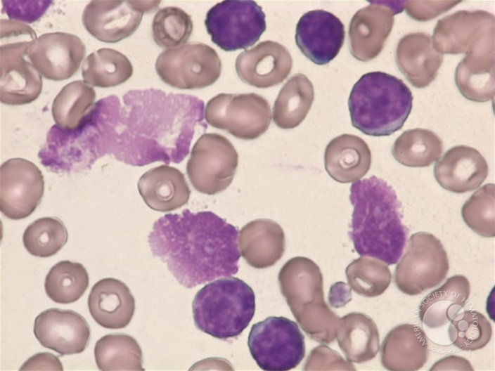
Chronic Lymphocytic Leukemia
US Epidemiology:
    Incidence: ~19,000/year
    US Prevalence: ~130,000 cases
Median age at diagnosis: 71 years
Male to female ratio: 2 to 1
Diagnosis usually made from blood
  Less common: lymph node, marrow
Immunophenotype
  sIg(dim) (light chain restricted)
  CD5+
  CD20 (dim)
  CD23+(bright)
Courtesy of Brad S Kahl, MD

Slide 11
Potential clinical manifestions of CLL
None
Marrow failure syndrome
  Anemia, Thrombocytopenia
Autoimmune cytopenias
  Anemia, thrombocytopenia, neutropenia
Immunodeficiency (low Ig levels)
  Recurrent infections
Symptoms
  Fatigue, night sweats, weight loss, fevers, pain
Courtesy of Brad S Kahl, MD

Slide 12
Summary: diagnosis & initial work up
Flow cytometry
Laboratory testing
  CBC, CMP
  LDH
  B2M
  FISH (CLL Panel)
  IGHV mutation analysis
  Consider TP53 mutation
Imaging
  Not needed for most patients
  Worth considering CT scan if starting treatment or if significant adenopathy or splenomegaly detected on exam
  Need if starting venetoclax
  Obtain PET scan if worried about Richter’s Transformation
Bone marrow
  Not needed at diagnosis but worth considering if starting treatment
Courtesy of Brad S Kahl, MD

Slide 13
Patients with CLL and which of the following prognostic factors generally do not respond well to chemoimmunotherapy?
Del(17p)
TP53 mutation
IGHV mutation
All of the above
Only a and b
I don’t know

Slide 14
(Brief) Summary of Genomic/Molecular Prognostic Factors
FISH defects
  17p deletion
  11q deletion
  12q trisomy
  Normal
  13q deletions
Immunoglobulin heavy chain variable region (IGHV)
  Mutated: better prognosis
  Unmutated: worse prognosis
CD38 status (≥ 30% = higher risk)
ZAP-70 status (≥ 20% = higher risk)
Unfavorable
Hierarchy
Favorable
Often included with flow but IGHV more important and less variable
Courtesy of Brad S Kahl, MD

Slide 15
CLL special consideration
High frequency of AI complications
  ITP, AIHA, neutropenia
High frequency of infections
  Check Ig levels
  Consider IVIg replacement therapy if recurrent infections and
  IgG < 300
High rate of skin cancer
  Low threshold to send to Dermatology
Courtesy of Brad S Kahl, MD

Slide 16
69-year-old man with a PMH of DJD, anxiety and BPH (from the practice of Ms Klebig)
5/2018: Worsening chronic low back pain, no B-symptoms, diffuse adenopathy
  Left inguinal LN biopsy: SLL/CLL
  Hypercellular marrow (70%) with 70% involvement by CLL
  RAI stage I, CLL-IPI: 4 (high risk), 13q deletion, TP53: Negative, IGH-V unmutated, CD49d: Positive
  Hgb: 13.3, Plts: 197,000, WBC: 17,800, ANC: 4,090, ALC: 12,638, LDH: 172, B2M: 2.40
Observation → 1/2019: Disease progression
2/2019: Acalabrutinib/obinutuzumab on clinical trial
  1/2020 Response assessment
    Bone marrow: Normocellular marrow, no morphologic features of lymphoma involvement
    Small CD5-positive kappa-restricted B-cell population detected on flow cytometry consistent with CLL/SLL (MRD=0.07%)
    CT chest/abdomen/pelvis: Near to complete resolution of lymphadenopathy

Slide 17
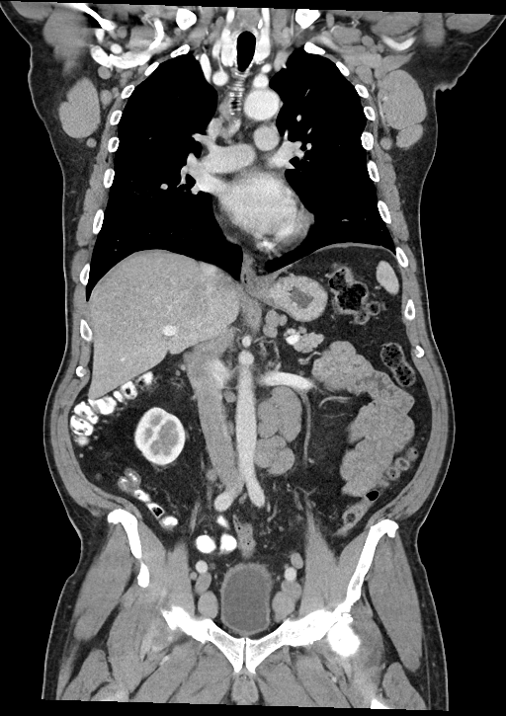
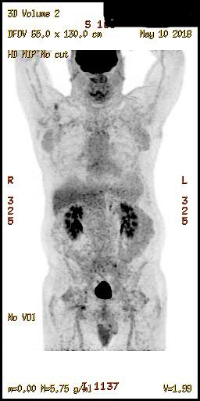
69-year-old man (from the practice of Ms Klebig)
Baseline imaging at diagnosis
CT (5/3/2018)
PET (5/10/2018)

Slide 18
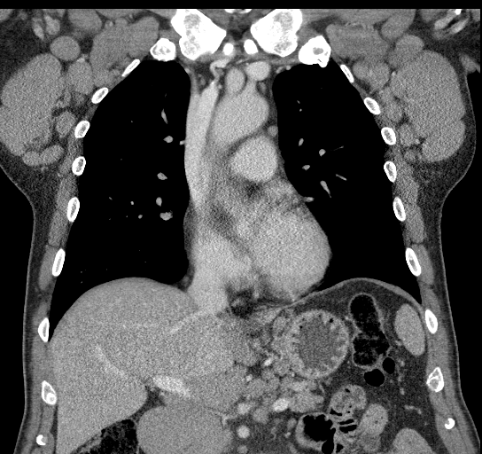
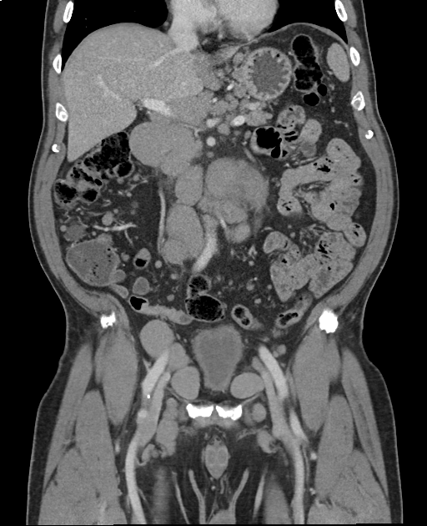
69-year-old man (from the practice of Ms Klebig)
Disease Progression (1/2019)
CT chest/abd/pelvis:
  Progression with bulky adenopathy
Bone marrow:
  CLL involving 70% of bone marrow cellularity (90% hypercellular marrow)
Hgb 13.1
Plts 198,000
WBC 56,600
ANC 6,790
ALC 45,320
Chem, LDH WNL

Slide 19
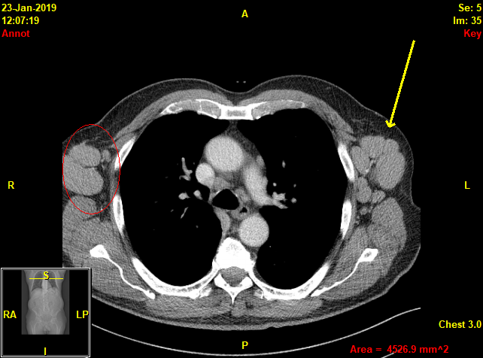
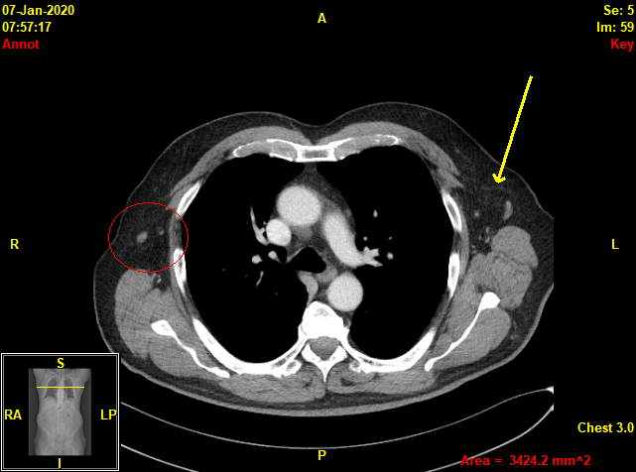
69-year-old man (from the practice of Ms Klebig)
Response to acalabrutinib/obinutuzumab therapy
Before (1/23/2019)
After (1/7/2020)

Slide 20
69-year-old man (from the practice of Ms Klebig)
Patient Education
Pharmacy consultation re potential drug interactions
CYP3A4 interactions - Avoid strong inhibitors & inducers
  Azole antifungals, -mycin antibiotics, protease inhibitors, etc
  Moderate – consider dose adjustment
  Avoid grapefruit/juice and Seville oranges
Avoid antacids or calcium supplements and H2 receptor antagonists for 2 hours before and after acalabrutinib
Avoid proton pump inhibitors due to potential decrease in drug exposure
Take with water, with or without food
Possible tumor lysis syndrome
Allopurinol x 10 days at start of therapy

Slide 21
69-year-old man (from the practice of Ms Klebig)
Patient Education
Acalabrutinib is typically very well tolerated
Bleeding tendency with BTK inhibitors
May note easy bleeding/bruising/petechiae
Avoid NSAIDs, ASA, vitamin E, fish oil
Hold acalabrutinib 3 days prior to and 3 days following minor procedure; 7 days for major procedure
Headache is likely
Usually temporary, first month or so
Typically easily managed with acetaminophen

Slide 22
69-year-old man (from the practice of Ms Klebig)
Patient Education
Risk for atrial fibrillation
Watch for palpitations, lightheadedness, syncope, dyspnea, irregular rapid pulse
Risk for hypertension
Diarrhea
Loperamide prn
Record # stools per day at baseline
Myalgia/arthralgia
Recommend increase activity, movement, stretching
Treat symptomatically
Nausea
Rash
Cytopenias
Anemia
  Typically not transfusion requiring
Leukopenia, neutropenia, lymphocytopenia
  Increased infection risk
Thrombocytopenia
Monitor weekly during 1st month
Consider dose adjustment if limiting
Take acalabrutinib indefinitely, as long as responding if no CR

Slide 23
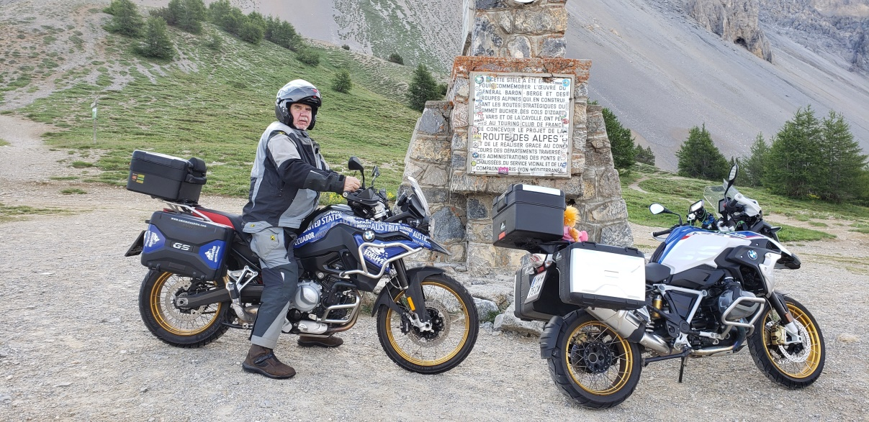
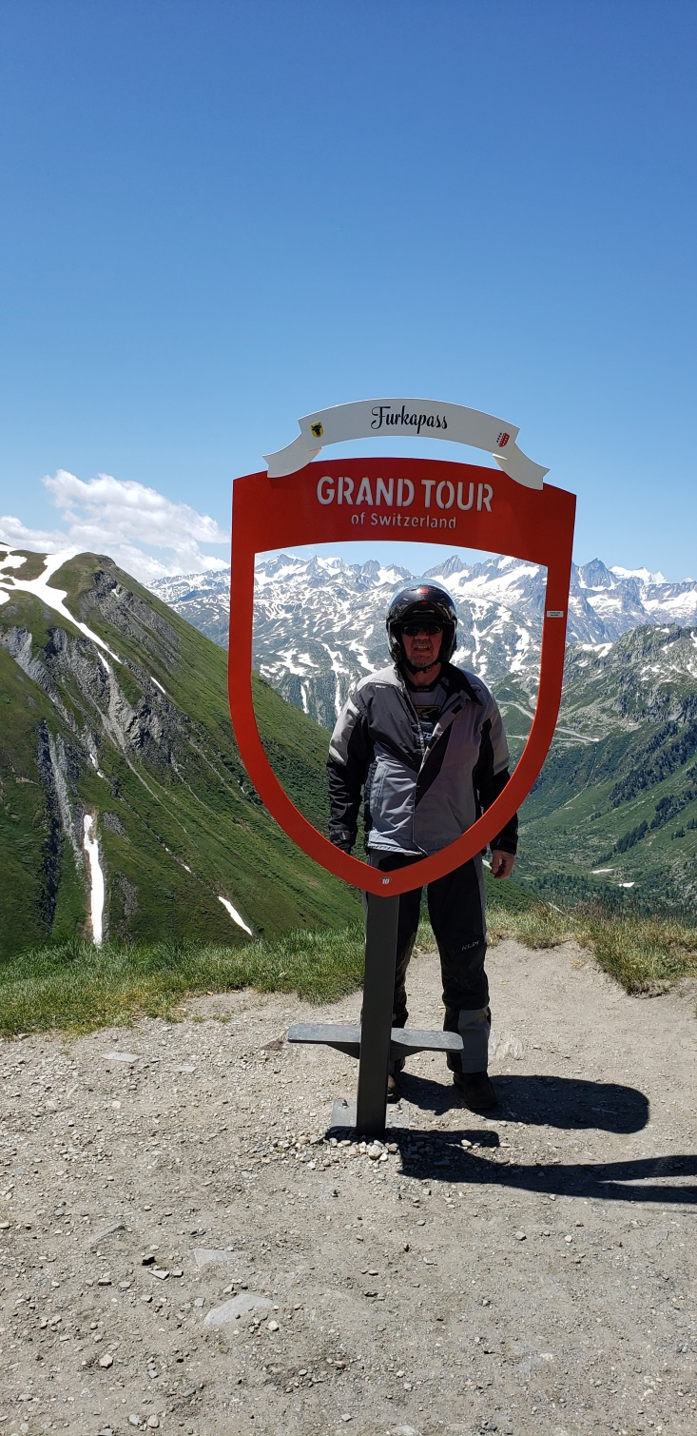
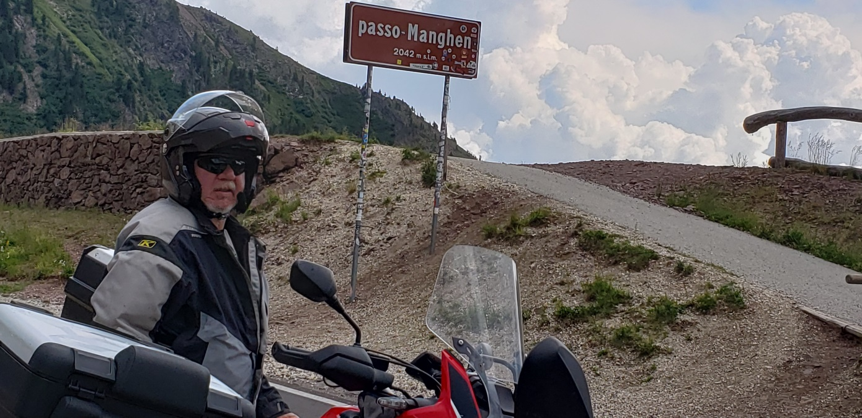
I really wish I could find words meaningful enough to express how thankful I am for all that you and everybody at Mayo has done for me. I was very sick just 18 month ago and today I feel great and extremely grateful for the program you put me in.

Slide 24
Agenda
Module 1: Biology, Clinical Presentation and Workup
Case Presentation: Ms Klebig — 69-year-old man
Module 2: New Agents/Regimens
Case Presentation: Ms Goodrich — 58-year-old man
Module 3: Key Clinical Trials
Case Presentation: Ms Klebig — 76-year-old woman
Module 4: First-Line Treatment Decision-Making
Case Presentation: Ms Goodrich — 84-year-old woman
Module 5: Use of Oncologic Agents to Treat COVID-19

Slide 25
Module 2: New Agents/Regimens

Slide 26
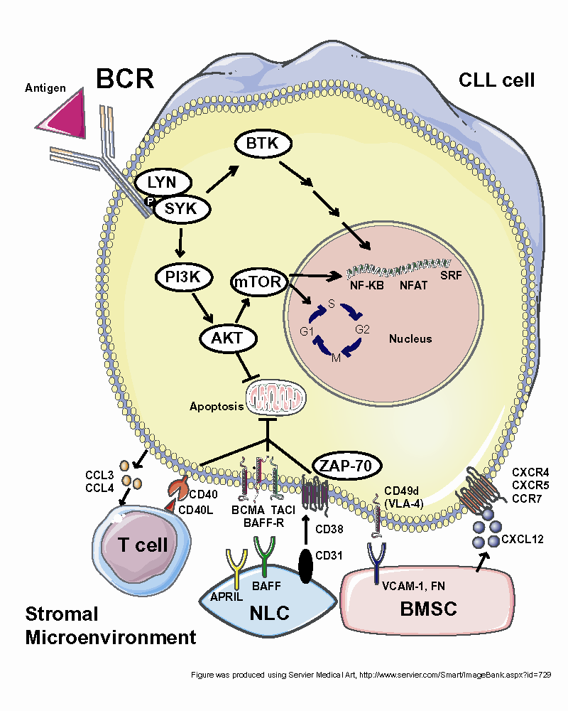
Novel agents in CLL have recently revolutionized therapy
Y
ibrutinib
acalabrutinib
obinutuzumab
BCR
CD20
idelalisib
duvelisib
venetoclax
BCL-2
Stromal Microenvironment
Courtesy of Matthew S Davids, MD
Adapted from Davids and Brown, Leuk Lymphoma, 2012

Slide 27
Newer options for 1st line CLL
BTK inhibitors
  Ibrutinib (FDA approved 2016)
  Acalabrutinib (FDA approved 2019)
  Zanubrutinib (TBD)
BCL-2 inhibitors
  Venetoclax (FDA approved 2019)
New anti-CD20 MoAbs
  Obinutuzumab (FDA approved 2019)
    Combination with Venetoclax (yes)
    Combination with Ibrutinib or Acalabrutinib (optional)
Courtesy of Brad S Kahl, MD

Slide 28
Ibrutinib
1st generation BTK inhibitor
  Associated with lymphocytosis
Highly effective
  Response rate ~ 90%, 75% still in remission at 5 years
  420 mg/day
  Beat FCR and BR head to head in phase III clinical trials
    No major difference in IgHV mutated patients
  Remissions shallow – need for indefinite therapy
Generally well tolerated
  Arthralgias/myalgias tend to improve with time
  Rash/skin issues can be nagging
  Hypertension (can be hard to manage)
  Atrial fibrillation 10-15%
  Bleeding (need to hold for surgery)
    No warfarin. Careful with other agents.
Courtesy of Brad S Kahl, MD

Slide 29
The use of anticoagulant therapy is an absolute contraindication to the use of ibrutinib in patients with CLL.
Agree
Disagree
I don’t know

Slide 30
Ibrutinib should be temporarily discontinued in patients scheduled to undergo surgical procedures.
Agree
Disagree
I don’t know

Slide 31
Acalabrutinib
2nd Generation BTK inhibitor
  More selective kinase inhibitor = less AE’s
Highly effective
  Activity appears comparable to ibrutinib
  No 5 year follow up at this point
Better tolerated (my opinion)
  Less arthralgia, myalgia, HTN, Afib, Bleeding
  Does cause headache – caffeine helps
Other issues
  100 mg po BID
  Can’t be on proton pump inhibitor
  Should take on empty stomach
Courtesy of Brad S Kahl, MD

Slide 32
Venetoclax
BCL-2 inhibitor
  No lymphocytosis
Highly effective
  Remission “deeper" than with BTKi’s
    More complete responses. More MRD negativity.
  Developed as a 12-month “time limited therapy” when used with obinutuzumab in 1st line
  Responses in ~90%. No 5-year data yet.
Generally well tolerated
  GI side effects, cytopenias
Tumor Lysis Syndrome
Courtesy of Brad S Kahl, MD

Slide 33
Which of the following disease-related factors is critical in attempting to determine an individual’s risk of developing tumor lysis syndrome from treatment with venetoclax for CLL?
White blood cell count
Size of lymph nodes
Tumor grade
All of the above
Only a and b
Only a and c
Only b and c
I don’t know

Slide 34
Which of the following patient-related factors is most important in attempting to determine an individual’s risk of developing tumor lysis syndrome from treatment with venetoclax for CLL?
Hepatic function
Renal function
Body mass index
I don’t know

Slide 35
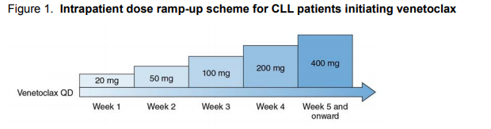
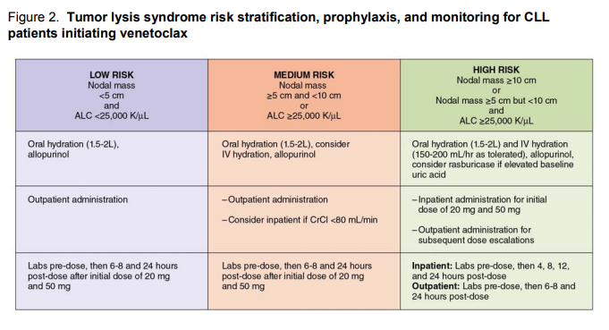
venetoclax
Toxicity profile different from other targeted agents: TLS risks
Courtesy of Brad S Kahl, MD

Slide 36
Obinutuzumab
Anti-CD20 MoAb
  Designed to be a new and improved rituximab
  Better than rituximab for CLL
Dosing: 1000 mg flat dose
  Cycle 1: Day 1 (100mg), 2 (900mg), 8, 15
  Cycle 2-6 Day 1
When to use it
  If using venetoclax 12-month time limited therapy, combine with obinutuzumab
  If using BTKi obinutuzumab, use is optional
    Improves outcomes marginally
    Adds some toxicity (mostly infections)
Courtesy of Brad S Kahl, MD

Slide 37
Approved PI3K Inhibitors for CLL:
Indication and Dosing
 | Idelalisib¹ | Duvelisib²
Mechanism of action | Selective PI3Kδ inhibitor | Dual inhibitor of PI3Kδ,γ
Indication | Relapsed CLL in combination with rituximab for patients with comorbidities | R/R CLL after at least 2 prior systemic therapies
Dosing | 150 mg orally, twice daily | 25 mg orally, twice daily
¹ Idelalisib package insert, October 2018; ² Duvelisib package insert, September 2018.

Slide 38
58-year-old man with a history of anxiety, recent depression, and 2 divorces since diagnosis (from the practice of Ms Goodrich)
4/2001: Diagnosed with asymptomatic Stage IVA SLL in 4/2001 at age 39
  Prognostic factors: 13q and 11q deletions, mutated IGHV
Observed until 2008 → Bulky adenopathy and lymphocytosis
Thrice weekly rituximab (PR) → PD in 2010
Clinical trial: FCR + ABT-263 (BCL-2 inhibitor) x 6 (PR) → PD 7/2013
Observed until early 2015: Bulky adenopathy, symptomatic splenomegaly (continued 13q and 11q deletions)
3/2015: Ibrutinib
  Nausea and diarrhea (ondansetron and Imodium for the first two years) → tapered off
Summer 2016: Kidney cancer → partial nephrectomy
  ALC rose upon holding drug, trended down over months/years
Currently, remains on ibrutinib at full dose

Slide 39
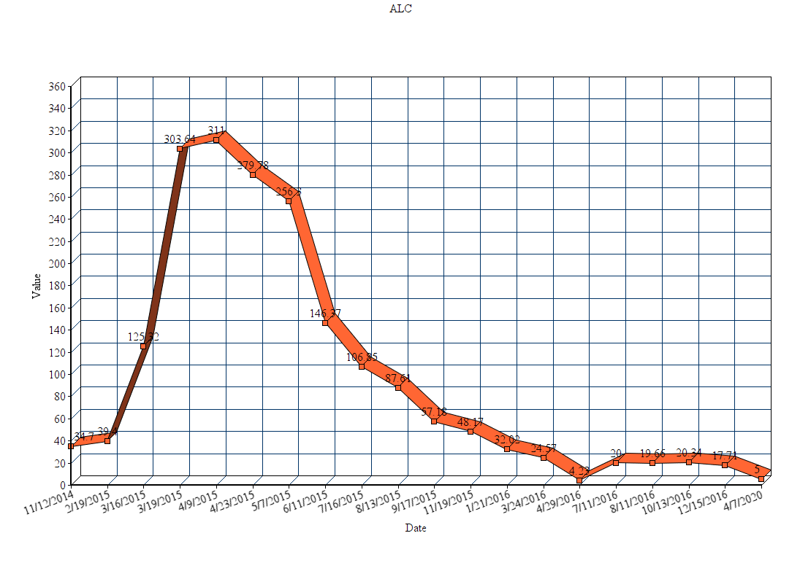
58-year-old man (from the practice of Ms Goodrich)

Slide 40
58-year-old man (from the practice of Ms Goodrich)
Teaching points
Common side effects
  Nausea, diarrhea, arthralgias, fatigue, minor bleeding
  Prescription and OTC meds to manage; lifestyle/diet changes; holding for procedures
Uncommon side effects
  Major bleeding
  A-fib/flutter
Potential for lymphocytosis
Contact/emergency numbers
Monitoring schedule
  I see/touch base weekly until good symptom management
  Frequent initial labs, we did TLS monitoring due to bulky adenopathy

Slide 41
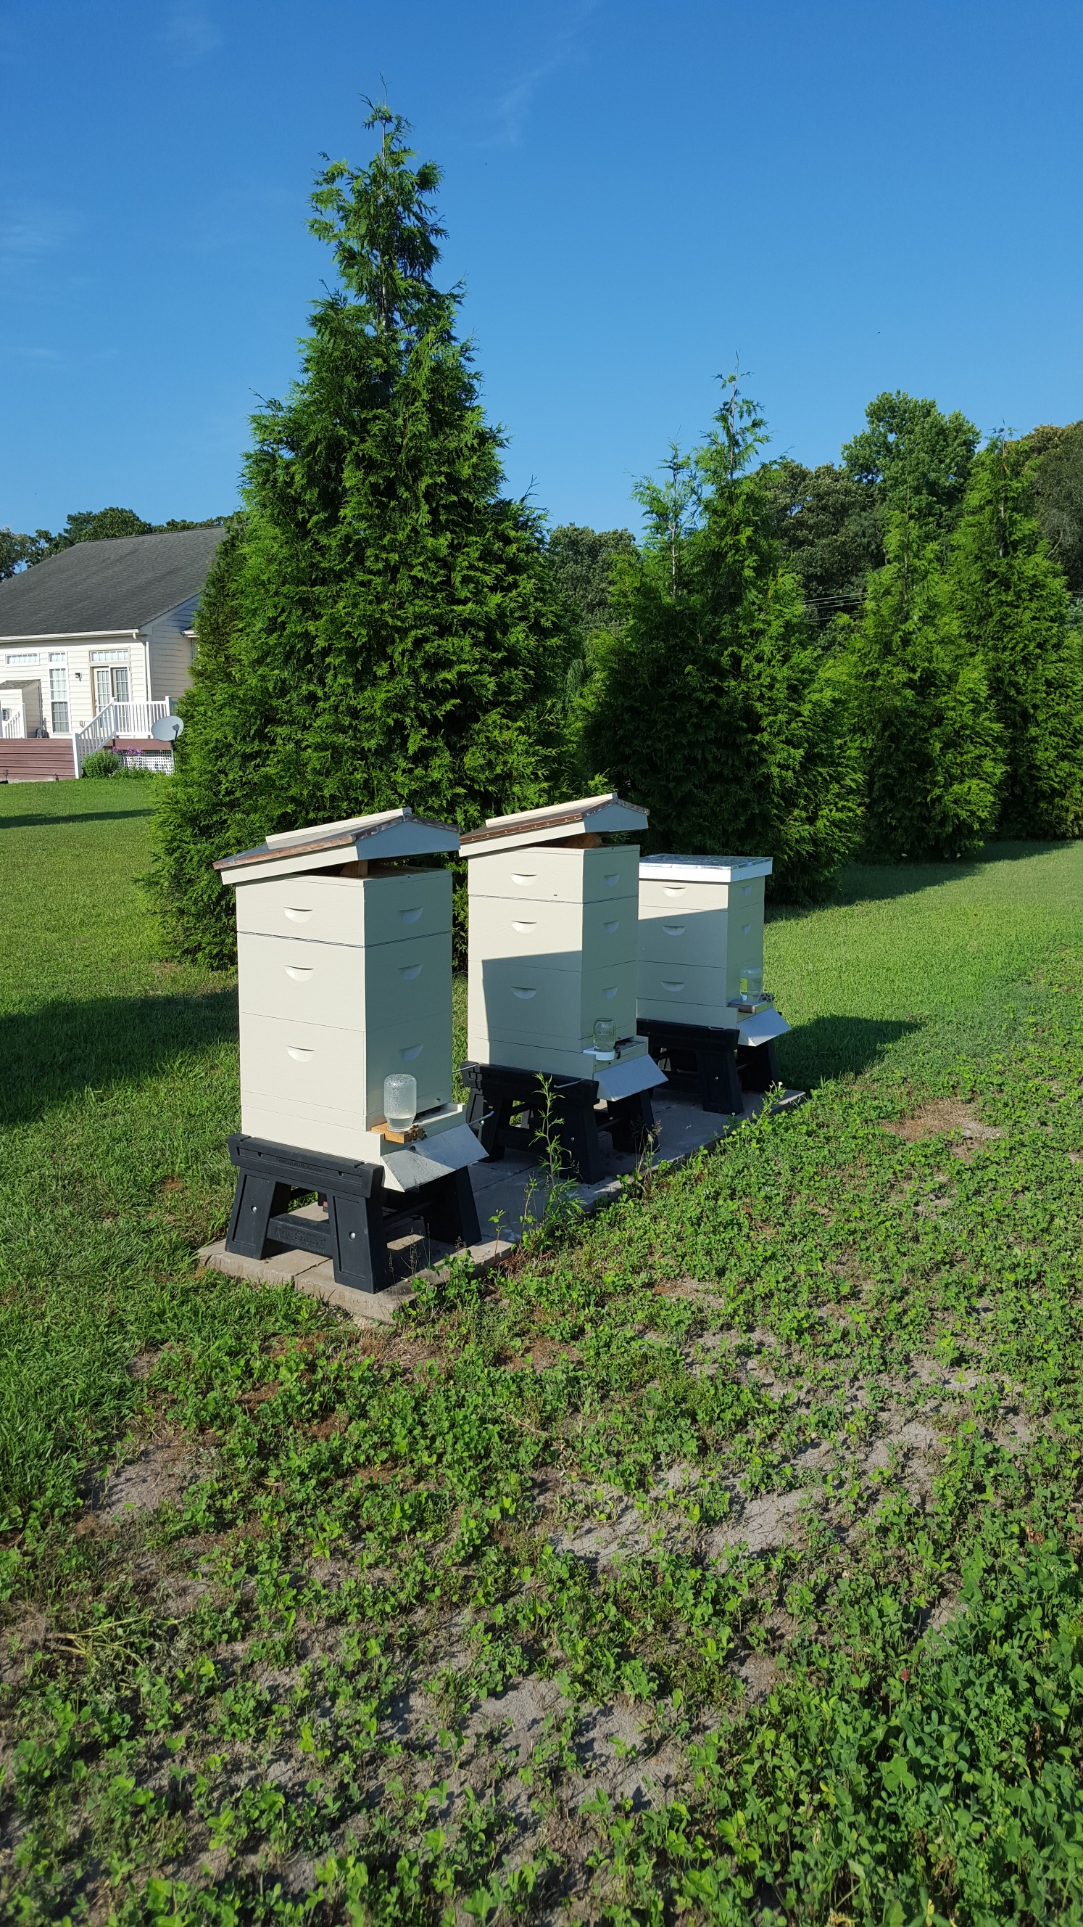
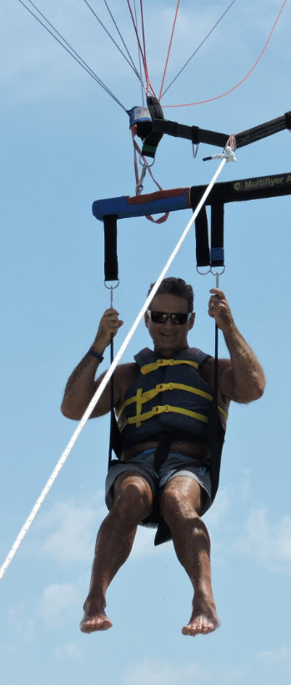
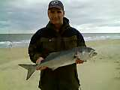
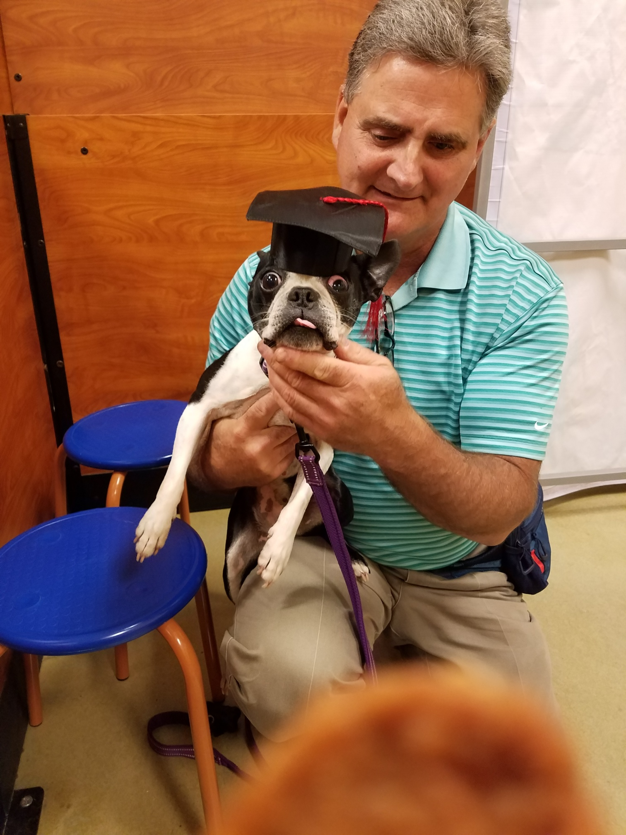
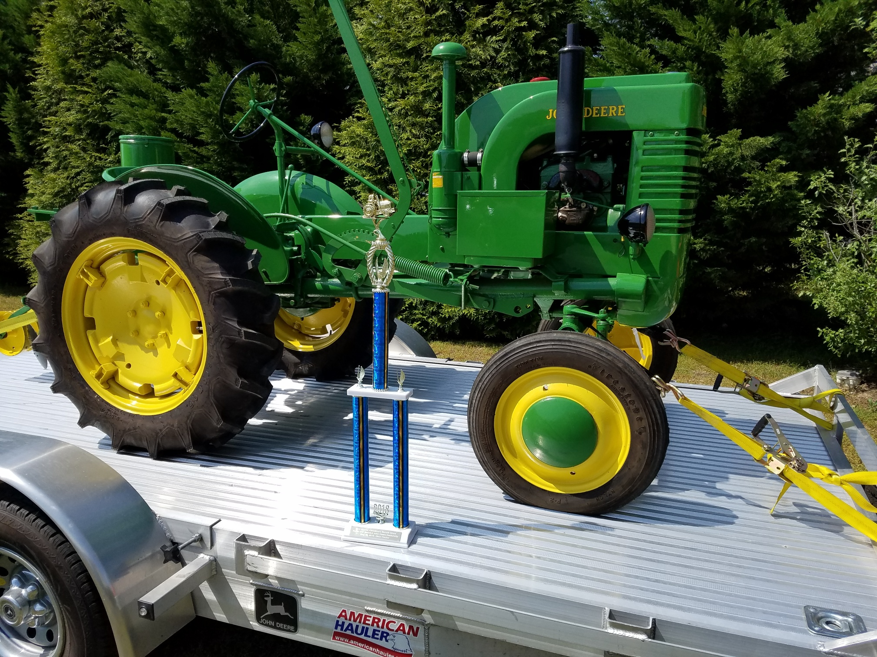

Slide 42
Agenda
Module 1: Biology, Clinical Presentation and Workup
Case Presentation: Ms Klebig — 69-year-old man
Module 2: New Agents/Regimens
Case Presentation: Ms Goodrich — 58-year-old man
Module 3: Key Clinical Trials
Case Presentation: Ms Klebig — 76-year-old woman
Module 4: First-Line Treatment Decision-Making
Case Presentation: Ms Goodrich — 84-year-old woman
Module 5: Use of Oncologic Agents to Treat COVID-19

Slide 43
Module 3: Key Clinical Trials

Slide 44
Phase III ECOG-ACRIN E1912 Study Design
Ibrutinib + rituximab (IR)
→ ibrutinib until PD
Eligibility
Previously untreated CLL requiring treatment Ability to tolerate FCR-based therapy Age ≤70 years
R
(2:1; N = 529)
FCR
Primary endpoint: PFS
Secondary endpoints: OS, ORR, Toxicity and Tolerability
ECOG-ACRIN E1912 Physician Fact Sheet, version 01/15/16;
www.clinicaltrials.gov (NCT02048813); Shanafelt TD et al. Proc ASH 2018;Abstract LBA-4.

Slide 45
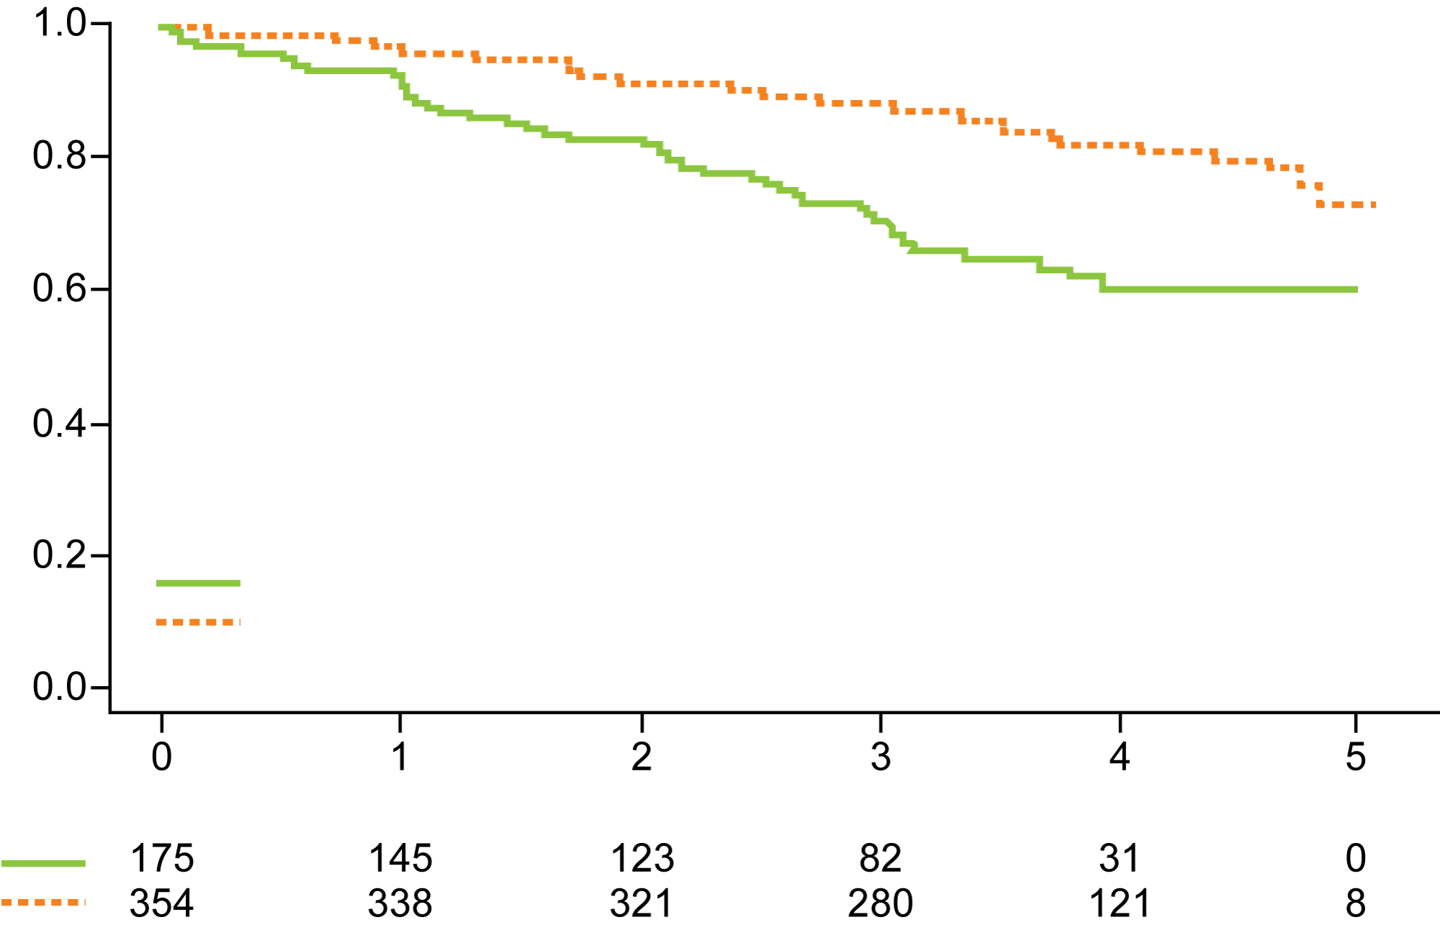
ECOG-ACRIN E1912 Extended Follow-Up: Up-Front IR Compared to FCR for Younger Patients with CLL
PFS
Probability
HR = 0.39
p < 0.0001
3-year rates: 89%, 71%
FCR (52 events/175 cases)
IR (58 events/354 cases)
Number at risk
Years
Grade ≥3 treatment-related AEs were reported in 70% of patients receiving IR and 80% of patients receiving FCR (odds ratio = 0.56; p = 0.013).
Among the 95 patients who discontinued ibrutinib, the most common cause was AE or complication.
Shanafelt TD et al. ASH 2019;Abstract 33.

Slide 46
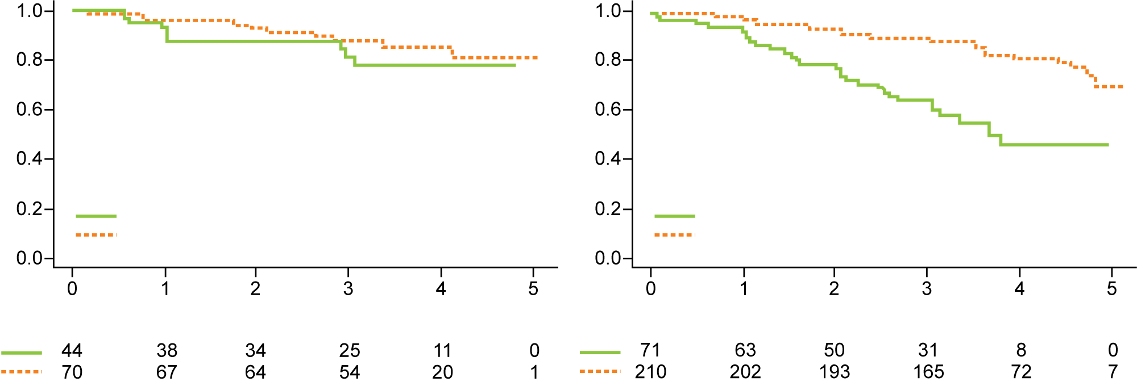
ECOG-ACRIN E1912 Extended Follow-Up: PFS by IGHV Mutation Status
IGHV mutation
No IGHV mutation
Probability
HR = 0.42
p = 0.086
3-year rates: 88%, 82%
Probability
HR = 0.28
p < 0.0001
3-year rates: 89%, 65%
FCR (8 events/44 cases)
IR (10 events/70 cases)
FCR (29 events/71 cases)
IR (36 events/210 cases)
Years
Years
Number at risk
Number at risk
On subgroup analysis by IGHV mutation status, IR was superior to FCR for CLL with no IGHV mutation (HR = 0.28; p < 0.0001).
With current follow-up the difference between IR and FCR is not significant for CLL with IGHV mutation (HR = 0.42; p = 0.086).
Shanafelt TD et al. ASH 2019;Abstract 33.

Slide 47
Phase III Alliance A041202 Study Design
(1:1:1); (N = 547)
Bendamustine + rituximab
Documented disease progression
Eligibility
Previously untreated CLL requiring treatment Age ≥65
R
Ibrutinib until PD
Ibrutinib until PD + rituximab
Primary endpoint: Progression-free survival (PFS)
Secondary endpoints: OS, ORR, Impact of MRD on PFS and OS, Duration of response, Toxicity and Tolerability
Woyach JA et al. N Engl J Med 2018;379(26):2517-28.
Woyach J et al. Alliance Fall Group Meeting, November 5, 2015.

Slide 48
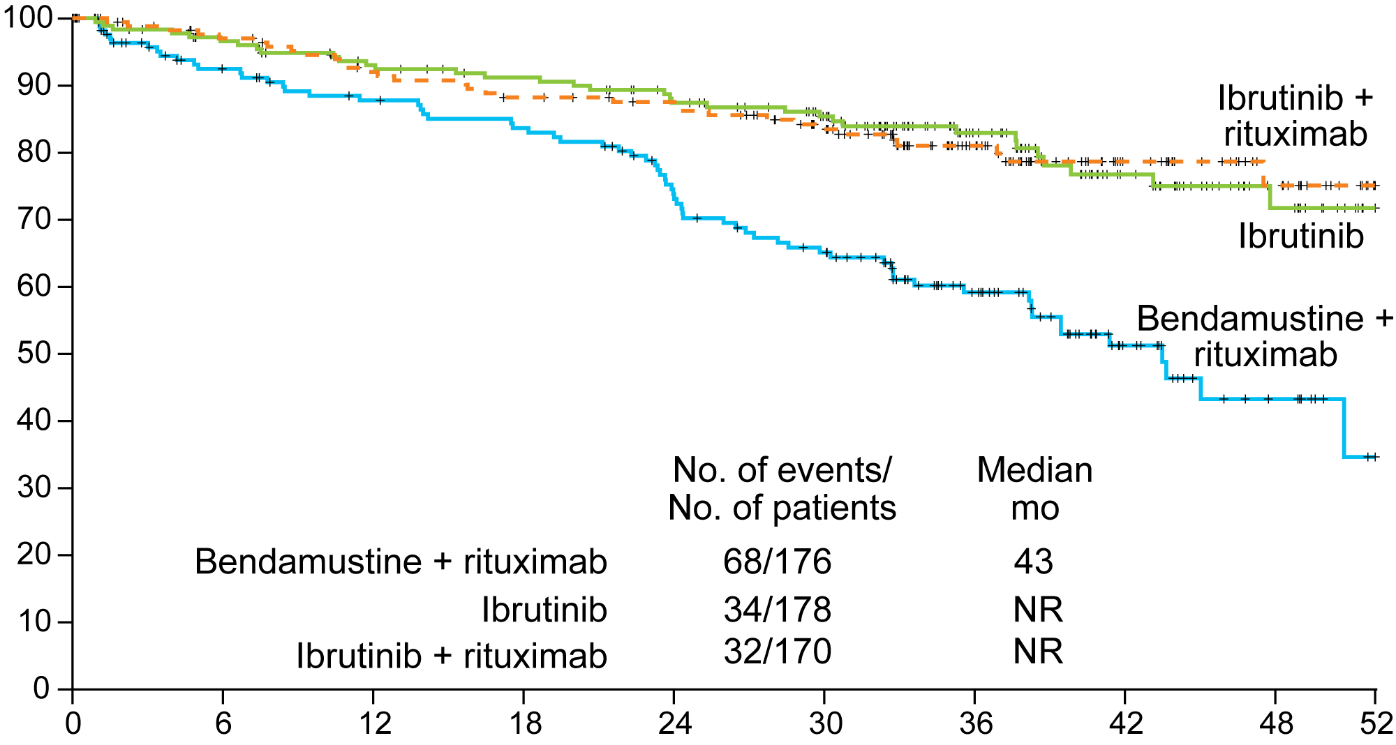
Alliance A041202: Efficacy with Ibrutinib Alone or in Combination with Rituximab Compared to Bendamustine/Rituximab
Patients who were alive and free
from disease progression (%)
Months
Woyach JA et al. N Engl J Med 2018;379(26):2517-28.

Slide 49
ELEVATE-TN: Phase III Trial Schema
Obinutuzumab +
chlorambucil
Accrual: 535
Eligibility
Previously untreated CLL
R
Acalabrutinib
Obinutuzumab +
acalabrutinib
Primary endpoint: Progression-free survival
www.clinicaltrials.gov. (NCT02475681) Accessed October 2019.

Slide 50
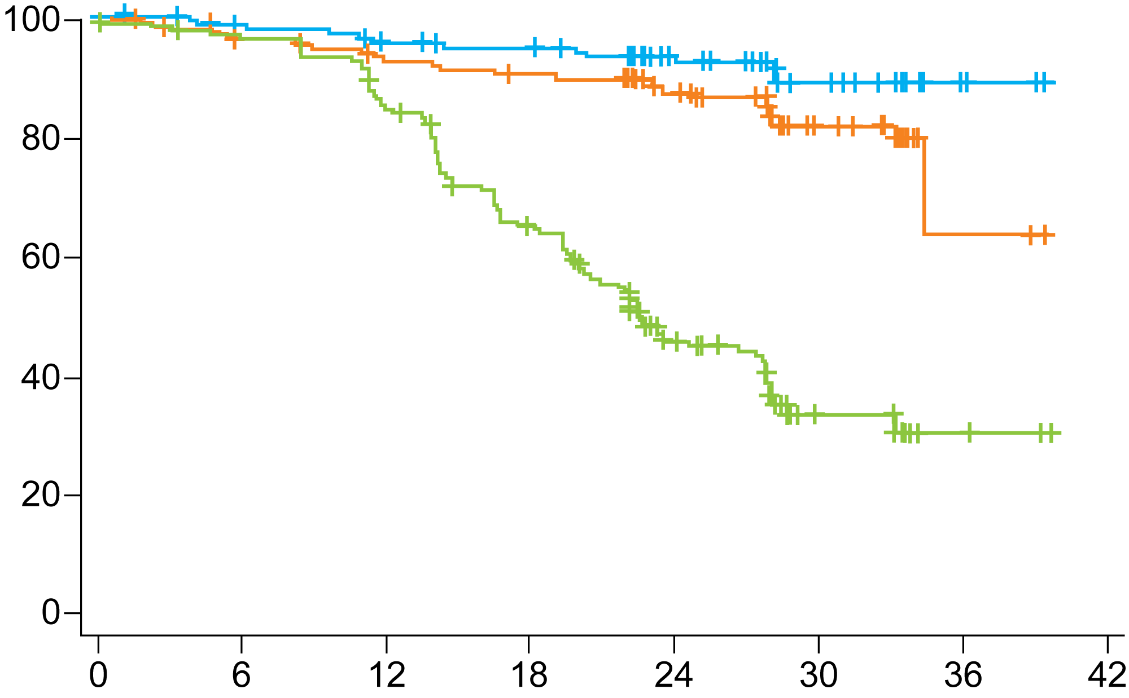
ELEVATE-TN: PFS (IRC)
Acala + Obin
Acala
Progression-free survival (%)
Clb + Obin
Months
Endpoint | Acala + Obin (n = 179) | Clb + Obin (n = 177) | Acala (n = 179)
Median PFS | Not reached | 22.6 mo | Not reached
HR (p-value) | 0.10 (<0.0001) |  | —
 | — | 0.20 (<0.0001)
Sharman JP et al. ASH 2019;Abstract 31.

Slide 51
CLL14 Phase III Study Schema
Chlorambucil +
obinutuzumab
Eligibility (n = 432)
Previously untreated CLL requiring treatment Total CIRS score >6
(1:1)
R
Venetoclax +
obinutuzumab
Primary endpoint: Progression-free survival
Treatment duration in both groups: 12 cycles, 28 days each
No crossover was allowed
The trial started with an initial cycle of obinutuzumab followed by the 5-week venetoclax dose ramp-up to help reduce tumor burden and decrease the risk of TLS
Daily oral venetoclax regimen:
  Initiated on day 22 of cycle 1, starting with a 5-week dose ramp-up (1 week each of 20, 50, 100 and 200 mg, then 400 mg daily for 1 week)
  Thereafter continuing at 400 mg daily until completion of cycle 12
www.clinicaltrials.gov. Accessed October 2019 (NCT02242942).
Fischer K et al. N Engl J Med 2019;380(23):2225-36.

Slide 52
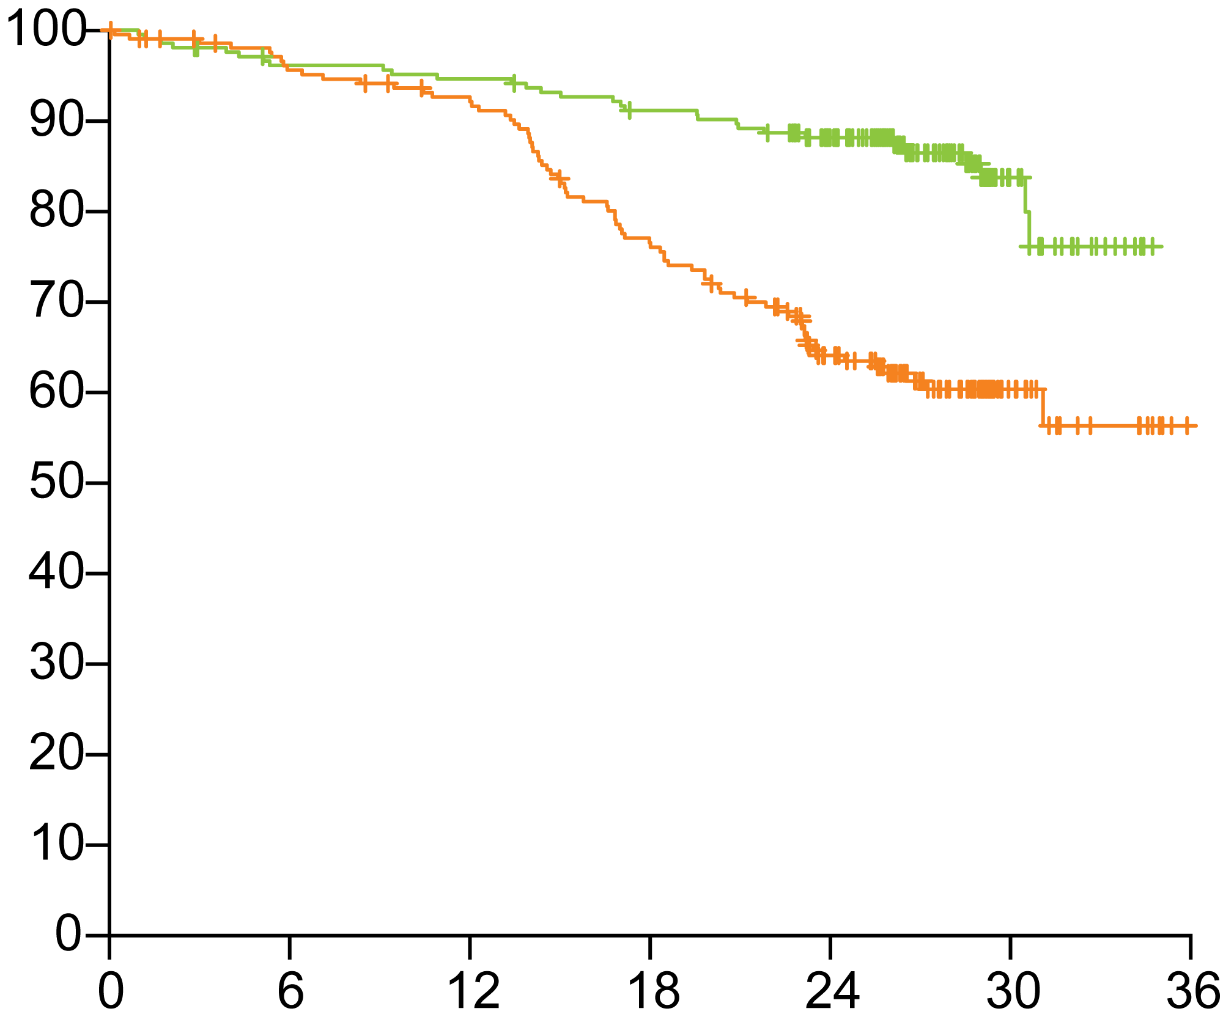
CLL14: Investigator-Assessed Progression-Free Survival
Venetoclax-obinutuzumab
Percentage of patients
Chlorambucil-obinutuzumab
Endpoint | Ven-obin (n = 216) | Chlor-obin (n = 216) | HR | p-value
PFS events | 30 | 77 | 0.35 | <0.001
24-mo PFS | 88.2% | 64.1% | — | —
Months to event
Fischer K et al. N Engl J Med 2019;380(23):2225-36.

Slide 53
CLL14: Minimal Residual Disease 3 Months After Treatment
MRD 3 months after treatment | MRD-negative |  | MRD responders
 | Veneto-obin (N = 216) | Chloram-obin (N = 216) | Veneto-obin (N = 216) | Chloram-obin (N = 216)
MRD in bone marrow | 56.9% | 17.1% | 33.8% | 10.6%
Odds ratio, p-value | OR: 6.4, p < 0.0001 |  | OR: 4.3, p < 0.0001
MRD in peripheral blood | 75.7% | 35.2% | 42.1% | 14.4%
Odds ratio, p-value | OR: 5.7, p < 0.0001 |  | OR: 4.3, p < 0.0001
Fischer K et al. N Engl J Med 2019;380(23):2225-36.

Slide 54
There is evidence to support the use of minimal residual disease assessment to evaluate the need for continued treatment in patients with CLL.
Agree
Disagree
I don’t know

Slide 55
MURANO Phase III Trial Schema
Venetoclax + Rituximab
Venetoclax monotherapy
until PD, unacceptable toxicity, or maximum of
2 years from D1C1
Eligibility
Relapsed/refractory CLL 1-3 prior lines of treatment, with ≥ CT-containing regimen) Prior bendamustine permitted if DoR ≥ 24 mos
R
1:1 (N = 389)
Bendamustine + Rituximab
Primary endpoint: Investigator-assessed progression-free survival
Daily oral venetoclax regimen:
  Starting with a 5-week dose ramp-up (1 week each of 20, 50, 100 and 200 mg, then 400 mg daily)
Rituximab was administered after the initial venetoclax dose ramp-up for 6 cycles
Seymour JF et al. ASH 2019;Abstract 355.

Slide 56
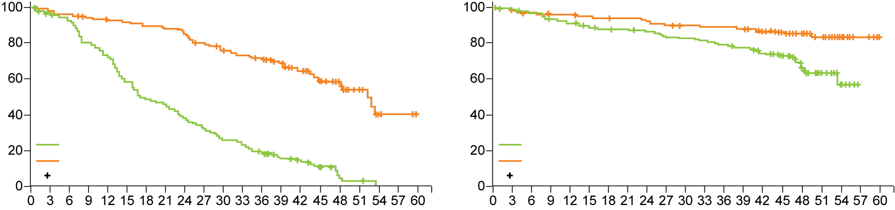
MURANO Trial: Survival Analyses with Venetoclax/
Rituximab for R/R CLL (48-Month Median Follow-Up)
 | VenR (n = 194) | BR (n = 195) | Hazard ratio | p-value
Four-year PFS | 57.3% | 4.6% | 0.19 | <0.0001
Four-year OS | 85.3% | 66.8% | 0.41 | <0.0001
Probability of PFS (%)
Probability of OS (%)
BR (N = 195)
VenR (N = 194)
Censored
BR (N = 195)
VenR (N = 194)
Censored
Time (months)
Time (months)
Seymour JF et al. ASH 2019;Abstract 355.

Slide 57
Select Ongoing Phase III Studies of First-Line Therapy in CLL
Study | Target N | Randomization | Primary endpoints
FLAIR (ISRCTN01844152) | 754 | Ibrutinib Ibrutinib + rituximab Ibrutinib + venetoclax FCR | PFS
GLOW/CLL3011 (NCT03462719) | 211 | Ibrutinib + venetoclax Chlorambucil + obinutuzumab | PFS
GAIA/CLL13 (NCT02950051) | 920 | Standard chemo (FCR/BR) Venetoclax + rituximab Venetoclax + obinutuzumab Ibrutinib + venetoclax + obinutuzumab | PFS, MRD negativity rate
www.clinicaltrials.gov. Accessed October 2019.
www.cancerresearchuk.org/about-cancer/find-a-clinical-trial/a-trial-ibrutinib-rituximab-chronic-lymphocytic-leukaemia-flair#undefined

Slide 58
76-year-old woman with a PMH of depression/anxiety, hypothyroidism, osteoporosis, thyroid cancer, and DVT/PE after hip ORIF (from the practice of Ms Klebig)
2008: Diagnosed with CLL (age 64)
  2010: R-CVP x 8 → 2012: Rituximab/methylprednisolone → 2014: Bendamustine/rituximab x 4 → 2015: Ibrutinib
  May 2018: Progression
  RAI stage I, CLL-IPI: 8 (very high risk), 17p deletion, TP53 mutated, IGH-V unmutated
  Hypercellular marrow (80%) with 80% involvement by CLL
  Hgb: 12.0, Plts: 229,000, WBC: 39,200, ANC: 10,580, ALC: 26,600, LDH: 270 (122-222)
6/2018: Venetoclax initiated
  Added to ibrutinib, which was then tapered off
8/2018 – 1/2019: Rituximab added x 6 months
Single-agent venetoclax continued

Slide 59
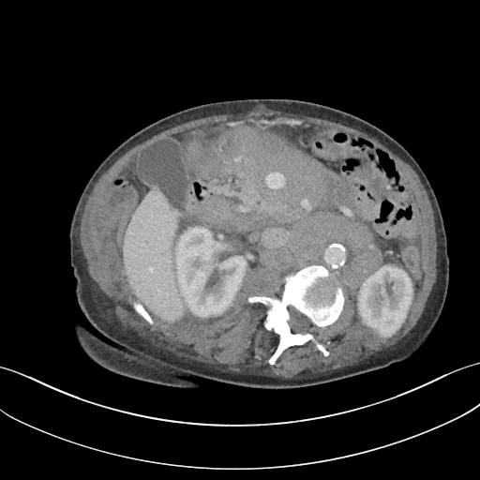
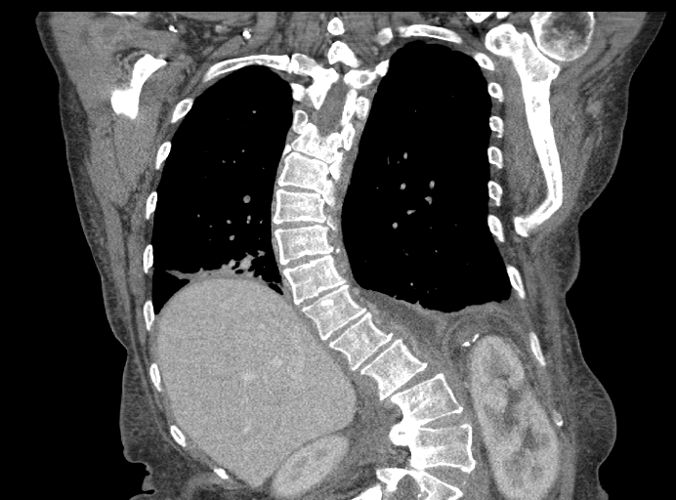
76-year-old woman (from the practice of Ms Klebig)
Baseline imaging: May 2018
CT: extensive confluent adenopathy

Slide 60

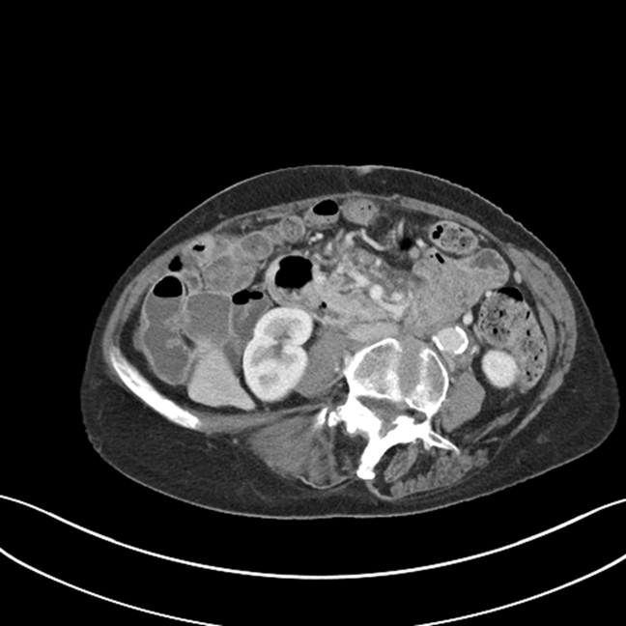
76-year-old woman (from the practice of Ms Klebig)
Response to therapy
May 2018
February 2019

Slide 61
76-year-old woman (from the practice of Ms Klebig)
Patient Education
Pharmacy consultation re potential drug interactions
  CYP3A4 interactions - Avoid strong inhibitors & inducers
    Azole antifungals, -mycin antibiotics, protease inhibitors, etc
    Moderate – consider dose adjustment
    Avoid grapefruit/juice, Seville oranges, and starfruit
Take with food and water, same time each day

Slide 62
76-year-old woman (from the practice of Ms Klebig)
Patient Education
Potential for tumor lysis syndrome
5 week ramp up to goal dose
Hospitalization for weekly ramp up (bulky)
TLS lab monitoring q8h x 24 hours
Allopurinol
Hydration
Nausea
prn antiemetic
Diarrhea
Loperamide prn
Record # stools per day at baseline
Cytopenias
Neutropenia
  Increased infection risk
Thrombocytopenia
  Bleeding risk
Anemia
  Typically not transfusion requiring

Slide 63
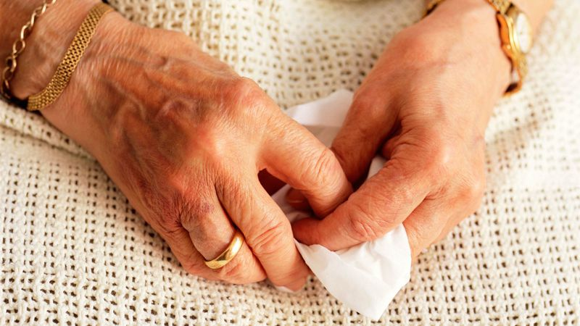


76-year-old woman (from the practice of Ms Klebig)
Change in patient over time
Very anxious, subdued at appts
6 weeks to decide on treatment
Worried about each step; did she even want treatment?
Now less anxious, more sociable, enjoys coming to appts, shopping with daughter

Slide 64
Agenda
Module 1: Biology, Clinical Presentation and Workup
Case Presentation: Ms Klebig — 69-year-old man
Module 2: New Agents/Regimens
Case Presentation: Ms Goodrich — 58-year-old man
Module 3: Key Clinical Trials
Case Presentation: Ms Klebig — 76-year-old woman
Module 4: First-Line Treatment Decision-Making
Case Presentation: Ms Goodrich — 84-year-old woman
Module 5: Use of Oncologic Agents to Treat COVID-19

Slide 65
Module 4: First-Line Treatment Decision-Making

Slide 66
Patients with newly diagnosed chronic lymphocytic leukemia (CLL) who feel well and are asymptomatic require treatment if…
Del(17p)/TP53 mutation is detected
White blood cell count exceeds 200,000
Both a and b
Neither a nor b
I don’t know

Slide 67
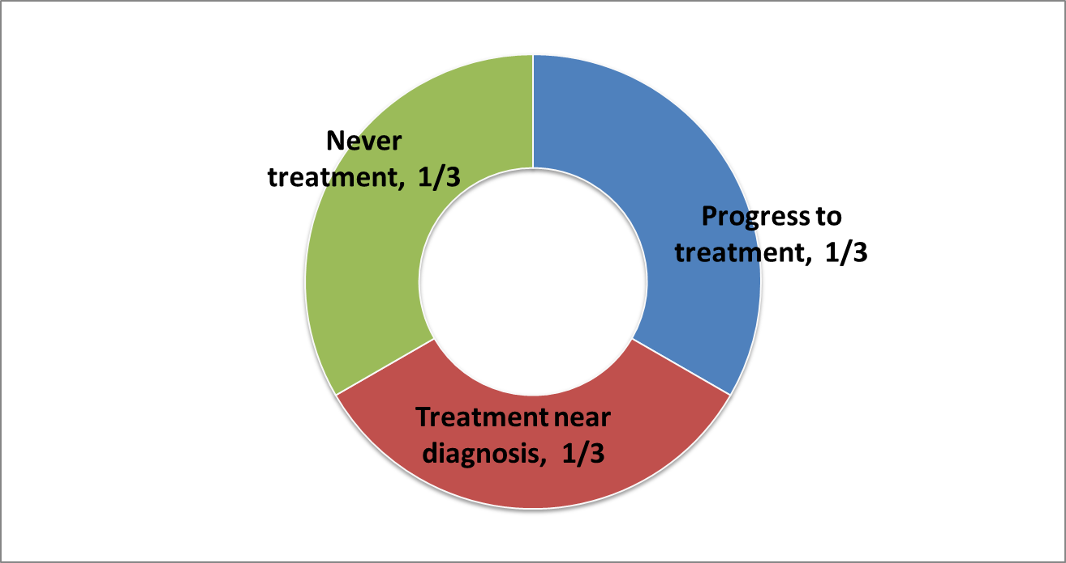
CLL: Dynamic Monitoring vs Treatment
CLL
Most CLL patients will require therapy
Rationale against treatment on diagnosis for asymptomatic patients (unless in a clinical trial)
Courtesy of Brad S Kahl, MD

Slide 68
Indications for treatment:
Disease-related symptoms
  Fatigue can by tricky
Progressive bulky disease
  spleen > 6 cm below costal margin; LN > 10 cm
Progressive bone marrow failure, manifesting as anemia or thrombocytopenia
Autoimmune complications poorly responsive to steroids
Progressive lymphocytosis: Lymphocyte doubling time < 6 months, or increase in ≥ 50% in a two-month period
*Note: Absolute lymphocyte count alone not an indication for treatment
Courtesy of Brad S Kahl, MD

Slide 69

A simplistic (and outdated) approach to CLL
FCR
ChlorambucilObinutuzumab
<60 yrs
>80 yrs
60-69 yrs
70-79 yrs
BR
Courtesy of Brad S Kahl, MD

Slide 70
Available clinical trial data demonstrate that younger patients with CLL with IGHV mutation but without del(17p) or TP53 mutation can experience prolonged remissions after the completion of short-term therapy with which of the following regimens?
Ibrutinib
Venetoclax
FCR (fludarabine/cyclophosphamide/rituximab)
Obinutuzumab/chlorambucil
I don’t know

Slide 71
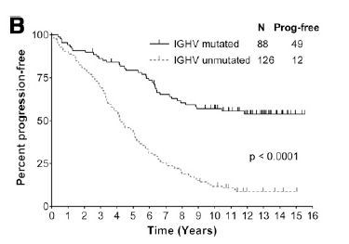
Rationale for frontline chemoimmunotherapy (CIT): durable remissions for some patients
FCR (fludarabine/cyclophosphamide/rituximab)
MDACC: 300pts received treatment with FCR frontline
  Plateau in PFS: no relapses beyond 10.4 years in 42 patients with favorable risk (mutated IGHV, no del17p or del11q)
Similar plateau in CLL8 and Rossi et al FCR studies
Bendamustine and Rituximab (BR) frontline: lower CR, PFS but not OS
Blood. 2008;112:975-980.
Blood. 2015;126(16):1921.
Blood. 2016;127(3):303.
Blood. 2016;127(2):208.
Blood. 2015;126(16):1921.
Courtesy of Brad S Kahl, MD

Slide 72
How to select a treatment for an individual patient?
Menu
Considerations
Immunochemotherapy
  FCR
  BR
  Chlorambucil/Obinutuzumab
Novel Agents
  Ibrutinib + obinutuzumab
  Acalabrutinib + obinutuzumab
  Venetoclax + Obinutuzumab
If deletion 17p or p53 mutation
  Chemo not very effective, better off with novel agents
If IgHV unmutated
  Chemo less effective than novel agents
If IgHV mutated
  Chemo and novels agents are similarly effective
Courtesy of Brad S Kahl, MD

Slide 73
Scenario #1
52 yo man with CLL requiring treatment.
  No p53 mutation or 17p deletion.
  IgHV unmutated.
Best options include
  Venetoclax plus obinutuzumab
  BTKi plus obinutuzumab
Pro’s and Con’s to each
Courtesy of Brad S Kahl, MD

Slide 74
Scenario #2
52 yo man with CLL requiring treatment.
  No p53 mutation by sequencing
  No 17p deletion or 11q deletion by FISH.
  IgHV mutated.
Best options include
  FCR
  Venetoclax plus obinutuzumab
  BTKi plus obinutuzumab
Pro’s and Con’s to each
Courtesy of Brad S Kahl, MD

Slide 75
Scenario #3
72 yo man with CLL requiring treatment.
  No p53 mutation.
  No 17p deletion or 11q deletion.
  IgHV unmutated.
Best options include
  Venetoclax plus obinutuzumab
  BTKi
Pro’s and Con’s to each.
Courtesy of Brad S Kahl, MD

Slide 76
Scenario #4
72 yo man with CLL requiring treatment.
  No p53 mutation or 17p deletion.
  IgHV mutated.
Best options include
  Venetoclax plus obinutuzumab
  BR
  BTKi
Pro’s and Con’s to each.
Courtesy of Brad S Kahl, MD

Slide 77
Scenario #5
72 yo man with CLL requiring treatment.
17p deletion by FISH
BTKi plus obinutuzumab
This is the one scenario where I favor indefinite therapy over time limited therapy
Courtesy of Brad S Kahl, MD

Slide 78
Take home points
1) CLL is not primarily “chemo-free” in frontline and r/r disease
2) BTK inhibitors have beaten FCR / BR / Clb-Obi
3) Two approved BTK inhibitors ibrutinib / acalabrutinib
4) Venetoclax approved in both frontline and r/r disease allows for fixed duration therapy
5) In r/r disease – targeted agents have beaten chemotherapy
Courtesy of Jeff Sharman, MD

Slide 79
53-year-old single mother of 3 teenagers with PMH of hypertension and GERD (from the practice of Ms Goodrich)
2015: Diagnosed with asymptomatic SLL, when adenopathy noted on routine mammogram
  WBC 7.9, Hgb 12, Plts 259K, ALC 2.3
  CT scans revealed adenopathy in chest, abd and pelvis, up to 3.4 cm
Observed
Mid-2019: Significant anemia (transfusion dependent, hemolysis work up: Negative)
  WBC 68.4K, Hgb 4.6, Plts 188K, ALC 64.6K
  FISH: Normal, IGHV mutated
  CT: Nodes up to 5.5 cm
  Declines marrow
Obinutuzumab + venetoclax (1 year of therapy attractive) → Good WBC and nodal response
  Tolerates well, no TLS
  Transfusion independent after 2 months on full-dose venetoclax
  Very late response

Slide 80
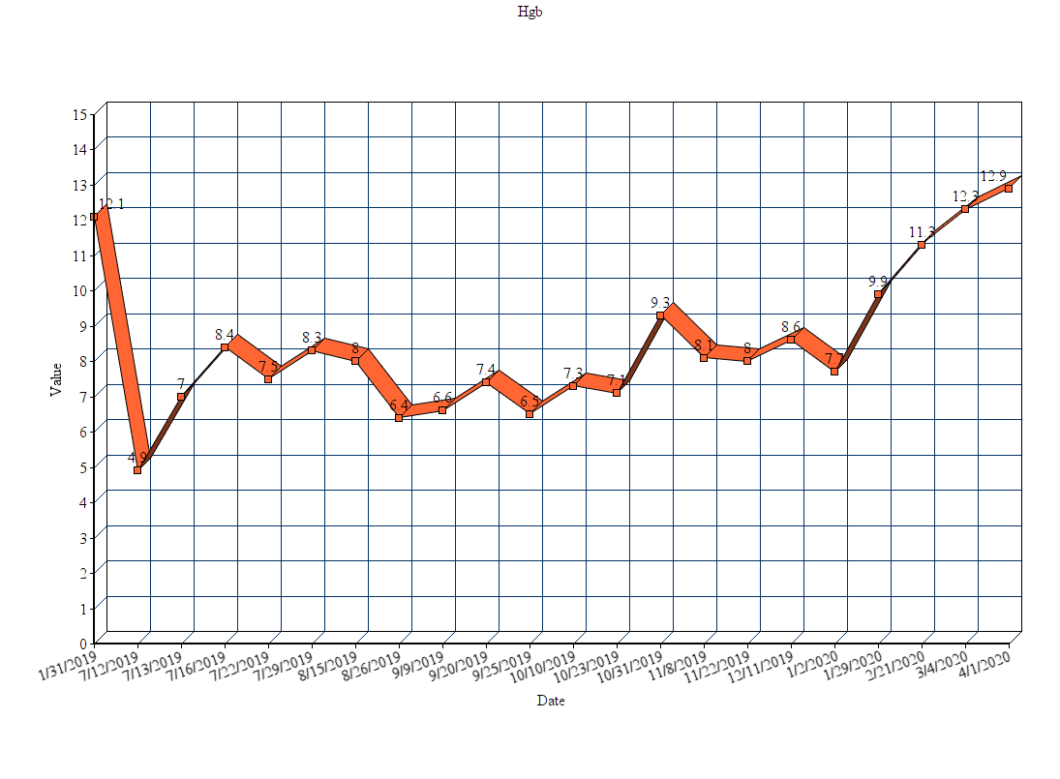
53-year-old single mother (from the practice of Ms Goodrich): Hgb

Slide 81
53-year-old single mother (from the practice of Ms Goodrich)
Teaching points and challenges
Obinutuzumab toxicity (infusion reaction, cytopenias, infection risk)
Venetoclax toxicity (mainly TLS, some nausea)
Relatively new combination regimen, health care teams still gaining expertise on patterns of toxicity and management, not typically using obinutuzumab widely
Mother and children were unaware of diagnosis
Continuing to work full time was a priority
Symptomatic anemia
Daughter active in travel sports, timed transfusions around tournaments

Slide 82
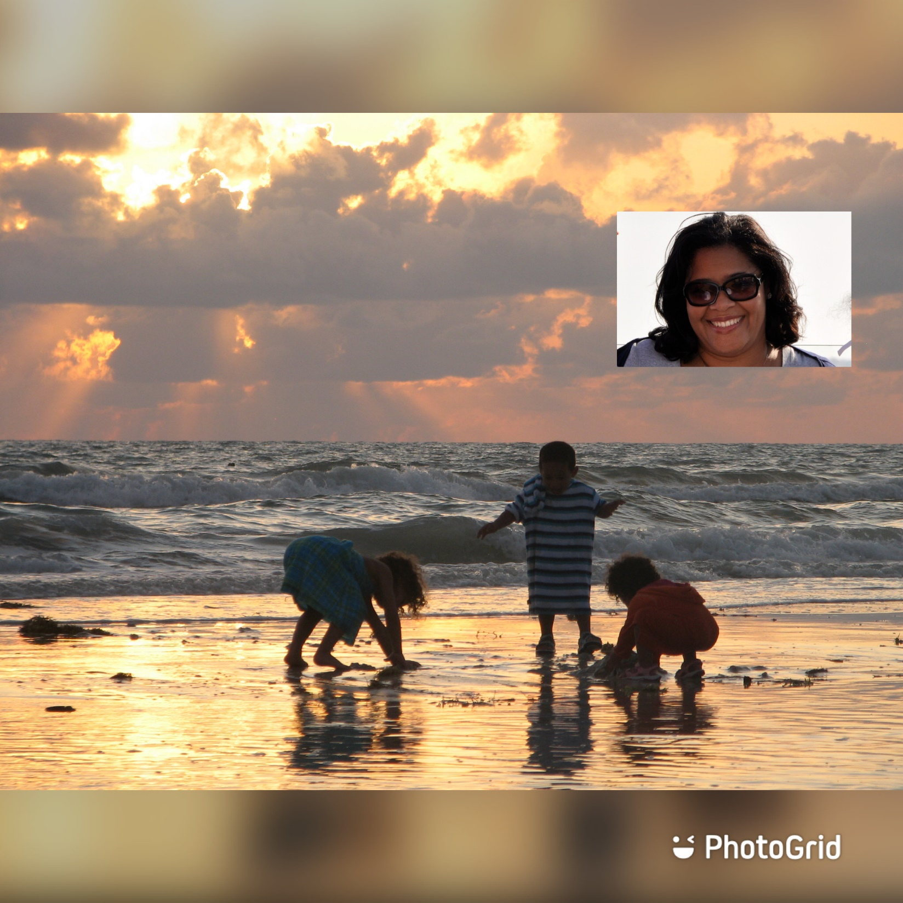

Slide 83
84-year-old widow with no significant PMH who lives in an independent living facility (from the practice of Ms Goodrich)
1999: Lymphocytosis → 2004: Diagnosed with CLL → 2009: BR (bulky adenopathy)
Developed Stevens-Johnson Syndrome with allopurinol
9/2017: First seen at JH (daughter 5 hours away, transports and accompanies to all visits)
  Asymptomatic, with extensive adenopathy, largest node < 4 cm
  13q, 11q and 17p and TP53 abnormalities, Unmutated IGHV
  WBC 59.6, Hgb 13.2, Plts 170K, ANC 5.9
Observed
Early 2020: Increasing adenopathy to 6 cm in multiple areas
  WBC 120K, Hgb 7.5, Plts 134K, creat 1.2 with creat clearance 31
Venetoclax + rituximab (2-year finite therapy)
  Admitted for first two doses due to allopurinol allergy, elevated ALC, tumor burden and creatinine clearance

Slide 84
84-year-old widow (from the practice of Ms Goodrich)
COVID19 quarantine, patient cannot leave ILF
  Collaborated with facility’s health care staff to obtain TLS monitoring labs around dose escalations
Main teaching point for this patient- HYDRATE
  No TLS!
Developed rash on 400 mg, tolerating 200 mg well
Current labs: WBC 5.2, Hgb 9.6, Plts 112K
Patient reports palpable adenopathy resolved
Will start rituximab when travel is possible

Slide 85
84-year-old widow (from the practice of Ms Goodrich)
COVID 19 and Telemedicine challenges
No computer in apartment, had relied on using computers in a common area
Smart phone novice
All communication via phone only
Patient unable to transmit photos of rash
Had to shift dose escalation days to be able to do any TLS monitoring
Took 24-48 hours to receive lab results
Allopurinol allergy
Has not started rituximab
Fortunately, quarantining well!

Slide 86
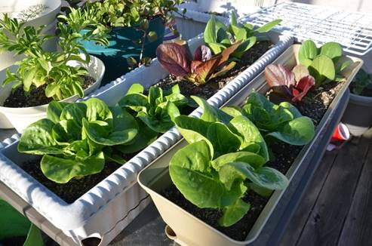

Slide 87
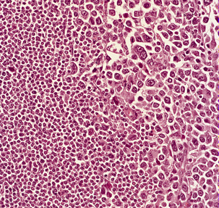
Richter’s Transformation
Transformation of CLL into aggressive lymphoma,
often diffuse large B-cell lymphoma
Occurs in 5-10% of patients
Poor prognosis (median OS = 5-8 months)
Clinical presentation:
  Sudden deterioration
  (increased lymphadenopathy,
  splenomegaly, worsening
  B symptoms)
  Elevated LDH
  Anemia, thrombocytopenia
Warnke RA et al. Tumors of the lymph nodes and spleen. Atlas of tumor pathology (electronic fascicle), Third series, fascicle 14, 1995, Washington, DC. Armed Forces Institute of Pathology

Slide 88
Agenda
Module 1: Biology, Clinical Presentation and Workup
Case Presentation: Ms Klebig — 69-year-old man
Module 2: New Agents/Regimens
Case Presentation: Ms Goodrich — 58-year-old man
Module 3: Key Clinical Trials
Case Presentation: Ms Klebig — 76-year-old woman
Module 4: First-Line Treatment Decision-Making
Case Presentation: Ms Goodrich — 84-year-old woman
Module 5: Use of Oncologic Agents to Treat COVID-19

Slide 89
Module 6: Use of Oncologic Agents to Treat COVID-19

