Slide 1
Oncology Grand Rounds
New Agents and Strategies in
Chimeric Antigen Receptor T-Cell Therapy
Tuesday, June 23, 2020
5:00 PM – 6:30 PM ET
Faculty
Krishna Komanduri, MD
Nikhil C Munshi, MD
Sattva S Neelapu, MD
Tiffany Richards, PhD, ANP-BC, AOCNP
Elizabeth Zerante, MS, AGACNP-BC
Moderator
Neil Love, MD

Slide 2
Dr Love — Disclosures
Dr Love is president and CEO of Research To Practice. Research To Practice receives funds in the form of educational grants to develop CME activities from the following commercial interests: AbbVie Inc, Acerta Pharma — A member of the AstraZeneca Group, Adaptive Biotechnologies, Agendia Inc, Agios Pharmaceuticals Inc, Amgen Inc, Array BioPharma Inc, a subsidiary of Pfizer Inc, Astellas, AstraZeneca Pharmaceuticals LP, Bayer HealthCare Pharmaceuticals, Biodesix Inc, bioTheranostics Inc, Blueprint Medicines, Boehringer Ingelheim Pharmaceuticals Inc, Boston Biomedical Inc, Bristol-Myers Squibb Company, Celgene Corporation, Clovis Oncology, Daiichi Sankyo Inc, Dendreon Pharmaceuticals Inc, Eisai Inc, EMD Serono Inc, Exelixis Inc, Foundation Medicine, Genentech, a member of the Roche Group, Genmab, Genomic Health Inc, Gilead Sciences Inc, GlaxoSmithKline, Grail Inc, Guardant Health, Halozyme Inc, Helsinn Healthcare SA, ImmunoGen Inc, Incyte Corporation, Infinity Pharmaceuticals Inc, Ipsen Biopharmaceuticals Inc, Janssen Biotech Inc, administered by Janssen Scientific Affairs LLC, Jazz Pharmaceuticals Inc, Kite, A Gilead Company, Lexicon Pharmaceuticals Inc, Lilly, Loxo Oncology Inc, a wholly owned subsidiary of Eli Lilly & Company, Merck, Merrimack Pharmaceuticals Inc, Myriad Genetic Laboratories Inc, Natera Inc, Novartis, Oncopeptides, Pfizer Inc, Pharmacyclics LLC, an AbbVie Company, Prometheus Laboratories Inc, Puma Biotechnology Inc, Regeneron Pharmaceuticals Inc, Sandoz Inc, a Novartis Division, Sanofi Genzyme, Seattle Genetics, Sirtex Medical Ltd, Spectrum Pharmaceuticals Inc, Taiho Oncology Inc, Takeda Oncology, Tesaro, A GSK Company, Teva Oncology, Tokai Pharmaceuticals Inc, Tolero Pharmaceuticals and Verastem Inc.

Slide 3
Dr Komanduri — Disclosures
Advisory Committee | Kiadis Pharma
Consulting Agreements | Autolus Therapeutics, Celgene Corporation, Helocyte Inc, Incyte Corporation, Kadmon, Kite, A Gilead Company, Novartis, Takeda Oncology
Contracted Research | Autolus Therapeutics, Celgene Corporation, Incyte Corporation, Kite, A Gilead Company, Novartis

Slide 4
Dr Munshi — Disclosures
Consulting Agreements | AbbVie Inc, Adaptive Biotechnologies, Amgen Inc, BeiGene, Bristol-Myers Squibb Company, Janssen Biotech Inc, Karyopharm Therapeutics, OncoPep,Takeda Oncology
Ownership Interest | OncoPep

Slide 5
Dr Richards — Disclosures
Advisory Committee | Celgene Corporation, GlaxoSmithKline, Takeda Oncology
Consulting Agreements | Celgene Corporation, GlaxoSmithKline, Janssen Biotech Inc, Takeda Oncology

Slide 6
Ms Zerante — Disclosures
Speakers Bureau | Cancer Treatment Centers of America

Slide 7
Commercial Support
This activity is supported by educational grants from Celgene Corporation, Kite, A Gilead Company, and Novartis.

Slide 8
Agenda
Module 1: Overview of Chimeric Antigen Receptor (CAR) T-Cell Therapy
Case Presentation: Ms Zerante — 73-year-old woman with DLBCL
Module 2: Side Effects Associated with CAR T-Cell Therapy
Case Presentation: Ms Zerante — 23-year-old woman with ALL
Module 3: Anti-BCMA CAR T-Cell Therapy in Multiple Myeloma (MM)
Case Presentation: Dr Richards — 58-year-old woman with MM
Case Presentation: Dr Richards — 62-year-old man with MM
Module 4: CD19-Directed CAR T-Cell Therapy for Aggressive Lymphomas
Case Presentation: Ms Zerante — 79-year-old man with DLBCL
Module 5: CAR T-Cell Therapy in Acute Lymphoblastic Leukemia (ALL)
Case Presentation: Ms Zerante — 41-year-old woman with ALL

Slide 9
Module 1: Overview of Chimeric Antigen Receptor (CAR) T-Cell Therapy
Immune mechanisms and therapies in oncology
  Allogeneic transplant
  Checkpoint inhibitors
  Vaccines (eg, sipuleucel-T)
Biology of CAR-modified T cells
Production and administration of CAR T cells
Available CAR-T products
Overview of efficacy of CAR-T therapy

Slide 10
When is the last time a patient in your practice or care died of large cell lymphoma, multiple myeloma or acute lymphoblastic lymphoma?
Within the past week
Between 1 week and 1 month ago
Between 1 month and 6 months ago
Between 6 months and 1 year ago
More than 1 year ago
I have not encountered a patient death by these causes

Slide 11
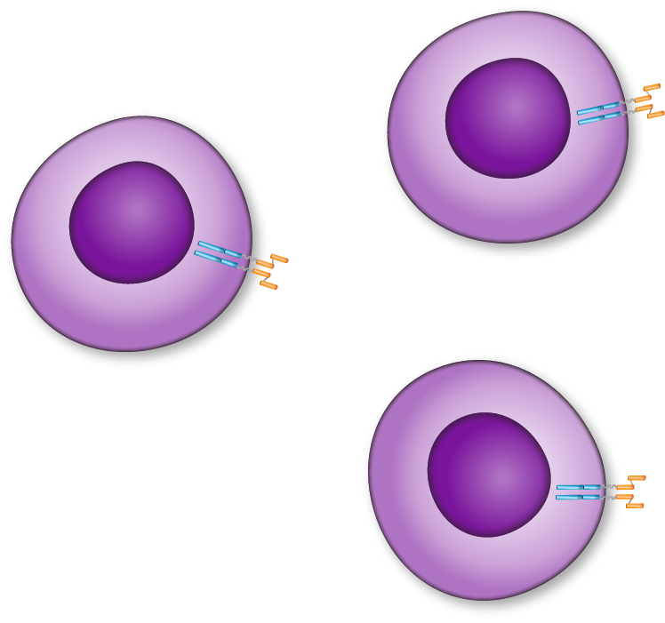





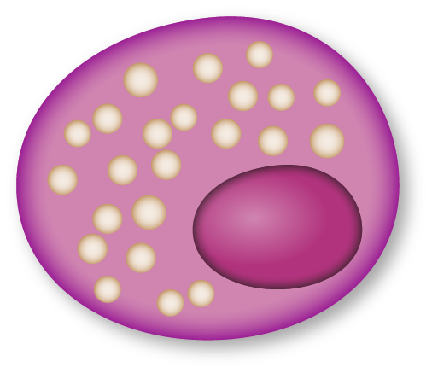





CAR T Cells: Mechanism of Action
T cell
Tumor cell
CAR enables T cell to recognize tumor cell antigen
Expression of CAR
Viral DNA
Insertion
Antigen
Tumor cell apoptosis
CAR T cells
multiply and release cytokines
Notes:
Slide created by E Squared Communications

Slide 12
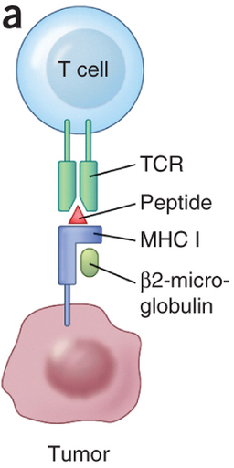
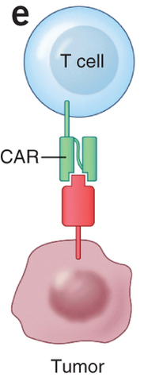
Chimeric Antigen Receptor (CAR) Modified T cells
Normal T cell
CAR T cell
Genetically engineered T cells altered to express an artificial receptor, CAR
Signaling domain
Ag-recognition domain
Target antigen
Courtesy of Sattva S Neelapu, MD
Adapted from Hinrichs & Restifo. Nat Biotech 2013

Slide 13
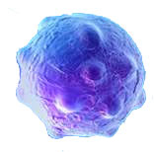
Treatment schema for CAR T-cell therapy
Conditioning Chemotherapy
CAR T cell
infusion
1st Tumor
Assessment
Leukapheresis
Toxicity monitoring
Day - 5
Day 0
Day 14
Day 30
Courtesy of Sattva S Neelapu, MD

Slide 14
CAR T cell response to antigen
CAR T cell
  Proliferate
  Make cytokines
  Kill the target cells
Courtesy of Sattva S Neelapu, MD

Slide 15
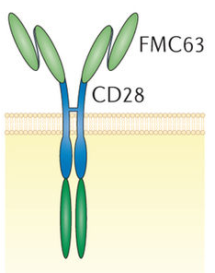
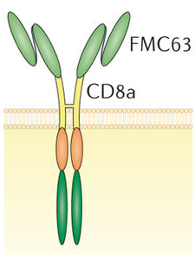

CD19 CAR T products in pivotal trials in NHL
NCI U Penn FHCRC / SCH
CD19 Ab
Hinge
Transmembrane
Signal 2
Signal 1
Gene transfer
CD28
4-1BB
4-1BB
CD3ζ
CD3ζ
CD3ζ
Retrovirus Lentivirus Lentivirus
KTE-C19 CTL-019 JCAR017 (CD4:CD8 = 1:1)
Axicabtagene ciloleucel Tisagenlecleucel Lisocabtagene maraleucel
Axi-cel Liso-cel
Courtesy of Sattva S Neelapu, MD
Adapted from van der Steegen et al. Nat Rev Drug Discov, 2015

Slide 16
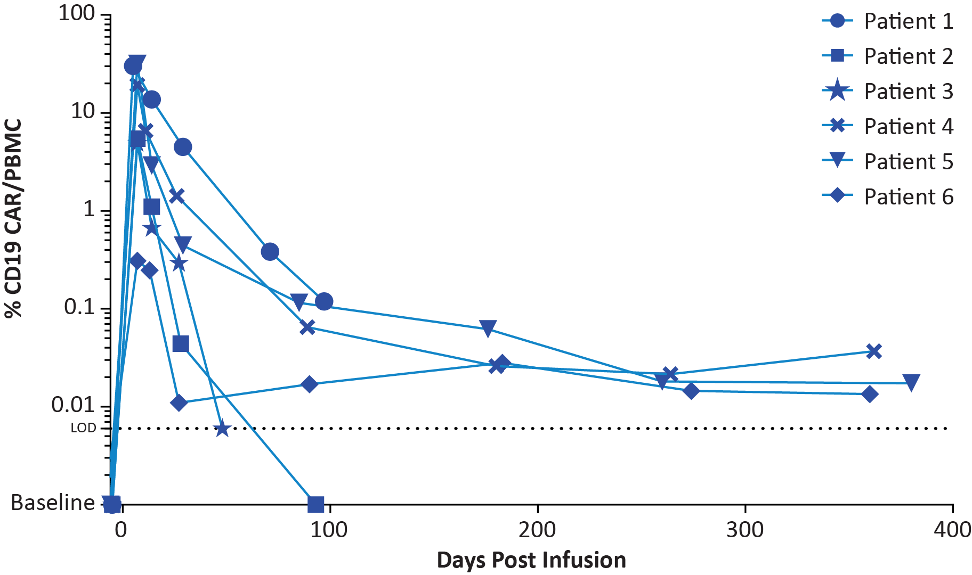
CAR T-cell expansion and persistence after axi-cel infusion
Peak expansion observed within 2 weeks
CAR T cells detectable beyond two years after infusion
Each infused CAR T cell can proliferate to >10,000 cells in the body
Courtesy of Sattva S Neelapu, MD
Locke, Neelapu et al, Mol Ther, 2017

Slide 17
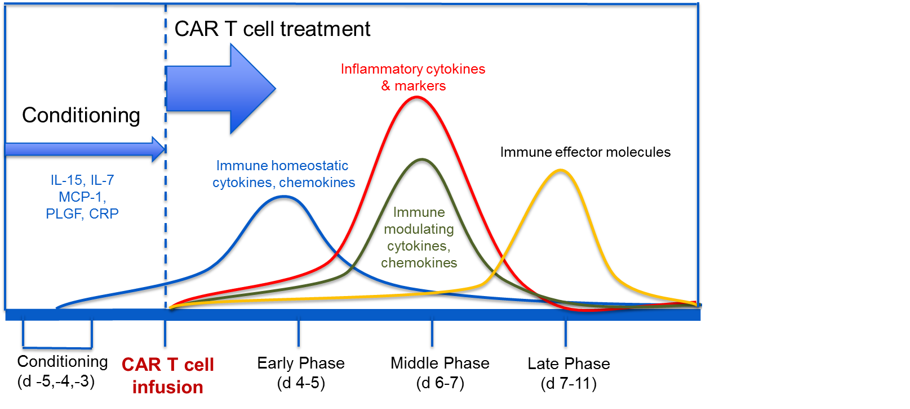
Cytokine pattern after axi-cel CAR T infusion
IL-6
IL-8
IL-10
IFNg
TNFa
Granzymes
Perforin
IL-2
IL-7
IL-15
Courtesy of Sattva S Neelapu, MD
Perez, et al, ASH, 2015

Slide 18
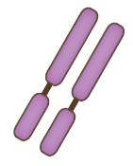










Chimeric Antigen Receptor T cells (CAR T Cells)
T cell
Exploit native antibody or T cell recognition and signaling pathways
Introduction of unique genes through viral vectors to allow recognition of tumor cells
Dramatic expansion after infusion, and effective tumor cell killing
After initial trials proving the efficacy in B cell malignancies, other targets, cancers and molecular constructs are being explored
CAR-T cell
Viral vector
Native TCR
BCMA-specific
CAR construct
Tumor Protein
Dead Myeloma cell
Myeloma cell
Image courtesy of Stephan Grupp, UPenn
Courtesy of Nikhil C Munshi, MD

Slide 19
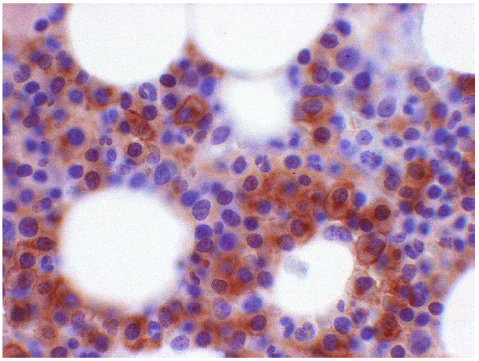
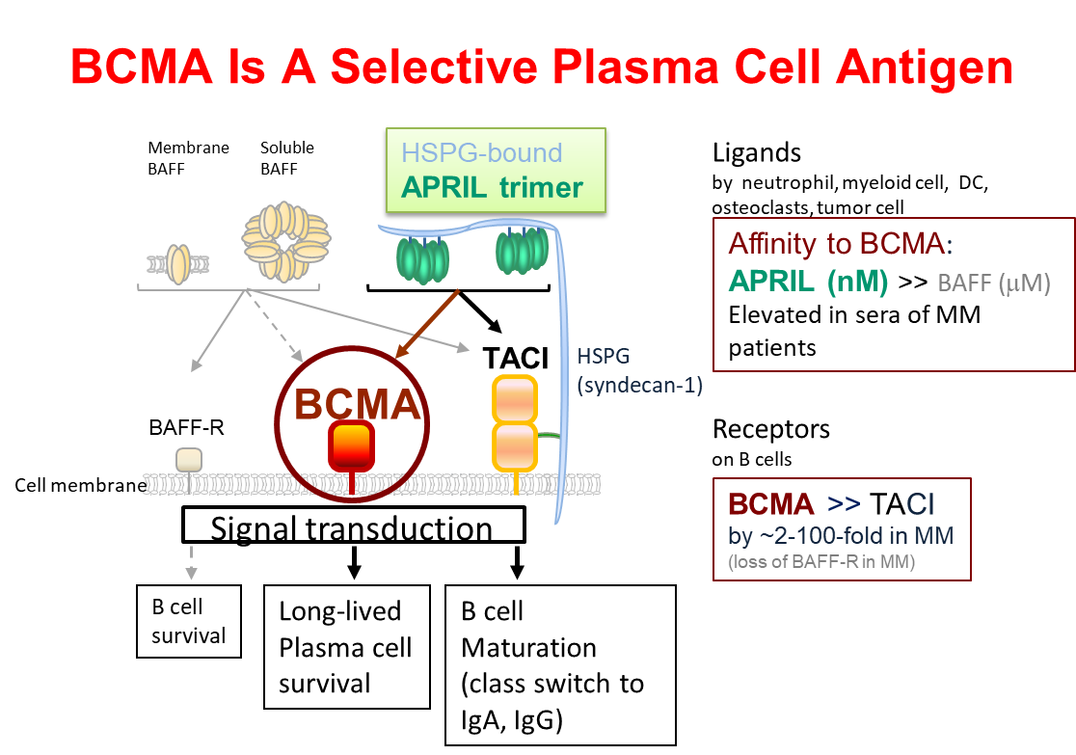
BCMA – A Promising Target in Multiple Myeloma
BCMA is member of the TNF receptor superfamily
  Expressed nearly universally on MM cells
  Expression largely restricted to plasma cells and some mature B cells
Multiple myeloma cells expressing BCMA
(brown color = BCMA protein)
Courtesy of Nikhil C Munshi, MD
Tai & Anderson Immunotherapy 2015; 7: 1187-99.

Slide 20
73-year-old woman with DLBCL (from the practice of Ms Zerante)
2015: Diagnosed with follicular lymphoma → multiple treatments (outside oncologist)
Presents with refractory, transformed DLBCL, with a significant disease burden
During COVID-19 pandemic: Fludarabine/cyclophosphamide lymphodepleting chemotherapy
  Robust fever – no identifiable cause, including COVID-19, after extensive infectious work up → resolves
CAR T cell infusion
  D+2-3 persistent fever → tocilizumab + dexamethasone
  D+10 double vision
  Recurrent diarrhea, significant elevation of inflammatory markers
  D+13 discharged
  D+30 PET: CR
Currently, discharged and at home, with recurrent infections
  CMV viremia, with pancytopenia, bacteremia, recurrent clostridioides difficile

Slide 21
Agenda
Module 1: Overview of Chimeric Antigen Receptor (CAR) T-Cell Therapy
Case Presentation: Ms Zerante — 73-year-old woman with DLBCL
Module 2: Side Effects Associated with CAR T-Cell Therapy
Case Presentation: Ms Zerante — 23-year-old woman with ALL
Module 3: Anti-BCMA CAR T-Cell Therapy in Multiple Myeloma (MM)
Case Presentation: Dr Richards — 58-year-old woman with MM
Case Presentation: Dr Richards — 62-year-old man with MM
Module 4: CD19-Directed CAR T-Cell Therapy for Aggressive Lymphomas
Case Presentation: Ms Zerante — 79-year-old man with DLBCL
Module 5: CAR T-Cell Therapy in Acute Lymphoblastic Leukemia (ALL)
Case Presentation: Ms Zerante — 41-year-old woman with ALL

Slide 22
Module 2: Side Effects Associated with CAR T-Cell Therapy
Overall performance criteria to receive CAR-T therapy
Cytokine release syndrome (CRS)
  Clinical manifestations and management
Neurotoxicity: Immune effector cell-associated neurotoxicity syndrome (ICANS)
Apps and guidelines (eg, MD Anderson Cancer Center CARTOX app)

Slide 23
The “cytokine storm” observed with CAR T-cell therapy shares some characteristics with a similar syndrome in patients with COVID-19.
Agree
Disagree
I don’t know

Slide 24
ICANS is a formalized hierarchy of neurologic sequelae of
CAR T-cell therapy.
Agree
Disagree
I don’t know

Slide 25
CD-19-directed CAR T-cell therapy can deplete normal B cells but seems to have minimal adverse consequences.
Agree
Disagree
I don’t know

Slide 26
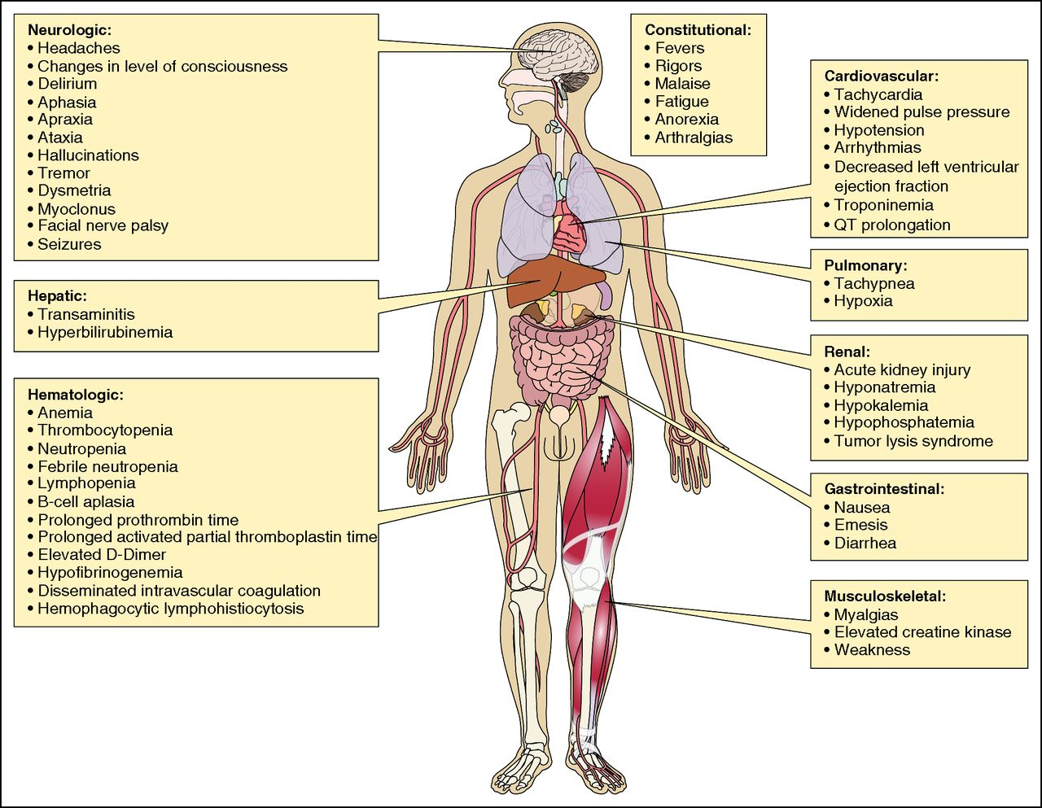
Cytokine release syndrome (CRS)
Systemic inflammatory response caused by cytokines released by CAR T cells and other immune cells and results in reversible organ dysfunction
Courtesy of Sattva S Neelapu, MD
Brudno and Kochenderfer, Blood 2016; 127:3321-3330

Slide 27
Cytokines are produced by T cells and bystander immune cells and may be inhibited by corticosteroids
Tocilizumab
Corticosteroids
Block IL-6 receptor
Courtesy of Sattva S Neelapu, MD
Hay et al. Blood 2017; 130:2295-2306
Maude SL. Blood 2017;130:2238-2240

Slide 28
Neurotoxicity or ICANS
(Immune effector Cell-Associated Neurotoxicity Syndrome)
Typically manifests as a toxic encephalopathy
  CRES – CAR-Related Encephalopathy Syndrome
  Word finding difficulty, confusion, disorientation, agitation, dysphasia, aphasia, somnolence, tremors, and impaired handwriting
  In more severe cases, seizures, motor weakness, incontinence, increased intracranial pressure, papilledema, and cerebral edema may also occur
  Onset may be during CRS or after CRS symptoms have subsided
  May last few hours to several days
  Generally reversible with no permanent neurological deficits
Courtesy of Sattva S Neelapu, MD

Slide 29
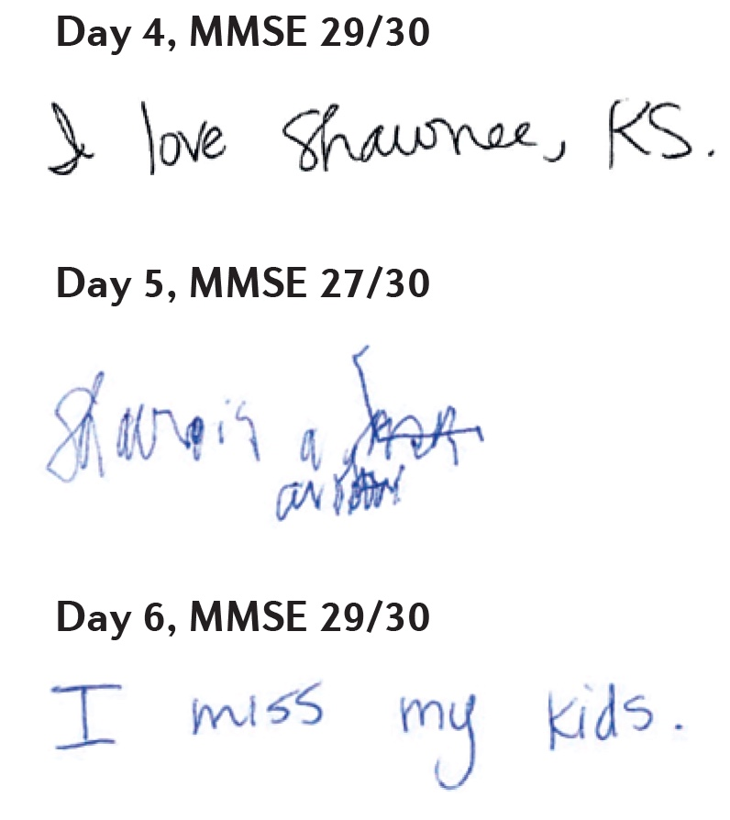
Handwriting Samples and MMSE After CAR T-Cell Therapy
Handwriting samples and mini mental status exam (MMSE) scores obtained on days 4, 5, and 6 after CAR T-cell therapy
Note how the patient’s handwriting was markedly impaired on day 5, despite only a small decrease in their MMSE score.
Neelapu SS et al. Nat Rev Clin Oncol 2018;15(1):47-62.

Slide 30
CARTOX App for Grading and Management of
CRS and ICANS
Smart phone app available free on both App Store (iPhone) and Google Play (Android)
Sherry Adkins
Neelapu et al. Nat Rev Clin Oncol, Jan 2018
Courtesy of Sattva S Neelapu, MD
Lee et al. Biol Blood Marrow Transplant, 2019 Apr;25 (4):625-638

Slide 31
CARTOX Working Group
Riegler et al, Ther Clin Risk Manage 2019 (adapted from Neelapu et al, Nat Rev Clin Onc 2017)
Courtesy of Nikhil C Munshi, MD

Slide 32
Patient Education Regarding
Car T Cell Therapy
CRS
Fever
Neurotoxicity
Tremors
Management of Toxicities
Tocilizumab
Steroids
Hypotension
Tachycardia
Hypoxia
Chills
Dizziness
Delirium
Confusion
Agitation
Cerebral Edema
Adkins, S. (2019). Car T cell therapy: adverse events and management. J. Adv Pract Onco Supple3. 21-28..

Slide 33
Patient Education Regarding
Car T Cell Therapy
Logistics
Stay locally for 30 days
Pancytopenia
When to come to ER
Inpatient vs outpatient
Frequent visits to hospital
Local Oncologist to coordinate care
Decreased blood counts
Blood and Platelet Transfusions
Growth Factor Support
Infections
Prophylactic Antibiotics
Other
When to call the clinic
Caregiver 24 hours a day
Ensure caregivers are present
Contact local oncologist
Adkins, S. (2019). Car T cell therapy: adverse events and management. J. Adv Pract Onco Supple3. 21-28..

Slide 34
23-year-old woman whose treatment is complicated by psychiatric issues (from the practice of Ms Zerante)
2017: Ph-negative ALL (normal cytogenetics) → Treated per CALGB protocol → Relapsed → Blinatumomab
Mental status change due to dissociative amnesia, conversion disorder → resolved
AlloSCT → POMP maintenance
Inotuzumab x 2 + steroids as bridging treatment
11/2019: tisagenlecleucel (tisa-cel) CAR T
  Renal, cardiac and hepatic dysfunction; Fungemia
  CRS D+1, ICANS D+13, HLH, DIC requiring transfusion support
  Adjustment disorder, with depressed mood, anxiety, PTSD
  D+28 bone marrow biopsy: NED
  Discharged ~D+55-60
  2/2020: D+84 BMBx: NED
3-4/2020: Relapsed disease → Inotuzumab + dexamethasone → BMBx: Residual disease
4/2020: Dexamethasone/venetoclax/vincristine pulses
5/2020: S/p lymphodepleting chemo → CD22 CAR product → no response → PD → Home hospice

Slide 35
Agenda
Module 1: Overview of Chimeric Antigen Receptor (CAR) T-Cell Therapy
Case Presentation: Ms Zerante — 73-year-old woman with DLBCL
Module 2: Side Effects Associated with CAR T-Cell Therapy
Case Presentation: Ms Zerante — 23-year-old woman with ALL
Module 3: Anti-BCMA CAR T-Cell Therapy in Multiple Myeloma (MM)
Case Presentation: Dr Richards — 58-year-old woman with MM
Case Presentation: Dr Richards — 62-year-old man with MM
Module 4: CD19-Directed CAR T-Cell Therapy for Aggressive Lymphomas
Case Presentation: Ms Zerante — 79-year-old man with DLBCL
Module 5: CAR T-Cell Therapy in Acute Lymphoblastic Leukemia (ALL)
Case Presentation: Ms Zerante — 41-year-old woman with ALL

Slide 36
Module 3: Anti-BCMA CAR T-Cell Therapy in Multiple Myeloma (MM)
Overview of current management of MM
  Key current issues
    Up-front management of MM (daratumumab)
    Minimal residual disease (MRD)/role of transplant
    Sequencing of therapies in relapsed disease
BCMA and related therapies
Key data sets: KarMMa, EVOLVE, CARTITUDE-1
Current role for CAR-T trials and other trials of BCMA-related therapies

Slide 37
Phase II Pivotal KarMMa Study
Study Status as of
Jan 14, 2020
ide-cel
manufacturing
(99% success rate)
1st Response Assessment
(1 mo)
RRMM
≥3 prior regimens with ≥2 consecutive cycles each (or best response of PD)
Previously exposed to:
  IMiD agent
  Proteasome inhibitor
  Anti-CD38 antibody
Refractory to last prior therapy per IMWG*
Screened N=158
Leukapheresis
CAR T Infusion†
Bridging
(≥14 before lymphodepletion)
Leukapheresed
N=140
Flu (30 mg/kg)
Treated N=128
(Target Dose CAR+ T cells)
Cy (300 mg/kg)
Days -5,-4,-3 0
150 × 10⁶ n=4
300 × 10⁶ n=70
450 × 10⁶ n=54
Endpoints
Primary: ORR (null hypothesis ≤50%)
Secondary: CRR (key secondary; null hypothesis ≤10%), Safety, DOR, PFS, OS, PK, MRD‡, QOL, HEOR
Exploratory: Immunogenicity, BCMA expression/loss, cytokines, T cell immunophenotype, GEP in BM
Median Follow-up (mo)
150 × 10⁶ 18.0
300 × 10⁶ 15.8
450 × 10⁶ 12.4
Total 13.3
Time since initial diagnosis, median (range) |  |  | 6 (1−18)
No. of prior anti-myeloma regimens, median (range) |  |  | 6 (3−16)
Prior autologous SCT, % | 1 >1 | 1 >1 | 94 34
Any bridging therapies for MM, % |  |  | 88
Refractory status, % | Anti-CD38 Ab-refractory Triple-refractory | Anti-CD38 Ab-refractor Triple- | 94 84
EudraCT: 2017-002245-29
ClinicalTrials.gov: NCT03361748
Courtesy of Nikhil C Munshi, MD
Munshi et al ASCO 2020

Slide 38
Best Overall Response
CR/sCR and MRD-negative
CR/sCR and MRD not evaluable
VGPR
PR
ORR=82%
ORR=73%
ORR=69%
CRR
39%
CRR
29%
CRR
33%
ORR=50%
CRR
25%
CAR+ T cells:
Primary (ORR >50%) and key secondary (CRR >10%) endpoints met in the ide-cel treated population
  ORR of 73% (95% CI, 65.8−81.1; P<0.0001*)
  CRR (CR/sCR) of 33% (95% CI, 24.7−40.9; P<0.0001)
Median time to first response of 1.0 mo (range, 0.5−8.8); median time to CR of 2.8 mo (range, 1.0−11.8)
Median follow-up of 13.3 mo across target dose levels
Data cutoff: 14 Jan 2020. MRD-negative defined as <10⁻⁵ nucleated cells by next generation sequencing. Only MRD values within 3 mo of achieving CR/sCR until progression/death (exclusive) were considered.
Values may not add up due to rounding.
CR/sCR, complete response/stringent CR; CRR, CR rate; MRD, minimal residual disease; ORR, overall response rate (≥PR); PR, partial response; VGPR, very good PR. *P value at the primary data cutoff with same ORR and 95% CI.
38
Courtesy of Nikhil C Munshi, MD
Munshi et al ASCO 2020

Slide 39
Progression-Free Survival
PFS by Target Dose
PFS by Best Response
Median (95% CI), mo
1.0
Median (95% CI), mo
150 × 10⁶ 2.8 (1.0−NE)
300 × 10⁶ 5.8 (4.2−8.9)
450 × 10⁶ 12.1 (8.8−12.3)
CR/sCR: 20.2 (12.3−NE)
VGPR: 11.3 (6.1−12.2)
PR: 5.4 (3.8−8.2)
Nonresponders: 1.8 (1.2−1.9)
1.0
At risk, N
150 × 10⁶ | 4 | 2 | 1 | 1 | 1 | 1 | 1 | 1 | 1 | 1 | 1 | 0
300 × 10⁶ | 70 | 56 | 42 | 33 | 29 | 24 | 17 | 14 | 11 | 7 | 2 | 0
450 × 10⁶ | 54 | 44 | 40 | 36 | 34 | 31 | 17 | 4 | 1 | 0 | 0
CR/sCR | 42 | 42 | 42 | 40 | 39 | 37 | 26 | 16 | 11 | 8 | 4 | 0
VGPR | 25 | 25 | 22 | 20 | 16 | 14 | 8 | 3 | 2 | 0 | 0
PR | 27 | 16 | 10 | 9 | 5 | 1 | 0 | 0 | 0 | 0 | 0
Nonresponders | 34 | 8 | 83 | 70 | 64 | 56 | 35 | 19 | 13 | 8 | 4 | 0
PFS increased with higher target dose; median PFS was 12 mo at 450 × 10⁶ CAR+ T cells
PFS increased by depth of response; median PFS was 20 mo in patients with CR/sCR
39
Data cutoff: 14 Jan 2020. NE, not estimable; PFS, progression-free survival.
Munshi et al ASCO 2020
Courtesy of Nikhil C Munshi, MD

Slide 40
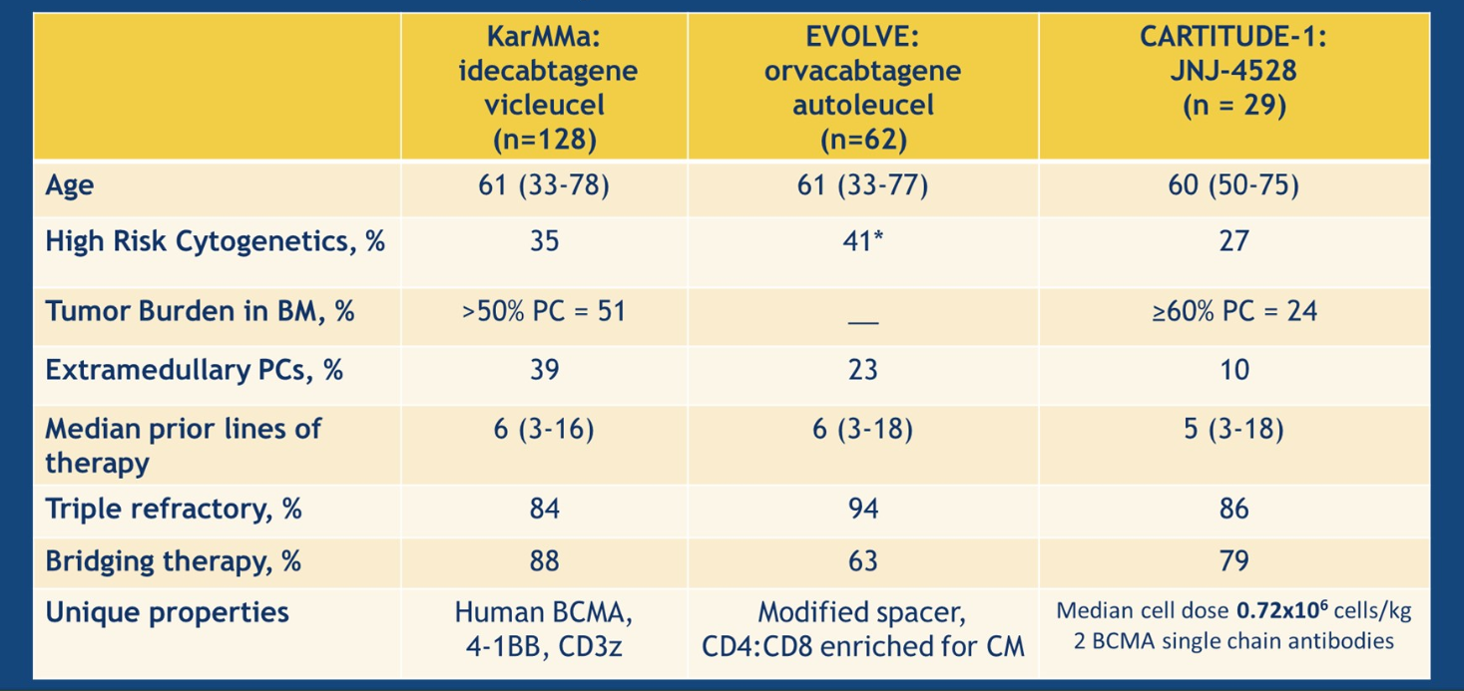
Recent CAR-T Studies - Characteristics
Courtesy of Nikhil C Munshi, MD
Patel et al ASCO 2020

Slide 41
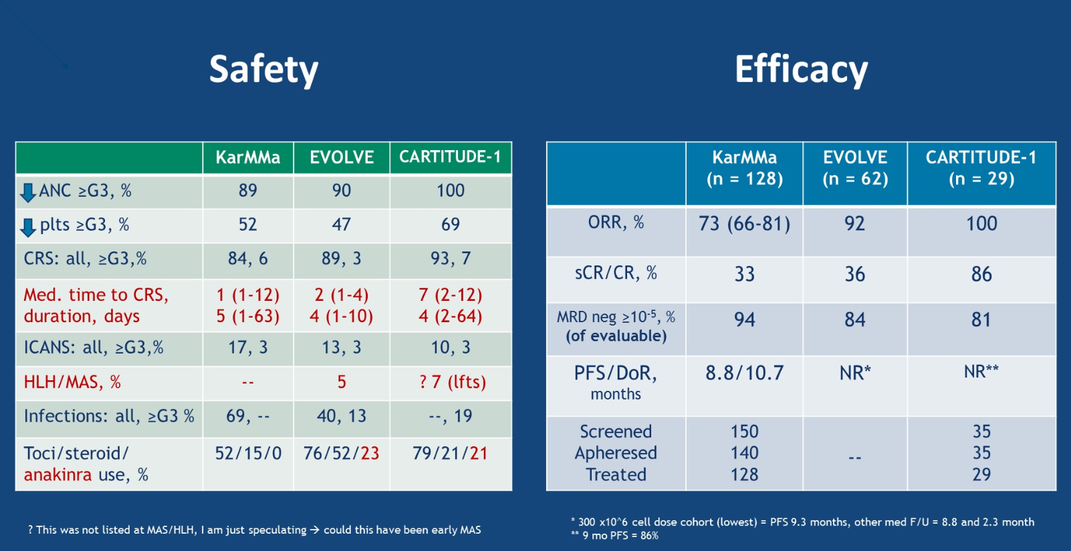
Recent CAR-T Studies – Safety and Efficacy
Courtesy of Nikhil C Munshi, MD
Patel et al ASCO 2020

Slide 42
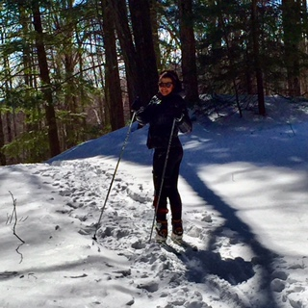
bb2121: Anti-BCMA Chimeric Antigen Receptor
T-Cell in Multiple Myeloma
anti-BCMA CAR design
Courtesy of Nikhil C Munshi, MD

Slide 43
58-year-old woman with MM (from the practice of Ms Richards)
2012: Diagnosed with IgG lambda light chain multiple myeloma, with CKS1B amplification
VRd x 5 with minimal response → changed to CyBorD with PR
Autologous cell stem cell transplant → relapsed 1 month post ASCT
Multiple lines of therapy with initial response with quick subsequent relapse
  Daratumumab/lenalidomide/dexamethasone
  Daratumumab/pomalidomide/dexamethasone
  Pomalidomide/cyclophosphamide/dexamethasone
Clinical trial of BCMA CAR T therapy
  Minimal Response (off therapy for 6 months)
  Diffuse arthralgias 6 weeks post-CAR T cell infusion
Restart daratumumab/pomalidomide/dexamethasone → PD
Currently, receiving cyclophosphamide/pomalidomide/dexamethasone

Slide 44
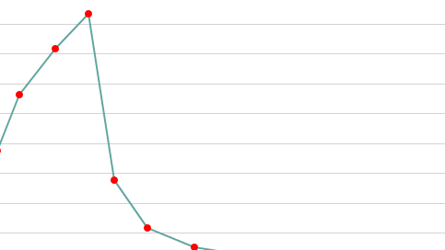
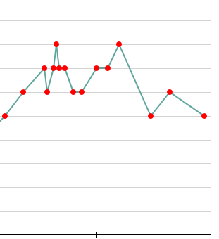
58-year-old woman (from the practice of Ms Richards)
Response to ASCT
Response after CAR T

Slide 45
62-year-old man with MM (from the practice of Ms Richards)
2017: Diagnosed with multiple myeloma, t(14;16)
VRd → 2018 ASCT → maintenance lenalidomide x 4 months → PD
Daratumumab/lenalidomide/dexamethasone
Daratumumab/bortezomib/dexamethasone with PD after 2 months
12/2019: Clinical trial with bb2121 → Complete remission
  Fever, rigors, wheezing; Required oxygen
  Grade 2 CRS (Tylenol, Duoneb inhaler -- albuterol and ipratropium) → resolved after 2 days
6/17/2020: Currently, still in CR

Slide 46
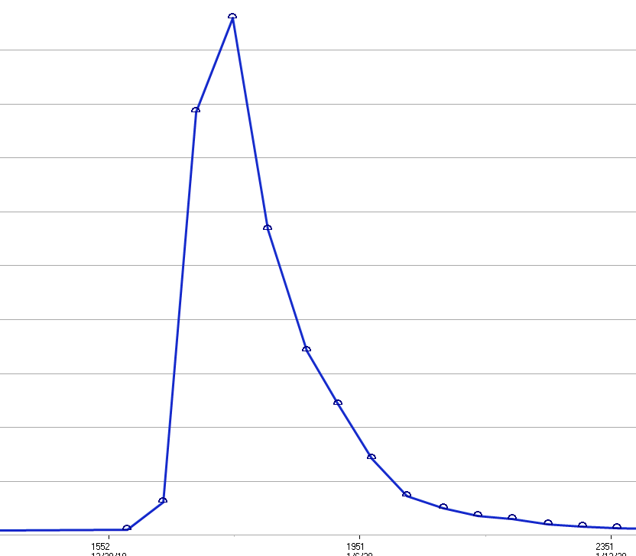
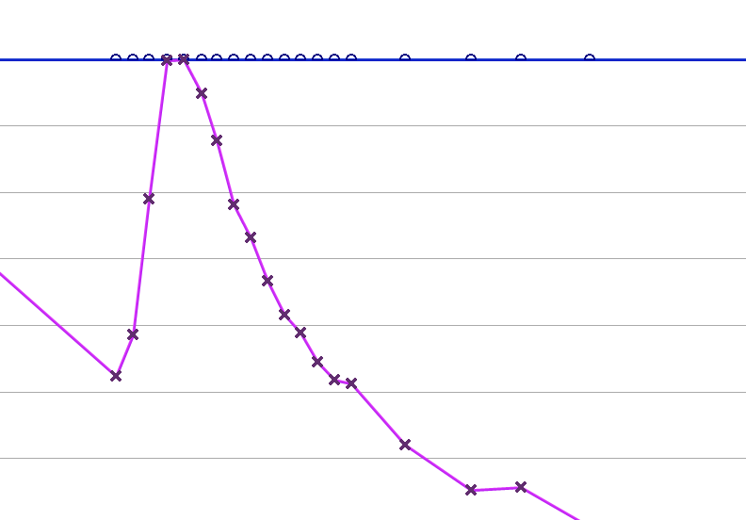
62-year-old man with MM (from the practice of Ms Richards)
C-reactive protein (CRP)
Ferritin

Slide 47
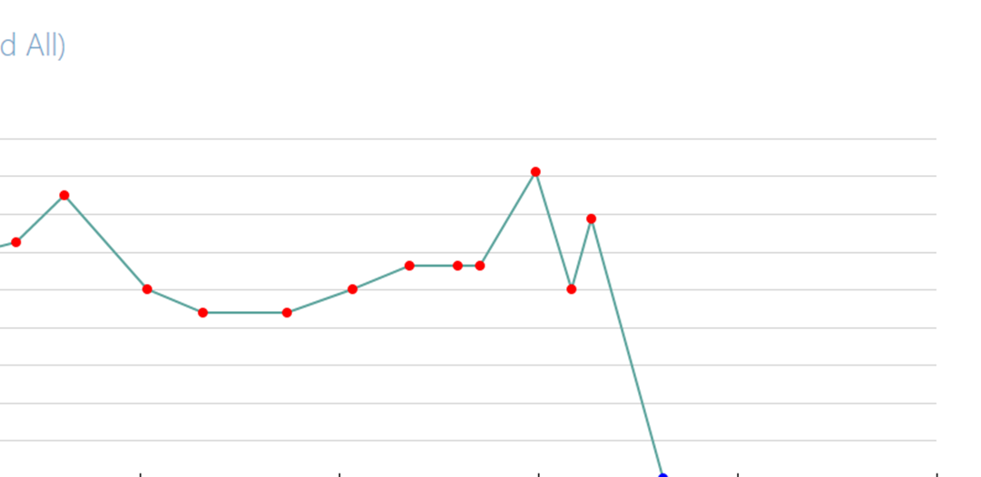
62-year-old man with MM (from the practice of Ms Richards)
Excellent response to CAR T-cell
Remains in remission 6 months post CAR T-cell therapy

Slide 48
Agenda
Module 1: Overview of Chimeric Antigen Receptor (CAR) T-Cell Therapy
Case Presentation: Ms Zerante — 73-year-old woman with DLBCL
Module 2: Side Effects Associated with CAR T-Cell Therapy
Case Presentation: Ms Zerante — 23-year-old woman with ALL
Module 3: Anti-BCMA CAR T-Cell Therapy in Multiple Myeloma (MM)
Case Presentation: Dr Richards — 58-year-old woman with MM
Case Presentation: Dr Richards — 62-year-old man with MM
Module 4: CD19-Directed CAR T-Cell Therapy for Aggressive Lymphomas
Case Presentation: Ms Zerante — 79-year-old man with DLBCL
Module 5: CAR T-Cell Therapy in Acute Lymphoblastic Leukemia (ALL)
Case Presentation: Ms Zerante — 41-year-old woman with ALL

Slide 49
Module 4: CD19-Directed CAR T-Cell Therapy for Aggressive Lymphomas
Overview of current management of diffuse large B-cell lymphoma (DLBCL)
  Key current issues
    Autologous stem cell transplant for recurrent disease
    Antibody-drug conjugates (polatuzamab vedotin)
    Other novel agents
  CD-19 as a target for treatment
  Key data sets: ZUMA-1, JULIET, TRANSCEND NHL 001
Overview of current management of mantle cell lymphoma (MCL)
  Key data sets: ZUMA-2, ZUMA-5
Current clinical role for CAR-T therapy

Slide 50
CD19 CAR T in NHL: Beginning of a paradigm shift
Aggressive B-cell NHL
R-CHOP or similar
40%
Relapse / Progression
~60% cured
2nd line chemo
Relapse / Progression
35%
HDT + ASCT (5% cured)
CD19 CAR T (15% cured)
~80% of all LCLs may be curable
CD19 CAR T in high-risk aggressive B-cell NHL
Randomized trials of CD19 CAR T vs. ASCT
CD19 CAR T in high-risk indolent B-cell NHL
Courtesy of Sattva S Neelapu, MD
CD19 CAR T in MCL

Slide 51
Multicenter CD19 CAR T-cell trials in aggressive NHL
Study | ZUMA-1 | JULIET | TRANSCEND
Reference | Neelapu et al. NEJM 2017 Locke et al. Lancet Oncol 2019 | Schuster et al. NEJM 2019 | Abramson et al. ASH 2019
CAR T design | CD19/CD3ζ/CD28 | CD19/CD3ζ/4-1BB | CD19/CD3ζ/4-1BB
CAR T dose | 2 x 10⁶/kg | Up to 0.6-6 x 10⁸ | 0.5-1.5 x 10⁸
Conditioning therapy | Cy/Flu | Cy/Flu or Bendamustine | Cy/Flu
Lymphoma subtypes Percentage | DLBCL / PMBCL / TFL 78 / 7 / 15 | DLBCL / TFL / Other 79 / 19 / 2 | DLBCL / PMBCL / TFL / Other 64 / 6 / 22 / 8
Relapsed/Refractory | Refractory | Relapsed or refractory | Relapsed or refractory
Relapse post-ASCT | 23% | 49% | 35%
Bridging therapy | None | Allowed | Allowed
Manufacturing success | 99% | 94% | 99%
Treated/Enrolled | 108/120 (90%) | 111/165 (67%) | 269/344 (78%)*
*Additional 7% received nonconforming product
Courtesy of Sattva S Neelapu, MD

Slide 52
Efficacy in multicenter CD19 CAR T trials in adult LBCL
Best response
PFS/OS
Study | Product | N | Best ORR | Best CR rate
ZUMA-1 | CD19/CD3ζ/ CD28 | 108 | 83% | 58%
JULIET | CD19/CD3ζ/ 4-1BB | 93 | 52% | 40%
TRANSCEND | CD19/CD3ζ/ 4-1BB | 256 | 73% | 53%
Median PFS | Median OS | Ref
5.9 mo | 25.8 mo | Neelapu et al, NEJM 2017; ASH 2019 Locke et al, Lancet Oncol 2019
2.9 mo | 12 mo | Schuster et al, NEJM 2019
6.8 mo | 21.1 mo | Abramson et al, ASH 2019
Courtesy of Sattva S Neelapu, MD

Slide 53
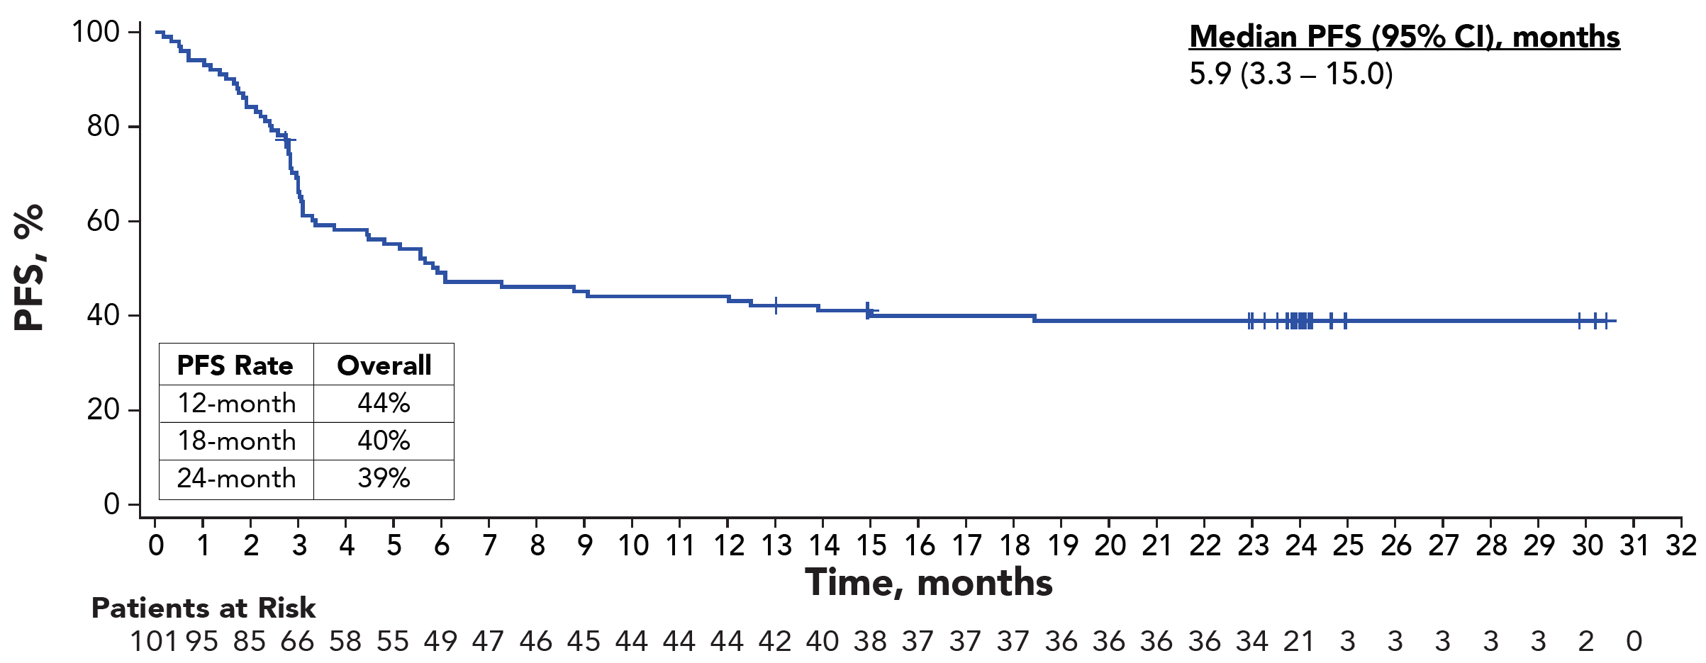
Durable responses with CAR T-cell therapy in r/r large B-cell lymphoma
ZUMA-1: PFS with axi-cel
39% progression-free at 27.1 mo
JULIET: PFS with tisagenlecleucel
34% progression-free at 14 mo#
Median f/u: 27.1 mo
Median PFS: 5.9 mo
Median f/u: 14 mo
Median PFS: 2.9 mo
Patients at Risk
#Calculated value from publication
Neelapu et al. N Eng J Med 2017
Locke et al. Lancet Oncol 2019
Schuster et al. N Eng J Med 2019
Courtesy of Sattva S Neelapu, MD

Slide 54
Durable responses with liso-cel in r/r large B-cell lymphoma
TRANSCEND: PFS for all patients
12-month PFS = 44%
TRANSCEND: PFS by lymphoma subtype
100
Median PFS (95% CI), months
Censored
100
Median f/u: 12.3 mo
Median PFS: 6.8 mo
80
PMBCL
80
NR (2.8‒NR)
tFL
60
NR (11.8‒NR)
60
Progression-free Probability (%)
HGBCL
Progression-free Probability (%)
Total
40
5.0 (2.9‒NR)
40
DLBCL, NOS
Median (95% CI): 6.8 (3.3‒14.1) months
tiNHL
2.9 (1.3‒NR)
3.0 (2.8‒6.3)
20
20
0
0
0
3
6
9
12
15
18
21
24
27
30
0
3
6
9
12
15
18
21
24
27
30
Months
Months
Total
256
133
100
87
65
47
33
23
14
1
0
N
33
20
13
13
10
9
6
4
2
0
57
41
34
27
17
15
12
9
7
0
14
7
7
7
5
0
18
7
5
3
3
1
1
1
1
0
131
56
40
36
29
21
13
8
4
1
0
Courtesy of Sattva S Neelapu, MD
Patients with co-morbidities have inferior PFS
Abramson et al. ASH 2019, Abstract 241

Slide 55
Axicabtagene ciloleucel and tisagenlecleucel:
Current indications in NHL
Axicabtagene ciloleucel (CD19/CD3ζ/CD28)
  Adult patients with relapsed or refractory large B cell lymphoma after two or more lines of systemic therapy, including DLBCL, high-grade B cell lymphoma, PMBCL, and transformed follicular lymphoma
Tisagenlecleucel (CD19/CD3ζ/4-1BB)
  Adult patients with relapsed/refractory large B cell lymphoma after two or more lines of systemic therapy including DLBCL, high-grade B cell lymphoma and transformed follicular lymphoma
Courtesy of Sattva S Neelapu, MD

Slide 56
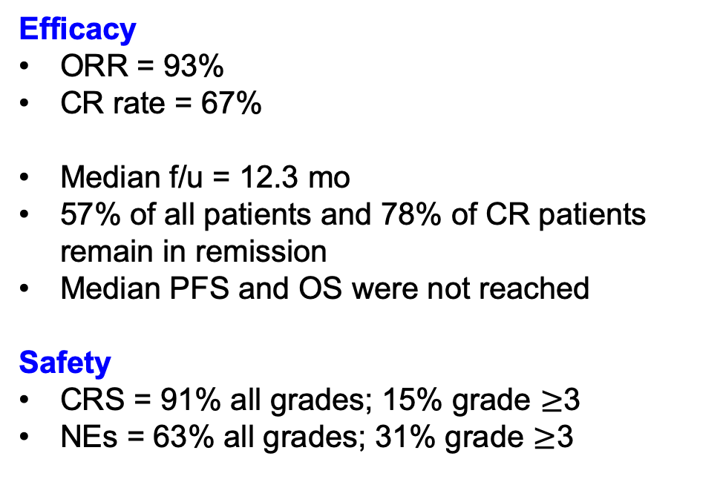
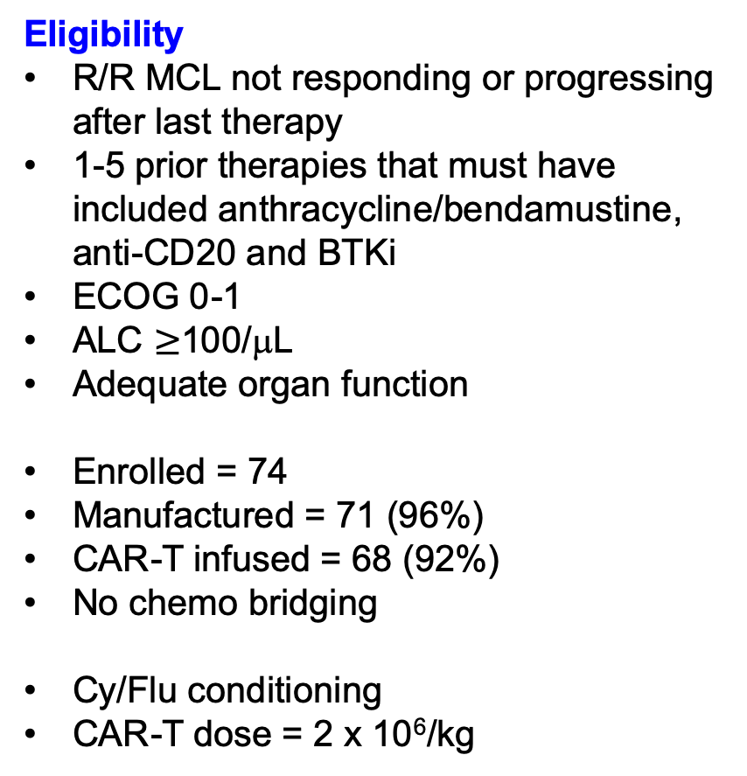
ZUMA-2: Ph 2 study of KTE-X19 in r/r mantle cell lymphoma
Eligibility
R/R MCL not responding or progressing after last therapy
1-5 prior therapies that must have included anthracycline/bendamustine, anti-CD20 and BTKi
ECOG 0-1
ALC $≥$100/μL
Adequate organ function
Enrolled = 74
Manufactured = 71 (96%)
CAR-T infused = 68 (92%)
No chemo bridging
Cy/Flu conditioning
CAR-T dose = 2 x 10⁶/kg
Efficacy
ORR = 93%
CR rate = 67%
Median f/u = 12.3 mo
57% of all patients and 78% of CR patients remain in remission
Median PFS and OS were not reached
Safety
CRS = 91% all grades; 15% grade $≥$3
NEs = 63% all grades; 31% grade $≥$3
Wang et al. ASH 2019; Abstract 754
Wang et al, N Eng J Med, 2020
Courtesy of Sattva S Neelapu, MD

Slide 57
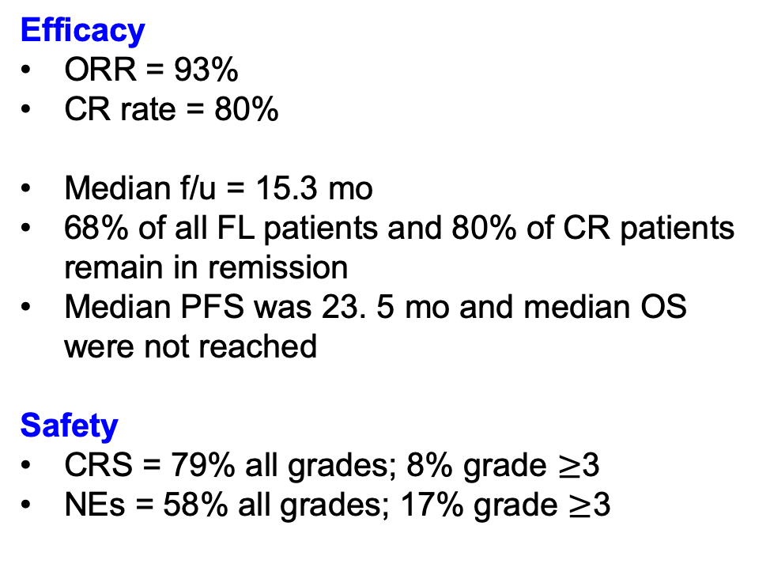
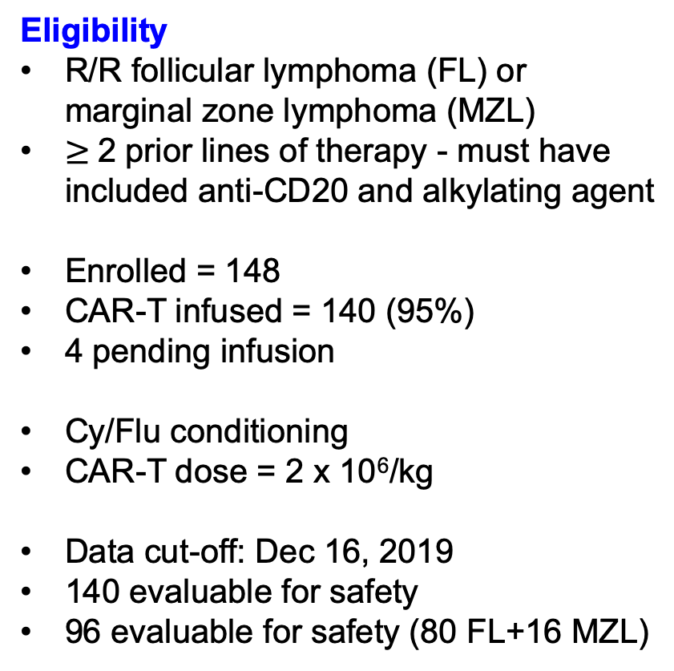
ZUMA-5: Ph 2 study of axi-cel in r/r indolent NHL
Eligibility
R/R follicular lymphoma (FL) or marginal zone lymphoma (MZL)
$≥$2 prior lines of therapy - must have included anti-CD20 and alkylating agent
Enrolled = 148
CAR-T infused = 140 (95%)
4 pending infusion
Cy/Flu conditioning
CAR-T dose = 2 x 10⁶/kg
Data cut-off: Dec 16, 2019
140 evaluable for safety
96 evaluable for safety (80 FL+16 MZL)
Efficacy
ORR = 93%
CR rate = 80%
Median f/u = 15.3 mo
68% of all FL patients and 80% of CR patients remain in remission
Median PFS was 23. 5 mo and median OS were not reached
Safety
CRS = 79% all grades; 8% grade $≥$3
NEs = 58% all grades; 17% grade $≥$3
Courtesy of Sattva S Neelapu, MD
Jacobson et al. ASCO 2020; Abstract 8008

Slide 58
79-year-old man with DLBCL (from the practice of Ms Zerante)
2005: Diagnosed with CLL and high-grade B-cell lymphoma, with MYC and BCL2 rearrangements
  Active surveillance
2017: B-cell lymphoma
Multiple prior treatments for DLBCL
Presents with a significant disease burden
CAR T-cell therapy with axi-cell
  Peak grade 2 CRS (hypotension and fever) day 4-5. Received Toci x1
  Peak 0 ICANS (though noted slowed speech)
  Developed C. Diff diarrhea during admission
Currently, 2 years later and patient remains in CR

Slide 59
Agenda
Module 1: Overview of Chimeric Antigen Receptor (CAR) T-Cell Therapy
Case Presentation: Ms Zerante — 73-year-old woman with DLBCL
Module 2: Side Effects Associated with CAR T-Cell Therapy
Case Presentation: Ms Zerante — 23-year-old woman with ALL
Module 3: Anti-BCMA CAR T-Cell Therapy in Multiple Myeloma (MM)
Case Presentation: Dr Richards — 58-year-old woman with MM
Case Presentation: Dr Richards — 62-year-old man with MM
Module 4: CD19-Directed CAR T-Cell Therapy for Aggressive Lymphomas
Case Presentation: Ms Zerante — 79-year-old man with DLBCL
Module 5: CAR T-Cell Therapy in Acute Lymphoblastic Leukemia (ALL)
Case Presentation: Ms Zerante — 41-year-old woman with ALL

Slide 60
Module 5: CAR T-Cell Therapy in Acute Lymphoblastic Leukemia (ALL)
Overview of current management of ALL
  Blinatumumab
    Administration/toxicity compared to CAR-T therapy
Key data set: ELIANA
Current clinical role for CAR-T therapy

Slide 61
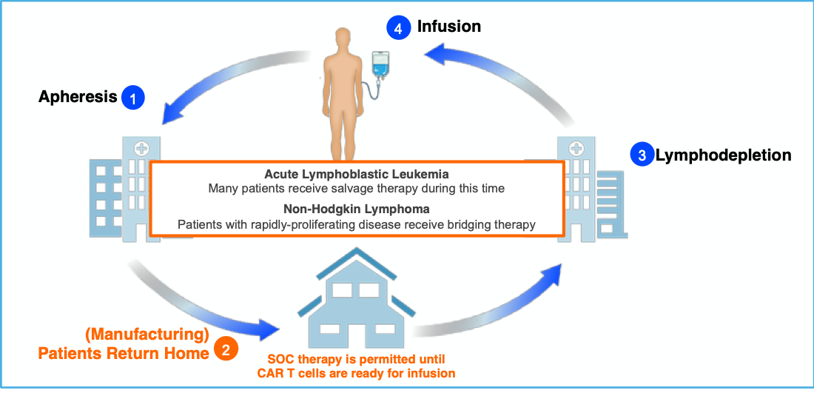
The CAR-T journey: phases of care for patient, developer, clinician
Few late complications but ongoing relapses (typically plateau by 2 years)
CAR-T
Inpatient
typical 0-2w
stay; major toxicities before one month
Follow-up
Care primarily with referring oncologist Relapse greatest cause of mortality
Pre-treatment period (therapies to achieve disease control, assessment, apheresis, cell manufacturing)
NEWDIGS Initiative • MIT Center for Biomedical Innovation

Slide 62
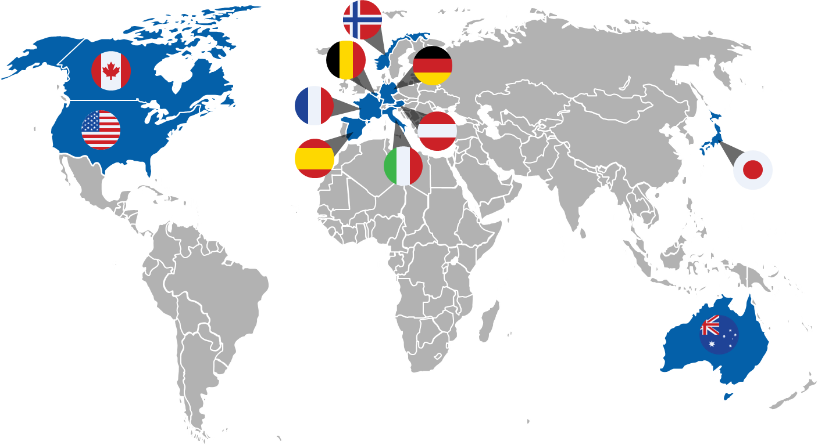
Global, Multicenter ELIANA Trial:
ALL Registration Study
ELIANA is a single arm global study with centralized manufacturing of tisagenlecleucel
25 sites in 11 countries across North America, Europe, Australia, and Asia
FPFV=8 APR 2015
Data cutoff: 23 NOV 2016

Slide 63
ELIANA: Primary Efficacy Analysis¹
Parameter | Efficacy Analysis Setª (n = 63)
Primary endpoint | % (n/N) | 95% CI | P
Overall remission rate (CR + CRi) within 3 months | 83 (52/63) | (71-91) | < .001^{d}
Best overall response, %^{b}
CR | 63
CRi | 19
Secondary endpoint
Best overall response of CR or CRi within 3 months with MRD-negative^{c} BM | 83 | (71-91) | < .001^{d}
Primary efficacy analysis consistent with interim analysis where primary endpoint was met
ª Patients infused with CTL019 ≥3 months prior to data cutoff. ^{b} The response was unknown in 6 patients. ^{c} MRD negative = MRD <0.01%.
^{d} Nominal P value presented to test null hypothesis of overall remission rate <20% for comparison with historical control.
1. Buechner J at al. 23rd Annual Congress of the European Hematology Association 2017 (EHA 2017). Abstract S476.
Notes:
The response in 6 patients (10%) was unknown (2 patients died before assessment [ALL and cerebral hemorrhage], 1 patient with remission at the day 28 assessment died prior to the 3-month assessment [encephalitis], 1 patient with indeterminate bone marrow remission died [systemic mycosis], 1 patient with unconfirmed remission proceeded to allo-SCT, and 1 patient achieved bone marrow remission but did not have a cerebrospinal fluid assessment by lumbar puncture postinfusion).

Slide 65
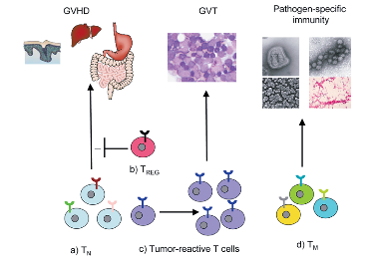
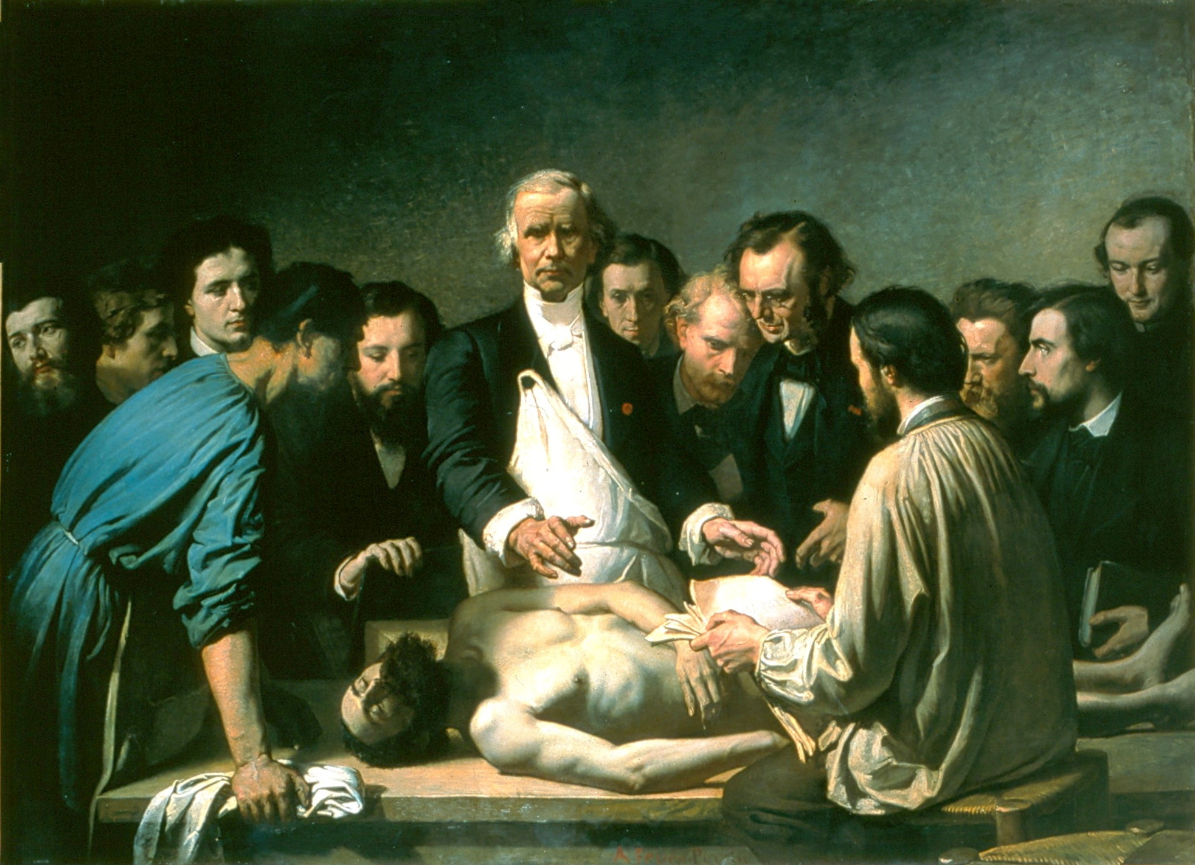
Stem Cell
Transplant era
(Combinations of chemotherapy, immunotherapy)
Our future:
Increasingly
effective
immunotherapies
No effective
therapies
➙
Chemotherapy
era
➙
➙
1960s
Combination chemotherapy +
stem cell transplants
2017
Approval of engineered
T cell therapies
1825
First description
of acute leukemia
1990s
T cells critical for
transplant cures—
dramatic increase in success

Slide 66
41-year-old woman with ALL (from the practice of Ms Zerante)
4/2013: Pre-B-cell ALL (normal cytogenetics) → CALGB-10403 pediatric regimen, with CR → NED
11/2016: Relapse t(4;16)
2/2017: Hyper-CVAD course B with rituximab followed by course A → Transplant
2/2018: Relapse
5/2018: Completes inotuzumab x 4 with remission
Early 2019: Relapse, with CD22-negative B-ALL
DOMP, intrathecal methotrexate bridging therapy to CAR-T
CAR-T cell infusion → D+7 fever, hypotension, tachycardia (tocilizumab)
  Discharged home D+16
4/10/2020: Relapse → Inotuzumab
5/5/2020 Bone marrow biopsy: Hypocellular marrow with residual CD19, CD22+ disease
5/14/2020: Admitted for blinatumomab, escalated to full dose 5/17 and discharged
Plan: Continue blinatumomab: If MRD-negative CR, then second TMI marrow transplant from unrelated donor

