Slide 1
Oncology Grand Rounds
New Agents and Strategies
in Gynecologic Cancers
Tuesday, June 9, 2020
5:00 PM – 6:30 PM ET
Faculty
Paula J Anastasia, RN, MN, AOCN
Jennifer Filipi, MSN, NP
David M O’Malley, MD
Shannon N Westin, MD, MPH
Moderator
Neil Love, MD

Slide 2
Dr Love — Disclosures
Dr Love is president and CEO of Research To Practice. Research To Practice receives funds in the form of educational grants to develop CME activities from the following commercial interests: AbbVie Inc, Acerta Pharma — A member of the AstraZeneca Group, Adaptive Biotechnologies, Agendia Inc, Agios Pharmaceuticals Inc, Amgen Inc, Array BioPharma Inc, Astellas, AstraZeneca Pharmaceuticals LP, Bayer HealthCare Pharmaceuticals, Biodesix Inc, bioTheranostics Inc, Blueprint Medicines, Boehringer Ingelheim Pharmaceuticals Inc, Boston Biomedical Inc, Bristol-Myers Squibb Company, Celgene Corporation, Clovis Oncology, Daiichi Sankyo Inc, Dendreon Pharmaceuticals Inc, Eisai Inc, EMD Serono Inc, Exelixis Inc, Foundation Medicine, Genentech, a member of the Roche Group, Genmab, Genomic Health Inc, Gilead Sciences Inc, GlaxoSmithKline, Guardant Health, Halozyme Inc, ImmunoGen Inc, Incyte Corporation, Infinity Pharmaceuticals Inc, Ipsen Biopharmaceuticals Inc, Janssen Biotech Inc, administered by Janssen Scientific Affairs LLC, Jazz Pharmaceuticals Inc, Kite, A Gilead Company, Lexicon Pharmaceuticals Inc, Lilly, Loxo Oncology Inc, a wholly owned subsidiary of Eli Lilly & Company, Merck, Merrimack Pharmaceuticals Inc, Myriad Genetic Laboratories Inc, Natera Inc, Novartis, Oncopeptides, Pfizer Inc, Pharmacyclics LLC, an AbbVie Company, Prometheus Laboratories Inc, Puma Biotechnology Inc, Regeneron Pharmaceuticals Inc, Sandoz Inc, a Novartis Division, Sanofi Genzyme, Seattle Genetics, Sirtex Medical Ltd, Spectrum Pharmaceuticals Inc, Taiho Oncology Inc, Takeda Oncology, Tesaro, A GSK Company, Teva Oncology, Tokai Pharmaceuticals Inc and Tolero Pharmaceuticals.

Slide 3
Ms Anastasia — Disclosures
No financial interests or affiliations to disclose

Slide 4
Ms Filipi — Disclosures
No financial interests or affiliations to disclose

Slide 5
Dr O’Malley — Disclosures
Advisory Committee | AbbVie Inc, Agenus Inc, Ambry Genetics, AstraZeneca Pharmaceuticals LP, Clovis Oncology, Eisai Inc, Genelux, Genentech, a member of the Roche Group, GOG Foundation Inc, ImmunoGen Inc, Janssen Biotech Inc, Leap Therapeutics Inc, Merck, Myriad Genetic Laboratories Inc, Novocure, Regeneron Pharmaceuticals Inc, Tarveda Therapeutics, Tesaro, A GSK Company
Consulting Agreements | AbbVie Inc, Agenus Inc, Ambry Genetics, AstraZeneca Pharmaceuticals LP, Clovis Oncology, Eisai Inc, Genentech, a member of the Roche Group, Genmab, GOG Foundation Inc, ImmunoGen Inc, Novocure, Regeneron Pharmaceuticals Inc, Seattle Genetics, Tesaro, A GSK Company
Contracted Research | AbbVie Inc, Agenus Inc, Ajinomoto Co Inc, Amgen Inc, Array BioPharma Inc, AstraZeneca Pharmaceuticals LP, Bristol-Myers Squibb Company, Clovis Oncology, Daré Bioscience, Eisai Inc, EMD Serono Inc, Ergomed Plc, Genentech, a member of the Roche Group, Genmab, GlaxoSmithKline, GOG Foundation Inc, ImmunoGen Inc, Iovance Biotherapeutics Inc, Janssen Biotech Inc, Johnson & Johnson Pharmaceuticals, Ludwig Institute for Cancer Research Ltd, Merck, New Mexico Cancer Care Alliance, Novocure, PRA Health Sciences, Regeneron Pharmaceuticals Inc, Seattle Genetics, Stemcentrx, Syneos Health, Tesaro, A GSK Company, TRACON Pharmaceuticals Inc, VentiRx Pharmaceuticals Inc
Data and Safety Monitoring Board/Committee | Marker Therapeutics Inc

Slide 6
Dr Westin — Disclosures
Consulting Agreements | AstraZeneca Pharmaceuticals LP, Circulogene, Clovis Oncology, Genentech, a member of the Roche Group, Merck, Novartis, Pfizer Inc, Tesaro, A GSK Company
Contracted Research | ArQule Inc, AstraZeneca Pharmaceuticals LP, Bayer HealthCare Pharmaceuticals, Clovis Oncology, Cotinga Pharmaceuticals, Genentech, a member of the Roche Group, Novartis, Tesaro, A GSK Company
Data and Safety Monitoring Board/Committee | Xenetic Biosciences

Slide 7
Commercial Support
This activity is supported by educational grants from AbbVie Inc, AstraZeneca Pharmaceuticals LP, Eisai Inc and Merck.

Slide 8
Agenda
Module 1: PARP Inhibitors in Ovarian Cancer — Biology, Clinical Benefit; Managing Side Effects, Optimizing Adherence
Case Presentation: Ms Filipi — 72-year-old retired nurse
Case Presentation: Ms Anastasia — 63-year-old music conductor
Module 2: Risks and Benefits of Immune Checkpoint Inhibitors (ICIs) in Endometrial Cancer
Case Presentation: Ms Filipi — 68-year-old non-profit manager
Case Presentation: Ms Anastasia — 67-year-old widow and grandmother
Module 3: Risks and Benefits of ICIs in Cervical Cancer
Case Presentation: Ms Filipi — 35-year-old personal trainer

Slide 9
Module 1: PARP Inhibitors in Ovarian Cancer — Biology, Clinical Benefit; Managing Side Effects, Optimizing Adherence

Slide 10
New Advanced Ovarian Cancer
Surgical Candidate???
YES
NO
Optimal Debulking?
Neoadjuvant Chemo
YES
NO
IV
IP
DD
Chemo
Interval Surgery
+/- Bevacizumab
Chemo
Maintenance
Surveillance
Courtesy, Shannon N Westin, MD, MPH

Slide 11
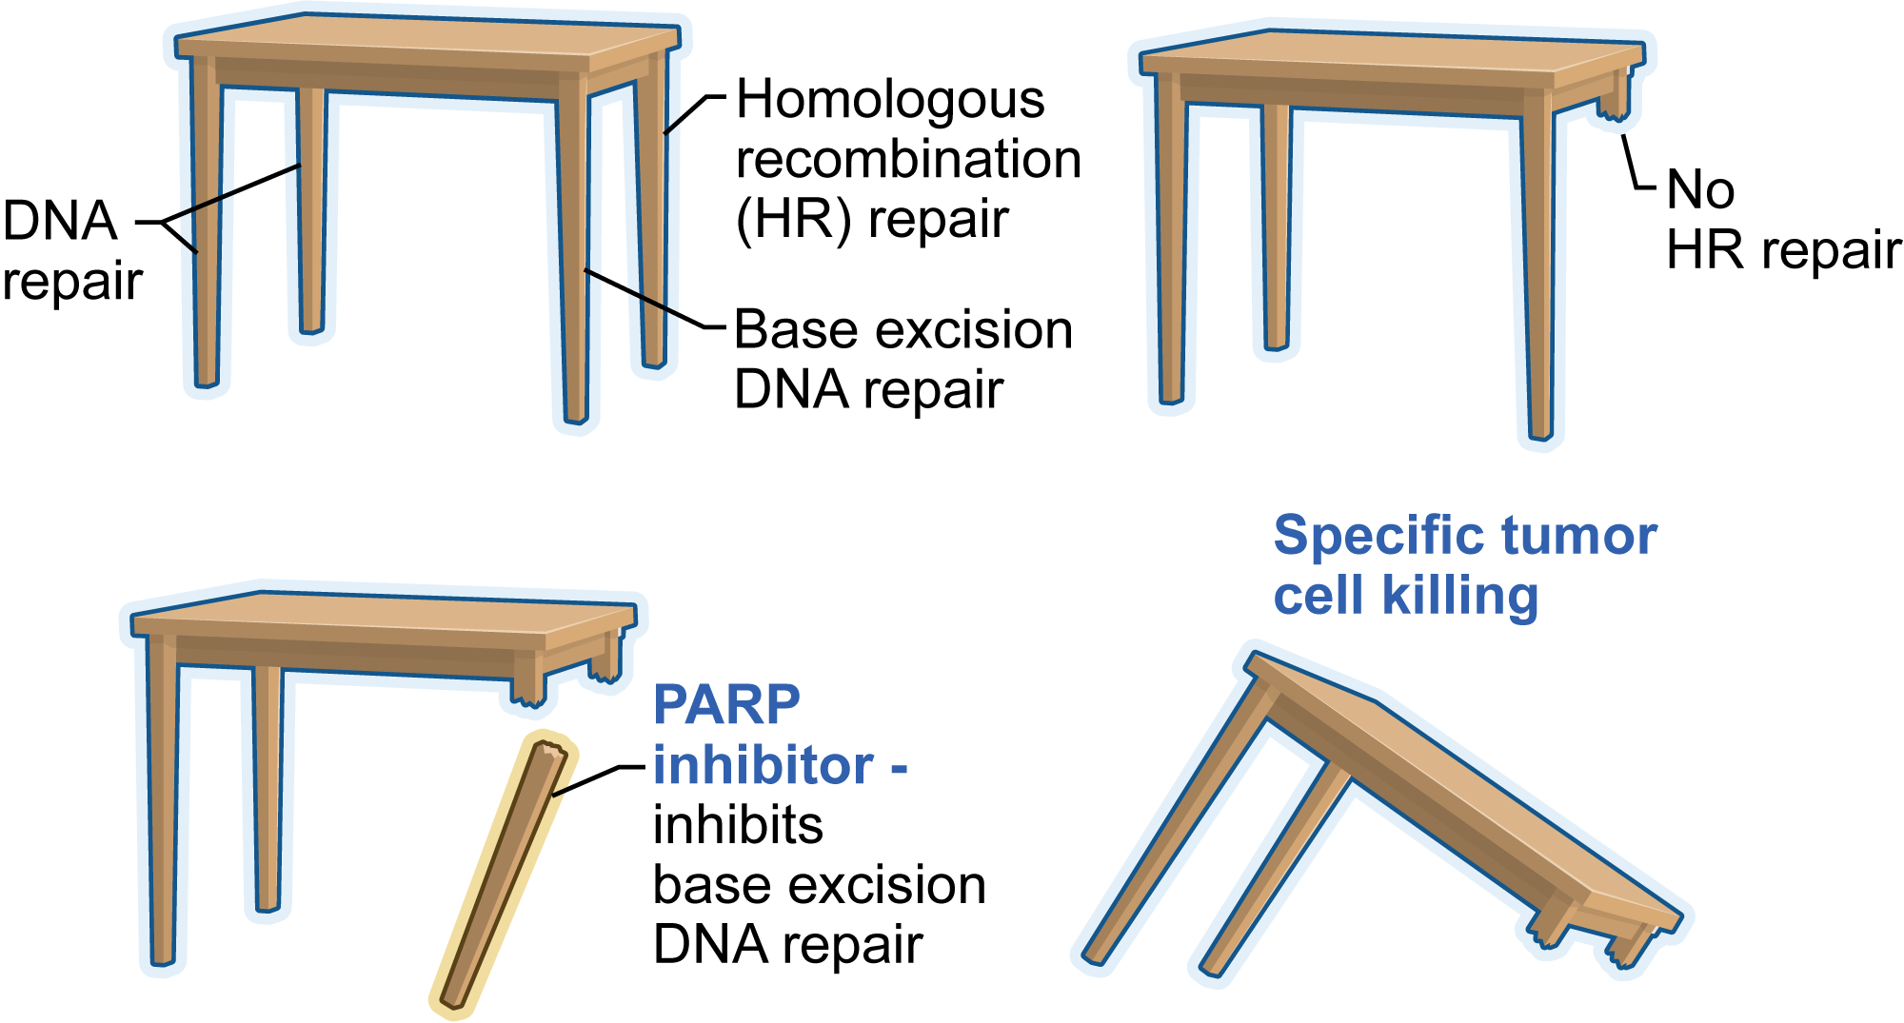
Mechanism of Cell Death from Synthetic Lethality Induced by PARP Inhibition
Courtesy of Jenny C Chang, MD

Slide 12
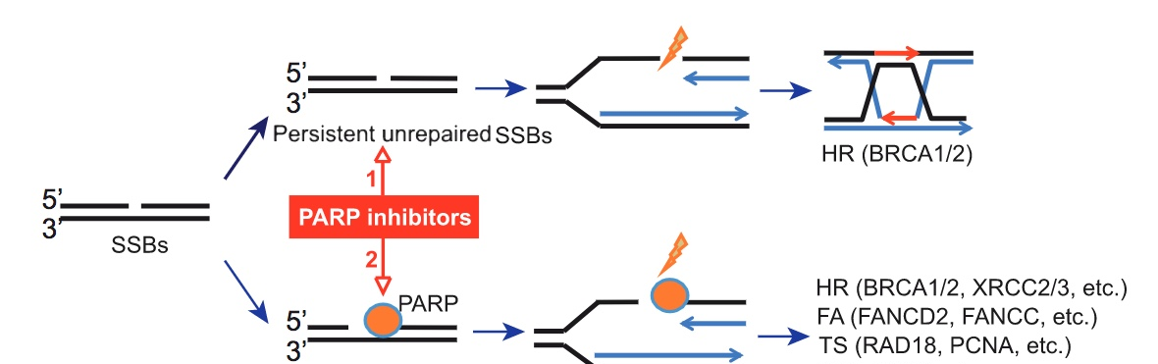
Dual Mechanisms of Action of PARP Inhibitors
Catalytic inhibition
Trapping of
PARP-DNA complexes
 | Catalytic inhibition IC₅₀ in wild-type DT40 cells (nM) | Catalytic inhibition IC₅₀ in wild-type DT40 cells (µM) | PARP-trapping potency (relative to olaparib) | Class
Veliparib | 30 | >50 | <0.2 | Type 1
Olaparib | 6 | 4.5 | 1 | Type 2
Rucaparib | 21 | 3 | 1 | Type 2
Niraparib | 60 | 2.3 | ~2 | Type 2
Talazoparib | 4 | 0.04 | ~100 | Type 2
Murai J, Pommier Y. Classification of PARP Inhibitors Based on PARP Trapping and Catalytic Inhibition, and Rationale for Combinations with Topoisomerase I Inhibitors and Alkylating Agents. In: Curtin NJ, Sharma RA, eds. PARP Inhibitors for Cancer Therapy. New York: Springer International Publishing;2015:261-74.

Slide 13
Phase 3 1L Maintenance Trials
Study Design |  | GOG-0218 (N=1873) | SOLO-1 (N=451) | PAOLA-1 (N=612) | PRIMA (N=620) | VELIA (N=1140)
Treatment arms vs placebo |  | Bevacizumab (n=625) | Olaparib (n=260) | Bevacizumab ± Olaparib | Niraparib | Veliparib
Key Patient Population |  | All comers | BRCA mutation | All comers | All comers | All comers
Undergo tumor testing |  | HRR (post-hoc) | BRCA | BRCA | HRD | BRCA
Stage | III | 73.8% | 84.6% | Eligible | Eligible: Attempt upfront debulking | Eligible
 | IV | 26.2% | 15.4% | Eligible | Eligible: Any debulking attempts | Eligible
Surgery | Residual disease after surgery | Stage III incomplete Macroscopic: 32.8% >1 cm: 41.0% | Macroscopicª Primary: 23.0% Interval: 19.1% | NR^{b} | Required for Stage III | Primary or Interval
 | Inoperable disease | 0 | 1.5% | NR^{b} | Eligible
Treatment Duration |  | 15 months | 24 months | 15 months for Bev 24 months for Olaparib | Until PD | 24 months
ªResidual disease based on stage was not reported. ^{b}Stage III and IV eligible, but requirements for prior surgery not reported (NR) on clinicaltrials.gov
Burger RA, N Engl J Med. 2011; Norquist B Clin Cancer Res 2018; Bevacizumab prescribing information; Moore K, NEJM 2018; Gonzalez-Martin NEJM 2019; Ray-Coquard NEJM 2019; Coleman NEJM 2019
Courtesy, Shannon N Westin, MD, MPH

Slide 14
SOLO-1: A Phase III Trial of Maintenance Olaparib in OC with BRCA Mutation
NCT01844986
Maintenance
Eligibility
Newly diagnosed ovarian, fallopian tube or primary peritoneal cancer FIGO Stage III-IV High-grade serous or endometrioid histology Deleterious or suspected deleterious BRCA1 or BRCA2 mutation-positive
CR or PR and no clinical evidence of PD after completing first-line platinum-based therapy
Olaparib 300 mg BID
(n = 260)
R
(2:1)
Placebo
(n = 131)
Primary endpoint: Investigator-assessed progression-free survival
www.clinicaltrials.gov; Moore KN et al. Proc ASCO 2014;Abstract TPS5616; Moore K et al. N Engl J Med 2018;[Epub ahead of print].

Slide 15
PRIMA Trial: A Phase III Trial of Maintenance Niraparib in OC
NCT02655016
Maintenance
Eligibility (N = 620)
Newly diagnosed ovarian cancer Advanced-stage (FIGO III or IV) disease Completion of first-line platinum-based therapy CR or PR to most recent platinum chemotherapy
Niraparib
R
(2:1)
Placebo
Primary endpoint: Progression-free survival
Gonzalez-Martin A et al. Proc ESMO 2018;Abstract 941PD.

Slide 16
Phase III PAOLA-1/ENGOT-OV25 Study Design
Maintenance Therapy
Eligibility
Newly diagnosed Stage III-IV high-grade serous/endometroid ovarian, fallopian tube or primary peritoneal cancer Surgery (upfront or interval) Platinum-taxane based chemo ≥ cycles of bevacizumab
Olaparib (300 mg BID) x 2 yrs
+
Bevacizumab
NED/CR/PR
R
(2:1; N = 806)
Placebo x 2 yrs
+
Bevacizumab
Primary endpoint: Investigator-assessed PFS
Secondary endpoints: TFST, PFS2, TSST, OS, HRQoL, Safety and tolerability
Ray-Coquard IL et al. ESMO 2019; Abstract 3955.

Slide 17
Phase III VELIA/GOG-3005 Study Design
Combination:
Cycles 1-6
Maintenance:
Cycles 7-36
(1:1:1)
(N = 1140)
Carboplatin + Paclitaxel + Veliparib 150mg BID
Veliparib 400mg BID
Veliparib
throughout
Eligibility
High-grade serous cancer FIGO Stage III or IV No prior systemic therapy ECOG PS 0-2 No CNS mets
Carboplatin + Paclitaxel + Veliparib 150mg BID
Placebo
R
Veliparib
combination
Carboplatin + Paclitaxel + Veliparib 150mg BID
Placebo
Control
Primary endpoint: Progression-free survival (PFS) for veliparib-throughout vs control, including the combination and maintenance phase
Coleman RL et al. ESMO 2019; Abstract 2772.

Slide 18
FDA approves niraparib for first-line maintenance of advanced ovarian cancer
Press Release – April 29, 2020
“The Food and Drug Administration approved niraparib for the maintenance treatment of adult patients with advanced epithelial ovarian, fallopian tube, or primary peritoneal cancer who are in a complete or partial response to first-line platinum-based chemotherapy.
Efficacy was investigated in PRIMA (NCT02655016), a double-blind, placebo-controlled trial that randomized 733 patients to niraparib or matched placebo. Patients were in a complete or partial response to first-line platinum-based chemotherapy.”
https://www.fda.gov/drugs/drug-approvals-and-databases/fda-approves-niraparib-first-line-maintenance-advanced-ovarian-cancer

Slide 19
FDA approves olaparib plus bevacizumab as maintenance treatment for ovarian, fallopian tube, or primary peritoneal cancers
Press Release – May 28, 2020
The Food and Drug Administration expanded the indication of olaparib to include its combination with bevacizumab for first-line maintenance treatment of adult patients with advanced epithelial ovarian, fallopian tube, or primary peritoneal cancer who are in complete or partial response to first-line platinum-based chemotherapy and whose cancer is associated with homologous recombination deficiency positive status defined by either a deleterious or suspected deleterious BRCA mutation, and/or genomic instability.
FDA also approved the Myriad myChoice® CDx (Myriad Genetic Laboratories, Inc.) as a companion diagnostic for olaparib.
Efficacy of this new indication was investigated in PAOLA-1 (NCT03737643), a randomized, double-blind, placebo-controlled, multi-center trial comparing olaparib with bevacizumab versus placebo plus bevacizumab in patients with advanced high-grade epithelial ovarian cancer, fallopian tube, or primary peritoneal cancer following first-line platinum-based chemotherapy and bevacizumab.
https://www.fda.gov/drugs/drug-approvals-and-databases/fda-approves-olaparib-plus-bevacizumab-maintenance-treatment-ovarian-fallopian-tube-or-primary

Slide 20
72-year-old retired nurse and grandmother (from the practice of Ms Filipi)
7/2019: Present to ER with BRBPR
  CA125: 1754
  Biopsy confirmed ovarian origin
Cytoreductive surgery
Carboplatin and paclitaxel x 6
  Thrombocytopenia
Genetic testing: Negative germline, somatic BRCA mutation
Maintenance olaparib

Slide 21
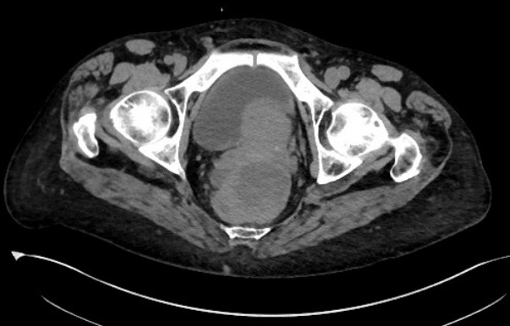
72-year-old retired nurse and grandmother (from the practice of Ms Filipi)

Slide 22
At a minimum, all patients with ovarian cancer should have the following assay(s) conducted at diagnosis regardless of family history of cancer.
BRCA germline testing
BRCA somatic testing
Multiplex germline testing
Multiplex somatic testing
Both a and b
Both c and d
I don’t know

Slide 23
Bevacizumab is often added to chemotherapy for patients presenting with ovarian cancer and…
Optimal debulking surgery
Ascites
Both a and b
Neither a nor b
I don’t know

Slide 24
In order to receive PARP inhibitor maintenance treatment after debulking surgery and first-line platinum-based chemotherapy, a patient with ovarian cancer…
Must have evidence of residual disease
Must not have experienced disease progression
Both a and b
Neither a nor b
I don’t know

Slide 25
In which of the following situations is the use of primary maintenance PARP inhibitors (postoperative, postchemotherapy) standard?
Patients with ovarian cancer and homologous recombinant proficiency
Patients with ovarian cancer and BRCA germline mutations
Both a and b
Neither a nor b
I don’t know

Slide 26
Which of the following PARP inhibitors is approved for use as primary maintenance therapy for patients with BRCA wild-type ovarian cancer?
Olaparib
Niraparib
Rucaparib
Veliparib
Both a and b
All of the above
I don’t know

Slide 27
Which of the following PARP inhibitors is approved in combination with bevacizumab for use as primary maintenance therapy after first-line platinum-based chemotherapy?
Olaparib
Niraparib
Rucaparib
Veliparib
Both a and b
All of the above
I don’t know

Slide 28
Which of the following PARP inhibitors has demonstrated benefit in combination with chemotherapy after debulking surgery and then continued as maintenance treatment?
Olaparib
Niraparib
Rucaparib
Veliparib
Both a and b
All of the above
I don’t know

Slide 29
What was the duration of treatment with olaparib and niraparib in the Phase III trials evaluating maintenance therapy with PARP inhibitors after debulking surgery and first-line platinum-based chemotherapy?
2 years for both
3 years for both
2 years for olaparib, 3 years for niraparib
2 years for niraparib, 3 years for olaparib
I don’t know

Slide 30
63-year-old Ashkenazi Jewish woman, mother, violinist and music conductor (from the practice of Ms Anastasia)
2-4/2018: Abdominal distension/bloating, early satiety; CT scan: solid pelvic mass14 x 7.6 cm, extensive omental caking, irregular nodularity at both lung bases
Baseline CA-125: 2247
Paracentesis: 2.3L removed, cytology c/w adenocarcinoma favor OC
Multigene hereditary cancer panel: Negative for pathogenic variant
7/2018: Completes neoadjuvant carboplatin and paclitaxel x 3 (CA-125: 68)
8/2018: Interval cytoreductive surgery → R0 (Stage 3C HGS ovarian cancer)
11/2018: Completes adjuvant carboplatin and paclitaxel x 3 (CA-125: 9)
  Thrombocytopenia post-surgery (nadir: 64K), Grade 1 neuropathy, fatigue, anemia, constipation
Genomic tumor testing: Somatic mutation HRD-positive
2/2019: Maintenance olaparib 300mg BID

Slide 31
Patient Education for Olaparib
Reinforce common side effects: fatigue and nausea, but short lived
Obtain Baseline CBC, Plt, Diff, Comprehensive Metabolic Panel, CA 125; Then monthly After 3 months may continue q 3 month labs and physical exam
Our practice monitors weekly CBC, Plt, Diff x 4 weeks
We hold dose one week if Plts < 75K, Hgb < 9.0g/dl, ANC < 1500/mm3
If blood counts are held a week and return to less than grade 1, package insert recommends dose reduction. We dose 150mg q am and 300mg at hs. PI recommends 150mg and 100mg in am and pm
We provide blood transfusion if Hgb < 9.0g/dl and or symptomatic
Consider daily folate, and monthly Vitamin B12 injection, especially if elevated MCV
For fatigue (r/o anemia, hypothyroid, dehydration) encourage exercise and mobility. Fatigue can be due to deconditioning.
Nausea may occur in form of queasiness: recommend prophylactic antiemetic initially then may taper If not needed
Small frequent meals and grazing
May benefit from PPI or anti-acid which can mimic nausea
Alternative options include behavior modification, acupuncture, CBD oil
If significant nausea where patient is not adequately hydrating or losing weight, hold drug one week; if improvement then consider dose reduction
Recommended guidelines: Discontinue PARP inhibitor maintenance therapy after 2 years (or recurrence)

Slide 32



63-year-old Ashkenazi Jewish woman -- Younger Years Before Her Cancer Diagnosis

Slide 33



Performing at Disneyland and Adventureland During Treatment

Slide 34
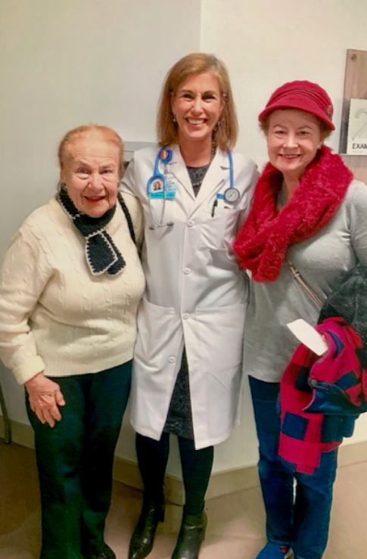
Remission
Completion of Chemo
Photo:
95 yr old Mother (who she drives 2hrs weekly to visit)
Dr Beth Karlan

Slide 35

Conducting Orchestra 2019

Slide 36


Girls Trip to Las Vegas
2019
Palm Springs Tram
Elevation 8500 ft

Slide 37
How often should complete blood counts be monitored in patients with ovarian cancer who are receiving niraparib?
Weekly for the duration of treatment
Monthly for the duration of treatment
Weekly for the first month, monthly for the next 11 months and periodically thereafter
Weekly for the first 6 months and monthly thereafter
I don’t know

Slide 38
Which PARP inhibitor has been associated with increased serum creatinine levels and normal renal function?
Olaparib
Niraparib
Rucaparib
Veliparib
None of the above
I don’t know

Slide 39
Hematologic Toxicity
Toxicity | Grade | Olaparib¹ | Rucaparib² | Niraparib³
Anemia (%) | All Grades | 90 | 67 | 50.1
 | Grade 3 and 4 | 15 | 23 | 25.3
Thrombocytopenia (%) | All | 30 | 39 | 61.3
 | Grades 3 and 4 | 3 | 6 | 33.8
Neutropenia (%) | All | 25 | 35 | 30.2
 | Grades 3 and 4 | 7 | 10 | 19.6
At maximum administered dose of olaparib (600 mg BID), G4 thrombocytopenia was observed⁴
Courtesy, Shannon N Westin, MD, MPH
¹FDA package insert, ²FDA package insert, ³NOVA NEJM 2016, ⁴Fong NEJM 2009

Slide 40
Gastrointestinal Toxicity
Toxicity | Grade | Olaparib ¹ | Rucaparib² | Niraparib³
Nausea (%) | All Grades | 64 | 77 | 74
 | Grade 3 and 4 | 3 | 5 | 3.0
Constipation (%) | All | 21⁵ | 40 | 40
 | Grades 3 and 4 | 0 | 2 | 0.5
Vomiting (%) | All | 43 | 46 | 34
 | Grades 3 and 4 | 4 | 4 | 2
Decreased appetite (%) | All | 22 | 39 | 25
 | Grades 3 and 4 | 1 | 3 | 0.3
Abdominal pain (%) | All | 43 | 32 | 23
 | Grades 3 and 4 | 8 | 3 | 1
Diarrhea (%) | All | 31 | 34 | 19
 | Grades 3 and 4 | 1 | 2 | 0.3
Dyspepsia (%) | All | 25 | 10⁴ | 11
 | Grades 3 and 4 | 0 | <1 | 0
Courtesy, Shannon N Westin, MD, MPH
¹FDA insert, ²FDA insert, ³NOVA NEJM 2016, ⁴Swisher Lancet Onc 2016, ⁵Ledermann Lancet Oncology 2014

Slide 41
Dose Adjustments for Adverse Events
Olaparib Dose Reductions | Dose (tablet)
Starting Dose | 300 mg BID
First Dose Reduction | 250 mg BID
Second Dose Reduction | 200 mg BID
Rucaparib Dose Reductions | Dose
Starting Dose | 600 mg twice daily
First Dose Reduction | 500 mg twice daily
Second Dose Reduction | 400 mg twice daily
Third Dose Reduction | 300 mg twice daily
Niraparib Dose Reductions | Dose
Starting Dose | 300 mg daily
First Dose Reduction | 200 mg daily
Second Dose Reduction | 100 mg daily
Courtesy, Shannon N Westin, MD, MPH
FDA Prescribing Information.
Notes:
Prior to initiating PARP inhibitor, prior chemotherapy adverse effects should have resolved to <grade 1.

Slide 42
Agenda
Module 1: PARP Inhibitors in Ovarian Cancer — Biology, Clinical Benefit; Managing Side Effects, Optimizing Adherence
Case Presentation: Ms Filipi — 72-year-old retired nurse
Case Presentation: Ms Anastasia — 63-year-old music conductor
Module 2: Risks and Benefits of Immune Checkpoint Inhibitors (ICIs) in Endometrial Cancer
Case Presentation: Ms Filipi — 68-year-old non-profit manager
Case Presentation: Ms Anastasia — 67-year-old widow and grandmother
Module 3: Risks and Benefits of ICIs in Cervical Cancer
Case Presentation: Ms Filipi — 35-year-old personal trainer

Slide 43
Module 2: Risks and Benefits of Immune Checkpoint Inhibitors (ICIs) in Endometrial Cancer

Slide 44
Checkpoint inhibitors are approved for and commonly used in cervical and endometrial cancer but not ovarian cancer.
I am aware of this
I was not aware of this

Slide 45
What is the usual sequence of treatment for patients with MSI-high metastatic endometrial cancer?
Chemotherapy first line; pembrolizumab second line
Chemotherapy first line; pembrolizumab second line for increased PD-L1 levels
Chemotherapy first line; pembrolizumab/lenvatinib second line
Pembrolizumab first line; chemotherapy second line
I don’t know

Slide 46
What is the usual sequence of treatment for patients with MS-stable metastatic endometrial cancer?
Chemotherapy first line; pembrolizumab second line
Chemotherapy first line; pembrolizumab second line for increased PD-L1 levels
Chemotherapy first line; pembrolizumab/lenvatinib second line
Pembrolizumab first line; chemotherapy second line
I don’t know

Slide 47
Have you encountered a patient with endometrial cancer who received pembrolizumab/lenvatinib?
No
Yes, but I did not observe loss of appetite and/or weight loss
Yes, and I observed loss of appetite and/or weight loss in at least 1 patient

Slide 48
The rapidity of onset and severity of hypertension associated with lenvatinib is greater than that with bevacizumab.
I am aware of this
I was not aware of this

Slide 49

Pembrolizumab in Patients with MSI-H Advanced Endometrial Cancer from the KEYNOTE-158 Study
David M. O’Malley,¹ Aurelien Marabelle,² Ana De Jesus Acosta,³ Sarina A. Piha-Paul,⁴ Alexander Arkhipov,⁵ Federico Longo,⁶ Daniel Motola-Kuba,⁷ Ronnie Shapira Frommer,⁸ Ravit Geva,⁹ Bobbie J. Rimel,¹⁰ Jose A. Lopez-Martin,¹¹ Aaron R. Hansen,¹² Janice M. Mehnert,¹³ Xinqun Chen,¹⁴ Fan Jin,¹⁴ Kevin Norwood,¹⁴ Patrick A. Ott¹⁵
¹The Ohio State University Wexner Medical Center and The Ohio State University James Comprehensive Cancer Center, Columbus, OH, USA; ²Gustave Roussy Cancer Campus, Villejuif, France; ³Kimmel Comprehensive Cancer Center at Johns Hopkins, Baltimore, MD, USA; ⁴University of Texas MD Anderson Cancer Center, Houston, TX, USA; ⁵Federal State Autonomous Institution “Treatment and Rehabilitation Center” of the Ministry of Health of the Russian Federation, Moscow, Russia; ⁶Hospital Universitario Ramón y Cajal, Instituto Ramón y Cajal de Investigación Sanitaria (IRICYS), CIBERONC, Madrid, Spain; ⁷COMOP A.C., Clinical Investigation, Mexico City, Mexico; ⁸Sheba Medical Center, Ramat-Gan, Israel; ⁹Division of Oncology, Tel Aviv Sourasky Medical Center, Tel-Aviv University, Tel Aviv, Israel; ¹⁰Cedars-Sinai Medical Center, Los Angeles, CA, USA; ¹¹Medical Oncology, 12 de Octubre University Hospital & Research Institute (i+12), Madrid, Spain; ¹²University of Toronto, Princess Margaret Cancer Centre, Toronto, ON, Canada; ¹³Rutgers Cancer Institute of New Jersey, New Brunswick, NJ, USA; ¹⁴Merck & Co., Inc., Kenilworth, NJ, USA; ¹⁵Dana-Farber Cancer Institute, Harvard Medical School, Boston, MA, USA
2019 esmo.org

Slide 50
Best Percentage Change From Baseline in Target Lesion Size
MSI-H Endometrial Cancer; per RECIST v1.1 by Central Review
O'Malley DM et al. ESMO 2019.
Includes patients who had ≥1 evaluable postbaseline tumor assessment. Changes from baseline >100% were truncated at 100%.
Data cutoff date: Dec 6, 2018.

Slide 51
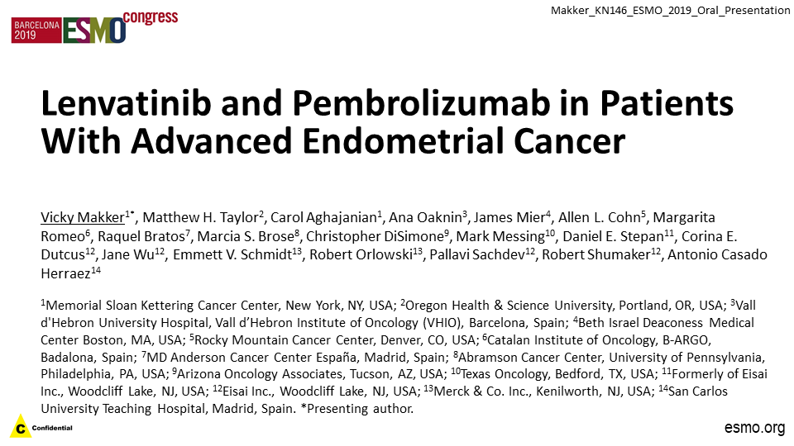

Slide 52
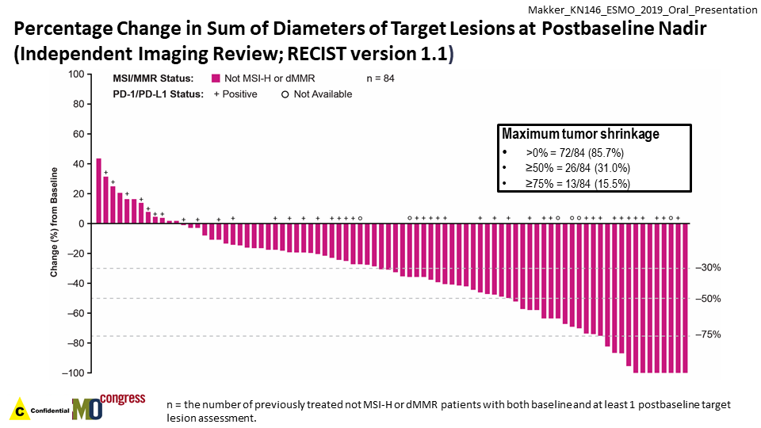
Courtesy, David M O’Malley, MD
Makker V et al. ESMO 2019.

Slide 53
68-year-old non-profit manager (from the practice of Ms Filipi)
2016: Endometrial cancer → surgery → carboplatin/paclitaxel x 6 → pelvic XRT
2019: Recurrence
Clinical trial (16-322): Avelumab + talazoparib in MSS endometrial cancer
  2020: PD (small volume disease and asymptomatic)
Pembrolizumab and lenvatinib (10mg → 14mg after a week)
  BP: 180/116 (asymptomatic)
    Held lenvatinib, 100mg losartan
  BP still high → added 25mg HCTZ
  BP still high → took another 25mg HCTZ
  BP finally stabilized
Restarted lenvatinib 14mg the following day with no further issues

Slide 54

I’m not feeling well….
This isn’t compatible with her goals
We gave her 5 days off and decreased her lenvatinib dose to 10mg
        Be careful about hypotension
Check thyroid studies (on pembrolizumab)
Change dose time from morning to nighttime

Slide 55





Slide 56


“I’m old and short and sometimes feel invisible. That’s why I dyed my hair purple. Thank you for making me feel seen and heard”

Slide 57
67-year-old widow and grandmother (from the practice of Ms Anastasia)
2018: High-grade Stage 3C endometrial cancer s/p TAH/BSO, PP ALND: 1 node+, MSI-stable, ER+ → Pelvic RT + weekly cisplatin → vaginal brachytherapy
1/2019-4/2019: Carboplatin + paclitaxel x 4
5/2019: Letrozole
8/2019-10/2019: Recurrent disease 1st relapse
Liposomal doxorubicin + bevacizumab x 3 → PD (liver and peritoneal mets)
10/2019: Pembrolizumab 200mg + Lenvatinib 20mg
  Dose hold and reduction of lenvatinib to 10mg (Gr 2 fatigue, nausea, diarrhea and wt loss)
2020: Relocates from East coast to California to be with 4 adult offspring, grandchildren
New bone mets, enlargement of peritoneal disease after 6 months of stable disease on pembrolizumab/lenvatinib

Slide 58
Lessons Learned from Cancer Survivors
~Being cancer free does not mean being free of cancer
~Transitioning to recovery is stressful
~Despite risk, survivors manifest remarkable resilience with respect to the cancer experience and even the potential to find benefit from the experience
~Cancer for many may provide a “teachable moment”
Rowland, J. What cancer survivors are telling us. New Haven, CT:
Defining Excellence in Cancer Survivorship, Yale Cancer Center; January 14-15, 2008.

Slide 59
Agenda
Module 1: PARP Inhibitors in Ovarian Cancer — Biology, Clinical Benefit; Managing Side Effects, Optimizing Adherence
Case Presentation: Ms Filipi — 72-year-old retired nurse
Case Presentation: Ms Anastasia — 63-year-old music conductor
Module 2: Risks and Benefits of Immune Checkpoint Inhibitors (ICIs) in Endometrial Cancer
Case Presentation: Ms Filipi — 68-year-old non-profit manager
Case Presentation: Ms Anastasia — 67-year-old widow and grandmother
Module 3: Risks and Benefits of ICIs in Cervical Cancer
Case Presentation: Ms Filipi — 35-year-old personal trainer

Slide 60
Module 3: Risks and Benefits of ICIs in Cervical Cancer

Slide 61
Pembrolizumab is approved as second-line treatment for metastatic cervical cancer…
In all patients
In patients with elevated PD-L1 levels
In combination with chemotherapy
All of the above
I don’t know

Slide 62
KEYNOTE-158
Multicenter, non-randomized, open- label, multi-cohort trial
Pembrolizumab 200 mg every 3 weeks until toxicity or progression
Among the 98 cervical cancer patients
  77 (79%) had tumors that expressed PD-L1 with a CPS ≥ 1 and
  Received at least one line of chemotherapy in the metastatic setting
Pembrolizumab [prescribing information]. Whitehouse Station,NJ:Merck & Co., Inc.;2018.
Chung HC et al J Clin Oncol. 2019 Jun 10;37(17):1470-1478.
Courtesy, David M O’Malley, MD

Slide 63
Efficacy Results in Patients with Recurrent or Metastatic Cervical Cancer (CPS ≥1) in KEYNOTE-158
Pembrolizumab [prescribing information]. Whitehouse Station,NJ:Merck & Co., Inc.;2018.
Chung HC et al J Clin Oncol. 2019 Jun 10;37(17):1470-1478.
Courtesy, David M O’Malley, MD

Slide 64
Checkpoint inhibitors frequently cause low-grade rash or other dermatologic side effects.
I am aware of this
I was not aware of this

Slide 65
Checkpoint inhibitors frequently cause thyroid dysfunction.
I am aware of this
I was not aware of this

Slide 66
The clinical and imaging presentation of checkpoint inhibitor-related autoimmune pneumonitis may be similar to the presentation of pneumonitis caused by COVID-19.
Agree
Disagree
I don’t know

Slide 67
35-year-old mom and personal trainer (from the practice of Ms Filipi)
8/2014: postcoital bleeding → 10/14 PAP: AIS but could not exclude invasive adenocarcinoma (HPV+ 18 and 45)
11/2014: Stage 1B cervical cancer, no distant mets → Hysterectomy, pelvic LN dissection → Chemo + XRT
1.5 years later, presents with pelvic and back pain
3/2018: Completes cisplatin, paclitaxel and bevacizumab x 8 → refractory disease
  Pain requiring narcotic, paclitaxel hypersensitivity reaction, febrile neutropenia, neuropathy
5/2018: Phase 1 trial of nivolumab and ipilimumab → Stable disease x 5 months
  Rash, fatigue, cough
10/2018: New mental status changes, headaches; Brain metastases (came off clinical trial)
  WBRT
PD-L1 positive staining; Pembrolizumab x 6
3/2019: Patient passes away

Slide 68

35-year-old woman (from the practice of Ms Filipi)

Slide 69
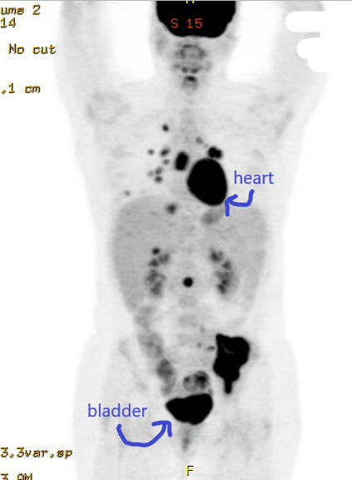
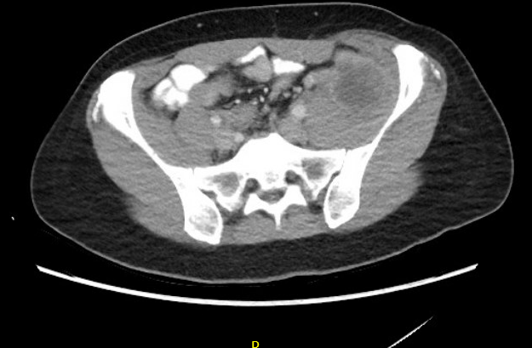
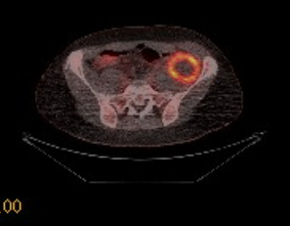
35-year-old woman (from the practice of Ms Filipi)

Slide 70
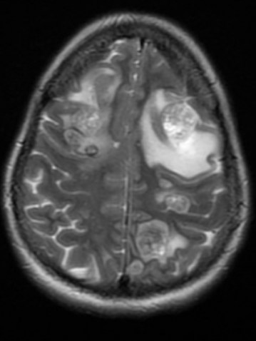
35-year-old woman (from the practice of Ms Filipi)
October 2018 Brain MRI: Numerous Metastases

