Slide 1

Role of Hormonal Therapy in the
Management of Prostate Cancer
Tuesday, September 15, 2020
9:00 AM – 10:00 AM ET
Faculty
Andrew J Armstrong, MD, ScM
Molly Kim, MSN, NP-C
Ellen Leidig, MSN, FNP-BC, RN
William K Oh, MD
Moderator
Neil Love, MD

Slide 2




Live Webinar Faculty
Andrew J Armstrong, MD, ScM
Professor of Medicine, Surgery, Pharmacology
and Cancer Biology
Director of Research
Duke Cancer Institute Center for Prostate
and Urologic Cancers
Divisions of Medical Oncology and Urology
Duke University
Durham, North Carolina
Ellen Leidig, MSN, FNP-BC
Nurse Practitioner, GU Medical Oncology
Duke Cancer Center
Durham, North Carolina
William K Oh, MD
Chief, Division of Hematology
and Medical Oncology
Professor of Medicine and Urology
Ezra M Greenspan, MD Professor in
Clinical Cancer Therapeutics
Icahn School of Medicine at Mount Sinai
Associate Director of Clinical Research
The Tisch Cancer Institute
Mount Sinai Health System
New York, New York
Molly Kim, MSN, NP-C
Nurse Practitioner
Genitourinary Medical Oncology
Mount Sinai Hospital
New York, New York

Slide 3
Commercial Support
This activity is supported by educational grants from Astellas and Pfizer Inc.

Slide 4
Dr Love — Disclosures
Dr Love is president and CEO of Research To Practice. Research To Practice receives funds in the form of educational grants to develop CME activities from the following commercial interests: AbbVie Inc, Acerta Pharma — A member of the AstraZeneca Group, Adaptive Biotechnologies Corporation, Agendia Inc, Agios Pharmaceuticals Inc, Amgen Inc, Array BioPharma Inc, a subsidiary of Pfizer Inc, Astellas, AstraZeneca Pharmaceuticals LP, Bayer HealthCare Pharmaceuticals, Biodesix Inc, bioTheranostics Inc, Blueprint Medicines, Boehringer Ingelheim Pharmaceuticals Inc, Bristol-Myers Squibb Company, Celgene Corporation, Clovis Oncology, Daiichi Sankyo Inc, Dendreon Pharmaceuticals Inc, Eisai Inc, EMD Serono Inc, Exelixis Inc, Foundation Medicine, Genentech, a member of the Roche Group, Genmab, Genomic Health Inc, Gilead Sciences Inc, GlaxoSmithKline, Grail Inc, Guardant Health, Halozyme Inc, Helsinn Healthcare SA, ImmunoGen Inc, Incyte Corporation, Infinity Pharmaceuticals Inc, Ipsen Biopharmaceuticals Inc, Janssen Biotech Inc, administered by Janssen Scientific Affairs LLC, Jazz Pharmaceuticals Inc, Kite, A Gilead Company, Lexicon Pharmaceuticals Inc, Lilly, Loxo Oncology Inc, a wholly owned subsidiary of Eli Lilly & Company, Merck, Merrimack Pharmaceuticals Inc, Myriad Genetic Laboratories Inc, Natera Inc, Novartis, Oncopeptides, Pfizer Inc, Pharmacyclics LLC, an AbbVie Company, Prometheus Laboratories Inc, Puma Biotechnology Inc, Regeneron Pharmaceuticals Inc, Sandoz Inc, a Novartis Division, Sanofi Genzyme, Seattle Genetics, Sirtex Medical Ltd, Spectrum Pharmaceuticals Inc, Sumitomo Dainippon Pharma Oncology Inc, Taiho Oncology Inc, Takeda Oncology, Tesaro, A GSK Company, Teva Oncology, Tokai Pharmaceuticals Inc and Verastem Inc.

Slide 5
RESEARCH TO PRACTICE NCPD PLANNING COMMITTEE MEMBERS, STAFF AND REVIEWERS
Planners, scientific staff and independent reviewers for Research To Practice have no relevant conflicts of interest to disclose.

Slide 6
Dr Armstrong — Disclosures
Advisory Committee | Astellas, AstraZeneca Pharmaceuticals LP, Bayer HealthCare Pharmaceuticals, Merck
Consulting Agreements | Astellas, AstraZeneca Pharmaceuticals LP, Bayer HealthCare Pharmaceuticals, Genomic Health Inc, Janssen Biotech Inc, Merck, Pfizer Inc, Sumitomo Dainippon Pharma Oncology Inc,
Contracted Research: | Astellas, AstraZeneca Pharmaceuticals LP, Bayer HealthCare Pharmaceuticals, Bristol-Myers Squibb Company, Constellation Pharmaceuticals, Dendreon Pharmaceuticals Inc, Genentech, a member of the Roche Group, Janssen Biotech Inc, Merck, Novartis, Pfizer Inc, Roche Laboratories Inc
Speakers Bureau | Bayer HealthCare Pharmaceuticals, Dendreon Pharmaceuticals Inc

Slide 7
Ms Kim — Disclosures
No relevant conflicts of interest to disclose

Slide 8
Ms Leidig — Disclosures
No relevant conflicts of interest to disclose

Slide 9
Dr Oh — Disclosures
Consulting Agreements | AstraZeneca Pharmaceuticals LP, Bayer HealthCare Pharmaceuticals, CPS Companion Diagnostics, Janssen Biotech Inc, Sanofi Genzyme, Sema4, TeneoBio

Slide 10



Steering Committee
Celestia S Higano, MD
Affiliate Professor, Department of Urologic Sciences
University of British Columbia
Director, Prostate Cancer Supportive Care Program
Vancouver Prostate Centre
Vancouver, British Columbia, Canada
Project Chair
Neil Love, MD
Research To Practice
Miami, Florida
A Oliver Sartor, MD
CE and Bernadine Laborde Professor for Cancer Research
Medical Director, Tulane Cancer Center
Assistant Dean for Oncology
Tulane Medical School
New Orleans, Louisiana

Slide 11

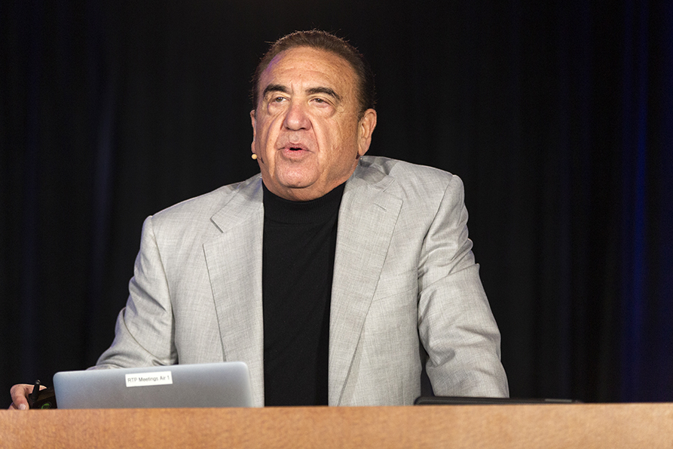




Slide 12
Role of Hormonal Therapy in the
Management of Prostate Cancer
Case 1: A 73-year-old man with metastatic hormone-sensitive prostate cancer (mHSPC)
Biology of prostate cancer and the androgen receptor
Overview of androgen deprivation therapy (ADT) and its role in the management of prostate cancer
Clinical and patient factors guiding the use of ADT alone or in combination with other treatment modalities
Educating patients on the secondary side effects associated with ADT
Addition of chemotherapy versus secondary hormonal therapy to ADT for the management of mHSPC
Monitoring for and management of cardiovascular and CNS-related events in patients receiving
hormonal therapy
Case 2: A 55-year-old man with metastatic castration-resistant prostate cancer (mCRPC)
Definition of castration-resistant disease and current role of secondary hormonal therapies in the treatment of mCRPC
Nonhormonal interventions (sipuleucel-T, radium 223, taxanes)
Case 3: A 77-year-old man with M0 prostate cancer
Management of initial PSA relapse
Management of PSA progression; choice of antiandrogen therapy

Slide 13
Role of Hormonal Therapy in the
Management of Prostate Cancer
Case 1: A 73-year-old man with metastatic hormone-sensitive prostate cancer (mHSPC)
Biology of prostate cancer and the androgen receptor
Overview of androgen deprivation therapy (ADT) and its role in the management of prostate cancer
Clinical and patient factors guiding the use of ADT alone or in combination with other treatment modalities
Educating patients on the secondary side effects associated with ADT
Addition of chemotherapy versus secondary hormonal therapy to ADT for the management of mHSPC
Monitoring for and management of cardiovascular and CNS-related events in patients receiving
hormonal therapy
Case 2: A 55-year-old man with metastatic castration-resistant prostate cancer (mCRPC)
Definition of castration-resistant disease and current role of secondary hormonal therapies in the treatment of mCRPC
Nonhormonal interventions (sipuleucel-T, radium 223, taxanes)
Case 3: A 77-year-old man with M0 prostate cancer
Management of initial PSA relapse
Management of PSA progression; choice of antiandrogen therapy

Slide 14

Case Presentation: A 73-year-old man with hormone-sensitive metastatic prostate cancer
Special Considerations
Wife died 1 year ago from breast cancer at the age of 72
Has no close family
Currently out of work as a chef in a restaurant and is very
concerned about finances as well as exposure to COVID-19
Never underwent PSA or rectal exam
Presents with back pain and is found to have multiple bone
metastases, high PSA and an enlarged prostate
(biopsy: Gleason 6 [3 + 3] prostate cancer)
Key Treatment Decision: ADT alone or with enzalutamide, apalutamide,
abiraterone or docetaxel

Slide 15
In general, which treatment strategy would be best for this patient?
Androgen deprivation therapy (ADT) alone
ADT plus chemotherapy
ADT plus secondary hormonal therapy
Other

Slide 16
To what extent do you believe the COVID-19 pandemic would affect this decision?
Significantly
Somewhat
Minimally or not at all

Slide 17
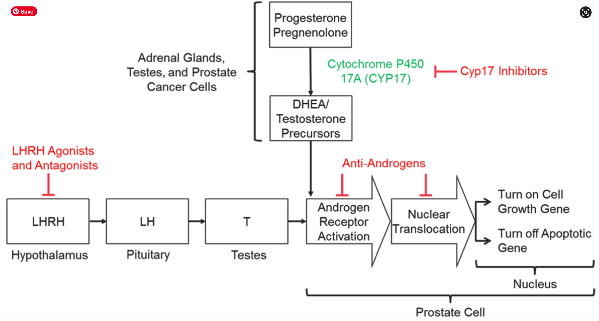
Mechanisms of Androgen Signaling Inhibition
Crawford DE et al. Prostate Cancer and Prostatic Diseases 2019;22:24-38.

Slide 18
Clinical Disease States Model of Prostate Cancer¹
Death from
other causes
Noncastrate prostate cancer
Castrate prostate cancer
Clinical Metastases
Clinically
localized disease
Rising PSA:
noncastrate
Clinical metastases:
noncastrate
Clinical metastases:
castrate
Rising PSA:
castrate
Death from
disease
Courtesy of Matthew R Smith, MD, PhD

Slide 19
Clinical Decision-Making in Hormone-Sensitive Metastatic Disease
Patient factors
  Performance status
  Co-morbidities, eg, pre-existing peripheral neuropathy
  I hate taking pills doc etc
Disease factors
  Extent of disease, volume of disease, presence/absence of visceral, eg, liver metastases
  Non AR biology, eg, poor psa expresser, significant neuroendocrine features
Economic factors
  Non viable co-pay or oral agents
Courtesy of Robert Dreicer, MD, MS

Slide 20
Treatment Options for mHSPC 2020
ADT plus docetaxel
ADT plus abiraterone acetate & prednisone
ADT plus apalutamide
ADT plus enzalutamide
ADT alone?
Treat the primary in addition to one of above?
Treat oligometastatic sites?
How to decide?
Courtesy of Neal Shore, MD

Slide 21
Choosing Oral Antiandrogen Therapy
Age
Comorbidities
  Diabetes
  History of seizure
  Falls
  Performance status
  Concomitant medications
Courtesy of Kara M Olivier, NP, APRN-BC

Slide 22
Phase 3 Studies in Hormone-Sensitive
Metastatic Prostate Cancer
Efficacy Endpoints
Coprimary:
OS
rPFS
Secondary:
Time to:
Pain progression
PSA progression
Next symptomatic skeletal event
Chemotherapy
Subsequent prostate cancer therapy
Patients with a mixture of newly diagnosed i.e. de novo and progressive metastatic prostate cancer
ADT + docetaxel, abiraterone acetate, enzalutamide and apalutamide
ADT + placebo
Survival benefit from combo therapy from 6 randomized studies is a median increase in greater than 1 year
Sweeney CJ et al. N Engl J Med. 2015;373:737-746, Fizazi K et al. N Engl J Med. 2017;377:352-360 , James N, et al. Lancet. 2015, . James ND, et al. N Engl J Med 2017;377:338-351, Armstrong A, et al JCO 2019, Chi K et al. NEJM 2019
Courtesy of Robert Dreicer, MD

Slide 23
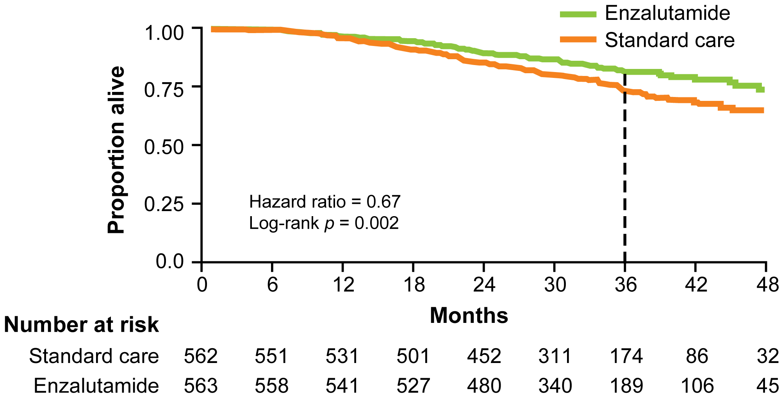
ENZAMET: ADT + Enzalutamide or Standard Nonsteroidal Antiandrogen Primary Endpoint: Overall Survival
A Mixed Bag
High and Low Volume
De novo vs Metach
Concurrent Docetaxel
Many Permutations
Median OS: Not estimable in either group
Est 3-yrs OS: 80% vs 72%
Davis ID et al. N Engl J Med 2019;381(2):121-31.

Slide 24
Summary Results for ADT + Enzalutamide (ARCHES) and ADT + Apalutamide (TITAN) in Metastatic HSPC
 | ARCHES (N = 1150) |  | TITAN (N = 1052)
Characteristics | 2/3rd high volume 17% prior docetaxel 25% prior RP/XRT |  | 2/3rd high volume 10% prior docetaxel 17% prior RP/XRT
 | ADT + enzalutamide (n = 574) | ADT (n = 576) | ADT + apalutamide (n = 525) | ADT (n = 527)
Radiographic PFS | NR | 19.0 mo | NR | 22.1 mo
 | HR (overall): 0.39 HR (prior docetaxel): 0.52 HR (high volume): 0.43 HR (low volume): 0.25 |  | HR (overall): 0.48 HR (prior docetaxel): 0.47 HR (high volume): 0.53 HR (low volume): 0.36
Overall survival | NR | NR | NR | NR
 | HR: 0.81 (immature) |  | HR (overall): 0.67 HR (prior docetaxel): 1.27 HR (high volume): 0.68 HR (low volume): 0.67
NR = not reached
Armstrong AJ et al. J Clin Oncol 2019;[Epub ahead of print]. Chi KN et al. N Engl J Med 2019;381(1):13-24.

Slide 25
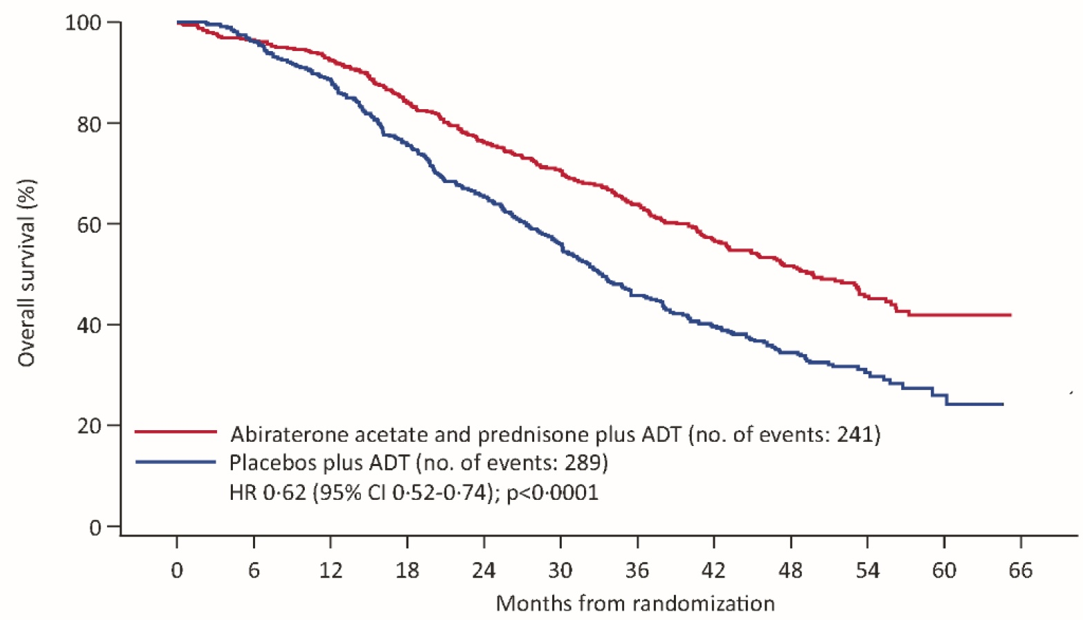
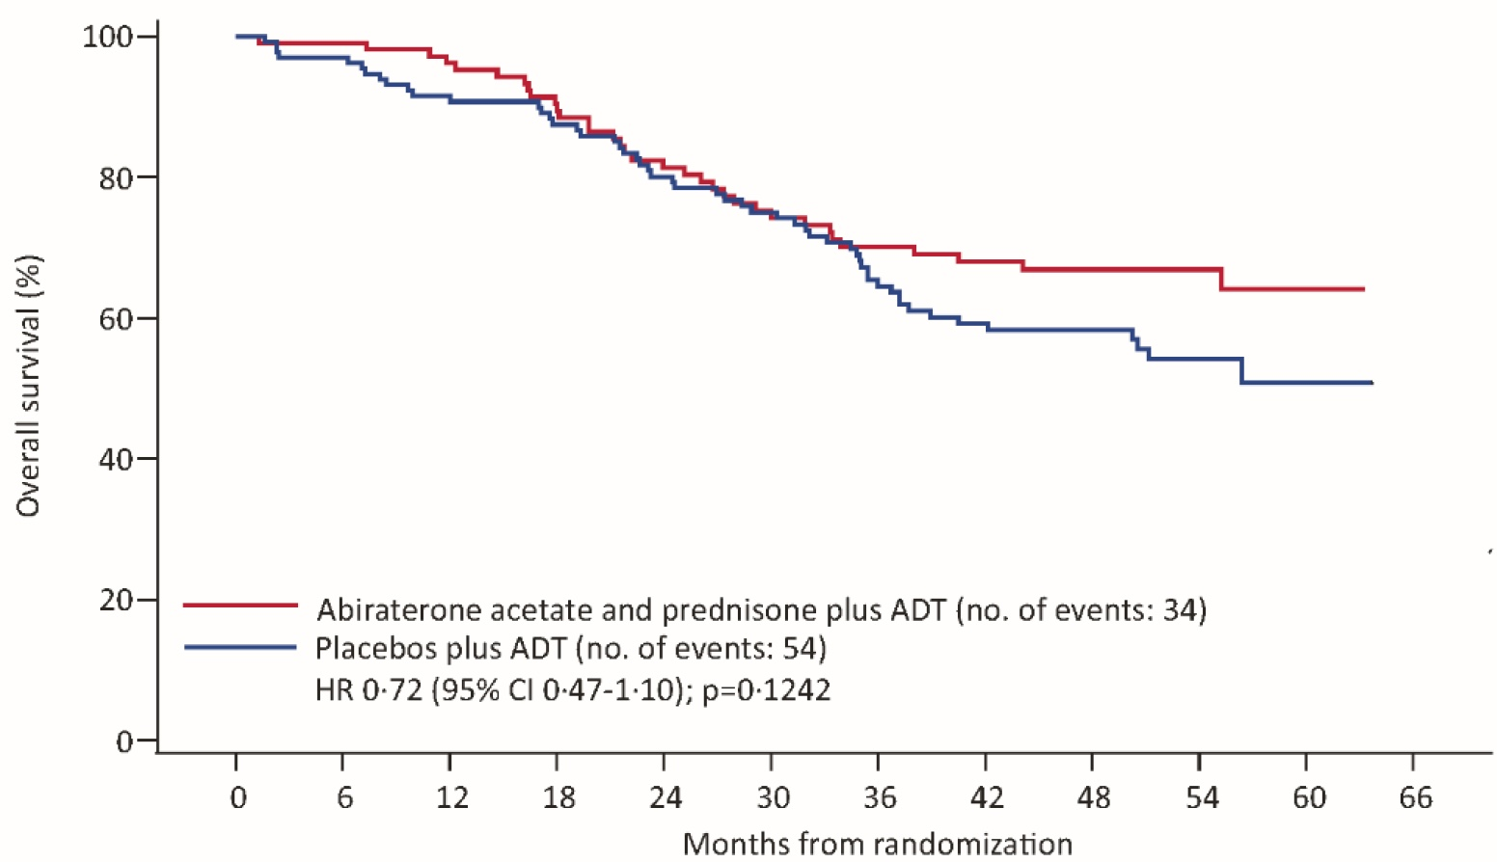
LATITUDE Final Overall Survival Analysis By Volume of Disease (CHAARTED definition*)
High-Volume Disease
Low-Volume Disease
 | ADT + AA + P (n = 487) | ADT + Placebo (n = 468) | HR | p-value
mOS | 49.7 mo | 33.3 mo | 0.62 | <0.0001
 | ADT + AA + P (n = 110) | ADT + Placebo (n = 133) | HR | p-value
mOS | Not reached | Not reached | 0.72 | 0.1242
*CHAARTED definition of low vs high volume: Presence of visceral mets and/or ≥ 4 bone mets, with one outside the vertebral column or pelvis
Fizazi K et al. Lancet Oncol 2019;20:686-700. Chi et al 2019 GU Cancers Symposium;Abstract 141.

Slide 26
CHAARTED: Docetaxel for mHSPC
SPARTAN ─ Overall Study Design
Phase 3 Placebo-Controlled, Randomized International Study
Sweeney et al. N Engl J Med 2015;373:737-46.
Courtesy of Matthew R Smith, MD, PhD

Slide 27
Summary of Risks of mHSPC Rx:
No head-to-head trials showing one is more effective than the other in terms of overall survival
Agent | Side Effects | Quality of Life | Financial Costs
Abiraterone | Hypertension Liver dysfunction Hyperkalemia Fluid retention/edema | Stable over time Potentially maintains better QOL over time | Next cheapest option Available in generic Continuous treatment
Enzalutamide | Fatigue Hypertension Seizure risk Cardiac risk | Stable over time | More expensive Not available in generic Continuous treatment
Apalutamide | Rash Hypothyroidism Fracture | Stable over time | More expensive Not available in generic Continuous treatment
Courtesy of David F Penson, MD, MPH

Slide 28
In general, which treatment strategy would be best for this patient?
Androgen deprivation therapy (ADT) with secondary hormonal therapy
ADT alone
ADT with chemotherapy
N = 57
Survey of live webinar audience

Slide 29
To what extent do you believe the COVID-19 pandemic would affect this decision?
Significantly
Somewhat
Minimally or not at all
N = 124
Survey of live webinar audience

Slide 30
For a patient with prostate cancer for whom androgen deprivation therapy (ADT) is being initiated, what potential side effects do
you generally counsel him about?
(Ms Kim)

Slide 31
A patient who has recently started ADT for prostate cancer complains that he has been experiencing hot flashes that have interrupted his sleep and contributed to fatigue. What would you recommend? (Ms Leidig)
Exercise first during the day, consider megace, an SSRI, ceiling/bedside fan, low-dose vitamin E
Venlafaxine 37.5 mg BID
Discuss role of black cohosh vs venlafaxine for relief of hot flashes
Recommend black cohosh or flaxseed oil, behavioral modification (use of fan and cold glass of water). If ineffective, we may prescribe interventions such as venlafaxine, gabapentin or megace
Black cohosh → venlafaxine
Oxybutynin at 5 mg starting dose

Slide 32
In what situations is ADT combined
with radiation therapy for patients with
locally advanced prostate cancer?
(Ms Leidig)

Slide 33
In general, how do you respond to a patient who is receiving ADT for prostate cancer and asks how long he can expect to experience side effects after treatment has been discontinued?
3 to 12 months (sometimes longer due to age, duration of ADT)
Depends on several factors, but about 3 to 6 months
Varies by patient (side effects dissipate as testosterone recovers)
Varies by patient (age, pretreatment testosterone levels, etc)
Side effects may last as long as duration patient was on ADT
Side effects dependent on testosterone recovery, which depends on duration
of therapy and other factors

Slide 34
Do you generally recommend nutritional supplements for patients with prostate cancer who are starting ADT? If so, which supplements would you recommend? (Ms Kim)
Yes (vitamin D3 at least 800 IU plus calcium 1,200 mg/d)
Yes (calcium 1,200 mg/d and vitamin D 1,000 IU/d)
Yes (refer to nutritionist)
Yes (calcium 1,200 mg and vitamin D 800 IU daily)
No (diet but not supplements per se)
Calcium 1,000 mg per day and vitamin D at least 400 IU per day

Slide 35
A 73-year-old man presents with a PSA of
660 ng/dL and difficulty urinating, and biopsy confirms Gleason 8 prostate cancer.
Scans show limited bone metastases in the ribs and pelvis. Which therapy would you recommend adding to ADT for this patient?
(Dr Armstrong)

Slide 36
An 85-year-old man with a remote history
of a hemorrhagic stroke is found to have metastatic prostate cancer with a PSA of
1,200 ng/dL and diffuse bone metastases.
He prefers to avoid chemotherapy if possible. Which therapy would you recommend adding to ADT for this patient? (Dr Armstrong)

Slide 37
How would you compare the rapidity of responses observed with secondary hormonal therapy (eg, abiraterone, enzalutamide or apalutamide) to that with docetaxel in patients receiving those agents in combination with ADT for metastatic hormone-sensitive prostate cancer (mHSPC)?
Secondary hormonal therapy yields more rapid responses
Cannot distinguish since ADT itself will result in rapid responses alone
Docetaxel yields more rapid responses
About the same
Docetaxel yields more rapid responses
Secondary hormonal therapy yields more rapid responses

Slide 38
How would you compare the global tolerability/toxicity of abiraterone, enzalutamide and apalutamide
for patients with mHSPC?

Slide 39
Do you believe intermittent ADT is as
effective and safe as continuous ADT
in men receiving long-term treatment
for metastatic prostate cancer?

Slide 40
In general, do you initiate calcium and vitamin D supplementation for your patients with prostate cancer preparing to receive secondary hormonal therapy?
Yes
Yes
Yes
Yes
Yes
Yes

Slide 41
In general, do you initiate antiresorptive agents such as zoledronic acid or denosumab for your patients with prostate cancer preparing to receive secondary hormonal therapy?
Yes, but only in the mCRPC setting, not mHSPC unless they have
osteopenia/osteoporosis or a prior fracture
Yes
Yes, in patients with mCRPC to the bone or if patient has osteopenia/osteoporosis
Yes (as appropriate, would obtain DXA scan and based on results treat with antiresorptive agents)
Yes
Yes

Slide 42
Role of Hormonal Therapy in the
Management of Prostate Cancer
Case 1: A 73-year-old man with metastatic hormone-sensitive prostate cancer (mHSPC)
Biology of prostate cancer and the androgen receptor
Overview of androgen deprivation therapy (ADT) and its role in the management of prostate cancer
Clinical and patient factors guiding the use of ADT alone or in combination with other treatment modalities
Educating patients on the secondary side effects associated with ADT
Addition of chemotherapy versus secondary hormonal therapy to ADT for the management of mHSPC
Monitoring for and management of cardiovascular and CNS-related events in patients receiving
hormonal therapy
Case 2: A 55-year-old man with metastatic castration-resistant prostate cancer (mCRPC)
Definition of castration-resistant disease and current role of secondary hormonal therapies in the treatment of mCRPC
Nonhormonal interventions (sipuleucel-T, radium 223, taxanes)
Case 3: A 77-year-old man with M0 prostate cancer
Management of initial PSA relapse
Management of PSA progression; choice of antiandrogen therapy

Slide 43

Case Presentation: A 55-year-old man with castration-resistant metastatic prostate cancer
Special Considerations
Grandson who is 4 years old currently lives with him
and his wife
Interested in alternative, complementary strategies,
particularly supplements and diet, but is open to other
approaches
Previous history
  Radical prostatectomy
  PSA recurrence: Radiation therapy
  Further progression: ADT plus docetaxel
  Further progression: Widespread bone metastases
Key Treatment Decision: Choice of systemic therapy — enzalutamide, abiraterone, chemotherapy, sipuleucel-T, radium-223

Slide 44
In general, which treatment would be best for this patient?
Sipuleucel-T
Chemotherapy
Enzalutamide
Apalutamide
Abiraterone
Radium-223
Other

Slide 45
To what extent do you believe the COVID-19 pandemic would affect this decision?
Significantly
Somewhat
Minimally or not at all

Slide 46
Therapeutic Decision-Making in mCRPC
mCRPC space increasingly impacted by movement of primarily AR directed therapies early in the treatment course
  Known resistance pathways of AR resistance limits utility of crossover of current agents
Clinical factors
  Symptoms yes/no
  Biochemical or overt radiographic progression
  Prior therapies
  Durability of initial ADT response
Courtesy of Robert Dreicer, MD, MS

Slide 47
Timeline of FDA Approvals in mCRPC
Survival
Radium-223
Enzalutamide
Cabazitaxel
Docetaxel
Abiraterone + prednisone
Sipuleucel-T
1992
1996
2000
2004
2008
2012
Strontium-89
Samarium-153
Zoledronic acid
Denosumab
Mitoxantrone
Palliation
Metastatic disease was defined by conventional imaging (eg, bone scan, CT scans)
Courtesy of Matthew R Smith, MD, PhD

Slide 48
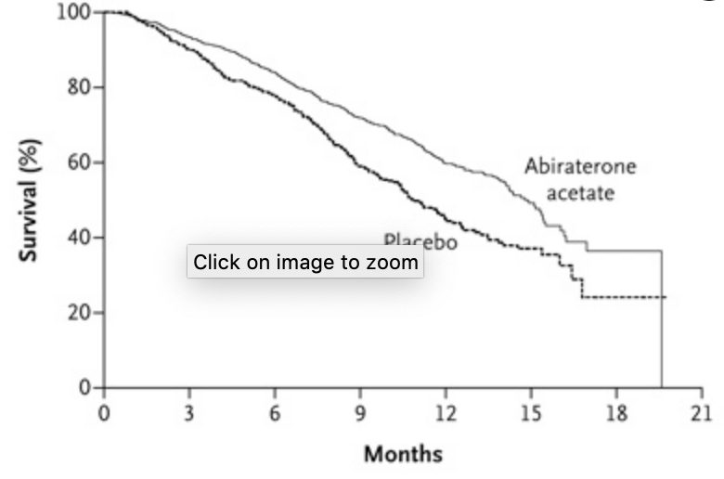
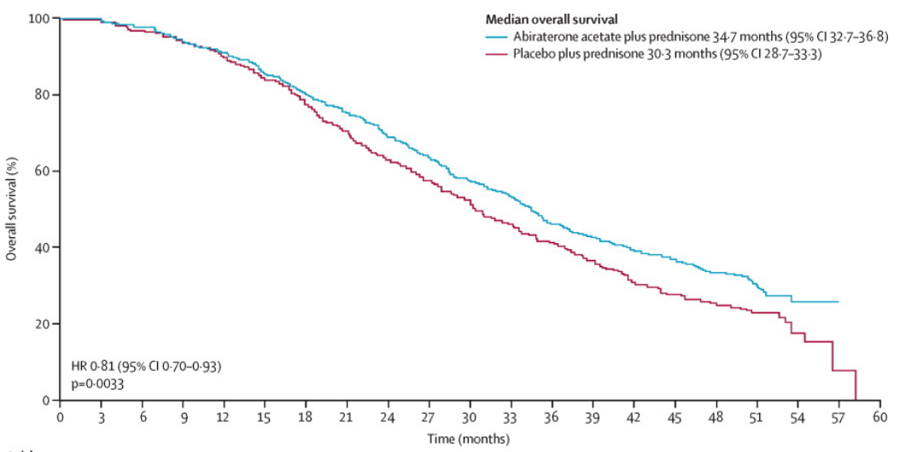
Phase III Trials of Abiraterone Acetate for mCRPC: Overall Survival
COU-AA-301: Previously Treated with Docetaxel
COU-AA-302: No Prior Chemotherapy
Abiraterone
acetate
Placebo
de Bono JS et al. N Engl J Med 2011;364(21):1995-2005; Ryan CJ et al. Lancet Oncol 2015;16(2):152-60.

Slide 49
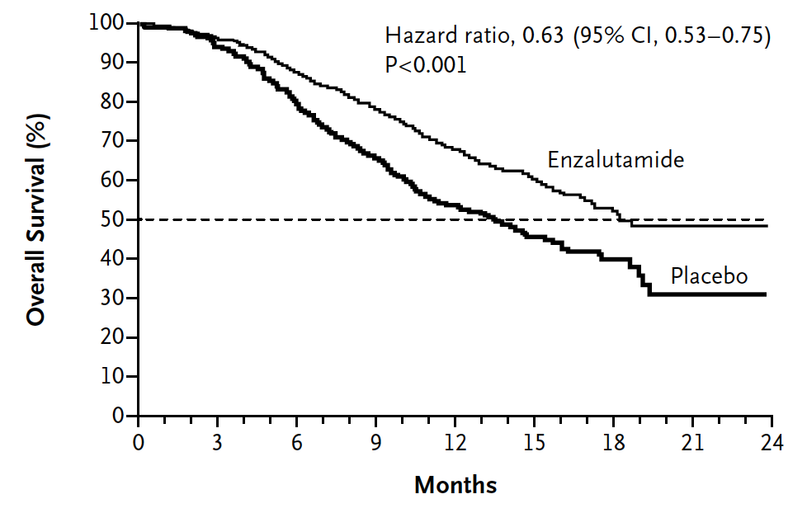
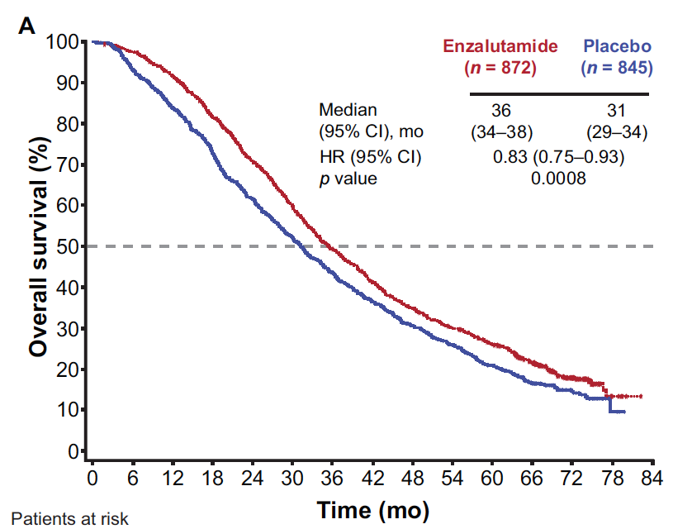
Phase III Trials of Enzalutamide for mCRPC: Overall Survival
AFFIRM: Previously Treated with Docetaxel
PREVAIL: No Prior Chemotherapy
Scher HI et al. N Engl J Med 2012; 367(13):1187-97; Armstrong AJ et al. Eur Urol 2020;78:347-57.

Slide 50
Selected FDA-Approved Drugs in Advanced Prostate Cancer
Sipuleucel-T
  Autologous cellular immunotherapy designed to stimulate a patient’s own immune system against prostate cancer, MOA unknown
  Minimal toxicity, apharesis required
Radium-223
  Radiopharmaceutical, alpha particle
  GI toxicity, typically mild, important to remind patients re: lack of PSA activity
  Administered by nuclear medicine or radiation oncology physicians
  Important to monitor patients monthly as NO activity against non bone metastastic sites
Courtesy of Robert Dreicer, MD, MS

Slide 51
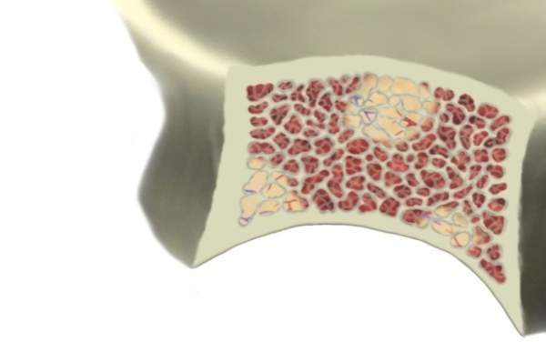

Range of an α-Emitting Radiopharmaceutical Compared to a β Emitter
Short range of α-particles could reduce bone marrow exposure¹
Bone
Marrow
Tumor
Bone Mineral
(Hydroxyapatite)
Radionuclide
Range of α-particle
(short range – ~2 to 10
cell diameters²)
Range of β-particle
(long range
– 10 to 1000 cell diameters²)
References: 1. Henriksen G, et al. Cancer Res. 2002;62:3120–3125. 2. Brechbiel MW. Dalton Trans. 2007;43:4918-4928.

Slide 52
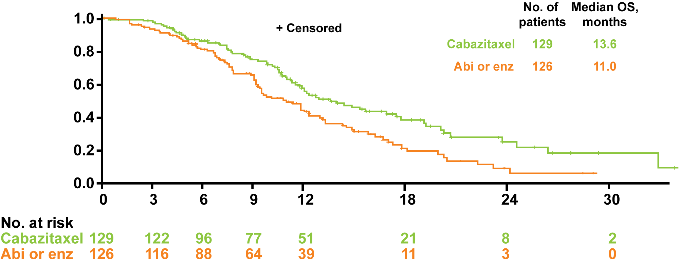
CARD: Cabazitaxel vs Abiraterone or Enzalutamide in mCRPC Previously Treated with Docetaxel and an Androgen-Signaling-Targeted Inhibitor
Overall survival (key secondary endpoint)
Summary of AEs | Cabazitaxel | Abi or enza
Grade ≥3 AE | 56.3% | 52.4%
AE leading to Tx discontinuation | 19.8% | 8.9%
AE leading to death | 5.6% | 11.3%
Kaplan-Meier estimate
HR = 0.64
p = 0.008
Time (months)
CARD met its primary objective: Cabazitaxel more than doubled rPFS versus abiraterone or enzalutamide
de Wit R et al; CARD Investigators. N Engl J Med 2019;381(26):2506-18.

Slide 53
Novel Agents for mCRPC
Poly(ADP-ribose) polymerase (PARP) inhibitors
  Directed at targeting cancers with defective DNA-damage repair
  Prostate cancer, most common defects in BRCA 1, BRCA 2 and ATM genes
  Side effects include progressive anemia, fatigue, GI side effects indigestion, nausea/vomiting, diarrhea, headaches
PSMA (prostate specific membrane antigen) targeted therapies
  In combination with a number of molecules: Lutetium, radioactive iodine, T cell targeting combinations

Slide 54
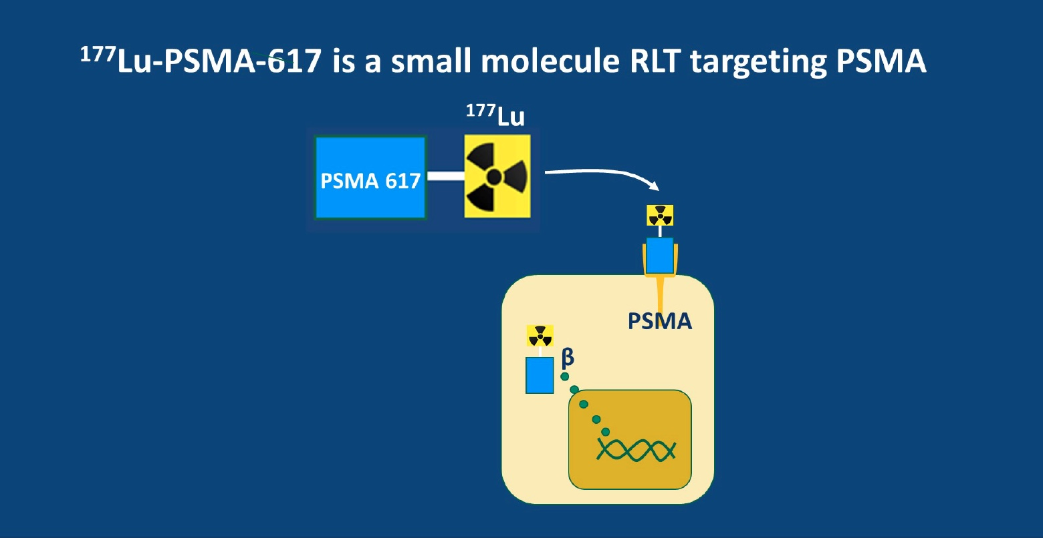
Wise DR. ASCO 2020 Highlights of the Day: Genitourinary Cancer (Prostate)

Slide 55
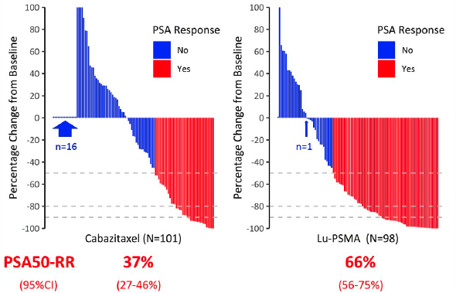
TheraP Study: ¹⁷⁷Lu-PSMA-617 (Lu-PSMA) Theranostic versus Cabazitaxel for Metastatic Castration-Resistant Prostate Cancer (mCRPC) Progressing After Docetaxel
Best PSA Response
Maximum truncated at 100%
Hofman MS et al. ASCO 2020;Abstract 5500.

Slide 56
FDA approves olaparib for HRR gene-mutated metastatic castration-resistant prostate cancer
Press Release — May 19, 2020
On May 19, 2020, the Food and Drug Administration approved olaparib for adult patients with deleterious or suspected deleterious germline or somatic homologous recombination repair (HRR) gene-mutated metastatic castration-resistant prostate cancer (mCRPC), who have progressed following prior treatment with enzalutamide or abiraterone.
Efficacy was investigated in PROfound (NCT02987543), an open-label, multicenter trial randomizing (2:1) 256 patients to olaparib 300 mg twice daily and 131 patients to investigator’s choice of enzalutamide or abiraterone acetate. All patients received a GnRH analog or had prior bilateral orchiectomy. Patients were divided into two cohorts based on their HRR gene mutation status. Patients with mutations in either BRCA1, BRCA2, or ATM were randomized in Cohort A (N=245); patients with mutations among 12 other genes involved in the HRR pathway were randomized in Cohort B (N=142); those with co-mutations (Cohort A gene and a Cohort B gene) were assigned to Cohort A.
https://www.fda.gov/drugs/drug-approvals-and-databases/fda-approves-olaparib-hrr-gene-mutated-metastatic-castration-resistant-prostate-cancer

Slide 57
FDA grants accelerated approval to rucaparib for BRCA-mutated metastatic castration-resistant prostate cancer
Press Release — May 15, 2020
The Food and Drug Administration granted accelerated approval to rucaparib for patients with deleterious BRCA mutation (germline and/or somatic)-associated metastatic castration-resistant prostate cancer (mCRPC) who have been treated with androgen receptor-directed therapy and a taxane-based chemotherapy.
Efficacy was investigated in TRITON2 (NCT02952534), an ongoing, multi-center, single arm clinical trial in 115 patients with BRCA-mutated (germline and/or somatic) mCRPC who had been treated with androgen receptor-directed therapy and taxane-based chemotherapy. Patients received rucaparib 600 mg orally twice daily and concomitant GnRH analog or had prior bilateral orchiectomy.
https://www.fda.gov/drugs/fda-grants-accelerated-approval-rucaparib-brca-mutated-metastatic-castration-resistant-prostate

Slide 58
A 67-year-old man receiving 3 blood pressure medications for refractory hypertension presents with metastatic castration-resistant prostate cancer (mCRPC) with moderately symptomatic metastatic disease to the bone, liver and lung. He states that he does not want chemotherapy, at least initially. He has received only ADT with leuprolide for the past 5 years. What would you recommend? (Dr Oh)
Enzalutamide
Docetaxel
Abiraterone
Abiraterone
Enzalutamide
Enzalutamide

Slide 59
An 82-year-old man with mCRPC is currently receiving leuprolide and enzalutamide. His PSA has declined from 120 ng/mL to 0.2 ng/mL over 3 months, and he has experienced a marked improvement in symptoms. During a routine clinic visit, his wife notes that he seems more fatigued and weaker than usual and mentions that he has tripped 3 times in the past 2 months, once resulting in a significant fall. What would you recommend? (Dr Oh)
Addition of physical therapy and exercise program
Continue enzalutamide at a reduced dose
Continue enzalutamide at a reduced dose
Continue enzalutamide at a reduced dose
Continue enzalutamide at a reduced dose
Continue enzalutamide at a reduced dose

Slide 60
Role of Hormonal Therapy in the
Management of Prostate Cancer
Case 1: A 73-year-old man with metastatic hormone-sensitive prostate cancer (mHSPC)
Biology of prostate cancer and the androgen receptor
Overview of androgen deprivation therapy (ADT) and its role in the management of prostate cancer
Clinical and patient factors guiding the use of ADT alone or in combination with other treatment modalities
Educating patients on the secondary side effects associated with ADT
Addition of chemotherapy versus secondary hormonal therapy to ADT for the management of mHSPC
Monitoring for and management of cardiovascular and CNS-related events in patients receiving
hormonal therapy
Case 2: A 55-year-old man with metastatic castration-resistant prostate cancer (mCRPC)
Definition of castration-resistant disease and current role of secondary hormonal therapies in the treatment of mCRPC
Nonhormonal interventions (sipuleucel-T, radium 223, taxanes)
Case 3: A 77-year-old man with M0 prostate cancer
Management of initial PSA relapse
Management of PSA progression; choice of antiandrogen therapy

Slide 61

Case Presentation: A 77-year-old man with M0 prostate cancer
Special Considerations
Sedentary and overweight with Type 2 diabetes on
oral agents
2015: Radical prostatectomy for primary Gleason 7 (4 + 3)
prostate cancer
2016: Salvage radiation therapy to pelvis; PSA undetectable
9 months later PSA is detected
Key Treatment Decision 1: Treat or observe?
ADT administered and PSA becomes undetectable
2019: PSA progression; negative workup
Key Treatment Decision 2: Add novel antiandrogen?

Slide 62
The patient wants to delay starting treatment for 6 to 12 months. How would you respond?
It’s acceptable to delay treatment for 6 to 12 months
Recommend treatment now

Slide 63
Balancing the Benefits and Risks of Treatment
Risks
Shared decision
making: goals of patient
Benefits
Delayed progression
Psychological benefits of receiving treatment
Expense: COST $$$$... ↓ QOL
ED and ↓ libido
Hot flashes
Changes in mood/ ↓cognition
↓ strength/ muscle mass
Osteoporosis
Anemia, fatigue
Metabolic syndrome
Cardiac risk, DM
Improved survival
Courtesy of Victoria Sinibaldi, RN, MS, CS, CANP, BC

Slide 64
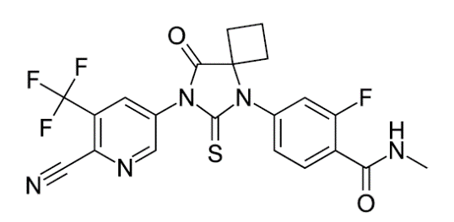
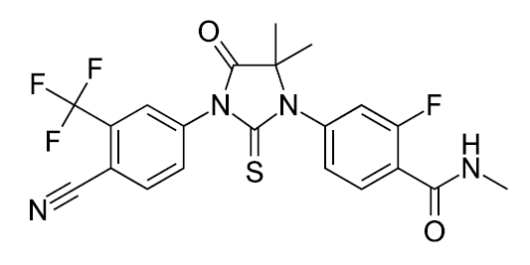
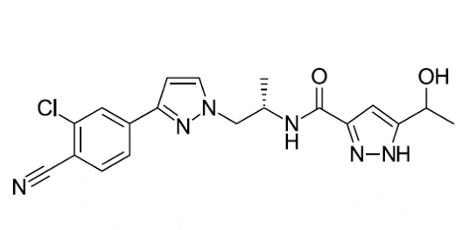
Next-Generation Androgen Receptor Inhibitors^{1,2}
Apalutamide
Enzalutamide
Darolutamide
Apalutamide and enzalutamide have similar structures
Darolutamide is structurally distinct from apalutamide and enzalutamide, characterized by low blood-brain barrier penetration^{1,2,} and may have improved tolerability
Courtesy of Matthew R Smith, MD, PhD

Slide 65
Oral Anti-androgen Agents Approved for M0 Prostate Cancer:
How Do You Choose?
Enzalutamide
  Cautious with patients with a history of falls and seizure
Apalutamide
  Risk of rash
Darolutamide
  Mild fatigue
  For all patients monitor CBC/diff, comprehensive metabolic panel and PSA.
Courtesy of Kara M Olivier, NP, APRN-BC

Slide 66
PROSPER/SPARTAN/ARAMIS Study Design: in High-Risk M0 CRPC
Similar trials with Enzalutamide (PROSPER), Apalutamide (SPARTAN) and Darolutamide (ARAMIS)
Primary endpoint: Metastasis-free survival
Key secondary endpoints:
OS
Time to first SSE
Time to initiation of first cytotoxic chemo
Time to pain progression
Estimated Enrollment:
1,200-1,500
M0 CRPC
PSA doubling time of ≤10 months
ECOG PS 0-1
ENZA/APA/DARO
2
R
1
Placebo
Courtesy of Karim Fizazi, MD. PhD

Slide 67
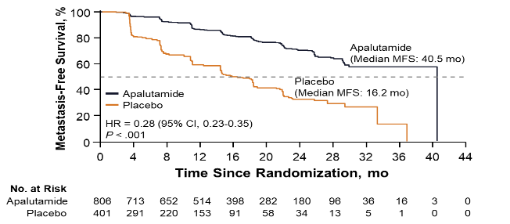
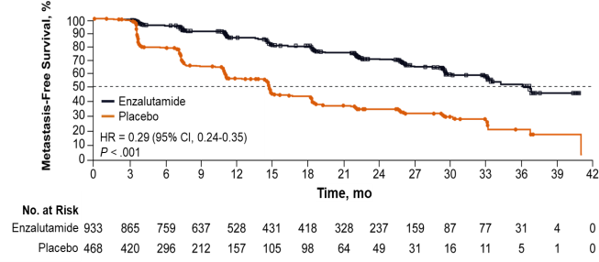
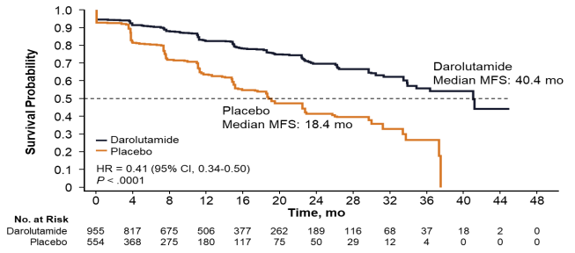
Primary Endpoint: Metastasis-Free Survival
SPARTAN¹
Apalutamide
72% reduction of distant progression or death
Median MFS: APA 40.5 vs PBO 16.2 months
24-month MFS benefit
PROSPER²
Enzalutamide
71% reduction of distant progression or death
Median MFS: ENZA 36.6 vs PBO 14.7 months
22-month MFS benefit
ARAMIS³
Darolutamide
59% reduction of distant progression or death
Median MFS: DARO 40.4 vs PBO 18.4 months
22-month MFS benefit
1. Smith MR et al. N Engl J Med. 2018;378:1408-1418. 2. Hussain M et al. N Engl J Med. 2018;378:2465-2474. 3. Fizazi K et al. N Engl J Med. 2019;380:1235-1246.
Courtesy of Matthew R Smith, MD, PhD

Slide 68
Safety in the 3 M0 CRPC trials
AE, n (%, unless indicated) | SPARTAN¹ |  | PROSPER^{2,3} |  | ARAMIS⁴
 | Apalutamide (n=803) | Placebo (n=398) | Enzalutamide (n=930) | Placebo (n=465) | Darolutamide (n=954) | Placebo (n=554)
Fatigue | 224 (30) | 84 (21) | 303 (33) | 64 (14) | 115 (12) | 48 (9)
Cognitive disorder | – | – | – | – | 4 (<1) | 1 (<1)
Memory impairment | – | – | – | – | 5 (1) | 7 (1)
Mental impairment disorder | 41 (5) | 12 (3) | 48 (5) | 9 (2) | – | –
Seizure/convulsion† | 2 (<1) | 0 (0) | 3 (<1) | 0 (0) | 2 (<1) | 1 (<1)
Bone fracture | 94 (12) | 26 (7) | 4% | 1% | 40 (4) | 20 (4)
Falls‡ | 125 (16) | 36 (9) | 106 (11) | 19 (4) | 40 (4) | 26 (5)
Hypertension | 199 (25) | 79 (20) | 111 (12) | 24 (5) | 63 (7) | 29 (5)
Coronary artery disorder | – | – | – | – | 31 (3) | 14 (3)
Heart failure | – | – | – | – | 18 (2) | 5 (1)
Major adverse cardiovascular event | – | – | 48 (5) | 13 (3) | – | –
Rash | 191 (24) | 22 (6) | – | – | 28 (3) | 5 (1)
Weight decreased | 129 (16) | 25 (6) | 55 (6) | 7 (2) | 34 (4) | 12 (2)
Hypothyroidism | 65 (8) | 8 (2) | – | – | 2 (<1) | 0 (0)
Courtesy of Karim Fizazi, MD. PhD

Slide 69
Major Cardiovascular Events in M0 CRPC Trials — Apalutamide and Enzalutamide
 | SPARTAN¹ |  | PROSPER²
 | APA (n = 803) | PBO (n = 398) | ENZA (n = 933) | PBO (n = 468)
Safety | AE reporting every 4 weeks |  | AE reporting every 4 months
AEs, %
Any grade | 97% | 93% | 87% | 77%
Grade ≥ 3 | 45% | 34% | 31% | 23%
Serious AEs | 25% | 23% | 24% | 13%
AEs leading to discontinuation | 11% | 7% | 9% | 6%
AEs leading to death | 1.2% (n=10) | 0.3% (n=1) | 3.4% (n=32) | 0.6% (n=3)
Major CV event | 1* | 1* | 5% | 3%
Seizures | 0.24% (n= 2) | 0 | 0.32% (n = 3) | 0
Smith MR, et al. N Engl J Med, 2018
Hussain M, et al. N Engl J Med. 2018
Courtesy of David F Penson, MD, MPH

Slide 70
A 72-year-old man has been receiving leuprolide for 3 years because of a rising PSA after radical prostatectomy. His PSA is 7 ng/mL, testosterone is undetectable and his PSA doubling time is 6 months. He has negative bone and CT scans of the abdomen and pelvis and feels well. He states that he wants to be aggressive in terms of treating his cancer in order to live as long as possible. What would you recommend? (Dr Oh)

