Slide 1
Oncology Grand Rounds
New Agents and Strategies in Urothelial Bladder Carcinoma
Thursday, June 18, 2020 5:00 PM – 6:30 PM ET
Faculty
Arjun Balar, MD Anastassia Daskalova, NP
Peter H O’Donnell, MD Susan K Roethke, CRNP, MSN, ANP-BC, AOCNP
Moderator Neil Love, MD

Slide 2
Dr Love — Disclosures
Dr Love is president and CEO of Research To Practice. Research To Practice receives funds in the form of educational grants to develop CME activities from the following commercial interests: AbbVie Inc, Acerta Pharma — A member of the AstraZeneca Group, Adaptive Biotechnologies, Agendia Inc, Agios Pharmaceuticals Inc, Amgen Inc, Array BioPharma Inc, Astellas, AstraZeneca Pharmaceuticals LP, Bayer HealthCare Pharmaceuticals, Biodesix Inc, bioTheranostics Inc, Blueprint Medicines, Boehringer Ingelheim Pharmaceuticals Inc, Boston Biomedical Inc, Bristol-Myers Squibb Company, Celgene Corporation, Clovis Oncology, Daiichi Sankyo Inc, Dendreon Pharmaceuticals Inc, Eisai Inc, EMD Serono Inc, Exelixis Inc, Foundation Medicine, Genentech, a member of the Roche Group, Genmab, Genomic Health Inc, Gilead Sciences Inc, GlaxoSmithKline, Guardant Health, Halozyme Inc, ImmunoGen Inc, Incyte Corporation, Infinity Pharmaceuticals Inc, Ipsen Biopharmaceuticals Inc, Janssen Biotech Inc, administered by Janssen Scientific Affairs LLC, Jazz Pharmaceuticals Inc, Kite, A Gilead Company, Lexicon Pharmaceuticals Inc, Lilly, Loxo Oncology Inc, a wholly owned subsidiary of Eli Lilly & Company, Merck, Merrimack Pharmaceuticals Inc, Myriad Genetic Laboratories Inc, Natera Inc, Novartis, Oncopeptides, Pfizer Inc, Pharmacyclics LLC, an AbbVie Company, Prometheus Laboratories Inc, Puma Biotechnology Inc, Regeneron Pharmaceuticals Inc, Sandoz Inc, a Novartis Division, Sanofi Genzyme, Seattle Genetics, Sirtex Medical Ltd, Spectrum Pharmaceuticals Inc, Taiho Oncology Inc, Takeda Oncology, Tesaro, A GSK Company, Teva Oncology, Tokai Pharmaceuticals Inc and Tolero Pharmaceuticals.

Slide 3
Dr Balar — Disclosures
Consulting Agreements | AstraZeneca Pharmaceuticals LP, Genentech, a member of the Roche Group, Janssen Biotech Inc, Merck, Nektar, Pfizer Inc, Seattle Genetics
Contracted Research | AstraZeneca Pharmaceuticals LP, Genentech, a member of the Roche Group, Immunomedics Inc, Janssen Biotech Inc, Merck, Nektar, Pfizer Inc, Seattle Genetics

Slide 4
Ms Daskalova — Disclosures
No financial interests or affiliations to disclose.

Slide 5
Dr O’Donnell — Disclosures
Consulting Agreement | Merck
Honoraria | Astellas, Atheneum Partners, FirstWord Publication, Genentech, a member of the Roche Group, Health Advances, Janssen Biotech Inc, Merck, Schlesinger Group, Seattle Genetics, The Dedham Group
Ownership Interest | Allergan, PrescriptIQ
Paid Travel | Astellas, Genentech, a member of the Roche Group, Janssen Biotech Inc, Merck, Seattle Genetics
Other | Janssen Biotech Inc, Nektar, National Institutes of Health

Slide 6
Ms Roethke — Disclosures
Advisory Committee | Astellas
Speakers Bureau | Astellas, Pfizer Inc

Slide 7
Commercial Support
This activity is supported by educational grants from Astellas and Seattle Genetics, Genentech, a member of the Roche Group, Janssen Biotech Inc, administered by Janssen Scientific Affairs LLC, and Merck.

Slide 8
Agenda
Module 1: Overview of Urothelial Bladder Cancer (UBC) Management
Case Presentation: Ms Roethke — 85-year-old widower and retired automotive mechanic
Module 2: Anti-PD-1/PD-L1 Antibodies for Patients with Nonmetastatic UBC
Module 3: Risks and Benefits of Immune Checkpoint Inhibitors in Advanced UBC
Case Presentation: Ms Daskalova — 78-year-old woman with a PMH of cervical cancer
Module 4: Integration of FGFR-Directed Therapy into Current UBC Management Algorithms
Case Presentation: Ms Roethke — 62-year-old auto body repairman
Module 5: Antibody-Drug Conjugates in UBC
Case Presentation: Ms Roethke — 70-year-old married man and retired telephone technician
Module 6: Management of UBC in the Era of COVID-19
Case Presentation: Ms Daskalova — 63-year-old man

Slide 9
Module 1: Overview of Urothelial Bladder Cancer (UBC) Management

Slide 10
When was the last time you encountered a patient with bladder cancer?
Within the past week
Between 1 week and 1 month ago
Between 1 month and 6 months ago
Between 6 months and 1 year ago
More than 1 year ago
I have not encountered a patient with bladder cancer in my practice

Slide 11
Which of the following is the most significant risk factor for the development of bladder cancer?
Obesity
Smoking
Female sex
I don’t know

Slide 12
Overview of Bladder Cancer
Patient profile
Median age at diagnosis: 73 years
76% male
Smoking is the most well-established risk factor (47% of all cases in the US)
Natural history
Non-muscle-invasive
Muscle-invasive
Metastatic
Cystectomy and ileal conduit/stoma management
Neoadjuvant and adjuvant chemotherapy
ACS Cancer Facts & Figures 2020; www.cancer.org.

Slide 13
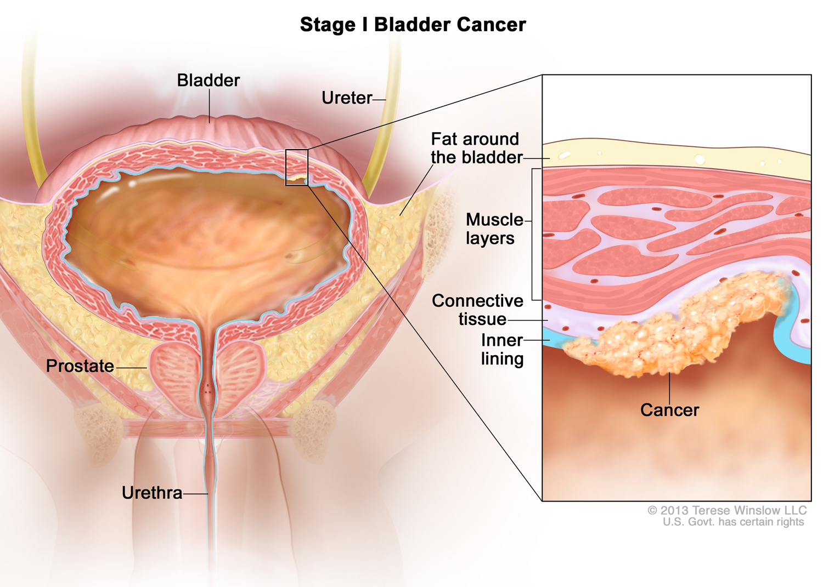
With permission from Terese Winslow LLC

Slide 14
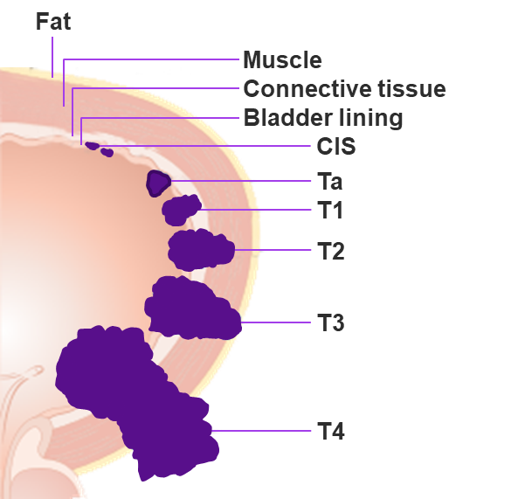
High-Risk Non‒Muscle-Invasive BC
High-risk (HR) NMIBC is defined as any carcinoma in situ (CIS), T1 tumor, and/or high-grade Ta tumor
Standard-of-care therapy for HR NMIBC is TURBT and intravesical Bacillus Calmette-Guérin (BCG)
Although there is a high rate of complete response (70%) to initial therapy, most patients with high-risk disease do not maintain response
30% of patients experience recurrence within 1 year
40% of patients at high risk progress to muscle-invasive disease
20%-30% of patients progress to metastatic disease
BCG unresponsive disease – standard of care is cystectomy
With the lack of a suitable comparator, single-arm designs testing novel agents are thought to be acceptable in the BCG-unresponsive population
World-wide BCG shortage
Cumberbatch MGK et al. Eur Urol. 2018;74:784-795. National Comprehensive Cancer Network. NCCN clinical practice guidelines in oncology (NCCN guidelines):
bladder cancer (Version 1.2019). https://www.nccn.org/professionals/physician_gls/pdf/bladder.pdf. Accessed January 7, 2019. Hemdan T et al. J Urol. 2014;191:1244. Herr HW et al. Urol Oncol. 2015;33:108.e1-4. 5. Anastasiadis A et al. Ther Adv Urol. 2012;4:13-32. US Department of Health and Human Services. BCG-unresponsive nonmuscle invasive bladder cancer: developing drugs and biologics for treatment—Guidance for industry. February 2018. https://www.fda.gov/ucm/groups/fdagov-public/@fdagov-drugs-gen/documents/document/ucm529600.pdf. Accessed February 5, 2019. Babjuk M et al. Eur Urol. 2017;71:447-461.
Courtesy of Arjun V. Balar, MD

Slide 15
85-year-old Widower and Prior Smoker with PMH of stage IV CKD, HTN, GERD, Anemia of Chronic Disease and Chronic Back Pain (from the practice of Ms Roethke)
5/2019: pT1 multifocal, high-grade invasive urothelial cancer (UC), with gross hematuria and clot retention
PCNU due to hydronephrosis at initial TURBT
6/2019, 8/2019: Recurrent non-muscle invasive disease → BCG
11/2019: Admitted with Hgb: 5.5
TURBT: Invasive high-grade UC, with invasion of muscularis propria
Not eligible for platinum-based chemo due to CKD, hearing loss, frailty
Molecular testing: PD-L1 CPS: 10
12/2019: Pembrolizumab 200mg Q3W x 6
Changed to 400mg Q6W during COVID-19 pandemic
Imaging: Smaller mass, but not contrast CT
5/2020 Cystoscopy to change ureteral stent: No visible tumor

Slide 16
Agenda
Module 1: Overview of Urothelial Bladder Cancer (UBC) Management
Case Presentation: Ms Roethke — 85-year-old widower and retired automotive mechanic
Module 2: Anti-PD-1/PD-L1 Antibodies for Patients with Nonmetastatic UBC
Module 3: Risks and Benefits of Immune Checkpoint Inhibitors in Advanced UBC
Case Presentation: Ms Daskalova — 78-year-old woman with a PMH of cervical cancer
Module 4: Integration of FGFR-Directed Therapy into Current UBC Management Algorithms
Case Presentation: Ms Roethke — 62-year-old auto body repairman
Module 5: Antibody-Drug Conjugates in UBC
Case Presentation: Ms Roethke — 70-year-old married man and retired telephone technician
Module 6: Management of UBC in the Era of COVID-19
Case Presentation: Ms Daskalova — 63-year-old man

Slide 17
Module 2: Anti-PD-1/PD-L1 Antibodies for Patients with Nonmetastatic UBC

Slide 18
When was the last time you encountered a patient with bladder cancer receiving an anti-PD-1/PD-L1 antibody?
Within the past week
Between 1 week and 1 month ago
Between 1 month and 6 months ago
Between 6 months and 1 year ago
More than 1 year ago
I have not encountered a patient with bladder cancer receiving an anti-PD-1/PD-L1 antibody in my practice

Slide 19
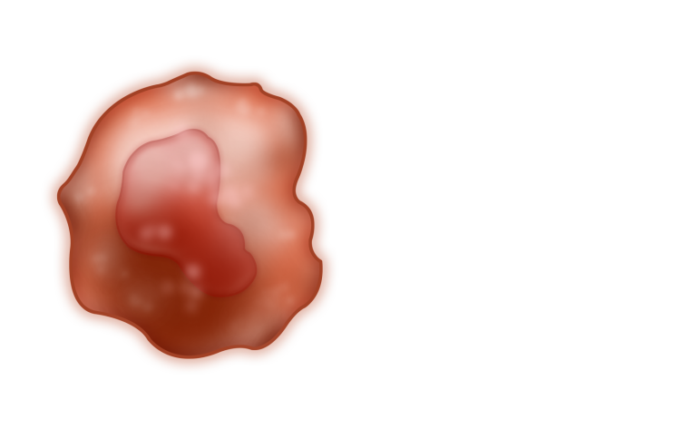
Anti-PD-1/PD-L1 Antibodies: Mechanism of Action
PD-1 expression on tumor-infiltrating lymphocytes is associated with decreased cytokine production and effector function
Anti-PD-1 antibodies bind PD-1 receptors on T cells and disrupts negative signaling triggered by PD-L1/PD-L2 to restore T-cell antitumor function
Anti-PD-L1 antibodies bind PD-L1 receptors
IFNγ
T-cell receptor
T-cell receptor
IFNγR
MHC
MHC
PI3K
Dendritic cell
Tumor cell
NFκB
CD28
B7
PD-L1
Other
T cell
PD-1
Shp-2
PD-1
PD-L1
PD-L2
Shp-2
PD-1
PD-1
PD-L2

Slide 20
KEYNOTE-057: Single-Arm, Open-Label Phase 2 Study (NCT02625961)
Patients
HR NMIBC patients unresponsive to BCG who decline to undergo or are ineligible for cystectomy
Patients with papillary disease must have fully resected disease at study entry
2 cohorts
Cohort A (n = 130): CIS with or without papillary disease (high-grade Ta or T1)
Cohort B (n = 130): papillary disease (high-grade Ta or any T1) without CIS
Evaluations with cystoscopy, cytology, ± biopsy Q12W × 2 years, then Q24W × 2 years and once yearly thereafter
and
CTU Q24W × 2 years or more frequently as clinically indicated
Primary End Points
CR (absence of HR NMIBC) in cohort A
DFS in cohort B
Pembrolizumab 200 mg Q3W
Secondary End Points
CR (absence of any disease: high-risk or low-risk NMIBC) in cohort A
DOR in cohort A
Safety/tolerability
Continue assessments and pembrolizumab until recurrence of HR NMIBC, PD, or 24 months of treatment complete
If no persistence or recurrence of HR NMIBC at any assessment
If HR NMIBC present at any assessment
Discontinue treatment; enter survival follow-up
Courtesy of Arjun V. Balar, MD

Slide 21
Duration of Complete Response is Clinically Meaningful
Of 96 patients, 39 achieved CR at first disease assessment
Patients not in CR at first disease assessment came off treatment
Median DOR (range): 16.2 (0.0+ to 30.4+)
12-mo DOR landmark
≈15 mo from start of therapy
57% by Kaplan Meier estimate
Number of patients with observed DOR ≥12 mo was
18/39 (46%) of initial complete responders
19% of all treated patients (n = 96)
Time CR achieved
0 | 3 | 6 | 9 | 12 | 15 | 18 | 21 | 24 | 27 | 30 | 33
No. at Risk | 39 | 36 | 27 | 18 | 18 | 14 | 10 | 5 | 4 | 2 | 1 | 0
Courtesy of Arjun V. Balar, MD
Notes:
From Paige - This needs a reference

Slide 22
IMvigor010: Primary Analysis from A Phase III Randomized Study of Adjuvant Atezolizumab (Atezo) versus Observation (Obs) in High-Risk Muscle-Invasive Urothelial Carcinoma (MIUC)
Hussain MH et al.
ASCO 2020;Abstract 5000.

Slide 23
IMvigor010 Phase III Trial Schema
Hussain MH et al. ASCO 2020; Abstract 5000.

Slide 24
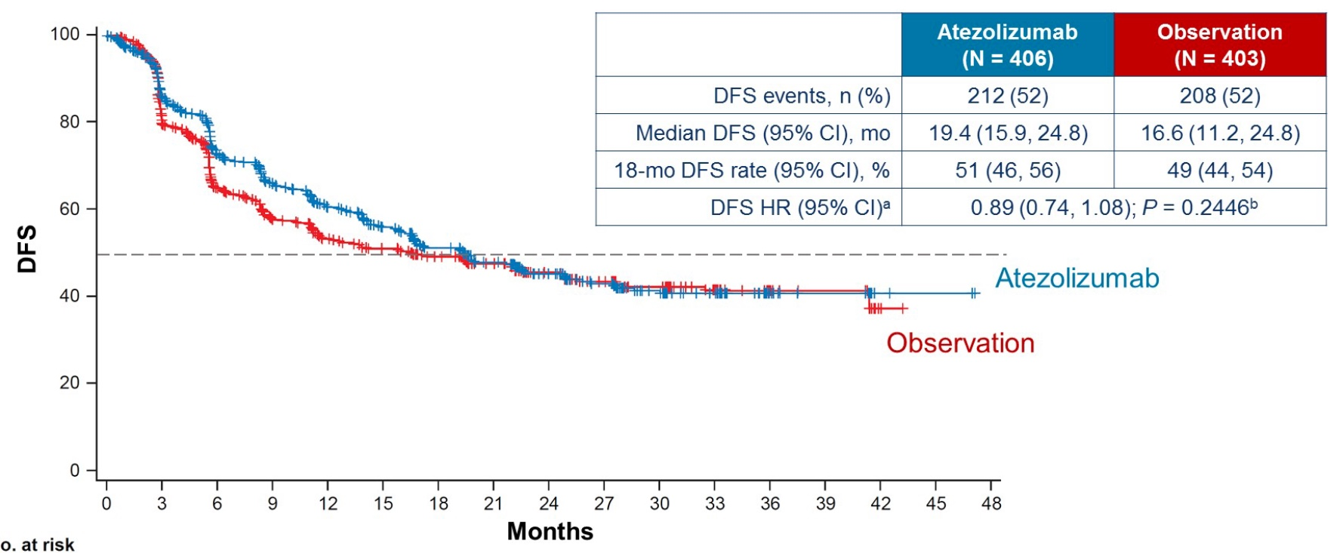
IMvigor010: Disease-Free Survival (DFS) in ITT Population
Hussain MH et al. ASCO 2020; Abstract 5000.

Slide 25
Agenda
Module 1: Overview of Urothelial Bladder Cancer (UBC) Management
Case Presentation: Ms Roethke — 85-year-old widower and retired automotive mechanic
Module 2: Anti-PD-1/PD-L1 Antibodies for Patients with Nonmetastatic UBC
Module 3: Risks and Benefits of Immune Checkpoint Inhibitors in Advanced UBC
Case Presentation: Ms Daskalova — 78-year-old woman with a PMH of cervical cancer
Module 4: Integration of FGFR-Directed Therapy into Current UBC Management Algorithms
Case Presentation: Ms Roethke — 62-year-old auto body repairman
Module 5: Antibody-Drug Conjugates in UBC
Case Presentation: Ms Roethke — 70-year-old married man and retired telephone technician
Module 6: Management of UBC in the Era of COVID-19
Case Presentation: Ms Daskalova — 63-year-old man

Slide 26
Module 3: Risks and Benefits of Immune Checkpoint Inhibitors in Advanced UBC

Slide 27
A long time ago, in a galaxy far far away?
1985 - MVAC reported
1997 - Gemcitabine reported to have activity
GC found comparable to MVAC in 2000
Response rates:
50-55% tumor regression
additional 33% with stable disease
Median PFS 7.5 months
OS 14 months
Sternberg et al., J Urol (1985)
Stadler et al., JCO (1997)
von der Maase et al., JCO (2000)
Courtesy of Peter H O’Donnell, MD

Slide 28
Current Treatment Paradigms Metastatic Urothelial Ca
Cisplatin eligible
gem/cis
Cisplatin ineligible
immunotherapy (pembro or atezo) if PD-L1+
gem/carbo
Chemotherapy unfit
immunotherapy (pembro or atezo)
Platinum refractory
5 immunotherapies (pembro level 1 evidence)
Courtesy of Peter H O’Donnell, MD

Slide 29
Response Rates to First-Line Therapy for Metastatic Urothelial Carcinoma
Partial response
Complete response
CISPLATIN ELIGIBLE
CISPLATIN INELIGIBLE

Slide 30
IMvigor210 Cohort 1 Study Design: First-Line Treatment
Inoperable locally advanced or metastatic UC
Predominantly UC histology
Tumor tissue evaluable for PD-L1 testingª
Cohort 1 (n = 119)
First-line cisplatin-ineligible
Atezolizumab 1,200 mg IV every 3 wk until RECIST 1.1 progression
Treatment
Patients
Cohort 2 (n = 310)
Platinum-treated mUC
Atezolizumab 1,200 mg IV every 3 wk until loss of clinical benefit
Cohort 1: Specific Inclusion Criteria
No prior treatment for mUC (>12 mo since perioperative chemoTx)
ECOG PS 0-2
Cisplatin ineligibility based on ≥1 of the following
Renal impairment: GFR <60 and >30 mL/min
Grade ≥2 hearing loss or peripheral neuropathy
ECOG PS 2
Primary endpoints: confirmed ORR by RECIST 1.1 by central IRF
Key secondary endpoints: DOR, PFS, OS, and safety
Courtesy of Arjun V. Balar, MD

Slide 31
KEYNOTE-052: Pembrolizumab as First-Line Therapy for Cisplatin-Ineligible Advanced UC¹
N = 350
Advanced urothelial cancer
No prior chemotherapy for metastatic disease
ECOG PS 0-2
Ineligible for cisplatin based on ≥1 of the following
CrCl <60 mL/min
ECOG PS 2
Grade ≥2 neuropathy or hearing loss
NYHA class III CHF
Pembrolizumab
200 mg every 3 wk
Primary endpoints: ORR in all patients and ORR in patients with PD-L1–positive tumors
Secondary endpoints: DOR, PFS, OS, and ORR in all patients, PD-L1–positive, and PD-L1–high expressing patients; safety and tolerability; establishing an assay cutpoint for high PD-L1 expression in first 100 patients, with validation in second 250 patients
Demographics
42% were ECOG PS 2
49% aged ≥75 y
85% had visceral metastases
49% had renal impairment
Courtesy of Arjun V. Balar, MD
1. Balar AV et al. Lancet. 2017;18:1483-1492.

Slide 32
Regulatory Updates for PD-1/PD-L1 Therapy in Advanced Cis-Ineligible UC
Requires the use of an FDA-approved companion diagnostic test to determine PD-L1 levels in tumor tissue
Pembrolizumab is indicated for the treatment of patients with locally advanced or metastatic UC who are not eligible for cisplatin-containing chemotherapy and whose tumors express PD-L1 (CPS ≥10) as determined by an FDA-approved test, or in patients who are not eligible for any platinum-containing chemotherapy regardless of PD-L1 status¹
Atezolizumab is indicated for the treatment of patients with locally advanced or metastatic UC who are not eligible for cisplatin-containing chemotherapy and whose tumors express PD-L1 (PD-L1–stained tumor-infiltrating immune cells covering ≥5% of the tumor area), as determined by an FDA-approved test, or are not eligible for any platinum-containing therapy regardless of PD-L1 status²
Courtesy of Arjun V. Balar, MD

Slide 33
IMvigor130 study design
Arm A
Atezo + platinum/gem
Locally advanced or mUC
No prior systemic therapy in the metastatic setting
ECOG PS ≤ 2
1L platinum-eligible
N = 1200
Randomised 1:1:1
Arm B
Atezo monotherapy
Arm C
Placebo + platinum/gem
Stratification factors:
PD-L1 IC status (IC0 vs IC1 vs IC2/3)
Bajorin risk factor score including KPS < 80% vs ≥ 80% and presence of visceral metastases (0 vs 1 vs 2 and/or patients with liver metastases)
Investigator choice of plt/gem (cisplatin + gem or carboplatin + gem)
Co-primary endpoints:
INV-assessed PFSª and OS (Arm A vs C)
OS (Arm B vs C, hierarchical approach)
Key secondary endpoints:
INV-ORRª and DOR
PFSª and OS (Arm B vs C; PD-L1 IC2/3 subgroup)
Safety
ª per RECIST 1.1.
Adapted from Grande et al. ESMO 2019
Courtesy of Jonathan E Rosenberg, MD

Slide 34
Maintenance Avelumab + Best Supportive Care (BSC) versus BSC Alone After Platinum-Based First-Line (1L) Chemotherapy in Advanced Urothelial Carcinoma (UC): JAVELIN Bladder 100 Phase III Interim Analysis
Powles T et al.
ASCO 2020;Abstract LBA1 (Plenary)

Slide 35
JAVELIN Bladder 100 Phase III Study Schema
Powles T et al. ASCO 2020;Abstract LBA1.

Slide 36
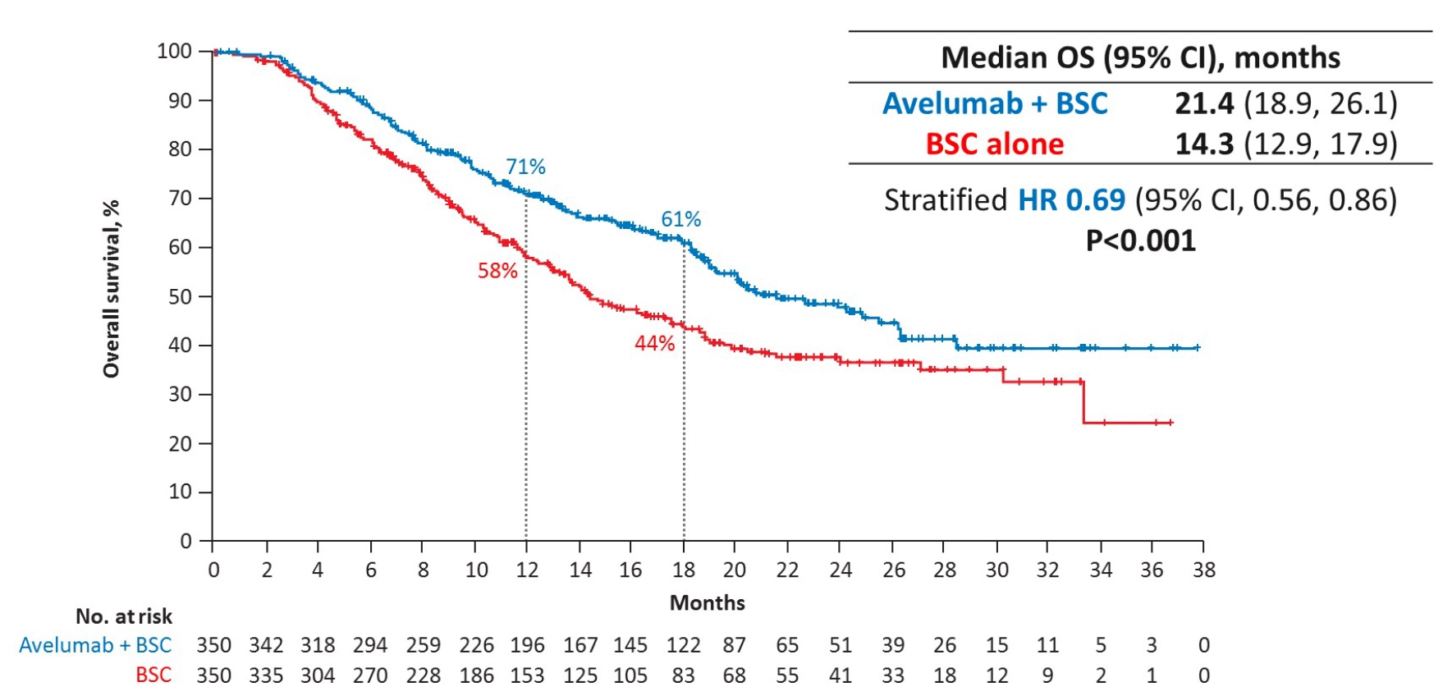
JAVELIN Bladder 100: OS in the Overall Population
Powles T et al. ASCO 2020;Abstract LBA1.

Slide 37
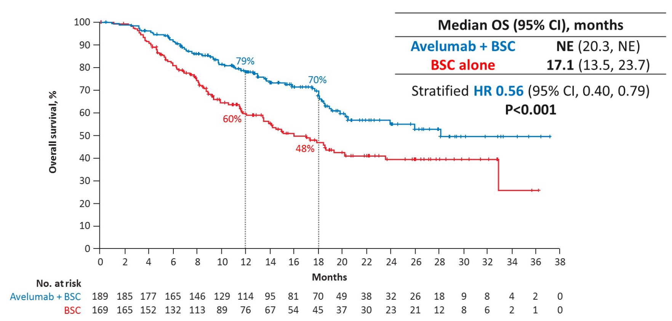
JAVELIN Bladder 100: OS in the PD-L1+ Population
Powles T et al. ASCO 2020;Abstract LBA1.

Slide 38
FDA-Approved Anti-PD-1/PD-L1 Antibodies for Patients with Progressive Metastatic UBC
Agent | Initial approval date
Atezolizumab (PD-L1) | May 2016
Nivolumab (PD-1) | February 2017
Durvalumab (PD-L1) | May 2017
Avelumab (PD-L1) | May 2017
Pembrolizumab (PD-1) | May 2017

Slide 39
The Constellation of irAEs
Encephalitis,
aseptic meningitis
Hypophysitis
Uveitis
Dry mouth/mucositis
Thyroiditis/hypothyroidism
Vasculitis
Pneumonitis
Thrombocytopenia/anemia
Myocarditis
Adrenal insufficiency
Hepatitis
Nephritis
Rash and vitiligo
Pancreatitis
Autoimmune diabetes
Enteritis
Colitis
Arthralgia
Neuropathy
Courtesy of Arjun V. Balar, MD

Slide 40
78-year-old woman with a PMH of cervical cancer, controlled HTN (from the practice of Ms Daskalova)
4/2019: Urinary urgency, frequency and hematuria past few months
CT AP: Bladder wall thickening, no lymphadenopathy or visceral mets
5/2019: TURBT: High-grade muscle-invasive urothelial cancer
6/2019: Cystectomy (pT4N2 – 8/21 nodes+), with negative margins → pt declines adjuvant therapy, opts for surveillance
1/2020: MRI AP and CT chest: Extensive recurrent tumor in cystectomy bed, new liver and lung mets, and retroperitoneal, pelvic and inguinal lymphadenopathy
Symptomatic: Pain, fatigue, weight loss, insomnia
Cisplatin-ineligible based on kidney function (Cr Cl <60 [37])
PDL1 status: Low
BRCA2 and TP53 mutations
Carboplatin + gemcitabine x 6 → Significant response
Plan to enroll on a clinical trial (“as maintenance”) with immunotherapy + personalized vaccine

Slide 41
Agenda
Module 1: Overview of Urothelial Bladder Cancer (UBC) Management
Case Presentation: Ms Roethke — 85-year-old widower and retired automotive mechanic
Module 2: Anti-PD-1/PD-L1 Antibodies for Patients with Nonmetastatic UBC
Module 3: Risks and Benefits of Immune Checkpoint Inhibitors in Advanced UBC
Case Presentation: Ms Daskalova — 78-year-old woman with a PMH of cervical cancer
Module 4: Integration of FGFR-Directed Therapy into Current UBC Management Algorithms
Case Presentation: Ms Roethke — 62-year-old auto body repairman
Module 5: Antibody-Drug Conjugates in UBC
Case Presentation: Ms Roethke — 70-year-old married man and retired telephone technician
Module 6: Management of UBC in the Era of COVID-19
Case Presentation: Ms Daskalova — 63-year-old man

Slide 42
Module 4: Integration of FGFR-Directed Therapy into Current UBC Management Algorithms

Slide 43
When was the last time you encountered a patient with bladder cancer receiving erdafitinib?
Within the past week
Between 1 week and 1 month ago
Between 1 month and 6 months ago
Between 6 months and 1 year ago
More than 1 year ago
I have not encountered a patient with bladder cancer receiving erdafitinib in my practice

Slide 44
FGFR Inhibition
Drug inhibitor
Courtesy of Peter H O’Donnell, MD
modified from Sethakorn and O’Donnell, BJUI (2016)

Slide 45
BLC2001: A Phase II Study of the Oral Pan-FGFR (1-4) Inhibitor Erdafitinib
Actual enrollment: 239
Eligibility
Metastatic or unresectable locally advanced UC Prior ICI allowed Progression on ≥1 line prior systemic chemo or within 12 months of (neo)adjuvant chemo OR Chemo-naïve: cisplatin ineligible per protocol criteria†
Regimen 1: 10 mg/d for 7 days on 7 days off
Regimen 3*: 8 mg QD with PD Uptitration to 9 mg QD n = 99
Screening for FGFR fusions/mutations on tissue by central lab
R
Regimen 2: 6 mg QD
Primary endpoint: Objective response rate
* Dose uptitration if ≥5.5 mg/dL target serum phosphate not reached by Day 14 and if no TRAEs
† Ineligibility for cisplatin: impaired renal function or peripheral neuropathy
Siefker-Radtke AO et al. Proc ASCO 2018;Abstract 4503; www.clinicaltrials.gov; Accessed May 24, 2019 (NCT02365597).

Slide 46
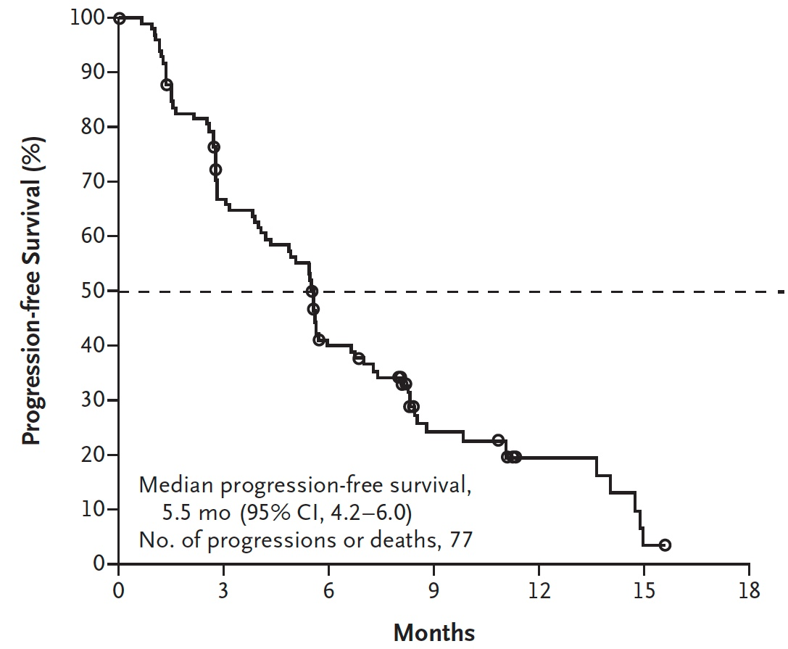
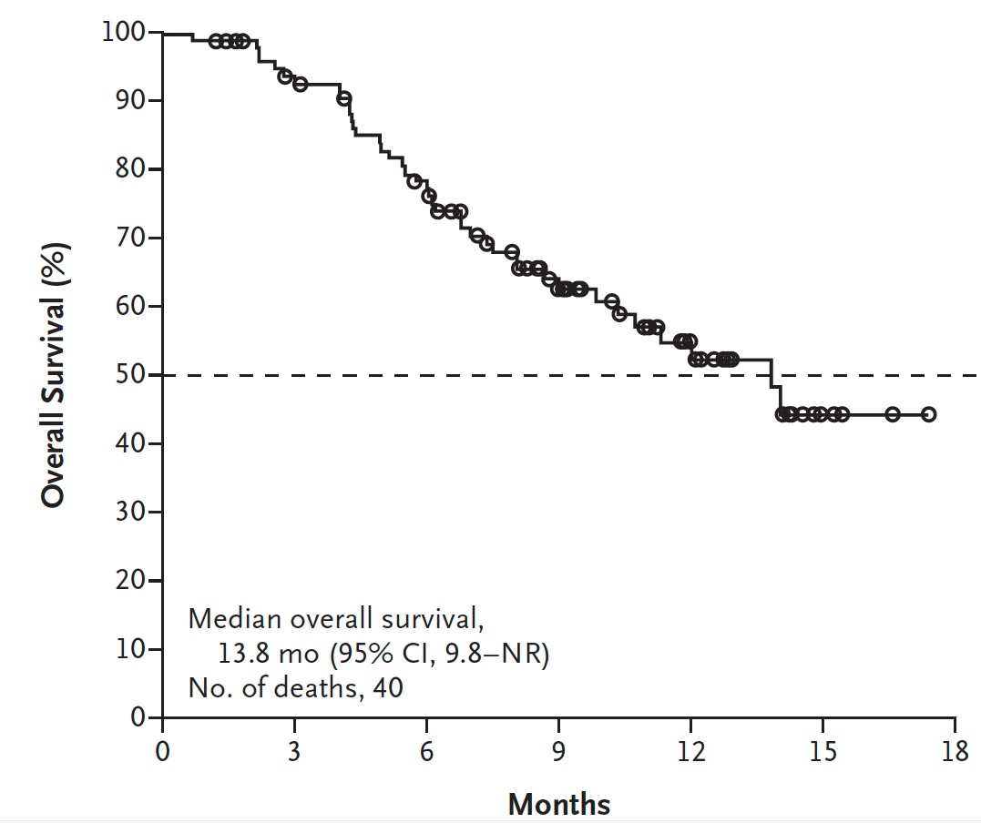
BLC2001: Erdafitinib Efficacy Data
Progression-Free Survival
Overall Survival
ORR = 40% (additional 39.4% with SD) Duration of Response (median) = 5.6 mo
Loriot Y et al. N Engl J Med 2019;381:338-348.

Slide 47
Erdafitinib FDA Approval
Accelerated approval for patients with locally advanced or metastatic urothelial carcinoma, with susceptible FGFR3 or FGFR2 genetic alterations, that has progressed during or following platinum-containing chemotherapy, including within 12 months of neoadjuvant or adjuvant platinum-containing chemotherapy (Apr 2019)
Courtesy of Peter H O’Donnell, MD

Slide 48
Erdafitinib - Toxicities
Courtesy of Peter H O’Donnell, MD
Siefker-Radtke AO et al. ASCO 2018;Abstract 4503.

Slide 49
Erdafitinib – Key Toxicities
5 WARNINGS AND PRECAUTIONS
5.1 Ocular Disorders
Erdafitinib can cause ocular disorders, including central serous retinopathy/retinal pigment epithelial detachment (CSR/RPED) resulting in visual field defect.
CSR/RPED was reported in 25% of patients treated with Erdafitinib, with a median time to first onset of 50 days. Grade 3 CSR/RPED, involving central field of vision, was reported in 3% of patients. CSR/RPED resolved in 13% of patients and was ongoing in 13% of patients at the study cutoff. CSR/RPED led to dose interruptions and reductions in 9% and 14% of patients, respectively and 3% of patients discontinued Erdafitinib.
Dry eye symptoms occurred in 28% of patients during treatment with Erdafitinib and were Grade 3 in 6% of patients. All patients should receive dry eye prophylaxis with ocular demulcents as needed.
Perform monthly ophthalmological examinations during the first 4 months of treatment and every 3 months afterwards, and urgently at any time for visual symptoms. Ophthalmological examination should include assessment of visual acuity, slit lamp examination, fundoscopy, and optical coherence tomography.
Withhold Erdafitinib when CSR occurs and permanently discontinue if it does not resolve within 4 weeks or if Grade 4 in severity. For ocular adverse reactions, follow the dose modification guidelines [see Dosage and Administration (2.3)].
5.2 Hyperphosphatemia
Increases in phosphate levels are a pharmacodynamic effect of Erdafitinib [see Pharmacodynamics (12.2)]. Hyperphosphatemia was reported as adverse reaction in 76% of patients treated with Erdafitinib. The median onset time for any grade event of hyperphosphatemia was 20 days (range: 8 –116) after initiating Erdafitinib. Thirty-two percent of patients received phosphate binders during treatment with Erdafitinib.
Courtesy of Peter H O’Donnell, MD
erdafitinib FDA label

Slide 50
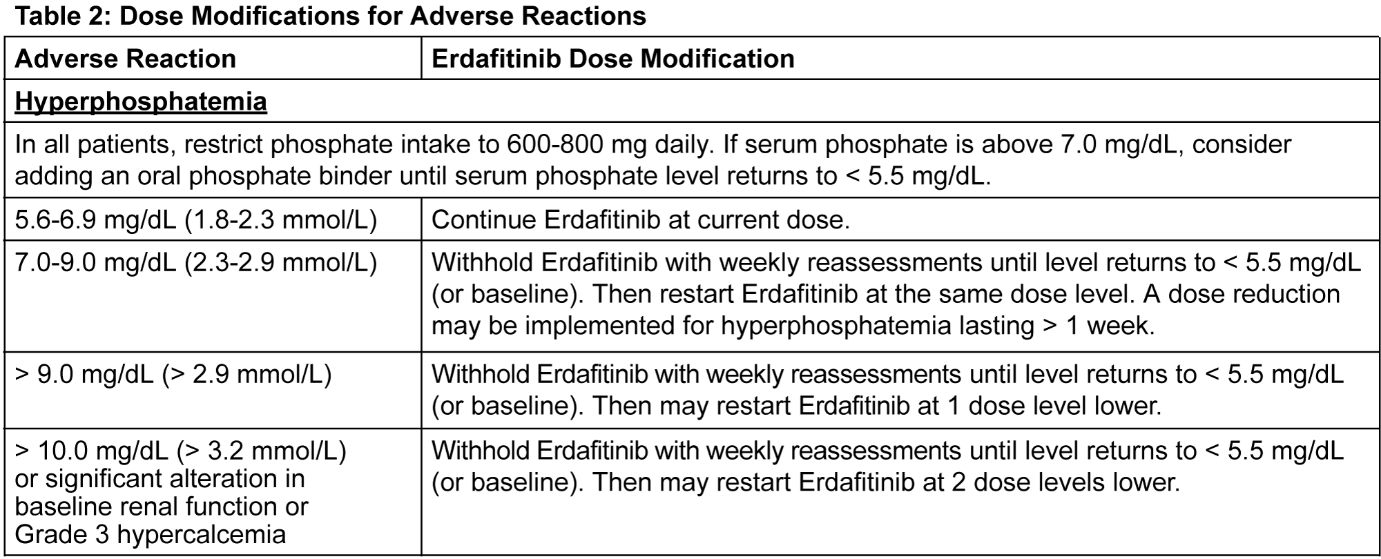
Erdafitinib Dosing, and Adjustments
Recommended starting dose is 8 mg (two 4 mg tablets) orally once daily, with dose increase to 9 mg (three 3 mg tablets) once daily based on serum phosphate levels and tolerability at 14–21 days.
Assess serum phosphate levels 14–21 days after initiating. Increase erdafitinib to 9 mg once daily if serum phosphate level is <5.5 mg/dl (and there are no ocular disorders or ≥Grade 2 adverse reactions).
Monitor phosphate levels monthly for hyperphosphatemia.
Courtesy of
Peter H O’Donnell, MD
erdafitinib FDA label

Slide 51
62-year-old man with PMH of Anxiety/Depression, Chronic Arthralgias and >30 Years History of Tobacco Use (from the practice of Ms Roethke)
3/2019 TURBT: High-grade MIBC, with focal invasion of muscularis propria and high-grade UC of prostatic urethra
6/2019: Completed neoadjuvant dose-dense MVAC x 3
Genomic testing: BRCA1 mutation, FGFR3 mutation
7/2019: Radical cystoprostatectomy, b/l pelvic lymph node dissection, creation of ileal conduit
Pathology: Residual 5.5-cm bladder tumor, micropapillary type with invasion to perivesical soft tissue, 4+ nodes
Wound infection and abcess, distress and anger related to ostomy
10/2019 CT: Normal
12/2019: New bone metastases (see scan)
1/2020: SBRT to T12
Erdafitinib
Transient, mild mouth sores
Developed CSR, erdafitinib held until improvement then re-started at reduced dose
3/2020: Improvement on bone scan; improvement in pain and general well-being

Slide 52
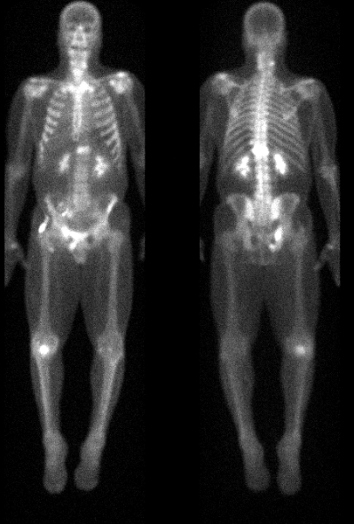
62-year-old man (from the practice of Ms Roethke)
12/2019: New Bone Mets
Intense uptake in T12 vertebral body
Right ischial tuberosity
Right pubic bone
Left iliac bone posteriorly

Slide 53
Agenda
Module 1: Overview of Urothelial Bladder Cancer (UBC) Management
Case Presentation: Ms Roethke — 85-year-old widower and retired automotive mechanic
Module 2: Anti-PD-1/PD-L1 Antibodies for Patients with Nonmetastatic UBC
Module 3: Risks and Benefits of Immune Checkpoint Inhibitors in Advanced UBC
Case Presentation: Ms Daskalova — 78-year-old woman with a PMH of cervical cancer
Module 4: Integration of FGFR-Directed Therapy into Current UBC Management Algorithms
Case Presentation: Ms Roethke — 62-year-old auto body repairman
Module 5: Antibody-Drug Conjugates in UBC
Case Presentation: Ms Roethke — 70-year-old married man and retired telephone technician
Module 6: Management of UBC in the Era of COVID-19
Case Presentation: Ms Daskalova — 63-year-old man

Slide 54
Module 5: Antibody-Drug Conjugates in UBC

Slide 55
When was the last time you encountered a patient with bladder cancer receiving enfortumab vedotin?
Within the past week
Between 1 week and 1 month ago
Between 1 month and 6 months ago
Between 6 months and 1 year ago
More than 1 year ago
I have not encountered a patient with bladder cancer receiving enfortumab vedotin in my practice

Slide 56
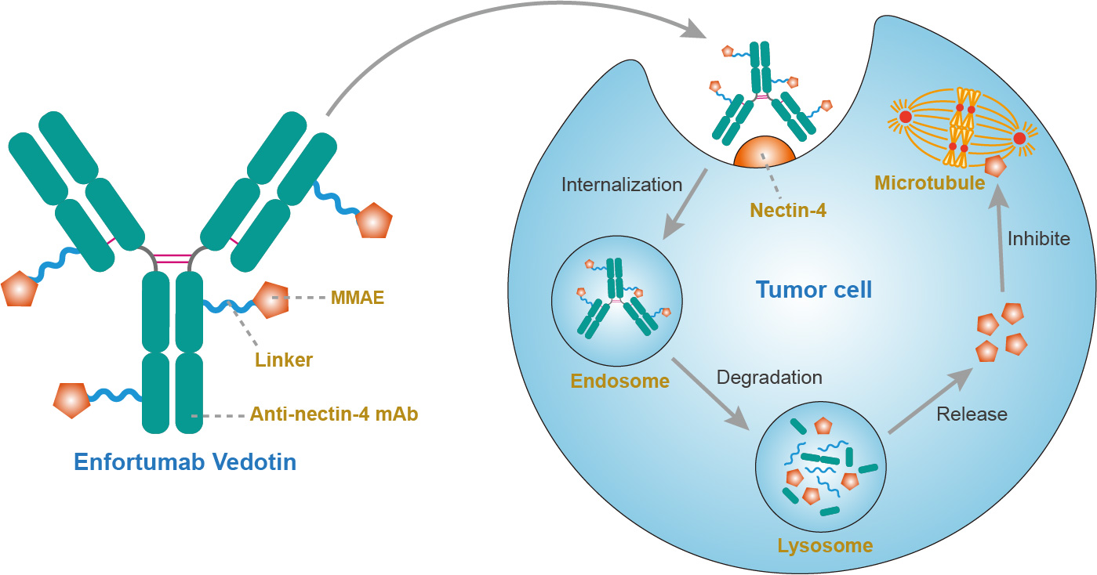
Enfortumab Vedotin Proposed Mechanism of Action
Inhibit
Courtesy of Peter H O’Donnell, MD
MMAE = monomethyl auristatin E
figure adapted from creativebiolabs.net

Slide 57
Enfortumab Phase II Study Design (EV-201)
ORR=objective response rate
BICR=blinded independent central review
DOR=duration of response
Courtesy of Peter H O’Donnell, MD
adapted from Petrylak et al., presented at ASCO 2019

Slide 58
Enfortumab Efficacy Data
44% ORR
12% CR
32% PR
84% of evaluable patients showed tumor reduction
Median DOR = 7.6 mos
Median PFS = 5.8 mos
Median OS = 11.7 mos
Efficacy data mirror those from phase I study of n=155 UC patients
Rosenberg et al., JCO (2019)
Rosenberg et al., JCO (2020)
Courtesy of Peter H O’Donnell, MD

Slide 59
FDA Approval of EV
For adult patients with locally advanced or metastatic urothelial cancer who have previously received a programmed death receptor-1 (PD-1) or programmed death-ligand 1 (PD-L1) inhibitor, and a platinum-containing chemotherapy in the neoadjuvant/adjuvant, locally advanced or metastatic setting (Dec 18, 2019)
fda.gov
Courtesy of Peter H O’Donnell, MD

Slide 60
EV - Tolerability
Courtesy of Peter H O’Donnell, MD
Rosenberg et al., JCO (2019)

Slide 61
Enfortumab – Key Toxicities
Courtesy of Peter H O’Donnell, MD
adapted from Petrylak et al., presented at ASCO 2019

Slide 62
EV-103 – First-line Cohorts of Enfortumab Vedotin + Pembrolizumab
Enfortumab vedotin 1.25 mg/kg + pembrolizumab (200 mg) in 1L cisplatin-ineligible la/mUC patients (N=45)
Dosing: Enfortumab vedotin on days 1 and 8 and pembrolizumab on day 1 of every 3-week cycle
Enfortumab vedotin exposure: Comparable to enfortumab vedotin monotherapy on 4-week schedule (Days 1, 8, and 15)²
Primary endpoints: safety and tolerability
Key secondary endpoints: dose-limiting toxicities, ORR, DOR, PFS, OS
Patient Population
Locally Advanced or Metastatic Urothelial Carcinoma
Dose
Escalation¹
enfortumab vedotin + pembrolizumab
cisplatin-ineligible
(n=5)
Dose Expansion Cohort A
enfortumab vedotin + pembrolizumab
cisplatin-ineligible
(n=40)
¹ Not included in the current analysis: three 1L patients treated with EV 1 mg/kg + pembrolizumab 200 mg and two 2L patients treated with EV 1.25 mg/kg + pembrolizumab 200 mg
² Rosenberg et al. J Clin Oncol. 2019;37(29):2592-600.
Courtesy of Daniel P Petrylak, MD
Rosenberg JE et al. GU Cancers Symposium 2020; Abstract 441.

Slide 63
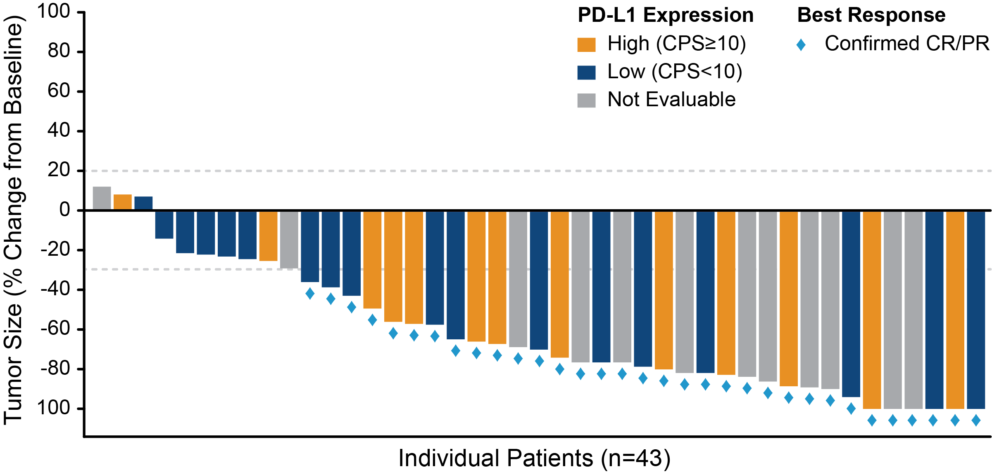
Maximal Target Lesion Reduction by PD-L1 status and Objective Response Rate per Investigator
93% had tumor reduction
Confirmed ORR 95% CI | 73.3% (33/45) (58.1, 85.4)
Complete response | 15.6% (7/45)
Partial response | 57.8% (26/45)
Best Overall Response Per RECIST v 1.1 by investigator (N=45)
Responses observed regardless of PD-L1 expression level
Two patients did not have post-baseline response assessments before end-of-treatment: 1 withdrew consent and 1 died before any post-baseline response assessment. These patients are included in the full analysis set used to calculate ORR, but are not included in the figure above. Horizontal lines at positive 20% and negative 30% denote thresholds for target lesions for disease progression and response, respectively.
Courtesy of Daniel P Petrylak, MD
Rosenberg JE et al. GU Cancers Symposium 2020; Abstract 441.

Slide 64
70-year-old man with PMH of CKD, T2DM, HTN, Hyperlipidemia (from the practice of Ms Roethke)
1/2017: High-grade UC of right distal ureter
3/2017: Completed neoadjuvant MVAC x 3 → 5/2017: R nephroureterectomy
Pathology: Residual 1-cm carcinoma invading muscularis, Node-negative
6/2017: Rapidly progressive recurrent disease, with gastric outlet obstruction → gastrojejunostomy
Pathology: Metastatic UC, marked peritoneal carcinamatosis
7/2017: Pembrolizumab 200mg Q3W → remarkable response, no measurable disease
4/2018: Adrenal insufficiency, treatment discontinued
Observation x 16 months
8/2019: Perirectal recurrence
Pembrolizumab resumed but discontinued due to continued tumor growth
11-12/2019: SBRT
4/2020 CT and MRI: Large mass invading bladder, rectum, seminal vesicles
Enfortumab vedotin
Bright red rash/exfoliative dermatitis -- treatment held -- resolved

Slide 65
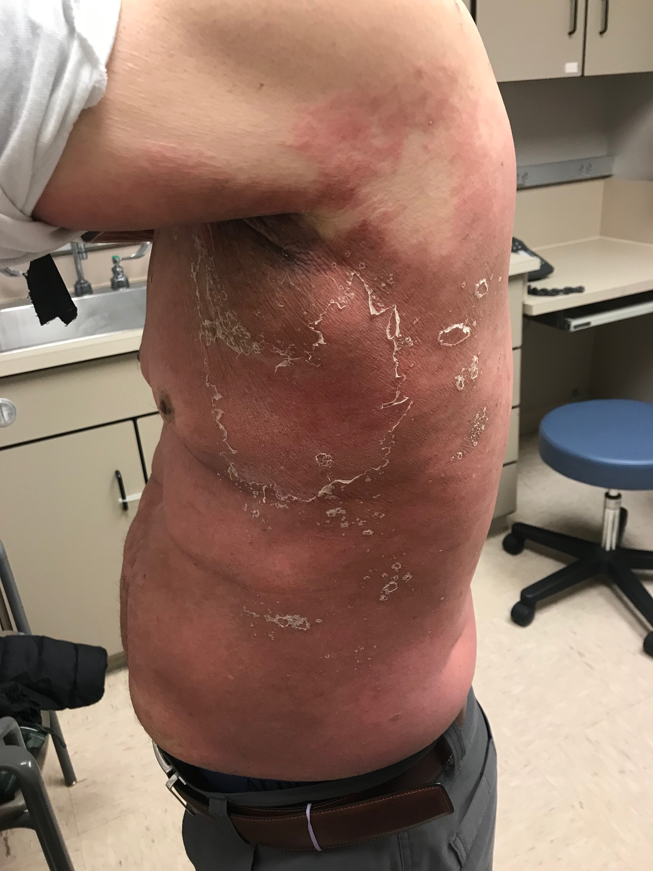
70-year-old man (from the practice of Ms Roethke)
Rash/Exfoliative Dermatitis After Starting Enfortumab Vedotin

Slide 66
Agenda
Module 1: Overview of Urothelial Bladder Cancer (UBC) Management
Case Presentation: Ms Roethke — 85-year-old widower and retired automotive mechanic
Module 2: Anti-PD-1/PD-L1 Antibodies for Patients with Nonmetastatic UBC
Module 3: Risks and Benefits of Immune Checkpoint Inhibitors in Advanced UBC
Case Presentation: Ms Daskalova — 78-year-old woman with a PMH of cervical cancer
Module 4: Integration of FGFR-Directed Therapy into Current UBC Management Algorithms
Case Presentation: Ms Roethke — 62-year-old auto body repairman
Module 5: Antibody-Drug Conjugates in UBC
Case Presentation: Ms Roethke — 70-year-old married man and retired telephone technician
Module 6: Management of UBC in the Era of COVID-19
Case Presentation: Ms Daskalova — 63-year-old man

Slide 67
Module 6: Management of UBC in the Era of COVID-19

Slide 68
63-year-old man (from the practice of Ms Daskalova)
Non-muscle-invasive BC → BCG
2/2018: Subsequent cystoscopy: Muscle-invasive BC → radical cystoprostatectomy and neobladder creation
Pathology: pT2aN0 papillary urothelial carcinoma
Surveillance
Second scan: New 1.8-cm lung nodule at the RUL C/W metastatic urothelial cancer
Gemcitabine plus split-dose cisplatin → worsening kidney function → Gemcitabine + carboplatin (cycles 2-3)
Restaging imaging: PD
FGFR tumor mutation
1/2019: Pembrolizumab → progressive disease → erdafitinib with good response
Contracted COVID-19 and passed away

